Slide 1
MUSE Task 5
Design and Construction of a
Liquid Hydrogen Target

Slide 2
Overview
LH2 targets are a known technology
LH2 target for MUSE is a basic geometry that has been used at Saclay, LAMPF, TRIUMF, MAX-lab and MAMI.
MUSE LH2 - “low-power” target
MUSE LH2 – “low-pressure” system
--› Safety and Operating Procedures well-known

Slide 3
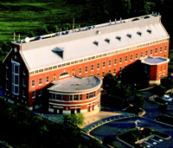
GW Cryogenics Laboratory Exploration Hall Room 133

Slide 4
Cryogenics Lab
Refitting of lab will begin with approval of funding
Former DC Deputy Chief of Safety and Wellness William Flint - now director of the Office of Health and Safety at GW will assure safe operating environment for all students, staff and faculty.
Estimate 3 months to bring Lab to operating conditions.
New shop just completed 25 meters from lab

Slide 5
Experts Consulted in Preparation of Lab Design and Target Construction
Kurt Hansen – MAX-lab
Christopher Keith – JLab
David Kendellen – Duke
Greg Smith – JLab
Andreas Thomas – MAMI
--› provided their actual costs and helpful hints
--› will draw on some of these for consultation

Slide 6
Cryogenics Lab Staffing
William Briscoe – Faculty
TBN – Technician
William Rutkowski – Chief Machinist
TBN – Associate Machinist
TBN – ½ Post-Doc (shared)
Saif Ahmad – GRA (finishing coursework)
TBN – GRA (3rd year student)
TBN – Hourly undergraduate as needed

Slide 7
Work Summary
Bring Cryolab to Safe Operating State 1-May-2014 1-Aug-2014
Design Drawings 1-May-2014 1-Aug-2014
Order Instrumentation, Hardware, and Monitoring Devices 1-Jul-2014 1-Sep-2014
Order Cryopump - Cold Head 1-Jul-2014 1-Sep-2014
Order Components of Motion System 1-Jul-2014 1-Sep-2014
Order Material/Supplies for Scattering Chamber, Cell, Target Ladder, Holders and Railings 1-Jul-2014 1-Sep-2014
Prototype Cells and Cell Holders Machining and Assembly 1-Sep-2014 1-Nov-2014
Build Test Stand Chamber 1-Sep-2014 1-Nov-2014
Pressure, Vacuum, Destructive Tests of Cell Prototypes 1-Nov-2014 1-Jan-2015
Evaluation - Design Modification 1-Jan-2014 1-Feb-2015

Slide 8
Work Summary
Prototype of Modified Cells 1-Feb-2015 1-Mar-2015
Second Round of Tests - Cold Test of Cells 1-Mar-2015 1-Apr-2015
Final Review of Design and Modifications 1-Apr-2015 1-May-2015
Construction of Scattering Chamber 1-May-2015 1-Jul-2015
Construction of Cells 1-May-2015 1-Jul-2015
Tests of Cells and Scattering Chamber 1-Jul-2015 1-Sep-2015
Evaluation - Modifications 1-Sep-2015 1-Oct-2015
Second Round of Tests of Scattering Chamber and Cells Including motion test and test of emergency conditions 1-Oct-2015 1-Dec-2015
Evaluation and Readiness Review 1-Dec-2015 1-Jan-2016
Construct Boxes for Shipping and Packing 1-Jan-2016 1-Feb-2016
Shipping, Receiving and Unpacking 1-Feb-2016 1-Mar-2016
In Situ Assembly and Testing 1-Mar-2016 1-Apr-2016
PSI Safety Engineering Review and Modifications to Make Compliant 1-Apr-2016 1-May-2016
Turn over to PSI 1-May-2016 1-Jun-2016

Slide 9
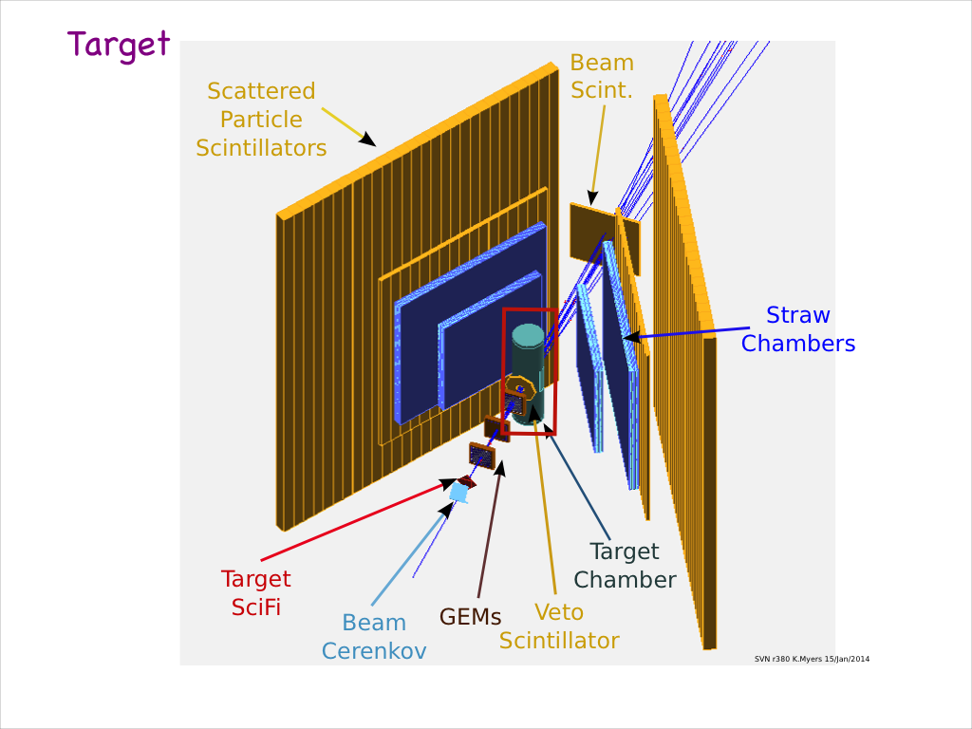

Slide 10
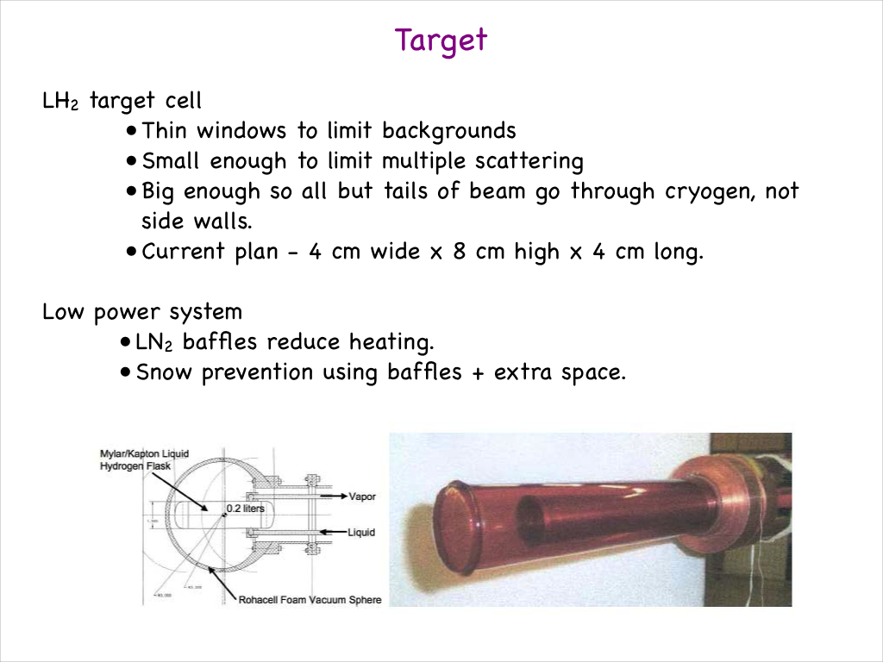
Target Parameters from Guy Ron

Slide 11
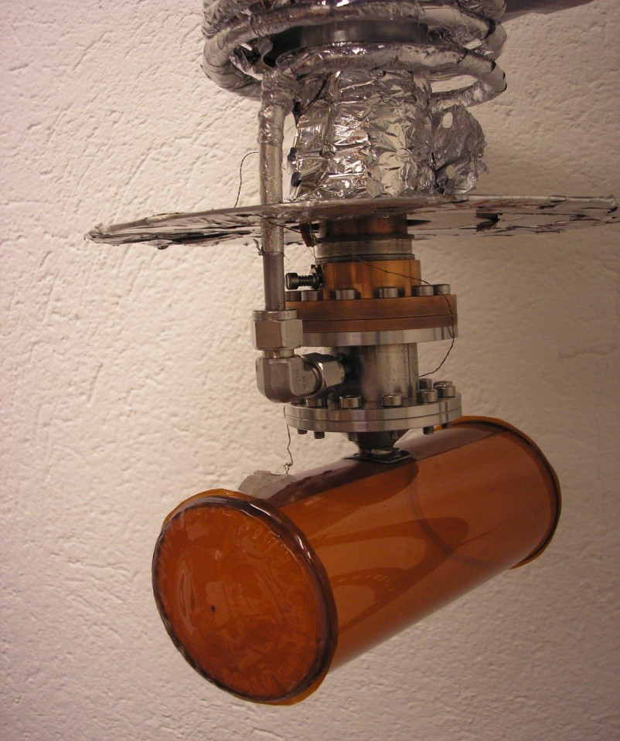
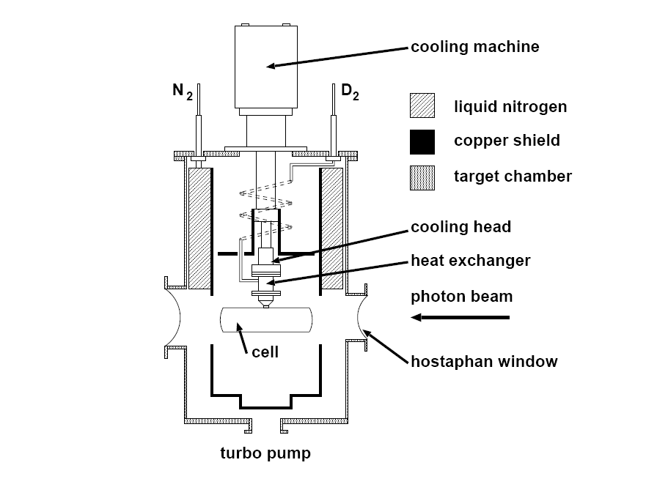
MAX-lab Target

Slide 12
Target Ladder Elements Requested by Spokespersons
Full Target
MT Target
Dummy with 6 X thickness of Kapton walls
Carbon Foil
Blank

Slide 13
Budgetary Considerations (Excluding Travel)
Item | Direct Cost | Indirect Cost | Contingency | Total
Materials & Supplies | $135K | $70K | $53K | $258k
Equipment | $65K |  | $17K | $82K
External Labor | $49K | $26K | $19K | $94K
Technician | $191K | $99K | $58K | $348K
Post-Doc | $80K | $42K | $12K | $134
Students | $67K | $35K | $11K | $113K
Total | $587K | $272K | $170K | $1,029K

Slide 14
Summary
Preparations begin with promise of funding
Search and hiring of personnel in parallel
Safety and security issues top priority
Known technology with several available consultants from other recent projects
Two-Years from start to turn key delivery
PSI takes over after delivery

