Slide 1
MUSE Project Management
Ronald Ransome
Rutgers
The State University of New Jersey
For the MUSE Collaboration

Slide 2
Outline
Project WBS Organization
Overall Schedule
Assessment of each WBS
Contingency management

Slide 3
WBS
There are 8 construction elements
We’ve included a catch-all “Installation” element
  This will contain miscellaneous work to be done before and after installation, as well as installation milestones
The Gantt chart also has a WBS 10 (Funding) which is simply for convenience of linking tasks to the funding schedule

Slide 4
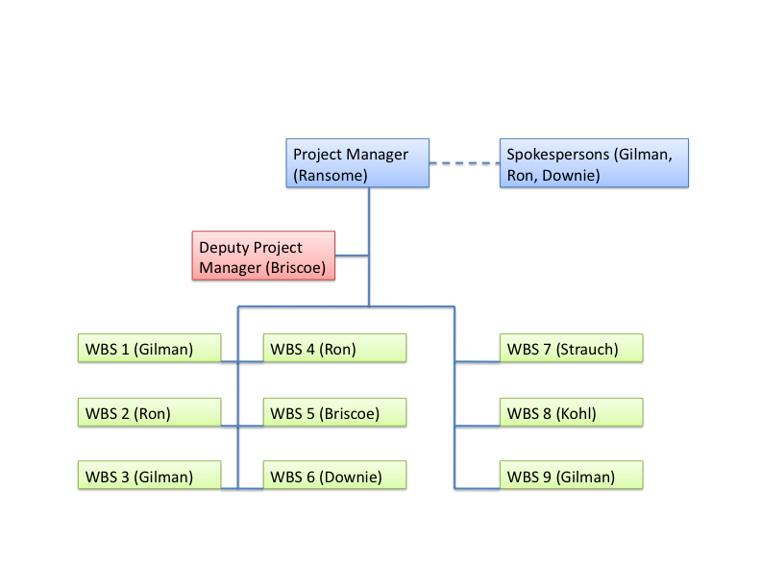

Slide 5
WBS Dictionary
WBS | Institution | Scope
1 | Rutgers | Build support table and frames for detectors
2 | Tel Aviv | Scintillating Fiber Detector
3 | Rutgers | Cerenkov Detector
4 | Hebrew | Straw Chambers
5 | GWU | LH2 Target
6 | GWU | Electronics and DAQ
7 | S.Carolina | Scintillators
8 | Hampton | GEM detectors
Each WBS is independent of the others until final assembly, except some electronics needed for testing

Slide 6
Schedule
Two major milestones:
  Test run in fall 2015
  Full run in fall 2016
Items needed for 2015 Run
  Support Table (WBS1) – by June (anticipated by March 2015)
  GEMs (already there)
  Half of Cerenkov (WBS3) – by July (by January 2015)
  Half of Scintillator (WBS7), Veto – by August (by August 2015)
  Sci-Fi detector (WBS2) – by September (by August 2015)
  Straw tube – 1 chamber (WBS4) – by October (by June 2015)
  Half of electronics (WBS6) – with associated detector (by July 2015)
  Does not need LH2

Slide 7
Budget & Contingency
Each WBS has a combination of labor and equipment.
Equipment is mainly standard, from well known designs, or off-the-shelf.
  Largest uncertainties come from currency exchange risks
Labor is mainly in salaried employees (i.e. grad students, post-docs, full time tech), not hourly. This gives some less uncertainty in costs.

Slide 9
Travel
Travel is a major expense
  Meetings (~$40K/year)
  Installation/testing 2015 (~$250K)
  Running 2016 onward (~$350K/year)

Slide 10
WBS
I will discuss major cost components, schedule, and risks for the WBS 2,3,4,7.
WBS 1 consists of low cost construction with very low construction, technical, or schedule risk
WBS 8 consists of minor backup to working system
WBS 5,6 discussed earlier today
WBS 9 currently has a primary cost of an on-site post-doc

Slide 11
WBS 4 – Straw Tubes
Major Cost Items
  Straws
    Straws & wire BOE – quote $24K
    Hardware (pins, caps) BOE – PANDA experience - $327K
    Contingency $146K
  Labor
    Salaried – 2 GS (one from HU, one from Temple)
    $175K (includes travel for Temple student)
    Contingency $35K
  Total Cost $637K +$202K contingency

Slide 12
WBS 4 - Schedule
Set up
  Requires mounting table, clean room
  Estimated Completion date – August 2014
Straw Construction
  Estimated at least 25/week
  First chamber completed – May, 2015
  Chamber 2-4 completed – January 2016

Slide 13
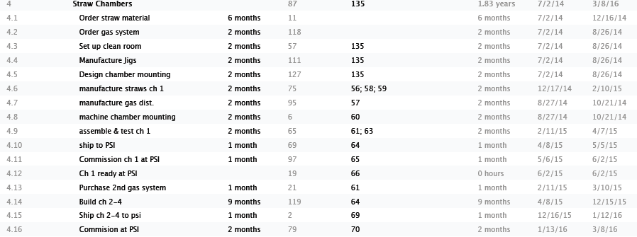
WBS4

Slide 14
WBS 4 – QA and Risk
QA
  Straws will be tested with source, planes with cosmics
  Pressure testing as straws are built
Major Risks
  Higher than anticipated failure rate
    Close consultation with PANDA to conform to proven procedures
    Buy enough extra parts to mitigate small batch costs/time delay
    We will buy 4000 straws at outset, and parts for 3500, with contingency for 500 more sets of parts

Slide 15
WBS 7 - Scintillator
Major Costs
  PMTs – BOE quote - $187K
  Scintillator – BOE quote - $78K
  Backing structure – BOE quote $44K
  Labor – BOE past experience - $110K
Total Cost $442K + $72K contingency

Slide 16
WBS 7 - Schedule
Pre-construction – order PMT’s and scintillator (2-3 months)
Scintillators are made in batches of 6, with one set completed before moving on.
Need to place orders by July 2014 to be ready for fall 2015 run.
Full set completed by early 2016, no risk on full run

Slide 17
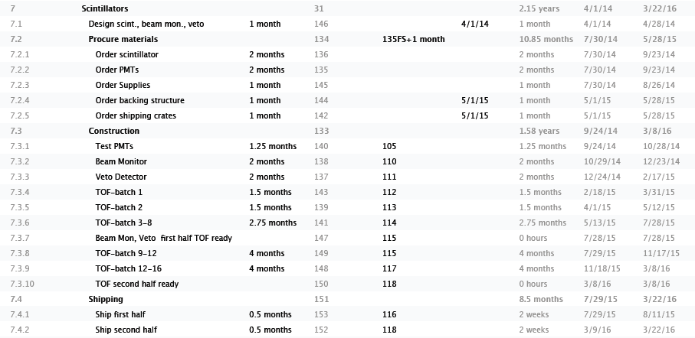
WBS7

Slide 18
WBS 7 – QA & Risk
QA – scintillators checked with source and cosmics before shipping
Risks
  low technical risk, this is a proven technology
  Some schedule risk for 2015 test run if material is delayed in arriving. Would require using smaller number for test, additional shipping costs.
  Some design risk, may increase size slightly if decision is made to move farther back (<10% cost)

Slide 19
WBS 2 SciFi
Major costs
  Fiber – BOE quotes - $12K
  PMT – BOE quotes - $23 K
  PMT bases, supplies – BOE past experience - $32K
  Labor – GS $70 K
  Total - $152K plus $29K contingency

Slide 20
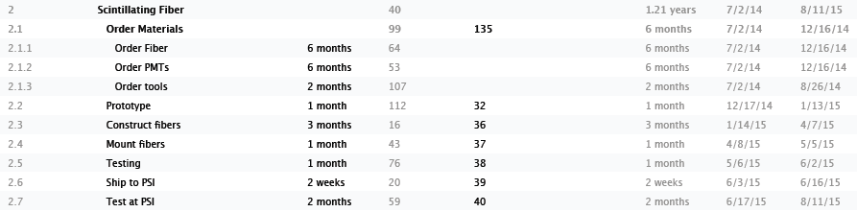
WBS2

Slide 21
WBS 2 Schedule, QA, Risk
Easily completed in 6 months after materials arrive
Will be tested with source and cosmics
No schedule risk
Low technical risk, proven technology

Slide 22
WBS 3 - Cerenkov
Major Cost
  PMTs – BOE quote - $195K
  Total cost $212 K plus $27 contingency
Schedule – easily assembled in 2 months after materials arrive
QA – cosmic and beam tests
No schedule risk
Low technical risk, proven technology

Slide 23
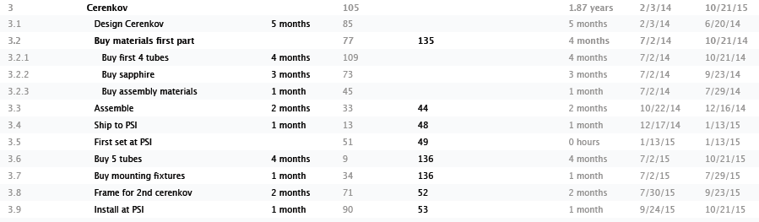
WBS3

Slide 24
Handling Contingency
Plans for handling contingency
  M&S/Labor Contingency
    <$5K up to WBS manager
    $5-25 K up to Project Manager
    >$25 K must be reviewed by managers for impact on scope and schedule, approval by Project Manager
  Travel Contingency
    Any anticipated change over $2 K must be approved by Project Manager
    Must take into account importance to set-up, construction, maintaining experiment (e.g. move to set-up travel out of collaboration meeting travel)

Slide 25
Schedule & Reporting
Schedule will be reviewed once date is know for funding
  Set milestones
Determine funding distribution based needs to prioritize test run 2015
Each WBS manager will report project progress to Project Manager on a bi-monthly basis.

Slide 26
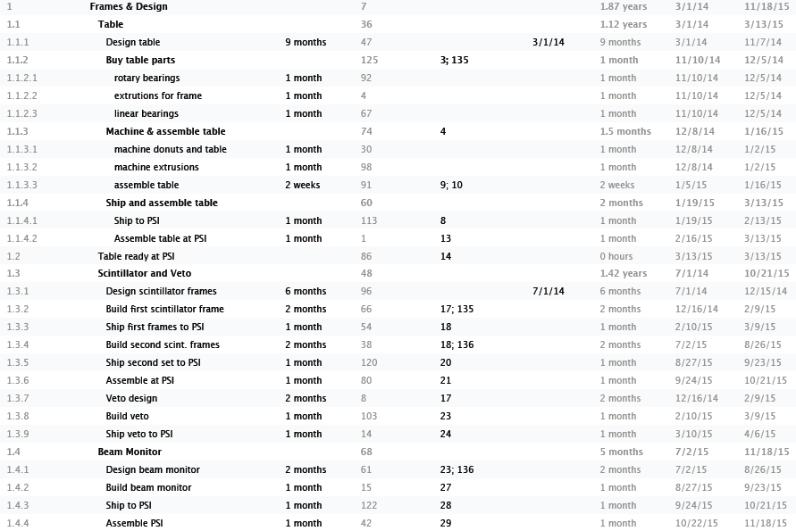
WBS 1

Slide 27
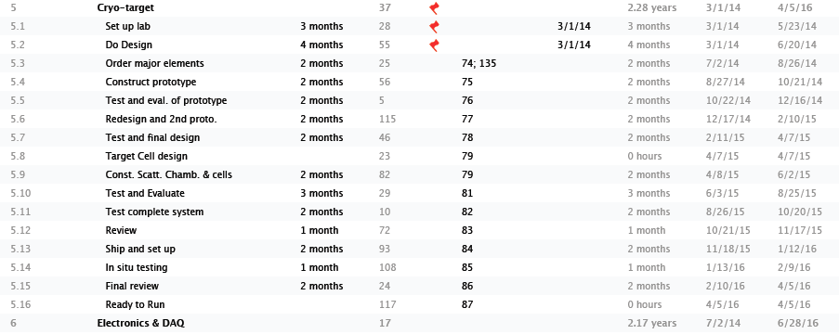
WBS5

Slide 28
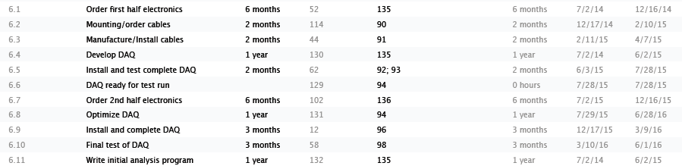
WBS6

