Slide 1

Rutgers Day—April 25, 2015
A tour through the Universe
with
Professor Terry Matilsky

Slide 2
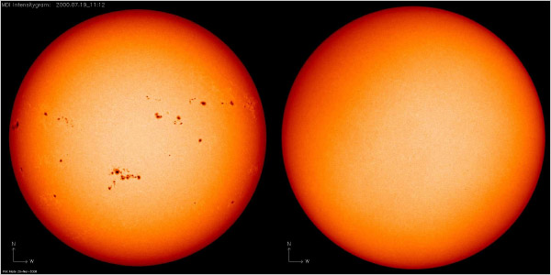
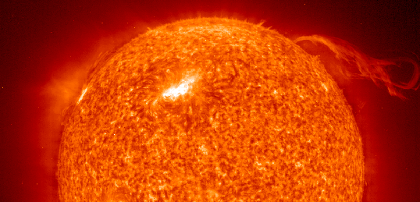

Slide 3
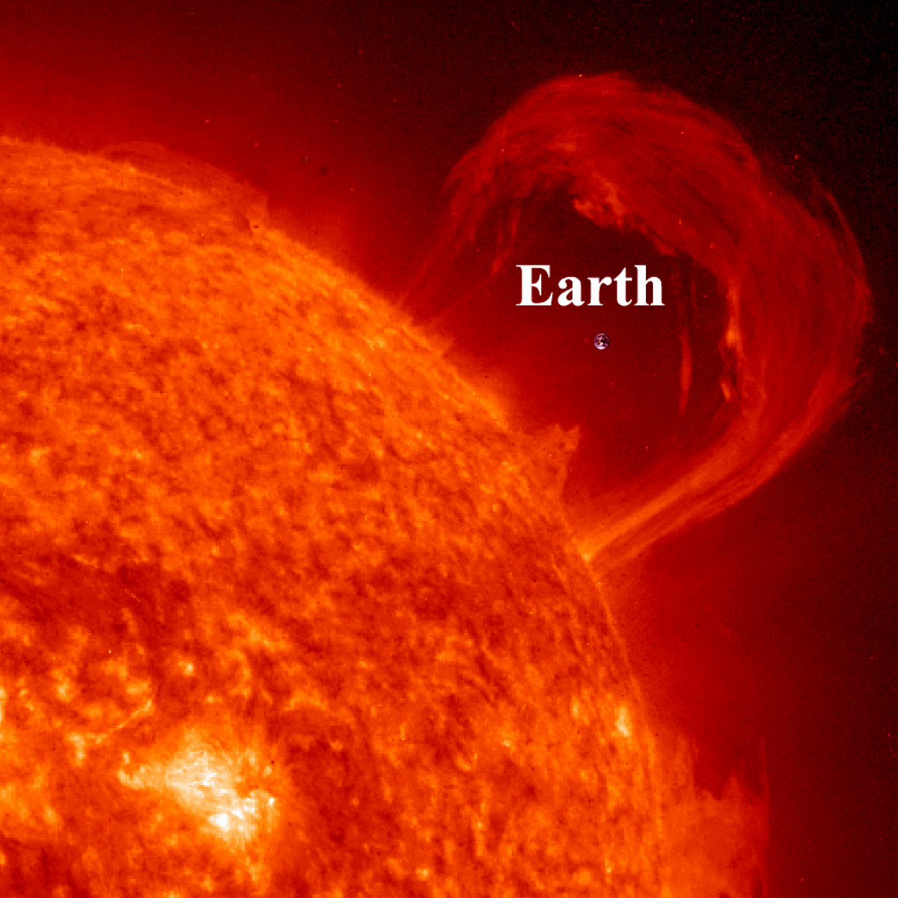

Slide 4
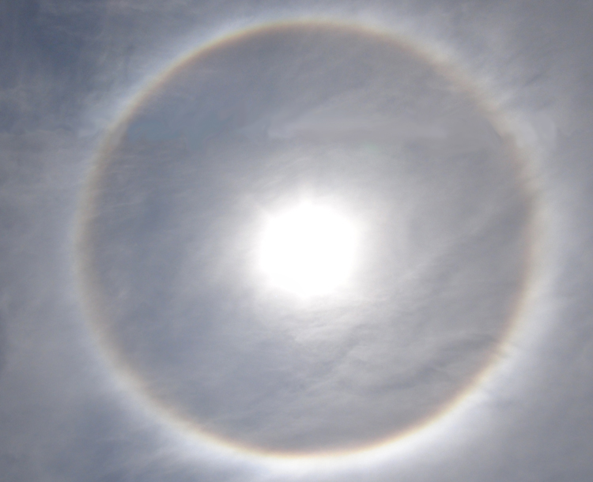

Slide 5
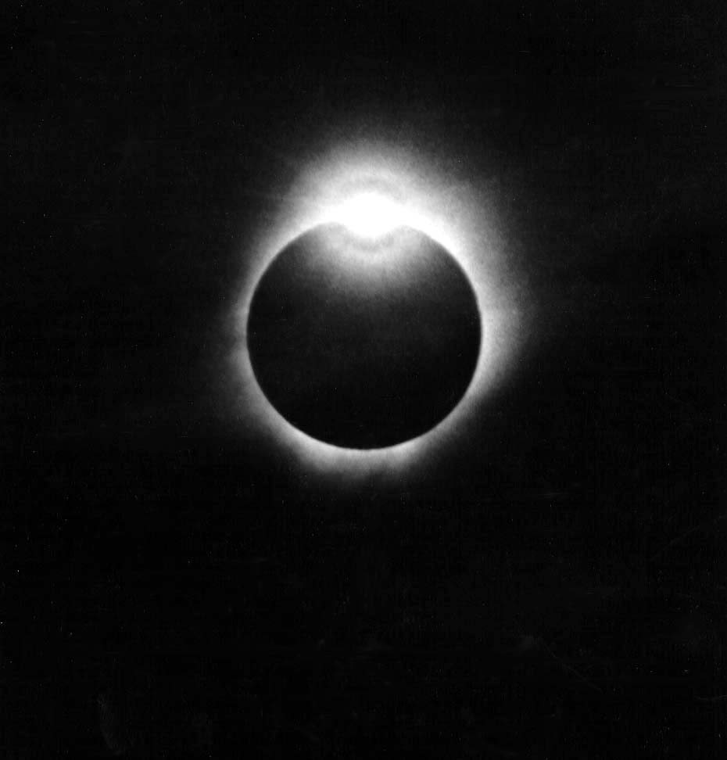
Photo credit: T. Matilsky
Notes:
7/11/91 “The Big One” Baja or Hawaii?
dynamic range of B&W film
----- Meeting Notes (10/21/14 10:55) -----
1/10 second later!

Slide 6
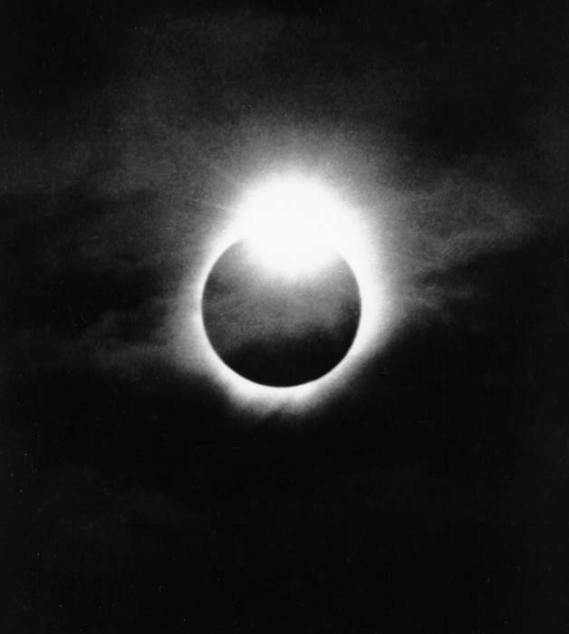
Photo credit: T. Matilsky
Notes:
0.1 sec later

Slide 7
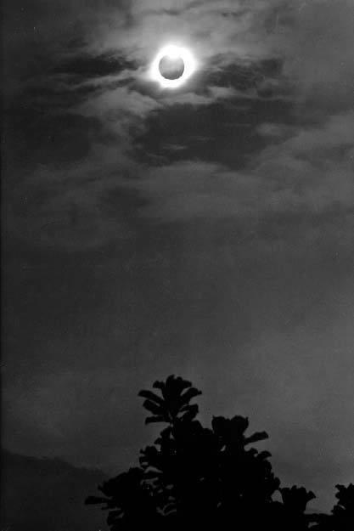
Photo Credit: T. Matilsky
Notes:
close to missing it.
pinatubo eruption
----- Meeting Notes (10/21/14 11:04) -----
more recently, in 2012, transit of venus. you can see my state of the art set-up here…. note duct tape

Slide 8
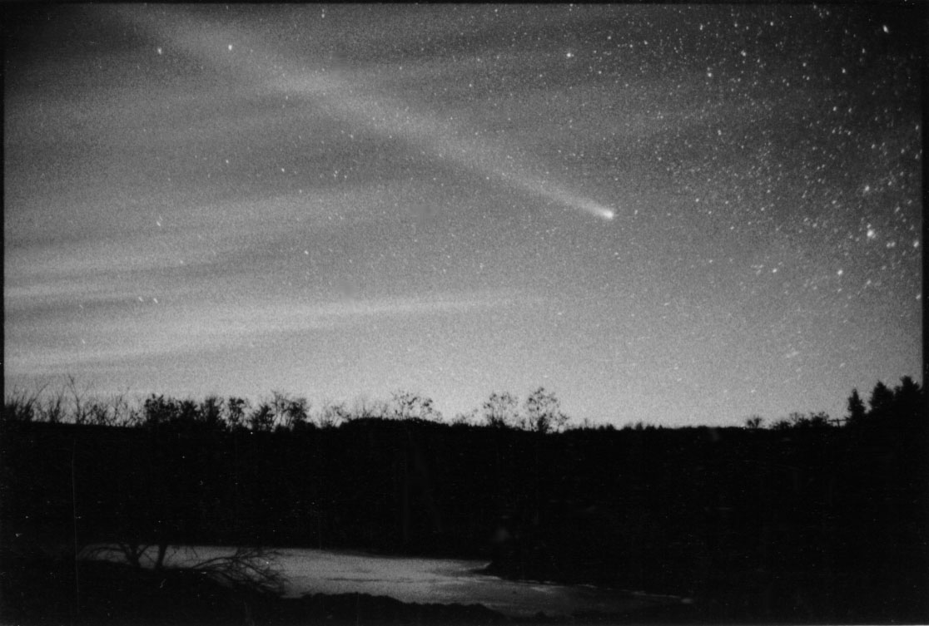
Photo Credit: Terry Matilsky

Slide 9
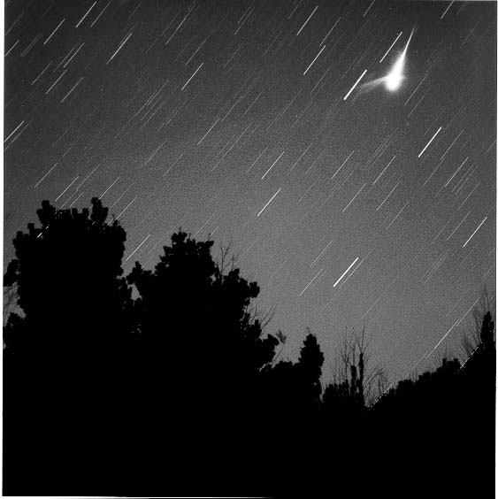
Photo Credit: T. Matilsky
Notes:
2001
Leonids noted for their fireballs
5-500 tons daily of dust impacts the earth
----- Meeting Notes (10/21/14 10:50) -----
the point from which you can apparently see the meteors emanating from
is called the radiant, and it is a perspective effect similar to the apparent convergence of railroad tracks in the distance….
----- Meeting Notes (10/25/14 13:12) -----
you can see this here….

Slide 10
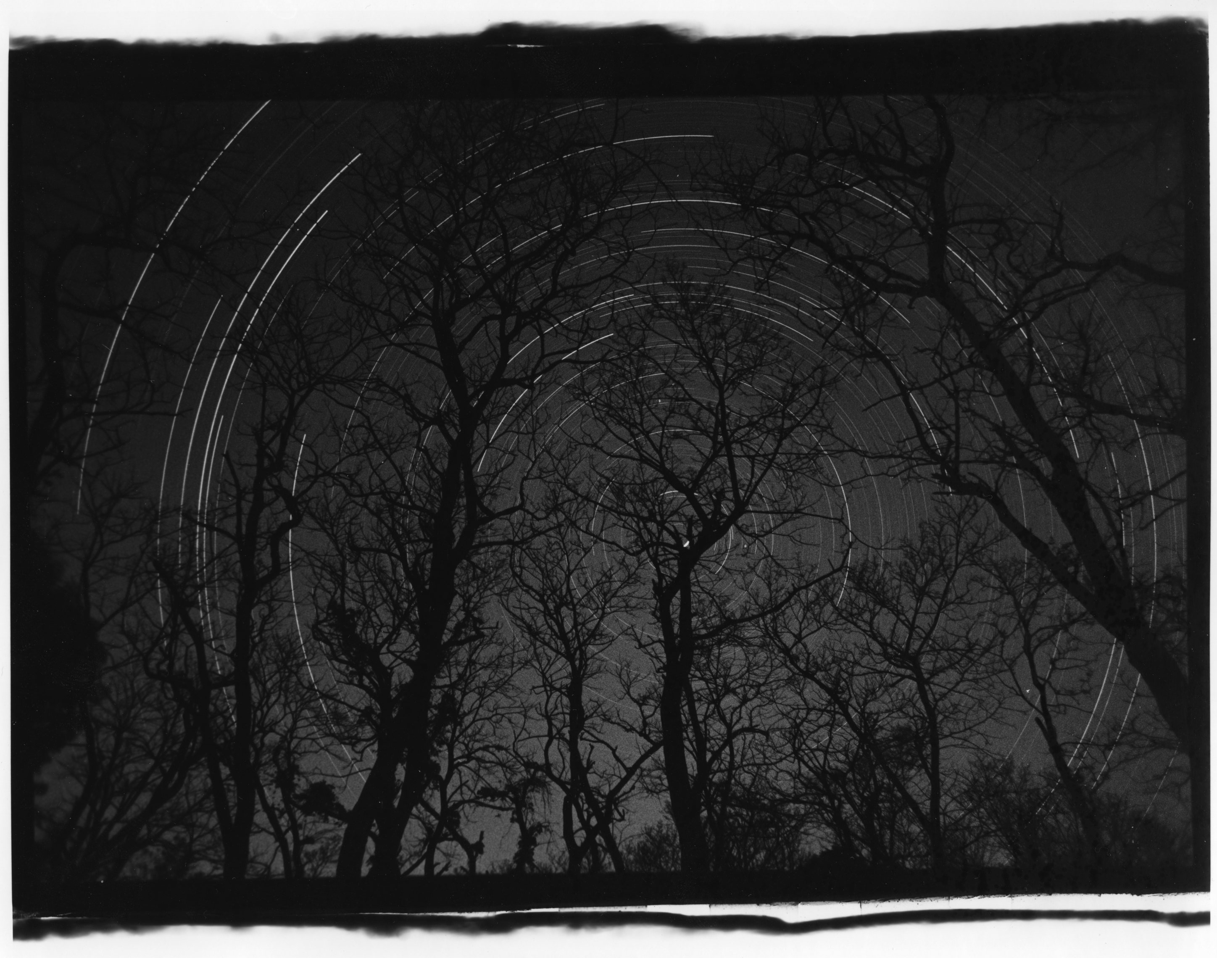
Photo credit: T. Matilsky
Notes:
Shenandoah June or January?
any foreground will do!

Slide 11
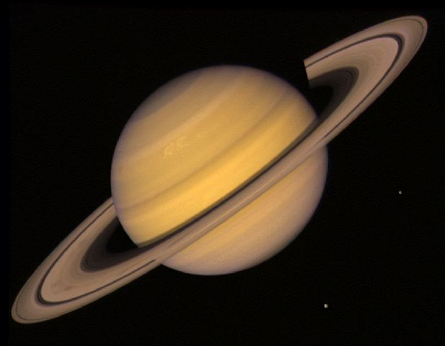

Slide 12
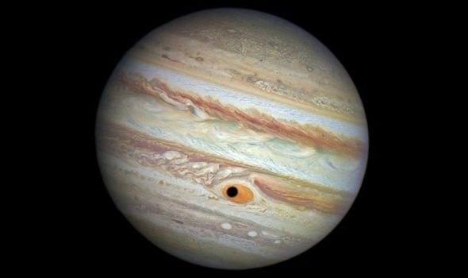
Photo credit: NASA

Slide 13
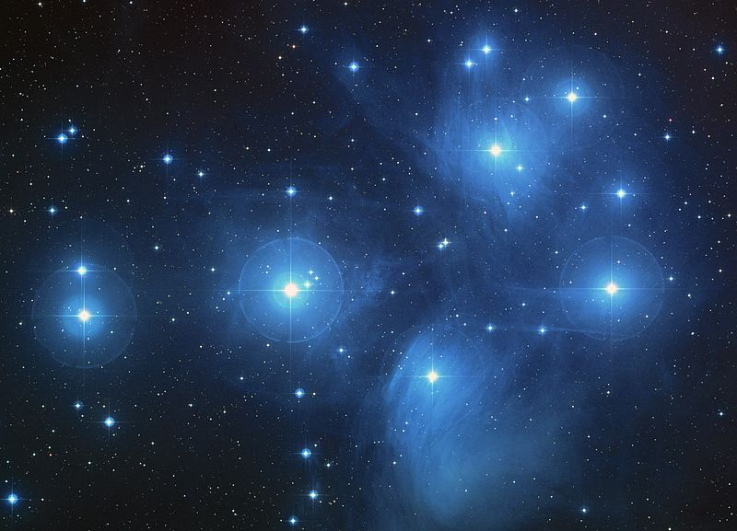

Slide 14
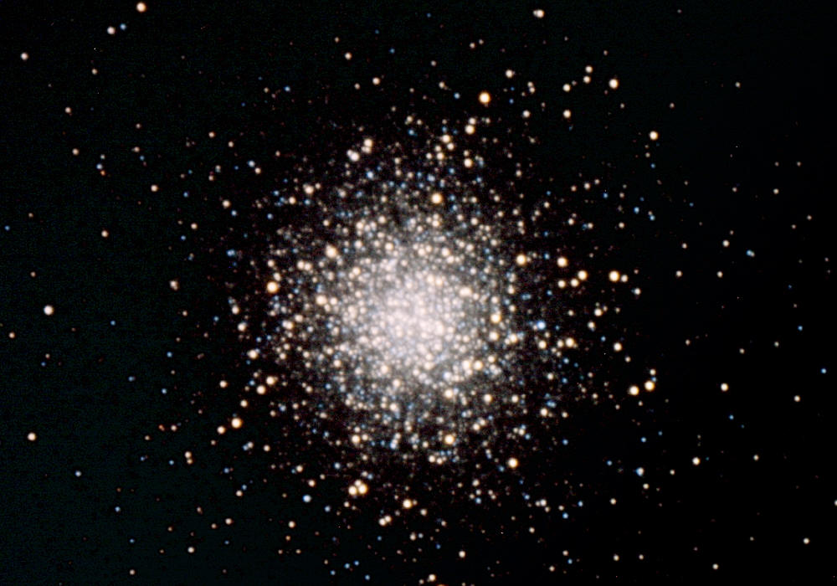

Slide 15
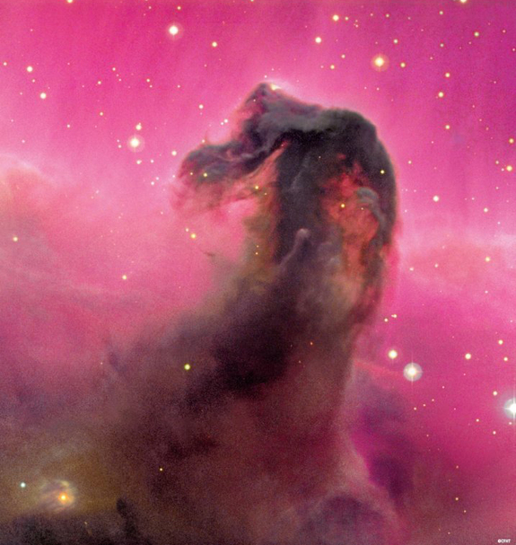

Slide 16
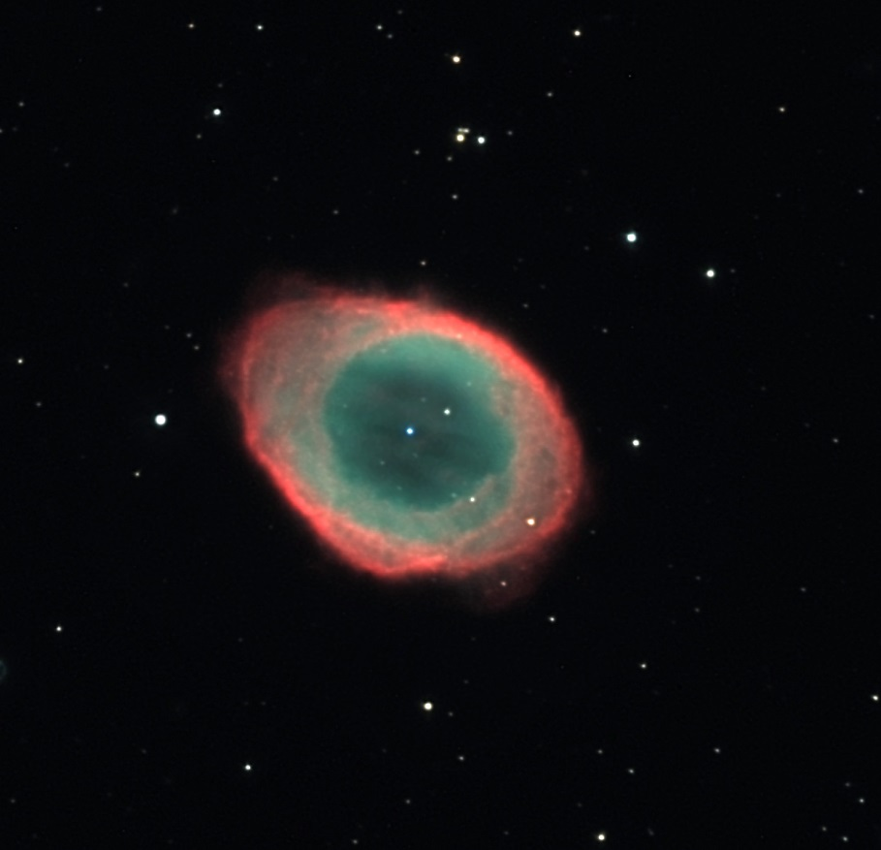

Slide 17
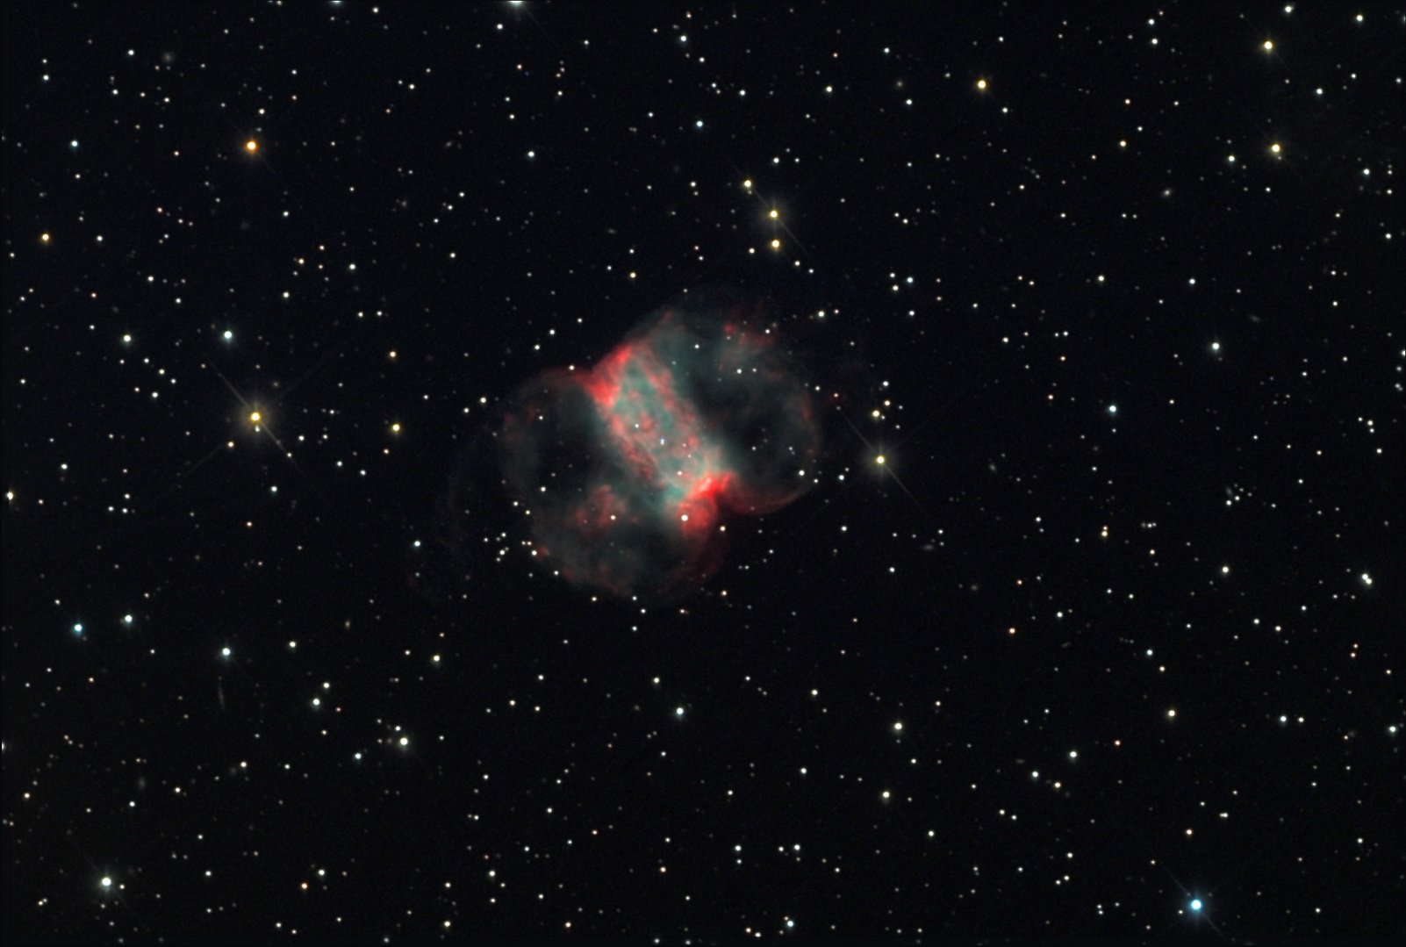

Slide 18
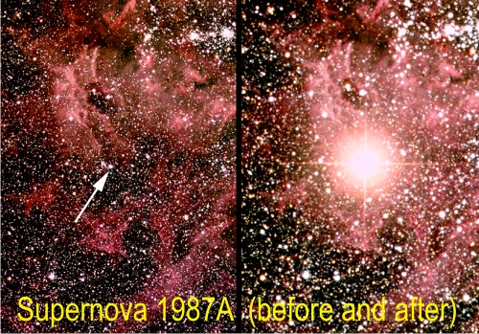

Slide 19
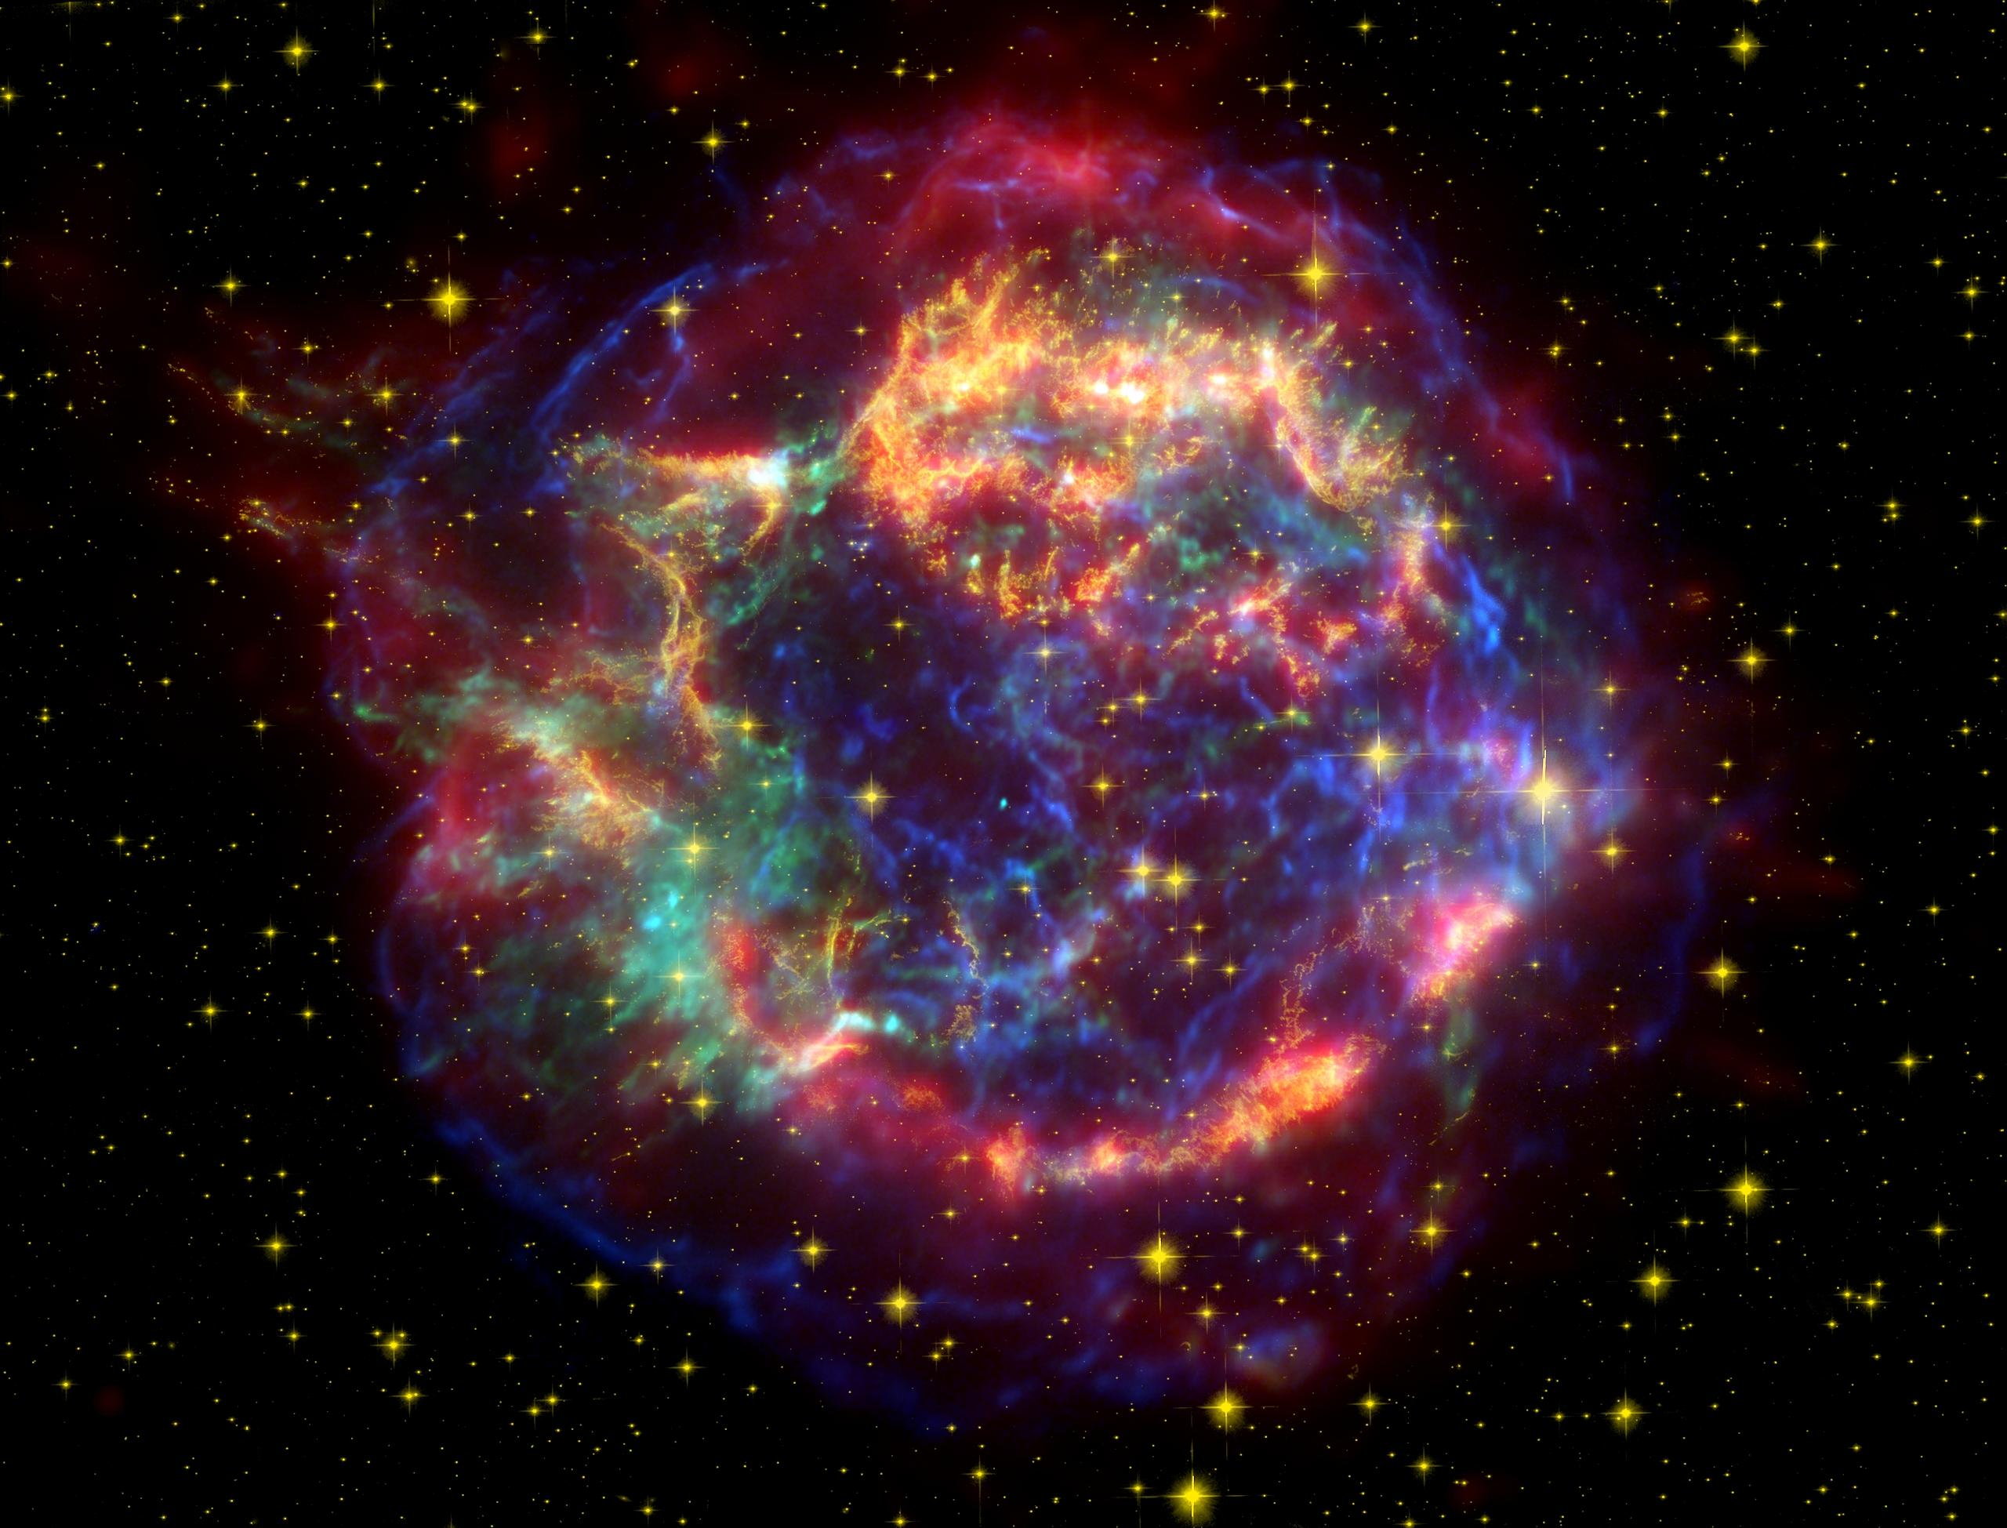

Slide 20
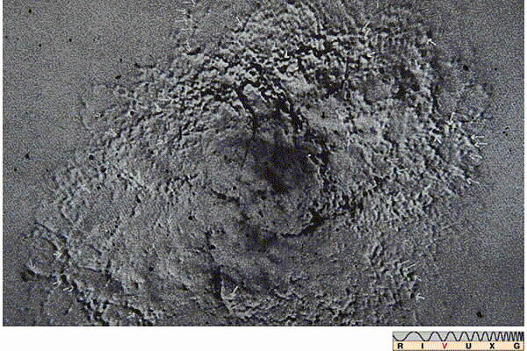

Slide 21
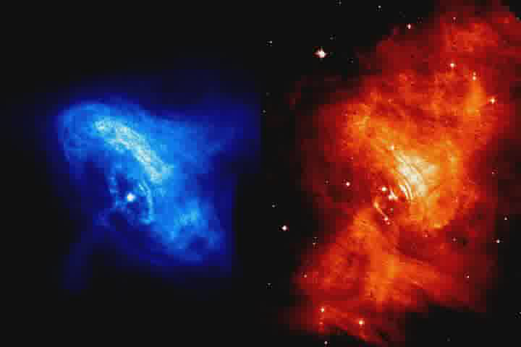

Slide 22
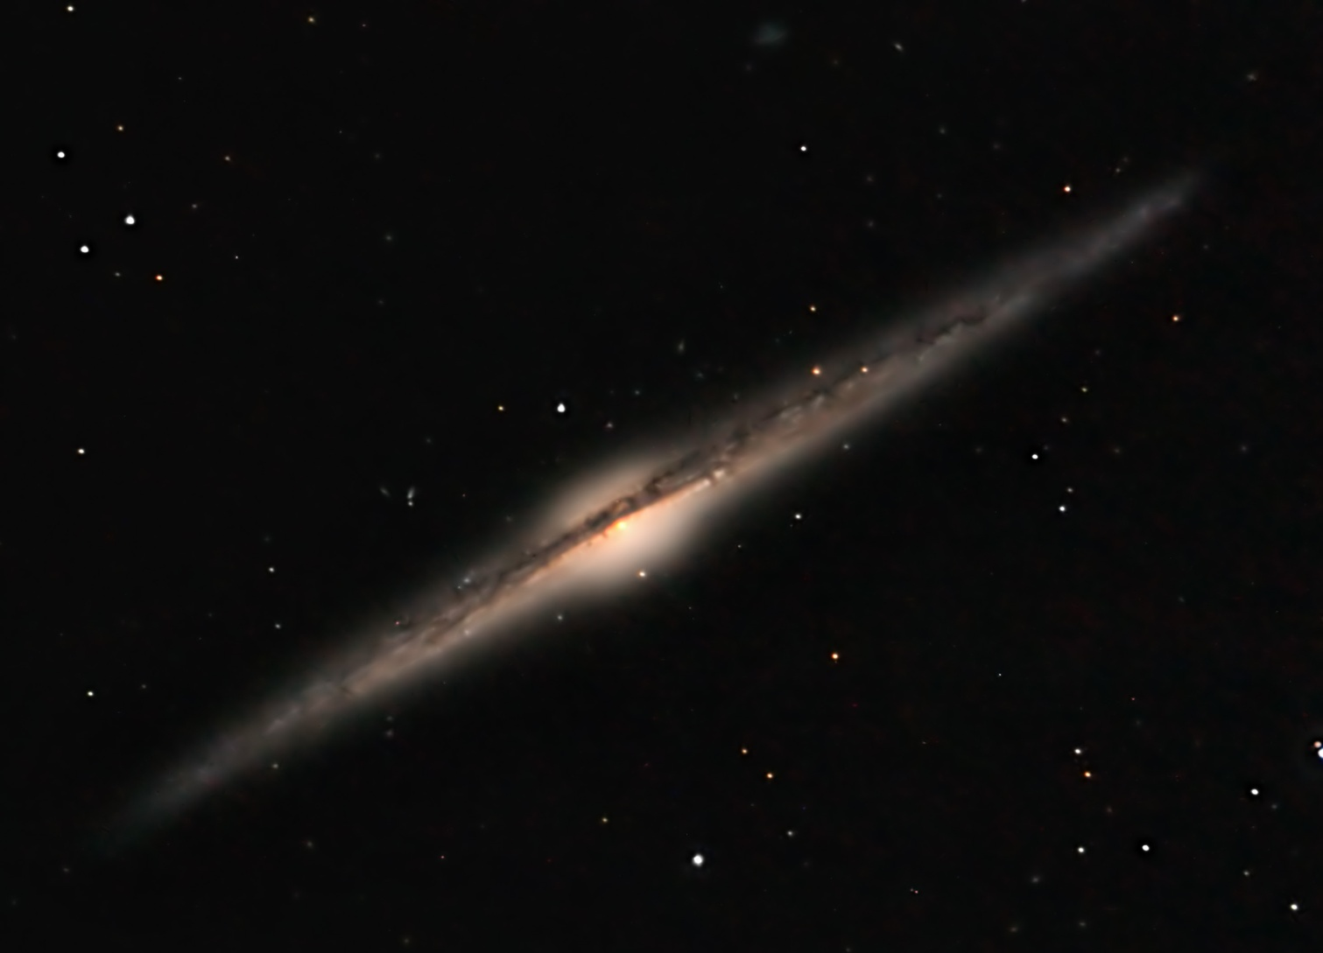
NGC 4565

Slide 23
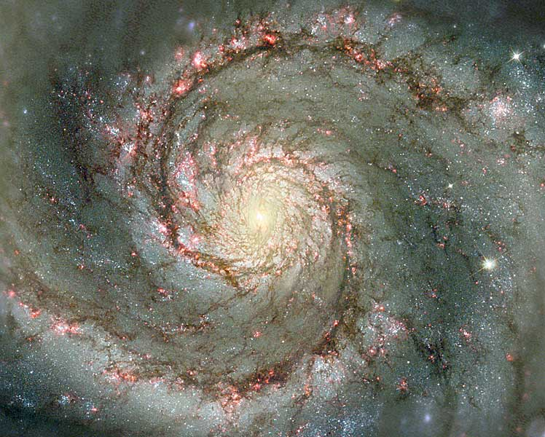
M 51
Photo credit: NASA

Slide 24
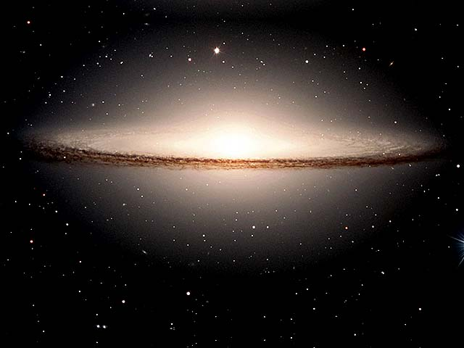

Slide 25
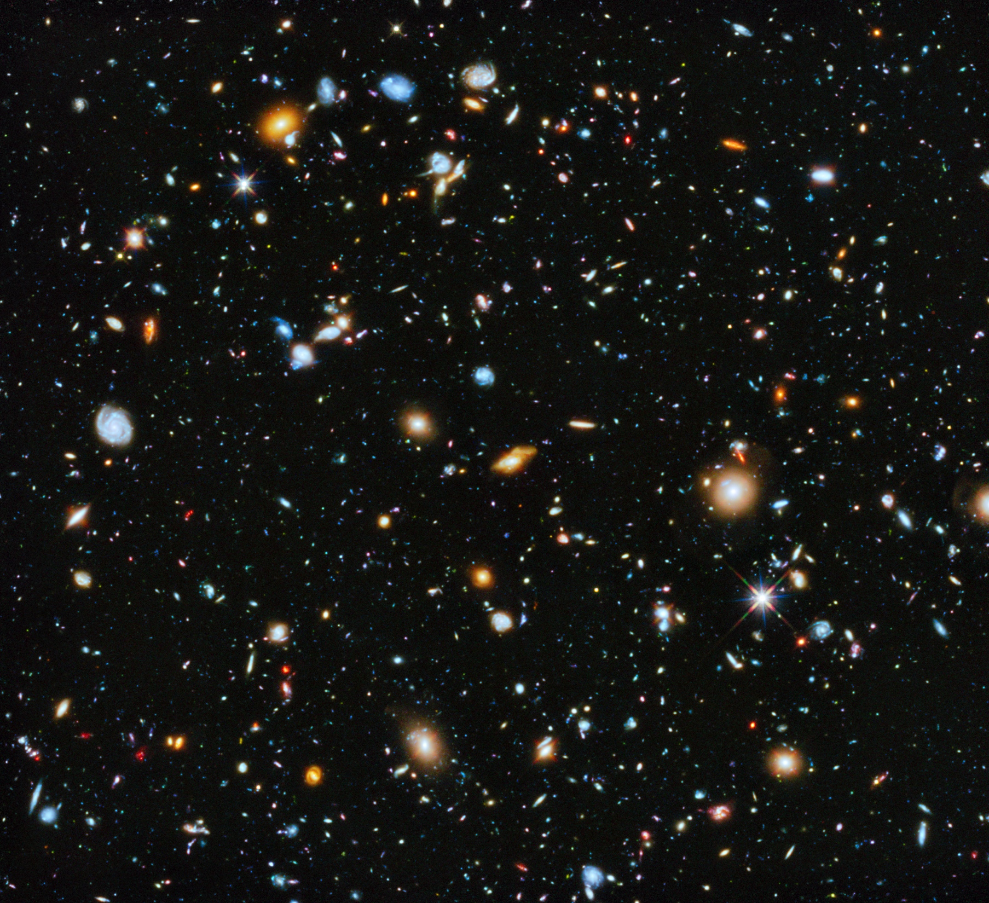
Notes:
2.4 arc minutes square--- about 1/15 Full Moon taken 2003-2004, it contains ~10,000 galaxies!

Slide 26
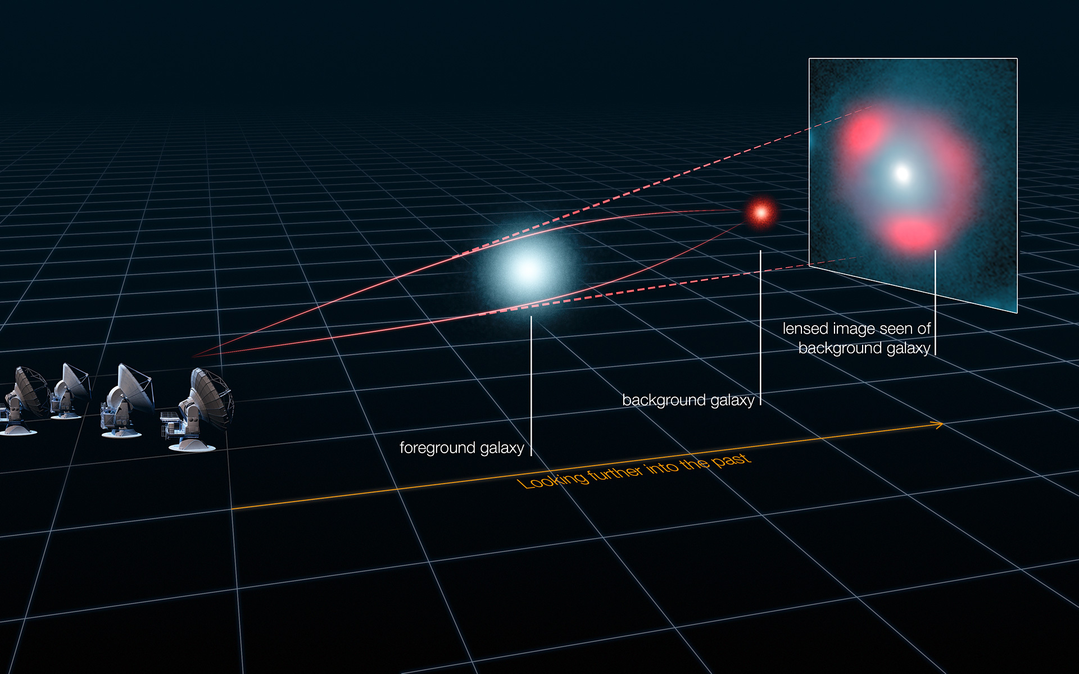
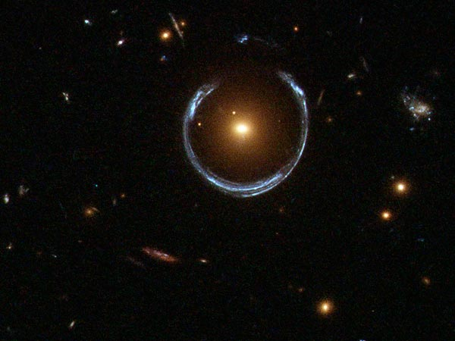

Slide 27
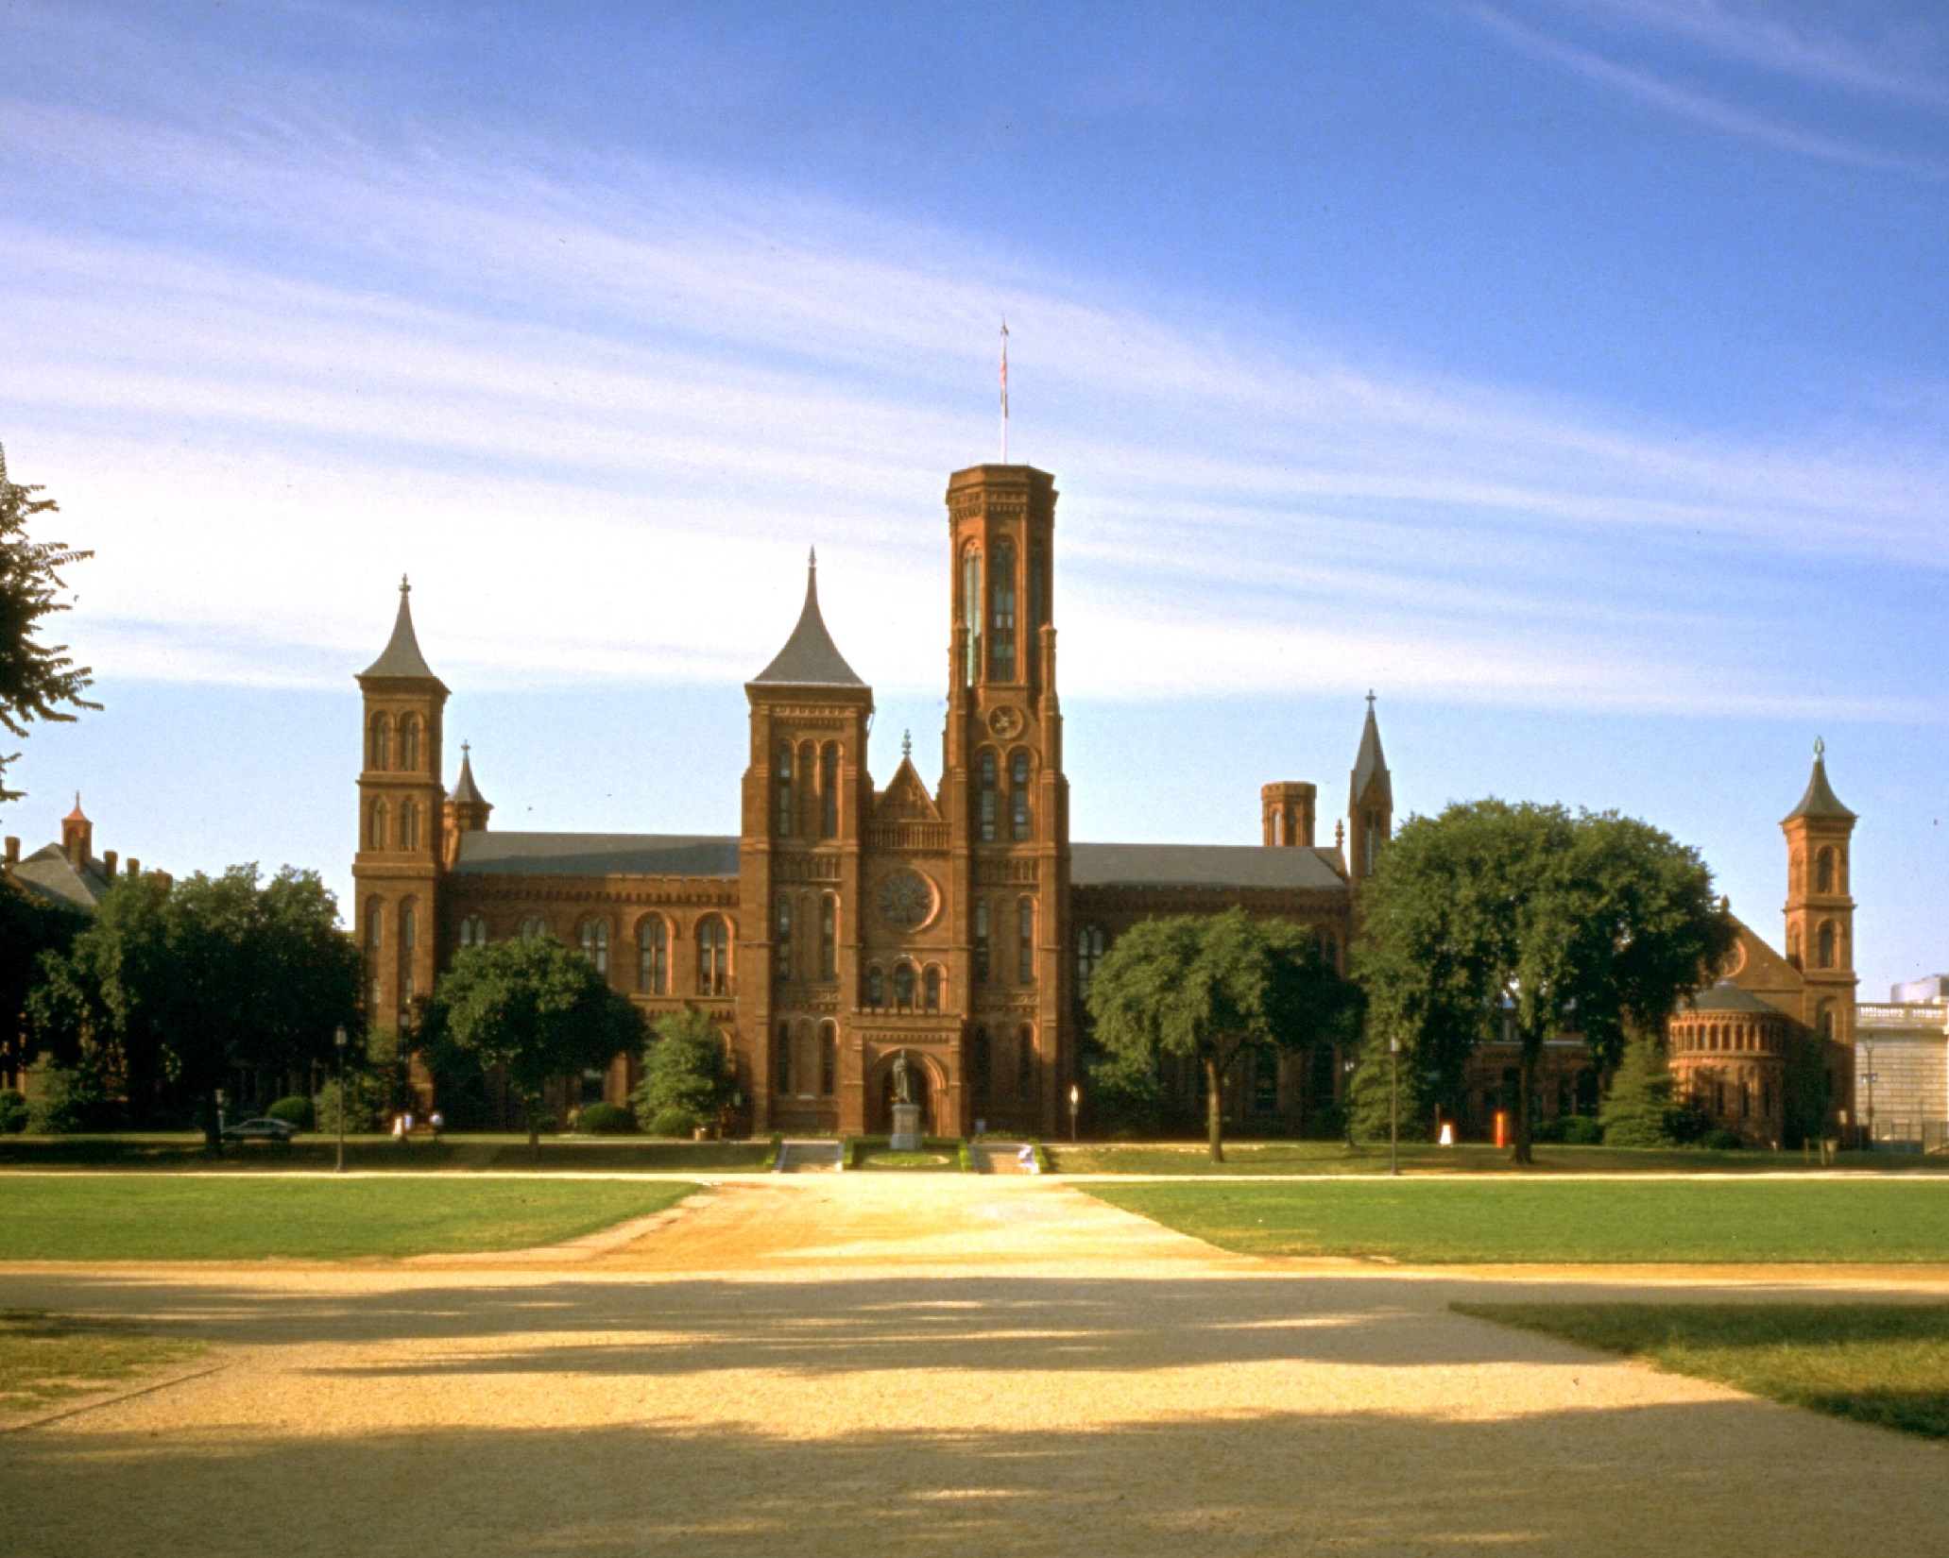

Slide 28
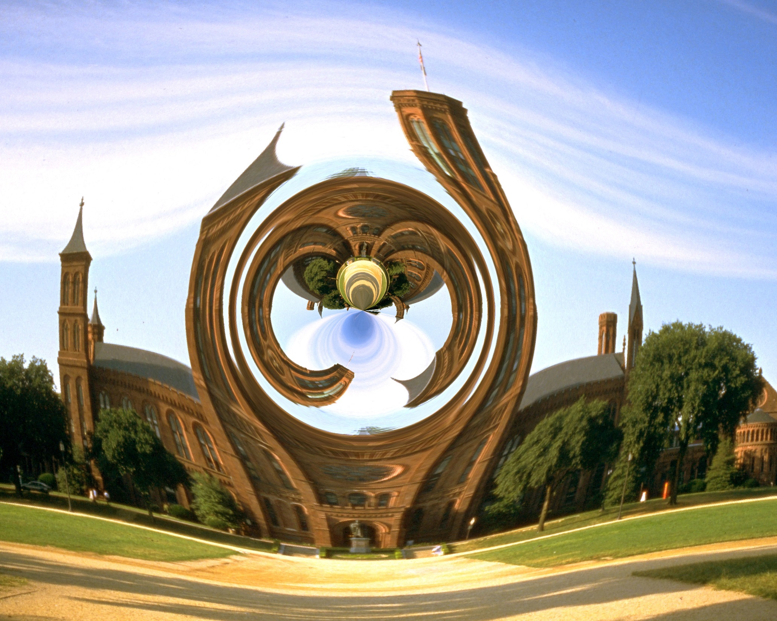

Slide 30
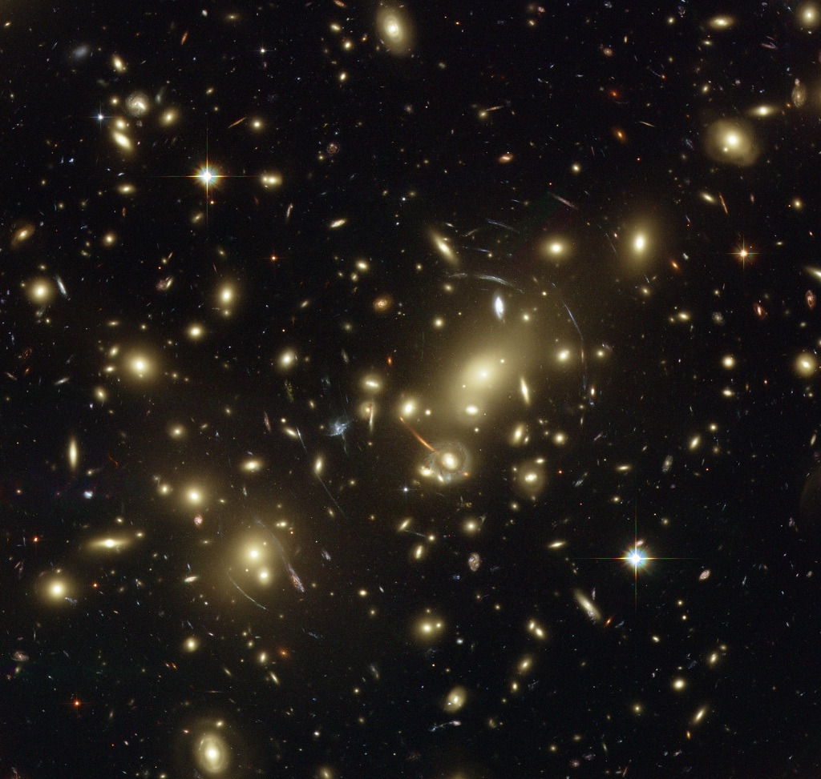

Slide 31
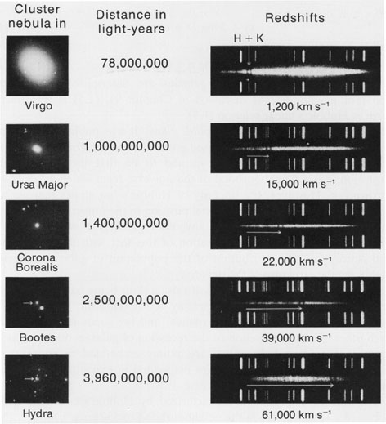

Slide 34
