Slide 1

Breaking News About
N=2* SYM On Four-Manifolds,
Without Spin
Gregory Moore
Rutgers University
WHCGP
July 20, 2020

Slide 2
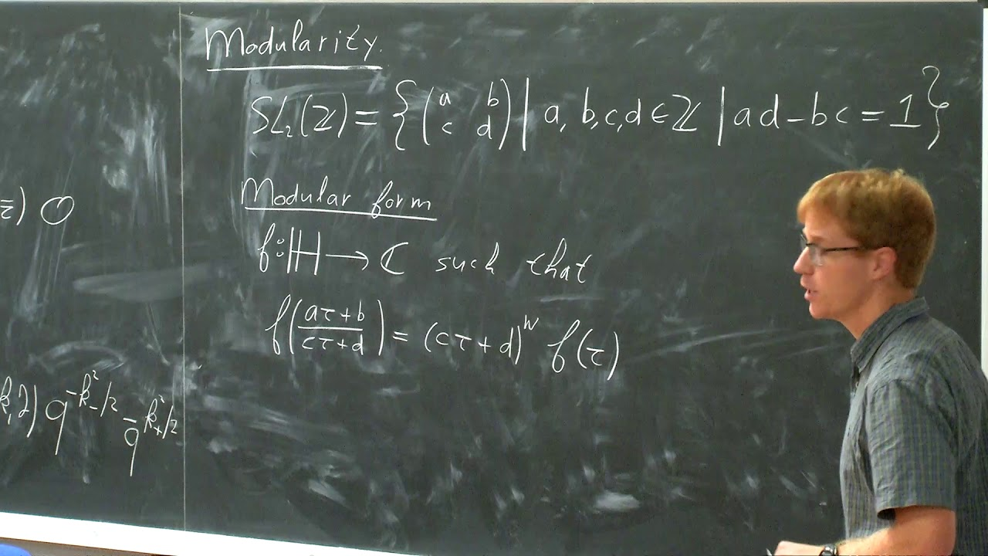
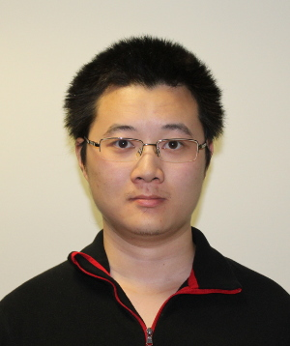
Work with JAN MANSCHOT
+ related work with JM
and XINYU ZHANG

Slide 3
1
Introduction & Main Claims
2
The N=2* Theory: UV Meaning Of Invariants
Coulomb Branch Integral:
New Identities & Interactions
3
4
Evaluation Of CB Integral: Wall Crossing & Mock Modular & Jacobi-Maass Forms Galore
5
LEET Near Cusps & Explicit Results
6
Remarks On S-Duality Orbits Of Partition Functions

Slide 4
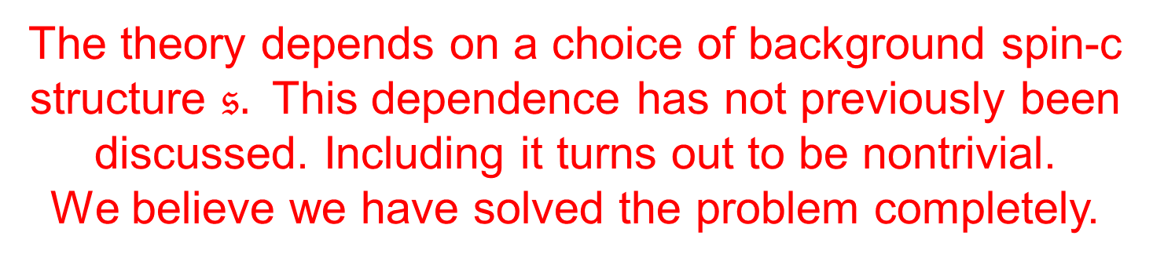
Nontechnical Summary
We study a TQFT in 4d whose partition function generalizes both the Donaldson invariants and the Vafa-Witten invariants, and interpolates between them.
The theory depends on a choice of background spin-c structure $𝔰.$ This dependence has not previously been discussed. Including it turns out to be nontrivial.
We believe we have solved the problem completely.
I gave a preliminary report at the end of my talk at StringMath 2018, where the last slide said…

Slide 5
Surprise!!
It doesn’t work!
Correct version appears to be non-holomorphic.
With Jan Manschot we have an alternative
which is currently being checked.
Does the u-plane integral make sense for
ANY family of Seiberg-Witten curves ?
どうもありがとうございます

Slide 6
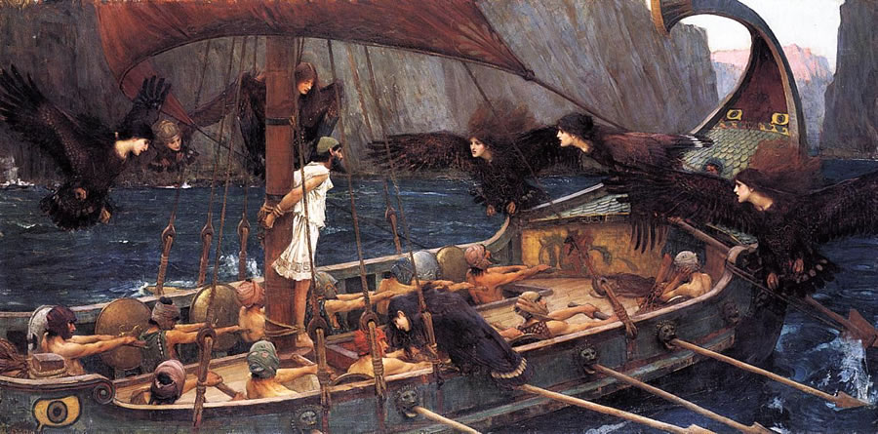
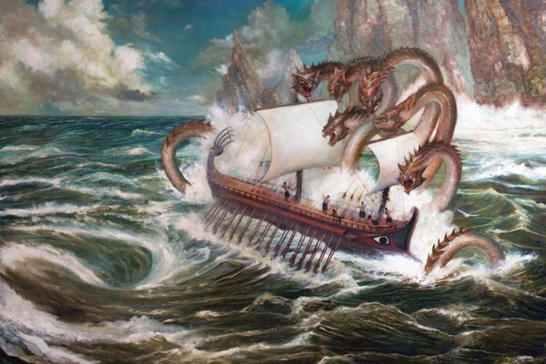
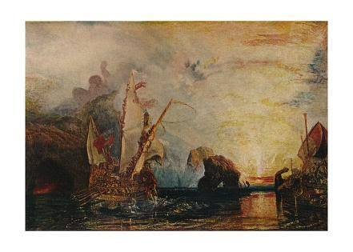
And then – oh Muse! – after many years wandering o’er stormy seas, ‘twixt whirlpools o’ singularities and monstrous mock modular forms, unnumbered toils we did endure through dark and dismal nights,‘till with the rosy-fingered
dawn, in the safe haven of explicit
formulae, with full many consistency
checks, we did arrive.

Slide 7

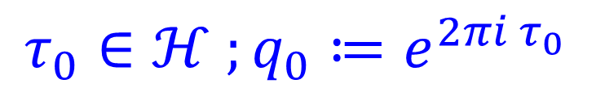

Intro & Main Claims – 1/6
d=4 N=2* SYM. $G=SU\left(2\right), SO\left(3\right)$
$X:$Smooth, compact, oriented, $∂X=∅ ,$ $b_{2}^{+}>0,$
For simplicity: Connected, $π_{1}\left(X\right)=0,$ignore torsion
Data needed to formulate the invariants:
$$τ_{0}∈ℋ ;q_{0}≔e^{2πi τ_{0}}$$
$$m∈ℂ$$
(UV) Spin-c structure: $𝔰, c_{uv}≔c_{1}\left(𝔰\right)∈H^{2}\left(X,ℤ\right)$
$$ν∈H^{2}\left(X;ℤ/2ℤ\right)$$
Orientation of $H^{2}\left(X;ℝ\right)$
Notes:
Say: Comparison with Freedman’s topological classification of four-manifolds shows there is a huge difference between the topological and smooth categories. Very deep.

Slide 8
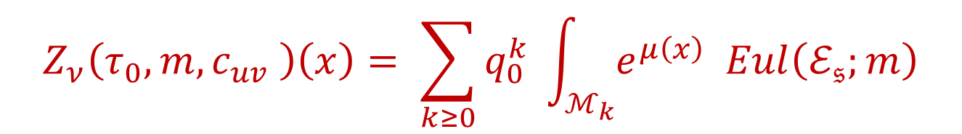
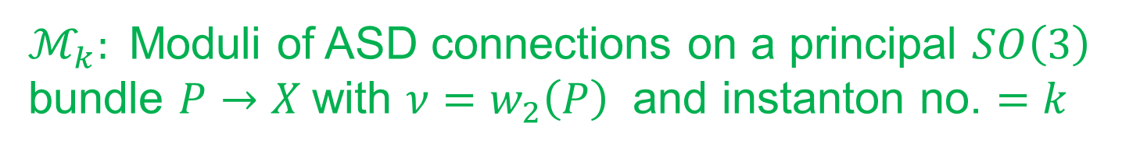

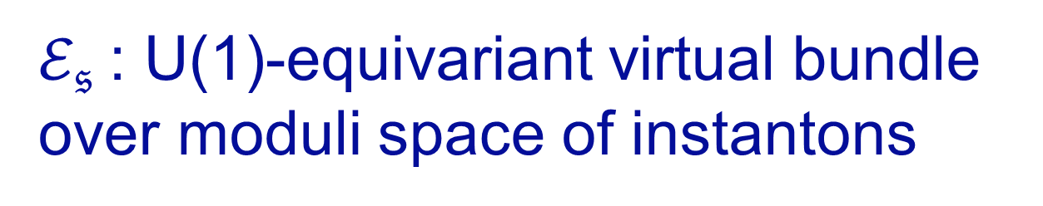
Intro & Main Claims – 2/6
Path integral defines a ``function’’
$$Z_{ν}\left(τ_{0}, m,c_{uv}\right):H_{∗}\left(X;ℤ\right)→ℂ$$
$$Z_{ν}\left(τ_{0},m, c_{uv} \right)\left(x\right)= \sum_{k≥0}{q_{0}^{k} \int_{ℳ_{k}}{e^{μ\left(x\right)} Eul\left(ℰ_{𝔰};m\right)}}$$
$ℳ_{k}:$Moduli of ASD connections on a principal $SO\left(3\right)$ bundle $P→X$with $ν=w_{2}\left(P\right)$ and instanton no. $=k$
$$μ:H_{∗}\left(X,ℤ\right)→H^{4−∗}\left(ℳ_{k};ℚ\right)$$
$ℰ_{𝔰}$: U(1)-equivariant virtual bundle
over moduli space of instantons

Slide 9
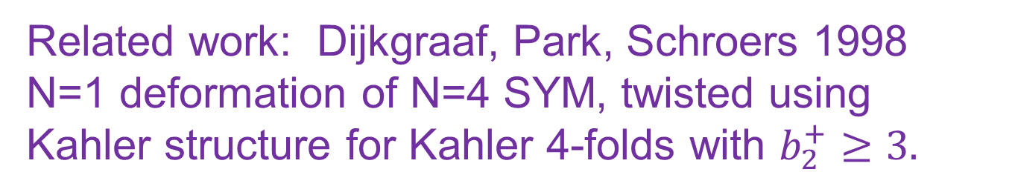
Intro & Main Claims – 3/6
Special cases were studied in
[Moore & Witten 1997; Labastida & Lozano 1998 ]
Those studies were limited to spin manifolds
with trivial spin-c structure.
Related work: Dijkgraaf, Park, Schroers 1998
N=1 deformation of N=4 SYM, twisted using
Kahler structure for Kahler 4-folds with $b_{2}^{+}≥3.$

Slide 10
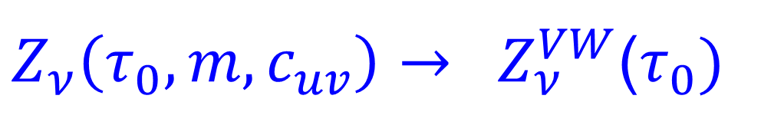
Intro & Main Claims – 4/6
An acs $ℐ$defines a canonical spin-c structure $𝔰\left(ℐ\right)$.
(Use canonical homomorphism $U\left(2\right)→Spin^{c}\left(4\right).)$
1A: For such a spin-c structure and $m→0$
$Z_{ν}\left(τ_{0},m,c_{uv}\right)→ Z_{ν}^{VW}$($τ_{0})$
1B: $m→∞ \& q_{0}→0 with Λ^{4}≔4m^{4}q_{0}$ fixed:
$$Z_{ν}^{renorm}\left(τ_{0},m,c_{uv}\right)→Z_{ν}^{DW}$$

Slide 11



Intro & Main Claims – 5/6
$$Z_{ν}=Z_{ν}^{CB}+Z_{ν}^{SW}$$
$Z_{ν}^{CB} :$ Coulomb branch integral
2a: Writing a single-valued measure
requires nonholomorphic interactions with $𝔰$
($⇒$ implications for class S generalization )
2b: Integrand is a total derivative
of a Maass-Jacobi form. (``Mock Jacobi form’’ )
2c: Value of the integral is a nonholomorphic
completion of a mock modular form.
2d: VW expression for $ℂℙ^{2}$ is a special case

Slide 12
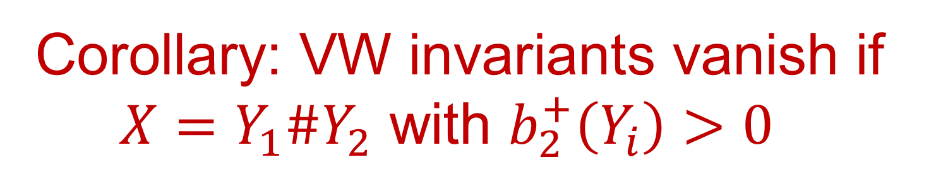
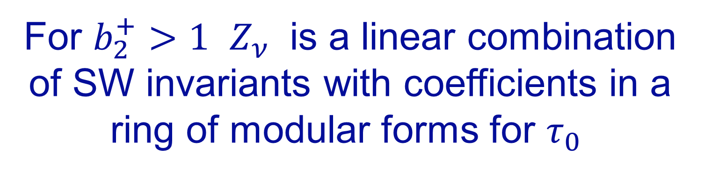
Intro & Main Claims – 6/6
For $b_{2}^{+}>1$ $Z_{ν}$ is a linear combination of SW invariants with coefficients in a ring of modular forms for $τ_{0}$
Corollary: VW invariants vanish if
$X=Y_{1}\#Y_{2}$ with $b_{2}^{+}\left(Y_{i}\right)>0$
(VW invariants only rigorously defined for algebraic surfaces: Tanaka-Thomas 2017; Sheshmani-Yau 2019)

Slide 13
1
Introduction & Main Claims
2
The N=2* Theory: UV Meaning Of Invariants
Coulomb Branch Integral:
New Identities & Interactions
3
4
Evaluation Of CB Integral: Wall Crossing & Mock Modular & Jacobi-Maass Forms Galore
5
LEET Near Cusps & Explicit Results
6
Remarks On S-Duality Orbits Of Partition Functions

Slide 14


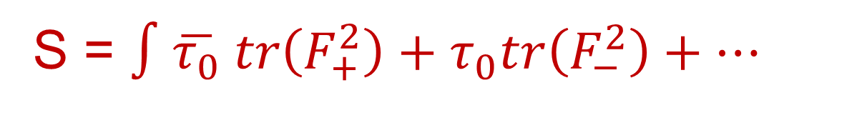

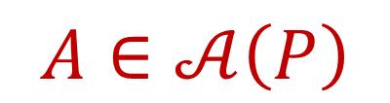
$𝒩=2^{∗}$ Theory
Bosonic Fields:
Vectormultiplet
$$A∈𝒜\left(P\right)$$
$$φ∈Γ\left(adP⊗ℂ\right)$$
S = $∫\overline{τ_{0}} tr\left(F_{+}^{2}\right)+τ_{0}tr\left(F_{−}^{2}\right)+⋯$
Adjoint HM: $q, \tilde{q}∈Γ\left(adP⊗ℂ\right)$
$$W=Tr\left( q \left(Ad\left(φ\right)+m\right)\tilde{q} \right)$$
$⇒U{\left(1\right)}_{b}$ symmetry: Charge$\left(q,\tilde{q}\right)=\left(1,−1\right)$

Slide 15

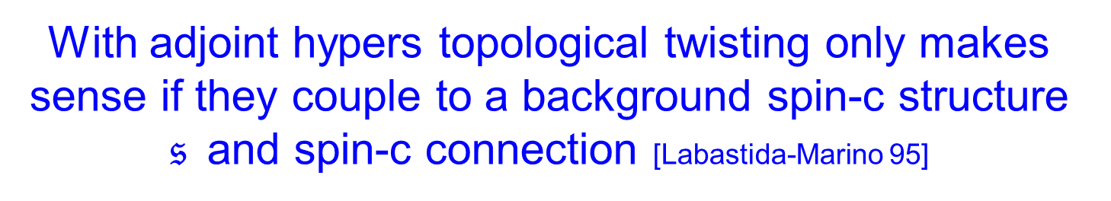

Topological Twisting
Couple to background $SO{\left(3\right)}_{R}$bundle with connection.
Choose an isomorphism with SO(3) bundle with connection associated to $\left(Λ^{2,+}TX , ∇^{LC}\right)$
Magically, all metric dependence is Q-exact (Witten 1988):
$$S= \int{τ_{0} tr\left(F^{2}\right)+Q\left(∗\right) }$$
N.B. Also holomorphic in $τ_{0}$
With adjoint hypers topological twisting only makes sense if they couple to a background spin-c structure $𝔰$and spin-c connection [Labastida-Marino 95]

Slide 16



Topological Twisting
HM bosons $\left(q,{\tilde{q}}^{∗} \right)⇒ M∈Γ\left(W^{+}⊗adP⊗ℂ\right)$
$W^{+}→ X :$Positive chirality rank two bundle associated to uv spin-c structure $𝔰$
$Q−$fixed point equations
$$F^{+}+\left[M,\overline{M}\right]=0$$
$$DM=0$$
``Nonabelian monopole/SW equations’’
[Labastida-Marino; Losev-Shatashvili-Nekrasov]
$U{\left(1\right)}_{b}$ acts on the moduli space $ℳ_{Q}$ of these eqs.
Fixed point set: $M=0$ is $ℳ_{asd}\left(P\right)=ℳ_{k}$

Slide 17


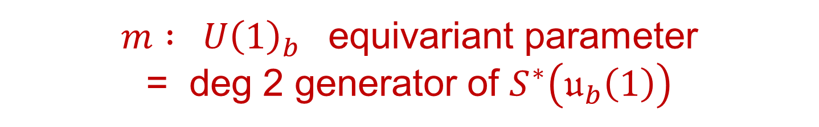
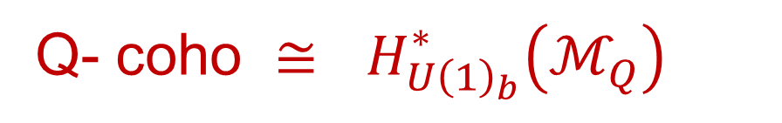
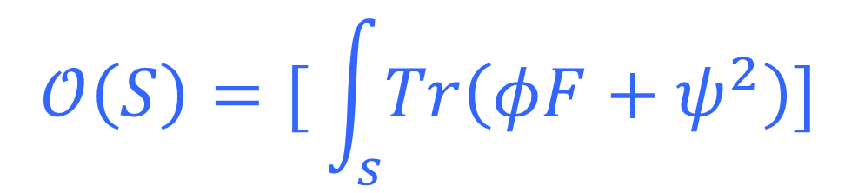
Observables
$$𝒪:H_{∗}\left(X,ℤ\right)→ Q−coho$$
$$𝒪\left(p\right)=\left[ Tr φ^{2}\left(p\right)\right]$$
$$𝒪\left(S\right)=[ \int_{s}{Tr\left(φF+ψ^{2}\right)]}$$
Q- coho $≅$ $H_{U{\left(1\right)}_{b}}^{∗}\left(ℳ_{Q}\right)$
$m :$ $U{\left(1\right)}_{b}$ equivariant parameter
= deg 2 generator of $S^{∗}\left(𝔲_{b}\left(1\right)\right)$
[Labastida-Marino; Losev-Shatashvili-Nekrasov]

Slide 18
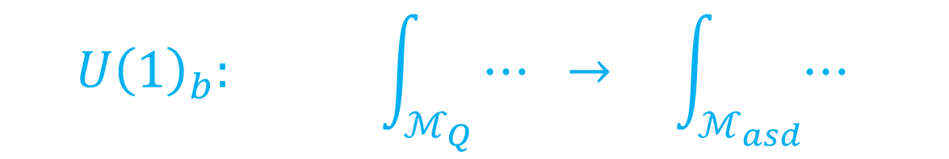
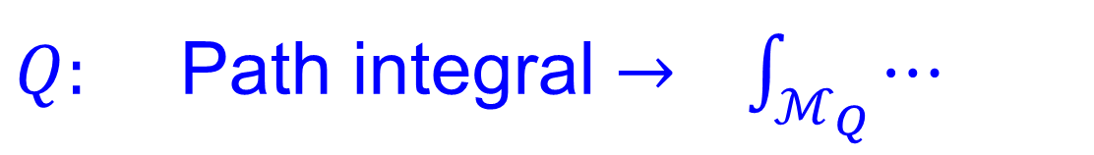
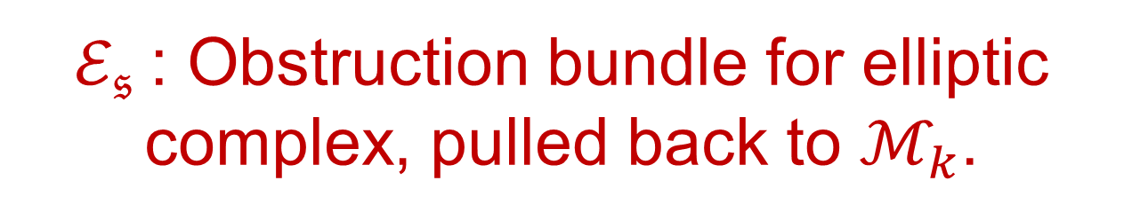


Localization
$Q:$ Path integral $→ \int_{ℳ_{Q}}{⋯}$
$$U{\left(1\right)}_{b}: \int_{ℳ_{Q}}{⋯ → \int_{ℳ_{asd}}{⋯ }}$$
$${〈e^{𝒪\left(x\right)}〉}_{𝒩=2^{∗}}=$$
$$\sum_{k≥0}{q_{0}^{k} \int_{ℳ_{k}}{e^{μ\left(x\right)}Eul\left(ℰ_{𝔰};m\right)}}$$
$ℰ_{𝔰}$: Obstruction bundle for elliptic complex, pulled back to $ℳ_{k}$.

Slide 19
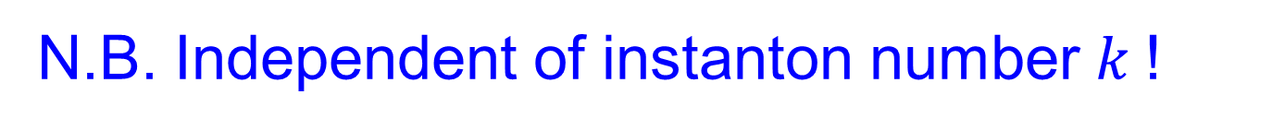
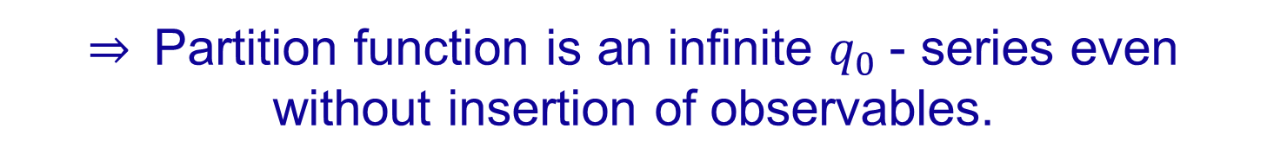
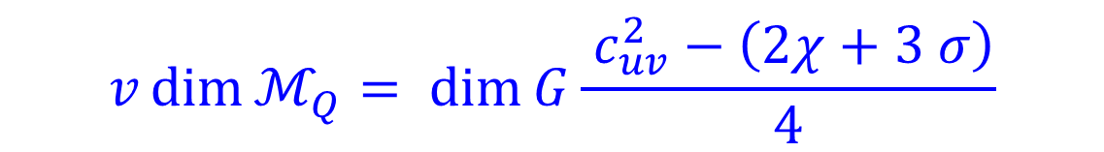



Index Computations
$$v\dim{ℳ_{Q}= \dim{G\frac{ c_{uv}^{2}−\left(2χ+3 σ\right)}{4}}}$$
N.B. Independent of instanton number $k$!
$$\dim{ℳ_{k} }=8k −\frac{3}{2}\left(χ+σ\right)$$
$⇒$Partition function is an infinite $q_{0}$- series even without insertion of observables.
$$Index D=−8k+\frac{3}{8}\left(c_{uv}^{2}−σ\right)$$
Conjecture: $ℰ_{𝔰}=$ker($D^{∗})$ for large $k$

Slide 20
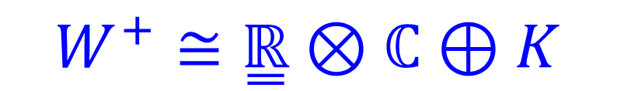


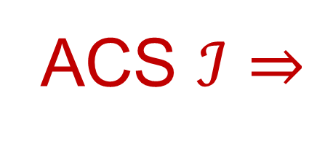
Relation To Vafa-Witten Equations-1/2
$$A∈𝒜\left(P\right) C∈Γ\left(ad P\right) B^{+}∈Ω^{2,+}\left(ad P\right)$$
$$F^{+}+\left[B^{+}, B^{+}\right]+[C,B^{+}] =0$$
$$D_{μ}C+D^{ν}B_{νμ}^{+}=0$$
ACS $ℐ⇒$
$$Λ^{2,+} T^{∗}X ≅\overset{̳}{ℝ}⊕K_{ℝ}$$
$ℐ$also determines a
canonical spin-c structure $𝔰\left(ℐ\right)$
$$W^{+}≅\overset{̳}{ℝ}⊗ℂ⊕K$$
Notes:
Even though the topological twists of N=4 SYM are very different.
Incidentally,
One is not allowed to cancel Witten from this equation.

Slide 21

Relation To Vafa-Witten Equations -2/2
DW twist of N=4 SYM is inequivalent to the SW twist.
Nevertheless, for $𝔰\left(ℐ\right)$Q-fixed point eqs coincide
Seiberg-Witten $≅$ Vafa-Witten

Slide 22
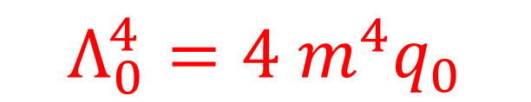

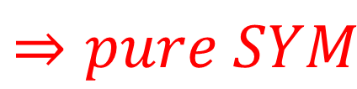
Mass Limits
$$Lim_{m→0}\left[N=2^{∗} SYM\right]=[N=4 SYM]$$
SW94:
$$m→∞ \& q_{0}→0$$
$$Λ_{0}^{4}=4 m^{4}q_{0}$$
$$⇒pure SYM$$

Slide 23


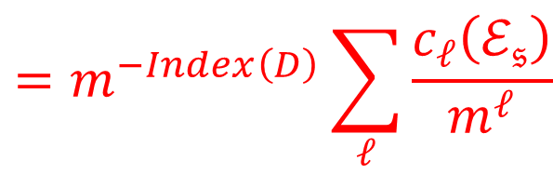

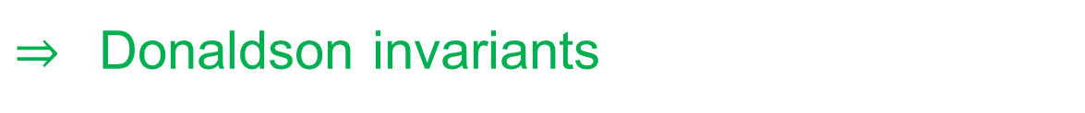
Mass Limits – 2
$$\sum_{k≥0}{q_{0}^{k} \int_{ℳ_{k}}{e^{μ\left(x\right)}Eul\left(ℰ_{𝔰};m\right)}}$$
$${〈e^{𝒪\left(x\right)}〉}_{𝒩=2^{∗}}=$$
$$Eul\left(ℰ_{𝔰};m\right)=\prod_{i}{\left(x_{i}+m\right)}$$
$$=m^{−Index\left(D\right)}\sum_{ℓ}{\frac{c_{ℓ}\left(ℰ_{𝔰}\right)}{m^{ℓ}}}$$
Leading term for $m→0 : c_{top}\left(ℰ_{𝔰}\right)$
For $𝔰\left(ℐ\right):$ $ℰ_{𝔰} ≅T^{∗}ℳ_{k}$ $⇒$``Euler character of $ℳ_{k}$‘’
Leading term for $m→∞ : c_{0}\left(ℰ_{𝔰}\right)$= 1
$⇒$ Donaldson invariants

Slide 24
1
Introduction & Main Claims
2
The N=2* Theory: UV Meaning Of Invariants
Coulomb Branch Integral:
New Identities & Interactions
3
Evaluation Of CB Integral: Wall Crossing & Mock Modular & Jacobi-Maass Forms Galore
4
5
LEET Near Cusps & Explicit Results
6
Remarks On S-Duality Orbits Of Partition Functions

Slide 25

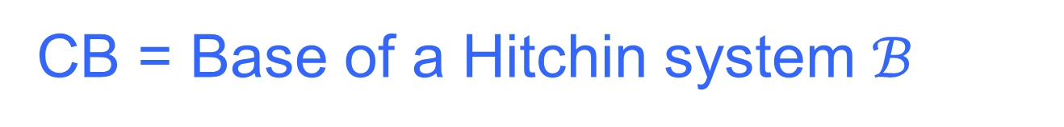
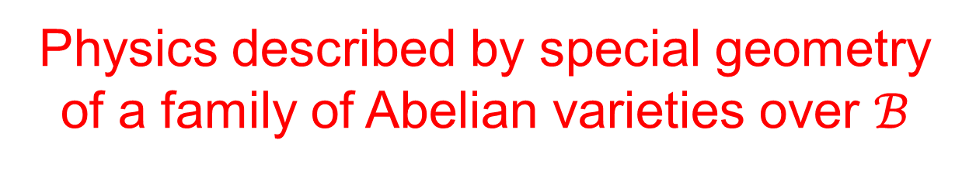
Coulomb Branch Integral
This is a useful and nontrivial test case for a
more general very interesting open problem:
Generalize DW theory to class S.
CB = Base of a Hitchin system $ℬ$
Here: $u∈ℂ≅ℬ$
Physics described by special geometry of a family of Abelian varieties over $ℬ$
SW94: Jacobians of a holo family of curves
Equipped with meromorphic differential

Slide 26
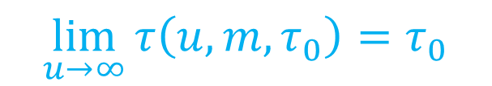
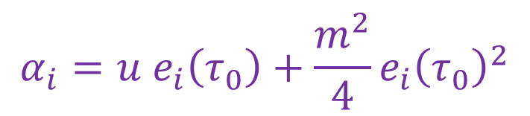
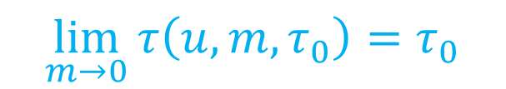
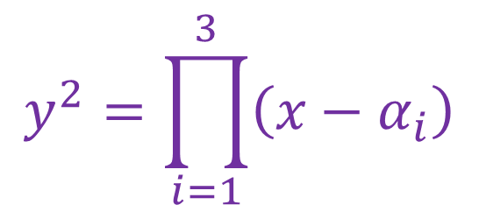
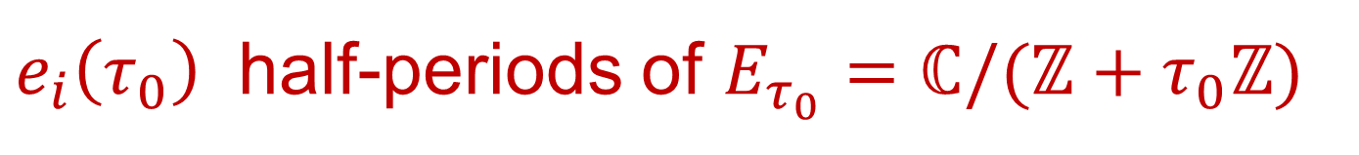
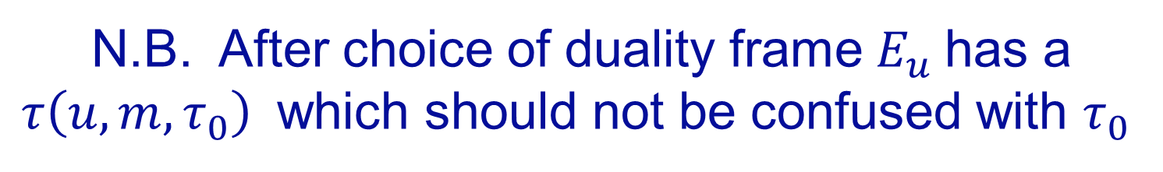
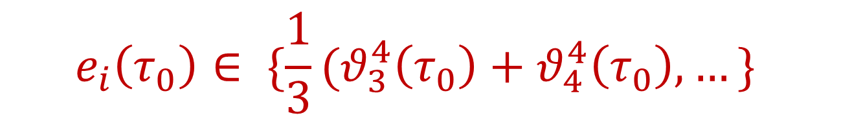

Seiberg-Witten Geometry
$$y^{2}=\prod_{i=1}^{3}{\left(x−α_{i}\right)}$$
$$E_{u}$$
$$α_{i}=u e_{i}\left(τ_{0}\right)+\frac{m^{2}}{4}e_{i}{\left(τ_{0}\right)}^{2}$$
$e_{i}\left(τ_{0}\right)$ half-periods of $E_{τ_{0}}=ℂ/(ℤ+τ_{0}ℤ)$
$$e_{i}\left(τ_{0}\right)∈ \{\frac{1}{3}(θ_{3}^{4}\left(τ_{0}\right)+θ_{4}^{4}\left(τ_{0}\right), …\}$$
N.B. After choice of duality frame $E_{u}$has a
$τ\left(u,m,τ_{0}\right)$ which should not be confused with $τ_{0}$
$$\lim_{m→0}{τ\left(u,m,τ_{0}\right)=τ_{0}}$$
$$\lim_{u→∞}{τ\left(u,m,τ_{0}\right)=τ_{0}}$$

Slide 27
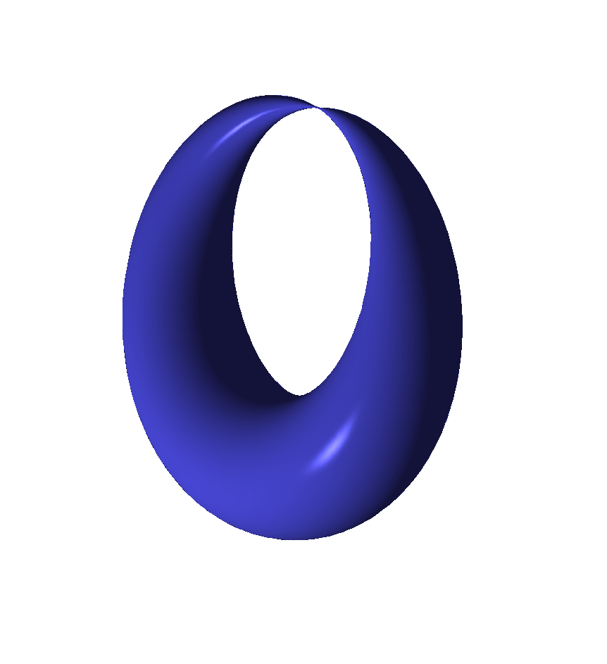





$$E_{u}$$
$$u_{1}$$
$$u_{3}$$
$u_{2}$
$$u_{j}=m^{2}e_{j}(τ_{0})$$

Slide 28

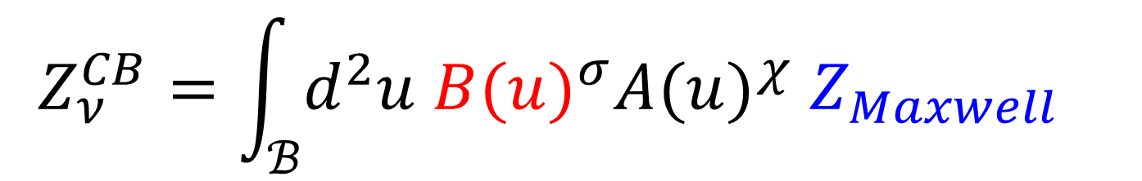
Path Integral Of U(1) LEET
LEET: U(1) Maxwell + N=2 superpartners with topological couplings
$$Z_{ν}^{CB}=\int_{ℬ}{d^{2}u {B(u)}^{σ}{A(u)}^{χ} Z_{Maxwell} }$$
$$B=\prod_{i}{{\left(u−u_{i}\right)}^{\frac{1}{8}} }$$
$⇒$ Potential problems with single-valued measure.

Slide 29
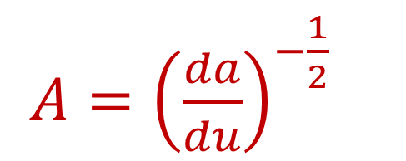
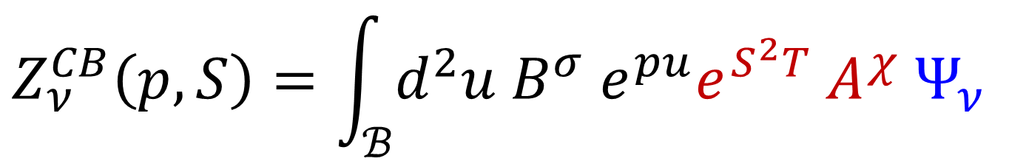
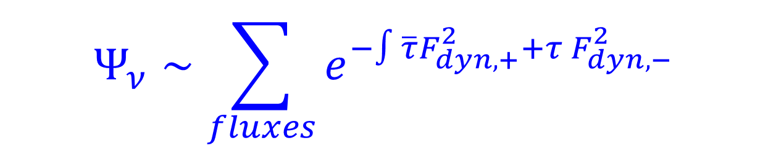
CB Measure: 1997-1998
$$Z_{ν}^{CB}\left(p,S\right)=\int_{ℬ}{d^{2}u B^{σ} e^{pu}e^{S^{2}T} A^{χ} Ψ_{ν} }$$
$A={\left(\frac{da}{du}\right)}^{−\frac{1}{2}}$
$$Ψ_{ν}∼\sum_{fluxes}{e^{−∫\overline{τ}F_{dyn,+}^{2}+τ F_{dyn,−}^{2}}}$$
Depend on duality frame –
- but the local system has nontrivial monodromy.

Slide 30
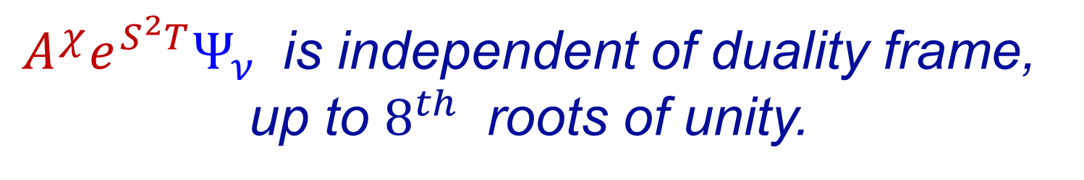
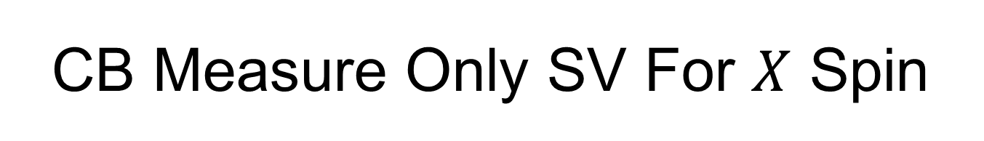
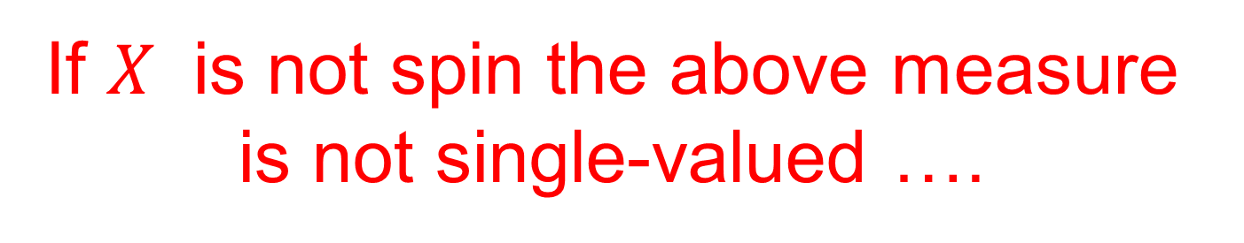
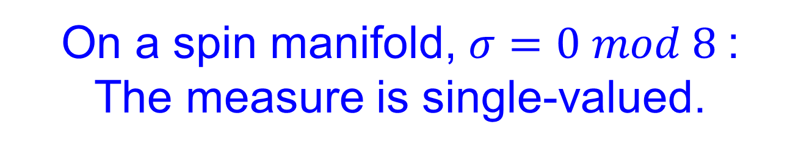
CB Measure Only SV For $X$ Spin
$A^{χ}e^{S^{2}T}Ψ_{ν}$ is independent of duality frame, up to $8^{th}$ roots of unity.
On a spin manifold, $σ=0 mod 8$:
The measure is single-valued.
If $X$ is not spin the above measure is not single-valued ….

Slide 31

CB Measure: New Interactions
We need to include the
background spin-c structure $𝔰$
There are couplings to the UV spin-c connection:
$$ΔS_{LEET}=∫c\left(u\right)F_{b}^{2}+d\left(u\right) F_{b}F_{dyn}$$
[Shapere-Tachikawa, 2008]
Surprise! No choice of holomorphic coupling makes the measure single-valued!

Slide 32




Resolution
``Weakly gauge’’ the $U{\left(1\right)}_{b}$symmetry:
Gauge group:
$$U{\left(1\right)}_{b}×G G∈\{ SU\left(2\right), SO\left(3\right)\}$$
$⇒$ Rank TWO gauge group.
Take UV coupling of $U{\left(1\right)}_{b}$ to zero:
Freezes $U{\left(1\right)}_{b}$vm fields to classical values
$$m=〈 a_{b} 〉$$
Nati Seiberg & Ann Nelson – 1993

Slide 33





Non-Holomorphic Coupling
Rank 2 Maxwell action: $F_{I}=\left(F_{b}, F_{dyn}\right)$
$$∼ ∫{\overline{τ}}_{IJ}F_{+}^{I}F_{+}^{J}+τ_{IJ}F_{−}^{I}F_{−}^{J}+⋯$$
$$τ_{IJ}=\left(\begin{matrix}\frac{d^{2}ℱ}{da^{2}} & \frac{d^{2}ℱ}{dadm} \\ \frac{d^{2}ℱ}{dadm} & \frac{d^{2}ℱ}{dm^{2}}\end{matrix}\right)$$
$$v=\frac{d^{2}ℱ}{dadm}$$
$$∫\overline{v} F_{b}^{+}F_{dyn}^{+}+v F_{b}^{−}F_{dyn}^{−}$$

Slide 34





Remark: SW limit $m→∞$
$$e^{ ∫\overline{v} F_{b}^{+}F_{dyn}^{+}+v F_{b}^{−}F_{dyn}^{−}}$$
Metric dependent & nonholomorphic, varying continuously on $ℬ$
$$→e^{i π ∫w_{2}\left(X\right)\frac{F_{dyn}}{2π} }$$
Important implications for the generalization of CB integral to class S theories: We do not want a $ℤ_{2}−$valued QRIF.

Slide 35


Coulomb Branch Measure: 2019 -2020
$$Z_{ν}^{CB}=\int_{ℬ}{Ω}$$
$$Ω=du∧d\overline{u} B^{σ}e^{pu}e^{S^{2}T}A^{χ}C^{c_{uv}^{2}}Ψ_{ν}$$
Nontrivial question: Is this single-valued ?
Step 1: Use modular parametrization.
Identify $ℬ$ with the modular curve $ℋ/Γ\left(2\right)$

Slide 36





Modular Parametrization
Weak coupling duality frame:
Nekrasov: Instanton partition function
$$ℱ\left(a,m\right)=\frac{1}{2}τ_{0}a^{2}+$$
$${+ m}^{2} f_{1}\left(τ_{0}\right) ( log \left(\frac{2a}{m}\right)−\frac{3}{4}+\frac{3}{2}\log\left(\frac{m}{Λ}\right) )$$
$$+a^{2}\sum_{n=2}^{∞}{f_{n}\left(τ_{0}\right) {\left(\frac{m}{a}\right)}^{2n}}$$
$f_{n}\left(τ_{0}\right):$polynomials: $E_{2}{,E}_{4},E_{6}$ wt = $2n−2$
[Minhahan, Nemeschansky, Warner; Dhoker, Phong]
$Λ, m$ dependence (also A,B couplings):
$[$Manschot, Moore, Xinyu Zhang 2019]

Slide 37





Modular Parametrization
$$τ=\frac{d^{2}ℱ}{da^{2}}$$
$$\frac{da}{du}=\oint_{A}{\frac{dx}{y}}$$
$${m^{2}\left(\frac{da}{du}\right)}^{2}=\frac{θ_{4}^{4}\left(τ\right)θ_{3}^{4}\left(τ_{0}\right)−θ_{3}^{4}\left(τ\right)θ_{4}^{4}\left(τ_{0}\right)}{η^{6}\left(τ_{0}\right)}$$
$$m^{−2} u\left(τ,τ_{0}\right)=\frac{e_{1}^{2}\left(τ_{0}\right) e_{23}\left(τ\right)+cycl.}{e_{1}\left(τ_{0}\right)e_{23}\left(τ\right)+cycl}$$
[Huang, Kashani-Poor,Klemm]
$$ℬ ≅ ℋ/Γ\left(2\right)$$

Slide 38




Modular Parametrization
$$τ=i ∞↔u=u_{1}$$
$$τ=τ_{0} ↔ u=∞$$
$$τ=0 ↔ u=u_{2 }$$
$$τ=1 ↔ u=u_{3 }$$

Slide 39




Two New Nontrivial Identities
$$C ≔\exp\left( −2 π i\frac{d^{2}ℱ}{dm^{2}} \right)={\left(\frac{Λ}{m}\right)}^{\frac{3}{2}}\frac{ θ_{1}\left(2τ,2v\right)}{θ_{2}^{2}\left(τ_{0}\right)θ_{4}\left(2τ\right)}$$
$$v≔\frac{d^{2}ℱ}{dadm}$$
$$\frac{θ_{2}\left(2τ, v\right)}{θ_{3}\left(2τ,v\right)}=\frac{θ_{2}\left(2τ_{0},0\right)}{θ_{3}\left(2τ_{0},0\right)}$$
Determines $v\left(τ,τ_{0}\right)$

Slide 40







The ``Period Point’’ $J$
$$b_{2}^{+}>1 ⇒Z_{ν}^{CB}=0$$
$Z_{Maxwell}$:
Frame dependent.
Not holomorphic.
Metric dependent.
$$b_{2}^{+}=1$$
$$Z_{ν}^{CB}≠0$$
$$∗J=J$$
$$H^{2}\left(X;ℝ\right)$$
$$J^{2}=1$$
$$J^{0}>0$$

Slide 41





Maxwell Partition Function
Sum over the first Chern class $λ∈2L+ν ,$ $L=H^{2}\left(X;ℤ\right)$
(Simplicity: Put $S=0.)$
$$Ψ_{ν}^{J}=\sum_{λ∈2L+ν}{∂_{\overline{τ}}E_{λ}^{J} q^{−\frac{1}{4}λ^{2}} e^{πi λ⋅c_{uv} v\left(τ,τ_{0}\right)}}$$
$$Erf\left(x\right)≔\int_{0}^{x}{e^{−πt^{2}}dt}$$
$$E_{λ}^{J}=Erf\left(x_{λ}\right)$$
$$x_{λ}=\sqrt{Imτ}(λ+ \frac{Imv}{Imτ} c_{uv})⋅J$$
Notes:
Say: derivative of Erf(x) goes to zero rapidly, so the sum is actually convergent, even though the holomorphic power of q has the wrong sign.

Slide 42


With all these ingredients we can now check that the CB measure is indeed monodromy invariant and hence well-defined.
The definition of the integral is still rather subtle. One must define naively divergent expressions like
$$Z_{μ}^{CB}=\int_{ℋ/Γ(2)}{d^{2}τ {\left(Im τ\right)}^{−s}q^{n}{\overline{q}}^{\tilde{n}}}$$
with $n<0$ and $\tilde{n}<0$
It can be done in a satisfactory way:
Korpas, Manschot, Moore, Nidaiev 2019

Slide 43
1
Introduction & Main Claims
2
The N=2* Theory: UV Meaning Of Invariants
Coulomb Branch Integral:
New Identities & Interactions
3
Evaluation Of CB Integral: Wall Crossing & Mock Modular & Jacobi-Maass Forms Galore
4
5
LEET Near Cusps & Explicit Results
6
Remarks On S-Duality Orbits Of Partition Functions

Slide 44





Evaluation Of CB Integral ?
$$Z_{ν}^{CB}=\int_{ℋ/Γ(2)}{Ω}$$
(For simplicity: $p=S=0$.)
$$Ω=dτ∧d\overline{τ} B^{σ}A^{χ}C^{c_{uv}^{2}}Ψ_{ν}^{J}$$
$$Ψ_{ν}^{J}=\sum_{λ∈2L+ν}{∂_{\overline{τ}}E_{λ}^{J} q^{−\frac{1}{4}λ^{2}} e^{πi λ⋅c_{uv} v\left(τ,τ_{0}\right)}}$$
$$Ω=d Λ$$
$$Λ=dτ B^{σ}A^{χ} C^{c_{uv}^{2}} \hat{G}$$
$$Ψ_{ν}^{J}=∂_{\overline{τ}} \hat{G}$$

Slide 45




Evaluation Of CB Integral ?
$$Ψ_{ν}^{J}=\sum_{λ∈2L+ν}{∂_{\overline{τ}}E_{λ}^{J} q^{−\frac{1}{4}λ^{2}} e^{πi λ⋅c_{uv} v\left(τ,τ_{0}\right)}}$$
$$Ψ_{ν}^{J}=∂_{\overline{τ}}\hat{G}$$
$$\hat{G}=\sum_{λ∈2L+ν}{E_{λ}^{J} q^{−\frac{1}{4}λ^{2}} e^{πi λ⋅c_{uv} v\left(τ,τ_{0}\right)}}$$
???
$$\lim_{λ^{2}→+∞}{E_{λ}^{J}= ±1 }$$
NO!!!

Slide 46




Evaluating Difference Of CB Integrals
$$Ψ^{J_{1}}−Ψ^{J_{2}}=∂_{\overline{τ}} {\hat{G}}^{J_{1},J_{2}}$$
$$\hat{G^{J_{1},J_{2}}}=\sum_{λ∈2L+ν}{E_{λ}^{J_{1},J_{2}}q^{−{\frac{1}{4}λ}^{2}}⋯}$$
$$E_{λ}^{J_{1}, J_{2}}= Erf\left(x_{λ}^{J_{1}}\right)−Erf\left(x_{λ}^{J_{2}}\right)$$
Converges nicely!
$⇒$Can use this to evaluate the difference
$Z_{ν}^{CB,J_{1}} −Z_{ν}^{CB,J_{2}}$ by a sum of residues.

Slide 47


Wall-Crossing
As the contour approaches the cusp $u_{j}:$ $E_{λ}^{J_{1},J_{2}}$ limits to
$$sign\left[\left(λ±\frac{1}{2} c_{uv}\right)⋅J_{1}\right]−sign\left[\left(λ±\frac{1}{2} c_{uv}\right)⋅J_{2}\right]$$
$⇒$ $Z_{ν}^{CB,J}$ is piecewise constant as function of $J$ but has nontrivial chamber dependence.
Chambers defined by various walls $W_{j}\left(λ\right)$

Slide 48

$$W_{j}\left(λ\right)$$

Slide 49



Continuous Metric Dependence
For the boundary at $u→∞$ the modular parameter
$τ→τ_{0}$. This leads to continuous metric dependence.
For $𝔰\left(ℐ\right)$one finds:
$$η{\left(τ_{0}\right)}^{−2χ}\sum_{λ}{\left[E\left(\sqrt{y_{0}}λ⋅J_{1}\right)−E\left(\sqrt{y_{0}}λ⋅J_{2}\right)\right]\left(λ⋅c_{uv}\right) q_{0}^{−λ^{2}} }$$
+ Another Term
Closely related: Nonholomorphic: $y_{0}=Im\left(τ_{0}\right)$

Slide 50


The Special Period Point
For any manifold with $b_{2}^{+}=1$ $∃$special $J_{0}$ such that
$$Ω=d Λ$$
$$Λ=dτ B^{σ}A^{χ} C^{c_{uv}^{2}} \hat{G}$$
Where we can write $\hat{G}$ explicitly so that $Λ$is:
Well-defined
Nonsingular away from $τ∈ \{ 0,1, i ∞, τ_{0}\}$
3. Modular: Good $q_{i}$expansion near cusps

Slide 51



Mock Jacobi-Maass Forms
These conditions determine $\hat{G}$uniquely.
It is a Jacobi-Maass form evaluated at $z=c_{uv} v\left(τ, τ_{0}\right)$
After doing the integration by parts we obtain mock modular forms as functions of $τ_{0}$
For $X=ℂℙ^{2}$ and $𝔰\left(ℐ\right)$ we reproduce exactly the mock modular forms used in Vafa-Witten.
+ many generalizations

Slide 52
1
Introduction & Main Claims
2
The N=2* Theory: UV Meaning Of Invariants
Coulomb Branch Integral:
New Identities & Interactions
3
Evaluation Of CB Integral: Wall Crossing & Mock Modular & Jacobi-Maass Forms Galore
4
5
LEET Near Cusps & Explicit Results
6
Remarks On S-Duality Orbits Of Partition Functions

Slide 53



LEET Near Cusps $u_{j}$
In the region of each cusp $u_{j} , j=1,2,3$
the LEET changes:
We have a U(1) VM coupled to a charge 1 HM.
(In the appropriate duality frame) [Seiberg-Witten 94]
There is a separate contribution to the path integral coming from the path integral of these three LEET.
We add the contributions, because we sum over vacua:
$$Z_{ν}=Z_{ν}^{CB}+\sum_{j=1}^{3}{Z_{ν,j}^{SW}}$$

Slide 54


When $b_{2}^{+}>1$ $Z_{ν}^{CB}$vanishes –
- we get true topological invariants:
$$Z_{ν}=\sum_{j=1}^{3}{Z_{ν,j}^{SW}}$$
So it is quite interesting to determine
The three effective actions

Slide 55
$$E_{u}$$
$$u_{1}$$
$$u_{3}$$
$u_{2}$
$$u_{j}=m^{2}e_{j}(τ_{0})$$

Slide 56






General Form Of Effective Action Near $u_{j}$
$a:$Local special coordinate vanishing at $u_{j}$
$$S_{LEET,j}^{SW}=$$
$$\int{α_{j}\left(a\right)Eul\left(X\right)+β_{j}\left(a\right)Sig\left(X\right)+γ_{j}\left(a\right)F_{dyn}^{2} }$$
$$+ \int{δ_{j}\left(a\right)F_{dyn}∧F_{b}+ε_{j}\left(a\right)F_{b}∧F_{b}}$$
+ $Q\left(∗\right)$

Slide 57



Determination Of Effective Action
MW97: The terms in the effective action at $u_{j}$ can be determined from the contribution to the wall-crossing behavior $Z_{ν}^{CB}$from $u_{j}$
$$Z_{ν,j}^{SW}=\sum_{c_{ir}=w_{2}\left(X\right)mod2}{SW\left(c_{ir}\right) {\left[𝒜_{j}^{χ}ℬ_{j}^{σ}𝒞_{j}^{c_{uv}^{2}}𝒟_{j}^{c_{uv}⋅c_{ir}}ℰ_{j}^{c_{ir}^{2}}\right]}_{q_{j}^{0}}}$$
There is a prescription for including the homology observables $e^{μ\left(x\right)}$

Slide 58



$$X=K3 @ p=0 \& S=0$$
$$p=12+\frac{1}{2}c_{uv}^{2}$$
$θ_{i}η$evaluated at $τ_{0}$

Slide 59



Relation To Previous Results
For $c_{uv}^{2}=2χ+3 σ$ and $m→0$ we recover and generalize formulae of [VW;DPS] for VW invariants.
For $c_{uv}=0$we recover formulae
of Labastida-Lozano
For $m→∞ , q_{0}→0$ after suitable renormalization we recover the ``Witten conjecture’’ for the Donaldson invariants in terms of the Seiberg-Witten invariants.
A generalization and unification of the 1990’s formulae:
Vafa-Witten; Witten; Moore-Witten;
Dijkgraaf-Park-Schroers; Labastida-Lozano

Slide 60
1
Introduction & Main Claims
2
The N=2* Theory: UV Meaning Of Invariants
Coulomb Branch Integral:
New Identities & Interactions
3
Evaluation Of CB Integral: Wall Crossing & Mock Modular & Jacobi-Maass Forms Galore
4
5
LEET Near Cusps & Explicit Results
6
Remarks On S-Duality Orbits Of Partition Functions

Slide 61

Concluding Remarks
Twisted $N=2^{∗}$on four-manifolds with a spin-c structure unifies and generalizes previous expressions for invariants of 4-manifolds derived from SYM.
Some technical points are still being sorted out.
Non-simply connected generalization and implications for three-manifold invariants?
Hamiltonian formulation (Floer theory)?
Derivation from 6d (2,0) theory?

Slide 62



S-Duality
In the $SU\left(2\right)$ theory $Z_{ν}$ is the partition function in the presence of ‘t Hooft flux
``Partition function in a background field for a magnetic $ℤ_{2}$1-form symmetry.’’
The $Z_{ν}$ span a vector space $𝒱$
But arbitrary linear combinations aren’t physically meaningful

Slide 63





Three Distinct Theories
$$T$$
$$S$$
$$𝒯\left(SU\left(2\right)\right)$$
$$𝒯\left(SO{\left(3\right)}_{−}\right)$$
$$𝒯\left(SO{\left(3\right)}_{+}\right)$$
Gaiotto, Moore, Neitzke 2009;
Aharony, Seiberg, Tachikawa 2013

Slide 64




Partition Functions For The $SO{\left(3\right)}_{±}$Theories
$$Z_{ν}^{SO{\left(3\right)}_{+}}=\sum_{ρ}{e^{i π ν⋅ρ}Z_{ρ}}$$
$$Z_{ν}^{SO{\left(3\right)}_{−}}=\sum_{ρ}{e^{\frac{iπ}{2}ρ^{2}+iπν⋅ρ}Z_{ρ}}$$
$$ΔS=\frac{iπ}{2}\int{P_{2}\left(w_{2}\left(P\right)\right)}$$
Aharony, Seiberg, Tachikawa 2013

Slide 65




S-Duality Transformations
$$T:Z_{ν}→ξ_{ν} Z_{ν}$$
$$S:Z_{ν}→{\left(−i τ_{0}\right)}^{w}\sum_{ρ}{e^{i πν⋅ρ}Z_{ρ}}$$
$$w=\frac{1}{2}\left(χ+3 σ−c_{uv}^{2}\right)$$
$$ξ_{ν}=ω^{ −\frac{1}{2}(2χ−3σ+c_{uv}^{2}+12ν^{2})}$$
$$ω=e^{\frac{2πi}{24}}$$
Derivation from 6d ?

Slide 66

Orbit Of Partition Functions -1/2
The $Z_{ν}$span a vector space $𝒱$
The physical partition functions of the theories form an orbit in that vector space.
It is a finite covering of the triangle of theories.

Slide 67








$${[Z}_{ν}^{SU\left(2\right)}]$$
For simplicity, work in $ℙ𝒱$
Partition functions live in a disjoint union of connected orbits, each double-covering the triangle of theories.
$${[Z}_{ν}^{SO{\left(3\right)}_{+}}]$$
$${[Z}_{ν+w_{2}\left(X\right)}^{SO{\left(3\right)}_{−}}]$$
${[Z}_{ν}^{SO{\left(3\right)}_{−}}$]
${[Z}_{ν+w_{2}\left(X\right)}^{SO{\left(3\right)}_{+}}$ ]
Orbits of $Z_{ν}^{SU\left(2\right)}=Z_{ν}$ and
$Z_{ν+w_{2}\left(X\right)}^{SU\left(2\right)}$ are the same.
$${[Z}_{ν+w_{2}\left(X\right)}^{SU\left(2\right)}]$$

Slide 68
REMARKS ON CLASS S:
SLIDES FROM MY
STRING MATH 2018
TALK IN SENDAI, JAPAN

Slide 69



u-plane for class S: General Remarks
UV interpretation is not clear in general.
These theories might give new 4-manifold invariants.
The u-plane is an integral over the base $ℬ$ of a
Hitchin fibration with a theta function associated
to the Hitchin torus. It will have the form
$$Z_{u}=\int_{ℬ}{du d\overline{u} ℋ Ψ }$$
$ℋ$ is holomorphic and metric-independent
$Ψ:$NOT holomorphic and metric- DEPENDENT
``theta function’’

Slide 70




Class S: General Remarks
$$ℋ=α^{χ} β^{σ}{\det\left(\frac{da^{i}}{du_{j}}\right)}^{1−\frac{χ}{2} }Δ_{phys}^{\frac{σ}{8}}$$
$Δ_{phys}$ a holomorphic function on $ℬ$ with first-order zeros at the loci of massless BPS hypers
$α,β$ will be automorphic forms on
Teichmuller space of the UV curve $C$
$α, β$ are related to correlation functions for fields in the (0,2) QFT gotten from reducing 6d (0,2)

Slide 71






Class S: General Remarks
$$Ψ∼\sum_{λ}{e^{i πλ⋅ξ}e^{−i π\overline{τ}\left(λ_{+},λ_{+}\right)−i πτ\left(λ_{−}⋅λ_{−}\right)+⋯}}$$
$$Γ⊂H^{1}\left(Σ;ℤ\right)$$
$$λ∈λ_{0}+Γ⊗H^{2}\left(X;ℤ\right)$$
Lagrangian sublattice
$$ξ∈Γ⊗H^{2}(X;ℝ)$$
If $ξ=ρ⊗w_{2}\left(X\right) mod 2$ then WC from interior of $ℬ$ will be cancelled by SW invariants
$⇒$ No new four-manifold invariants…

Slide 72




$Ψ$ comes from a ``partition function’’ of
a level 1 SD 3-form on $M_{6}=Σ×X$
Quantization: Choose a QRIF $Ω$ on $H^{3}\left(M_{6};ℤ\right)$
Natural choice: [Witten 96,99; Belov-Moore 2004]
$$Ω\left(x\right)=\exp\left( i π WCS\left(θ∪x; S^{1}×M_{6} \right)\right)$$
Choice of weak-coupling duality frame + natural choice of $spin^{c}$ structure gives
$ξ=ρ⊗w_{2}\left(X\right)$
Notes:
Mention: Btw – this quadratic refinement isn’t quite canonical: Rather, it depends on a choice of Wu structure. It is related to work I’m doing with Samuel Monnier, I will talk about closely related things next week in Okinawa.

Slide 73




Case Of SU(2) $𝒩=2^{∗}$
Using the tail-wagging-dog argument, analogous formulae were worked out for $𝒩=2^{∗}$, by Moore-Witten and Labastida-Lozano in 1998, but only in the case when $X$ is spin.
L&L checked S-duality for the case $b_{2}^{+}>1$
The generalization to $X$ which is NOT spin is nontrivial: The standard expression from
Moore-Witten and Labastida-Lozano is
NOT single-valued on the u-plane.

Slide 74



This is not surprising: The presence of external
$U{\left(1\right)}_{baryon}$ gauge field $F_{baryon}∼c_{1}\left(𝔰\right)$ means
there should be new interactions:
$$e^{ κ_{1}\left(u\right)c_{1}{\left(𝔰\right)}^{2}+κ_{2}\left(u\right)λ⋅c_{1}\left(𝔰\right)}$$
Shapere & Tachikawa
Holomorphy, 1-loop singularities,
single-valuedness forces:
$${\left(u−u_{1}\right)}^{−\frac{c_{1}{\left(𝔰\right)}^{2}}{8}}e^{−i\frac{∂a_{D}}{∂m} λ⋅c_{1}\left(𝔰\right)}$$

Slide 75
Surprise!!
It doesn’t work!
Correct version appears to be non-holomorphic.
With Jan Manschot we have an alternative
which is currently being checked.
Does the u-plane integral make sense for
ANY family of Seiberg-Witten curves ?

Slide 76
MORE DETAILS ABOUT MOCK MODULAR FORMS :
SLIDES FROM MY
JMM TALK
JANUARY, 2020, DENVER

Slide 77







Relation To Mock Modular Forms -1.1
$Z_{u}$ : A sum of integrals of the form :
$$I_{f}=\int_{ℱ_{∞}}{dτd\overline{τ} {\left(Im τ\right)}^{−s} f\left(τ, \overline{τ}\right)}$$
$$f\left(τ, \overline{τ}\right)=\sum_{m−n∈ℤ }{c\left(m,n\right)q^{m} {\overline{q}}^{n}}$$
Support of $c$ is bounded below
Strategy: Find $\hat{h}\left(τ,\overline{τ}\right)$such that
$$∂_{\overline{τ}}\hat{h} ={\left(Im τ\right)}^{−s} f\left(τ,\overline{τ}\right)$$
$\hat{h} \left(τ,\overline{τ}\right)$ is modular of weight (2,0)
Notes:
Say in words the measure is modular invariant . Say in words that modularity of h-hat is crucial so that the finite boundaries do not contribute.

Slide 78







Relation To Mock Modular Forms – 1.2
$$\hat{h}\left(τ, \overline{τ}\right)=h\left(τ\right)+R$$
We choose an explicit solution
$∂_{\overline{τ}}R ={(Imτ)}^{−s} f\left(τ,\overline{τ}\right)$
vanishing exponentially fast at $Imτ→∞$
$h\left(τ\right)$: mock modular form
$$h\left(τ\right)=\sum_{m∈ℤ}{d\left(m\right)q^{m}}$$
$$q=e^{2πiτ}$$
$$h\left(−\frac{1}{τ}\right)=τ^{2}h\left(τ\right)$$
$$+τ^{2}\int_{−i∞}^{0}{\frac{f\left(τ,\overline{v}\right)}{{\left(\overline{v}−τ\right)}^{s}}d\overline{v}}$$

Slide 79





Doing The Integral
$$I_{f}=\int_{ℱ_{∞}}{dτd\overline{τ} y^{−s} f\left(τ, \overline{τ}\right)}$$
$$∂_{\overline{τ}}\hat{h} =y^{−s} f\left(τ,\overline{τ}\right)$$
$$h\left(τ\right)=\sum_{m∈ℤ}{d\left(m\right)q^{m}}$$
$$I_{f}=d\left(0\right)$$
Note: $d\left(0\right)$undetermined by diffeq but fixed by the modular properties: Subtle!
$∃$Long history of the definition & evaluation of such integrals with singular modular forms – refs at the end.

Slide 80







Examples 1.1
$$X=ℂℙ^{2}: b_{2}=b_{2}^{+}=1$$
$$Z_{u}=\int_{ℱ_{∞}}{dτd\overline{τ} ℋ Ψ }$$
$ℋ=\frac{θ_{4}^{12}}{η^{9}}exp[{S^{2}T\left(τ\right) ] }$
$$Ψ=e^{−2πy b^{2}}\sum_{k∈ℤ+\frac{1}{2}}{∂_{\overline{τ}}\left(\sqrt{y} \left(k+b\right)\right){\left(−1\right)}^{k} {\overline{q}}^{k^{2}} e^{−2πi \overline{z} k }}$$
$$z=\frac{S}{ω}$$
$$b=\frac{Im\left(z\right)}{y}$$
$$y=Im\left(τ\right)$$
Notes:
Well, H and Psi are complicated, but nevertheless we found an h-hat
And the holomorphic part is:

Slide 81






Examples 1.2
$$h\left(τ,z\right)= \frac{r}{θ_{4}\left(τ\right)}\sum_{n∈ℤ }{\frac{{\left(−1\right)}^{n}q^{\frac{n^{2}}{2}−\frac{1}{8}}}{1−r^{2}q^{n−\frac{1}{2}}}}$$
$$z=\frac{S}{ω}$$
$$r=e^{i π z}$$
$$ω=θ_{2}\left(τ\right)θ_{3}\left(τ\right)$$
$$Z_{u}=Z_{DW}\left(S\right)={\left[ ℋ h\left(τ,z\right)\right]}_{q^{0}}$$
$$Z_{DW}\left(S\right)=−\frac{3}{2}S+S^{5}+3 S^{9}+54 S^{13}+2540 S^{17}+⋯$$

