Slide 1

Simons Collaboration Discussion – Gauge Symmetries
Gregory Moore
Rutgers
October 13, 2021
October 13, 2021

Slide 2

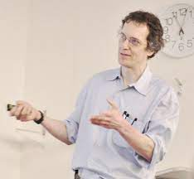
The organizers asked me to suggest some thoughts and open problems on the topic of ``gauge symmetries.''
Huh?
Gauge symmetry is a redundancy, not a symmetry.
Who wants to be redundant?
Maybe I should answer a
different question and just
leave out the word “gauge” …

Slide 3



But we live in a world with gravity…

Slide 4
and the best experts in quantum gravity ensure us that there are no global symmetries either …

Slide 5

NOT

Slide 6
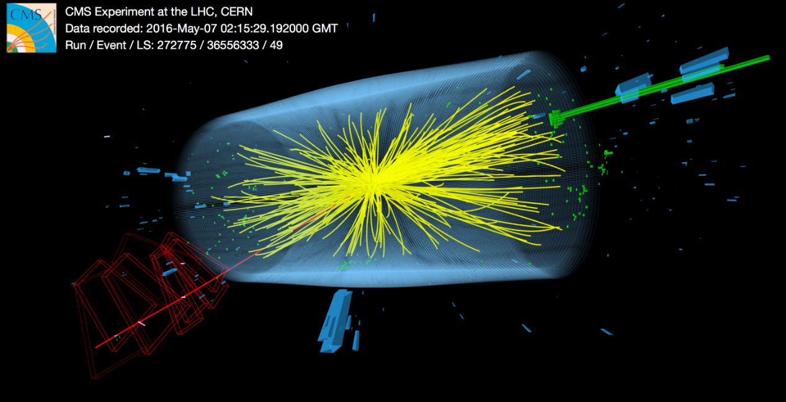


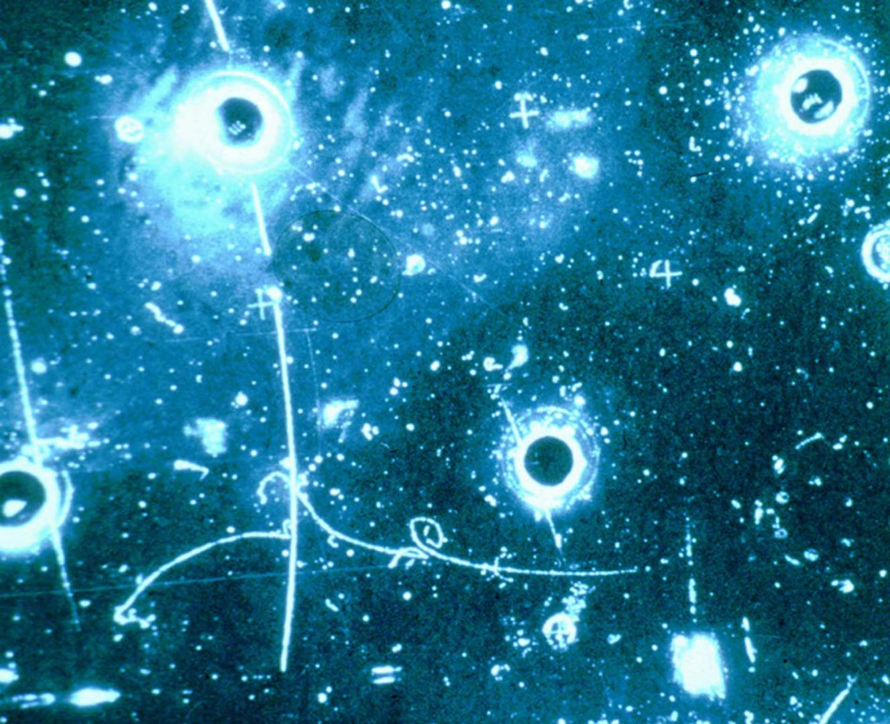
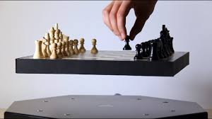
Why are gauge symmetries useful?
Locality in field theory

Slide 7

Intersection theory on moduli spaces of PDE’s
(often associated with a Q-fixed points)
lead to global invariants of manifolds.
These moduli spaces are often stacks, and the automorphisms of objects are important information, that you can only recover from a gauge principle.
Homogeneous coordinates for $ℂℙ^{n}$?
Projective/injective resolutions ?

Slide 8

Traditional Questions
What are the interesting extensions of $Aut(P)$ $×$ $Diff(X)$ in higher dimensions?
What can we say about the topology and geometry of these groups?
What can we say about the representation theory of these groups?

Slide 9
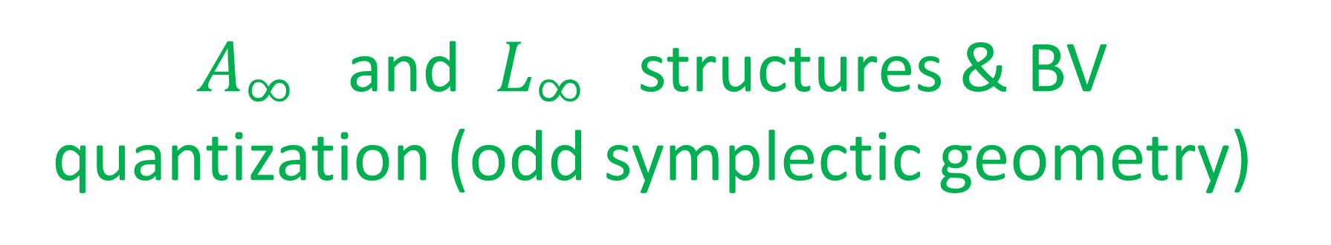
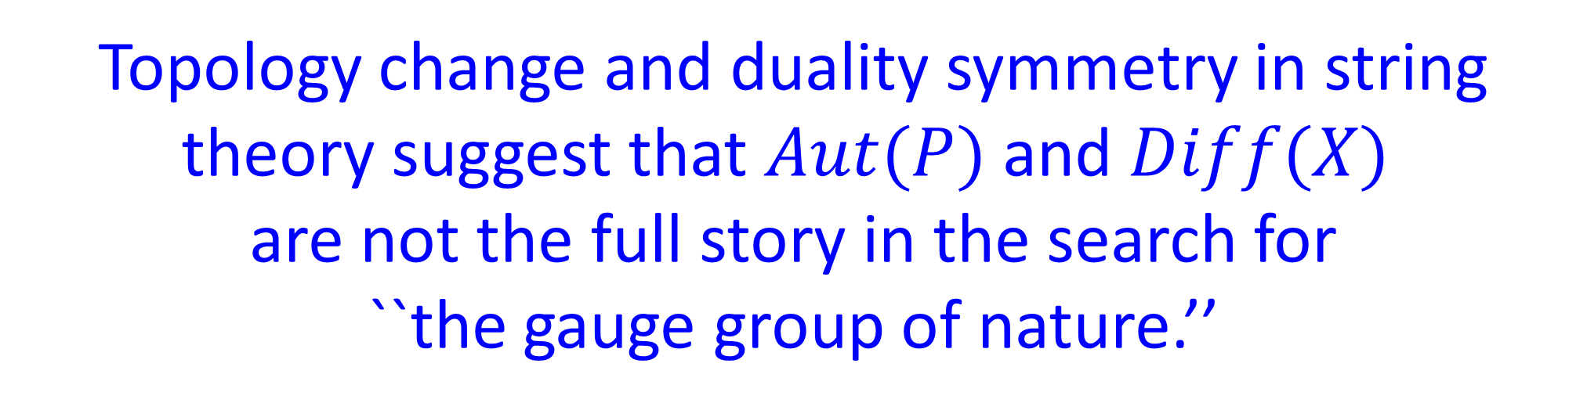
Topology change and duality symmetry in string theory suggest that $Aut(P)$and $Diff(X)$
are not the full story in the search for
``the gauge group of nature.’’
String field theory gives a hint
$A_{∞}$ and $L_{∞}$ structures & BV quantization (odd symplectic geometry)

Slide 10
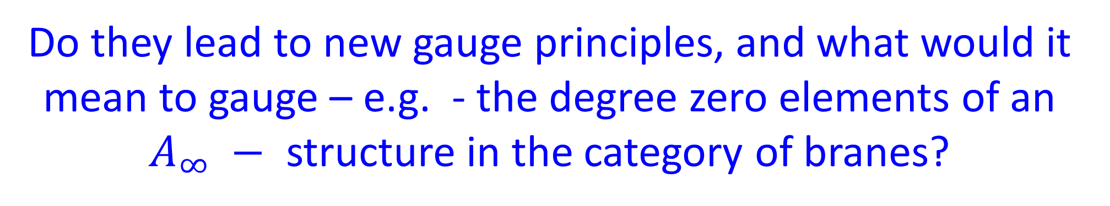
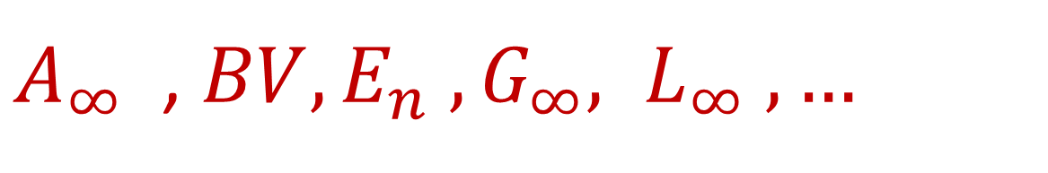
Generalizations Of Symmetry – 1
Homotopical algebra
$A_{∞}$ , $BV,E_{n} , G_{∞}, L_{∞} , …$
has been showing up in various aspects of supersymmetric field theories in diverse dimensions.
Do they lead to new gauge principles, and what would it mean to gauge – e.g. - the degree zero elements of an
$A_{∞} −$ structure in the category of branes?

Slide 11

Generalizations Of Symmetry – 2
p-form gauge theories/symmetries:
Traditional descriptions: $B→B+d Λ$ etc. have limitations.
The language of groupoids is very useful: The gauge fields are objects, the gauge symmetries are invertible morphisms.
Leads to different models for differential cohomologies,
different models have different pros/cons in different situations
e.g. the groupoid of $E_{8}$bundles with connection is a useful model for the M-theory C-field, in some situations.

Slide 12
What Is The Nonabelian 6d (2,0) Theory ?
No known local field theoretic degrees of freedom in the nonabelian case. (And maybe there shouldn’t be.)
``Parallel transport’’ wrt ``nonabelian 2-form gauge potential’’ should be a map of chiral WZW models associated with bordisms between surfaces…
Not flat.
Can a generalized notion of gauge symmetry lead to a local field theoretic description of the nonabelian 6d (2,0) theories?

Slide 13

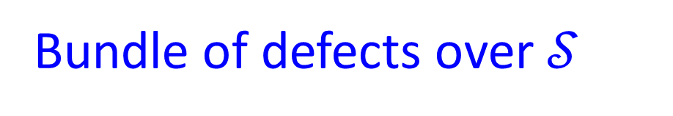
Generalizations Of Symmetry – 3
``Categorical symmetry’’
Suppose we have a family of field theories
with control parameters $𝒮$
2d (2,2) LG models: $𝒮=\{$Kahler metrics} x {Holomorphic Morse superpotentials}
Bundle of defects over $𝒮$
They form a local system

Slide 14

$℘:\left[0,1\right]→𝒮$ $⇒$ $A_{∞}−$functor $𝔽\left(℘\right): 𝔅𝔯\left(𝒯_{1}\right)→𝔅𝔯\left(𝒯_{2}\right)$
$$℘_{1}∼℘_{2} ⇒ 𝔽\left(℘_{1}\right) ∼ 𝔽\left(℘_{2}\right)$$
$$𝔽(℘_{1})∘𝔽\left(℘_{2}\right) ∼𝔽\left(℘_{1}∘℘_{2}\right)$$
Making $𝒮$ the target space of fields we see that $𝔽\left(℘\right)$ describes a defect.
We know how to collide them.

Slide 15
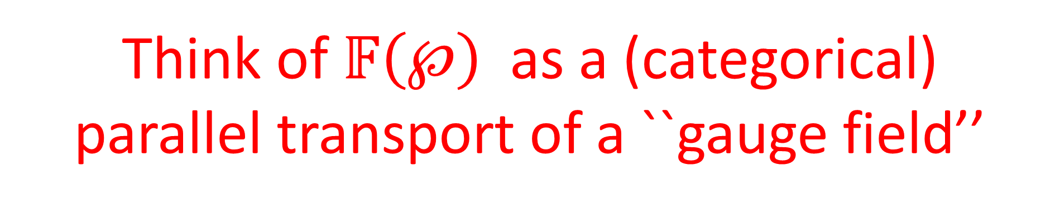
Think of $𝔽\left(℘\right)$ as a (categorical)
parallel transport of a ``gauge field’’
Is the underlying ``gauge principle’’ a valid way of describing ``categorical symmetry’’ ?
What would it mean to gauge a categorical symmetry ?

Slide 16
Generalizations Of Symmetry – 4
Morphisms in a categorical symmetry are not necessarily invertible
So can we describe bordisms of manifolds as
morphisms in a categorical symmetry in gravity?
That would suggest that it is interesting to consider the result of summing over bordisms in a topological field theory.
Indeed, in the past two years the quantum gravity community has been discussing exactly this idea.

Slide 17
REALLY!

Slide 18
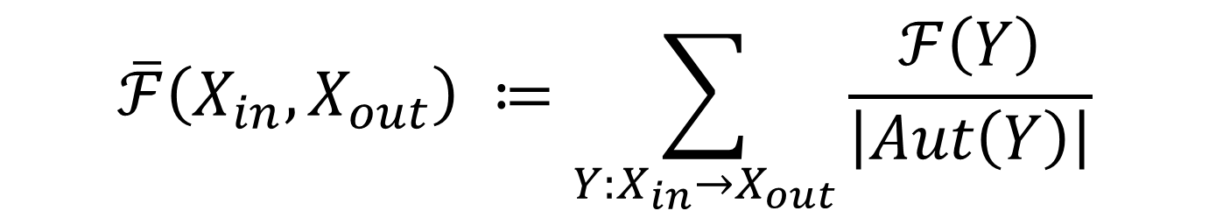
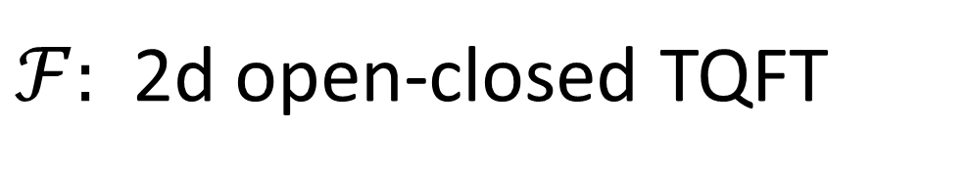
Summing Bordisms In 2d TQFT
$ℱ:$ 2d open-closed TQFT
Describe/investigate/interpret
$$\overline{ℱ}\left(X_{in}, X_{out}\right) ≔\sum_{Y:X_{in}→X_{out}}{\frac{ℱ\left(Y\right)}{\left|Aut\left(Y\right)\right|}}$$
N.B.!! $Y$ need not be connected $⇒$ nontrivial, even in 2d
Maxfield & Marolf; Gardiner & Megas; Anindya Banerjee & GM wip

Slide 19
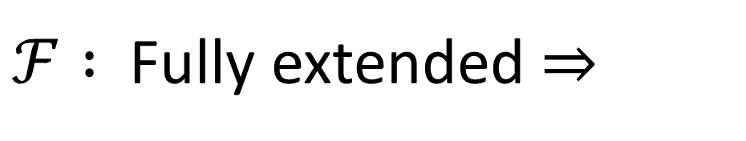
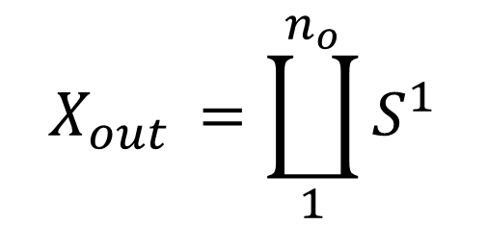
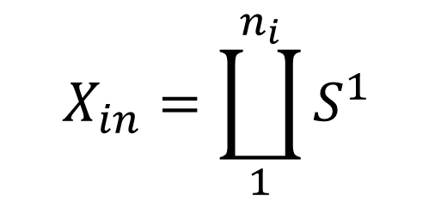

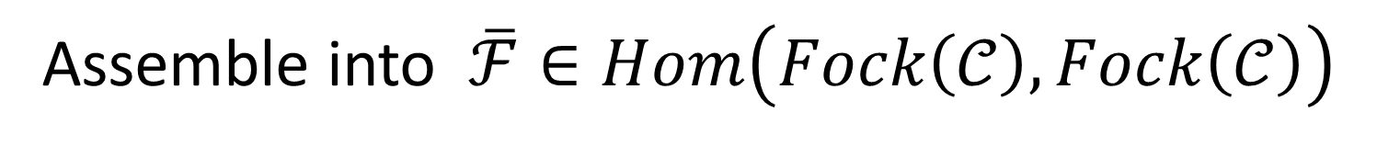
Example
$$X_{in}=\coprod_{1}^{n_{i}}{S^{1}}$$
$$X_{out }=\coprod_{1}^{n_{o}}{S^{1}}$$
$$\overline{ℱ}∈Hom\left(S^{n_{i}}𝒞, S^{n_{o}}𝒞\right)$$
Assemble into $\overline{ℱ}∈Hom\left(Fock\left(𝒞\right), Fock\left(𝒞\right)\right)$
$ℱ :$Fully extended $⇒$
$$\overline{ℱ}=Φ Φ^{∨}$$
$Φ$constructed from a coherent state in the Fock space

