Slide 1
Twisted Equivariant Matter
Gregory Moore, Rutgers University, SCGP, June 12 , 2013
References:
1. D. Freed and G. Moore, Twisted Equivariant Matter, arXiv:1208.5055
2. G. Moore, Quantum Symmetries and K-Theory,
Lecture Notes, Home page: Talk 44

Slide 2
Prologue & Apologia
A few years ago, Dan Freed and I were quite intrigued by the papers of
Kitaev; Fu, Kane & Mele; Balents & J.E. Moore; Furusaki, Ludwig, Ryu & Schnyder; Roy; Stone, et. al. relating classification of topological phases of matter to K-theory.
So, we spent some time struggling to understand what these papers had to say to us, and then we wrote our own version of this story. That paper is the subject of today’s talk.
I’ll be explaining things that you all probably know, but in a language which is perhaps somewhat unusual.
This is perhaps not a completely silly exercise because the new language suggests interesting (?) questions which might not otherwise have been asked.

Slide 3
Main goal for today:
Give some inkling of how classification of topological phases can be made equivariant wrt physical symmetries, just using basic axioms of quantum mechanics.
and in particular for free fermions how one is led to twisted equivariant K-theory.

Slide 4
Physical Motivations -1
Topological phases = connected components of continuous families of gapped nonrelativistic QM systems
Restrict to physical systems with a symmetry group G and look at continuous families of systems with G-symmetry: We get a refined picture

Slide 5
Physical Motivations - 2
Suppose we have a (magnetic) crystallographic group:
In band structure theory one wants to say how the (magnetic) point group P acts on the Bloch wavefunctions. But this can involve tricky phases. If P(k) is a subgroup of P which fixes k how are the phase-choices related for different P(k₁) and P(k₂)?
Textbooks deal with this in an ad hoc and unsatisfactory (to me) way.
The theory of twistings of K-theory provides a systematic approach to that problem.

Slide 6
1
Introduction
2
Review of symmetry in quantum mechanics
3
Gapped systems and (reduced) topological phases
4
Equivariant twisted K-theory of a point
5
Finite-dimensional systems and the 10 CT-groups
6
Digression: Dyson’s 3-fold way and Altland-Zirnbauer
7
Bloch Theory
8
Equivariant twisted K-theory of a groupoid.
9
Back to Bloch

Slide 7


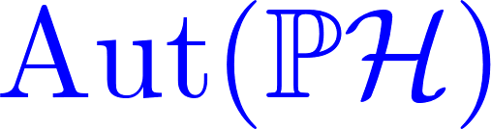
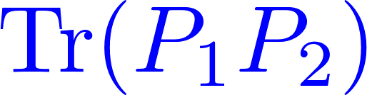


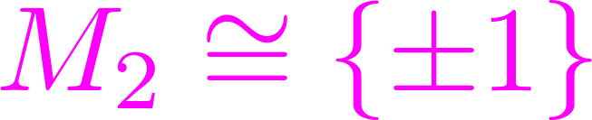
Symmetry in Quantum Mechanics: Wigner’s Theorem
Complex Hilbert space
Pure states: Rank one projectors
Automorphisms preserving quantum overlaps
Wigner’s Theorem:
Two components: unitary & antiunitary

Slide 8






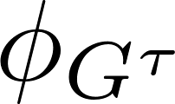
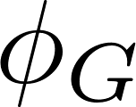
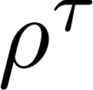

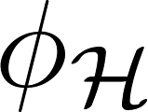
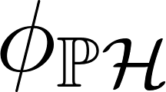
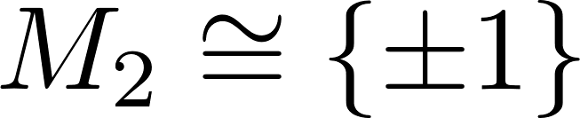
Symmetry Group G of the Quantum State Space

Slide 9
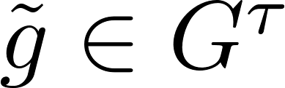
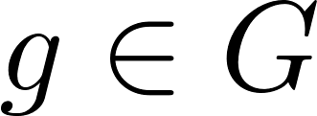
Lighten Up!
We need to lighten the notation.
denotes a lift of g (there are many: torsor for U(1) )
So, just denote all four homomorphisms by ; distinguish by context.

Slide 10

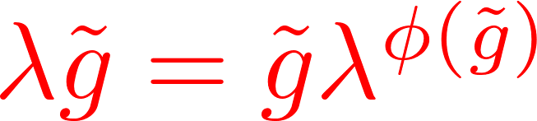
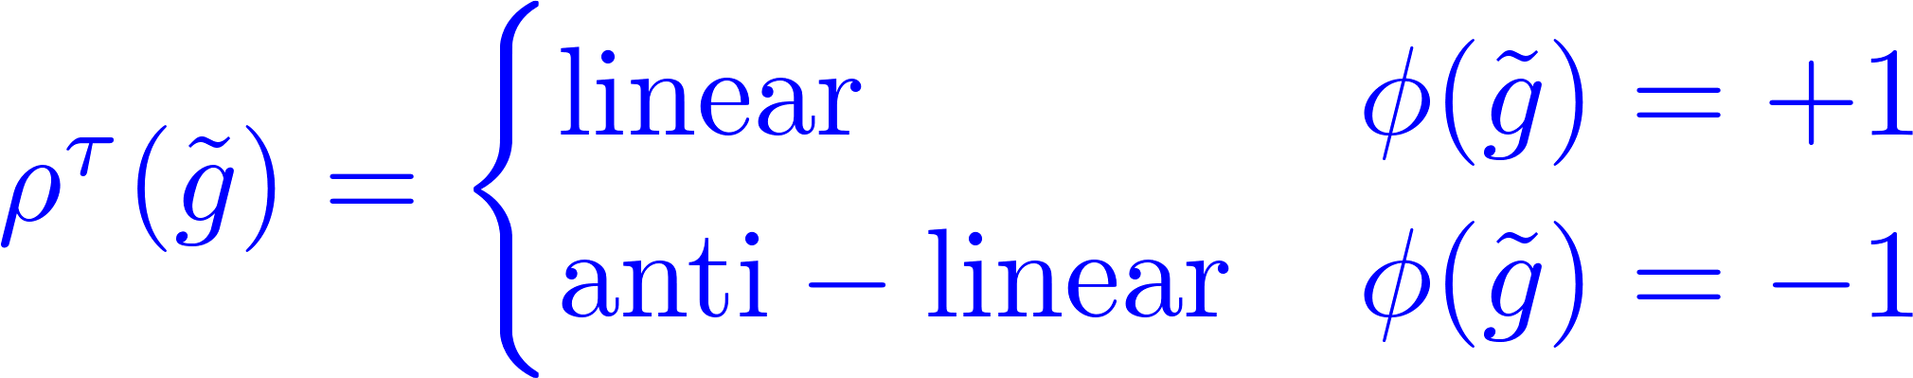
-Twisted Extension
So define abstract notion of a -twisted extension of a Z₂-graded group
Wigner: Given a quantum symmetry group G of the states we get a
-twisted extension of G with a ``-twisted representation’’

Slide 11
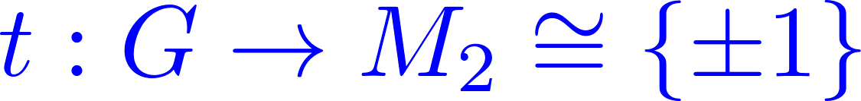
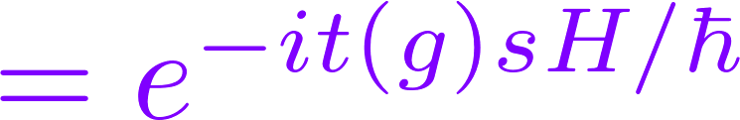
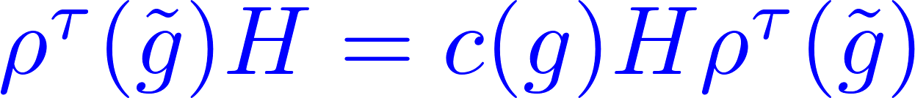
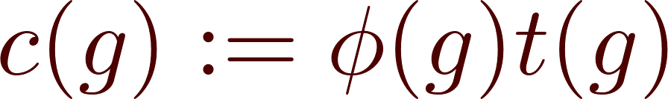
Symmetry of the Dynamics
If the physical system has a notion of time-orientation, then a physical symmetry group has a homomorphism
Time-translationally invariant systems have unitary evolution: U(s). Then G is a symmetry of the dynamics if:

Slide 12
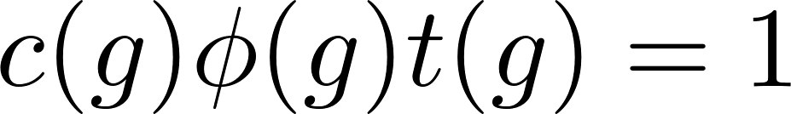
Dynamics - Remarks
Which one is dependent on the other two depends on what problem you are solving.
If c(g) = -1 for any group element then Spec(H) is symmetric around zero
So, if H is bounded below and not above
(as in typical relativistic QFT examples)
then c=1 and =t (as is usually assumed).

Slide 13
1
Introduction
2
Review of symmetry in quantum mechanics
3
Gapped systems and (reduced) topological phases
4
Equivariant twisted K-theory of a point
5
Finite-dimensional systems and the 10 CT-groups
6
Digression: Dyson’s 3-fold way and Altland-Zirnbauer
7
Bloch Theory
8
Equivariant twisted K-theory of a groupoid.
9
Back to Bloch

Slide 14
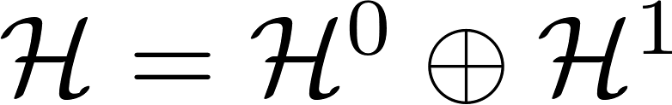
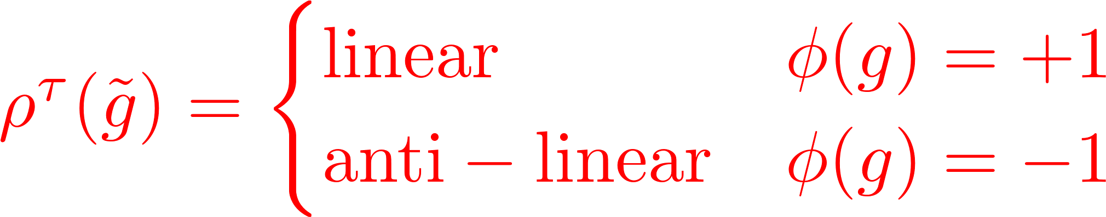
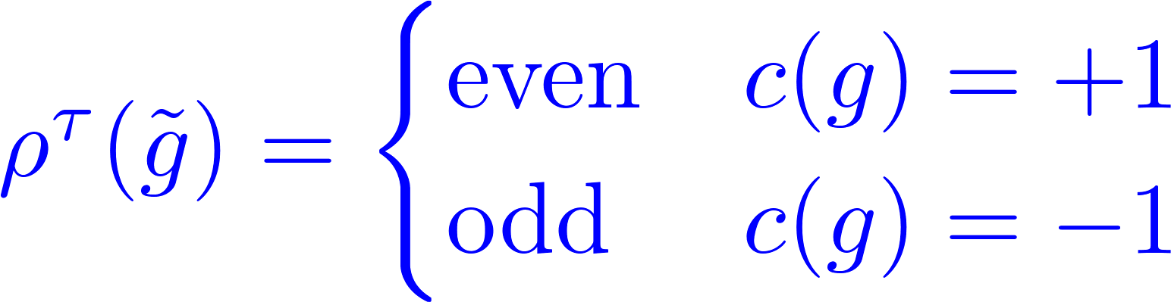
Gapped Systems
Definition: A QM system is gapped if 0 is in the resolvent set of H, i.e. 1/H exists and is a bounded operator.
Remark: In this case the Hilbert space is Z₂-graded by sign(H):
E < 0
E > 0
So, if G is a symmetry of a gapped quantum system we get a -twisted extension with:

Slide 15
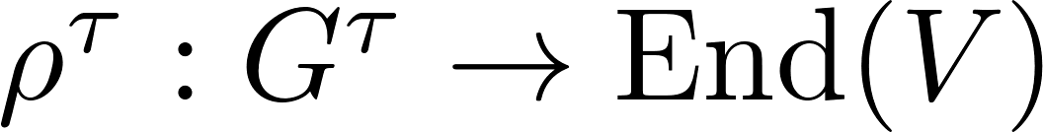
(, , c)-Twisted Representation of G
Again, this motivates an abstract definition:
Definition: A (, ,c)-twisted Representation of G is:
1. A -twisted extension:
2. Together with a Z₂-graded vector space V and a homomorphism

Slide 16
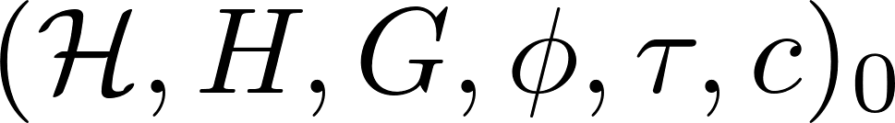
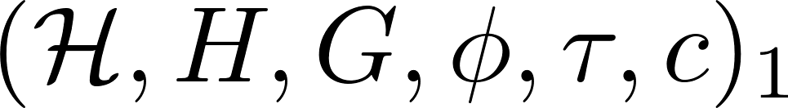

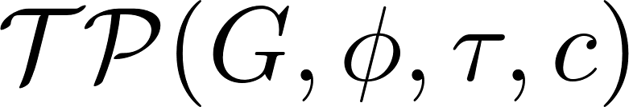
Continuous Families of Quantum Systems with Symmetry
Define isomorphic quantum systems with symmetry type (G, , ,c)
Define notion of a continuous family of gapped quantum systems with symmetry type (G, , , c)
if there is a continuous family parametrized by [0,1] with end-systems isomorphic to systems 0 & 1.
Set of homotopy classes of gapped systems with symmetry type (G, , , c)

Slide 17
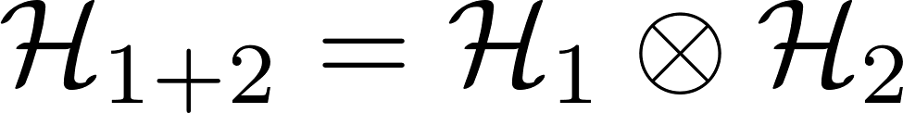

Algebraic Structure -1
In general the only algebraic structure is given by combination of systems with the same symmetry type.
Not much explored….
…. might not be that interesting …

Slide 18
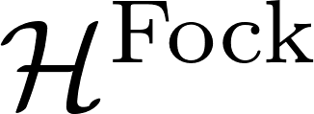

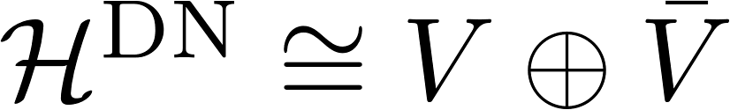
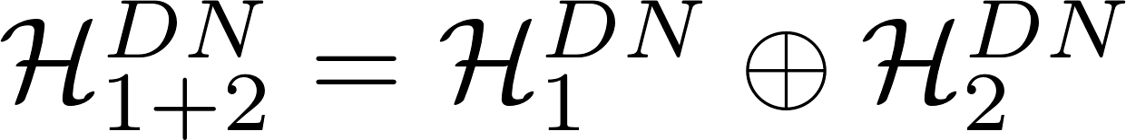
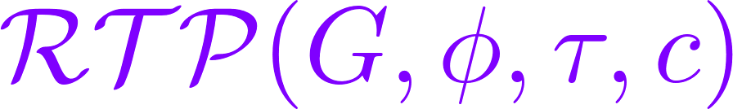
Algebraic Structure: Free Fermions
Monoid structure:
Now define ``Free fermions with a symmetry’’
``Group completion’’ or ``quotient’’ by a suitable notion of ``topologically trivial systems’’
Abelian group
Under special assumptions about the symmetry type (G,,,c) RTP can be identified with a twisted K-theory group.

Slide 19
1
Introduction
2
Review of symmetry in quantum mechanics
3
Gapped systems and (reduced) topological phases
4
Equivariant twisted K-theory of a point
5
Finite-dimensional systems and the 10 CT-groups
6
Digression: Dyson’s 3-fold way and Altland-Zirnbauer
7
Bloch Theory
8
Equivariant twisted K-theory of a groupoid.
9
Back to Bloch

Slide 20
Equivariant K-theory of a Point
Now let G be compact Lie group. (It could be a finite group.)
K_{G}(pt) is the representation ring of G. It can be defined in two ways:
Group completion of the monoid of finite-dimensional complex representations.
Typical element: R₁ – R₂, with R₁,R₂, finite-dimensional representations on complex vector spaces.
Rep_{s}(G): Z₂-graded fin. dim. cplx reps (with even G-action);
Triv_{s}(G) : Those with an odd automorphism P: P(g) = (g) P.

Slide 21

Twisting Equivariant K-theory of a point
There are very sophisticated viewpoints in terms of ``nontrivial bundles of spectra’’ … but here twisting just amounts to changing some signs and phases in various defining equations.
We’ll get a little more sophisticated later.
Preserve associativity:
● Is a 2-cocycle

Slide 22
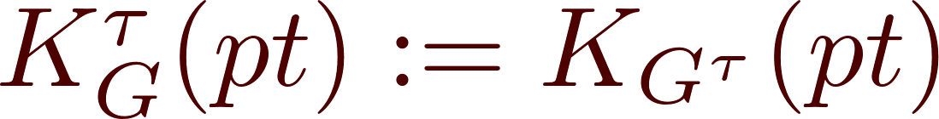
An example of a ``twisting of the equivariant K-theory of a point’’ is just an isomorphism class of a central extension of G
Now we can form a monoid of twisted representations
(= projective representations of G = representations of G) and group complete or divide by the monoid of trivial representations to get an abelian group:

Slide 23
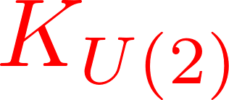

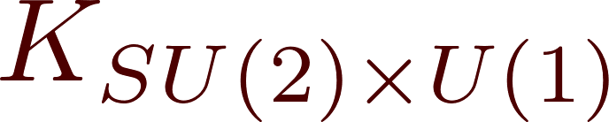

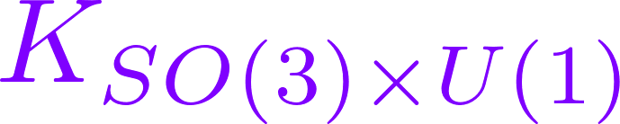
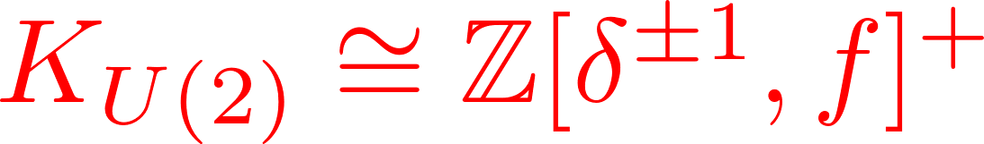
Example
Consider a 2-dimensional Hilbert space H = C²

Slide 24

Adding the other ingredients we saw from the general realization of symmetry in gapped quantum mechanics gives new twistings:
-twisted extension
``Pairing of
particles and
holes”
``Trivial”

Slide 25
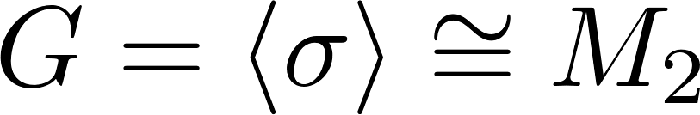
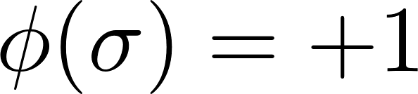
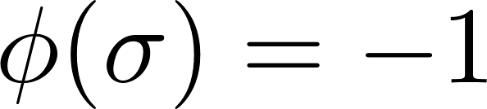
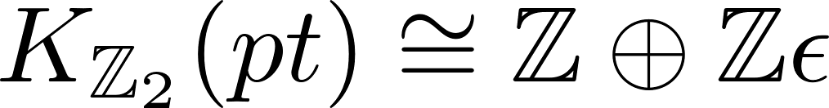
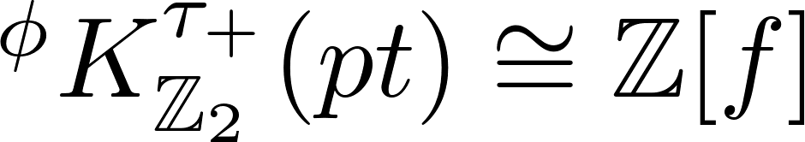
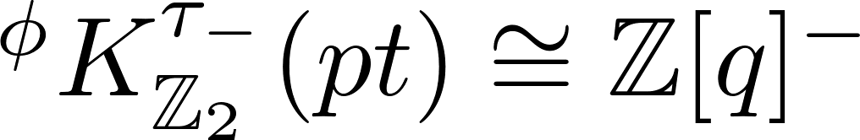
Example
Sign rep.
Real rep f = R²
H-rep. q=H, odd powers

Slide 26
1
Introduction
2
Review of symmetry in quantum mechanics
3
Gapped systems and (reduced) topological phases
4
Equivariant twisted K-theory of a point
5
Finite-dimensional systems and the 10 CT-groups
6
Digression: Dyson’s 3-fold way and Altland-Zirnbauer
7
Bloch Theory
8
Equivariant twisted K-theory of a groupoid.
9
Back to Bloch

Slide 27
Finite-Dimensional Systems
Continue to take G to be a compact group.
Restrict to finite-dimensional Hilbert space H
Proof: 1. Homotope H to H² = 1 & (twisted) reps of compact groups are discrete.
For RTP: Use monoid structure provided by free fermions:
With a suitable notion of ``trivial system’’ – perhaps justified by ``pairing of particles and holes’’ we obtain:

Slide 28
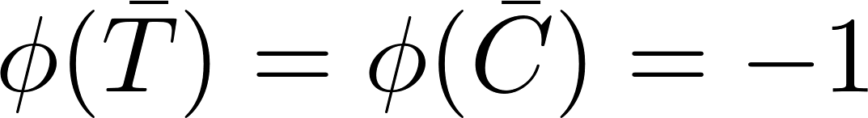
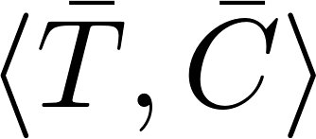
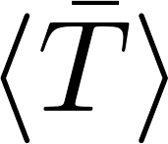
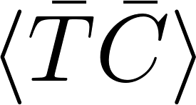
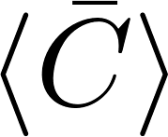
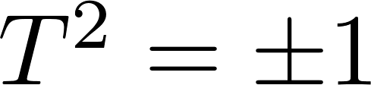
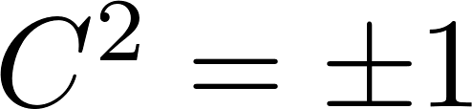
The 10 CT-groups
5 subgroups:
There are 10 possible -twisted extensions. They are determined by whether the lifts T,C satisfy:
and/or

Slide 29
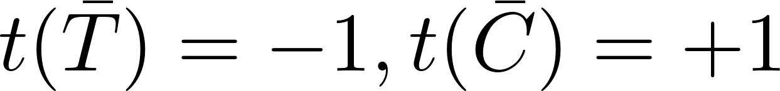
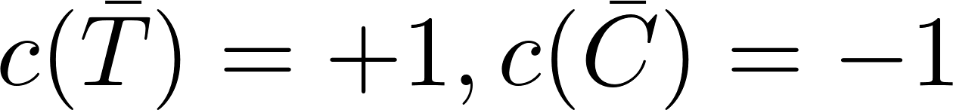
Theorem: The category of (A, , , c)-twisted representations, where A is a subgroup of M_{2,2} , is equivalent to the category of modules of real or complex Clifford algebras.
Various versions of this statement have appeared in Kitaev; Ludwig et. al.; Fidkowski & Kitaev; Freed & Moore
It is also related to the Altland-Zirnbauer-Heinzner-Huckleberry solution of the free fermion Dyson problem. (See below.)

Slide 30


Relation to standard K-theories
There is in turn a relation between twistings of K-theories, central simple superalgebras, and simple degree shift of K-groups, so that in the very special case where

Slide 31
1
Introduction
2
Review of symmetry in quantum mechanics
3
Gapped systems and (reduced) topological phases
4
Equivariant twisted K-theory of a point
5
Finite-dimensional systems and the 10 CT-groups
6
Digression: Dyson’s 3-fold way and Altland-Zirnbauer
7
Bloch Theory
8
Equivariant twisted K-theory of a groupoid.
9
Back to Bloch

Slide 32


Digression: Dyson’s 3-fold way
Dyson’s Problem: Given a symmetry type (G,,) with c=1 and
H, what is the ensemble of commuting Hamiltonians?
Schur’s lemma for irreducible -twisted representations: Z(H) is a real associative division algebra.
Frobenius theorem: There are three real associative division algebras R,C,H.

Slide 33

Generalizes to 10-fold way
Given a symmetry type (G,,,c) and H, what is the ensemble of graded-commuting Hamiltonians?
Schur’s lemma for irreducible (,,c)-twisted representations: Z_{s}(H) is a real associative super-division algebra.
Theorem (Wall, Deligne): There are ten real associative super-division algebras:

Slide 34
1
Introduction
2
Review of symmetry in quantum mechanics
3
Gapped systems and (reduced) topological phases
4
Equivariant twisted K-theory of a point
5
Finite-dimensional systems and the 10 CT-groups
6
Digression: Dyson’s 3-fold way and Altland-Zirnbauer
7
Bloch Theory
8
Equivariant twisted K-theory of a groupoid.
9
Back to Bloch

Slide 35

Noncompact groups?
When we generalize to noncompact groups and infinite-dimensional Hilbert spaces there are many possibilities.
One physically important case is where we consider a crystal
A set of points C with atoms, spins or currents invariant under translation by a rank d lattice . Then C is invariant under the magnetic crystallographic group. So there is an extension:
P  O(d) x Z₂ is a finite group: ``Magnetic point group’’
There are still too many possibilities for (,) to say something about
TP (,) so we narrow it down using some more physics.

Slide 36



Bloch Theory -1
Single electron approximation:
W is a finite dimensional vector space. e.g. for internal spin:
The Schrödinger operator H is invariant under G(C)

Slide 37
Bloch Theory -2
Now, because G(C) is a symmetry of the quantum system the Hilbert space H is a (,,c)-twisted representation of G(C) for some (,,c).
G(C) acts on Hilbert space H
For simplicity assume  acts without central extension
(i.e. no magnetic field).

Slide 38



Bloch Theory -3
Now reinterpret H as the Hilbert space of sections of a twisted equivariant Hilbert bundle over the Brillouin torus.
Brillouin torus; Irreps of 

Slide 39







Bloch Theory - 4
Dual torus
Poincare line bundle:
Sections of L are equivalent to -equivariant functions:

Slide 40




Insulators
The Hamiltonian H defines a continuous family of self-adjoint operators on E . This gives the usual band structure:
E_{f}
In an insulator there wil be a gap, hence an energy E_{f} so that we have a direct sum of Hilbert bundles:

Slide 41
Equivariant Insulators: Two Cases
E⁻ and E⁺ are finite and infinite-dimensional Hilbert bundles over T*, respectively.
For some purposes it is useful to focus on a finite number of bands above the Fermi level and make E⁺ a finite-dimensional bundle.
Thus, there are two cases: E⁺ has finite or infinite dimension.
Through the Fourier transform to Bloch waves this translates into E⁻ and E⁺ being
``twisted equivariant bundles over the groupoid T*//P ‘’ .
We next spend the next 10 slides explaining this terminology.

Slide 42
1
Introduction
2
Review of symmetry in quantum mechanics
3
Gapped systems and (reduced) topological phases
4
Equivariant twisted K-theory of a point
5
Finite-dimensional systems and the 10 CT-groups
6
Digression: Dyson’s 3-fold way and Altland-Zirnbauer
7
Bloch Theory
8
Equivariant twisted K-theory of a groupoid.
9
Back to Bloch

Slide 43




Groups As Categories
Now we want to give a geometrical interpretation to (,,c)-twisted representations of G.
Suppose G is a group, and think of it as acting on a point:
(Two points are identified)
Therefore, we have a category:
One object:
Morphisms are group elements
Axioms of a category are equivalent to existence of identity and associativity.
(This is a special category because all morphisms are invertible.)

Slide 44
Central Extensions as Line Bundles
Now, for every group element g we give a complex line L_{g}, together with a product law:
Require associativity:
This defines a line bundle over the space of morphisms with a product law. Then G is the associated principal U(1) bundle over G.

Slide 45

-Twisted Extensions
For a complex vector space V define notation:
Now each arrow, g, has (g) = ± 1 attached and we modify the product law to
Require associativity:

Slide 46

(,,c)-twisted representations, again
First we use the homomorphism c: G  M₂ to give a
Z₂-grading to the lines L_{g}.
A (,,c)-twisted representation is a Z₂-graded vector space V (“vector bundle over a point”) together with a C-linear and even isomorphism:

Slide 47





Groupoids
Definition: A groupoid G is a category all of whose morphisms are invertible
Points = objects are now NOT identified.
Example: Group G acts on a topological space X.
Objects = X, Morphisms = X x G. Groupoid denoted G=X//G

Slide 48








Composable Morphisms
{(f₁,f₂): end(f₁)=beg(f₂)}
{(f₁,f₂,f₃): end(f_{i})=beg(f_{i+1})}
etc.

Slide 49



Twisting K-theory of a groupoid
Homomorphism of a groupoid G M₂:
Definition: Let G be a groupoid with homomorphisms
,c: G M₂. A (,c)-twisting of the K-theory of G is:
a.) A collection of Z₂-graded complex lines L_{f},  f G₁, Z₂-graded by c(f).
b.) A collection of C-linear, even, isomorphisms (data on G₂):
c.) Satisfying the associativity (cocycle) condition (on G₃)

Slide 50
Remarks
We define a twisting of K-theory of G before defining the K-theory!
We will think of twistings of T*// P as defining a symmetry class of the band structure problem.
These twistings have a nice generalization to a class of geometrical twistings given by bundles of central simple superalgebras and invertible bimodules.
Isomorphism classes of such twistings, for G = X//G are given, as a set, by
(There are yet more general twistings,….)

Slide 51



Definition of a (, , c)-twisted bundle
a.) A complex Z₂-graded bundle over G_{0.}
b.) A collection of C-linear, even isomorphisms over G_{1.}
c.) Compatibility (gluing) condition on G_{2.}

Slide 52

Definition of twisted K-theory on a groupoid
Isomorphism classes of -twisted bundles form a monoid Vect(G) under .
Triv(G) is the submonoid of bundles with an odd automorphism P: V  V
is a generalization of equivariant KR-theory with twistings and groupoids.
For X=pt recover previous description.

Slide 53
1
Introduction
2
Review of symmetry in quantum mechanics
3
Gapped systems and (reduced) topological phases
4
Equivariant twisted K-theory of a point
5
Finite-dimensional systems and the 10 CT-groups
6
Digression: Dyson’s 3-fold way and Altland-Zirnbauer
7
Bloch Theory
8
Equivariant twisted K-theory of a groupoid.
9
Back to Bloch

Slide 54




Back to Bloch
The magnetic point group P acts on H to define a twisted equivariant bundle over T* with a canonical twisting _{can}
E⁺ FINITE
E⁺ INFINITE
projects onto:

Slide 55







Relation to more standard K-groups
Take E⁺ to be infinite-dimensional, and assume:

Slide 56








Cases studied in the literature
Turner, et. al.
Kane, et. al.
Remark: Kane-Mele and Chern-Simons invariants descend to RTP and are equal. KO invariant refines Kane-Mele invt.

Slide 57



Example: Diamond Structure
Localization:
8 Fixed Points under k  - k
  Orbit of 4 L-points  Orbit of 3 X-points

Slide 58




A K-theory invariant which is an element of

Slide 59
Things To Do
Compute the canonical twisting and the equivariant K-groups for more elaborate (nonsymmorphic) magnetic crystallographic groups.
Relate K-theory invariants to edge-phenomena and entanglement spectra.
Are there materials which realize twistings other than the canonical twisting? They would have to be exotic.

