Slide 1
Two Projects Using
Lattices, Modular Forms,
String Theory & K3 Surfaces
Gregory Moore
SCGP Workshop
Automorphic forms, mock modular forms and string theory
August 31, 2016

Slide 2
Desperately Seeking Moonshine
Part I
a project with Jeff Harvey
still in progress…

Slide 3
Part II
Holography & Zamolochikov Volumes Of Moduli Spaces of Calabi-Yau Manifolds
Time permitting ……
G. Moore, ``Computation Of Some Zamolodchikov Volumes, With An Application,’’ arXiv:1508.05612

Slide 4

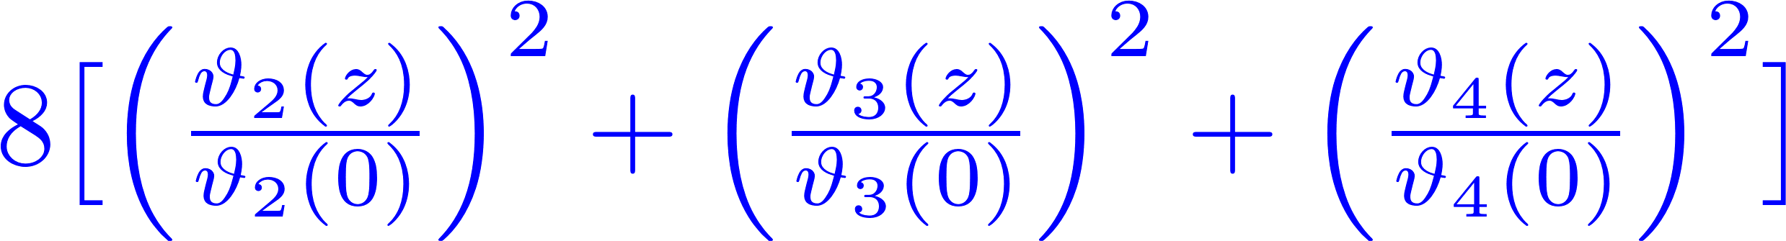
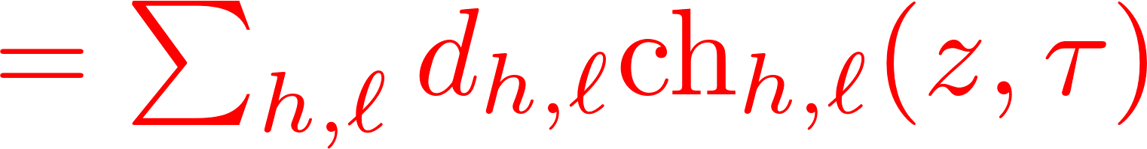
Motivation (For Part I) -1/2
Search for a conceptual explanation of
Mathieu Moonshine phenomena.
Eguchi, Ooguri, Tachikawa 2010

Slide 5
Motivation – 2/2
Dimensions of irreps of the sporadic finite simple group M24 !
But there is no known analog of the FLM construction.
Proposal: It is related to the ``algebra of BPS states.''
Something like: M24 is a distinguished group of
automorphisms of the algebra of spacetime BPS states in some string compactification using K3.

Slide 6
String-Math, 2014
Today’s story begins in Edmonton, June 11, 2014. Sheldon Katz was giving a talk on his work with Albrecht Klemm and Rahul Pandharipande
He was describing how to count BPS states for type II strings on a K3 surface taking into account the
so(4) = su(2) + su(2) quantum numbers of a particle in six dimensions.
(O(4) is the automorphism group of the orthogonal to M^{1,1}
in six-dimensional Minkowski space. )
Slide # 86 said ….

Slide 7
Notes:
at which point I opened my big mouth and
pointed out that 231 is the dimension of an
irreducible representation of M24 – and indeed KKP checked that the first few degeneracies can be written nicely as sums of dimensions of irreps. Now Shamit gave his take on this, based on a paper he wrote with Miranda Cheng, John Duncan, and Sarah Harrison.

Slide 8
Heterotic/Type II Duality
Het/T4 = IIA/K3
Dabholkar-Harvey states: Perturbative heterotic BPS states
D4-D2-D0 boundstates
Roughly: Cohomology groups of the moduli spaces of objects in D^{b}(K3) with fixed K-theory invariant and stable wrt a stability condition determined by a complexified Kahler class.

Slide 9

Heterotic Toroidal Compactifications
Narain moduli space of CFT’s:

Slide 10
We pause for a small advertisement

Slide 11

Algebra Of BPS States -1/2
DH/Perturbative BPS States
SYM ground state at rest
Dimension one Virasoro primary
Vector space of DH states is graded by
Mutually local dimension one Virasoro primaries form a Lie algebra:

Slide 12

Algebra Of BPS States -2/2
Problem: V_{L}(P₁) and V_{L}(P₂) for Narain vectors P₁ and P₂ are in general not mutually local.
Solution: Choose a spatial direction. There are unique boosts along this direction so that
Observe: For the boosted vertex operators there is a term in the OPE:
V₁*V₂ is the product in the algebra of BPS states.

Slide 13
End of advertisement

Slide 14
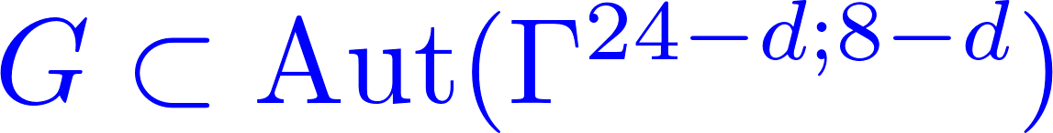



Crystal Symmetries Of Toroidal Compactifications
Construct some heterotic string compactifications with large interesting crystallographic group symmetries.
Then G is a crystal symmetry of the CFT:
Example: Weyl group symmetries of enhanced YM gauge theories.
These are NOT the kinds of crystal symmetries we want

Slide 15

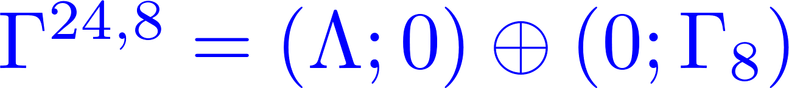

Conway Subgroup Symmetries
Start with a distinguished d=0 compactification:
Crystal symmetry:
Note that Co₀ is not a Weyl group symmetry of any enhanced Yang-Mills gauge symmetry.
Now ``decompactify’’

Slide 16


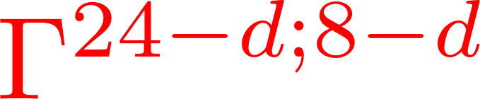
A Lattice Lemmino
Primitively embedded.
Isometric of rank d.
&
Then there exists embedded even unimodular lattice
such that, if
has crystal symmetry

Slide 17
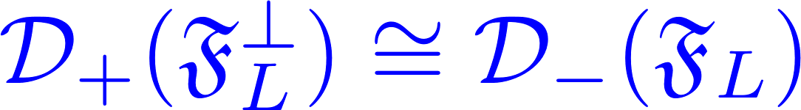

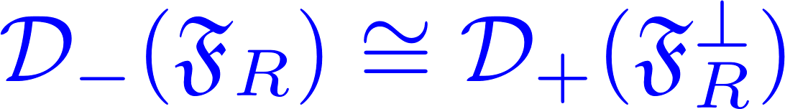
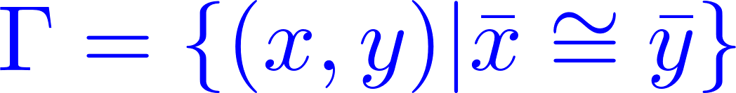
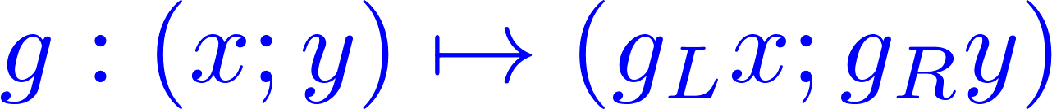


Easy Proof
Uses standard ideas of lattice theory.

Slide 18
CSS Compactifications
This construction defines points of moduli space with
Conway Subgroup Symmetry:
call these CSS compactifications.
What crystal symmetries can you get?
In general, a sublattice preserves none of the
crystal symmetries of the ambient lattice.
Consider, e.g., the lattice generated by (p,q) in the square lattice in the plane.

Slide 19
Fixed Sublattices Of The Leech Lattice
The culmination of a long line of work is the classification by Hohn and Mason of the 290 isomorphism classes of fixed-point sublattices of the Leech lattice:

Slide 20
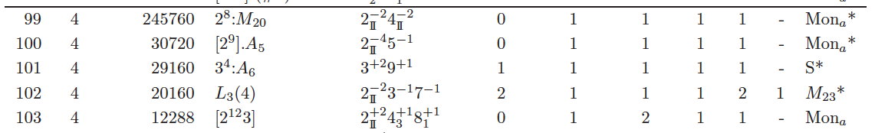
Symmetries For Het/T4
These discrete groups will be automorphisms of the algebra of BPS states at the CSS points.
Het/II duality implies the space of D4D2D0 BPS states on K3 will naturally be in representations of these subgroups of Co₀ .

Slide 21

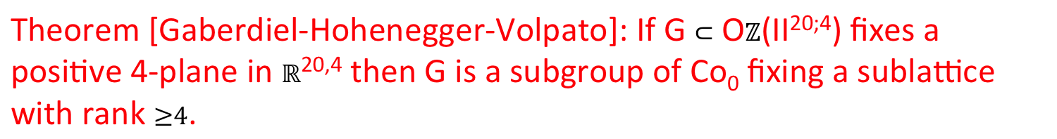
Symmetries Of IIA/K3
Theorem [Gaberdiel-Hohenegger-Volpato]: If G $⊂$ O$ℤ$(II^{20;4}) fixes a positive 4-plane in $ℝ$^{20,4} then G is a subgroup of Co₀ fixing a sublattice with rank $≥4$.
Remark 1: GHV theorem classifies possible symmetries of sigma models with K3 target.
Remark 2: GHV generalize the arguments in Kondo’s paper proving Mukai’s theorem that the symplectic automorphisms of K3 are subgroups of M23 with at least 5 orbits on $Ω$
Interpreted by Huybrechts in terms of the bounded derived category of K3 surfaces
Notes:
So: we should think of GHV as the ``quantum Mukai theorem’’

Slide 22
But Is There Moonshine In KKP Invariants?
So the invariants of KKP will show ``Moonshine’’ with respect to this symmetry……
But this is a little silly: All these groups are subgroups of O(20). If we do not look at more structure (such as the detailed lattice of momenta/characteristic classes) we might as well consider the degeneracies as O(20) representations.

Slide 23
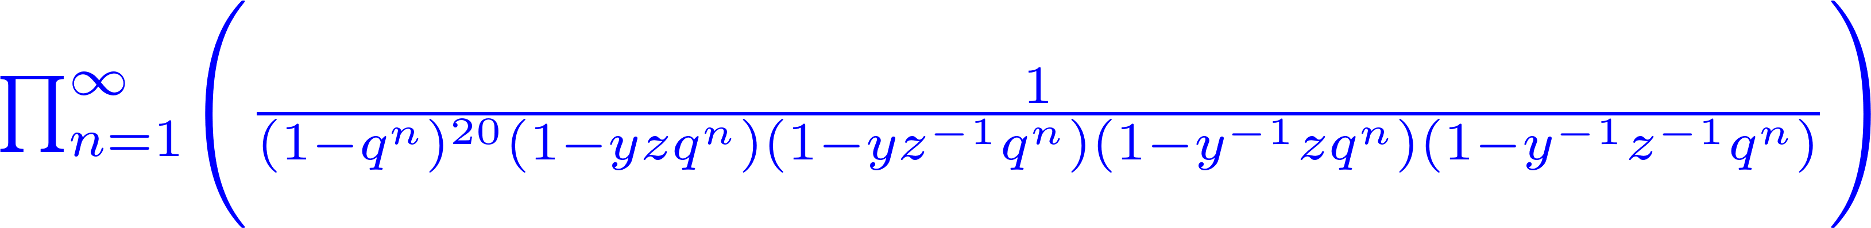

Silly Moonshine
is just the SO(4) character of a Fock space of 24 bosons.
All the above crystal groups are subgroups of O(20) so the ``Moonshine’’ wrt those groups is a triviality.
IS THERE MORE GOING ON ??

Slide 24
We now make an
instructive digression….

Slide 25

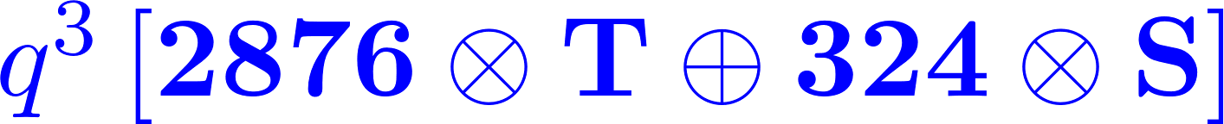



Baby Case: CSS Compact’s For T7 & d=1
Decompose partition function of BPS states wrt reps of transverse rotation group O(1)
Degeneracies of T and S dutifully decompose nicely as representions of Co₂:
That’s trivial because Co₂ $⊂$ O(23)
But is there a Co₀ x O(1) symmetry? Co₀ is NOT a subgroup of O(23).
Co₀ x O(1) symmetry CANNOT come from a linear action on V₂₄.

Slide 26


The SumDimension Game
ETC.

Slide 27
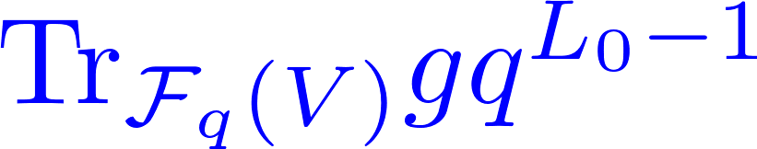
Defining Moonshine
Any such decomposition defines the massive states of F_{q}(V) as a representation of Co₀ x O(1).
Problem: There are infinitely many such decompositions!
What physical principle distinguishes which, if any, are ``interesting’’ ?
Definition: You have committed Moonshine (for d=1) if you exhibit the massive sector of F_{q}(V) as a representation of
Co₀ x O(1)such that the graded character of any element g:
is a modular form for $Γ$₀(m) where m = order of g .

Slide 28
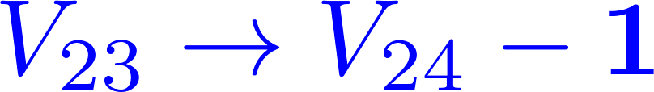
Virtual Representations
Most candidate Co₀ x O(1) representations will fail to be modular.
But if we allow virtual reps modularity is easy:
The characters are guaranteed to be modular!
But massive levels will in general be virtual representations, not true representations.

Slide 29
But, There Can Be Magic …
If the negative representations cancel for ALL the massive levels then there is in fact a modular invariant solution to the SumDimension game.
In fact, the negative representations of Co₀ x O(1) do indeed cancel and ALL the massive levels are in fact true representations!!
Even though there is no linear representation of
Co₀ x O(1) on the 24 bosons that gives the above degeneracies !!

Slide 30


But! The same argument
also shows they are
also true representations
of O(24) x O(1).

Slide 31
Lessons From Digression
Modularity of characters distinguishes solutions of SumDimension game.
Virtual Fock spaces are modular.
There can be nontrivial cancellation of the negative representations leading to a modular solution of the SumDimension game.
But, a ``mysterious’’ discrete symmetry can sometimes simply be a subgroup of a more easily understood continuous symmetry.

Slide 32
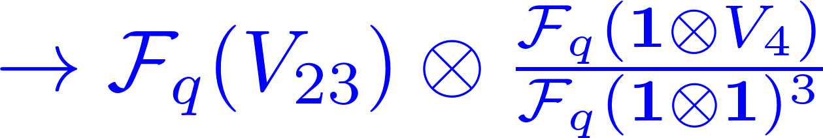
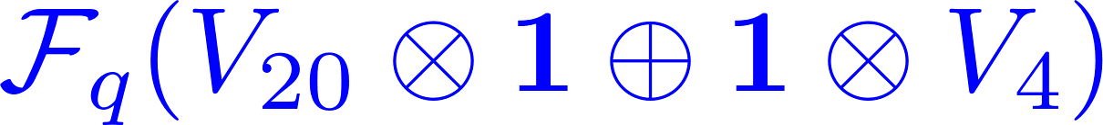

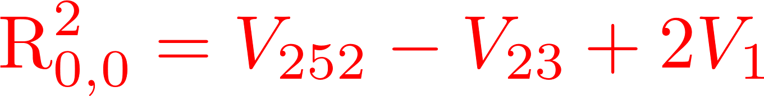
What About d=4 ?
Magical positivity fails:
But we are desperately seeking Moonshine...
So we ask: Could it still be that, magically, some positive combination of representations from the SumDimension game is nevertheless modular?

Slide 33
So we played the sum dimension game in
all possible ways for lowest levels –
the possibilities rapidly proliferate….
For each such decomposition we calculated the graded character of involutions 2A and 2B in M24
The resulting polynomial in q is supposed to be the leading terms of SOME modular form of SOME weight with SOME multiplier system….

Slide 34
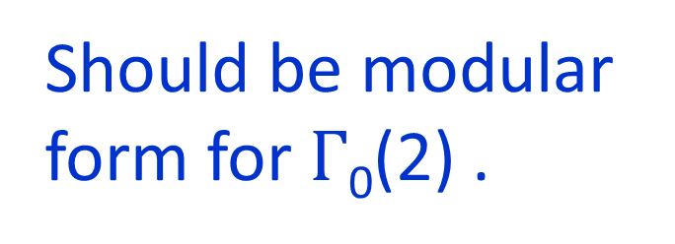
Characters Of An Involution
+ …..
Should be modular form for $Γ$₀(2) .
Weight?
(assumed
half-integral)
Multiplier system?

Slide 35

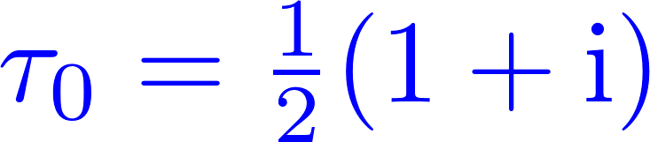
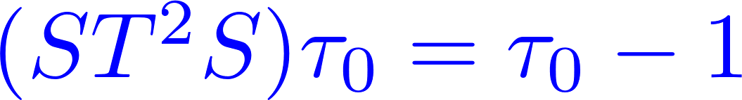
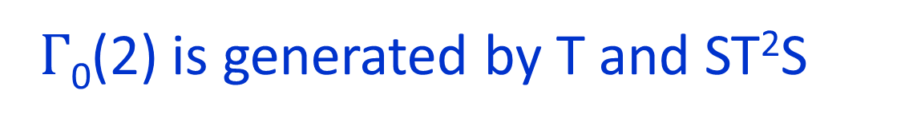

A Trick
$Γ$₀(2) is generated by T and ST²S
ST²S has an ``effective fixed point’’
One can deduce the multiplier system from the weight.

Slide 36
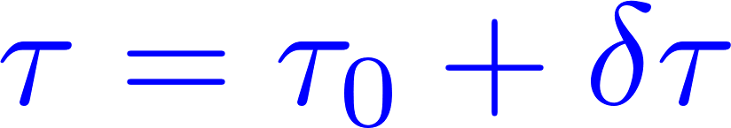

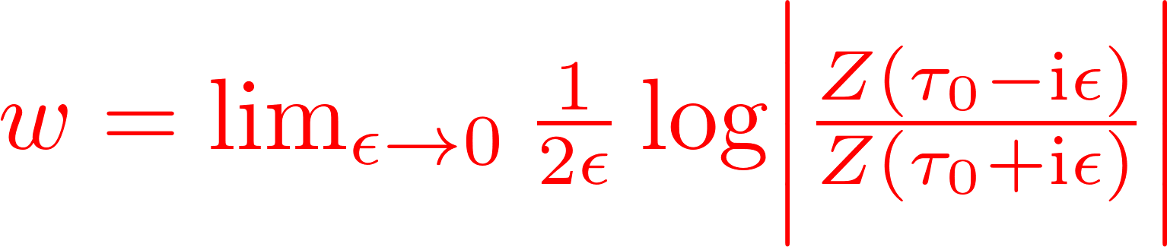
What Is Your Weight?
Convergence is good so can compute the weight numerically.
For Z_{2A} it converges to -8.4…… Not pretty. Not half-integral !!
No positive combination of reps is modular. No M24 Moonshine.

Slide 37


Slide 38

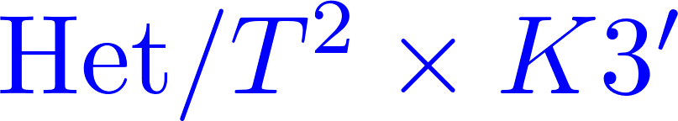

Application To Heterotic-Type II Duality
Existence of CSS points have some interesting math predictions.
K3 and ellipticaly fibered CY3
[Ferrara, Harvey, Strominger, Vafa; Kachru, Vafa (1995) ]
Perturbative heterotic string states
Vertical
D4-D2-D0 boundstates

Slide 39
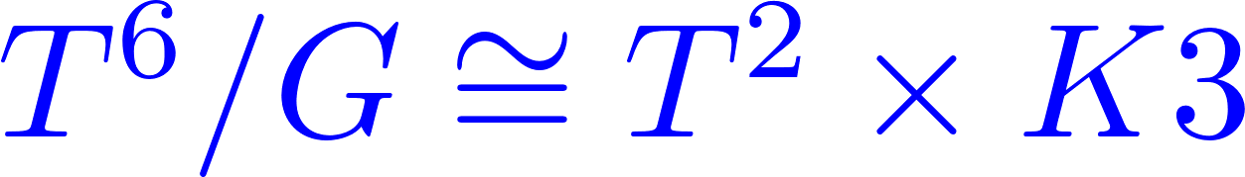

Generalized Huybrechts Theorem
So, if we can make a suitable orbifold of CSS compactifications of the heterotic string on T6
And if there is a type II dual then we can conclude:
is the subgroup of Co₀ fixing the rank two sublattice
and centralizing the orbifold action.

Slide 40
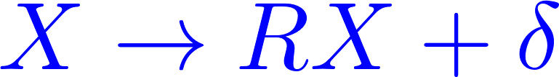
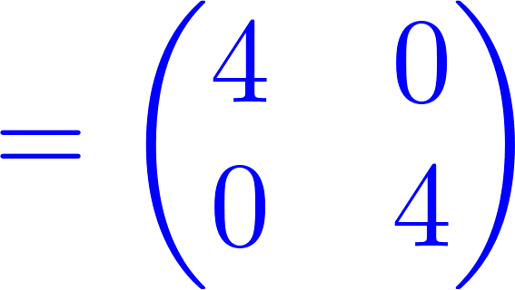



An Explicit Example -1/2
For simplicity: $ℤ$₂ orbifold
Gram matrix of
There exists g_{R} in W(E8) fixing with ev’s
+1⁴ , -1⁴. Mod out by this on the right.

Slide 41



An Explicit Example – 2/2
Need to choose involution g_{L}.
There are four conjugacy classes of involutions in Co₀.
We must have at least four +1 eigenvlaues.
A
B
C
But are they consistent?

Slide 42
Consistency Conditions For Asymmetric Orbifolds
One loop modular invariance:
OK
Mysterious mod two condition:
[Narain, Sarmadi, Vafa 1986]
for all Narain vectors p.
OK for C; Not for A & B

Slide 43
Do We Need The Mod Two Condition?
(Discussion on this includes Nati Seiberg.)
Simplest example of a model that is one-loop-modular but violates the NSV mod two condition:
Consider the product of N circles at self-dual radius.
Z₂ Orbifold group:
These violate the NSV mod two condition for all N.
Claim 1: The model is anomalous for N = 1,2,3 mod 4
Claim 2: The model is sensible for N = 0 mod 4
Both claims contradict several papers in the literature.

Slide 44
Three General Questions
Question One
Should every heterotic model on K3 x T² have a type II dual?
Question Two
Reducing d=2 to d=1 (and turning on suitable flat fields) enhances the Conway subgroups.
What is the type II dual interpretation?
Notes:
Well, we certainly do have a type II duals for the CSS points of toroidal compactifications and thinking about these also raises some interesting questions.

Slide 45
There is a well-developed theory of D-brane categories on X: Derived category and Fukaya category, related by homological mirror symmetry, etc etc.
What about D-brane categories on X x S¹ ?
D-branes sit at a point of S¹ or wrap it.
Obj(X x S1 ) = Obj(D(X)) + Obj(Fuk(X)).
But there can be boundstates between them!
At self-dual radius of S¹ there is N=3 susy!
So it should be possible to study this using topological sigma models.
Notes:
Need to explain how question three is related to the talk: Making d smaller enlarges the discrete group symmetries. For example we can go from d=2 to d=1 by compactifying on a suitable circle and turning on flat fields. So the same must be true on the type II side: So taking the derived category and compactifying on a circle and turning on flat fields can dramatically enlarge the discrete symmetries of the category of D-branes.
But what is the category of D-branes then?

Slide 46
Question Three
In the type II interpretation CSS only arise for special values of the flat RR fields.
Somehow, these flat RR fields can have important effects on branes.
For example – heterotic on T⁸ can give E₈³ gauge symmetry. Somehow IIA/K3 x T⁴ must have such gauge symmetry!

Slide 47
Part I Conclusions
So, what can we say about Mathieu Moonshine?
GHV: Quantum Mukai theorem:
Symmetries of K3 sigma models are not subgroups of M24
This talk:
M24 does not govern symmetries of nonperturbative spacetime BPS states of type IIA K3 compactifications.
Still leaves the possibility: Algebra of BPS states of the PERTURBATIVE BPS states of IIA on, say, K3 x S1.

Slide 48
Part II
Holography & Zamolochikov Volumes Of Moduli Spaces of Calabi-Yau Manifolds
Time permitting ……
G. Moore, ``Computation Of Some Zamolodchikov Volumes, With An Application,’’ arXiv:1508.05612

Slide 49
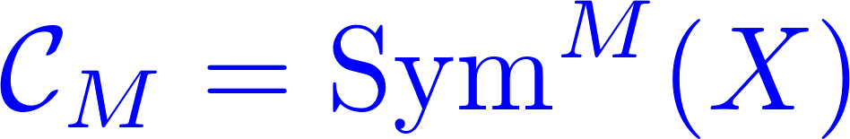


AdS3/CFT2
The large M limit of these CFT’s exist:
Holographically dual to IIB strings on
Gives one route to application of
Rademacher series and mock modular
forms to string theory.

Slide 50
Some recent activity has centered on question:
``Do more general sequences {C_{M}} have holographic duals with weakly coupled gravity? ‘’
Put necessary conditions (e.g. existence of a
Hawking-Page phase transition) on partition functions Z(C_{M}) for a holographic dual of an appropriate type to exist.
Keller; Hartman, Keller, Stoica; Haehl, Rangamani; Belin, Keller, Maloney; ….

Slide 51

Shamit
Kachru
Our paper: Apply criterion of existence of a Hawking-Page phase transition to the elliptic genus.

Slide 52
Shamit’s Question
``How likely is it for a sequence of CFT’s
{ C_{M} } to have this HP phase transition? ‘’
A complicated question and hard to make precise.
Notes:
But once you start admitting more general sequences of CFT’s like { \CC_M } another question arises – which was first put to me by Shamit

Slide 53
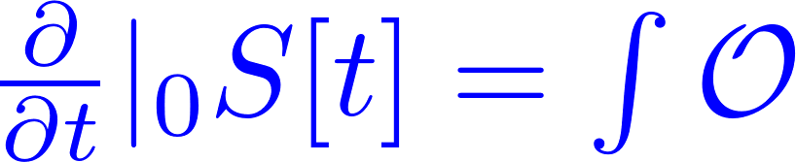
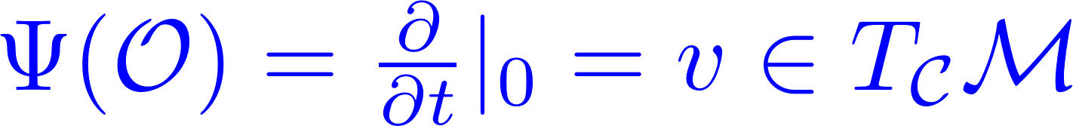
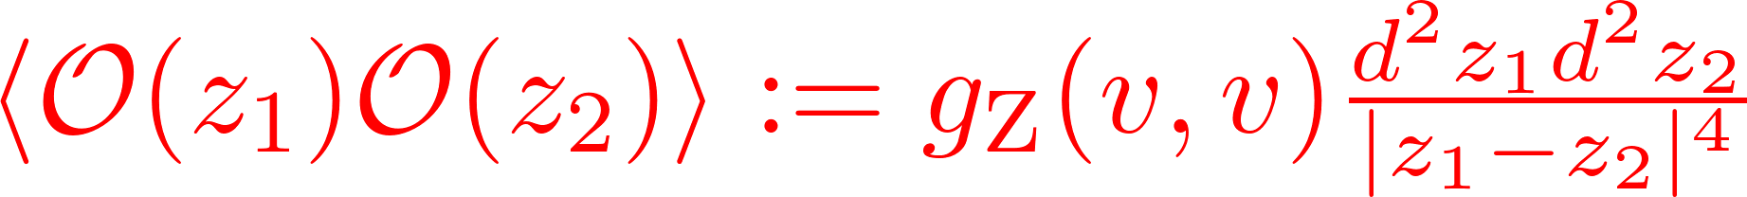
Zamolodchikov Metric
Space of CFT’s is thought to have a topology. So we can speak of continuous families and connected components.
At smooth points the space is thought to be a manifold and there is a canonical isomorphism:

Slide 54
Remarks
Canonical normalization
Moduli spaces arising in string compactifications and AdS3/CFT2 holography have finite Zamolodchikov volumes!
[Horne & Moore, 1994; Douglas, Douglas & Lu, 2005]
Particularly natural family:K3 surfaces:
Also Hilb^{m}(K3) – a similar double-coset

Slide 55

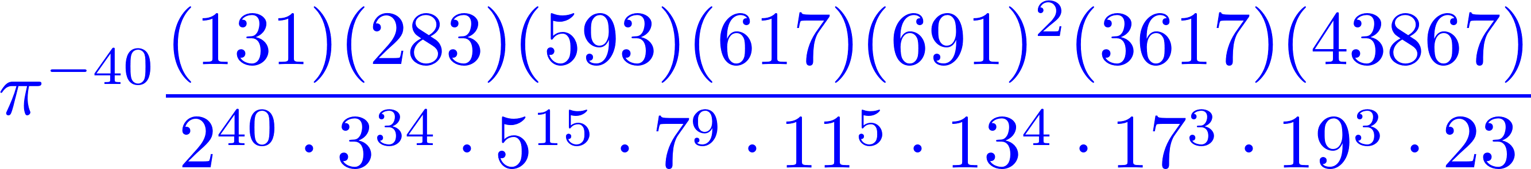

Volumes
Using results from number theory, especially the ``mass formulae’’ of Carl Ludwig Siegel, one can -- with some nontrivial work -- compute the
Z-volumes of these spaces. For example:

Slide 56

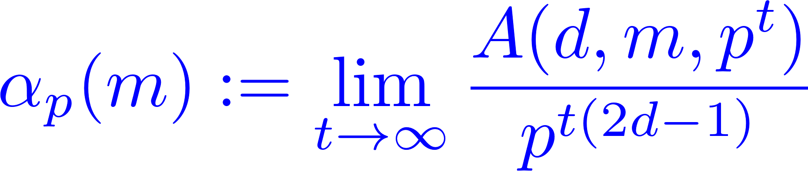
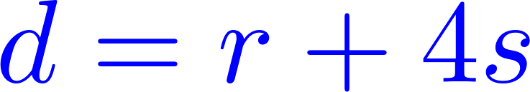
Much harder, but from C.L. Siegel we get:

Slide 57
For p an odd prime & t > e

Slide 58
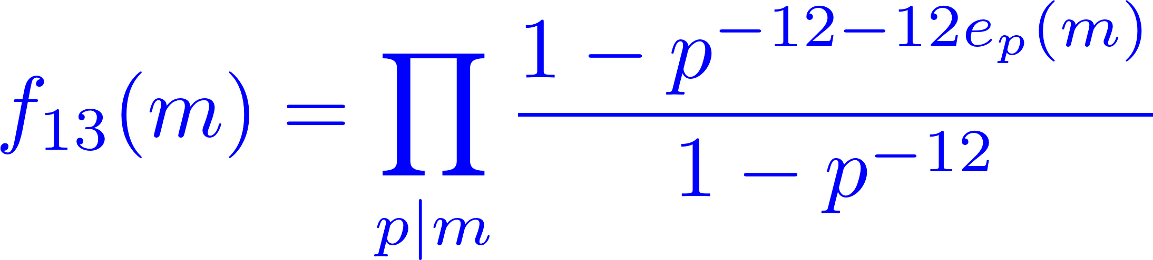


Slide 59
Other Applications Of Mass Formulae?
Counting Chiral CFT’s ?
[S. Kachru, A. Maloney, G. Moore]
Counting Flux Vacua ?
[M. Cheng, ``G. Moore’’, N. Paquette]

Slide 60

Quantum Gravity & New Moonshines
Alejandra Castro, Miranda Cheng,
Anne Taormina & Katrin Wendland
May 28 – June 18, 2017

