Slide 1
Partition Functions Of Twisted Supersymmetric Gauge Theories On Four-Manifolds Via u-Plane Integrals
Gregory Moore
Rutgers University
Mostly review; new work with I. Nidaiev;
work in progress with Jan Manschot.
European String Workshop,
April 12, 2018
Notes:
Now, this subject is not incredibly popular (although I think it is a good one),
So progress takes place on geological time scales. So, here’s the outline of the talk….

Slide 2
1
Introduction
2
Cambrian: Witten Reads Donaldson
Carboniferous: SW Theory & u-plane Derivation
Of Witten’s Conjecture.
3
4
Holocene: Three New Apps
5
Holomorphic Anomaly & Continuous Metric Dep.
6
Back To The Future

Slide 3
Donaldson Invariants Of 4-folds
$X:$Smooth, compact, oriented, $∂X=∅ ,$ ($π_{1}\left(X\right)=0)$
$P→X$ : Principal SO(3) bundle.
$X$ has metric $g_{μν} .$Consider moduli space of instantons:
$$ℳ≔ \{ A: F+∗F=0\} mod 𝒢$$
Donaldson defines cohomology classes in$ℳ$
associated to points and surfaces in $X$: $μ\left(p\right) \& μ\left(S\right)$
$$℘_{D}\left(p^{ℓ}S^{r}\right)≔\int_{ℳ}{μ{\left(p\right)}^{ℓ} μ{\left(S\right)}^{r}}$$
Independent of metric! $⇒$ smooth invariants of $X$.
Combined with Freedman theorem: Spectacular!
Notes:
Say: Comparison with Freedman’s topological classification of four-manifolds shows there is a huge difference between the topological and smooth categories. Very deep.

Slide 4
Witten’s Interpretation: Topologically Twisted SYM On X
Consider $𝒩=$ 2 SYM theory on X for gauge group G
Witten’s ``topological twisting’’: Couple to special
external gauge fields for certain global symmetries.
Result: Fermion fields and susy operators are differential
forms; The twisted theory is defined on non-spin manifolds.
And there is a scalar susy operator with $Q^{2}=0$
Formally: Correlation functions of operators in $Q$-coho. localize to
integrals over the moduli spaces of G-ASD connections (or generalizations thereof).
Witten’s proposal: For $G=SU\left(2\right)$ correlation functions of
the special operators are the Donaldson polynomials.

Slide 5
Local Observables
$℘∈Inv(𝔤)$ $⇒ U=℘\left(φ\right)$
$$φ∈Ω^{0}(adP⊗ℂ)$$
Descent formalism
$$H_{∗}(X,ℂ)$$
$$H^{∗}(Fieldspace;Q)$$
$$μ$$
Localization identity
$$H^{∗}(ℳ)$$
$$U(p)=Tr_{2}\left(\frac{φ^{2}}{8π^{2}}\right)$$
$$U\left(S\right)∼\int_{S}{Tr(φF+ψ^{2})}$$
$$𝔤=𝔰𝔲(2)$$

Slide 6
Donaldson-Witten Partition Function
$$Z_{DW}^{}\left(p,s\right)={〈e^{U(p)+U\left(S\right)}〉}_{Λ}$$
$$\int_{X}{Tr F^{2}=8 π^{2}k}$$
$$=\sum_{k}{Λ_{}^{\frac{1}{2}\dim\left(ℳ_{k}\right)}\int_{ℳ_{k}}{e^{μ\left(p\right)+μ\left(S\right)}}}$$
Strategy: Evaluate in LEET $⇒$Witten (1994)
introduces the Seiberg-Witten invariants.
Major success in
Physical Mathematics.

Slide 7
What About Other N=2 Theories?
Natural Question: Given the successful application of $𝒩=$ 2 SYM for SU(2) to the theory of 4-manifold invariants, are there interesting applications of OTHER $𝒩=$ 2 field theories?
Topological twisting just depends on $SU{\left(2\right)}_{R}$
symmetry and makes sense for any $𝒩=2$ theory.
$${Z^{𝒯}≔ 〈e^{U(p)+U\left(S\right)}〉}_{𝒯}$$
Also an interesting exercise in QFT to compute
correlation functions of nontrivial theories in 4d.

Slide 8
SU(2) With Matter
$$ℛ=2^{⊕N_{fl}}$$
Mass parameters $m_{f}∈ℂ, f=1, …, N_{fl}$
$$M∈Γ(S^{+}⊗E^{⊕N_{fl}})$$
$w_{2}(P)=w_{2}\left(X\right)$
$$𝒩=2^{∗}:ℛ=(adj_{ℂ}⊕adj_{ℂ}^{∗})$$
$$m∈ℂ$$
$$M∈Γ(S^{+}⊗L^{\frac{1}{2}}⊗adP)$$
$$w_{2}\left(L\right)=w_{2}\left(P\right)$$
[Labastida-Marino ‘98]

Slide 9
UV Interpretation
$$Z\left(p,S\right)={〈e^{U(p)+U\left(S\right)}〉}_{𝒯}$$
$$=\sum_{k}{Λ_{}^{\frac{1}{2}\dim\left(ℳ_{k}\right)}\int_{ℳ_{k}}{e^{μ\left(p\right)+μ\left(S\right)}}}$$
But now $ℳ_{k}$:
is the moduli space of:
$$F^{+}=𝒟(M,\overline{M})$$
$$γ⋅D M=0$$
U(1) case: Seiberg-Witten equations.
``Generalized monopole equations’’
[Labastida-Marino; Losev-Shatashvili-Nekrasov]

Slide 10
1
Introduction
2
Cambrian: Witten Reads Donaldson
3
Carboniferous: SW Theory & u-plane Derivation
Of Witten’s Conjecture.
4
Holocene: Three New Apps
5
Holomorphic Anomaly & Continuous Metric Dep.
6
Back To The Future
Notes:
Now we turn to the carboniferous, the period when many of the resources we use today with such gay abandon were created.

Slide 11
Coulomb Branch Vacua On $ℝ^{4}$
$SU\left(2\right)→U(1)$ by vev of adjoint Higgs field $φ$:
Order parameter: $u=〈 U\left(p\right)〉∈ℂ$
Coulomb branch: $ℬ=𝔱⊗ℂ/W≅ℂ$
$$adP→L^{2}⊕𝒪⊕L^{−2}$$
Photon: Connection A on L
$$U\left(1\right) VM: \left(a, A, χ, ψ,η\right)$$
$a:$ complex scalar field on $ℝ^{4}:$
Compute couplings in U(1) LEET.
Then compute path integral with this action.
Then integrate over vacua.

Slide 12
Seiberg-Witten Theory: 1/2
For G=SU(2) SYM coupled to matter the LEET
can be deduced from a holomorphic family of
elliptic curves with differential:
$$\frac{dλ}{du}=\frac{dx}{y}$$
$$E_{u}: y^{2}=4x^{3}−g_{2}x−g_{3}$$
$$u∈ℂ$$
$g_{2},g_{3}$ are polynomials in u, masses, $Λ,$modular functions of $τ_{0}$
$Δ≔4\left(g_{2}^{3}−27 g_{3}^{2}\right)$ : polynomial in u
$Δ\left(u_{j}\right)=0 :$Discriminant locus

Slide 13
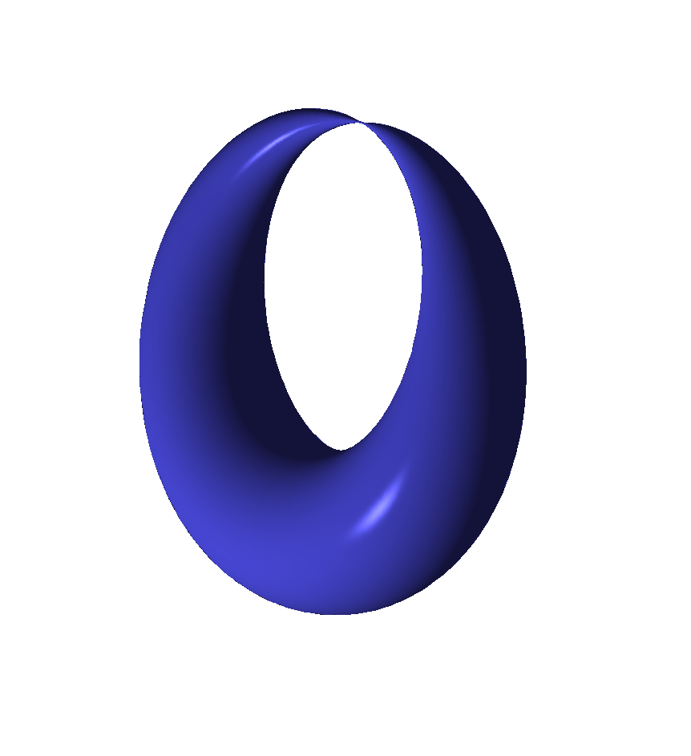
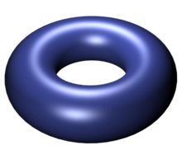
$$E_{u_{j}}$$
$$E_{u}$$
$$u_{j}$$
$$u$$

Slide 14
Examples
$$N_{fl}=0: y^{2}=(x−u)(x−Λ^{2})(x+Λ^{2})$$
$$𝒩=2^{∗}:y^{2}=\prod_{i=1}^{3}{\left(x−α_{i}\right)}$$
$$α_{i}=u e_{i}\left(τ_{0}\right)+\frac{m^{2}}{4}e_{i}{\left(τ_{0}\right)}^{2}$$
$$N_{fl}=4: y^{2}=W_{1}W_{2}W_{3}+η^{12}\sum_{i=1}^{3}{R_{4}^{i}W_{i}+}η^{24} R_{6}$$
$$W_{i}=x−u e_{i}\left(τ_{0}\right)−R_{2}e_{i}{\left(τ_{0}\right)}^{2}$$
$$R_{2}∼Tr_{8_{i}}𝔪^{2}$$
$$R_{4}^{i}∼Tr_{8_{i}}𝔪^{4}$$
$$R_{6}∼Tr_{8_{i}}𝔪^{6}$$
$Δ$: 6th order polynomial in $u$ with $∼3×{10}^{3}$terms

Slide 15
Local System Of Charges
Electro-mag. charge lattice: $Γ_{u}=H_{1}(E_{u};ℤ)$
has nontrivial monodromy around discriminant locus: $Δ\left(u_{j}\right)=0$
LEET: Requires choosing a duality frame:
$$Γ_{u}≅ℤγ_{e}⊕ℤγ_{m}⇒τ\left(u\right)$$
$S∼\int_{X}{\overline{τ}F_{+}^{2}+τF_{−}^{2}+⋯}$

Slide 16
$$N_{fl}=0$$
$$N_{fl}=1$$
$$𝒩=2^{∗}$$
$$N_{fl}=4$$
LEET breaks down at $u=u_{j}$ where $Im\left(τ\right)→0$

Slide 17
Seiberg-Witten Theory: 2/2
LEET breaks down because there are new
massless fields associated to BPS states
$$u=u_{j}$$
$$U{\left(1\right)}_{j} VM: {\left(a,A,χ,ψ,η\right)}_{j}$$
LEET $u∈𝒰_{j}:$
+
Charge 1 HM: $\left(M=q⊕{\tilde{q}}^{∗}, ⋯\right)$

Slide 18
Evaluate $Z_{DW}^{}$ Using LEET
$$Z_{DW}^{}\left(p,S\right)={〈e^{U\left(p\right)+U\left(S\right)}〉}_{Λ}$$
$$=\sum_{k}{Λ_{0}^{\frac{1}{2}\dim\left(ℳ_{k}\right)}\int_{ℳ_{k}}{e^{μ\left(p\right)+μ\left(S\right)}}}$$
$$Z_{DW}=Z_{u}+\sum_{u_{j}}{Z_{j}^{SW}}$$
$$u=−Λ^{2}$$
$$u=Λ^{2}$$

Slide 19
u-Plane Integral $Z_{u}$
Can be computed explicitly from QFT of LEET
Vanishes if $b_{2}^{+}>1$ .
When $b_{2}^{+}=1:$
$$Z_{u}=∫du d\overline{u} ℋ Ψ$$
$ℋ$ is holomorphic and metric-independent
$Ψ$: Sum over line bundles for the U(1) photon.
(Remnant of sum over SU(2) gauge bundles.)
$$Ψ∼\sum_{λ=c_{1}\left(L\right)}{e^{−i π\overline{τ}\left(\overline{u}\right)λ_{+}^{2}−i πτ\left(u\right)λ_{−}^{2}}}$$
NOT holomorphic and metric- DEPENDENT

Slide 20
Initial Comments On $Z_{u}$
$Z_{u}$is a very subtle integral.
It requires careful regularization
and definition$.$
(It is also related to integrals from number theory
such as `` $Θ−$lifts’’ and mock modular forms…)
But first let’s finish writing down the
full answer for the partition function.

Slide 21
Contributions From $𝒰_{j}$
Path integral for $U{\left(1\right)}_{j}$VM + HM:
General considerations imply $Z_{j}^{SW}=$
$$\sum_{λ∈\frac{1}{2}w_{2}\left(X\right)+H^{2}\left(X,ℤ\right)}{SW\left(λ\right)e^{2πi λ⋅λ_{0}} R_{λ}\left(p,S\right)}$$
Special coordinate: $a_{j}$
$$u=u_{j}+κ_{j}a_{j}+𝒪(a_{j}^{2})$$
$$R_{λ}\left(p,S\right)=Res[ \left(\frac{da_{j}}{a_{j}^{1+\frac{d\left(λ\right)}{2}}}\right) e^{2pu+S^{2}T\left(u\right)+i \left(\frac{du}{da_{j}}\right)S⋅λ}C{\left(u\right)}^{λ^{2}}P{\left(u\right)}^{σ}E{\left(u\right)}^{χ}]$$
C,P,E:Universal functions. In principle computable.
$$d\left(λ\right)=\frac{ {\left(2λ\right)}^{2}−c_{}^{2}}{4}$$
$$c_{}^{2}=2χ+3 σ$$

Slide 22
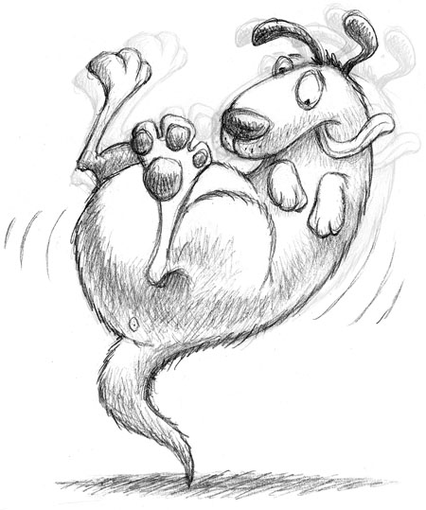
Deriving C,P,E From Wall-Crossing
$$\frac{d}{dg_{μν}}Z_{u}=∫Tot deriv=\oint_{∞}{du\left(….\right)+\sum{\oint_{u_{j}}{du\left(…\right)}}}$$
$Z_{u}$ piecewise constant: Discontinuous jumps across walls:
$$Δ_{j}Z_{u}+ΔZ_{j}^{SW}=0⇒ C\left(u\right), P\left(u\right), E\left(u\right)$$
Then for $b_{2}^{+}>1 , Z_{u}=0,$but we know the couplings to compute $Z_{SW}$!
$Z_{u}$ is the tail that wags the dog.

Slide 23
Witten Conjecture
$⇒$a formula for all X with ${b_{2}^{}}^{+}>0.$For $b_{2}^{+}\left(X\right)>1$ we derive ``Witten’s conjecture’’:
$$Z_{DW}^{}\left(p,S\right)=2^{c^{2}−χ_{h}} ( e^{\frac{1}{2}S^{2}+2p }\sum_{λ}{SW\left(λ\right)e^{2πi λ⋅λ_{0}}e^{2S⋅λ}+}e^{−\frac{1}{2}S^{2}−2p}\sum_{λ}{SW\left(λ\right)e^{2πi λ⋅λ_{0}}e^{−2iS⋅λ})}$$
$$χ_{h}=\frac{χ+σ}{4}$$
$$c^{2}=2χ+3 σ$$
Example: $X=K3:$
$$Z=\text{sinh}{(\frac{S^{2}}{2}+2 p)}$$

Slide 24
Generalization To $N_{fl}>0$
$$Z\left(p;S;m_{f}\right)=\sum_{j=1}^{2+N_{fl}}{Z(p,S;m_{f};u_{j})}$$
$$b_{2}^{+}>1$$
$$Z\left(p,S;m_{f};u_{j}\right)=α^{χ}β^{σ} \sum_{λ}{SW\left(λ\right)e^{2πi λ⋅λ_{0}}}R_{j}(p,S)$$
X is SWST $⇒$
$R_{j}(p,S)$ is computable explicitly as a function of $p,S,m_{f},Λ,τ_{0}$ from first order degeneration of the SW curve.

Slide 25
$R_{j}\left(p,s\right)=μ_{j}^{χ_{h}}{\left(\frac{du}{da}\right)}^{χ_{h}+σ}\exp\left( 2p u_{j}+S^{2}T\left(u_{j}\right)−i {\left(\frac{du}{da}\right)}_{j}S⋅λ\right)$
$$y^{2}=4x^{3}−g_{2}\left(u,m\right)x −g_{3}\left(u,m\right)$$
Assume a simple zero for $Δ$ as $u→u_{j}$
Choose local duality frame with $a_{j}→0$
Nonvanishing period: $\frac{da_{j}}{du}$ and $\frac{da_{j,D}}{du}→i ∞$:
$${\left(\frac{da_{j}}{du}\right)}^{2}{\left.​\right|}_{u_{j}}∼\left(\frac{g_{2}}{g_{3}}\right){\left.​\right|}_{u_{j}}$$
$$μ_{j}∼\left(\frac{g_{2}^{3}}{Δ^{′}}\right){\left.​\right|}_{u_{j}}$$

Slide 26
1
Introduction
2
Cambrian: Witten Reads Donaldson
3
Carboniferous: SW Theory & u-plane Derivation
Of Witten’s Conjecture.
4
Holocene: Three New Apps
5
Holomorphic Anomaly & Continuous Metric Dep.
6
Back To The Future

Slide 27
Application 1: Case Of $𝒩=2^{∗}$
Using these methods analogous formulae were worked out for N=2*, by Labastida-Lozano in 1998, but only in the case when $X$ is spin.
They checked S-duality for the case $b_{2}^{+}>1$
The generalization to $X$ which is NOT spin is nontrivial and involves new effective interactions not in the literature.
$${\left(u−u_{1}\right)}^{−\frac{c_{1}{\left(𝔰\right)}^{2}}{8}}e^{−i\frac{∂a_{D}}{∂m} λ⋅c_{1}\left(𝔰\right)}$$

Slide 28
Application 2: S-Duality Of $N_{fl}=4$
$Z(p,S;τ_{0})$ is expected to have modular properties:
$$\sum_{j=1}^{6}{\begin{aligned}μ_{j}^{χ_{h}} κ_{j}^{χ_{h}+σ} e^{p u_{j}+i κ_{j}λ⋅S+⋯} \\ \end{aligned}}$$
$$κ_{j}={\left(\frac{g_{3}\left(u_{j}\right)}{g_{2}\left(u_{j}\right)}\right)}^{\frac{1}{2}}$$
$$μ_{j}=η^{−24}\left(τ_{0}\right)g_{2}{\left(u_{j}\right)}^{3}\prod_{k}{{\left(u_{j}−u_{k}\right)}^{−1}}$$
Sum over $j$ gives symmetric rational function of $u_{j}$ $⇒$ $Z$ will be modular:
Notes:
Need to say: That’s without taking into account the alpha and beta coefficients.
These will be overall powers of \eta(\tau_0) and might change the net weight.

Slide 29
$$γ=\left(\begin{matrix}a & b \\ c & d\end{matrix}\right)∈SL(2,ℤ)$$
$$Z\left(\frac{p+\frac{c}{cτ_{0}+d}S^{2}}{{\left(c τ_{0}+d\right)}^{2}},\frac{S}{{\left(cτ_{0}+d\right)}^{2}};\frac{aτ_{0}+b}{cτ_{0}+d};γ⋅𝔪\right)$$
$={\left(cτ_{0}+d\right)}^{χ+3σ} Z(p,S;τ_{0};𝔪)$
(Neglecting $α,β$ coefficients.)

Slide 30
Application 3: AD3 Partition Function
Consider $N_{fl}=1$. At a critical point $m=m_{∗}$ two
singularities $u_{±}$ collide at $u=u_{∗}$ and the SW
curve becomes a cusp: $y^{2}=x^{3}$ [Argyres,Plesser,Seiberg,Witten]
Two mutually nonlocal BPS states have vanishing mass:
$$\oint_{γ_{1}}{λ→0 }$$
$$\oint_{γ_{2}}{λ→0 }$$
$$γ_{1}⋅γ_{2}≠0$$
Physically: No local Lagrangian for the LEET :
Signals a nontrivial superconformal field theory
appears in the IR in the limit $m→m_{∗}$

Slide 31
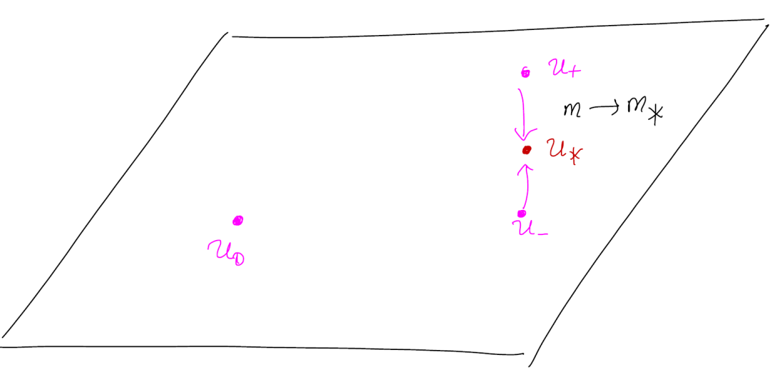
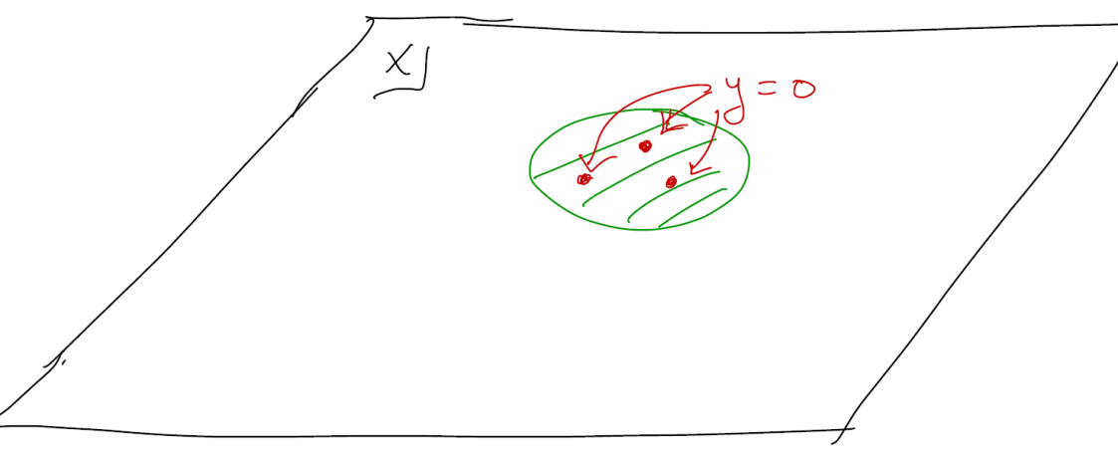
AD3 From $SU\left(2\right) N_{f}=1$
SW curve in the scaling region:
$$y^{2}=x^{3}−3 Λ_{AD}^{2} x+u_{AD}$$
$$Λ_{AD}^{2}∼\left(m−m_{∗}\right)$$
Call it the ``AD3-Family over the $u_{AD}−$plane’’

Slide 32
AD3 Partition Function - 1
Work with Iurii Nidaiev
The $SU\left(2\right) N_{fl}=1$u-plane integral has a nontrivial
contribution from the scaling region $u_{±}→u_{∗}$
$$\lim_{m→m_{∗}}{Z_{u} − \int{du d\overline{u}\lim_{m→m_{∗}}{Measure\left(u,\overline{u};m\right) ≠0 }}}$$
Limit and integration commute except in an
infinitesimal region around $u_{∗}$
Attribute the discrepancy to the
contribution of the AD3 theory

Slide 33
AD3 Partition Function - 2
1. Limit $m→m_{∗}$ exists. (No noncompact Higgs branch.)
2. The partition function is a sum over all
Q-invariant field configurations.
3. Scaling region near $u_{∗}$ governed by AD3 theory.
$\lim_{m→m_{∗}}{Z^{SU\left(2\right),N_{fl}=1}}$``contains’’ the AD partition function
Extract it from the scaling region. Our result:
$$Z^{AD3}=\lim_{Λ_{AD}→0}\left( Z_{u}^{AD3−family}+Z_{SW}^{AD3−family}\right)$$
Claim: This is the AD3 TFT on $X$ for $b_{2}^{+}>0 .$

Slide 34
AD3 Partition Function: Evidence 1/2
Existence of limit is highly nontrivial. It follows
from ``superconformal simple type sum rules’’ :
Theorem [MMP, 1998] If the superconformal simple
type sum rules hold:
a.) ${ χ}_{h}−c^{2} −3≤0$
b.) $\sum_{λ}{SW\left(λ\right)e^{2π i λ⋅λ_{0}}λ^{k}=0 }$ $0≤k≤χ_{h}−c^{2}−4$
Then the limit $m→m_{∗}$exists
It is now a rigorous theorem that SWST $⇒$SCST

Slide 35
AD3 Partition Function: Evidence 2/2
For $b_{2}^{+}>0$ recover the expected selection rule:
$$〈{U(p)}^{ℓ}U{\left(S\right)}^{r}〉≠0 \text{only} \text{for}\frac{6ℓ+r}{5}=\frac{χ_{h}−c^{2}}{5}$$
Consistent with background charge for AD3 computed by Shapere-Tachikawa.
Explicitly, if $X \text{of} SWST \text{and} b_{2}^{+}>1:$

Slide 36
Explicitly, if $X \text{of} SWST \text{and} b_{2}^{+}>1:$
$$Z^{AD3}=\frac{1}{𝔅!}K_{1}K_{2}^{χ}K_{3}^{σ} \sum_{λ}{e^{2πi λ⋅w_{2}}SW\left(λ\right)⋅}$$
$$⋅\{{\left(λ⋅S\right)}^{𝔅−2}(24{\left(λ⋅S\right)}^{2}+𝔅\left(𝔅−1\right)S^{2}\}$$
$$𝔅=χ_{h}−c^{2}=−\frac{7 χ+11 σ}{4}$$
Surprise! p drops out: U(p) is a ``null vector’’

Slide 37
1
Introduction
2
Cambrian: Witten Reads Donaldson
3
Carboniferous: SW Theory & u-plane Derivation
Of Witten’s Conjecture.
4
Holocene: Three New Apps
5
Holomorphic Anomaly & Continuous Metric Dep.
6
Back To The Future

Slide 38
$Z_{u}$ Wants To Be A Total Derivative
$$Z_{u}=∫du d \overline{u} ℋ\left(u\right) Ψ$$
$$Ψ=\sum_{λ}{\frac{d}{d\overline{u}}\left(ℰ\left(r_{λ}^{ω},b_{λ}\right)\right)e^{−i πτλ^{2}−i S⋅\frac{du}{da}+2 πi \left(λ−λ_{0}\right)⋅w_{2}}}$$
$$ℰ\left(r,b\right)=\int_{b}^{r}{e^{−2πt^{2}}dt}$$
$$r_{λ}^{ω}=\sqrt{y}λ_{+}−\frac{i}{4π\sqrt{y}}S_{+} \frac{du}{da}$$
Lower limit $b_{λ}$ must be independent of $\overline{u}$ but can depend on $λ,ω,u.$
[Korpas & Manschot; Moore & Nidaiev ]
?
$$Z_{u} = ∫du d \overline{u}\frac{d}{d\overline{u}}( ℋ\left(u\right)Θ^{ω})$$

Slide 39
$$Z_{u} =∮d \overline{u}\frac{d}{d\overline{u}}\left( ℋ\left(u\right)Θ^{ω}\right)=∮d\overline{u} ℋΨ$$
No!
has nontrivial periods in general!
BUT: The difference for two metrics CAN be evaluated by residues!
$$Z_{u}^{ω}−Z_{u}^{ω_{0}}=∫du d\overline{u} \frac{d}{d\overline{u}}(ℋ{\hat{Θ}}^{ω,ω_{0}})$$
$${\hat{Θ}}^{ω,ω_{0}}=\sum_{λ}{\left(ℰ\left(r_{λ}^{ω}\right)−ℰ\left(r_{λ}^{ω_{0}}\right)\right)e^{−i πτ\left(u\right)λ^{2}+⋯}}$$
$$r_{λ}^{ω}=\sqrt{y}λ_{+}−\frac{i}{4π\sqrt{y}}S_{+} \frac{du}{da}$$
Modular completion of indefinite theta function of Vigneras, Zwegers, Zagier

Slide 40
Holomorphic Anomaly & Metric Dependence
For theories with a manifold of superconformal couplings, $τ\left(u\right)→τ_{0}$ when $u→∞$
$${\hat{Θ}}^{ω,ω_{0}}\left(τ\left(u\right),…\right)→{\hat{Θ}}^{ω,ω_{0}}\left(τ_{0},…\right)$$
Contour integral at $∞⇒ For$ $b_{2}^{+}=1,$ many ``topological’’ correlators:
Nonholomorphic in $τ_{0}$
Depend continuously on metric
[Moore & Witten, 1997
-- albeit sotto voce ]

Slide 41
Special Case Of $ℂℙ^{2}$
No walls: $ω∈H^{2}\left(X,ℝ\right)≅ℝ,$ so we
only see holomorphic anomaly.
$⇒$Path integral derivation of the holomorphic anomaly.

Slide 42
Vafa-Witten Partition Functions
VW twist of N=4 SYM formally computes the ``Euler character’’ of instanton moduli space.
(Not really a topological invariant. True mathematical meaning unclear, but see
recent work of Tanaka & Thomas; Gholampour, Sheshmani, & Yau.)
Physics suggests the partition function is both
modular (S-duality) and holomorphic.
Surprise! Computations of Klyachko and Yoshioka for $X=ℂℙ^{2}$show that the holomorphic generating function is only mock modular.
But a nonholomorphic modular completion exists.

Slide 43
This has never been properly derived from a path integral argument. .
But we just derived completely analogous results for the $N_{fl}=4$ and $𝒩=2^{∗}$ theories
from a path integral, suggesting VW will also have continuous metric dependence.
Indeed, continuous metric dependence in VW theory for $SU(r>1)$ has been predicted in papers of Jan Manschot using rather different methods.
We hope that a similar path integral derivation can be found for the $𝒩=4$ Vafa-Witten twisted theory.

Slide 44
1
Introduction
2
Cambrian: Witten Reads Donaldson
3
Carboniferous: SW Theory & u-plane Derivation
Of Witten’s Conjecture.
4
Holocene: Three New Apps
5
Holomorphic Anomaly & Continuous Metric Dep.
6
Back To The Future

Slide 45
Future Directions
Lots of details to clean up
Comparison with localization results of Gukov et. al.
There is an interesting generalization to invariants for families of four-manifolds.
Generalization to all theories in class S:
Many aspects are clear – this is under study.
Does the u-plane integral make sense for
ANY family of Seiberg-Witten curves ?

