Slide 1
Quantum Field Theory
And Invariants Of
Smooth Four-Dimensional Manifolds
Gregory Moore
Rutgers University
Joint Mathematics Meeting, Jan. 18, 2020, Denver

Slide 2

1
Physical Mathematics
2
Math & Physics Problems
3
Instantons & Donaldson Invariants
Topological Field Theory
4
5
Low Energy Effective Field Theory
6
New Results On $Z_{u}$
Directions For Future Research
7

Slide 3
Phys-i-cal Math-e-ma-tics, n.
Brit. /ˈfɪzᵻkl ˌmaθ(ə)ˈmatɪks / , U.S. /ˈfɪzək(ə)l ˌmæθ(ə)ˈmædɪks/
Pronunciation:
Physical mathematics is a fusion of mathematical and physical ideas, motivated
by the dual, but equally central, goals of
1. Elucidating the laws of nature at their most fundamental level,
together with
2. Discovering deep mathematical truths.
Notes:
Now, the history of the relation between math and fundamental physics
Has had its ups and downs over the past centuries. A high water mark came
After the upheavals in early 20th century physics with the introduction of
General relativity and quantum mechanics. In a famous paper Dirac said --

Slide 4
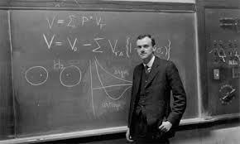
1931: Dirac’s Paper on Monopoles
Notes:
But then something happened during the 30’s – 60’s and there was relatively
Little interaction. This was perhaps most famously articulated by Freeman Dyson –

Slide 5
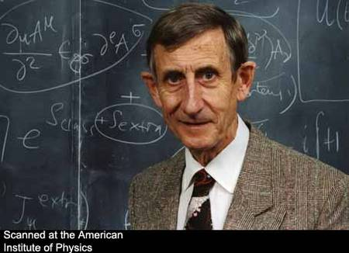
1972: Dyson’s Announcement
Notes:
And indeed there is a chapter in Graham’s book called “The long divorce.’’

Slide 6

Well, I am happy to report that
Mathematics and Physics have remarried!
Change began in the 1970’s …..
Atiyah, Bott, Singer, …

Slide 7
Some great mathematicians
got interested in aspects of fundamental physics …..
While some great physicists started producing results requiring ever increasing mathematical
sophistication, …..

Slide 8
Physical Mathematics
In the past few decades a new field has emerged
with its own distinctive character, its own aims and values,
its own standards of proof.
One of the guiding principles is certainly the discovery
of the ultimate foundations of physics.
This quest has led to ever more sophisticated mathematics…
A second guiding principle is that physical insights can lead to surprising and new results in mathematics
Such insights are a great success - just as profound and notable as an experimental confirmation
of a theoretical prediction.
Notes:
This is what Graham’s book is about.

Slide 9
Today:
I will explain just one emblematic example of a remarkable convergence
of physical and mathematical ideas.

Slide 10
1
Physical Mathematics
2
Math & Physics Problems
3
Instantons & Donaldson Invariants
Topological Field Theory
4
5
Low Energy Effective Field Theory
6
New Results On $Z_{u}$
Directions For Future Research
7

Slide 11
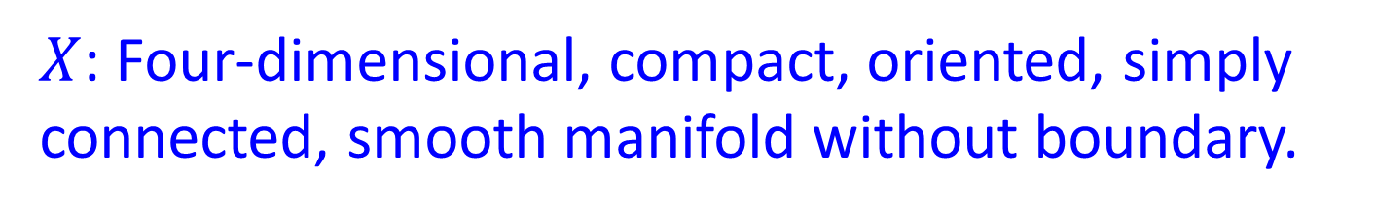
Four Dimensional
Differentiable Topology
$X$: Four-dimensional, compact, oriented, simply connected, smooth manifold without boundary.
We do not know anything even close to a complete topological invariant.
One thing we know for sure is that the
world of such four-dimensional
manifolds is really wild.

Slide 13
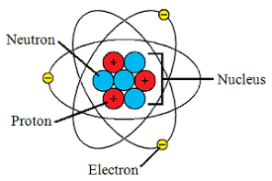






Nuclear Force
Protons have positive
electric charge
It’s cozy in there:
$$r={10}^{−15}m.$$
Electrical force between two protons at
this distance produces an acceleration ….
$$∼{10}^{28} g$$
Fighter
pilots
$∼9 g$
Fastest roller
coaster $∼6 g$
Notes:
You all learned in school that atoms look like this. (Actually, it is quite inaccurate for many
Reasons. For one thing, if we scaled up the atom to be the size of Princeton Stadium then
The nuclear would be the size of a baseball.
I could spend some time trying to convey how big 10^(28) but it’s
Just one of those Carl Sagan numbers: billions x billions x billions
So, what holds the nucleus together? There must be another force –
The nuclear force. Also called the “strong force” for reasons that I hope
Are now clear.

Slide 14
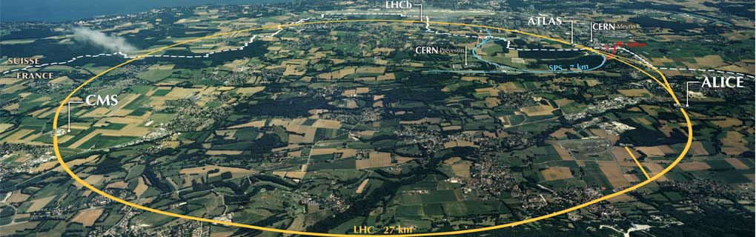
The strong force is very subtle – it has been studied with particle accelerators
for decades - up to the present day…
Large Hadron Collider at CERN
Notes:
Biggest experiment ever carried out by man – with the exception of global warming.

Slide 15
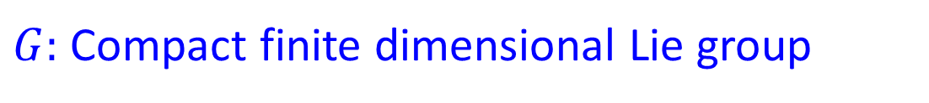



Mathematical Formulation Of The Strong Force: Yang-Mills Theory
$G:$ Compact finite dimensional Lie group
Lie algebra $𝔤$ equipped with invariant bilinear form $tr$
$𝒜:$ Space of connections on principal $G$-bundles over $X$
$𝒜/𝒢$ : Connections up to isomorphism (gauge equivalence classes)
Given $∇_{P}$: connection on $P→X$AND a Riemannian metric on $X$
$$A_{YM}=\int_{X}{tr\left(F∧ ∗F\right) }$$
Yang-Mills action
$∗:$Hodge star: Depends on the metric $g_{μν}$ on $X$
$A_{YM}$ descends to a function on $𝒜/𝒢$

Slide 16
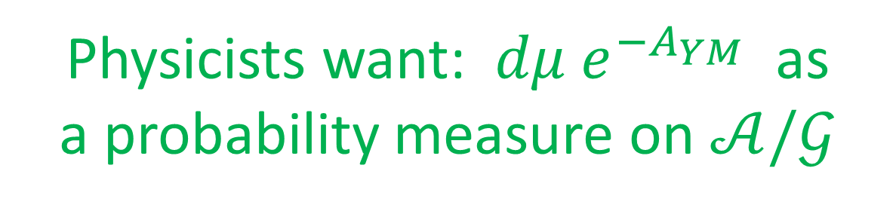
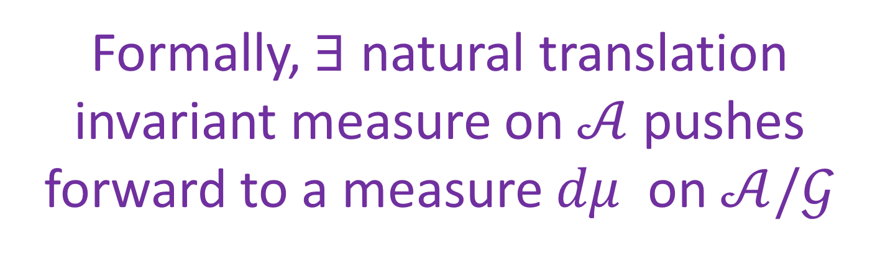
Formally, $∃$ natural translation invariant measure on $𝒜$ pushes forward to a measure $dμ$ on $𝒜/𝒢$
Physicists want: $dμ e^{−A_{YM}}$ as
a probability measure on $𝒜/𝒢$
Expectation values: ``path integral’’
Overwhelming evidence suggests it makes mathematical sense

Slide 17
1
Physical Mathematics
2
Math & Physics Problems
3
Instantons & Donaldson Invariants
Topological Field Theory
4
5
Low Energy Effective Field Theory
6
New Results On $Z_{u}$
Directions For Future Research
7

Slide 18

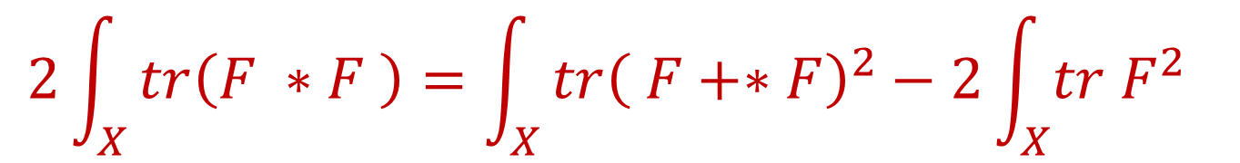
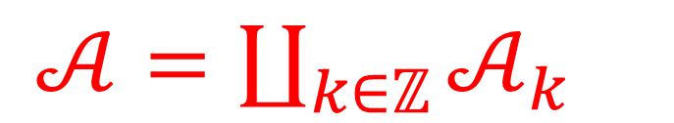

Most important connections:
The minima of $A_{YM}$
$$2\int_{X}{tr\left(F ∗F \right)=\int_{X}{tr{\left( F+∗F\right)}^{2}−2\int_{X}{tr F^{2}} }}$$
With suitable definition of trace:
$$k:=\int_{X}{tr F^{2 }∈ℤ}$$
is a Chern-Weil representation of a characteristic class:
$𝒜=\coprod_{k∈ℤ}{𝒜_{k}}$

Slide 19
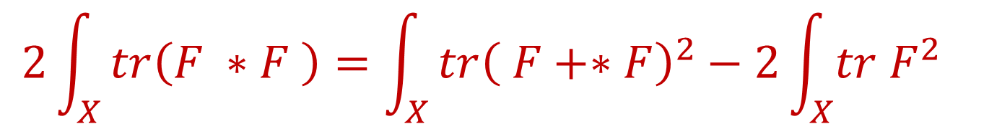

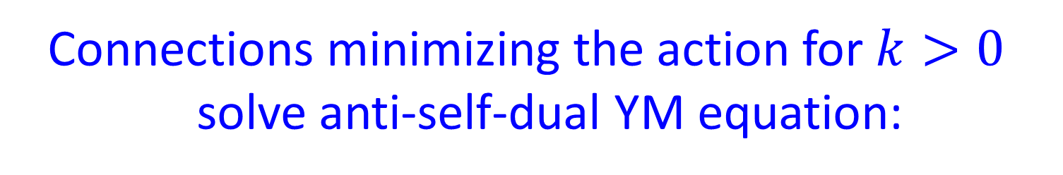
Instantons -1.1
$$2\int_{X}{tr\left(F ∗F \right)=\int_{X}{tr{\left( F+∗F\right)}^{2}−2\int_{X}{tr F^{2}} }}$$
Connections minimizing the action for $k>0$
solve anti-self-dual YM equation:
$$F_{+}≔\frac{1}{2}\left(F+∗F \right)=0$$

Slide 20
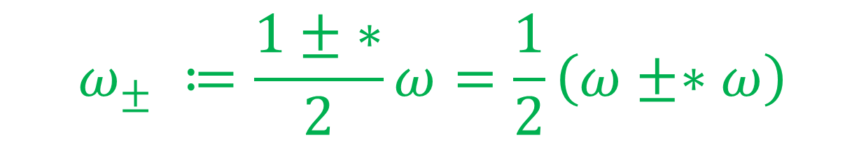
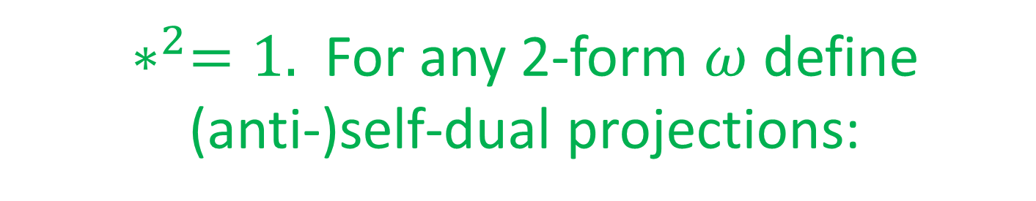
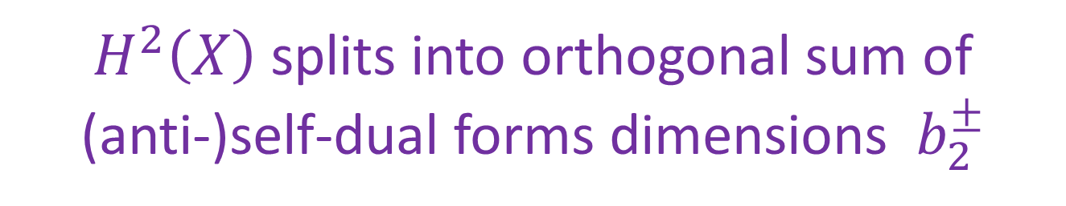
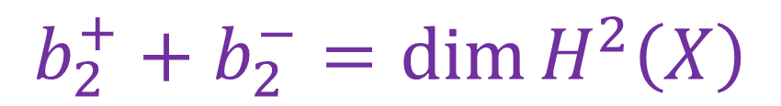

Reminder On Self-Duality
$∗^{2}=1.$For any 2-form $ω$ define
(anti-)self-dual projections:
$$ω_{±} ≔\frac{1± ∗}{2}ω=\frac{1}{2}\left(ω±∗ω\right)$$
$H^{2}\left(X\right)$= $\{$closed/exact 2-forms $\}$
$H^{2}\left(X\right)$ splits into orthogonal sum of
(anti-)self-dual forms dimensions $b_{2}^{±}$
$$b_{2}^{+}+b_{2}^{−}=\dim{H^{2}\left(X\right)}$$

Slide 21

Instantons – 1.2
Solutions to $F_{+}=0$ are called instantons.
Ever since their discovery in 1975 by Belavin, Polyakov, Schwartz, and Tyupkin they have been intensively studied by physicists interested in Yang-Mills theory.
Notes:
So the physicists were having a great time learning all sorts of things about the
Instantons in the 1970’s

Slide 22

Meanwhile, back at the ranch

Slide 23
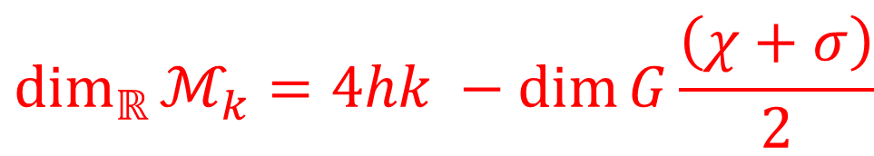


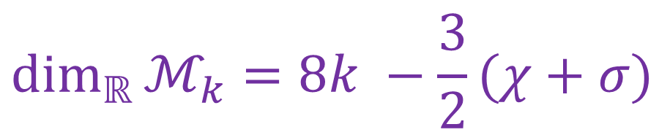
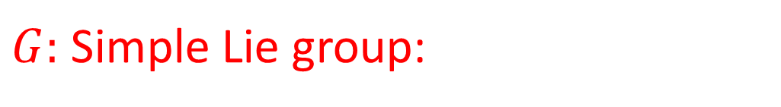
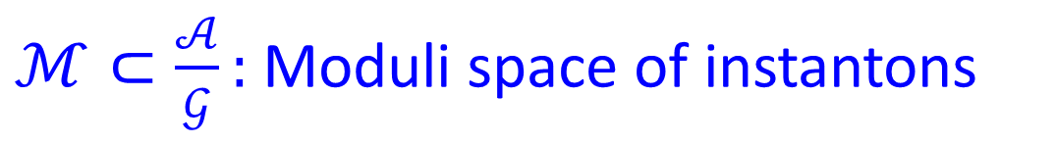
Starting in the late 1970’s mathematicians such as Atiyah, Bott, Drinfeld, Hitchin, Manin, Singer, Uhlenbeck…. were producing remarkable mathematical results about these instantons.
There are continuous families of instanton solutions:
$$ℳ=\coprod_{k∈ℤ}{ℳ_{k}}$$
$ℳ⊂\frac{𝒜}{𝒢}:$ Moduli space of instantons
$G:$ Simple Lie group:
$$\dim_{ℝ}{ℳ_{k}=4hk −\dim{G\frac{\left(χ+σ\right)}{2} }}$$
$$\dim_{ℝ}{ℳ_{k}=8k −\frac{3}{2}(χ+σ)}$$
$$G=SU\left(2\right),SO(3)$$

Slide 24


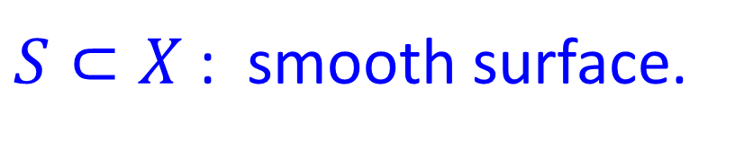


Donaldson Invariants
$S⊂X$: smooth surface.
$ℳ\left(S\right)$: subspace where the Dirac equation on $S$coupled to $∇_{P}$ has a solution
Poincare dual to $ℳ\left(S\right)$defines ${μ\left(S\right)∈H}^{2}\left(ℳ;ℤ\right)$
$$=\sum_{k}{\int_{ℳ_{k}}{\frac{μ{\left(S\right)}^{r}}{r!} }}$$
$$Z_{D}\left(S\right)≔\int_{ℳ}{e^{μ\left(S\right)} }$$
Formally a function on $H_{2}\left(X;ℂ\right)$
Metric independent $⇒$Topological Invariant of $X$!
Notes:
Say: \mu(S) only depends on the HOMOLOGYof S

Slide 25
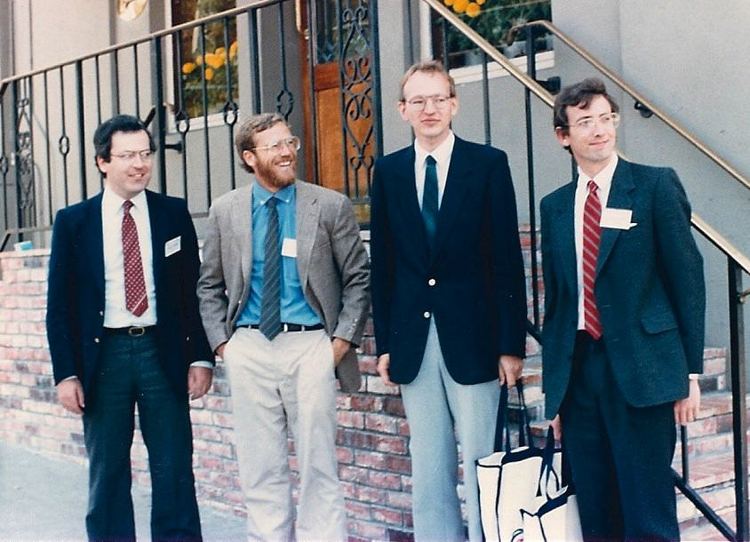
The discovery of these and related topological invariants led to major advances in the differential topology of four-manifolds

Slide 26


Slide 27


Slide 28
Donaldson invariants are extremely hard to compute
It took a lot of effort to compute
a few special examples….
Mathematicians hit a wall…

Slide 29
1
Physical Mathematics
2
Math & Physics Problems
3
Instantons & Donaldson Invariants
Topological Field Theory
4
5
Low Energy Effective Field Theory
6
New Results On $Z_{u}$
Directions For Future Research
7

Slide 30
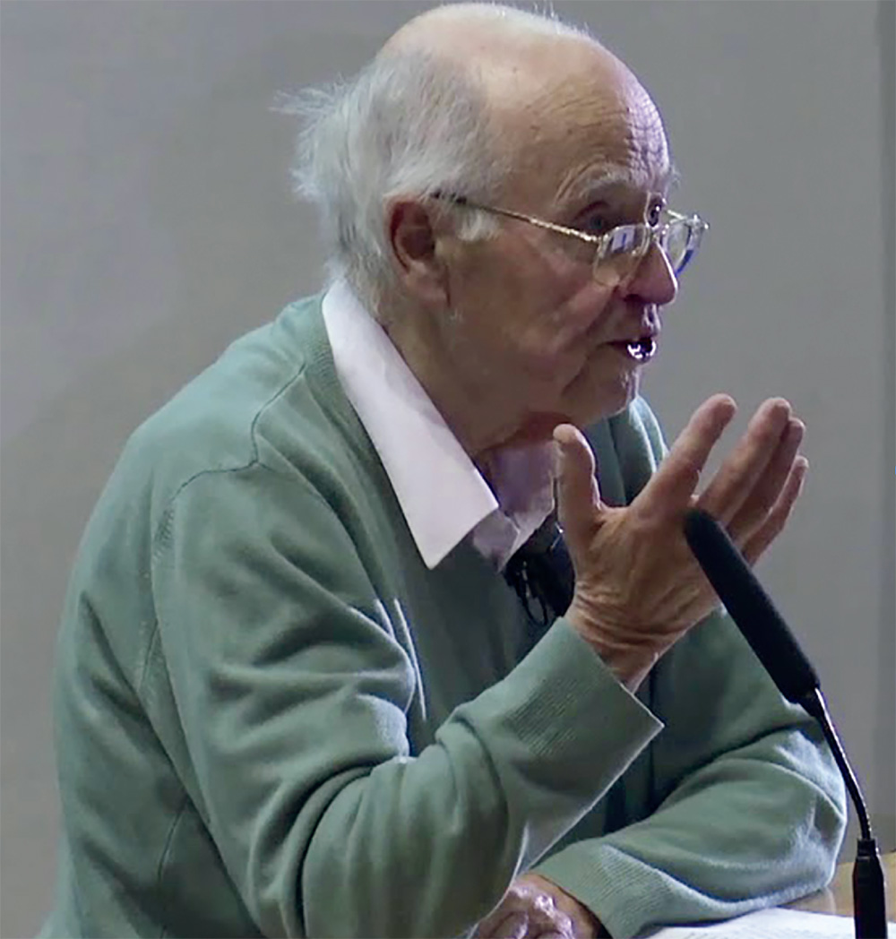
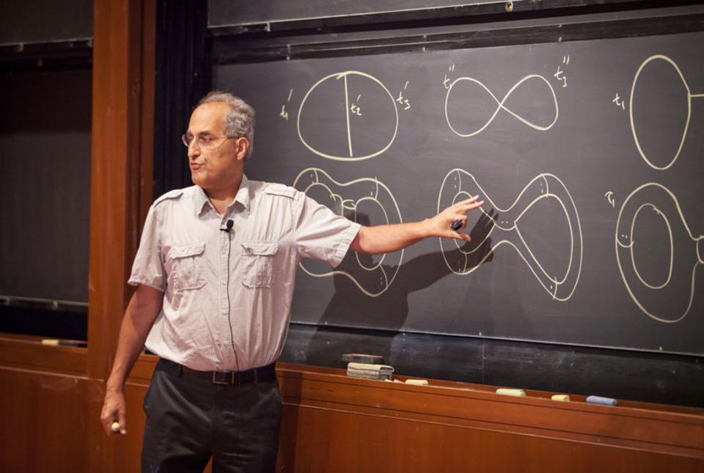
A Turning Point: Atiyah’s Question:
What is the physical interpretation of
the Donaldson invariants?

Slide 31


Slide 32
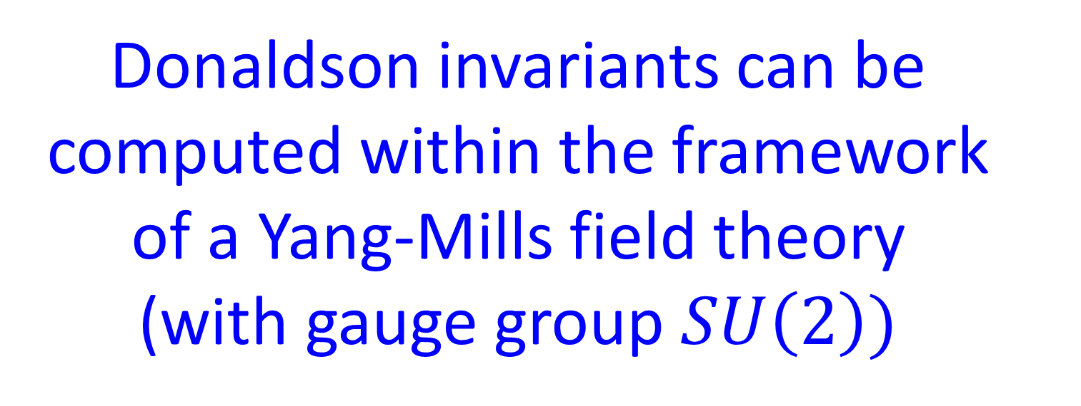
Witten’s Answer
Donaldson invariants can be computed within the framework
of a Yang-Mills field theory
(with gauge group $SU\left(2\right))$

Slide 34
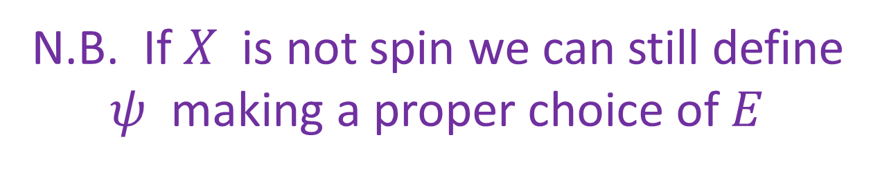

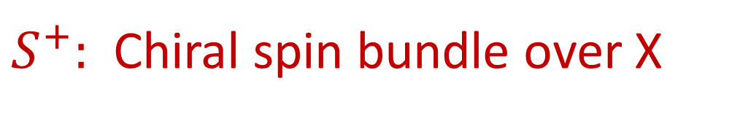
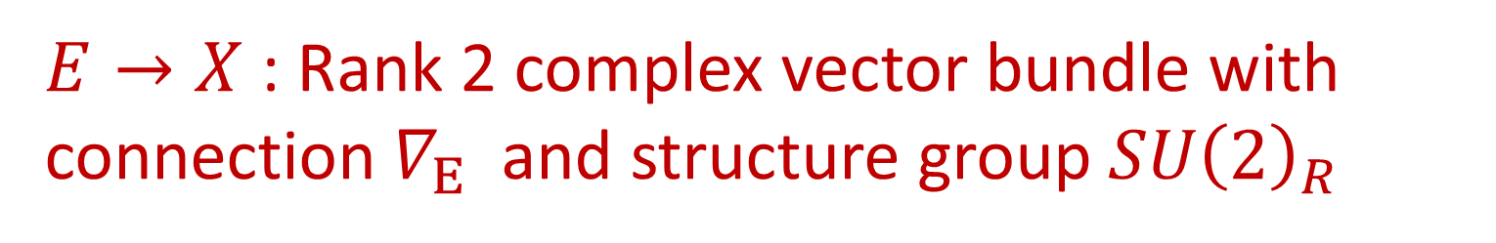
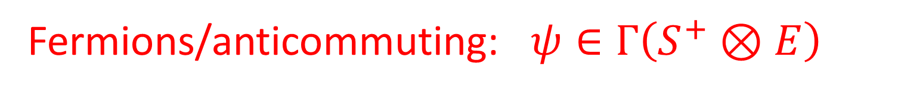

N=2 Super-Yang-Mills Theory
$$∇_{P}∈𝒜$$
Fields:
$$φ∈Γ\left(adP⊗ℂ\right)$$
Fermions/anticommuting: $ψ∈Γ\left(S^{+}⊗E\right)$
$S^{+}:$ Chiral spin bundle over X
$E→X$: Rank 2 complex vector bundle with connection $∇_{E}$ and structure group $SU{\left(2\right)}_{R}$
N.B. If$X$ is not spin we can still define $ψ$ making a proper choice of $E$
Notes:
A lot of the fun in Donaldson theory comes when we consider non-spin manifolds
So it is important to note that if X is not spin ….

Slide 35
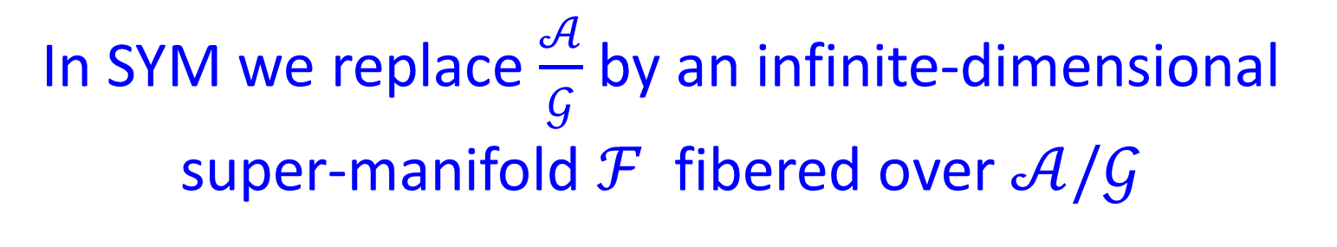

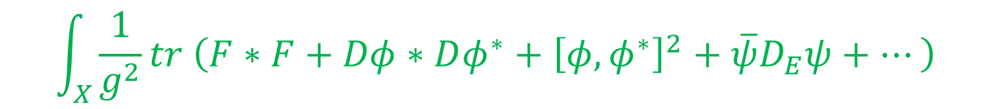
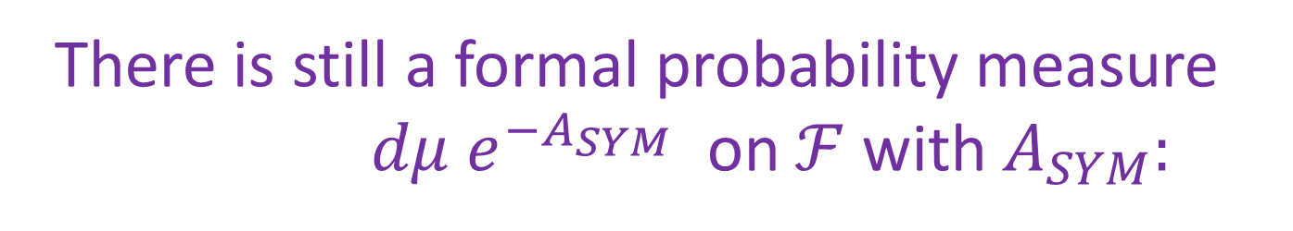
Topological Twisting
In SYM we replace $\frac{𝒜}{𝒢}$ by an infinite-dimensional
super-manifold $ℱ$ fibered over $𝒜/𝒢$
There is still a formal probability measure
$dμ e^{−A_{SYM}}$ on $ℱ$ with $A_{SYM}:$
$$\int_{X}{\frac{1}{g^{2}}tr \left(F∗F+Dφ∗Dφ^{∗}+{\left[φ,φ^{∗}\right]}^{2}+\overline{ψ}D_{E}ψ+⋯\right)}$$
For a special choice of $E,∇_{E}$ the variation of the measure wrt metric $g_{μν}$ on $X$ is a total derivative

Slide 36

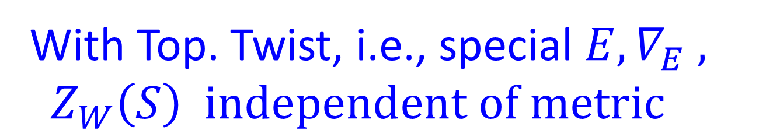



Observables In Witten’s Theory
$S⊂X$: smooth surface.
$$𝒪\left(S\right)≔\int_{S}{tr\left(φF+ψ^{2}\right)}$$
$$Z_{W}\left(S\right)≔〈e^{𝒪\left(S\right)}〉$$
$Z_{W}(S)$ is a function on $H_{2}\left(X;ℂ\right)$
With Top. Twist, i.e., special $E, ∇_{E} , Z_{W}\left(S\right) independent of metric$
Notes:
At least formally. Well, this should sound familiar!

Slide 37
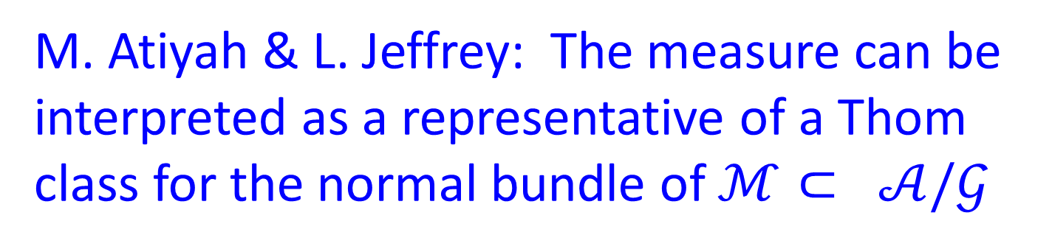
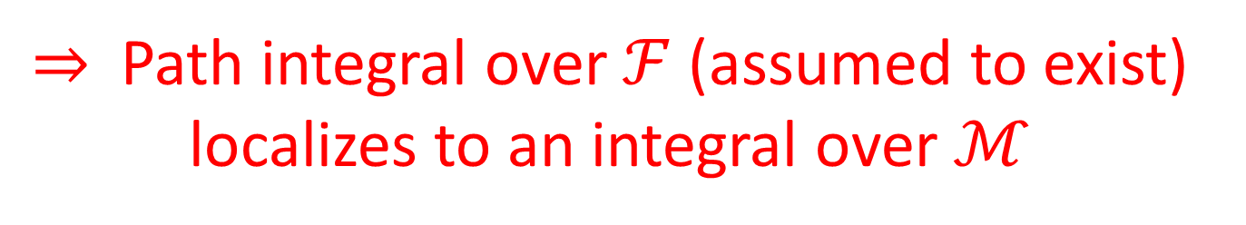

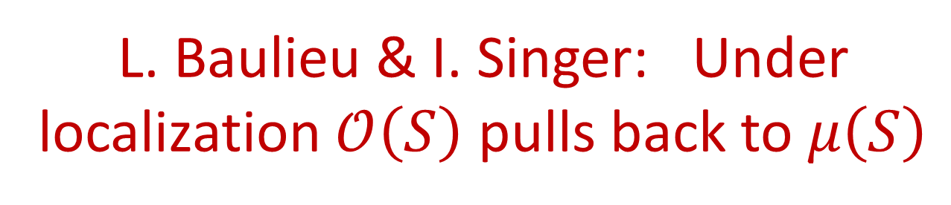
Localization
M. Atiyah & L. Jeffrey: The measure can be interpreted as a representative of a Thom class for the normal bundle of $ℳ⊂ 𝒜/𝒢$
$⇒$Path integral over $ℱ$(assumed to exist)
localizes to an integral over $ℳ$
L. Baulieu & I. Singer: Under localization $𝒪\left(S\right)$ pulls back to $μ\left(S\right)$
Claim: $Z_{D}\left(S\right)=Z_{W}\left(S\right)$
Notes:
And I will henceforth call it the Donaldson-Witten partition function

Slide 38


Slide 39


Slide 40
Quantum Field Theory
Computing Donaldson invariants
a la Witten requires computing
expectation values in a
Yang-Mills theory
How hard can that be?

Slide 41


Abelian field theory
Nonabelian field theory

Slide 42
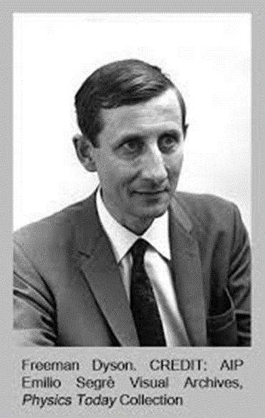
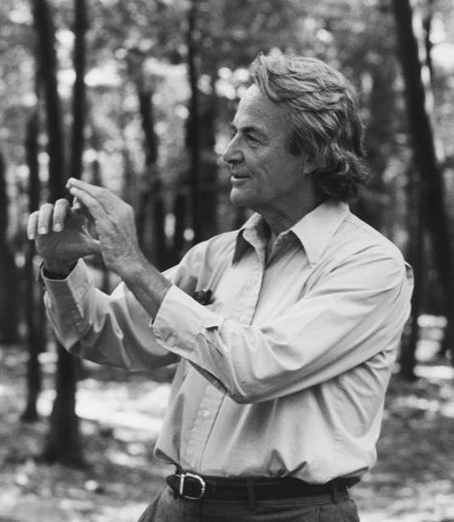
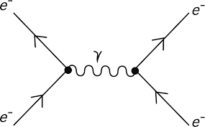

Abelian: Maxwell’s theory: Hard, but solvable - Feynman, Schwinger, Tomonaga (1946-1949)
Nonabelian: $MUCH^{n}$ harder:
Not solved yet

Slide 43
So, computing correlation functions of operators in nonabelian
Yang-Mills theory is extremely difficult
So we seem to have exchanged one hard problem for another…..

Slide 44
1
Physical Mathematics
2
Math & Physics Problems
3
Instantons & Donaldson Invariants
Topological Field Theory
4
5
Low Energy Effective Field Theory
6
New Results On $Z_{u}$
Directions For Future Research
7

Slide 45

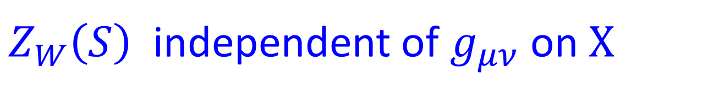
Low Energy Effective Theory – 1.1
$Z_{W}\left(S\right)$ independent of $g_{μν}$on $X$
Consider metric $L^{2}g_{μν}$ in the limit $L→∞$
Quantum theory: Length ~ 1/Energy
Minima of energy (or action): “Vacua”
Small deviations from a vacuum can be
described by a DIFFERENT QFT: The LEET

Slide 46
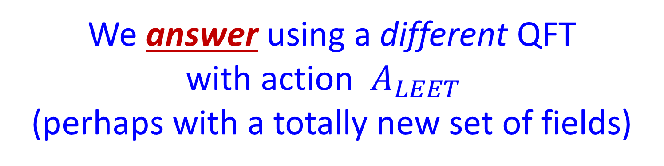

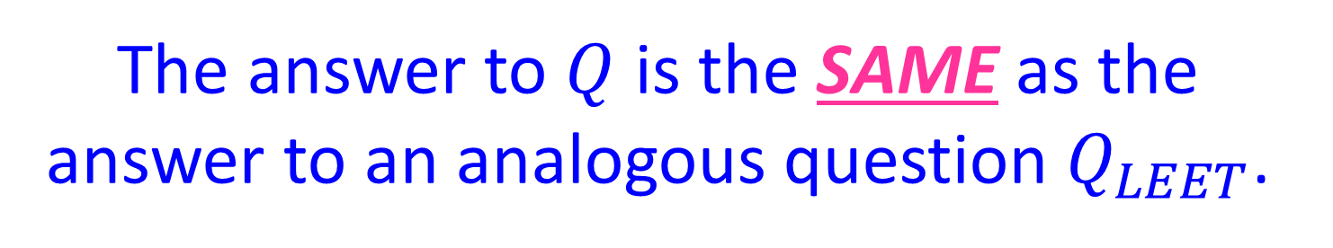
Low Energy Effective Theory – 1.2
We ask a question $Q$ of a QFT, with action $A,$
We answer using a different QFT
with action $A_{LEET}$
(perhaps with a totally new set of fields)
The answer to $Q$ is the SAME as the answer to an analogous question $Q_{LEET}$.

Slide 47
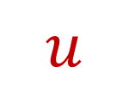


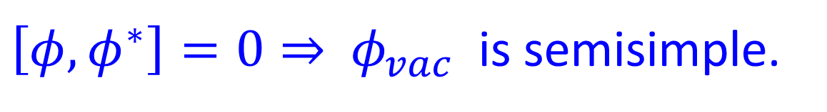
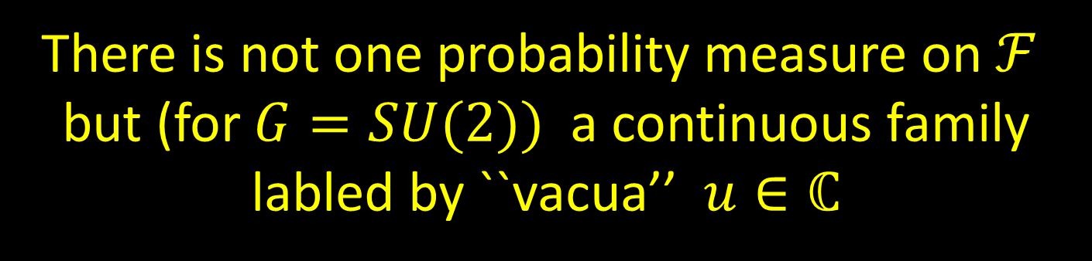


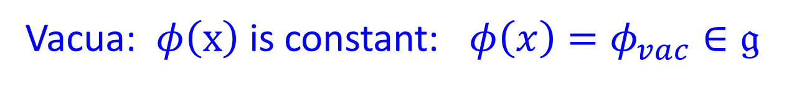
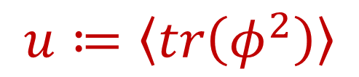
Moduli Spaces Of Vacua
$$A_{SYM}=\int_{ℝ^{4}}{tr( F∗F+{\left|Dφ\right|}^{2 }}+{\left[φ,φ^{∗}\right]}^{2})$$
Vacua: $φ\left(x\right)$ is constant: $φ\left(x\right)=φ_{vac}∈𝔤$
$\left[φ,φ^{∗}\right]=0⇒$ $φ_{vac}$ is semisimple.
Any constant will do! So there is a moduli space of vacua:
$$SU\left(2\right):$$
$u≔〈tr\left(φ^{2}\right)〉$
$∼$
$tr(φ_{vac}^{2})∈ℂ$
$$u$$
There is not one probability measure on $ℱ$ but (for $G=SU(2))$a continuous family labled by ``vacua’’ $u∈ℂ$

Slide 48

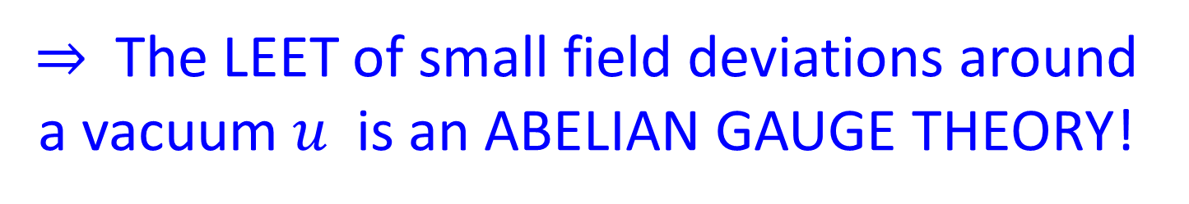
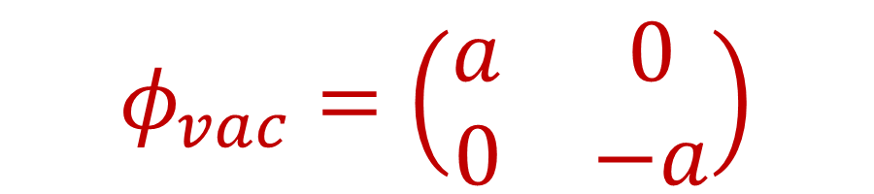
Spontaneous Symmetry Breaking
For $G=SU\left(2\right):$ gauge $φ_{vac}$to the form
$$φ_{vac}=\left(\begin{matrix}a & 0 \\ 0 & −a\end{matrix}\right)$$
Automorphisms of the vacuum are
U(1) gauge transformations.
$⇒$The LEET of small field deviations around a vacuum $u$ is an ABELIAN GAUGE THEORY!

Slide 49
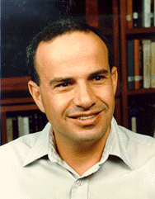









Seiberg-Witten Paper
Seiberg & Witten (1994)
The LEET has action $A_{LEET}^{u}$ that depends on $u$
Seiberg-Witten: $A_{LEET}^{u}$ can be computed from the periods of a meromorphic 1-form $λ_{u}$ on a family of Riemann surfaces $Σ_{u}$
$$G=SU\left(2\right):$$
$$E_{u}: y^{2}=x^{2}\left(x−u\right)+\frac{1}{4}x$$
$$E_{u}$$
$$λ=\frac{dx}{y}\left(x−u\right)$$
$$u$$
Notes:
Many aspects of the physics are encoded in this family of Seiberg-Witten curves

Slide 50




Local System Of Charges
Electro-mag. charge lattice: $Γ_{u}=H_{1}(E_{u};ℤ)$
Electromagnetic duality: To write a LEET we must choose a splitting:
$$Γ_{u}≅ℤγ_{e}⊕ℤγ_{m}⇒τ\left(u\right)$$
$A_{LEET}^{u}∼\int_{X}{\overline{τ\left(u\right)}F_{+}^{2}+τ(u)F_{−}^{2}+⋯}$
$Γ_{u}$ has nontrivial monodromy around discriminant locus: $Δ\left(u_{j}\right)=0$
Notes:
Moreover, to write the action one actually uses this lattice.
These theories enjoy electromagnetic duality: What this means is that
To write an action one must choose a splitting of this symplectic
Lattice – that is, a choice of A and B-cycles.

Slide 51






$$E_{u_{j}}$$
$$E_{u}$$
$u_{1}$=-1
$$u$$
$u_{2}$=+1

Slide 52




Seiberg-Witten Theory - II
LEET breaks down near discriminant locus:
BUT!
$$u_{1}=−1$$
$$u_{2}=1$$
Near $u_{j}$we can use a different LEET – there are new
fields (``monopole fields’’) which need to be included.
It is also an Abelian gauge theory and
has an action $A_{LEET}^{u_{j}}$

Slide 53




SUMMING OVER VACUA
Quantum effects $⇒$ the path integral for compact $X$will be given by a sum over ALL the vacua on $ℝ^{4}$.
Two kinds of vacua
Continuous moduli space of vacua parametrized by $u≔{〈trφ^{2}〉}_{u}∈ℂ$
ALSO: The LEET $A_{LEET}^{u_{j}}$ near the discriminant loci $u_{j}∈\{ −1, +1 \} each has$ its own set of vacua.
Vacua of $A_{LEET}^{u_{j}}$ are enumerated by the solutions to the renowned Seiberg-Witten equations

Slide 54






Evaluate $Z_{DW}\left(S\right)$Using LEET
$$Z_{D}(S)=\int_{ℳ}{e^{μ\left(S\right)}}$$
$${=Z_{W}\left(S\right)= 〈e^{𝒪\left(S\right)}〉 }_{ }$$
$$Z_{W}=Z_{u}+\sum_{u_{j}}{Z_{j}^{SW}}$$
$$u=−1$$
$$u=1$$

Slide 55


Preliminary Comments On $Z_{u}$
${ Z}_{u}$an explicit integral over complex
$u−$plane computed using QFT techniques
We will return to it and
discuss it in detail.
But first let’s finish writing down the
full answer for the path integral.

Slide 56






Contributions From $u_{j}$
Path integral for the LEET with action $A_{LEET}^{u_{j}}$takes
the general form of a sum over vacua (soln’s to SWE):
$𝔰𝔭𝔦𝔫c$structure:
$$\sum_{λ∈𝔖𝔭𝔦𝔫c}{SW\left(λ\right) R_{λ}\left(S\right) }$$
$$w_{2}\left(TX\right)=λ mod 2$$
$$R_{λ}\left(S\right):=Res_{u_{j}}[ \left(\frac{du}{u}\right) e^{S^{2}T\left(u\right)+i\frac{S⋅λ}{ω\left(u\right)} }C{\left(u\right)}^{λ^{2}}P{\left(u\right)}^{σ}E{\left(u\right)}^{χ}]$$
$ω\left(u\right):$ Nonvanishing period in the neighborhood of $u_{j}$
$$T\left(u\right) ∼ω{\left(u\right)}^{−2} E_{2}\left(τ\left(u\right)\right)$$
Notes:
Now to write the Seiberg-Witten equations one needs to choose
What is called a spin-c structure on X. For our purposes this is just
A cohomology class

Slide 57



Everything is already known EXCEPT:
$$C{\left(u\right)}^{λ^{2}}P{\left(u\right)}^{σ}E{\left(u\right)}^{χ}$$
Functions $C,P,E$ : independent of $X$
but difficult to derive from first principles.
Using a phenomenon known as
``wall crossing’’ one can derive $C,P,E$, directly from $Z_{u}$
$⇒$ $Z_{u}$ is of fundamental importance.

Slide 58







Witten Conjecture
$Z_{u}=0$ when $b_{2}^{+}>1⇒$
If X has $b_{2}^{+}>1$ then:
$$Z_{DW}\left(S\right)=2^{c^{2}−χ_{h}} ( e^{\frac{1}{2}S^{2}}\sum_{λ}{SW\left(λ\right) e^{S⋅λ}+}$$
$$+ i^{χ_{h}}e^{−\frac{1}{2}S^{2}}\sum_{λ}{SW\left(λ\right)e^{−iS⋅λ})}$$
$$χ_{h}=\frac{χ+σ}{4}$$
Example: $X=K3:$
$$Z_{DW}(S)=\text{sinh}{(\frac{S^{2}}{2})}$$
$$c^{2}=2χ+3 σ$$
Notes:
Say in words: when b2+ > 1 Z-u vanishes.

Slide 59


The Donaldson invariants can be written in terms of the Seiberg-Witten invariants: They carry the same information about the four-dimensional space
Much easier
to compute!
Notes:
Just like we saw how counting the holes and the sources of sinks of flowing water on a surface encode the same invariant.

Slide 60


Notes:
Cultural differences between physicists and mathematicians.

Slide 61


Mad Dash After A Breakthrough

Slide 62
Comments On The Witten Conjecture
Agrees with structure theorem of P. Kronheimer and T. Mrowka – whose work provided important background for Witten’s conjecture.
Physical derivation sketched above was given by G. Moore and E. Witten in 1997
P. Feehan and T. Leness have outlined
a rigorous proof of this conjecture using standard techniques of differential geometry.

Slide 63

1
Physical Mathematics
2
Math & Physics Problems
3
Instantons & Donaldson Invariants
Topological Field Theory
4
Low Energy Effective Field Theory
5
6
New Results On $Z_{u}$
Directions For Future Research
7

Slide 64






$u$-Plane Integral $Z_{u}$
Can be computed explicitly from QFT of LEET
Vanishes if $b_{2}^{+}>1$ .
When $b_{2}^{+}=1:$
$$Z_{u}=∫du d\overline{u} ℋ Ψ$$
$ℋ$ is holomorphic and metric-independent
$Ψ$: Sum over principal $U\left(1\right)$ bundles for gauge field
of the Abelian LEET:
$$Ψ∼\sum_{v=c_{1}\left(L\right)}{e^{−i π\overline{τ}\left(\overline{u}\right)v_{+}^{2}−i πτ\left(u\right)v_{−}^{2}}}$$
NOT holomorphic and metric- DEPENDENT

Slide 65


u-Plane: Recent Progress 1.1
The u-plane integral turns out to be closely related to the theory of mock modular (and Jacobi) forms
Such a connection was noted for special cases
$X=ℂℙ^{2} \& S^{2}×S^{2}$by Moore-Witten (1997)
and Malmendier-Ono (2008)
New point: The relation holds for ALL 4-manifolds with $b_{2}^{+}=1$
G. Korpas, J. Manschot, G. Moore, I. Nidaiev (2019)

Slide 66







u-Plane: Recent Progress 1.2
$$E_{u}: y^{2}=x^{2}\left(x−u\right)+\frac{1}{4}x$$
There is a unique A-cycle in $H_{1}\left(E_{u};ℤ\right)$ invariant under monodromy $u→e^{2πi }u$ (for $\left|u\right|>1 )$
$$ω≔\oint_{A}{\frac{dx}{y}}$$
Choose B-cycle:$⇒$
$$τ\left(u\right)=\oint_{B}{\frac{dx}{y} /\oint_{A}{\frac{dx}{y}}}$$
$$u=\frac{θ_{2}^{4}+θ_{4}^{4}}{2 θ_{2}^{2}θ_{4}^{2}} =\frac{1}{8}q^{−\frac{1}{4}}+\frac{5}{2}q^{\frac{1}{4}}+⋯$$
$$q=e^{2πiτ}$$

Slide 67

$$Γ^{0}\left(4\right)=\{\left(\begin{matrix}∗ & 0 \\ ∗ & ∗\end{matrix}\right)mod4\} ⊂SL\left(2,ℤ\right)$$

Slide 68







Relation To Mock Modular Forms – 1.1
$Z_{u}$ : A sum of integrals of the form :
$$I_{f}=\int_{ℱ_{∞}}{dτd\overline{τ} {\left(Im τ\right)}^{−s} f\left(τ, \overline{τ}\right)}$$
$$f\left(τ, \overline{τ}\right)=\sum_{m−n∈ℤ }{c\left(m,n\right)q^{m} {\overline{q}}^{n}}$$
Support of $c$ is bounded below
Strategy: Find $\hat{h}\left(τ,\overline{τ}\right)$such that
$$∂_{\overline{τ}}\hat{h} ={\left(Im τ\right)}^{−s} f\left(τ,\overline{τ}\right)$$
$\hat{h} \left(τ,\overline{τ}\right)$ is modular of weight (2,0)
Notes:
Say in words the measure is modular invariant . Say in words that modularity of h-hat is crucial so that the finite boundaries do not contribute.

Slide 69







Relation To Mock Modular Forms – 1.2
$$\hat{h}\left(τ, \overline{τ}\right)=h\left(τ\right)+R$$
We choose an explicit solution
$∂_{\overline{τ}}R ={(Imτ)}^{−s} f\left(τ,\overline{τ}\right)$
vanishing exponentially fast at $Imτ→∞$
$h\left(τ\right)$: mock modular form
$$h\left(τ\right)=\sum_{m∈ℤ}{d\left(m\right)q^{m}}$$
$$q=e^{2πiτ}$$
$$h\left(−\frac{1}{τ}\right)=τ^{2}h\left(τ\right)$$
$$+τ^{2}\int_{−i∞}^{0}{\frac{f\left(τ,\overline{v}\right)}{{\left(\overline{v}−τ\right)}^{s}}d\overline{v}}$$

Slide 70





Doing The Integral
$$I_{f}=\int_{ℱ_{∞}}{dτd\overline{τ} y^{−s} f\left(τ, \overline{τ}\right)}$$
$$∂_{\overline{τ}}\hat{h} =y^{−s} f\left(τ,\overline{τ}\right)$$
$$h\left(τ\right)=\sum_{m∈ℤ}{d\left(m\right)q^{m}}$$
$$I_{f}=d\left(0\right)$$
Note: $d\left(0\right)$undetermined by diffeq but fixed by the modular properties: Subtle!
$∃$Long history of the definition & evaluation of such integrals with singular modular forms – refs at the end.

Slide 71







Examples 1.1
$$X=ℂℙ^{2}: b_{2}=b_{2}^{+}=1$$
$$Z_{u}=\int_{ℱ_{∞}}{dτd\overline{τ} ℋ Ψ }$$
$ℋ=\frac{θ_{4}^{12}}{η^{9}}exp[{S^{2}T\left(τ\right) ] }$
$$Ψ=e^{−2πy b^{2}}\sum_{k∈ℤ+\frac{1}{2}}{∂_{\overline{τ}}\left(\sqrt{y} \left(k+b\right)\right){\left(−1\right)}^{k} {\overline{q}}^{k^{2}} e^{−2πi \overline{z} k }}$$
$$z=\frac{S}{ω}$$
$$b=\frac{Im\left(z\right)}{y}$$
$$y=Im\left(τ\right)$$
Notes:
Well, H and Psi are complicated, but nevertheless we found an h-hat
And the holomorphic part is:

Slide 72






Examples 1.2
$$h\left(τ,z\right)= \frac{r}{θ_{4}\left(τ\right)}\sum_{n∈ℤ }{\frac{{\left(−1\right)}^{n}q^{\frac{n^{2}}{2}−\frac{1}{8}}}{1−r^{2}q^{n−\frac{1}{2}}}}$$
$$z=\frac{S}{ω}$$
$$r=e^{i π z}$$
$$ω=θ_{2}\left(τ\right)θ_{3}\left(τ\right)$$
$$Z_{u}=Z_{DW}\left(S\right)={\left[ ℋ h\left(τ,z\right)\right]}_{q^{0}}$$
$$Z_{DW}\left(S\right)=−\frac{3}{2}S+S^{5}+3 S^{9}+54 S^{13}+2540 S^{17}+⋯$$

Slide 73

Examples 1.3
$$b_{2}=2 \& b_{2}^{+}=1$$

Slide 74

1
Physical Mathematics
2
Math & Physics Problems
3
Instantons & Donaldson Invariants
Topological Field Theory
4
Low Energy Effective Field Theory
5
New Results On $Z_{u}$
6
Directions For Future Research
7

Slide 75



Notes:
Well, 1994 was 25 years ago. Has anything happened since then? Well, quite a bit.
I have just told you one vignette within the larger subject of physical mathematics.
I could tell you other remarkable stories of the interplay between mathematicians
And physicists.
You might still be wondering: What about the four-manifold story? Well, there
Has been steady progress, and new results. I’ve produced a few myself. There
Hasn’t been anything like the Seiberg-Witten revolution – but it is clear the story is not over. The SW invariants are blind to certain very interesting questions about 4-dimensional spaces. As I said: We do not have anything close to a complete topological
Invariant. Will physics once again point the way? Some of us hope so, but we
Don’t know. That is always the nature of research, we don’t know what we’ll find because we are exploring the unknown –
Thanks for your attention.

Slide 76

FUTURE DIRECTIONS
Other N=2 Theories
Family Invariants
3. $b_{2}^{+}=0$
4. Manifolds with boundary and Floer theory
5. Physical Interpretation of Bauer-Furuta Invariant?
6. Vafa-Witten theory (twisted N=4 SYM)

Slide 77


What About Other N=2 Theories?
There are infinitely many other four-dimensional N=2 supersymmetric quantum field theories.
Topological twisting makes sense
for any $𝒩=2$ theory $𝒯$.
Natural Question: Given the successful application
of $𝒩=$ 2 SYM for $G=SU(2)$ to the theory of
4-manifold invariants, are there interesting applications of OTHER $𝒩=$ 2 field theories?

Slide 78






How Lagrangian Theories Generalize Donaldson Invariants
$$=\int_{ℳ}{e^{μ\left(S\right)}ℰ}\left(𝒱\right)$$
$$Z\left(S\right)={〈e^{𝒪\left(S\right)}〉}_{𝒯}$$
But now $ℳ$: is the moduli space of:
$$F^{+}=𝒟(M,\overline{M})$$
$$γ⋅D M=0$$
$$M∈Γ\left( W^{+}⊗V\right)$$
$W^{+}:$ Rank 2 bundle associated to a $𝔰𝔭𝔦𝔫c$ structure
``Generalized monopole equations’’
[Labastida-Marino; Losev-Shatashvili-Nekrasov]
U(1) case: Seiberg-Witten equations.
Notes:
Say in words V is an associate bundle to the gauge bundle for a quaternionic representation of G

Slide 79




Example: SU(2) $𝒩=2^{∗}$
$$M∈Γ\left( W^{+}⊗ad P⊗ℂ\right)$$
It has been a long-standing problem to derive a formula for $Z_{u}$ for this theory when $X$ is not spin.
The generalization is nontrivial and involves
unknown interactions in the LEET that depend on the $𝔰𝔭𝔦𝔫c$ structure.
Recent work with Jan Manschot has derived these interactions – they violate some folk wisdom.
Notes:
As an application of these newly discovered interactions we
Decided to revisit the old puzzle of the conflict between holomorphy
And modularity in this theory.

Slide 80





Puzzle Of Holomorphy vs. S-duality
The definition of the
$𝒩=2^{∗}$theory depends
on a choice of $τ_{0}:$
$$τ_{0}=\frac{θ}{2π}+ i \frac{4π}{g^{2}}$$
S-duality: Physical quantities only depend on the isomorphism class of $E_{τ_{0}}=ℂ/(ℤ+τ_{0}ℤ)$
Formal arguments: The path integral $Z_{2^{∗}}\left(S;τ_{0}\right)$ is both a modular form in $τ_{0}$and holomorphic in $τ_{0}$.
Problem: For $X=ℂℙ^{2}$There is no suitable modular form of the required weight and multiplier system!

Slide 81




$Z_{u}$To The Rescue
Resolution: The path integral is modular in $τ_{0}$, but not holomorphic.
It is a nonholomorphic completion
of a mock modular form.
Now $Z_{u}$, not just its integrand, is a mock modular form (of $τ_{0})$
$Z_{u}$depends on the $𝔰𝔭𝔦𝔫c$structure.
Notes:
But for a special choice of spin-c structure we can make contact with
a famous result of Vafa and Witten.

Slide 82




Example
$${c ≔c}_{1}(\det{W^{+}) }$$
For $c^{2}=9$ and $w_{2}\left(adP\right)=0$
$$Z\left(0,τ_{0}\right)=h\left(τ_{0}\right)+\int_{−\overline{τ_{0}}}^{i∞}{\frac{θ_{3}\left(2u\right)}{{\left(τ_{0}+u\right)}^{\frac{3}{2}}}du }$$
Fourier expansion of $h\left(τ_{0}\right)$ is related to class numbers
This case should be compared with
result of Vafa-Witten for N=4 SYM
Notes:
So, even in one of the simplest N=2 Lagrangian theories, beyond the Seiberg-Witten example, there are interesting things to learn.

Slide 83
Class S: Conjecture A
Another class of theories is derived from
six-dimensional QFT by compactification on a Riemann surface C. [Lerche et. al.; Witten; Gaiotto; Gaiotto,Moore,Neitzke]
Not always described by an action principle – somewhat more mysterious.
Conjecture A: For all Lagrangian and all class S theories the four-manifold invariants can be written in terms of Seiberg-Witten invariants, using formulae generalizing the Witten conjecture.
Nontrivial checks: Pure SU(N) [M. Marino & G. Moore]
& simplest non-Lagrangian [Moore-Nidaiev]

Slide 84
Family Donaldson Invariants – 1.1
There is an interesting generalization to invariants for families of four-manifolds.
Mentioned by Donaldson long ago. Little work has been done.
$$Z_{D}\left(S\right)∈H^{∗}(BDiff\left(X\right))$$

Slide 85



Family Donaldson Invariants – 1.2
Couple to ``topologically twisted supergravity’’
$$Z\left[g_{μν},Ψ_{μν}\right]=〈\exp{( \int_{X}{Ψ^{μν}Λ_{μν} ) 〉}}$$
Closed & horizontal diff(X)-equivariant
differential form on $Met(X)$
Descends to cohomology class $∈H^{∗}(\frac{Met\left(X\right)}{Diff\left(X\right)})$
Conjecture B: These are the
family Donaldson invariants
Under discussion with J. Cushing, M. Rocek, and V. Saxena

Slide 86

NOT

Slide 87
Some references for evaluation of modular integrals:
H. Peterson, Math. Ann. 127, 33 (1954)
Dixon-Kaplunovsky-Louis, Nucl. Phys. B329 (1990) 27
Harvey-Moore, Nucl. Phys. B463 (1996) 315
Moore-Witten, Adv. Theor. Math. Phys. 1 (1997) 298
Borcherds, Inv. Math. 132 (1998) 491
Brunnier-Funke, Duke Math J. 125.1 (2004)
Bringmann-Diamantis-Ehlen, Int. Math. Res. Not. (2017)
Korpas-Manschot-Moore-Nidaiev, e-print arXiv:1910.13410

