Slide 1

The Shapes Of Spaces and the
Nuclear Force
Gregory Moore
Rutgers University
IAS, May 29, 2019

Slide 2
1
Physical Mathematics
Topological Invariants Of Spaces
2
Physics: Maxwell & Yang-Mills
3
The Mathematicians Take Note
4
Topological Field Theory
5
Effective Theories & A Breakthrough
6
Settling A Debate & A Summary
7

Slide 3
Phys-i-cal Math-e-ma-tics, n.
Brit. /ˈfɪzᵻkl ˌmaθ(ə)ˈmatɪks / , U.S. /ˈfɪzək(ə)l ˌmæθ(ə)ˈmædɪks/
Pronunciation:
Physical mathematics is a fusion of mathematical and physical ideas, motivated
by the dual, but equally central, goals of
elucidating the laws of nature at their most fundamental level, together with
discovering deep mathematical truths.

Slide 4
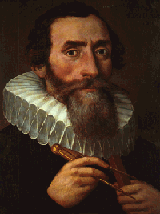
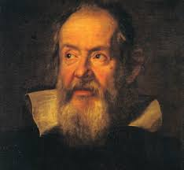
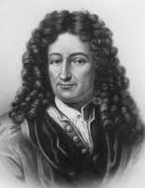
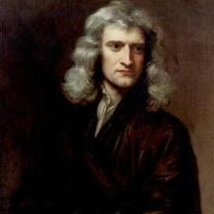
Kepler
Galileo
Mathematicians ?
Physicists?
Newton
Leibniz
Notes:
We could ask: Were tje founders of the modern scientific era in the 16th and 17th century such as
Kepler, Galileo, Newton, and Leibniz, mathematicians? Or physicsists?
I am not a historian or philosopher of science, but my impression is that
Were neither – they thought of themselves as “natural philosophers’’

Slide 5
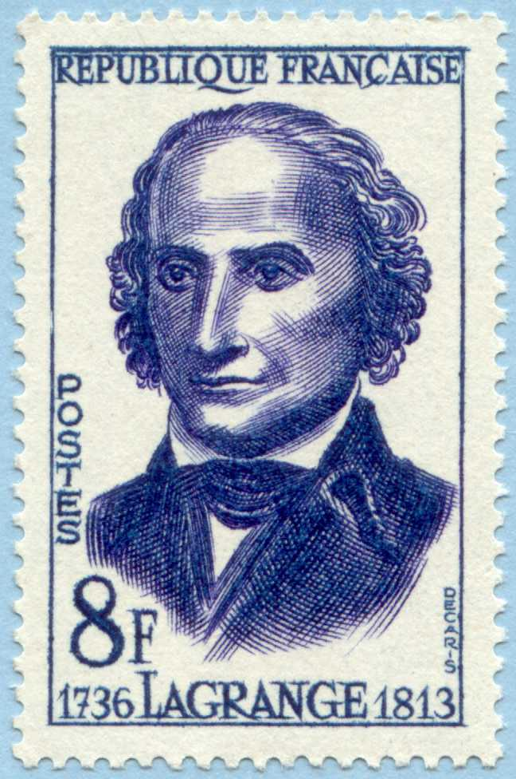
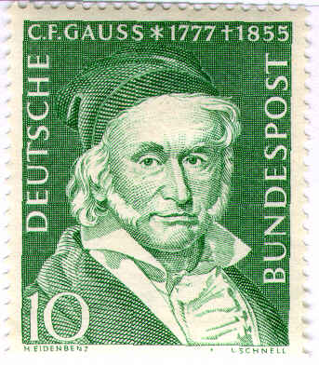
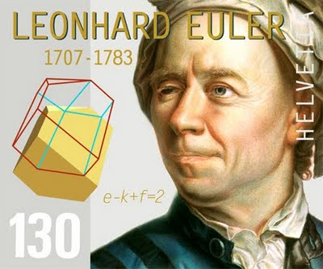
When did Natural Philosophers become either
Physicists or Mathematicians?
Even around the turn of the 19th century …
The separation is a result of specialization and the growth
of science in the 19th century.
Notes:
Well, these days we no longer have natural philosophers. We have physicists and mathematicians.
So we should ask –
The separation has had its ups and downs – and this is discussed in detail in Graham’s book.
One high point of the interaction was surely shortly after the discovery of the present form of
Quantum mechanics. You can find exuberant statements of the importance of the relation
Between math and physics from Dirac and Einstein during this period. My favorite is the
Opening of Dirac’s momentous paper on the magnetic monopole -

Slide 6
As described in detail in Graham Farmelo’s book, in the mid-twentieth century, there was a long divorce between fundamental physics and modern mathematics.
This started to change in the late 1960’s and early 1970’s.

Slide 7
Some great mathematicians
got interested in aspects of fundamental physics …..
While some great physicists started producing results requiring ever increasing mathematical
sophistication, …..

Slide 8
Physical Mathematics
In the past few decades a new field has emerged
with its own distinctive character, its own aims and values,
its own standards of proof.
One of the guiding principles is certainly the discovery
of the ultimate foundations of physics.
This quest has led to ever more sophisticated mathematics…
A second guiding principle is that physical insights can lead to surprising and new results in mathematics
Such insights are a great success - just as profound and notable as an experimental confirmation
of a theoretical prediction.
Notes:
This is what Graham’s book is about.

Slide 9
Today:
I will explain just one emblematic example of a remarkable convergence
of physical and mathematical ideas.
Notes:
It is a story in which I played a role, but not a starring role.
At least two of the people that did play a starring role are in the audience.
One of the major stars is no longer with us.

Slide 10
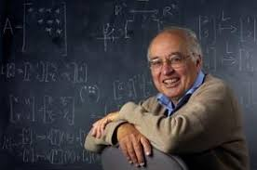
Notes:
Aside from being absolutely brilliant Michael was extremely friendly
and just bubbled over with infectious enthusiasm. He was always overflowing
with ideas and was always extremely generous and willing to share his insights and
Thoughts. We will certainly miss him greatly.

Slide 11
Two Basic Questions
Mathematics
What is the shape of a space?
How can we tell when two geometric objects
can be deformed into each other ?
Physics
What holds stuff together?
How can we describe the forces
that attract and repel matter?
Notes:
On the face of it, these questions appear to have absolutely no relation to each
Other. In fact, as I will describe, they are quite deeply related.

Slide 12
1
Physical Mathematics
Topological Invariants Of Spaces
2
Physics: Maxwell & Yang-Mills
3
The Mathematicians Take Note
4
Topological Field Theory
5
Effective Theories & A Breakthrough
6
Settling A Debate & A Summary
7

Slide 13
Mathematics
What is the shape of a space?
How can we tell when two geometric objects
can be deformed into each other ?
Notes:
So, let’s start with the mathematical question.

Slide 14

Topology
Take a geometrical object – a ``space’’
You can continuously deform it :
You can squish, pull, push,
just don’t cut, rip, or tear.
In topology the surface of a coffee cup and of a donut are ``the same.’’
Notes:
We live in three dimensions: There are three independent directions in which we
Can move: One of them is up and down. Another is left and right. Another is forward and back.
Time is a fourth dimension, although for us it is special because we can’t willingly move in
Both directions. But mathematically there is no problem identifying it as a dimension.

Slide 15
Suppose we have different spaces
– like the surface of a coffee cup, of a donut, and of a basketball –
Are they ``topologically the same’’ ?
We need to find a property that does not change under deformation:
``topological invariant”.
One such property is the
“dimension” of a space.

Slide 16
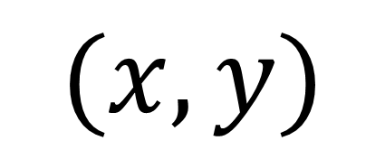
$$(x,y)$$

Slide 17
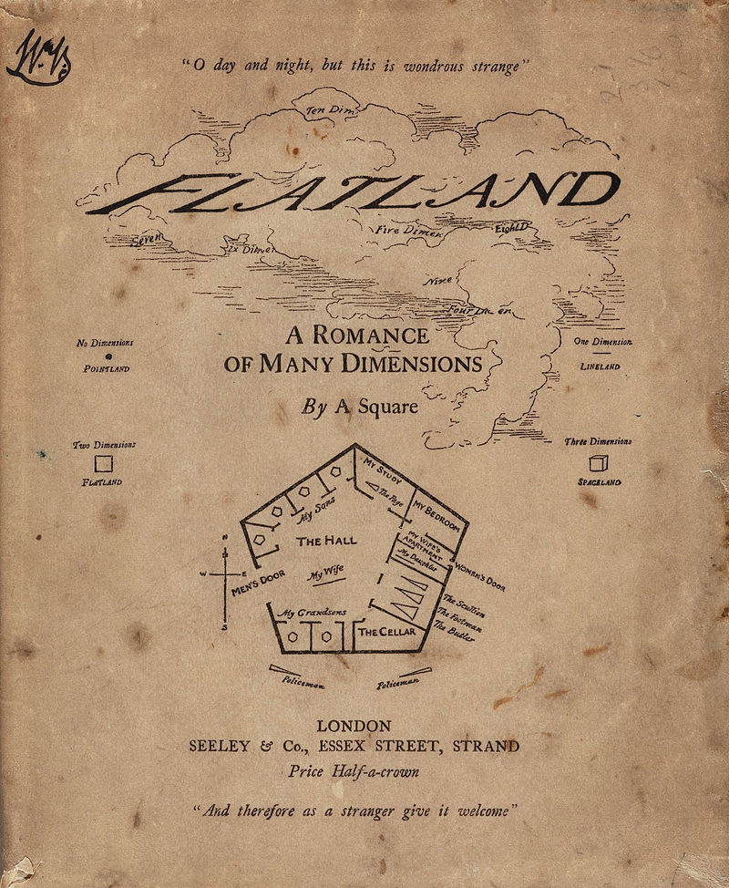


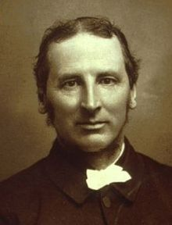

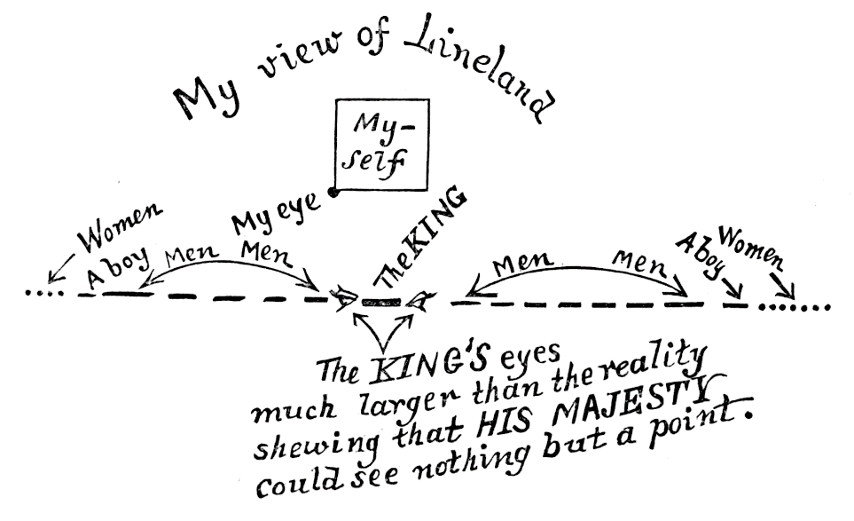
Notes:
In this figure the x-axis is pointing out of the screen, into the third dimension.
You can imagine life in worlds of different dimensions. This goes back
at least to the beloved book ``Flatland’’
by a certain Mr. Square. It’s a delightful mathematical exploration of what life is like in
different dimensions. It is also a biting satire on the injustices of Victorian society.
Whatever you may think of Victorian society, it was undeniably 3+1 dimensional, and
the author Edwinn Abbott lived in a 3+1 dimensional world. Nevertheless, if we
imagine him interacting with the inhabitants of LineLand we have an example of a surface defect:
The inhabitants of LineLand describe their world with a 1+1 dimensional QFT, but there are
Also interactions with ambient 3+1 dimensional beings like Edwin Abbott
Of course, LineLand could be embedded in a 2+1 dimensional Flatland, (as in the book),
But FlatLand is embedded in Abbott’s 3+1 dimensions – so we have an example of
a defect within a defect.
And clearly you can generalize this…

Slide 18
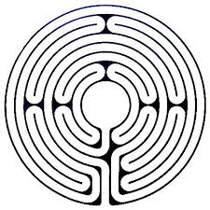
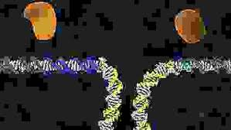
One Dimension

Slide 19
One Dimension
Notes:
NOW DO THE GLUING DEMONSTRATION WITH A SHOESTRING –
(Nima told me this conference was being run on a shoestring – so I took him
Literally.)

Slide 20
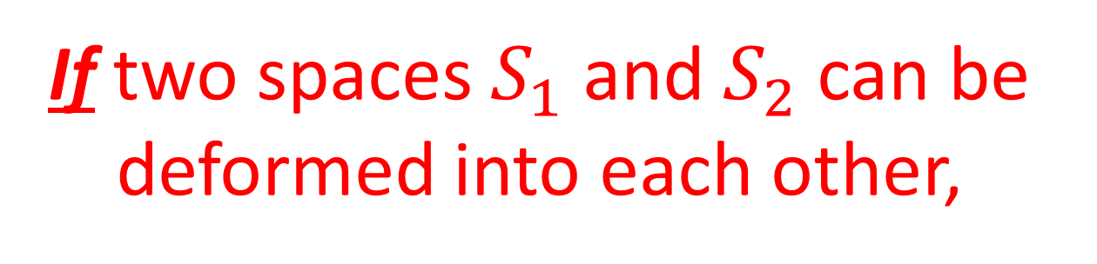
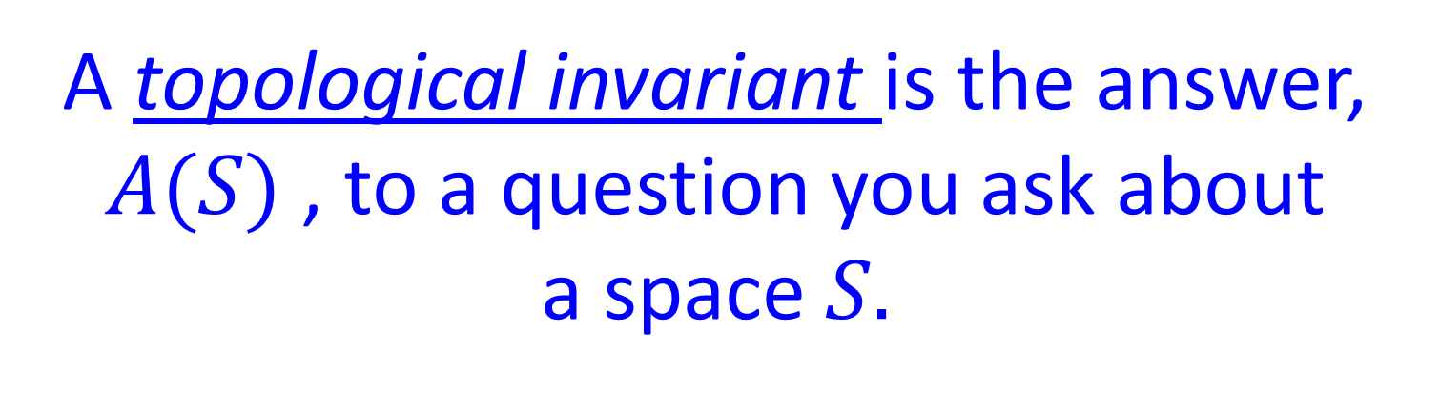

Topological Invariant
A topological invariant is the answer, $A(S)$ , to a question you ask about
a space $S.$
If two spaces $S_{1}$ and $S_{2}$ can be deformed into each other,
i.e. if two spaces are topologically equivalent.
Then, the answers to the question must be the same:
$$A\left(S_{1}\right)=A\left(S_{2}\right)$$

Slide 21


A One-Dimensional Topological Invariant
Question:
Take a little walk: Do you get back home ?
(always walk forward)
If $A\left(S\right)=$ Yes
Then $S$ is topologically a circle
If $A\left(S\right)=$No
Then $S$ is topologically a line
Notes:
That’s all there is: Two cases.
From now on I’m going to talk about spaces, like the circle, that have no boundary, no ends.
“complete topological invariant” – it’s the question which, if you can answer it,
Tells you exactly what the topological type is. It’s like 20 questions – you can ask
Questions which give you partial information – a “complete topological invariant”
Is like a single question which, if answered, identifies the object exactly.

Slide 22
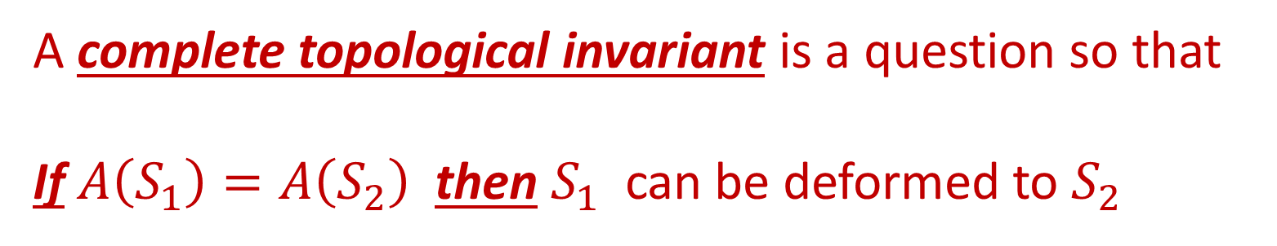
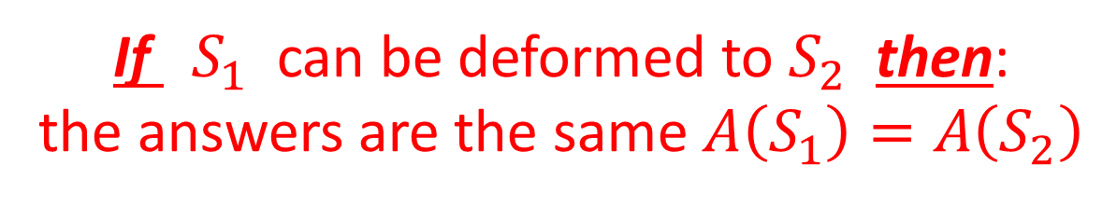
A Complete Topological Invariant
Topological invariant: A question so that,
If ${ S}_{1}$ can be deformed to $S_{2}$ then:
the answers are the same $A\left(S_{1}\right)=A\left(S_{2}\right)$
Dimension is a topological invariant –
But it doesn’t distinguish two different spaces: Circle and Line are both one dimensional
A complete topological invariant is a question so that
If $A\left(S_{1}\right)=A\left(S_{2}\right)$ then $S_{1}$can be deformed to $S_{2}$

Slide 23

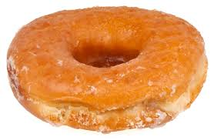
Two Dimensions

Slide 24
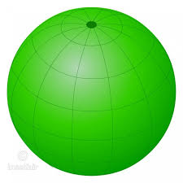
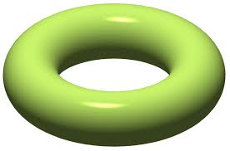
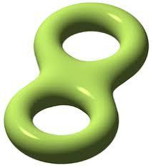
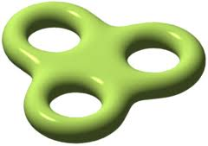
etc.

Slide 25
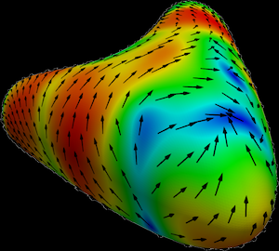
Measuring Topology By Counting
Complete topological invariant: Count holes
More than one
way to count …
If water is flowing on
the surface:
Notes:
Actually the two are the same. That’s a theorem – proven by another
IAS professor –Marston Morse.

Slide 26
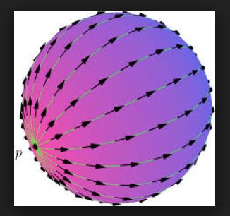
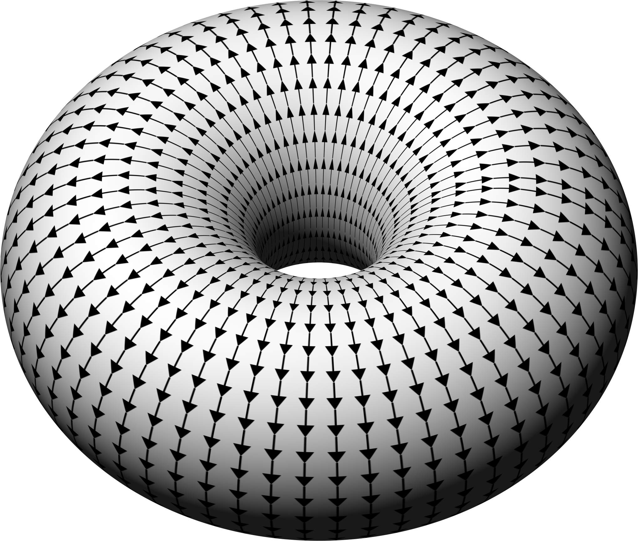
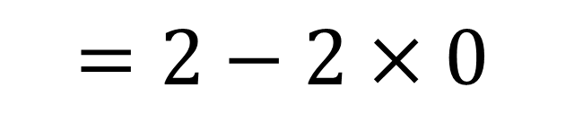
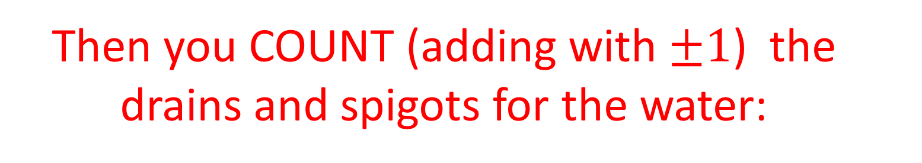

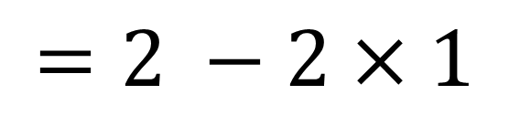
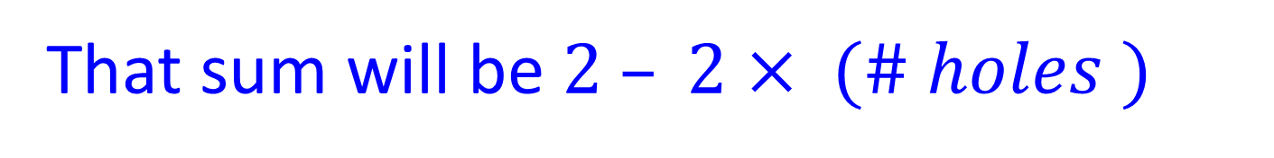

Then you COUNT (adding with $±1$) the drains and spigots for the water:
This is also a complete topological invariant.
That sum will be $2 – 2× (\# holes )$
$$2$$
$$0$$
$$=2 −2×1$$
$$=2−2×0$$
Notes:
So counting holes, and counting sources and sinks encode the same topological information – We will see a much more nontrivial instance of this kind of thing
Near the end of the talk.

Slide 27
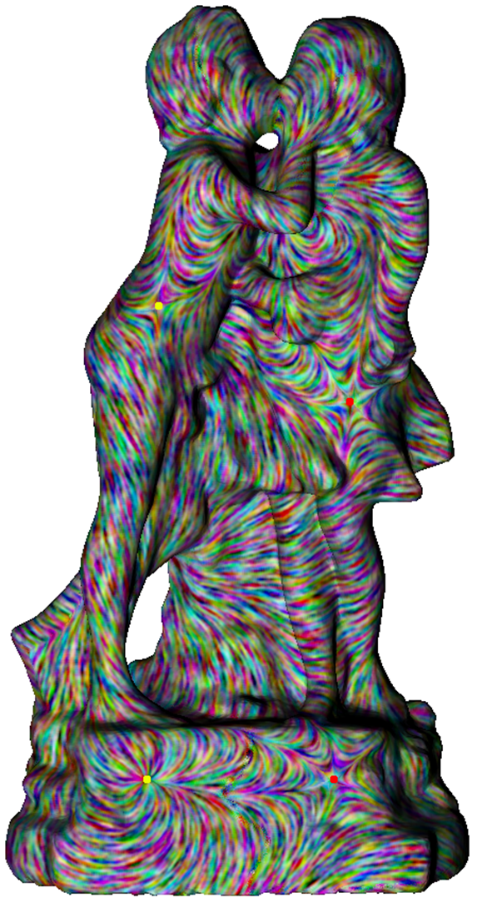
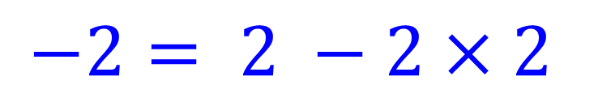
$$−2= 2 −2×2$$
SUM OVER
DRAINS & SPIGOTS = -2
Notes:
By the way, the signs ARE important. Here’s a surface with two holes, and, assuming you aren’t distracted by other things, you can compute its topology by counting: The authors of this picture have imagined water flowing on the surface and you find all the
Sources and sinks – here are a few – and add them up to get ….

Slide 28
Making Spaces Abstractly: Gluing

Slide 29
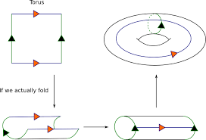
Making Spaces Abstractly: Gluing

Slide 30
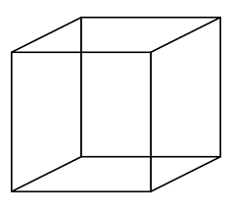

Three Dimensions
Identify opposite sides: Gives a space with no boundary.
Notes:
So if you walked tried to walk away by going through an arch on one side
you would automatically come in through the “other arch” – because it is
Really the SAME arch, because they have been identified.
It’s like the hotel California: You can check out, but you can never leave.
The same is true of the light rays reflected from the back of your head –
So you would see the back of your head.

Slide 31
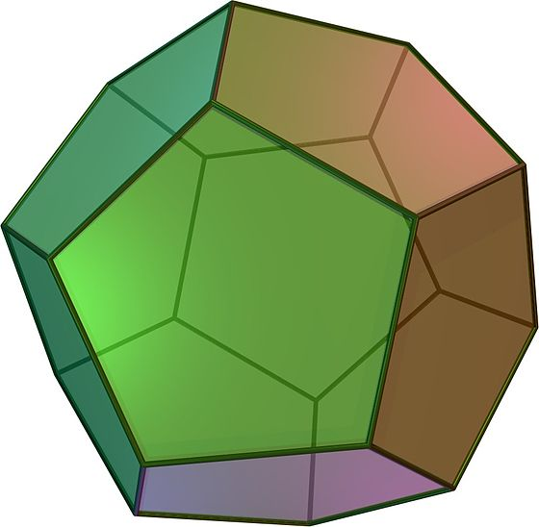
Three Dimensions: Things Get Harder
Identify opposite sides: Gives a space with no boundary.
Notes:
Then you can see the back of your head – in many ways. So living in such a space would
Look a little like this:

Slide 32
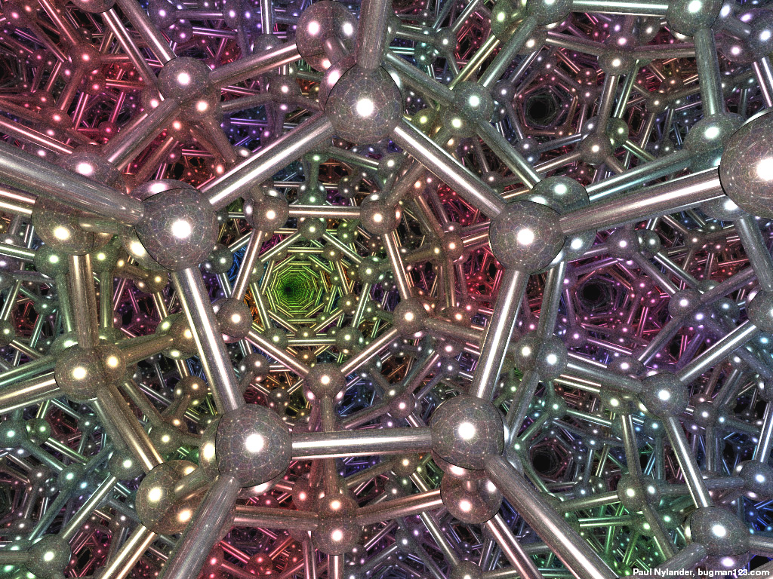
This Is What You See

Slide 33
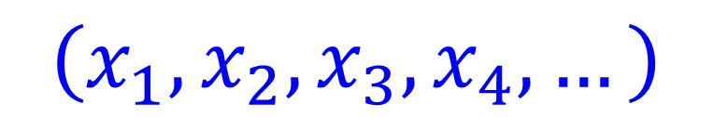
More Than Three Dimensions?
Makes mathematical sense.
Any point has an address, and the address just has more numbers – one for each dimension
$$\left(x_{1},x_{2},x_{3},x_{4}, …\right)$$

Slide 34
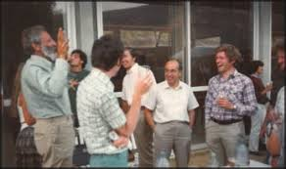
Topological Classification In Higher Dimensions
There is an unusual animal that has the ability to think clearly about these topological questions in higher dimensions
Homo sapiens topologensis
This animal can find topological invariants
of higher dimensional spaces…

Slide 35
You might expect that as the number of dimensions increases, the problem gets harder… but…
there is a big surprise …..

Slide 36
Four Dimensions Is The Hardest !
There are many unanswered questions.
One thing we know for sure is that the
world of possible four-dimensional
spaces is really wild.
We do not know anything even close to a complete topological invariant.
Notes:
At least – for some questions. Technically: The four-dimensional smooth Poincare’ conjecture is still unresolved.

Slide 38
1
Physical Mathematics
Topological Invariants Of Spaces
2
Physics: Maxwell & Yang-Mills
3
The Mathematicians Take Note
4
Topological Field Theory
5
Effective Theories & A Breakthrough
6
Settling A Debate & A Summary
7

Slide 39
Physics
What holds stuff together?
How can we describe the forces
that attract and repel matter?
What forces are there?

Slide 40

Gravity

Slide 41

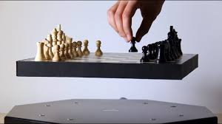
Electricity & Magnetism

Slide 42
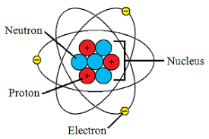




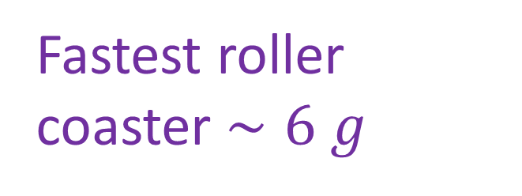

Nuclear Force
Protons have positive
electric charge
It’s cozy in there:
$$r={10}^{−15}m.$$
Electrical force between two protons at
this distance produces an acceleration ….
$$∼{10}^{28} g$$
Fighter
pilots
$∼9 g$
Fastest roller
coaster $∼6 g$
Notes:
You all learned in school that atoms look like this. (Actually, it is quite inaccurate for many
Reasons. For one thing, if we scaled up the atom to be the size of Princeton Stadium then
The nuclear would be the size of a baseball.
I could spend some time trying to convey how big 10^(28) but it’s
Just one of those Carl Sagan numbers: billions x billions x billions
So, what holds the nucleus together? There must be another force –
The nuclear force. Also called the “strong force” for reasons that I hope
Are now clear.

Slide 43
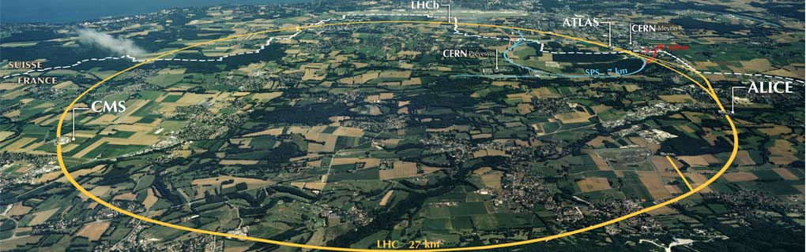
The strong force is very subtle – it has been studied with particle accelerators
for decades - up to the present day…
Large Hadron Collider at CERN
Notes:
Biggest experiment ever carried out by man – with the exception of global warming.

Slide 44
Mathematical Description Of Forces
Fields are created by charges
Fields move charges
Notes:
And, thanks to these experiments and some brilliant theoretic insights we now
Have a mathematical description of the strong force.

Slide 45
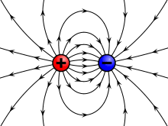
Electric & Magnetic Forces
5 Volt/meter
3 Volt/meter
Physicists use equations to find the fields:
That’s called field theory.

Slide 46
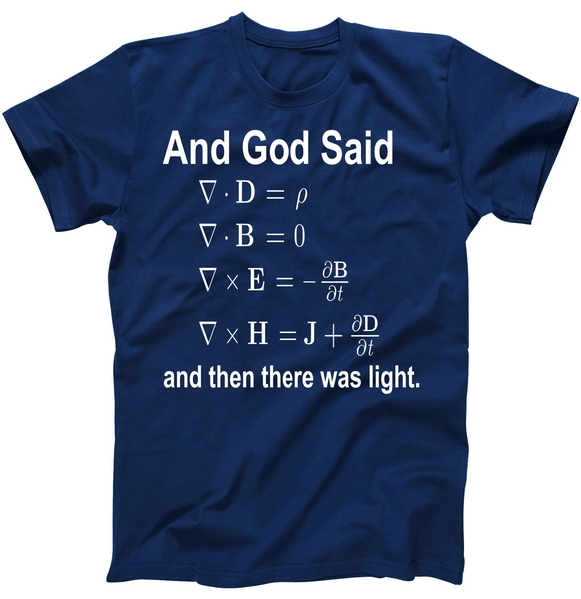
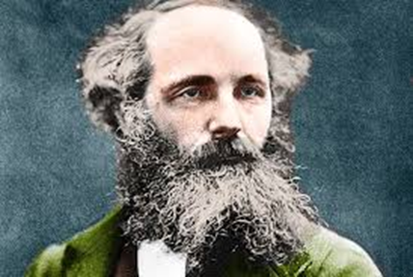


Slide 47

Notes:
Thus solving the age-old puzzle of “What is light?”

Slide 48


Nuclear Force
Volt/meter
  $$q$$
  $$\overline{q}$$
Volt/meter

Slide 49


$$3×5=15$$
$$5×3=15$$

Slide 50
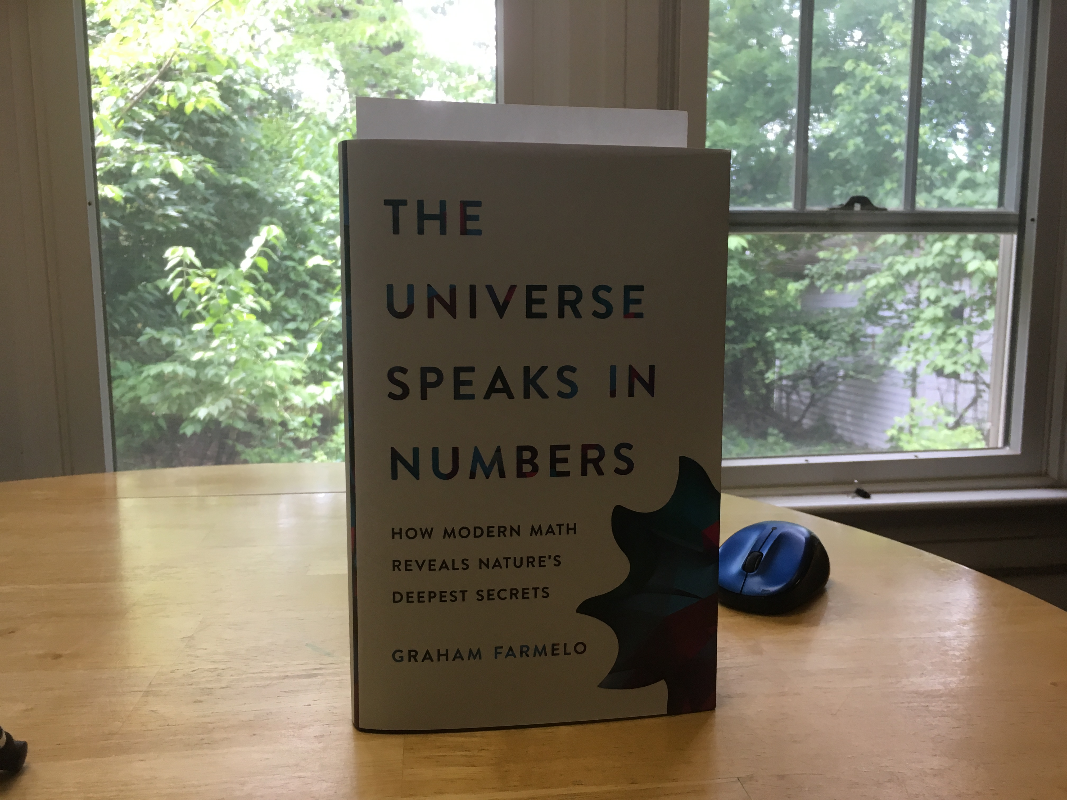
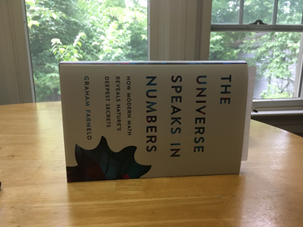



Commutative vs. Noncommutative
Abelian vs. Nonabelian
¼ Turn
x-axis
¼ Turn
z-axis
¼ Turn
z-axis
¼ Turn
x-axis
Notes:
Sometimes the order in which you do things matter.
Whether you put on your shirt first, or your pants, doesn't matter.
But whether you put on your underpants first or second really matters!
More mathematically.
Adding numbers is commutative 3+5 = 5+3, so is multiplying normal numbers. Rotations are a bit
different: Rotations around a fixed axis are commutative. Illustrate rotations in 3 space that do
not commute. That's why solving a Rubik's cube is harder than setting a clock, or tuning to a radio
station. Now, the multiplication of matrices is the way one deals mathematically with rotations.

Slide 51
Abelian field theory
Nonabelian field theory

Slide 52

Yang-Mills Equations
Equations that govern the nuclear force field were first written at the
IAS, 1954
These generalize Maxwell’s equations.
But they have another kind of solution …
Noncommutative light.
Notes:
And there’s an interesting story about the first announcement of these equations
Which you can find in Graham’s book.
Yang-Mills equations are the generalization of Maxwell’s equations
That tell how the lines of nuclear force look – and how they point and
Also how the matrices change in space and time.
Because of the noncommutativity – these equations have a property that
Mathematicians call “nonlinear” -- and nonlinear equations can have some
remarkable properties. For example, black holes are a result of the nonlinearity
Of the Einstein equations for gravity. More down to earth – the equations
that describe the propagation of water down a canal are nonlinear --

Slide 53

Soliton
Notes:
If you are in a pool and you push the water together to try
To make a little lump or a hill, then it will just fall back to a smooth
Surface. We say that it will dissipate. Solitons are not like that – they
Stick together – it is amazing – and it is due to the nonlinearity of the
Equations for water waves.

Slide 54

Instantons = Solitons Of YM Equations
Instantons are localized in space AND ``time’’.
So they are localized in all four dimensions,
including ``time’’ – hence the name.
1975: A.A. Belavin, A.M. Polyakov,
A.S. Schwartz, and Yu.S. Tyupkin
Notes:
So, our quest to understand the physics of the strong force led to the discovery of
These instanton solutions to the Yang-Mills equations. And physicists were having a great time in the early seventies playing with these instantons…

Slide 55

Meanwhile, back at the ranch

Slide 56
1
Physical Mathematics
Topological Invariants Of Spaces
2
Physics: Maxwell & Yang-Mills
3
The Mathematicians Take Note
4
Topological Field Theory
5
Effective Theories & A Breakthrough
6
Settling A Debate & A Summary
7

Slide 57


Notes:
Atiyah and his student Nigel Hitchin were getting interested in these
Instantons of the physicists, and producing some pretty beautiful results
About them, and they had a student – Simon Donaldson --

Slide 58

Donaldson Invariants
Let’s COUNT the number of ways
of putting instantons into a
four-dimensional space
Instantons are localized objects (in all four dimensions) and they can only “fit” in a
compact four-dimensional space in special ways.
Big surprise: This is a
topological invariant of the space !!!

Slide 59



Cartoon Of Donaldson Invariants
``Donaldson invariant’’ for 3 instantons = 2
``Donaldson invariant’’ for 3 instantons = 2

Slide 60

Using this new (1984) topological invariant Donaldson could prove dramatic new results:
Example: There are exotic four-dimensional spaces where you can’t do calculus
Notes:
Maybe you are thinking: Well, big deal, of course _I_ can’t do calculus
on some perfectly nice four-manifolds! I can hardly do calculus at all!
The point is that even the best mathematicians here at the IAS can’t do it either.
Because it is logically impossible to do so. This is a big deal..

Slide 61


Slide 62


Slide 63
Donaldson invariants are extremely hard to compute and interpret
Big fat books were written just to compute a few special examples….
Mathematicians hit a wall…

Slide 64
1
Physical Mathematics
Topological Invariants Of Spaces
2
Physics: Maxwell & Yang-Mills
3
The Mathematicians Take Note
4
5
Topological Field Theory
Effective Theories & A Breakthrough
6
Settling A Debate & A Summary
7

Slide 65


A Turning Point: Atiyah’s Question
What is the physical interpretation of
the Donaldson invariants?

Slide 66


Slide 67
Witten’s Answer
Donaldson invariants can be computed within the framework
of a Yang-Mills field theory¹
¹Technically: A certain generalization of a Yang-Mills theory
with a different set of quarks and electrons from what we
see in nature

Slide 69
Topological Field Theory
Vast simplification of physics:
Length scales and time scales do not matter
No difference between yesterday, last week, 100 years ago, 1 billion years ago.
No difference between your commute to work, and your extra-galactic vacation trip.

Slide 70
What does matter is topology!

Slide 71

Huge impact in both physics and math:
Thousands of papers
Fresh woods & pastures new …
It might even be of practical use. It is being employed by
Microsoft’s Station Q as a road to quantum computation.

Slide 74
Quantum Field Theory
Computing Donaldson invariants
a la Witten requires computing probabilities in a
Yang-Mills theory
How hard can that be?

Slide 75




Abelian: Maxwell’s theory: Hard, but solvable - Feynman, Schwinger, Tomonaga (1946-1949)
Nonabelian: $MUCH^{n}$ harder:
Not solved yet

Slide 76
Recall: Witten reformulated the Donaldson invariants as probabilities
for certain events in Yang-Mills theories
in four-dimensional spaces.
But computing probabilities in
Yang-Mills theories is extremely difficult
So we seem to have exchanged one hard problem for another…..

Slide 77
1
Physical Mathematics
Topological Invariants Of Spaces
2
Physics: Maxwell & Yang-Mills
3
The Mathematicians Take Note
4
5
Topological Field Theory
Effective Theories & A Breakthrough
6
Settling A Debate & A Summary
7

Slide 78
Effective Theories
Topology is unaffected by distance –
by scaling things up to bigger and bigger sizes.
In Yang-Mills theory, when one asks questions about events at larger and larger scales the answers can simplify
The answers can be the SAME as answers to analogous questions in
a DIFFERENT, but simpler, theory

Slide 79


Effective Theories At Long Distance

Slide 80




$${10}^{−15} meters$$

Slide 81

$$10 meters$$

Slide 82

$${10}^{500} meters$$

Slide 83

$${10}^{wtf} meters$$

Slide 84

$${10}^{wtff} meters$$

Slide 85




$$F^{+}= \overline{M}M$$
DM = 0

Slide 86
Seiberg-Witten Paper
Seiberg & Witten (1994)
Viewed from afar: The YM theory used by
Witten simplifies dramatically:
It is an ABELIAN field theory –
a generalization of Maxwell’s theory –
not of Yang & Mills’ theory
Much easier to work with

Slide 87


Seiberg-Witten equations have soliton-like solutions: ``vortices in a superconductor’’
Seiberg-Witten topological invariants: Count these `` vortices’’ in our 4-dimensional space
The Donaldson invariants can be written in terms of the Seiberg-Witten invariants: They carry the same information about the four-dimensional space
Much easier
to compute!
Notes:
Just like we saw how counting the holes and the sources of sinks of flowing water on a surface encode the same invariant.

Slide 88


Notes:
Cultural differences between physicists and mathematicians.

Slide 89

Mad Dash After A Breakthrough

Slide 90
1
Physical Mathematics
Topological Invariants Of Spaces
2
Physics: Maxwell & Yang-Mills
3
The Mathematicians Take Note
4
5
Topological Field Theory
Effective Theories & A Breakthrough
6
Settling A Debate & A Summary
7

Slide 91
Two Basic Questions
Mathematics
What is the shape of a space?
How can we tell when two geometric objects
can be deformed into each other ?
Physics
What holds stuff together?
How can we describe the forces
that attract and repel matter?
Notes:
On the face of it, these questions appear to have absolutely no relation to each
Other. In fact, as I will describe, they are quite deeply related.

Slide 92
Settling A Debate
Notes:
To me the best response was the SUBSEQUENT discovery of the Seiberg-Witten invariants

Slide 93

Shape of a space?
Strong force ?

Slide 94
Topological Invariants!
Yang-Mills instantons!

Slide 95
Donaldson invariants
(instanton counting)
Topological Field Theory

Slide 96
Long distance
effective theory?

Slide 97
Seiberg-Witten Theory !

Slide 98
Seiberg-Witten invariants!

Slide 99



Notes:
Well, 1994 was 25 years ago. Has anything happened since then? Well, quite a bit.
I have just told you one vignette within the larger subject of physical mathematics.
I could tell you other remarkable stories of the interplay between mathematicians
And physicists.
You might still be wondering: What about the four-manifold story? Well, there
Has been steady progress, and new results. I’ve produced a few myself. There
Hasn’t been anything like the Seiberg-Witten revolution – but it is clear the story is not over. The SW invariants are blind to certain very interesting questions about 4-dimensional spaces. As I said: We do not have anything close to a complete topological
Invariant. Will physics once again point the way? Some of us hope so, but we
Don’t know. That is always the nature of research, we don’t know what we’ll find because we are exploring the unknown –
Thanks for your attention.

Slide 101
Notes:
Well, 1994 was 25 years ago. Has anything happened since then? Well, quite a bit.
I have just told you one vignette within the larger subject of physical mathematics.
I could tell you other remarkable stories of the interplay between mathematicians
And physicists.
You might still be wondering: What about the four-manifold story? Well, there
Has been steady progress, and new results. I’ve produced a few myself. There
Hasn’t been anything like the Seiberg-Witten revolution – but it is clear the story is not over. The SW invariants are blind to certain very interesting questions about 4-dimensional spaces. As I said: We do not have anything close to a complete topological
Invariant. Will physics once again point the way? Some of us hope so, but we
Don’t know. That is always the nature of research, we don’t know what we’ll find because we are exploring the unknown –
Thanks for your attention.

Slide 102

NOT

