Slide 1
Atomic-Engineering and Topological Insulators
Sean (Seongshik) Oh
Assistant Professor in Physics and Astronomy
mbe.rutgers.edu
_{50 μm}
_{2 nm}

Slide 2
Outline
Introduction of Atomic-Layer Engineering
Complex oxide engineering
Topological insulator engineering

Slide 3
What we do
What we do:
Explore unknown territories in condensed matter physics
using a unique Atomic-Layer Molecular Beam Epitaxy (AL-MBE)
and other tools
What we study:
1. Complex-oxide heterostructures for strongly correlated physics
and for post-silicon applications
2. Topological Insulators: Bulk insulator but metallic on surface, proposed
as a platform for spintronics and quantum computers.
3. Electronic devices such as tunnel junctions, field effect device,
memory devices.

Slide 4
History of Atomic-Layer Engineering

Slide 5
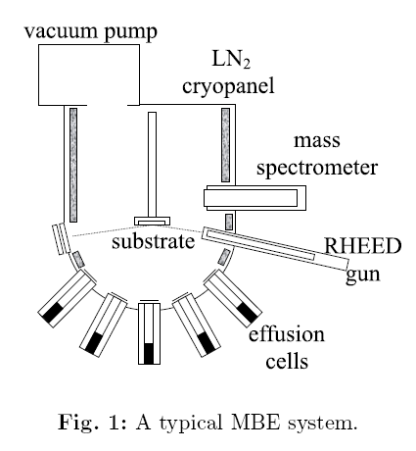
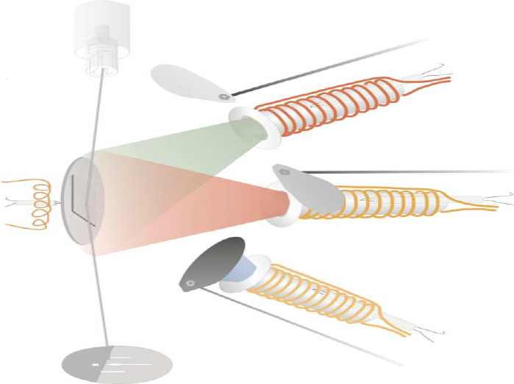
What is Molecular Beam Epitaxy (MBE)?

Slide 6
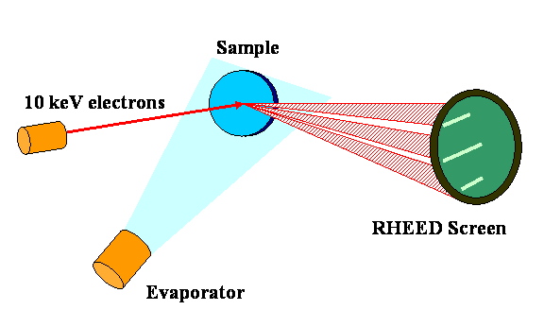
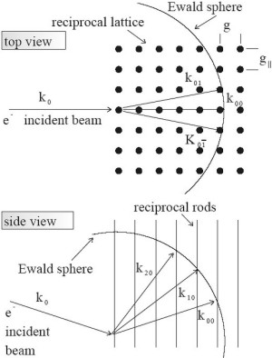
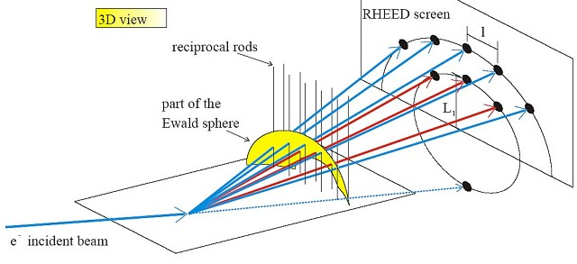
Reflection High Energy Electron Diffraction (RHEED)

Slide 7
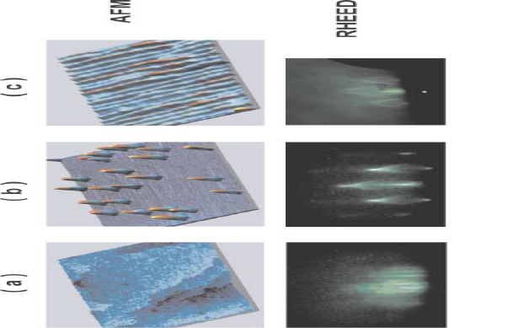
RHEED pattern gives information on real space morphology:

Slide 8
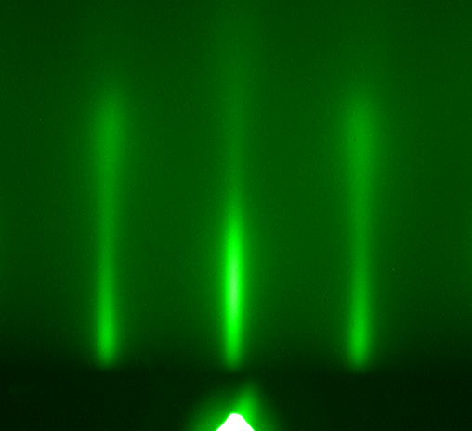
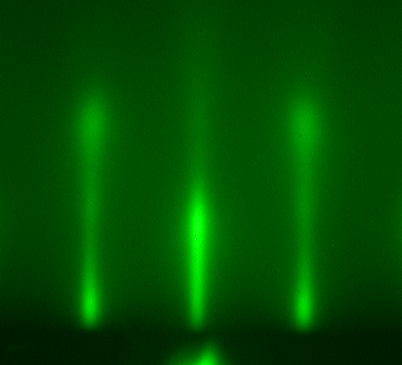
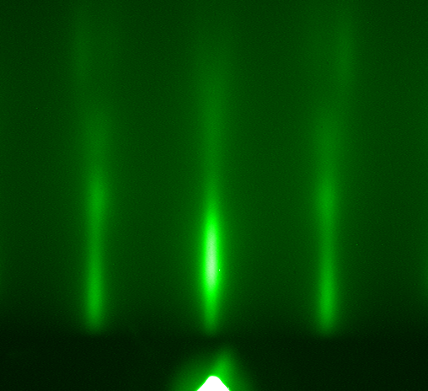
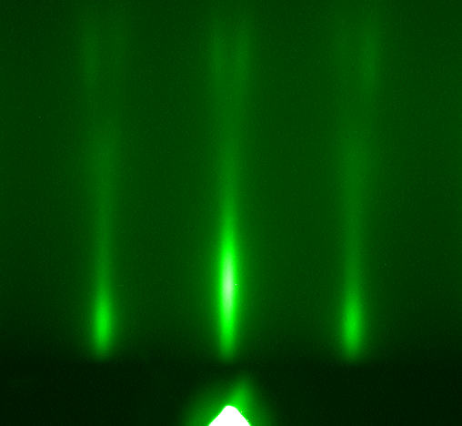
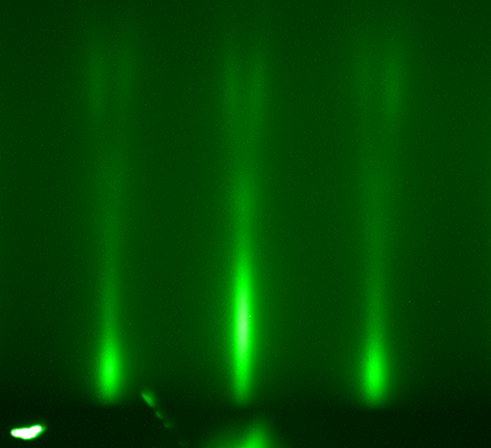
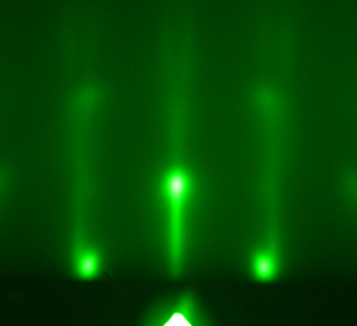
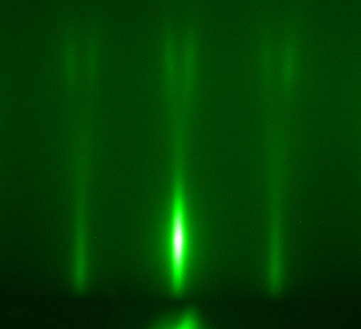
7
6
5
4
3
2
1

Slide 9
Electric field effect device on atomically-engineered system

Slide 10
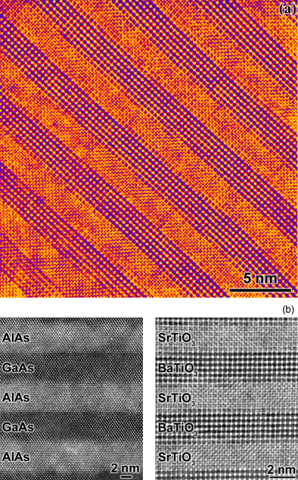
MBE grown superlattices

Slide 11
History of atomic-layer engineering (MBE)

Slide 12
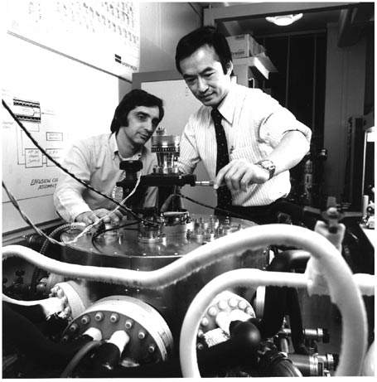
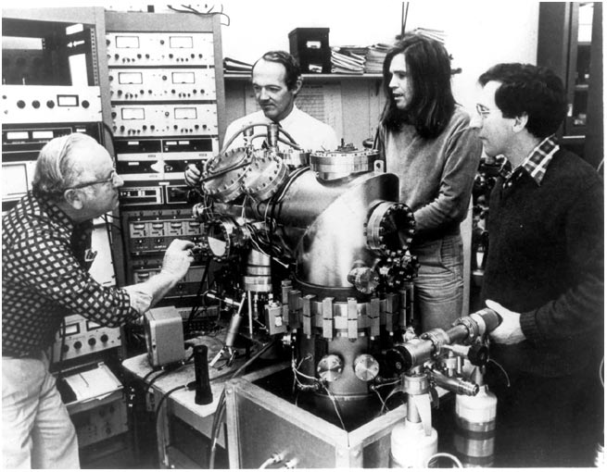
1970s: Birth of Molecular Beam Epitaxy
Modulation doping in GaAs/Al(Ga)As,
Bell lab 1978
First MBE, Bell lab 1970

Slide 13
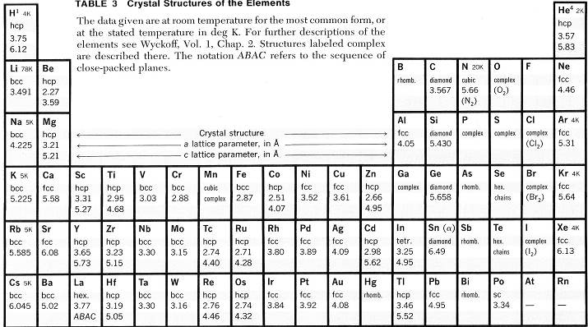
Semiconductor MBE:
Si, Ge, GaAs, GaN, AlAs, InP, InAs, …
Semiconductor

Slide 14
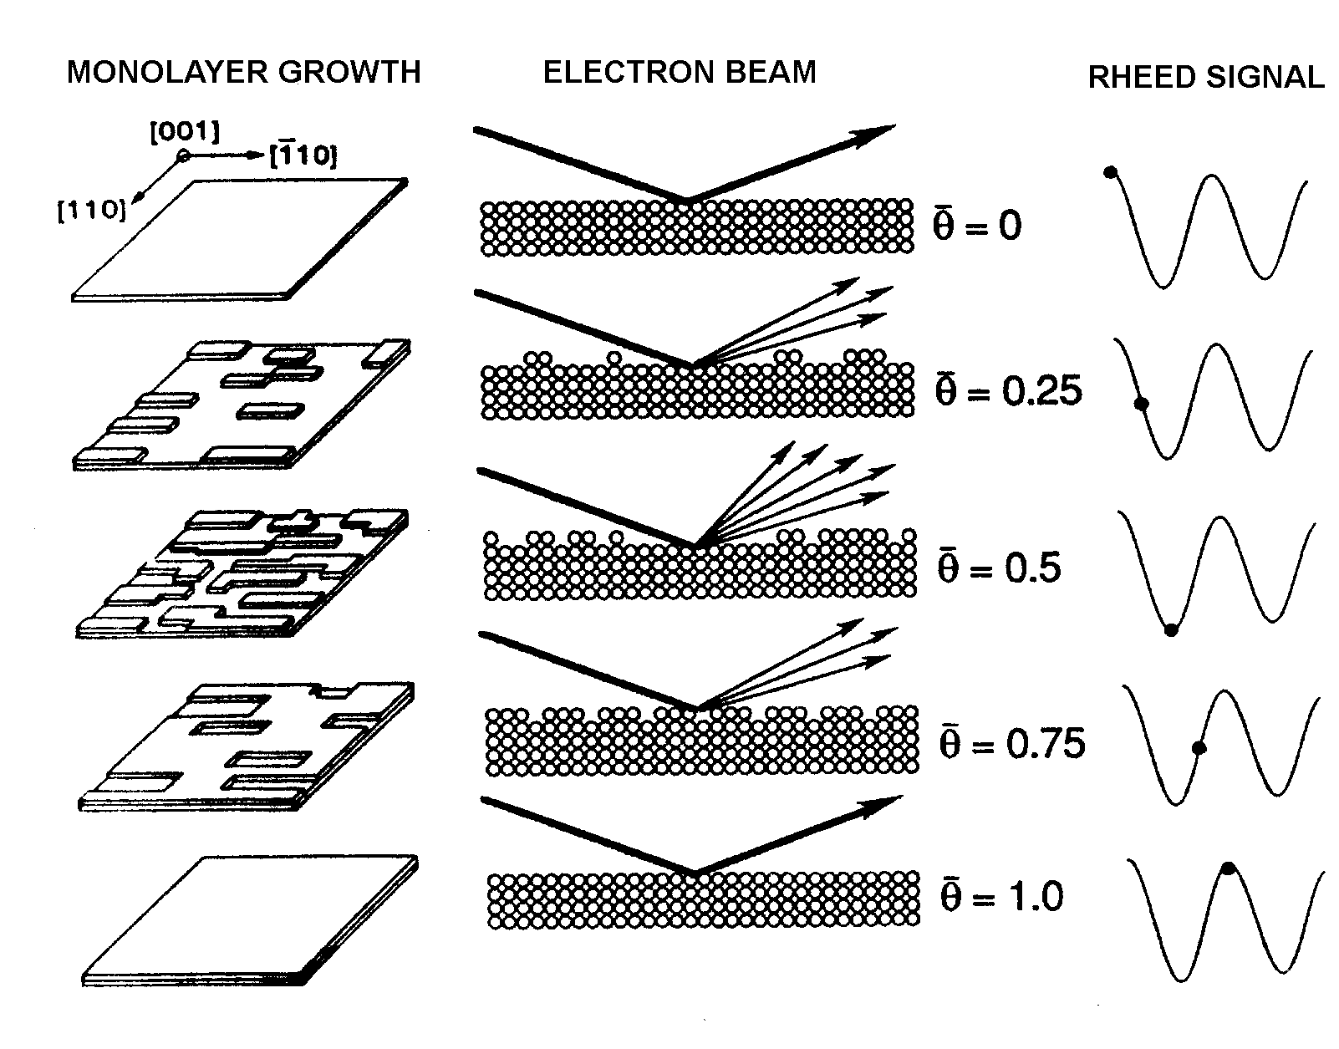
1980s: Atomic-layer engineering in III-V semiconductors
Discovery of RHEED oscillations in Ga(Al)As growth ➔ atomic layer-by-layer growth

Slide 15
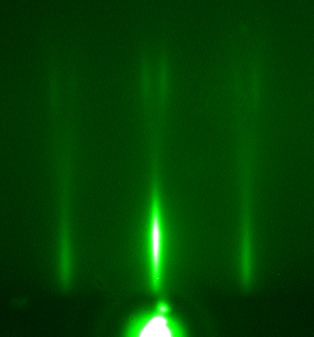
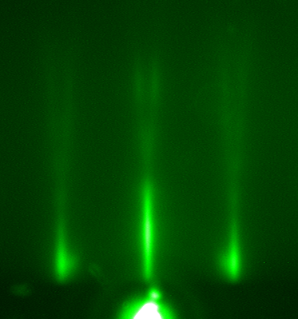
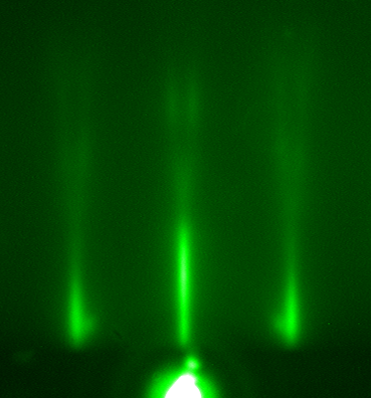
1990s: Atomic-layer engineering in complex oxides
Atomic-layer-by-layer growth of a layered superconductor
1
2
• • •
1
Bi₂O_{2+δ}
4
Sr(La)O
3
CuO₂
Ca
15.4Å
4
CuO₂
3
2
Sr(La)O
1
Bi₂O_{2+δ}
• • •

Slide 16
Semiconductor MBE
Si, Ge, GaAs, GaN, AlAs, InP, InAs, …
Semiconductor

Slide 17
Complex oxide MBE
1. High Critical Temperature Superconductor: YBa₂Cu₃O_{7-δ}, Bi₂Sr₂CaCu₂O_{8+δ}
2. Colossal Magneto-Resistance Metal: La_{1-x}Sr_{x}MnO₃
3. Semiconductor: ZnO, SrTiO₃
4. Ferroelectric and Piezoelectric: BaTiO₃, PbZr_{x}Ti_{1-x}O₃
5. Multiferroic (Ferroelectric + (Ferro-)Magnetic): BiFeO₃
6. Battery Materials: LiCoO₂

Slide 18
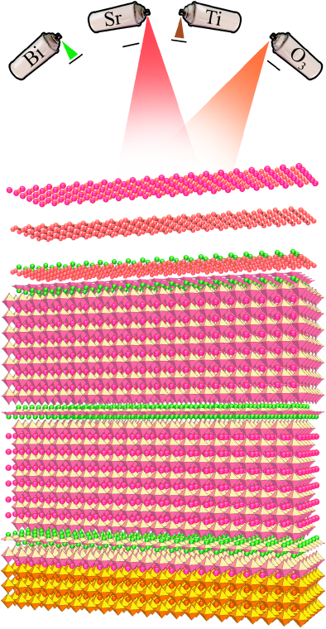
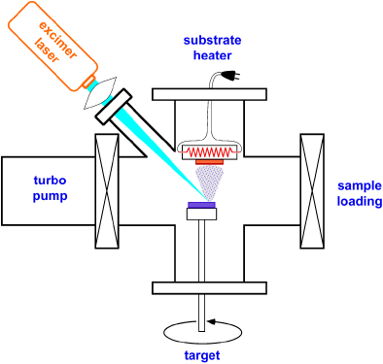
MBE vs PLD for complex oxides
MBE
PLD

Slide 19
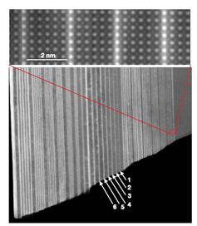
2000s: Molecular-layer engineering in complex-oxides by Pulsed Laser Deposition (PLD)

Slide 20
MBE vs PLD for complex oxides
PLD
MBE
Pros:
Using stoichiometric target, relatively easy to achieve stoichiometry, as far as there is no volatile element
Cons:
Limited to molecular-layer engineering
Hard to handle volatile elements
Highly energetic: 10~100 eV ➔ oxygen deficiency, intermixing
Pros:
True atomic-layer engineering possible
Gentle growth process: ~0.1eV➔ negligible intermixing and oxygen deficiency
Cons:
Need to accurately control individual element
Source oxidation leads to flux drift
More difficult than PLD

Slide 21
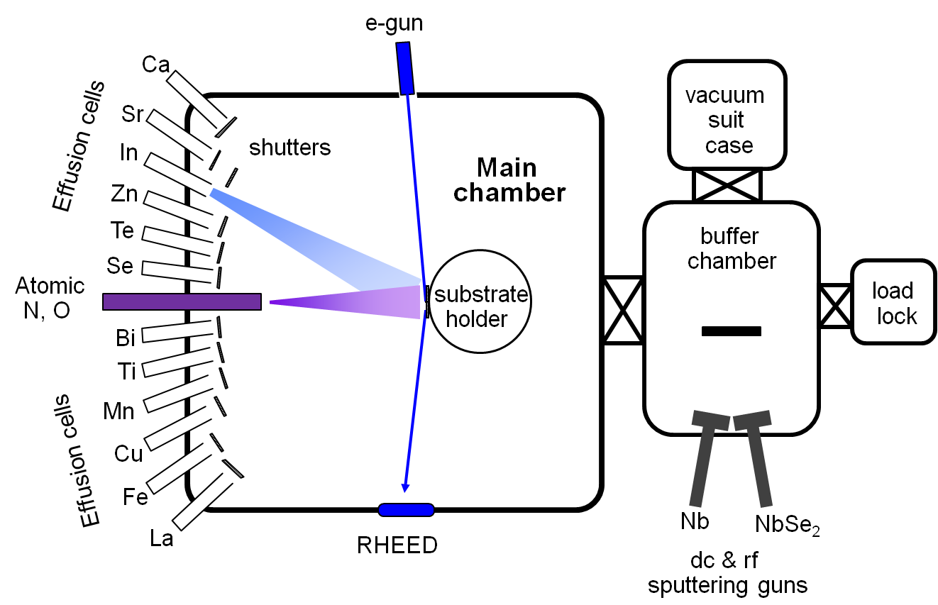
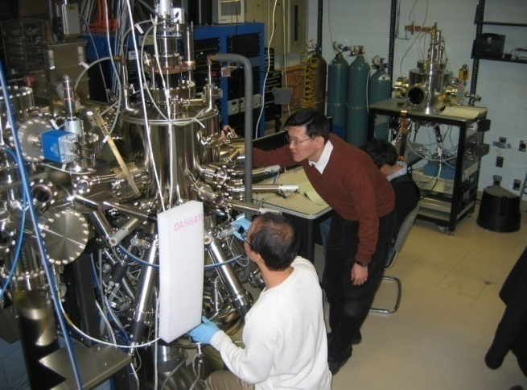
Newly developed COAL-MBE in Rutgers
Patented differential pumping scheme; completely eliminated source oxidation
No requirement for real-time flux control ➔ much simpler operation
In-situ UHV sputtering combined
Highly-optimized computer control

Slide 22
Topological insulators

Slide 23
What is topological insulator?

Slide 24
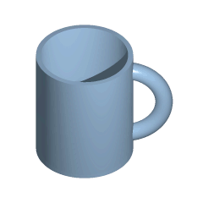



What is topology?
If topology is different, they cannot be deformed from one to the other without cutting.
Genus = 1
Genus = 0

Slide 25
What is insulator?
CB
CB
E_{f}
E_{f}
E
VB
VB
k
Metal
Insulator

Slide 26
Topological vs. Conventional (Trivial) insulators
Band structure topology of the surface state is different, hence the term “topological”
Trivial
Insulator
Topological
Insulator
Surface Band

Slide 27
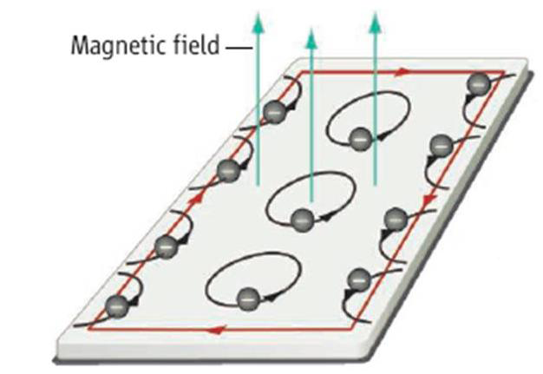
Quantum Hall system
Quantum Hall system (2D)
  Topological metallic edge states in magnetic field (broken time reversal symmetry)
+Insulator
-Insulator
+Insulator
+Insulator
-Insulator
+Insulator
Cond. band minimum
Fermi level
Valence band maximum

Slide 28
Topological Insulator
2D Topological insulator
  Topological metallic edge states without magnetic field (with time reversal symmetry)
+Insulator
-Insulator
+Insulator
Cond. band minimum
Fermi level
Valence band maximum

Slide 29
Quantum Hall system vs. Topological insulator
B
Quantum Hall system
Topological insulator
Spin-momentum unlocked
Absence of back scattering
➔ Perfectly conducting edge states
Magnetic field required
Spin-momentum locked
Absence of backscattering
No magnetic field required

Slide 30
3D Topological insulator
Bulk of the material is insulating but surface is metallic when there is no magnetism involved (i.e. when time reversal symmetric)
Metallic surface states
Vacuum
Vacuum (Conventional insulator)
Topological
insulator

Slide 31
Evidence for topological surface states

Slide 32
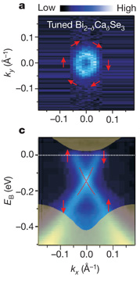
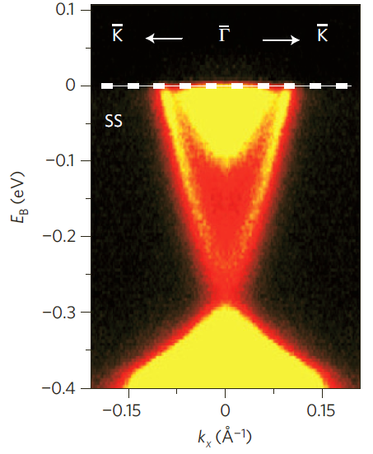
ARPES on Bi₂Se₃ single crystal
Spin-momentum locked surface band observed
as predicted by theory
Xia, Hasan et al. Nature Phys ‘09
Hsieh, Hasan et al., Nature ‘09

Slide 33
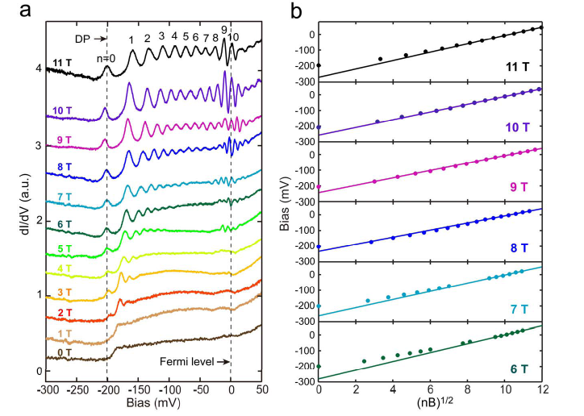
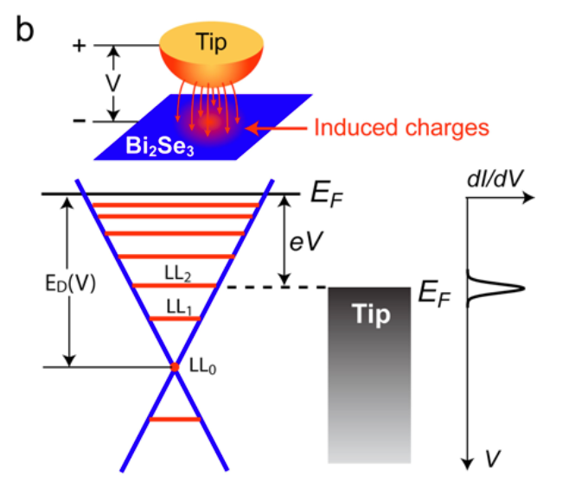

Surface Landau Levels - STM
Bi₂Se₃
Qi-Kun Xue et al.
arXiv:1001.3220 (2010)

Slide 34
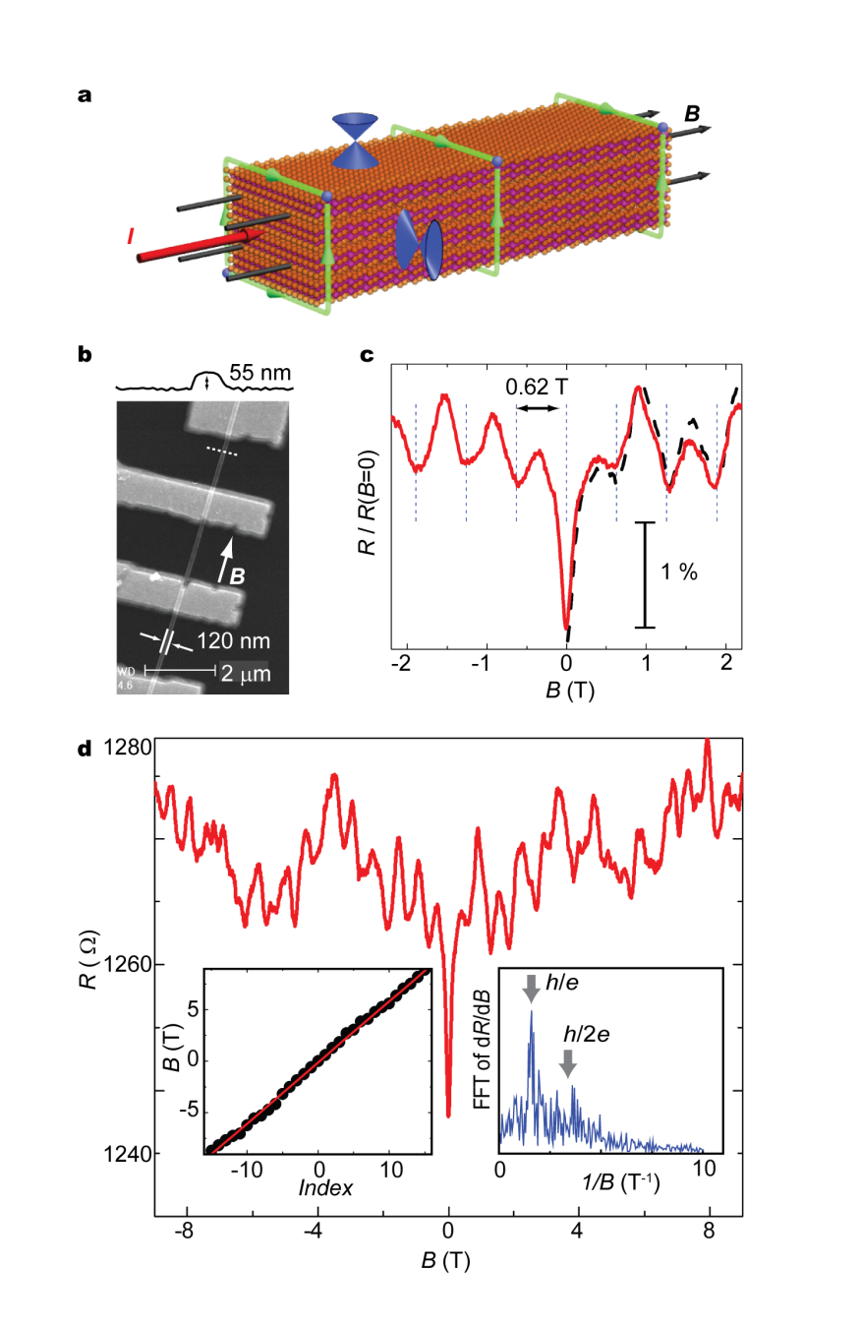
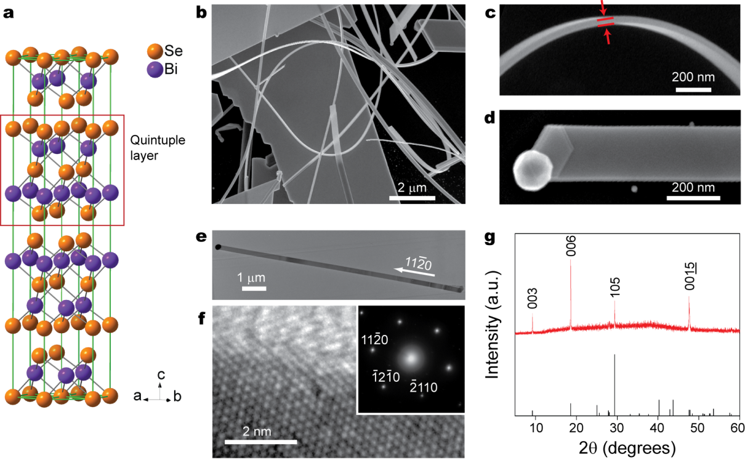
Aharonov-Bohm Oscillation
Nano-ribbon of Bi₂Se₃
Yi Cui et al. Nature Materials (2009)

Slide 35
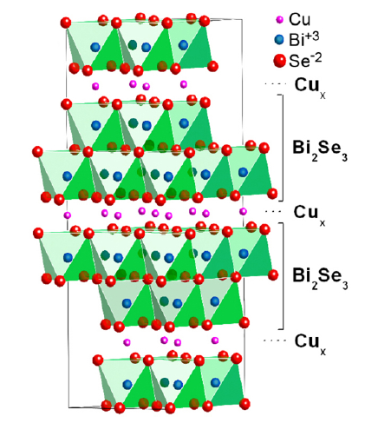
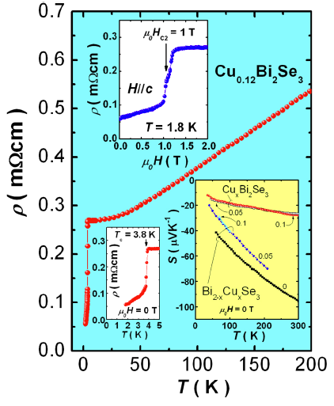
Superconductivity
R.J. Cava et al. PRL (2010)

Slide 36
Thin film topological insulators and transport properties

Slide 37
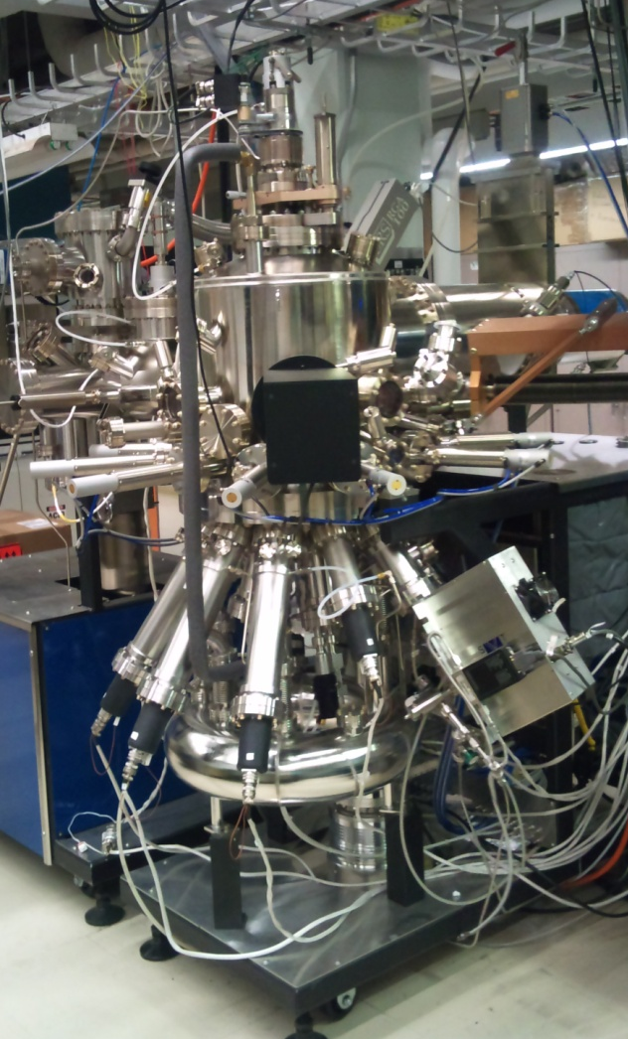
Molecular Beam Epitaxy
MBE System

Slide 38
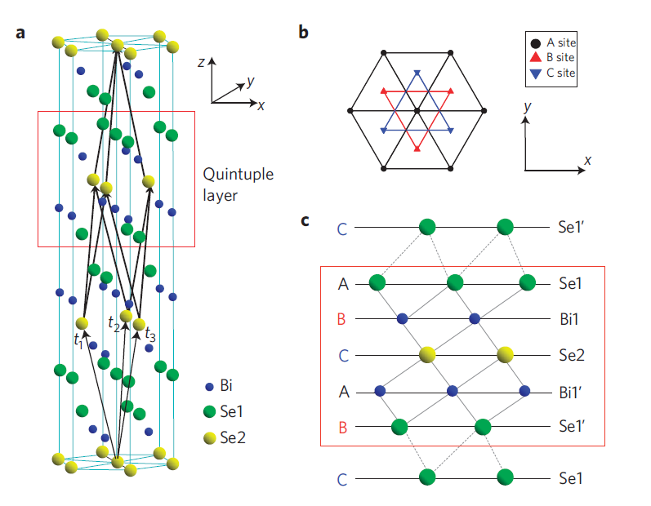
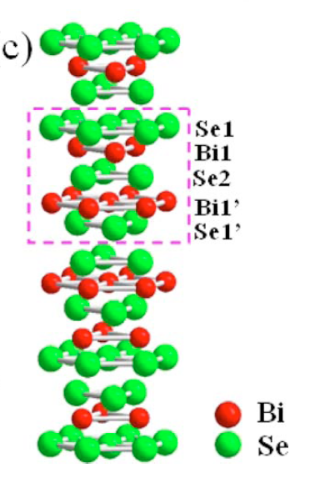
Topological insulator Bi₂(Se,Te)₃
Quintuple
Layer
~1nm
Rhombohedral
a: 4.1396 Å c: 28.636 Å

Slide 39
Bi₂Se₃ on Si

Slide 40
Single temperature Attempts
Single temperature
Crystal orientation disorder
2nd Phase clusters
110°C
190°C
250°C

Slide 41
Two-Step Growth
Single Se layer ~110°C
2nd QL Bi₂Se₃ ~110°C
Raising to ~220°C after 2QL Bi₂Se₃
Further growth at ~220°C
doi: 10.1016/j.tsf.2011.07.033

Slide 42
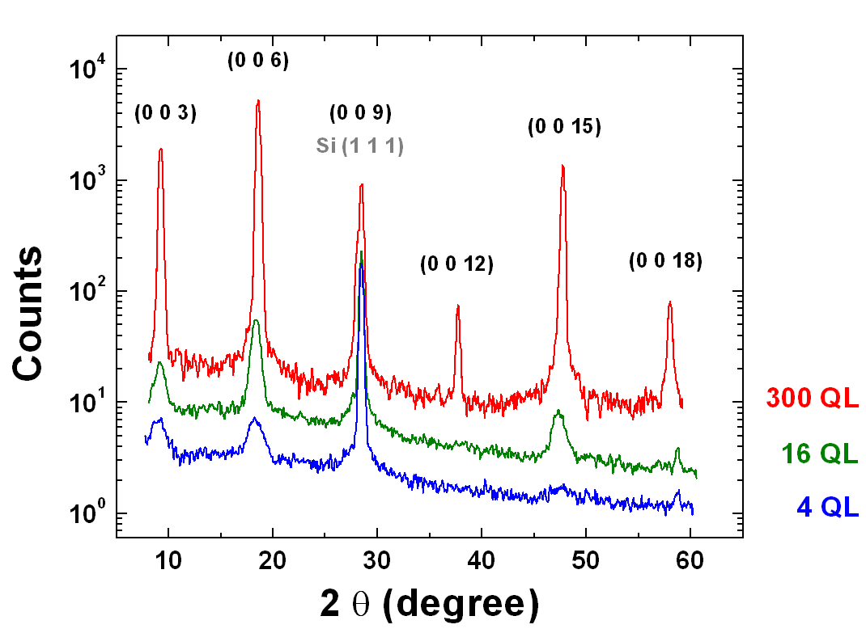
XRD

Slide 43
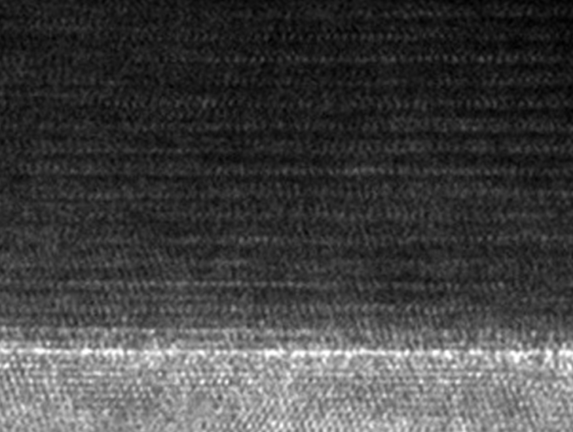
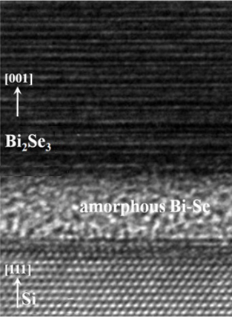
TEM Images
Bi₂Se₃ [001]
Si [111]
Atomically sharp interface
H.D Li et al
New J. Phys., 2010,
12, 103038

Slide 44
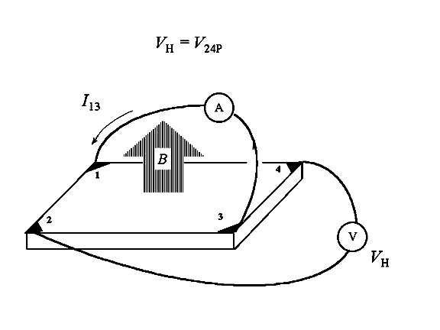
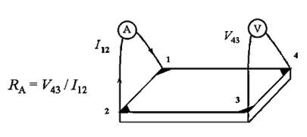
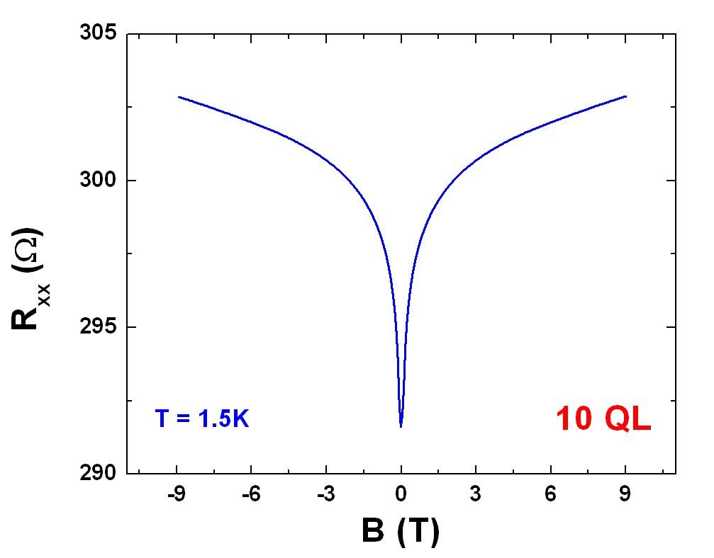
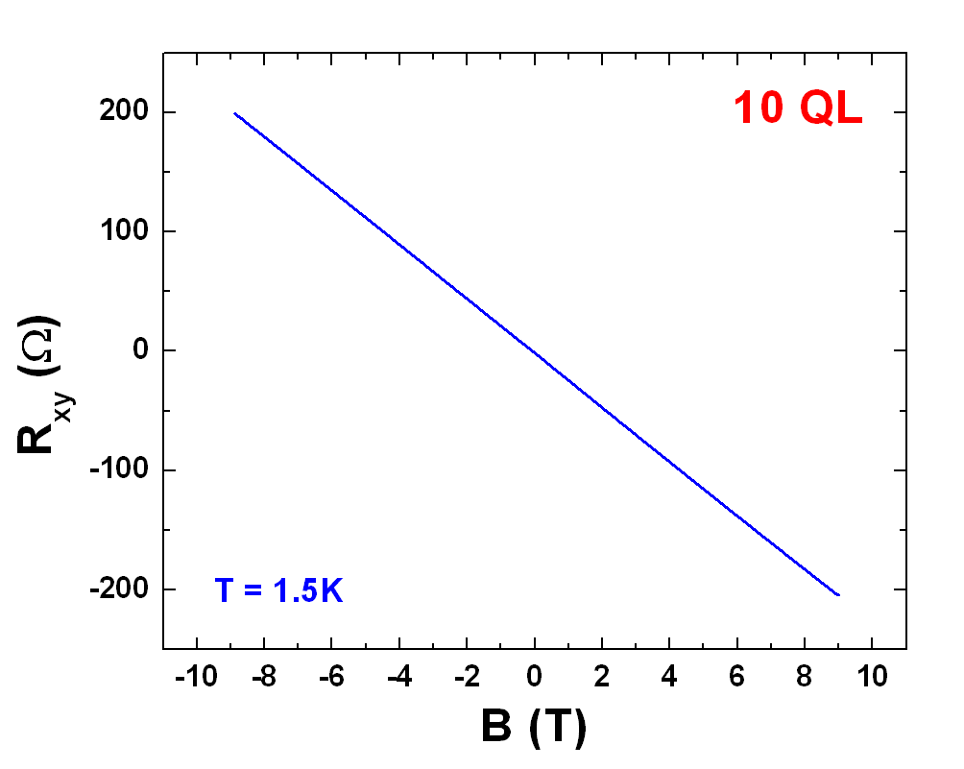
Transport Measurement
Van der Pauw technique
Slope = 1/n_{sheet}e
Hall effect

Slide 45
Carrier density for ideal TI
If the contribution to conduction is only via SS, we expect sheet carrier density to be independent of thickness!
t₁
n_{2d}
t₁
t₂
thickness
t₂

Slide 46
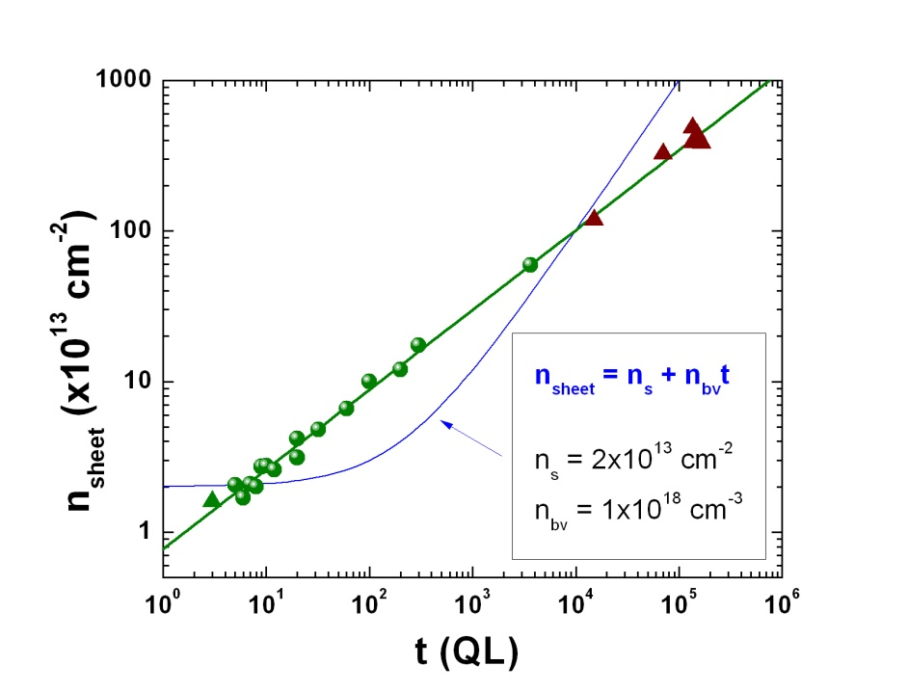
Sheet carrier density vs thickness
Volume carrier density changes with thickness.

Slide 47
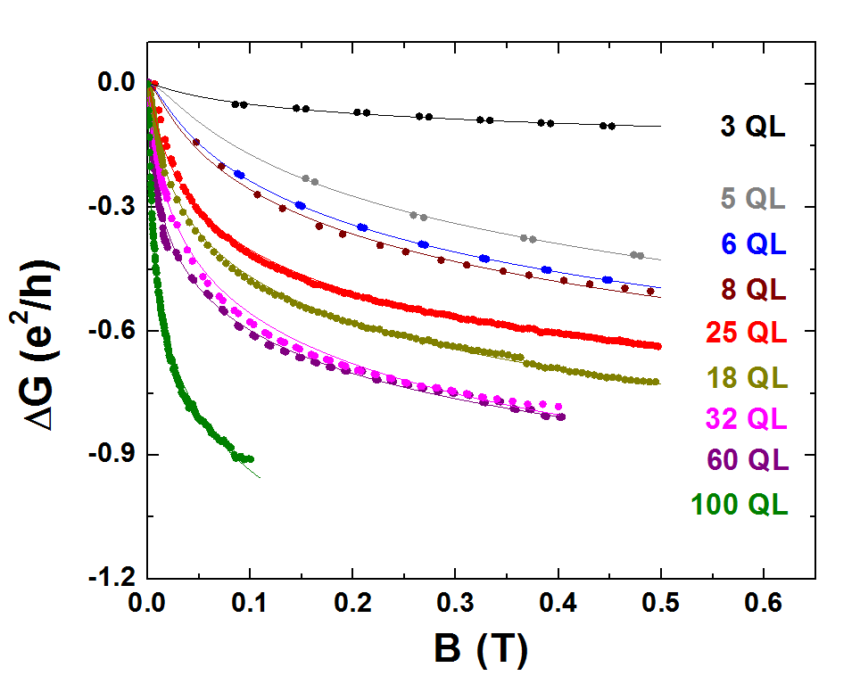
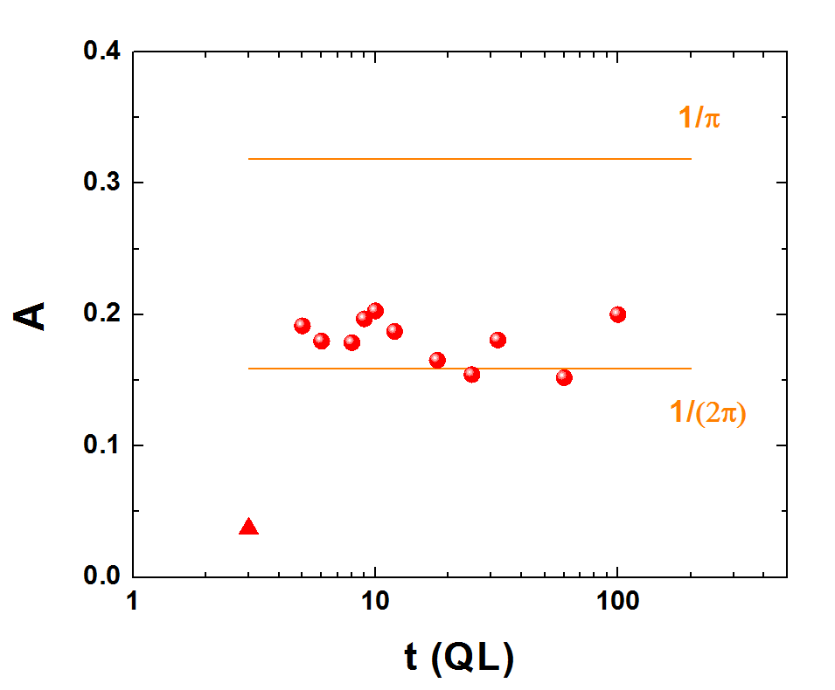
Weak anti-localization in Bi₂Se₃
with
Two surfaces
One surface
Well-defined WAL effect for 5 – 100 QL.
How much is due to surface?

Slide 48
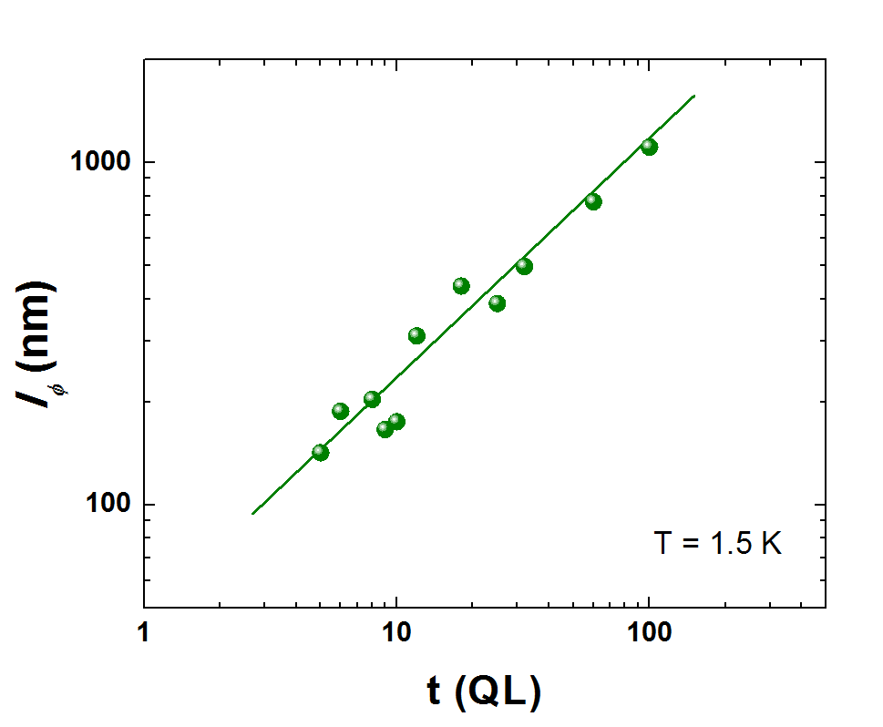
Phase coherence length
Coherence length scales as t^{0.7}
Should scale as t⁰ for ideal TI’s without any surface-bulk interaction, and as t¹ if bulk transport dominates
PHYSICAL REVIEW B 84, 073109 (2011)

Slide 49
Bi₂Se₃ on Sapphire

Slide 50

Surface Images
100QL on Si(111)
300QL on Al₂O₃ (0001)
Record Values
n=1.6x10¹⁸ cm⁻³
μ=2600 cm²V⁻¹s⁻¹
n=1x10¹⁸ cm⁻³
μ =8700 cm²V⁻¹s⁻¹

Slide 51


Non-linear Hall resistance
Two-carrier model
Bi₂Se₃ on Al₂O₃
Bi₂Se₃ on Si

Slide 52
Sheet Carrier densities vs. Thickness
n_{SS}: thickness independent (3.0 x 10¹³ cm⁻²) from 2 through 2750 QL
➔ 1 QL thick surface channel for each of the top and bottom surfaces
n_{total} (=n_{SS}+n_{BS}) remains nearly unchanged from 2 through 300 QL
➔ Dominance of n_{SS} up to 300 QL
Bi₂Se₃ on Al₂O₃
2 QL

Slide 53
Sheet Carrier densities vs. Thickness
Bi₂Se₃ on Si
Bi₂Se₃ on Al₂O₃

Slide 54

Weak antilocalization effect comparison
Bi₂Se₃ on Si
Bi₂Se₃ on Al₂O₃
~t⁰
~t^{0.7}
Should scale as t⁰ for ideal TI’s without any surface-bulk interaction, and as t¹ for non-TI without any surface state
WAL effect of Bi₂Se₃ on Al₂O₃ is already close to ideal

Slide 55
Giant Kerr Rotation in Bi₂Se₃
Measured on our films by Armitage group in Johns Hopkins University

Slide 56
(Bi_{1-x}In_{x})₂Se₃
TI to Non-TI Transition
0%, topological
2%, topological
4%, trivial
20%, trivial
Measured on our films by Hasan group in Princeton on our films

Slide 57
Groups working on our thin films
Peter Armitage in Johns Hopkins,
Zahid Hasan in Princeton,
Daniel Dessau in U of Colorado,
Dale van Harlingen in UIUC,
Dimitri Basov in UCSD,
Vidya Madhavan and Stephen Wilson in Boston College,
Abhay Pasupathy and Tony Heinz in Columbia,
Kenneth Burch in U of Toronto,
Jay Kikkawa in UPenn,
Daniel Y. Park in Seoul National University

Slide 58
Future

Slide 59
Main issues with Topological Insulators
There do exist 2D surface states
However, real materials have significant bulk conduction
Two parallel approaches:
  Implement devices accessing and utilizing the surface states
  Improve the materials using atomic-scale engineering

Slide 60


Future Works
Suppress bulk carriers

Slide 61

Future Works
Coupling with magnetic materials

Slide 62


Future Works
Electric Field Effect
Spin-polarized current

Slide 63
Artificial topological insulators
Growth Sequence
1/(in-plane lattice constant)
Bi₂Se₃/Bi₂Te₃ superlattices: RHEED images

Slide 64



Devices we are making

Slide 65
Future
Achieve close-to-ideal TI with thin film engineering
  Modulation doping
  Random mixing
  Superlattice mixing
Move the Fermi level into the gap through gating
Spin tunneling into TI surface band
Cooper pair tunneling into TI surface band
Superconducting TI
TI with strong correlation
TI-like oxides with atomic-scale engineering

Slide 66
What graduate students are expected to do in our group:
1. Design unique artificial materials that are expected to exhibit novel
electronic properties in collaboration with theory groups
2. Atomically engineer new materials and fabricate devices out of them
3. Measure properties of these devices and structures (in collaboration with
other groups in Rutgers or outside)
4. Do numerical/analytic analysis to explain observed phenomena, in
collaboration with theory groups.
5. Provide the unique materials to other world leading groups for in-depth
investigation of the new materials ➔ High chance of forming networks with
a wide range of world leading experts in various fields.
6. Explore possible applications and Go to Step 1.

Slide 67

Thank you!
mbe.rutgers.edu
Growth: Thin Solid Films 520, 224 (2011)
Anomalous bulk properties (Bi₂Se₃ on Si): Phys. Rev. B 84, 073109 (2011)
Surface vs. Bulk states: Appl. Phys. Lett. 99, 012109 (2011)
Thickness-independent surface states (Bi₂Se₃ on Al₂O₃): arXiv:1104.5709
Optical observation of the surface states: arXiv:1105.0237

