Slide 1
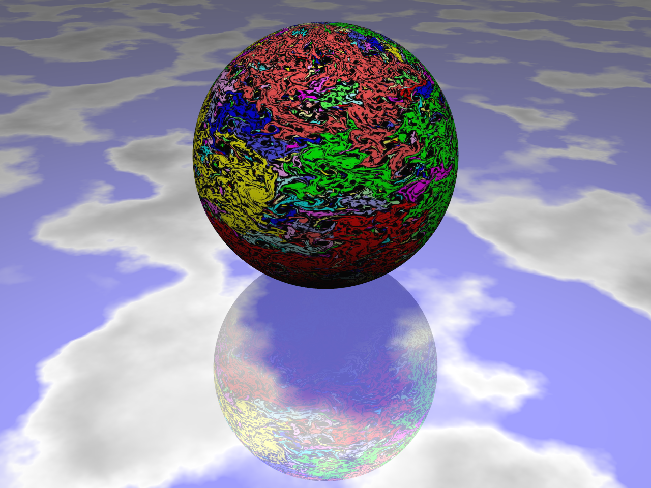
Symmetries of turbulent state
Gregory Falkovich
Weizmann Institute of Science
D. Bernard, A. Celani,
G. Boffetta, S. Musacchio
Rutgers, May 10, 2009

Slide 2
Turbulence is a state of a physical system with many degrees of freedom deviated far from equilibrium. It is irregular both in time and in space.
Ω
L
Physics Today 59(4), 43 (2006)

Slide 3
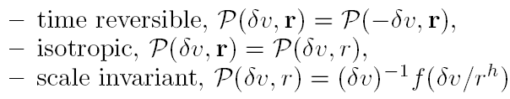

Slide 4

Energy cascade and Kolmogorov scaling

Slide 5

Lack of scale-invariance in direct turbulent cascades

Slide 6
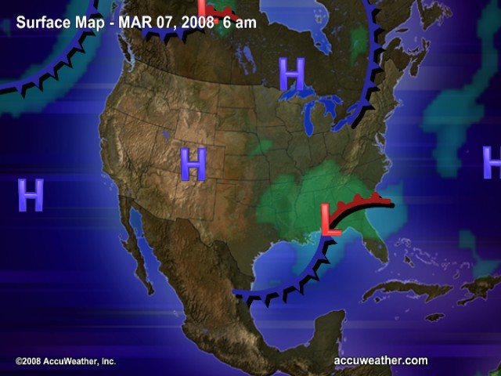
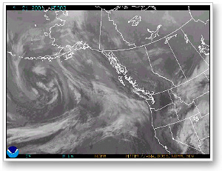

Slide 7

Euler equation in 2d describes transport of vorticity

Slide 8
Family of transport-type equations
m=2 Navier-Stokes
m=1 Surface quasi-geostrophic model,
m=-2 Charney-Hasegawa-Mima model
Electrostatic analogy: Coulomb law in d=4-m dimensions

Slide 10

This system describes geodesics on an infinitely-dimensional Riemannian manifold of the area-preserving diffeomorfisms. On a torus,

Slide 11
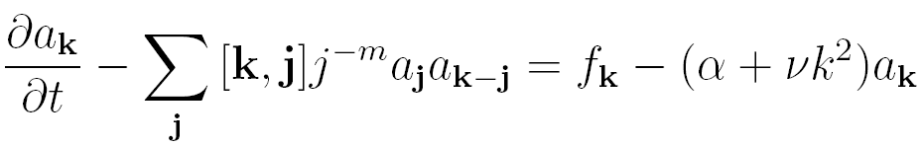
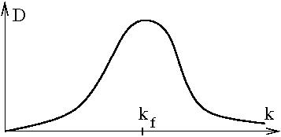
Add force and dissipation to provide for turbulence
(*)
lhs of (*) conserves

Slide 12

Kraichnan’s double cascade picture
Q
P
k
pumping

Slide 13
Inverse Q-cascade

Slide 14
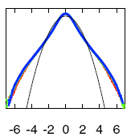


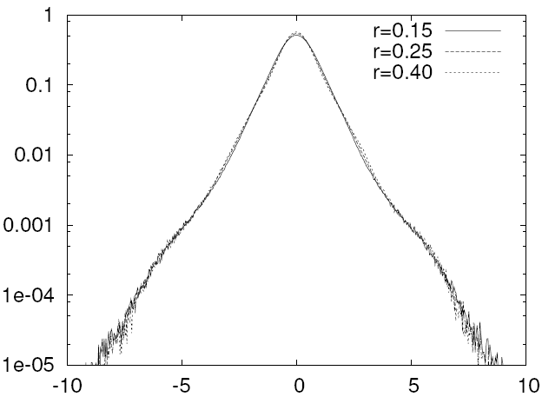
Small-scale forcing – inverse cascades

Slide 15

Locality + scale invariance → conformal invariance ?
Polyakov 1993

Slide 16
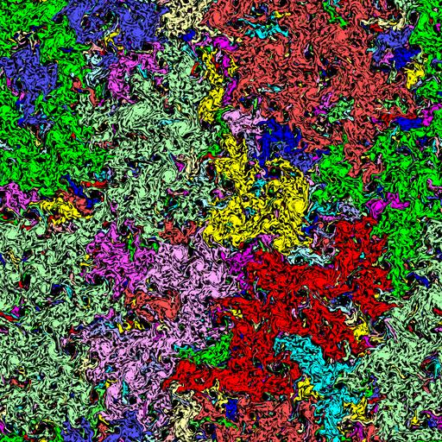

Slide 17






_____________
=

Slide 18
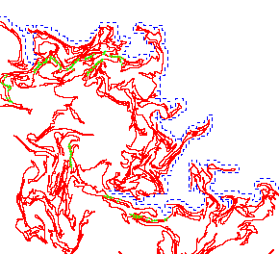
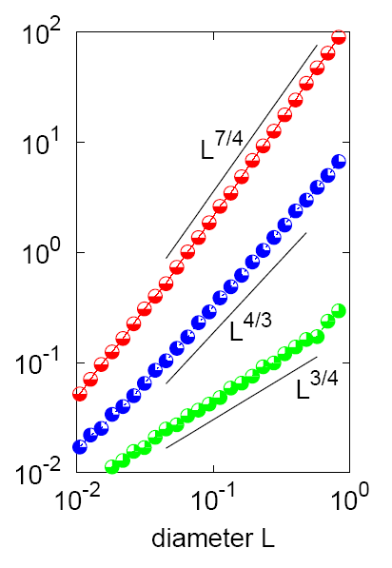
Boundary
Frontier
Cut points
perimeter P
Bernard, Boffetta, Celani &GF, Nature Physics 2006, PRL2007

Slide 19

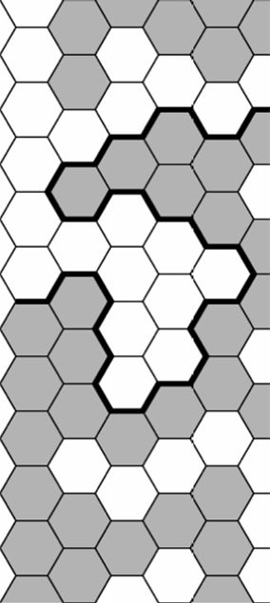
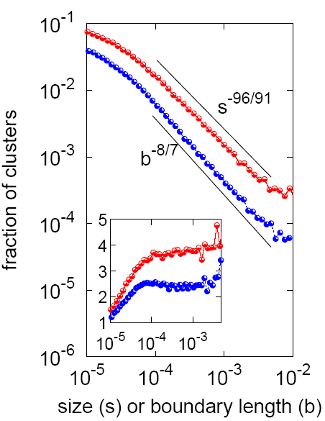
Vorticity clusters

Slide 20


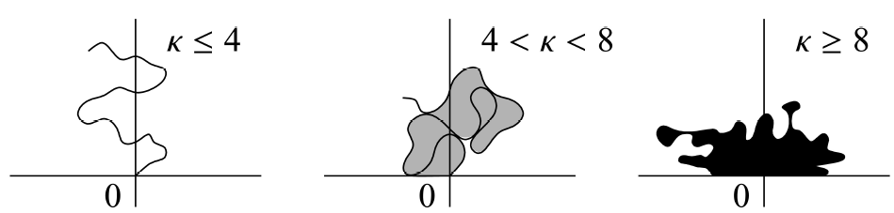
Schramm-Loewner Evolution (SLE)

Slide 21
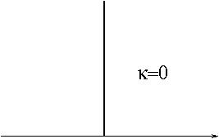





Slide 22
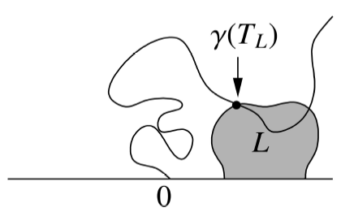
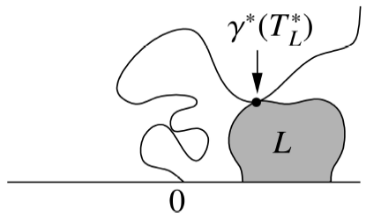
What it has to do with turbulence?

Slide 23

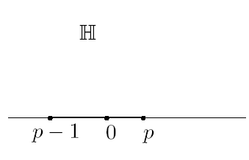

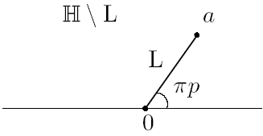
C=ξ(t)

Slide 24
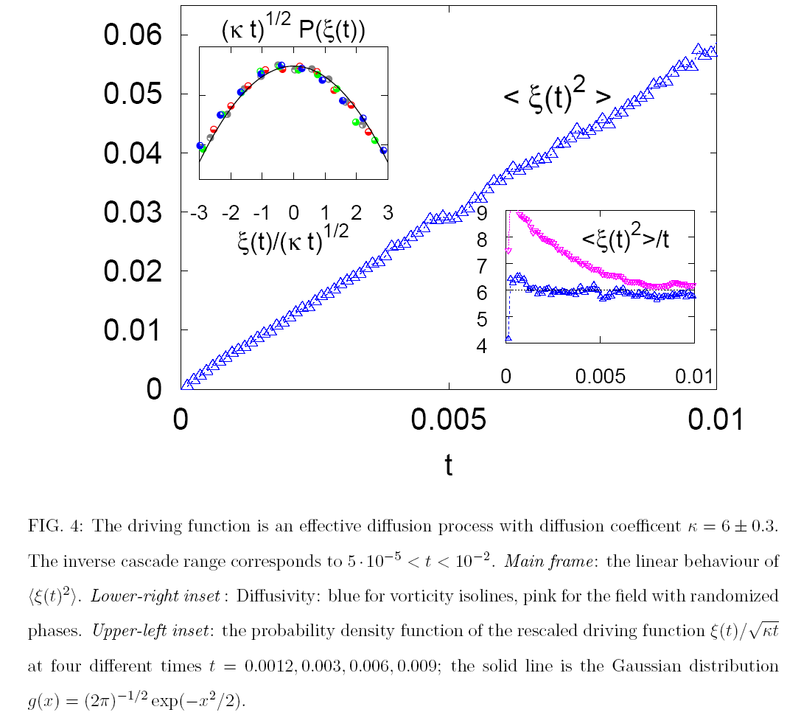

Slide 25




Slide 26
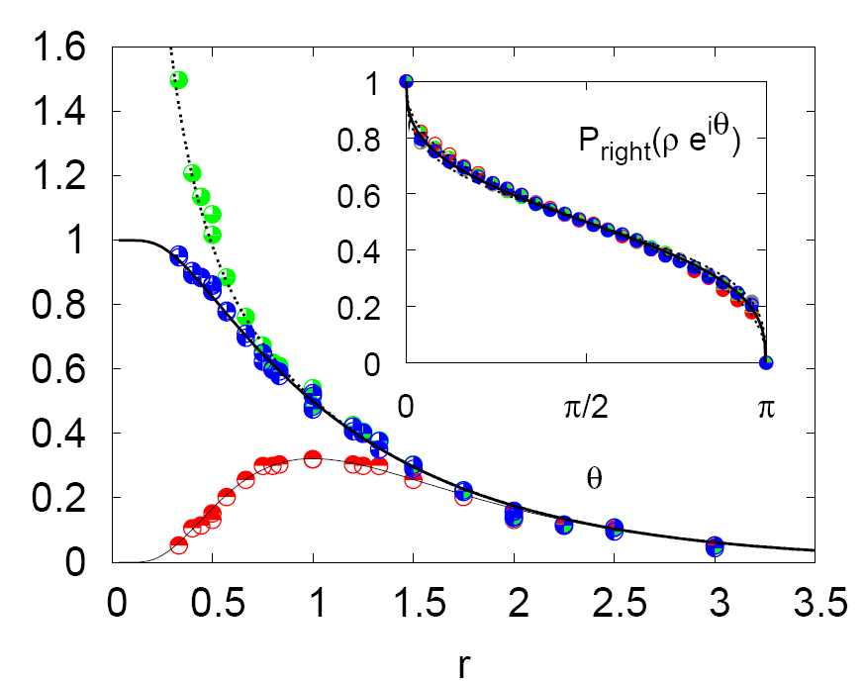

Slide 27
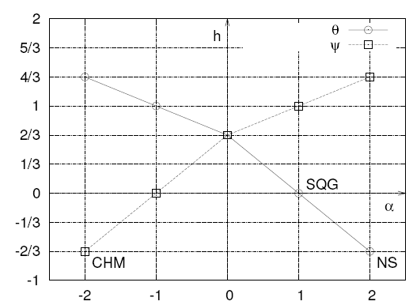

m

Slide 28



Slide 30
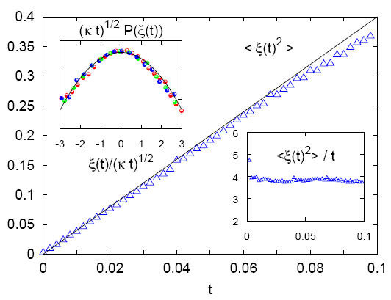

Slide 31
Different systems producing SLE
Critical phenomena with local Hamiltonians
Random walks, non necessarily local
Inverse cascades in turbulence
Nodal lines of wave functions in chaotic systems
Spin glasses
Rocky coastlines

Slide 32
Conclusion
Inverse cascades seems to be scale invariant.
Within experimental accuracy, isolines of advected quantities
are conformal invariant (SLE) in turbulent inverse cascades.
Why?

