Slide 1


Has BICEP2 Detected Gravitational Waves from the Early Universe?
(Or have they just seen schmutz?)
David Spergel
Work with Raphael Flauger (IAS/NYU) and Colin Hill (Princeton)

Slide 2
Why is this important?
Glimpse into the universe in its first 10⁻³⁰ s
Probe of physics near the Planck Scale
Direct evidence for gravitons and quantum nature of gravitational field
Open up a new area of cosmology
Potentially, most important new physics results of this century!

Slide 3

Big Story of March 18

Slide 5
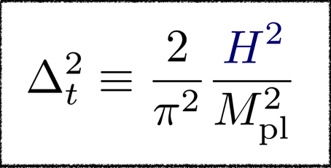
Gravitational Waves
During inflation, any massive field experiences quantum fluctuations.
This process generates fluctuations in the gravitons at the deSitter temperature:

Slide 6
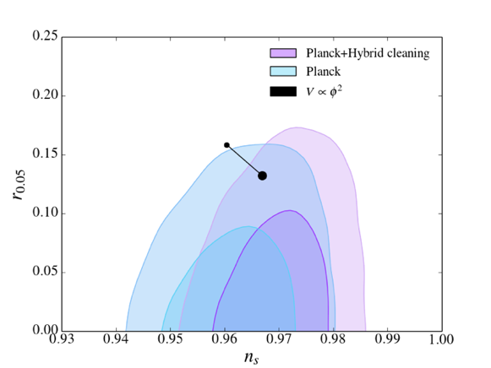
Nearly Scale Invariant Fluctuations

Slide 7
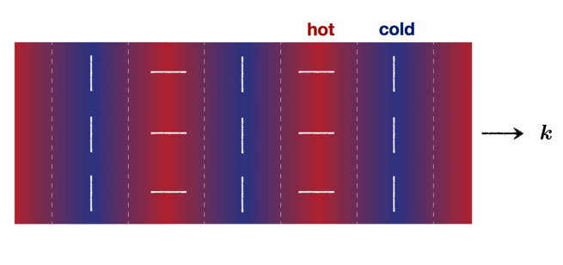
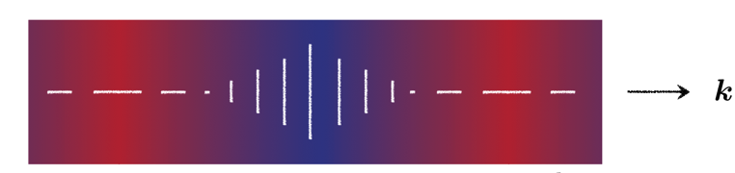
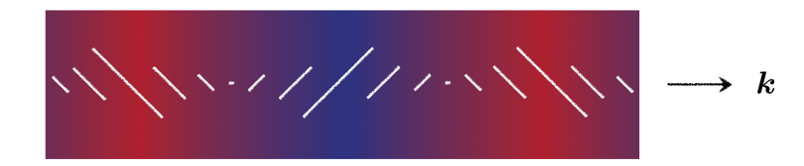
E
B

Slide 8
Inflationary Predictions
Flat Universe
Nearly Scale Invariant Fluctuations
Gaussian Fluctuations
Adiabatic Fluctuations
Superhorizon Fluctuations
Gravity Waves

Slide 9
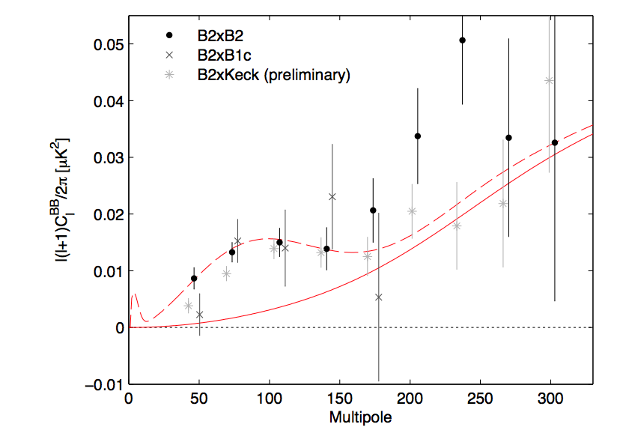

Slide 10
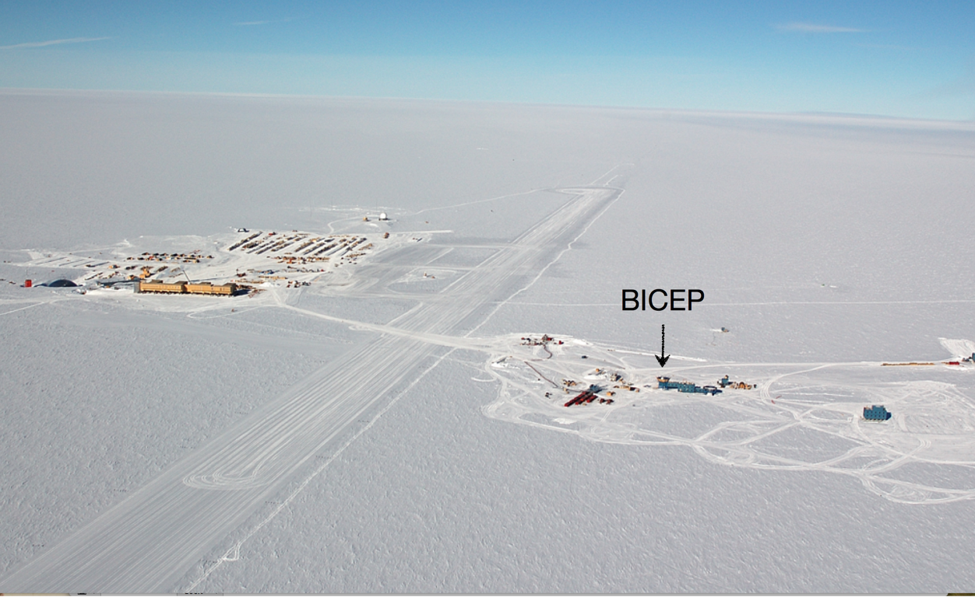
Heroic Science

Slide 11
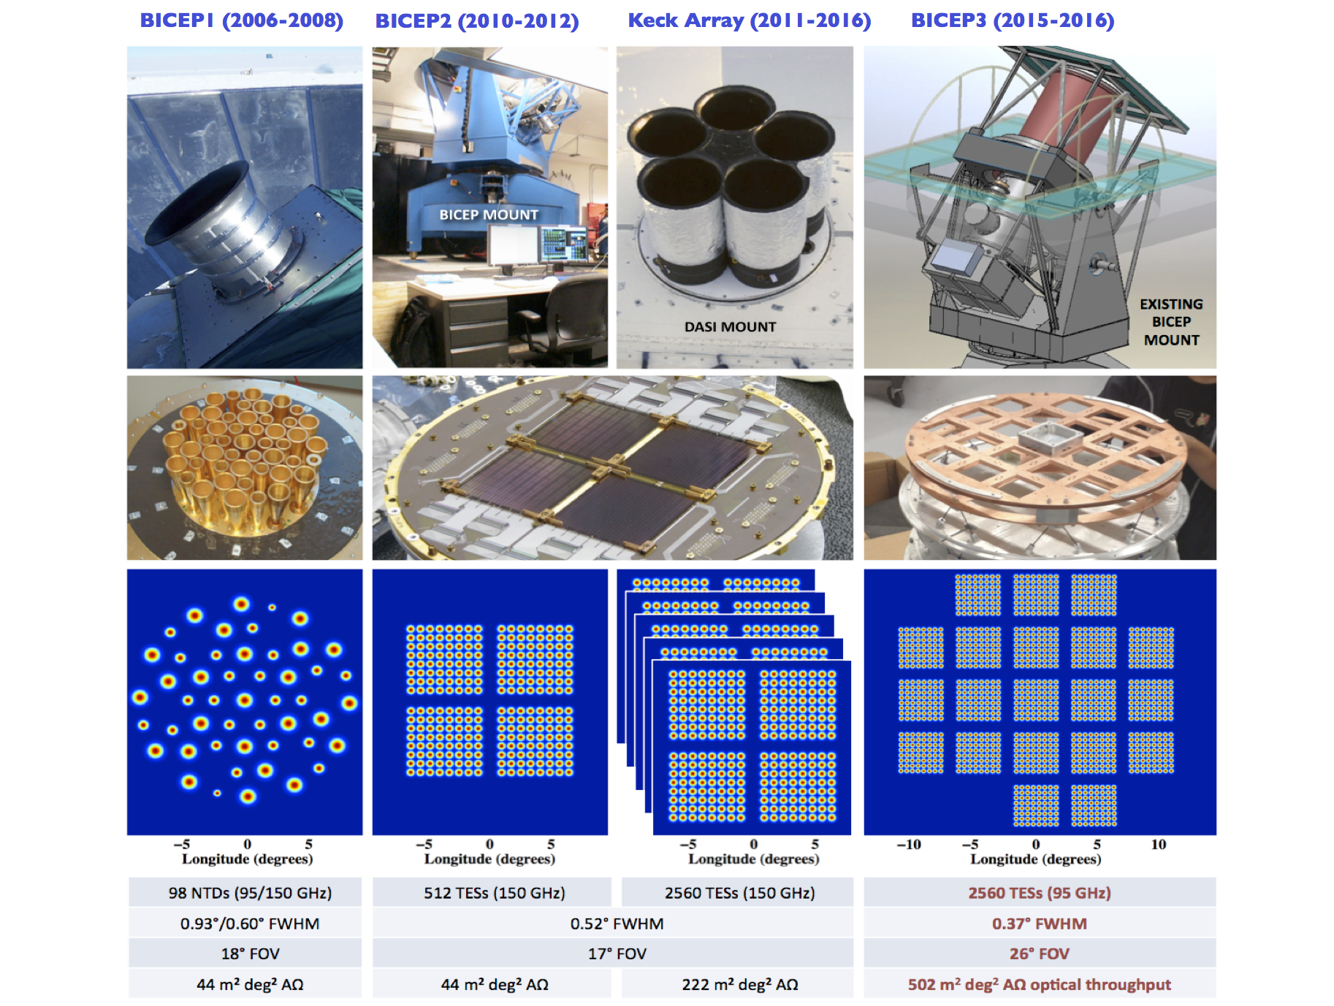

Slide 12
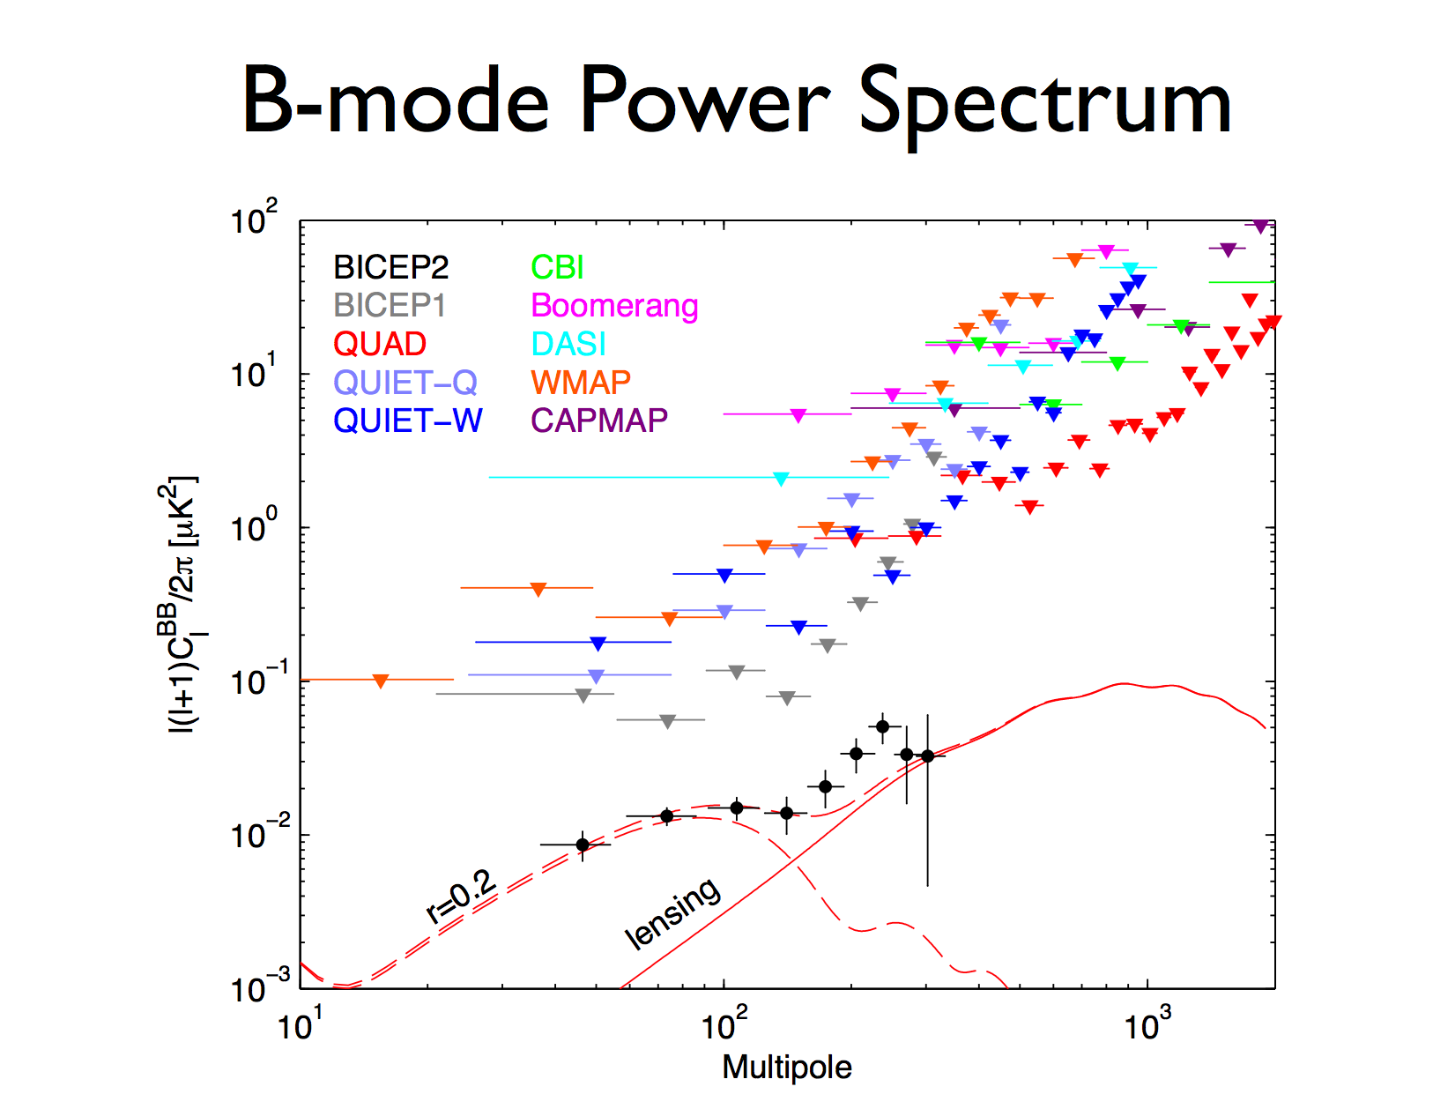

Slide 13
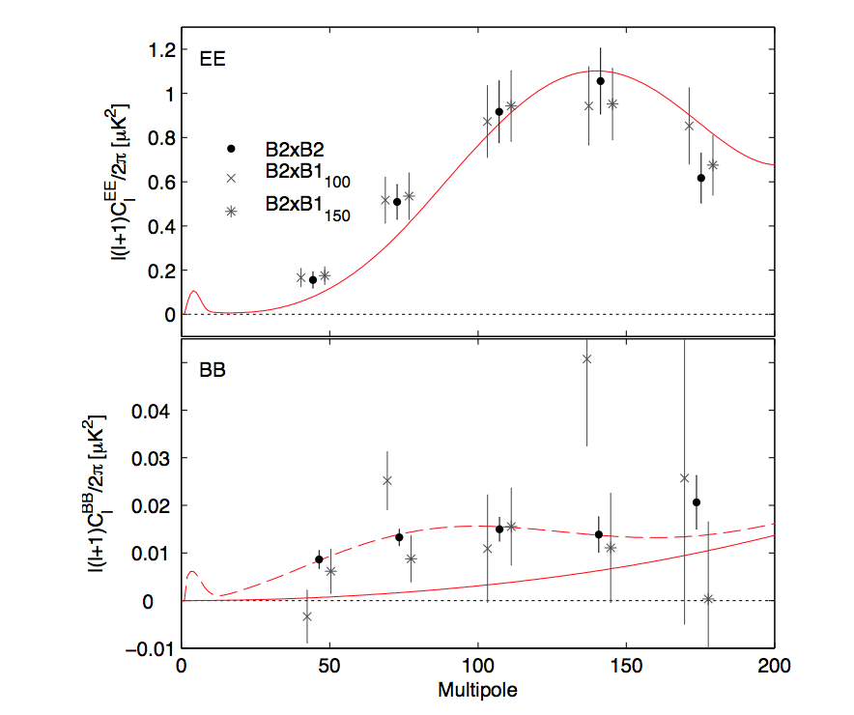
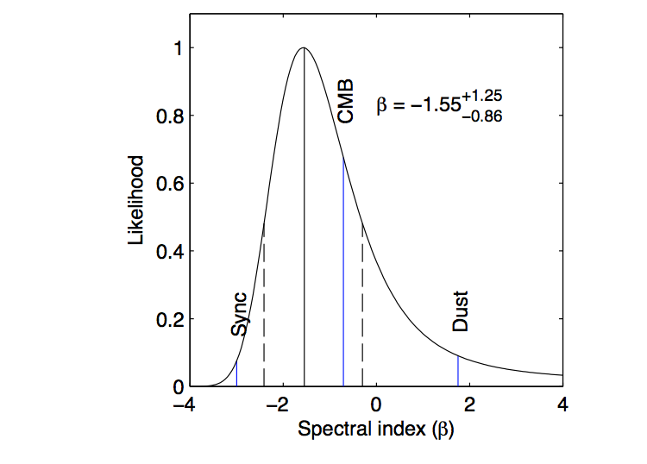
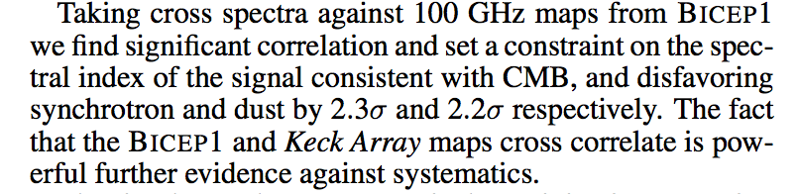
Spectral Dependence

Slide 14
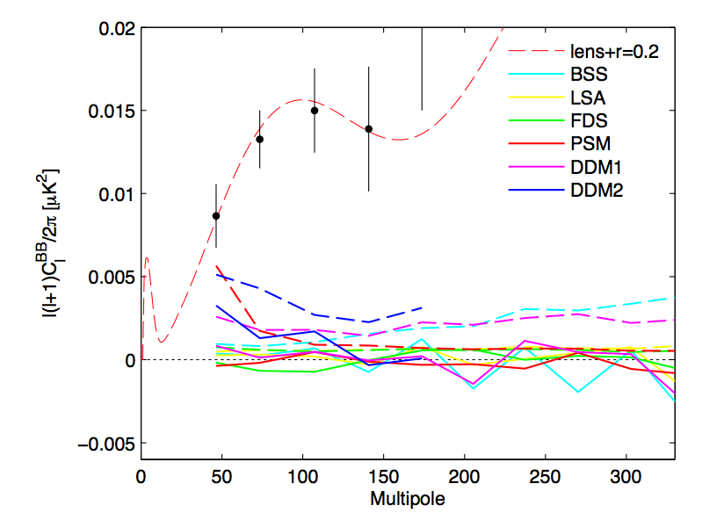
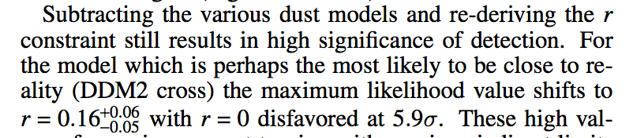
BICEP Team’s Estimate of Dust

Slide 15
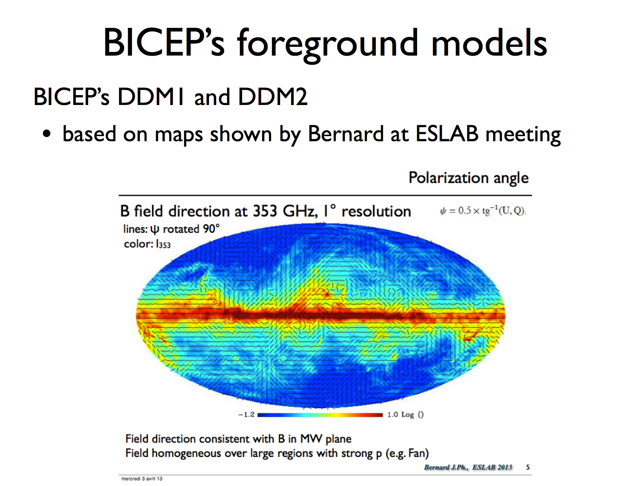

Slide 16
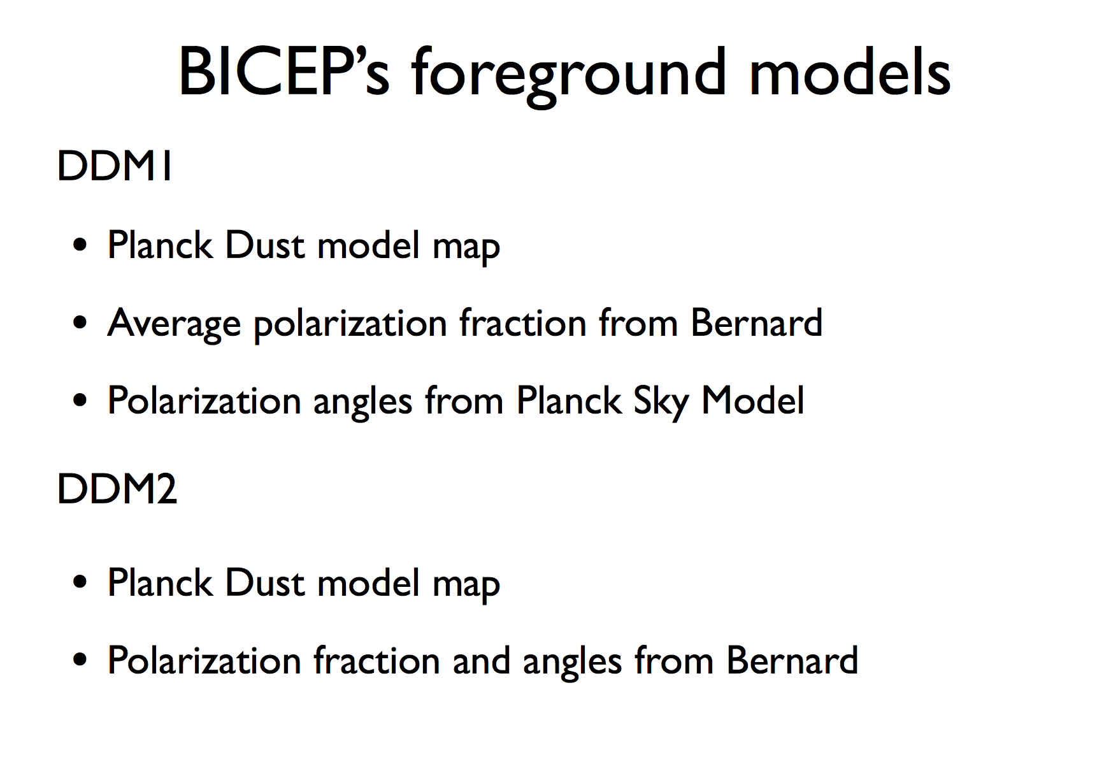

Slide 17
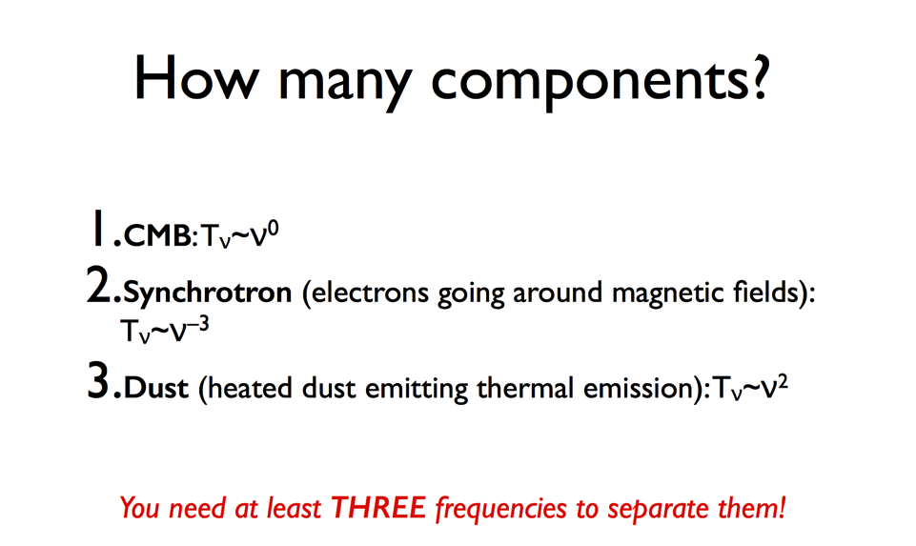
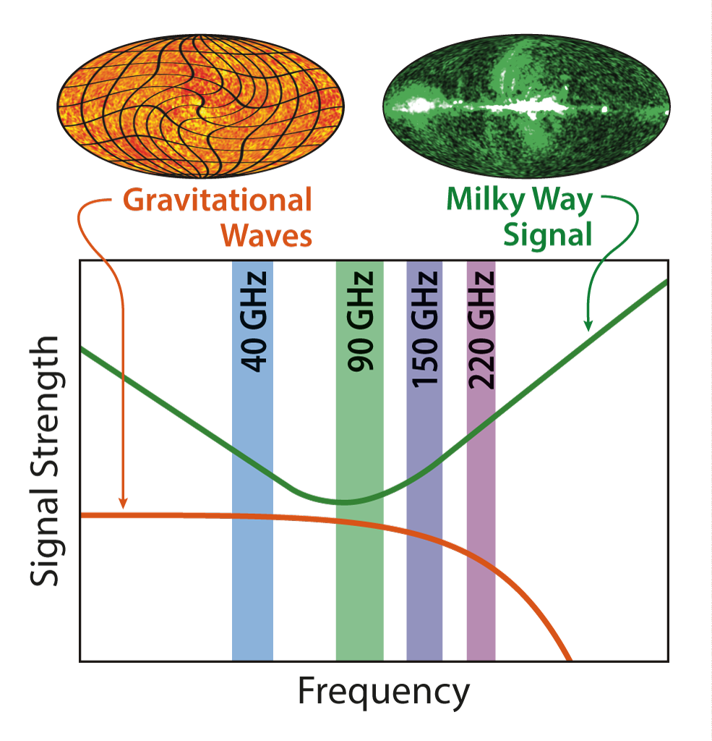
I was immediately doubtful about this result…

Slide 18
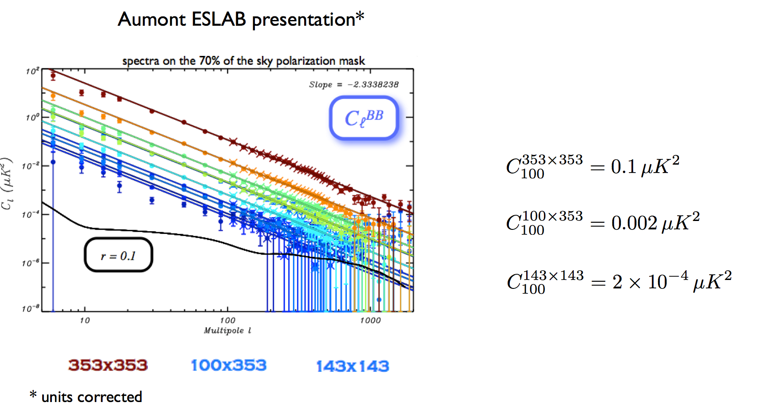
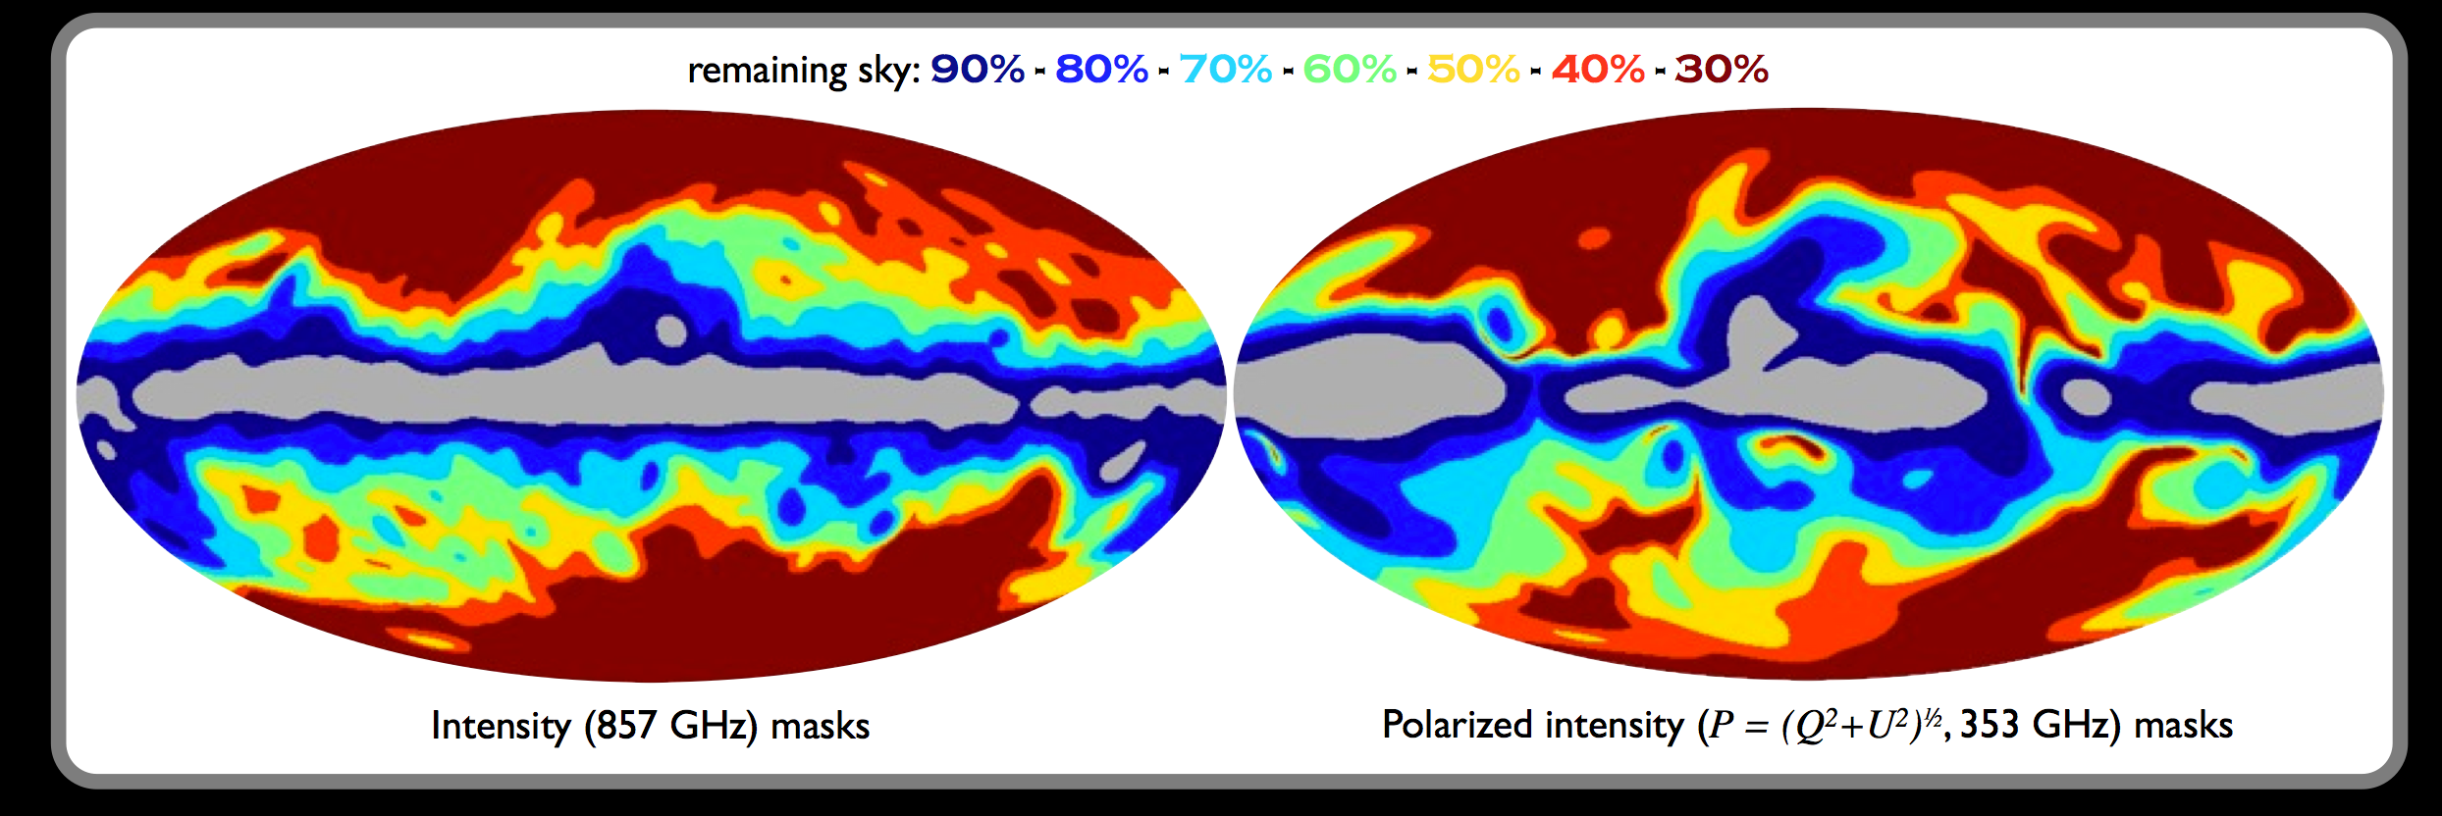

Slide 19
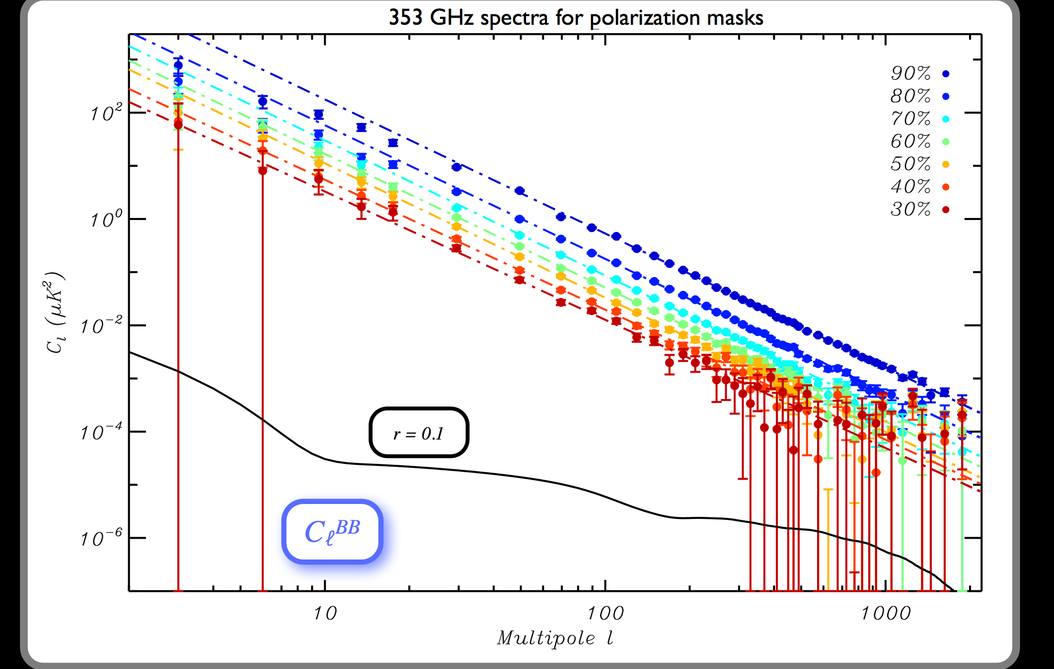

Slide 20
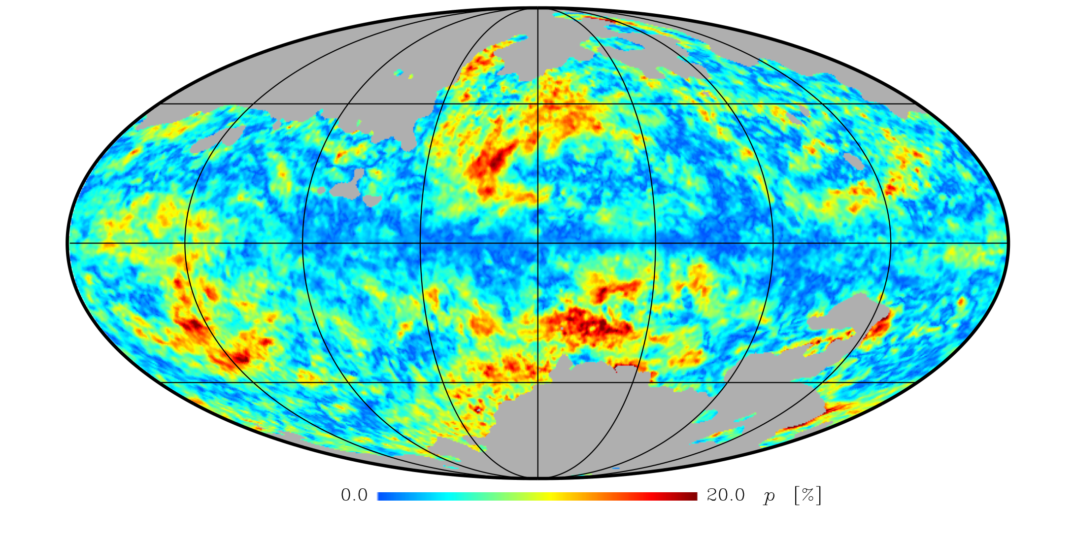
Planck has shown dust is highly polarized…
1405.0871 Planck Collaboration

Slide 21
Properties of Polarized Dust
Polarization fractions up to 20% at high galactic latitude
Correlates with synchrotron (known from WMAP data but even clearer with Planck)
Correlates with starlight polarization
Planck Team:1405.0874

Slide 22
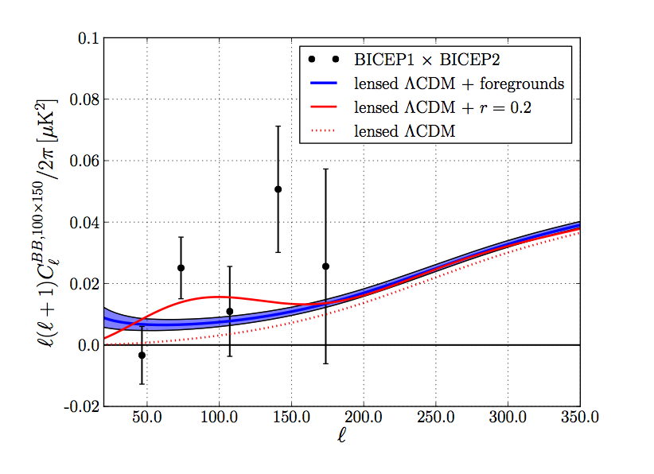
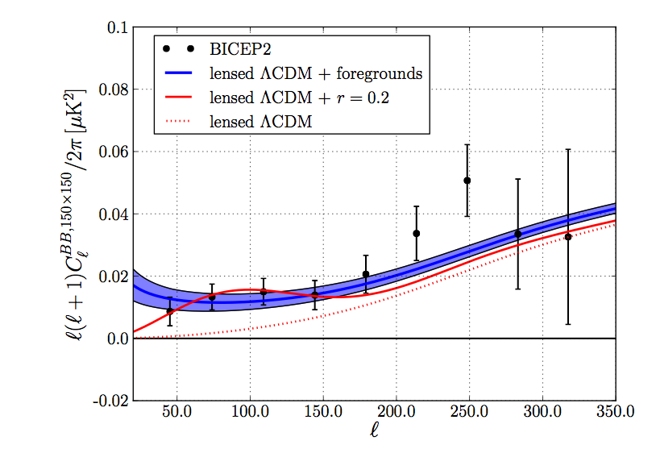
Dust vs. CMB
BICEP1 x BICEP2
Can’t distinguish between the two based on BICEP data alone
Level of polarization need typical for high galactic latitude (p ~0.1)
This is NOT a 5.9 sigma detection
BICEP2 x BICEP2
Flauger, Hill and DNS

Slide 23
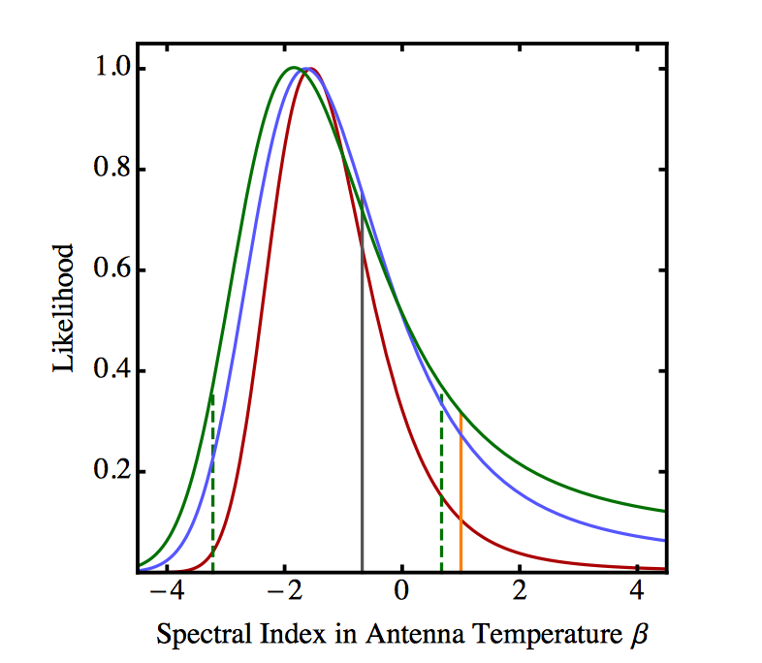
Spectral Index of Signal
Should use proper errors
Include CMB Lensing signal
Include synch + dust correlations
Dust and GW differ by less than 1 sigma

Slide 24
Problematic BICEP Paper Figure
Doesn’t include lensing contribution
Auto-correlation assume polarizations of 5% and are missing small scale power (for most templates)
Cross-correlations assume “perfect” template

Slide 25
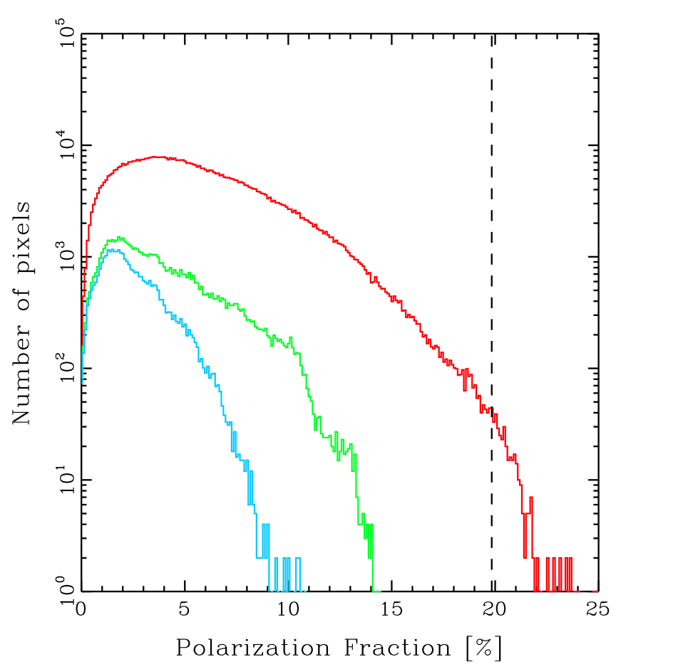
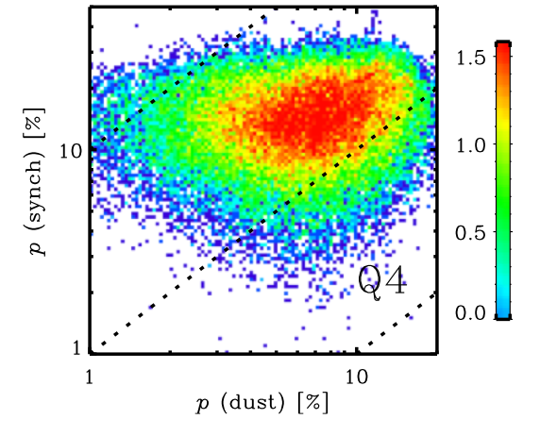
Typical Polarization Fraction
Region is highly polarized in synchrotron (30%) and required polarization fraction ~10% is typical
1405.0871 Planck Collaboration

Slide 26
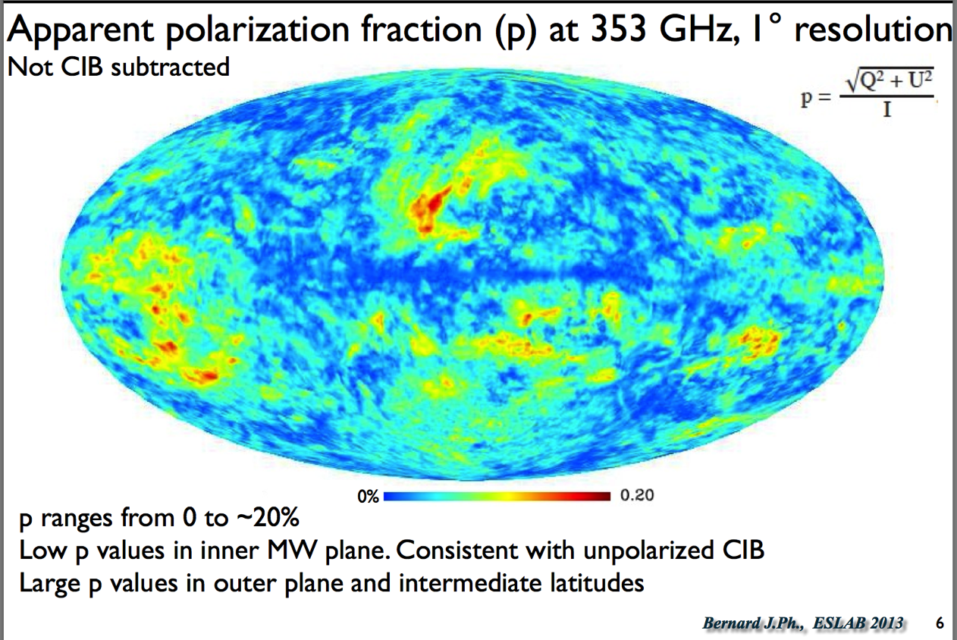
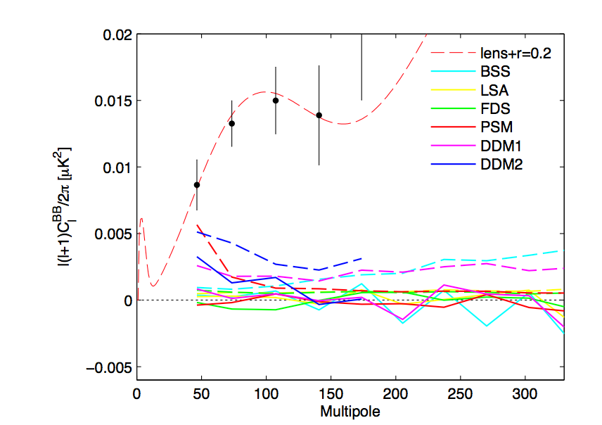
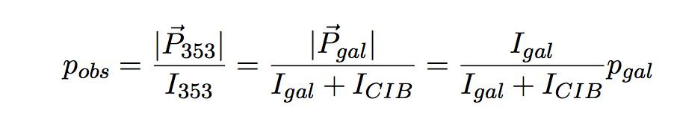
BICEP2 Dust Estimates

Slide 27
BICEP2 Dust Models reconsidered
DDM2 and DDM1 need to be corrected to proper polarization fraction for region
LSS and BSA should be scaled to proper polarization for this part of sky (instructions on model say scale from 3.6%)
PSM should be run in “simulation” mode and the maximum polarization fraction set to 20%
FDS model assumes uniform field with rather arbitrary direction (Q=U)

Slide 28
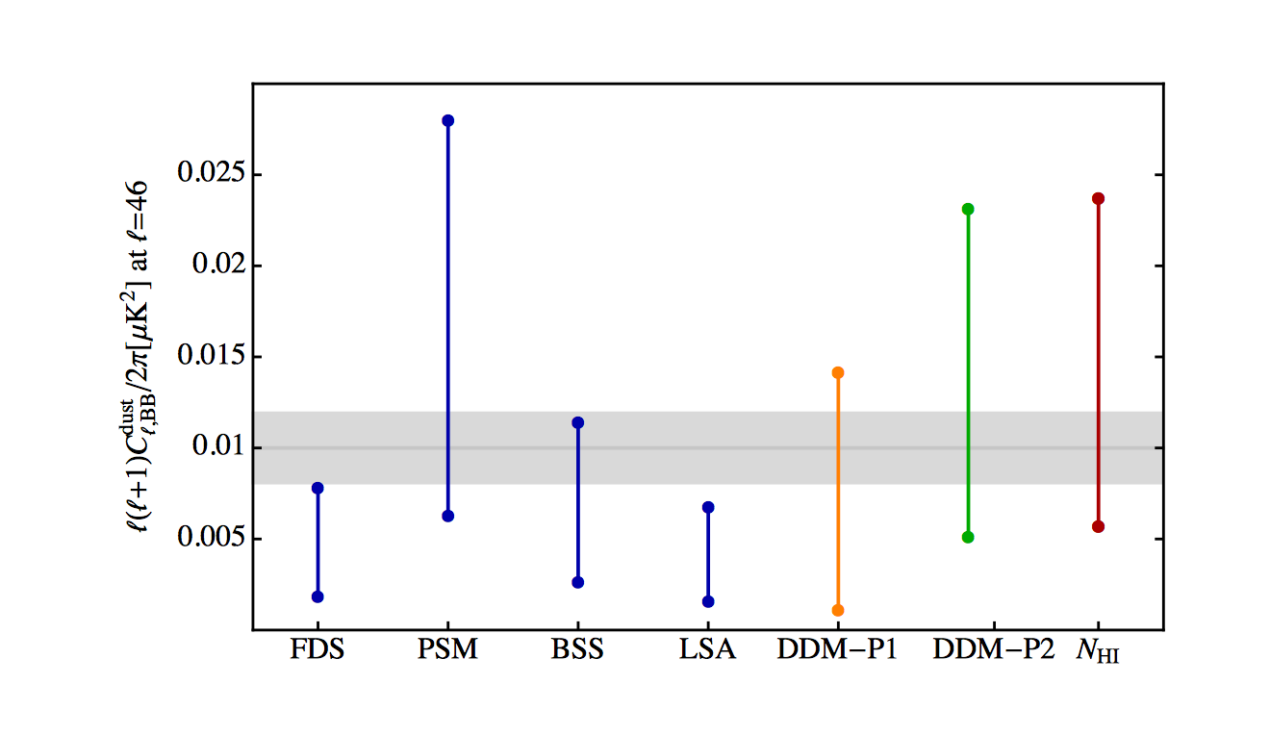
BICEP2 Auto-correlations

Slide 29
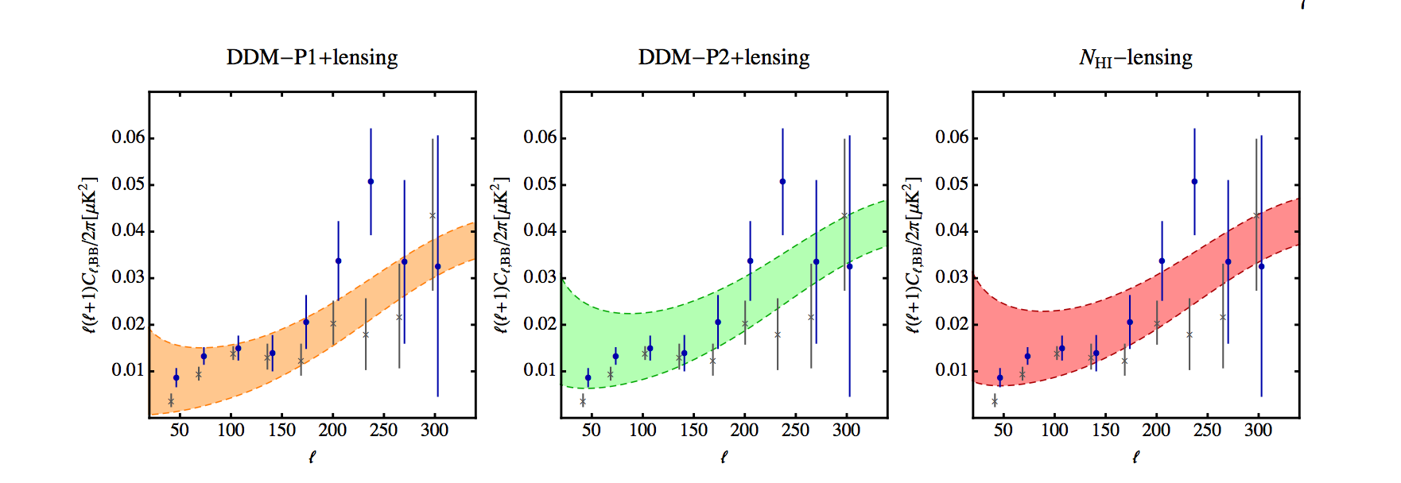
Our Data Driven Models
Polarization direction from starlight measurements in region
Polarization fraction from Boulanger maps

Slide 30
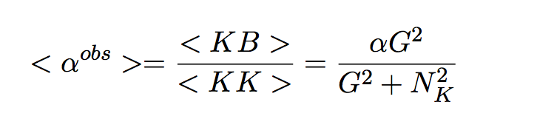
Cross-correlations
Cross-correlations require an accurate template. Otherwise the cross-correlation leads to an underestimate of the signal

Slide 31
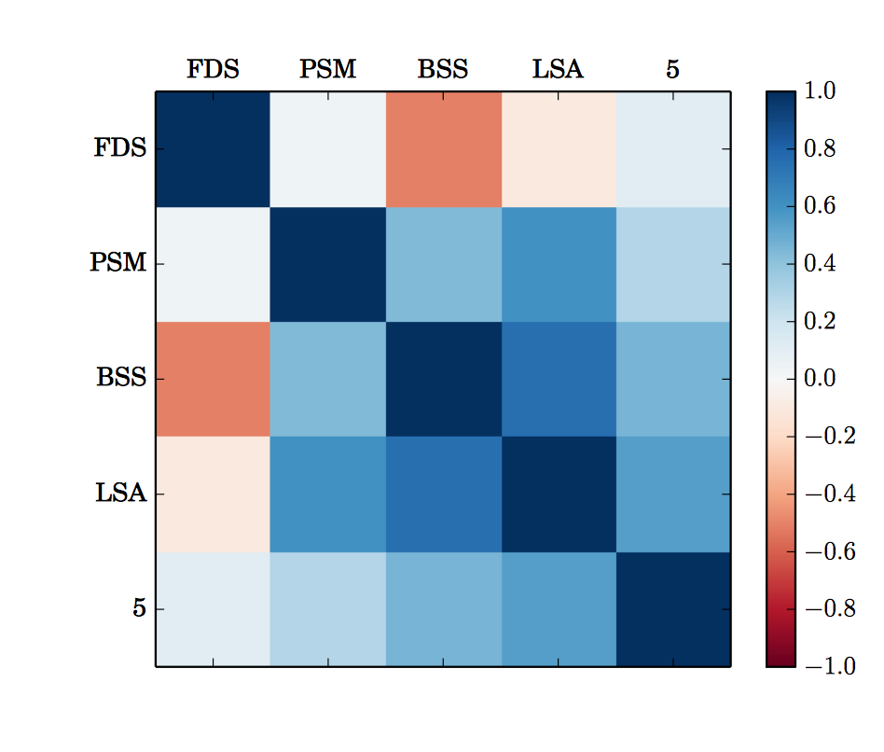
BICEP2 Cross-correlations

Slide 32
Next Steps: Our List in June
BICEP2 team should release their maps (and transfer functions) and their systematics paper
Planck team will likely announce their analysis of the polarization fraction in the region✔
If this is a low polarization fraction region, then the combination of the data sets will point towards discovery ✖
If this is a high polarization fraction region, BICEP2 will have provided the best upper limit on B modes (but should modify their claims) ✔

Slide 33
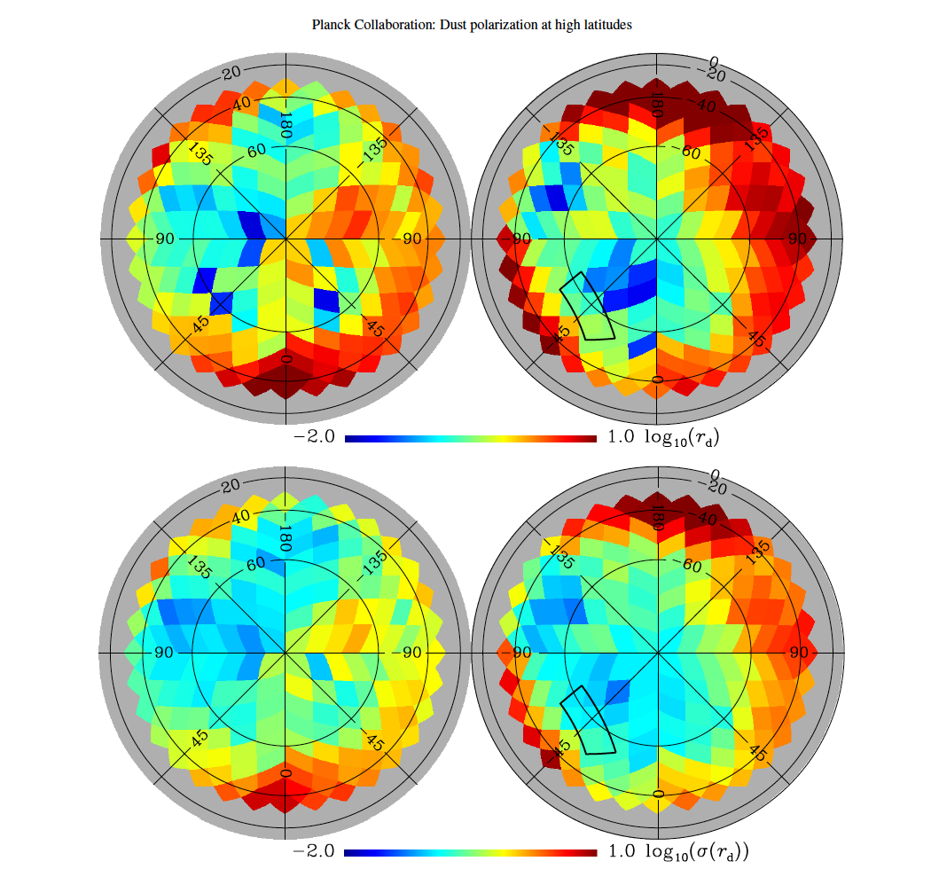

Slide 34
New Planck Data

Slide 36
Conclusion on BICEP Claim
Planck has seen a dust signal in the region consistent with dust explaining ALL of the BICEP2 detection
If the signal was all cosmological, then Planck would have seen nothing.
DETECTION AWAITS MORE DATA AT OTHER FREQUENCIES IN CLEANER PARTS OF THE SKY!

Slide 37
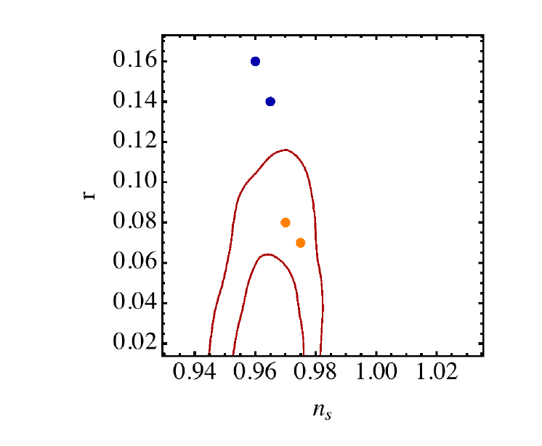
Constraints on r

Slide 38
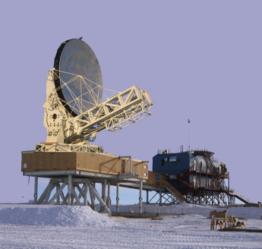
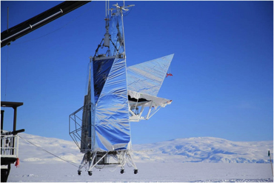
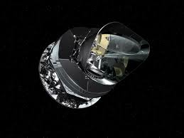
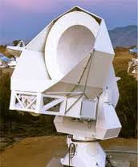
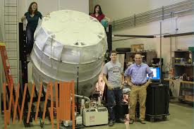
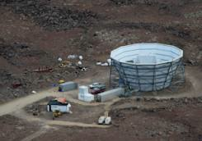
Hopefully, future experiments will detect Primordial Gravitational Waves

Slide 39
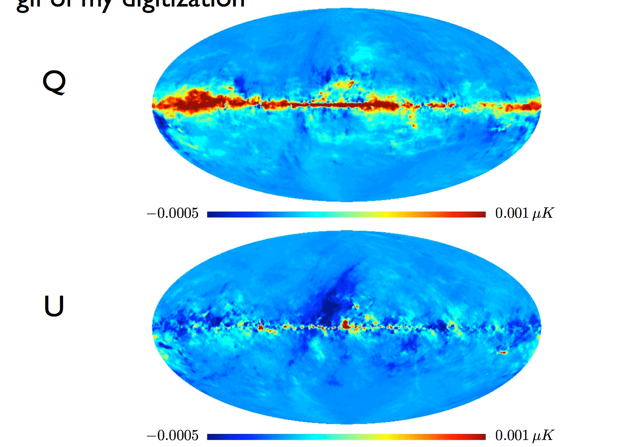

Slide 40
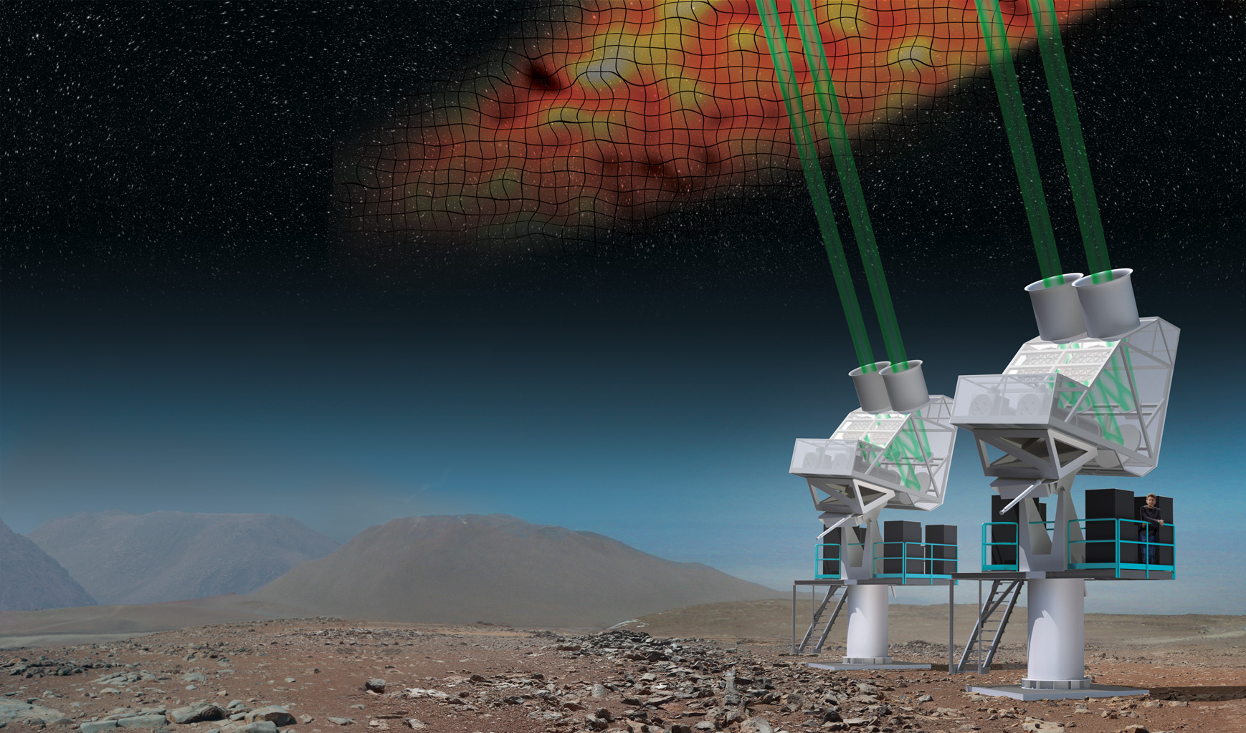
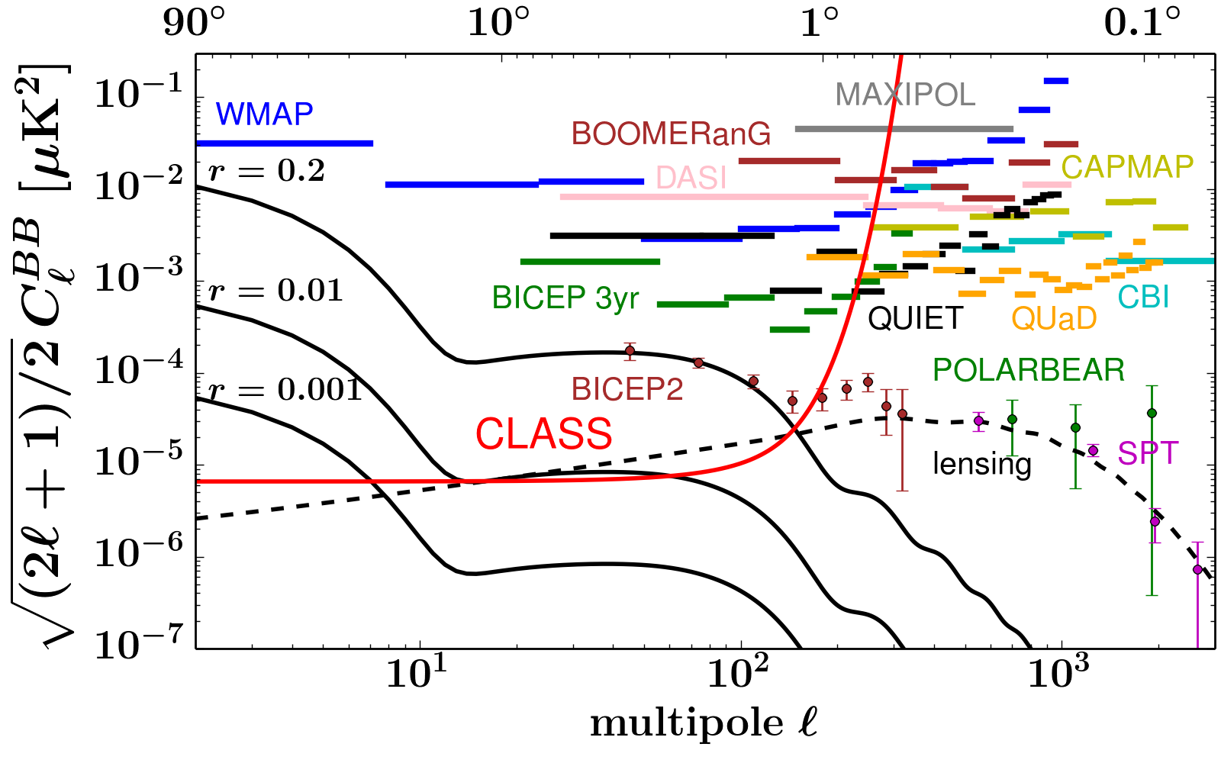
150 GHz +
220 GHz
Cosmology Large Angular Scale Surveyor
(CLASS)
90 GHz
90 GHz
40 GHz

Slide 41
PIXIE: 400 Spectral channels spanning 2.5 decades in frequency!

Slide 42
