Slide 1
Generalized Global Symmetries
Nathan Seiberg
Institute for Advanced Study
O. Aharony, NS, Y. Tachikawa, arXiv:1305.0318
S. Gukov, A. Kapustin, arXiv:1307.4793
A. Kapustin, R. Thorngren, arXiv:1308.2926, arXiv:1309.4721
A. Kapustin, NS, arXiv:1401.0740
D. Gaiotto, A. Kapustin, NS, B. Willett, to appear
Thank G. Moore, S. Razamat

Slide 2
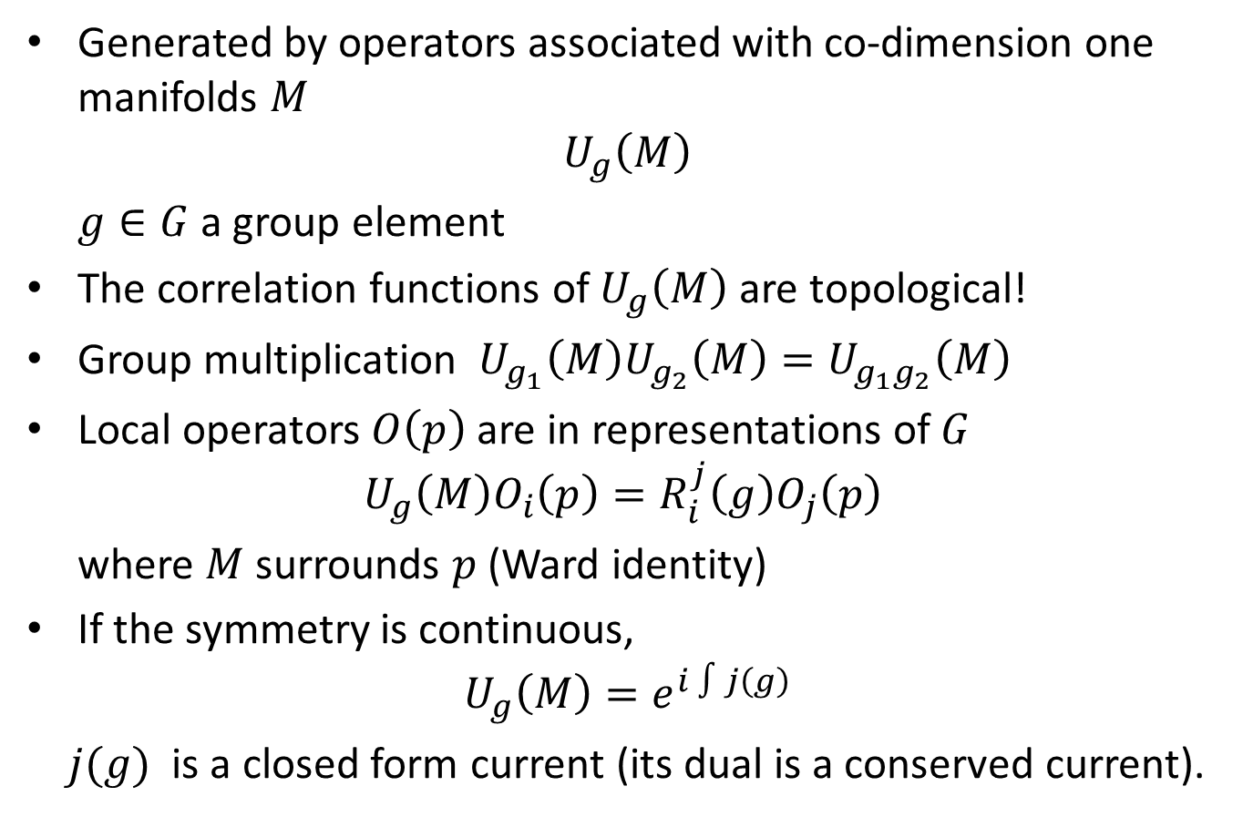
Ordinary global symmetries
Generated by operators associated with co-dimension one manifolds $M$
$$U_{g}\left(M\right)$$
$g∈G$ a group element
The correlation functions of $U_{g}\left(M\right)$ are topological!
Group multiplication $U_{g_{1}}\left(M\right)U_{g_{2}}\left(M\right)=U_{g_{1}g_{2}}\left(M\right)$
Local operators $O\left(p\right)$ are in representations of$G$
$$U_{g}\left(M\right)O_{i}\left(p\right)=R_{i}^{j}\left(g\right)O_{j}\left(p\right)$$
where $M$ surrounds $p$(Ward identity)
If the symmetry is continuous,
$$U_{g}\left(M\right)=e^{i ∫j\left(g\right)}$$
$j(g)$ is a closed form current (its dual is a conserved current).
Notes:
Physicists love symmetries.
First we learned about global symmetries.
Then we were taught that gauge symmetries are better – separate symmetry in each point in space time.
In fact, global symmetries are not present in a theory of gravity at all and hence they are not “fundamental.”
The more modern view is that gauge symmetries are not fundamental. The same theory can have different presentations with different gauge symmetries. Gauge symmetries are not symmetries.
In this talk focus on global symmetries.
This is an abstract definition. No need for Lagrangian. It is valid whether the symmetry is spontaneously broken or not.

Slide 3

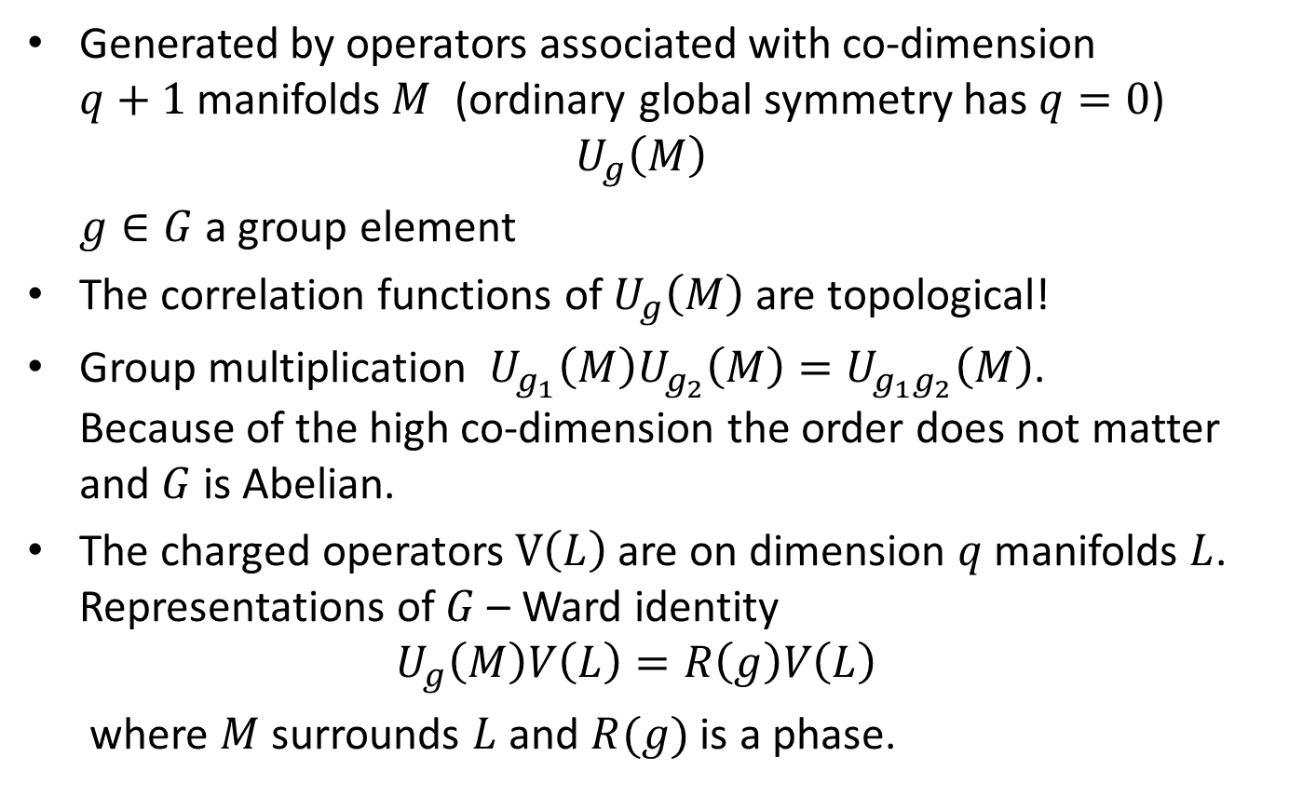
$q$-form global symmetries
Generated by operators associated with co-dimension $q+1$manifolds$M$ (ordinary global symmetry has $q=0$)
$$U_{g}\left(M\right)$$
$g∈G$ a group element
The correlation functions of $U_{g}\left(M\right)$ are topological!
Group multiplication $U_{g_{1}}\left(M\right)U_{g_{2}}\left(M\right)=U_{g_{1}g_{2}}\left(M\right)$. Because of the high co-dimension the order does not matter and $G$ is Abelian.
The charged operators $V\left(L\right)$ are on dimension $q$manifolds $L$. Representations of$G$– Ward identity
$$U_{g}\left(M\right)V\left(L\right)=R\left(g\right)V\left(L\right)$$
where $M$ surrounds $L$ and $R(g)$ is a phase.

Slide 4
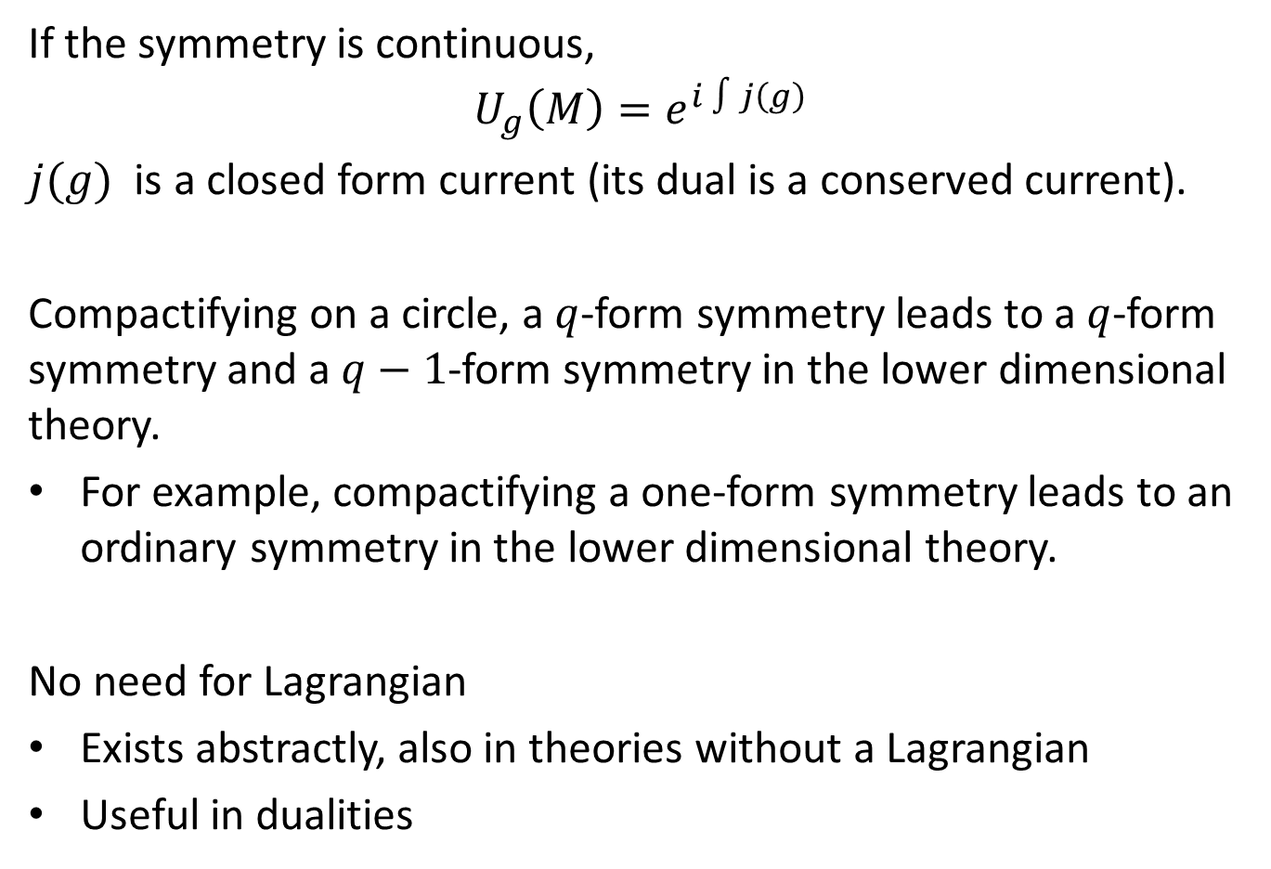
$q$-form global symmetries
If the symmetry is continuous,
$$U_{g}\left(M\right)=e^{i ∫j\left(g\right)}$$
$j(g)$ is a closed form current (its dual is a conserved current).
Compactifying on a circle, a $q$-form symmetry leads to a $q$-form symmetry and a $q−1$-form symmetry in the lower dimensional theory.
For example, compactifying a one-form symmetry leads to an ordinary symmetry in the lower dimensional theory.
No need for Lagrangian
Exists abstractly, also in theories without a Lagrangian
Useful in dualities

Slide 5
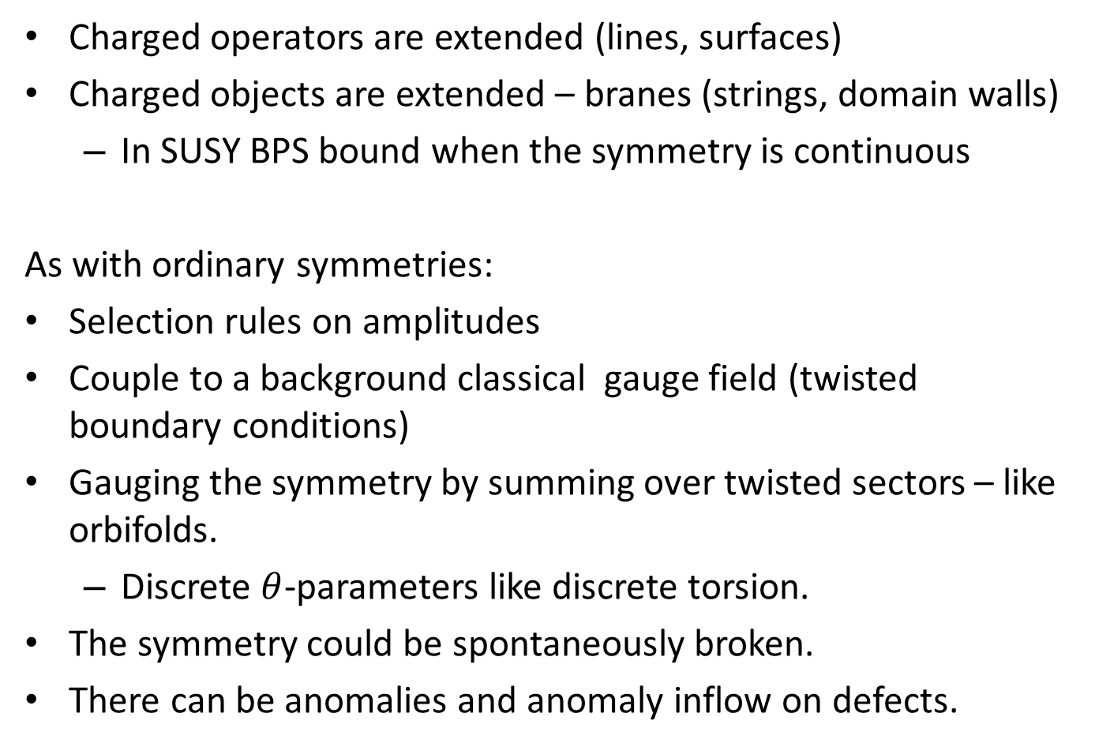
$q$-form global symmetries
Charged operators are extended (lines, surfaces)
Charged objects are extended – branes (strings, domain walls)
  In SUSY BPS bound when the symmetry is continuous
As with ordinary symmetries:
Selection rules on amplitudes
Couple to a background classical gauge field (twisted boundary conditions)
Gauging the symmetry by summing over twisted sectors – like orbifolds.
  Discrete $θ$-parameters like discrete torsion.
The symmetry could be spontaneously broken.
There can be anomalies and anomaly inflow on defects.

Slide 6

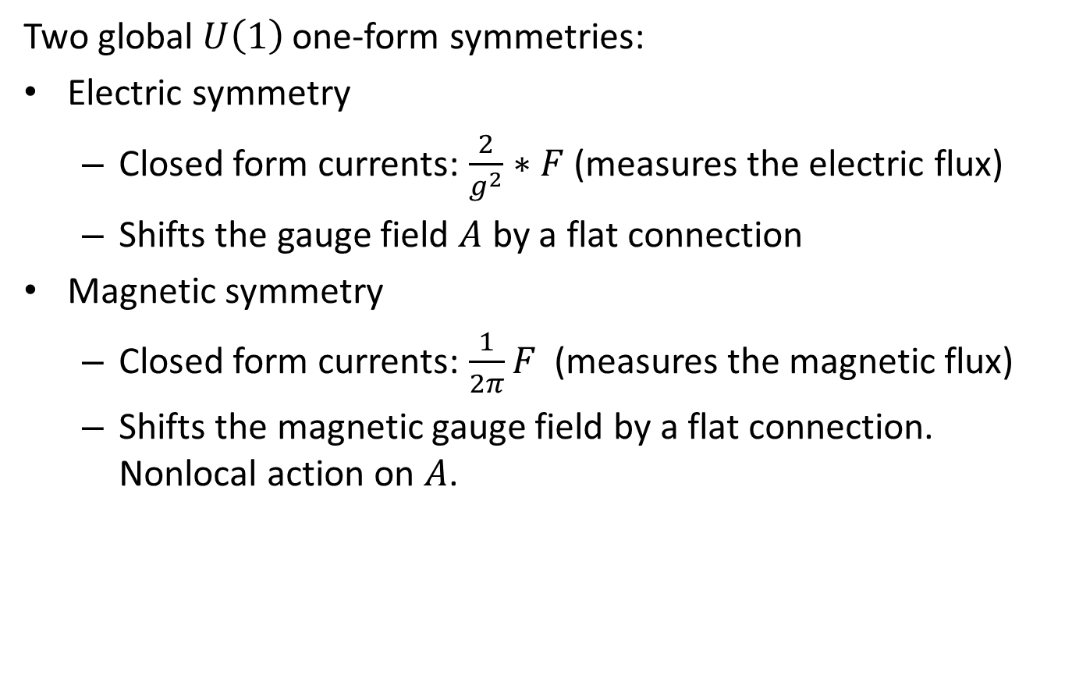
Example 1: $4d$ $U(1)$ gauge theory
Two global $U\left(1\right)$ one-form symmetries:
Electric symmetry
  Closed form currents: $\frac{2}{g^{2}}∗F$ (measures the electric flux)
  Shifts the gauge field $A$ by a flat connection
Magnetic symmetry
  Closed form currents: $\frac{1}{2π}F$ (measures the magnetic flux)
  Shifts the magnetic gauge field by a flat connection. Nonlocal action on $A$.
Notes:
Kinematics

Slide 7
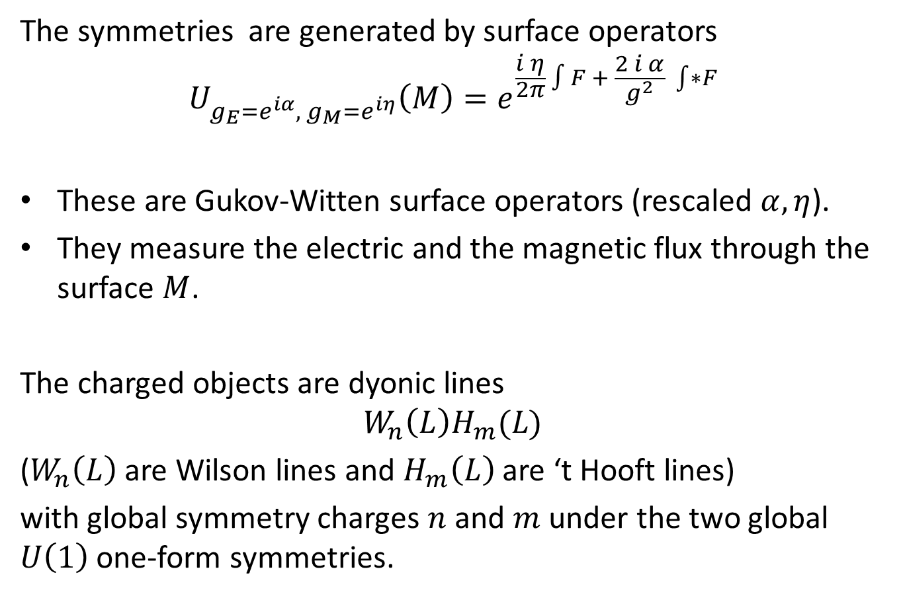
Example 1: $4d$ $U(1)$ gauge theory
The symmetries are generated by surface operators
$$U_{g_{E}=e^{iα}, g_{M}=e^{iη}}\left(M\right)=e^{\frac{i η}{2π} ∫F + \frac{2 i α}{g^{2}} \int{∗}F }$$
These are Gukov-Witten surface operators (rescaled $α, η$).
They measure the electric and the magnetic flux through the surface $M$.
The charged objects are dyonic lines
$$W_{n}\left(L\right)H_{m}(L)$$
($W_{n}\left(L\right)$ are Wilson lines and $H_{m}\left(L\right)$ are ‘t Hooft lines)
with global symmetry charges $n$ and $m$under the two global $U\left(1\right)$ one-form symmetries.

Slide 8

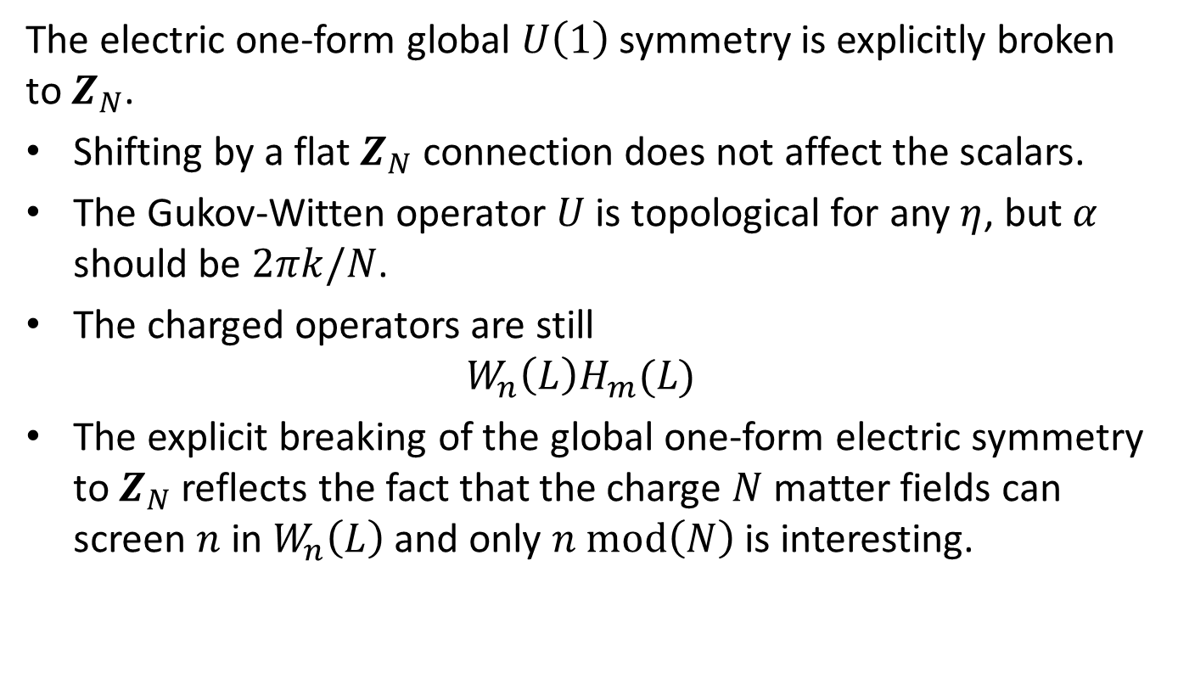
Example 2: $4d$ $U(1)$ gauge theory with charge $N$ scalars
The electric one-form global $U\left(1\right)$ symmetry is explicitly broken to $Z_{N}$.
Shifting by a flat $Z_{N}$ connection does not affect the scalars.
The Gukov-Witten operator $U$ is topological for any $η$, but $α$ should be $2πk/N$.
The charged operators are still
$$W_{n}\left(L\right)H_{m}(L)$$
The explicit breaking of the global one-form electric symmetry to $Z_{N}$ reflects the fact that the charge $N$ matter fields can screen $n$ in $W_{n}\left(L\right)$ and only $n mod\left(N\right)$ is interesting.

Slide 9

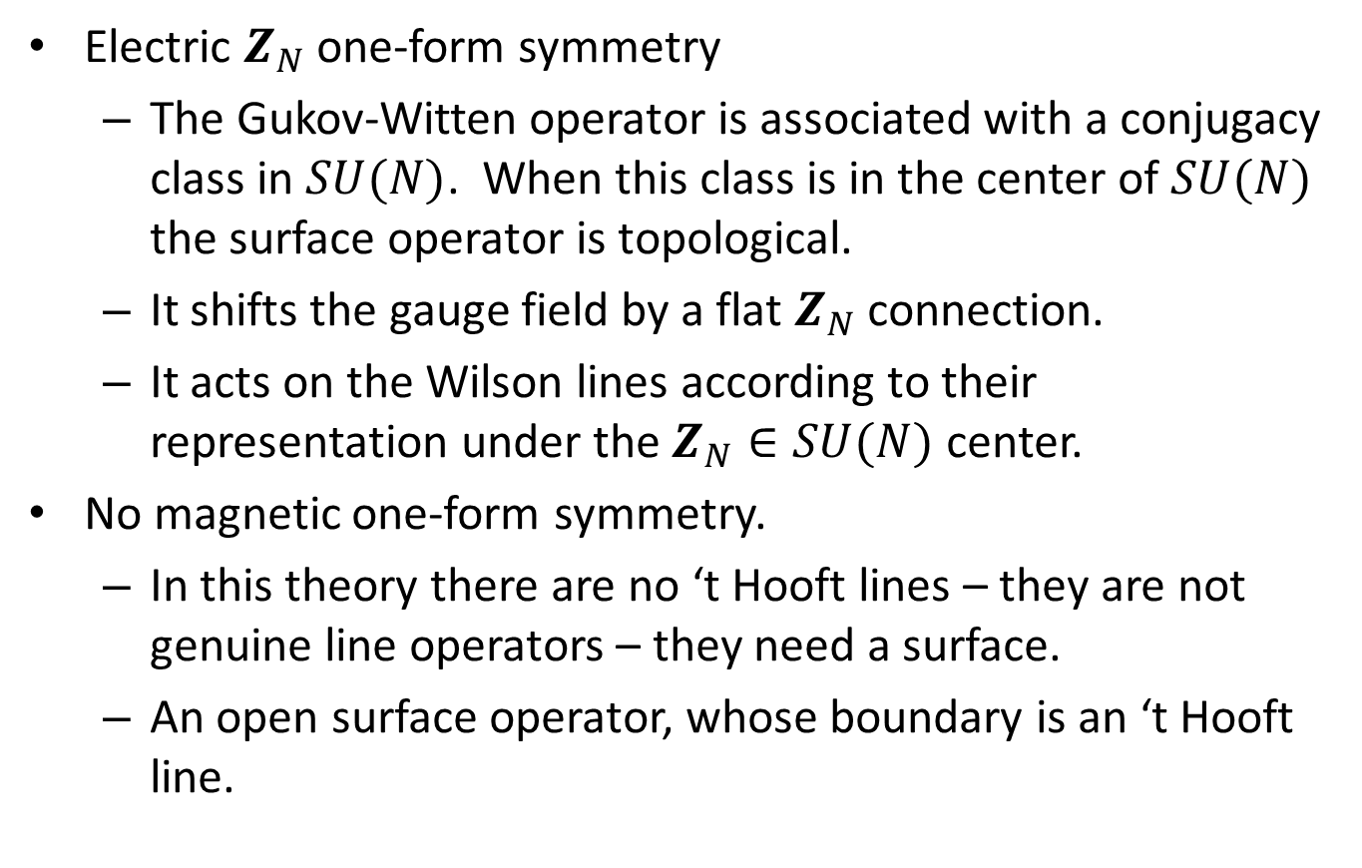
Example 3: $4d$ $SU(N)$ gauge theory
Electric $Z_{N}$ one-form symmetry
  The Gukov-Witten operator is associated with a conjugacy class in $SU(N)$. When this class is in the center of $SU(N)$ the surface operator is topological.
  It shifts the gauge field by a flat $Z_{N}$ connection.
  It acts on the Wilson lines according to their representation under the $Z_{N}∈SU(N)$ center.
No magnetic one-form symmetry.
  In this theory there are no ‘t Hooft lines – they are not genuine line operators – they need a surface.
  An open surface operator, whose boundary is an ‘t Hooft line.

Slide 10
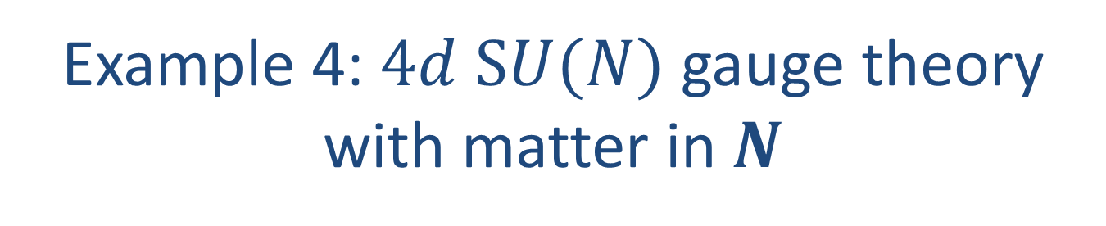

Example 4: $4d$ $SU(N)$ gauge theory with matter in $N$
The presence of the charged matter explicitly breaks the electric one-form${ Z}_{N}$ symmetry.
Hence, there is no global one-form symmetry.

Slide 11

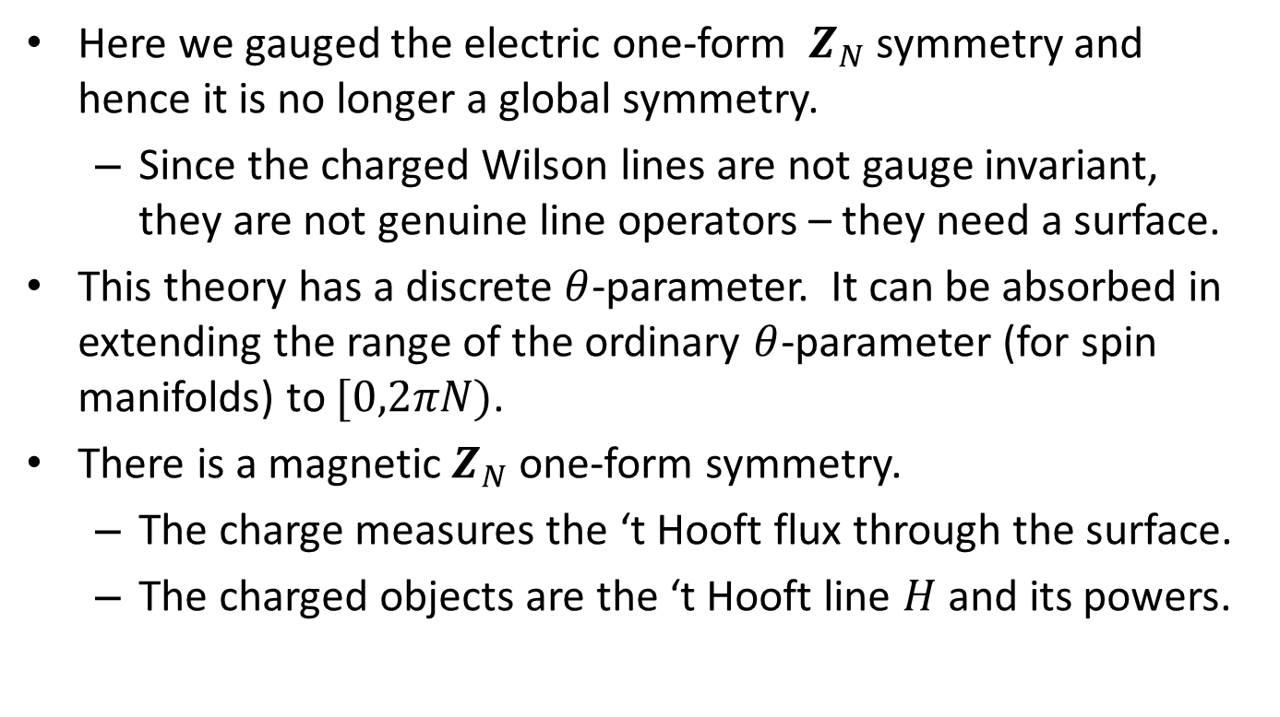
Example 5: $4d$ $SU(N)/Z_{N}$ gauge theory
Here we gauged the electric one-form ${ Z}_{N}$ symmetry and hence it is no longer a global symmetry.
  Since the charged Wilson lines are not gauge invariant, they are not genuine line operators – they need a surface.
This theory has a discrete $θ$-parameter. It can be absorbed in extending the range of the ordinary $θ$-parameter (for spin manifolds) to $[0,2πN)$.
There is a magnetic $Z_{N}$ one-form symmetry.
  The charge measures the ‘t Hooft flux through the surface.
  The charged objects are the ‘t Hooft line $H$ and its powers.

Slide 12
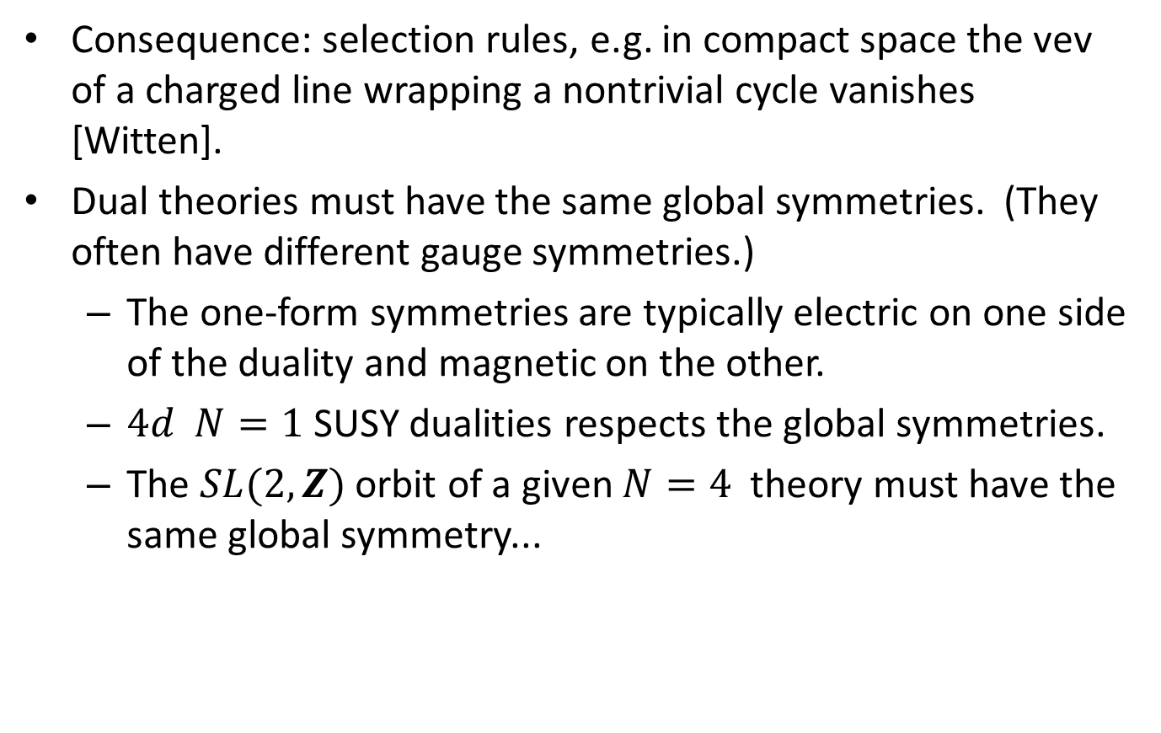
Significance of these symmetries
Consequence: selection rules, e.g. in compact space the vev of a charged line wrapping a nontrivial cycle vanishes [Witten].
Dual theories must have the same global symmetries. (They often have different gauge symmetries.)
  The one-form symmetries are typically electric on one side of the duality and magnetic on the other.
  $4d N=1$ SUSY dualities respects the global symmetries.
  The $SL(2,Z)$ orbit of a given $N=4$ theory must have the same global symmetry...
Notes:
Dynamics

Slide 13
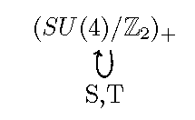
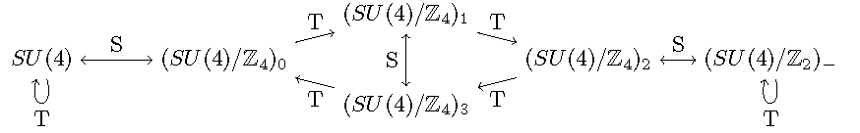
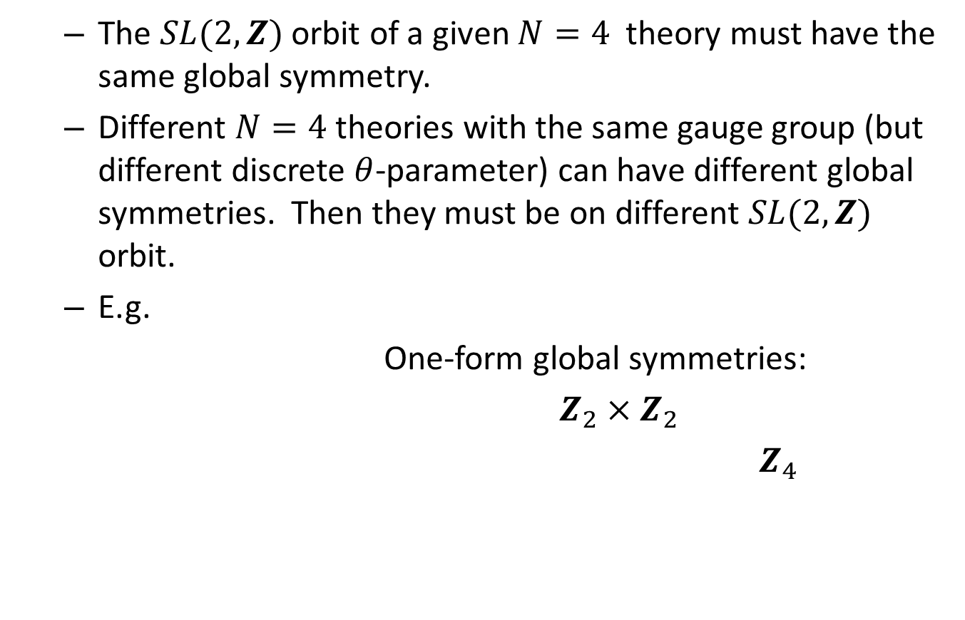
Significance of these symmetries
  The $SL(2,Z)$ orbit of a given $N=4$ theory must have the same global symmetry.
  Different $N=4$theories with the same gauge group (but different discrete $θ$-parameter) can have different global symmetries. Then they must be on different $SL(2,Z)$ orbit.
  E.g.
  One-form global symmetries:
  $Z_{2}×Z_{2}$
  $Z_{4}$

Slide 14
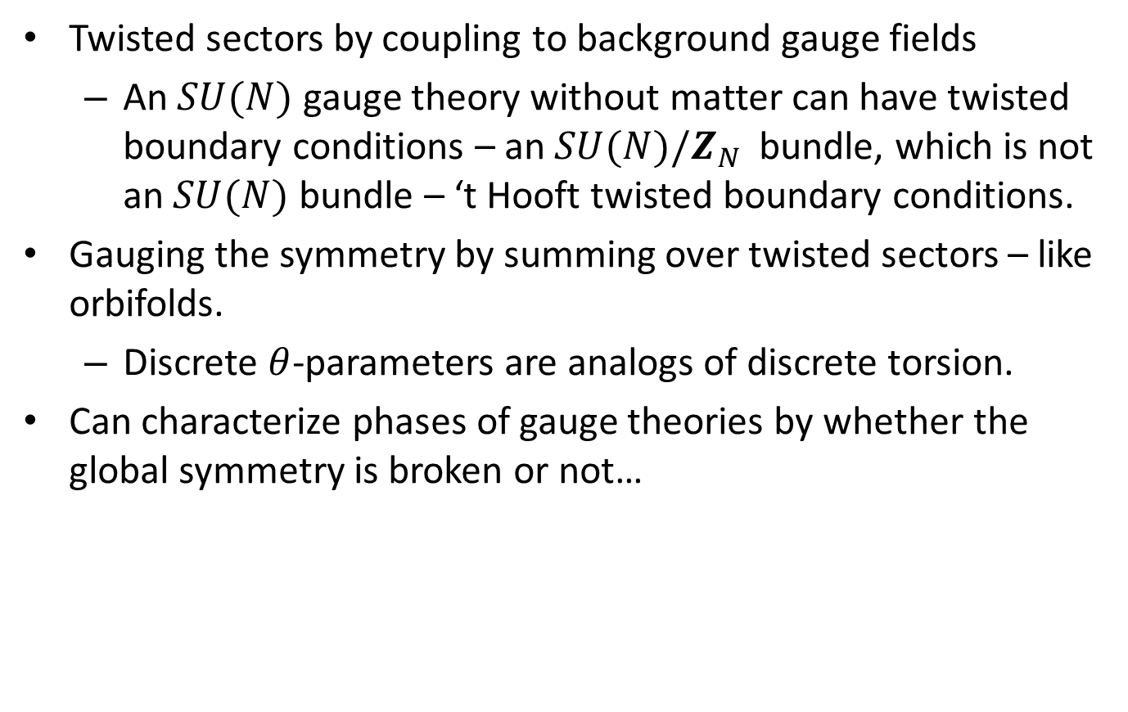
Significance of these symmetries
Twisted sectors by coupling to background gauge fields
  An $SU(N)$ gauge theory without matter can have twisted boundary conditions – an $SU(N)/Z_{N}$bundle, which is not an $SU(N)$ bundle – ‘t Hooft twisted boundary conditions.
Gauging the symmetry by summing over twisted sectors – like orbifolds.
  Discrete $θ$-parameters are analogs of discrete torsion.
Can characterize phases of gauge theories by whether the global symmetry is broken or not…

Slide 15
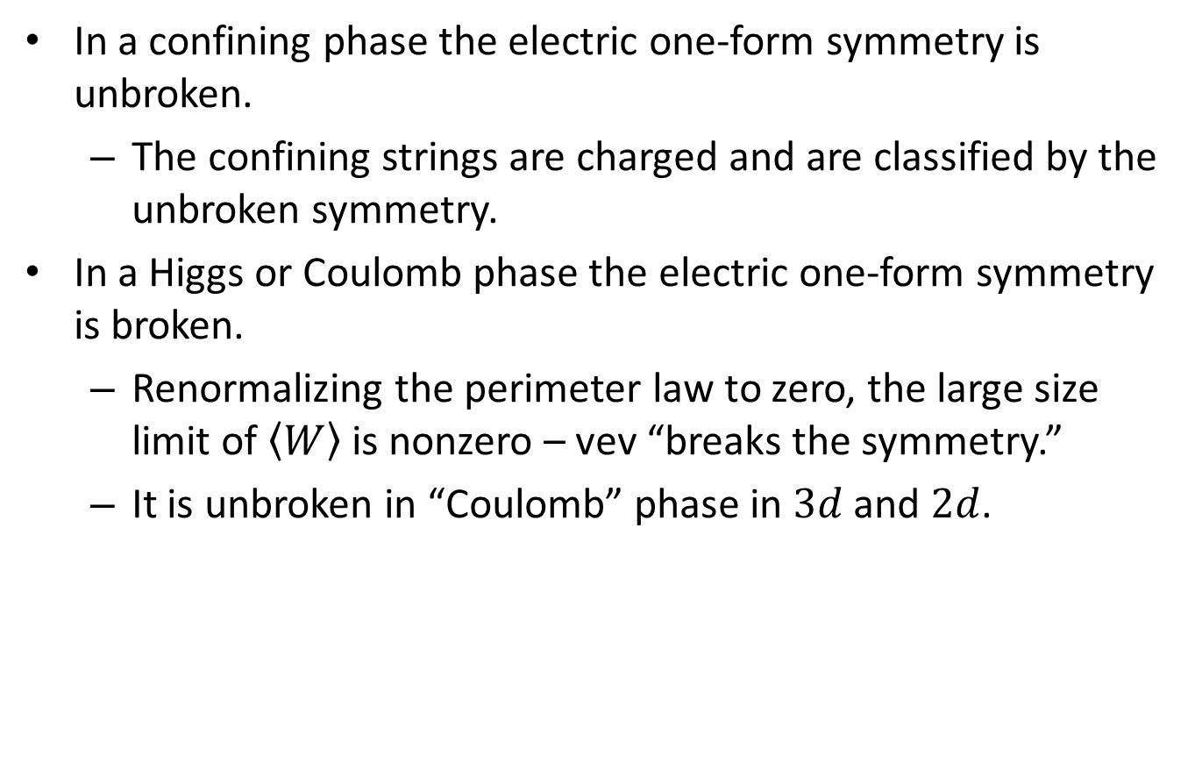
Characterizing phases
In a confining phase the electric one-form symmetry is unbroken.
  The confining strings are charged and are classified by the unbroken symmetry.
In a Higgs or Coulomb phase the electric one-form symmetry is broken.
  Renormalizing the perimeter law to zero, the large size limit of $〈W〉$ is nonzero – vev “breaks the symmetry.”
  It is unbroken in “Coulomb” phase in $3d$and $2d$.
Notes:
Dynamics

Slide 16
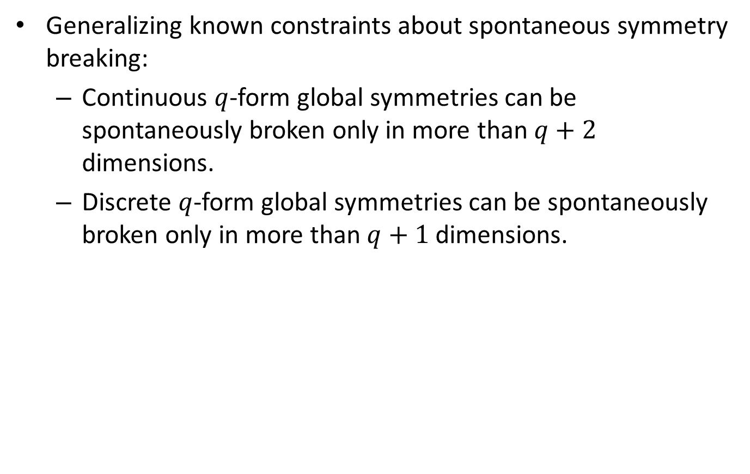
Characterizing phases
Generalizing known constraints about spontaneous symmetry breaking:
  Continuous $q$-form global symmetries can be spontaneously broken only in more than $q+2$ dimensions.
  Discrete $q$-form global symmetries can be spontaneously broken only in more than $q+1$ dimensions.

Slide 17
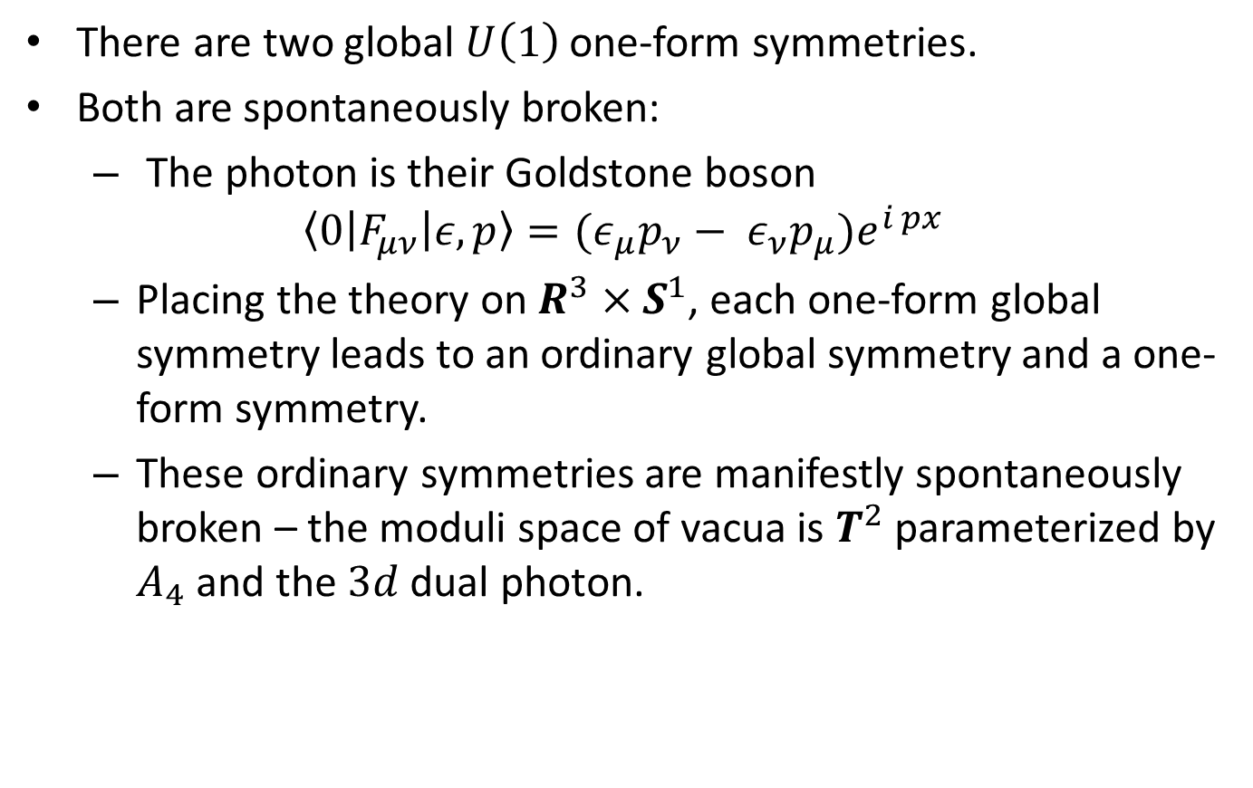
Example 1: $4d$ $U(1)$ gauge theory
There are two global $U\left(1\right)$ one-form symmetries.
Both are spontaneously broken:
  The photon is their Goldstone boson
$$〈0|F_{μν}|ε,p〉={(ε}_{μ}p_{ν}− ε_{ν}p_{μ})e^{i px}$$
  Placing the theory on $R^{3}×S^{1}$, each one-form global symmetry leads to an ordinary global symmetry and a one-form symmetry.
  These ordinary symmetries are manifestly spontaneously broken – the moduli space of vacua is $T^{2}$ parameterized by $A_{4}$ and the $3d$ dual photon.

Slide 18
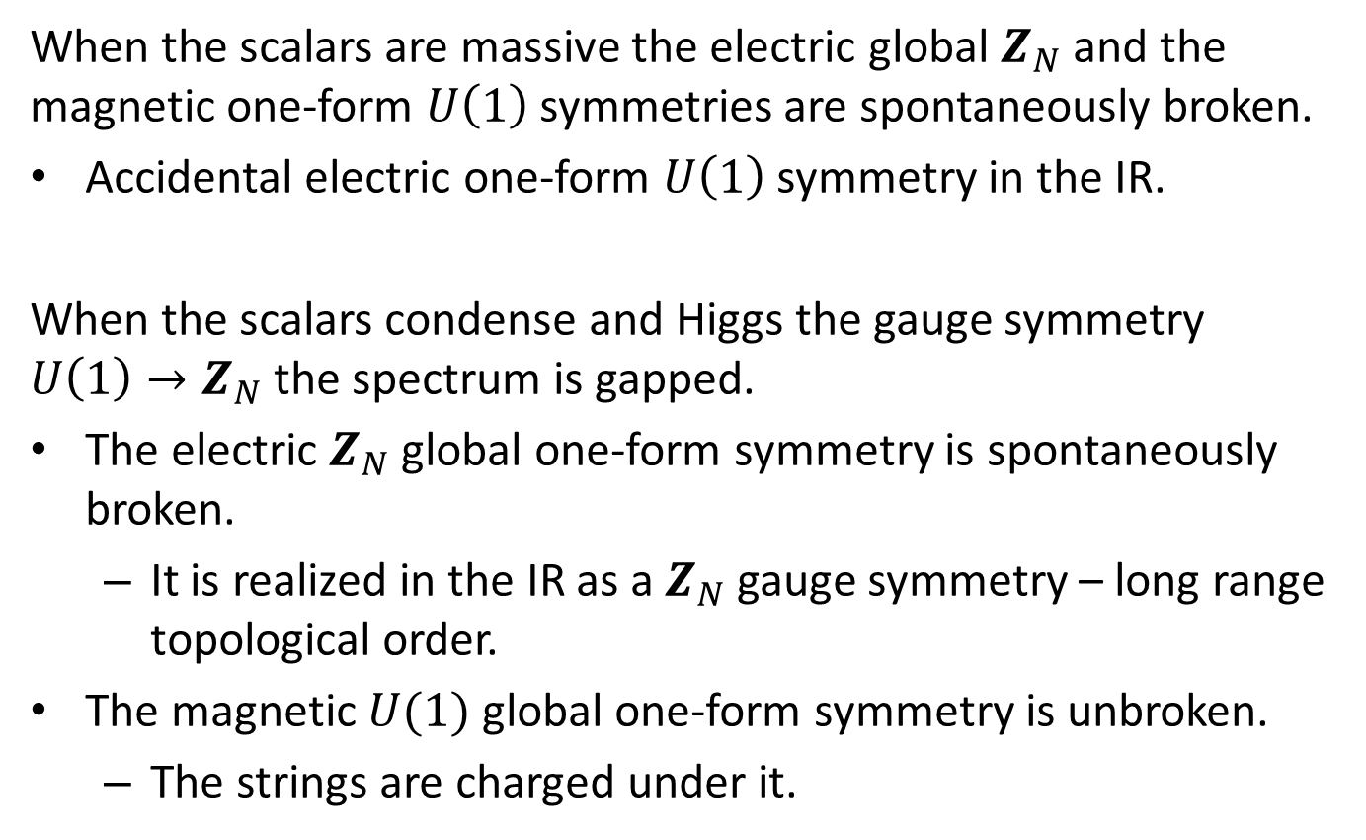
Example 2: $4d$ $U(1)$ gauge theory with charge $N$ scalars
When the scalars are massive the electric global $Z_{N}$ and the magnetic one-form $U\left(1\right)$ symmetries are spontaneously broken.
Accidental electric one-form $U\left(1\right)$ symmetry in the IR.
When the scalars condense and Higgs the gauge symmetry $U\left(1\right)→Z_{N}$ the spectrum is gapped.
The electric $Z_{N}$global one-form symmetry is spontaneously broken.
  It is realized in the IR as a $Z_{N}$gauge symmetry – long range topological order.
The magnetic $U(1)$ global one-form symmetry is unbroken.
  The strings are charged under it.

Slide 19
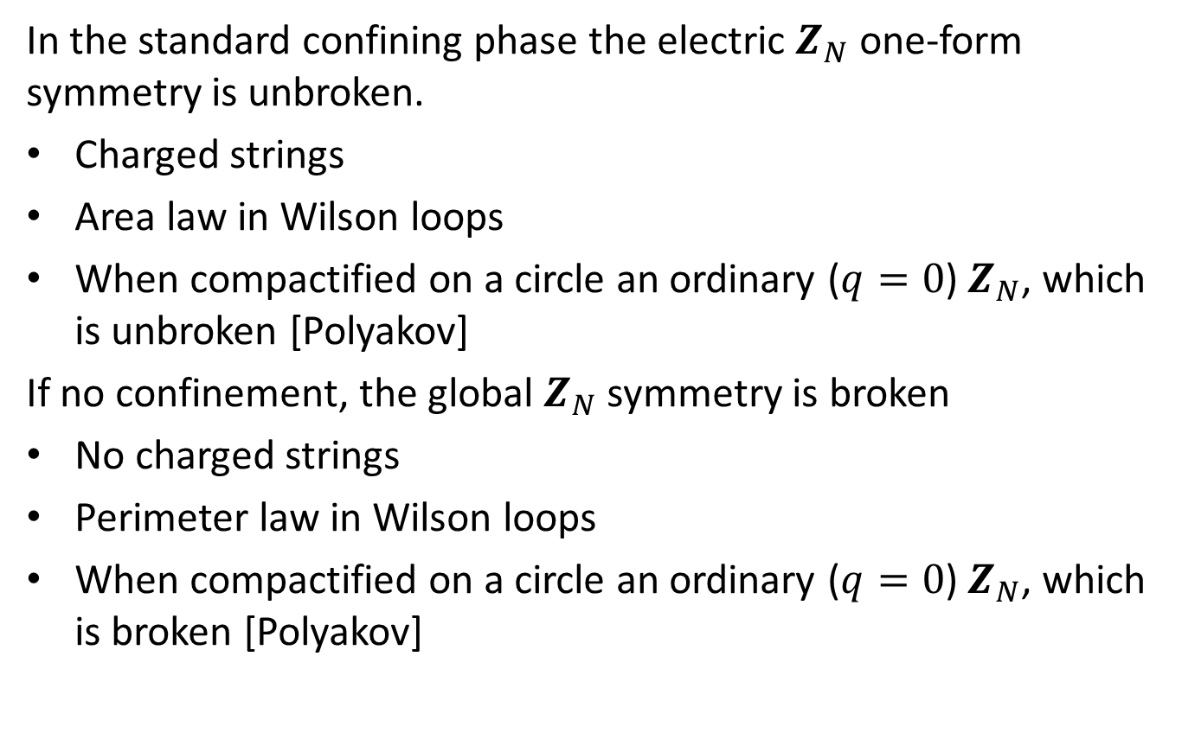
Example 3: $4d$ $SU(N)$ gauge theory
In the standard confining phase the electric $Z_{N}$ one-form symmetry is unbroken.
Charged strings
Area law in Wilson loops
When compactified on a circle an ordinary ($q=0$) $Z_{N}$, which is unbroken [Polyakov]
If no confinement, the global $Z_{N}$ symmetry is broken
No charged strings
Perimeter law in Wilson loops
When compactified on a circle an ordinary ($q=0$) $Z_{N}$, which is broken [Polyakov]

Slide 20

Example 3: $4d$ $SU(N)$ gauge theory
Can also have a phase with confinement index $t$, where the global one-form symmetry is spontaneously broken $Z_{N}→Z_{t}$.
$W$ has area law but $W^{t}$ has a perimeter law [Cachazo, NS, Witten].
In this case there is a $Z_{N/t}$ gauge theory at low energies – long range topological order.

Slide 21
Example 4: $4d$ $SU(N)$ gauge theory with matter in $N$
No global one-form symmetry.
Hence we cannot distinguish between Higgs and confinement.
This is usually described as screening the loop [Fradkin, Shenker; Banks, Rabinovici].
From our perspective, due to lack of symmetry.
Notes:
There could be other more subtle characteristics and lead to phase transitions.

Slide 22

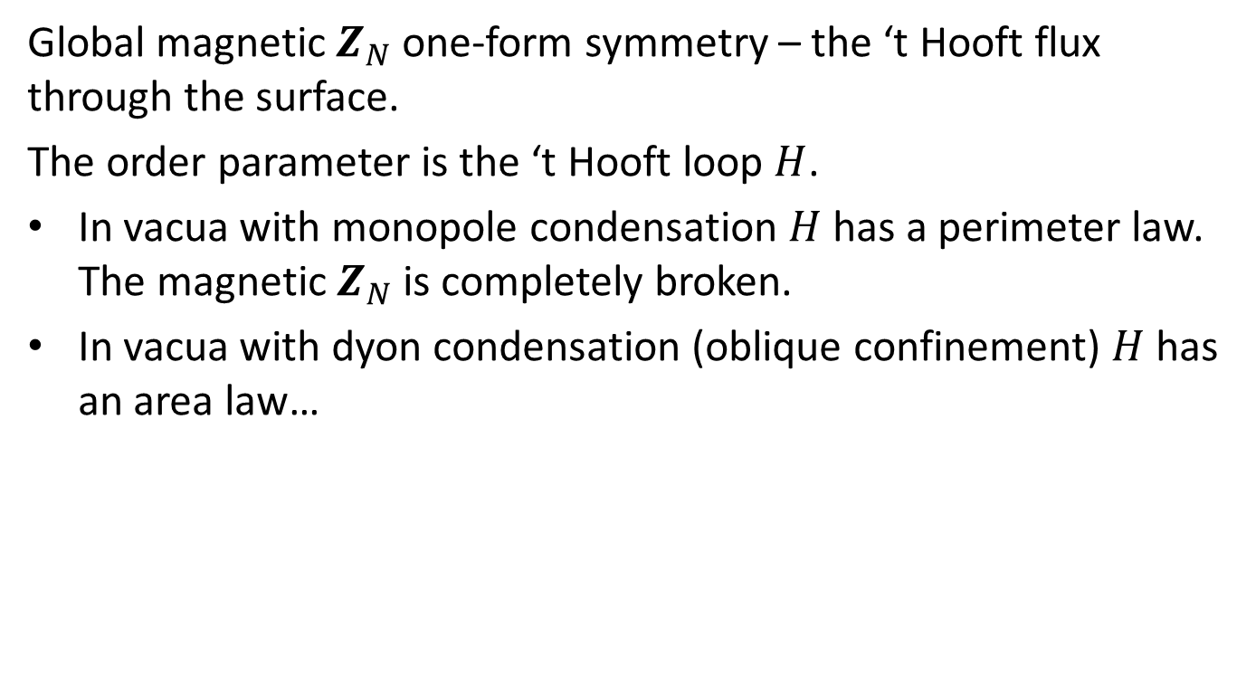
Example 5: $4d$ $SU(N)/Z_{N}$ gauge theory
Global magnetic $Z_{N}$ one-form symmetry – the ‘t Hooft flux through the surface.
The order parameter is the ‘t Hooft loop $H$.
In vacua with monopole condensation $H$ has a perimeter law. The magnetic $Z_{N}$is completely broken.
In vacua with dyon condensation (oblique confinement) $H$ has an area law…

Slide 23
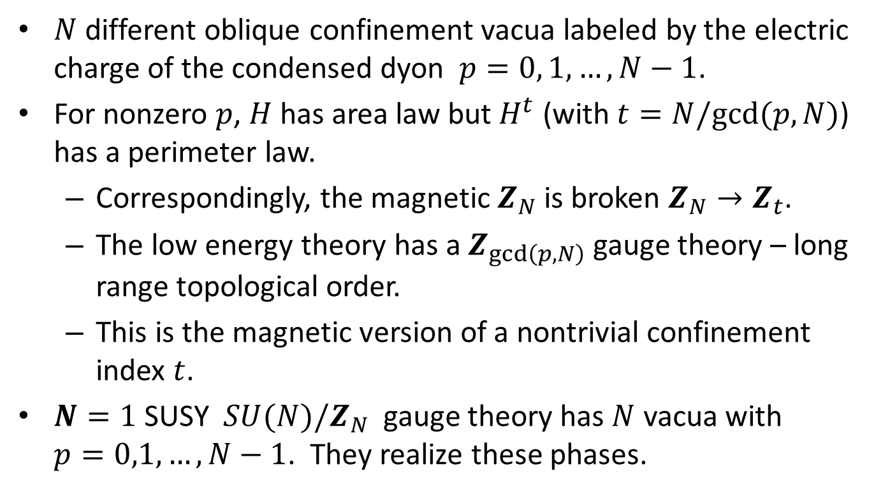
Example 5: $4d$ $SU(N)/Z_{N}$ gauge theory
$N$ different oblique confinement vacua labeled by the electric charge of the condensed dyon $p=0, 1,…,N−1$.
  For nonzero $p$, $H$has area law but$H^{t}$ (with $t=N/gcd(p,N)$) has a perimeter law.
  Correspondingly, the magnetic $Z_{N}$is broken $Z_{N}→Z_{t}$.
  The low energy theory has a $Z_{gcd\left(p,N\right)}$ gauge theory – long range topological order.
  This is the magnetic version of a nontrivial confinement index $t$.
$N=1$SUSY $SU(N)/Z_{N}$ gauge theory has $N$ vacua with $p=0,1,…,N−1$. They realize these phases.

Slide 24

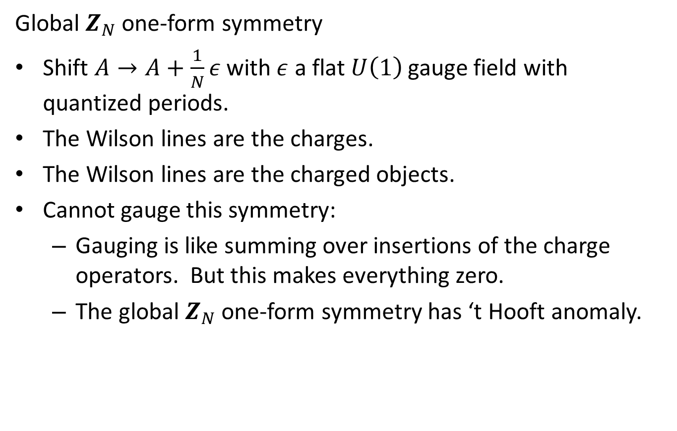
Example 6: $3d$ $U{\left(1\right)}_{N}$
Global $Z_{N}$ one-form symmetry
Shift $A→A+\frac{1}{N}ε$ with $ε$ a flat $U\left(1\right)$ gauge field with quantized periods.
The Wilson lines are the charges.
The Wilson lines are the charged objects.
Cannot gauge this symmetry:
  Gauging is like summing over insertions of the charge operators. But this makes everything zero.
  The global $Z_{N}$ one-form symmetry has ‘t Hooft anomaly.

Slide 25
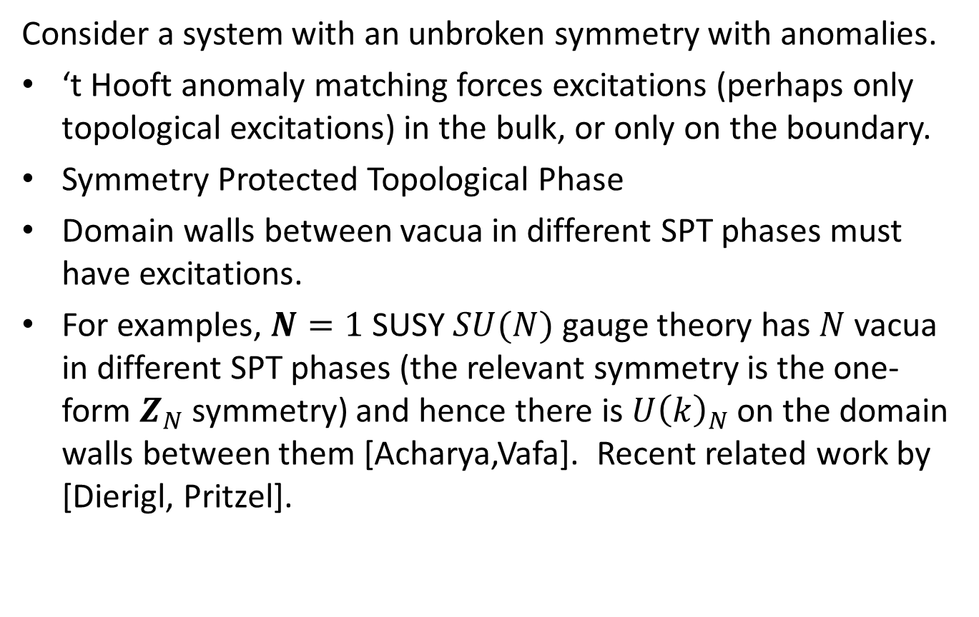
Higher Form SPT Phases
Consider a system with an unbroken symmetry with anomalies.
‘t Hooft anomaly matching forces excitations (perhaps only topological excitations) in the bulk, or only on the boundary.
Symmetry Protected Topological Phase
Domain walls between vacua in different SPT phases must have excitations.
For examples, $N=1$ SUSY $SU(N)$ gauge theory has $N$ vacua in different SPT phases (the relevant symmetry is the one-form $Z_{N}$ symmetry) and hence there is $U{\left(k\right)}_{N}$ on the domain walls between them [Acharya,Vafa]. Recent related work by [Dierigl, Pritzel].

Slide 26
Conclusions
Higher form global symmetries are ubiquitous.
They help classify
  extended objects (strings, domain walls, etc.)
  extended operators/defects (lines, surfaces, etc.)
As global symmetries, they must be the same in dual theories.
They extend Landau characterization of phases based on order parameters that break global symmetries.
  Rephrase the Wilson/’t Hooft classification in terms of broken or unbroken one-form global symmetries.
Anomalies
  ‘t Hooft matching conditions
  Anomaly inflow
  Degrees of freedom on domain walls

Slide 27
Thank you for your attention

