Slide 1
Partition Functions Of Twisted Supersymmetric Gauge Theories On Four-Manifolds Via u-Plane Integrals
Gregory Moore
Rutgers University
Mostly review. Includes new work
with Iurii Nidaiev & Jan Manschot
StringMath2018, Tohoku Univ.
June 20, 2018
Notes:
Now, this subject is not incredibly popular (although I think it is a good one),
So progress takes place on geological time scales. So, here’s the outline of the talk….

Slide 2
1
Introduction
2
Cambrian: Witten Reads Donaldson
Carboniferous: SW Theory & u-plane Derivation
Of Witten’s Conjecture.
3
4
Holocene: Three New Apps
5
Holomorphic Anomaly & Continuous Metric Dep.
6
Back To The Future

Slide 3
Donaldson Invariants Of 4-folds
$X:$Smooth, compact, oriented, $∂X=∅ ,$ ($π_{1}\left(X\right)=0)$
$P→X$ : Principal SO(3) bundle.
$X$ has metric $g_{μν} .$Consider moduli space of instantons:
$$ℳ≔ \{ A: F+∗F=0\} mod 𝒢$$
Donaldson defines cohomology classes in$ℳ$
associated to points and surfaces in $X$: $μ\left(p\right) \& μ\left(S\right)$
$$℘_{D}\left(p^{ℓ}S^{r}\right)≔\int_{ℳ}{μ{\left(p\right)}^{ℓ} μ{\left(S\right)}^{r}}$$
Independent of metric! $⇒$ smooth invariants of $X$.
Combined with Freedman theorem: Spectacular!
Notes:
Say: Comparison with Freedman’s topological classification of four-manifolds shows there is a huge difference between the topological and smooth categories. Very deep.

Slide 4
Witten’s Interpretation: Topologically Twisted SYM On X
Consider $𝒩=$ 2 SYM theory on $X$ for gauge group G
Witten’s ``topological twisting’’: Couple to special
external gauge fields for certain global symmetries.
Result: Fermion fields and susy operators are differential
forms; The twisted theory is defined on non-spin manifolds.
And there is a scalar susy operator with $Q^{2}=0$
Formally: Correlation functions of operators in $Q$-coho. localize
to integrals over the moduli spaces of G-ASD connections (or generalizations thereof).
Witten’s proposal: For $G=SU\left(2\right)$ correlation functions of
the special operators are the Donaldson polynomials.

Slide 5
Local Observables
$℘∈Inv(𝔤)$ $⇒ U=℘\left(φ\right)$
$$φ∈Ω^{0}(adP⊗ℂ)$$
Descent formalism
$$H_{∗}(X,ℂ)$$
$$H^{∗}(Fieldspace;Q)$$
$$μ$$
Localization identity
$$H^{∗}(ℳ)$$
$$U(p)=Tr_{2}\left(\frac{φ^{2}}{8π^{2}}\right)$$
$$U\left(S\right)∼\int_{S}{Tr(φF+ψ^{2})}$$
$$𝔤=𝔰𝔲(2)$$

Slide 6
Donaldson-Witten Partition Function
$$Z_{DW}^{}\left(p,S\right)={〈e^{U(p)+U\left(S\right)}〉}_{Λ_{0}}$$
$$\int_{X}{Tr F^{2}=8 π^{2}k}$$
$$=\sum_{k≥0}{Λ_{0}^{4k}\int_{ℳ_{k}}{e^{μ\left(p\right)+μ\left(S\right)}}}$$
Strategy: Evaluate in LEET $⇒$Witten (1994)
introduces the Seiberg-Witten invariants.
Major success in
Physical Mathematics.

Slide 7
What About Other N=2 Theories?
Natural Question: Given the successful application of $𝒩=$ 2 SYM for SU(2) to the theory of 4-manifold invariants, are there interesting applications of OTHER $𝒩=$ 2 field theories?
Topological twisting just depends on $SU{\left(2\right)}_{R}$
symmetry and makes sense for any $𝒩=2$ theory.
$${Z^{𝒯}≔ 〈e^{U(p)+U\left(S\right)}〉}_{𝒯}$$
Also an interesting exercise in QFT to compute
correlation functions of nontrivial theories in 4d.

Slide 8
SU(2) With Matter On $X$
$$ℛ=2^{⊕N_{fl}}$$
Mass parameters $m_{f}∈ℂ, f=1, …, N_{fl}$
$$M∈Γ(S^{+}⊗E^{⊕N_{fl}})$$
$w_{2}(P)=w_{2}\left(X\right)$
$$𝒩=2^{∗}:ℛ=(adj_{ℂ}⊕adj_{ℂ}^{∗})$$
$$m∈ℂ$$
$$M∈Γ(S^{+}⊗ℒ^{\frac{1}{2}}⊗adP)$$
$$c_{1}\left(ℒ\right)≡w_{2}\left(X\right)$$
[Labastida-Marino ‘98]

Slide 9
UV Interpretation
$$Z\left(p,S\right)={〈e^{U(p)+U\left(S\right)}〉}_{𝒯}$$
$$=\sum_{k}{Λ^{k}\int_{ℳ_{k}}{e^{μ\left(p\right)+μ\left(S\right)}ℰ}}$$
But now $ℳ_{k}$: is the moduli space of:
$$F^{+}=𝒟(M,\overline{M})$$
$$γ⋅D M=0$$
``Generalized monopole equations’’
[Labastida-Marino; Losev-Shatashvili-Nekrasov]
U(1) case: Seiberg-Witten equations.

Slide 10
1
Introduction
2
Cambrian: Witten Reads Donaldson
3
Carboniferous: SW Theory & u-plane Derivation
Of Witten’s Conjecture.
4
Holocene: Three New Apps
5
Holomorphic Anomaly & Continuous Metric Dep.
6
Back To The Future
Notes:
Now we turn to the carboniferous, the period when many of the resources we use today with such gay abandon were created.

Slide 11
Coulomb Branch Vacua On $ℝ^{4}$
$SU\left(2\right)→U(1)$ by vev of adjoint Higgs field $φ$:
Order parameter: $u=〈 U\left(p\right)〉∈ℂ$
Coulomb branch: $ℬ=𝔱⊗ℂ/W≅ℂ$
$$adP→L^{2}⊕𝒪⊕L^{−2}$$
Photon: Connection A on L
$$U\left(1\right) VM: \left(a, A, χ, ψ,η\right)$$
$a:$ complex scalar field on $ℝ^{4}:$
Compute couplings in U(1) LEET.
Then compute path integral with this action.
Then integrate over vacua.

Slide 12
Seiberg-Witten Theory: 1/2
For G=SU(2) SYM coupled to matter the LEET
can be deduced from a holomorphic family of
elliptic curves with differential:
$$\frac{dλ}{du}=\frac{dx}{y}$$
$$E_{u}: y^{2}=4x^{3}−g_{2}x−g_{3}$$
$$u∈ℂ$$
$g_{2},g_{3}$ are polynomials in $u$, masses, $Λ,$modular functions of $τ_{0}$
$Δ≔4\left(g_{2}^{3}−27 g_{3}^{2}\right)$ : polynomial in $u$
$Δ\left(u_{j}\right)=0 :$Discriminant locus

Slide 13
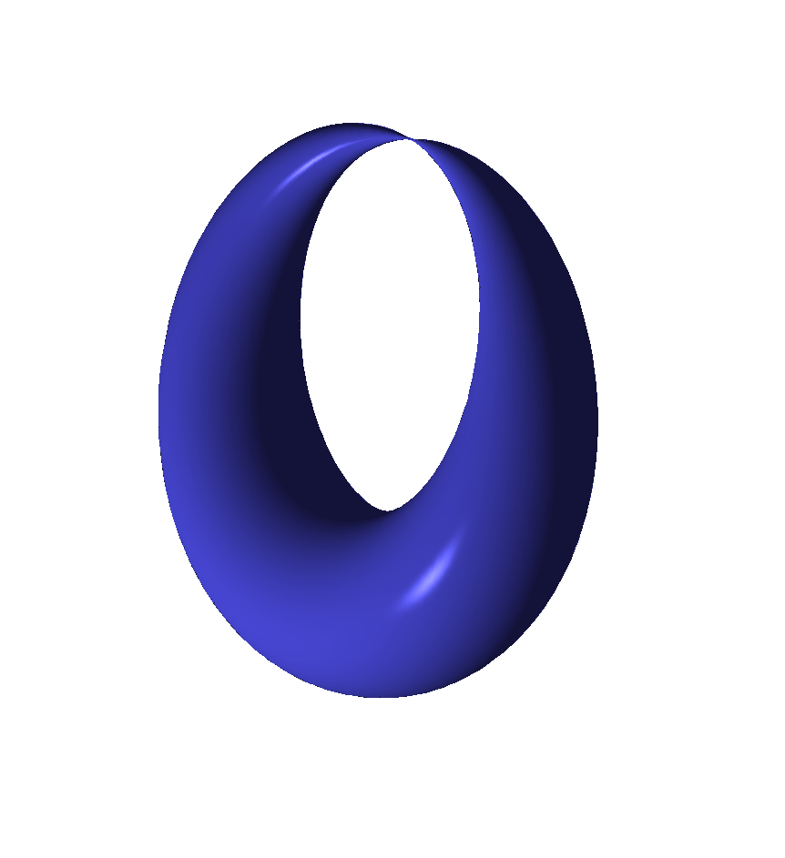
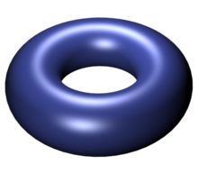
$$E_{u_{j}}$$
$$E_{u}$$
$$u_{j}$$
$$u$$

Slide 14
Examples From SW ‘94
$$N_{fl}=0: y^{2}=(x−u)(x−Λ^{2})(x+Λ^{2})$$
$$𝒩=2^{∗}:y^{2}=\prod_{i=1}^{3}{\left(x−α_{i}\right)}$$
$$α_{i}=u e_{i}\left(τ_{0}\right)+\frac{m^{2}}{4}e_{i}{\left(τ_{0}\right)}^{2}$$
$$N_{fl}=4: y^{2}=W_{1}W_{2}W_{3}+η^{12}\sum_{i=1}^{3}{R_{4}^{i}W_{i}+}η^{24} R_{6}$$
$$W_{i}=x−u e_{i}\left(τ_{0}\right)−R_{2}e_{i}{\left(τ_{0}\right)}^{2}$$
$Δ$: 6th order polynomial in $u$ with $∼3×{10}^{3}$terms

Slide 15
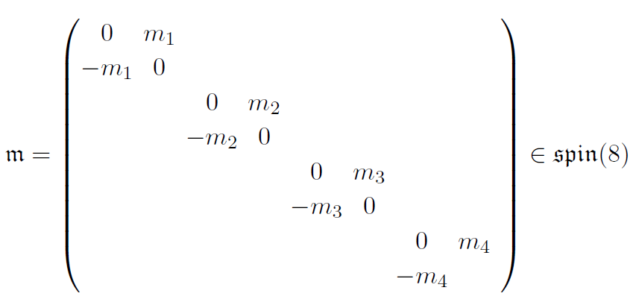
$$R_{2}∼Tr_{8_{i}}𝔪^{2}$$
$$R_{4}^{i}∼Tr_{8_{i}}𝔪^{4}$$
$$R_{6}∼Tr_{8_{i}}𝔪^{6}$$
$$SL\left(2,ℤ\right)→Aut\left(𝔰𝔭𝔦𝔫\left(8\right)\right)≅S_{3}$$

Slide 16
Local System Of Charges
Electro-mag. charge lattice: $Γ_{u}=H_{1}(E_{u};ℤ)$
has nontrivial monodromy around discriminant locus: $Δ\left(u_{j}\right)=0$
LEET: Requires choosing a duality frame:
$$Γ_{u}≅ℤγ_{e}⊕ℤγ_{m}⇒τ\left(u\right)$$
$S∼\int_{X}{\overline{τ}F_{+}^{2}+τF_{−}^{2}+⋯}$

Slide 17
$$N_{fl}=0$$
$$N_{fl}=1$$
$$𝒩=2^{∗}$$
$$N_{fl}=4$$
LEET breaks down at $u=u_{j}$ where $Im\left(τ\right)→0$

Slide 18
Seiberg-Witten Theory: 2/2
LEET breaks down because there are new
massless fields associated to BPS states
$$u=u_{j}$$
Charge 1 HM: $\left(M=q⊕{\tilde{q}}^{∗}, ⋯\right)$
LEET in $𝒰_{j}:$
+
$$U{\left(1\right)}_{j} VM: {\left(a,A,χ,ψ,η\right)}_{j}$$

Slide 19
Evaluate $Z_{DW}$Using LEET
$$Z_{DW}(p,S)={〈e^{U\left(p\right)+U\left(S\right)}〉}_{Λ}$$
$$=\sum_{k}{Λ^{k}\int_{ℳ_{k}}{e^{μ\left(p\right)+μ\left(S\right)}ℰ }}$$
$$Z_{DW}=Z_{u}+\sum_{u_{j}}{Z_{j}^{SW}}$$
$$u=−Λ^{2}$$
$$u=Λ^{2}$$

Slide 20
$u$-Plane Integral $Z_{u}$
Can be computed explicitly from QFT of LEET
Vanishes if $b_{2}^{+}>1$ .
When $b_{2}^{+}=1:$
$$Z_{u}=∫du d\overline{u} ℋ Ψ$$
$ℋ$ is holomorphic and metric-independent
$Ψ$: Sum over line bundles for the U(1) photon.
(Remnant of sum over SU(2) gauge bundles.)
$$Ψ∼\sum_{λ=c_{1}\left(L\right)}{e^{−i π\overline{τ}\left(\overline{u}\right)λ_{+}^{2}−i πτ\left(u\right)λ_{−}^{2}}}$$
NOT holomorphic and metric- DEPENDENT

Slide 21
Comments On $Z_{u}$
$Z_{u}$is a very subtle integral.
It requires careful regularization
and definition$.$
It is also related to integrals from number theory
such as `` $Θ−$lifts’’ and mock modular forms.
It is very nearly an integral of a total derivative…
But first let’s finish writing down the
full answer for the partition function.

Slide 22
Contributions From $𝒰_{j}$
Path integral for $U{\left(1\right)}_{j}$VM + HM: LEET: Need unknown couplings:
$$C{\left(u\right)}^{λ^{2}}P{\left(u\right)}^{σ}E{\left(u\right)}^{χ}$$
$$\sum_{λ∈\frac{1}{2}w_{2}\left(X\right)+H^{2}\left(X,ℤ\right)}{SW\left(λ\right)e^{2πi λ⋅λ_{0}} R_{λ}\left(p,S\right)}$$
$$R_{λ}\left(p,S\right)=Res[ \left(\frac{da_{j}}{a_{j}^{1+\frac{d\left(λ\right)}{2}}}\right) e^{2pu+S^{2}T\left(u\right)+i \left(\frac{du}{da_{j}}\right)S⋅λ}C{\left(u\right)}^{λ^{2}}P{\left(u\right)}^{σ}E{\left(u\right)}^{χ}]$$
Special coordinate: $a_{j}$
$$u=u_{j}+κ_{j}a_{j}+𝒪(a_{j}^{2})$$
$$d\left(λ\right)=\frac{ {\left(2λ\right)}^{2}−c^{2}}{4}$$
$$c^{2}=2χ+3 σ$$

Slide 23
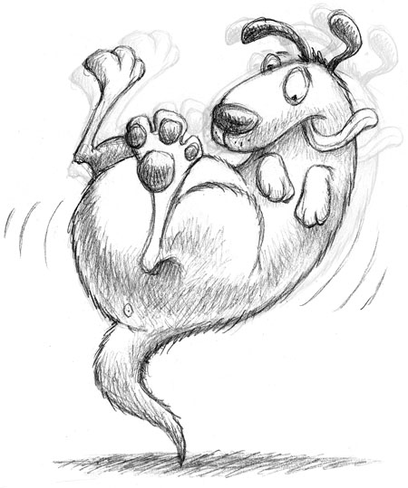
Deriving C,P,E From Wall-Crossing
$$\frac{d}{dg_{μν}}Z_{u}=∫Tot deriv=\oint_{∞}{du\left(….\right)+\sum{\oint_{u_{j}}{du\left(…\right)}}}$$
$Z_{u}$ piecewise constant: Discontinuous jumps across walls:
$$Δ_{j}Z_{u}+ΔZ_{j}^{SW}=0⇒ C\left(u\right), P\left(u\right), E\left(u\right)$$
Then for $b_{2}^{+}>1 , Z_{u}=0,$but we know the couplings to compute $Z_{SW}$!
$Z_{u}$ is the tail that wags the dog.

Slide 24
Witten Conjecture
$⇒$a formula for all $X$ with $b_{2}^{+}>0.$For $b_{2}^{+}\left(X\right)>1$ we derive ``Witten’s conjecture’’:
$$Z_{DW}^{}\left(p,S\right)=2^{c^{2}−χ_{h}} ( e^{\frac{1}{2}S^{2}+2p }\sum_{λ}{SW\left(λ\right)e^{2πi λ⋅λ_{0}}e^{S⋅λ}+}$$
$$+ i^{χ_{h}}e^{−\frac{1}{2}S^{2}−2p}\sum_{λ}{SW\left(λ\right)e^{2πi λ⋅λ_{0}}e^{−iS⋅λ})}$$
$$χ_{h}=\frac{χ+σ}{4}$$
Example: $X=K3:$
$$Z=Λ_{0}^{6}\text{sinh}{(\frac{{\left(Λ_{0}S\right)}^{2}}{2}+2Λ_{0}^{2} p)}$$
$$c^{2}=2χ+3 σ$$

Slide 25
SWST
SWST = Seiberg-Witten Simple Type
$SW\left(λ\right)≠0$ ONLY when moduli space of solutions to Seiberg-Witten is
zero-dimensional.
All known $X$ with $b_{2}^{+}>1$ are of SWST

Slide 26
Generalization To $N_{fl}>0$
$$Z\left(p;S;m_{f}\right)=\sum_{j=1}^{2+N_{fl}}{Z(p,S;m_{f};u_{j})}$$
$$b_{2}^{+}>1$$
$$Z\left(p,S;m_{f};u_{j}\right)= \sum_{λ}{SW\left(λ\right)e^{2πi λ⋅λ_{0}}}R_{j}(p,S)$$
$X$ is SWST $⇒$
$R_{j}(p,S)$ is computable explicitly as a function of $p,S,m_{f},Λ(τ_{0})$ from first order degeneration of the SW curve.

Slide 27
$$Z\left(p,S;m_{f};Λ\right)=$$
$$α^{χ}β^{σ}\sum_{j=1}^{2+N_{fl}}{μ_{j}^{χ_{h}} ν_{j}^{χ_{h}+σ}e^{2 p u_{j}+S^{2}T_{j}} F_{j}\left(S\right)}$$
$$ν_{j}∼{\left(g_{2}\left(u_{j}\right)\right)}^{\frac{1}{4}}$$
$$μ_{j}=g_{2}{\left(u_{j}\right)}^{3}/\prod_{t≠j}{(u_{j}−u_{t}) }$$
$$F_{j}\left(S\right)=\sum_{λ}{SW\left(λ\right)e^{i πλ⋅c_{1}\left(𝔰\right)} cos\left(ν_{j}λ⋅S\right) }$$
$$y^{2}=4x^{3}−g_{2}\left(u,m_{j}\right)x −g_{3}\left(u,m_{j}\right)$$

Slide 28
1
Introduction
2
Cambrian: Witten Reads Donaldson
3
Carboniferous: SW Theory & u-plane Derivation
Of Witten’s Conjecture.
4
Holocene: Three New Apps
5
Holomorphic Anomaly & Continuous Metric Dep.
6
Back To The Future

Slide 29
Application 1: S-Duality Of $N_{fl}=4$
$Z(p,S;τ_{0})$ is expected to have modular properties:
$$α^{χ}β^{σ}\sum_{j=1}^{6}{μ_{j}^{χ_{h}} ν_{j}^{χ_{h}+σ}e^{2 p u_{j}+S^{2}T_{j}} F_{j}\left(S\right)}$$
$$ν_{j}∼{\left(g_{2}\left(u_{j}\right)\right)}^{\frac{1}{4}}$$
$$μ_{j}=g_{2}{\left(u_{j}\right)}^{3}/\prod_{t≠j}{(u_{j}−u_{t}) }$$
Sum over $j$ gives symmetric rational function of $u_{j}$ $⇒$ $Z$ will be modular:
Notes:
Need to say: That’s without taking into account the alpha and beta coefficients.
These will be overall powers of \eta(\tau_0) and might change the net weight.

Slide 30
$$γ=\left(\begin{matrix}a & b \\ c & d\end{matrix}\right)∈SL(2,ℤ)$$
$$Z\left(\frac{p+c(cτ_{0}+d)S^{2}}{{\left(c τ_{0}+d\right)}^{2}},\frac{S}{{\left(cτ_{0}+d\right)}^{2}};\frac{aτ_{0}+b}{cτ_{0}+d};γ⋅𝔪\right)$$
$$={\left(cτ_{0}+d\right)}^{w} Z(p,S;τ_{0};𝔪)$$
$$w=\frac{2χ+3 σ}{2}$$

Slide 31
Application 2: Collision Of Mutually Local Singularities
Interesting things when mass parameters $m_{j}$
take values so that $u_{j}$ collide.
$$u$$
-$Λ_{0}^{2}$
$$Λ_{0}^{2}$$

Slide 32
Application 2: Collision Of Mutually Local Singularities
Interesting things when mass parameters $m_{j}$
take values so that $u_{j}$ collide.
$$u$$
-$Λ_{0}^{2}$
$$Λ_{0}^{2}$$

Slide 33
$$e^{i πτ_{0}}∼ \frac{Λ_{0}^{4}}{m_{1}m_{2}m_{3}m_{4}}$$
$$m_{j}=M+δm_{j}$$
$$W^{eff}∼ \sum_{f}{δm_{f} {\tilde{Q}}^{f}Q_{f}}$$
$⇒Z$ should be $SU\left(N_{fl}\right)−$equivariant integral over
moduli space of $U\left(1\right)−$multimonopole equations:
$$F^{+}=\sum_{f}{{\overline{M}}^{f}M_{f} γ⋅DM_{f}=0}$$

Slide 34
In the limit $δm_{j}→0$ the dominant term in $Z$ is:
$$J(\tilde{S})\sum_{f}{\prod_{t≠f}{{\left(δm_{f}−δm_{t}\right)}^{−χ_{h}} e^{δm_{f} \tilde{p}}}}$$
$$J\left(\tilde{S}\right)=e^{{\tilde{S}}^{2}/2}\sum_{λ}{e^{i πλ⋅c_{1}\left(𝔰\right)}SW\left(λ\right)\cos\left(λ⋅\tilde{S}\right)}$$
This agrees with computations of Dedushenko, Gukov and Putrov of the equivariant integrals
on $U(1)$-multimonopole space.

Slide 35
Application 3: AD3 Partition Function
Consider $N_{fl}=1$. At a critical point $m=m_{∗}$ two
singularities $u_{±}$ collide at $u=u_{∗}$ and the SW
curve becomes a cusp: $y^{2}=x^{3}$ [Argyres,Plesser,Seiberg,Witten]
Two mutually nonlocal BPS states have vanishing mass:
$$\oint_{γ_{1}}{λ→0 }$$
$$\oint_{γ_{2}}{λ→0 }$$
$$γ_{1}⋅γ_{2}≠0$$
Physically: No local Lagrangian for the LEET :
Signals a nontrivial superconformal field theory
appears in the IR in the limit $m→m_{∗}$

Slide 36
AD3 From $SU\left(2\right) N_{fl}=1$
$$u$$
$$Λ_{1}^{2}$$
$$m→\frac{3}{2}Λ_{1}=m_{∗}$$
SW curve in the scaling region:
$$y^{2}=x^{3}−3 Λ_{AD}^{2} x+u_{AD}$$
$$Λ_{AD}^{2}∼\left(m−m_{∗}\right)$$
Call it the ``AD3-Family over the $u_{AD}−$plane’’

Slide 37
AD3 Partition Function - 1
No obvious UV definition of the invariant.
The $SU\left(2\right) N_{fl}=1$u-plane integral has a nontrivial
contribution from the scaling region $u_{±}→u_{∗}$
$$\lim_{m→m_{∗}}{Z_{u} − \int{du d\overline{u}\lim_{m→m_{∗}}{Measure\left(u,\overline{u};m\right) ≠0 }}}$$
Limit and integration commute except in an
infinitesimal region around $u_{∗}$
Attribute the discrepancy to the
contribution of the AD3 theory

Slide 38
AD3 Partition Function - 2
1. Limit $m→m_{∗}$ exists. (No noncompact Higgs branch.)
2. The partition function is a sum over all
Q-invariant field configurations.
3. Scaling region near $u_{∗}$ governed by AD3 theory.
$\lim_{m→m_{∗}}{Z^{SU\left(2\right),N_{fl}=1}}$``contains’’ the AD3 partition function
Extract it from the scaling region. Our result:
$$Z^{AD3}=\lim_{Λ_{AD}→0}\left( Z_{u}^{AD3−family}+Z_{SW}^{AD3−family}\right)$$
Claim: This is the AD3 TFT on $X$ for $b_{2}^{+}>0 .$

Slide 39
AD3 Partition Function: Evidence 1/2
Existence of limit is highly nontrivial. It follows
from ``superconformal simple type sum rules’’ :
Theorem [Marino,Moore,Peradze, 1998] If the superconformal simple type sum rules hold:
a.) ${ χ}_{h}−c^{2} −3≤0$
b.) $\sum_{λ}{SW\left(λ\right)e^{2π i λ⋅λ_{0}}λ^{k}=0 }$ $0≤k≤χ_{h}−c^{2}−4$
Then the limit $m→m_{∗}$exists
It is now a rigorous theorem that SWST $⇒$SCST
Feehan & Leness

Slide 40
AD3 Partition Function: Evidence 2/2
For $b_{2}^{+}>0$ recover the expected selection rule:
$$〈{U(p)}^{ℓ}U{\left(S\right)}^{r}〉≠0 \text{only} \text{for}\frac{6ℓ+r}{5}=\frac{χ_{h}−c^{2}}{5}$$
Consistent with background charge for AD3 computed by Shapere-Tachikawa.
Explicitly, if $X \text{of} SWST \text{and} b_{2}^{+}>1:$

Slide 41
Explicitly, if $X \text{of} SWST \text{and} b_{2}^{+}>1:$
$$Z^{AD3}=\frac{1}{𝔅!}K_{1}K_{2}^{χ}K_{3}^{σ} \sum_{λ}{e^{2πi λ⋅w_{2}}SW\left(λ\right)⋅}$$
$$⋅\{{\left(λ⋅S\right)}^{𝔅−2}(24{\left(λ⋅S\right)}^{2}+𝔅\left(𝔅−1\right)S^{2})\}$$
$$𝔅=χ_{h}−c^{2}=−\frac{7 χ+11 σ}{4}$$
Surprise! p drops out: U(p) is a ``null vector’’

Slide 42
Should We Be Surprised?
Already for $N_{fl}=0$ and SWST it is also
true that $U{\left(p\right)}^{2}−Λ_{0}^{4}$ is a null vector.
Without a good physics reason why
these should be null vectors one
suspects that there are (standard)
4-manifolds not of SWST.

Slide 43
1
Introduction
2
Cambrian: Witten Reads Donaldson
3
Carboniferous: SW Theory & u-plane Derivation
Of Witten’s Conjecture.
4
Holocene: Three New Apps
5
Holomorphic Anomaly & Continuous Metric Dep.
6
Back To The Future

Slide 44
$Z_{u}$ Wants To Be A Total Derivative
$$Z_{u}=∫du d \overline{u} ℋ\left(u\right) Ψ$$
$$Ψ=\sum_{λ}{\frac{d}{d\overline{u}}\left(ℰ\left(r_{λ}^{ω},b_{λ}\right)\right)e^{−i πτλ^{2}−i S⋅\frac{du}{da}+2 πi \left(λ−λ_{0}\right)⋅w_{2}}}$$
$$ℰ\left(r,b\right)=\int_{b}^{r}{e^{−2πt^{2}}dt}$$
$$r_{λ}^{ω}=\sqrt{y}λ_{+}−\frac{i}{4π\sqrt{y}}S_{+} \frac{du}{da}$$
Lower limit $b_{λ}$ must be independent of $\overline{u}$
but can depend on $λ,ω,u.$
[Korpas & Manschot; Moore & Nidaiev ]
?
$$Z_{u} = ∫du d \overline{u}\frac{d}{d\overline{u}}( ℋ\left(u\right)Θ^{ω})$$

Slide 45
Not obvious: No obvious choice for $b_{λ}$
with both convergence and modular invariance.
BUT: The difference for two metrics
CAN be evaluated by residues!
$$Z_{u}^{ω}−Z_{u}^{ω_{0}}=∫du d\overline{u} \frac{d}{d\overline{u}}(ℋ{\hat{Θ}}^{ω,ω_{0}})$$
$${\hat{Θ}}^{ω,ω_{0}}=\sum_{λ}{\left(ℰ\left(r_{λ}^{ω}\right)−ℰ\left(r_{λ}^{ω_{0}}\right)\right)e^{−i πτ\left(u\right)λ^{2}+⋯}}$$
$$r_{λ}^{ω}=\sqrt{y}λ_{+}−\frac{i}{4π\sqrt{y}}S_{+} \frac{du}{da}$$
Modular completion of indefinite theta function of Vigneras, Zwegers, Zagier

Slide 46
Holomorphic Anomaly & Metric Dependence
For theories with a manifold of superconformal couplings, $τ\left(u\right)→τ_{0}$ when $u→∞$
$${\hat{Θ}}^{ω,ω_{0}}\left(τ\left(u\right),…\right)→{\hat{Θ}}^{ω,ω_{0}}\left(τ_{0},…\right)$$
Contour integral at $∞⇒ For$ $b_{2}^{+}=1,$ many ``topological’’ correlators:
Nonholomorphic in $τ_{0}$
Depend continuously on metric
[Moore & Witten, 1997
-- albeit sotto voce ]

Slide 47
Special Case Of $ℂℙ^{2}$
No walls: $ω∈H^{2}\left(X,ℝ\right)≅ℝ,$ so we
only see holomorphic anomaly.
$⇒$Path integral derivation of the holomorphic anomaly.

Slide 48
Vafa-Witten Partition Functions
VW twist of N=4 SYM formally computes the ``Euler character’’ of instanton moduli space.
(Not really a topological invariant. True mathematical meaning unclear, but see
recent work of Tanaka & Thomas; Gholampour, Sheshmani, & Yau.)
Physics suggests the partition function is both
modular (S-duality) and holomorphic.
Surprise! Computations of Klyachko and Yoshioka for $X=ℂℙ^{2}$show that the holomorphic generating function is only mock modular.
But a nonholomorphic modular completion exists.

Slide 49
This has never been properly derived
from a path integral argument.
But we just derived completely analogous results for the $N_{fl}=4$ theory
from a path integral, suggesting VW will also have continuous metric dependence.
Indeed, continuous metric dependence in VW theory for $SU(r>1)$ has been predicted in papers of Jan Manschot using rather different methods.
We hope that a similar path integral derivation can be found for the $𝒩=4$ Vafa-Witten twisted theory.

Slide 50
1
Introduction
2
Cambrian: Witten Reads Donaldson
3
Carboniferous: SW Theory & u-plane Derivation
Of Witten’s Conjecture.
4
Holocene: Three New Apps
5
Holomorphic Anomaly & Continuous Metric Dep.
6
Back To The Future

Slide 51
Future Directions
There is an interesting generalization to invariants for families of four-manifolds.
Couple to ``topologically twisted supergravity’’
$$Z∈H^{∗}(BDiff\left(X\right))$$
Generalization to all theories in class S:
Many aspects are clear – this is under study.

Slide 52
u-plane for class S: General Remarks
UV interpretation is not clear in general.
These theories might give new 4-manifold invariants.
The u-plane is an integral over the base $ℬ$ of a
Hitchin fibration with a theta function associated
to the Hitchin torus. It will have the form
$$Z_{u}=\int_{ℬ}{du d\overline{u} ℋ Ψ }$$
$ℋ$ is holomorphic and metric-independent
$Ψ:$NOT holomorphic and metric- DEPENDENT
``theta function’’

Slide 53
Class S: General Remarks
$$ℋ=α^{χ} β^{σ}{\det\left(\frac{da^{i}}{du_{j}}\right)}^{1−\frac{χ}{2} }Δ_{phys}^{\frac{σ}{8}}$$
$Δ_{phys}$ a holomorphic function on $ℬ$ with first-order zeros at the loci of massless BPS hypers
$α,β$ will be automorphic forms on
Teichmuller space of the UV curve $C$
$α, β$ are related to correlation functions for fields in the (0,2) QFT gotten from reducing 6d (0,2)

Slide 54
Class S: General Remarks
$$Ψ∼\sum_{λ}{e^{i πλ⋅ξ}e^{−i π\overline{τ}\left(λ_{+},λ_{+}\right)−i πτ\left(λ_{−}⋅λ_{−}\right)+⋯}}$$
$$Γ⊂H^{1}\left(Σ;ℤ\right)$$
$$λ∈λ_{0}+Γ⊗H^{2}\left(X;ℤ\right)$$
Lagrangian sublattice
$$ξ∈Γ⊗H^{2}(X;ℝ)$$
If $ξ=ρ⊗w_{2}\left(X\right) mod 2$ then WC from interior of $ℬ$ will be cancelled by SW invariants
$⇒$ No new four-manifold invariants…

Slide 55
$Ψ$ comes from a ``partition function’’ of
a level 1 SD 3-form on $M_{6}=Σ×X$
Quantization: Choose a QRIF $Ω$ on $H^{3}\left(M_{6};ℤ\right)$
Natural choice: [Witten 96,99; Belov-Moore 2004]
$$Ω\left(x\right)=\exp\left( i π WCS\left(θ∪x; S^{1}×M_{6} \right)\right)$$
Choice of weak-coupling duality frame + natural choice of $spin^{c}$ structure gives
$ξ=ρ⊗w_{2}\left(X\right)$
Notes:
Mention: Btw – this quadratic refinement isn’t quite canonical: Rather, it depends on a choice of Wu structure. It is related to work I’m doing with Samuel Monnier, I will talk about closely related things next week in Okinawa.

Slide 56
Case Of SU(2) $𝒩=2^{∗}$
Using the tail-wagging-dog argument, analogous formulae were worked out for $𝒩=2^{∗}$, by Moore-Witten and Labastida-Lozano in 1998, but only in the case when $X$ is spin.
L&L checked S-duality for the case $b_{2}^{+}>1$
The generalization to $X$ which is NOT spin is nontrivial: The standard expression from
Moore-Witten and Labastida-Lozano is
NOT single-valued on the u-plane.

Slide 57
This is not surprising: The presence of external
$U{\left(1\right)}_{baryon}$ gauge field $F_{baryon}∼c_{1}\left(𝔰\right)$ means
there should be new interactions:
$$e^{ κ_{1}\left(u\right)c_{1}{\left(𝔰\right)}^{2}+κ_{2}\left(u\right)λ⋅c_{1}\left(𝔰\right)}$$
Shapere & Tachikawa
Holomorphy, 1-loop singularities,
single-valuedness forces:
$${\left(u−u_{1}\right)}^{−\frac{c_{1}{\left(𝔰\right)}^{2}}{8}}e^{−i\frac{∂a_{D}}{∂m} λ⋅c_{1}\left(𝔰\right)}$$

Slide 58
Surprise!!
It doesn’t work!
Correct version appears to be non-holomorphic.
With Jan Manschot we have an alternative
which is currently being checked.
Does the u-plane integral make sense for
ANY family of Seiberg-Witten curves ?

Slide 59
どうもありがとうございます

