Slide 1
Algebraic structure of the IR limit of massive d=2 N=(2,2) theories
IAS, October 13, 2014
Gregory Moore, Rutgers University
collaboration with
Davide Gaiotto & Edward Witten
draft is ``nearly finished’’…
Notes:
Quote what John Adams said about it: "You know how it is when someone asks you to ride in a terrific sports car, and then you wish you hadn't?"

Slide 2
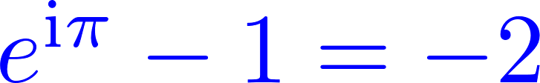





So, why isn’t it on the arXiv ?
The draft seems to have stabilized for a while at around 350 pp …..
So, why isn’t it on the arXiv?
In our universe we are all familiar with the fact that
In that part of the multiverse in which we have the refined identity
our paper has definitely been published!

Slide 3
Much ``written’’ material is available:
Several talks on my homepage.
Davide Gaiotto: Seminar at Perimeter, Fall 2013: ``Algebraic structures in massive (2,2) theories
In the Perimeter online archive of talks.
Davide Gaiotto: ``BPS webs and
Landau-Ginzburg theories,’’
Talk at String-Math 2014. On the web.

Slide 4
Three Motivations
IR sector of massive 1+1 QFT with N =(2,2) SUSY
2. Knot homology.
3. Spectral networks & categorification of 2d/4d wall-crossing formula [Gaiotto-Moore-Neitzke].
(A unification of the Cecotti-Vafa and Kontsevich-Soibelman formulae.)

Slide 5
Outline
Introduction & Motivations
Overview of Results
Some Review of LG Theory
LG Theory as SQM
Boosted Solitons & Soliton Fans
Motivation from knot homology & spectral networks
Conclusion

Slide 6
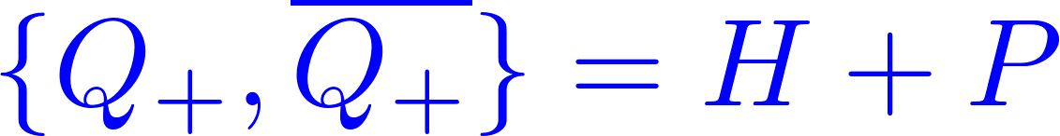
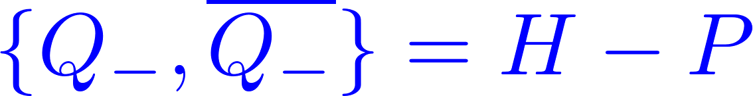
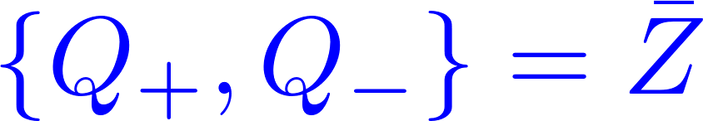

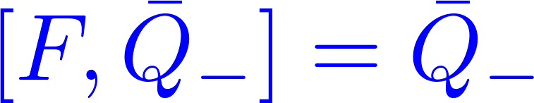

d=2, N=(2,2) SUSY
We will be interested in situations where
two supersymmetries are unbroken:

Slide 7
Main Goal & Result
Goal: Say everything we can about the theory in the far IR.
Since the theory is massive this would appear to be trivial.
Result: When we take into account the BPS states there is an extremely rich mathematical structure.

Slide 8
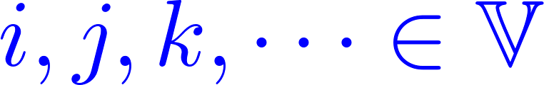
Vacua and Solitons
The theory has many vacua:
There will be BPS states/solitons s_{ij} on R
We develop a formalism – which we call the ``web-based formalism’’ -- which describes many things:

Slide 9
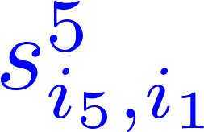
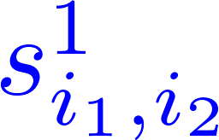
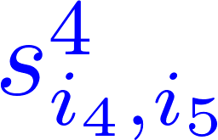
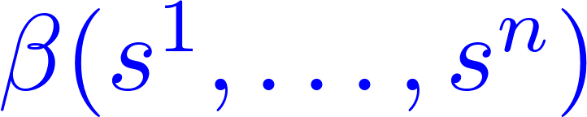
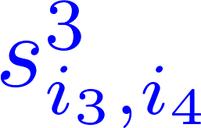
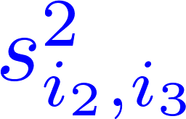

Interior Amplitudes
BPS states have ``interaction amplitudes’’ governed by an L algebra

Slide 10

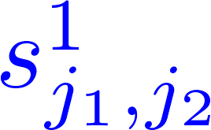
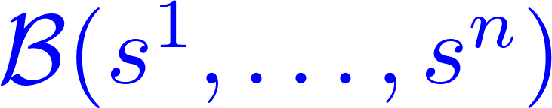
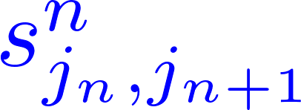

Branes/Half-BPS BC’s
BPS ``emission amplitudes’’ are governed by an A algebra

Slide 11



Interfaces
Given a pair of theories T₁, T₂ we construct supersymmetric interfaces
There is an (associative) way of ``multiplying’’ interfaces to produce new ones

Slide 12
Interface OPE
We give a method to compute the product. It can be considered associative, once one introduces a suitable notion of ``homotopy equivalence’’ of interfaces.

Slide 13

Mapping branes
Using interfaces we can ``map’’ branes in theory T₁, to branes in theory T₂ .

Slide 14
This will be the key idea in defining a ``parallel transport’’ of Brane categories.

Slide 15
Categorification of 2d wall-crossing
If we have continuous path of theories
(e.g. a continuous family of LG superpotentials)
then we can construct half-supersymmetric interfaces between the theories.
When the path crosses marginal stability walls we construct interfaces which ``implement’’ wall-crossing.
Half-susy interfaces form an A 2-category, and to a continuous family of theories we associate a flat parallel transport of brane categories.
The flatness of this connection implies, and is a categorification of, the 2d wall-crossing formula.
Notes:
Now, I realize that the use of such language is socially inappropriate in the present social situation …

Slide 16
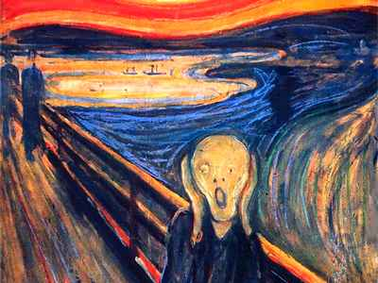

Slide 17





Slide 18
Enough with vague generalities!
Now I will start to be more systematic.
First review d=2 N=(2,2) Landau-Ginzburg
Then review the relation to Morse theory.
The key ideas behind everything we
do come from Morse theory.

Slide 19
Outline
Introduction & Motivations
Overview of Results
Some Review of LG Theory
LG Theory as SQM
Boosted Solitons & Soliton Fans
Motivation from knot homology & spectral networks
Conclusion

Slide 20
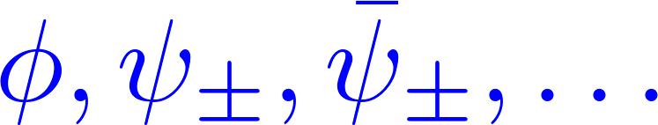




LG Models - 1
Chiral superfield
Holomorphic superpotential
Massive vacua are Morse critical points:
Label set of vacua:

Slide 21

LG Models -2
More generally,…
(X,): Kähler manifold.
W: X  C Superpotential (A holomorphic Morse function)

Slide 22

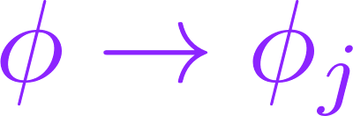


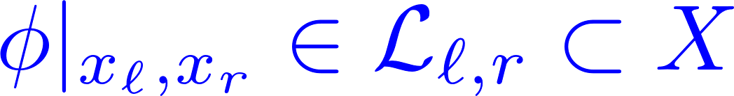

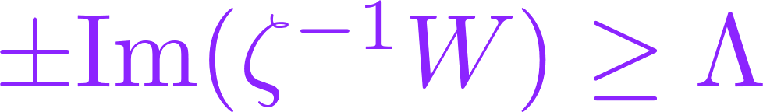
Boundary conditions for 
Boundaries
at infinity:
Boundaries at finite distance: Preserve
ζ-susy:
(Simplify: =d)

Slide 23
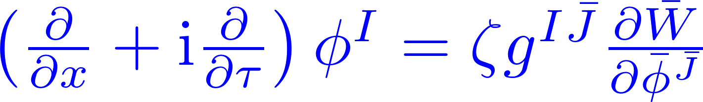
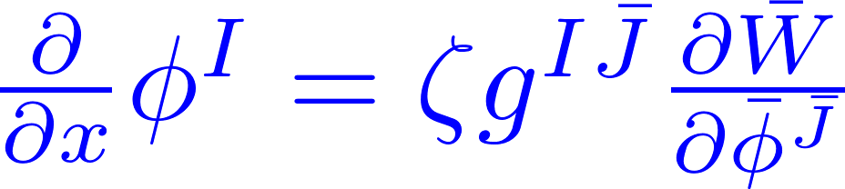
Fields Preserving ζ-SUSY
U(ζ)[Fermi] =0 implies the ζ-instanton equation:
Time-independent: ζ-soliton equation:

Slide 24
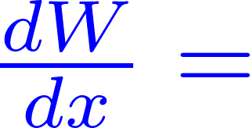
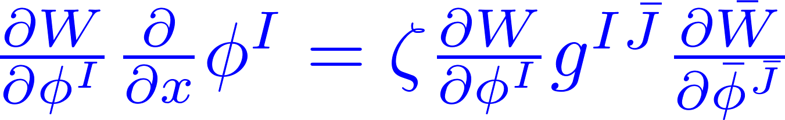
Projection to W-plane
The projection of solutions to the complex W plane are contained in straight lines of slope 

Slide 25
Lefshetz Thimbles
If D contains x  -
If D contains x  +
Inverse image in X of all solutions defines left and right Lefshetz thimbles
They are Lagrangian subvarieties of X

Slide 26
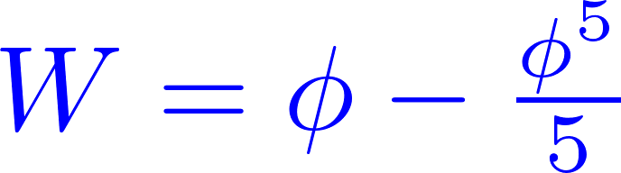
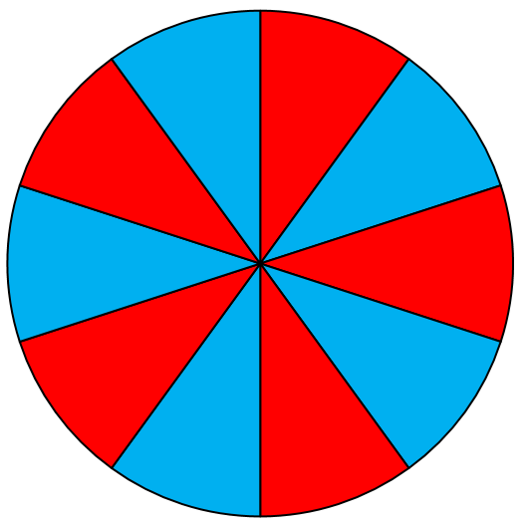




Example:

Slide 27
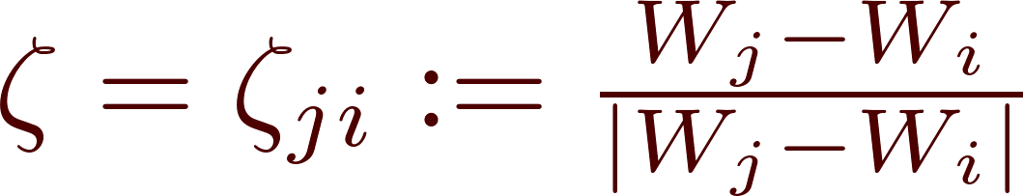
Solitons For D=R
Scale set by W
For general  there is
no solution.
But for a suitable phase there is a solution
This is the classical soliton. There is one for each intersection (Cecotti & Vafa)
(in the fiber of a regular value)

Slide 28
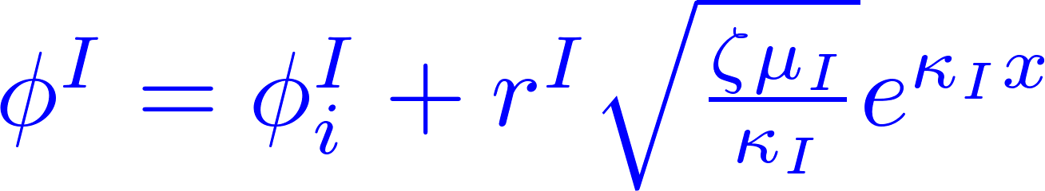

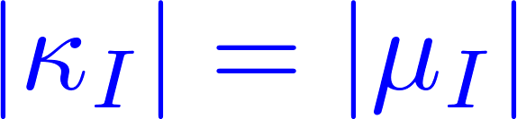




Near a critical point

Slide 29
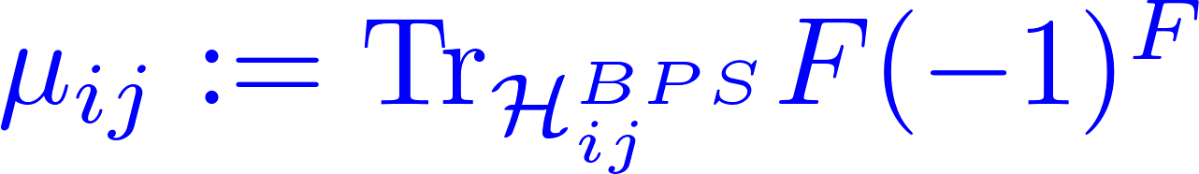
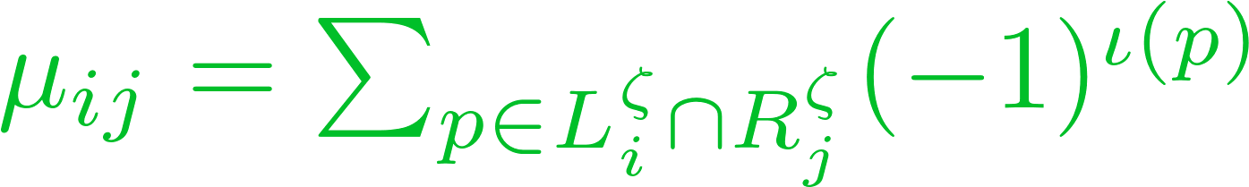
BPS Index
The BPS index is the Witten index:
``New supersymmetric index’’ of Fendley & Intriligator;
Cecotti, Fendley, Intriligator, Vafa; Cecotti & Vafa c. 1991
Remark: It can be computed with a signed sum over classical solitons:

Slide 30


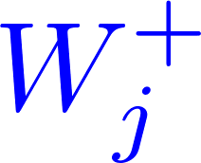


These BPS indices were studied by [Cecotti, Fendley, Intriligator, Vafa and by Cecotti & Vafa]. They found the wall-crossing phenomena:
Given a one-parameter family of W’s:
Notes:
Just say: We’d like to “categorify that” that is, understand it at the level of BPS spaces themselves.

Slide 31

One of our goals will be to ``categorify’’ this wall-crossing formula.
That means understanding what actually happens to the ``off-shell complexes’’ whose cohomology gives the BPS states.
We define chain complexes whose cohomology is the space of BPS states
Complex

Slide 32
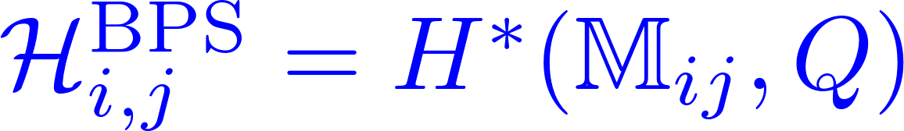


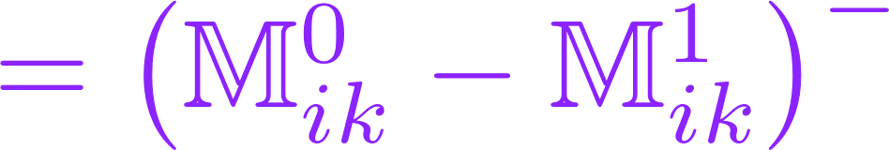
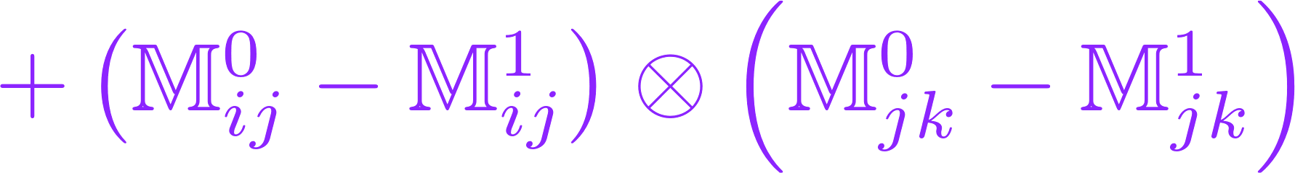
Replace wall-crossing for indices:

Slide 33
Outline
Introduction & Motivations
Overview of Results
Some Review of LG Theory
LG Theory as SQM
Boosted Solitons & Soliton Fans
Motivation from knot homology & spectral networks
Conclusion

Slide 34

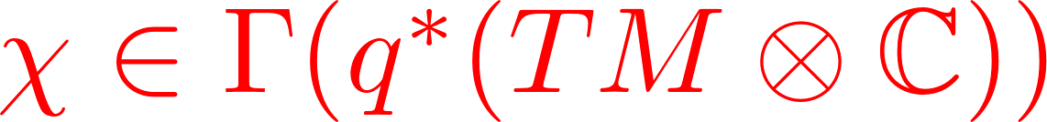
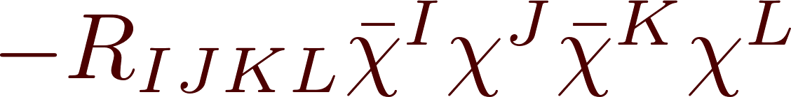


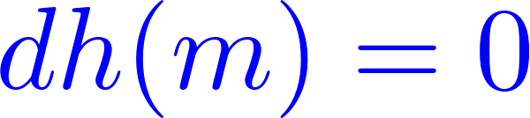

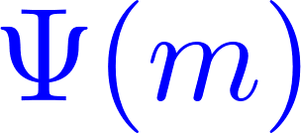

SQM & Morse Theory
(Witten: 1982)
M: Riemannian; h: M  R, Morse function
SQM:
Perturbative vacua:

Slide 35
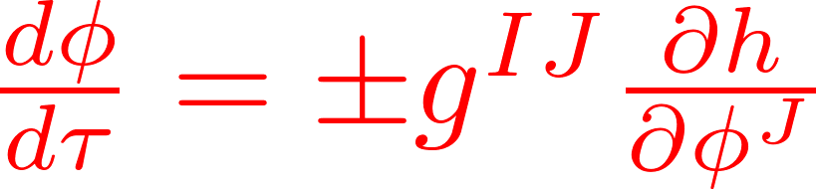

Instantons & MSW Complex
Instanton equation:
``Rigid instantons’’ - with zero reduced moduli – will lift some perturbative vacua. To compute exact vacua:
MSW complex:
Space of groundstates (BPS states) is the cohomology.

Slide 36

Why d² = 0
The moduli space has two ends.
Ends of the moduli space correspond to broken flows which cancel each other in computing d² = 0. (A similar argument shows independence of the cohomology from h and g_{IJ}.)

Slide 37


1+1 LG Model as SQM
Target space for SQM:
Recover the standard 1+1 LG model with superpotential: Two –dimensional ζ-susy
algebra is manifest.

Slide 38
Two advantages of this view
1. Nice formulation of supersymmetric interfaces
2. Apply Morse theory ideas to the formulation of various BPS states.

Slide 39
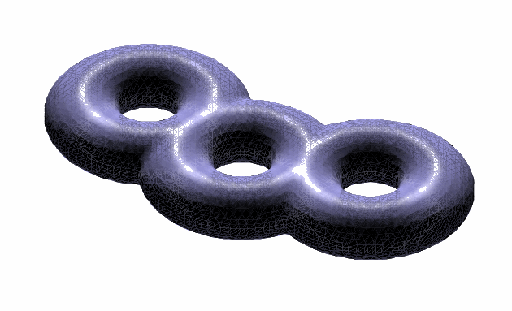
Families of Theories
This presentation makes construction of half-susy interfaces easy:
Consider a family of Morse functions
Let ℘ be a path in C connecting z₁ to z₂.
View it as a map z: [x_{l}, x_{r}]  C with z(x_{l}) = z₁ and z(x_{r}) = z₂
C

Slide 40
Domain Wall/Interface
Using z(x) we can still formulate our SQM!
From this construction it manifestly preserves two supersymmetries.

Slide 41
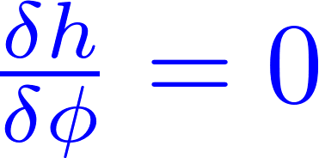


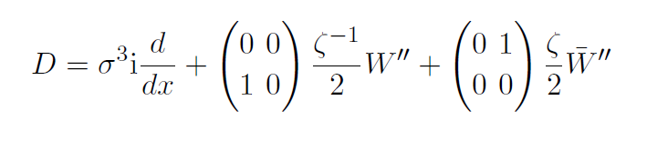
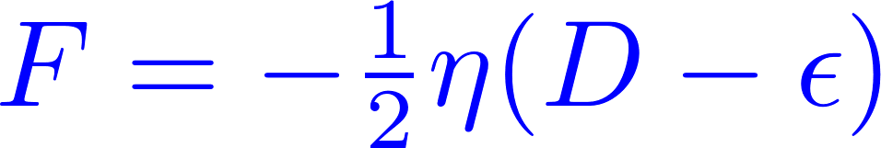
MSW Complex
Now return to a single W. Another good thing about this presentation is that we can discuss ij solitons in the framework of Morse theory:
Equivalent to the ζ-soliton equation
(Taking some shortcuts here….)

Slide 42
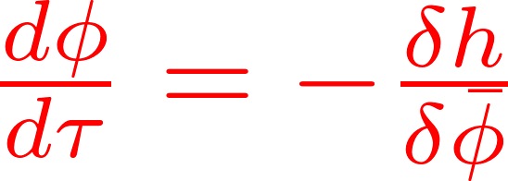
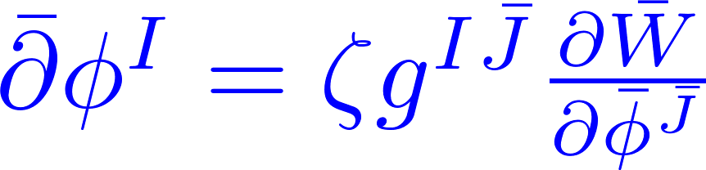
Instantons
Instanton equation
At short distance scales W is irrelevant and we have the usual holomorphic map equation.
(Leading a relation to the Fukaya-Seidel category.)
At long distances the theory is almost trivial since it has a mass scale, and it is dominated by the vacua of W.

Slide 43
Scale set by W

Slide 45
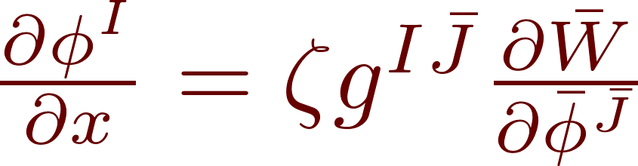
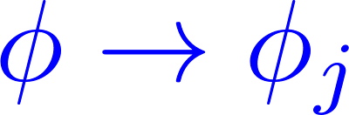
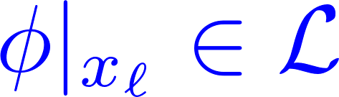

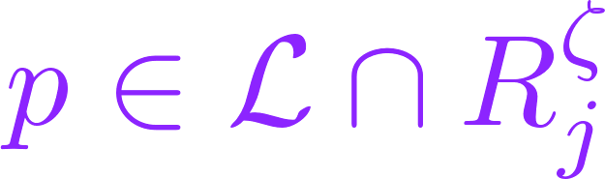
BPS Solitons on half-line D:
Semiclassically:
Q -preserving BPS states must be solutions of differential equation
Classical solitons on the positive half-line are labeled by:

Slide 46

Quantum Half-Line Solitons
MSW complex:
Grading the complex: Assume X is CY and that we can find a logarithm:
Then the grading is by

Slide 47
Half-Plane Instantons
Scale set by W

Slide 48

These instantons define the differential Q on the complex of approximate groundstates:
and the cohomology gives the BPS states on the half-line:

Slide 49





What is the space of BPS states on an interval ?
The theory is massive:
For a susy state, the field in the middle of a large interval is close to a vacuum:

Slide 50





Does the Problem Factorize?
For the Witten index: Yes
Naïve categorification?
No!
Notes:
To understand that, let’s begin by thinking about BPS states on a half-line.

Slide 51
Solitons On The Interval
When the interval is much longer than the scale set by W the MSW complex is
The Witten index factorizes nicely:
But the differential
is too naïve !

Slide 52




Slide 53


Instanton corrections to the naïve differential

Slide 54
Outline
Introduction & Motivations
Overview of Results
Some Review of LG Theory
LG Theory as SQM
Boosted Solitons & Soliton Fans
Motivation from knot homology & spectral networks
Conclusion

Slide 55



The Boosted Soliton - 1
We are interested in the ζ-instanton equation for a fixed generic ζ
We can still use the soliton to produce a solution for phase ζ
Therefore we produce a solution of the instanton equation with phase  if

Slide 56


The Boosted Soliton -2
Stationary soliton
``Boosted soliton’’
These will define edges of webs…

Slide 57



The Boosted Soliton - 3
Put differently, the stationary soliton in Minkowski space preserves the supersymmetry:
So a boosted soliton preserves supersymmetry :
 is a real boost. In Euclidean space this becomes a rotation:
And for suitable  this will preserve ζ-susy

Slide 58


More corrections to the naïve differential

Slide 60

Path integral on a large disk
Choose boundary conditions preserving ζ-supersymmetry:
Consider a cyclic ``fan of solitons’’

Slide 61

Localization
The path integral of the LG model with these boundary conditions (with A-twist) localizes on moduli space of ζ-instantons:
We assume the mathematically nontrivial statement that, when the index of the Dirac operator (linearization of the instanton equation) is positive then the moduli space is nonempty.

Slide 62

Gluing
Two such solutions can be ``glued’’ using the boosted soliton solution -

Slide 63
Ends of moduli space
This moduli space has several “ends” where solutions of the ζ-instanton equation look like
We call this picture a
ζ - web: w

Slide 64
ζ-Vertices
The red vertices represent solutions from the compact and connected components of
The contribution to the path integral from such components are called ``interior amplitudes.’’
In the A-model for the zero-dimensional moduli spaces they count (with signs) the solutions to the ζ-instanton equation.

Slide 65

Path Integral With Fan Boundary Conditions
Just as in the Morse theory proof of d²=0 using ends of moduli space corresponding to broken flows, here the broken flows correspond to webs w
Label the ends of M(F) by webs w. Each end contributes Ψ(w) to the path integral:
The total wavefunction is Q-invariant
The wavefunctions Ψ(w) are themselves constructed by gluing together wavefunctions Ψ(r) associated with ζ-vertices r
L identities on the interior amplitudes

Slide 66





Example:
Consider a fan of vacua {i,j,k,t}. One end of the moduli space looks like:
The red vertices are path integrals with rigid webs. They have amplitudes _{ikt} and _{ijk}.
?

Slide 67
Ends of Moduli Spaces in QFT
In LG theory (say, for X= C^{n}) the moduli space cannot have an end like the finite bndry of R₊
In QFT there can be three kinds of ends to moduli spaces of the relevant PDE’s:
UV effect: Example: Instanton shrinks to zero size; bubbling in Gromov-Witten theory
Large field effect: Some field goes to 
Large distance effect: Something happens at large distances.

Slide 68

None of these three things can happen at the finite boundary of R₊. So, there must be another end:
Amplitude:

Slide 69

The boundaries where the internal distance shrinks to zero must cancel leading to identities on the amplitudes like:
This set of identities turns out to be the
Maurer-Cartan equation for an
L - algebra.
This is really a version of the argument for d² = 0 in SQM.

Slide 70
Outline
Introduction & Motivations
Overview of Results
Some Review of LG Theory
LG Theory as SQM
Boosted Solitons & Soliton Fans
Motivation from knot homology & spectral networks
Conclusion

Slide 71

Knot Homology -1/5
(Approach of E. Witten, 2011)
Study (2,0) superconformal theory based on Lie algebra g
D:
p
TIME
M₃: 3-manifold containing a surface defect at R x L x {p}
More generally, the surface defect is supported on a link cobordism L₁ → L₂:

Slide 72



Knot Homology – 2/5
Now, KK reduce by U(1) isometry of the cigar D with fixed point p to obtain 5D SYM on
R x M₃ x R₊
Link cobordism

Slide 73

Knot Homology – 3/5
Hilbert space of states depends on M₃ and L:
is identified with the knot homology of L in M₃.
This space is constructed from a chain complex using infinite-dimensional Morse theory on a space of gauge fields and
adjoint-valued differential forms.

Slide 74

Knot Homology 4/5
Equations for the semiclassical states generating the MSW complex are the Kapustin-Witten equations for gauge field with group G and adjoint-valued one-form  on the four-manifold M₄ = M₃ x R⁺
Boundary conditions at y=0 include Nahm pole and extra singularities at the link L involving a representation R^{v} of the dual group.
Differential on the complex comes from counting ``instantons’’ – solutions to a PDE in 5d written by Witten and independently by Haydys.

Slide 75





Knot Homology 5/5
In the case M₃ = C x R with coordinates (z, x¹) these are precisely the equations of a gauged Landau-Ginzburg model defined on 1+1 dimensional spactime (x⁰,x¹) with target space
Gaiotto-Witten showed that in some situations one can reduce this model to an ungauged LG model with finite-dimensional target space.

Slide 76
Outline
Introduction & Motivations
Overview of Results
Some Review of LG Theory
LG Theory as SQM
Boosted Solitons & Soliton Fans
Motivation from knot homology & spectral networks
Conclusion

Slide 77
Theories of Class S
(Slides 77-91 just a reminder for experts.)
Begin with the (2,0) superconformal theory based on Lie algebra g
Compactify (with partial topological twist) on a Riemann surface C with codimension two defects D inserted at punctures s_{n} ∈ C.
Get a four-dimensional QFT with
d=4 N=2 supersymmetry S[g,C,D]
Coulomb branch of these theories
described by a Hitchin system on C.

Slide 78
UV Curve
Seiberg-Witten Curve
SW differential
For g =su(K)
is a K-fold branched cover

Slide 79
Canonical Surface Defect in S[g,C,D]
For z ∈ C we have a canonical surface defect S_{z}
It can be obtained from an M2-brane ending at x¹=x²=0 in R⁴ and z in C
This is a 1+1 dimensional QFT localized at (x¹,x²)=(0,0) coupled to the ambient four-dimensional theory. At a generic point on the Coulomb branch it is massive.
In the IR the different vacua for this M2-brane are the different sheets in the fiber of the SW curve over z.

Slide 80
Susy interfaces for S[g,C,D]
Interfaces between S_{z} and S_{z’} are labeled by open paths ℘ on C
This data, together with an angle ☺ defines a susy interface L,☺ .

Slide 81

Spectral networks
(D. Gaiotto, G. Moore, A. Neitzke)
Spectral networks are combinatorial
objects associated to a branched covering of Riemann surfaces   C with 
Spectral network
C
branch point

Slide 82
S-Walls
Spectral network ☺ of phase ☺ is
a graph in C.
Edges are made of WKB paths:
The path segments are ``S-walls of type ij’’

Slide 83

12
32
32
21
21
23
But how do we choose which WKB paths to fit together?

Slide 84

Evolving the network -1/3
ji
ij
Near a (simple) branch point of type (ij):
ji

Slide 85
Evolving the network -2/3
Evolve the differential equation.
There are rules for how to continue
when S-walls intersect. For example:

Slide 86


Slide 87


Formal Parallel Transport
Introduce the generating function of framed BPS degeneracies:

C

Slide 88
Homology Path Algebra
To any relative homology class
a  H₁(,{x_{i}, x_{j’} }; Z) assign X_{a}
X_{a} generate the “homology path algebra” of 

Slide 89
Four (Defining) Properties of F
1
(``Parallel transport’’)
2
Homotopy invariance
=
(``Flat parallel transport’’)
3
If  does NOT intersect ☺ :
4
If  DOES
intersect ☺ :
``Detour rule’’

Slide 90


Detour Rule
ij
Detour Rule
= Wall-crossing formula for

Slide 91

Theorem: These four conditions completely determine both F(,☺) and 
One can turn this formal transport into a rule for pushing forward a flat GL(1,C) connection on Σ to a flat GL(K,C) connection on C.
``Nonabelianization map’’
We want to categorify the parallel transport F(,☺) and the framed BPS degeneracies:

Slide 92
Outline
Introduction & Motivations
Overview of Results
Some Review of LG Theory
LG Theory as SQM
Boosted Solitons & Soliton Fans
Motivation from knot homology & spectral networks
Conclusion

Slide 93
Summary – 1/2
1. Instantons effects can be thought of in terms of an ``effective theory’’ of BPS particles.
2. This naturally leads to L and A structures.
3. Naïve categorification can fail. (Example of the BPS states on the interval and half-lines.)
4. We expect these algebraic structures to be universal identities for massive 1+1 N=(2,2) QFT.
(Because the web formalism can be formulated
at this level of generality.)

Slide 94
Summary – 2/2
5. When there are paths of Landau-Ginzburg theories, one can define supersymmetric interfaces. Colliding these interfaces with the boundaries gives a map of branes.
6. This defines a notion of flat parallel transport of the A category of branes. Existence of this transport categorifies
2d wall-crossing.

Slide 95
Some Open Problems
What is the relation of interior amplitudes to
S-matrix singularities?
2. Generalization to 2d4d systems:
Categorification of the 2d4d WCF.
(Under discussion with T. Dimofte.)
3. Is the formalism at all useful for knot homology?

