Slide 1
Many-body Floquet systems & time-crystalline order
Daniel Cerkoney

Slide 2
Overview
What is a Floquet system?
  Floquet theorem & quasienergy
  Consequences of the Floquet theorem
Comparison with spatial crystals
Can one prepare these systems?
  Yes! (Zhang et al. 2017, Choi et al. 2017)

Slide 3
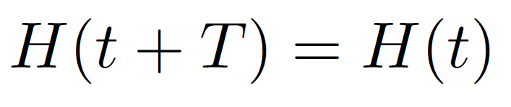

What is a Floquet system?
Exhibits discrete time translation symmetry:
For such a system, the Floquet theorem must hold
Floquet Theorem:
(Note: totally analogous to Bloch’s theorem!)

Slide 4
What is a Floquet system?
Exhibits discrete time translation symmetry:
For such a system, the Floquet theorem must hold:
Expectation:
In complete analogy with physical crystallization, we should be able to prepare a system in such a time-crystalline phase, i.e., a time crystal.

Slide 5
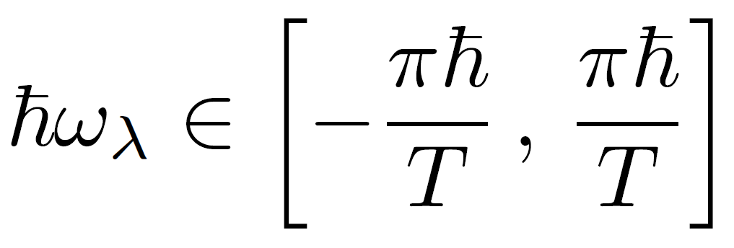
Floquet Theorem & Quasienergy
Energy → Quasienergy
Energy is now only unique modulo the drive period!

Slide 6
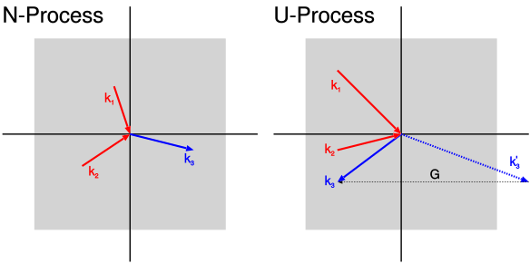
Floquet Theorem & Quasienergy
Energy → Quasienergy
See umklapp processes in spatial crystals:

Slide 7
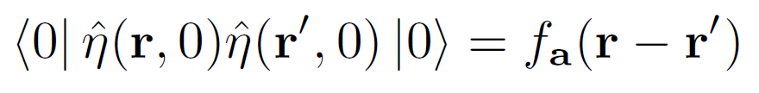
Existence of time crystals
Do they exist in equilibrium?
Naively, we expect so by analogy with spatial crystals
Spatial case: long-range (periodic) spatial order

Slide 8
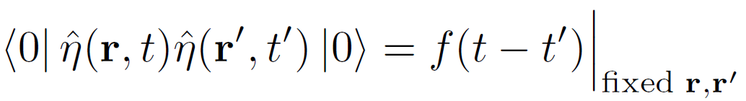
Existence of time crystals
A caveat: no-go theorem for systems in thermal equilibrium!*
Most generally, can define a time crystal by existence of time-dependent long-range order:
  Intuitively, we don’t expect to get this in the ground state
  turns out to hold at finite T in equilibrium too!
  *Watanabe & Oshikawa (Phys. Rev. Lett. 114, 251603 (24 June 2015))

Slide 9
Existence of time crystals
What about non-equilibrium (driven) systems?
Spontaneous time-translation symmetry breaking is possible!*
  Many-body localization turns out to be important to get time-dependent correlations in the lowest energy eigenstate
E.g., a spin-1/2 system in the presence of a laser
  Driving: spin flips at regular intervals
  Strong disorder: many-body localization
  Long-range interactions: induce time crystallization
  *Else, Bauer & Nayak (Phys. Rev. Lett. 117, 090402 (25 August 2016))

Slide 10

Existence of time crystals
What about non-equilibrium (driven) systems?
Spontaneous time-translation symmetry breaking is possible!*
  Many-body localization turns out to be important to get time-dependent correlations in the lowest energy eigenstate
E.g., a spin-1/2 system in the presence of a laser
  Driving: spin flips at regular intervals
  Strong disorder: many-body localization
  Long-range interactions: induce time crystallization
Signature of time crystallization = subharmonic response
  *Else, Bauer & Nayak (Phys. Rev. Lett. 117, 090402 (25 August 2016))

Slide 11
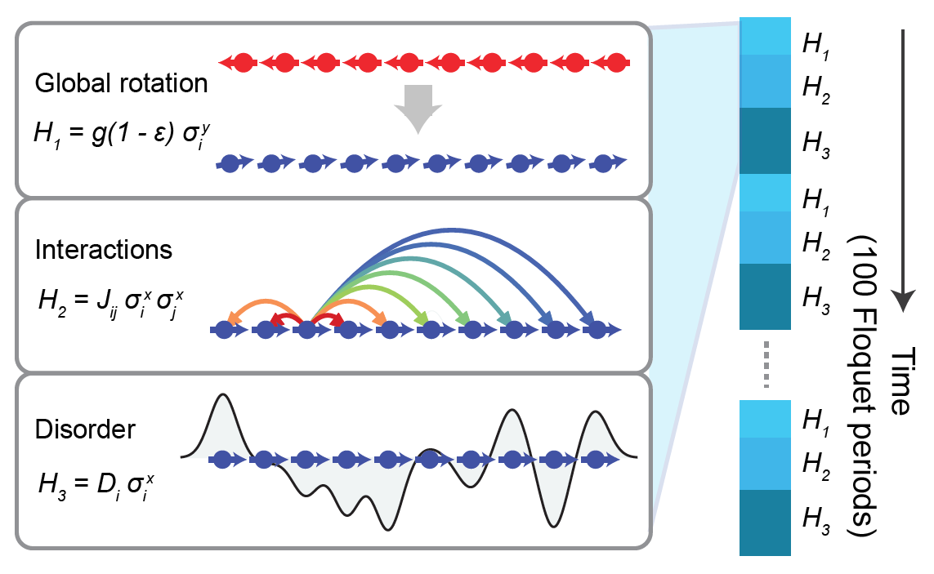
First experimental observation
Setup: driven linear spin chain of trapped Yb+ ions
Monroe et al. (Nature 543, 217–220 (09 March 2017))

Slide 12
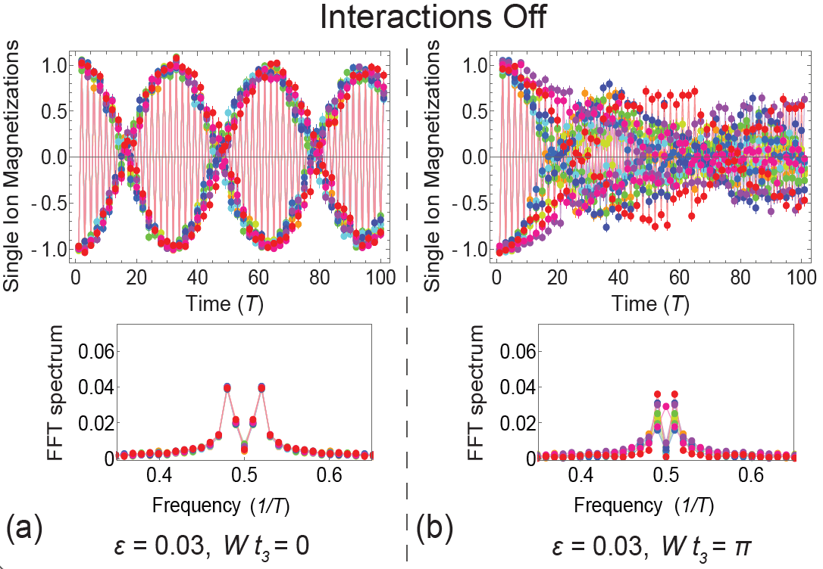
First experimental observation
Signature: subharmonic response in magnetization
Monroe et al. (Nature 543, 217–220 (09 March 2017))

Slide 13
First experimental observation
Signature: subharmonic response in magnetization
Not robust to disorder without interactions
Monroe et al. (Nature 543, 217–220 (09 March 2017))

Slide 14
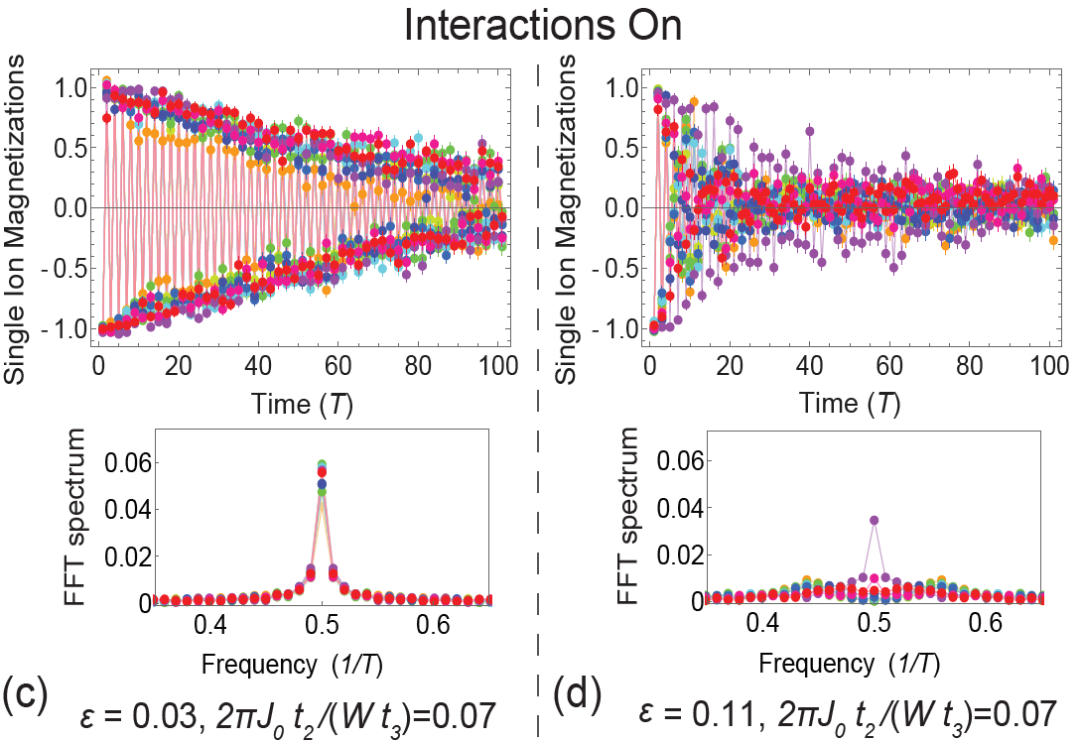
First experimental observation
Signature: subharmonic response in magnetization
Monroe et al. (Nature 543, 217–220 (09 March 2017))

Slide 15
First experimental observation
Signature: subharmonic response in magnetization
Interactions + disorder = stable time crystal
Monroe et al. (Nature 543, 217–220 (09 March 2017))

Slide 16
First experimental observation
Signature: subharmonic response in magnetization
Like a spatial crystal, we can melt it!
Monroe et al. (Nature 543, 217–220 (09 March 2017))

Slide 17
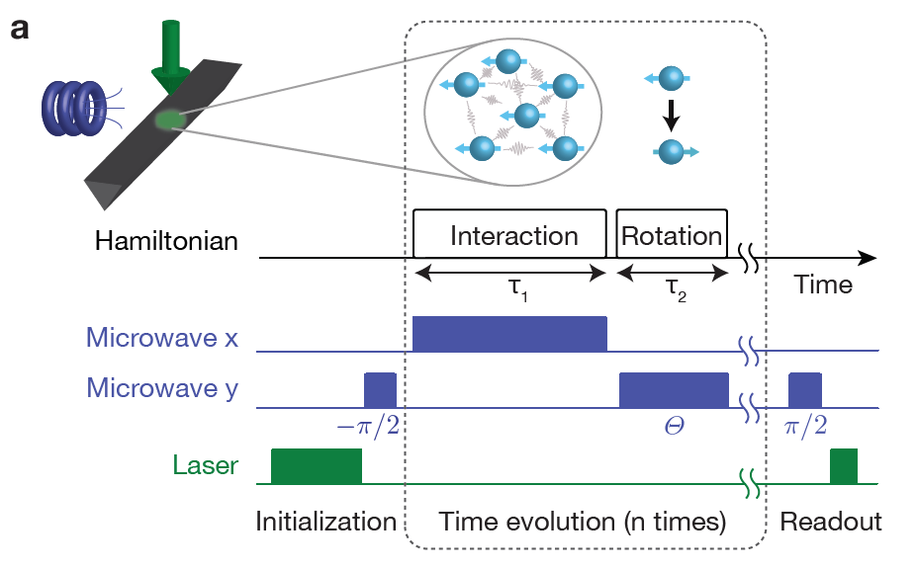
Another experiment
Setup: driven nitrogen-vacancy spin impurities in diamond.
Lukin et al. (Nature 543, 221–225 (09 March 2017))

Slide 18
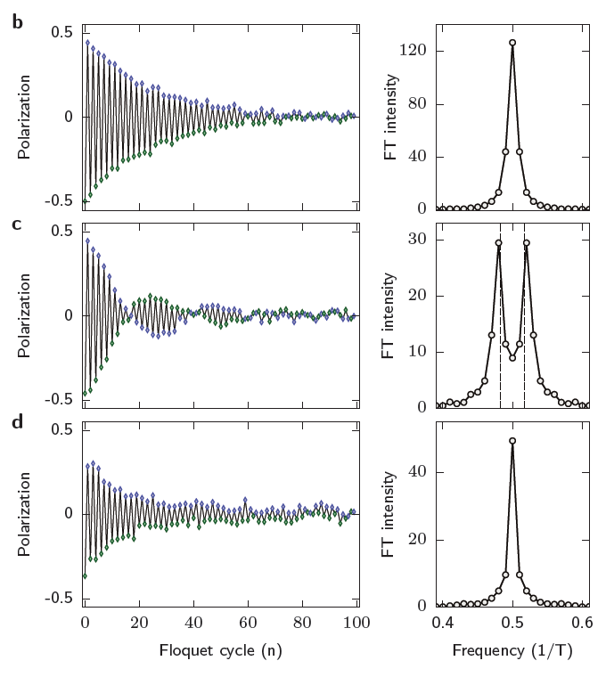
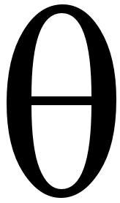
Another experiment
Signature: subharmonic response in polarization
Low interactions
Low interactions
+ perturb
High interactions
+ perturb
= time crystal
Lukin et al. (Nature 543, 221–225 (09 March 2017))

Slide 19
Summary
Many-body Floquet systems allow us to study of the effects of spontaneous time-translation symmetry (TTS) breaking
Discrete TTS leads to time-crystalline order
The consequences of time crystallization are analogous to the familiar spatial case, but…
Can only realize in out-of-equilibrium (driven) systems

