Slide 1
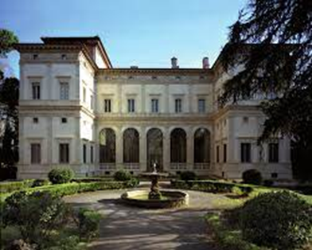
2d Categorical Wall-Crossing With Twisted Masses, And An Application To Knot Invariants
Gregory Moore
Rutgers
September 29, 2021

Slide 2

Part of this talk is review of old things
Witten, 1982; Cecotti & Vafa, 1992
Some foundational material: D. Gaiotto, G. Moore, & E. Witten 2015 (GMW)
New things are work with AHSAN KHAN
arXiv:2010.11837
arXiv:21??.????

Slide 3

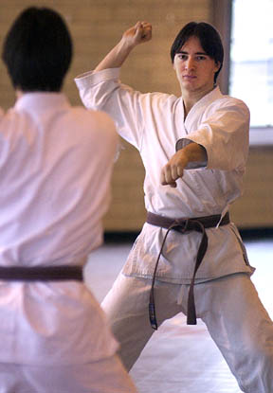

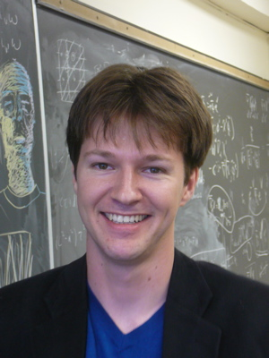

+ comment resulting from discussions with
With nontrivial input from Andy and Tudor

Slide 4
Supersymmetric Quantum Mechanics And Homological algebra
1
2
2D N=(2,2) Landau-Ginzburg Models
3
Thimble Branes & Their Local Operators
4
Categorical Wall-Crossing
5
Generalization To Twisted Masses
6
Relation To 3d Indices

Slide 5



SQM & Morse-Novikov Theory (Witten: 1982)
M: Riemannian; $ξ:$Closed 1-form
Locally $ξ=dh$ with $h:M→ℝ$the traditional superpotential.
But $h$need not be single-valued: $ξ$ need not be exact.
Call $ξ$ the ``super-one-form’’
SQM:
$$φ:ℝ_{t}→M$$
$$L=g_{IJ}\left(φ\right){\dot{φ}}^{I}{\dot{φ}}^{J} −∥ξ∥^{2}+⋯$$

Slide 6

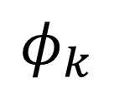


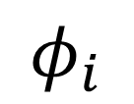


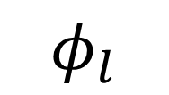

SQM & Morse-Novikov Theory (Witten: 1982)
SQM:
$$φ:ℝ_{t}→M$$
$$L=g_{IJ}\left(φ\right){\dot{φ}}^{I}{\dot{φ}}^{J} −∥ξ∥^{2}+⋯$$
Classical vacua:
$$ξ\left(φ_{i}\right)=0$$
``critical points’’
``Mass matrix’’ $D_{I}ξ_{J}{\left.​\right|}_{φ_{i}}$ is invertible
$$φ_{j}$$
$$φ_{k}$$
$$φ_{i}$$
Approximate quantum vacua:
$$Ψ\left(φ_{i}\right)$$
Fermion number: $F\left(Ψ\left(φ_{i}\right)\right)=\frac{1}{2}\left(d_{−}\left(φ_{i}\right)−d_{+}(φ_{i})\right)$
$$φ_{l}$$

Slide 7
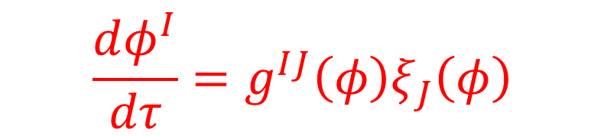


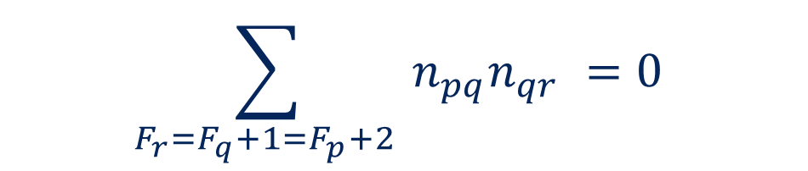
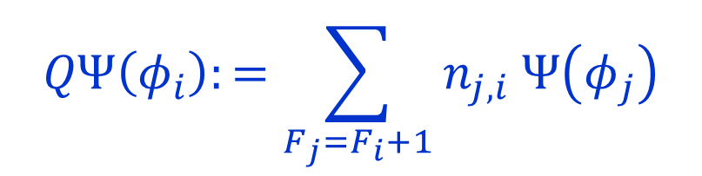
Instantons & MSW Complex
The approximate vacua are not exact because of instanton effects.
$$\frac{dφ^{I}}{dτ}=g^{IJ}\left(φ\right)ξ_{J}\left(φ\right)$$
Instanton equation:
Use instantons to define an operator $Q$
on approximate ground states
$$QΨ\left(φ_{i}\right):=\sum_{F_{j}=F_{i}+1}{n_{j,i} Ψ\left(φ_{j}\right)}$$
$$\sum_{F_{r}=F_{q}+1=F_{p}+2 }{n_{pq}n_{qr} =0 }$$
Broken flows:
$$⇒ Q^{2}=0$$

Slide 8



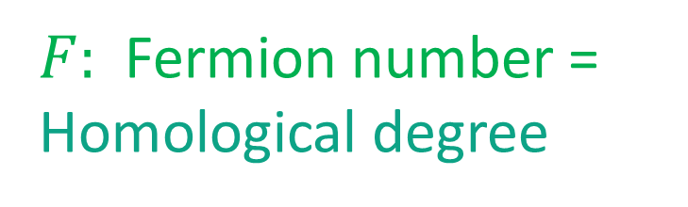


MSW Chain Complex
$𝒞 ≔\left(V,F,Q\right)$
SQM: $V⊂ℋ$: The span of the approximate ground states $Ψ\left(φ_{i}\right)$
$F:$ Fermion number =
Homological degree
$Q:$Susy operator$=$
Differential
$$\left[F,Q\right]=Q$$
$$Q^{2}=0$$
MSW complex: MSW(${M,g}_{IJ}, ξ_{I})$
Exact ground states $≅$ $H^{∗}\left(V,Q\right)≅H^{∗}\left(M;d+ξ\right)$

Slide 9




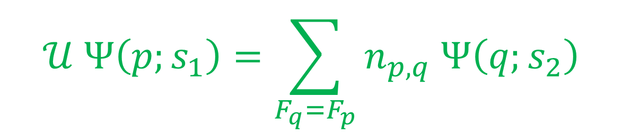

Homotopies Of Metric And Super-one-form
Now consider a continuous family:
$$\left(g_{IJ}\left(φ;s\right), ξ_{I}\left(φ;s\right)\right)$$
$$s_{1}≤s≤s_{2}$$
How does the MSW complex change?
Define $𝒰:MSW\left(s_{1}\right)→MSW\left(s_{2}\right)$
$$𝒰 Ψ\left(p;s_{1}\right)=\sum_{F_{q}=F_{p}}{n_{p,q} Ψ\left(q;s_{2}\right)}$$
$$\frac{dφ^{I}}{ds}=g^{IJ}\left(φ;s\right)ξ_{J}\left(φ;s\right)$$
Claim:
$$𝒰 F=F 𝒰$$
$$𝒰 Q_{1}= Q_{2} 𝒰$$

Slide 10
Under continuous deformation of metric and super-one-form
the MSW complex changes by
a chain map.
Actually, it is a very special kind of chain map:
A homotopy equivalence of chain complexes.

Slide 11


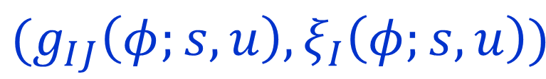
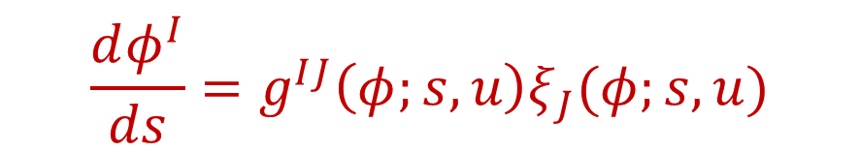

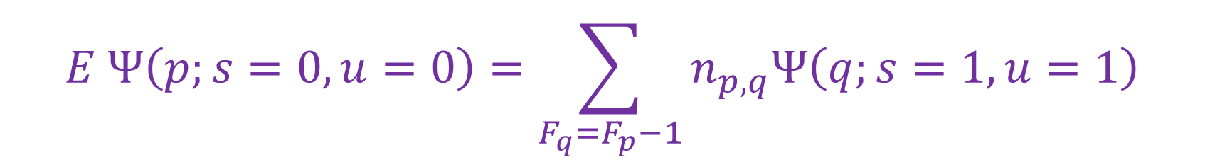

Homotopies Of Paths $⇒$Homotopy Of Chain Maps
$$u$$
$$Met\left(M\right)×\left\{ξ′s\right\}$$
$$(g_{IJ}\left(φ;s,u\right), ξ_{I}\left(φ;s,u\right))$$
(Fixed @ s=0,1)
$$s$$
$u=0$gives a chain map $𝒰_{0} :{\left(V,F,Q\right)}_{1}→ {\left(V,F,Q\right)}_{2}$
$u=1$gives a chain map $𝒰_{1} :{\left(V,F,Q\right)}_{1}→ {\left(V,F,Q\right)}_{2}$
$$𝒰_{0} −𝒰_{1}=Q_{2} E+E Q_{1}$$
$$\frac{dφ^{I}}{ds}=g^{IJ}\left(φ;s,u\right)ξ_{J}(φ;s,u)$$
$$E Ψ\left(p;s=0,u=0\right)=\sum_{F_{q}=F_{p}−1}{n_{p,q}Ψ\left(q;s=1,u=1\right)}$$

Slide 12




Definition: Homotopies Of Chain Maps
Two chain maps $f_{0}, f_{1} :𝒞_{1}→𝒞_{2}$ are homotopic if
There is a Fermion number -1 map $E:V_{1}→V_{2}$
$$f_{0} −f_{1}=Q_{2} E+E Q_{1}$$
If there are
chain maps….
$$f:𝒞_{1}→𝒞_{2}$$
$$g:𝒞_{2}→𝒞_{1}$$
$$g∘f ∼Id_{𝒞_{1}}$$
$$f∘g ∼Id_{𝒞_{2}}$$
Then the chain complexes $𝒞_{1}$ and $𝒞_{2}$ are homotopy equivalent.

Slide 13
Supersymmetric Quantum Mechanics And Homological algebra
1
2
2D N=(2,2) Landau-Ginzburg Models
3
Thimble Branes & Their Local Operators
4
Categorical Wall-Crossing
5
Generalization To Twisted Masses
6
Relation To 3d Indices

Slide 14
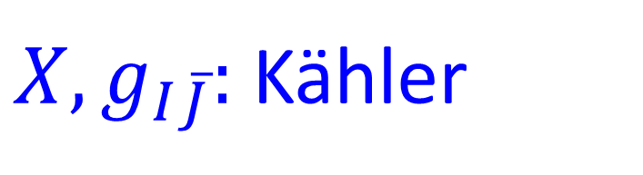

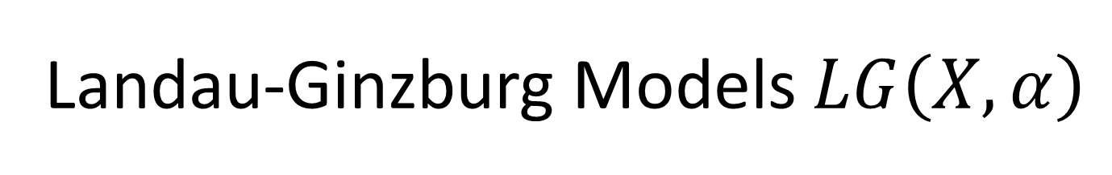

Landau-Ginzburg Models $LG\left(X,α\right)$
$X,g_{I\overline{J}}:$Kähler
$$α∈Ω^{1,0}\left(X\right) , \overline{∂}α=0$$
Locally $α=∂W$ with $W:X→ℂ$, but we will be considering multi-valued $W$
$$S=\int_{ℝ}{dt \int_{D}{dx \left( g_{I\overline{J}}\left(φ\left(x,t\right)\right) ∂_{μ}φ^{I} ∂^{μ}φ^{\overline{J}} − ∥α\left(φ\right)∥^{2}+⋯ \right)}}$$
Poincare invariant vacua for $D=ℝ$:
$$𝕍=\left\{ φ_{i} \right| α\left(φ_{i}\right)=0 \}$$
Branes
$$D= \left[x_{0},∞\right)$$

Slide 15


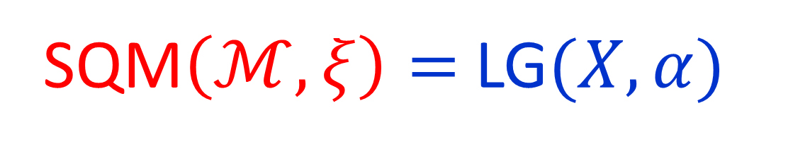
2d LG Model As 1d SQM
Consider SQM with target: $ℳ=Map\left(φ: D→X\right)$
$$∥δφ∥^{2}=\int_{D}{g_{I\overline{J}}\left(φ\left(x\right)\right)}δφ^{I} δφ^{\overline{J}}$$
$α∈Ω^{1,0}\left(X\right)$ induces a super-one-form $ξ$on $ℳ$
$$ξ\left[φ\right]=\int_{D}{\left[φ^{∗}\left(ω\right)−Re\left(ζ^{−1}α_{I}\left(φ\right)δφ^{I}\right)dx \right]}$$
SQM$\left(ℳ, ξ\right)=$LG$(X,α)$

Slide 16


Superpotential With Twisted Masses
Usual discussion: $α=∂W$
with $W:X→ℂ$ holomorphic and Morse
If $α$ has nonzero periods there is no single-valued superpotential
``twisted masses’’
$∃$Minimal Abelian cover $π:\hat{X}→X$ so that $π^{∗}\left(α\right)=∂ \hat{W}$
$Γ:$Free Abelian Deck group $⊂ H_{1}\left(X;ℤ\right)$

Slide 17



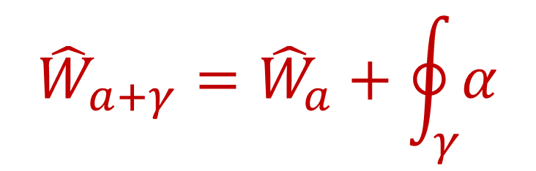

It is often convenient to consider $LG\left(\hat{X}, \hat{α}=∂\hat{W}\right)$
and work equivariantly wrt $Γ$
Vacua of $LG\left(\hat{X}, \hat{α}=∂\hat{W}\right)$ : $\hat{𝕍}= \{ {\hat{φ}}_{a} | d\hat{W}\left({\hat{φ}}_{a}\right)=0 \}$
Abbreviate vacua ${\hat{φ}}_{a}, {\hat{φ}}_{b}, …$ simply by $a, b,…$
Write $free$ $Γ−$action on $\hat{𝕍} :$ $a→a+γ$
$${\hat{W}}_{a+γ}={\hat{W}}_{a}+\oint_{γ}{α}$$

Slide 18


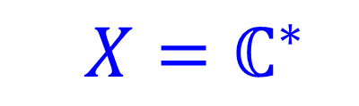

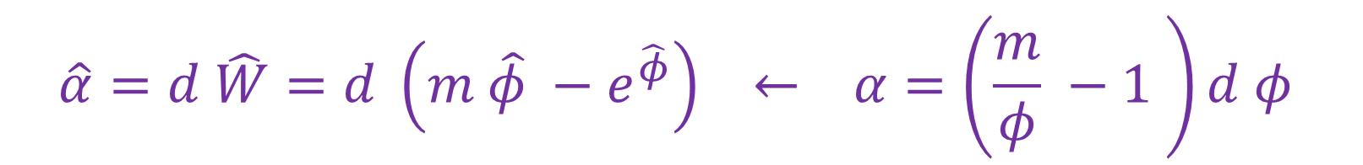
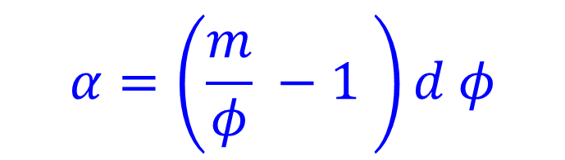
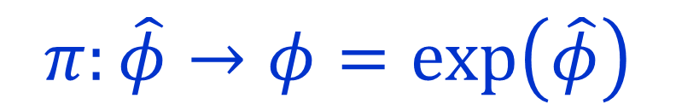

Example 1: Mirror Of The Free Chiral
$$α=\left(\frac{m}{φ} −1 \right)d φ$$
$$X=ℂ^{∗}$$
$$𝕍=\left\{ φ_{0}=m≠0 \right\}$$
$$π:\hat{X}=ℂ → X=ℂ^{∗}$$
$$π:\hat{φ}→φ=\exp\left(\hat{φ}\right)$$
$$Γ≅ℤ$$
$$\hat{α}=d \hat{W}=d \left(m \hat{φ} −e^{\hat{φ}}\right) ← α=\left(\frac{m}{φ} −1 \right)d φ$$
$$\hat{𝕍}=\{ {\hat{φ}}_{a}=\log{m+2πi a \left|a∈ℤ\right\} }$$
$${\hat{W}}_{a}=m\log{m +2πi a m }$$
$${\hat{W}}_{a+n}={\hat{W}}_{a}+2πi m n$$
Twisted mass

Slide 19


Other Examples
Mirror of $ℂℙ^{1}:$ $α=\left(\frac{t}{φ^{2}} +\frac{m}{φ} +t \right)d φ$
$$φ∈{X= ℂ}^{∗}$$
Discussed in GMW framework in Galakhov (2021) and Khan-Moore, to appear
There are two vacua $φ_{i}, φ_{j}$ and rank one deck group $Γ≅ℤ$
LG models for knot homology
[Gaiotto-Witten; Galakhov-Moore; Aganagic]

Slide 20
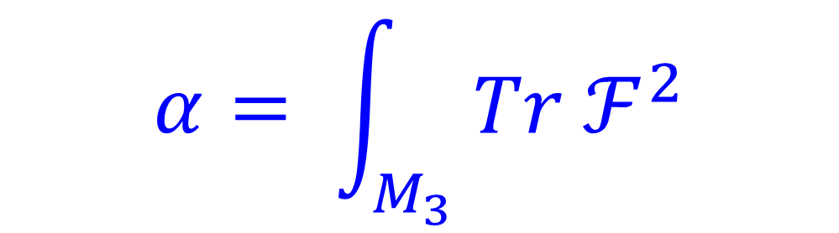
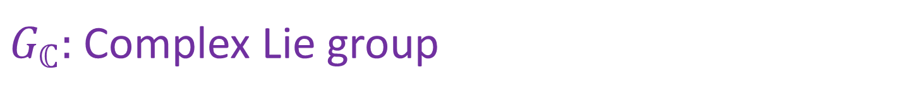
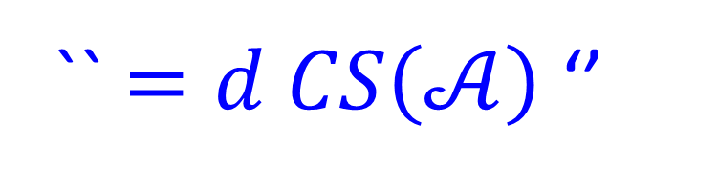

Chern-Simons-Landau-Ginzburg
$G_{ℂ}:$Complex Lie group
$M_{3}:$Riemannian 3-fold $⇒$ LG model $CSLG\left[{G_{ℂ}, M}_{3}\right]$
$$X=\left\{ Complex G_{ℂ}−connections on a 3−manifold M_{3} \right\}$$
$$α= \int_{M_{3}}{ Tr ℱ^{2}}$$
`` $=d CS\left(𝒜\right)$‘’
Vacua on $D=ℝ$: Flat $G_{ℂ} −$connections

Slide 21
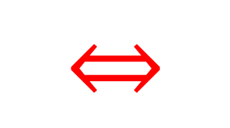

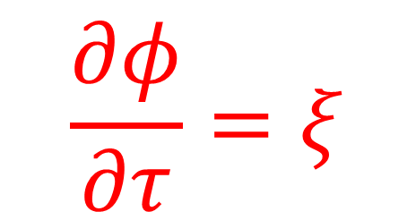
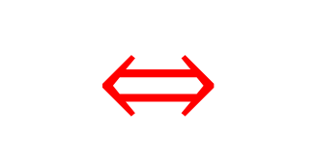

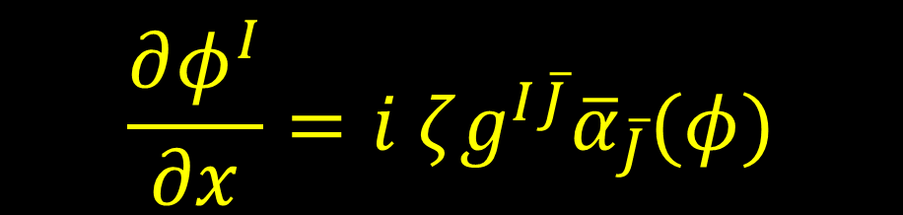
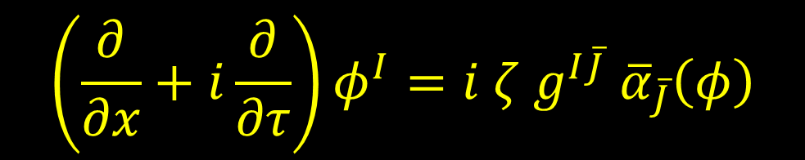
Morse Theory Flows In LG Language
$SQM\left(ℳ,ξ\right)$vacua:
$$\frac{∂φ^{I}}{∂x}=i ζg^{I\overline{J}}{\overline{α}}_{\overline{J}}(φ)$$
$$ξ=0$$
$$⇔$$
We call this the ζ-soliton equation
$$\frac{∂φ}{∂τ}=ξ$$
$$\left(\frac{∂}{∂x}+i\frac{∂}{∂τ}\right)φ^{I}=i ζ g^{I\overline{J}} {\overline{α}}_{\overline{J}}\left(φ\right)$$
$$⇔$$
We call this the ζ-instanton equation

Slide 22
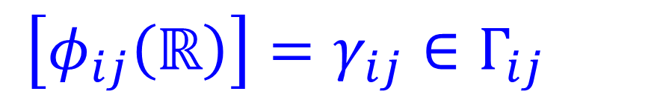


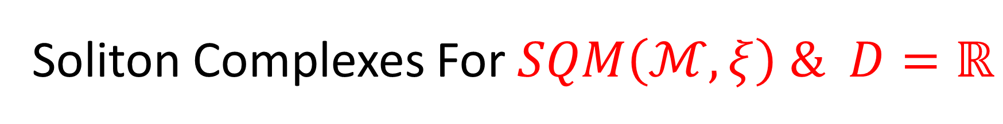


Soliton Complexes For $SQM\left(ℳ, ξ\right) \& D=ℝ$
$$φ\left(x\right)→φ_{i}$$
$$φ\left(x\right)→φ_{j}$$
$$R_{ij}=\left(Span\{Ψ[φ_{ij}\left(x\right)]\},{ F}_{ij} , Q_{ij} \right)$$
$$F_{ij} Ψ_{ij}=η\left(D_{φ_{ij}}\right) Ψ_{ij}$$
$Q_{ij} :$ Count $ζ−$instantons
``Flavor Charge’’ :
$\left[φ_{ij}\left(ℝ\right)\right]=γ_{ij}∈Γ_{ij}$
$Γ_{ij}=$ paths in $X$from $φ_{i}$ to $φ_{j}$ --- up to homology.

Slide 23




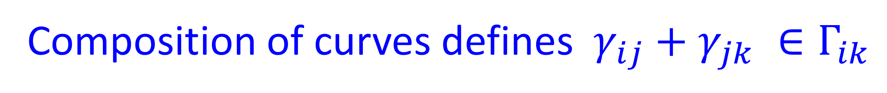



Adding Charges
Composition of curves defines $γ_{ij}+γ_{jk} ∈Γ_{ik}$
$$φ_{j}$$
$$φ_{k}$$
$$γ_{ij}$$
$$φ_{i}$$
$$γ_{jk}$$
Abelian group structure on $Γ_{ii}≅Γ$.
$Γ_{ij}$ is a $Γ−$torsor

Slide 24





$R_{ij}$is graded by $Γ−$torsor $Γ_{ij}$
$$R_{ij}= ⊕_{{γ_{ij}∈Γ_{ij}}_{ }}R_{γ_{ij}}$$
``BPS index’’
$$μ_{γ_{ij}}≔Tr_{R_{γ_{ij}}} e^{i π F_{ij}}$$
Central charge: $Z_{γ_{ij}}=\oint_{γ_{ij}}{α }$
Generalizes the standard ($α$exact) $Z_{ij}=W_{i} −W_{j}$
``Twisted mass property’’
$$Z_{γ_{ij}+γ}=Z_{γ_{ij}}+Z_{γ}$$

Slide 25


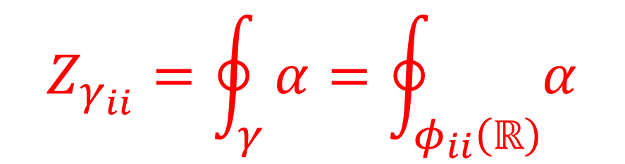

Periodic Solitons
Qualitatively new feature with twisted masses:
$$φ\left(x\right)→φ_{i}$$
$$φ\left(x\right)→φ_{i}$$
When $α$ is not exact there can be nontrivial solutions!
$$Z_{γ_{ii}}=\oint_{γ}{α=\oint_{φ_{ii}\left(ℝ\right)}{α}}$$
$R_{ii}$ can be nontrivial!

Slide 26
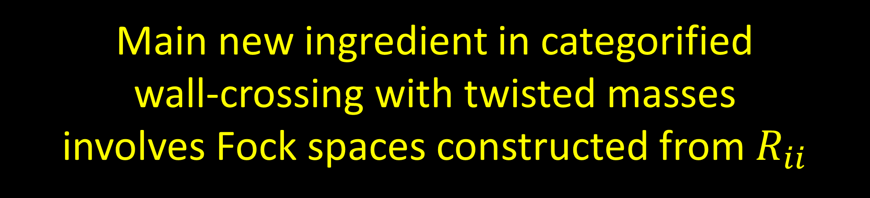
Main new ingredient in categorified
wall-crossing with twisted masses
involves Fock spaces constructed from $R_{ii}$

Slide 27
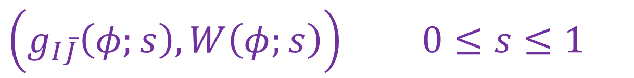



Wall-Crossing When $α=∂W$
$\left(g_{I\overline{J}}\left(φ;s\right), W\left(φ;s\right)\right)$ $0≤s≤1$
$μ_{ij}\left(s\right)$ is only piecewise constant: CFIV, CV 1991, 1992
Happens when two central charges are parallel.
CVWCF: Tells how $μ_{ij}\left(s\right)$jump.
Categorified CVWCF: Describe how the homotopy equivalence class of $R_{ij}$jumps.

Slide 28

Remarks
1. We claim that the homotopy equivalence class is physically meaningful so this is a well-posed question.
2. Moreover, the homotopy equivalence class of $R_{ij}$ is a nontrivial refinement of $μ_{ij}$

Slide 29
Remarks
It is often said that the only thing we can hope to compute exactly in interacting, non-integrable QFTs are Witten indices.
For general LG$\left(X,W\right)$ are interacting & non-integrable
So what we are doing here has some tension with this standard folklore.

Slide 30


Wall-Crossing Formula With Twisted Masses: 1/ 3
``Vacuum Groupoid Algebra’’ :
For each $γ_{ij}∈Γ_{ij}$ introduce a variable $x_{γ_{ij}}$
$$x_{γ_{ij}} x_{γ_{kl}}=δ_{jk} x_{γ_{ij}+γ_{jk} }$$

Slide 31

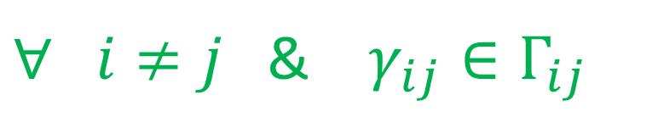


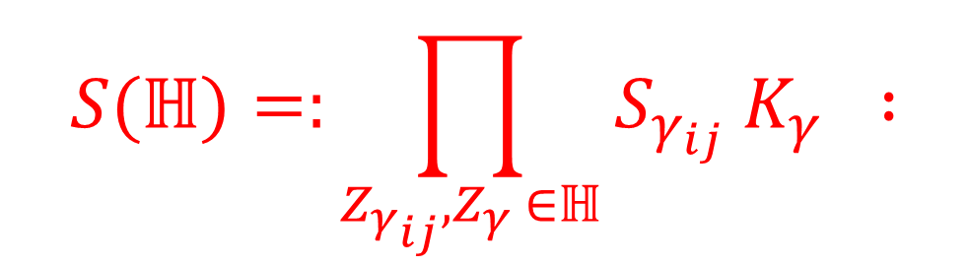

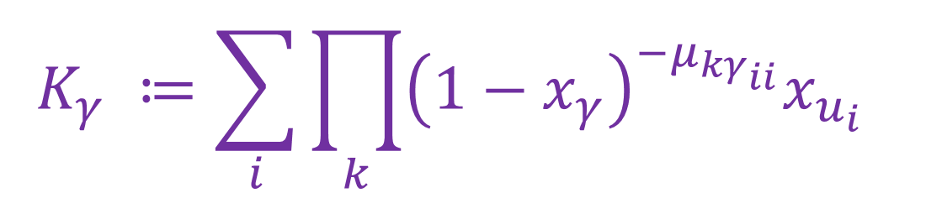
Wall-Crossing Formula With Twisted Masses: 2/3
$∀ i≠j$& $γ_{ij}∈Γ_{ij}$
$$S_{γ_{ij}}:=1+μ_{γ_{ij}} x_{γ_{ij}}$$
$$K_{γ} ≔\sum_{i}{{\prod_{k}{{\left(1−x_{γ}\right)}^{−μ_{kγ_{ii}}}x_{u_{i}}} }^{ }}$$
$$u_{i}∈Γ_{ii}$$
$$∀ γ∈Γ$$
Additive identity
For any half-plane $ℍ⊂ℂ$
$$S(ℍ)=:\prod_{Z_{γ_{ij}}, Z_{γ} ∈ℍ}{S_{γ_{ij}} K_{γ} : }$$
Phase-ordered product

Slide 32
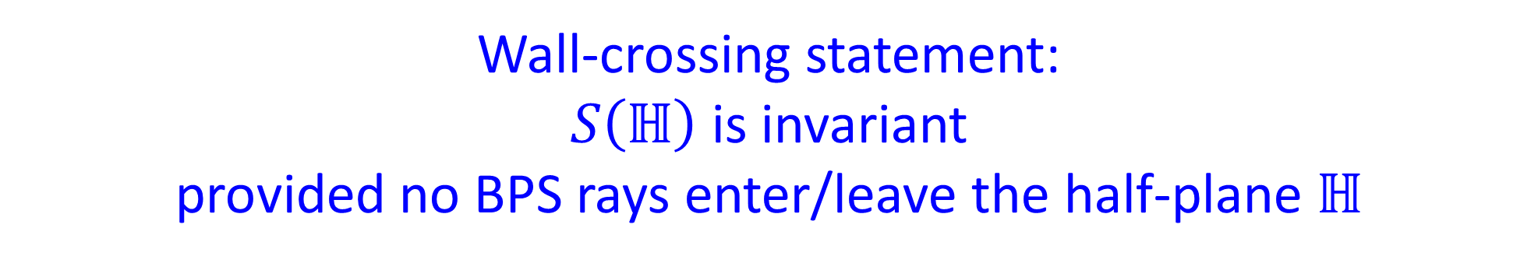
Wall-Crossing Formula With Twisted Masses: 3/3
Wall-crossing statement:
$S\left(ℍ\right)$ is invariant
provided no BPS rays enter/leave the half-plane $ℍ$
Very similar to the mathematics of the 2d-4d WCF.
[Kontsevich,Soibelman 2008; Gaiotto,Moore,Neitzke 2010]

Slide 33
Supersymmetric Quantum Mechanics And Homological algebra
1
2
2D N=(2,2) Landau-Ginzburg Models
3
Thimble Branes & Their Local Operators
4
Categorical Wall-Crossing
5
Generalization To Twisted Masses
6
Relation To 3d Indices

Slide 34


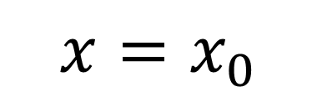
Branes
Use the ($A_{∞}$algebra/category of) Branes.
$$𝔅$$
The homotopy class of the category of branes is invariant.
$$x=x_{0}$$

Slide 35






Lefshetz Thimbles
Choose a half plane $ℍ$and phase $ζ .$
For each vacuum $φ_{i}$ there is a canonical brane $𝔗_{i}$
Consider all v$alues φ\left(x_{0}\right)∈X$so there is a solution
$$\frac{∂φ^{I}}{∂x}=i ζg^{I\overline{J}}{\overline{α}}_{\overline{J}}$$
$$φ\left(x_{0}\right)→φ_{i}$$
$$ℒ_{i}^{right}\left(ζ\right)⊂X$$
$$x→+∞$$
$ℒ_{i}^{right}\left(ζ\right)⊂X$are Lagrangian subspaces and provide
nice half-susy bc’s. [Hori-Iqbal-Vafa]

Slide 36

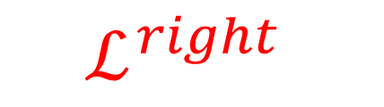

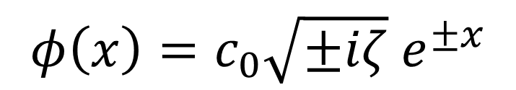
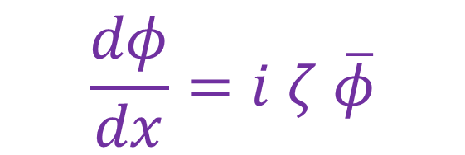



Example 1 of Lefshetz Thimbles
$$W=\frac{1}{2}φ^{2}$$
$$\frac{dφ}{dx}=i ζ \overline{φ}$$
$$φ_{i}=0$$
$$ℒ^{right}$$
$$φ\left(x\right)=c_{0}\sqrt{±iζ} e^{±x}$$
$$ℒ^{left}$$
$$c_{0}∈ℝ$$

Slide 37
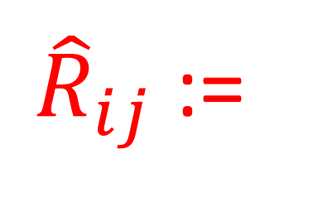





Boundary Condition-Changing Local Operators
Choose a half-plane $ℍ⊂ℂ,$and a phase $ζ$
${\hat{R}}_{ij}$:=
Vector space of local bc changing operators between $𝔗_{j}\left(ζ\right)$ and $𝔗_{i}(ζ)$
$$𝔗_{i}$$
${\hat{R}}_{ij}$is a chain complex
$$𝔗_{j}$$

Slide 38



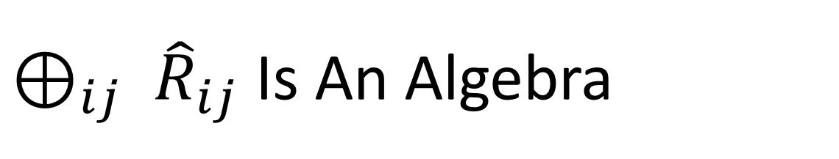



${⊕_{ij} \hat{R}}_{ij}$ Is An Algebra
$$𝔗_{i}$$
$$𝔗_{i}$$
$$𝔗_{j}$$
$$ρ_{ijk}^{\left(2\right)}:{\hat{R}}_{ij}⊗{\hat{R}}_{jk}→{\hat{R}}_{ik}$$
$$𝔗_{k}$$
$$𝔗_{k}$$

Slide 39



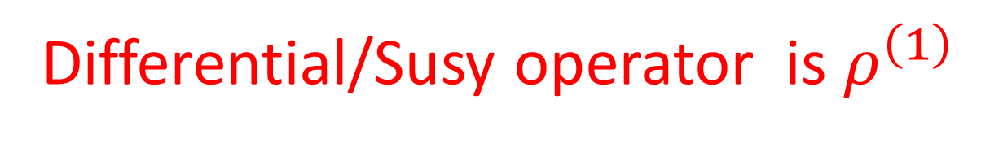






${⊕_{ij} \hat{R}}_{ij}$ has higher ``OPE Products’’
$$i$$
$$i$$
$$ρ^{\left(n\right)}\left(δ_{1}, …, δ_{n}\right)$$
$$j$$
$$j$$
Differential/Susy operator is $ρ^{\left(1\right)}$

Slide 40

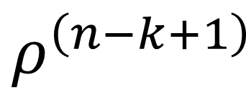
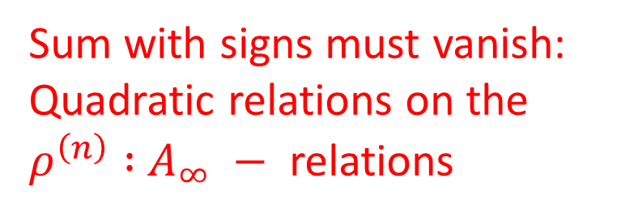
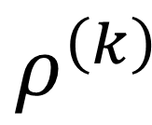
$⊕_{ij} {\hat{R}}_{ij}$ Is An $A_{∞}−$Algebra
$$ρ^{\left(k\right)}$$
$$ρ^{\left(n−k+1\right)}$$
Sum with signs must vanish: Quadratic relations on the $ρ^{\left(n\right)} :$ $A_{∞} −$ relations

Slide 41







Web Formalism ($α=∂W )$
These multiplications can be constructed explicitly using the ``web formalism’’ of GMW.
$$𝔗_{i}$$
$$i$$
$$𝔗_{j}$$
$$j$$
$$k$$
$$𝔗_{k}$$

Slide 42
Sources For The Web Formalism
Only 51 pages !!!

Slide 43


There is a notion of homotopy equivalence
of $A_{∞}$ -algebras.
It extends the notion of homotopy equivalence
of chain complexes, and says how the OPE’s are related to each other.
Categorical wall-crossing will involve the homotopy equivalence of these $A_{∞}−$algebras.

Slide 44










An $A_{∞}−$ Category $\hat{R}$ (When $α=∂ W )$
Choose $ζ, ℍ⊂ℂ$
Objects = thimbles
$$𝔗_{i}$$
$${\hat{R}}_{ij}$$
$$Z_{ij}∈ℍ$$
$$Hop\left(𝔗_{i}, 𝔗_{j}\right)=$$
$$ℤ$$
$$i=j$$
$$0$$
$$Z_{ij}∉ℍ$$

Slide 45




The Product Formula ($α=∂W )$
${\hat{R}}_{ij}$ can be written in terms of $R_{ij}$ [GMW]
$$\hat{R}≔⊕_{ij}{\hat{R}}_{ij} e_{ij}$$
$$=⊗_{Z_{ij}∈ℍ } \left(ℤ 1+R_{ij}e_{ij}\right)$$
phase ordered!
$${\hat{R}}_{ik}=R_{ik}⊕R_{ij}⊗R_{jk}⊕⋯$$

Slide 46












$${\hat{R}}_{ik} =R_{ik} ⊕ R_{ij}⊗R_{jk}⊕⋯$$
$$ℍ$$
$$i$$
$$∥Z_{ij}$$
$$i$$
$$∥Z_{ik}$$
$$⊕$$
$$j$$
$$⊕⋯$$
$$k$$
$$k$$
$$∥Z_{jk}$$
Summands correspond to sequences of central
charges $Z_{i,i_{1}}, Z_{i_{1},i_{2}}, …, Z_{i_{n},k}$ whose phases are clockwise ordered in the half plane $ℍ$

Slide 47

Naïve Differential On ${\hat{R}}_{ik}$
$${\hat{R}}_{ik}=R_{ik}⊕R_{ij}⊗R_{jk}⊕⋯$$
$${{\hat{Q}}^{naive}}_{ }=Q_{ik}⊕ \left( Q_{ij}⊗1+1⊗Q_{jk} \right)⊕ ⋯$$
PHYSICALLY WRONG!
We missed important instanton effects

Slide 48













Domain Wall Junctions: $ζ−$instanton equation
$$\left(\frac{∂}{∂x}+i\frac{∂}{∂τ}\right)φ^{I}=i ζ g^{I\overline{J}} {\overline{α}}_{\overline{J}}\left(φ\right)$$
$$φ_{ij}\left(x\right)$$
$${∥ Z}_{ij}$$
$$φ≅φ_{i}$$
$${∥ Z}_{ki }$$
$$φ≅φ_{j}$$
Note: $Z_{ij}, Z_{jk} , Z_{ki}$ clockwise ordered….
$$φ_{ki}\left(x\right)$$
$$φ≅φ_{k}$$
$${∥ Z}_{jk}$$
$$x+i τ$$
$$φ_{jk}\left(x\right)$$

Slide 49
Explicit examples studied in
S. M. Carroll, S. Hellerman and M. Trodden, “Domain wall junctions are 1/4 - BPS states,” Phys. Rev. D 61, 065001 (2000) [hep-th/9905217].
G. W. Gibbons and P. K. Townsend, “A Bogomolny equation for intersecting domain walls,” Phys. Rev. Lett. 83, 1727 (1999) [hep-th/9905196].
H. Oda, K. Ito, M. Naganuma and N. Sakai, “An Exact solution of BPS domain wall junction,” Phys. Lett. B 471, 140 (1999) [hep-th/9910095].

Slide 50


Interior Amplitude
$$φ_{ij} ⊗φ_{jk} ⊗φ_{ki} ∈R_{ij}⊗R_{jk}⊗R_{ki}$$
Counting solutions defines an ``interior amplitude’’
$β_{ijk}∈R_{ij}⊗R_{jk}⊗R_{ki}$
Summing over all such cyclic fans defines an $L_{∞}−$algebra
$R_{c}= ⊕_{cyclic fans} R_{i_{1}i_{2}}⊗⋯ ⊗R_{i_{n}i_{1}}$
$β$ is a Maurer-Cartan element in an $L_{∞}$algebra.
(generalizes the ``broken flows identity.’’ )

Slide 51
Supersymmetric Quantum Mechanics And Homological algebra
1
2
2D N=(2,2) Landau-Ginzburg Models
3
Thimble Branes & Their Local Operators
4
Categorical Wall-Crossing
5
Generalization To Twisted Masses
6
Relation To 3d Indices

Slide 52




Categorical Wall-Crossing ($α=∂W)$
IF:
${\left(X, g_{I\overline{J}}, α, ζ\right)}_{1} ∼$ ${\left(X, g_{I\overline{J}}, α, ζ\right)}_{2}$
THEN:
$$\hat{R}{\left(X, g_{I\overline{J}}, α, ζ\right)}_{1}∼\hat{R}{\left(X, g_{I\overline{J}}, α, ζ\right)}_{2}$$
$⇒$ how the $R_{ij}$complexes change (up to h.e.)

Slide 53








$$Z$$
$$Z$$
$$Z_{ij}$$
$$Z_{jk}$$
$$Z_{ik}$$
$$Z_{ik}$$
$$Z_{ij}$$
$$Z_{jk}$$

Slide 54






Definition: Cones In Homological Algebra
If $f:𝒞_{1}→𝒞_{2}$is a chain map
$𝒞_{1} ≔\left(V_{1},F_{1},Q_{1}\right)$
$𝒞_{2} ≔\left(V_{2},F_{2},Q_{2}\right)$
Then $Cone\left(f\right)$ is the new chain complex with
$$Q_{Cone\left(f\right)}=\left(\begin{matrix}Q_{2} & f \\ 0 & −Q_{1}\end{matrix}\right)$$
$$V ≔V_{2}⊕V_{1}\left[−1\right]$$

Slide 55


Interior Amplitude Induces A Chain Map
$$β_{ijk} ∈R_{ij}⊗R_{jk}⊗R_{ki}$$
$CPT⇒∃$ (deg=-1) contraction: $K:R_{ij}⊗R_{ji}→ℤ$
Chain map:
$$M\left(β_{ijk}\right):R_{ik}→R_{ij}⊗R_{jk}$$
Corrects ${\hat{Q}}^{naive}$: off-diagonal component of differential on ${\hat{R}}_{ik}$
$M\left(β_{ijk}\right)=$ ${\hat{Q}}_{ik}:R_{ik}→R_{ij}⊗R_{jk}$

Slide 56






$$Z_{ij}∥Z_{jk}$$
Defines a chain map
Defines a chain map
$$M^{L}\left(β_{ijk}\right):R_{ik}^{L}[1]→R_{ij}^{L}⊗R_{jk}^{L}$$
$$M^{R}\left(β_{ikj}\right):R_{ij}^{R}⊗R_{jk}^{R}→R_{ik}^{R}$$

Slide 57


Solving Cat. Wall Crossing For $α=∂W$
An elegant way of solving the wall-crossing constraint
$$R_{ik}^{R}∼Cone\left(M^{L}\left(β_{ijk}\right):R_{ik}^{L}[1]→R_{ij}^{L}⊗R_{jk}^{L}\right)$$
$$R_{ik}^{L}∼Cone\left(M^{R}\left(β_{ikj}\right):R_{ij}^{R}⊗R_{jk}^{R}→R_{ik}^{R} \right)$$
Conversely, if ${\hat{R}}^{L}∼{\hat{R}}^{R}$ then, up to homotopy,
$R_{ik}^{L}$ and $R_{ik}^{R}$
are related by cone constructions as above

Slide 58
$$R_{ik}^{R}∼Cone\left(M^{L}\left(β_{ijk}\right):R_{ik}^{L}[1]→R_{ij}^{L}⊗R_{jk}^{L}\right)$$
$$R_{ik}^{L}∼Cone\left(M^{R}\left(β_{ikj}\right):R_{ij}^{R}⊗R_{jk}^{R}→R_{ik}^{R} \right)$$
Taking Euler characters gives the Cecotti-Vafa wall-crossing formula:
$$μ_{ik}^{R}=μ_{ik}^{L}+μ_{ij}^{L} μ_{jk}^{L}$$
$$μ_{ik}^{L}=μ_{ik}^{R} −μ_{ij}^{R}μ_{jk}^{R}$$

Slide 59



Cecotti-Vafa Cones
How do they generalize to the case with twisted masses?

Slide 60
Supersymmetric Quantum Mechanics And Homological algebra
1
2
2D N=(2,2) Landau-Ginzburg Models
3
Thimble Branes & Their Local Operators
4
Categorical Wall-Crossing
5
Generalization To Twisted Masses
6
Relation To 3d Indices

Slide 61


Generalization To Twisted Masses
Work in progress with Ahsan Khan
Definition: A cyclic fan of charges is a cyclically-ordered set
$$\left\{ γ_{i_{0}i_{1}}, γ_{i_{1}i_{2}},…, γ_{i_{n}i_{0}}\right\}$$
So that the phases of $Z_{γ_{k,k+1}}$ are monotonically decreasing (clockwise)
New ingredient: Successive $Z_{γ_{k},γ_{k+1}}$can be parallel.

Slide 62











Representations Of (Irreducible) Webs
$$\left\{ γ_{i_{0}i_{1}}, γ_{i_{1}i_{2}},…, γ_{i_{n}i_{0}}\right\}$$
$$i_{k}≠i_{k+1}$$
Irreducible fans:
$$Z_{γ_{i_{n}i_{0}}}$$
$$Z_{γ_{i_{0}i_{1}}}$$
$$i_{0}$$
$$⋯$$
$$i_{1}$$
$$Z_{γ_{i_{1}i_{2} }}$$
$$⋯$$
$$i_{2}$$
$$R_{γ_{i_{0}i_{1}}}⊗R_{γ_{i_{1}i_{2}}}⊗⋯⊗R_{γ_{i_{n}i_{0}}}$$
GMW web formalism applies to give $L_{∞}$ algebra structure on the sum over all these pictures

Slide 63









Vertices For Generalized Webs
$$\left\{ γ_{i_{0}i_{1}}, {γ_{i_{1}i_{1}}, γ_{i_{1}i_{1}}, …, {2γ}_{i_{1}i_{1}}, … γ}_{i_{1}i_{2}},…, γ_{i_{n}i_{0}}\right\}$$
$$Z_{γ_{i_{n}i_{0}}}$$
$$Z_{γ_{i_{0}i_{1}}}$$
$$i_{0}$$
$Z_{γ_{i_{1}i_{1}}}$, $Z_{γ_{i_{1}i_{1}}},{…, Z}_{2γ_{i_{1}i_{1}}} , …$
$$i_{1}$$
$$⋯$$
$$i_{1}$$
$$Z_{γ_{i_{1}i_{2} }}$$
$$i_{2}$$

Slide 64







Representations Of Generalized Webs
$$\left\{ γ_{i_{0}i_{1}}, {γ_{i_{1}i_{1}}, γ_{i_{1}i_{1}}, …, {2γ}_{i_{1}i_{1}}, …, γ}_{i_{1}i_{2}},…, γ_{i_{n}i_{0}}\right\}$$
$ℱ_{γ_{jj}}≔$ Graded Fock space on $R_{γ_{jj}}$
$$i≠j≠k≠i$$
$$ℱ_{γ_{ij},γ_{jk}} ≔⊗_{γ_{ij}<γ_{jj} <γ_{jk} } ℱ_{γ_{jj}}$$
$$i$$
$$j$$
$$j$$
$$k$$

Slide 65

$$R_{c}= ⊕_{\left\{γ_{i_{0}i_{1}}, …., γ_{i_{n}i_{0}}\right\} irred}$$
$$ℱ_{γ_{i_{n}i_{0}},γ_{i_{0}i_{1}}}⊗R_{γ_{i_{0}i_{1}}}⊗⋯⊗ℱ_{γ_{i_{n−1}i_{n}}, γ_{i_{n}i_{0}}}⊗R_{γ_{i_{n}i_{0}}}$$
Conjecture: Has a natural $L_{∞}$structure associated with generalized webs.
Checked in several special cases.

Slide 66



$A_{∞} −$ Category Of Branes
${\hat{R}}_{ij}≔$Sum over all half-plane fans with
Fock spaces of periodic jj solitons
inserted between factors $R_{γ_{ij}}$ and $R_{γ_{jk}}$
Conjecture: $\left(\hat{R}, R_{c}\right)$ has the structure of an
$LA_{∞}$-category (= open closed homotopy category)

Slide 67















Example: Mirror Of $ℂℙ^{1}$
$$α=\left(\frac{t}{φ^{2}} +\frac{m}{φ} +t \right)d φ$$
$$φ∈{X= ℂ}^{∗}$$
Two vacua: $φ_{i} \& φ_{j}$ & $Γ=ℤγ$ is rank one.
$$Z_{γ}$$
Peacock pattern
$ℍ=$UHP
$$Z_{γ_{ij}+nγ}$$
$$Z_{γ_{ji}+mγ}$$
$$⋯$$
$$⋯$$
$$Z_{γ_{ji}+2γ}$$
$$Z_{γ_{ij}+γ}$$
$$⋯$$
$$⋯$$
$$Z_{γ_{ji}+γ}$$
$$Z_{γ_{ij}}$$

Slide 68



$$Z_{γ}$$
$ℍ=$UHP
$$Z_{γ_{ij}+nγ}$$
$$Z_{γ_{ji}+mγ}$$
$$⋯$$
$$⋯$$
$$Z_{γ_{ji}+2γ}$$
$$Z_{γ_{ij}+γ}$$
$$⋯$$
$$⋯$$
$$Z_{γ_{ji}+γ}$$
$$Z_{γ_{ij}}$$
$$\hat{R}=$$
$$⊗_{\left(n=0\right)}^{∞} \left(\begin{matrix}ℤ & R_{γ_{ij}+nγ} \\ 0 & ℤ\end{matrix}\right)⊗_{k≥1}\left(\begin{matrix}ℱ\left[R_{kγ_{ii}}\right] & 0 \\ 0 & ℱ\left[R_{kγ_{jj}}\right]\end{matrix}\right)⊗_{n=∞}^{1}\left(\begin{matrix}ℤ & 0 \\ R_{γ_{ji}+nγ} & ℤ\end{matrix}\right)$$

Slide 69
Supersymmetric Quantum Mechanics And Homological algebra
1
2
2D N=(2,2) Landau-Ginzburg Models
3
Thimble Branes & Their Local Operators
4
Categorical Wall-Crossing
5
Generalization To Twisted Masses
6
Relation To Three-Dimensional SQFT

Slide 70

RELATION TO 3D INDEX
With nontrivial input from Andy and Tudor

Slide 71



Motivation
Recent striking conjecture by Garoufalidis, Gu, and Marino,
``Peacock Patterns And Resurgence In Complex Chern-Simons Theory’’
They observed a relation between the 3d index
$$I_{T}\left(q,x\right)=Tr_{ℋ_{T}}{\left(−1\right)}^{F}q^{\frac{1}{2}R+j_{3}} x^{e}$$
$T: 3d$SUSY class R theory associated
with a hyperbolic knot complement $T\left(M_{K}\right)$
and Stokes matrices related to
thimbles in complex Chern-Simons theory on $M_{K}$

Slide 72
We give it a natural context and state a conjecture about PDE’s (Kapustin-Witten equations)
which implies the GGM conjecture.
In fact, the conjecture has been stated before by Victor Mikhaylov (2017) for different reasons.

Slide 73




$$T\left(M_{3}\right)$$
$T\left(M_{3}\right)$is a theory obtained by reduction of 6d (2,0) on $M_{3}$
with topological twist (class R)
[Dimofte, Gaiotto, Gukov; Terashima-Yamazaki]
Consider $T\left(M_{3}\right)$on $𝒞×ℝ_{t}$
With ``holomorphic-topological twist’’ [Witten; Oh-Yagi] we can identify the index $I_{T}\left(q,x\right)$with the trace over the
Q-cohomology of local operators at the tip of the cigar.

Slide 74



KK Reduction of Cigar $⇒$ LG model With A Brane
Get a LG theory on half space with boundary condition $𝔅_{Cigar}$
$Q−$closed local operators on $𝒞×ℝ_{t}$
Boundary operators for $𝔅_{cigar}$
$$I_{T\left(M_{3}\right)}\left(q,x\right)=Tr_{Hop\left(𝔅_{cigar}, 𝔅_{cigar}\right)} {\left(−1\right)}^{F}q^{J_{1}} x^{J_{2}}$$

Slide 75













LG Model = CSLG$\left[M_{3}\right]$
$6d \left(2,0\right)/$ $M_{3}×𝒞×ℝ_{t}$
$$U{\left(1\right)}_{𝒞}$$
$$M_{3}$$
$T\left[M_{3}\right]/$ $𝒞×ℝ_{t}$
$5D SYM/$ $M_{3}×ℝ_{+}×ℝ_{t}$
$$U{\left(1\right)}_{𝒞}$$
$$M_{3}$$
$LG/$ $ℝ_{+}×ℝ_{t}$
$$≅$$
$CSLG\left[M_{3}\right]/$ $ℝ_{+}×ℝ_{t}$
$$𝔅_{cigar}$$
$$𝔅_{Nahm}$$

Slide 76






Relation to KW Equations With Nahm bc’s.
$$U{\left(1\right)}_{𝒞}$$
$6d \left(2,0\right)$ / $M_{3}×𝒞×ℝ_{t}$
5d SYM / $M_{3}×ℝ_{+}×ℝ_{t}$
$$ds^{2}= g_{IJ}\left(x\right)dx^{I}dx^{J}+dy^{2}+dt^{2}$$
Witten: BPS equations = KW equations for $𝒜$on $M_{3}×ℝ_{+}$
$$Im(𝒜^{a})=\frac{e^{a}}{y}+𝒪\left(1\right) Re\left(𝒜^{a}\right)=ω^{a} +𝒪\left(y\right)$$
$$y→0$$
$e^{a}, ω^{a} :$ Dreibein and spin connection
for Riemannian metric on $M_{3}$ & $G_{c}=SL\left(2,ℂ\right)$

Slide 77





Nahm = $∑$ Chan-Paton $×$ Lefshetz
Vacua of $CSLG[M_{3}]$ : Flat connections $σ_{i}$
$$𝔅_{Nahm}≅ \sum_{i}{ ℰ_{σ_{i}} 𝔗_{σ_{i}}}$$
KW equations with $𝒜_{y}=0$ are the $ζ−$soliton equations for $CSLG[M_{3}]$
Chan-Paton complex $ℰ_{σ_{i}}\left(𝔅_{Nahm}\right)$ is M$SW$for
KW & Nahm bc’s $@ y→0$ & $𝒜→σ_{i} @$ $y→∞$

Slide 78



$${𝒪= \left(−1\right)}^{F}q^{J_{1}} x^{J_{2}}$$
$$Tr_{Hop\left(𝔅_{cigar}, 𝔅_{cigar}\right)}𝒪=\sum_{i}{Tr_{ℰ_{σ_{i}}}𝒪_{ }× Tr_{Hop\left(𝔗_{σ_{i}},𝔗_{σ_{j}}\right)}𝒪_{ }× Tr_{ℰ_{σ_{j}}}𝒪_{ } }$$
$$Tr_{Hop\left(𝔗_{σ_{i}}, 𝔗_{σ_{j}}\right)} 𝒪=S_{σ_{i}, σ_{j}}\left(q,x\right)$$
Stokes matrices for
Chern-Simons thimbles

Slide 79





Specialize to Hyperbolic Knot Complement
$M_{3}=M_{K}$ knot complement in $S^{3}$ of a hyperbolic knot.
Among flat $SL\left(2,ℂ\right)$ connections on $M_{K}$there is a distinguished one: $σ_{1}$
$σ_{1}:$corresponds to the complete hyperbolic metric.
$$𝒜= ω+i e$$
$$ℤ$$
$$σ_{i}=σ_{1}$$
Conjecture:
$$ℰ_{σ_{i}}\left(𝔅_{Nahm}\right)≅$$
$$0$$
Else

Slide 80



Interesting Generalization
$L:$ Colored (by reps of SL(2) ) link in $M_{3}$
Witten: Modify Nahm boundary condition
in 5d SYM with ‘t Hooft line L
Corresponds to a brane $𝔅\left(L\right)$ in $CSLG\left[M_{3}\right]$
Up to homotopy equivalence,
it only depends on isotopy class of $L⊂M_{3}$

Slide 81

Potentially New Knot Invariants
Conjecture:
$a.)$The h.e. class of the ${ A}_{∞}−$category of $𝔅𝔯\left(CSLG\left(M_{3}\right)\right)$
is a 3-manifold invariant
b.) The h.e. class of $A_{∞}$ - algebras $Hop\left(𝔅\left(L\right), 𝔅\left(L\right)\right)$
are (new?) colored link invariants.

Slide 82

Conclusion
Using the framework of GMW we derived a categorified version of the Cecotti-Vafa WCF
The framework can be extended to the case with twisted masses. Here there are qualitatively new features
involving Fock spaces of periodic solitons.
This circle of ideas applied to CSLG[$M_{3}]$gives a natural framework for interpreting a recent striking conjecture of GGM, and moreover suggests potentially new colored link invariants.

