Slide 1
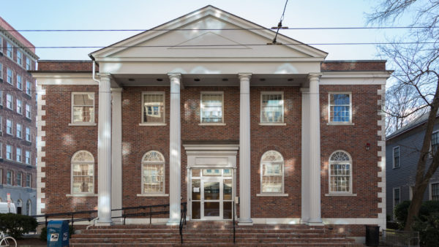
Summing Over Bordisms In TQFT
Gregory Moore
Rutgers
March 16, 2022

Slide 2

Work with
Anindya Banerjee
arXiv:2201.00903

Slide 3
1
Motivation
2
Reminders On TQFT
3
Summed & Total Amplitudes: Splitting Property
4
Example: $d=1$
5
Example: $d=2,$closed
6
Example: $d=2,$open-closed
7
Closed constrained boundaries & ensemble interpretation
8
$d≥3$: Comments
9
Summary & Some Open Problems

Slide 4

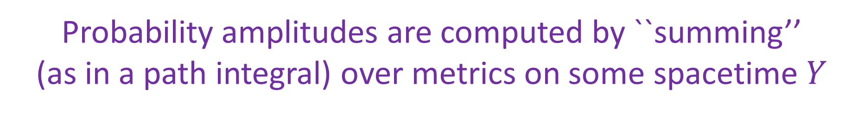
I. Motivation
A longstanding problem in quantum gravity:
Probability amplitudes are computed by ``summing’’
(as in a path integral) over metrics on some spacetime $Y$
$\exp{\{ −\frac{G_{N}}{16π^{2}}\int_{Y}{ℛ\left(g\right)vol\left(g\right)+ .. . }}$}
If we sum over metrics, should we also sum over topologies?

Slide 5
Summing Over Topologies In AdS/CFT:
Hawing-Page transition as
Confinement/Deconfinement in N=4 SYM
Poincare series/Rademacher expansion of elliptic genus of K3 as sum over topologies in AdS3/CFT2
Recent understanding of the ``Page curve’’ and
(no) ``information loss’’ via dominance of different
topologies related to BHs.

Slide 6
Summing Over Topologies In AdS/CFT:
Hawing-Page transition as
Confinement/Deconfinement in N=4 SYM
Poincare series/Rademacher expansion of elliptic genus of K3 as sum over topologies in AdS3/CFT2
Recent understanding of the ``Page curve’’ and
(no) ``information loss’’ via dominance of different
topologies related to BHs.

Slide 7
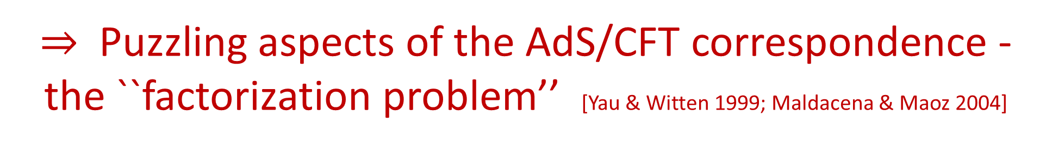
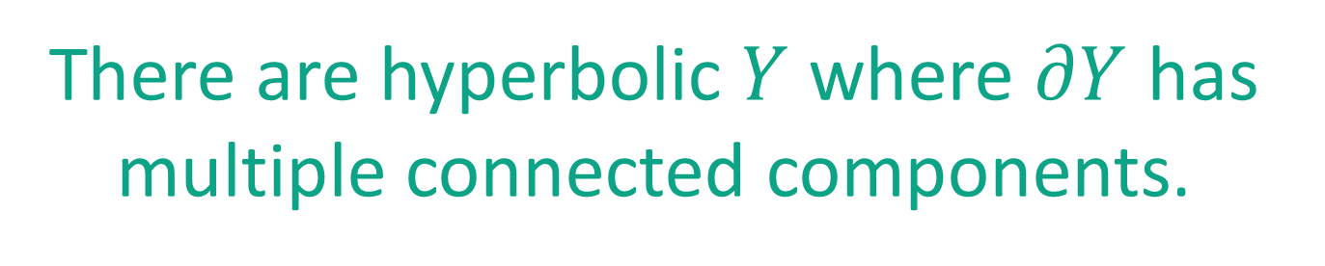
Puzzles In AdS/CFT
There are hyperbolic $Y$ where $∂Y$ has multiple connected components.
$⇒$Puzzling aspects of the AdS/CFT correspondence - the ``factorization problem’’ [Yau & Witten 1999; Maldacena & Maoz 2004]
Saad-Shenker-Stanford [1903.11115] identifies sum of topologies in``JT gravity’’ with a matrix model:
Raises conceptual questions about whether string theory
should be dual to an ensemble of QFTs.

Slide 8
Motivated by these issues, and the recent vigorous discussion in the quantum gravity community, D. Marolf and H. Maxfield recently [2002.08950] considered a curious
``topological model of 2d gravity.’’
An essential part of their discussion involved summing over topologies with disconnected components.
My project with Anindya Banerjee was motivated by the desire to understand the MM model in terms of standard TQFT.
I will comment on the MM paper more throughout the talk.

Slide 9
1
Motivation
2
Reminders On TQFT
3
Summed & Total Amplitudes: Splitting Property
4
Example: $d=1$
5
Example: $d=2,$closed
6
Example: $d=2,$open-closed
7
Closed constrained boundaries & ensemble interpretation
8
$d≥3$: Comments
9
Summary & Some Open Problems

Slide 10

II. Reminders On TQFT
Definition of a ``bordism’’
Let $X_{in}, X_{out}$ be smooth, compact manifolds of dimension $d−1.$
A bordism $Y:X_{in}→ X_{out}$ is:
A $d$-manifold $Y$together with a disjoint decomposition $∂Y={\left(∂Y\right)}_{in} \coprod{ {\left(∂Y\right)}_{out}}$
Diffeomorphisms ${\left(∂Y\right)}_{in}≅X_{in} \& {\left(∂Y\right)}_{out}≅X_{out}$
Embeddings $X_{in}×\left[0,1\right)→Y \& X_{out}×\left(−1, 0\right] →Y$
which reduce to the specified diffeos on the boundary of $Y$

Slide 11

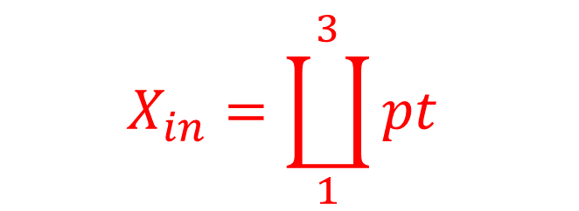


There are 105 such bordisms.
+ infinitely many more including disjoint unions with circles….
$$X_{in}=\coprod_{1}^{3}{pt }$$
$$X_{out}=\coprod_{1}^{5}{pt }$$
$$Y:$$
$$→$$

Slide 12

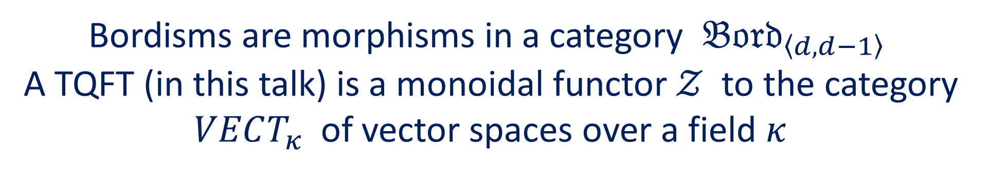
Bordisms are morphisms in a category $𝔅𝔬𝔯𝔡_{〈d,d−1〉}$
A TQFT (in this talk) is a monoidal functor $𝒵$ to the category
$VECT_{κ}$ of vector spaces over a field $κ$
$𝒵\left(X\right):$Vector space of ``states’’ for spatial manifold $X$
$𝒵(X_{1}\coprod{X_{2})≅ 𝒵\left(X_{1}\right)⊗𝒵\left(X_{2}\right) }$
$$Y:X_{in}→X_{out}$$
$$𝒵\left(Y\right)∈Hom\left(𝒵\left(X_{in}\right), 𝒵\left(X_{out}\right)\right)$$
$$𝒵\left(Y_{1}∘Y_{2}\right)=𝒵\left(Y_{1}\right)∘𝒵\left(Y_{2}\right)$$

Slide 13

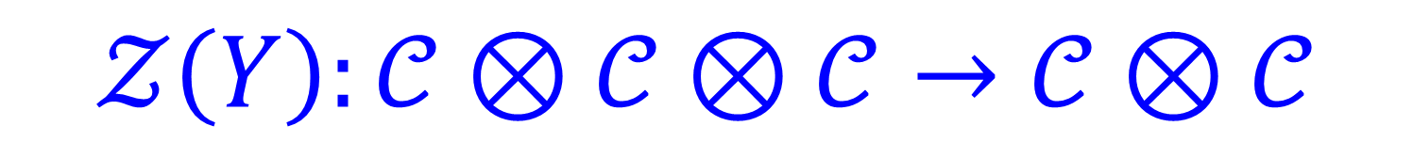

$$Y: S^{1}∐S^{1}∐S^{1}→ S^{1}∐S^{1}$$
$$𝒞≔𝒵\left(S^{1}\right)$$
$$𝒵\left(Y\right):𝒞⊗𝒞⊗𝒞→𝒞⊗𝒞$$

Slide 14
1
Motivation
2
Reminders On TQFT
3
Summed & Total Amplitudes: Splitting Property
4
Example: $d=1$
5
Example: $d=2,$closed
6
Example: $d=2,$open-closed
7
Closed constrained boundaries & ensemble interpretation
8
$d≥3$: Comments
9
Summary & Some Open Problems

Slide 15

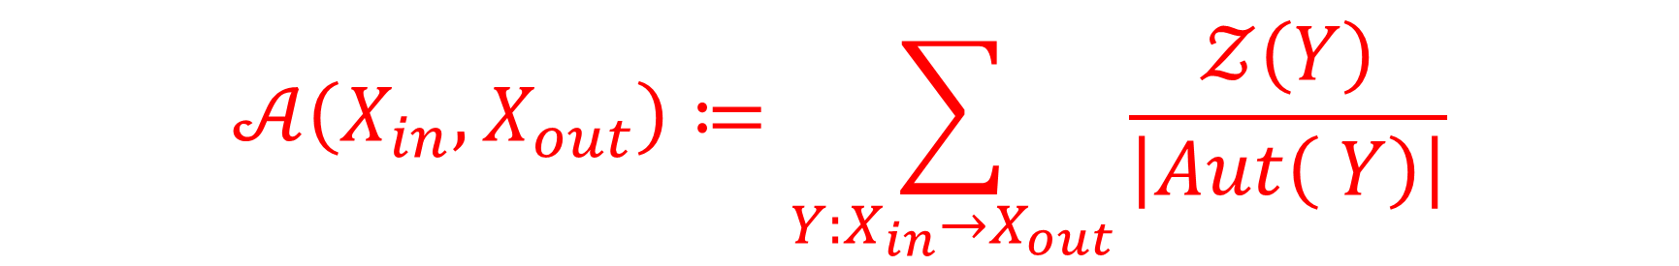
III. Summed & Total Amplitudes: Splitting Property
Recall we can have different bordisms between fixed $X_{in}$ and $X_{out}$
Given a TQFT $𝒵$ (the ``seed TQFT’’) define the ``summed amplitude’’
$$𝒜\left(X_{in}, X_{out}\right)≔\sum_{Y:X_{in}→X_{out}}{\frac{𝒵\left(Y\right)}{\left|Aut\left( Y\right)\right|}}$$
$Aut\left(Y\right):$Automorphism group of homeomorphism type restricting to the identity on the boundary.

Slide 16
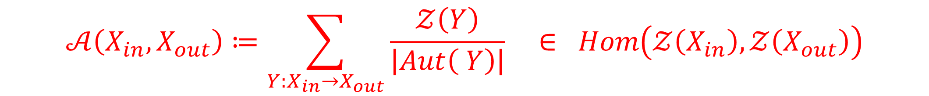
Some Questions:
$$𝒜\left(X_{in}, X_{out}\right)≔\sum_{Y:X_{in}→X_{out}}{\frac{𝒵\left(Y\right)}{\left|Aut\left( Y\right)\right|} ∈ Hom\left(𝒵\left(X_{in}\right), 𝒵\left(X_{out}\right)\right)}$$
1. Does it exist?
2. Is it computable?
3. What properties does it have ?
4. Extension to the fully local TQFT ?

Slide 17
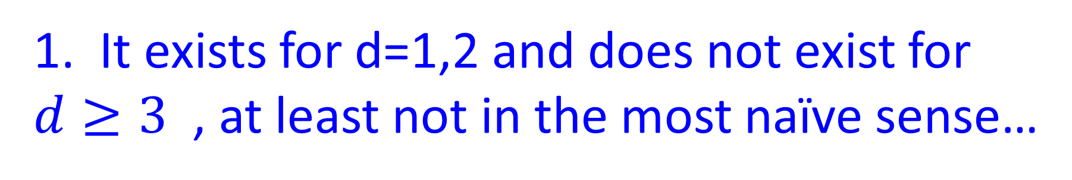
Some Answers:
1. It exists for d=1,2 and does not exist for $d≥3$ , at least not in the most naïve sense…
2. Yes, when it exists.
3. From explicit computations: Splitting Property
4. For d=2, this is the extension to open-closed TQFT.

Slide 18
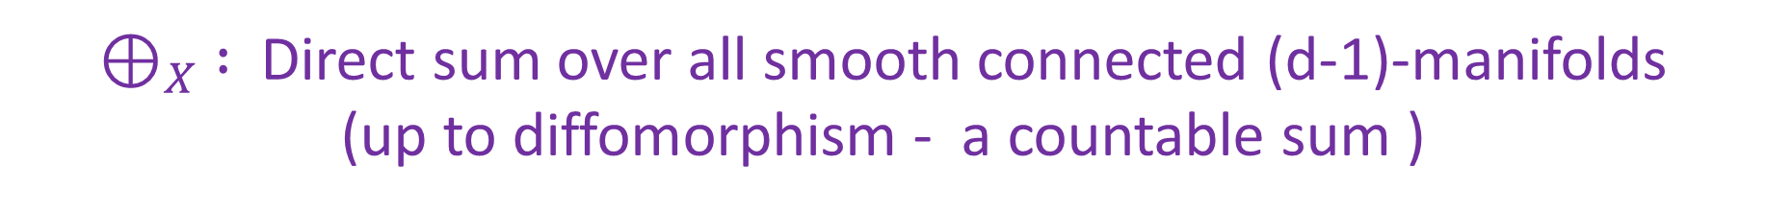
The Total Amplitude
Consider all summed amplitudes simultaneously as a linear transformation on the tensor algebra:
$$𝒜 ∈End\left( T^{∗}\left( ⊕_{X}𝒵\left(X\right)\right)\right)$$
$⊕_{X} :$ Direct sum over all smooth connected (d-1)-manifolds
(up to diffomorphism - a countable sum )
The summed amplitudes descend to
$\overline{𝒜} ∈End\left( S^{∗}\left( ⊕_{X}𝒵\left(X\right)\right)\right)$ $:=End\left(Fock\left(𝒵\right)\right)$

Slide 19

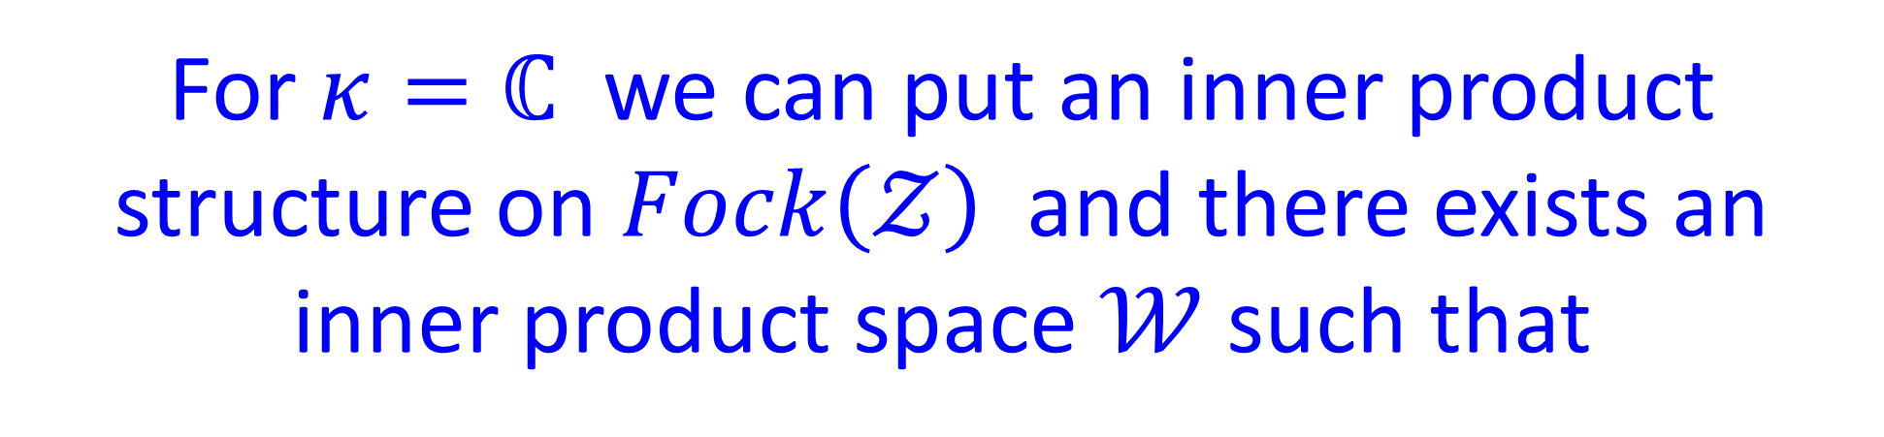
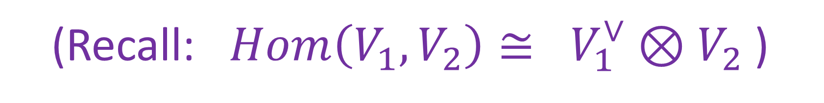
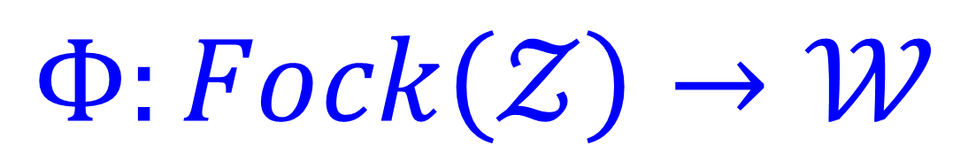
The Splitting Property
For $κ=ℂ$ we can put an inner product structure on $Fock\left(𝒵\right)$ and there exists an inner product space $𝒲$such that
$$\overline{𝒜}=ΦΦ^{∗}$$
$$Φ:Fock\left(𝒵\right)→𝒲$$
(Recall: $Hom\left(V_{1},V_{2}\right)≅ V_{1}^{∨}⊗V_{2}$)

Slide 20
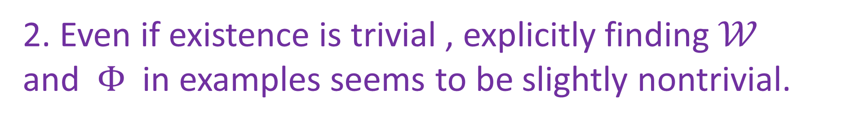

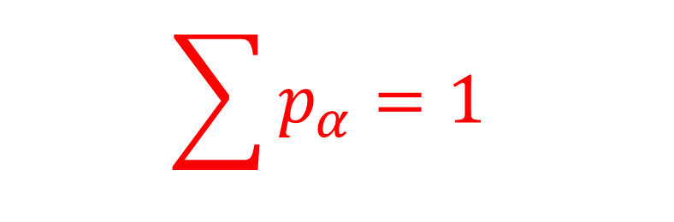
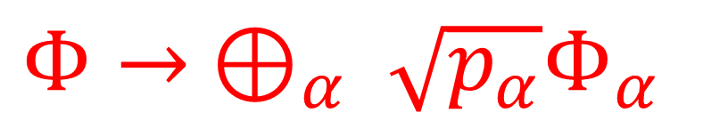
$$\overline{𝒜}=ΦΦ^{∗}$$
  1. $\overline{𝒜}$ need not be positive definite.
2. Even if existence is trivial , explicitly finding $𝒲$ and$Φ$ in examples seems to be slightly nontrivial.
3. $𝒲$ is not unique: $𝒲→ ⊕_{α} 𝒲_{α}$
$$\sum{p_{α}=1 }$$
$$Φ→ ⊕_{α} \sqrt{p_{α}}Φ_{α}$$

Slide 21
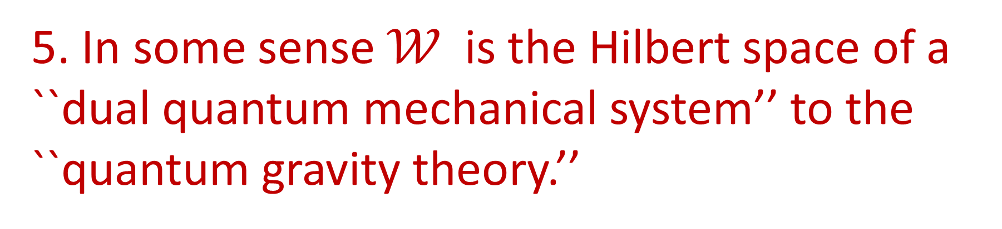


4. There might be a ``minimal $𝒲^{′′}$
5. In some sense $𝒲$is the Hilbert space of a ``dual quantum mechanical system’’ to the ``quantum gravity theory.’’
6. Reminiscent of the Stinespring theorem
and Hilbert $C^{∗}$ algebras.
7. Possible role for ``quantum mechanics with noncommutative amplitudes’’ 1701.07746 ?

Slide 22
1
Motivation
2
Reminders On TQFT
3
Summed & Total Amplitudes: Splitting Property
4
Example: $d=1$
5
Example: $d=2,$closed
6
Example: $d=2,$open-closed
7
Closed constrained boundaries & ensemble interpretation
8
$d≥3$: Comments
9
Summary & Some Open Problems

Slide 23
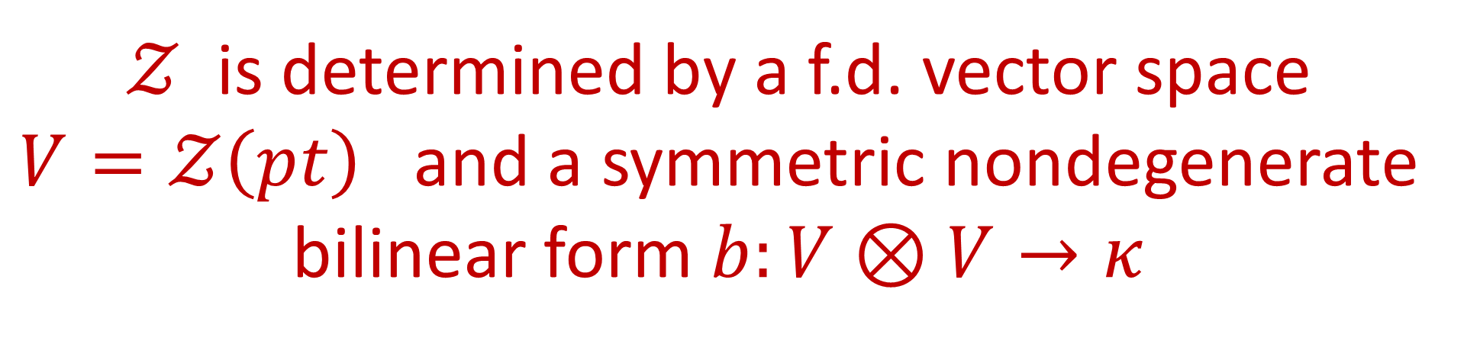
IV. Example: d=1, unoriented
$𝒵$ is determined by a f.d. vector space
$V=𝒵\left(pt\right)$ and a symmetric nondegenerate bilinear form $b:V⊗V→κ$

Slide 24


$$Fock\left(𝒵\right)=Fock\left(V\right)=S^{∗}V=κ⊕V⊕S^{2}V⊕⋯$$
Start with $X_{in}=X_{out}=∅$
$$𝒵\left(S^{1}\right)=\dim_{κ}{V }$$
$$𝒜\left(∅,∅\right)=\exp{\dim_{κ}{V }}$$

Slide 25



Nondegenerate $b ⇒$canonical isomorphisms
$$b^{∨}:V→V^{∨}$$
$$b_{∨}:V^{∨}→V$$
Applied to amplitudes $𝒜\left(n_{in}, n_{out}\right)$ they produce all $𝒜\left(n_{in}^{′}, n_{out}^{′}\right)$ with $n_{in}+n_{out}=n_{in}^{′}+n_{out}^{′}$

Slide 26
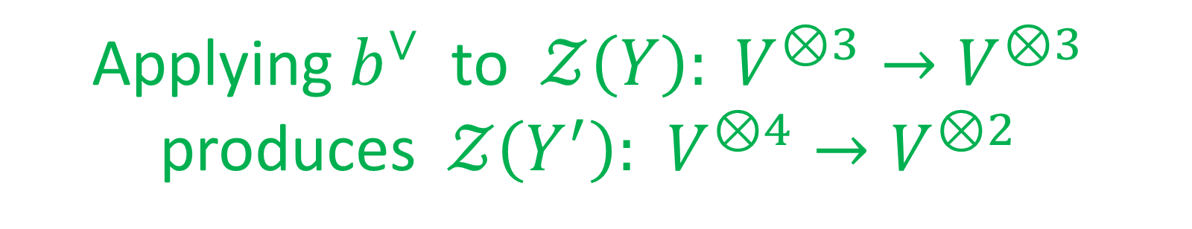
Applying $b^{∨}$ to $𝒵\left(Y\right): V^{⊗3}→V^{⊗3}$
produces $𝒵\left(Y^{′}\right):$ $V^{⊗4}→V^{⊗2}$

Slide 27


Hartle-Hawking Vector & Covector
HH vector: The sum of nothing to something:
$$\overline{𝒜}$$
$$κ↪Fock\left(𝒵\right) → Fock\left(𝒵\right) :1↦Ψ_{HH} ∈Fock\left(𝒵\right)$$
HH covector: The sum of anything to nothing:
$$\overline{𝒜}$$
$$Fock\left(𝒵\right)→Fock\left(𝒵\right)→κ : Ψ_{HH}^{∨}∈Hom\left(Fock\left(𝒵\right), κ\right)$$

Slide 28


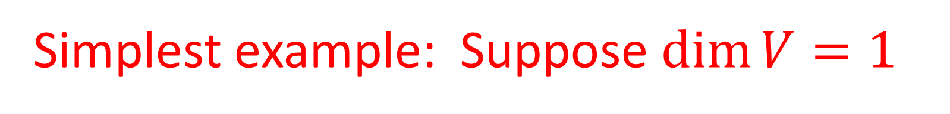


Simplest example: Suppose $\dim{V=1 }$
Take $κ=ℂ$ and choose $v$ with $b\left(v,v\right)=1$
$$Ψ_{HH}^{∨}=\exp\left(1\right) \sum_{n=0}^{∞}{\frac{\left(2n\right)!}{n!2^{n}} {\left(v^{∨}\right)}^{2n}}$$
$$+$$
$$+$$

Slide 29
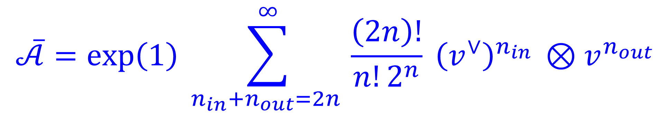
$$\overline{𝒜}=\exp\left(1\right) \sum_{n_{in}+n_{out}=2n }^{∞}{\frac{\left(2n\right)!}{n!2^{n}} {\left(v^{∨}\right)}^{n_{in} }⊗v^{n_{out}}}$$
$$∈S^{∗}V^{∨}⊗S^{∗}V≅End\left(Fock\left(V\right)\right)$$

Slide 30

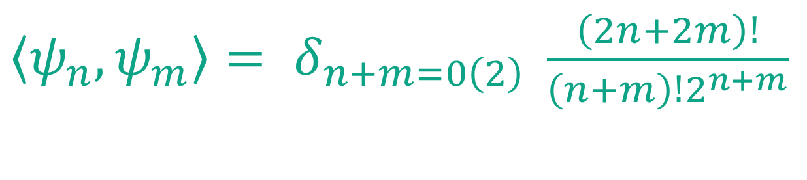
Splitting
$$\frac{\left(2n\right)!}{n!2^{n}}= \int{\frac{dh}{\sqrt{2π}} h^{2n} e^{−\frac{1}{2}h^{2}} }$$
Wick’s theorem:
$$ψ_{n}={\left(2π\right)}^{−\frac{1}{4}}h^{n}e^{−\frac{1}{4}h^{2}} ∈L^{2}\left(ℝ\right)=𝒲$$
${〈ψ_{n}, ψ_{m}〉= δ}_{n+m=0\left(2\right) }$ $\frac{\left(2n+2m\right)!}{\left(n+m\right)!2^{n+m}}$
$Φ=\exp\left(\frac{1}{2}\right)\sum_{n}{{\left(v^{∨}\right)}^{n}⊗ψ_{n}∈Hom\left(Fock\left(V\right), 𝒲\right) }$

Slide 31
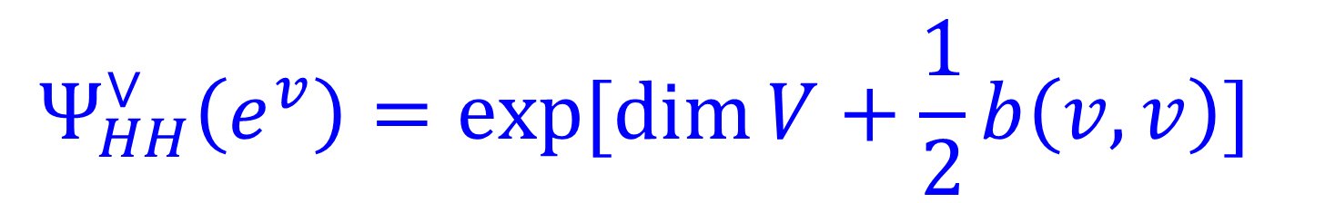
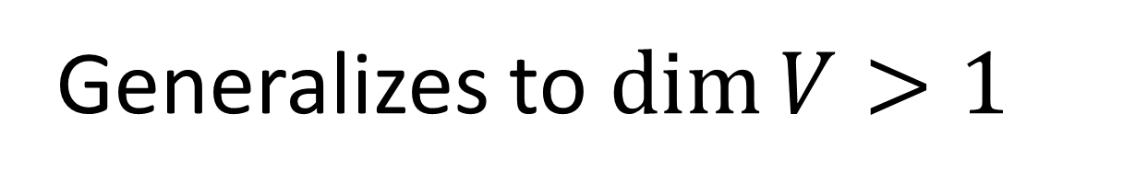


Generalizes to $\dim{V>1 }$
$$Ψ_{HH}^{∨}\left(e^{v}\right)=exp⁡[\dim{V+\frac{1}{2}b\left(v,v\right)] }$$
$$v∈V$$
Since $Ψ_{HH}^{∨}$ is multilinear & totally symmetric so completely
determined by values on the diagonal.
Various formulae presented in the literature
[MM, Gardiner-Megas] should be understood this way

Slide 32
1
Motivation
2
Reminders On TQFT
3
Summed & Total Amplitudes: Splitting Property
4
Example: $d=1$
5
Example: $d=2,$closed
6
Example: $d=2,$open-closed
7
Closed constrained boundaries & ensemble interpretation
8
$d≥3$: Comments
9
Summary & Some Open Problems

Slide 33
V. Example: d=2 & Oriented
Semisimple
Non-semisimple
Closed
Yes
Examples
Open-closed
Yes
????

Slide 34
$𝒵\left(S^{1}\right)=𝒞:$ f.d. commutative Frobenius algebra
[Friedan, Dijkgraaf, Segal,… ]
$$𝒵\left(Disk\right): θ_{𝒞}:𝒞→κ$$
$b\left(φ_{1},φ_{2}\right)=θ_{𝒞}\left(φ_{1}φ_{2}\right)$: Symmetric nondegenerate form
Open-closed case discussed later.

Slide 35


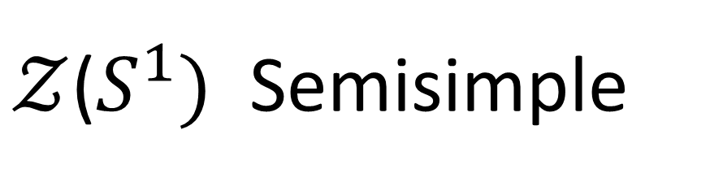

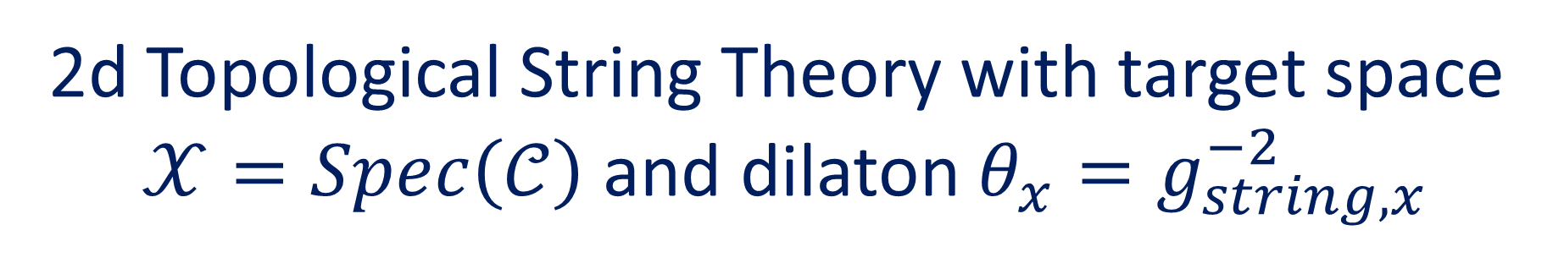
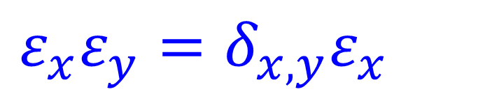
$𝒵$($S^{1})$ Semisimple
$$𝒞= ⊕_{x∈𝒳} 𝒞_{x}$$
$$= ⊕_{x∈𝒳}ℂε_{x}$$
$$ε_{x}ε_{y}=δ_{x,y}ε_{x}$$
$$θ\left(ε_{x}\right)=θ_{x} ∈κ^{∗}$$
2d Topological String Theory with target space
$𝒳=Spec\left(𝒞\right)$ and dilaton $θ_{x}=g_{string,x}^{−2}$

Slide 36
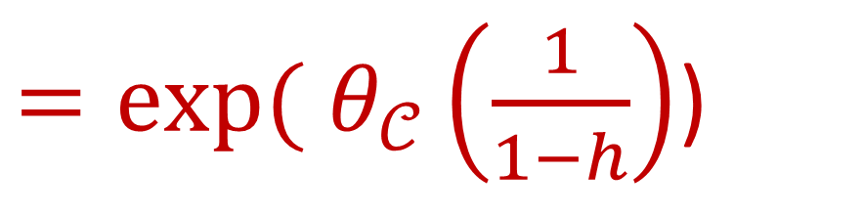
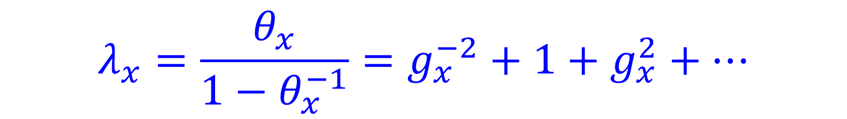
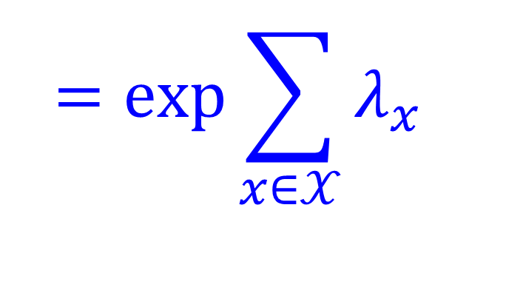
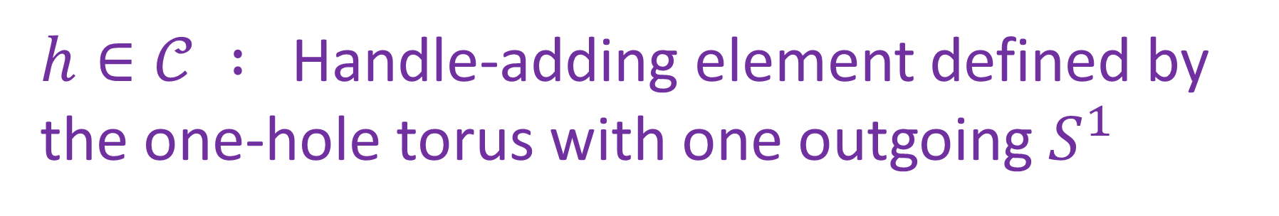
$$\overline{𝒜}\left(∅, ∅\right)=\exp\left( 𝒵\left(Y_{0}\right)+𝒵\left(Y_{1}\right)+⋯\right)$$
$$=\exp{\sum_{x∈𝒳}{λ_{x} }}$$
$=exp⁡( θ_{𝒞}\left(\frac{1}{1−h}\right)$)
$h∈𝒞 :$Handle-adding element defined by the one-hole torus with one outgoing $S^{1}$
$$λ_{x}=\frac{θ_{x}}{1−θ_{x}^{−1}}=g_{x}^{−2}+1+g_{x}^{2}+⋯$$

Slide 37
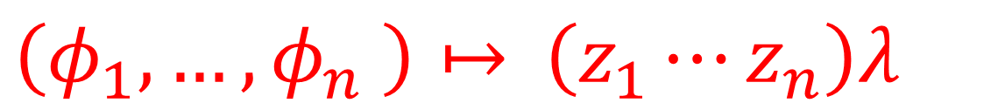
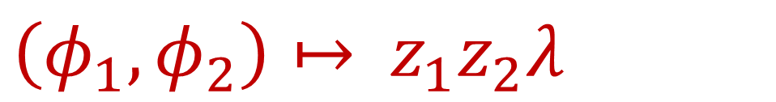



$$\overline{𝒜}\left(S^{1}∐S^{1}, ∅\right)\left(φ_{1}, φ_{2}\right)= ?$$
For simplicity: Take $\dim{𝒞=1 }$
$$φ_{1}=z_{1}ε, φ_{2}=z_{2}ε ∈𝒞$$
Bordisms with one connected component:
$\left(φ_{1},φ_{2}\right)↦$ $z_{1}z_{2}λ$
Bordisms with one connected component and $n$ ingoing circles:
$\left(φ_{1},…, φ_{n} \right)↦$ $\left(z_{1}⋯z_{n}\right)λ$

Slide 38

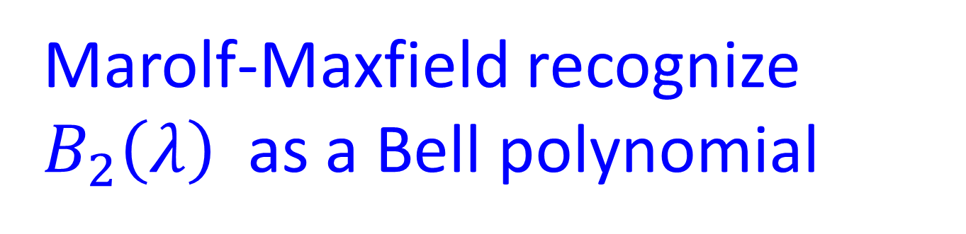
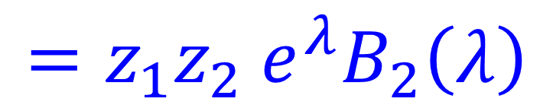
Returning to 2 ingoing circles: We can also have
bordisms with two connected components:
$$\left(φ_{1},φ_{2}\right)↦ z_{1}z_{2}λ^{2}$$
Altogether:
$\overline{𝒜}\left(2,0\right)\left(φ_{1}, φ_{2}\right)$ $=z_{1}z_{2} e^{λ}\left(λ+λ^{2}\right)$
Marolf-Maxfield recognize $B_{2}\left(λ\right)$ as a Bell polynomial
$$=z_{1}z_{2} e^{λ}B_{2}\left(λ\right)$$

Slide 39
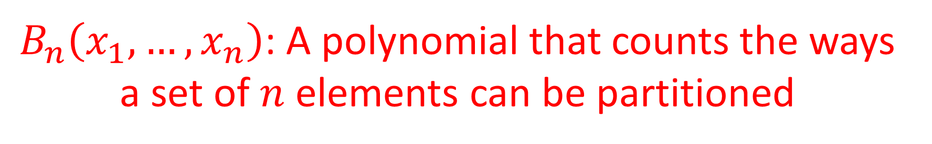

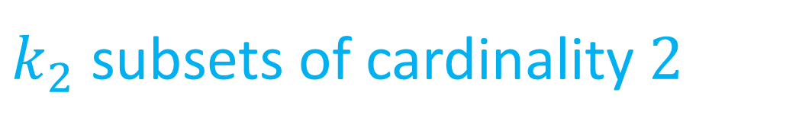
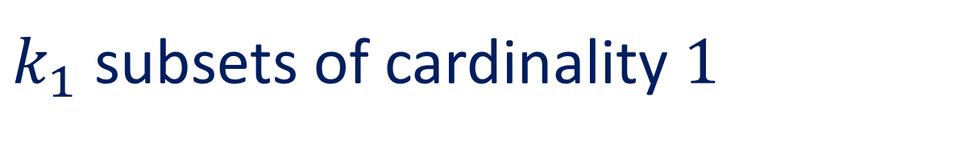
Bell Polynomials
$B_{n}\left(x_{1},…, x_{n}\right)$: A polynomial that counts the ways a set of $n$elements can be partitioned
Coefficient of $x_{1}^{k_{1}}x_{2}^{k_{2}}⋯$: counts disjoint decompositions with
$k_{1}$ subsets of cardinality $1$
Etc.
$k_{2}$ subsets of cardinality $2$
$$B_{n}\left(λ\right)≔B_{n}\left(λ, λ, …,λ\right)$$

Slide 40
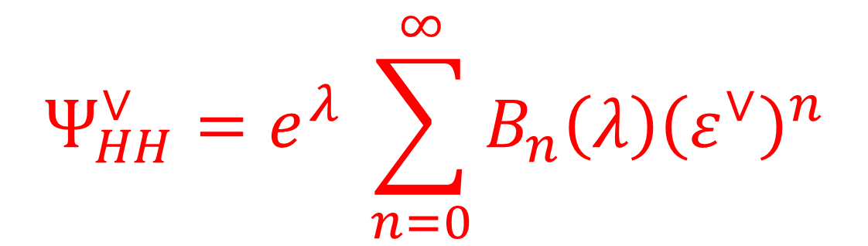
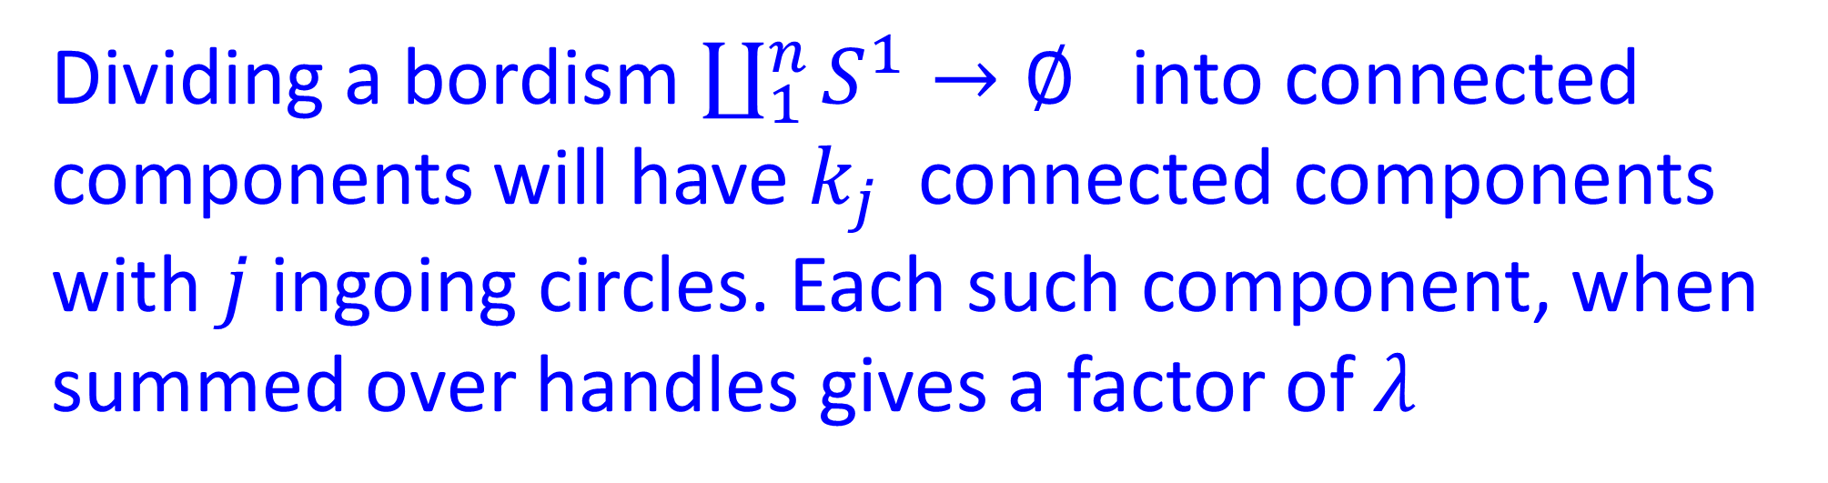
Dividing a bordism $\coprod_{1}^{n}{S^{1}→∅ }$into connected components will have $k_{j}$ connected components with $j$ingoing circles. Each such component, when summed over handles gives a factor of $λ$
Upshot is:
$$Ψ_{HH}^{∨}=e^{λ} \sum_{n=0}^{∞}{B_{n}\left(λ\right){\left(ε^{∨}\right)}^{n}}$$

Slide 41
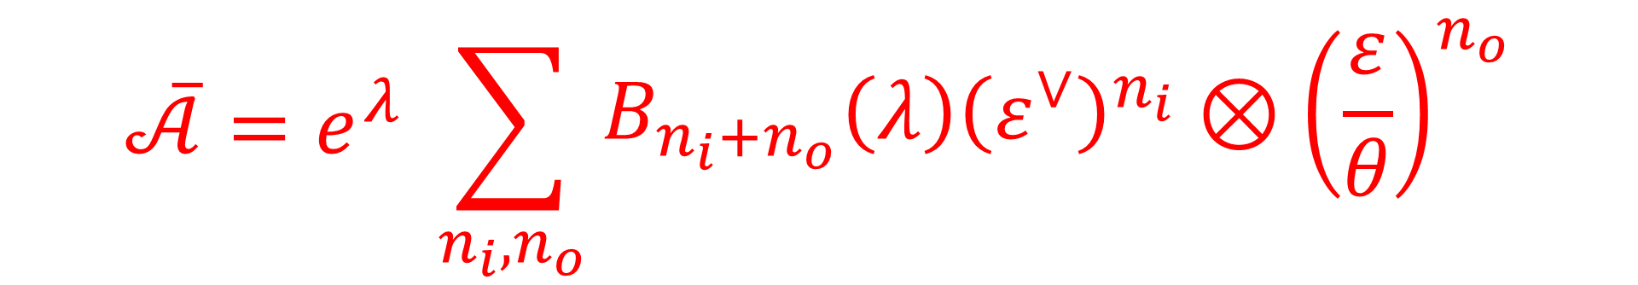


Applying $b_{∨}$
$$\overline{𝒜}=e^{λ} \sum_{n_{i},n_{o}}{\begin{aligned}B_{n_{i}+n_{o}}\left(λ\right){\left(ε^{∨}\right)}^{n_{i}}⊗{\left(\frac{ε}{θ}\right)}^{n_{o}} \\ \end{aligned}}$$
$${e^{λ}B}_{n}\left(λ\right)=\sum_{d=0}^{∞}{\frac{λ^{d}}{d!}d^{n}}$$
Used extensively in the Marolf-Maxfield paper.

Slide 42
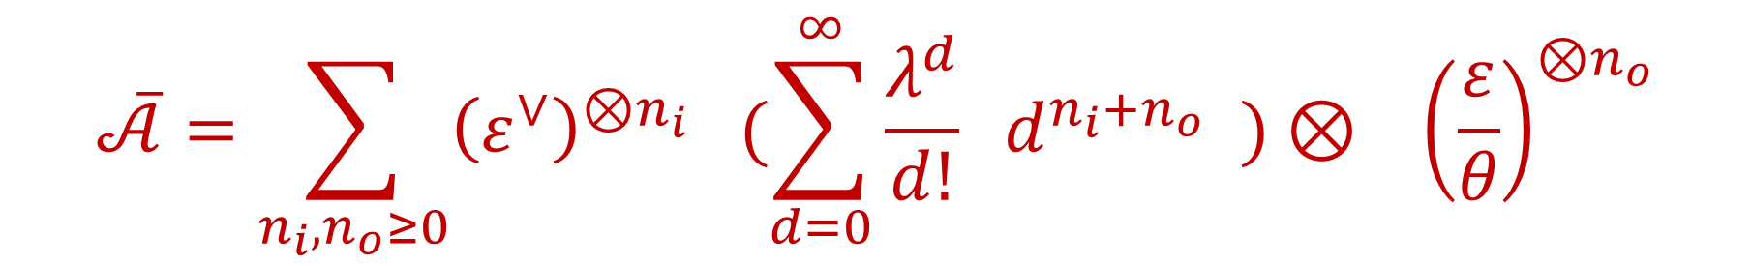
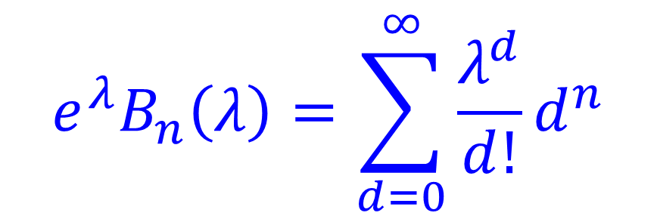
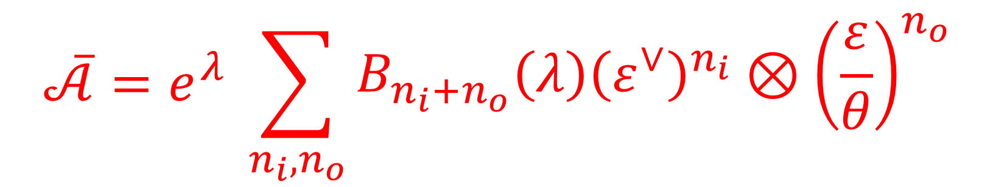
$$\overline{𝒜}=e^{λ} \sum_{n_{i},n_{o}}{\begin{aligned}B_{n_{i}+n_{o}}\left(λ\right){\left(ε^{∨}\right)}^{n_{i}}⊗{\left(\frac{ε}{θ}\right)}^{n_{o}} \\ \end{aligned}}$$
$${e^{λ}B}_{n}\left(λ\right)=\sum_{d=0}^{∞}{\frac{λ^{d}}{d!}d^{n}}$$
$$\overline{𝒜}=\sum_{n_{i},n_{o}≥0}{{\left(ε^{∨}\right)}^{⊗n_{i}} (\sum_{d=0}^{∞}{\frac{λ^{d}}{d!} d^{n_{i}+n_{o}} )⊗ {\left(\frac{ε}{θ}\right)}^{⊗n_{o}}}}$$

Slide 43
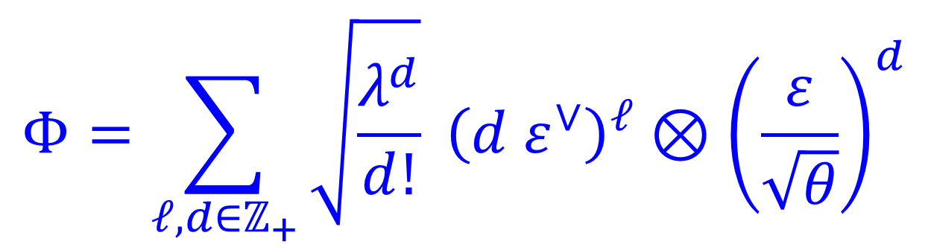
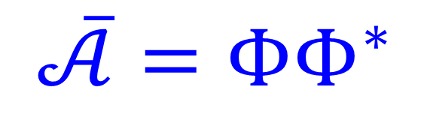

Frobenius structure gives canonical real structure and sesquilinear form
$$ε^{∗}=θε^{∨} {\left(ε^{∨}\right)}^{∗} ={\left(θ^{∗}\right)}^{−1} ε$$
$$𝒲=Fock\left(𝒞\right)$$
For $θ$ real, but not necessarily positive,
$$Φ=\sum_{ℓ,d∈ℤ_{+}}{\sqrt{\frac{λ^{d}}{d!}} {\left(d ε^{∨}\right)}^{ℓ}⊗{\left(\frac{ε}{\sqrt{θ}}\right)}^{d}}$$
$$\overline{𝒜}=ΦΦ^{∗}$$

Slide 44
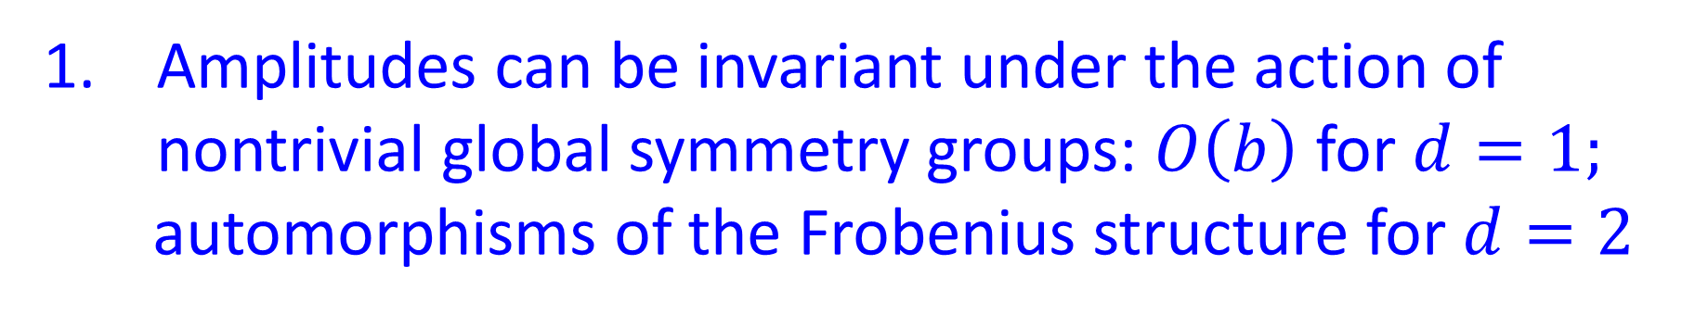
Comments
Amplitudes can be invariant under the action of nontrivial global symmetry groups: $O\left(b\right)$ for $d=1;$
automorphisms of the Frobenius structure for $d=2$
2. Amplitudes can depend on continuous parameters
3. $\left({Ψ_{HH},Ψ}_{HH}^{∨}\right)$ is NOT $𝒜\left(∅,∅\right)$
In fact, it is divergent.
4. Relation to Coherent States (also used in MM)

Slide 45
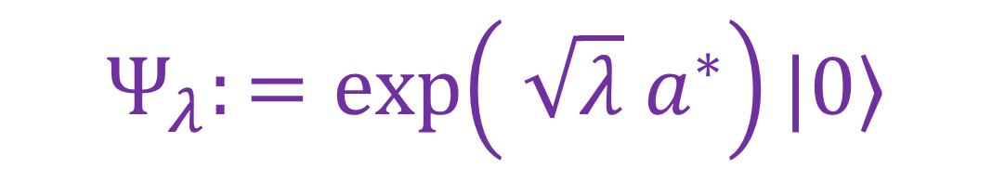




Relation To Coherent States - 1/2
$$\frac{1}{\sqrt{d!}}{\left(a^{∗}\right)}^{d}|0〉 ≔|d〉↔ {\left(\frac{ε}{\sqrt{θ}}\right)}^{d}∈S^{d}𝒞$$
$$\left[a,a^{∗} \right]=1$$
$$Ψ_{λ}:=\exp\left( \sqrt{λ} a^{∗}\right)|0〉$$
$$N:=a^{∗}a$$
$${e^{λ}B}_{n}\left(λ\right)=〈Ψ_{λ},N^{n} Ψ_{λ}〉$$

Slide 46






Relation To Coherent States - 2/2
$$Z_{ann}:𝒲→𝒞^{∨}⊗$$
$$𝒲$$
$$|d〉↦\left(d ε^{∨}\right)⊗|d〉$$
$$〈d|↦〈d|⊗\left(\frac{d}{θ} ε\right)$$
$$Z_{cr}:𝒲^{∨}→𝒲^{∨}⊗𝒞$$
$$\overline{𝒜}=〈 Ψ_{λ} ,\frac{1}{1−Z_{cr}} \frac{1}{1−Z_{ann}}Ψ_{λ} 〉$$
$$∈ S^{∗}𝒞^{∨}⊗S^{∗}𝒞 ≅ End\left(Fock\left(𝒞\right)\right)$$

Slide 47
1
Motivation
2
Reminders On TQFT
3
Summed & Total Amplitudes: Splitting Property
4
Example: $d=1$
5
Example: $d=2,$closed
6
Example: $d=2,$open-closed
7
Closed constrained boundaries & ensemble interpretation
8
$d≥3$: Comments
9
Summary & Some Open Problems

Slide 48




VI. d=2 Open-Closed: Oriented, Semi-simple
In/out manifolds are disjoint unions of circles and oriented intervals
The intervals are 1-morphisms
in a category (of manifolds with corners)
$$b$$
$a,b$ are objects in a category of boundary conditions.
[Moore
& Segal]
$$𝒵\left(I_{ab}\right)=Hom\left(a,b\right)≔𝒪_{ab}$$
$$a$$

Slide 49

The surfaces are now 2-morphisms in a 2-category
$$∂Y={\left(∂Y\right)}_{in} \coprod{ {\left(∂Y\right)}_{out} \coprod{{\left(∂Y\right)}_{constrained} }}$$

Slide 50
We can also have closed constrained boundaries
Three conceptually distinct kinds of boundaries
Ingoing/outgoing circles & intervals
2. Constrained boundaries connecting in/out endpoints
to in and/or out endpoints of intervals
3. Closed constrained boundaries

Slide 51



Side Remark On Marolf-Maxfield Model
MM define their model by summing over surfaces $Y$with boundary, with the weighting factor
$$\exp\left\{S_{0}χ\left(Y\right)+S_{∂}\right|π_{0}\left(∂Y\right)\left| \right\}$$
$S_{∂}\left|π_{0}\left(∂Y\right)\right|$is not a local term in the action
Resolution: When one is careful about the interpretations of the circles $S_{∂}$ is a parameter that need not be interpreted as a part of the action

Slide 52



There are different interpretations depending on whether we take the boundary circles to be in/out going or constrained boundaries.
In our language MM consider $\dim{𝒞=1 }$
(Generalizing their story to $\dim{𝒞>1}:$ Gardiner-Megas)
$$Ψ_{HH}^{∨}(\exp{(\tilde{u}ε))=exp⁡[ λ e^{\tilde{u}}] }$$
$$\tilde{u}=u_{MM} e^{S_{∂}−S_{0}}$$
Or, if we consider their boundaries to be closed constrained boundaries then $e^{S_{∂}}$is a fugacity

Slide 53



Splitting Formula - Simplest Case
For simplicity (we can relax all these conditions):
1. $\dim{𝒞=1 }$
2. All constrained boundaries are labeled with
single b.c. $a$ with $Hom\left(a,a\right)=𝒪_{aa}$
3. No closed constrained boundaries
4. All in/out manifolds are intervals $I_{aa}$

Slide 54



$μ^{−1}$ = open string coupling: $μ^{2}=θ$
For $μ$ real, $θ>0$
$$\overline{𝒜}=ΦΦ^{∗}$$
$$Φ: S^{∗}𝒪_{aa}→L^{2}\left(ℰ_{N_{a}}\right)$$
``Cardy condition’’ implies $𝒪_{aa}≅Mat_{N_{a}×N_{a}}\left(ℂ\right)$ [Moore&Segal]
$ℰ_{N_{a}}=$ $vector space of N_{a}×N_{a}$Hermitian matrices

Slide 55




$$Φ=\sum_{n}{\sum_{S=\left\{i_{1}j_{1}, i_{2}j_{2}, …i_{n}j_{n}\right\}}{\prod_{a=1}^{n}{e_{i_{a}j_{a}}^{∨}}}}$$
$$\int_{ℰ_{N_{a}}}{\left[dH\right] e^{−\frac{1}{2}U\left(H\right)}\prod_{a=1}{H_{j_{a}i_{a}} 〈 H |}}$$
$e_{ij}$ : Basis of matrix units for $𝒪_{aa} ;e_{ij}^{∨}$ is the dual basis
$$e^{−U\left(H\right)}=\int_{\sqrt{−1}ℰ_{N_{a}}}{\left[dS\right]\exp\left(\left(\frac{λ}{{\det\left(1−S\right)}^{\frac{1}{μ}}} \right)−Tr\left(SH\right)\right)}$$
Corollary:
$$Ψ_{HH}^{∨}\left(e^{T}\right)=exp⁡[ λ/(\det{{\left(1−T\right)}^{\frac{1}{μ}} )] }$$
Gardiner-Megas

Slide 56
Remark: A Funny Mathematical Structure
$$m_{n} ≔ \overline{𝒜}\left(n,1\right):S^{n}𝒪_{aa} →𝒪_{aa}$$
Give a series of $n$-linear multiplications on $𝒪_{aa}$

Slide 57
1
Motivation
2
Reminders On TQFT
3
Summed & Total Amplitudes: Splitting Property
4
Example: $d=1$
5
Example: $d=2,$closed
6
Example: $d=2,$open-closed
7
Closed constrained boundaries & ensemble interpretation
8
$d≥3$: Comments
9
Summary & Some Open Problems

Slide 58

VII. Constrained Boundaries &
An Ensemble Interpretation
MM paper aimed to give an interpretation of the 2d model in terms of an ensemble average of 1d models.
Sum over bordisms $∅→∅$ with $L$ constrained boundaries of type $a$
Disconnected surfaces
$$+$$

Slide 59





$$\frac{{\overline{𝒜}}_{\left\{L\right\}}\left(∅, ∅\right)}{\overline{𝒜}\left(∅, ∅\right)}= B_{L}\left(x_{1},…, x_{L}\right)$$
$$x_{j}=θ_{𝒞}\left(\frac{1}{1−h}B_{a}^{j}\right)$$
$$B_{a}:=ι_{a}\left(1_{𝒪_{aa}}\right)∈𝒞$$
$$B_{a} =\frac{N_{a}}{μ} ε$$
$$dim𝒞=1 :$$

Slide 60





$$\frac{{\overline{𝒜}}_{\left\{L\right\}}\left(∅, ∅\right)}{\overline{𝒜}\left(∅, ∅\right)}= {\left(\frac{1}{μ}\right)}^{L}\sum_{d=0}^{∞}{e^{−λ}\frac{λ^{d}}{d!} {\left(dN_{a}\right)}^{L}}$$
$$= {\left(\frac{1}{μ}\right)}^{L} {〈 𝒵{\left(S^{1}\right)}^{L}〉}_{ℰ}$$
$𝒵$ is a stochastic variable on an ensemble $ℰ$ of 1d oriented TQFT’s $𝒵_{d}$ labeled by $d∈ℤ_{+}$ with
$$p\left(𝒵_{d}\right)=e^{−λ} \frac{λ^{d}}{d!}$$
$$𝒵_{d}\left(S^{1}\right)=\dim{V_{d} =d N_{a}}$$

Slide 61
It would be interesting to give an ensemble interpretation to the full set of open/closed amplitudes.
This suggests it could be interesting to consider TQFT’s where the target category is the category of f.d. vector bundles over measure spaces
as a way to model ensemble averages of
field theories.

Slide 62
1
Motivation
2
Reminders On TQFT
3
Summed & Total Amplitudes: Splitting Property
4
Example: $d=1$
5
Example: $d=2,$closed
6
Example: $d=2,$open-closed
7
Closed constrained boundaries & ensemble interpretation
8
$d≥3$: Comments
9
Summary & Some Open Problems

Slide 63



VIII. Comments On $d≥3$
Can we extend these ideas to d=3 TQFT ?
Classification of manifolds is MUCH more difficult !!
$$𝒜\left(∅, ∅\right)=exp⁡( \sum_{Y}{𝒵\left(Y\right) ) }$$
Sum over closed connected 3-folds $Y$

Slide 64

That includes the sum over $Y=S^{1}×Σ_{g}$
$$𝒵\left(Y\right)=\dim{𝒵\left(Σ_{g}\right)}$$
For standard fully local TQFT, $\dim{𝒵\left(Σ_{g}\right)}$grows with $g$
The sum is irretrievably divergent.
Can we have $\dim{𝒵\left(Σ_{g}\right)=0 }$ for sufficiently large $g$ ?
Sergei Gukov: No!
Cut along the boundary of a handlebody for any $g$
If $\dim{𝒵\left(Σ_{g}\right)=0 }$for any $g$ then all amplitudes vanish!!

Slide 65

Is there some way to modify the domain and/or codomain categories to produce
interesting examples for d>2 ?
Could various ideas from noncompact 3d Chern-Simons theory be useful here?
Categroids? (Useful to Andersen & Kashaev)

Slide 66
1
Motivation
2
Reminders On TQFT
3
Summed & Total Amplitudes: Splitting Property
4
Example: $d=1$
5
Example: $d=2,$closed
6
Example: $d=2,$open-closed
7
Closed constrained boundaries & ensemble interpretation
8
$d≥3$: Comments
9
Summary & Some Open Problems

Slide 67


IX. Summary And Open Problems
For suitable parameters of our TQFT, the total amplitude
$\overline{𝒜} ∈End\left(⊗_{X}S^{∗}(𝒵\left(X\right))\right)$ $:=End\left(Fock\left(𝒵\right)\right)$
Has a splitting:
$$\overline{𝒜}=ΦΦ^{∗}$$
$$Φ:Fock\left(𝒵\right)→𝒲$$
We also worked out some examples for non-semi-simple d=2 TQFT. The splitting persists

Slide 68
Extensions of the d=2 results
The general non-semisimple case, closed, and open
2. Other tangential structures: Unorientable, (s)pin, …
3. G-equivariant theories

Slide 69
Extensions of the d=2 results
4. Couple to 2d YM with nontrivial area dependence
(summed amplitudes appear to exist)
5. Topological string theory: $\overline{𝒜}∈End\left(S^{∗}H_{q}^{∗}\left(𝒳\right)\right)$

Slide 70

Is the existence of a splitting formula deep or a trivial consequence of linear algebra ?
Rough idea: The total amplitude is symmetric under exchange of all in-going boundaries for all out-going boundaries.
But any symmetric (f.d. complex) matrix $S$
can be written as $S=ΦΦ^{tr}$
If it doesn’t just follow by linear algebra,
is there an a priori reason why it should hold?

Slide 71

A splitting formula for JT gravity might have interesting implications for
the ongoing discussion about the role of ensemble averages in AdS/CFT
And what to do about $d≥3$ ???
Thanks for your attention!

Slide 72
SUPPLEMENT 1

Slide 73










Quantum Systems
Set of physical ``states’’
Set of physical ``observables’’
Born Rule:
Probability measures on $ℝ$.
is the probability that a measurement of the observable O
in the state s has value between r₁ and r₂ .

Slide 74










Dirac-von Neumann Axioms
Density matrices $ρ$: Positive trace class operators on Hilbert space of trace =1
Self-adjoint operators T on Hilbert space
Spectral Theorem: There is a one-one correspondence of self-adjoint operators T and projection valued measures:
Example:

Slide 75







Continuous Families Of Quantum Systems
Hilbert bundle over space X of control parameters.
For each x get a probability measure $℘x$:

Slide 76

Noncommutative Control Parameters
We would like to define a family of quantum systems parametrized by a NC manifold whose ``algebra of functions’’ is a general C* algebra $𝔄$
What are observables?
What are states?
What is the Born rule?
What replaces the Hilbert bundle?
Notes:
Stress that amplitudes are elements of a noncommutative algebra so the usual formulae do not immediately generalize.

Slide 77






Noncommutative Hilbert Bundles
Definition: Hilbert C* module $ℰ$over C*-algebra $𝔄$.
Complex vector space $ℰ$ with a right-action of $𝔄$
and an ``inner product’’ valued in $𝔄$
(Positive element of the C* algebra.)
$\left(Ψ_{1}, Ψ_{2}a\right)=\left(Ψ_{1}, Ψ_{2}\right)a$ …..
Like a Hilbert space, but ``overlaps’’ are valued
in a (possibly) noncommutative algebra.

Slide 78





Quantum Mechanics With Noncommutative Amplitudes
Basic idea: Replace the Hilbert space by a Hilbert C* module
Overlaps are valued in a possibly noncommutative algebra.
QM:
QMNA:
Notes:
Stress that amplitudes are elements of a noncommutative algebra so the usual formulae do not immediately generalize.

Slide 79






Example 1: Hilbert Bundle Over A Commutative Manifold

Slide 80



Example 2: Hilbert Bundle Over A Fuzzy Point
Def: ``fuzzy point’’ has

Slide 81



Observables In QMNA
Consider ``adjointable operators’’
The adjointable operators
$𝔅$ are another C* algebra.
Definition: QMNA observables
are self-adjoint elements of $𝔅$
(Technical problem: There is no spectral theorem for self-adjoint elements of an abstract C* algebra. )

Slide 82











C* Algebra States
Definition: A C*-algebra state $ω$ $∈𝒮(𝔄)$
is a positive linear functional
d$μ$ = a positive measure on X:
$ρ$ = a density matrix
Notes:
OK, after many failed attempts to make sense of a Born rule in the context of QMNA I finally decided that a good definition of a QMNA state is the following:

Slide 83



QMNA States
Definition: A QMNA state is a completely positive unital map
``Completely positive’’ comes up naturally both in math and in quantum information theory.
Positive:
Unital:
Completely positive
Notes:
Say: So now we can move on to the QMNA Born rule.

Slide 84


QMNA Born Rule
Main insight is that we should regard the Born Rule as a map
For general $𝔄$the datum $ω$ $∈𝒮(𝔄)$together
with complete positivity of $φ$give just the right information to state a Born rule in general:
Notes:
Just say that this works very well with the case of a commutative base.

Slide 85




Family Of Quantum Systems Over A Fuzzy Point
``A NC measure $ω$ $∈𝒮(𝔄)$’’ is equivalent to a density matrix $ρA$ on $ℋA$
QMNA state:

Slide 86


Quantum Information Theory
& Noncommutative Geometry
Last expression is the measurement by Bob of T in the state $ρA$ prepared by Alice and sent to Bob through quantum channel $ℰ$.

Slide 87
END OF SUPPLEMENT 1
BEGIN SUPPLEMENT 2

Slide 88




MM construction of ``baby universe Hilbert space’’
A sesquilinear form on $S^{∗}𝒞$ is defined by
$$〈 φ_{1},φ_{2}〉=Ψ_{HH}^{∨}\left(K\left(φ_{1}\right)φ_{2}\right)$$
$$φ=\sum_{n=0}^{∞}{c_{n}ε^{n} → f_{φ}\left(x\right)=\sum_{n=0}^{∞}{c_{n}x^{n}}}$$
$$〈φ_{1}, φ_{2}〉=\sum_{d=0}^{∞}{\frac{λ^{d}}{d!} {\left(f_{1}\left(d\right)\right)}^{∗} f_{2}\left(d\right) }$$
$Ann\left(〈⋅,⋅〉\right)≅$A vector space of
order $≤1$entire functions that vanish on $ℤ_{+}$

Slide 89





$S^{∗}𝒞$is viewed as a $∗$-algebra.
MM then imitate the GNS construction and define a ``baby universe Hilbert space’’
$$ℋ_{BU}≔S^{∗}𝒞/Ann(〈⋅,⋅〉)$$
$$≅ \{ \left(ξ_{0},ξ_{1},…\right)∈ℂ^{∞} | \sum{\frac{λ^{d}}{d!} {\left|ξ_{d}\right|}^{2} <∞ \} }$$
$$\left(λ>0 \right)$$
$≅$H.O. representation of Heisenberg algebra
Expectation values in a coherent state are then interpreted as stochastic expectations of a ``universe creation operator $Z$’’

Slide 90


$Ψ_{HH}^{∨}$ is viewed as defining an expectation value on polynomials in a stochastic variable $Z$on $S^{∗}𝒞$where $Z\left(ε\right)$ has the interpretation of the partition function of a 1d TQFT chosen
from an ensemble with Poisson probability distribution
$$p\left(d\right)=e^{−λ} \frac{λ^{d}}{d!}$$
for an ensemble of 1d TQFTs with $\dim{V=d . }$

Slide 91
END OF SUPPLEMENT 2
BEGIN SUPPLEMENT 3

Slide 92
Coupling To 2D YM With Positive Area
Morphisms are surfaces with area, which is additive under gluing.
$$ℋ=L^{2}{\left(G\right)}^{G}⊗𝒞$$
$G=SU\left(2\right)$ : Orthonormal basis: $ψ_{ℓ}⊗ε$ $ℓ=1,2,3, …$

Slide 93




$$\log{𝒜\left(∅, ∅\right)=\int_{0}^{∞}{\frac{dA}{A} A^{p} \sum_{g=0}^{∞}{\sum_{ℓ=1}^{∞}{θ^{1−g} ℓ^{2−2g} e^{−A \left( e^{2}\left(ℓ^{2}−1\right)+μ_{0}\right)}}}}}$$
$$=Γ\left(p\right) \sum_{ℓ=1}^{∞}{ \frac{θℓ^{2}}{1−{\left(θℓ^{2}\right)}^{−1}} \frac{1}{{\left(e^{2}\left(ℓ^{2}−1\right)+μ_{0}\right)}^{p}}}$$
Converges for $Re\left(p\right)>\frac{3}{2}$
Expected to admit analytic continuation in $p$
There are similar expressions for other amplitudes. Splitting?

