Slide 1

Global Anomalies In
Six-Dimensional Supergravity
Gregory Moore
Rutgers University
Work with DANIEL PARK & SAMUEL MONNIER
Work in progress with SAMUEL MONNIER
Strings 2018, Okinawa
June 29, 2018
Notes:
.

Slide 2

1
Introduction & Summary Of Results
2
Six-dimensional Sugra & Green-Schwarz Mech.
3
Quantization Of Anomaly Coefficients.
Geometrical Anomaly Cancellation, $η$-Invariants
& Wu-Chern-Simons
4
5
Technical Tools & Future Directions
6
F-Theory Check
7
Concluding Remarks

Slide 3
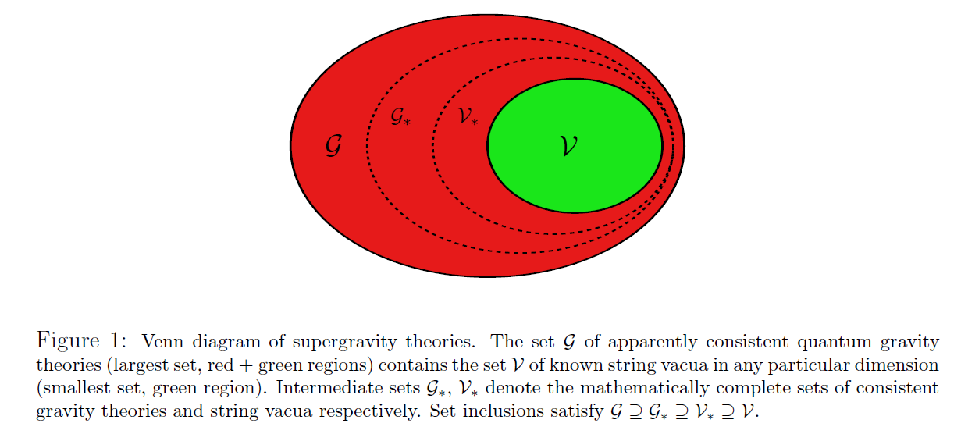
Motivation
Relation of apparently consistent theories
of quantum gravity to string theory.
From W. Taylor’s TASI lectures:
State of art summarized in
Brennan, Carta, and Vafa 1711.00864

Slide 4


Brief Summary Of Results
Focus on 6d sugra
(More) systematic study of global anomalies
Result 1: NECESSARY CONDITION:
unifies & extends all previous conditions
Result 2: NECESSARY & SUFFICIENT:
A certain 7D TQFT $Z_{TOP}$ must be trivial.
But effective computation of $Z_{TOP}$ in
the general case remains open.
Result 3: Check in F-theory:
(Requires knowing the global form of the
identity component of the gauge group.)

Slide 5
1
Introduction & Summary Of Results
2
Six-dimensional Sugra & Green-Schwarz Mech.
3
Quantization Of Anomaly Coefficients.
Geometrical Anomaly Cancellation, $η$-Invariants
& Wu-Chern-Simons
4
5
Technical Tools & Future Directions
6
F-Theory Check
7
Concluding Remarks

Slide 6
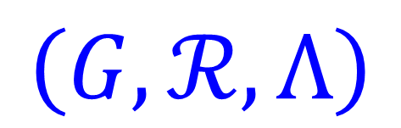
(Pre-) Data For 6d Supergravity
(1,0) sugra multiplet + vector multiplets +
hypermultiplets + tensor multiplets
VM: Choose a (possibly disconnected) compact Lie group $G$.
HM: Choose a quaternionic representation $ℛ$ of $G$
TM: Choose an integral lattice $Λ$ of signature (1,T)
Pre-data:
$$\left(G,ℛ,Λ\right)$$

Slide 7
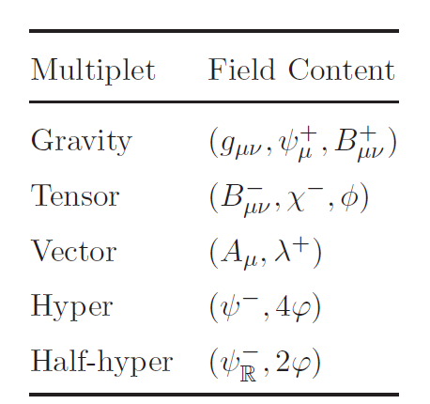
6d Sugra - 2
Can write multiplets, Lagrangian,
equations of motion. [Riccioni, 2001]
Fermions are chiral (symplectic
Majorana-Weyl)
2-form fieldstrengths
are (anti-)self dual

Slide 8


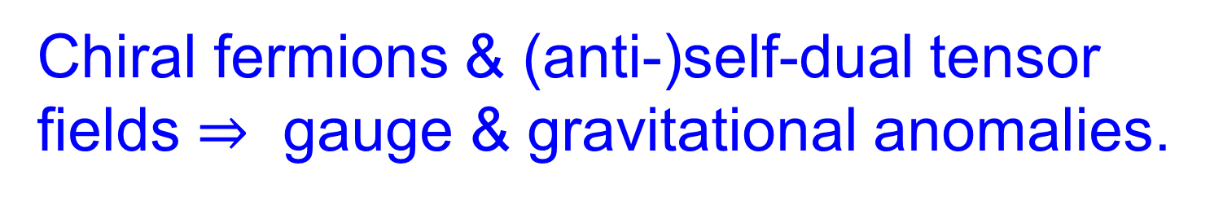
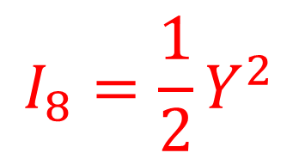
The Anomaly Polynomial
Chiral fermions & (anti-)self-dual tensor fields $⇒$ gauge & gravitational anomalies.
From $(G,ℛ,Λ)$ we compute,
following textbook procedures,
$$I_{8}∼ \left(\dim_{ℍ}\left(ℛ\right)−\dim\left(G\right)+29 T −273\right)Tr\left(R^{4}\right)+⋯$$
$$+ \left(9−T\right){\left(Tr R^{2}\right)}^{2}+{(F}^{4}−type) +⋯$$
6d Green-Schwarz mechanism requires
$$I_{8}=\frac{1}{2}Y^{2}$$
$$Y∈Ω^{4}\left(𝒲;Λ⊗ℝ\right)$$

Slide 9
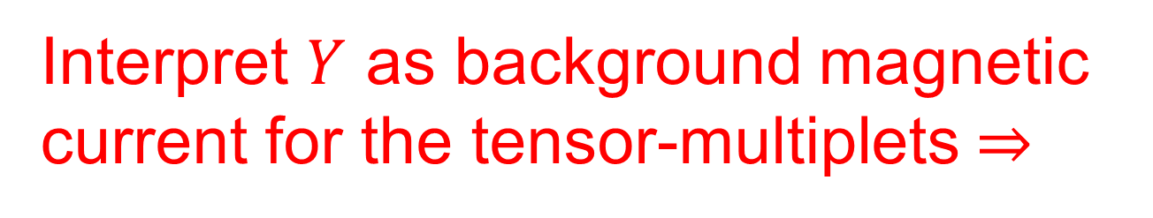

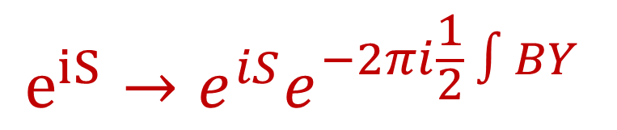
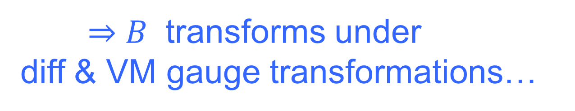
Standard Anomaly Cancellation
Interpret $Y$ as background magnetic
current for the tensor-multiplets $⇒$
$$dH=Y$$
$⇒B$ transforms under
diff & VM gauge transformations…
Add counterterm to sugra action
$$e^{iS}→e^{iS}e^{−2πi\frac{1}{2} ∫BY }$$
Notes:
Now …. SOME people might say ….

Slide 10

So, What’s The Big Deal?
Notes:
you wouldn’t want to be one of those people – would you? Yes, some people can’t understand that there can be subtleties. Let’s have a closer look.

Slide 11
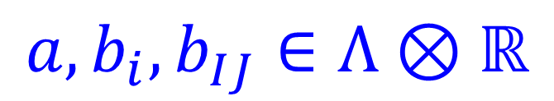

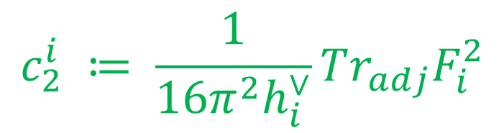


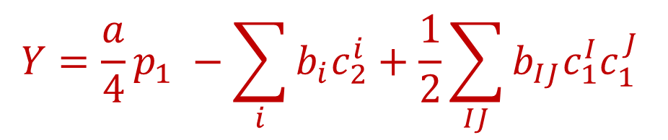
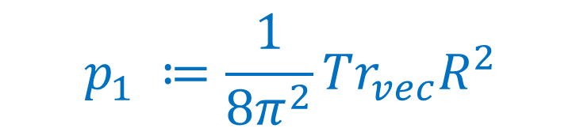
Definition Of Anomaly Coefficients
Let’s try to factorize:
$$I_{8}=\frac{1}{2}Y^{2}$$
$$Y∈Ω^{4}\left(𝒲;Λ⊗ℝ\right)$$
$$𝔤=𝔤_{ss}⊕𝔤_{Abel}≅⊕_{i}𝔤_{i}⊕_{I}𝔲{\left(1\right)}_{I}$$
$$Y=\frac{a}{4}p_{1} −\sum_{i}{b_{i}c_{2}^{i}+\frac{1}{2}\sum_{IJ}{{b_{IJ}c}_{1}^{I}c_{1}^{J} }}$$
General form of $Y$:
$$p_{1} ≔\frac{1}{8π^{2}}Tr_{vec}R^{2}$$
Anomaly coefficients:
$$c_{2}^{i} ≔ \frac{1}{16π^{2}h_{i}^{∨}}Tr_{adj}F_{i}^{2}$$
$$a,b_{i},b_{IJ}∈Λ⊗ℝ$$

Slide 12
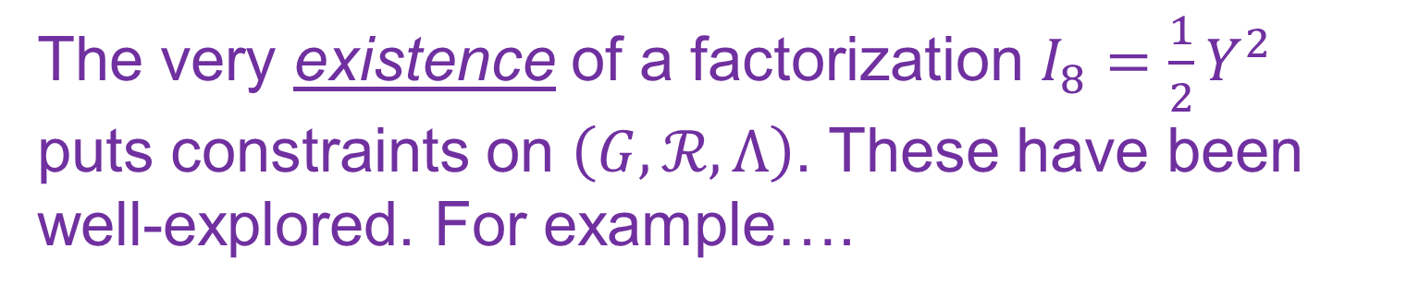
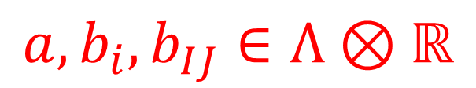
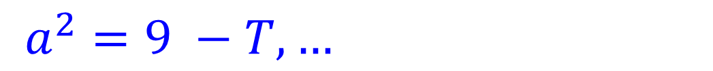
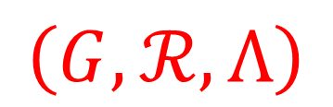
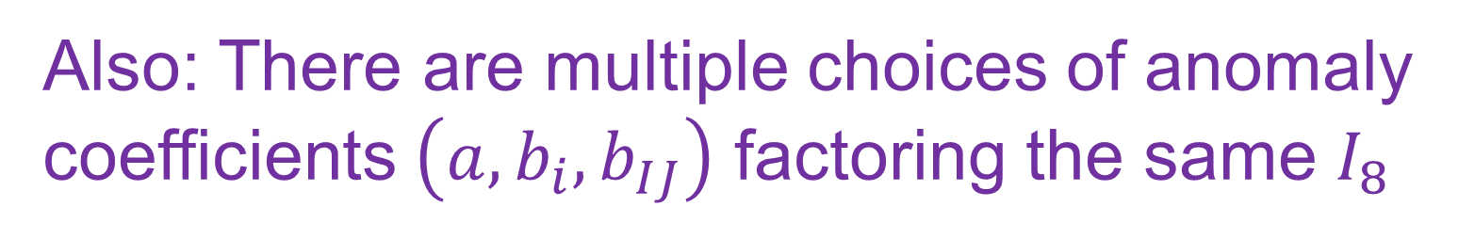
The Data Of 6d Sugra
The very existence of a factorization $I_{8}=\frac{1}{2}Y^{2}$ puts constraints on $\left(G,ℛ,Λ\right)$. These have been well-explored. For example….
$$\dim_{ℍ}{ ℛ −\dim{G+29 T −273 }}=0$$
$a^{2}=9 −T, …$
Also: There are multiple choices of anomaly coefficients $\left(a,b_{i},b_{IJ}\right)$ factoring the same $I_{8}$
Full data for 6d sugra:
$$\left(G,ℛ,Λ\right)$$
AND
$$a,b_{i},b_{IJ}∈Λ⊗ℝ$$

Slide 13


Standard Anomaly Cancellation -2/2
For any ( $G,ℛ,Λ,a,b)$adding the
GS term cancels all perturbative anomalies.
All is sweetness and light…

Slide 14
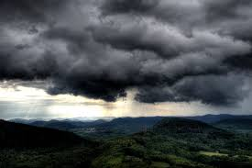
There are solutions of the factorizations conditions that cannot be realized in F-theory!
Global anomalies ?
Does the GS counterterm even make mathematical sense ?

Slide 15

1
Introduction & Summary Of Results
2
Six-dimensional Sugra & Green-Schwarz Mech.
3
Quantization Of Anomaly Coefficients.
Geometrical Anomaly Cancellation, $η$-Invariants
& Wu-Chern-Simons
4
5
Technical Tools & Future Directions
6
F-Theory Check
7
Concluding Remarks

Slide 16

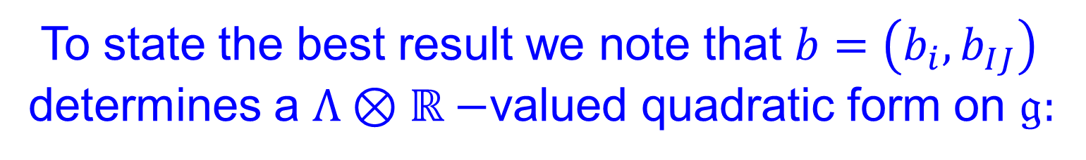
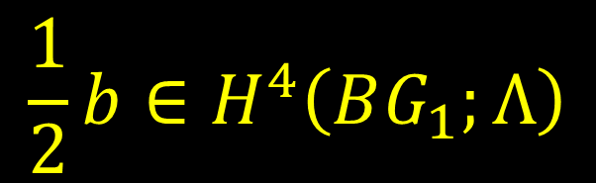
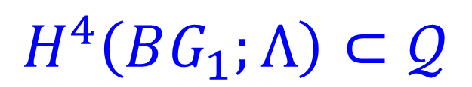
The New Constraints
Global anomalies have been considered before.
We have just been a little more systematic.
To state the best result we note that $b=\left(b_{i},b_{IJ}\right)$
determines a $Λ⊗ℝ−$valued quadratic form on $𝔤:$
Vector space $𝒬$ of such quadratic forms
arises in topology: $𝒬≅H^{4}\left(BG_{1};Λ⊗ℝ\right)$
$$H^{4}\left(BG_{1};Λ\right)⊂𝒬$$
$$\frac{1}{2}b∈H^{4}\left(BG_{1};Λ\right)$$

Slide 17
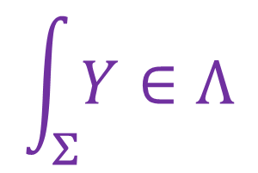
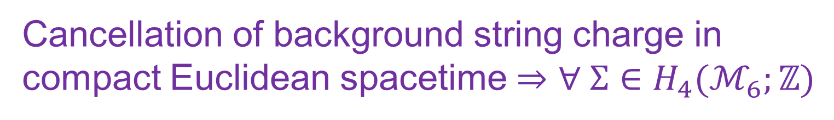
A Derivation
A consistent sugra can be put on an
arbitrary spin 6-fold with arbitrary gauge bundle.
Cancellation of background string charge in
compact Euclidean spacetime $⇒$ $∀ Σ∈H_{4}(ℳ_{6};ℤ)$
$$\int_{Σ}{Y∈Λ}$$
Because the background string
charge must be cancelled by strings.
This is a NECESSARY but not (in general)
SUFFICIENT condition for cancellation of all
global anomalies…

Slide 18
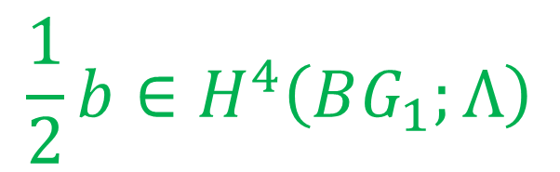


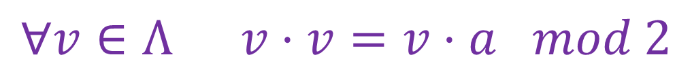
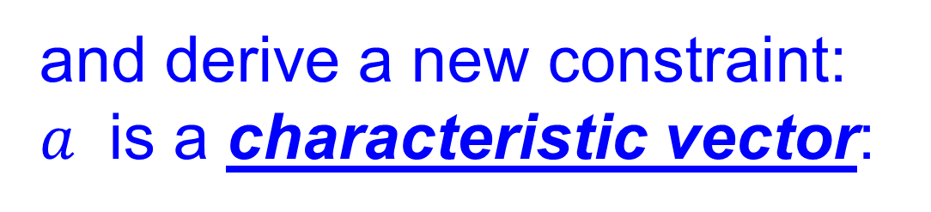
6d Green-Schwarz Mechanism Revisited
Goal: Understand Green-Schwarz anomaly cancellation in precise mathematical terms.
Benefit: We recover the constraints:
$$\frac{1}{2}b∈H^{4}\left(BG_{1};Λ\right)$$
$$a∈Λ$$
$$Λ^{∨}≅Λ$$
and derive a new constraint:
$a$ is a characteristic vector:
$$∀v∈Λ v⋅v=v⋅a mod 2$$

Slide 19

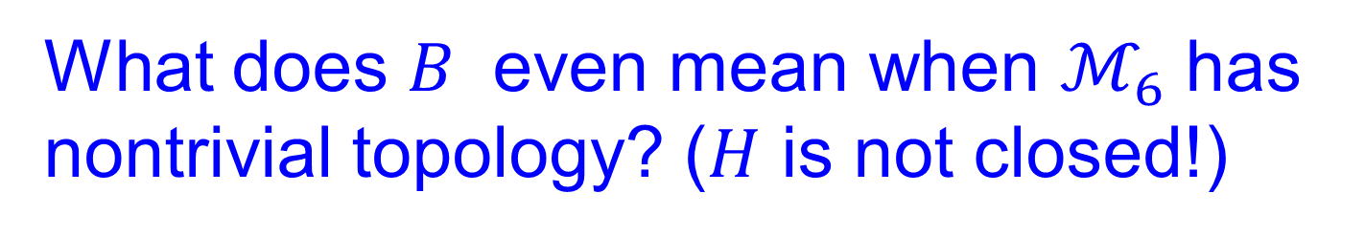


What’s Wrong With Textbook Green-Schwarz Anomaly Cancellation?
What does $B$ even mean when $ℳ_{6}$ has
nontrivial topology? ($H$ is not closed!)
How are the periods of $dB$ quantized?
Does the GS term even make sense?
$$\frac{1}{2}\int_{ℳ_{6}}{B Y=\frac{1}{2}\int_{𝒰_{7}}{dB Y }}$$
must be independent of extension to $𝒰_{7}$ !

Slide 20
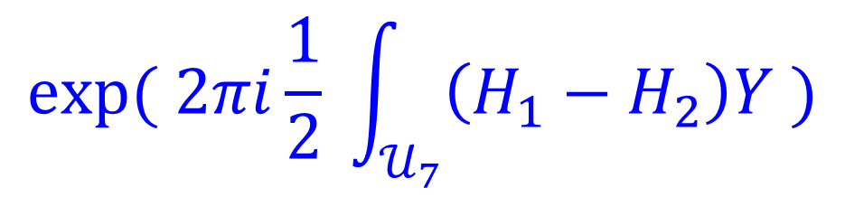
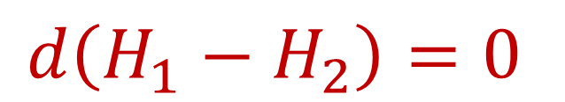


But it isn’t ….
Even for the difference of two B-fields,
$$d\left(H_{1}−H_{2}\right)=0$$
we can quantize $\left[H_{1}−H_{2}\right]∈H^{3}(𝒰_{7};Λ)$
$$exp⁡( 2πi\frac{1}{2} \int_{𝒰_{7}}{\left(H_{1}−H_{2}\right)Y )}$$
is not well-defined because
of the factor of $\frac{1}{2}.$

Slide 21

1
Introduction & Summary Of Results
2
Six-dimensional Sugra & Green-Schwarz Mech.
3
Quantization Of Anomaly Coefficients.
Geometrical Anomaly Cancellation, $η$-Invariants
& Wu-Chern-Simons
4
5
Technical Tools & Future Directions
6
F-Theory Check
7
Concluding Remarks

Slide 22
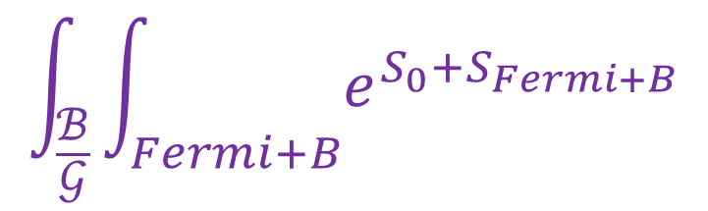


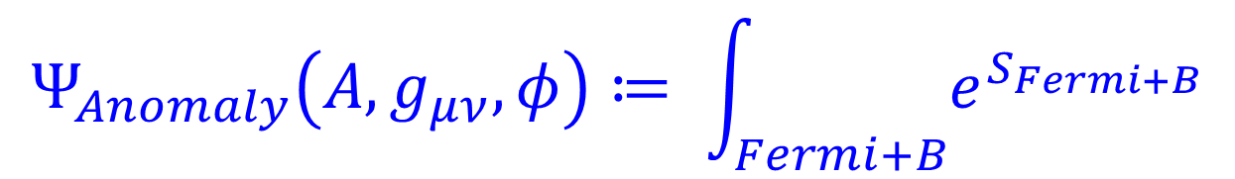
Geometrical Formulation Of Anomalies
Space of all fields in 6d sugra is fibered
over nonanomalous fields:
$ℬ=Met\left(ℳ_{6}\right)×Conn\left(𝒫\right)×\{Scalar fields\}$
Partition function:
$$\int_{\frac{ℬ}{𝒢}}{\int_{Fermi+B}{e^{S_{0}+S_{Fermi+B}}}}$$
$$Ψ_{Anomaly}\left(A,g_{μν},φ\right)≔ \int_{Fermi+B}{e^{S_{Fermi+B}}}$$
is a section of a line bundle over $ℬ/𝒢$
You cannot integrate a section of a line bundle over $ℬ/𝒢$ unless it is trivialized.

Slide 23


Approach Via Invertible Field Theory
Definition [Freed & Moore]:
An invertible field theory $Z$ has
Partition function $∈ℂ^{∗}$
One-dimensional Hilbert spaces of states ...
satisfying natural gluing rules.
Freed: Geometrical interpretation of anomalies in d-dimensions = Invertible field theory in (d+1) dimensions

Slide 24

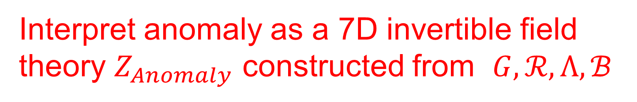

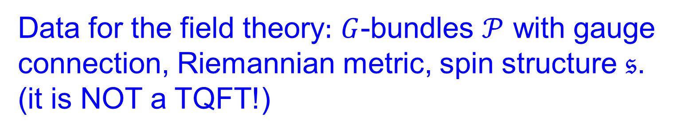
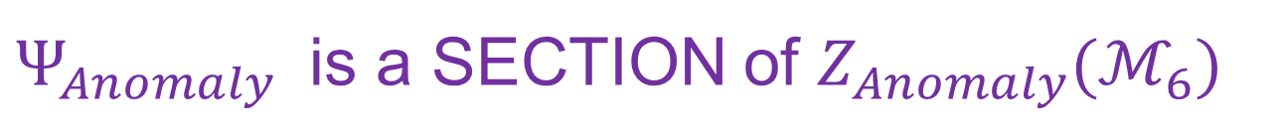
Invertible Anomaly Field Theory
Interpret anomaly as a 7D invertible field theory $Z_{Anomaly}$ constructed from $G,ℛ,Λ,ℬ$
Data for the field theory$:$ $G$-bundles $𝒫$ with gauge connection, Riemannian metric, spin structure $𝔰$.
(it is NOT a TQFT!)
Varying metric and gauge connection $⇒$
$Z_{Anomaly}(ℳ_{6})$ is a LINE BUNDLE
$Ψ_{Anomaly}$ is a SECTION of $Z_{Anomaly}(ℳ_{6})$

Slide 25


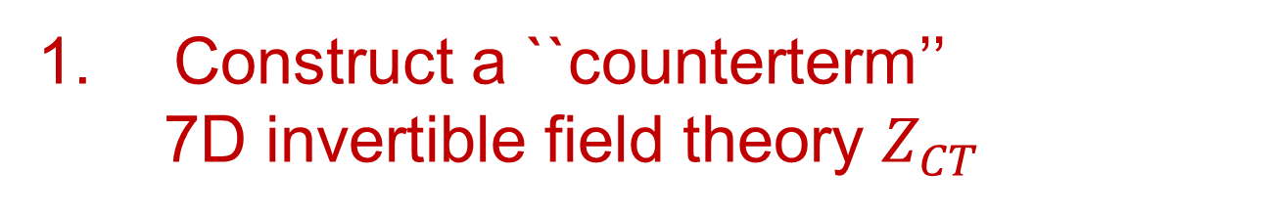

Anomaly Cancellation In Terms of Invertible Field Theory
Construct a ``counterterm’’
7D invertible field theory $Z_{CT}$
$$Z_{CT}\left(ℳ_{6}\right)≅Z_{Anomaly}{\left(ℳ_{6}\right)}^{∗}$$
2. Using just the data of the local fields
in six dimensions, we construct a section:
$$Ψ_{CT}∈Z_{CT}(ℳ_{6})$$
$\int_{Fermi+B}{e^{S_{Fermi+B}}}$ $Ψ_{CT}$
Then:
is canonically a function on $ℬ/𝒢$

Slide 26
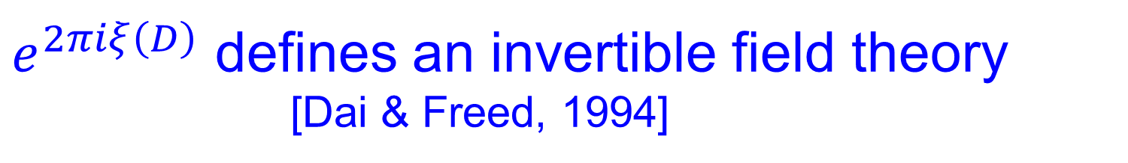
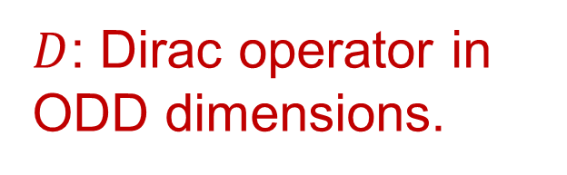
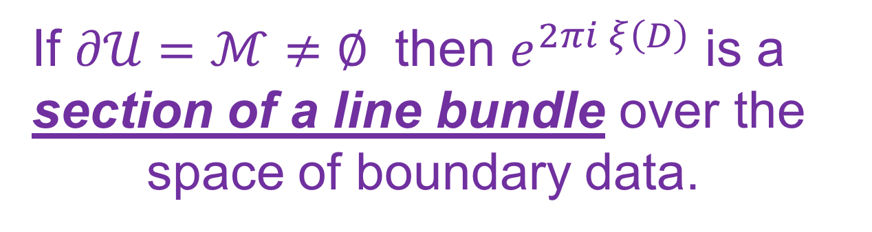
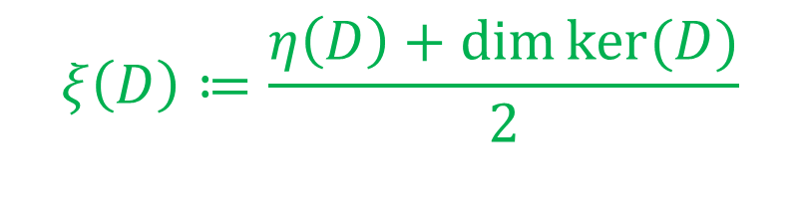
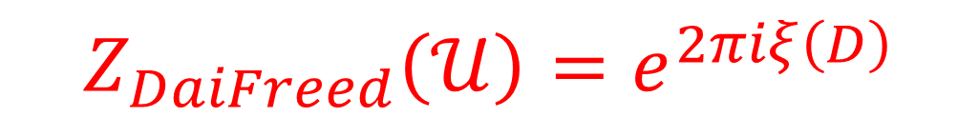
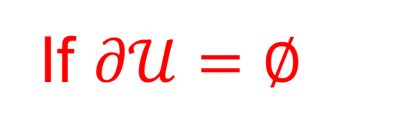
Dai-Freed Field Theory
$D$: Dirac operator in ODD dimensions.
$$ξ\left(D\right)≔\frac{η\left(D\right)+\dim{ker⁡(D)}}{2}$$
$e^{2πiξ\left(D\right)}$ defines an invertible field theory
[Dai & Freed, 1994]
If $∂𝒰=∅$
$$Z_{DaiFreed}\left(𝒰\right)=e^{2πiξ\left(D\right)}$$
If $∂𝒰=ℳ≠∅$ then $e^{2πi ξ\left(D\right)}$ is a section of a line bundle over the
space of boundary data.
Suitable gluing properties hold.

Slide 27
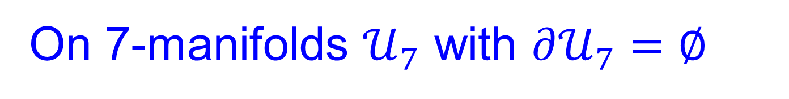
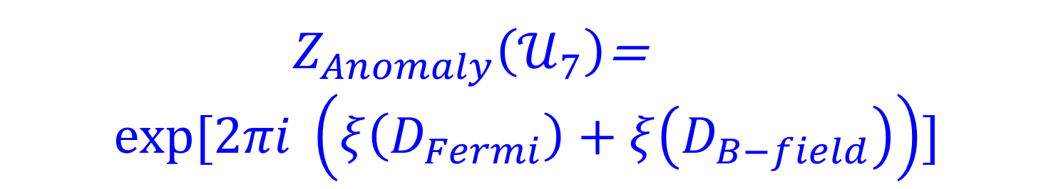
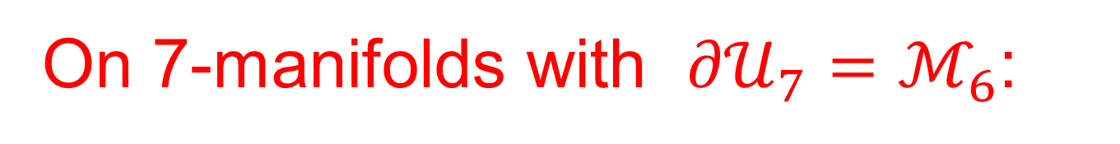
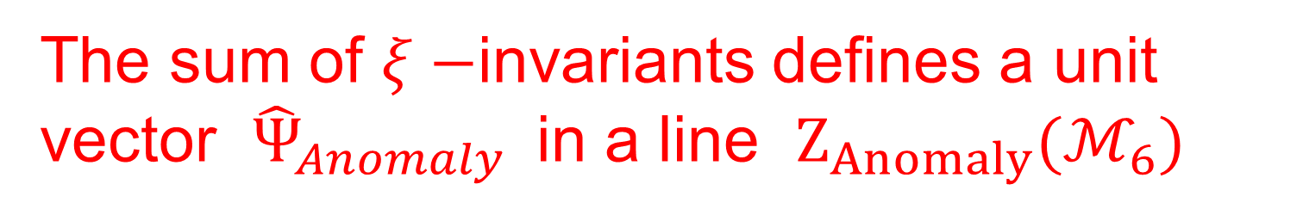
Anomaly Field Theory For 6d Sugra
On 7-manifolds $𝒰_{7}$ with $∂𝒰_{7}=∅$
${ Z}_{Anomaly}\left(𝒰_{7}\right)$=
$$exp⁡[2πi \left(ξ\left(D_{Fermi}\right)+ξ\left(D_{B−field}\right)\right)]$$
On 7-manifolds with ${∂𝒰}_{7}=ℳ_{6}$:
The sum of $ξ−$invariants defines a unit vector ${\hat{Ψ}}_{Anomaly}$in a line $Z_{Anomaly}(ℳ_{6})$

Slide 28
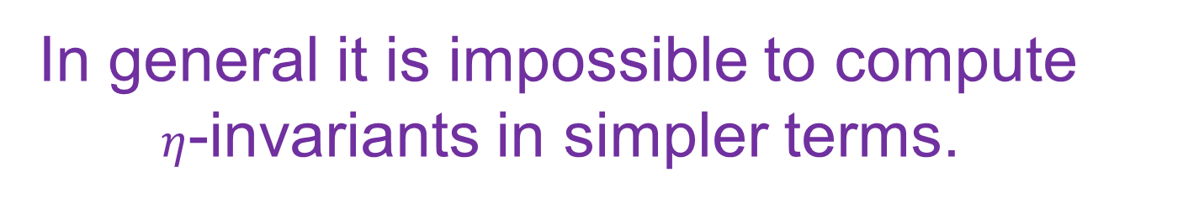
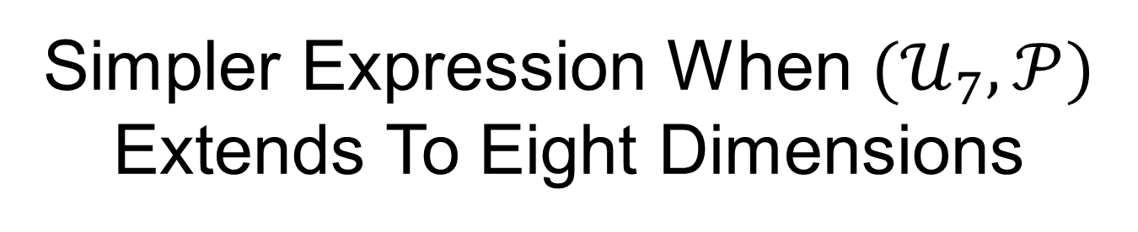
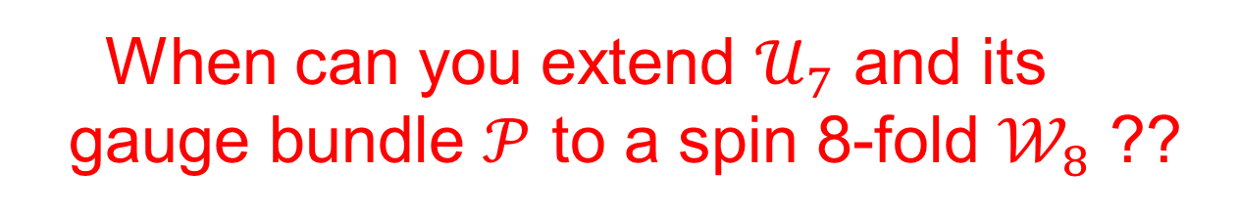
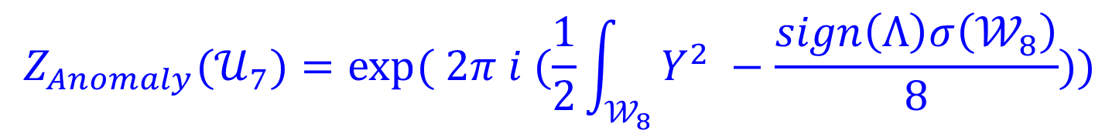

Simpler Expression When $(𝒰_{7},𝒫)$
Extends To Eight Dimensions
In general it is impossible to compute
$η$-invariants in simpler terms.
But if the matter content is such that $I_{8}=\frac{1}{2}Y^{2}$
AND if $(𝒰_{7},𝒫)$ is bordant to zero:
$$Z_{Anomaly}(𝒰_{7})=exp⁡( 2π i (\frac{1}{2}\int_{𝒲_{8}}{Y^{2} −\frac{sign\left(Λ\right)σ\left(𝒲_{8}\right)}{8}))}$$
When can you extend $𝒰_{7}$ and its
gauge bundle $𝒫$ to a spin 8-fold $𝒲_{8}$ ??

Slide 29
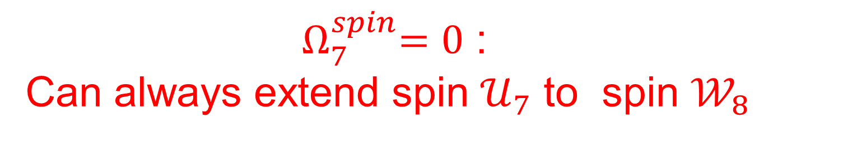



Spin Bordism Theory
${ Ω}_{7}^{spin}=0$ :
Can always extend spin $𝒰_{7}$ to spin $𝒲_{8}$
$Ω_{7}^{spin}\left(BG\right):$ Can be nonzero: There can be
obstructions to extending a $G$-bundle $𝒫→𝒰_{7}$
to a $G$-bundle $\tilde{𝒫}→ 𝒲_{8}$
$Ω_{7}^{spin}\left(BG\right)=0$ for many groups, e.g.
products of $U(n), SU(n), Sp(n).$Also $E_{8}$
But for some $G$ it is nonzero!
Notes:
Say: We’ll come back to this.

Slide 30








When 7D data extends to $𝒲_{8}$ the formula
$$Z_{Anomaly}(𝒰_{7})=exp⁡( 2π i (\frac{1}{2}\int_{𝒲_{8}}{Y^{2} −\frac{sign\left(Λ\right)σ\left(𝒲_{8}\right)}{8}))}$$
$⇒$ clue to constructing $Z_{CT}:$
$$Z_{Anomaly}\left(𝒰_{7}\right)= exp{( 2πi \int_{𝒲_{8}}{\frac{1}{2}X\left(X+λ′\right) )}}$$
$$X= Y−\frac{1}{2}λ′$$
$$λ ≔\frac{1}{2}p_{1}$$
$$λ^{′}=a⊗λ$$
Thanks to our quantization condition on $b$,
$X∈Ω^{4}\left(𝒲_{8};Λ\right)$ has coho class in $H^{4}\left(𝒲_{8};Λ\right)$

Slide 31



$$\exp{( 2πi \int_{𝒲_{8}}{\frac{1}{2}X\left(X+λ′\right) )}}$$
is independent of extension ONLY if
$a∈Λ$ is a characteristic vector:
$$∀ v∈Λ { v}^{2}=v⋅a mod 2$$
This is the partition function of a 7D topological field theory known as
``Wu-Chern-Simons theory.’’

Slide 32




Wu-Chern-Simons Theory
Generalizes spin-Chern-Simons to p-form gauge fields.
Developed in detail in great generality by
Samuel Monnier arXiv:1607.0139
Our case: 7D TFT $Z_{WCS}$ of a (locally defined) 3-form gauge potential C with fieldstrength $X = dC$
$$\left[X\right]∈H^{4}\left(⋯;Λ\right)$$
Instead of spin structure we need a
``Wu-structure’’: A trivialization $ω$ of:
$$ν_{4}=w_{4}+w_{3} w_{1}+w_{2}^{2}+w_{1}^{4}$$

Slide 33





Wu-Chern-Simons
In our case $ν_{4}=w_{4}$ will have a trivialization in 6
and 7 dimensions, but we need to choose one
to make sense of $Z_{WCS}\left(𝒰_{7}\right)$ and $Z_{WCS}\left(ℳ_{6}\right)$
$$Z_{WCS}(𝒰_{7})= exp{( − 2πi \int_{𝒲_{8}}{\frac{1}{2}X\left(X+λ′\right) )}}$$
$$λ^{′}=a⊗λ$$
$a$ must be a characteristic vector of $Λ$
$$Λ^{∨}≅Λ$$

Slide 34







Defining $Z_{CT}$From $Z_{WCS}$
To define the counterterm line bundle $Z_{CT}$ we want to evaluate $Z_{WCS}$ on $(ℳ_{6}, Y)$.
$$\left[Y\right]=\frac{1}{2}a⊗λ+[X]$$
Problem 1:
$Y$ is shifted:
$$\left[X\right]=∑b_{i}c_{2}^{i}+\frac{1}{2}∑b_{IJ}c_{1}^{I}c_{1}^{J}∈H^{4}\left(⋯;Λ\right)$$
Problem 2:
$Z_{WCS}^{ω}$ needs a choice of Wu-structure $ω$.
!! We do not want to add a choice of Wu structure to the defining set of sugra data
$$\left(G,ℛ,Λ,a,b\right)$$

Slide 35





Defining $Z_{CT}$From $Z_{WCS}$
Solution: Given a Wu-structure $ω$ we can shift $Y$ to $X=Y −\frac{1}{2}v\left(ω\right)$ , an unshifted field, such that $Z_{WCS}^{ω}(…;Y−\frac{1}{2}v\left(ω\right))$ is independent of $ω$
$$Z_{CT}\left(⋯;Y\right)≔Z_{WCS}^{ω}\left(⋯; Y−\frac{1}{2}v\left(ω\right)\right)$$
Thus, $Z_{CT}$ is independent of Wu structure $ω$: So no need to add this extra data to the definition of 6d sugra.
$Z_{CT}$ transforms properly under B-field, diff, and VM gauge transformations: $Z_{CT}\left(ℳ_{6} \right)≅Z_{Anomaly}{\left(ℳ_{6} \right)}^{∗}$

Slide 36


Anomaly Cancellation
${{ Z}_{TOP}≔ Z}_{Anomaly}×Z_{CT}$ is a 7D
topological field theory that is defined
bordism classes of $G$-bundles.
7D partition function is a homomorphism:
$Z_{Anomaly}×Z_{CT}$ $:Ω_{7}^{spin}\left(BG\right)→U\left(1\right)$
If this homomorphism is trivial then
${ Z}_{Anomaly}×Z_{CT}\left(ℳ_{6}\right)≅1$
is canonically trivial.

Slide 37



Anomaly Cancellation
Suppose the 7D TFT is indeed trivializable
Now need a section, $Ψ_{CT}\left(ℳ_{6} \right)$ which is local
in the six-dimensional fields.
This will be our Green-Schwarz counterterm:
$$\int_{Fermi+B}{e^{S_{Fermi+B}}Ψ_{CT}(ℳ_{6};A,g_{μν},B)}$$
The integral will be a function on $ℬ/𝒢$

Slide 38

1
Introduction & Summary Of Results
2
Six-dimensional Sugra & Green-Schwarz Mech.
3
Quantization Of Anomaly Coefficients.
Geometrical Anomaly Cancellation, $η$-Invariants
& Wu-Chern-Simons
4
5
Technical Tools & Future Directions
6
F-Theory Check
7
Concluding Remarks

Slide 39



Checks & Hats:
Differential Cohomology
$$H^{k}\left(X\right)→{\check{H}}^{k}\left(X\right)$$
Notes:
At this point, do what what I’ve said carefully you need
Some technical tools, and an important one is differential
Cohomology. The notation involves a lot of checks and hats
As we replace cohomology groups by differential cohomology
Groups. I’m reminded of a wonderful story told by Peter Freund
In his delightful book about his days as a postdoc with Stuckelberg.
Except here, the checks and hats really mean something. Very roughly

Slide 40
Checks & Hats:
Differential Cohomology
Precise formalism for working with p-form fields in
general spacetimes (and p-form global symmetries)
Three independent pieces of gauge invariant information:
Wilson lines
Fieldstrength
Topological class
Differential cohomology is an infinite-dimensional
Abelian group that precisely accounts for these data and nicely summarizes how they fit together.
Exposition for physicists: Freed, Moore & Segal, 2006

Slide 41



Construction Of The Green-Schwarz Counterterm:
$$Ψ_{CT}=\exp{2πi \int_{ℳ_{6}}^{E,ω}{gst}}$$
$$gst={\left(\frac{1}{2}\left[\left(\check{H}−\frac{1}{2}\check{η}\right)∪\left(\check{Y}+\frac{1}{2}\check{ν}\right)\right)\right]}_{hol}, h_{2}−\frac{1}{2}η )$$
Section of the right line bundle & independent
of Wu structure $ω$.
Locally constructed in six dimensions, but
makes sense in topologically nontrivial cases.
Locally reduces to the expected answer

Slide 42




Conclusion: All Anomalies Cancel:
for $\left(G,ℛ,Λ,a,b\right)$ such that:
$$I_{8}=\frac{1}{2} Y^{2}$$
$a∈Λ≅Λ^{∨}$ is characteristic & $a^{2}=9−T$
$$\frac{1}{2}b∈H^{4}\left(BG_{1};Λ\right)$$
$$Ω_{7}^{spin}\left(BG\right)=0$$

Slide 43
Except,…

Slide 44

What If The Bordism Group Is Nonzero?
We would like to relax the last condition,
but it could happen that
$Z_{Anomaly}×Z_{CT}$ $:Ω_{7}^{spin}\left(BG\right)→U\left(1\right)$
defines a nontrivial bordism invariant.
For example, if $G=O\left(N\right),$ for suitable representations,
the 7D TFT might have partition function $\exp{2πi \int_{𝒰_{7}}{w_{1}^{7}}}$
Then the theory would be anomalous.

Slide 45


Future Directions
Understand how to compute ${ Z_{TOP}≔ Z}_{Anomaly}×Z_{CT}$
When $Ω_{7}^{spin}\left(BG\right)$is nonvanishing
there will be new conditions.
(Examples exist!!)
Finding these new conditions in complete
generality looks like a very challenging problem…

Slide 46
1
Introduction & Summary Of Results
2
Six-dimensional Sugra & Green-Schwarz Mech.
3
Quantization Of Anomaly Coefficients.
Geometrical Anomaly Cancellation, $η$-Invariants
& Wu-Chern-Simons
4
5
Technical Tools & Future Directions
6
F-Theory Check
7
Concluding Remarks

Slide 47
And What About F-Theory ?
F-Theory compactifications
?

Slide 48



F-Theory: It’s O.K.
$𝔤$ is determined from the
discriminant locus [Morrison & Vafa 96]
In order to check $\frac{1}{2}b∈H^{4}(BG_{1};Λ)$
we clearly need to know $G_{1}.$
We found a way to determine $G_{1}$.
F-theory passes this test.
We believe a very similar argument also gives
the (identity component of) 4D F-theory.

Slide 49
1
Introduction & Summary Of Results
2
Six-dimensional Sugra & Green-Schwarz Mech.
3
Quantization Of Anomaly Coefficients.
Geometrical Anomaly Cancellation, $η$-Invariants
& Wu-Chern-Simons
4
5
Technical Tools & Future Directions
6
F-Theory Check
7
Concluding Remarks
Notes:
So that’s the end of the scientific part of my talk. I want to take
The last few minutes to say a few words about Joe and to thank
The organizers.

Slide 50

Notes:
I don’t need to tell this audience what a great physicist
Joe Polchinski was, but he was also a good friend ever since we met
at Harvard in the mid-80’s, and I’d like to say a few words about him.
I am grateful to Joe for many things and I’ll just tell you about one.
You know, it is very rare that you go to a seminar that completely
changes your career path. Those moments are real treasures. Joe gave such a seminar at Harvard
Around 1985. It was beautiful, clear, to the point, filled with enthusiasm and it set me onto a good path, as well as a good collaboration with him. So, I have to thank Joe for that - and for many other things as well. He was is a model of enthusiasm, good nature, and integrity that we should all try to emulate.
Finally, as the last speaker, it falls to me in leading all of us in thanking the organizers.

Slide 51

HUGE THANKS TO THE ORGANIZERS!
Hirosi Ooguri Koji Hashimoto
おおぐり ひろし はしもと こうじ
Youhei Morita Yoshihisa Kitazawa
もりた ようへい きたざわ よしひさ
Hitoshi Murayama Hirotaka Sugawara
むらやま ひとし すがわら ひろたか
and the OIST!!
Notes:
So, in square dancing there is a sweet tradition where, at the end
Of the dance everyone joins hands in one big circle and, in unison,
Says “Thank you!” and applauds. Well, I think we can skip the joining hands part, but we could and should say “Thank you” in unison to the organizers – so, altogether now, on the count of three, let’s give them a big “Thank you” . Ready?
One, two, three -- “THANK YOU” !

