Slide 1
Web Formalism and the IR limit of 1+1 N=(2,2) QFT
- or -
A short ride with a big machine
String-Math, Edmonton, June 12, 2014
Gregory Moore, Rutgers University
collaboration with
Davide Gaiotto & Edward Witten
draft is ``nearly finished’’…
Notes:
Quote what John Adams said about it: "You know how it is when someone asks you to ride in a terrific sports car, and then you wish you hadn't?"

Slide 2
Three Motivations
IR sector of massive 1+1 QFT with N =(2,2) SUSY
2. Knot homology.
3. Categorification of 2d/4d wall-crossing formula.
(A unification of the Cecotti-Vafa and Kontsevich-Soibelman formulae.)

Slide 3
Witten (2010) reformulated knot homology in terms of Morse complexes.
This formulation can be further refined to a problem in the categorification of Witten indices in certain LG models (Haydys 2010, Gaiotto-Witten 2011)
Gaiotto-Moore-Neitzke studied wall-crossing of BPS
degeneracies in 4d gauge theories. This leads naturally
to a study of Hitchin systems and Higgs bundles.
When adding surface defects one is naturally led to a “nonabelianization map” inverse to the usual abelianization map
of Higgs bundle theory. A “categorification” of that map should lead to a categorification of the 2d/4d wall-crossing formula.

Slide 4
Goals & Results - 1
Goal: Say everything we can about massive (2,2) theories in the far IR.
Since the theory is massive this would appear to be trivial.
Result: When we take into account the BPS states there is an extremely rich mathematical structure.
We develop a formalism – which we call the ``web-based formalism’’ –
(that’s the ``big machine’’) - which shows that:

Slide 5
Goals & Results - 2
BPS states have ``interaction amplitudes’’ governed by an L algebra
(Using just IR data we can define an L - algebra and there are ``interaction amplitudes’’ of BPS states that define a solution to the Maurer-Cartan equation of that algebra.)
There is an A category of branes/boundary conditions, with amplitudes for emission of BPS particles from the boundary governed by solutions to the MC equation.
(A and L are mathematical structures which play an important role in open and closed string field theory, respectively. )
Notes:
Now, I realize that the use of such language is socially inappropriate in the present social situation …

Slide 6
Goals & Results - 3
If we have a pair of theories then we can construct supersymmetric interfaces between the theories.
Such interfaces define A functors between Brane categories.
Theories and their interfaces form an A 2-category.
Given a continuous family of theories (e.g. a continuous family of LG superpotentials) we show how to
construct a ``flat parallel transport’’ of Brane categories.
The parallel transport of Brane categories is constructed using interfaces.
The flatness of this connection implies, and is a categorification of, the 2d wall-crossing formula.
Notes:
Now, I realize that the use of such language is socially inappropriate in the present social situation …

Slide 7
Outline
Introduction: Motivations & Results
Web-based formalism
Web representations & L∞
Half-plane webs & A∞
Interfaces
Flat parallel transport
Summary & Outlook

Slide 8
Definition of a Plane Web
We now give a purely mathematical construction.
It is motivated from LG field theory.
Vacuum data:
1. A finite set of ``vacua’’:
2. A set of weights
Definition: A plane web is a graph in R², together with a coloring of faces by vacua (so that across edges labels differ) and if an edge is oriented so that i is on the left and j on the right then the edge is parallel to z_{ij} = z_{i} – z_{j} . (Option: Require vertices at least 3-valent.)

Slide 10
Physically, the edges will be worldlines of BPS solitons
in the (x,t) plane, connecting two vacua:
See Davide Gaiotto’s talk.
Useful intuition: We are joining together straight strings under a tension z_{ij}. At each vertex there is a no-force condition:

Slide 11
Deformation Type
Equivalence under translation and stretching (but not rotating) of strings subject to edge constraints defines deformation type.

Slide 12




Moduli of webs with fixed deformation type
(z_{i} in generic position)

Slide 13
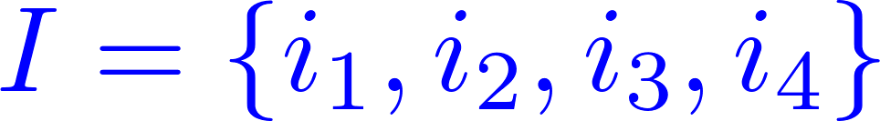
Cyclic Fans of Vacua
Definition: A cyclic fan of vacua is a cyclically-ordered set
are ordered clockwise
so that the rays

Slide 14


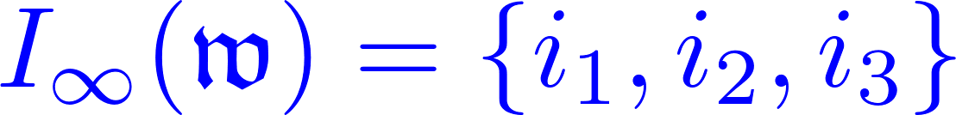
Fans at vertices and at ∞
For a web w there are two kinds of cyclic fans we should consider:
Local fan of vacua at a vertex v:
Fan of vacua ∞ :

Slide 15
Convolution of Webs
Definition: Suppose w and w’ are two plane webs and
v ∈ V(w) such that
The convolution of w and w’ , denoted w *_{v} w’ is the deformation type where we glue in a copy of w’ into a small disk cut out around v.

Slide 17
The Web Ring
Free abelian group generated by oriented deformation types of plane webs.
``oriented’’: Choose an orientation o(w) of D^{red}(w)

Slide 18
Rigid, Taut, and Sliding
A rigid web has d(w) = 0.
It has one vertex:
A taut web has d(w) = 1:
A sliding web has d(w) = 2

Slide 19

The taut element
Definition: The taut element t is the sum of all taut webs with standard orientation
Theorem:
Proof: The terms can be arranged so that there is a cancellation of pairs:
Representing two ends of a moduli space of sliding webs

Slide 20



Slide 21
Outline
Introduction: Motivations & Results
Web-based formalism
Web representations & L∞
Half-plane webs & A∞
Interfaces
Flat parallel transport
Summary & Outlook

Slide 22
Web Representations
Definition: A representation of webs is
a.) A choice of Z-graded Z-module R_{ij} for every ordered pair ij of distinct vacua.
b.) A degree = -1
perfect pairing
For every cyclic fan of vacua introduce a fan representation:

Slide 23
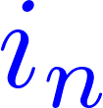




Slide 24


Web Rep & Contraction
Given a rep of webs and a deformation type w we define the representation of w :
There is a natural contraction operator:
by applying the contraction K to the pairs R_{ij} and R_{ji} on each internal edge:

Slide 26

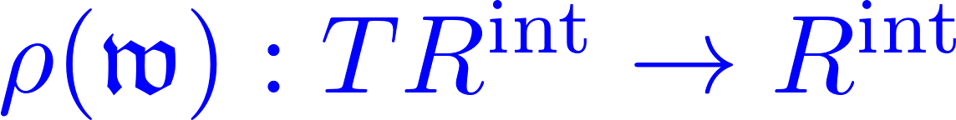



Extension to Tensor Algebra
Rep of all vertices.
vanishes, unless

Slide 27

Example

Slide 28
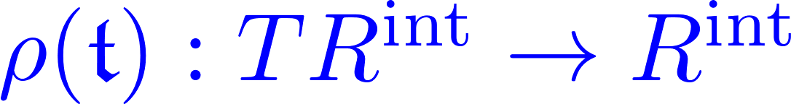

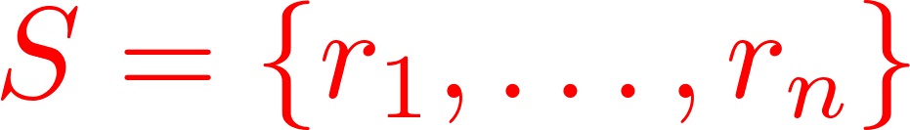


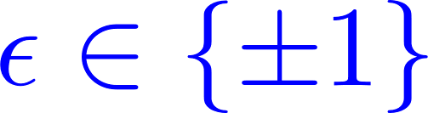
L -algebras

Slide 29
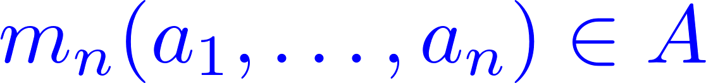
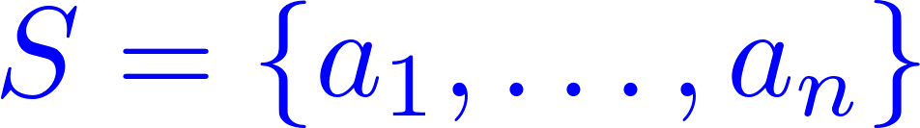


L and A Algebras
If A is a vector space (or Z-module) then an -algebra structure is a series of multiplications:
Which satisfy quadratic relations:

Slide 30


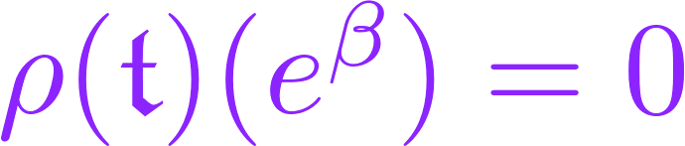
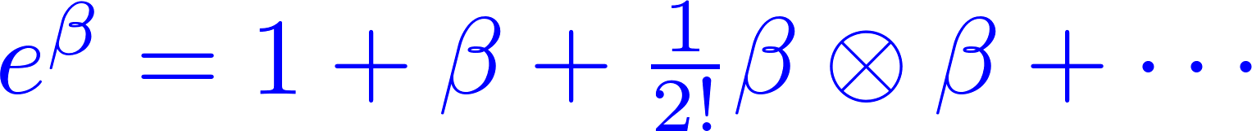
The Interior Amplitude
Sum over cyclic fans:
Interior amplitude:
Satisfies the L
``Maurer-Cartan equation’’
``Interaction amplitudes for solitons’’

Slide 31
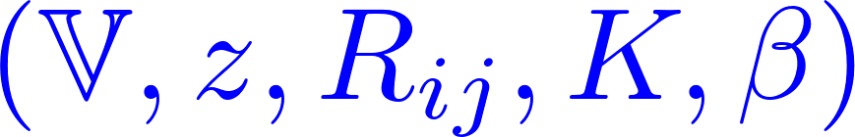
Definition of a Theory
By a Theory we mean a collection of data

Slide 32
Outline
Introduction: Motivations & Results
Web-based formalism
Web representations & L∞
Half-plane webs & A∞
Interfaces
Flat parallel transport
Summary & Outlook

Slide 33
Half-Plane Webs
Same as plane webs, but they sit in a half-plane H.
Some vertices (but no edges) are allowed on the boundary.
Interior vertices
time-ordered boundary vertices.
deformation type, reduced moduli space, etc. ….

Slide 34
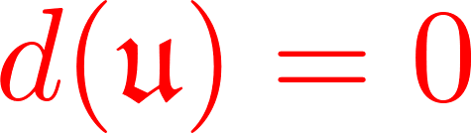
Rigid Half-Plane Webs

Slide 35
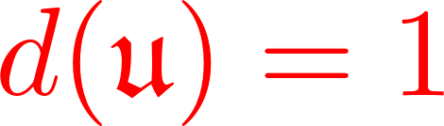
Taut Half-Plane Webs

Slide 36
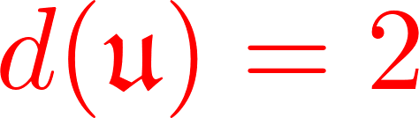
Sliding Half-Plane webs

Slide 37
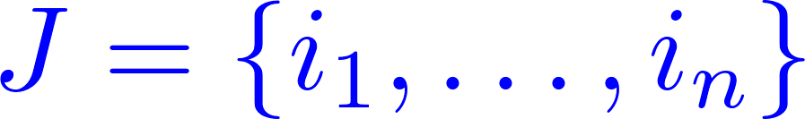
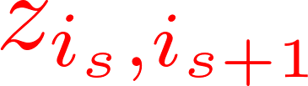
Half-Plane fans
A half-plane fan is an
ordered set of vacua,
such that successive
vacuum weights:
are ordered clockwise and in the half-plane:

Slide 38



Convolutions for Half-Plane Webs
We can now introduce a convolution at boundary vertices:
Local half-plane fan at a boundary vertex v:
Half-plane fan at infinity:
Free abelian group generated by oriented def. types of half-plane webs
There are now two convolutions:

Slide 39
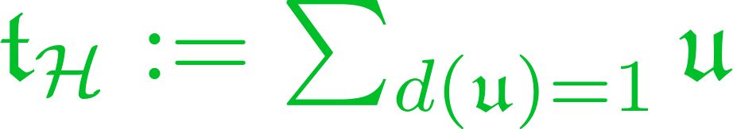
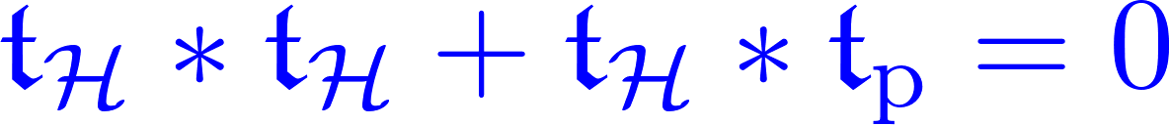
Convolution Theorem
Define the half-plane
taut element:
Theorem:
Proof: A sliding half-plane web can degenerate
(in real codimension one) in two ways: Interior edges can collapse onto an interior vertex, or boundary edges can collapse onto a boundary vertex.

Slide 41
Half-Plane Contractions
A rep of a half-plane fan:
(u) now contracts R(u):
time ordered!

Slide 42
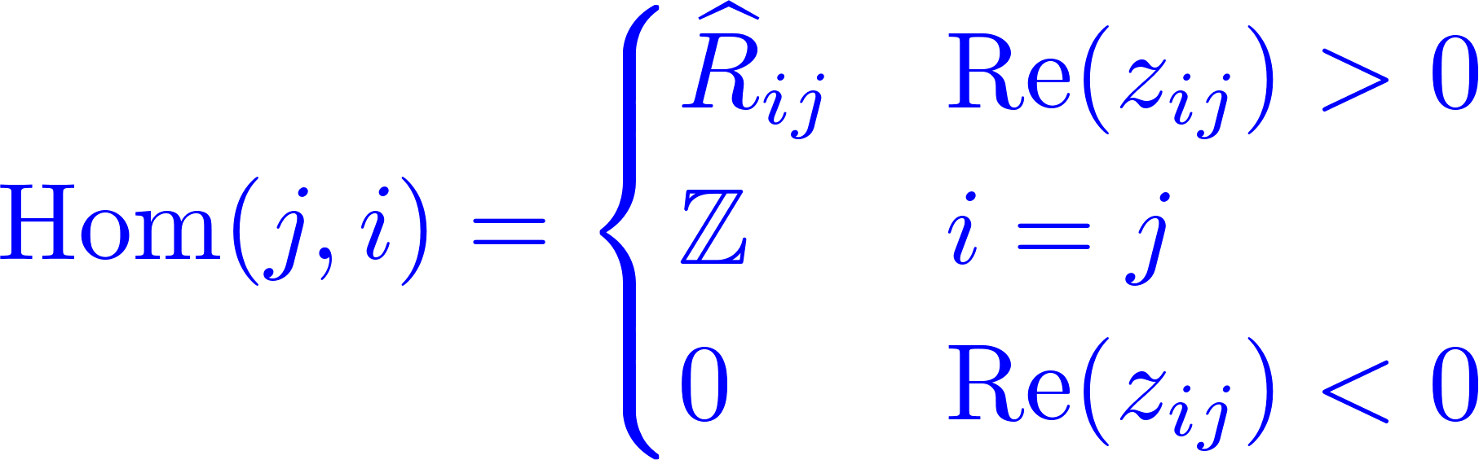

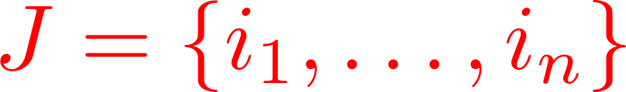
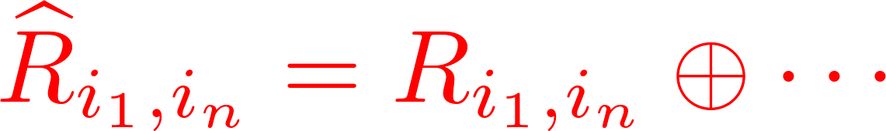
The Vacuum A Category
(For H = the positive half-plane )
Objects: i ∈ V.
Morphisms:

Slide 43

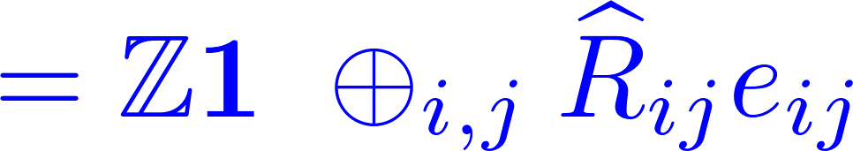
Hint of a Relation to Wall-Crossing
The morphism spaces can be defined by a
Cecotti-Vafa/Kontsevich-Soibelman-like product:
Suppose V = { 1, …, K}.
Introduce the elementary K x K matrices e_{ij}
phase ordered!

Slide 44
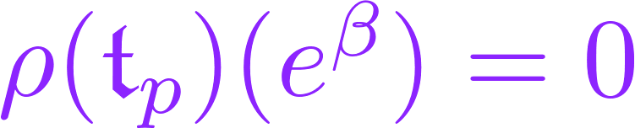
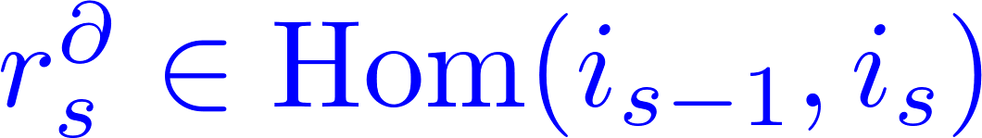
A Multiplication
Interior amplitude:
Satisfies the L
``Maurer-Cartan equation’’

Slide 45









Slide 46




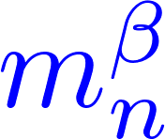


Enhancing with CP-Factors
Z-graded module
CP-Factors:
Enhanced A category :

Slide 47
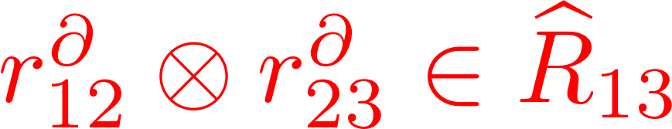

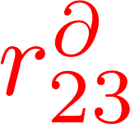
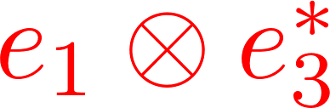
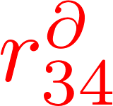




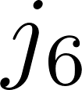
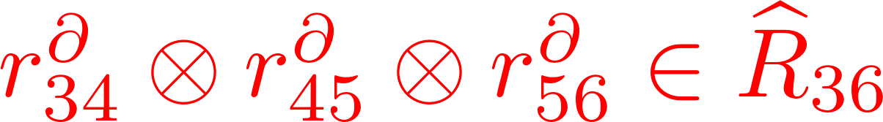
Example: Composition of two morphisms

Slide 48
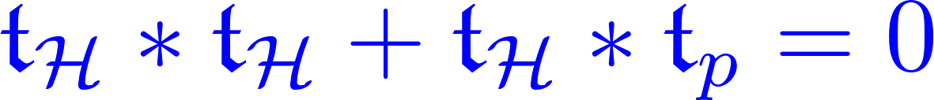


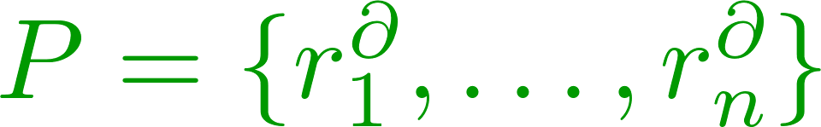


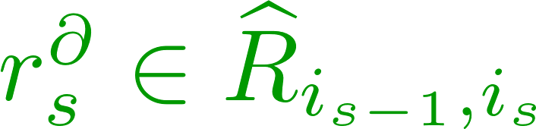
Proof of A Relations

Slide 49



and the second line vanishes.
Hence we obtain the A relations for :
Defining an A category :

Slide 50
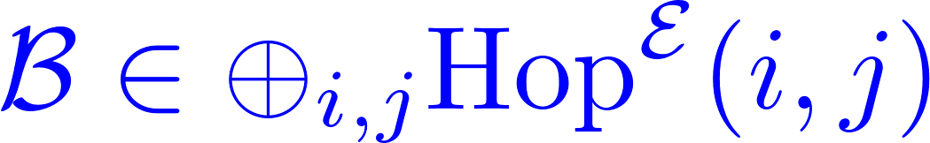
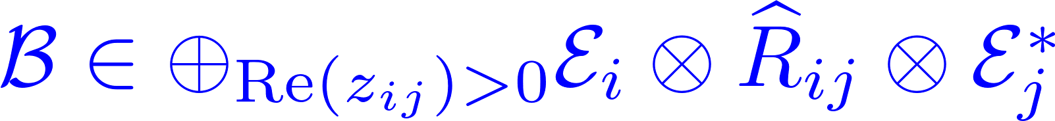

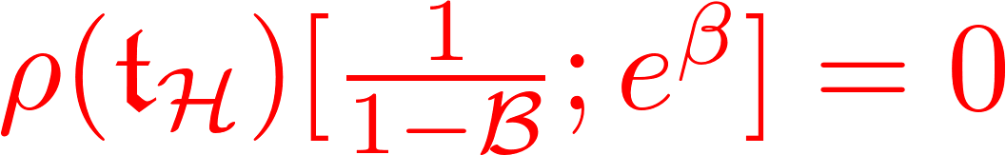
Boundary Amplitudes
A Boundary Amplitude B (defining a Brane) is a solution of the A MC:
``Emission amplitude’’ from the boundary:

Slide 51

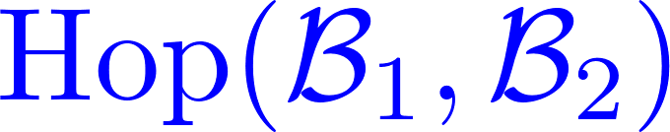

Category of Branes
The Branes themselves are objects in an A category
(“Twisted complexes”: Analog of the derived category.)

Slide 52
Outline
Introduction: Motivations & Results
Web-based formalism
Web representations & L∞
Half-plane webs & A∞
Interfaces
Flat parallel transport
Summary & Outlook

Slide 53
Families of Data
Now suppose the data of a Theory varies continuously with space:
We have an interface or Janus between the theories
at x_{in} and x_{out}.
?? How does the Brane category change??
We wish to define a ``flat parallel transport’’ of
Brane categories. The key will be to develop a theory
of supersymmetric interfaces.

Slide 54



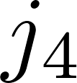
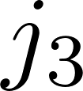
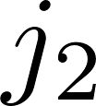
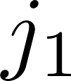
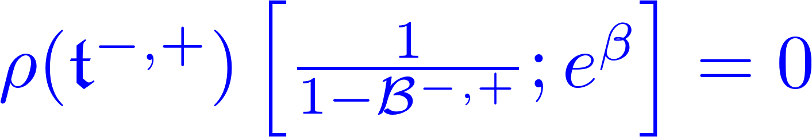
Interface webs & amplitudes
Given data
Introduce a notion of ``interface webs’’
These behave like half-plane webs and we can define an Interface Amplitude to be a solution of the MC equation:

Slide 55
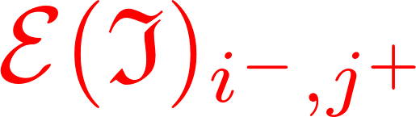
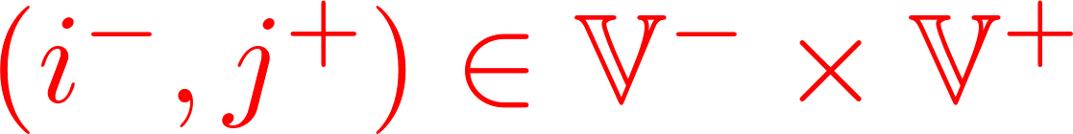
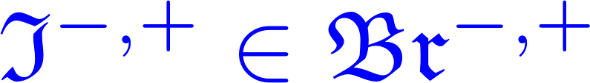
Category of Interfaces
Interfaces are very much like Branes,
Chan-Paton:
In fact we can define an A category of Interfaces between the two theories:
Note: If one of the Theories is trivial we simply recover the category of Branes.

Slide 56
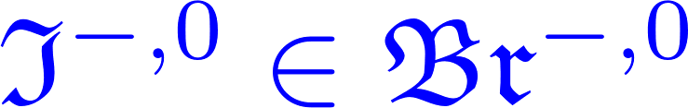
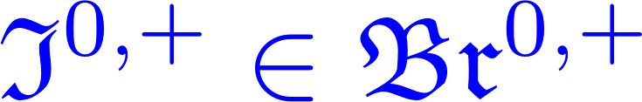




Composition of Interfaces -1
Want to define a ``multiplication’’ of the Interfaces…

Slide 57
Composition of Interfaces - 2

Slide 58

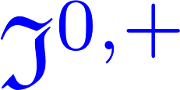

Mapping of Branes
Special case: ``maps’’ branes in theory T ⁰ to branes in theory T ⁺ :

Slide 59



Technique: Composite webs
Given data
Introduce a notion of ``composite webs’’

Slide 60

Def: Composition of Interfaces
A convolution identity implies:
Interface amplitude
Physically: An OPE of susy Interfaces
Theorem: The product is an A bifunctor

Slide 61




Associativity?

Slide 62






Homotopy Equivalence
(Standard homological algebra)
Product is associative up to homotopy equivalence

Slide 63




Webology: Deformation type, taut element, convolution identity, …

Slide 64



An A 2-category
Objects, or 0-cells are Theories:
1-Morphisms, or 1-cells are objects in the category of Interfaces:
2-Morphisms, or 2-cells are morphisms in the category of Interfaces:

Slide 65








Slide 66
Outline
Introduction: Motivations & Results
Web-based formalism
Web representations & L∞
Half-plane webs & A∞
Interfaces
Flat parallel transport
Summary & Outlook

Slide 67


Parallel Transport of Categories
For any continuous path:
we want to associate an A functor:

Slide 68
Interface-Induced Transport
Idea is to induce it via a suitable Interface:
But how do we construct the Interface?

Slide 69





Example: Spinning Weights
constant
We can construct explicitly:

Slide 70



Technique: Curved Webs
Webology: Deformation type, taut element, convolution identity, …

Slide 71



Reduction to Elementary Paths:

Slide 72

Categorified ``S-wall crossing’’
For spinning weights this works very well.
decomposes as a product of ``trivial parallel transport Interfaces’’ and ``S-wall Interfaces,’’ which categorify
the wall-crossing of framed BPS indices.
In this way we categorify the ``detour rules’’ of the nonabelianization map of spectral network theory.

Slide 73
General Case?
To continuous ℘ we want to associate an A functor
etc.
You can’t do that for arbitrary (x) !

Slide 74







Slide 75


Categorified Cecotti-Vafa Wall-Crossing
We cannot construct F[] keeping  and R_{ij} constant!
Existence of suitable Interfaces needed for flat transport of Brane categories implies that the
web representation jumps discontinuously:

Slide 76
Categorified Wall-Crossing
In general: the existence of suitable wall-crossing Interfaces needed to construct a flat parallel transport F[] demands that for certain paths of vacuum weights the web representations (and interior amplitude) must jump discontinuously.
Moreover, the existence of wall-crossing interfaces constrains how these data must jump.

Slide 77
Outline
Introduction: Motivations & Results
Web-based formalism
Web representations & L∞
Half-plane webs & A∞
Interfaces
Flat parallel transport
Summary & Outlook

Slide 78
Summary
Motivated by 1+1 QFT we constructed a web-based formalism
2. This naturally leads to L and A structures.
3. It gives a natural framework to discuss Brane categories and Interfaces and the 2-category structure
4. There is a notion of flat parallel transport of Brane categories. The existence of such a transport implies categorified wall-crossing formulae

Slide 79
Outlook
1. There are many interesting applications to Physical Mathematics: See Davide Gaiotto’s talk.
2. There are several interesting generalizations of the web-based formalism, not alluded to here.
3. The generalization of the categorified 2d-4d wall-crossing formula remains to be understood.

