Slide 1
The u-Plane Integral As A Tool In The Theory Of Four-Manifolds
Gregory Moore
Rutgers University
SCGP, April 26 , 2017

Slide 2
1
Introduction
2
Lightning Summary: The Physical Derivation Of Witten’s Conjecture Relating Donaldson & SW
3
Brief Overview Of The World Of N=2 Theories
Donaldson-Witten Partition Function For General Compact Simple Lie Group
4
5
Theories With Matter & Superconformal Simple Type
6
Two Possible Future Directions

Slide 3
Introduction
Most of this talk reviews work done around 1997-1998:
Moore & Witten
Marino & Moore
Marino, Moore, & Peradze
Overlapping work: Losev, Nekrasov, & Shatashvili
Central Question: Given the successful application of N=2 SYM for SU(2) to the theory of 4-manifold invariants, are there interesting applications of OTHER N=2 field theories?
Recently re-visited with Iurii Nidaiev

Slide 4
1
Introduction
2
Lightning Summary: The Physical Derivation Of Witten’s Conjecture Relating Donaldson & SW
3
Brief Overview Of The World Of N=2 Theories
Donaldson-Witten Partition Function For General Compact Simple Lie Group
4
5
Theories With Matter & Superconformal Simple Type
6
Two Possible Future Directions

Slide 5

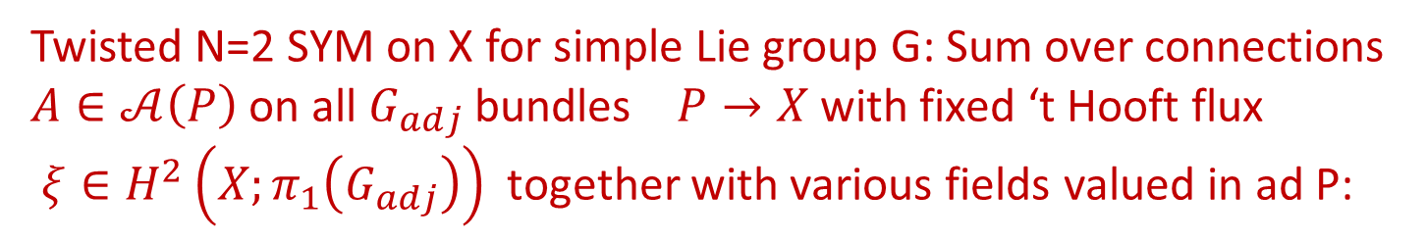



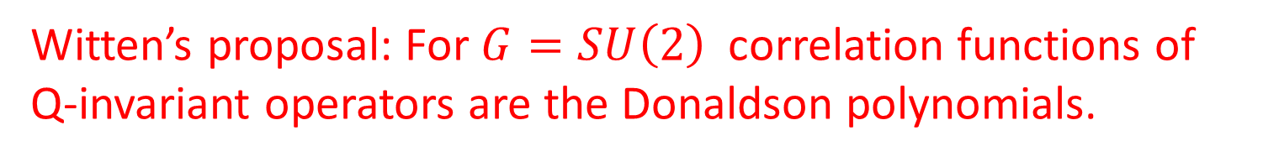
Review: Derivation Of Witten Conjecture From SU(2) SYM
$X:$Smooth, compact, $∂X=∅ ,$oriented, ($π_{1}\left(X\right)=0)$
Twisted N=2 SYM on X for simple Lie group G: Sum over connections
$A∈𝒜\left(P\right)$on all $G_{adj}$ bundles $P→X$with fixed ‘t Hooft flux
$ξ∈H^{2}\left(X;π_{1}\left(G_{adj}\right)\right)$together with various fields valued in ad P:
$$φ∈Ω^{0}(adP⊗ℂ)$$
$$χ∈ΠΩ^{2,+}\left(adP\right)$$
$$η∈ΠΩ^{0}(adP)$$
$$ψ∈ΠΩ^{1}\left(adP\right)$$
Formally: Correlation functions of Q-invariant operators localize to
integrals over the finite-dimensional moduli spaces of G-ASD conn’s.
Witten’s proposal: For $G=SU\left(2\right)$ correlation functions of
Q-invariant operators are the Donaldson polynomials.

Slide 6
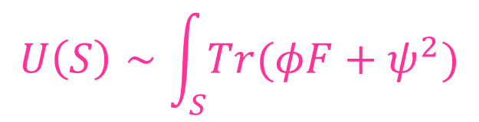

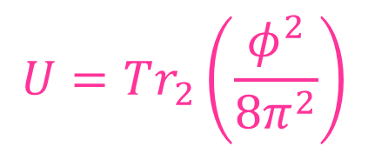
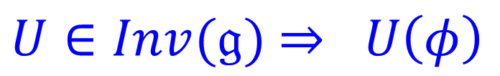

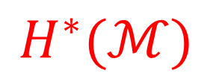
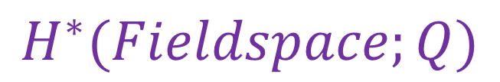

Local Observables
$U∈Inv(𝔤)$ $⇒ U\left(φ\right)$
Descent formalism
$$H_{∗}(X,ℤ)$$
$$H^{∗}(Fieldspace;Q)$$
$$μ$$
Localization identity
$$H^{∗}(ℳ)$$
$$U=Tr_{2}\left(\frac{φ^{2}}{8π^{2}}\right)$$
$$U\left(S\right)∼\int_{S}{Tr(φF+ψ^{2})}$$
$$𝔤=𝔰𝔲(2)$$

Slide 7
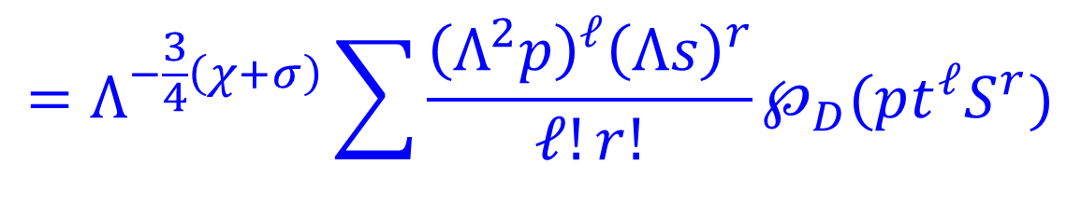
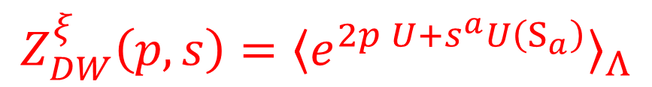


Donaldson-Witten Partition Function
$$Z_{DW}^{ξ}\left(p,s\right)={〈e^{2p U+s^{a}U\left(S_{a}\right)}〉}_{Λ}$$
$$=Λ^{−\frac{3}{4}\left(χ+σ\right)}\sum{\frac{{\left(Λ^{2}p\right)}^{ℓ}{\left(Λs\right)}^{r}}{ℓ!r!}℘_{D}(pt^{ℓ}S^{r})}$$
Mathai-Quillen & Atiyah-Jeffrey:
Path integral formally localizes:
$$ℳ↪𝒜/𝒢$$
Strategy: Evaluate in LEET:
Integrate over vacua on $ℝ^{4}$

Slide 8

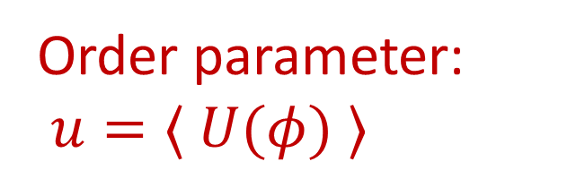
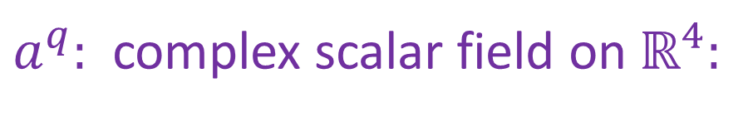



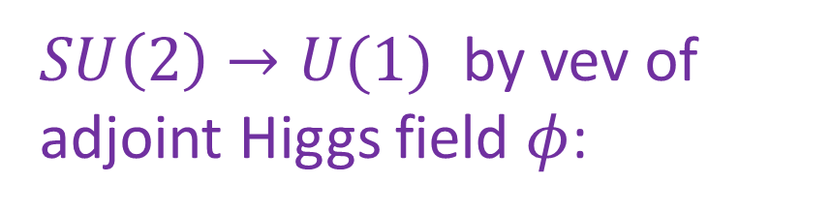
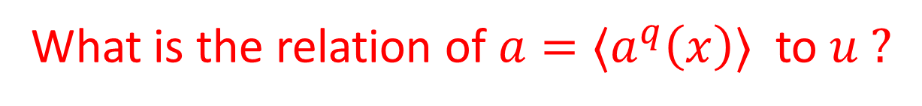
Spontaneous Symmetry Breaking
$SU\left(2\right)→U(1)$ by vev of adjoint Higgs field $φ$:
Order parameter: $u=〈 U(φ) 〉$
Coulomb branch: $ℬ=𝔱⊗ℂ/W≅ℂ$
$$adP→L^{2}⊕𝒪⊕L^{−2}$$
Photon: Connection A on L
$$U\left(1\right) VM: \left(a^{q}, A, χ, ψ,η\right)$$
$a^{q}:$ complex scalar field on $ℝ^{4}:$
Do path integral of quantum fluctuations around
$$a^{q}\left(x\right)=a+δa(x)$$
What is the relation of $a=〈a^{q}\left(x\right)〉$ to $u ?$
What are the couplings in the LEET for the U(1) VM ?

Slide 9
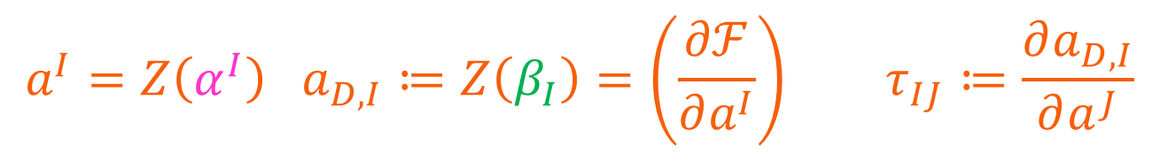
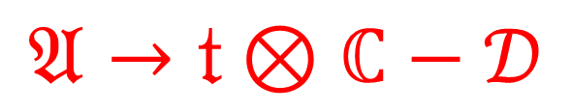

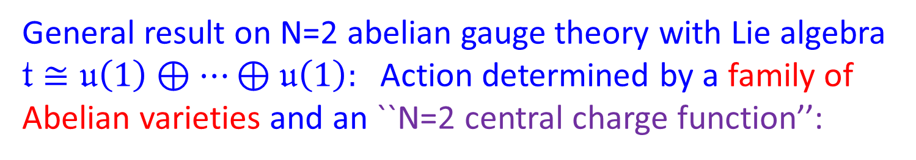




LEET: Constraints of N=2 SUSY
General result on N=2 abelian gauge theory with Lie algebra
$𝔱≅𝔲\left(1\right)⊕⋯⊕𝔲\left(1\right):$ Action determined by a family of
Abelian varieties and an ``N=2 central charge function’’:
$$𝔄→𝔱⊗ℂ−𝒟$$
$$Γ≔H_{1}\left(𝔄;ℤ\right)$$
$$Z:Γ→ℂ$$
$$〈dZ, dZ 〉=0$$
Duality Frame: $Γ≅Γ^{electric}⊕Γ^{magnetic}$
$$a^{I}=Z\left(α^{I}\right) a_{D,I}≔Z\left(β_{I}\right)=\left(\frac{∂ℱ}{∂a^{I}}\right) τ_{IJ}≔\frac{∂a_{D,I}}{∂a^{J}}$$
$$Action∼\int_{X}{\overline{τ}{\left(F^{+}\right)}^{2}+τ{\left(F^{−}\right)}^{2}+da^{q}∗\left(Im τ\right)d \overline{a^{q}}+⋯}$$

Slide 10

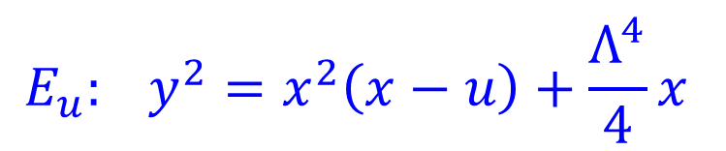
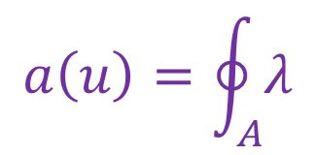

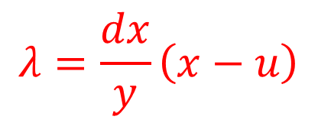

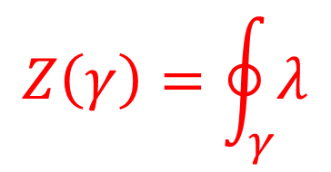
Seiberg-Witten Theory:
For G=SU(2) SYM $𝔄$is a family of elliptic curves:
$$E_{u}: y^{2}=x^{2}\left(x−u\right)+\frac{Λ^{4}}{4}x$$
$$u∈ℂ$$
$$Z\left(γ\right)=\oint_{γ}{λ}$$
$$λ=\frac{dx}{y}\left(x−u\right)$$
$$a\left(u\right)=\oint_{A}{λ}$$
$$u→∞: Invariant cycle A:$$
Choose B-cycle: $⇒τ\left(a\right)⇒$Action for LEET
LEET breaks down at $u=±Λ^{2}$ where $Im\left(τ\right)→0$

Slide 11

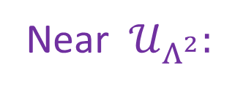

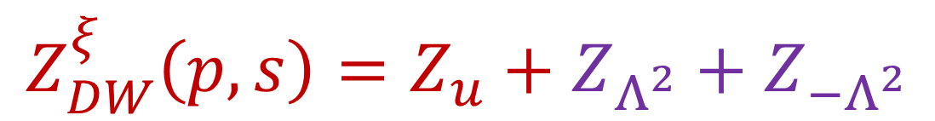

Seiberg-Witten Theory - II
LEET breaks down because there are new
massless fields associated to BPS states
$$u=−Λ^{2}$$
$$u=Λ^{2}$$
$$U{\left(1\right)}_{D} VM: (a_{D}, A_{D}, χ_{D},ψ_{D},η_{D})$$
Near $𝒰_{Λ^{2}}:$
+
Charge 1 HM: $\left(M=q⊕{\tilde{q}}^{∗}, ⋯\right)$
$$Z_{DW}^{ξ}\left(p,s\right)=Z_{u}+Z_{Λ^{2}}+Z_{−Λ^{2}}$$

Slide 12
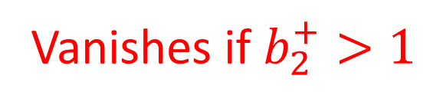


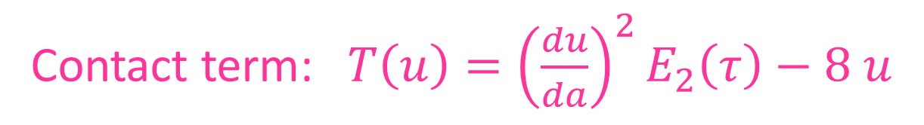

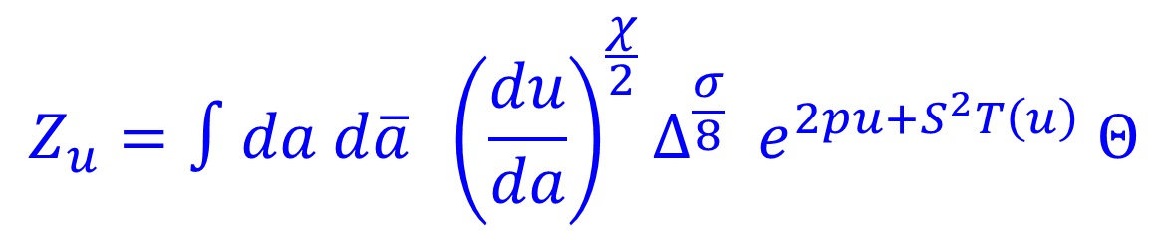
u-Plane Integral $Z_{u}$
Can be computed explicitly from QFT of LEET
Vanishes if $b_{2}^{+}>1$
$$Z_{u}=∫da d\overline{a} {\left.\left(\frac{du}{da}\right.\right)}^{\frac{χ}{2}}Δ^{\frac{σ}{8}} e^{2pu+S^{2}T\left(u\right)} Θ$$
$$Δ=\left(u−Λ^{2}\right)\left(u+Λ^{2}\right)$$
Contact term: $T\left(u\right)={\left(\frac{du}{da}\right)}^{2}E_{2}\left(τ\right)−8 u$
$Θ$: Sum over line bundles for the U(1) photon.

Slide 13
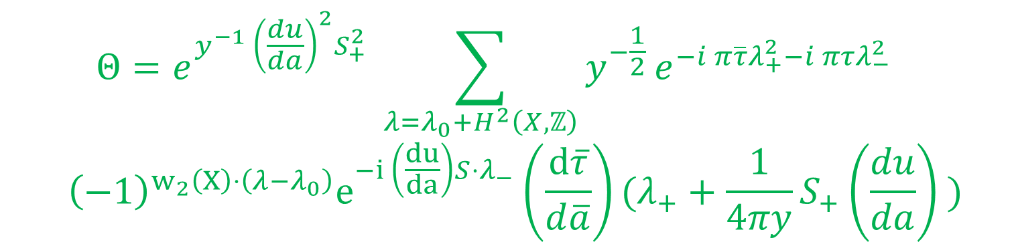
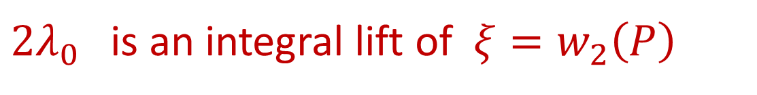
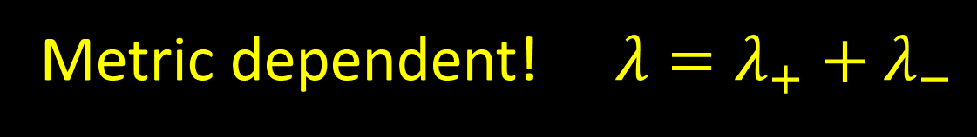

Photon Theta Function
$$Θ=e^{y^{−1} {\left(\frac{du}{da}\right)}^{2}S_{+}^{2}} \sum_{λ=λ_{0}+H^{2}\left(X,ℤ\right)}{y^{−\frac{1}{2}}}e^{−i π\overline{τ}λ_{+}^{2}−i πτλ_{−}^{2}}$$
$${\left(−1\right)}^{w_{2}\left(X\right)⋅\left(λ−λ_{0}\right)}e^{−i \left(\frac{du}{da}\right)S⋅λ_{−}}\left(\frac{d\overline{τ}}{d\overline{a}}\right)(λ_{+}+\frac{1}{4πy}S_{+}\left(\frac{du}{da}\right) )$$
$$τ=x+i y$$
${2λ}_{0}$ is an integral lift of $ξ=w_{2}\left(P\right)$
Metric dependent! $λ=λ_{+}+λ_{−}$

Slide 14

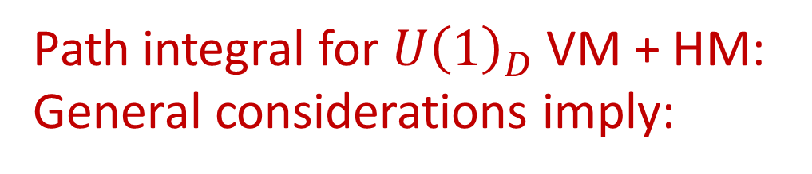
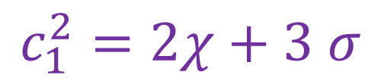

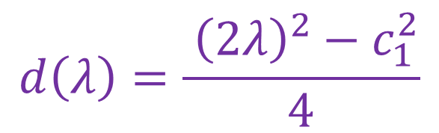
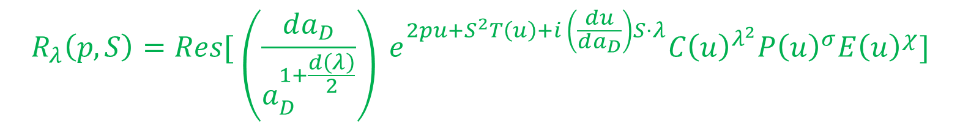
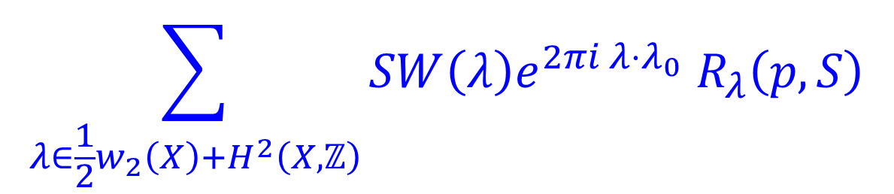
Contributions From $𝒰_{Λ^{2}}$
Path integral for $U{\left(1\right)}_{D}$VM + HM:
General considerations imply:
$$\sum_{λ∈\frac{1}{2}w_{2}\left(X\right)+H^{2}\left(X,ℤ\right)}{SW\left(λ\right)e^{2πi λ⋅λ_{0}} R_{λ}\left(p,S\right)}$$
$$R_{λ}\left(p,S\right)=Res[ \left(\frac{da_{D}}{a_{D}^{1+\frac{d\left(λ\right)}{2}}}\right) e^{2pu+S^{2}T\left(u\right)+i \left(\frac{du}{da_{D}}\right)S⋅λ}C{\left(u\right)}^{λ^{2}}P{\left(u\right)}^{σ}E{\left(u\right)}^{χ}]$$
$$u=Λ^{2}+Series a_{D}$$
$$d\left(λ\right)=\frac{ {\left(2λ\right)}^{2}−c_{1}^{2}}{4}$$
$$c_{1}^{2}=2χ+3 σ$$
C,P,E : Universal functions. In principle computable.

Slide 15
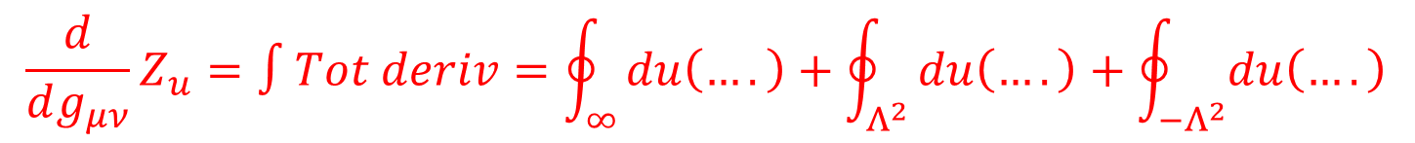
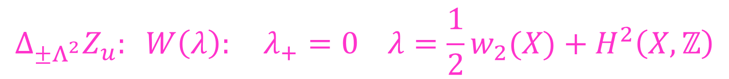

Deriving C,P,E From Wall-Crossing
$$\frac{d}{dg_{μν}}Z_{u}=∫Tot deriv=\oint_{∞}{du\left(….\right)+\oint_{Λ^{2}}{du\left(….\right)+\oint_{−Λ^{2}}{du\left(….\right)}}}$$
$Z_{u}$ piecewise constant: Discontinuous jumps across walls:
$$Δ_{∞}Z_{u}: W\left(λ\right): λ_{+}=0 λ=λ_{0}+H^{2}\left(X,ℤ\right)$$
Precisely matches formula of G$ö$ttsche!
$$Δ_{±Λ^{2}}Z_{u}: W\left(λ\right): λ_{+}=0 λ=\frac{1}{2}w_{2}(X)+H^{2}\left(X,ℤ\right)$$
$$Δ_{Λ^{2}}Z_{u}+ΔZ_{Λ^{2}}=0⇒ C\left(u\right), P\left(u\right), E\left(u\right)$$

Slide 16
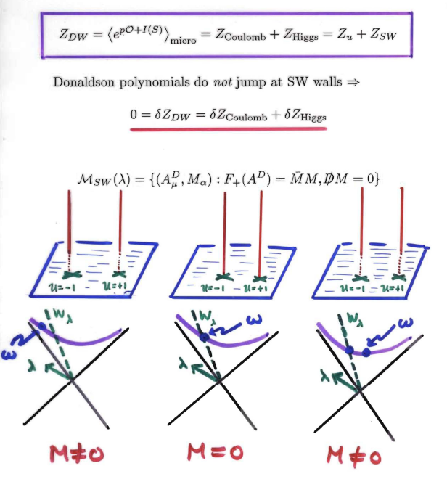

Slide 17
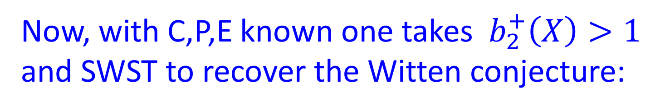
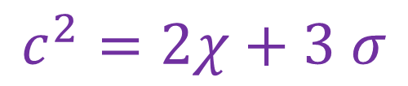
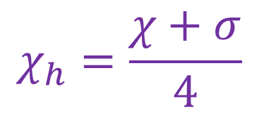
Witten Conjecture
Now, with C,P,E known one takes $b_{2}^{+}\left(X\right)>1$
and SWST to recover the Witten conjecture:
$$Z_{DW}^{ξ}\left(p,s\right)=2^{c^{2}−χ_{h}} ( e^{\frac{1}{2}S^{2}+2p }\sum_{λ}{SW\left(λ\right)e^{2πi λ⋅λ_{0}}e^{2S⋅λ}+}e^{−\frac{1}{2}S^{2}−2p}\sum_{λ}{SW\left(λ\right)e^{2πi λ⋅λ_{0}}e^{−2iS⋅λ})}$$
$$χ_{h}=\frac{χ+σ}{4}$$
$$c^{2}=2χ+3 σ$$

Slide 18
1
Introduction
2
Lightning Summary: The Physical Derivation Of Witten’s Conjecture Relating Donaldson & SW
3
Brief Overview Of The World Of N=2 Theories
Donaldson-Witten Partition Function For General Compact Simple Lie Group
4
5
Theories With Matter & Superconformal Simple Type
6
Two Possible Future Directions

Slide 19
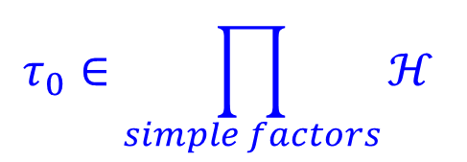
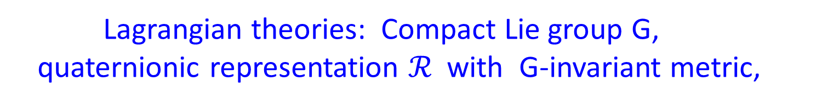


N=2 Theories
Lagrangian theories: Compact Lie group G,
quaternionic representation $ℛ$with G-invariant metric,
$$τ_{0}∈\prod_{simple factors}{ℋ }$$
$$m∈Lie(G_{f})$$
$$G_{f}=Z\left(G\right)⊂O\left(ℛ\right)$$
Class S: Theories associated to Hitchin
systems on Riemann surfaces.
Superconformal theories
Couple to N=2 supergravity

Slide 20
Superconformal Theories
Lagrangian Theories
Class S Theories

Slide 21
1
Introduction
2
Lightning Summary: The Physical Derivation Of Witten’s Conjecture Relating Donaldson & SW
3
Brief Overview Of The World Of N=2 Theories
Donaldson-Witten Partition Function For General Compact Simple Lie Group
4
5
Theories With Matter & Superconformal Simple Type
6
Two Possible Future Directions

Slide 22
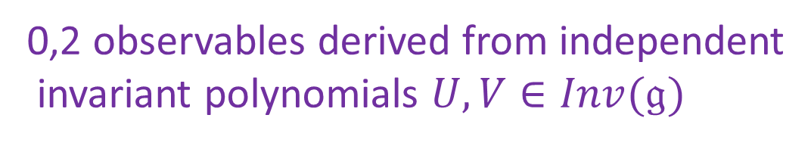
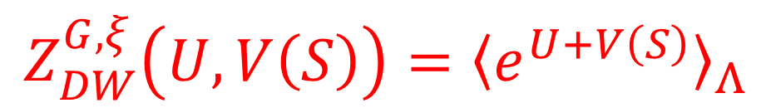
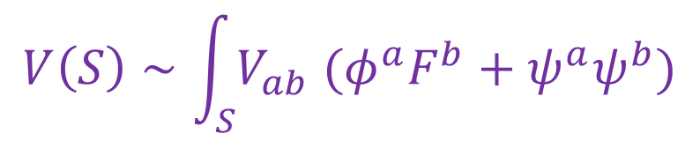
G-Donaldson Invariants
Pure VM theory for G a compact simple Lie group of rank r
0,2 observables derived from independent
invariant polynomials $U,V∈Inv(𝔤)$
$$V\left(S\right)∼\int_{S}{V_{ab} (φ^{a}F^{b}+ψ^{a}ψ^{b})}$$
$$Z_{DW}^{G,ξ}\left(U,V\left(S\right)\right)={〈e^{U+V\left(S\right)}〉}_{Λ}$$
Formally the path integral localizes to G-ASD moduli space
Generating function of generalization of
Donaldson polynomials for any G.
Rigorous setup: Kronheimer & Mrowka

Slide 23
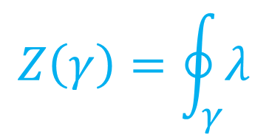







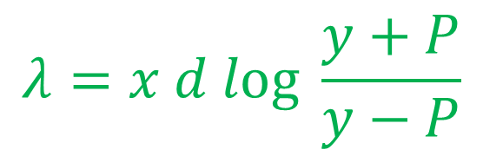
LEET On Coulomb Branch
Coulomb branch: $ℬ=𝔱⊗ℂ /W$
SSB: $G→T ⇒$Abelian VM’s valued in T
Example of SW Geometry : G=SU(N)
$$Σ_{u}:$$
$$y^{2}=P{\left(x\right)}^{2}−Λ^{2N}$$
$$P\left(x\right)=x^{N}+u_{2}x^{N−2}+⋯+u_{N}$$
$$𝔄_{u}=Jac\left(Σ_{u}\right)$$
$$Γ_{u}=H_{1}\left(Σ_{u};ℤ\right)$$
$$Z\left(γ\right)=\oint_{γ}{λ}$$
$$λ=x d log \frac{y+P}{y−P}$$

Slide 24
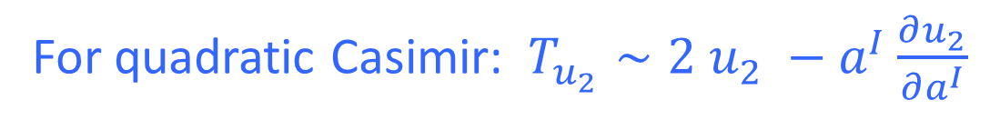
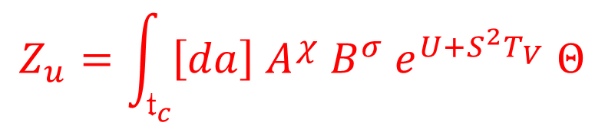
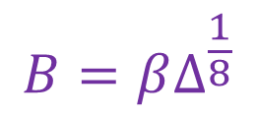


u-Plane Integral
Can compute u-plane integral explicitly from QFT:
$∃$almost canonical duality frame in weak-coupling region at $∞$
$⇒ 𝔱−$valued VM: $\left(a,A,χ, η, ψ\right)$
$$Z_{u}=\int_{𝔱_{c}}{\left[da\right] A^{χ} B^{σ} e^{U+S^{2}T_{V}} Θ}$$
$$A=α{\left(Det\left(\frac{∂u^{I}}{∂a^{J}}\right)\right)}^{\frac{1}{2}}$$
$$B=βΔ^{\frac{1}{8}}$$
$Δ:$ Holomorphic function vanishing along ``discriminant locus’’ $𝒟$
$T_{V}:$ Contact term. General theory Losev-Nekrasov-Shatashvili; Edelstein, Gomez-Reino, Marino
For quadratic Casimir: $T_{u_{2}}∼2 u_{2} −a^{I}\frac{∂u_{2}}{∂a^{I}}$

Slide 25



Theta Function
$Θ$: Theta function for abelian gauge fields remaining after SSB
Reduction of structure group $G_{adj}→T$
Classes for fluxes in a torsor for $H^{2}\left(X;Λ_{wt}\left(𝔤\right)\right)≅Λ_{wt}\left(𝔤\right)⊗H^{2}\left(X;ℤ\right)$
$$\left[F\right]=4 πλ λ∈Λ_{wt}\left(𝔤\right)⊗H^{2}\left(X;ℤ\right)+λ_{0} ≔Λ$$
$$Θ∼\sum_{λ∈Λ}{e^{−i πλ_{+}\overline{τ}λ_{+} −i πλ_{−}τλ_{−} }e^{i π\left(λ−λ_{0}\right)⋅ρ⊗w_{2}\left(X\right)} e^{i \frac{∂V}{∂a^{I}} λ_{−}^{I}⋅S }}$$
Metric dependent $⇒$ Possible wall-crossing

Slide 26




Discriminant Locus
Just as in rank 1, the integrand is singular along a ``discriminant locus’’ $𝒟 w$here BPS states become
massless and some $U\left(1\right)⊂T$ becomes strongly coupled.
$$𝒟= ∪_{i} 𝒟_{i}$$
$𝒟_{i}$ generalizes $u= ±Λ^{2}$
Higher rank: complicated intersections where multiple
BPS states become massless, i.e. multiple periods of
the curve vanish.
Integral $Z_{u}$must be regularized by
cutting out tubular regions around $𝒟_{i}$

Slide 27



General Form Of $Z_{DW}$
$$Z_{DW}^{G,ξ}\left(p,s\right)=Z_{u}+\sum_{i}{Z_{𝒟_{i}} +\sum_{i≠j}{Z_{𝒟_{ij}}+⋯ +Z_{mx}}}$$
Cancelling wall-crossing inductively determines
$Z_{𝒟_{i}}$ from $Z_{u}$ and $Z_{𝒟_{ij}}$from $Z_{𝒟_{i}}$ , etc.
All $Z_{𝒟_{i_{1}…i_{k}}}$vanish for $b_{2}^{+}>1$ EXCEPT $Z_{mx}$
So for $b_{2}^{+}>1$ the answer is given entirely by $Z_{mx}$

Slide 28




The ``N=1 Vacua’’
$𝒟_{mx}$ contains $h=h^{∨}\left(G\right)$isolated points $v_{𝔞}$
permutated by spontan. broken $ℤ/hℤ$ R-symmetry
$$Z_{DW}^{G,ξ}\left(U,V\right)=\sum_{v_{𝔞}}{Z_{DW}^{G,ξ}\left(U,V;v_{𝔞}\right)}$$
$$b_{2}^{+}>1$$
In principle, other maximal degenerations – corresponding
to superconformal points- might have contributed.
But detailed analysis shows they do not for G=SU(3) and it is
natural to conjecture that this is the case for all G.

Slide 29





Analog Of Witten Conjecture
In duality frame where max degeneration is $a_{D}^{I}=0$
the $Θ$function is a sum over
$$λ∈\frac{1}{2}ρ⊗w_{2}\left(X\right)+ Λ_{wt}\left(𝔤\right)⊗H^{2}\left(X;ℤ\right)$$
r independent spin-c structures : $f_{I}∈\frac{1}{2}w_{2}\left(X\right)+H^{2}\left(X;ℤ\right)$
$$SW\left(λ\right)≔\prod_{I}{SW\left(f_{I}\right)}$$
$$Z_{DW}^{G,ξ}\left(U,V;v_{𝔞}\right)=e^{i θ_{𝔞}}\sum_{λ}{e^{\left(2πiλ⋅λ_{0}\right)}SW\left(λ\right) R_{λ}\left(U;V\right)}$$
$$R_{λ}(U,V)=Res[ (da_{D}^{1}∧⋯∧da_{D}^{r})/\prod_{I}{({{a_{D}^{}}^{I})}^{1+\frac{d\left(f_{I}\right)}{2}}) ℰ\left(a_{D}^{I}\right)e^{Us+S^{2}T_{V}+i\frac{∂V}{∂a_{D}^{I}}S⋅f_{I}}}$$
All computable from the degenerate curve
and its first order variation.

Slide 30

Example Of SU(N)
Notes:
With Iurii Nidaiev we are now trying to write the analogous formula
For the other compact simple Lie groups – in part because Aliakbar
Daemi asked us what the result would be.

Slide 31
1
Introduction
2
Lightning Summary: The Physical Derivation Of Witten’s Conjecture Relating Donaldson & SW
3
Brief Overview Of The World Of N=2 Theories
Donaldson-Witten Partition Function For General Compact Simple Lie Group
4
5
Theories With Matter & Superconformal Simple Type
6
Two Possible Future Directions

Slide 32



Including Matter
Now consider the general Lagrangian theory:
Data: $G, ℛ, m, Λ or q=e^{2πi τ}$
Twisted N=2 theory is again of MQ form:
Localize on moduli space of generalized monopole equations.
Q: Differential for $G_{f}$– equivariant cohomology
with parameters $m∈Lie\left(G_{f}\right)$
Labastida & Marino; Losev-Nekrasov-Shatashvili
$$Z\left(U,V\left(S\right)\right)=\sum_{ℓ, r}{\frac{1}{ℓ!r!} \int_{ℳ}{ω_{U}^{ℓ} ω_{V\left(S\right)}^{r} Eul\left(Cok\left(𝔽\right)\right)}}$$

Slide 33








SU(2) With Fundamental Hypers
Moore & Witten
$$ℛ=N_{fl}\left(2⊕2^{∗}\right)$$
$$Spin\left(2N_{fl}\right)⊂G_{f}$$
Mass parameters $m_{f}∈ℂ, f=1, …, N_{fl}$
Must take $ξ=w_{2}\left(X\right)$
Seiberg-Witten:
$$E_{u} : y^{2}=x^{3}+a_{2}x^{2}+a_{4}x+a_{6}$$
$a_{k}:$Polynomials in $Λ,m_{f}, u$
$Z_{u}$ has exactly the same expression as before
but now, e.g. da/du depends on $m_{f}$
New ingredient: $𝒟$ has $2+N_{fl}$
points $u_{i}:$ $Δ=\prod_{i}{(u−u_{i})}$

Slide 34






Analog Of Witten Conjecture
$$Z\left(p;s;m_{f}\right)=\sum_{j=1}^{2+N_{fl}}{Z(p,s;m_{f};u_{j})}$$
$$b_{2}^{+}>1$$
$$Z(p,s;m_{f};u_{j})={\tilde{α}}^{χ}{\tilde{β}}^{σ} \sum_{λ}{SW\left(λ\right)e^{2πi λ⋅λ_{0}}}R_{j}(p,s)$$
X is SWST $⇒$
$R_{j}\left(p,s\right)=κ_{j}^{χ_{h}}{\left(\frac{du}{da}\right)}^{χ_{h}+σ}\exp\left( 2p u_{j}+S^{2}T\left(u_{j}\right)−i {\left(\frac{du}{da}\right)}_{j}S⋅λ\right)$
$u=u_{j}+κ_{j}q_{j}+𝒪$($q_{j}^{2}$)
Everything computable explicitly as functions of the
masses from first order degeneration of the SW curve.

Slide 35






Superconformal Points
Consider $N_{fl}=1$. At a critical point $m=m_{∗}$ two
singularities $u_{±}$ collide at $u=u_{∗}$ and the SW
curve becomes a cusp: $y^{2}=x^{3}$ [Argyres,Plesser,Seiberg,Witten]
Two mutually nonlocal BPS states have vanishing mass:
$$\oint_{γ_{1}}{λ→0 }$$
$$\oint_{γ_{2}}{λ→0 }$$
$$γ_{1}⋅γ_{2}≠0$$
Physically: No local Lagrangian for the LEET :
Signals a nontrivial superconformal field theory.
$$m=m_{∗}+z$$

Slide 36




Superconformal Simple Type – 1/2
Analyze contributions at the two colliding points $u_{±}$
$R_{j}\left(p,s\right)=κ_{j}^{χ_{h}}{\left(\frac{du}{da}\right)}^{χ_{h}+σ}\exp\left( 2p u_{j}+S^{2}T\left(u_{j}\right)−i {\left(\frac{du}{da}\right)}_{j}S⋅λ\right)$
$$=const. e^{2pu_{∗}+S^{2}T\left(u_{∗}\right)}e^{i θ_{∓}} z^{\frac{c^{2}−χ_{h}}{2}}(1+Series in z^{\frac{1}{2}} )$$
$$\exp\left( e^{i θ_{±}} z^{\frac{1}{4}} \left(1+Series in z^{\frac{1}{2}}\right) S⋅λ\right)$$
$$\frac{c^{2}−χ_{h}}{2}=\frac{7 χ+11 σ}{8}<0$$
Perfectly reasonable!
Physics: $\lim_{z→0} Z_{DW} \left(p,s;m_{∗}+z\right) <∞$

Slide 37




Superconformal Simple Type – 2/2
Physics: $\lim_{z→0} Z_{DW} \left(p,s;m_{∗}+z\right) <∞$
No IR divergences on X
No noncompact moduli spaces of vacua
Form of explicit answer implies the only way this can hold for all
polynomials in pnt and S is for a series expansion in z with
coefficients made from $SW\left(λ\right)$to be regular
Theorem [MMP]: There is no divergence in $Z_{DW}$ if :
a.) ${ χ}_{h}−c^{2} −3≤0$
b.) $\sum_{λ}{SW\left(λ\right)e^{2π i λ⋅λ_{0}}λ^{k}=0 }$ $0≤k≤χ_{h}−c^{2}−4$
Conditions a,b define SST.
MMP checked that all known (c. 1998)
4-folds with $b_{2}^{+}>1$ are SST.
Notes:
We also observed that it implies a generalization of the Noether inequality
Giving a topological lower bound on the number of SW basic classes.

Slide 38
1
Introduction
2
Lightning Summary: The Physical Derivation Of Witten’s Conjecture Relating Donaldson & SW
3
Brief Overview Of The World Of N=2 Theories
Donaldson-Witten Partition Function For General Compact Simple Lie Group
4
5
Theories With Matter & Superconformal Simple Type
6
Two Possible Future Directions

Slide 39
Two Possible Future Directions
Invariants for families of 4-manifolds
New invariants
(or new facts about old invariants)
from superconformal theories??

Slide 40



Families Of Four-Manifolds – 1/5
Donaldson invariants can be generalized to families of
four-manifolds: Donaldson, Durham lectures 1989
Naïve attempt at a physical approach:
Couple N=2 field theory to N=2 supergravity:
$$g_{μν}, ψ_{μα}^{A}, {\overline{ψ}}_{μ\dot{α}}^{A}, …$$
Topological twist: $⇒g_{μν}, Ψ_{μν} , φ^{μ}, …$
$$Qg_{μν}=Ψ_{μν} ,QΨ_{μν}=D_{μ}φ_{ν}+D_{ν}φ_{μ }, Qφ^{μ}=0 , …$$
Superfields describe (Cartan model) for
d$iff\left(X\right)−$ equivariant cohomology of $Ω^{∗}\left(Met\left(X\right)\right)$

Slide 41





Families Of Four-Manifolds – 2/5
$S=\left\{ Q, V \right\}+const ∫tr F∧F$
$$T_{μν}=\left\{ Q, Λ_{μν}\right\}$$
$$D^{μ}Λ_{μν}=\left\{ Q, Z_{ν}\right\}$$
$$Q\left( S+\int_{X}{vol\left(g\right)}Ψ^{μν}Λ_{μν}+vol\left(g\right)φ^{μ}Z_{μ}\right)=0$$
(For a fixed volume form $vol\left(g\right) .$)

Slide 42



Families Of Four-Manifolds – 3/5
$$Z\left[g_{μν},Ψ_{μν}, φ^{μ}\right]=∫d\left[A,φ,χ,ψ, η\right] exp(S+\int_{X}{Ψ^{μν}Λ_{μν}+φ^{μ}Z_{μ}) }$$
$Q−$closed diff(X)-equivariant
differential form on $Met(X)$
Diffeomorphism invariant
Descends to cohomology class $∈H^{∗}(\frac{Met\left(X\right)}{Diff\left(X\right)})$
Conjecture: These are the family Donaldson invariants
n – parameter families of metrics have wall-crossing
in the degree n component for $b_{2}^{+}\left(X\right)≤n+1$

Slide 43




Four-Manifold Families – 4/5
Singularities of (b-1)-form component for b-dimensional
families are associated with classes $λ∈H^{2}\left(X;ℤ\right)$
$$b=b_{2}^{+}\left(X\right)$$
Suppose $λ∈H^{2}\left(X;ℤ\right)$ is ASD for a metric $g^{\left(0\right)}$
Perturb : $g\left(t\right)=g^{\left(0\right)}+\sum_{α=1}^{b}{t^{α}p_{α}}$
$$Z^{sing}∼c\left(\frac{λ^{2}}{2}\right) ω_{b−1} +d \left(∗\right)$$
$ω_{b−1}$ angular form in $t^{α}$ around the point t=0 .
For G=SU(2) c(n) are the coefficients of the same modular
form that appears in the standard Donaldson WCF.

Slide 44

Four-Manifold Families – 5/5
One can also couple $g_{μν}, Ψ_{μν}, φ^{μ}$ to
the LEET around $𝒰_{Λ^{2}}$
It is natural to expect that this will give the family SW invariants formulated by
T.-J. Li & A.-K. Liu.
… and moreover that there is an analog of
the Witten conjecture for the family
Donaldson invariants.

Slide 45
Superconformal Theories – 1/4
Basic question:
There are lots of interesting superconformal theories.
(Some of them don’t even
have Lagrangian descriptions.)
Nevertheless, they can be topologically
twisted and have Q-invariant operators.
Is this a source of new
four-manifold invariants?

Slide 46






Superconformal Theories – 2/4
Important lesson from $SU\left(2\right) N_{fl}=4$
$τ\left(u;m_{a}\right)$ approaches a FINITE limit as $u→∞$
Completely changes the wall-crossing story.
$$\frac{d}{dg_{μν}}Z_{u}∼\sum_{ℓ, r}{℘^{ℓ}S^{r}\lim_{R→∞}{\oint_{\left|u\right|=R}{du u^{\frac{σ+1+2 ℓ+r}{2}}Θ_{ℓ, r}\left(τ_{0}\right)(1+Series \frac{1}{u},\frac{1}{\overline{u}})}}}$$
$$\frac{1}{2}\left(σ+1+2ℓ+r\right)<−1$$
No wall-crossing at $b_{2}^{+}=1$
$$\frac{1}{2}\left(σ+1+2ℓ+r\right)≥−1$$
Continuous metric dependence!
TFT fails utterly !!

Slide 47







Superconformal Theories – 3/4
Now consider SU(2) $N_{fl}=1$ at $m=m_{∗}$
$$\lim_{m→m_{∗}}{Z_{u} ≠\int{du d\overline{u}\lim_{m→m_{∗}}{Measure\left(u,\overline{u};m\right) ≔ Z_{u}^{∗}}}}$$
$Z_{u}^{∗} :$continuous or no metric dependence from singularity!
Continuous metric dependence for $σ+r+6ℓ<−7$
No metric dependence for $σ+r+6 ℓ≥−7$
Conjecture:
$Z_{u}^{∗}+Z_{u_{0}}+ {〈 e^{p 𝒪_{1}+𝒪_{2}\left(S\right) } 〉}_{AD3 Theory}$
is topologically invariant except for wall-crossing at $u=∞$ for $b_{2}^{+}\left(X\right)=1$

Slide 48


Superconformal Theories – 4/4
The truth of this conjecture would suggest that the
superconformal theories might provide new
four-manifold invariants, at least in some range of $r \& ℓ$
The truth of this conjecture would then strongly motivate
an investigation of the u-plane integral for general class S.
Much of the structure of $Z_{u}$ is known – follows pattern of higher rank.
Some important details remain to be understood more clearly.
Can, in principle, be derived from a 2d (2,0) QFT derived from
reduction of abelian 6d (2,0) theory along a four-manifold.

