Slide 1
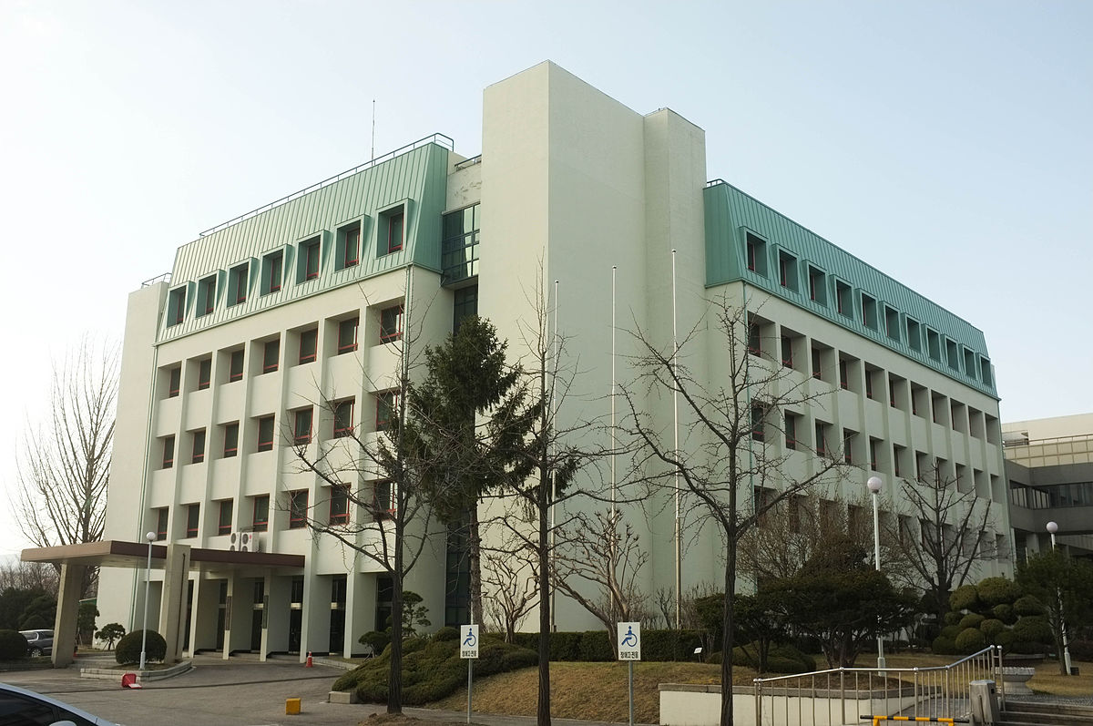
Finite Symmetries Of Field Theories
From TFT
Gregory Moore
Rutgers
Strings In Seoul, Sept. 15, 2023

Slide 2
1
Preliminary Remarks
2
Fields Without Fields
Finite Homotopy Theories
3
Defects & Domain Walls
4
5
Symmetry Action Via Quiche
6
Composition Of Defects
Open Problems
7

Slide 3
N.B. v3 is a significant upgrade

Slide 4
Many Many Antecedants
``Like every global symmetry on the brane this is a gauge symmetry in spacetime’’ – N. Seiberg, hep-th/9608111
Theory of topological modes/singletons in AdS/CFT:
Witten 98: ``AdS/CFT Correspondence And Topological Field Theory,’’
followed up c. 2004 by Belov & Moore, …
developed much further by Apruzzi, Bah, Bhardwaj, Bonetti, Bullimore, Garcia Etxebarria, Hosseini, Minasian, Schafer-Nameki, Tiwari,….

Slide 5
Many Many Antecedants
Open-Closed 2d TQFT: Moore & Segal, ….
Fuchs, Runkel, Schweigert, Valentino, … , Kapustin & Saulina, …
Gaiotto, Kapustin, Seiberg, Willet: Section 6 & 7.3, ...
Gaiotto-Kulp, 2008.05960
Kong & Zheng, 1705.01087
What we add: Systematic calculus of defects in TFT,
especially, finite homotopy theories
and how it ``implements symmetry.’’

Slide 6
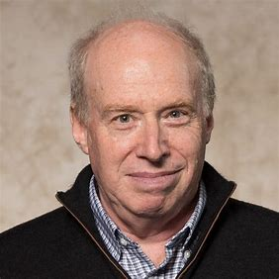
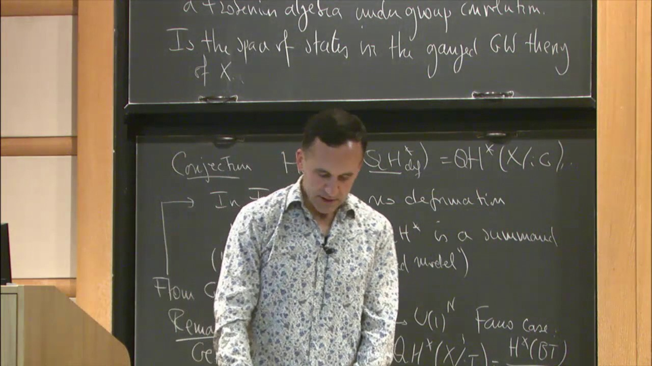
Previous Talks
Perimeter Lectures (with lecture notes):
Finite Symmetry In QFT, PIRSA, June 13-17, 2022
StringMath 2022 & arXiv…
CMSA , Nov. 8, 2022
Simons Foundation, November 17, 2022
KITP, March 13, 2023

Slide 7
1
Preliminary Remarks
2
Fields Without Fields
Finite Homotopy Theories
3
Defects & Domain Walls
4
5
Symmetry Action Via Quiche
6
Composition Of Defects
Open Problems
7

Slide 8
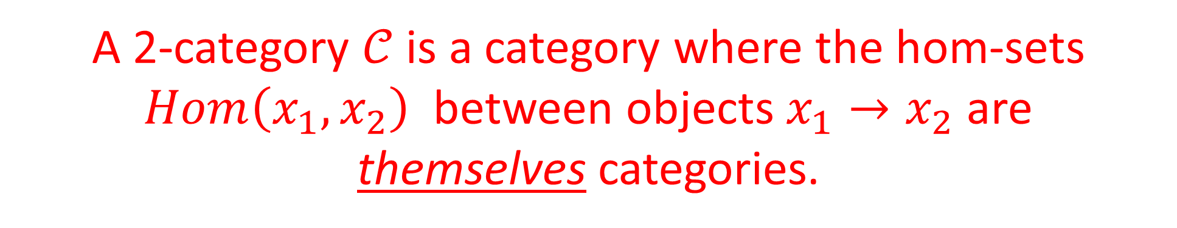
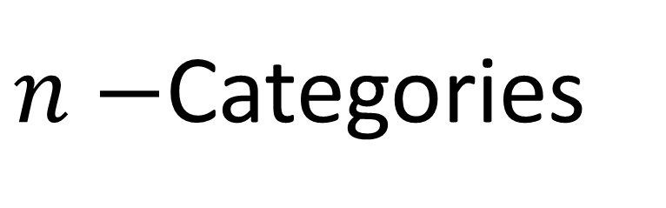
$n−$Categories
A 2-category $𝒞$is a category where the hom-sets $Hom\left(x_{1},x_{2}\right)$ between objects $x_{1}→x_{2}$are
themselves categories.
The objects of the category $Hom\left(x_{1},x_{2}\right)$are called ``1-morphisms’’ in $𝒞$
The morphisms of the category $Hom\left(x_{1},x_{2}\right)$are called ``2-morphisms’’ in $𝒞$
The objects $x_{1},x_{2}$ of $𝒞$are hence called ``0-morphisms’’ in $𝒞$
Lots of compatibility conditions
Definition: An n-category is a category $𝒞$ whose morphism spaces are n-1 categories.

Slide 9
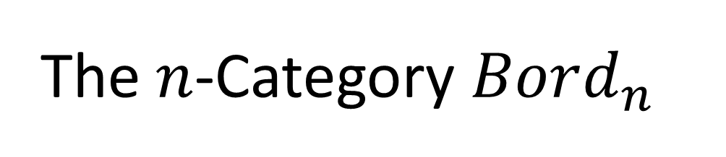
The $n$-Category $Bord_{n}$
Objects (0-morphisms) = 0-dimensional manifolds ;
1-Morphisms = 1d bordisms between 0-folds;
2-Morphisms = 2d bordisms between 1d bordisms; …
Bord_{n}:

Slide 10


Monoidal $n$-category
``Monoidal’’: There is a notion of $⊗$on all the k-morphisms. Monoidal unit 0-morphism: $1_{𝒞}$
For $Bord_{n}$ the $⊗−$product is disjoint union. $1_{Bord_{n}}$ is the empty 0-manifold
$VECT:$1-category of fin. dim. complex vector spaces. $1_{𝒞}= ℂ$
ALG(VECT): Algebras, bimodules, bimodule maps
$$1_{𝒞}=ℂ$$
CAT: Categories, Functors, Natural transformations
With suitable $⊗,$tensor unit $1_{CAT}=VECT$

Slide 11


Field Theory Without Fields
Generalize functorial picture of field theory from Atiyah, Segal, ….
A p-dimensional ``field theory’’ is a monoidal functor $F:Bord_{p}→𝒞$
$𝒞 is$a monoidal $p$-category
Values $F\left(M_{k}\right)$on $k−$manifolds without boundary are the result of ``doing the path integral.’’
Categorical language formalizes constraints of locality

Slide 12
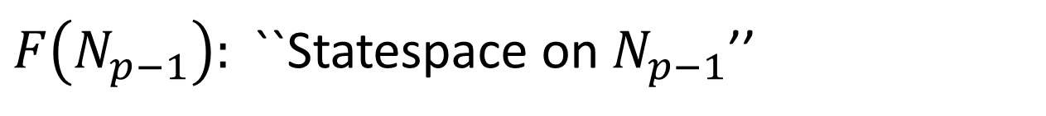
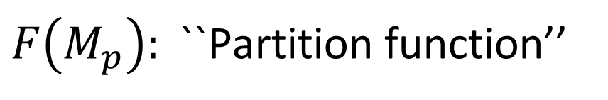
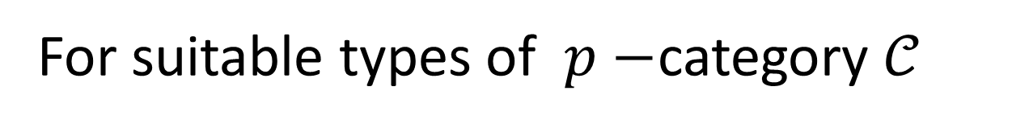

Field Theory Without Fields
For suitable types of $p−$category $𝒞$
$M_{p}:$ p-dimensional, compact, w/out $∂$ $⇒F\left(M_{p}\right)∈ℂ$
$F\left(M_{p}\right):$``Partition function’’
$N_{p−1}:$ (p-1)-dimensional, compact w/out $∂ ⇒F\left(N_{p−1}\right)∈Obj(VECT)$
$F\left(N_{p−1}\right):$``Statespace on $N_{p−1}$’’
$R_{p−2}:$ (p-2)-dimensional, compact w/out $∂⇒F\left(R_{p−2}\right):$
More complicated: object in a ``higher category.’’

Slide 13
Defects Within Defects
Baez & Dolan, …., Lurie, …
Kapustin, arXiv:1004:2307.
P
β
B
A
α
Q
Notes:
So, the lesson that we can take away is that at least part of the notion of extended field theory is to include defects in the definition of a qft.

Slide 14

Adding Fields: Background Fields
Fields should be locally defined on $p$-manifolds,
pull back under local diffeomorphisms, satisfy a sheaf property
Orientation, (s)pin structure, G-bundle with connection,
Riemannian metric, differential cochain, foliation, …
Freed & Hopkins: [1301.5959, sec. 3]
Def: A $field ℱ$is a sheaf on $Man_{p}^{op}$ valued in simplical sets $Set_{Δ}$
$$F:Bord_{p}\left(ℱ\right)→𝒞$$

Slide 15
1
Preliminary Remarks
Fields Without Fields
2
Finite Homotopy Theories
3
Defects & Domain Walls
4
5
Symmetry Action Via Quiche
6
Composition Of Defects
Open Problems
7

Slide 16
Important COMPUTABLE class of theories, underlies almost all our examples.
Kontsevich, Quinn, Freed, Turaev, …

Slide 17
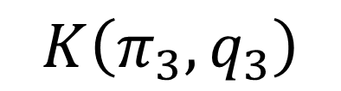


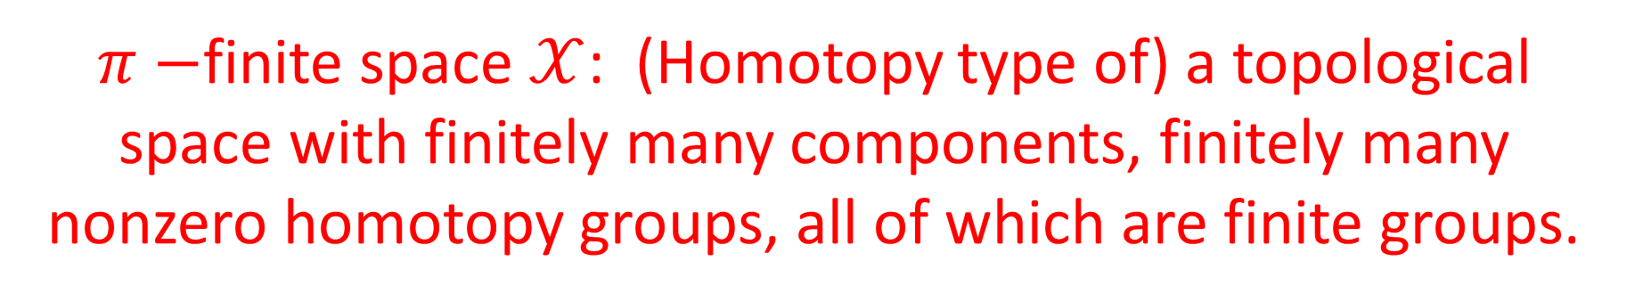


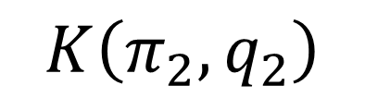


$π−$finite space $𝒳$: (Homotopy type of) a topological space with finitely many components, finitely many nonzero homotopy groups, all of which are finite groups.
$$⋯$$
$$K\left(π_{3},q_{3}\right)$$
$$⋯$$
$$𝒳^{\left(3\right)}$$
$$K\left(π_{2},q_{2}\right)$$
$$𝒳^{\left(2\right)}$$
$$K\left(π_{3},q_{3}+1\right)$$
$$𝒳^{\left(1\right)}=K\left(π_{1},q_{1}\right)$$
$$K\left(π_{2},q_{2}+1\right)$$

Slide 18

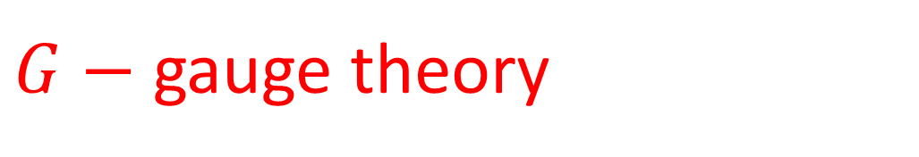

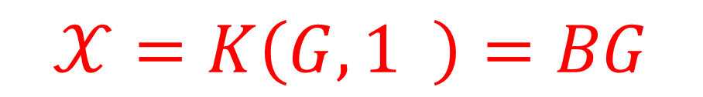



$$𝒳=K\left(G,1 \right)=BG$$
$G−$ gauge theory
$$𝒳=K\left(A,q+1 \right)$$
Will be used to describe
``q-form symmetry for group A ‘’
$$K\left(A,2 \right)$$
$$𝒳$$
Classifying space of a ``$2−$group’’
$$BG$$
Will be used to describe ``2-group symmetry‘’
$π−$finite spaces $𝒳$ also known as ``higher groups’’

Slide 19

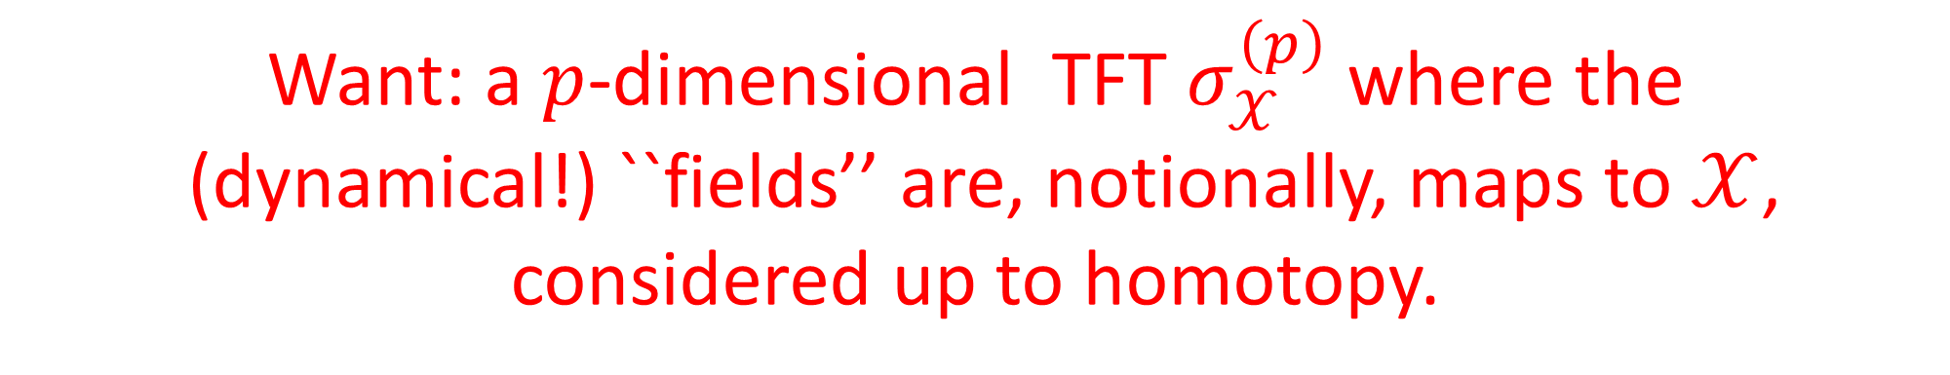

Want: a $p$-dimensional TFT $σ_{𝒳}^{\left(p\right)}$where the
(dynamical!) ``fields’’ are, notionally, maps to $𝒳$,
considered up to homotopy.
But we need to specify the codomain $𝒞$
TFT should really be denoted $σ_{𝒳,𝒞}^{\left(p\right)}$ but in the paper it is written $σ_{𝒳}^{\left(p\right)}$

Slide 20

Two constructions that change category number:
Suppose $𝒞$ is a monoidal $n$-category

Slide 21

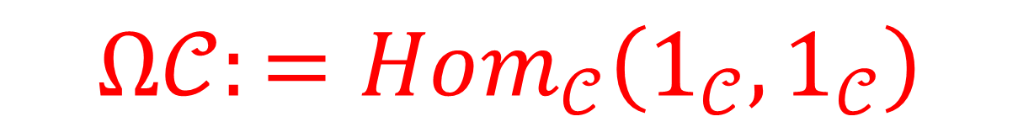
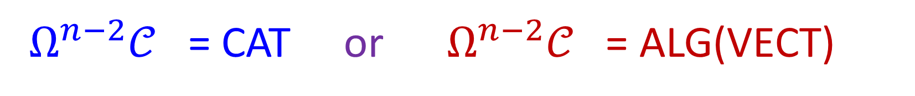
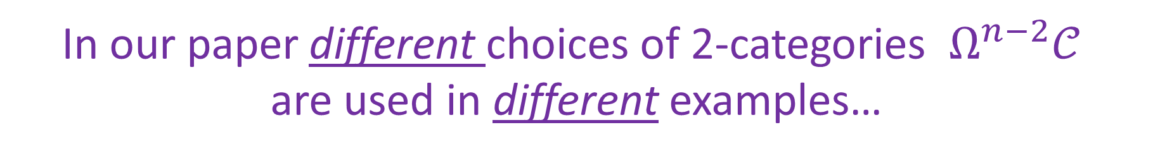
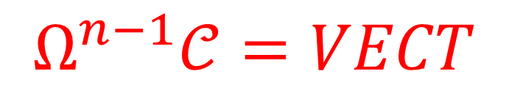
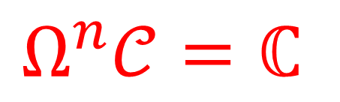
$$Ω𝒞:=Hom_{𝒞}\left(1_{𝒞}, 1_{𝒞}\right)$$
A monoidal $(n−1)$-category. We ALWAYS take:
$$Ω^{n−1}𝒞=VECT$$
$$Ω^{n}𝒞=ℂ$$
In our paper different choices of 2-categories $Ω^{n−2}𝒞$
are used in different examples…
$Ω^{n−2}𝒞$ = CAT or $Ω^{n−2}𝒞$ = ALG(VECT)
Latter choice leads to language of modules over an algebra

Slide 22
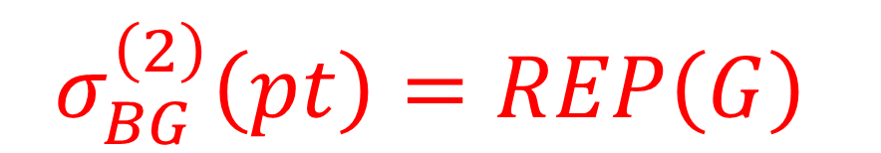




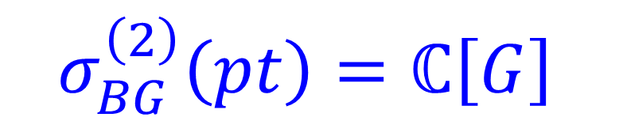
Example:
For 2d gauge theory for finite group $G$:
$$𝒞=CAT$$
$$𝒞=ALG(VECT)$$
OR
$$σ_{BG}^{\left(2\right)}\left(pt\right)=REP\left(G\right)$$
$$σ_{BG}^{\left(2\right)}\left(pt\right)=ℂ\left[G\right]$$
So the results depend on the choice of $𝒞$

Slide 23




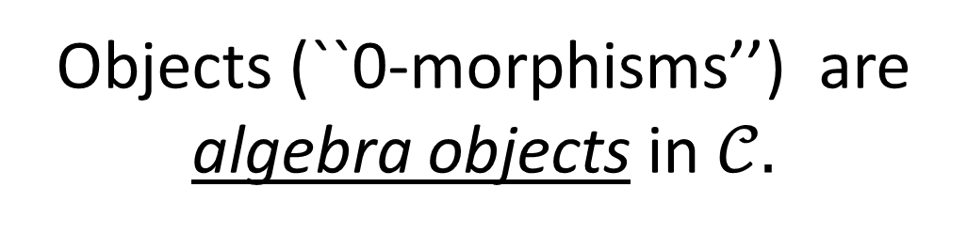
$$𝒞^{Morita}=ALG\left(𝒞\right)$$
Objects (``0-morphisms’’) are
algebra objects in $𝒞.$
$𝒞$is an $n$-category
$𝒞^{Morita}$ is an $\left(n+1\right)$-category
ALG(VECT): 2-category of Algebras, bimodules, bimodule maps
ALG(CAT)=TENSCAT: 3-category of tensor categories:
Tensor categories, Bimodule categories, Bimodule functors, Natural transformations

Slide 24
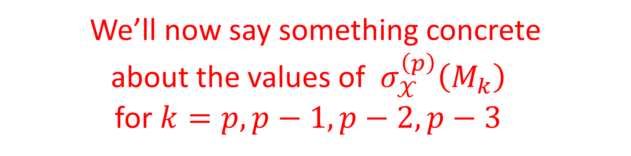
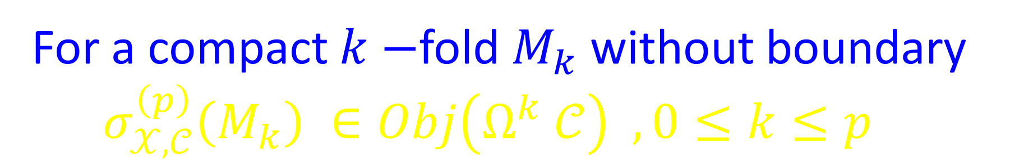
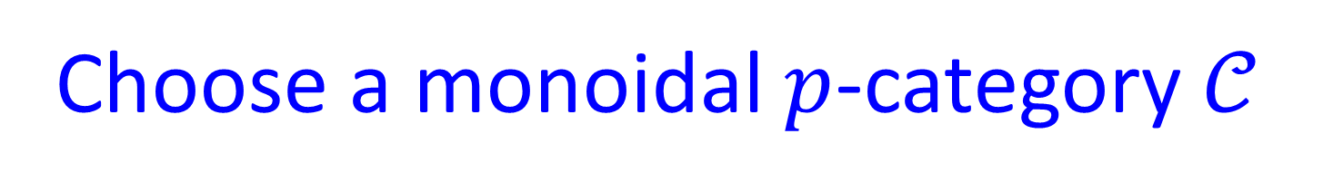
Choose a monoidal $p$-category $𝒞$
For a compact $k−$fold $M_{k}$ without boundary $σ_{𝒳,𝒞}^{\left(p\right)}\left(M_{k}\right) ∈Obj\left(Ω^{k} 𝒞\right) ,0≤k≤p$
We’ll now say something concrete
about the values of $σ_{𝒳}^{\left(p\right)}\left(M_{k}\right)$
for $k=p,p−1,p−2, p−3$

Slide 25

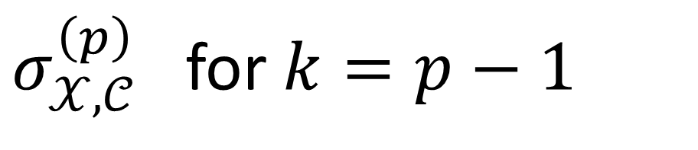
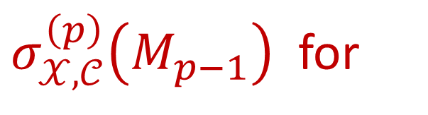


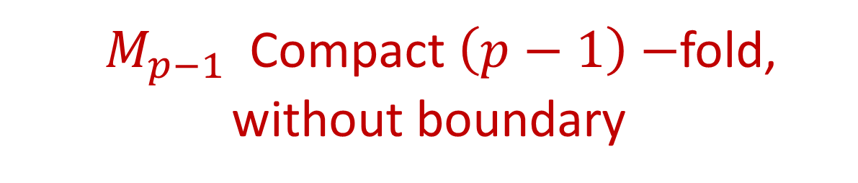
$σ_{𝒳,𝒞}^{\left(p\right)}$ for $k=p−1$
Notation: For any manifold $M$of any dimension $𝒳^{M}≔Map\left(M,𝒳\right)$
${ M}_{p−1}$Compact $\left(p−1\right)−$fold, without boundary
$σ_{𝒳,𝒞}^{\left(p\right)}\left(M_{p−1}\right)$ for
will be an object in $Ω^{p−1}𝒞$
$$=VECT$$
$σ_{𝒳,𝒞}^{\left(p\right)}\left(M_{p−1}\right) :$ ``Space of states’’ on the spatial slice $M_{p−1}$
N.B. Vectors determined by a bordism $∅→ M_{p−1}$ might very well be zero, hence are not ``states’’ in the sense of quantum theory.

Slide 26
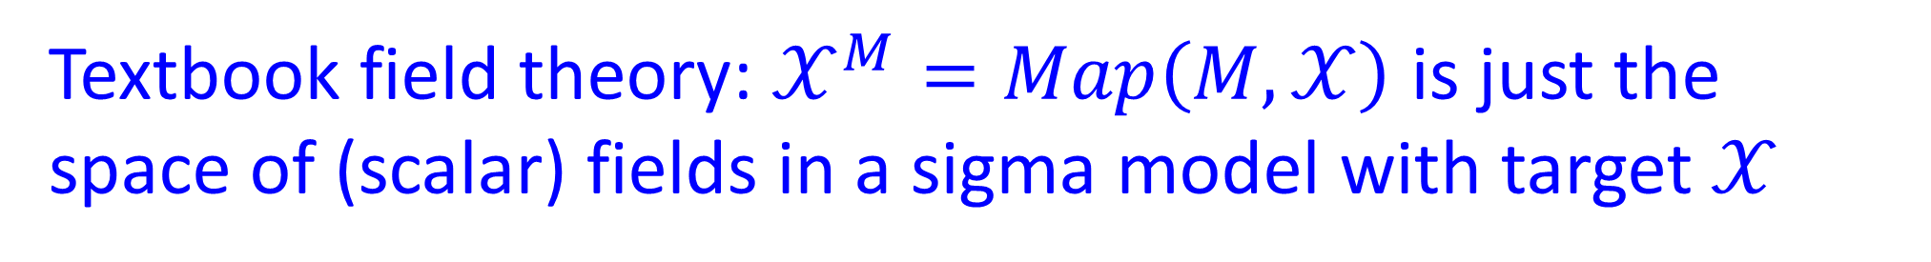

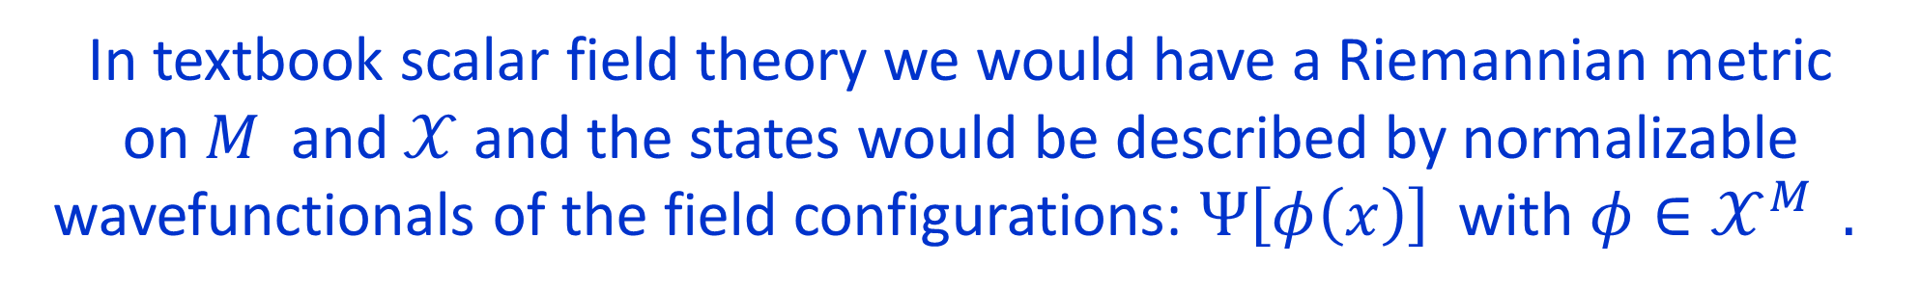
Textbook field theory: $𝒳^{M}=Map\left(M,𝒳\right)$ is just the space of (scalar) fields in a sigma model with target $𝒳$
In textbook scalar field theory we would have a Riemannian metric
on $M$ and $𝒳$and the states would be described by normalizable wavefunctionals of the field configurations: $Ψ\left[φ\left(x\right)\right]$ with $φ∈𝒳^{M} .$
Hilbert space of states: $L^{2}\left(𝒳^{M}\right)$
In TFT: Just work up to homotopy equivalence.
So we just want the vector space of locally constant functions on $𝒳^{M_{p−1}}$
$$σ_{𝒳,𝒞}^{\left(p\right)}\left(M_{p−1}\right) ≔Fun\left(π_{0}\left(𝒳^{M_{p−1}}\right)\right)$$

Slide 27
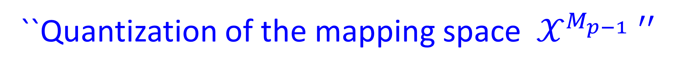

$$σ_{𝒳,𝒞}^{\left(p\right)}\left(M_{p−1}\right) ≔Fun\left(π_{0}\left(𝒳^{M_{m−1}}\right)\right)$$
Example: If $𝒳=K\left(A,q\right)$ then $π_{0}\left(𝒳^{M_{p−1}}\right)=H^{q}\left(M_{p−1}, A\right)$
If $𝒳=K\left(G,1\right)$ then since
$π_{0}\left(𝒳^{M_{p−1}}\right) =$ { isom. Classes of principal $G−$bundles over $M_{p−1}$ }
our ``statespace’’ is the vector space of
functions of G-bundles over the spatial manifold.
``Quantization of the mapping space $𝒳^{M_{p−1}} ′′$

Slide 28



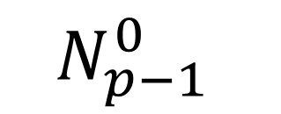
Amplitudes
$$M_{p}$$
$$N_{p−1}^{0}$$
$$N_{p−1}^{1}$$
$$M_{p}: N_{p−1}^{0} →N_{p−1}^{1}$$

Slide 29
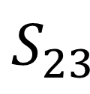


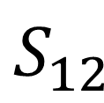


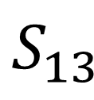
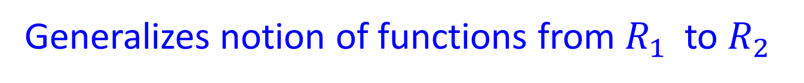










Correspondence Course
$$S_{ }$$
$$f_{1}$$
$$f_{2}$$
Generalizes notion of functions from $R_{1}$ to $R_{2}$
We can compose functions.
$$R_{1}$$
$$R_{2}$$
$${S_{13}}_{ }$$
$$g_{1}$$
$$g_{3}$$
We would like to
compose correspondences:
$$S_{12}$$
$${S_{23}}_{ }$$
$$f_{1}$$
$$f_{12}$$
$$f_{23}$$
$$f_{3}$$
$$R_{1}$$
$$R_{2}$$
$$R_{2}$$

Slide 30



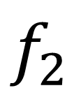

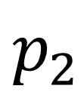
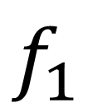
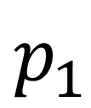
Homotopy Fiber Product
$$S_{1}×_{h}S_{2}$$
$$p_{1}$$
$$p_{2}$$
$$S_{1}$$
$${S_{2}}_{ }$$
$$f_{1}$$
$$f_{2}$$
$$B$$
$$S_{1}×_{h} S_{2} ≔\left\{ \left(s_{1},s_{2},γ\right): γ:f_{1}\left(s_{1}\right)→f_{2}\left(s_{2}\right) \right\}$$

Slide 31



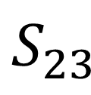

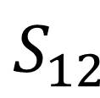

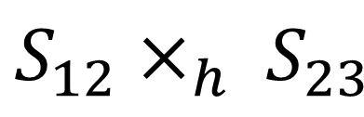




Correspondence Course
$${S_{12}×_{h} S_{23}}_{ }$$
$$g_{1}$$
$$g_{3}$$
$$S_{12}$$
$${S_{23}}_{ }$$
$$f_{1}$$
$$f_{12}$$
$$f_{23}$$
$$f_{3}$$
$$R_{1}$$
$$R_{2}$$
$$R_{2}$$
Gives a way of composing correspondences. Composition has good properties.

Slide 32
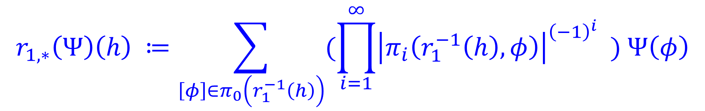
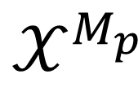
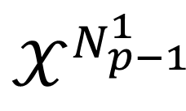




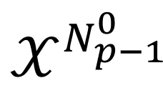
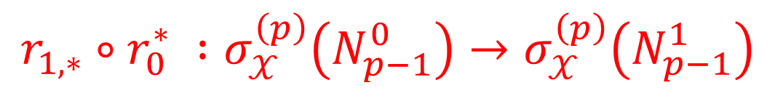
Amplitudes
$$M_{p}: N_{p−1}^{0} →N_{p−1}^{1}$$
$$𝒳^{M_{p}}$$
$$r_{0}$$
$$r_{1}$$
$$r_{1,∗}∘r_{0}^{∗} :σ_{𝒳}^{\left(p\right)}\left(N_{p−1}^{0}\right)→σ_{𝒳}^{\left(p\right)}\left(N_{p−1}^{1}\right)$$
$$𝒳^{N_{p−1}^{0}}$$
$$𝒳^{N_{p−1}^{1}}$$
If $Ψ∈Fun\left(𝒳^{M_{p}}\right)$is locally constant
then $r_{1,∗}\left(Ψ\right)∈Fun\left(𝒳^{N_{p−1}^{1}}\right)$is locally constant, where
$$r_{1,∗}\left(Ψ\right)\left(h\right) ≔\sum_{\left[φ\right]∈π_{0}\left(r_{1}^{−1}\left(h\right)\right)}{(\prod_{i=1}^{∞}{{\left|π_{i}\left(r_{1}^{−1}\left(h\right),φ\right)\right|}^{{\left(−1\right)}^{i}} ) Ψ\left(φ\right)}}$$

Slide 33
The fact that amplitudes compose properly follows naturally from properties of homotopy fiber products.
Partition function $\left(k=p\right)$ just take $N_{p−1}^{0}=N_{p−1}^{1}=∅$

Slide 34




$σ_{𝒳,𝒞}^{\left(p\right)}$ for $k=p−2$
$Ω^{p−2}𝒞=CAT ⇒ σ_{𝒳}^{\left(p\right)} \left(M_{p−2}\right)$must be a category.
Should be some kind of locally ``constant vector spaces’’ over $𝒳^{M_{p−2}}$
$σ_{𝒳,𝒞}^{(p)}\left(M_{p−2}\right)≔VECT(π_{≤1}\left(𝒳^{M_{p−2}}\right)$)
``Quantization of the mapping space $𝒳^{M_{p−2}}$‘’
$$𝒳=BG ⇒π_{≤1}\left(𝒳^{M_{p−2}}\right)=$$
Groupoid of principal $G−$bundles over $M_{p−2}$

Slide 35


$σ_{𝒳}^{\left(p\right)}$ for $k=p−3$
$𝒞=ALG\left(CAT\right) \& p=3$
$𝒳=BG :$ $σ^{\left(3\right)}\left(pt\right)=VECT\left[G\right]$as a tensor category:
$${\left(V_{1}∗V_{2}\right)}_{g}= ⊕_{g_{1}g_{2}=g} {\left(V_{1}\right)}_{g_{1}}⊗{\left(V_{2}\right)}_{g_{2}}$$

Slide 36
At each categorical level there is some ``quantization’’ of a suitable correspondence of mapping spaces.
Not quantization in terms of symplectic geometry, but in the above homotopical sense.
Precise general formulation of ``quantization’’ in this setting is given
(to some extent) in FHLT sec. 8.4

Slide 37


In addition to the choice of $𝒳$ and $𝒞$ one can also consider a ``twisted’’ construction based on a choice of cocycle $λ∈Z^{p}\left(𝒳,ℂ^{∗}\right)$
For $𝒳=BG$ these would be Dijkgraaf-Witten theories.
e.g. $σ_{𝒳,𝒞,λ}^{\left(p\right)}\left(M_{p−1}\right) :$Vector space of
locally-constant sections
of a flat line bundle $L^{\left(λ\right)}→𝒳^{M_{p−1}}$

Slide 38
1
Preliminary Remarks
Fields Without Fields
2
3
Finite Homotopy Theories
4
Defects & Domain Walls
5
Symmetry Action Via Quiche
6
Composition Of Defects
Open Problems
7

Slide 39


We can extend FHLT to a general
theory of defects in theories $σ_{𝒳,𝒞,λ}^{\left(p\right)}$
Suggests a general framework
for defects in general TFT’s.
Defects are associated to subsets $Z⊂M_{p}$
where $Z$need not be smooth…

Slide 40

Questions To Answer:
What data are necessary to specify a defect?
i.e. what are the ``labels’’ carried by a defect?
Classical labels, semiclassical labels, global labels, local labels.
How does the presence of such defects
affect the quantum values $σ_{𝒳,𝒞,λ }^{\left(p\right)}\left( M_{k},𝒟\left(Z\right)\right)$
Is there a product law on defects?
How do the labels compose?

Slide 41





Classical Labels
Assume $Z$a smooth manifold of codimension $ℓ≔cod\left(Z⊂M\right)$ .
$$Z$$
Around any point $℘∈Z$
there is $\text{a} \text{linking} \text{sphere} S^{ℓ−1}$
$$℘$$
Classical labels: $π_{0}\left(𝒳^{S^{ℓ−1}}\right)$
Although commonly used, they can be inaccurate for describing the quantum systems.

Slide 42



Global labels: Surround $Z$by a ``small’’ neighborhood $U_{Z}$ with a manifold boundary $∂U_{Z}.$
$$Z$$
$∂U_{Z}$ will be of codimension 1 so there is an associated statespace $σ\left(∂U_{Z}\right)$
$$δ_{𝒟(Z)}∈ σ\left(∂U_{Z}\right)=state space ∈Obj\left(VECT\right)$$
i.e. $δ_{𝒟\left(Z\right)}$ is a vector in the complex vector space $σ\left(∂U_{Z}\right)$

Slide 43




Local Labels: When $Z$ is a smooth submanifold we can hope to characterize the defect by examining
the neighborhood of a point $℘∈Z .$
Basic idea: Try to implement KK reduction along the linking sphere $S^{ℓ−1}$ of $℘∈Z$where $ℓ≔cod\left(Z⊂M\right)$
Local Label $δ_{𝒟\left(℘\right)}∈Obj\left(Hom\left( 1_{Ω^{ℓ−1}𝒞}, σ_{𝒳,𝒞}^{\left(p\right)}\left(S^{ℓ−1}\right)\right)\right)$
$\left(m−\left(ℓ−1\right)\right)−1= \left(m−ℓ\right)−$category

Slide 44


Sanity check: $ℓ=p .$ Local label = global label.
$$Ω^{p−1}𝒞=VECT$$
$$1_{Ω^{p−1}𝒞} =ℂ$$
$σ^{\left(p\right)}\left(S^{p−1}\right) =$ Vector space of ``states’’ on $S^{p−1}$
$δ_{𝒟\left(℘\right)}$is a vector in statespace on $S^{p−1}:$
State/operator correspondence.
Lower codimension: There is a difference.

Slide 45








Claim: $Z$smooth with trivialized normal bundle then the local label determines the global label:
``KK Reduction”: $σ^{\left(ℓ−1\right)}\left(N\right)≔σ\left(N×S^{ℓ−1}\right)$
Data of local defect defines a left boundary theory
$δ^{\left(ℓ−1\right)}$ for $\left(m−ℓ+1\right)−$dimensional theory $σ^{\left(ℓ−1\right)}$
$$∈Hom\left( σ^{\left(ℓ−1\right)}\left(∅\right), σ^{\left(ℓ−1\right)}\left(Z\right)\right)$$
$$δ^{\left(ℓ−1\right)}$$
$$Z_{m−ℓ}$$
$$σ^{\left(ℓ−1\right) }$$
Gives vector $δ_{𝒟\left(Z\right)}$ in vector space
$$σ^{\left(ℓ−1\right)}\left(Z\right)=σ\left(Z×S^{\left(ℓ−1\right)}\right)$$
[0,1]

Slide 47

One key point in the general theory of defects:
When $Z$is not smooth we treat it as a
stratified space and consider the links
starting with the lowest codimension
and then move up in codimension.

Slide 48





Semiclassical Defect Data In FHT
For $σ_{𝒳,𝒞}^{\left(p\right)}$we can compute the local and global labels from
``semiclassical data’’ (thought of as dynamical fields for the defect)
DEF: Semiclassical local defect data: $ψ:𝒴→ 𝒳^{S^{\left(ℓ−1\right)}}$
Apply ``quantization procedure’’ of FHLT to the correspondence:
$$𝒴$$
$$ψ$$
$$𝒳^{S^{\left(ℓ−1\right)}}$$
$$∗$$

Slide 49




Simplest example: $ℓ=p$: Point defect
Local label $∈Hom\left(ℂ , σ_{𝒳}^{\left(p\right)}\left(S^{p−1}\right)\right)$
$$\text{i}\text{.}\text{e}\text{. }\text{is} \text{a} \text{vector} \text{in}{ σ}_{𝒳}^{\left(p\right)}\left(S^{p−1}\right)=Fun\left(π_{0}\left(𝒳^{S^{p−1}}\right)\right)$$
Given $\left(𝒴,ψ\right)$ we compute this vector to be the pushforward of the function $Ψ=1$ on $𝒴:$
$$h∈𝒳^{S^{p−1}}$$
$$ψ_{∗}(Ψ)\left(h\right)=\sum_{φ∈π_{0}\left(ψ^{−1}\left(h\right)\right)}{\prod_{i=1}^{∞}{{| π}_{i}{\left(ψ^{−1}\left(h\right), φ\right)|}^{{\left(−1\right)}^{i−1}} }}$$

Slide 50









Semiclassical Approach To Computation Of $σ_{𝒳,𝒞}^{\left(p\right)}(M_{k},𝒟\left(Z\right))$
Mapping space $ℳ$ is space of pairs $\left(φ_{blk}, φ_{dfct}\right)$
$$φ_{blk}:M→𝒳$$
$$φ_{dfct}:Z→𝒴$$
$$𝒴$$
$$φ_{dfct}$$
``Quantization’’ of $ℳ$ gives partition functions, ``statespaces’’, amplitudes, etc. in the presence of the defect defined by $(ψ,𝒴).$
$$Z$$
$$ψ$$
$$φ_{blk,Z}$$
$$𝒳^{S^{\left(ℓ−1\right)}}$$

Slide 51





Domain Walls & Boundary Theories
$$σ_{𝒳}^{\left(p\right)}$$
$$σ_{𝒳}^{\left(p\right)}$$
Specialize to $ℓ=1:$
$$σ_{𝒳_{1}}^{\left(p\right)}$$
$$σ_{𝒳_{2}}^{\left(p\right)}$$
Natural generalization

Slide 52





Domain Walls & Boundary Theories
Easily implemented by semiclassical data for a domain wall between different FHT’s:
$$𝒴$$
$$ψ_{1}$$
$$ψ_{2}$$
$$𝒳_{1}^{ }$$
$$𝒳_{2}^{ }$$

Slide 53



Boundary theories: $𝒳_{1}=∅$ OR $𝒳_{2}=∅$
``Dirichlet’’: $𝒴=pt.$
So $ψ$ chooses a connected component of $𝒳$
``Neumann’’: $𝒴=𝒳 \& ψ∼Identity.$
Names arise from the case of $G−$gauge theory with $𝒳=BG$
But lots of other boundary theories are possible….

Slide 54







Example: $𝒳=BG$
General set of semiclassical boundary conditions:
$$ψ=Bf$$
$$f:H→G$$
$$𝒴=BH$$
$$BG$$
Include twisting by $λ∈H^{p}\left(𝒳, ℂ^{∗}\right)$
$σ_{𝒳,𝒞,λ}^{\left(p\right)}:$p-dimensional Dijkgraaf-Witten theory.
Extra data:
$$μ∈C^{p−1}\left(BH, ℂ^{∗}\right) : δμ={\left(Bf\right)}^{∗}\left(λ\right)$$

Slide 55











If $∂M_{p} =N_{p−1}$then the
relevant mapping space is
$$ℳ= \{ \left(φ_{blk}, φ_{bdy}\right):$$
$$φ_{bdy}$$
$$BH$$
Reduction of structure group on the boundary from $G$ to $H$
$$\}$$
$$N$$
$$Bf$$
Adding a (homotopical) sigma model $N→G/f(H)$ , as expected when we break $G−$symmetry to $H−$symmetry on the boundary.
$$φ_{blk}{\left.​\right|}_{N}$$
$$BG$$

Slide 56








Example of quantum result with such boundary conditions:
$𝒞=ALG\left(CAT\right)=TENSCAT \& p=3$
$$σ_{𝒳,λ}^{(3)}($$
$$\left(f,μ\right)$$
$$)$$
$$∈Hom\left(1_{𝒞} , σ_{𝒳,λ}^{\left(3\right)}\left(pt\right) )\right)$$
Will be a module category for the tensor category $σ_{BG}^{\left(3\right)}\left(pt\right)=VECT\left[G\right].$
Will be $VECT[G/f(H)$ $]$
$${\left(V∗W\right)}_{gH} ≔ ⊕_{g^{′},g^{′′}H} L_{g^{′},g^{′′}H}^{\left(λ\right)}⊗V_{g^{′}}⊗W_{g^{′′}H }$$
$$g^{′}\left(g^{′′}H\right)=gH$$
$L_{g^{′}, g^{′′}H}^{\left(λ\right)}$: Constructed from the cocycle $λ$

Slide 57






Defects Within Defects
$$𝒲$$
One could go on to develop this formalism to describe defects within defects
$$𝒴_{1}$$
$$𝒴_{2}$$
$$ψ_{1}$$
$$ψ_{2}$$
Used in the paper to discuss composition of N/D and D/N boundary conditions, and duality domain walls.
$$𝒳$$

Slide 58

Nontrivial Topological Effects
Classical labels: $π_{0}\left(𝒳^{S^{ℓ−1}}\right)$
They are inadequate. Section 4.4.
$$p=3, K\left(A,2\right)→𝒳→BG, 𝒞=TENSCAT$$
$σ_{𝒳}^{\left(3\right)}\left(pt\right)=VECT\left[A^{∨}×G \right]:$Vector bundles over $G$with coeff’s in $VECT\left[A^{∨}\right]$
$${\left(W_{1}∗W_{2}\right)}_{g}= ⊕_{g_{1}g_{2}=g}K_{g_{1},g_{2}}⊗W_{g_{1}}⊗W_{g_{2}}$$
$K_{g_{1},g_{2}}→A^{∨} :$ A line bundle computed from Postnikov map $k:BG→K(A,3)$
For a line in a D boundary theory the classical labels are $g∈G$
Quantum Labels: Object in $VECT\left[G×A^{∨}\right]$ with above composition.

Slide 59
1
Preliminary Remarks
Fields Without Fields
2
3
Finite Homotopy Theories
4
Defects & Domain Walls
5
Symmetry Action Via Quiche
6
Composition Of Defects
Open Problems
7

Slide 60
Generalized, categorical, noninvertible,… ``symmetries’’
We describe a framework for understanding these terms using the sandwich or quiche picture

Slide 61






Motivation 1:
If $𝒞$ is a Morita category….
TFT $∼$ Algebra
$$σ_{BG}^{\left(2\right)}\left(pt\right) = ℂ\left[G\right]$$
Algebra
$$σ_{BG}^{\left(3\right)}\left(pt\right) = VECT\left[G\right]$$
$⊗−$category
(algebra object in CAT )
Boundary theory $∼$ module for the algebra
$⇒$Import notions from algebra: Regular representation,….

Slide 62
It is good to separate the notion of abstract group (algebra) from it’s action on a module.
Relations between algebra elements will universally be true in all modules.
Field theory: Compute relations among defects in non-topological theories
by computations within a TFT

Slide 63



Motivation 2:
4d Yang-Mills for compact group $G=SU\left(N\right)$
From Lagrangian we can’t tell if the gauge group is
$G$ or $G^{adj}=PSU\left(N\right)$ or $G/A$ with $A⊂Z\left(G\right)≅ℤ_{N}$
$F: 4d G$gauge theory: partition function/Hilbert space:
Sum over all $G−$bundles:
Isomorphism class in 4d just determined by $c_{2}\left(P\right)$

Slide 64




$PSU\left(N\right)$ gauge theory: To compute the partition function/Hilbert space: Sum over all $G^{adj}−$bundles:
Isom. class in 4d is determined by $c_{2}\left(P\right)$
$$\text{AND} w_{2}\left(P\right)∈H^{2}\left(M;ℤ_{N}\right)$$
$w_{2}\left(P\right)∈π_{0}\left(𝒳^{M}\right)$ with $𝒳=K\left(ℤ_{N},2\right)$
The gauge bundle of $PSU\left(N\right)$ gauge theory determines a (topological) ``$ℤ_{N} −$gerbe’’ on the 4-fold $M$

Slide 65







This suggests 4d PSU(N) gauge theory is a boundary theory for $σ_{𝒳}^{\left(5\right)}$with $𝒳=K(ℤ_{N},2)$ :
Almost true: We couple $PSU\left(N\right)$on the boundary of $M_{5}≔M×ℝ_{<0}$
by demanding that the boundary value of $φ_{bulk}:M_{5}→K\left(ℤ_{N},2\right)$is homotopic to the gerbe determined by the $PSU\left(N\right)$- bundle.
$$ℝ_{<0}$$
$\tilde{F}:$Almost PSU(N) gauge theory but with an extra field: Isomorphism of the boundary value of the bulk gerbe with the gauge theory gerbe.
$$M_{4}$$
$$σ_{𝒳}^{\left(5\right)}$$
$$\tilde{F}$$

Slide 66






Now include a topological boundary theory $ρ$on the left:
$$M_{4}$$
This is a four-dimensional gauge theory with gauge algebra $𝔰𝔲\left(N\right)$
$$σ_{𝒳}^{\left(5\right)}$$
$$ρ$$
$$\tilde{F}$$
We get different gauge theories by choosing different boundary theories $ρ$

Slide 67





$$M_{k}$$
This is $4d F≔$SU(N) gauge theory because the Dirichlet bc trivializes the ``bulk’’ $ℤ_{N}−$gerbe, forcing us to couple YM only to SU(N)-bundles
$$σ_{𝒳}^{\left(5\right)}$$
$$D$$
$$\tilde{F}$$

Slide 68









$$M$$
$$σ_{𝒳}^{\left(5\right)}$$
$$N$$
This is PSU(N) gauge-theory
$$\tilde{F}$$
$$M$$
This is $SU(N)/A$ gauge-theory for
$A⊂Z\left(SU\left(N\right)\right)$with
topological coupling determined
by $𝒫_{q}\left(w_{2}\left(P\right)\right)$
$$σ_{𝒳}^{\left(5\right)}$$
$$\left(A,q\right)$$
$$\tilde{F}$$

Slide 69





Definition 1: A $p$-dimensional quiche is a pair $\left(ρ,σ\right)$ with
$σ:$ $\left(p+ 1\right)−$dimensional TFT
$ρ:$ $p−$dimensional topological boundary theory
``right module for $σ$’’
$$ρ$$
$$σ$$

Slide 70









Definition 2: An action by the quiche $\left(ρ,σ\right)$ on a
$p$-dimensional field theory $F$, (not necessarily topological),
is a boundary theory (``left module for $σ$’’) $\tilde{F}$
(not necessarily topological ) and an isomorphism:
Note: Different $θ$’s for same $\left(ρ,σ,\tilde{F}\right)$ differ by elements of $Aut\left(F\right):$
$$θ$$
$$ρ$$
$$σ$$
$$\tilde{F}$$
$$F$$
$$≅$$
$$M_{k≤p}$$
Partially justifies the viewpoint
that this is a ``symmetry.’’

Slide 71

Our first reference complaint:

Slide 72



Example: G-Symmetry In Quantum Mechanics
$F:$ p=1 dimensional field theory
$F\left(pt\right)=ℋ$ Hilbert space
$F\left(\left[0,t\right]\right)= U\left(t\right)=e^{−t H}∈Hom\left(ℋ,ℋ\right)$
Actually: $F\left(germ\left(pt\right)\right)=\left(ℋ, H\right)$
Kontsevich & Segal
Suppose $ρ:G→U\left(ℋ\right)$has image commuting with $H$
$G$ need not be Abelian (need not be finite!)
Won’t be sensitive to higher homotopy so take $σ→σ_{BG}^{\left(2\right)}$

Slide 73










Need to define the left $σ−$module $\tilde{F}$
$$\tilde{F}$$
$$σ( )$$
$$∈Hom_{ALG\left(VECT\right)}\left( σ\left(pt\right),σ\left(∅\right)\right)$$
$$=Hom_{ALG\left(VECT\right)}\left( ℂ\left[G\right],ℂ\right)$$
$$=\{ ℂ\left[G\right]−ℂ bimodules \}$$
$$\tilde{F}$$
as a left $ℂ\left[G\right]−$module
$$σ( )$$
$$≔ℋ_{ }$$

Slide 75







Quiche: $\left(ρ,σ_{BG}^{\left(2\right)}\right)$ with $ρ$= Dirichlet
$$σ_{BG}^{\left(2\right)}\left( \right)$$
$=ℂ\left[G\right]$ as a $ℂ−ℂ$ bimodule
Quantization of $G−$bundles on [0,1] trivialized at both ends: {Trivialized bundles} $=G$,
so quantization gives functions on $G.$
$$a$$
Topological $ρ−$defects in the Dirichlet boundary are labeled by $a∈ℂ\left[G\right]$

Slide 76







$$θ$$
$$F$$
$$\tilde{F}$$
$$a∈ℂ\left[G\right]$$
$$ρ\left(a\right)∈End\left(ℋ\right)$$
$$≅$$
Insertion on topological boundary $⇒$
$ρ\left(a\right)$ commutes with $U\left(t\right)$ $⇒$
$ρ\left(a\right)$ commutes with $H$

Slide 77



$$Z$$
$$θ$$
$$F$$
$$\tilde{F}$$
$$a∈ℂ\left[G\right]$$
$$𝒪\left(Z\right)∈End\left(ℋ\right)$$
$$≅$$
$𝒪\left(Z\right):$A more general topological operator

Slide 78









$$θ$$
$$ξ∈B$$
$$F$$
$$B$$
$$\tilde{F}$$
$$T\left(ξ\right) ∈End\left(ℋ\right)$$
$$T$$
$$≅$$
$$T:B→End\left(ℋ\right)$$
Not topological: Gives general operator on $ℋ$

Slide 79


In general,….
all manipulations, e.g. OPE’s of defects, etc. done within the TFT $σ$ give universal relations independent of the field theory $F$ on which the symmetry acts.
Some ``generalized topological symmetry’’ operators on $F$ might be very hard to describe within $F$but easy to describe in a quiche.
Example 4.4: Slice knot defects in 3d field theory that do not bound a disk.

Slide 80
1
Preliminary Remarks
Fields Without Fields
2
3
Finite Homotopy Theories
4
Defects & Domain Walls
Symmetry Action Via Quiche
5
6
Composition Of Defects
Open Problems
7

Slide 81






Given defects $\left(𝒟_{1},Z_{1}\right) \& \left(𝒟_{2},Z_{2}\right)$ with $Z_{1}, Z_{2}$
codimension $ℓ ,$parallel, trivialized normal bundles:
$$P^{ℓ }$$
$$S^{ℓ−1}$$
$$D_{1}^{ℓ}$$
$$D_{2}^{ℓ}$$
N.B. The product of cod $ℓ$ defects is expressed in terms of cod $ℓ$ defects.

Slide 82


In FHT, if the local defects are described by semiclassical data as above, this translates to the equation:
$$ψ=r_{1}∘g$$
$$ψ_{1}×ψ_{2}$$
$𝒴$: homotopy fiber product of $ψ_{1}×ψ_{2}$ and $r_{0}$

Slide 83




















Example: Domain walls in finite gauge theory
$$H_{12}$$
$$H_{23}$$
$$f_{1}$$
$$f_{12}$$
$$f_{23}$$
$$f_{3}$$
$$𝒟$$
$$∗$$
$$𝒟$$
$$G_{1}$$
$$G_{2}$$
$$G_{2}$$
$$G_{3}$$
$$Z_{12}\left(g\right)$$
$$=\sum_{\left[g\right]}{𝒟}$$
$$f_{1}π_{1}$$
$$f_{3}π_{3}$$
$$G_{1}$$
$$G_{3}$$
$\left[g\right]∈f_{12}\left(H_{12}\right)\backslash G_{2}/f_{23}(H_{23})$
$$Z_{\left(12\right)}\left(g\right)=\left\{ \left(h_{12},h_{23}\right)\right| f_{12}\left(h_{12}\right) g f_{23}{\left(h_{23}\right)}^{−1}=g \}⊂H_{12}×H_{23}$$

Slide 84
1
Preliminary Remarks
Fields Without Fields
2
3
Finite Homotopy Theories
4
Defects & Domain Walls
Symmetry Action Via Quiche
5
Composition Of Defects
6
7
Open Problems

Slide 85

Some Future Directions
Several examples in the paper show topological subtleties in labeling and composition laws of defects. Physical consequences?
Some applications are described in the paper: Duality defects, modular invariant combinations of left & rightmovers in 2d CFT, … It would be nice to see more.
Given $\left(𝒳,λ\right)$can we find a ``traditional’’ field theory
description of $σ_{𝒳,𝒞,λ}^{\left(p\right)}$or a ``traditional’’ field theory
on which $\left(ρ,σ_{𝒳}^{\left(p+1\right)}\right)$acts?

Slide 86
Some Future Directions
Extension to families of QFT’s.
e.g. higher Berry curvatures?
Spacetime symmetries.
(Start with P,T-invariance)
Continuous symmetries?

Slide 87
Thanks for your attention!

