Slide 1

Finite Symmetries Of Field Theories
From TQFT
Gregory Moore
Rutgers
Symmetry Seminar, May 23, 2023

Slide 2
1
Preliminary Remarks
2
Fields Without Fields
Finite Homotopy Theories
3
Defects & Domain Walls
4
5
Symmetry Action Via Quiche
6
Composition Of Defects
Open Problems
7

Slide 3
N.B. v3 is a significant upgrade

Slide 4
Many Many Antecedants
``Like every global symmetry on the brane this is a gauge symmetry in spacetime’’ – N. Seiberg, hep-th/9608111
Theory of topological modes/singletons in AdS/CFT:
Witten 98: ``AdS/CFT Correspondence And Topological Field Theory,’’
followed up c. 2004 by Belov & Moore, …
developed much further by Apruzzi, Bah, Bhardwaj, Bonetti, Garcia Etxebarria, Hosseini, Minasian, Schafer-Nameki, Tiwari,….

Slide 5
Many Many Antecedants
Open-Closed 2d TQFT: Moore & Segal, ….
Fuchs, Runkel, Schweigert, Valentino, … , Kapustin & Saulina, …
Gaiotto, Kapustin, Seiberg, Willet: Section 6 & 7.3, ...
Gaiotto-Kulp, 2008.05960
Kong & Zheng, 1705.01087
What we add: Systematic calculus of defects in TFT,
especially, finite homotopy theories
and how it ``implements symmetry.’’

Slide 6
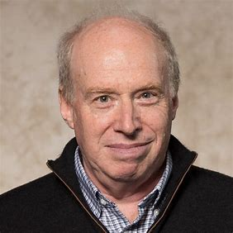
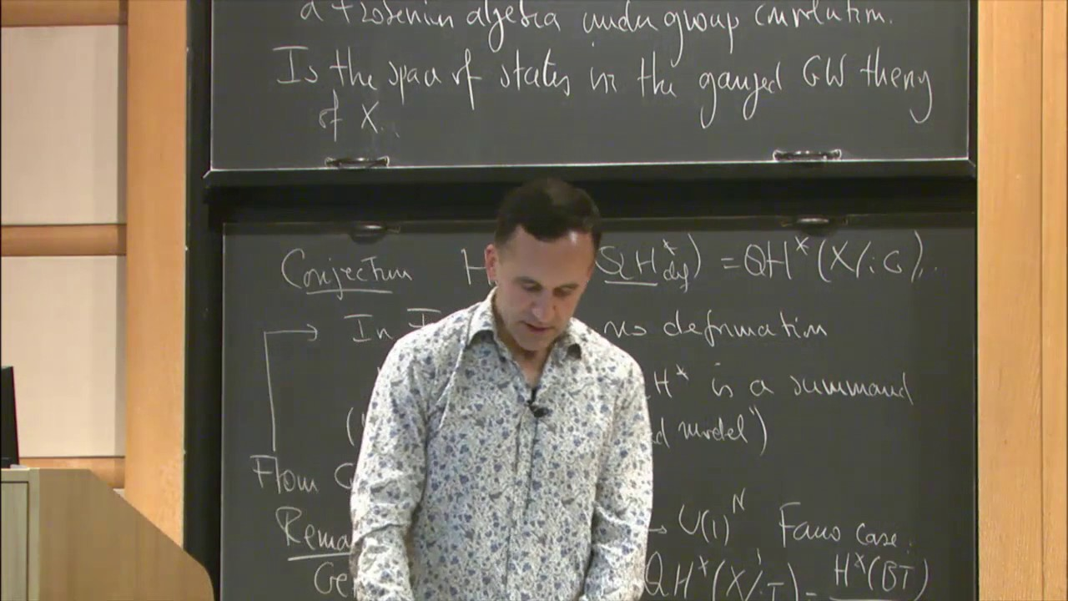
Previous Talks
Perimeter Lectures (with lecture notes):
Finite Symmetry In QFT, PIRSA, June 13-17, 2022
StringMath 2022 & arXiv…
CMSA , Nov. 8, 2022
Simons Foundation, November 17, 2022
KITP, March 13, 2023

Slide 7
1
Preliminary Remarks
2
Fields Without Fields
Finite Homotopy Theories
3
Defects & Domain Walls
4
5
Symmetry Action Via Quiche
6
Composition Of Defects
Open Problems
7

Slide 8
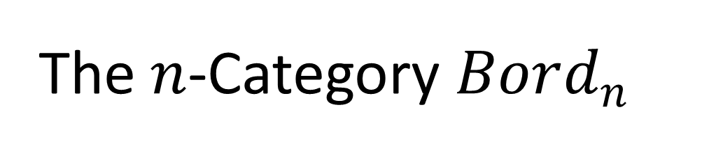
The $n$-Category $Bord_{n}$
Definition: An n-category is a category C whose morphism spaces are n-1 categories.
Objects (0-morphisms) = 0-dimensional manifolds ;
1-Morphisms = 1d bordisms between 0-folds;
2-Morphisms = 2d bordisms between 1d bordisms; …
Bord_{n}:

Slide 9

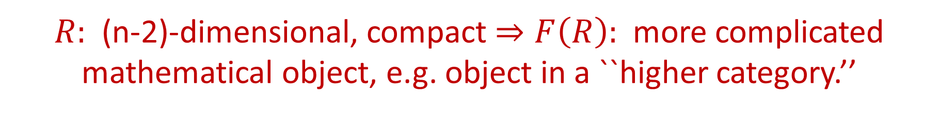
Field Theory Without Fields
Generalize functorial picture of field theory from Atiyah, Segal, ….
An $n$-dimensional ``field theory’’ is a monoidal functor $F:Bord_{n}→𝒞$
Result of ``doing the path integral.’’
$M:$ n-dimensional, compact $⇒F\left(M\right)∈ℂ$
$N:$ (n-1)-dimensional, compact $⇒F\left(N\right)∈Obj(VECT)$
– not necessarily linear (e.g. $𝒞=HolSym$, Moore-Tachikawa 2011)
$R:$ (n-2)-dimensional, compact $⇒F\left(R\right):$ more complicated mathematical object, e.g. object in a ``higher category.’’

Slide 10
Defects Within Defects
Baez & Dolan, …., Lurie, …
Kapustin, arXiv:1004:2307.
P
β
B
A
α
Q
Notes:
So, the lesson that we can take away is that at least part of the notion of extended field theory is to include defects in the definition of a qft.

Slide 11

Adding Fields: Background Fields
Fields should be locally defined on $n$-manifolds,
pull back under local diffeomorphisms, satisfy a sheaf property
Orientation, (s)pin structure, G-bundle with connection, Riemannian metric, differential cochain, foliation, …
Freed & Hopkins: [1301.5959, sec. 3]
Def: A $field ℱ$is a sheaf on $Man_{n}^{op}$ valued in simplical sets $Set_{Δ}$
$$F:Bord_{n}\left(ℱ\right)→𝒞$$

Slide 12
1
Preliminary Remarks
Fields Without Fields
2
Finite Homotopy Theories
3
Defects & Domain Walls
4
5
Symmetry Action Via Quiche
6
Composition Of Defects
Open Problems
7

Slide 13
Important and rich class of theories, underlies almost all our examples.
Kontsevich, Quinn, Freed, Turaev, …

Slide 14
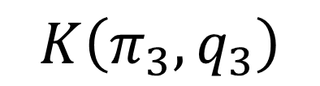

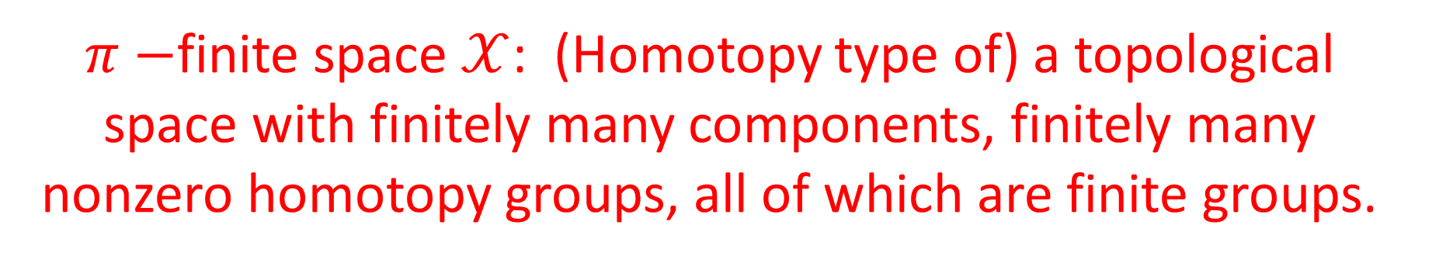


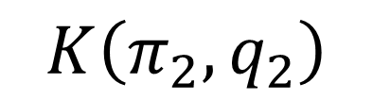


$π−$finite space $𝒳$: (Homotopy type of) a topological space with finitely many components, finitely many nonzero homotopy groups, all of which are finite groups.
$$⋯$$
$$K\left(π_{3},q_{3}\right)$$
$$⋯$$
$$𝒳^{\left(3\right)}$$
$$K\left(π_{2},q_{2}\right)$$
$$𝒳^{\left(2\right)}$$
$$BK\left(π_{3},q_{3}\right)=K\left(π_{3},q_{3}+1\right)$$
$$𝒳^{\left(1\right)}=K\left(π_{1},q_{1}\right)$$
$$BK\left(π_{2},q_{2}\right)=K\left(π_{2},q_{2}+1\right)$$

Slide 15

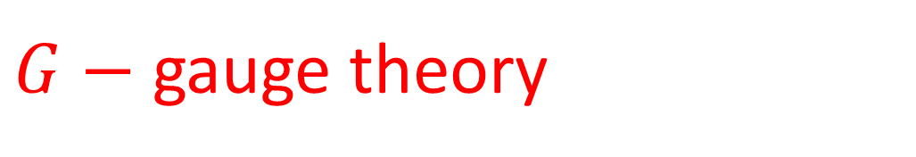
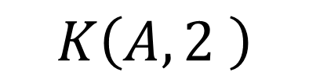
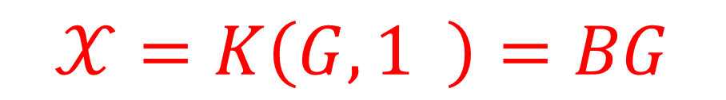

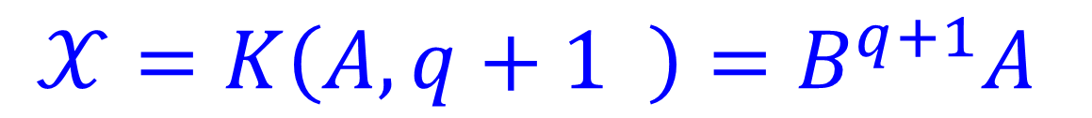

$$𝒳=K\left(G,1 \right)=BG$$
$G−$ gauge theory
$$𝒳=K\left(A,q+1 \right)=B^{q+1}A$$
Will be used to describe
``q-form symmetry for group A ‘’
$$K\left(A,2 \right)$$
$$𝒳$$
Classifying space of a ``$2−$group’’
$$BG$$
Will be used to describe ``2-group symmetry‘’
$π−$finite spaces $𝒳$ also known as ``higher groups’’

Slide 16

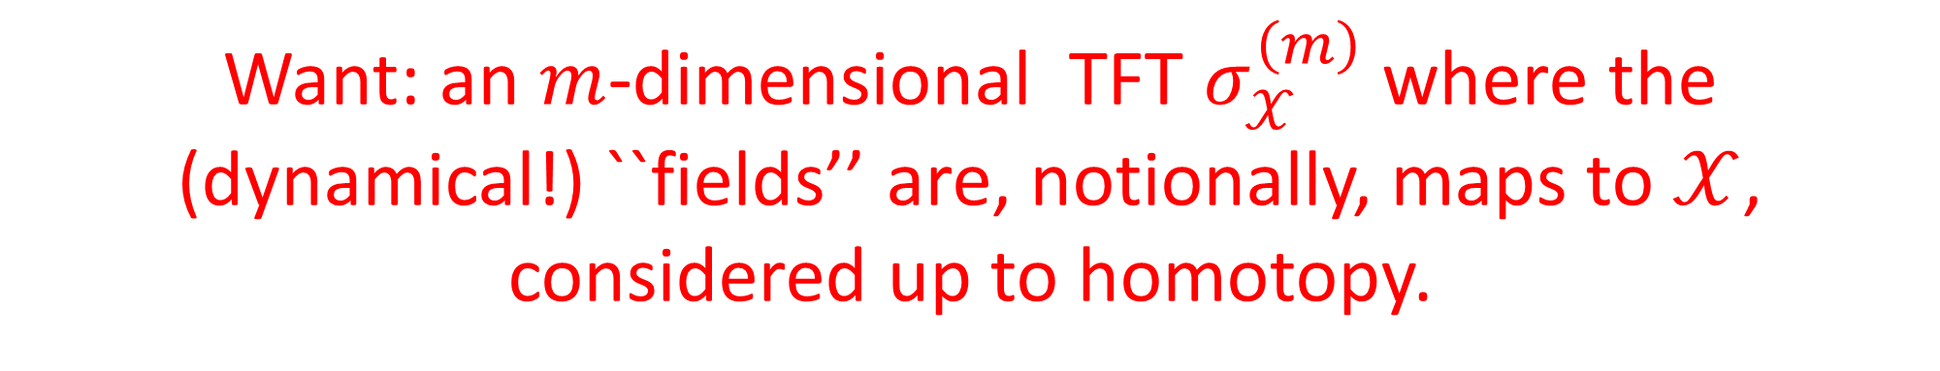

Want: an $m$-dimensional TFT $σ_{𝒳}^{\left(m\right)}$where the (dynamical!) ``fields’’ are, notionally, maps to $𝒳$, considered up to homotopy.
But we need to specify the codomain $𝒞$
TFT should really be denoted $σ_{𝒳,𝒞}^{\left(m\right)}$ but in the paper it is written $σ_{𝒳}^{\left(m\right)}$

Slide 17


Monoidal $m$-category: $⊗$ and $1_{𝒞}$
$VECT:$1-category of fin. dim. complex vector spaces. $1_{𝒞}= ℂ$
ALG(VECT): Algebras, bimodules, bimodule maps
$$1_{𝒞}=ℂ$$
CAT: Categories, Functors, Natural transformations
With suitable $⊗,$tensor unit $1_{CAT}=VECT$

Slide 18

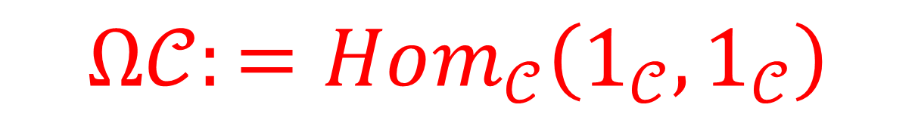
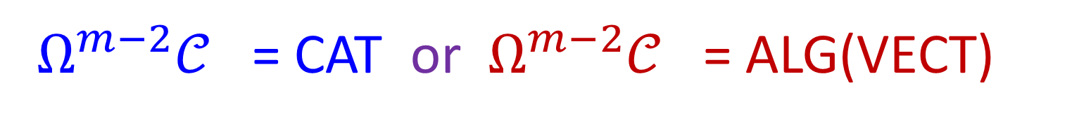
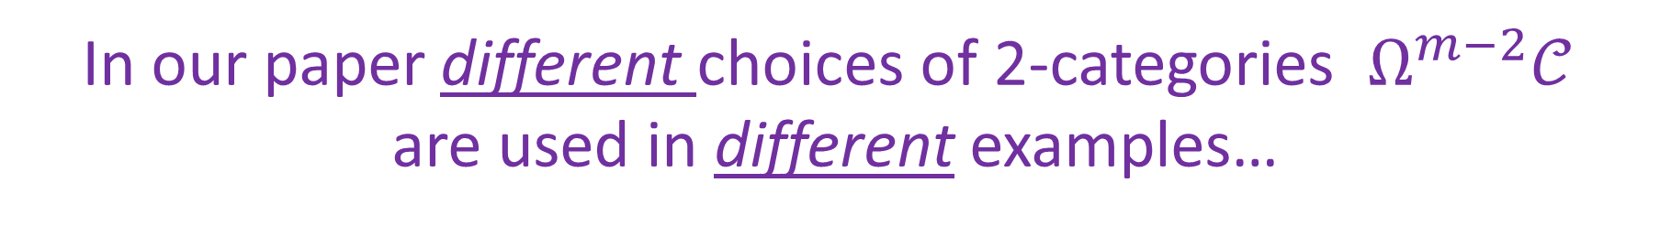


$$Ω𝒞:=Hom_{𝒞}\left(1_{𝒞}, 1_{𝒞}\right)$$
A monoidal $(m−1)$-category. We ALWAYS take:
$$Ω^{m−1}𝒞=VECT$$
$$Ω^{m}𝒞=ℂ$$
In our paper different choices of 2-categories $Ω^{m−2}𝒞$
are used in different examples…
$Ω^{m−2}𝒞$ = CAT or $Ω^{m−2}𝒞$ = ALG(VECT)
Latter choice leads to language of modules over an algebra

Slide 19




Example:
For 2d gauge theory for finite group $G$we get:
$$σ_{BG}^{\left(2\right)}\left(pt\right)=REP\left(G\right)$$
OR
$$σ_{BG}^{\left(2\right)}\left(pt\right)=ℂ\left[G\right]$$
Depending on the choice of $𝒞$

Slide 20


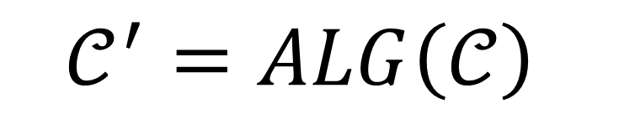

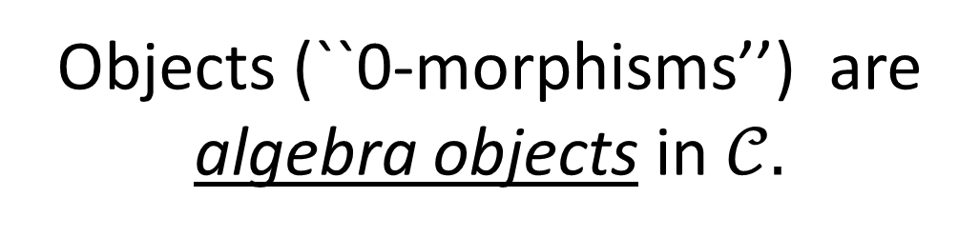
$$𝒞^{′}=ALG\left(𝒞\right)$$
Objects (``0-morphisms’’) are
algebra objects in $𝒞.$
$𝒞$is an $m$-category
$𝒞^{′}$ is an $\left(m+1\right)$-category
ALG(VECT): 2-category of Algebras, bimodules, bimodule maps
ALG(CAT)=TENSCAT: 3-category of tensor categories:
Tensor categories, Bimodule categories, Bimodule functors, Natural transformations

Slide 21
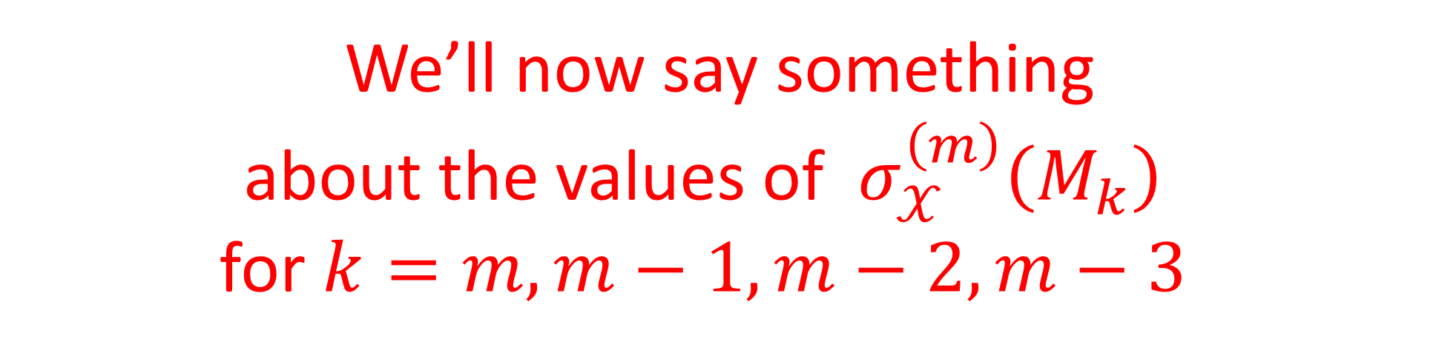
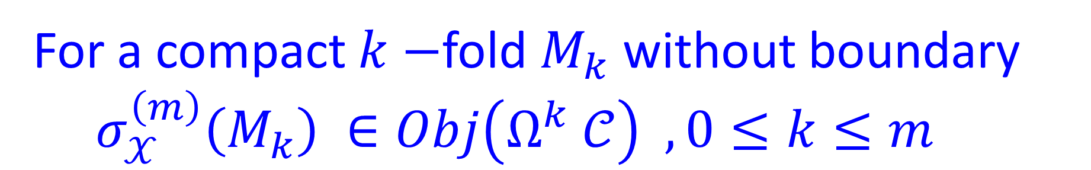
For a compact $k−$fold $M_{k}$ without boundary $σ_{𝒳}^{\left(m\right)}\left(M_{k}\right) ∈Obj\left(Ω^{k} 𝒞\right) ,0≤k≤m$
We’ll now say something
about the values of $σ_{𝒳}^{\left(m\right)}\left(M_{k}\right)$
for $k=m,m−1,m−2, m−3$

Slide 22

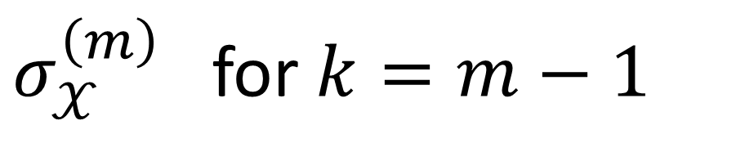
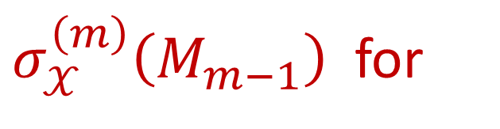


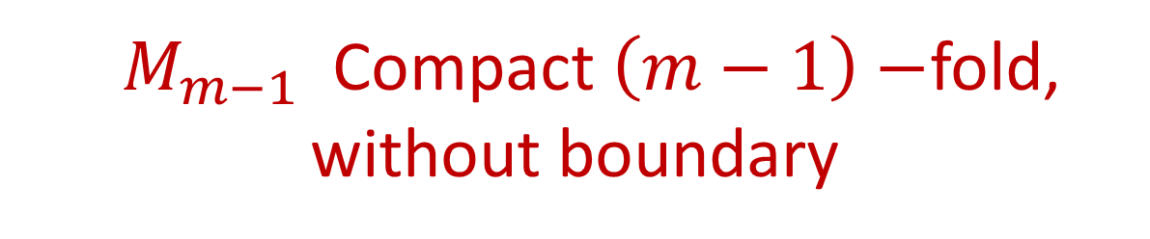
$σ_{𝒳}^{\left(m\right)}$ for $k=m−1$
Notation: For any manifold $M$of any dimension $𝒳^{M}≔Map\left(M,𝒳\right)$
${ M}_{m−1}$Compact $\left(m−1\right)−$fold, without boundary
$σ_{𝒳}^{\left(m\right)}\left(M_{m−1}\right)$ for
will be an object in $Ω^{m−1}𝒞$
$$=VECT$$
$σ_{𝒳}^{\left(m\right)}\left(M_{m−1}\right) :$ ``Space of states’’ on the spatial slice $M_{m−1}$
N.B. Vectors determined by a bordism $∅→ M_{m−1}$ might very well be zero, hence are not ``states’’ in the sense of quantum theory.

Slide 23
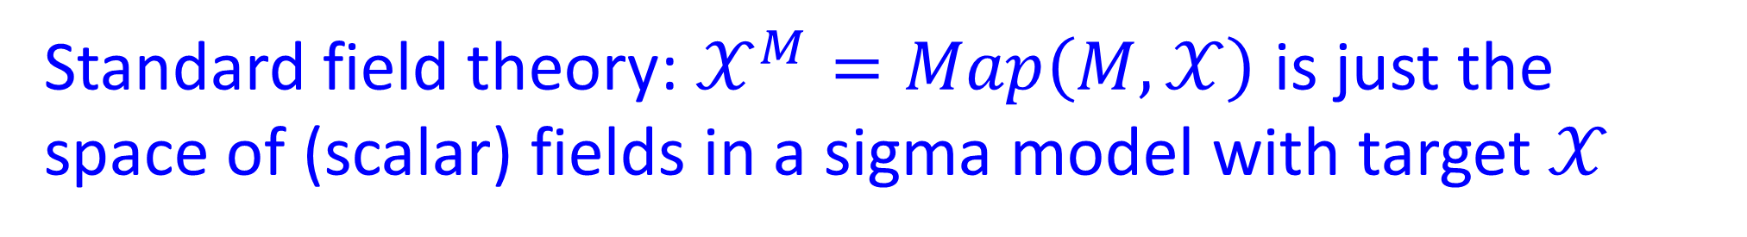

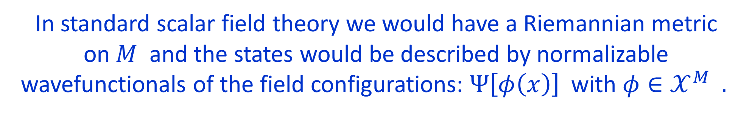
Standard field theory: $𝒳^{M}=Map\left(M,𝒳\right)$ is just the space of (scalar) fields in a sigma model with target $𝒳$
In standard scalar field theory we would have a Riemannian metric
on $M$ and the states would be described by normalizable wavefunctionals of the field configurations: $Ψ\left[φ\left(x\right)\right]$ with $φ∈𝒳^{M} .$
Hilbert space of states: $L^{2}\left(𝒳^{M}\right)$
Here we just work up to homotopy equivalence.
So we just want the vector space of locally constant functions on $𝒳^{M_{m−1}}$
$$σ_{𝒳}^{\left(m\right)}\left(M_{m−1}\right) ≔Fun\left(π_{0}\left(𝒳^{M_{m−1}}\right)\right)$$

Slide 24
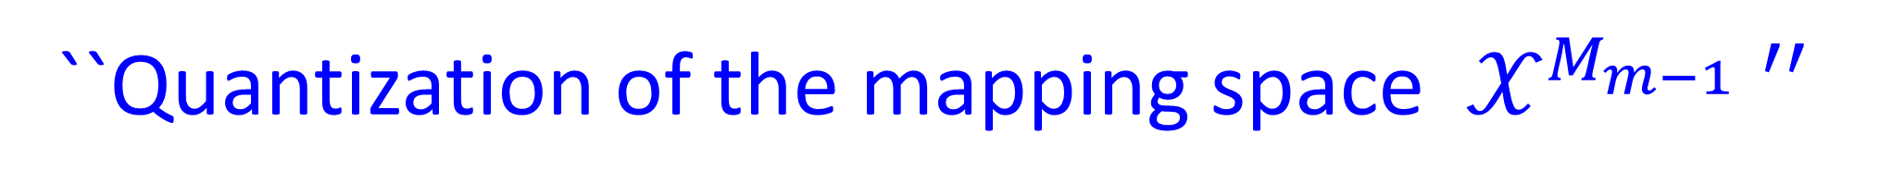
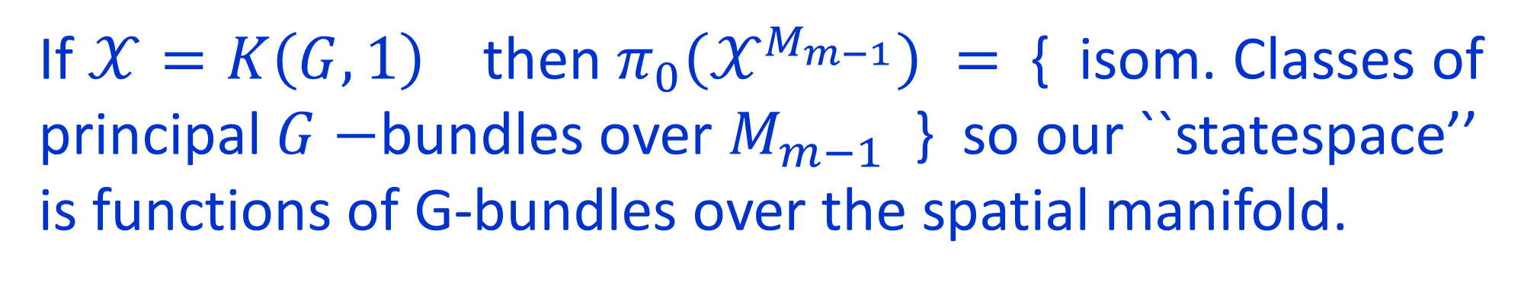
$$σ_{𝒳}^{\left(m\right)}\left(M_{m−1}\right) ≔Fun\left(π_{0}\left(𝒳^{M_{m−1}}\right)\right)$$
Example: If $𝒳=K\left(A,q\right)$ then $π_{0}\left(𝒳^{M_{m−1}}\right)=H^{q}\left(M_{m−1}, A\right)$
If $𝒳=K\left(G,1\right)$ then $π_{0}\left(𝒳^{M_{m−1}}\right) =$ { isom. Classes of principal $G−$bundles over $M_{m−1}$ } so our ``statespace’’ is functions of G-bundles over the spatial manifold.
``Quantization of the mapping space $𝒳^{M_{m−1}} ′′$

Slide 25



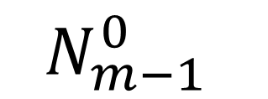
Amplitudes
$$M_{m}$$
$$N_{m−1}^{0}$$
$$N_{m−1}^{1}$$
$$M_{m}: N_{m−1}^{0} →N_{m−1}^{1}$$

Slide 26
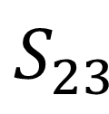


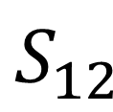


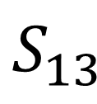
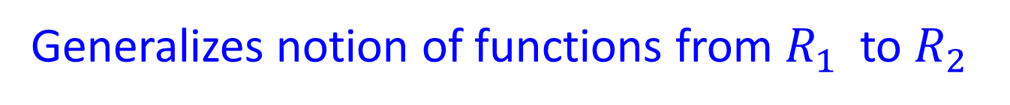










Correspondence Course
$$S_{ }$$
$$f_{1}$$
$$f_{2}$$
Generalizes notion of functions from $R_{1}$ to $R_{2}$
We would like to compose correspondences:
$$R_{1}$$
$$R_{2}$$
$${S_{13}}_{ }$$
$$g_{1}$$
$$g_{3}$$
$$S_{12}$$
$${S_{23}}_{ }$$
$$f_{1}$$
$$f_{12}$$
$$f_{23}$$
$$f_{3}$$
$$R_{1}$$
$$R_{2}$$
$$R_{2}$$

Slide 27



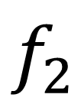

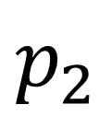
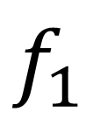
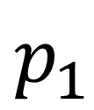
Homotopy Fiber Product
$$S_{1}×_{h}S_{2}$$
$$p_{1}$$
$$p_{2}$$
$$S_{1}$$
$${S_{2}}_{ }$$
$$f_{1}$$
$$f_{2}$$
$$R$$
$$S_{1}×_{h} S_{2} ≔\left\{ \left(s_{1},s_{2},γ\right): γ:f_{1}\left(s_{1}\right)→f_{2}\left(s_{2}\right) \right\}$$

Slide 28
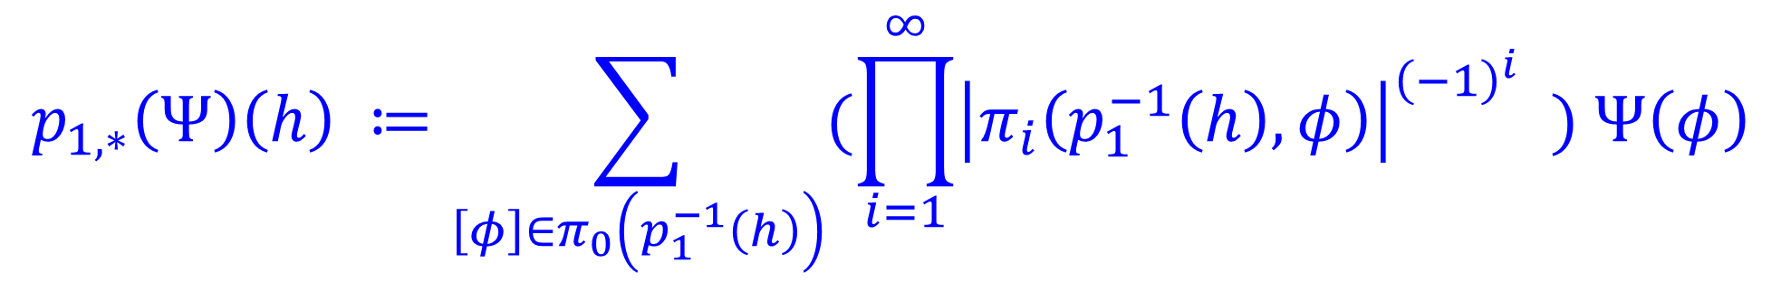
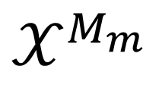
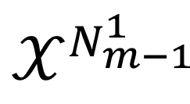



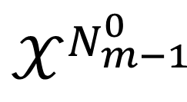
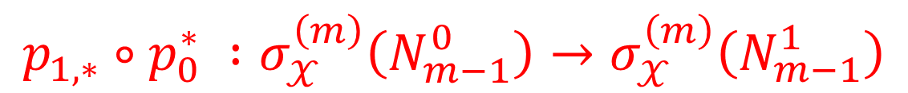
Amplitudes
$$M_{m}: N_{m−1}^{0} →N_{m−1}^{1}$$
$$𝒳^{M_{m}}$$
$$p_{0}$$
$$p_{1}$$
$$p_{1,∗}∘p_{0}^{∗} :σ_{𝒳}^{\left(m\right)}\left(N_{m−1}^{0}\right)→σ_{𝒳}^{\left(m\right)}\left(N_{m−1}^{1}\right)$$
$$𝒳^{N_{m−1}^{0}}$$
$$𝒳^{N_{m−1}^{1}}$$
$$p_{1,∗}\left(Ψ\right)\left(h\right) ≔\sum_{\left[φ\right]∈π_{0}\left(p_{1}^{−1}\left(h\right)\right)}{(\prod_{i=1}^{∞}{{\left|π_{i}\left(p_{1}^{−1}\left(h\right),φ\right)\right|}^{{\left(−1\right)}^{i}} ) Ψ\left(φ\right)}}$$

Slide 29
The fact that amplitudes compose properly follows naturally from properties of homotopy fiber products.
Partition function $\left(k=m\right)$ just take $N_{m−1}^{0}=N_{m−1}^{1}=∅$

Slide 30

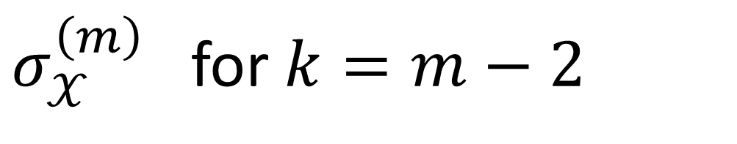
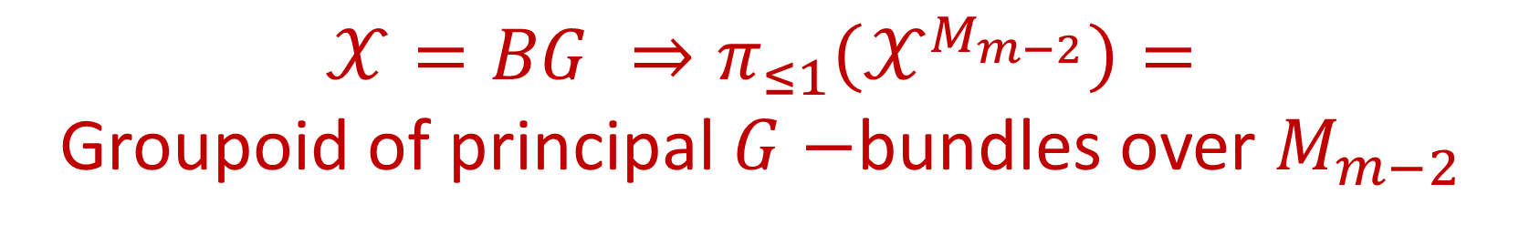
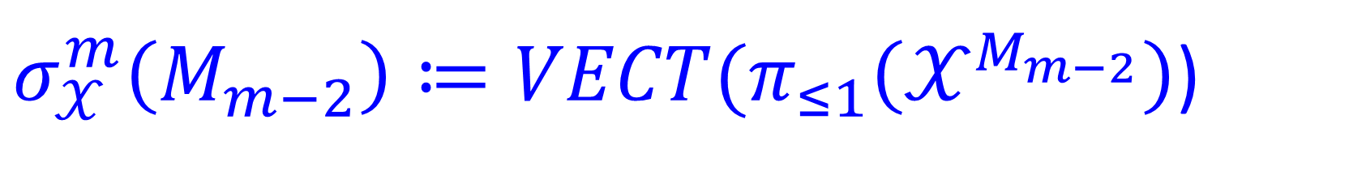
$σ_{𝒳}^{\left(m\right)}$ for $k=m−2$
$Ω^{m−2}𝒞=CAT ⇒ σ_{𝒳}^{\left(m\right)} \left(M_{m−2}\right)$must be a category.
Should be some kind of locally ``constant vector spaces’’ over $𝒳^{M_{m−2}}$
$σ_{𝒳}^{m}\left(M_{m−2}\right)≔VECT(π_{≤1}\left(𝒳^{M_{m−2}}\right)$)
``Quantization of the mapping space $𝒳^{M_{m−2}}$‘’
$$𝒳=BG ⇒π_{≤1}\left(𝒳^{M_{m−2}}\right)=$$
Groupoid of principal $G−$bundles over $M_{m−2}$

Slide 31

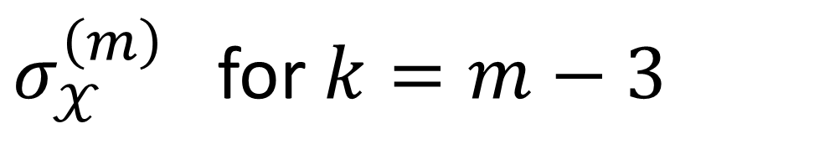
$σ_{𝒳}^{\left(m\right)}$ for $k=m−3$
$𝒞=ALG\left(CAT\right) \& m=3$
$𝒳=BG :$ $σ^{\left(3\right)}\left(pt\right)=VECT\left[G\right]$as a tensor category:
$${\left(V_{1}∗V_{2}\right)}_{g}= ⊕_{g_{1}g_{2}=g} {\left(V_{1}\right)}_{g_{1}}⊗{\left(V_{2}\right)}_{g_{2}}$$

Slide 32
At each categorical level there is some ``quantization’’ of a suitable correspondence of mapping spaces.
Not quantization in terms of symplectic geometry, but in the above homotopical sense.
Precise general formulation of ``quantization’’ in this setting is given
(to some extent) in FHLT sec. 8.4

Slide 33
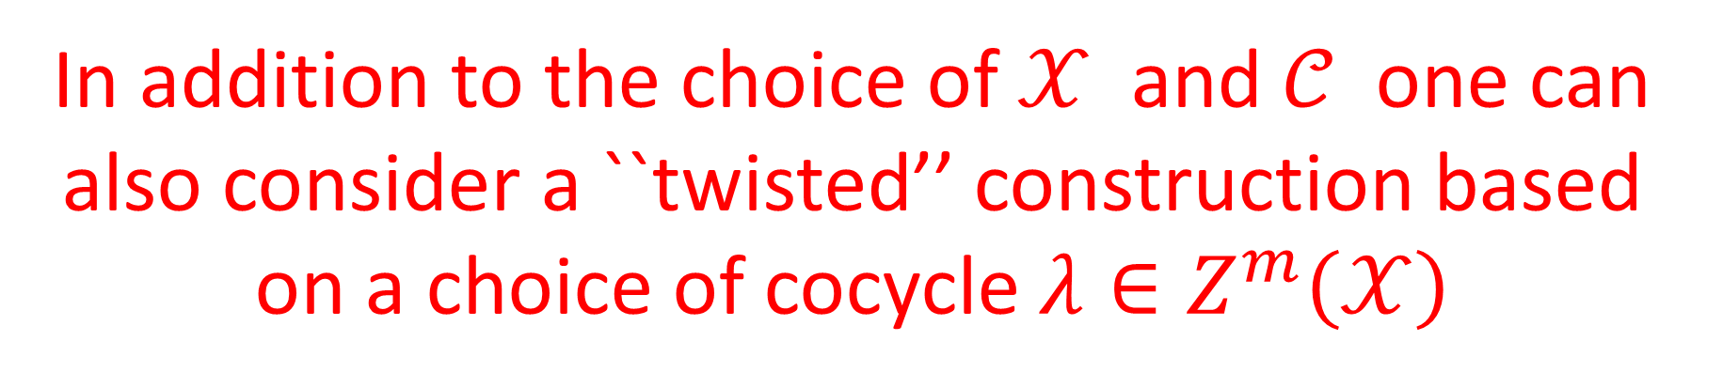
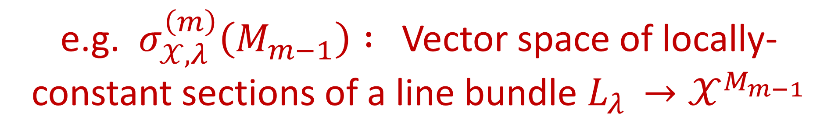
In addition to the choice of $𝒳$ and $𝒞$ one can also consider a ``twisted’’ construction based on a choice of cocycle $λ∈Z^{m}\left(𝒳\right)$
For $𝒳=BG$ these would be Dijkgraaf-Witten theories.
e.g. $σ_{𝒳,λ}^{\left(m\right)}\left(M_{m−1}\right) :$Vector space of locally-constant sections of a line bundle $L_{λ }→𝒳^{M_{m−1}}$

Slide 34
1
Preliminary Remarks
Fields Without Fields
2
3
Finite Homotopy Theories
4
Defects & Domain Walls
5
Symmetry Action Via Quiche
6
Composition Of Defects
Open Problems
7

Slide 35
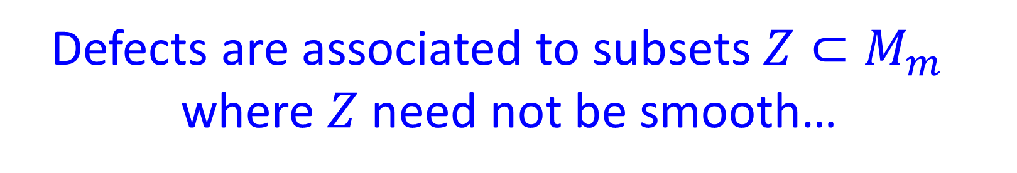
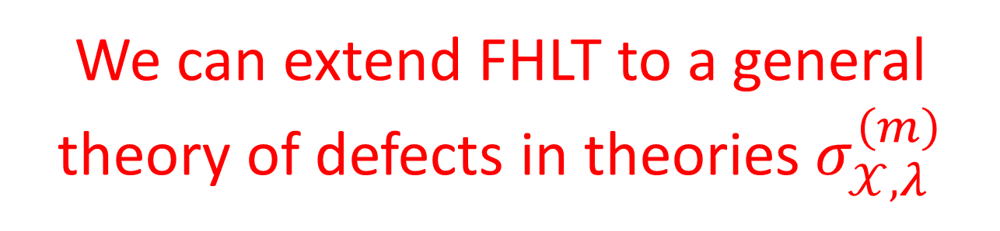
We can extend FHLT to a general
theory of defects in theories $σ_{𝒳,λ}^{\left(m\right)}$
Suggests a general framework
for defects in general TQFT’s.
Defects are associated to subsets $Z⊂M_{m}$
where $Z$need not be smooth…

Slide 36
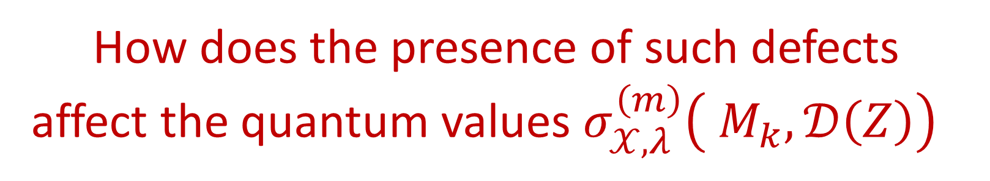
Questions To Answer:
What data are necessary to specify a defect?
i.e. what are the ``labels’’ carried by a defect?
Classical labels, semiclassical labels, quantum labels, local labels, global labels.
How does the presence of such defects
affect the quantum values $σ_{𝒳,λ }^{\left(m\right)}\left( M_{k},𝒟\left(Z\right)\right)$
Is there a product law on defects?
How do the labels compose?

Slide 37


Global labels: Surround $Z$by a ``small’’ neighborhood $U_{Z}$ with a manifold boundary $∂U_{Z}.$
$∂U_{Z}$ will be of codimension 1 so there is an associated statespace $σ\left(∂U_{Z}\right)$
$$δ_{𝒟(Z)}∈ σ\left(∂U_{Z}\right)=state space ∈Obj\left(VECT\right)$$
i.e. $δ_{𝒟\left(Z\right)}$ is a vector in the complex vector space $σ\left(∂U_{Z}\right)$

Slide 38



Local Labels: When $Z$ is a smooth submanifold we can hope to characterize the defect by examining
the neighborhood of a point $p∈Z .$
Basic idea: Try to implement KK reduction along the linking sphere $S^{ℓ−1}$ of $p∈Z$where $ℓ≔cod\left(Z⊂M\right)$
Local Label $δ_{𝒟\left(p\right)}∈Obj\left(Hom\left( 1_{Ω^{ℓ−1}𝒞}, σ\left(S^{ℓ−1}\right)\right)\right)$
$\left(m−\left(ℓ−1\right)\right)−1= \left(m−ℓ\right)−$category

Slide 39


Sanity check: $ℓ=m .$ Local label = global label.
$$Ω^{m−1}𝒞=VECT$$
$$1_{Ω^{ℓ−1}𝒞} =ℂ$$
$σ\left(S^{m−1}\right) =$ Vector space of ``states’’ on $S^{m−1}$
$δ_{𝒟\left(p\right)}$is a vector in statespace on $S^{m−1}:$
State/operator correspondence.
Already for line defects the choice of $Ω^{m−2}𝒞$makes a difference.

Slide 40








Claim: $Z$smooth with trivialized normal bundle then local labels can be integrated to global labels:
``KK Reduction”: $σ^{\left(ℓ−1\right)}\left(N\right)≔σ\left(N×S^{ℓ−1}\right)$
Data of local defect defines a left boundary theory
$δ^{\left(ℓ−1\right)}$ for $\left(m−ℓ+1\right)−$dimensional theory $σ^{\left(ℓ−1\right)}$
$$∈Hom\left( σ^{\left(ℓ−1\right)}\left(∅\right), σ^{\left(ℓ−1\right)}\left(Z\right)\right)$$
$$δ^{\left(ℓ−1\right)}$$
$$Z$$
$$σ^{\left(ℓ−1\right) }$$
Gives vector $δ_{𝒟\left(Z\right)}$ in vector space
$$σ^{\left(ℓ−1\right)}\left(Z\right)=σ\left(Z×S^{\left(ℓ−1\right)}\right)$$
[0,1]

Slide 42

When $Z$is not smooth we treat it as a stratified space and consider the links starting with the lowest codimension and then move up.

Slide 43





Semiclassical Data
For $σ_{𝒳}^{\left(m\right)}$we can derive the local and global labels from
``semiclassical data’’ (thought of as dynamical fields for the defect)
DEF: Semiclassical local defect data: $ψ:𝒴→ 𝒳^{S^{\left(ℓ−1\right)}}$
Apply ``quantization procedure’’ of FHLT to the correspondence:
$$𝒴$$
$$ψ$$
$$𝒳^{S^{\left(ℓ−1\right)}}$$
$$∗$$

Slide 44






Simplest example: $ℓ=m$: Point defect
Local label $∈Hom\left(ℂ , σ_{𝒳}^{\left(m\right)}\left(S^{m−1}\right)\right)$ i.e. is a vector in $σ_{𝒳}^{\left(m\right)}\left(S^{m−1}\right)$
$$=Fun\left(π_{0}\left(𝒳^{S^{m−1}}\right)\right)$$
We compute this vector to be the pushforward of the function $Ψ=1$ on $𝒴:$
$$Ψ\left(h\right)=\sum_{φ∈π_{0}\left(ψ^{−1}\left(h\right)\right)}{\prod_{i=1}^{∞}{{| π}_{i}{\left(ψ^{−1}\left(h\right), φ\right)|}^{{\left(−1\right)}^{i−1}} }}$$
$$h∈𝒳^{S^{m−1}}$$

Slide 45










Semiclassical Approach to Global Labels
For Defects In $σ_{𝓧}^{\left(m\right)}$
Mapping space $ℳ$ is space of pairs $\left(φ_{blk}, φ_{dfct}\right)$
$$φ_{blk}:M→𝒳$$
$$φ_{dfct}:Z→𝒴$$
$$𝒴$$
$$φ_{dfct}$$
``Quantization’’ of $ℳ$ gives partition functions, ``statespaces’’, amplitudes, etc. in the presence of the defect with local sc label $ψ.$
$$Z$$
$$ψ$$
$$φ_{blk,Z}$$
$$𝒳^{S^{\left(ℓ−1\right)}}$$

Slide 46





Domain Walls & Boundary Theories
Specialize to $ℓ=1: 𝒳^{S^{0}}=𝒳∐𝒳$
and then generalize to give semiclassical data for a domain wall between FHT’s:
$$𝒴$$
$$ψ_{1}$$
$$ψ_{2}$$
$$𝒳_{1}^{ }$$
$$𝒳_{2}^{ }$$

Slide 47


Boundary theories: $𝒳_{1}=∅$ OR $𝒳_{2}=∅$
``Dirichlet’’: $𝒴=pt.$ & choose component of $𝒳$
``Neumann’’: $𝒴=𝒳 \& ψ=Identity.$
Names arise from the case of $G−$gauge theory with $𝒳=BG$
But lots of other boundary theories are possible….

Slide 48





Example: $𝒳=BG \& λ∈Z^{m}\left(BG, ℂ^{∗}\right)$
$σ_{𝒳,λ}^{\left(m\right)}:$m-dimensional Dijkgraaf-Witten theory.
A general set of semiclassical boundary conditions:
$$f:H→G \& μ∈C^{m−1}\left(BH, ℂ^{∗}\right) : δμ={\left(Bf\right)}^{∗}\left(λ\right)$$
$$ψ=Bf$$
$$𝒴=BH$$
$$BG$$

Slide 49











If $∂M_{m} =N_{m−1}$then the
relevant mapping space is
$$ℳ= \{ \left(φ_{blk}, φ_{bdy}\right):$$
$$φ_{bdy}$$
$$BH$$
Reduction of structure group on the boundary from $G$ to $H$
$$\}$$
$$N$$
$$Bf$$
Adding a (homotopical) sigma model $N→G/f(H)$ , as expected when we break $G−$symmetry to $H−$symmetry on the boundary.
$$φ_{blk}{\left.​\right|}_{N}$$
$$BG$$

Slide 50








$𝒞=ALG\left(CAT\right)=TENSCAT \& m=3$
$$σ_{𝒳,λ}^{(3)}($$
$$\left(f,μ\right)$$
$$)$$
$$∈Hom\left(1_{𝒞} , σ_{𝒳,λ}^{\left(3\right)}\left(pt\right) )\right)$$
Will be a module category for the tensor category $σ_{BG}^{\left(3\right)}\left(pt\right)=VECT\left[G\right].$
Will be $VECT[G/H$ $]$
$${\left(V∗W\right)}_{gH} ≔ ⊕_{g^{′},g^{′′}H} L_{g^{′},g^{′′}H}⊗V_{g^{′}}⊗W_{g^{′′}H }$$
$$g^{′}\left(g^{′′}H\right)=gH$$
$L_{g^{′}, g^{′′}H}$: Constructed from the cocycle $λ$

Slide 51




Defects Within Defects
$$𝒵$$
One could go on to develop this formalism to describe defects within defects
$$𝒴_{1}$$
$$𝒴_{2}$$
Used in the paper to discuss composition of N/D and D/N boundary conditions, and duality domain walls.
$$𝒳$$

Slide 52

Nontrivial Topological Effects
Classical labels: $π_{0}\left(𝒳^{S^{ℓ−1}}\right)$
They are inadequate. Section 4.4.
$$m=3, B^{2}A→𝒳→BG, 𝒞=TENSCAT$$
$σ_{𝒳}^{\left(3\right)}\left(pt\right)=VECT\left[A^{∨}×G \right]:$Vector bundles over $G$with coeff’s in $VECT\left[A^{∨}\right]$
$${\left(W_{1}∗W_{2}\right)}_{g}= ⊕_{g_{1}g_{2}=g}K_{g_{1},g_{2}}⊗W_{g_{1}}⊗W_{g_{2}}$$
$K_{g_{1},g_{2}}→A^{∨} :$ A line bundle computed from Postnikov map $k:BG→B^{3}A$
For a line in a D boundary theory the classical labels are $g∈G$
Quantum Labels: Object in $VECT\left[G×A^{∨}\right]$ with above composition.

Slide 53
1
Preliminary Remarks
Fields Without Fields
2
3
Finite Homotopy Theories
4
Defects & Domain Walls
5
Symmetry Action Via Quiche
6
Composition Of Defects
Open Problems
7

Slide 54
Generalized, categorical, noninvertible,… ``symmetries’’
We describe a framework for understanding these terms using the sandwich or quiche picture

Slide 55





Motivation 1:
TFT $∼$ Algebra
$$σ_{BG}^{\left(2\right)}\left(pt\right) = ℂ\left[G\right]$$
Algebra
$⊗−$category
$$σ_{BG}^{\left(3\right)}\left(pt\right) = VECT\left[G\right]$$
(algebra object in CAT )
Boundary theory $∼$ module for the algebra
$⇒$Important notions from algebra: Regular representation,….

Slide 56
It is good to separate the notion of abstract group (algebra)from it’s action on a module.
Relations between algebra elements will universally be true in all modules.
Field theory: Compute relations among defects by computations within the TFT

Slide 57



Motivation 2:
4d Yang-Mills for compact group $G=SU\left(N\right)$
From Lagrangian we can’t tell if the gauge group is
$G$ or $G^{adj}=PSU\left(N\right)$ or $G/A$ with $A⊂Z\left(G\right)$
$F: 4d G$gauge theory: partition function/Hilbert space:
Sum over all $G−$bundles: Just need $c_{2}\left(P\right)$

Slide 58



For $PSU\left(N\right)$ gauge theory: To compute the partition function/Hilbert space:
Sum over all $G^{adj}−$bundles: Need $c_{2}\left(P\right)$ …
AND $w_{2}\left(P\right)∈H^{2}\left(M;Z(SU\left(N\right))\right)$
Obstruction to lifting the $PSU\left(N\right)$ bundle to an
$SU\left(N\right)$ bundle is a $ℤ_{N} −$gerbe on the 4d spacetime.

Slide 59







PSU(N) gauge theory as a boundary theory for
$σ_{𝒳}^{\left(5\right)}$with $𝒳=B^{2}ℤ_{N}$ :
New boundary field: Isomorphism of restriction of $ℤ_{N}$gerbe from 4d with $ℤ_{N}$ gerbe describing obstruction to lifting PSU(N) bundle to SU(N) bundle. So $\tilde{F}$ is not exactly $PSU\left(N\right)$ gauge theory.
This is just $F≔$SU(N) gauge theory because the Dirichlet bc trivializes the $A−$gerbe, forcing us to couple YM only to SU(N)-bundles
$$M_{k}$$
$$σ_{𝒳}^{\left(5\right)}$$
$$D$$
$$\tilde{F}$$

Slide 60









$$M$$
$$σ_{𝒳}^{\left(5\right)}$$
$$N$$
This PSU(N) gauge-theory
$$\tilde{F}$$
$$M$$
This is $SU(N)/A$ gauge-theory for
$A⊂Z\left(SU\left(N\right)\right)$with
topological coupling determined
by $𝒫_{q}\left(w_{2}\left(P\right)\right)$
$$σ_{𝒳}^{\left(5\right)}$$
$$\left(A,q\right)$$
$$\tilde{F}$$

Slide 61





Definition 1: An $n$-dimensional quiche is a pair $\left(ρ,σ\right)$ with
$σ:$ $\left(n+ 1\right)−$dimensional TFT
$ρ:$ $n−$dimensional topological boundary theory
(=``right module for $σ$’’
$⇒$ ``right $∂−$theory’’)
$$ρ$$
$$σ$$

Slide 62








Definition 2: An action by the quiche $\left(ρ,σ\right)$ on an
$n$-dimensional field theory $F$, (not necessarily topological),
is a ``left’’ boundary theory (``left module for $σ$’’) $\tilde{F}$
(not necessarily topological ) and an isomorphism:
Note: Different $θ$’s for same $\left(ρ,σ,\tilde{F}\right)$ differ by elements of $Aut\left(F\right):$
$$θ$$
$$ρ$$
$$σ$$
$$\tilde{F}$$
$$F$$
$$≅$$
Partially justifies the viewpoint
that this is a ``symmetry.’’

Slide 63

Our first reference complaint:

Slide 64



Example: G-Symmetry In Quantum Mechanics
$F:$ n=1 dimensional field theory
$F\left(pt\right)=ℋ$ Hilbert space
$F\left(\left[0,t\right]\right)= U\left(t\right)=e^{−t H}∈Hom\left(ℋ,ℋ\right)$
Actually: $F\left(germ\left(pt\right)\right)=\left(ℋ, H\right)$
Kontsevich & Segal
Suppose $ρ:G→U\left(ℋ\right)$has image commuting with $H$
$G$ need not be Abelian (need not be finite!)
Won’t be sensitive to higher homotopy so take $σ→σ_{BG}^{\left(2\right)}$

Slide 65










Need to define the left $σ−$module $\tilde{F}$
$$\tilde{F}$$
$$σ( )$$
$$∈Hom_{ALG\left(VECT\right)}\left( σ\left(pt\right),σ\left(∅\right)\right)$$
$$=Hom_{ALG\left(VECT\right)}\left( ℂ\left[G\right],ℂ\right)$$
$$=\{ ℂ\left[G\right]−ℂ bimodules \}$$
$$\tilde{F}$$
as a left $ℂ\left[G\right]−$module
$$σ( )$$
$$≔ℋ_{ }$$

Slide 67







Quiche: $\left(ρ,σ_{BG}^{\left(2\right)}\right)$ with $ρ$= Dirichlet
$$σ_{BG}^{\left(2\right)}\left( \right)$$
$=ℂ\left[G\right]$ as a $ℂ−ℂ$ bimodule
Quantization of $G−$bundles on [0,1] trivialized at both ends: {Trivialized bundles} $=G$,
so quantization gives functions on $G.$
$$a$$
Topological $ρ−$defects in the Dirichlet boundary are labeled by $a∈ℂ\left[G\right]$

Slide 68







$$θ$$
$$F$$
$$\tilde{F}$$
$$a∈ℂ\left[G\right]$$
$$ρ\left(a\right)∈End\left(ℋ\right)$$
$$≅$$
Insertion on topological boundary $⇒$
$ρ\left(a\right)$ commutes with $U\left(t\right)$ $⇒$
$ρ\left(a\right)$ commutes with $H$

Slide 69









$$θ$$
$$ξ∈B$$
$$F$$
$$B$$
$$\tilde{F}$$
$$T\left(ξ\right) ∈End\left(ℋ\right)$$
$$T$$
$$≅$$
$$T:B→End\left(ℋ\right)$$
Not topological: Gives general operator on $ℋ$

Slide 70


In general,….
all manipulations, e.g. OPE’s of defects, etc. done within the TFT $σ$ give universal relations independent of the field theory $F$ on which the symmetry acts.
Some ``generalized topological symmetry’’ operators on $F$ might be very hard to describe within $F$but easy to describe in a quiche.
Example 4.4: Slice knot defects in 3d field theory that do not bound a disk.

Slide 71
1
Preliminary Remarks
Fields Without Fields
2
3
Finite Homotopy Theories
4
Defects & Domain Walls
Symmetry Action Via Quiche
5
6
Composition Of Defects
Open Problems
7

Slide 72






Given defects $\left(𝒟_{1},Z_{1}\right) \& \left(𝒟_{2},Z_{2}\right)$ with $Z_{1}, Z_{2}$
codimension $ℓ ,$parallel, trivialized normal bundles:
$$P^{ℓ }$$
$$S^{ℓ−1}$$
$$D_{1}^{ℓ}$$
$$D_{2}^{ℓ}$$
N.B. The product of cod $ℓ$ defects is expressed in terms of cod $ℓ$ defects.

Slide 73


In FHT, if the local defects are described by semiclassical data as above, this translates to the equation:
$$ψ=r_{1}∘g$$
$$ψ_{1}×ψ_{2}$$
$𝒴$: homotopy fiber product of $ψ_{1}×ψ_{2}$ and $r_{0}$

Slide 74




















Example: Domain walls in finite gauge theory
$$H_{12}$$
$$H_{23}$$
$$f_{1}$$
$$f_{12}$$
$$f_{23}$$
$$f_{3}$$
$$𝒟$$
$$∗$$
$$𝒟$$
$$G_{1}$$
$$G_{2}$$
$$G_{2}$$
$$G_{3}$$
$$Z_{12}\left(g\right)$$
$$=\sum_{\left[g\right]}{𝒟}$$
$$f_{1}π_{1}$$
$$f_{3}π_{3}$$
$$G_{1}$$
$$G_{3}$$
$\left[g\right]∈f_{12}\left(H_{12}\right)\backslash G_{2}/f_{23}(H_{23})$
$$Z_{\left(12\right)}\left(g\right)=\left\{ \left(h_{12},h_{23}\right)\right| f_{12}\left(h_{12}\right) g f_{23}{\left(h_{23}\right)}^{−1}=g \}$$

Slide 75
1
Preliminary Remarks
Fields Without Fields
2
3
Finite Homotopy Theories
4
Defects & Domain Walls
Symmetry Action Via Quiche
5
Composition Of Defects
6
7
Open Problems

Slide 76

Some Future Directions
Several examples in the paper show topological subtleties in labeling and composition laws of defects. Physical consequences?
Some applications are described in the paper: Duality defects, modular invariant combinations of left & rightmovers in 2d CFT, … It would be nice to see more.
Given $\left(𝒳,λ\right)$can we find a ``traditional’’ field theory
(gauge fields, fermion fields, p-form fields, …)
on which $\left(ρ,σ_{𝒳}^{\left(m\right)}\right)$acts?

Slide 77
Some Future Directions
Extension to families of QFT’s.
e.g. higher Berry curvatures?
Spacetime symmetries.
(Start with P,T-invariance)
Continuous symmetries?

Slide 78
Thanks for your attention!

