Slide 1
A Few Remarks On The Interaction Of Theoretical Condensed Matter & Physical Mathematics
I will raise a few questions, suggest a few
potentially interesting future directions.
Disclaimers
I haven’t been working in this subject for a few years, even though I regard it as one of the most vibrant areas in Physical Mathematics.
So I’m probably pretty uninformed/out of the loop on some important points.
And some of the suggestions I make might be pretty silly.
Notes:
So you are probably wondering: why did I agree to be on this panel? Well, I’m wondering the same thing. Indeed, I probably should not
have agreed, but one thing I was thinking at the time was this:

Slide 2

So why did he agree to be on the panel?
What was he thinking ???
ACP(2015)Working group – expert opinions.
Birthday questions: Haldane, Freedman, Seiberg.
Two suggestions for interesting future directions.

Slide 3
Questions From An Aspen/Harvard Working Group
Dan Freed, Mike Freedman, Matt Hastings, Mike Hopkins, Anton Kapustin, Alexei Kitaev, Constantin Teleman
How to relate three distinct approaches to the mathematical classification of ``SRE’’ or ``invertible’’ topological phases.
Boundary conditions in topological field theory: When does a SRE phase only allow gapless boundary conditions?
Questions related to lattice realizations of topological phases.
Notes:
I was lucky enough to be part of a working group on topological phases that met at the ACP in summer 2015 and at Harvard just last January. The other members of the working group were … So while I’ve been out of the loop these people definitely are not so you might be interested in what THEY find interesting.

Slide 4

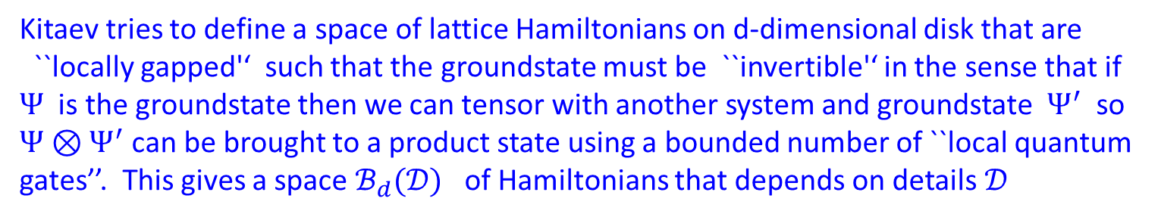


First Approach: Lattice
Kitaev tries to define a space of lattice Hamiltonians on d-dimensional disk that are
``locally gapped'‘ such that the groundstate must be ``invertible'‘ in the sense that if $Ψ$ is the groundstate then we can tensor with another system and groundstate $Ψ^{′}$so $Ψ⊗Ψ^{′}$can be brought to a product state using a bounded number of ``local quantum gates’’. This gives a space $ℬ_{d}(𝒟)$ of Hamiltonians that depends on details $𝒟$
Then we want to take some kind of limit ${ ℬ}_{d}≔ \lim_{𝒟}{ℬ_{d}(𝒟)}$
Kitaev argues the set of spaces $\{ℬ_{d}\}_{d≥0}$forms something
known in topology as a “loop spectrum“:
$$ℬ_{d}→Ωℬ_{d+1}$$
Details can (more or less) be carried out for free fermions – leading to K and KO
spectrum. The interacting case is less clear, and $ℬ_{d}$is only clear for low values of $d.$

Slide 5
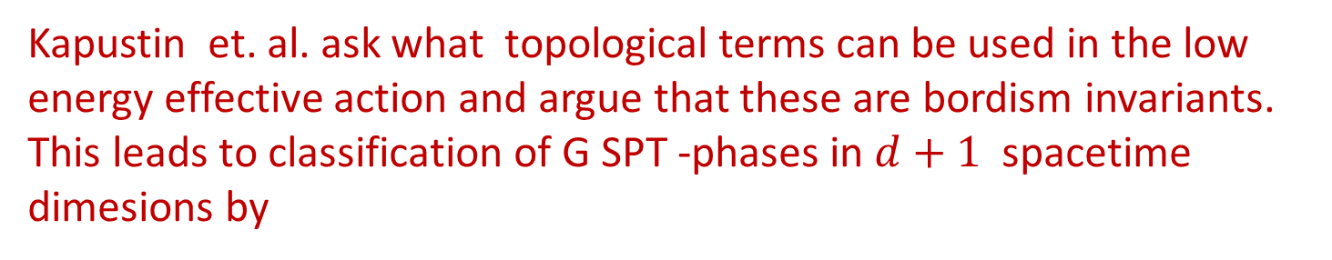

Second & Third Approaches: TFT
Kapustin et. al. ask what topological terms can be used in the low energy effective action and argue that these are bordism invariants. This leads to classification of G SPT -phases in $d+1$ spacetime dimesions by
$$Hom\left(Ω_{d+1}^{structure}\left(BG\right), U\left(1\right)\right)$$
Freed-Hopkins PROVE a mathematical theorem classifying ``reflection positive extended invertible topological field theories’’ and produce a very closely related answer, using somewhat more elaborate ideas from bordism theory.
20-20 hindsight: Agreement of Kapustin and Freed-Hopkins is not that surprising since an ``invertible topological field theory’’ is essentially a formalization of what one ought to mean by a ``classical topological field theory’’.
Notes:
In fact, Freed and I actually were the ones that introduced the idea of an
``invertible topological field theory’’ in the first place and what we had in mind was precisely that: formalizing topological terms in the Lagrangian.

Slide 6

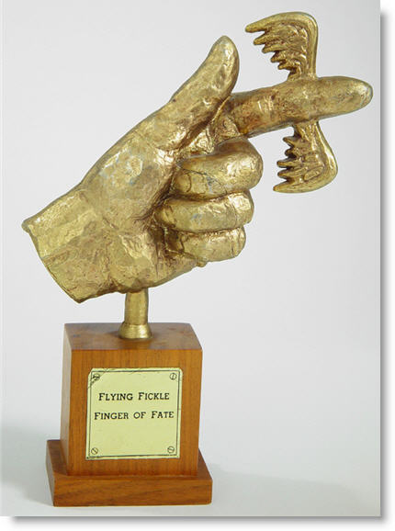
The Big Gap
Relating the lattice approach to the field theory
approach faces some challenges:
Technically hard to define precisely the correct spaces
of locally gapped lattice Hamiltonians with SRE ground state.
3d codes of Haah?
Field theory versions of
nonabelian Dijkgraaf-Witten models?

Slide 7
Needed: Theory of Interfaces Between Topological Field Theories
When does a gapped phase (i.e. a TFT) only have gapless boundary conditions?

Slide 8

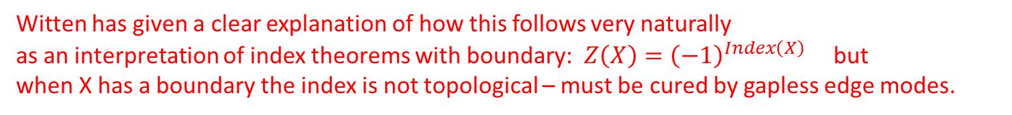
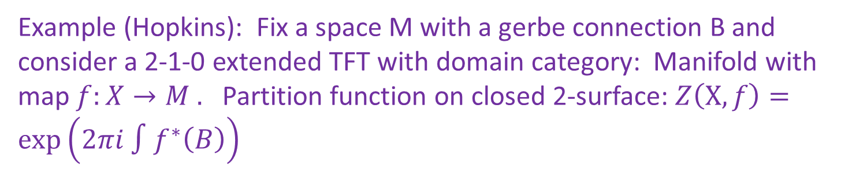
Examples
Gapless modes at boundaries of topological
insulators and superconductors.
Witten has given a clear explanation of how this follows very naturally
as an interpretation of index theorems with boundary: $Z\left(X\right)={\left(−1\right)}^{Index\left(X\right)}$ but
when X has a boundary the index is not topological – must be cured by gapless edge modes.
Example: Invertible 3+1 theory with domain category: Unoriented manifolds with SO(3) bundle $P→X$. $Z\left(P\right)={\left(−1\right)}^{w_{2}{\left(P\right)}^{2}\left[X\right]}$
Example (Hopkins): Fix a space M with a gerbe connection B and consider a 2-1-0 extended TFT with domain category: Manifold with map $f:X→M .$ Partition function on closed 2-surface: $Z\left(X,f\right)=\exp\left(2πi ∫f^{∗}\left(B\right)\right)$
If $B$is not torsion can prove there is no TFT boundary condition.

Slide 9
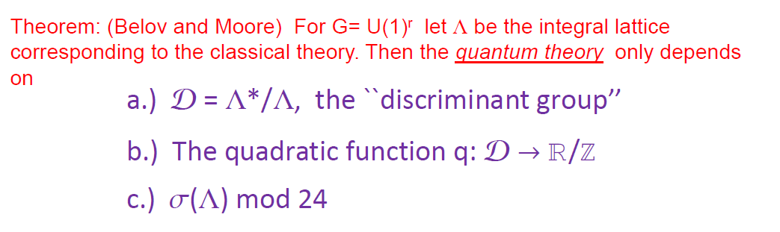
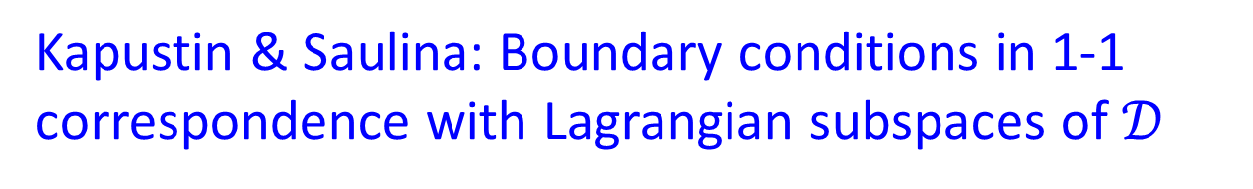
Clarification Needed: Abelian Chern Simons
Kapustin & Saulina: Boundary conditions in 1-1
correspondence with Lagrangian subspaces of $𝒟$
Freed-Hopkins-Lurie-Teleman: Claim to construct the entire 3-2-1-0
extended TFT but have MORE boundary conditions than
Kapustin-Saulina (but they seem a little exotic).

Slide 10
Three Birthday Questions
Haldane 60: 2011
Freedman 60: 2011
Seiberg 60: 2016

Slide 11
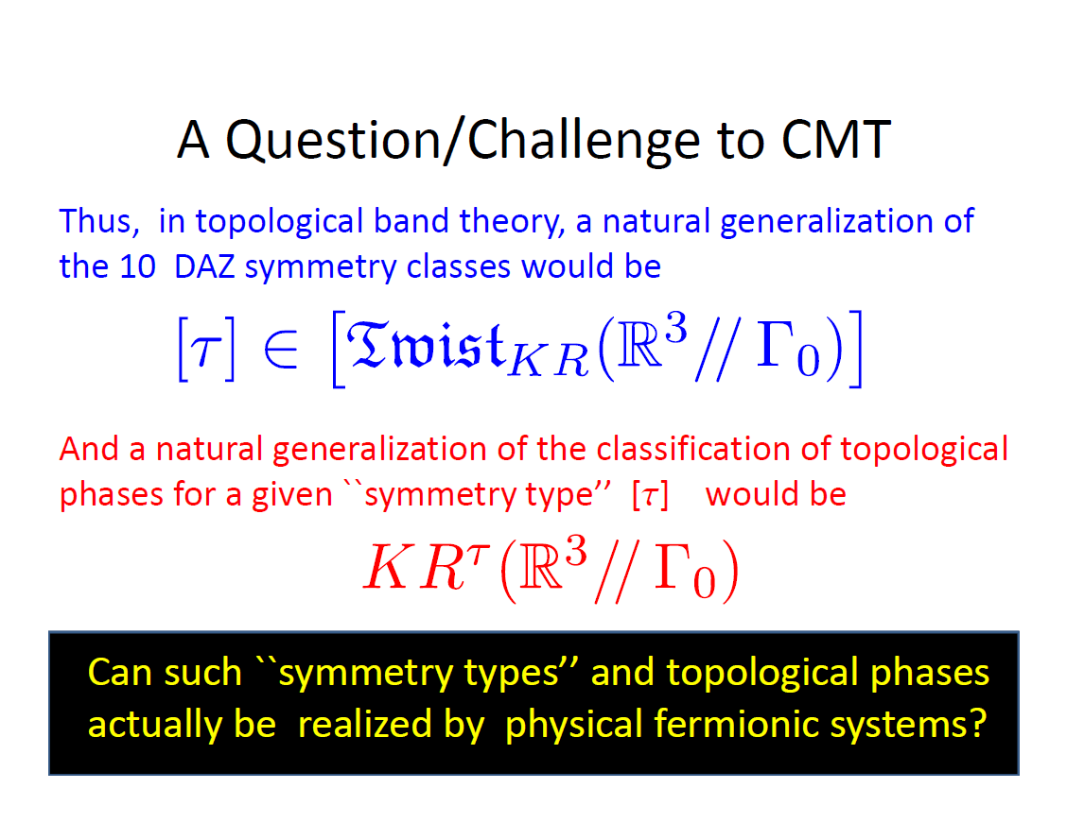
From HaldaneFest talk 2011

Slide 12

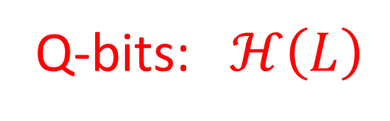
A Question From FreedmanFest 2011
Can Khovanov homology of knots and links be usefully applied to generalize Kitaev’s idea for fault-tolerant
quantum codes using topological phases of matter?
Q-bits:$ℋ\left(L\right)$
Quantum gates: $Φ\left(Σ\right):ℋ\left(L_{1}\right)→ℋ(L_{2})$

Slide 13
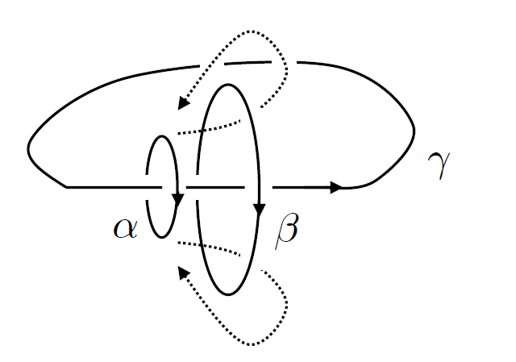
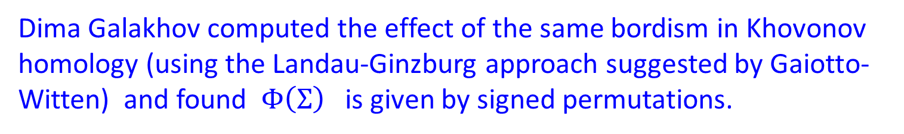
Realization In Recent Literature?
Michael Levin and Chengie Wang
1403.7437
Chao-Ming Jian and Xiao-Liang Qi
1405.6688
Pavel Putrov, Juven Wang, Xiao-Gang Wen, and Shing-Tung Yau: 1602.05951, 1612.09298
Dima Galakhov computed the effect of the same bordism in Khovonov homology (using the Landau-Ginzburg approach suggested by Gaiotto-Witten) and found $Φ\left(Σ\right)$is given by signed permutations.

Slide 14
A Point From SeibergFest 2016:
Given a continuous family of Hamiltonians with a gap in the spectrum there is, in general, not one Berry connection, but rather a family of Berry connections.
This can have physical consequences:
I will illustrate that using examples
from topological band structure.
But the general remark should
have broad applications.

Slide 15
Two Possible New Directions -1/2
Modular tensor categories have had very little impact on
string theory itself. (Despite the original motivation.)
Of course, they have played an important role in mathematics (VOA theory, knot theory, 3-manifold invariants) and in topological phases of matter.
(Rather surprisingly they played an important role in
supersymmetric field theory just in the past few years.)
Can recent work on topological phases and generalizations
of modular tensor categories be usefully applied to CFT ?

Slide 16
Example: There is interesting recent work on
``G-crossed braided tensor categories’’ . [Barkeshli, et. a.l.]
Does it shed any useful insight into orbifold theories?
I realized only recently (with Jeff Harvey) that actually our
knowledge of consistency conditions for asymmetric orbifolds
is rather incomplete. Maybe the new ideas in the theory
of topological phases can give a complete solution to this
old problem.
We started to work this out with Nati Seiberg …..
Still, it seems a good project and there is plenty to do here.

Slide 17
Possible New Directions – 2/2
Will C* algebras and noncommutative geometry
play a more dominant role in the theory of
topological phases?
Haldane: Noncommutative coordinates in Laughlin ``wavefunctions’’
Bellissard et. al. : Noncommutative geometries associated to homogeneous but aperiodic media.

