Slide 1
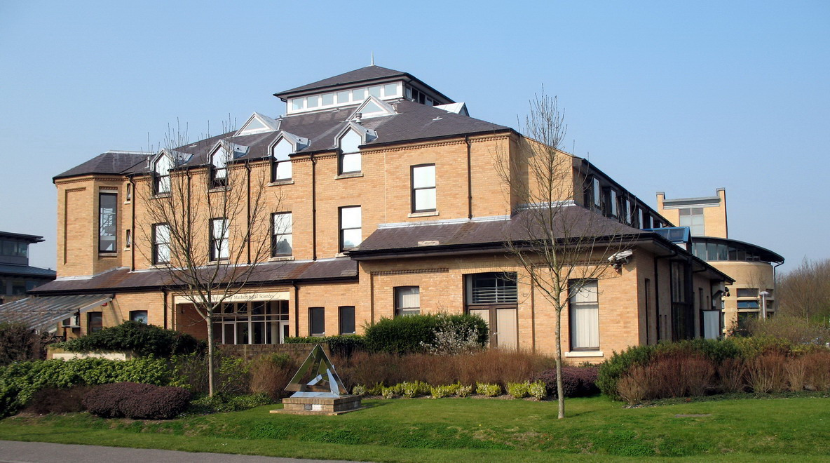
N=2* SYM And
Four Manifold Invariants
Gregory Moore, Rutgers University
May 26, 2021

Slide 2
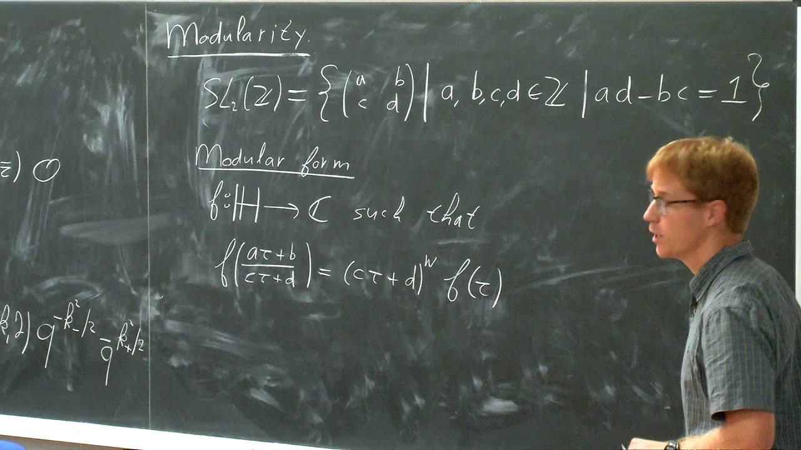
Work with JAN MANSCHOT
arXiv:2104.06492

Slide 3
Closely related to previous work of:
Dijkgraaf, Park, Schroers (1998)
Labastida & Lozano (1998)
Labastida & Marino (1997)
Losev, Nekrasov, Shatashvili (1997)
Moore & Witten (1997)
Vafa & Witten (1994)
Witten (1988 - 1997)
Also related: Recent work of
Göttsche, Kool, Nakajima, and Williams

Slide 4
1
Motivation
2
Preliminaries And Background
3
Physical Formulation Of Partition Function
4
Mathematical Formulation Of Partition Function
5
Coulomb Branch Integral: Measure & Evaluation
6
LEET Near Cusps & Explicit Results

Slide 5
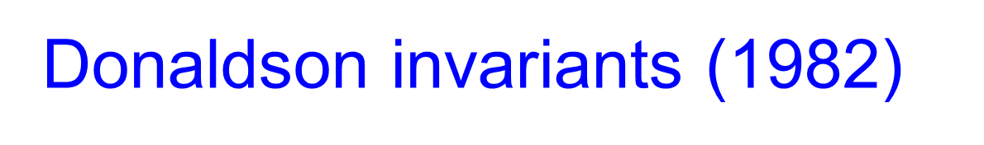
Glorious History Of
SYM & Four-Manifolds
Instantons (1975)
Donaldson invariants (1982)
TQFT (1988)
Seiberg-Witten Invariants (1994)
Revolution of 1995

Slide 6
But not all questions are answered…

Slide 7
The SW revolution was based on pure SU(2) N=2 SYM
The basic idea of topological twisting applies to any
d=4, N=2 QFT
Is there more to learn about 4-manifolds from Susy QFT?

Slide 8
This Talk
Study 4-fold invariants for ``SU(2) N=2* theory’’
Interpolates between Donaldson &
Vafa-Witten invariants
Important lessons for several future generalizations
Key to explicit evaluation:
``Coulomb branch integral’’ aka ``u-plane integral’’
Automorphic forms; indefinite theta functions;
mock modular forms; Jacobi Maass forms

Slide 9
1
Motivation
2
Preliminaries And Background
3
Physical Formulation Of Partition Function
4
Mathematical Formulation Of Partition Function
5
Coulomb Branch Integral: Measure & Evaluation
6
LEET Near Cusps & Explicit Results

Slide 10

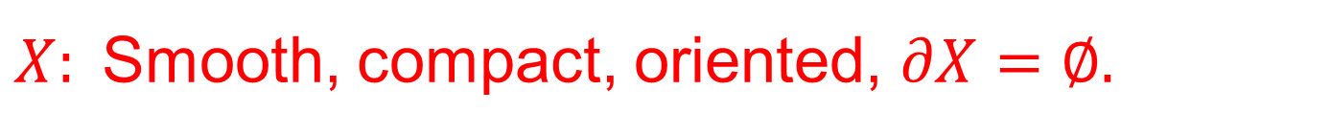

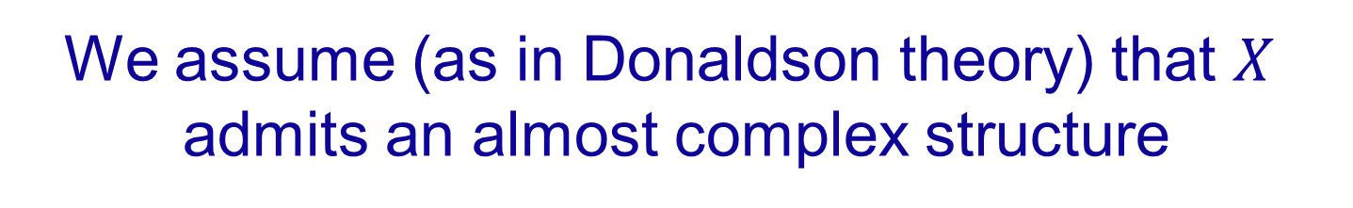
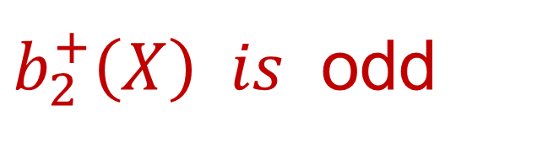
Four-Manifolds We Consider
$X:$Smooth, compact, oriented, $∂X=∅.$
For simplicity: Connected, $π_{1}\left(X\right)=0$
We assume (as in Donaldson theory) that $X$
admits an almost complex structure
$b_{2}^{+}\left(X\right) is$ odd
Important: Do not assume $X$ is spin
Notes:
This talk will be based on something called topologically twisted d=4 N=2* supersymmetric Yang-Mills theory with gauge group G = SU(2) or SO(3).
But you don’t need to know what all that means to follow many of the main messages.

Slide 11
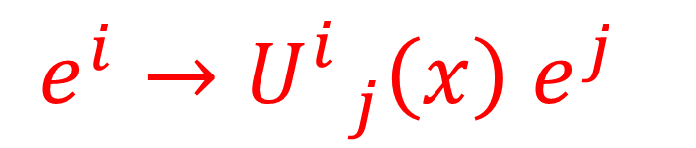
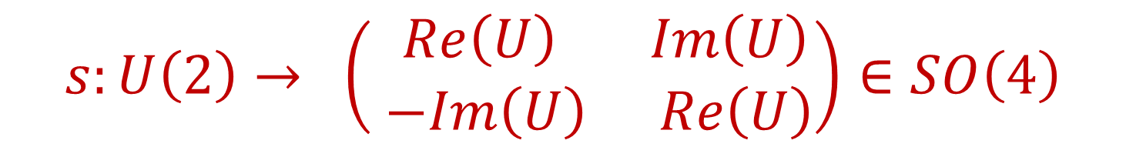

Almost Complex Structure
$T^{∗}X⊗ℂ$ has a basis $e^{i}, {\left(e^{i}\right)}^{∗}$ $i=1,2$
Across patches:
$$e^{i}→U_{ j}^{i}\left(x\right) e^{j}$$
$$s:U\left(2\right)→ \left(\begin{matrix}Re\left(U\right) & Im\left(U\right) \\ −Im\left(U\right) & Re\left(U\right)\end{matrix}\right)∈SO\left(4\right)$$
Notes:
Need to say U(x) is unitary

Slide 12

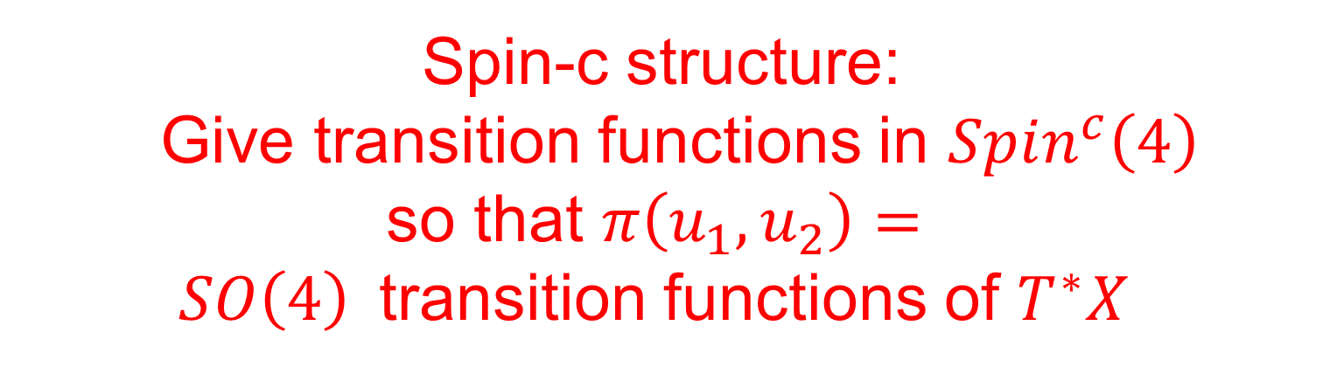
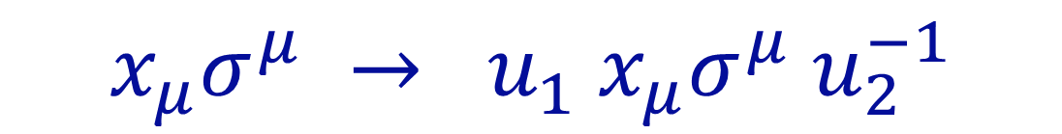
Preliminary: $Spin^{c}$-structure – 1/3
$Spin^{c}\left(4\right)$ $≔ \{\left(u_{1},u_{2}\right)|\det\left(u_{1}\right)=\det\left(u_{2}\right)\}⊂U\left(2\right)×U\left(2\right)$
$$π: Spin^{c}\left(4\right)→SO\left(4\right)$$
$$x_{μ}σ^{μ} → u_{1} x_{μ}σ^{μ} u_{2}^{−1}$$
Spin-c structure:
Give transition functions in $Spin^{c}\left(4\right)$
so that $π\left(u_{1},u_{2}\right)=$
$SO\left(4\right)$transition functions of $T^{∗}X$
Notes:
MARCOS STORY: 1998 KITP

Slide 13


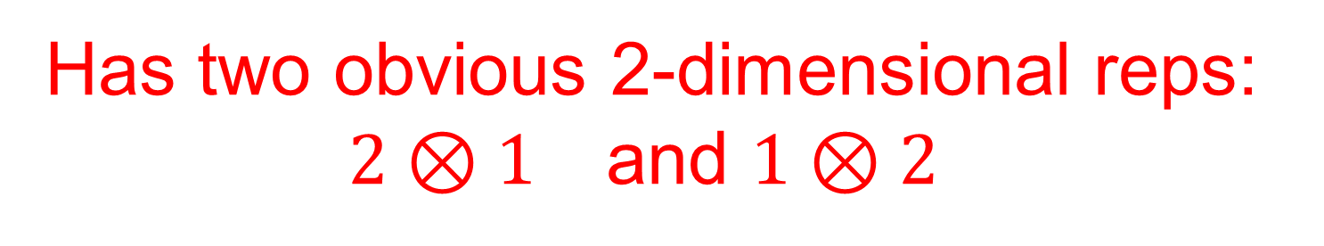
Preliminary: $Spin^{c}$-structure – 2/3
$Spin^{c}\left(4\right)$ $≔ \{ \left(u_{1},u_{2}\right)|\det\left(u_{1}\right)=\det\left(u_{2}\right)\}⊂U\left(2\right)×U\left(2\right)$
Has two obvious 2-dimensional reps:
$2⊗1$ and $1⊗2$
Given a spin-c structure these define chiral spinor bundles
$$W^{± }→ X$$
Notes:
MARCOS STORY: 1998 KITP

Slide 14

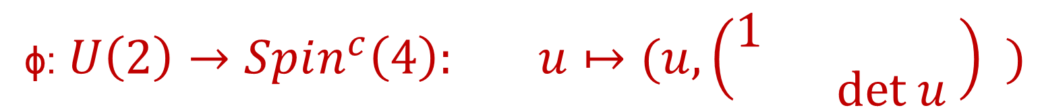



$$c\left(𝔰\right)≔c_{1}(\det{W^{±})∈H^{2}\left(X;ℤ\right) }$$
$$ℓ=\frac{c{\left(𝔰\right)}^{2}−2χ−3 σ}{8} ∈ℤ$$
An ACS $ℐ$defines a canonical spin-c structure $𝔰\left(ℐ\right)$
$Spin^{c}\left(4\right)$ $≔ \{ \left(u_{1},u_{2}\right)|\det\left(u_{1}\right)=\det\left(u_{2}\right)\}⊂U\left(2\right)×U\left(2\right)$
ϕ: $U\left(2\right)→Spin^{c}\left(4\right): u↦(u, \left(\begin{matrix}1 & \\ & det u \end{matrix}\right) )$
$$π∘φ∼s$$
For $𝔰\left(𝒥\right)$
$$ℓ=0$$

Slide 15
1
Motivation
2
Preliminaries And Background
3
Physical Formulation Of Partition Function
4
Mathematical Formulation Of Partition Function
5
Coulomb Branch Integral: Measure & Evaluation
6
LEET Near Cusps & Explicit Results

Slide 16

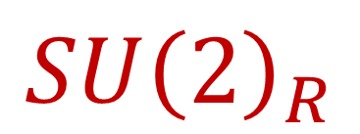
SU(2) N=2* SYM
$$𝔰𝔲{\left(2\right)}_{+}⊕𝔰𝔲{\left(2\right)}_{−}⊕𝔰𝔲{\left(2\right)}_{R}⊕𝔤_{gauge}$$
Local Lorentz
Hypermultiplet scalars in rep:
$$ℛ=𝔰𝔲{\left(2\right)}_{gauge}⊗ℍ$$
$$SU{\left(2\right)}_{R}$$

Slide 17



Topological Twisting
Couple to background $SU{\left(2\right)}_{R}$gauge field
Identify $𝔰𝔲{\left(2\right)}_{R}$ with $𝔰𝔲{\left(2\right)}_{+}$ in local Lorentz algebra
Hypermultiplet scalar fields
become spinors under twisting
What if $X$ is not spin?
Cure the problem by introducing an ``ultraviolet’’ spin-c structure $𝔰_{uv}$

Slide 18
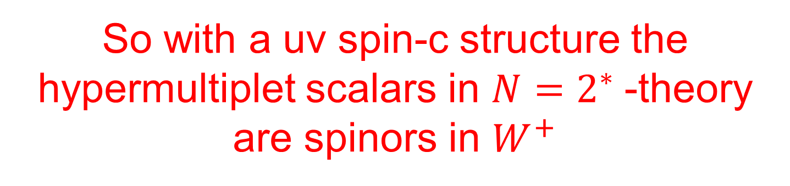

So with a uv spin-c structure the hypermultiplet scalars in $N=2^{∗}$-theory are spinors in $W^{+}$
For $N=2^{∗}$basic topological twisting needs to be supplemented with extra data
It is not known how to twist the general d=4 N=2 theory.

Slide 19

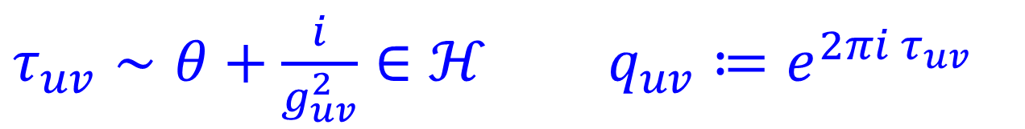

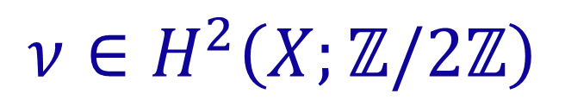


Topologically Twisted Partition Function
Data needed to formulate the partition function:
$τ_{uv}∼θ+\frac{i}{g_{uv}^{2}}∈ℋ q_{uv}≔e^{2πi τ_{uv}}$
$$m∈ℂ$$
$Λ:$ UV scale
$$t≔m/Λ$$
(UV) Spin-c structure $𝔰_{uv},$
$$c_{uv}≔c\left(𝔰_{uv}\right)∈H^{2}\left(X,ℤ\right)$$
‘t Hooft flux
$$ν∈H^{2}\left(X;ℤ/2ℤ\right)$$
Notes:
Say: Comparison with Freedman’s topological classification of four-manifolds shows there is a huge difference between the topological and smooth categories. Very deep.

Slide 20
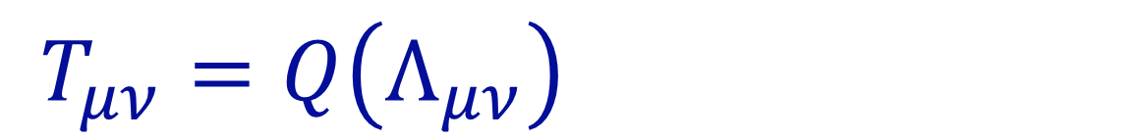

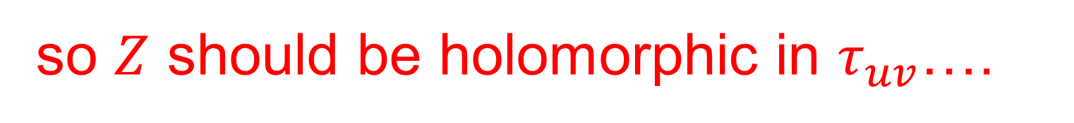
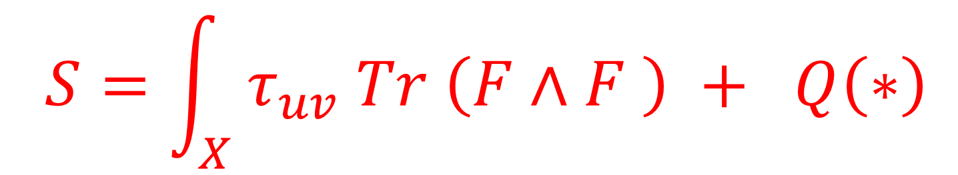
….. and a metric $g_{μν}$ ….
$T_{μν}=Q\left(Λ_{μν}\right)$
So metric should drop out….
$$S=\int_{X}{ τ_{uv} Tr \left(F∧F \right) + Q\left(∗\right)}$$
so $Z$ should be holomorphic in $τ_{uv}$….

Slide 21
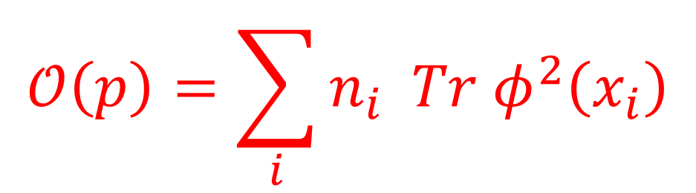
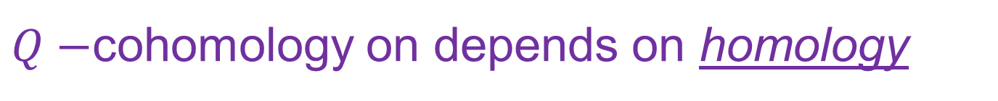
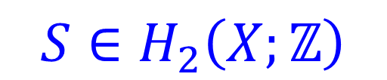
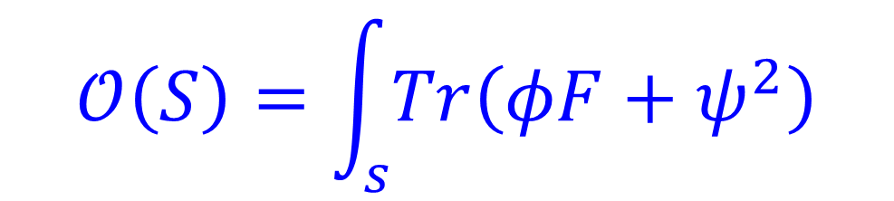
Operators In The TQFT
$Q−$cohomology on depends on homology
$$p∈H_{0}\left(X;ℤ\right)⇒p=n_{1}x_{1}+⋯n_{k}x_{k}$$
$$S∈H_{2}\left(X;ℤ\right)$$
$$𝒪\left(p\right)=\sum_{i}{n_{i} Tr φ^{2}\left(x_{i}\right)}$$
$$𝒪\left(S\right)=\int_{s}{Tr\left(φF+ψ^{2}\right)}$$

Slide 22
Path integral defines a ``function’’
$$Z_{ν}\left(τ_{uv},c_{uv},t\right):H_{∗}\left(X;ℤ\right)→ℂ$$
$$Z_{ν}\left(x;τ_{uv},c_{uv},t\right) ≔{〈 e^{𝒪\left(x\right) }〉}_{𝒩=2^{∗}}$$
We evaluate this function very explicitly
and check some physical expectations.

Slide 23
1
Motivation
2
Preliminaries And Background
3
Physical Formulation Of Partition Function
4
Mathematical Formulation Of Partition Function
5
Coulomb Branch Integral: Measure & Evaluation
6
LEET Near Cusps & Explicit Results

Slide 24



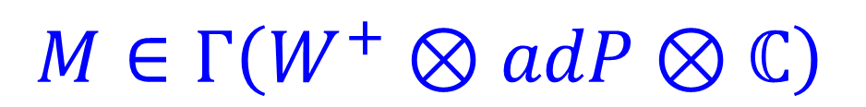

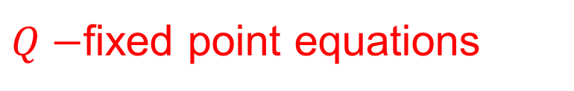

Mathematical Formulation
Of The Invariants
Principal $SO\left(3\right)$ bundle
$$P→X$$
$$A∈𝒜\left(P\right)$$
$M∈Γ\left(W^{+}⊗adP⊗ℂ\right)$
$W^{+}→ X :$Positive chirality rank two bundle associated to uv spin-c structure $𝔰_{uv}$
$Q−$fixed point equations
$$F^{+}+\left[M,\overline{M}\right]=0$$
$$γ⋅DM=0$$
``adjoint SW equations’’
[Labastida-Marino; Losev-Shatashvili-Nekrasov]

Slide 25
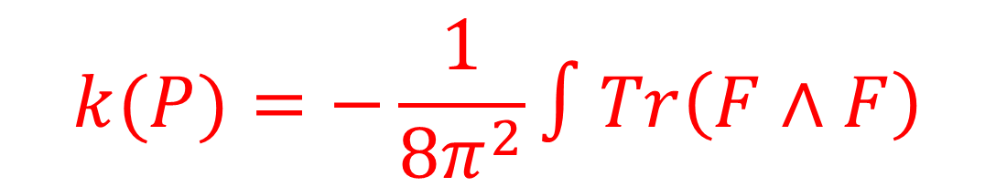
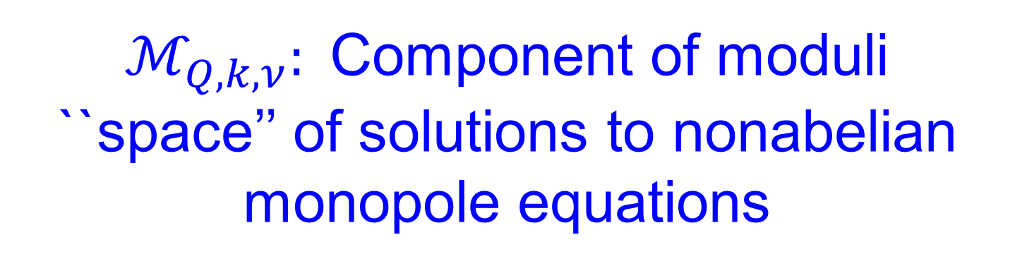
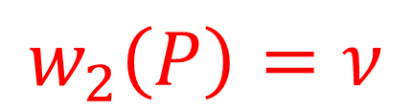
$ℳ_{Q,k,ν}:$Component of moduli ``space’’ of solutions to nonabelian monopole equations
$$w_{2}\left(P\right)=ν$$
$$k(P)=−\frac{1}{8π^{2}}∫Tr\left(F∧F\right)$$

Slide 26
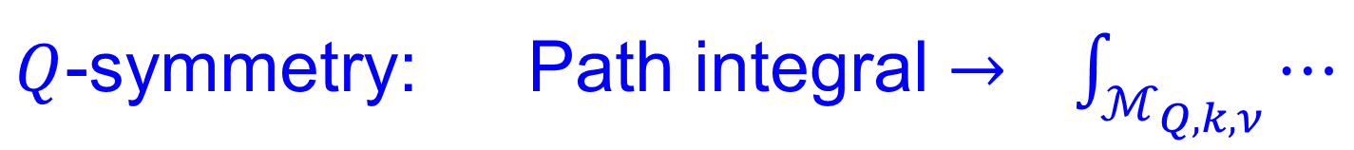
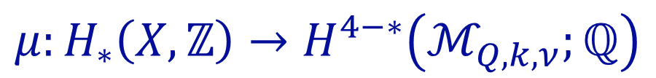

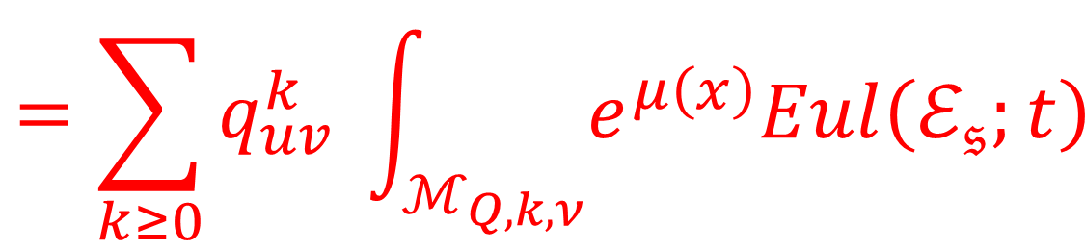
Math Definition Of Partition Function
$$Z_{ν}\left(x;τ_{uv},c_{uv},t\right) ≔{〈 e^{𝒪\left(x\right)}〉}_{𝒩=2^{∗}}$$
$$=\sum_{k≥0}{q_{uv}^{k} \int_{ℳ_{Q,k,ν}}{e^{μ\left(x\right)}Eul\left(ℰ_{𝔰};t\right)}}$$
$$μ:H_{∗}\left(X,ℤ\right)→H^{4−∗}\left(ℳ_{Q,k,ν};ℚ\right)$$
$ℰ_{𝔰}$: Obstruction bundle for elliptic complex
$Q$-symmetry: Path integral $→ \int_{ℳ_{Q,k,ν}}{⋯}$

Slide 27
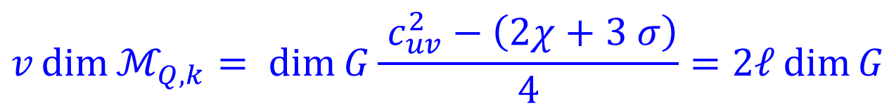
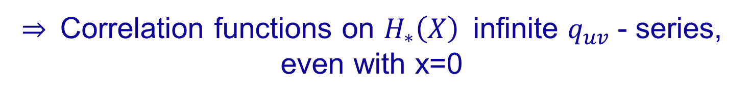


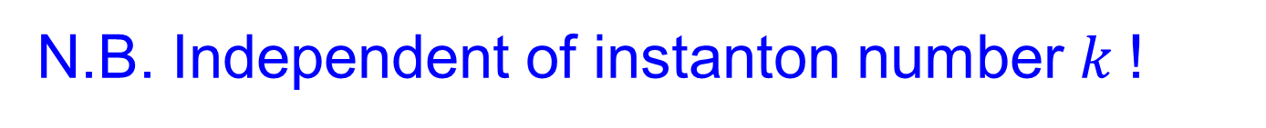
Index Computations
$$v\dim{ℳ_{Q,k}= \dim{G\frac{ c_{uv}^{2}−\left(2χ+3 σ\right)}{4}=2ℓ\dim{G }}}$$
N.B. Independent of instanton number $k$!
$$\dim{ℳ_{inst, k} }=8k −\frac{3}{2}\left(χ+σ\right)$$
$$Index γ⋅D=−8k+\frac{3}{8}\left(c_{uv}^{2}−σ\right)$$
$⇒$Correlation functions on $H_{∗}\left(X\right)$infinite $q_{uv}$- series,
even with x=0

Slide 28



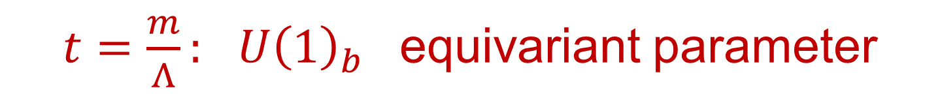
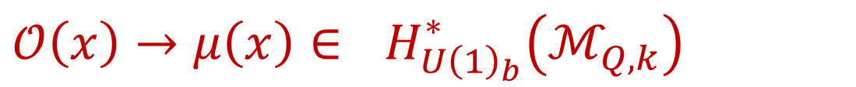
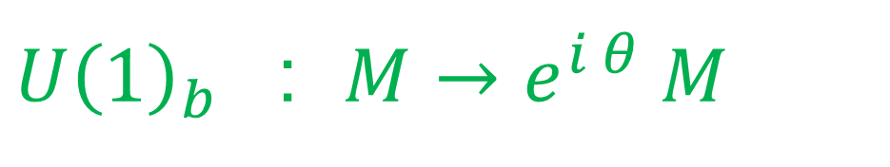
$U{\left(1\right)}_{b}$ Symmetry
$$F^{+}+\left[M,\overline{M}\right]=0$$
$$γ⋅DM=0$$
$U{\left(1\right)}_{b}$ : $M→e^{i θ} M$
$U{\left(1\right)}_{b}$ acts on the moduli space $ℳ_{Q,k}$ of these eqs.
$𝒪\left(x\right)→μ\left(x\right)∈$ $H_{U{\left(1\right)}_{b}}^{∗}\left(ℳ_{Q,k}\right)$
$t=\frac{m}{Λ}:$ $U{\left(1\right)}_{b}$ equivariant parameter
[Labastida-Marino; Losev-Shatashvili-Nekrasov]

Slide 29
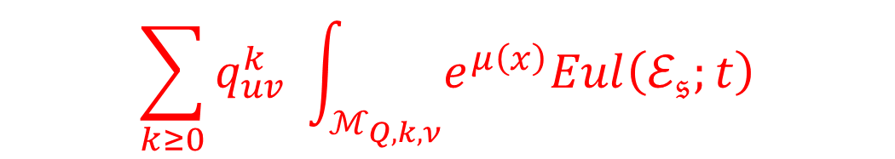
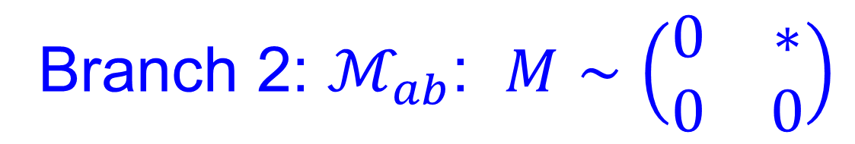
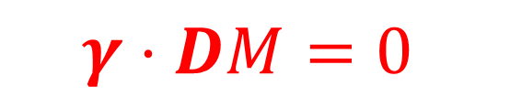


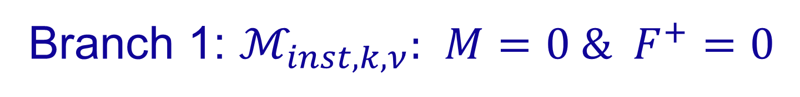
$U{\left(1\right)}_{b}$Localization
$$\sum_{k≥0}{q_{uv}^{k} \int_{ℳ_{Q,k,ν}}{e^{μ\left(x\right)}Eul\left(ℰ_{𝔰};t\right)}}$$
$$F^{+}+\left[M,\overline{M}\right]=0$$
$$γ⋅DM=0$$
Fixed point set for $M→e^{iθ} M$ has TWO branches
Branch 1: $ℳ_{inst,k,ν}:$ $M=0 \& F^{+}=0$
Branch 2: $ℳ_{ab}$: $M∼\left(\begin{matrix}0 & ∗ \\ 0 & 0\end{matrix}\right)$

Slide 30


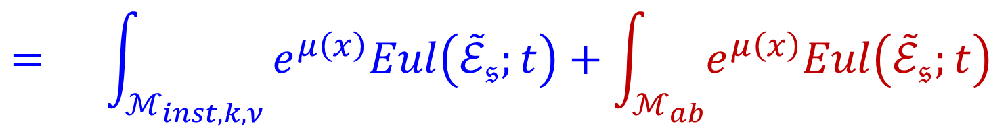
$U{\left(1\right)}_{b}$Localization
$$\int_{ℳ_{Q,k,ν}}{e^{μ\left(x\right)}Eul\left(ℰ_{𝔰};t\right)}$$
$$= \int_{ℳ_{inst,k,ν}}{e^{μ\left(x\right)}Eul\left({\tilde{ℰ}}_{𝔰};t\right)+\int_{ℳ_{ab}}{e^{μ\left(x\right)}Eul\left({\tilde{ℰ}}_{𝔰};t\right)} }$$
First focus on the instanton contribution.

Slide 31
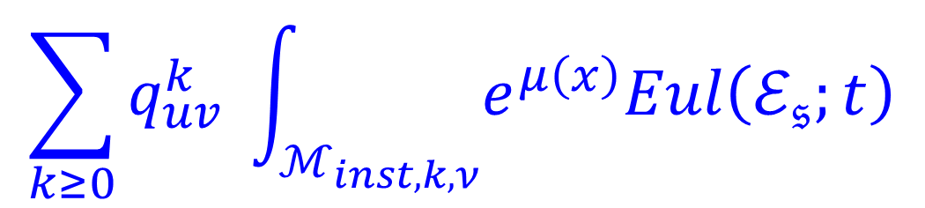
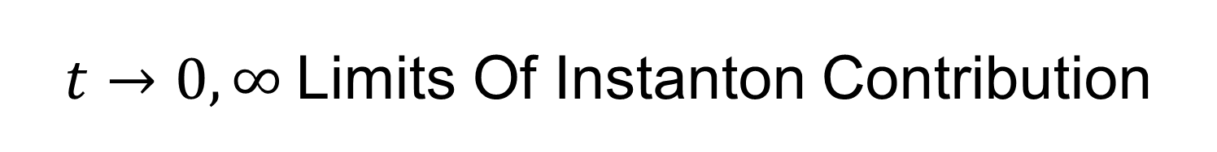
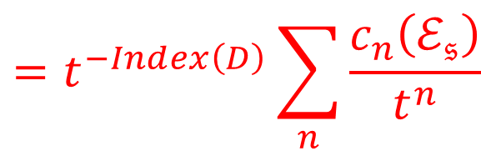

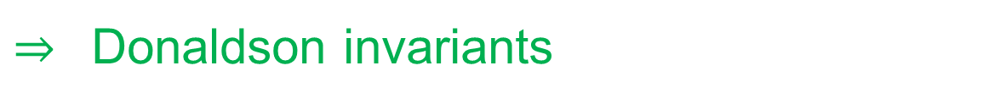
$t→0,∞$Limits Of Instanton Contribution
$$\sum_{k≥0}{q_{uv}^{k} \int_{ℳ_{inst,k,ν}}{e^{μ\left(x\right)}Eul\left(ℰ_{𝔰};t\right)}}$$
$$Eul\left(ℰ_{𝔰};t\right)=\prod_{i}{\left(x_{i}+t\right)}$$
$$=t^{−Index\left(D\right)}\sum_{n}{\frac{c_{n}\left(ℰ_{𝔰}\right)}{t^{n}}}$$
Leading term for $m→∞ : c_{0}\left(ℰ_{𝔰}\right)$= 1
$⇒$ Donaldson invariants
Leading term for $m→0 : c_{top}\left(ℰ_{𝔰}\right)$
$𝔰_{uv}= 𝔰\left(ℐ\right):$ $ℰ_{𝔰} ≅T^{∗}ℳ_{k}$ $⇒$``Euler character of $ℳ_{inst,k}$‘’

Slide 32
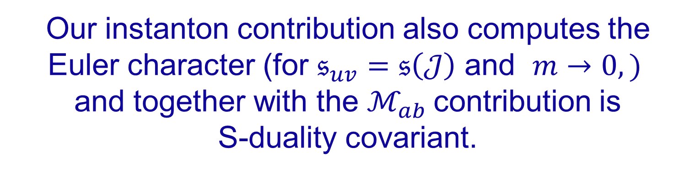
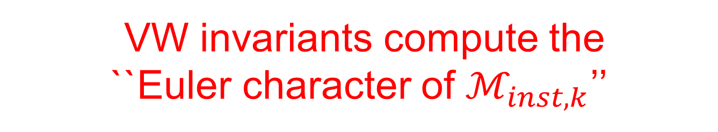
Relation To Vafa-Witten Invariants-1/2
VW invariants compute the
``Euler character of $ℳ_{inst,k}$’’
and they are S-duality covariant….
Our instanton contribution also computes the
Euler character (for $𝔰_{uv}=𝔰\left(𝒥\right)$ and $m→0,)$
and together with the $ℳ_{ab}$contribution is
S-duality covariant.
Natural guess: we get VW invariants.
Notes:
Even though the topological twists of N=4 SYM are very different.
Incidentally,
One is not allowed to cancel Witten from this equation.

Slide 33
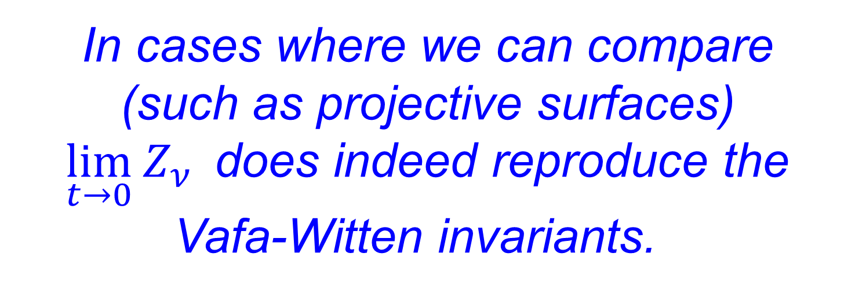
In cases where we can compare
(such as projective surfaces)
$\lim_{t→0} Z_{ν}$does indeed reproduce the
Vafa-Witten invariants.
This is surprising since the DW and VW twists are very different.
The Q-fixed point equations are different, but can be viewed as deformation equivalent.
(long story…)

Slide 34
1
Motivation
2
Preliminaries And Background
3
Physical Formulation Of Partition Function
4
Mathematical Formulation Of Partition Function
5
Coulomb Branch Integral: Measure & Evaluation
6
LEET Near Cusps & Explicit Results

Slide 35
The partition function on a compact manifold will equal a sum over all the vacua.
In particular we need to integrate over the Coulomb branch.

Slide 36
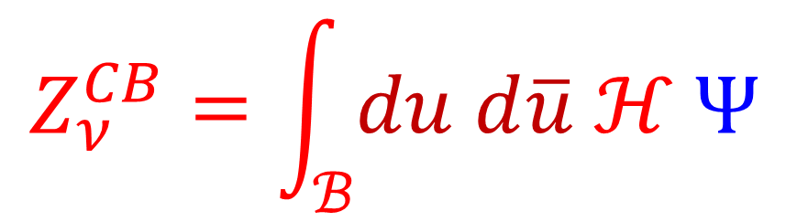



Coulomb Branch Integral
In principle defined for general class S theory.
$$Z_{ν}^{CB}=\int_{ℬ}{du d\overline{u} ℋ Ψ }$$
$ℋ$ is holomorphic and metric-independent
$Ψ:$NOT holomorphic and metric- DEPENDENT
``indefinite theta function’’
$ℬ$: Base of a Hitchin system
Today: $u∈ℂ≅ℬ$will be identified with a modular curve

Slide 37
5
Coulomb Branch Integral: Measure & Evaluation
5a
Seiberg-Witten Review
5b
Formulating The Measure And Integral
5c
Evaluation Using Mock This & That

Slide 38






Seiberg-Witten Review – 1/6
$$y^{2}=\prod_{i=1}^{3}{\left(x−α_{i}\right)}$$
$$E_{u}$$
$$α_{i}=u e_{i}\left(τ_{uv}\right)+m^{2}e_{i}{\left(τ_{uv}\right)}^{2}$$
$e_{i}\left(τ_{uv}\right)$ half-periods of $E_{τ_{uv }}=ℂ/(ℤ+τ_{uv}ℤ)$
Together with $λ∈Ω^{1,0}\left(E_{u}\right)$s.t. $\frac{dλ}{du}=\frac{dx}{y}$
Discriminant $∼η^{24}\left(τ_{uv}\right)\prod_{i=1}^{3}{{\left(u−m^{2}e_{i}\left(τ_{uv}\right)\right)}^{2}}$

Slide 39







$$E_{u}$$
$$ℬ^{∗}$$
$$u_{1}$$
$$u_{3}$$
$u_{2}$
$$u_{j}=m^{2}e_{j}(τ_{uv})$$

Slide 40






Special Geometry
$H_{1}\left(E_{u};ℤ\right)$: Fibers of a local system over $ℬ^{∗}$
Definition: A ``duality frame’’ is a local choice of $A,B−$cycles
Periods of $λ$define homomorphism $Z_{u}:H_{1}\left(E_{u};ℤ\right)→ℂ$
$$a\left(u\right)≔\oint_{A}{λ }$$
$$a_{D}\left(u\right)≔\oint_{B}{λ }$$
Fact: There is a locally
holomorphic function $ℱ\left(a\right)$
$$a_{D}=\frac{dℱ}{da}$$

Slide 41






$$\frac{da}{du}=\oint_{A}{\frac{dx}{y}}$$
$$\frac{da_{D}}{du}=\oint_{B}{\frac{dx}{y}}$$
$$τ=\frac{da_{D}}{da}= \frac{d^{2}ℱ}{da^{2}}$$
N.B.
$τ\left(u,m,τ_{uv}\right)$should not be confused with $τ_{uv}$
$$\lim_{m→0}{τ\left(u,m,τ_{uv}\right)=τ_{uv}}$$
$$\lim_{u→∞}{τ\left(u,m,τ_{uv}\right)=τ_{uv}}$$

Slide 42





Weak Coupling Prepotential
$u→∞:∃$Canonical duality frame (``weak coupling’’) :
$$ℱ\left(a,m\right)=\frac{1}{2}τ_{uv}a^{2}+$$
$${+ m}^{2} ( log \left(\frac{2a}{m}\right)−\frac{3}{4}+\frac{3}{2}\log\left(\frac{m}{Λ}\right) )$$
$$+a^{2}\sum_{n=2}^{∞}{f_{n}\left(τ_{uv}\right) {\left(\frac{m}{a}\right)}^{2n}}$$
$f_{n}\left(τ_{uv}\right):$polynomials: $E_{2}{,E}_{4},E_{6}$ wt = $2n−2$
[Minhahan, Nemeschansky, Warner; Dhoker, Phong]
$Λ −$dependence: New, and important for our story.
Derived using Nekrasov partition function in
$[$Manschot, Moore, Xinyu Zhang 2019]

Slide 43





Modular Parametrization
Remarkably: One can invert these equations and express periods as bimodular forms in $τ, τ_{uv}$
$${m^{2}\left(\frac{da}{du}\right)}^{2}=\frac{θ_{4}^{4}\left(τ\right)θ_{3}^{4}\left(τ_{uv}\right)−θ_{3}^{4}\left(τ\right)θ_{4}^{4}\left(τ_{uv}\right)}{η^{6}\left(τ_{uv}\right)}$$
$$m^{−2} u\left(τ,τ_{uv}\right)=\frac{e_{1}^{2}\left(τ_{uv}\right) e_{23}\left(τ\right)+cycl.}{e_{1}\left(τ_{uv}\right)e_{23}\left(τ\right)+cycl}$$
$$ℬ ≅ℋ/Γ(2)$$
$$≅ℱ\left(Γ\left(2\right)\right)$$

Slide 44





$$τ=i ∞↔u=u_{1}$$
$$u→∞$$
$$τ=0 ↔ u=u_{2 }$$
$$τ=1 ↔ u=u_{3 }$$

Slide 45
5
Coulomb Branch Integral: Measure & Evaluation
5a
Seiberg-Witten Review
5b
Formulating The Measure And Integral
5c
Evaluation Using Mock This & That

Slide 46




Coulomb Branch Measure
$$Z_{ν}^{CB}=\int_{ℱ\left(Γ\left(2\right)\right)}{Ω}$$
$$Ω=dτ∧d\overline{τ} ℋ Ψ$$
Begin with Maxwell partition function $Ψ$
$$Ψ∼\sum_{fluxes}{e^{−S_{class.}}}$$
Frame dependent.
Not holomorphic.
Metric dependent.

Slide 47







The ``Period Point’’ $J$
$$b_{2}^{+}>1 ⇒Z_{ν}^{CB}=0$$
$$b_{2}^{+}=1$$
$$Z_{ν}^{CB}≠0$$
$$∗J=J$$
$$H^{2}\left(X;ℝ\right)$$
$$J^{2}=1$$
$J∈$Forward Light Cone

Slide 48






Maxwell Partition Function
$$Ψ^{J}∼\sum_{fluxes}{e^{−∫\overline{τ}{\left(u\right)f}_{+}^{2}+τ(u) f_{−}^{2} }}$$
Sum over the first Chern class
$λ∈2L+\overline{ν} ,$ $L=H^{2}\left(X;ℤ\right)$
$$Ψ_{ν}^{J}=\sum_{λ∈2L+\overline{ν}}{∂_{\overline{τ}}E_{λ}^{J} q^{−\frac{1}{4}λ^{2}} e^{πi λ⋅z}}$$
$$+S \frac{du}{da}$$
$$v≔\frac{d^{2}ℱ}{dadm}$$
$$z=c_{uv} v\left(τ, τ_{uv}\right)$$
Notes:
Say: derivative of Erf(x) goes to zero rapidly, so the sum is actually convergent, even though the holomorphic power of q has the wrong sign.

Slide 49






Maxwell Partition Function
$$Ψ_{ν}^{J}=\sum_{λ∈2L+ν}{∂_{\overline{τ}}E_{λ}^{J} q^{−\frac{1}{4}λ^{2}} e^{πi λ⋅z}}$$
$$z=c_{uv} v\left(τ, τ_{uv}\right)+S \frac{du}{da}$$
$$v≔\frac{d^{2}ℱ}{dadm}$$
$$Erf\left(x\right)≔\int_{0}^{x}{e^{−πt^{2}}dt}$$
$$E_{λ}^{J}=Erf\left(x_{λ}\right)$$
$$x_{λ}=\sqrt{Im τ}(λ+ \frac{Im z}{Im τ} )⋅J$$
Notes:
Say: derivative of Erf(x) goes to zero rapidly, so the sum is actually convergent, even though the holomorphic power of q has the wrong sign.

Slide 50




Maxwell Coupling To $𝔰_{uv}$
$$∼exp(\int_{X}{v F_{b}^{+}f^{+}+\overline{v}F_{b}^{−}f^{−}) }$$
$$v≔\frac{d^{2}ℱ}{dadm}$$
Folklore
Nonholomorphic!
6d derivation will involve $ℂ^{∗}−$valued quadratic refinement
Notes:
SAY: THIS WAS A KEY INGREDIENT MISSING IN THE LATE 90’s AND LED TO THE PROBLEMS ENCOUNTERED THEN. It also violates folklore because people would generally expect the coupling to the background spin-c structure to be topological and holomorphic

Slide 51





Remarkable Equation For $v(τ,τ_{uv})$
$$v≔\frac{d^{2}ℱ}{dadm}$$
$$=(a_{D}−aτ)/m$$
$$\frac{θ_{2}\left(ν, 2τ\right)}{θ_{3}\left(ν, 2τ\right)}=\frac{θ_{2}\left(0,2τ_{uv}\right)}{θ_{3}\left(0,2τ_{uv}\right)}$$
Determines bimodular $v\left(τ,τ_{uv}\right)$

Slide 52



Holomorphic Part Of Measure
$${ℋ_{bare}= A}_{1}^{σ}$$
$${A_{2}^{χ}A}_{3}^{c_{uv}^{2}}$$
Include observables:
$$ℋ= ℋ_{bare} A_{4}^{p} A_{5}^{c_{uv}⋅S}A_{6}^{S^{2}}$$
Depend on duality frame –
- but the local system has nontrivial monodromy.

Slide 53




Local Topological Interactions
$$A_{1}^{8}=\prod_{i}{\left(u−u_{i}\right)= }$$
$${\left(2m\right)}^{6}\frac{η{\left(τ_{uv}\right)}^{24}η{\left(τ\right)}^{12}}{{\left(θ_{4}{\left(τ\right)}^{4}θ_{3}{\left(τ_{uv}\right)}^{4}−θ_{3}{\left(τ\right)}^{4}θ_{4}{\left(τ_{uv}\right)}^{4}\right)}^{3}}$$
$$A_{2}^{−4}=\frac{θ_{4}^{4}\left(τ\right)θ_{3}^{4}\left(τ_{uv}\right)−θ_{3}^{4}\left(τ\right)θ_{4}^{4}\left(τ_{uv}\right)}{m^{2}η^{6}\left(τ_{uv}\right)}$$
$$A_{3} ≔\exp\left( −2 π i\frac{d^{2}ℱ}{dm^{2}} \right)={\left(\frac{Λ}{m}\right)}^{\frac{3}{2}}\frac{ θ_{1}\left(2τ,2v\right)}{θ_{2}^{2}\left(τ_{uv}\right)θ_{4}\left(2τ\right)}$$

Slide 54
With all these ingredients we can now check that the CB measure is indeed monodromy invariant and hence well-defined.
(Nontrivial!)

Slide 55
The measure on the Coulomb branch is physical and must be single-valued
Even though several couplings
in the LEET are multi-valued.
Even though there is no gobal duality frame.
Interesting constraint on low-energy couplings

Slide 56
What about defining the integral
of the measure?

Slide 57




$$u→u_{j}$$
$${ℋ→q}_{j}^{−\frac{ℓ}{2}} F\left(τ_{uv}\right)\left(1+𝒪\left(q_{j}\right)\right)$$
$u→∞$ i.e. $τ→τ_{uv}$
$${\left(τ−τ_{uv}\right)}^{ℓ−\frac{3}{2}} \sum_{λ}{⋯e^{ −\frac{m}{Λ} {\left(τ−τ_{uv}\right)}^{−\frac{1}{2}} S⋅λ }}$$
Do the phase integral first.
(as in string theory)

Slide 58
5
Coulomb Branch Integral: Measure & Evaluation
5a
Seiberg-Witten Review
5b
Formulating The Measure And Integral
5c
Evaluation Using Mock This & That

Slide 59







Relation To Mock Modular Forms -1.1
$Z_{ν}^{CB}$ : A sum of integrals of the form
$$I_{f}=\int_{ℱ_{∞}}{dτd\overline{τ} {\left(Im τ\right)}^{−s} f\left(τ, \overline{τ}\right)}$$
$$f\left(τ, \overline{τ}\right)=\sum_{m−n∈ℤ }{c\left(m,n\right)q^{m} {\overline{q}}^{n}}$$
Support of $c$ is bounded below
Strategy: Find $\hat{h}\left(τ,\overline{τ}\right)$such that
$$∂_{\overline{τ}}\hat{h} ={\left(Im τ\right)}^{−s} f\left(τ,\overline{τ}\right)$$
$\hat{h} \left(τ,\overline{τ}\right)$ is modular of weight (2,0)
Notes:
Say in words the measure is modular invariant . Say in words that modularity of h-hat is crucial so that the finite boundaries do not contribute.

Slide 60






Relation To Mock Modular Forms – 1.2
We choose an explicit solution
$∂_{\overline{τ}}R ={(Imτ)}^{−s} f\left(τ,\overline{τ}\right)$
vanishing exponentially fast at $Imτ→∞$
$R$ is not modular, but it’s failure to be modular must be holomorphic.
$$\hat{h}\left(τ, \overline{τ}\right)=h\left(τ\right)+R$$
$h\left(τ\right)$: mock modular form
$$h\left(τ\right)=\sum_{m∈ℤ}{d\left(m\right)q^{m}}$$
$$q=e^{2πiτ}$$

Slide 61




Doing The Integral
$$I_{f}=\int_{ℱ_{∞}}{dτd\overline{τ} y^{−s} f\left(τ, \overline{τ}\right)}$$
$$∂_{\overline{τ}}\hat{h} =y^{−s} f\left(τ,\overline{τ}\right)$$
$$I_{f}=d\left(0\right)$$
$$h\left(τ\right)=\sum_{m∈ℤ}{d\left(m\right)q^{m}}$$
Note: $d\left(0\right)$undetermined by diffeq but fixed by the modular properties: Subtle!

Slide 62







Evaluation Of CB Integral ?
$$Z_{ν}^{CB}=\int_{ℱ\left(Γ\left(2\right)\right)}{Ω}$$
$$Ω=dτ∧d\overline{τ} ℋ Ψ_{ν}^{J}$$
$$Ψ_{ν}^{J}=\sum_{λ∈2L+ν}{∂_{\overline{τ}}E_{λ}^{J} q^{−\frac{1}{4}λ^{2}} e^{−2πi λ⋅z}}$$
$$z=c_{uv} v\left(τ, τ_{uv}\right)+S \frac{du}{da}$$
$$Ω=d Λ$$
$$Λ=dτ ℋ \hat{G}$$
$$Ψ_{ν}^{J}=∂_{\overline{τ}} \hat{G}$$

Slide 63




Evaluation Of CB Integral ?
$$Ψ_{ν}^{J}=\sum_{λ∈2L+ν}{∂_{\overline{τ}}E_{λ}^{J} q^{−\frac{1}{4}λ^{2}} e^{−2πi λ⋅z}}$$
$$Ψ_{ν}^{J}=∂_{\overline{τ}}\hat{G}$$
$$\hat{G}=\sum_{λ∈2L+ν}{E_{λ}^{J} q^{−\frac{1}{4}λ^{2}} e^{−2πiλ⋅z}}$$
???
$$\lim_{|λ_{+}|→+∞}{E_{λ}^{J}= ±1 }$$
NO!!!

Slide 64




Evaluating Difference Of CB Integrals
$$Ψ^{J_{1}}−Ψ^{J_{2}}=∂_{\overline{τ}} {\hat{G}}^{J_{1},J_{2}}$$
$$\hat{G^{J_{1},J_{2}}}=\sum_{λ∈2L+ν}{E_{λ}^{J_{1},J_{2}}q^{−{\frac{1}{4}λ}^{2}}e^{−2πiλ⋅z}}$$
$$E_{λ}^{J_{1}, J_{2}}= Erf\left(x_{λ}^{J_{1}}\right)−Erf\left(x_{λ}^{J_{2}}\right)$$
Converges nicely!
$⇒$Can use this to evaluate the difference
$Z_{ν}^{CB,J_{1}} −Z_{ν}^{CB,J_{2}}$ by a sum of residues.

Slide 65



Metric & Holomorphic Anomaly
Wall crossing involves
modular functions
For the boundary at $u→∞$ the modular parameter
$τ→τ_{uv}$. This leads to continuous metric dependence.
Closely related: Nonholomorphic in $τ_{uv}$
$$\frac{∂}{∂{\overline{τ}}_{uv}}Z_{ν}^{CB}=y^{−\frac{3}{2}}η^{−2χ}\sum_{λ}{K\left[λ_{+}, λ_{−}\right]{\overline{q_{uv}}}^{λ_{+}^{2}}q_{uv}^{−λ_{−}^{2}}}$$

Slide 66



The Special Period Point
For any manifold with $b_{2}^{+}=1$
$∃$special $J_{0}$ such that $Ψ_{ν}^{J_{0}}$factorizes:
$$Ψ_{ν}^{J_{0}}=f_{ν} Θ_{L_{−}}\left(τ,z\right)$$
$$f_{ν}=\sum_{λ∈2ℤ+ν}{∂_{\overline{τ}}E_{λ}^{J} q^{−\frac{1}{4}λ^{2}} e^{−2πi λ⋅z}}$$

Slide 67



Measure As A Total Derivative
$$Ω=d Λ$$
$$Λ=dτ ℋ \hat{G}$$
Where we can write $\hat{G}$ explicitly so that $Λ$is:
Well-defined
Nonsingular away from $τ∈ \{ 0,1, i ∞, τ_{uv}\}$
3. Good $q_{i}$expansion near cusps

Slide 68



Harmonic Jacobi-Maass Forms
These conditions determine $\hat{G}$uniquely.
Modular completion of an Appel-Lerche sum
$$F\left(τ, z\right)∼ \frac{e^{−2πi z}}{θ_{4}\left(2τ\right)} \sum_{n∈ℤ}{\frac{{\left(−1\right)}^{n}q^{n^{2}−\frac{1}{4} }}{1+e^{4πi z}q^{2n−1}}}$$
$$z=c_{uv} v\left(τ, τ_{uv}\right)+S \frac{du}{da}\left(τ, τ_{uv}\right)$$

Slide 69



Technical Comment On Poles
$Λ$ must be nonsingular away from $τ∈ \{ 0,1, i ∞, τ_{uv}\}$
$F\left(τ,z\right)$ has poles for
$$z=\frac{1}{4}\left(a+b τ\right) a=1 mod 2 b=2 mod 4$$
But for $z=c_{uv} v\left(τ, τ_{uv}\right)$ one can add a meromorphic form to $F\left(τ,z\right)$to cancel unwanted poles

Slide 70


The Integral Is a Mock Modular Form
For $𝔰_{uv}=𝔰\left(𝒥\right)$ we find $Z_{ν}^{CB,J_{0}}=$
$${\hat{g}}_{ν}\left(τ_{uv},{\overline{τ}}_{uv}\right) Θ_{L_{−}}(τ_{uv})/η^{2χ}(τ_{uv})$$
$$g_{ν}=3 \sum_{n≥0}{H\left(4n−2μ\right)q_{uv}^{n−\frac{ν}{2}}}$$

Slide 71



… but other $𝔰$generalize …
For $ℂℙ^{2}$ & $c_{uv}=1$ (acs $⇒c_{uv}=3 )$
$$\frac{∂}{∂{\overline{τ}}_{uv}}Z_{ν} =y_{uv}^{−\frac{3}{2}} η^{−2} \hat{E_{2}} Θ_{ν}\left(−{\overline{τ}}_{uv}\right)$$

Slide 72
Including Observables

Slide 73
1
Motivation
2
Preliminaries And Background
3
Physical Formulation Of Partition Function
4
Mathematical Formulation Of Partition Function
5
Coulomb Branch Integral: Measure & Evaluation
6
LEET Near Cusps & Explicit Results

Slide 74



C$ontributions$ Of The Cusps$u_{j}$
Near each cusp $u_{j} , j=1,2,3$
the description of the vacuum changes:
We have a U(1) VM coupled to a charge 1 HM.
(In the appropriate duality frame) [Seiberg-Witten 94]
There is a separate contribution to the path integral coming from the path integral of these three LEET.
We add the contributions, because we sum over vacua:
$$Z_{ν}=Z_{ν}^{CB}+\sum_{j=1}^{3}{Z_{ν,j}^{SW}}$$

Slide 75


When $b_{2}^{+}>1$ $Z_{ν}^{CB}$vanishes –
- we get true topological invariants:
$$Z_{ν}=\sum_{j=1}^{3}{Z_{ν,j}^{SW}}$$
So it is quite interesting to determine
the three effective actions

Slide 76

$$E_{u}$$
$$u_{1}$$
$$u_{3}$$
$u_{2}$
$$u_{j}=m^{2}e_{j}(τ_{0})$$

Slide 77

MW97: The behavior of the CB integral a$t u_{j}$ uniquely fixes $Z_{ν,j}^{SW}$

Slide 78






Determination Of Effective Action
$$Z_{ν,j}^{SW}=\sum_{c_{ir} }{SW\left(c_{ir}\right) \prod_{n=1}^{12}{F_{n,j}{\left(τ_{uv};t\right)}^{Δ_{n}}}}$$
$$χ_{h}=\frac{1}{4}\left(χ+σ\right)$$
$$ℓ=\frac{c_{uv}^{2}−λ}{8}$$
$$λ=2χ+3σ$$
$$x^{2} ≔{\left(\frac{c_{uv}−c_{ir}}{2}\right)}^{2}$$
$$S⋅c_{ir} S^{2} S⋅c_{uv}$$

Slide 79
+
+

Slide 80
Including Observables

Slide 81




Full Modular Transformation Law
$$Z_{ν}\left(\tilde{p}, \tilde{S},\frac{aτ_{uv}+b}{cτ_{uv}+d}\right)={\left(cτ_{uv}+d\right)}^{w}\sum_{μ}{B_{μ,ν}\left(γ\right)Z_{μ}\left(p,S,τ_{uv}\right)}$$
$$w=−\frac{χ}{2}−4ℓ$$
$$\tilde{S}=\frac{S}{{\left(cτ+d\right)}^{2}}$$
$$\tilde{p}=\frac{1}{{\left(cτ+d\right)}^{2}} \left( p−2πi c \left(cτ+d\right)S^{2}\right)$$

Slide 82






$${[Z}_{ν}^{SU\left(2\right)}]$$
$${[Z}_{ν}^{SO{\left(3\right)}_{+}}]$$
$${[Z}_{ν+w_{2}\left(X\right)}^{SO{\left(3\right)}_{−}}]$$
${[Z}_{ν}^{SO{\left(3\right)}_{−}}$]
${[Z}_{ν+w_{2}\left(X\right)}^{SO{\left(3\right)}_{+}}$ ]
$${[Z}_{ν+w_{2}\left(X\right)}^{SU\left(2\right)}]$$

Slide 83
CONCLUDING REMARKS

Slide 84




Relation To Previous Results
For $𝔰\left(ℐ\right)$and $m→0$ we recover and generalize formulae of [VW;DPS] for VW invariants.
For $c_{uv}=0$we recover formulae
of Labastida-Lozano
For $m→∞ , q_{uv}→0$ after suitable renormalization we recover the ``Witten conjecture’’ for the Donaldson invariants in terms of the Seiberg-Witten invariants.
Recover and generalize explicit evaluation of u-plane integral for $ℂℙ^{2}, S^{2}×S^{2}$ of Moore-Witten, Malmendier-Ono
A generalization and unification of the 1990’s formulae:

Slide 85
Recent Discussions Of Holomorphic Anomaly

Slide 87
+
+

Slide 88




Comparing With GKNW
$X:$General
four-manifold
admitting acs.
$X:$Projective algebraic surface
Canonical spin-c structure determined by the complex structure
Arbitrary spin-c structure $𝔰_{uv}$
Further refinement of invariants computing
$χ_{y}$-genus
?!?!?!?!?

Slide 90






Comparison $\left(t large\right)$ shows:
$$\int_{ℳ_{ab}}{⋯ ∼ Z_{ν,1}^{SW} }$$
$$u_{1}∼\frac{m^{2}}{6}$$
$$u_{2}∼−\frac{m^{2}}{12}+Λ_{0}^{2}$$
$$\int_{ℳ_{inst}}{⋯ ∼ Z_{ν,2}^{SW} + Z_{ν,3}^{SW}}$$
$$u_{3}∼−\frac{m^{2}}{12}−Λ_{0}^{2}$$
Showing that the instanton contribution alone cannot be S-duality covariant.

Slide 91

Future Directions
$X$complex: Compute Refined Versions From Physics
With X. Zhang:
Interesting generalization to 5d SYM
Derivation from 6d (2,0) theory?
Generalization of these techniques to class S

Slide 95
1
Motivation
2
Preliminaries And Background
3
Summary Of Main Results
4
Mathematical Formulation Of Partition Function
5
Coulomb Branch Integral: Measure & Evaluation
6
LEET Near Cusps & Explicit Results

Slide 96
FAQ 1
SW94 showed the SW curve for N=2*
is invariant under S-duality.
What about the partition functions?
Partition functions are suitably
S-duality covariant with some interesting nontrivial details.
See previous talks for details.

Slide 97


FAQ 2:
SW94: Set $q_{uv}m^{4}=Λ_{0}^{4}$fixed and take $m→∞.$ This gives the $N_{f}=0$ SW curve.
Does limit of $Z_{ν}$exist and give
the DW partition function?
Yes, sort of.
The limit does not exist.
But $Z_{ν}$ is naturally a sum of three terms.
Throwing one away, and renormalizing the others, there is a well-defined limit.
It reproduces the DW function.
(With an interesting orientation issue.)

Slide 98




FAQ 3:
$$S=\int_{X}{ τ_{uv} Tr \left(F∧F \right) + Q\left(∗\right)}$$
Is the partition function metric independent and holomorphic in $τ_{uv} ?$
Yes, when $b_{2}^{+}>1.$
Absolutely not when $b_{2}^{+}=1.$
In fact, most correlators vary continuously with metric.

Slide 99




$$〈𝒪{\left(S\right)}^{r}𝒪{\left(p\right)}^{n}〉$$
Varies continuously with metric when
$$ℓ=\frac{c{\left(𝔰\right)}^{2}−2χ−3 σ}{8} ∈ℤ$$
(i.e. a$ll but finitely many correlators)$
We derive very explicit formulae for the holomorphic and metric anomalies.

Slide 100




FAQ 4:
Again using $Q−$symmetry the coupling to the background spin-c connection is expected to be holomorphic in $u=〈Tr\left(φ^{2}\right)〉$
$$S_{LEET}=\int_{X}{ κ_{1}\left(u\right) f∧F_{𝔰} +κ_{2}\left(u\right)F_{𝔰}^{2}}$$
Shapere & Tachikawa
$F_{𝔰} :$ Fieldstrength of background spin-c connection
$f$: dynamical U(1) fieldstrength of
the Coulomb branch LEET
Yes, for $κ_{2}\left(u\right)$. No for $κ_{1}\left(u\right).$

Slide 101
This has important implications for the
class S generalization
We also give explicit formulae for these couplings.

