Slide 1


Monopolia
Gregory Moore
Nambu Memorial Symposium
University of Chicago
March 13, 2016
Notes:
Thank you for the invitation to speak; it is an honor to be here. Unfortunately I never met Nambu, but given his profound contribution to spontaneous symmetry breaking and to the introduction of nonabelian Yang-Mills theory into mainstream particle physics it seemed appropriate to me to talk about magnetic monopoles – since magnetic monopoles are one of the interesting things one encounters when combining spontaneous symmetry breaking with nonabelian Yang-Mills theory.
The title of the talk is ``Monopolia’’ because it is about some explorations in the land of magnetic monopoles I’ve been involved in. It also refers to an idea I had as a graduate student to update Albrecht Durer’s masterpiece to take into account modern developments in speculative philosophy…

Slide 2
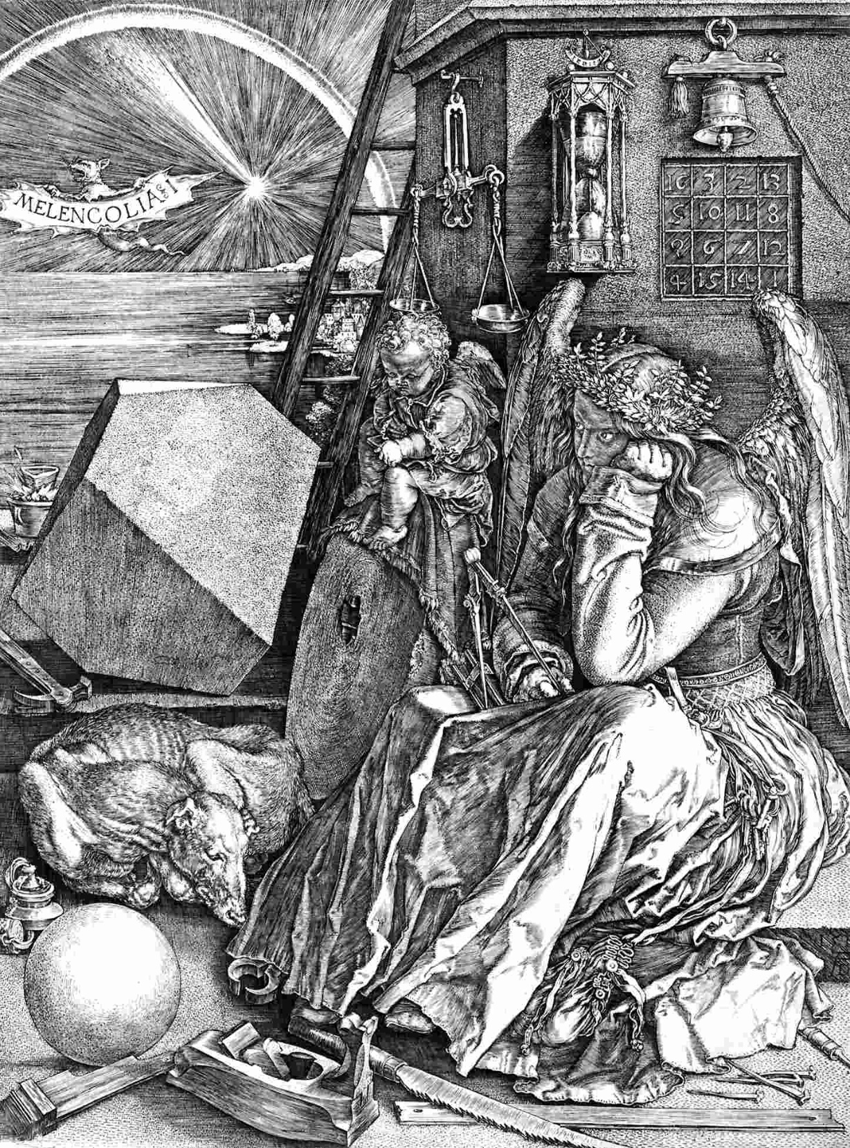







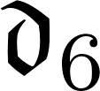



MONOPOLIA

Slide 3
Robbert Dijkgraaf’s Thesis Frontispiece

Slide 4
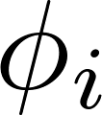
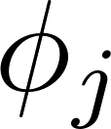
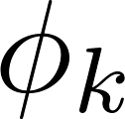
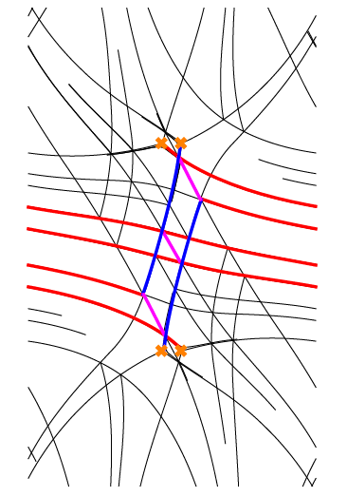
Late Edition
The BPS Times
``Making the World
a Stabler Place’’
Today, BPS degeneracies, wall-crossing formulae. Tonight, Sleep. Tomorrow, K3 metrics, BPS algebras, p.B6
Est. 1975
www.bpstimes.com
SEOUL, FRIDAY, JUNE 28, 2013
₩ 2743.75
INVESTIGATORS SEE
NO EXOTICS IN PURE SU(N) GAUGE THEORY
WILD WALL CROSSING
IN SU(3)
Use of Motives Cited
EXPONENTIAL
GROWTH OF 
By E. Diaconescu, et. al.
RUTGERS – An application of results on the motivic structure of quiver moduli spaces has led to a proof of a conjecture of GMN. p.A12
By D. Galakhov, P. Longhi, T. Mainiero,
G. Moore, and A. Neitzke
An instanton correction to the differential
Operadic Structures Found in
Infrared Limit of 2D LG Models
AUSTIN – Some strong coupling regions exhibit wild wall crossing.
``I didn’t think this could happen,’’ declared Prof. Nathan Seiberg of the Institute for Advanced Study in Princeton. Continued on p.A4
Semiclassical, but
Framed, BPS States
NOVEL CONSTRUCTION OF d ON INTERVAL
By G. Moore, A. Royston, and D. Van den Bleeken
Hope Expressed for Categorical WCF
RUTGERS – Semiclassical framed BPS states have been constructed as zeromodes of a Dirac operator on moduli spaces of singular monopoles. Wall-crossing implies novel results on the existence of harmonic spinors on noncompact hyperkahler manifolds.
By D. Gaiotto, G. Moore, and E. Witten
PRINCETON - A Morse-theoretic formulation of LG models has revealed -structures familiar from String Field Theory. LG models are nearly trivial in the infrared, a fact which leads to an alternative formulation of the well-known Fukaya-Seidel category associated to LG models. -

Slide 5


Semiclassical framed BPS states
arXiv:1512.08924
L^2-Kernels Of Dirac-Type Operators On Monopole Moduli Spaces
arXiv:1512.08923
Brane bending and monopole moduli
arXiv:1404.7158
arXiv:1404.5616
Parameter counting for singular monopoles on R3

Slide 6
Goal Of Our Project
Recently there has been some nice progress in understanding BPS states in d=4, N=2 supersymmetric field theory:
No Exotics Theorem, Wall-Crossing Formulae, Exact Results For Line Defect Vev’s
What can we learn about the differential geometry of monopole moduli spaces
from these results?

Slide 7
1
Introduction
2
Monopoles & Monopole Moduli Space
3
Singular Monopoles
4
Singular Monopole Moduli: Dimension & Existence
5
Semiclassical N=2 d=4 SYM: Collective Coordinates
6
Semiclassical (Framed) BPS States
7
Application 1: No Exotics & Generalized Sen Conjecture
8
Application 2: Wall-crossing & Fredholm Property
9
Future Directions

Slide 8


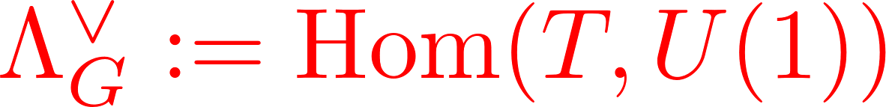
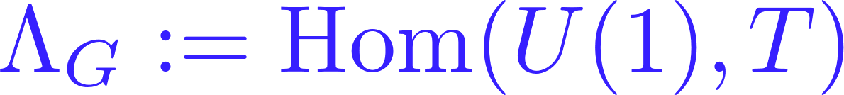
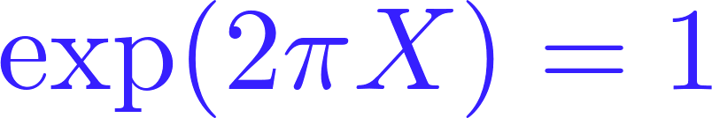
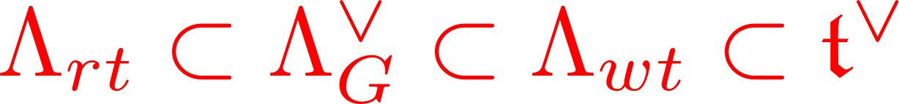
Lie Algebra Review: 1/4
Let G be a compact simple Lie group with Lie algebra g.
is regular if Z(X) has minimal dimension.
Then Z(X) = t is a Cartan subalgebra.
is a Cartan subgroup.
character lattice

Slide 9
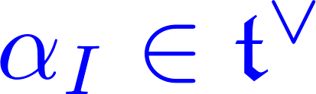

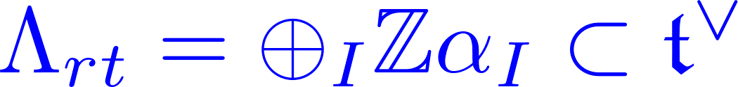
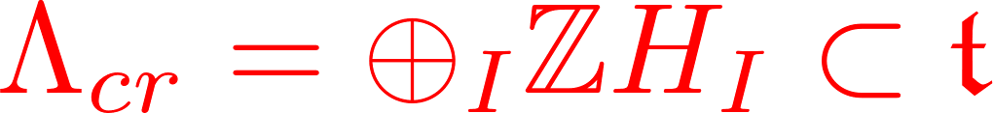
Lie Algebra Review: 2/4
Moreover, a regular element X determines a set of simple roots
and simple coroots

Slide 10







Slide 11
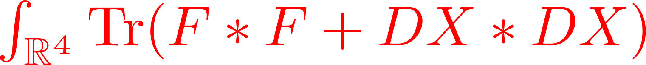

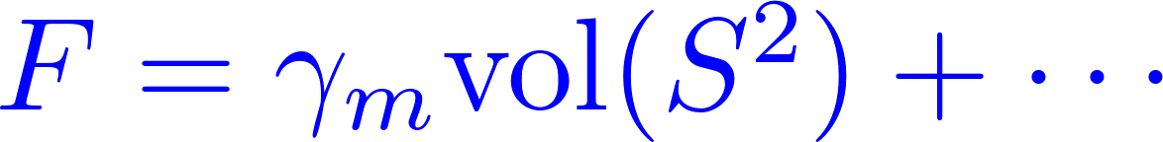
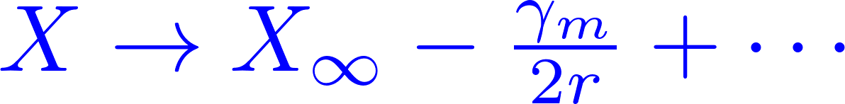




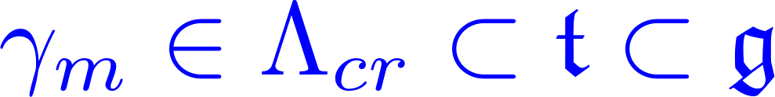
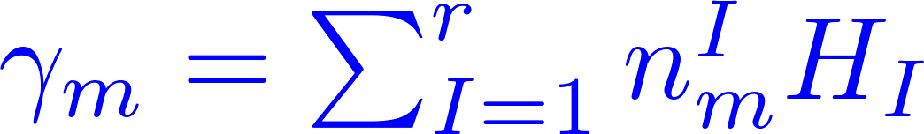
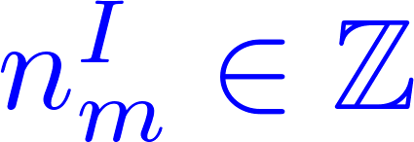
Nonabelian Monopoles
Yang-Mills-Higgs system for compact simple G
on R³
regular

Slide 12

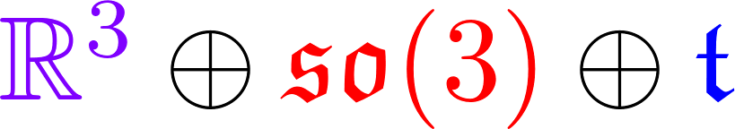
Monopole Moduli Space
SOLUTIONS/GAUGE TRANSFORMATIONS
If M is nonempty then [Callias; E. Weinberg]:
Known: M is nonempty iff all magnetic charges nonnegative and at least one is positive (so 4  dim M )
M has a hyperkahler metric.
Group of isometries with Lie algebra:
Translations
Rotations
Global gauge transformations

Slide 13


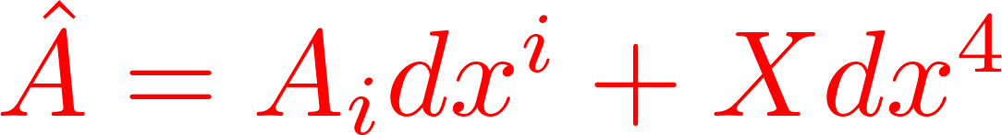
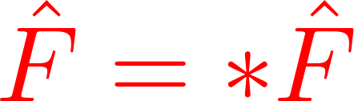

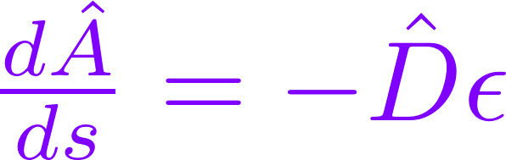
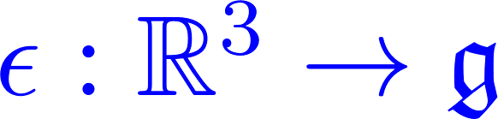

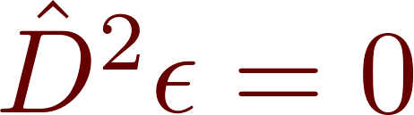
Action Of Global Gauge Transformations
Killing vector field on M
Directional derivative
along G(H) at

Slide 14
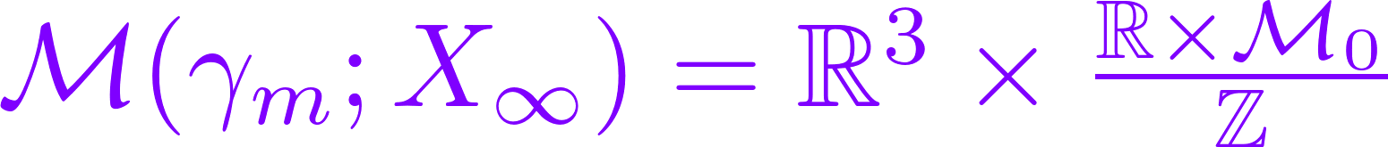
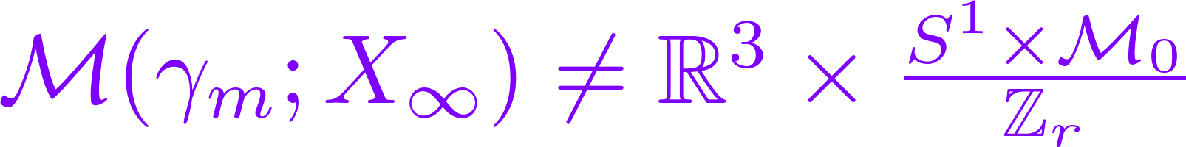
Strongly Centered Moduli Space
Orbits of translations
Orbits of G(X)
Higher rank is different!

Slide 15
1
Introduction
2
Monopoles & Monopole Moduli Space
3
Singular Monopoles
4
Singular Monopole Moduli: Dimension & Existence
5
Semiclassical N=2 d=4 SYM: Collective Coordinates
6
Semiclassical (Framed) BPS States
7
Application 1: No Exotics & Generalized Sen Conjecture
8
Application 2: Wall-crossing & Fredholm Property
9
Future Directions

Slide 16

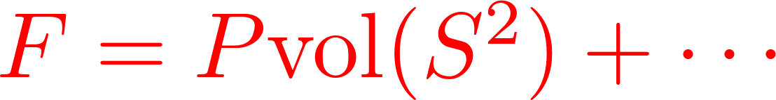
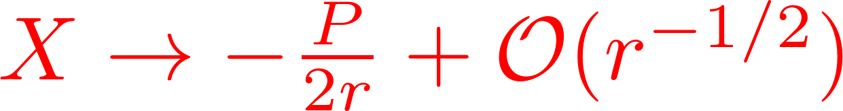

Singular Monopoles
AND
Use: construction of ‘t Hooft line defects (``line operators’’)
Kapustin; Kapustin-Witten

Slide 17
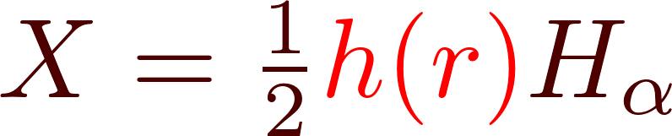
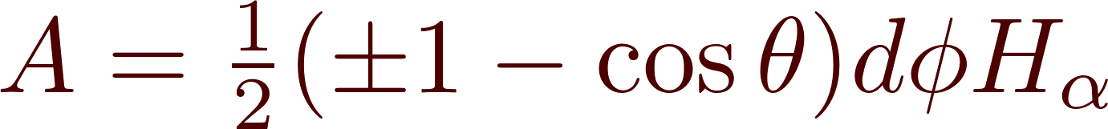
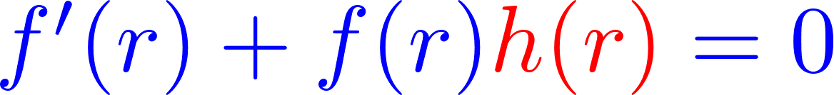
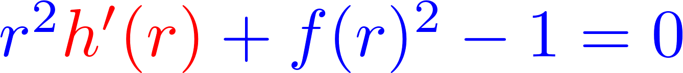
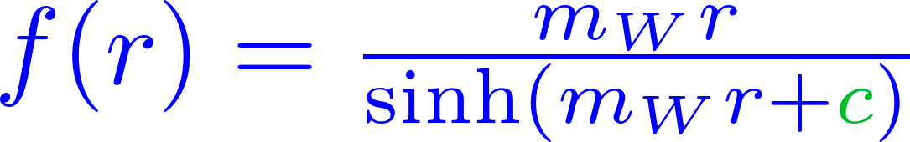
Example: A Singular Nonabelian SU(2) Monopole
Bogomolnyi eqs:
(‘t Hooft; Polyakov; Prasad & Sommerfield took c = 0 )
c > 0 is the singular monopole: Physical interpretation?

Slide 18
1
Introduction
2
Monopoles & Monopole Moduli Space
3
Singular Monopoles
4
Singular Monopole Moduli: Dimension & Existence
5
Semiclassical N=2 d=4 SYM: Collective Coordinates
6
Semiclassical (Framed) BPS States
7
Application 1: No Exotics & Generalized Sen Conjecture
8
Application 2: Wall-crossing & Fredholm Property
9
Future Directions

Slide 19


Singular Monopole Moduli Space
SOLUTIONS/GAUGE TRANSFORMATIONS
When is it nonempty?
What is the dimension?
If P = _{m} is P screened or not ?
Is the dimension zero?
or not?

Slide 20
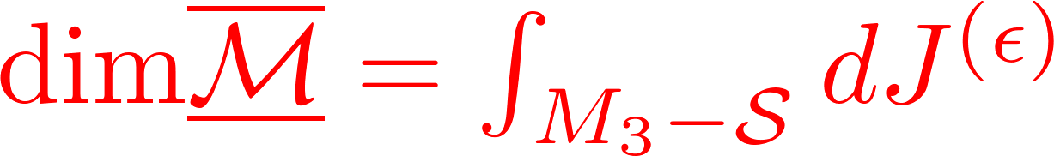
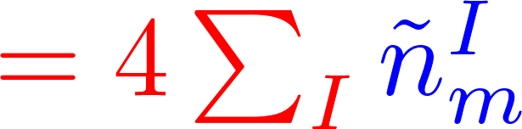
Dimension Formula
Assuming the moduli space is nonempty repeat computation of Callias; E. Weinberg to find:
For a general 3-manifold we find:
Relative magnetic charges.

Slide 21
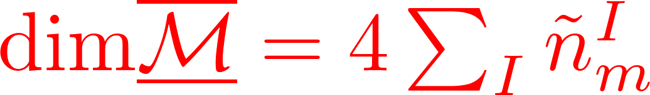
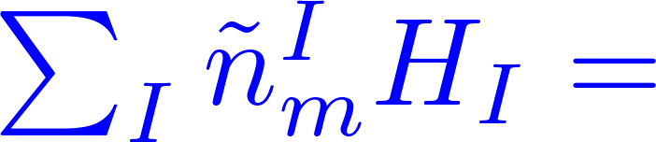
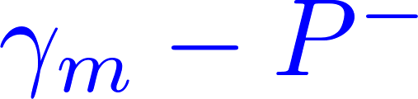

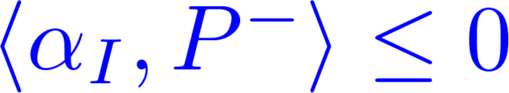
Dimension Formula
_{m} from r  and – P⁻ from r  0
Weyl group image such that
(Positive chamber determined by X )

Slide 22
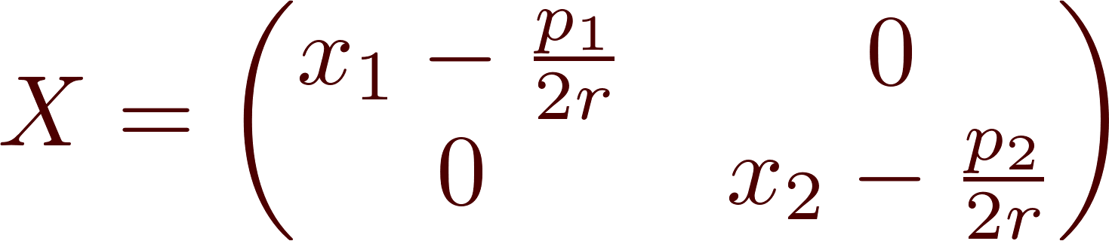



D-Brane Interpretation
Intuition for relative charges comes from D-branes. Example: Singular SU(2) monopoles from D1-D3 system
Notes:
SAY: But life is very different depending on whether p1 > p2 or not.
Now, all of this fits very nicely with brane configurations such as this one with D1’s ending on D3’s; and that in turn ties in nicely with Seiberg’s talk because in order to match to our results and factor out the U(1) COM degree of freedom you need to be careful
only to allow consistent sets of semi-infinite strings to end on the D3’s.

Slide 23
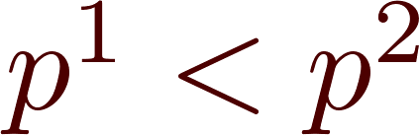
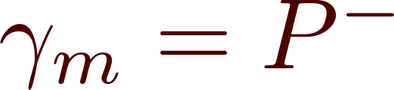
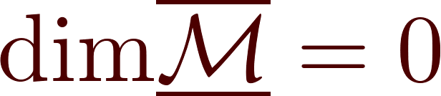
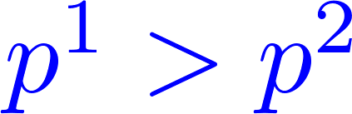
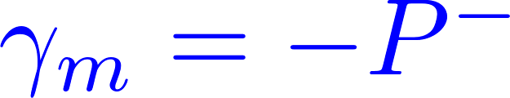
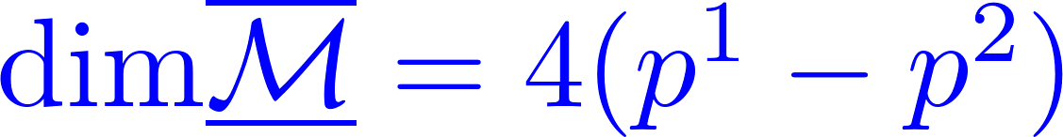

Slide 24
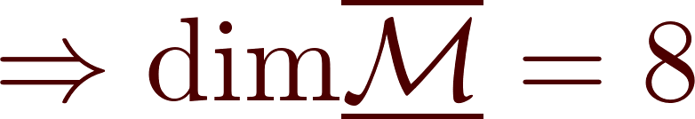
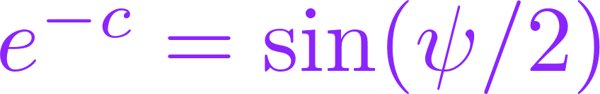
Application: Meaning Of The Singular ‘t Hooft-Polyakov Ansatz
Two smooth monopoles in the presence of minimal SU(2) singular monopole.
They sit on top of the singular monopole but have a relative phase:
Two D6-branes on an O6⁻ plane;
Moduli space of d=3 N=4 SYM with two massless HM

Slide 25
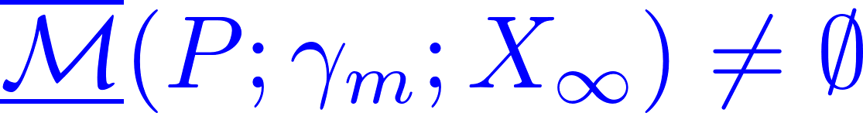


Properties of M
Conjecture:
Hyperkähler (with singular loci - monopole bubbling)
[Kapustin-Witten]
Isometries as before, but without translation.

Slide 26
1
Introduction
2
Monopoles & Monopole Moduli Space
3
Singular Monopoles
4
Singular Monopole Moduli: Dimension & Existence
5
Semiclassical N=2 d=4 SYM: Collective Coordinates
6
Semiclassical (Framed) BPS States
7
Application 1: No Exotics & Generalized Sen Conjecture
8
Application 2: Wall-crossing & Fredholm Property
9
Future Directions

Slide 27




N=2 Super-Yang-Mills
Second real adjoint scalar Y
Vacuum requires [X, Y]=0.
Meaning of ζ: BPS equations on R³ for preserving

Slide 28






ζ And BPS States
BPS bound:
Definition: BPS states saturate the bound.
Framed BPS states: Phase ζ is part of the
data describing ‘t Hooft-Wilson line defect L
Smooth/unframed/vanilla BPS states:

Slide 29





Semiclassical Regime
Definition: Series expansions for
a_{D}(a;☹) converges:
Local system of charges has natural duality frame:
(Trivialized after choices of
cuts in logs for a_{D}. )
In this regime there is a well-known semiclassical approach to describing BPS states.
Notes:
Make sure to state that there is no wall crossing as we change the dynamical scale.

Slide 30


Collective Coordinate Quantization
At weak coupling BPS monopoles are heavy:
Use moduli space approximation
The semiclassical states at (u,ζ) with electromagnetic charge ^{e}  _{m} should be described in terms of supersymmetric quantum mechanics on
OR
What sort of SQM?
How is (u,ζ) related to X?
How does ^{e} have anything to do with it?

Slide 31




What Sort Of SQM?
(Sethi, Stern, Zaslow; Gauntlett & Harvey ; Tong; Gauntlett, Kim, Park, Yi;
Gauntlett, Kim, Lee, Yi; Bak, Lee, Yi; Bak, Lee, Lee, Yi; Stern & Yi)
N=4 SQM on M(_{m},X) with a potential:
States are spinors on M

Slide 32





How is (u,ζ) related to X?
Need to write X, Y as functions on the Coulomb branch
Nicely encodes quantum corrections, e.g.
goes beyond the weak-potential approximation.

Slide 33
1
Introduction
2
Monopoles & Monopole Moduli Space
3
Singular Monopoles
4
Singular Monopole Moduli: Dimension & Existence
5
Semiclassical N=2 d=4 SYM: Collective Coordinates
6
Semiclassical (Framed) BPS States
7
Application 1: No Exotics & Generalized Sen Conjecture
8
Application 2: Wall-crossing & Fredholm Property
9
Future Directions

Slide 34




Semiclassical BPS States: Overview
Semiclassical framed or vanilla BPS states with magnetic charge _{m} will be:
a Dirac spinor  on M(_{m}) or M(_{m})
Must be suitably normalizable:
Must be suitably equivariant….
Many devils in the details….

Slide 35






States Of Definite Electric Charge
has a t-action: G(H) commutes with D
Cartan torus T of adjoint group acts on
Organize L²-harmonic spinors by T-representation:

Slide 36







Framed BPS States: The Answer
L is an ‘t Hooft line defect of charge P and phase 

Slide 37

Vanilla BPS States & Smooth Monopoles
Begin analysis on universal cover: M~
Physical states  must descend to M
-- Electric Charge --
T acts on M, and T = t/☹_{mw}
States  of definite electric charge
transform with a definite character of t:

Slide 38






Separating The Center Of Mass
Separating the COM involves the nontrivial identity:

Slide 39

L² - Condition
No L² harmonic spinors on R⁴
Only ``plane-wave-normalizable’’ in R⁴
Note: The L² condition is crucial!
We do not want ``extra’’ internal d.o.f.
Contrast this with the hypothetical
``instanton particle’’ of 5D SYM.

Slide 40

Semiclassical Smooth BPS States
????

Slide 41





Tricky Subtlety: 1/3
Spinors must descend to
Generated by isometry 
Subtlety: Imposing electric charge
quantization only imposes invariance under
a proper subgroup of the Deck group:
Notes:
So, when we say that a spinor is in a definite charge state with properly
Quantized electric charge we have exp[2\pi G(\lambda)]Psi = Psi
But the problem is that the isometries exp[2\pi G(\lambda)] are nontrivial powers of the generator of the Deck group.

Slide 42




Put differently:
T acts on M, so choosing a point m₀  M
Using the relation of M to rational maps from P¹ to the flag variety we prove:

Slide 43


Tricky Subtlety: 3/3
only generate a subgroup r Z, where r is,
roughly speaking, the gcd(magnetic charges)
Extra restriction to Z/rZ invariant subspace:
Notes:
Using the interpretation of monopole moduli space in terms of the space of rational maps to the flag variety you can PROVE

Slide 44
Combine above picture with results on N=2,d=4:
No Exotics Theorem
Wall-Crossing
Exact Results On Line Defect VEV’s

Slide 45
1
Introduction
2
Monopoles & Monopole Moduli Space
3
Singular Monopoles
4
Singular Monopole Moduli: Dimension & Existence
5
Semiclassical N=2 d=4 SYM: Collective Coordinates
6
Semiclassical (Framed) BPS States
7
Application 1: No Exotics & Generalized Sen Conjecture
8
Application 2: Wall-crossing & Fredholm Property
9
Future Directions

Slide 46






Exotic (Framed) BPS States
-reps
Vanilla BPS:
Half-Hyper from COM:
Framed BPS: No HH factor:
Exotic BPS states: States in h() transforming nontrivially under su(2)_{R}
Definition:

Slide 47
No Exotics Conjecture/Theorem
Conjecture [GMN]: su(2)_{R} acts trivially on h(): exotics don’t exist.
Theorem: It’s true!
Diaconescu et. al. : Pure SU(N) vanilla and framed
(for pure ‘t Hooft line defects)
Sen & del Zotto: Simply laced G (vanilla)
Cordova & Dumitrescu: Any theory with ``Sohnius’’ energy-momentum supermultiplet (vanilla, so far…)

Slide 48


Geometry Of The R-Symmetry
Riemannian holonomy: SO(4N)
Hyperkähler holonomy: USp(2N)
SU(2)_{R} is the commutant of USp(2N)
Collective coordinate expression for generators of su(2)_{R}
This defines a lift to the spin bundle.
Generators do not commute with
Dirac, but do preserve kernel.

Slide 49



have so(3) action of rotations. Suitably defined, it commutes with su(2)_{R}.
Again, the generators do not commute with D₀, D, but do preserve the kernel.
Equality of
- reps.
Notes:
Say: This is an isomorphism of so(3)_rot + su(2)_R representations.

Slide 50

Geometrical Interpretation Of The
No-Exotics Theorem -1
All spinors in the kernel
have chirality +1

Slide 51

So, the absolute number of BPS states is the same as the BPS index!
This kind of question arises frequently in BPS theory…

Slide 52





Geometrical Interpretation Of The
No-Exotics Theorem - 2
Choose any complex structure on M.
su(2)_{R} becomes ``Lefshetz sl(2)’’

Slide 53


Geometrical Interpretation Of The
No-Exotics Theorem - 3
vanishes except in the middle degree q =N, and is primitive wrt ``Lefshetz sl(2)’’.

Slide 54
Adding Matter-1/2
(Manton & Schroers; Sethi, Stern & Zaslow; Gauntlett & Harvey ;
Tong; Gauntlett, Kim, Park, Yi; Gauntlett, Kim, Lee, Yi; Bak, Lee, Yi)
Add matter hypermultiplets in a quaternionic representation R of G.
Bundle of hypermultiplet fermion zeromodes defines a vector bundle E over M :
E =associated bundle to the universal bundle.
Universal connection is hyperholomophic

Slide 55





Adding Matter-2/2
(work with Daniel Brennan)
Real rank of E
Sum over weights  of R.
States are now L²-sections of

Slide 56

Geometrical Interpretation Of The
No-Exotics Theorem - 4
vanishes except in the middle degree q =N, and is primitive wrt ``Lefshetz sl(2)’’.
SU(2) N=2* m  0 recovers the famous
Sen conjecture

Slide 57
1
Introduction
2
Monopoles & Monopole Moduli Space
3
Singular Monopoles
4
Singular Monopole Moduli: Dimension & Existence
5
Semiclassical N=2 d=4 SYM: Collective Coordinates
6
Semiclassical (Framed) BPS States
7
Application 1: No Exotics & Generalized Sen Conjecture
8
Application 2: Wall-crossing & Fredholm Property
9
Future Directions

Slide 58
Semiclassical Wall-Crossing: Overview
Easy fact: There are no L² harmonic spinors for ordinary Dirac operator on a noncompact hyperkähler manifold.
 Semiclassical chamber (Y∝=0) where all populated magnetic charges are just simple roots (M₀ = pt)
Other semiclassical chambers have nonsimple magnetic charges filled.
Nontrivial semi-classical wall-crossing
(Higher rank is different.)
Interesting math predictions

Slide 59
Jumping Index
The L²-kernel of D jumps.
No exotics theorem
Harmonic spinors have definite chirality
L² index jumps!
How?!
Along hyperplanes in Y-space zeromodes mix with continuum and D⁺ fails to be Fredholm.
(Similar picture proposed by M. Stern & P. Yi)
We give explicit formulae for these hyperplanes.

Slide 60




How Does The BPS Space Jump?
Unframed/smooth/
vanilla:
&
Framed:
&

Slide 61



Framed Wall-Crossing: 1/2
``Protected spin characters’’
Where does it jump?

Slide 62




Framed Wall-Crossing: 2/2
How does it jump across W(_{h}) ?
is an operator-valued function of

Slide 63


Example: Semiclassical Vanilla
Wall Crossing
Does not exist for g = su(2) (Seiberg & Witten 1994)
[Gauntlett, Kim, Lee, Yi (2000) ]
``Constituent BPS states exist’’

Slide 64







Why choose _{m} = H₁ + H₂ ??
= Taub-NUT:
Zeromodes of D₀ can be explicitly computed
[C. Pope, 1978]
What do the zeromodes look like ??

Slide 65




Slide 66








Example: Semiclassical Framed
Wall-Crossing
Well-known spectrum of smooth BPS states
[Seiberg & Witten]:
Line defect L:

Slide 67


Explicit Generator Of PSC’s
Predictions for ker D for infinitely many moduli spaces of arbitrarily high magnetic charge.

Slide 68
1
Introduction
2
Monopoles & Monopole Moduli Space
3
Singular Monopoles
4
Singular Monopole Moduli: Dimension & Existence
5
Semiclassical N=2 d=4 SYM: Collective Coordinates
6
Semiclassical (Framed) BPS States
7
Application 1: No Exotics & Generalized Sen Conjecture
8
Application 2: Wall-crossing & Fredholm Property
9
Future Directions

Slide 69
Future Directions -1/4
Add matter and arbitrary Wilson-’t Hooft lines. (In progress with Daniel Brennan)
Understand better how Fredholm property fails by using asymptotic form of the monopole metric.
Combine the localization result of
Ito, Okuda, Taki with ``Darboux expansion’’ of
GMN to get an interesting L²-index theorem on (noncompact!) monopole moduli spaces ?

Slide 70



Future Directions -2/4
(In progress with Daniel Brennan & Andy Royston)
Understand better how Fredholm property of D fails:
Use asymptotic metric for moduli space for widely separated monopoles with charges  {simple roots}

Slide 71

Future Directions -3/4
(In progress with Anindya Dey)
There are methods to compute vev’s of susy line defects on R³ x S¹ exactly.
GMN-2010
Weak coupling expression + known nonperturbative corrections.
Surprising nonperturbative correction

Slide 72


Future Directions -4/4
Localization computations of the same quantities by Ito, Okuda, Taki (2011) give expressions like:
a, b : complexified Fenchel-Nielsen coordinates
Involves integrals over moduli spaces of singular monopoles of characteristic classes.

Slide 73

So, What Did He Say?
Recent
new
old
Recent results on N=2 d=4
imply new results about the
differential geometry of old
monopole moduli spaces.

