Slide 1
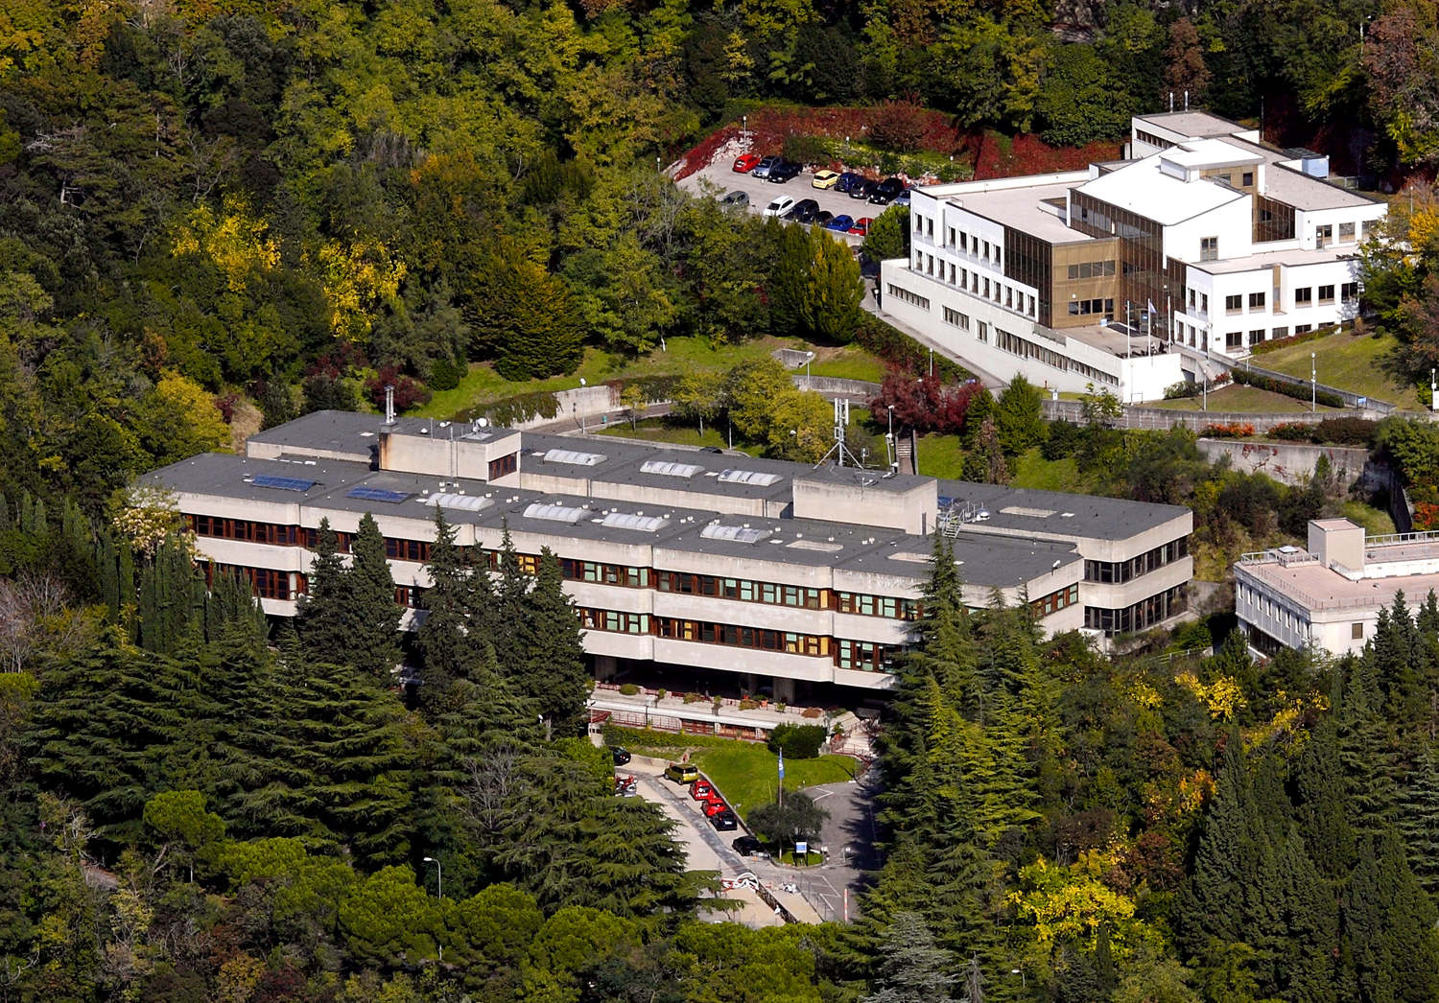
Update On Susy Field Theory And Invariants Of Smooth Four-Manifolds
Gregory Moore, Rutgers University
StringMath@ICTP,
June 9, 2024

Slide 2
1
Motivation
2
Topologically Twisted d=4 N=2 Field Theory
3
Review Of The Donaldson-Witten Paradigm
4
d=5: ``K-theoretic Donaldson invariants’’
5
Family Donaldson invariants

Slide 3
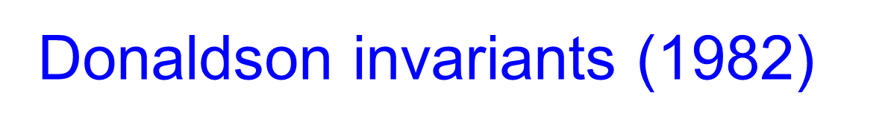
Glorious History Of
4d Field Theory & Four-Manifold Topology
Instantons (BPST) (1975)
Donaldson invariants (1982)
TQFT (1988)
Seiberg-Witten Invariants (1994)
Revolution of 1995
Notes:
Maybe not as glorious, but certainly not inglorious

Slide 4
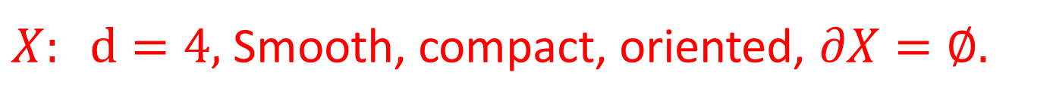
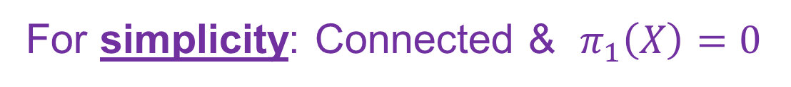

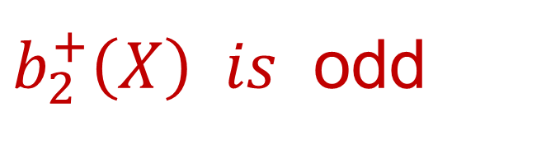
But not all questions are answered…
$X: d=4,$Smooth, compact, oriented, $∂X=∅.$
For simplicity: Connected & $π_{1}\left(X\right)=0$
Essential in Donaldson & Seiberg-Witten theory:
$X$admits an almost complex structure
$b_{2}^{+}\left(X\right) is$ odd
Misses ``half’’ the world of four-manifolds!
We’ll relax that condition in the final part of the talk.

Slide 5

Generalizations Of The
Donaldson-Witten Paradigm
Other 4d N=2 theories
5d theories
6d theories
Coupling to background supergravity…
These might lead to truly new invariants that are independent of the
Donaldson/SW invariants …

Slide 6
…. or not …
Today’s talk: Some of these generalizations lead to
interesting issues in QFT,
analytic number theory,
and topology.
So it is worth thinking about.

Slide 7
1
Motivation
2
Topologically Twisted d=4 N=2 Field Theory
3
Review Of The Donaldson-Witten Paradigm
4
d=5: ``K-theoretic Donaldson invariants’’
5
Family Donaldson invariants

Slide 8

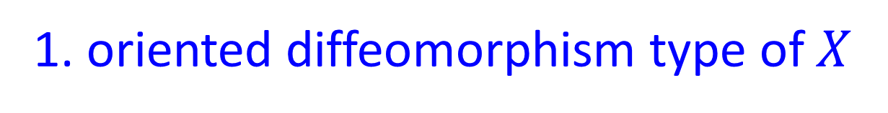

Witten’s Homomorphism
$$φ_{W}:SO\left(4\right)→\frac{Spin\left(4\right)×SU{\left(2\right)}^{R}}{⟨ \left(−1,−1, −1 \right)⟩}$$
$\left\langle \left(−1,−1,−1\right)\right\rangle ≅μ_{2}$acts trivially on vectormultiplets
Twisted SYM based on $φ_{W}$
gives function $Z_{W}:H_{∗}\left(X\right)→ℂ$
$Z_{W}$only depends on:
1. oriented diffeomorphism type of $X$
2. A choice of ‘t Hooft flux

Slide 9

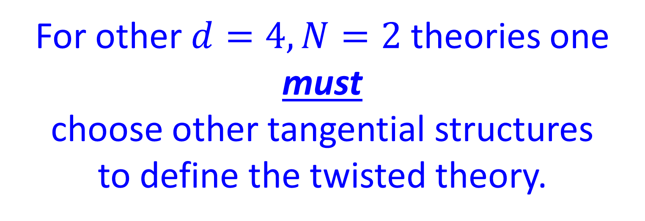
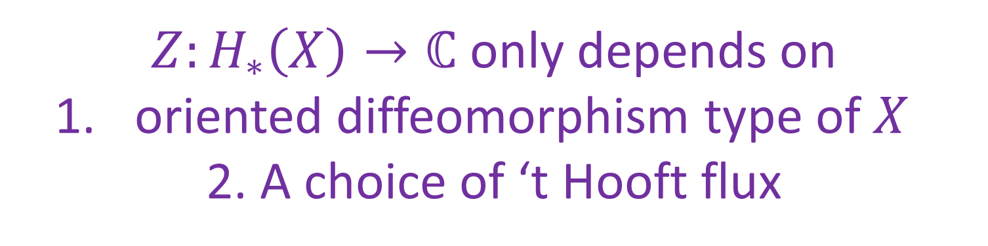
For other $d=4,N=2$theories one must
choose other tangential structures
to define the twisted theory.
$N=2^{∗}$ one must choose a spin-c structure
(Labastida-Marino; Manschot-Moore)
$Z:H_{∗}\left(X\right)→ℂ$ only depends on
oriented diffeomorphism type of $X$
2. A choice of ‘t Hooft flux
AND 3. an ``ultraviolet’’ spin-c structure

Slide 10


What is the general tangential structure?
WIP with Vivek Saxena and Ranveer Singh gives generalization of top twisting to arbitrary renormalizable Lagrangian
d=4
N=2 theories
Goal: Further generalization to arbitrary class S theories.

Slide 11
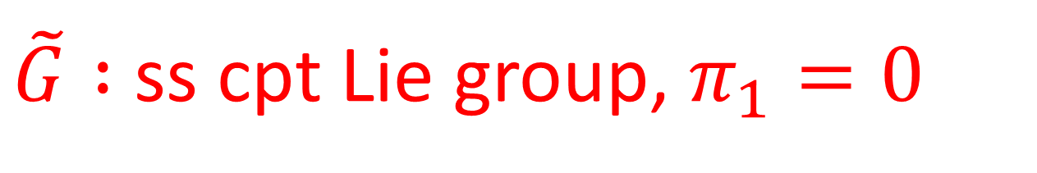
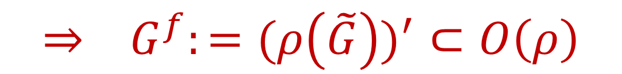
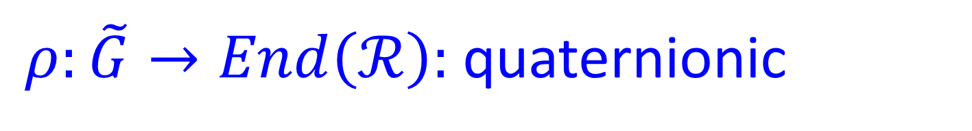
Basic Data For A Renormalizable Lagrangian d=4 N=2 Theory
$\tilde{G} :$ss cpt Lie group, $π_{1}=0$
$ρ:\tilde{G}→End\left(ℛ\right):$quaternionic
$$⇒ G^{f}:=(ρ{\left(\tilde{G}\right))}^{′}⊂O\left(ρ\right)$$
$${\tilde{G}}^{cover}≔\tilde{G}×Spin\left(4\right)×SU{\left(2\right)}^{R}×G^{f}$$

Slide 12

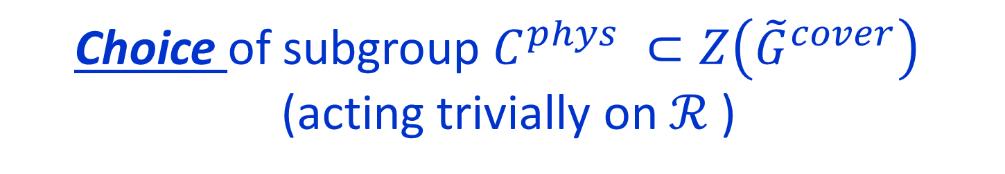

Structure Group Of The Physical Theory
$${\tilde{G}}^{cover}≔\tilde{G}×Spin\left(4\right)×SU{\left(2\right)}^{R}×G^{f}$$
Choice of subgroup $C^{phys} ⊂Z\left({\tilde{G}}^{cover}\right)$
(acting trivially on $ℛ$)
Fields of the physical theory are based on a bundle $P^{phys}$with connection $∇^{phys}$for structure group
$$G^{phys}≔ {\tilde{G}}^{cover}/C^{phys}$$

Slide 13
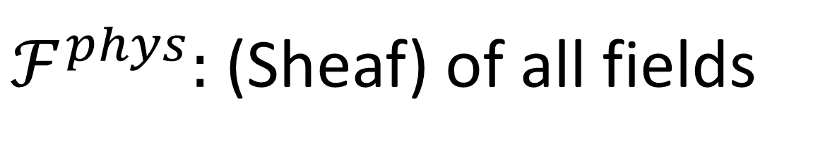
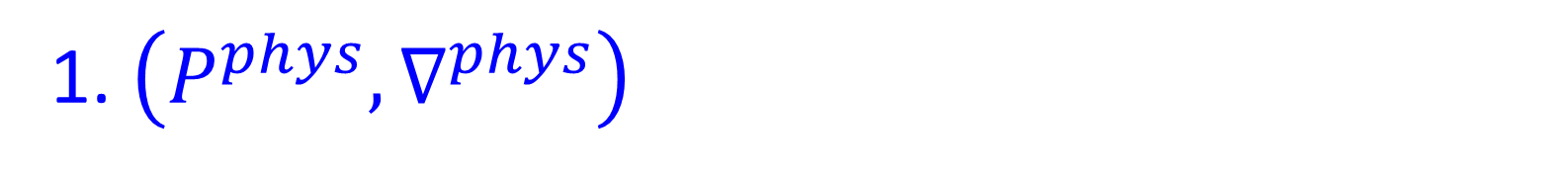
$ℱ^{phys}:$(Sheaf) of all fields
1. $\left(P^{phys},∇^{phys}\right)$
2. Flat gerbe (1-form symmetry field)
3. Masses, couplings, hypermultiplet fields

Slide 14
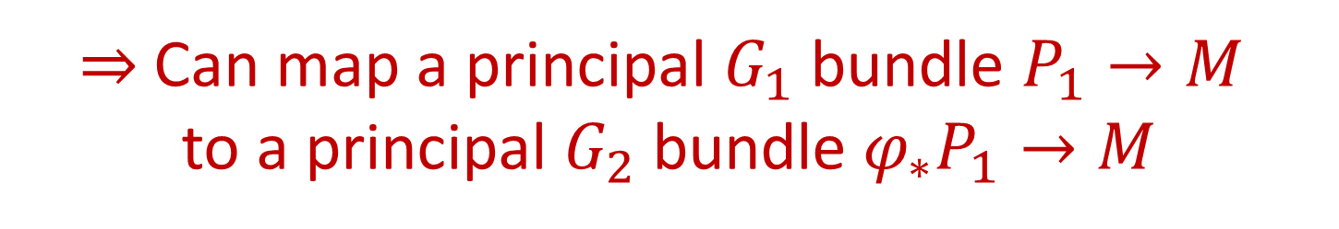
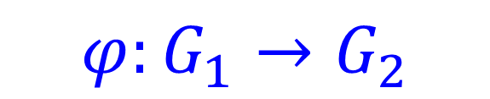

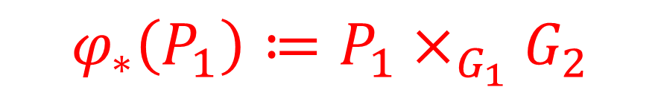
Transfer Of Structure Group
$$φ:G_{1}→G_{2}$$
Homomorphism of groups
$⇒$Can map a principal $G_{1}$bundle $P_{1}→M$
to a principal $G_{2}$bundle $φ_{∗}P_{1}→M$
Transition functions $g_{αβ}:U_{αβ}→G_{1}$map to new transition functions $φ\left(g_{αβ}\right):U_{αβ}→G_{2}$
$$φ_{∗}\left(P_{1}\right)≔P_{1}×_{G_{1}}G_{2}$$
$$Bφ: BG_{1}→BG_{2}$$

Slide 15
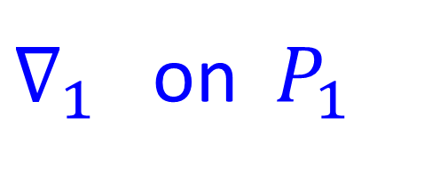


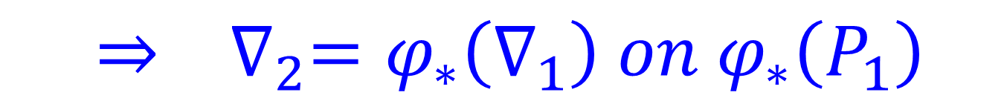
$φ_{∗}$extends to category of
bundles with connection:
$∇_{1}$ on $P_{1}$
$$⇒ ∇_{2}=φ_{∗}\left(∇_{1}\right) on φ_{∗}\left(P_{1}\right)$$
$$Hol\left(∇_{2},γ\right)=φ\left(Hol\left(∇_{1},γ\right)\right)$$

Slide 16
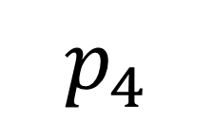
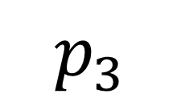
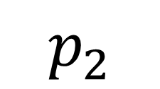
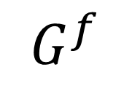
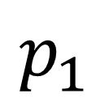
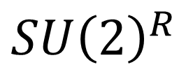

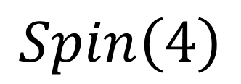
$$\left(\tilde{G}×Spin\left(4\right)×SU{\left(2\right)}^{R}×G^{f}\right)$$
$$p_{1}$$
$$p_{2}$$
$$p_{3}$$
$$p_{4}$$
$$\tilde{G}$$
$$Spin\left(4\right)$$
$$SU{\left(2\right)}^{R}$$
$$G^{f}$$
$p_{1,∗}\left(P^{phys},∇^{phys}\right)≔{(P}_{1}, A)$Dynamical gauge field bundle
$${\left(p_{2}\right)}_{∗}\left(P^{phys},∇^{phys}\right)=\left(Fr\left(X\right), ∇^{LC}\right)$$
$p_{3,∗}\left(P^{phys},∇^{phys}\right)≔$R-symmetry bundle & connection
$p_{4,∗}\left(P^{phys},∇^{phys}\right)≔$Flavor bundle & connection

Slide 17

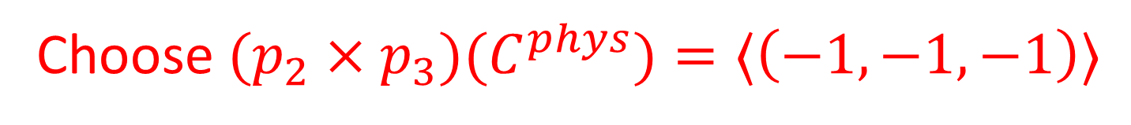
The Untwisted Theory Does Not Need A Spin Structure
Only need a principal bundle with structure group:
$$G^{phys}=(\tilde{G}×Spin\left(4\right)×SU{\left(2\right)}^{R}×G^{f})/C^{phys}$$
Choose ${(p_{2}×p_{3})(C}^{phys})=⟨\left(−1,−1,−1\right)⟩$
$$⊂Z\left( Spin\left(4\right)×SU{\left(2\right)}^{R}\right)$$
Such bundles can very well exist
on nonspin manifolds

Slide 18
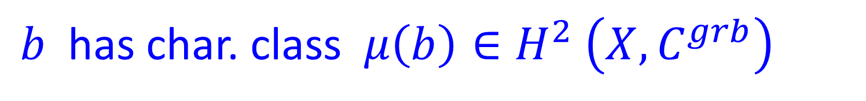

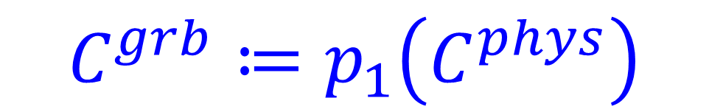
Role of the gerbe $b$ is to allow introduction of ‘t Hooft flux
Best done via slab/sandwich/quiche/SymTFT picture
(see e.g. Dan Freed’s StringMath2022 talk)
$b$ has char. class $μ\left(b\right)∈H^{2} \left(X, C^{grb}\right)$
$$C^{grb}≔p_{1}\left(C^{phys}\right)$$

Slide 19

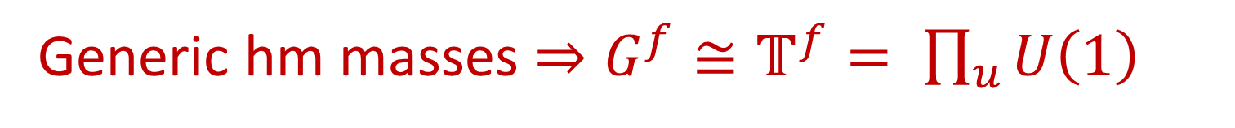

Existence of $P^{phys}$Puts A Condition On
`` 1-Form Symmetry Fields’’
$$ρ≅⊕_{u}ρ_{u}$$
Generic hm masses $⇒G^{f}≅𝕋^{f}= \prod_{u}{U\left(1\right)}$
$${\left(p_{4,u}\right)}_{∗}\left( P^{phys}\right)=ℒ_{u} ⇒ c\left(u\right)=c_{1}\left(ℒ_{u}\right)$$
$$μ\left(b\right)+w_{2}\left(X\right)+c\left(u\right)=0 ∈H^{2}\left(X,ℤ_{n_{u}}\right)$$
Generalizes several special cases in the literature:
[Moore-Witten, Labastida-Marino,Manschot-Moore, Aspman-Furrer-Manschot]
Notes:
Another misconception: These conditions come from the existence of hypermultiplets.

Slide 20





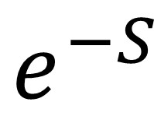
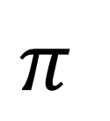

$$e^{−S}$$
$$ℱ^{phys}$$
$$ℂ$$
$$π$$
$$Z=π_{∗}:$$
$$ℱ^{bck}$$
$$ℂ$$
Dynamical fields are the fiber of $π$
In general the fibration is nontrivial

Slide 21
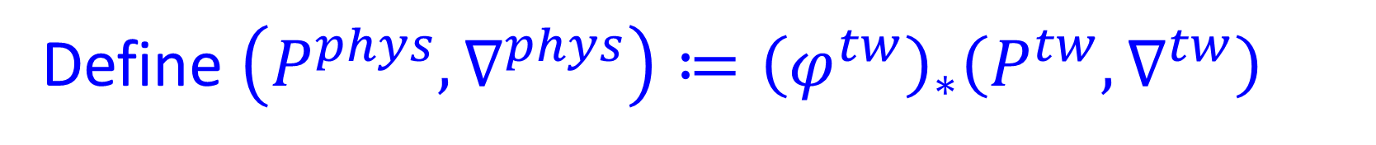



Topological Twisting Via
Transfer Of Structure Group
Upgrade $φ_{W}$to $φ^{tw}: G^{tw} → G^{phys}$
Define $\left(P^{phys},∇^{phys}\right)≔{\left(φ^{tw}\right)}_{∗}\left(P^{tw},∇^{tw}\right)$
Such that $Z\left(∇^{tw,bck}\right)$is invariant under continuous deformations of $∇^{tw,bck}$
because for such backgrounds
$∃ Q$ such that $Q^{2}=0$

Slide 22



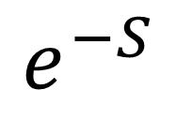
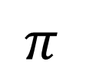



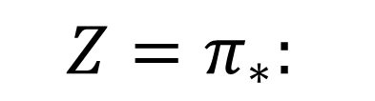


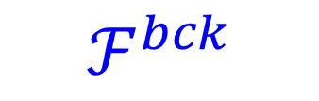


$$φ_{∗}^{tw}$$
$$e^{−S}$$
$$ℱ^{tw}$$
$$ℱ^{phys}$$
$$ℂ$$
$$π$$
$$π$$
$$Z=π_{∗}:$$
$$ℱ^{tw,bck}$$
$$ℱ^{bck}$$
$$ℂ$$
We construct explicit:
$$φ^{tw}$$
$$G^{tw}=\left(\tilde{G}×Spin\left(4\right)×𝕋^{f}\right)/C^{tw}$$
$$G^{phys}$$

Slide 23

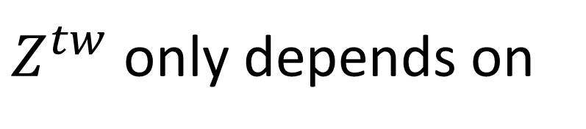

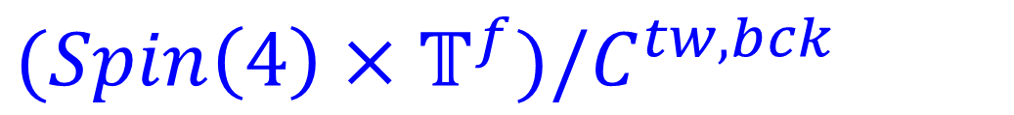
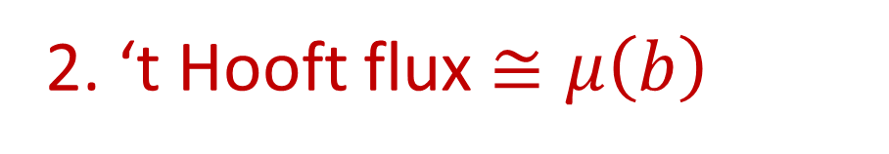
$Z^{tw}$only depends on
1. Diffeomorphism type of $X$
2. ‘t Hooft flux $≅μ\left(b\right)$
3. ``Generalized Spin-c structure’’:
Principal bundle $P^{c}$for
$(Spin\left(4\right)×𝕋^{f})/C^{tw,bck}$
$$p_{1,∗}P^{c}=Fr(X)$$

Slide 24

Just like generalized symmetries & their ‘t Hooft anomalies …
Topological twisting data should be an RG invariant, so it should be possible to extract $ℱ^{tw}$from the LEET SW theory
will allow us to find twisting data for general class S theories.

Slide 25


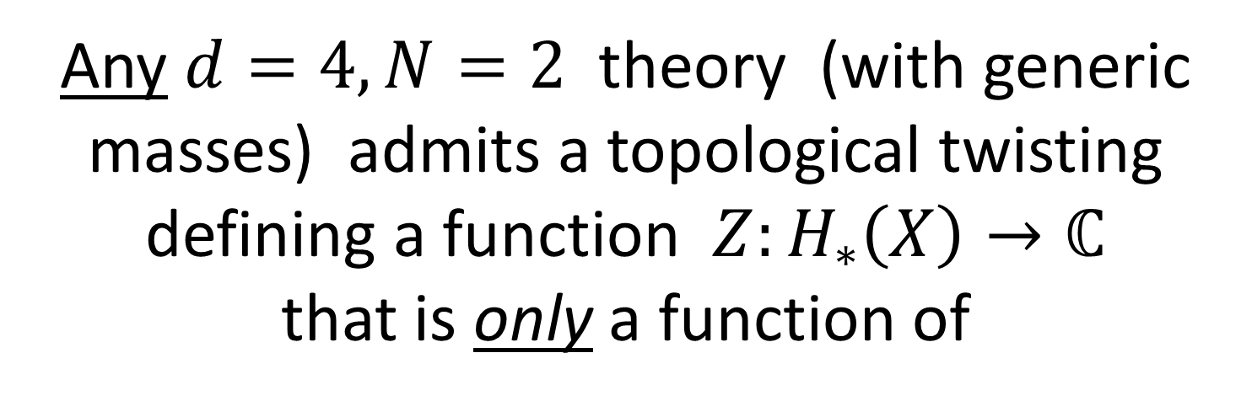
Conjecture:
Any $d=4,N=2$theory (with generic masses) admits a topological twisting
defining a function $Z:H_{∗}\left(X\right)→ℂ$
that is only a function of
1. Oriented diffeomorphism type of $X$
2. Iso class of background gerbes for $B^{2}C$
3. ``Generalized Spin-c structure’’

Slide 26
1
Motivation
2
Topologically Twisted d=4 N=2 Field Theory
3
Review Of The Donaldson-Witten Paradigm
4
d=5: ``K-theoretic Donaldson invariants’’
5
Family Donaldson invariants

Slide 27
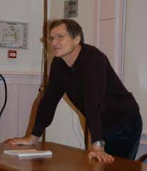
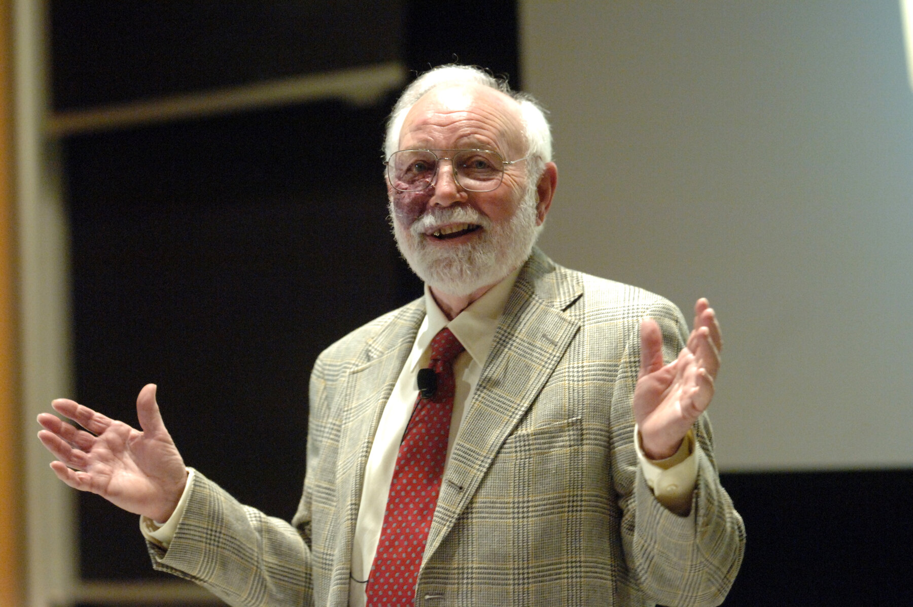

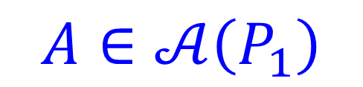
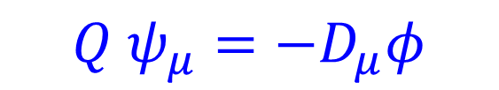
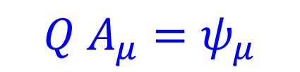
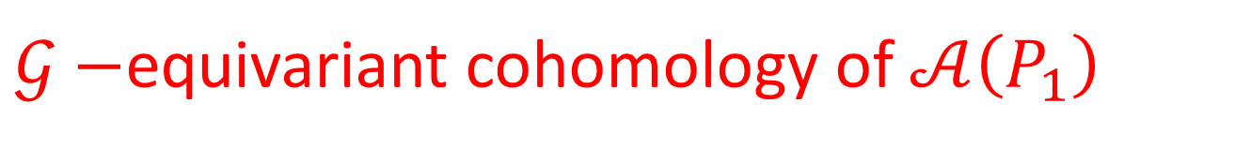
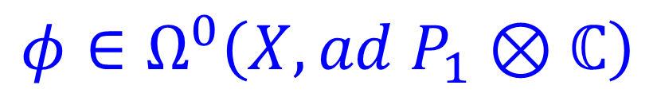
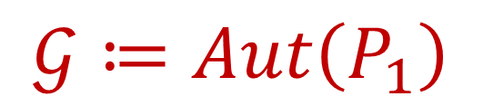

$$Q A_{μ}=ψ_{μ}$$
$$Q ψ_{μ}=−D_{μ}φ$$
$$Q φ=0$$
$$A∈𝒜\left(P_{1}\right)$$
$$φ∈Ω^{0}\left(X, ad P_{1}⊗ℂ\right)$$
$$An important viewpoint in$$
$$the section on families below$$
Baulieu & Singer, 1988
$𝒢−$equivariant cohomology of $𝒜\left(P_{1}\right)$
$$𝒢≔Aut\left(P_{1}\right)$$
Group of gauge transformations
Notes:
Go back to theory of SU(2) VM

Slide 28







$Q−$closed observables: $𝒪\left(pt\right)=Tr\left(φ^{2}\left(pt\right)\right)$
$$\{ K, Q \} =d⇒$$
$$𝒪_{j}≔K^{j}𝒪$$
$$𝒪\left(Σ_{j}\right)≔\int_{Σ_{j}}{𝒪_{j} }$$
only depends on $\left[Σ_{j}\right]∈H_{j}\left(X\right)$
Function on $H_{∗}\left(X\right):$
$$Z_{W}\left(Σ\right)={\left\langle e^{𝒪\left(Σ\right)}\right\rangle }_{tw}$$
Witten (1988):
$Z_{W}$independent of metric $g_{μν}$on $X$

Slide 29






Witten (1988) & Atiyah& Jeffrey(1990)
$Z_{W}\left(Σ\right)$path integral localizes to
an integral over
$$ℳ ⊂𝒜(P_{1})/𝒢$$
$ℳ≔\left\{A∈𝒜\left(P_{1}\right):F{\left(A\right)}^{+}=0 \right\}$/$𝒢$
$$F^{+}≔\frac{1}{2}\left(F+∗F \right)$$

Slide 30




Donaldson Invariants
Donaldson: $μ:H_{∗}\left(X\right)→H^{∗}\left(ℳ\right)$
$$Z_{D}:H_{∗}\left(X\right)→ℚ$$
$$Z_{D}\left(Σ\right)=\int_{ℳ}{e^{μ\left(Σ\right)}}$$
$ℳ$depends on $g_{μν} ,$but $Z_{D}$does not

Slide 31




Main Statement
$$Z_{W}=Z_{D}$$
$${=: Z}_{DW}$$
$Z_{DW}$only depends on
1. oriented diffeomorphism type of $X$
2. A choice of ‘t Hooft flux

Slide 32







Evaluation Of $Z_{DW}\left(Σ\right)$
$Z_{DW}$ independent of $g_{μν}$on $X$
Consider metric $L^{2}g_{μν}$ in the limit $L→∞$
$⇒$Use Seiberg-Witten LEET
$Z_{DW}$ $=Z_{Coul}^{J} +Z_{SW}^{J}$
Witten 94
Moore-Witten 97
$$b_{2}^{+}=1 :$$
$J:$oriented line $H^{2,+}\left(X\right)⊂H^{2}\left(X\right)$

Slide 33


One can deduce $Z_{SW}^{J}$ from $Z_{Coul}^{J}$
Moore-Witten, 1997
S$o start with Z_{Coul}^{J}$

Slide 34









$$Z_{Coul}^{J}$$
Integral over the Coulomb branch of vacua on $ℝ^{4} ,$
$G=SU\left(2\right):$parametrized by $u=\left\langle Trφ^{2}\right\rangle ,$
Measure is computed using SW LEET for U(1) VM
$$λ_{SW}$$
$$E_{u}$$
$${−Λ}^{2}$$
$$Λ^{2}$$
$$u$$

Slide 35



u-Plane Integral
SW94: Coulomb branch has a modular parametrization:
$$u\left(τ\right)=\frac{θ_{2}^{4}+θ_{3}^{4}}{2 θ_{2}^{2}θ_{3}^{2}} =\frac{1}{8}q^{−\frac{1}{4}}+\frac{5}{2}q^{\frac{1}{4}}+⋯$$
$$q=e^{2πiτ}$$
Coulomb branch $≅UHP/Γ^{0}\left(4\right)$

Slide 36

$$Γ^{0}\left(4\right)=\{\left(\begin{matrix}∗ & 0 \\ ∗ & ∗\end{matrix}\right)mod4\} ⊂SL\left(2,ℤ\right)$$

Slide 37




$$Z_{Coul}^{J}\left(Σ\right)= \int_{ℱ\left(Γ^{0}\left(4\right)\right)}{dτd\overline{τ} ℋ\left(τ\right)\frac{∂}{∂\overline{τ}} {\hat{G}}^{J}\left(τ,\overline{τ}, Σ\right)}$$
Comes from the
photon path integral
$${\hat{G}}^{J}\left(τ,\overline{τ}, Σ\right)$$
Not holomorphic in $τ \left(or u\right)$
Continuously metric dependent.
${\hat{G}}^{J}\left(τ,\overline{τ}, Σ\right)$ : Is a mock Jacobi form
G. Korpas, J. Manschot, G. Moore, I. Nidaiev (2019)

Slide 38

$$Z_{Coul}^{J}\left(Σ\right)∼\sum_{cusps}{{\left[ℋ\left(τ\right)G^{J}\left(τ,Σ\right)\right]}_{q^{0}}}$$
Cusps = $∞∪ τ=0 \left[Monopole\right] ∪ τ=2 \left[Dyon \right]$

Slide 39




Singularities at $u= ±Λ^{2}$ spoil topological invariance.
Restore it with integral over ``Higgs branch vacua’’
$$Z_{SW}^{J}\left(Σ\right)=\sum_{c∈Spin^{c}\left(X\right)}{SW^{J}\left(c\right) f_{c}\left(Σ\right) }$$
$$SW^{J}\left(c\right)∈ℤ$$
Seiberg-Witten invariants
$f_{c}\left(Σ\right) :$ Trigonometric function of $Σ$
computed $from Z_{Coul}^{J}\left(Σ\right)$

Slide 40


What Do The Other (Lagrangian) Theories Compute?
The path integral for topologically twisted Lagrangian theories localizes to intersection theory on $ℳ$
$ℳ:$moduli stack of the
Nonabelian Seiberg-Witten equations
[Labastida-Marino 1997; Losev-Shatashvili-Nekrasov1997 ]
(instanton moduli space is a special case)

Slide 41






Nonabelian Monopole Equations
aka Nonabelian Seiberg-Witten Equations
$$G^{tw}=\left(\tilde{G}×Spin\left(4\right)×𝕋^{f}\right)/C^{tw}$$
$p_{2,∗}\left(P^{tw},∇^{tw}\right)=\left(Fr\left(X\right),∇^{LC}\right)$ is fixed
$ℛ=V⊕V^{∗} ,$ where $V$ is a complex representation of $\tilde{G}$
$V⊗S^{+} :$Representation of $G^{tw}$
$𝒱:$Associated bundle:
$$M∈Γ\left(𝒱\right)$$
$$F^{+}=q(M,\overline{M})$$
$$γ⋅D M=0$$

Slide 42


! Need an orientation on $ℳ$
Discussions with D. Freed and M. Hopkins
seek to describe the 5d invertible theory
whose Hilbert space
is the orientation line of $ℳ.$
Notes:
So far the concrete results are just for the instanton moduli stack, where my role has mostly been as chief cheerleader and pest – a little like Edmund Halley’s role in writing the Principia -

Slide 43



Freed-Hopkins construct a KO class $T$on $𝒜(P_{1})/𝒢$ that restricts to the tangent bundle
on the instanton moduli stack,
using elaborate topological methods compute $w_{i}\left(T\right)$ for $i=1,2$
!!! turns out to be cohomological
in $w_{i}\left(X\right), w_{i}\left(P\right), i=1,…, 4$
a surprise since $w_{i}(T)$
mod-two indices in KO theory.
And is consistent with a mod-two index computation I worked out with E. Witten (January 2024).

Slide 44
1
Motivation
2
Topologically Twisted d=4 N=2 Field Theory
3
Review Of The Donaldson-Witten Paradigm
4
d=5: ``K-theoretic Donaldson invariants’’
5
Family Donaldson invariants

Slide 45

``K-Theoretic Donaldson Invariants’’
Notes:
We’ve been working on this since Sept. 30, 2021, and indeed Heeyeon spoke about it at StringMath 2022. But we had some puzzles back then which we have not resolved.

Slide 46



$𝒩=1$5D SYM
$G^{phys}=(SU{\left(2\right)}^{g}×Spin\left(4\right)×SU{\left(2\right)}^{R}×U{\left(1\right)}^{\left(I\right)})/ℤ_{2}$
Vectormultiplet: $V=\left(A, σ,λ_{α}^{A}\right)$
$$J^{\left(I\right)}=tr F^{2} ⇒ V^{\left(I\right)}=\left(A^{\left(I\right)}, σ^{\left(I\right)}, …\right)$$
Seiberg 1995
$A^{\left(I\right)}$ a connection on $P^{\left(I\right)}:$
a principal $U\left(1\right) −bundle over X_{5}$

Slide 47



Electric Coupling Of Instanton Particle
$$\int_{X_{5}}{A^{\left(I\right)}∧J^{(I)}= }\int_{X_{5}}{A^{\left(I\right)}∧tr F^{2} }$$
Supersymmetrization gives entire 5d SYM action coupled to background $V^{\left(I\right)}$
$S\left[V;V^{\left(I\right)}\right]=\int_{X_{5}}{A^{\left(I\right)}∧tr F^{2} + \int{ σ^{\left(I\right)} tr F∗F +⋯ }}$
$$σ^{\left(I\right)}∼g_{5d,SYM}^{−2}$$

Slide 49

Is $\int_{X_{5}}{A^{\left(I\right)}∧trF^{2} }$
globally well-defined?
Yes!
$\left(P^{\left(I\right)}, A^{\left(I\right)}\right)$corresponds to an element of ${\check{H}}^{2}\left(X_{5}\right)$
$CS\left(A\right)$ corresponds to an element of ${\check{H}}^{4}\left(X_{5}\right)$
$${\check{H}}^{2}\left(X_{5}\right)×{\check{H}}^{4}\left(X_{5}\right)→{\check{H}}^{1}\left(pt\right)≅ℝ/ℤ$$

Slide 50


Is $\int_{X_{5}}{A^{\left(I\right)}∧trF^{2} }$
globally well-defined?
Well…. almost …
When $w_{2}\left(P_{1}\right)≠0$ instanton particles have fractional charge so the exponentiated electric coupling can have an anomaly
Expect: Cancelled by anomaly in the fermion determinant.
(Discussion with Freed & Hopkins)

Slide 51





Now take $X_{5}=X_{4}×S^{1}$
$θ∼ \oint_{S^{1}}{A^{\left(I\right)}}$const. on $X_{4}$
${P^{\left(I\right)} \& F}^{\left(I\right)}$pulled back from $X_{4}$
We have a partial topological twist based on transfer of structure group
$$φ: ℤ_{2} ×SO\left(4\right)→\left(Spin\left(5\right)×SU{\left(2\right)}^{R}\right)/ℤ_{2}$$
Background fields: $φ_{∗}\left(∇^{LC}\right)$
Topological on $X_{4}$but a nontopological, spin, theory on $S^{1}$
$$𝒬^{2}=∂_{t}$$

Slide 52


SQM With Target $ℳ$
Topological on $X_{4}$ $⇒$
Can shrink $X_{4}⇒$
Describe the twisted theory in terms of
SQM with target space
the moduli stack of instantons
[Nekrasov, 1996]

Slide 53



Potential Global Anomalies
5D:
$Pfaff\left(γ⋅D_{X_{4}×S^{1}}\right)$ not well-defined on $𝒜/𝒢$
1D:
$Pfaff\left(γ⋅D_{S^{1}}\right)$ not well-defined on $Lℳ$
Anomaly if $ℳ\left(X_{4}\right)$is not spin
[Witten ’85; Atiyah ‘85]
All controlled by ``the same’’
6d mod-two index in KO theory

Slide 54




A computation with E. Witten
gives a useful formula for it.
Special case of our result:
$X$admits an ACS and $G=PSU(2N)$:
$ℳ$ is spin iff $w_{2}\left(P_{1}\right)⋅w_{2}\left({TX}_{4}\right)=0$
Note: Independent of instanton number $k .$
Compatible with more general formula from Freed-Hopkins for $w_{i}\left(T\right).$

Slide 55





Line Bundle On $ℳ$
$$\int_{X_{4}×S^{1}}{A^{\left(I\right)}∧J^{(I)}= }\int_{X_{4}×S^{1}}{A^{\left(I\right)}∧tr F^{2}}$$
$⇒$ SQM($ℳ) couples$ to a
``line bundle with connection’’ $ℒ^{\left(I\right)}→ℳ$
${\check{H}}^{2}\left(X_{4}\right)×{\check{H}}^{4}(X_{4}×𝒜(P_{1})/𝒢$) $→ {\check{H}}^{2}(𝒜(P_{1})/𝒢$)
w/ Kim, Manschot, Tau, Zhang:
$ℤ_{2}:$ Global anomaly : $w_{2}\left(P_{1}\right)⋅n^{\left(I\right)}≠0$
$$n^{\left(I\right)}≔c_{1}\left(P^{\left(I\right)}\right)∈H^{2}\left(X_{4},ℤ\right)$$

Slide 56




(Conjectural) Anomaly Cancellation
$$w_{2}\left(P^{g}\right)⋅\left(w_{2}\left(X_{4}\right)+n^{\left(I\right)}\right)=0$$
$$Pfaff\left(γ⋅D_{S^{1}}\right)⋅e^{i ∮𝒜^{\left(I\right)}}$$
Conjecture $𝒜^{\left(I\right)}:$
``U(1) gauge field’’ of a Spin-c structure on $ℳ$
One can show
$X_{4}$admits an ACS $⇒$ $ℳ_{ }$ is spin-c

Slide 57




When global anomalies cancel, the partition function is a function of
1. Oriented diffeomorphism type of $X_{4}$
2. ‘t Hooft flux
3. $n^{\left(I\right)}≔c_{1}\left(P^{\left(I\right)}\right)$
4. $ℛ=R Λ_{4d}$
$$ℛ^{4}=\exp\left[ −8 π^{2}\frac{R}{g_{5d,YM}^{2}} +i θ \right]$$

Slide 58




$Z\left(ℛ,n^{\left(I\right)}\right)=\sum_{k=0}^{∞}{ℛ^{\frac{d_{k}}{2}} T{r_{ℋ_{k}}\{\left(−1\right)}^{F}exp({− ℛ D_{ℒ^{\left(I\right)}}^{2} )}}$}
$d_{k}=\dim_{ℝ}{ℳ_{k}}$ $=4h^{∨}k −\dim{G\frac{χ+σ}{2} }$
In good cases, the Witten index is the
$L^{2}$ index of the Dirac operator $D_{ℒ^{\left(I\right)}}$
$⇒$``K-theoretic Donaldson invariants’’
[Nekrasov, 1996; Losev, Nekrasov, Shatashvili, 1997]

Slide 59
2006:
2019:

Slide 60


What We Add
We study $Z\left(ℛ, n^{\left(I\right)}\right)$ using both
the Coulomb branch integral
and,
for $X_{4}$a toric Kahler manifold,
toric localization.

Slide 61


Total partition function is a sum of two terms
$$Z^{J}\left(ℛ,n^{\left(I\right)}\right)=Z_{Coul}^{J}\left(ℛ,n^{\left(I\right)}\right)+Z_{SW}^{J}\left(ℛ,n^{\left(I\right)}\right)$$
$Z_{Coul}^{J}\left(ℛ,n^{\left(I\right)}\right):$ Coulomb branch integral
of the 4d theory from reduction
$X_{5}=$ $X_{4}×S^{1}→X_{4}$
One can deduce $Z_{SW}^{J}$ from $Z_{Coul}^{J}$

Slide 62




Coulomb Branch For $X_{5}=X_{4}×S^{1}$
For 5d SYM gauge group of rank 1:
Coulomb branch = $ℂ$
parametrized by :
$$U=〈 Tr_{F}Pexp \oint_{S^{1}}{\left(σdx^{5}+i A\right) 〉}$$
``1-form symmetry’’ $℘:U→−U$

Slide 63





Modular Parametrization Of $U−$plane
The Coulomb branch is a branched double cover of the modular curve for $Γ^{0}\left(4\right)$
$$U^{2}=4 \left(ℛ^{4}−2 ℛ^{2} u\left(τ\right)+1\right)$$
$$u\left(τ\right)=\frac{θ_{2}{\left(τ\right)}^{2}}{θ_{3}{\left(τ\right)}^{2}}+\frac{θ_{3}{\left(τ\right)}^{2}}{θ_{2}{\left(τ\right)}^{2}}$$
Hauptmodul for $Γ^{0}\left(4\right)$
Similar to Aspman, Furrer & Manschot
Notes:
The Seiberg-Witten geometry is much more subtle than in the usual 4d case, and I would say is not fully understood but one thing that is clear is that there is again a modular parametrization of the Coulomb branch but now…

Slide 64




$$U^{2}=4 \left(ℛ^{4}−2 ℛ^{2} u\left(τ\right)+1\right)$$
$⇒$ $℘$ is also the deck transformation
of the double cover
$$Z_{Coul}^{J}\left(ℛ,n\right)=\int_{ℂ_{U}}{Ω_{Coul}}$$
$${℘^{∗}Ω}_{Coul}= {\left(−1\right)}^{w_{2}\left(P^{g}\right)⋅\left(w_{2}\left(X\right)+n^{\left(I\right)}\right)} Ω_{Coul}$$
$⇒ Z_{Coul}^{J}=0$when there is a global anomaly

Slide 65




$$Z_{Coul}^{J}\left(ℛ,n^{\left(I\right)}\right)=2\int_{ℱ(Γ^{0}\left(4\right))}{dτd\overline{τ}\frac{ν}{U} C^{n^{2}}{ Ψ}^{J}\left(τ,\frac{n^{\left(I\right)}}{2} ζ\right)}$$
$$ν\left(τ\right)=\frac{θ_{4}^{13−b_{2}}}{η^{9}}$$
$$C\left(τ,ℛ\right)$$
Suitably modular invariant and holomorphic ``contact term’’
$${ Ψ}^{J}\left(τ,\frac{n^{\left(I\right)}}{2} ζ\right)$$
Photon partition function

Slide 66




$$Ψ^{J}\left(τ,z\right)=\sum_{k∈H^{2}\left(X,ℤ\right)}{\left(\frac{∂}{∂\overline{τ}} E_{k}^{J} \right)q^{−\frac{k^{2}}{2}}e^{−2πi k⋅z} {\left(−1\right)}^{k⋅K}}$$
$$E_{k}^{J}=Erf\left( \sqrt{Imτ} \left(k+ \frac{Im z}{Im τ} \right)⋅J \right)$$
Not holomorphic.
Continuously metric dependent
$$z→\frac{n^{\left(I\right)}}{2} ζ\left(τ,ℛ\right)$$
$$ζ\left(τ, ℛ\right)∼\frac{∂^{2}ℱ}{∂a ∂m_{inst}}$$

Slide 67




Measure As A Total Derivative
$$Z_{Coul}^{J}\left(ℛ,n^{\left(I\right)}\right)=\int_{ℱ}{dτd\overline{τ} ℋ\left(τ\right){ Ψ}^{J}\left(τ,\frac{n^{\left(I\right)}}{2} ζ\right)}$$
$∃$suitably modular invariant
and nonsingular ${\hat{G}}^{J}\left(τ, \overline{τ}\right)$
$$\frac{∂}{∂\overline{τ}}{\hat{G}}^{J}=Ψ^{J}$$
(It can be hard to find explicit formulae
for ${\hat{G}}^{J}$one needs the theory of mock modular forms….)

Slide 68

$$Z_{Coul}^{J}\left(n,ℛ\right)=\sum_{i=1,2,3}{∮dτ_{i}ℋ\left(τ_{i}\right)G^{J}\left(τ_{i}\right)}$$
????????
Notes:
Well, if you do that you get results that disagree with GNY. This confused us for two years. We now understand the resolution.

Slide 69






$U, C, {\hat{G}}^{J}$are functions of $τ$ and of $ℛ$
Subtle order of limits: $ℛ→0$ vs. $Im τ→∞$
Example: $u\left(τ\right)∼ \frac{1}{8}q^{−\frac{1}{4}}+\frac{5}{2}q^{\frac{1}{4}}−\frac{31}{4}q^{\frac{3}{4}}+𝒪\left(q^{\frac{5}{4}}\right)$
$$U^{2}=4 \left(ℛ^{4}−2 ℛ^{2} u\left(τ\right)+1\right)$$
$$U→±2$$
vs
$$U→∞$$

Slide 70



$$\frac{U+2}{ℛ^{2}}→u\left(τ\right)+⋯$$
$$\frac{U−2}{ℛ^{2}}→u\left(τ\right)+⋯$$
4d physics
4d physics
5d physics
$$U∼0$$
5d physics
Notes:
Mention that Aharony-Razamat-Seiberg-Willet had related issues relating 3d dualities to 4d dualities.

Slide 71

5d physics
4d physics
$$\frac{πτ_{bp}}{4}=i\log\left(1/ℛ\right)+⋯$$

Slide 72


$$Z_{Coul}\left(ℛ,n^{\left(I\right)}\right)=2\sum_{i}{ }{\left[ ν\left(τ, ℛ\right) C{\left(τ, ℛ\right)}^{n^{2}} G\left(τ,ℛ\right)\right]}_{q_{i}^{0}}$$
If we first expand the expressions in $\left[…. \right]$
in $ℛ$around $ℛ=0$ then take the constant $q^{0}$ term at each order in $ℛ$ we find remarkable and nontrivial agreement with GNY.

Slide 73




Examples Of Explicit Results
$$X=ℂℙ^{2}$$
$$Z_{Coul}\left(n,ℛ\right)={\left[ ν\left(τ, ℛ\right) C{\left(τ, ℛ\right)}^{n^{2}} G\left(τ,ℛ\right)\right]}_{q^{0}}$$
$$G\left(τ,ℛ\right)=−\frac{e^{i πn\frac{ζ(τ,ℛ)}{2}}}{θ_{4}\left(τ\right)} \sum_{ℓ∈ℤ}{ {\left(−1\right)}^{ℓ} \frac{q^{\frac{ℓ^{2}}{2}−\frac{1}{8}}}{1−e^{i πn ζ\left(τ,ℛ\right)}q^{ℓ−\frac{1}{2}}}}$$
$$ζ\left(τ,ℛ\right)={\left(θ_{2}\left(τ\right)θ_{3}\left(τ\right)\right)}^{−1} \int_{0}^{ℛ}{\frac{dx}{\sqrt{1−2u\left(τ\right)x^{2}+x^{4}}}}$$

Slide 74



Examples Of Explicit Results
Wall Crossing Formula:
$$Z_{Coul}^{J} −Z_{Coul}^{J^{′}}={\left[ ν C^{n^{2}}Θ^{J,J^{′}}\left(τ,ℛ\right)\right]}_{q^{0}}$$
$$Θ^{J,J^{′}}= \sum_{k∈H^{2}\left(X,ℤ\right)}{\left(s_{k}^{J}−s_{k}^{J^{′}}\right)q^{−\frac{k^{2}}{2}}e^{−2πi k⋅n ζ(τ,ℛ)} {\left(−1\right)}^{k⋅K}}$$
$$s_{k}^{J}≔sign\left( \sqrt{Imτ} \left(k+ \frac{Im ζ\left(τ,ℛ\right)}{Im τ} \right)⋅J \right)$$

Slide 75

Using toric localization and the 5d instanton partition function we derived exactly the same formula for wall-crossing @ $∞$
This would be another entire seminar….

Slide 76



Using the wall-crossing behavior of $Z_{Coul}^{J}\left(ℛ,n\right)$
at the strong coupling cusps allows
one to derive $Z_{SW}^{J}$ $⇒$partition function for $b_{2}^{+}>1$
$S(ℛ,n)=$ $\frac{2^{2χ+3 σ−χ_{h}}}{{\left(1−ℛ^{2}\right)}^{\frac{1}{2}n^{2}+χ_{h}}} \sum_{c}{SW\left(c\right) {\left(\frac{1+ℛ}{1−ℛ}\right)}^{c⋅\frac{n}{2}}}$
$Z\left(ℛ,n\right)$ = Terms in the power
series with $ℛ^{d}$ with $d=\frac{χ+σ}{4} mod 4$
Agrees with, and generalizes, GKW Conjecture 1.1

Slide 77




$E_{1}$Theory
$$ℛ^{4}=\exp\left[ −8 π^{2}\frac{R}{g_{5d,YM}^{2}} +i θ \right]$$
$g_{5d,sym}^{2}=∞ corresponds to the E_{1}$
5d superconformal theory [Seiberg 1995]
And our formulae above indeed have special properties at $ℛ^{4}=1.$

Slide 78



Moving Up To Six Dimensions
All this should generalize to (anomaly-free) 6d SYM theories on $X_{4}×𝔼$
$$Index\left(D_{ℒ^{\left(I\right)}}\right)→Ell\left(σ(ℳ)\right)$$
Anomaly free $⇒$ Moduli space of nonabelian Seiberg-Witten equations
Relation to tmf[2d (0,1) theory]
Gukov, Pei, Putrov, and Vafa?

Slide 79
1
Motivation
2
Topologically Twisted d=4 N=2 Field Theory
3
Review Of The Donaldson-Witten Paradigm
4
d=5: ``K-theoretic Donaldson invariants’’
5
Family Donaldson invariants

Slide 80


Family Donaldson Invariants
There is an interesting generalization to invariants for families of four-manifolds.
Mentioned by Donaldson long ago.
A modest amount of work has been done
in the math literature .

Slide 81




Families Of Metrics
Couple twisted theory to a
family of metrics: $g_{μν}\left(x;s\right)$
$s∈𝒫 :$Parameters of the family.
$Z_{DW}(g_{μν}\left(x;s\right)$) is independent of $s.$
A suitable coupling to background supergravity gives a partition function which is a closed differential form $Z_{i_{1}…i_{p}}{ds}^{i_{1}}∧⋯ds^{i_{p}} .$

Slide 82


Periods of ${ Z}_{i_{1}…i_{p}}{ds}^{i_{1}}∧⋯ds^{i_{p}}$ are the family Donaldson invariants.
No restriction on $b_{2}^{+}.$No assumption of ACS.
Does it see the other half of the world of four-manifolds?

Slide 83



Universal Family
$$𝒫=Met(X)/Diff^{+}\left(X\right)$$
$$π_{j}\left(\frac{Met\left(X\right)}{Diff^{+}\left(X\right)}\right)≅π_{j−1}\left(Diff^{+}\left(X\right)\right)$$
$$π_{1}\left(\frac{Met\left(X\right)}{Diff^{+}\left(X\right)}\right) ≅π_{0}\left(Diff^{+}\left(X\right)\right)$$
$π_{0}\left(Diff^{+}\left(X\right)\right)$: 4d mapping class group

Slide 84







Donaldson-Witten a la Baulieu-Singer
$$P→X$$
$$𝒢≔Aut\left(P_{1}\right)$$
$𝒢−$equivariant cohomology of $𝒜\left(P_{1}\right)$
$${\left( Ω^{∗}\left(𝒜\left(P_{1}\right)\right)⊗S^{∗}\left(Lie𝒢\right)\right)}^{ 𝒢}$$
$$Q A_{μ}=ψ_{μ}$$
$$Q ψ_{μ}=−D_{μ}φ$$
$$Q φ=0$$
Atiyah & Jeffrey + Baulieu & Singer
$Z_{DW}$ : Pushforward in $𝒢−$equivariant cohomology.

Slide 85






$$𝒢_{d}≔Diff^{+}(X)$$
$𝒢_{d}−$equivariant cohomology of $MET\left(X\right)$
$$Q g_{μν}=Ψ_{μν}$$
$$Q Ψ_{μν}=∇_{μ}Φ_{ν}+∇_{ν}Φ_{μ}$$
$$QΦ^{μ}=0$$
These arise from truncated twisted N=2 superconformal gravity
$Φ^{μ} :$Ghost field

Slide 86



Action $e^{−S}$ is a closed equivariant class in the $𝒢 ⋊𝒢_{d} −$equivariant cohomology of $MET\left(𝕏\right)×𝒜\left(P\right)$
Push-forward in $𝒢−$equivariant cohomology is a $𝒢_{d}−$equivariant class on $MET\left(𝕏\right)$
Thanks to heroic computations by JC and VS we have explicit actions $e^{−S}$obtained by coupling to truncated & twisted
$N=2$conformal supergravity

Slide 87


Coupling To Twisted Truncated Background Supergravity
$$S\left[g,Ψ,Φ\right]=S_{DW}+ ∫\sqrt{g} {( Ψ}^{μν}Λ_{μν}+Φ^{μ}Z_{μ}+Ψ^{μσ}Ψ_{ σ }^{ν} Υ_{μν} )$$
$$T_{μν}^{SYM}= \{Q, Λ_{μν}\}$$
$$Λ_{μν}=Im τ_{IJ} \left( F_{ρμ}^{−,I} χ_{ν}^{ρ,J}\right)+⋯$$
$$Z_{μ} = ℱ_{IJK} ψ_{μ}^{I} F_{ρσ}^{+,J} χ^{ρσ K}+⋯$$
$$Υ_{μν}=Im τ_{IJ} χ_{μρ}^{I} χ_{ν}^{ρ,J}+⋯$$

Slide 88



$γ⊂\frac{Met\left(X\right)}{Diff^{+}\left(X\right)}$ nontrivial 1-cycle from some nontrivial element of $π_{0}\left(Diff^{+}\left(X\right)\right)$
$$\oint_{γ}{ds \int_{X}{vol\left(g\right)\frac{{dg}_{μν}}{ds} \left\langle Λ^{μν}\right\rangle }}$$
$$Q\left(Λ_{μν}\right)= T_{μν}^{SYM}+⋯$$

Slide 89

This raises several questions:
$Λ^{μν}$is NOT $Q$-closed!!!
Does our period integral localize to
moduli spaces of instantons?
Does tree-level exactness (of LEET) persist?

Slide 90
Questions & Future Directions
Topological data for twisting the general d=4 N=2 theory?
Invertible theory governing orientation of nonabelian SW moduli
Global anomalies of 5D SYM …
Generalization to elliptic invariants from 6d theories on $X×E$
Puzzles concerning the family generalization of Donaldson invariants
Other puzzles and directions I did not have time to mention ….

Slide 91

NOT

