Slide 1
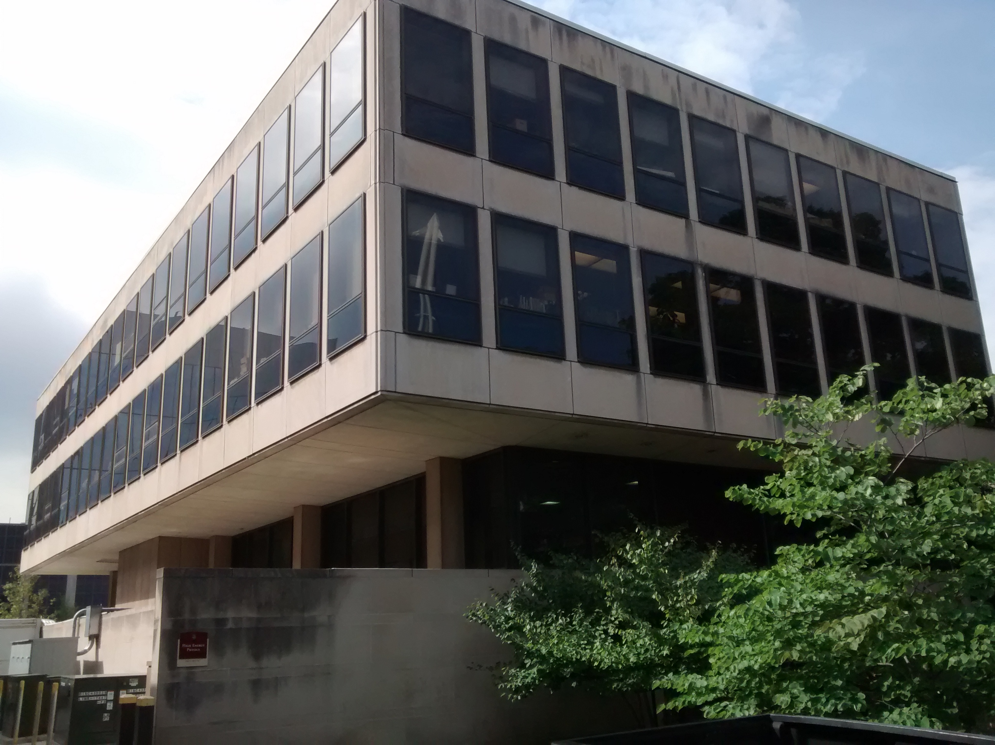
Partita For Jeff
JeffFest, May 14, 2022

Slide 3
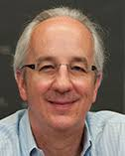
First encounter:
Jadwin Hall, 1982
’82-’85 Corresponded by p-mail!

Slide 4
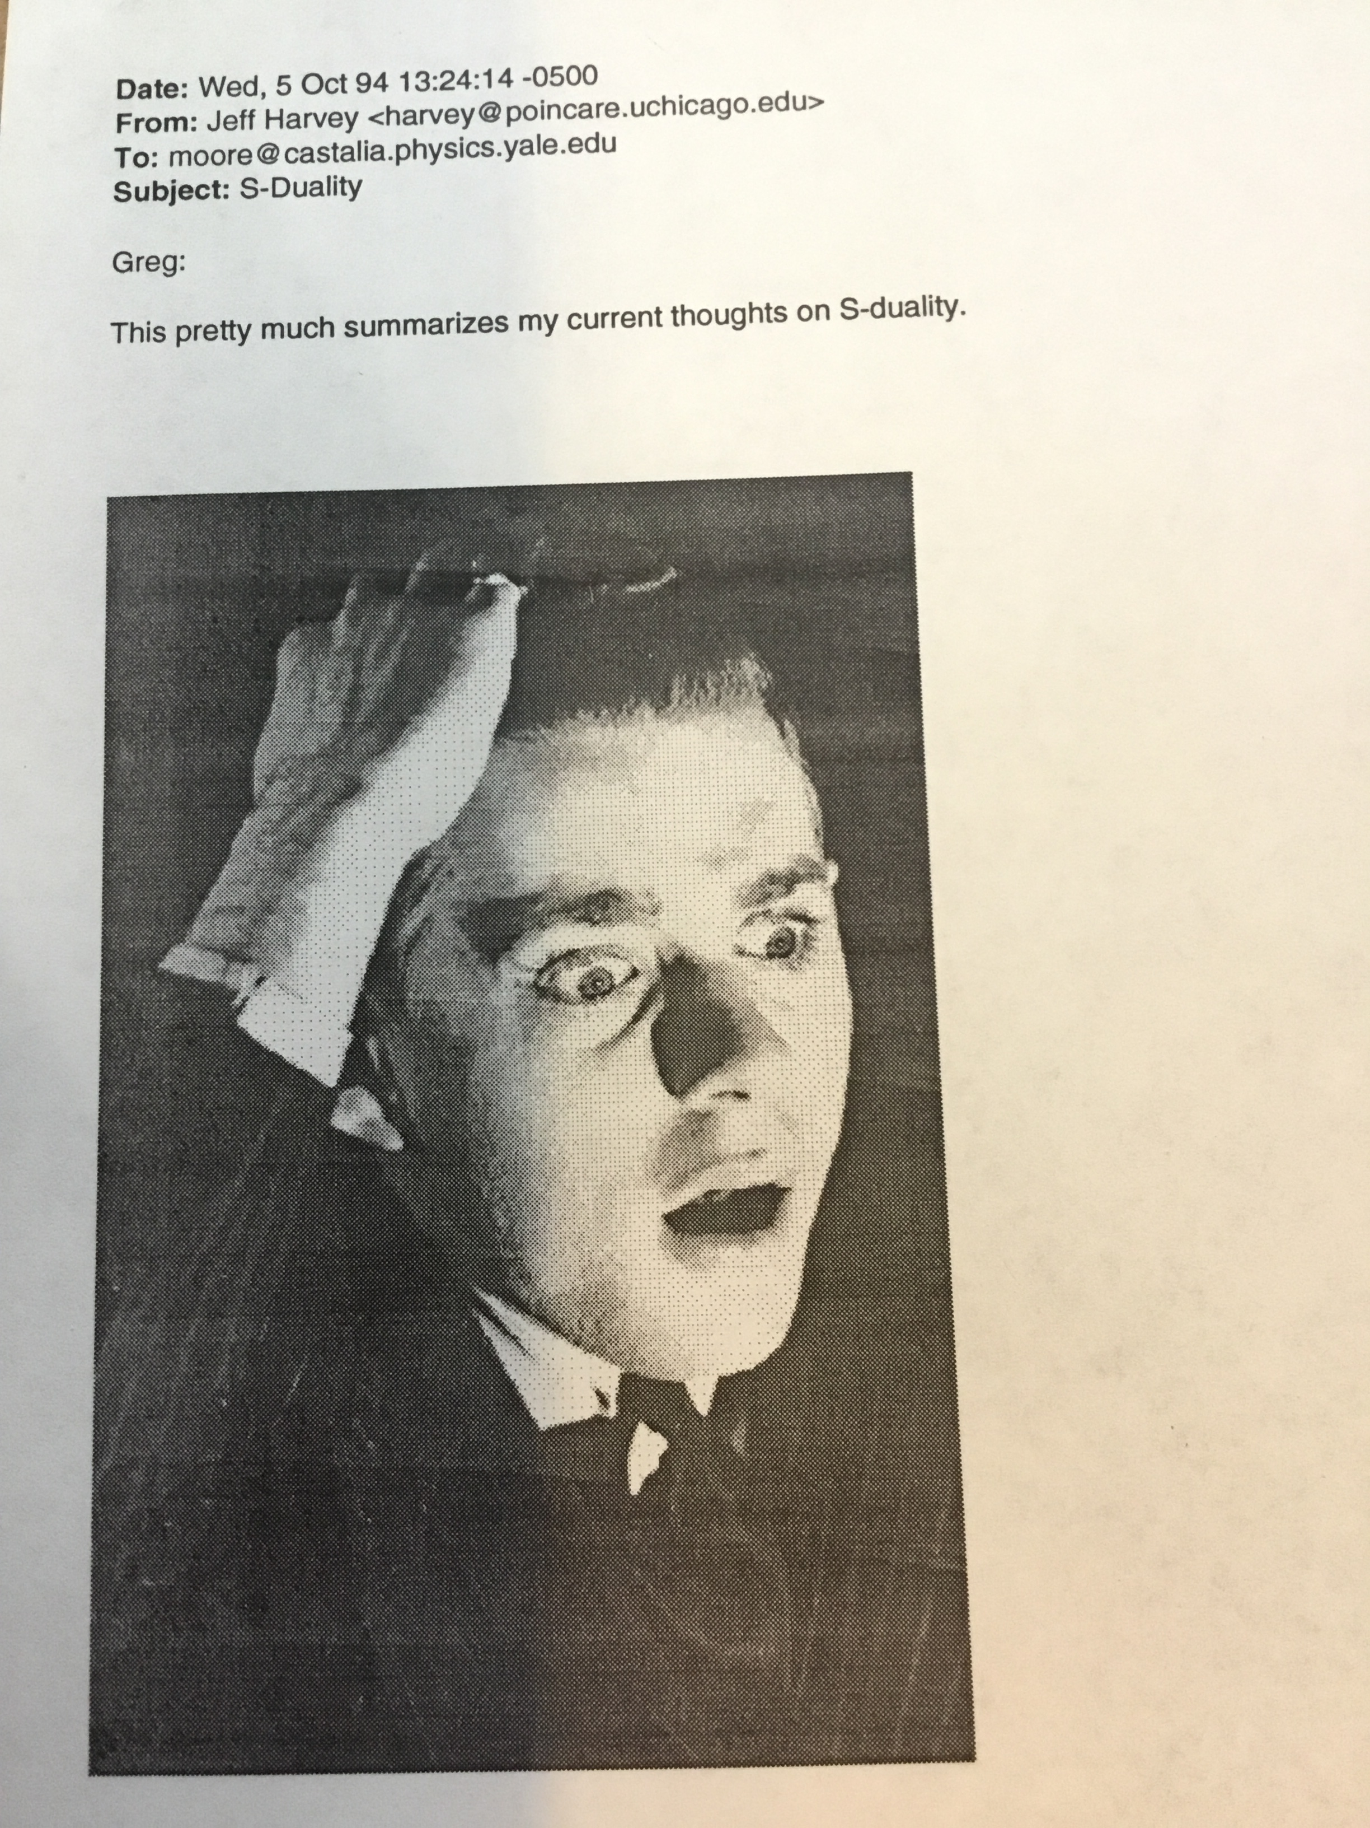
One of the wittiest and funniest physicists in the field

Slide 5
Jeff As Singer-Songwriter
NYT: September 22, 1998

Slide 6
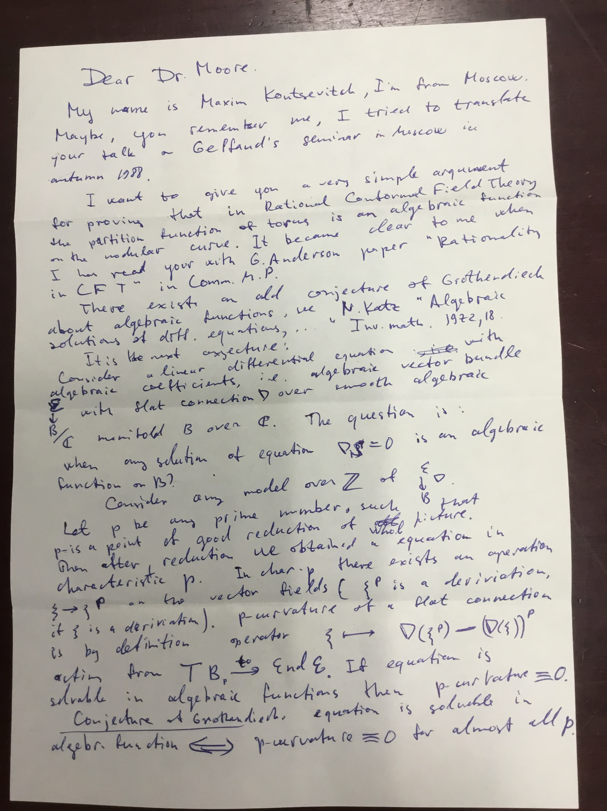
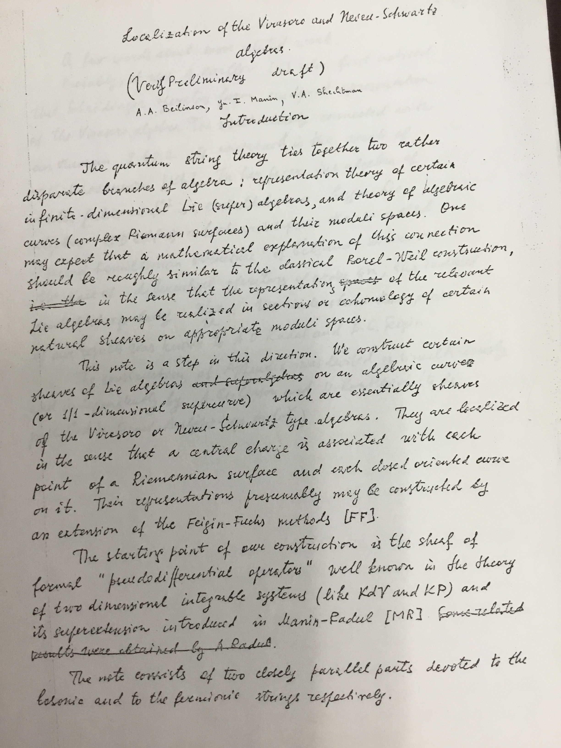
Razor sharp wit:
Aspen 1986
Genus envy!

Slide 7
Another shared interest:
Classical solo piano, in fact we put together the piano at the ACP together

Slide 8
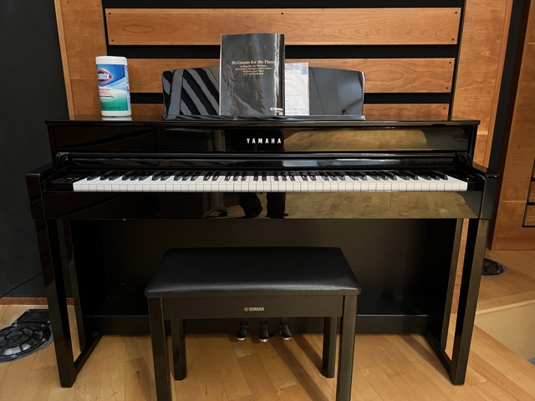

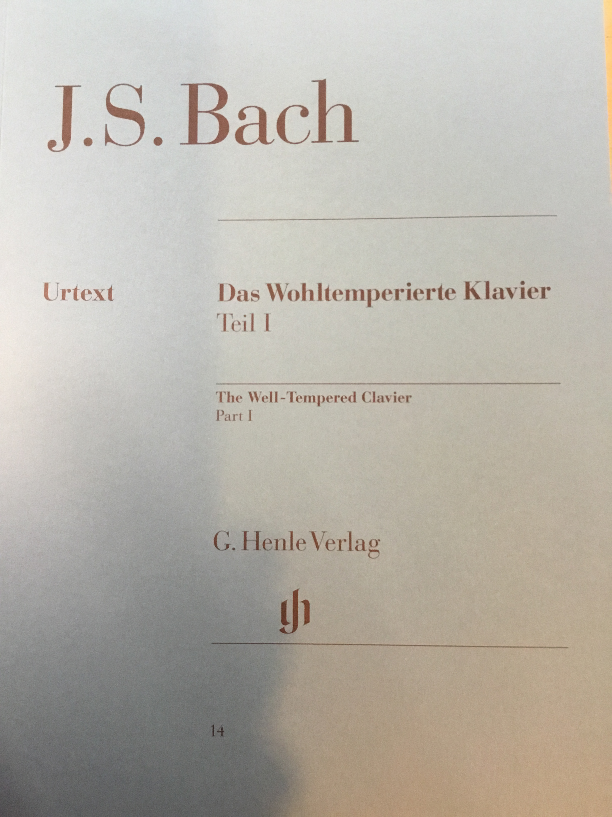
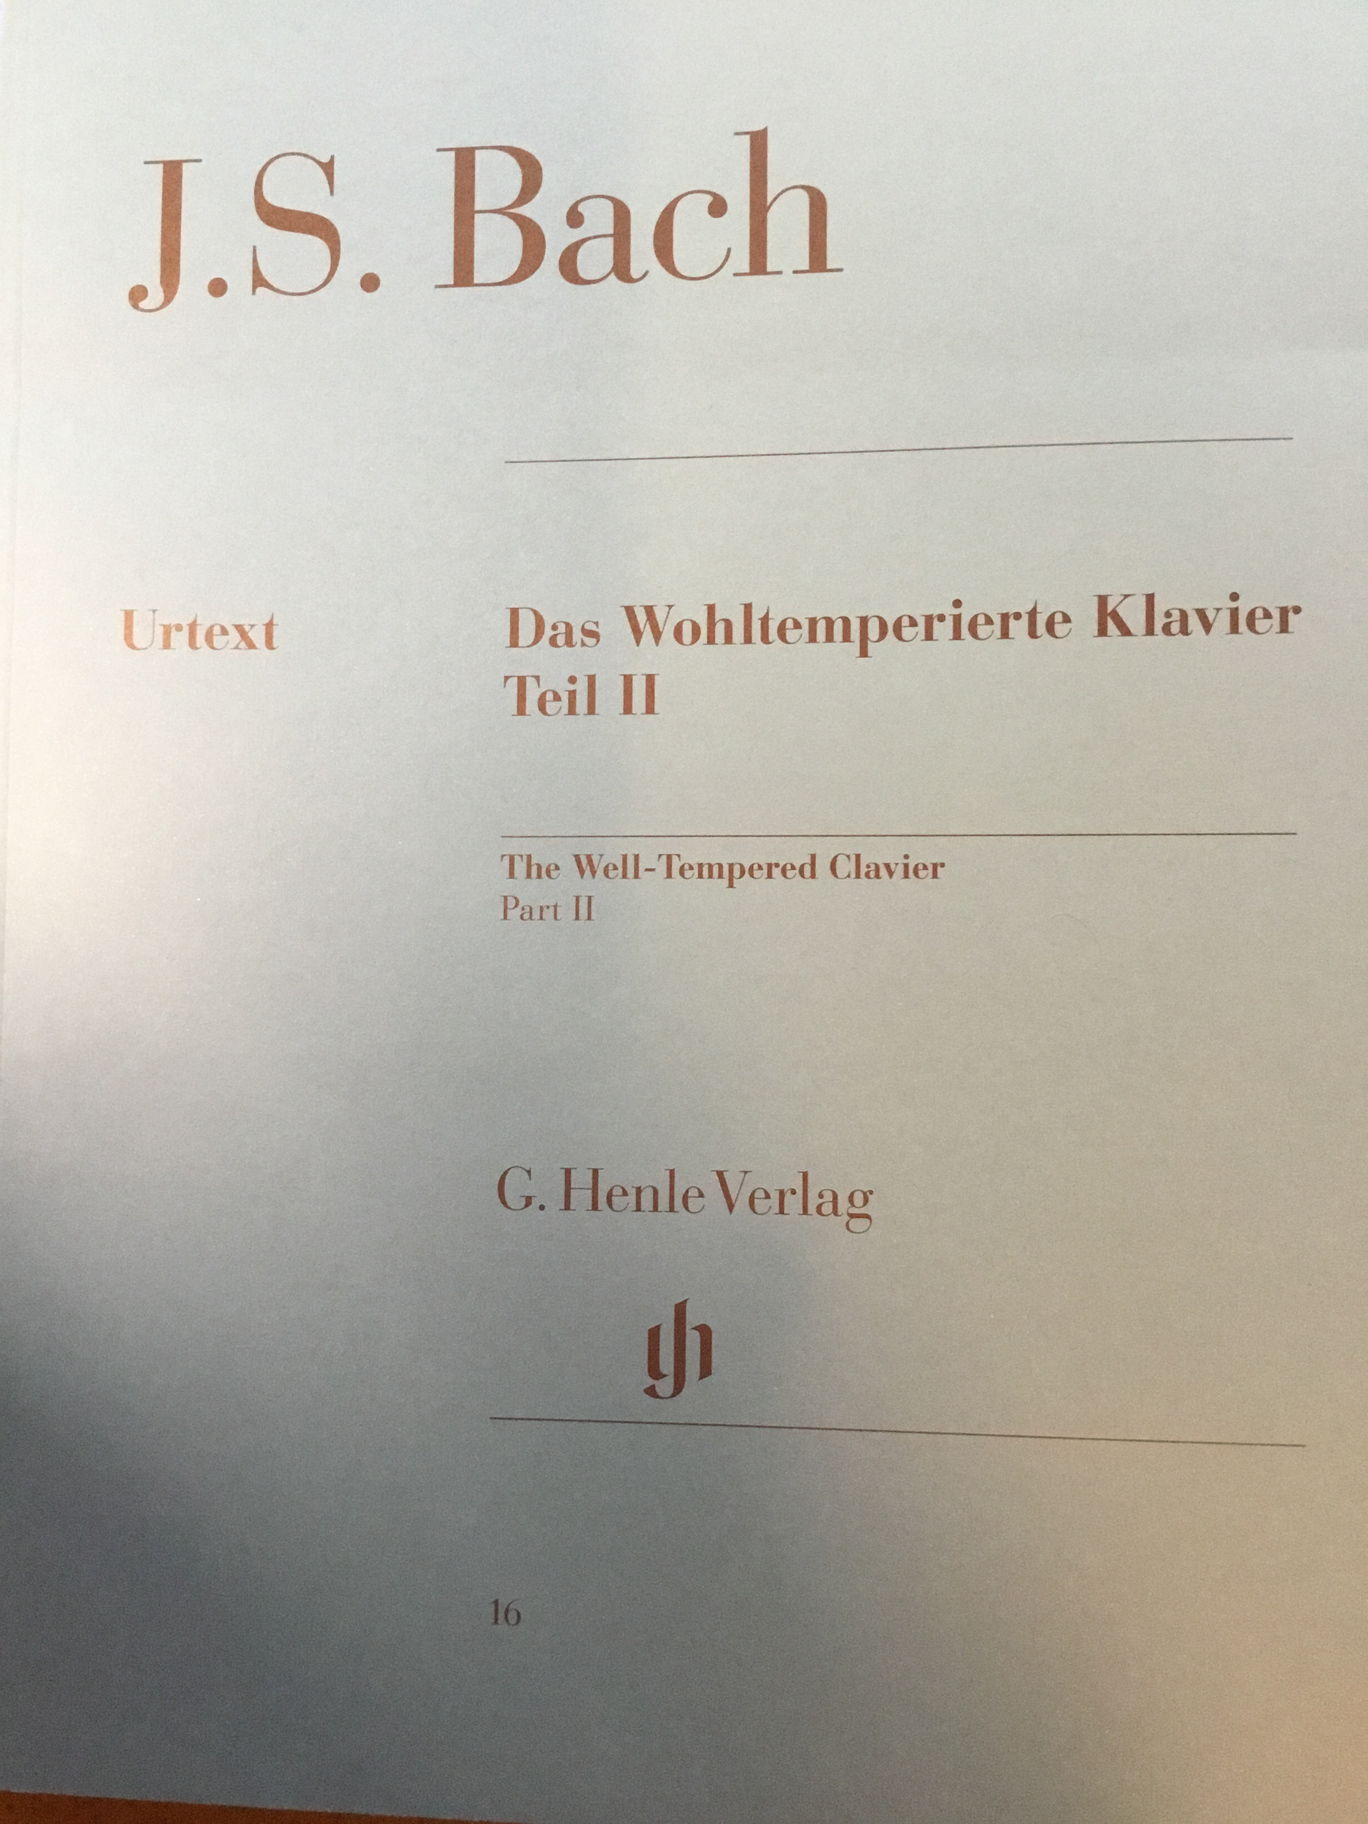

Slide 10
Moonshine Phenomena,
Supersymmetry, and Quantum Codes

Slide 11
Philosophy – 1/2
We can divide physicists into two types:
Our world is a random choice drawn from a huge ensemble:

Slide 12
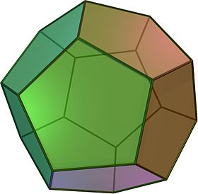
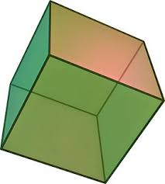
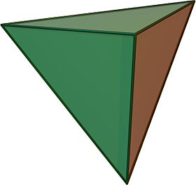
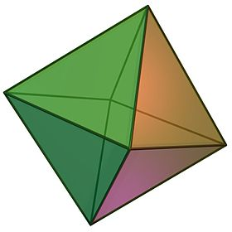
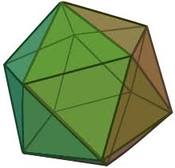
Philosophy – 2/2
The fundamental laws of nature are based on some beautiful exceptional mathematical structure:

Slide 13

I believe Jeff is Type II…
even though he is co-inventor
of the heterotic string….
partly, because of his enduring interest in the relation of
2d CFT to finite group theory.

Slide 14
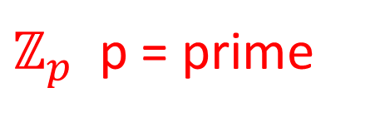


Finite-Simple Groups
Jordan-Holder Theorem: Finite simple
groups are the atoms of finite group theory.
$ℤ_{p}$ p = prime
$$A_{n} n≥5$$
$SL_{n}(𝔽_{p})$ etc.
Notes:
M stands for ”Monster” but it could also stand for “Magic” because there are many truly amazing properties it satisfies.
|M| \sim 10^{54}. |Co1| \sim 4 x 10^{18}. |M24| \sim 2 x 10^8.

Slide 15
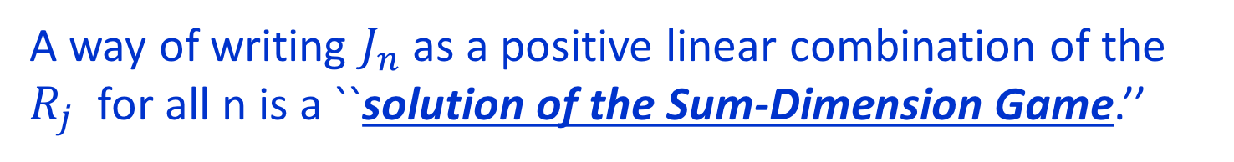
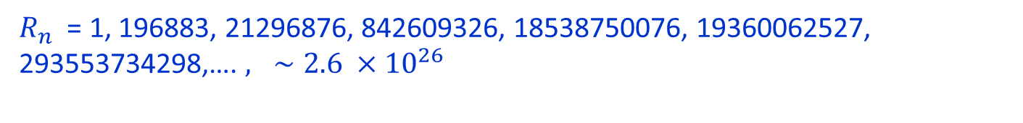





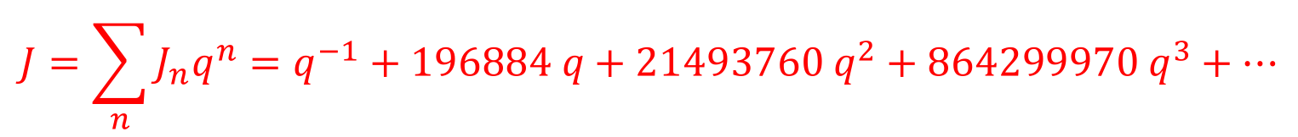
McKay & Conway-Norton 1978-1979
$$J=\sum_{n}{J_{n}q^{n}=q^{−1}+196884 q+21493760 q^{2}+864299970 q^{3}+⋯}$$
Now list the dimensions of irreps of $𝕄$
$R_{n}$ = 1, 196883, 21296876, 842609326, 18538750076, 19360062527, 293553734298,…. $, ∼2.6 ×{10}^{26}$
$$J_{−1 }=R_{1}$$
$$J_{1}=R_{1}+R_{2}$$
$$J_{2}=R_{1}+R_{2}+R_{3}$$
$$J_{3}={2R}_{1}+{2R}_{2}+R_{3}+R_{4}$$
A way of writing $J_{n}$as a positive linear combination of the $R_{j}$ for all n is a ``solution of the Sum-Dimension Game.’’
There are infinitely many such solutions!!

Slide 16
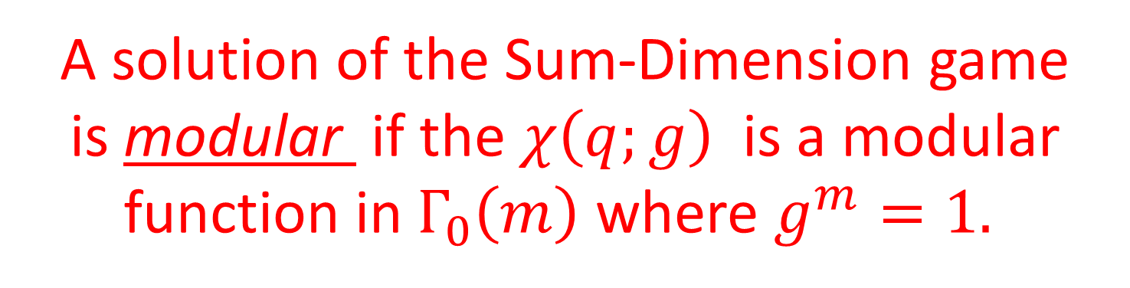


McKay & Conway-Norton 1978-1979
Which, if any, of these solutions is interesting?
Every solution defines an infinite-dimensional
$ℤ$-graded representation of $𝕄$
$$V=q^{−1} R_{1}⊕q\left(R_{1}⊕R_{2}\right)⊕q^{2}\left(R_{1}⊕R_{2}⊕R_{3}\right)⊕⋯$$
Now for every $g∈𝕄$we can compute the character:
$$χ\left(q;g\right)≔Tr_{V} {g q}^{N}$$
A solution of the Sum-Dimension game
is modular if the $χ\left(q;g\right)$is a modular function in $Γ_{0}\left(m\right)$where $g^{m}=1.$

Slide 17
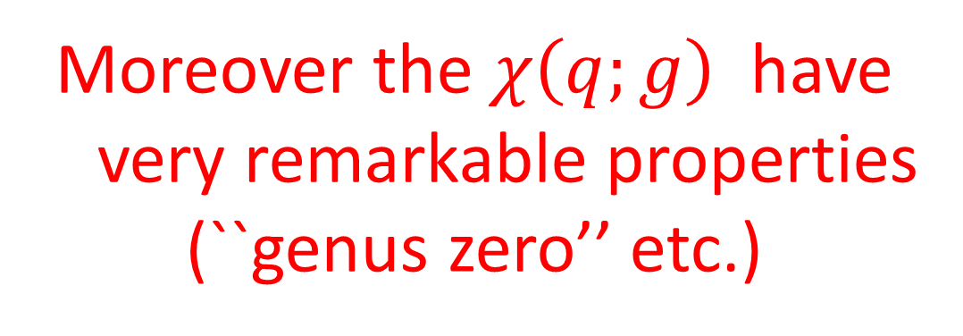
Amazing Fact Of Monstrous Moonshine
There is a unique modular solution
of the Sum-Dimension game!
Moreover the $χ\left(q;g\right)$ have
very remarkable properties
(``genus zero’’ etc.)

Slide 18
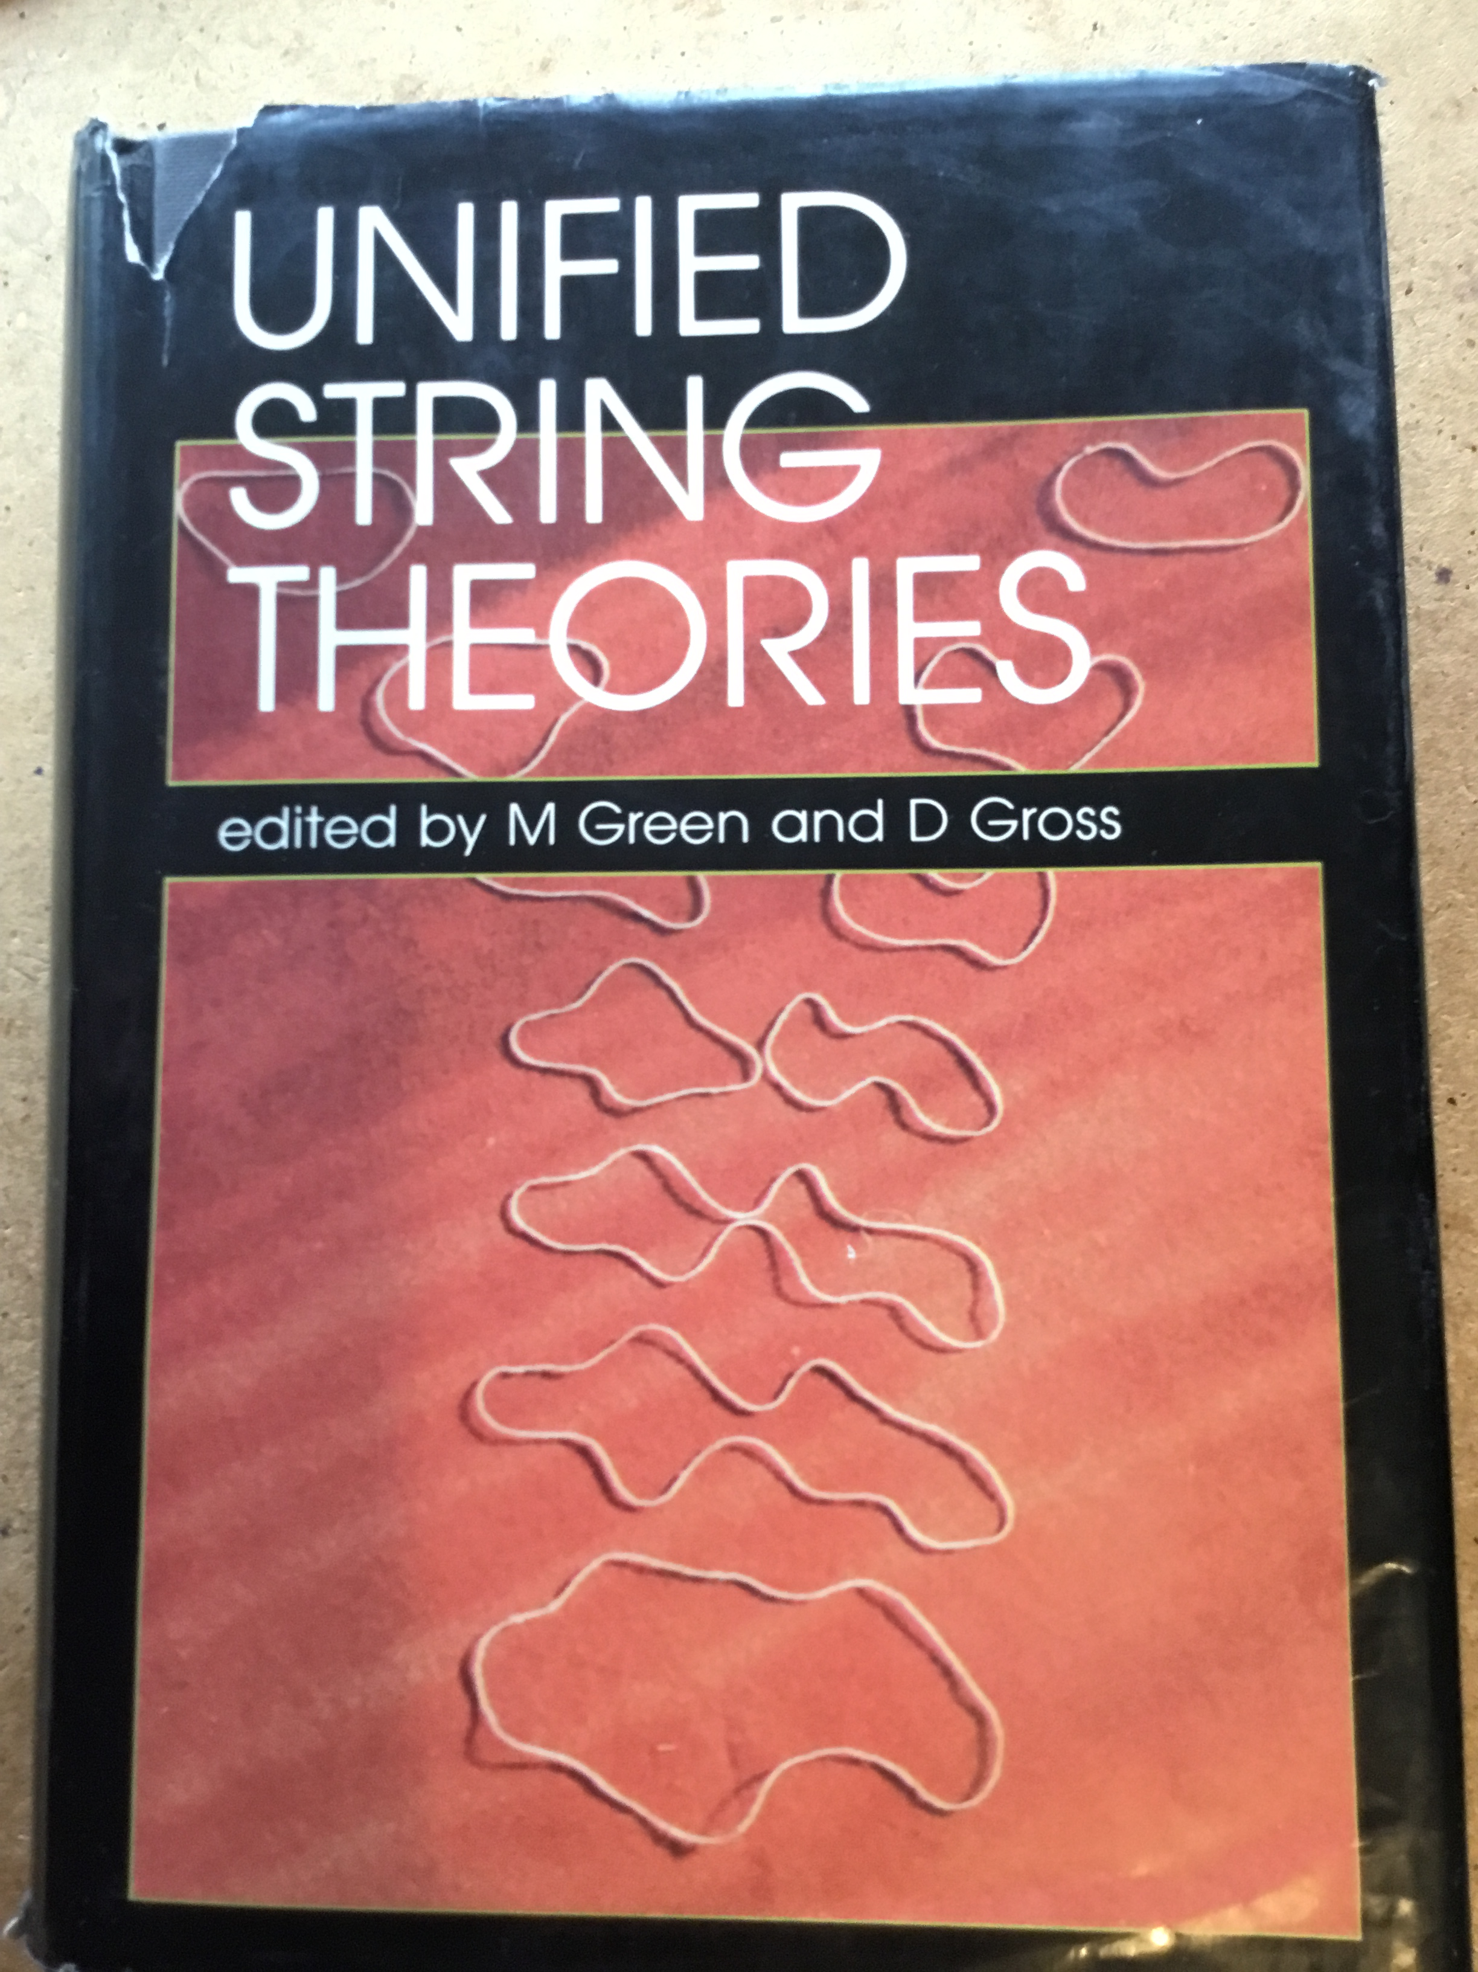
I learned of the explanation by rational CFT from Jeff’s talk at Santa Barbara in 1985,
Explaining the work
of FLM in physical
terms

Slide 20
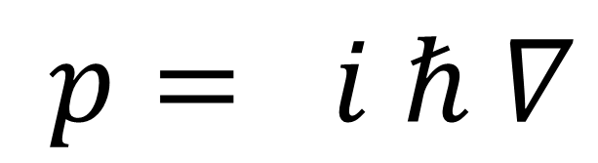
Brilliant paper.
But there are two problems:
-
$$p= i ℏ ∇$$
Really?
What is the actual supercurrent?
Today I will fill in this gap.
It is very recent work with R. Singh, making heavy use of ideas from
my most recent paper with Jeff.

Slide 21
New Moonshine
Eguchi, Ooguri, Tachikawa 2010
There are analogous moonshine phenomena relating the elliptic genus of K3 to M24.
Cheng, Duncan, Harvey (2012,2013)
“Umbral Moonshine”

Slide 22
The New Moonshine Phenomena Remain Unexplained
There is no known analog of the FLM
construction explaining umbral moonshine.
Despite 12 years of intense effort by a small,
but devoted, community of physicists and
mathematicians….
We don’t understand something about symmetries
of 2d conformal field theories.
It might be something important.
Or maybe not.

Slide 23
In one of our (several) attempts to explain these phenomena Jeff and I discovered a curious relation between supercurrents in certain superconformal 2d field theories and quantum error correcting codes.

Slide 24

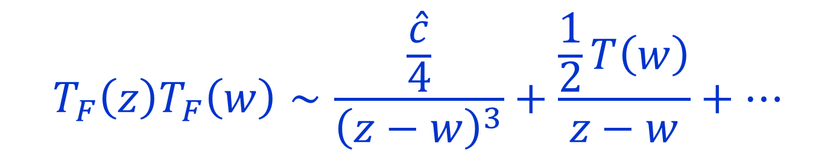
A WZW Model Equivalent To K3
Amazing result of GTVW: The supersymmetric
sigma model on a special K3 surface is isomorphic
to the product of 6 copies of (a spin lift of a)
bosonic k=1 SU(2) WZW model !
So it must be possible to write
$T_{F}(z)$ of dimension (3/2,0)
$$T_{F}\left(z\right)T_{F}\left(w\right)∼\frac{\frac{\hat{c}}{4}}{{\left(z−w\right)}^{3}}+\frac{\frac{1}{2}T\left(w\right)}{z−w}+⋯$$

Slide 25

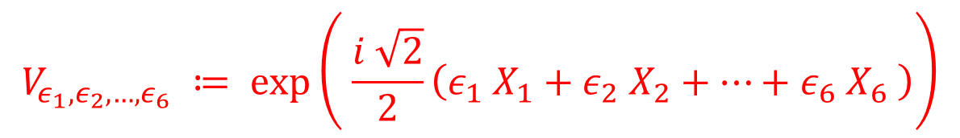
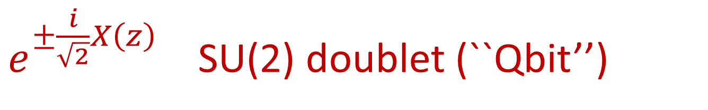

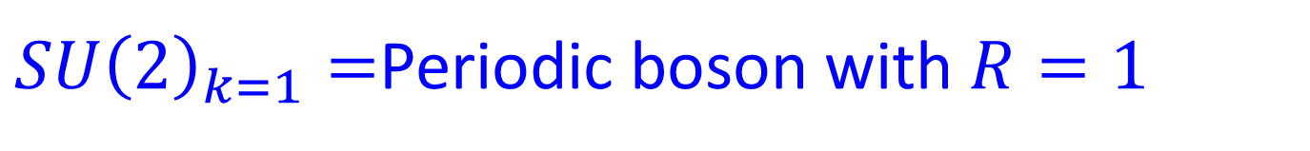

Chiral Fields Of Dimension 3/2
$SU{\left(2\right)}_{k=1}=$Periodic boson with $R=1$
$e^{±\frac{i}{\sqrt{2}}X\left(z\right)}$ SU(2) doublet (``Qbit’’)
Conformal dimension $=1/4$
So in WZW for $SU{\left(2\right)}^{6}$
$$V_{ε_{1}, ε_{2}, …, ε_{6}} ≔ \exp\left( \frac{i \sqrt{2}}{2}\left(ε_{1} X_{1}+ε_{2} X_{2}+⋯+ε_{6} X_{6} \right)\right)$$
$$ε_{i}∈\{ ±1 \}$$
${⇒ 2}^{6}$ vertex operators of conformal dimension = $\left(\frac{1}{4}\right)×6=\frac{3}{2}$

Slide 26

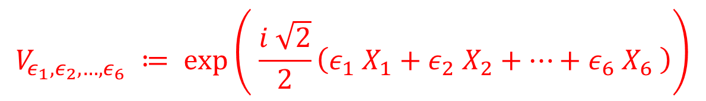

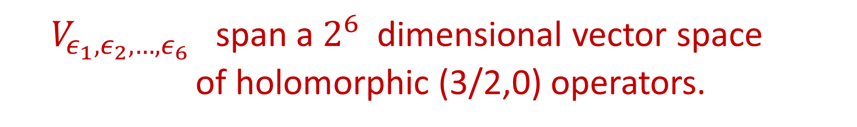
Chiral Fields Of Dimension 3/2
$$V_{ε_{1}, ε_{2}, …, ε_{6}} ≔ \exp\left( \frac{i \sqrt{2}}{2}\left(ε_{1} X_{1}+ε_{2} X_{2}+⋯+ε_{6} X_{6} \right)\right)$$
$$ε_{i}∈\{ ±1 \}$$
$V_{ε_{1},ε_{2},…, ε_{6}}$ span a $2^{6}$ dimensional vector space
of holomorphic (3/2,0) operators.
Identify this space with the space of states in a
system of 6 Qbits.
For any $s∈{\left(ℂ^{2}\right)}^{⊗6}$ write $V_{s}$

Slide 27
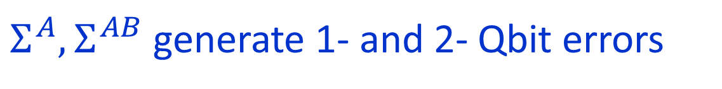
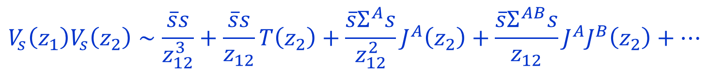
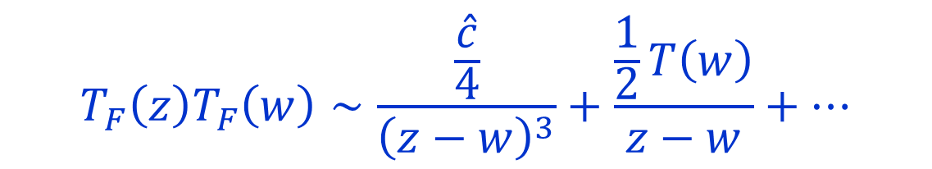

Which Ones Are Supercurrents?
The $V_{s}$ have OPE’s:
$$V_{s}\left(z_{1}\right)V_{s}\left(z_{2}\right)∼\frac{\overline{s}s}{z_{12}^{3}}+\frac{\overline{s}s}{z_{12}}T\left(z_{2}\right)+\frac{\overline{s}Σ^{A}s}{z_{12}^{2}}J^{A}\left(z_{2}\right)+\frac{\overline{s}Σ^{AB}s}{z_{12}}J^{A}J^{B}\left(z_{2}\right)+⋯$$
$J^{A}$ : generators of $SU{\left(2\right)}^{6}$ affine Lie algebra, $A=1, …, 3⋅6=18$
$Σ^{A}, Σ^{AB}$ generate 1- and 2- Qbit errors
$$T_{F}\left(z\right)T_{F}\left(w\right)∼\frac{\frac{\hat{c}}{4}}{{\left(z−w\right)}^{3}}+\frac{\frac{1}{2}T\left(w\right)}{z−w}+⋯$$

Slide 28

N=1 Generator
Up to global symmetry there is a unique N=1 generator.
Using results of GTVW it is $V_{Ψ}$for
$$Ψ= \left[∅\right]+i \left[123456\right]+(\left[1234\right]+\left[3456\right]+1256])+i(\left[12\right]+\left[34\right]+[56])$$
$$+ (\left[135\right]+\left[245\right]+\left[236\right]+[146])−i(\left[246\right]+235]+[136]+[145])$$
$$\left[135\right]≔| − , + , − , + , − , + 〉$$
Obtained by tedious translation from the susy for the K3 sigma model….
Is there a code governing this quantum state?
Yes!! It is the ``hexacode’’

Slide 29


The Field $𝔽_{4}$
Finite field of $4=2^{2}$ elements: $𝔽_{4}=\left\{ 0, 1, ω, \overline{ω} \right\}$
Addition: $1+ω=\overline{ω}$ $1+\overline{ω}=ω$ $ω+\overline{ω}=1$
Multiplication: $ω⋅ω=\overline{ω} ω⋅\overline{ω}=1$

Slide 30



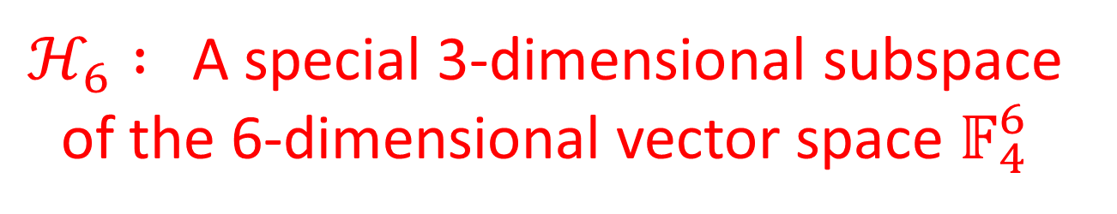
Codes Over $𝔽_{4}$
Hexacode: $ℋ_{6}⊂ 𝔽_{4}^{6}$
$ℋ_{6} :$A special 3-dimensional subspace of the 6-dimensional vector space $𝔽_{4}^{6}$

Slide 31







$𝔽_{4}$ & The Quaternion Group
$$Q≅ \left\{ ±1, ±i σ^{1} , ±i σ^{2} , ±i σ^{3} \right\}⊂SU(2)$$
Group of special unitary bit-flip and phase-flip errors
Associate Pauli operators $h\left(x\right)$ to $x∈𝔽_{4}$
$$h\left(x\right)h\left(y\right)=c_{x,y} h(x+y)$$
$$h\left(0\right)=\left(\begin{matrix}1 & 0 \\ 0 & 1 \end{matrix}\right)$$
$$h\left(1\right)=\left(\begin{matrix}0 & 1 \\ −1 & 0 \end{matrix}\right)$$
$$h\left(ω\right)=\left(\begin{matrix}0 & i \\ i & 0 \end{matrix}\right)$$
$$h\left(\overline{ω}\right)=\left(\begin{matrix}−i & 0 \\ 0 & i \end{matrix}\right)$$
$c_{x,y} :$ A sign that cannot be removed by redefinitions.

Slide 32



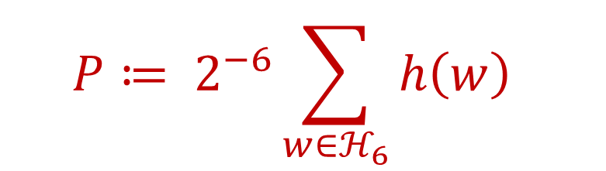
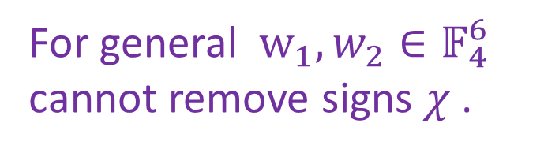


N=1 Generator And The Hexacode
For $w=\left(x_{1},x_{2},…, x_{6}\right)∈𝔽_{4}^{6}$ define
$$h\left(w\right)≔h\left(x_{1}\right)⊗h\left(x_{2}\right)⊗⋯⊗h\left(x_{6}\right)$$
For general $w_{1},w_{2}∈𝔽_{4}^{6}$
cannot remove signs $χ$ .
$$h\left(w_{1})h(w_{2}\right)=χ\left(w_{1},w_{2}\right)h\left(w_{1}+w_{2}\right)$$
But! On the hexacode:
$$h\left(w_{1})h(w_{2}\right)=h\left(w_{1}+w_{2}\right)$$
$w_{1},w_{2}∈ℋ_{6}⊂ 𝔽_{4}^{6}$
$$P≔ 2^{−6}\sum_{w∈ℋ_{6}}{h\left(w\right) }$$
$$Ψ∈Im P$$

Slide 33
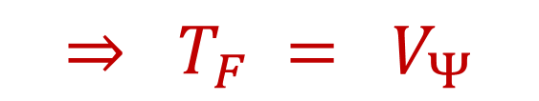
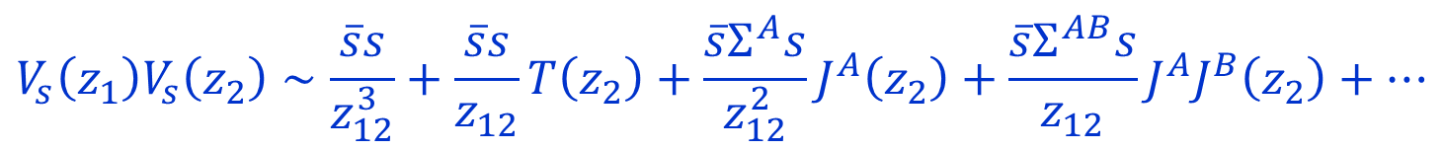

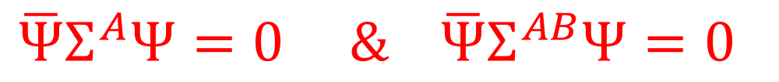
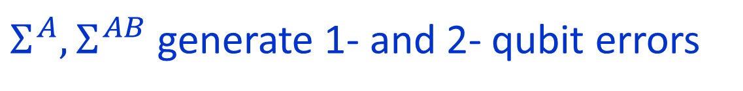
Consequences: 1/2
$V_{Ψ}$ generates an N=1 superconformal symmetry:
$$V_{s}\left(z_{1}\right)V_{s}\left(z_{2}\right)∼\frac{\overline{s}s}{z_{12}^{3}}+\frac{\overline{s}s}{z_{12}}T\left(z_{2}\right)+\frac{\overline{s}Σ^{A}s}{z_{12}^{2}}J^{A}\left(z_{2}\right)+\frac{\overline{s}Σ^{AB}s}{z_{12}}J^{A}J^{B}\left(z_{2}\right)+⋯$$
$Σ^{A}, Σ^{AB}$ generate 1- and 2- qubit errors
$$\overline{Ψ}Σ^{A}Ψ=0 \& \overline{Ψ}Σ^{AB}Ψ=0$$
Because $Ψ$ is in a QEC.
$$⇒ T_{F} = V_{Ψ}$$

Slide 34

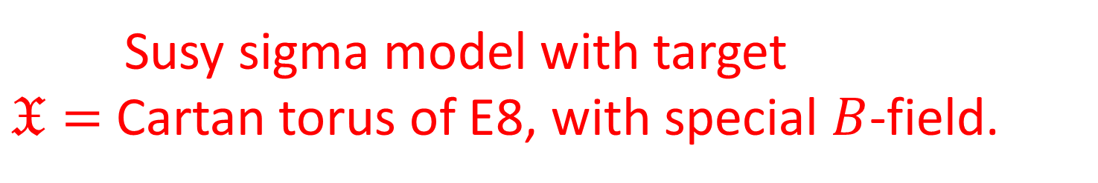
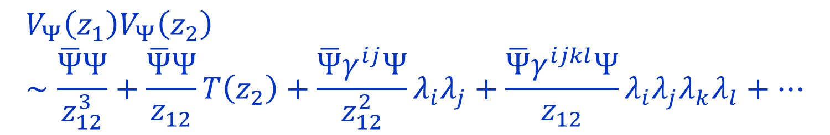
Conway Group Moonshine
[Frenkel, Lepowsky, Meurman; Duncan; Duncan-Mack-Crane]
Susy sigma model with target
$𝔛=$ Cartan torus of E8, with special $B$-field.
$$V_{Ψ}\left(z_{1}\right)V_{Ψ}\left(z_{2}\right)∼\frac{\overline{Ψ}Ψ}{z_{12}^{3}}+\frac{\overline{Ψ}Ψ}{z_{12}}T\left(z_{2}\right)+\frac{\overline{Ψ}γ^{ij}Ψ}{z_{12}^{2}}λ_{i}λ_{j}+\frac{\overline{Ψ}γ^{ijkl}Ψ}{z_{12}}λ_{i}λ_{j}λ_{k}λ_{l}+⋯$$
Vanishing of last two terms follows from error-correcting properties of Golay code
$$T_{F}=V_{Ψ}$$

Slide 35
Now we will use these ideas from my work with Jeff
to fill in the old gap in the
Beauty & Beast paper

Slide 36

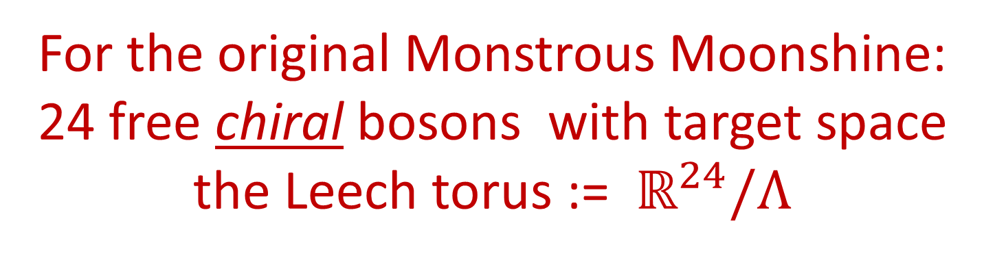
RCFT Approach To FLM
For the original Monstrous Moonshine:
24 free chiral bosons with target space
the Leech torus := $ℝ^{24}/Λ$
$Λ⊂ℝ^{24}$ is the Leech lattice,
D25-brane
Moreover, target space torus has a very special ``B-field’’
$$S=∫d^{2}σ ( G_{μν} ∂_{i}x^{μ} ∂^{i}x^{ν}+B_{μν}ε^{ij}∂_{i}x^{μ}∂_{j}x^{ν})$$
Notes:
Later I will show you how you can construct the Golay code for yourself
At your own kitchen table – were you so inclined

Slide 37


$ℤ_{2}−$Orbifold
Now gauge the global symmetry:
$\vec{x}→−\vec{x}$for $\vec{x}∈ℝ^{24}/Λ$

Slide 38
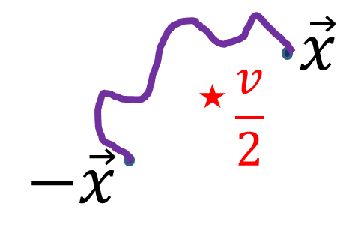

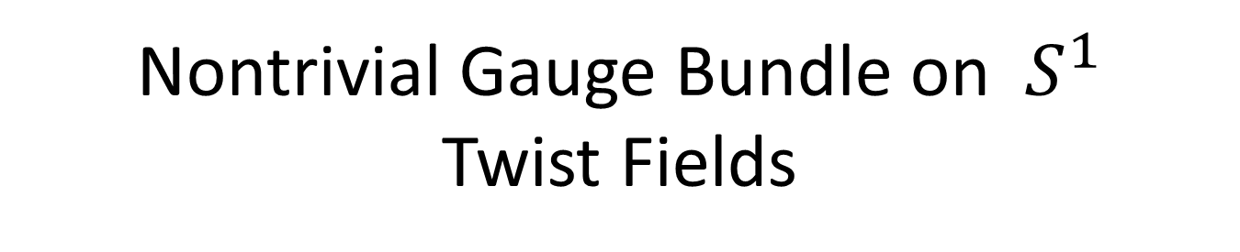

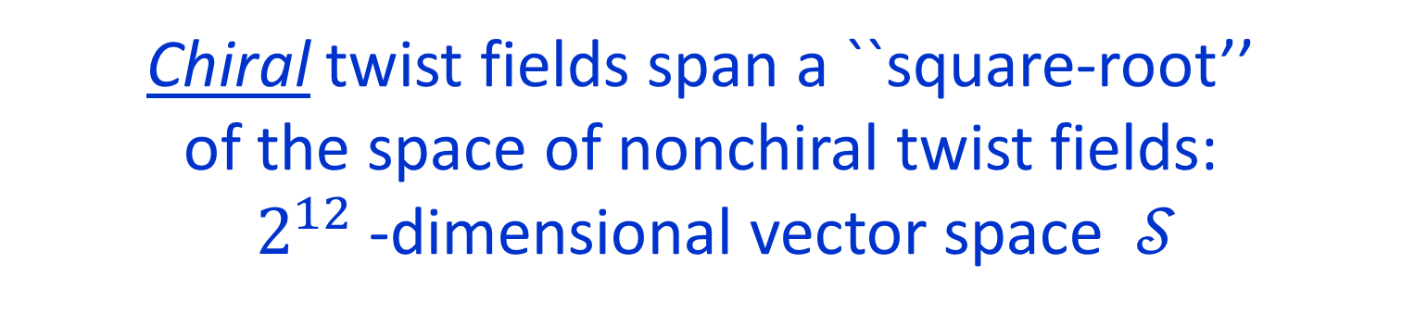
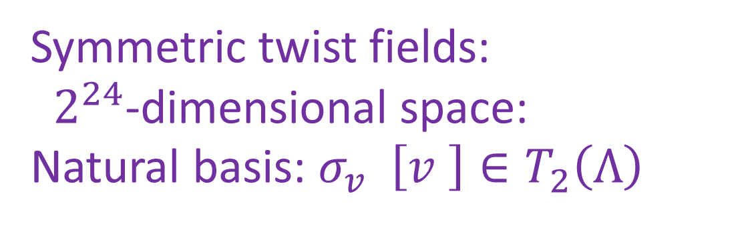
Nontrivial Gauge Bundle on $S^{1}$
Twist Fields
Symmetric twist fields:
$2^{24}$-dimensional space:
Natural basis: $σ_{v}$ $\left[v \right]∈T_{2}\left(Λ\right)$
Identify order two points in the torus $ℝ^{24}/Λ$
$$T_{2}\left(Λ\right)≔Λ/2Λ$$
Chiral twist fields span a ``square-root’’
of the space of nonchiral twist fields:
$2^{12}$-dimensional vector space $𝒮$

Slide 39
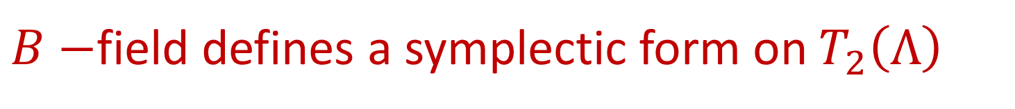
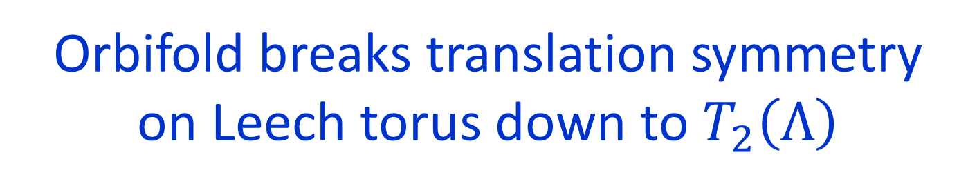
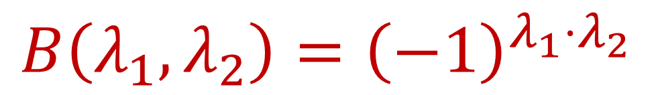
Noncommutative Translations- 1/2
Orbifold breaks translation symmetry
on Leech torus down to $T_{2}\left(Λ\right)$
$B−$field defines a symplectic form on $T_{2}\left(Λ\right)$
$$B\left(λ_{1}, λ_{2}\right)={\left(−1\right)}^{λ_{1}⋅λ_{2}}$$

Slide 40

Noncommutative Translations - 2/2
Translation symmetry on zero-modes converted
to a magnetic translation group:
$$T\left(\left[λ_{1}\right]\right)T\left(\left[λ_{2}\right]\right)=ε\left(λ_{1},λ_{2}\right)T\left(\left[λ_{1}+λ_{2}\right]\right)$$
$$\frac{ε\left(λ_{1},λ_{2}\right)}{ε\left(λ_{2},λ_{1}\right)}= {\left(−1\right)}^{λ_{1}⋅λ_{2}}$$
Early example of noncommutative geometry on D-branes with a B-field

Slide 41
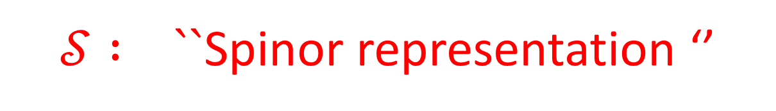
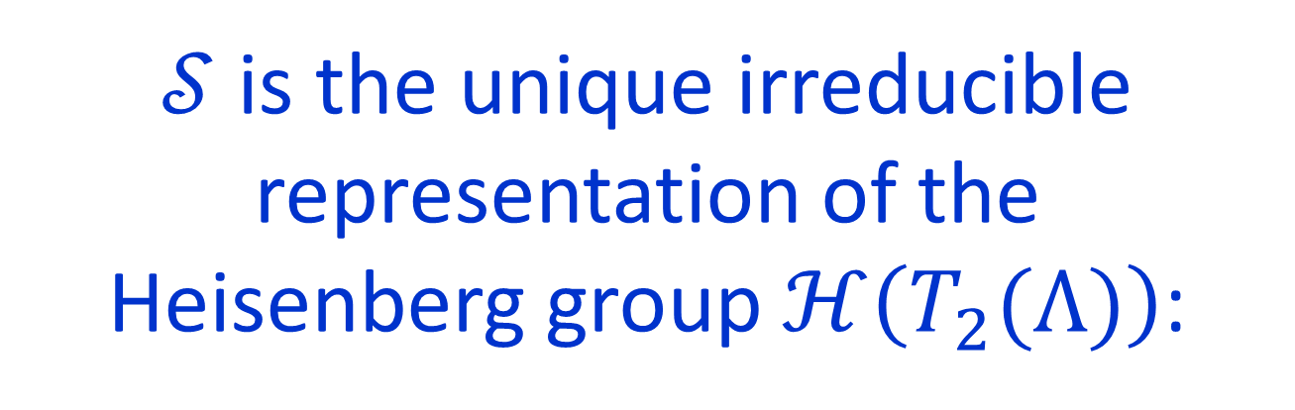

$T\left(\left[λ\right]\right)$ generate a discrete Heisenberg group
$$0→ ℤ_{2} → ℋ\left(T_{2}\left(Λ\right)\right)→ T_{2}\left(Λ\right)→0$$
$𝒮$ is the unique irreducible representation of the
Heisenberg group $ℋ\left(T_{2}(Λ)\right)$:
Construct it using $γ−$matrices.
$𝒮 : ``$Spinor representation ‘’

Slide 42
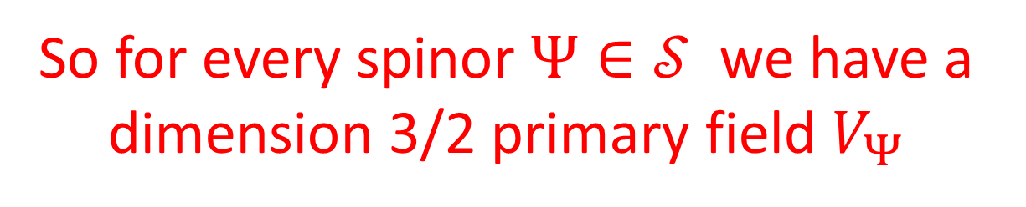
So for every spinor $Ψ∈𝒮$we have a dimension 3/2 primary field $V_{Ψ}$
Jeff and I speculated that once again a supercurrent would be determined from a special spinor determined by a code.
But now we need to know about
the OPE of bosonic twist fields …..
Much more challenging …..

Slide 44



With a student,
Ranveer Singh,
we have indeed realized the supercurrent in this way
$$V_{Ψ}\left(z_{1}\right)V_{Ψ}\left(z_{2}\right)∼$$
$$∼\frac{\overline{Ψ}Ψ}{z_{12}^{3}}+\frac{1}{8}\frac{\overline{Ψ}Ψ}{z_{12}}T\left(z_{2}\right)+\frac{1}{z_{12}}\sum_{λ:λ^{2}=4}{κ\left(λ\right)e^{i λ⋅X\left(z\right)}}⋯$$

Slide 45




$$∼\frac{\overline{Ψ}Ψ}{z_{12}^{3}}+\frac{1}{8}\frac{\overline{Ψ}Ψ}{z_{12}}T\left(z_{2}\right)+\frac{1}{z_{12}}\sum_{λ:λ^{2}=4}{κ\left(λ\right)e^{i λ⋅X\left(z\right)}}⋯$$
$$κ\left(λ\right)∼〈Ψ, T\left(\left[λ\right]\right)Ψ〉$$
$$T\left(\left[λ\right]\right)∈ℋ\left(T_{2}\left(Λ\right)\right)$$
Construct an Abelian subgroup $\hat{ℒ}⊂ℋ\left(T_{2}\left(Λ\right)\right)$
$$P=2^{−12}\sum_{\left[λ\right]∈\hat{ℒ}}{T\left(\left[λ\right]\right)}$$
is a rank one projection operator.

Slide 46





Constructing a suitable $\hat{ℒ}⊂ℋ\left(T_{2}\left(Λ\right)\right)$ requires a lattice $Λ_{sc}⊂Λ$such that
$$λ_{1},λ_{2}∈Λ_{sc} ⇒ λ_{1}⋅λ_{2}=0 mod 2$$
$$2Λ ⊂Λ_{sc}⊂Λ$$
$$2^{12}$$
$$2^{12}$$
$λ∈Λ_{sc}⇒ λ^{2}=0 mod 4$
Nonzero ${λ∈Λ}_{sc}⇒$ $λ^{2}>4$

Slide 47






Choose an isomorphism $T_{2}\left(Λ\right)≅𝔽_{2}^{24}$
$$ℒ→ 𝒞 ⊂ 𝔽_{2}^{24}$$
Supercurrent = $V_{Ψ}$ for $Ψ∈Im\left(P\right)$
$$λ^{2}=4 ⇒ 〈Ψ, T\left(\left[λ\right]\right)Ψ〉=0$$
because of the error correcting properties of $𝒞$
$V_{Ψ}$is a superconformal current
in the B&B formulation of the Monster

Slide 48



Example of a sublattice $Λ_{sc}$
Dong, Li, Mason, Norton:
There is an isometric embedding of $L\left(\sqrt{2}\right)$into the Leech lattice for every Niemeier lattice L
$$Λ_{sc}≅ Λ\left(\sqrt{2}\right)$$
Are there others? Does the (spin cover of the) B&B model have several supersymmetries ?

Slide 50
Time Reversal In Abelian Chern-Simons Theory

Slide 51

Several of my recent works with Jeff have involved discriminant forms of lattices in various ways.
Here is another application of finite Abelian groups equipped with quadratic function…
$$q:𝒟 →ℝ/ℤ$$
$$q\left(x+y\right)−q\left(x\right)−q\left(y\right)+q\left(0\right)=b\left(x,y\right)$$

Slide 52



When does 3d Chern-Simons-Witten theory have a time reversal symmetry?
$$\int_{𝒜/𝒢}{\left[dA\right] exp⁡(\frac{ik}{4π} \int{Tr\left(A dA+\frac{2}{3}A^{3}\right)) }}$$
General theory based on compact group $G$ and a ``level’’ $k∈H^{4}\left(BG;ℤ\right)$
Which $\left(G,k\right)$ give
T-reversal invariant theories?

Slide 53
Some nontrivial examples of
T-invariant CSW theories
appeared in
(Cordova, Shin, Seiberg; … )
But there is no systematic understanding.

Slide 54




With my student Roman Geiko we have recently carried out a systematic study for
Spin Chern-Simons Theory with
torus gauge group $G≅U{\left(1\right)}^{r}$
$$S=\frac{1}{4π}∫K_{IJ} A_{I} d A_{J}$$
$K_{IJ} : r×r$nondegenerate, integral symmetric matrix: determines integral lattice $L$

Slide 55



Classical T-reversal:
$∃ U∈GL\left(r, ℤ\right)$ such that
$$UKU^{tr}=−K$$
(Note: $σ\left(L\right)=0 )$
But there can be quantum T-reversal symmetries not visible classically.
Rank 2 studied by Delmastro & Gomis

Slide 56





The quantum theory does not depend on all the details of $L$
What does it depend on?
Finite Abelian group $𝒟\left(L\right)≔L^{∨}/L$
a.k.a ``group of anyons’’ a.k.a. ``group of 1-form symmetries’’
Quadratic Function (spin of anyons) :
$q_{W}\left(x\right)=\frac{1}{2}\left(\tilde{x},\tilde{x}−W\right)+\frac{1}{8}\left(W,W\right) mod ℤ$
$$\frac{1}{\sqrt{\left|𝒟\left(L\right)\right|}}\sum_{x∈𝒟(L)}{e^{2πi q_{W}\left(x\right)} }$$
$$=e^{2πi\frac{σ(L)}{8}}$$

Slide 57



Theorem
[ Belov & Moore; Freed,Lurie,Hopkins, Teleman]
The quantum theory only depends on the equivalence class of the triple $\left(𝒟, q, \overline{σ}\right)$
$$q:𝒟→ℝ/ℤ$$
$$\overline{σ}∈ℤ/24ℤ$$
$$\frac{1}{\sqrt{\left|𝒟\right|}}\sum_{x∈𝒟}{e^{2πi q\left(x\right)} }$$
$$=e^{2πi\frac{\overline{σ} }{8}}$$
Conversely, every such triple arises from some torus CSW theory

Slide 58




Equivalence of triples
$\left(𝒟,q,\overline{σ}\right)≅\left(𝒟^{′},q^{′},\overline{σ} \right)$
$∃$isomorphism
$$f:𝒟→𝒟^{′}$$
$$∃ Δ^{′}∈𝒟^{′}$$
$$q\left(x\right)=q^{′}\left(f\left(x\right)+Δ^{′}\right)$$

Slide 59




T-Reversal Criterion
$$[(𝒟,q,\overline{σ})]=[\left(𝒟,−q, −\overline{σ}\right)]$$
$q:$Determines the spin of anyons
$b:$Determines the braiding of anyons
$$T$$

Slide 60



Simpler Problem: The Witt Group (1936)
$$b\left(x,y\right)=q\left(x+y\right)−q\left(x\right)−q\left(y\right)+q\left(0\right)$$
Throw away $q,\overline{σ}$ and just keep $b.$
Classify $\left[\left(𝒟, b\right)\right]$
$$\left[\left(𝒟_{1},b_{1}\right)\right]+\left[\left(𝒟_{2},b_{2}\right)\right]≔\left[\left(𝒟_{1}⊕𝒟_{2}, b_{1}⊕b_{2}\right)\right]$$
Abelian monoid $𝒟ℬ$

Slide 61




Submonoid $𝒮𝓅ℓ$ Split forms:
$$𝒟=𝒟_{1}⊕𝒟_{2}$$
$b{\left.​\right|}_{𝒟_{1}}=0$ & $𝒟_{1}=𝒟_{1}^{⊥}$
$$𝒲𝒾𝓉𝓉 ≔ 𝒟ℬ/𝒮𝓅ℓ$$
Abelian group whose structure is known. Roughly speaking:
$$𝒲𝒾𝓉𝓉 ≅{\left(ℤ_{2}\right)}^{∞}⊕{\left(ℤ_{4}\right)}^{∞}$$

Slide 62


$$𝒮𝓅ℓ⊂ 𝒟ℬ^{T}≔ \{ \left[𝒟,b\right]=\left[𝒟,−b\right] \} ⊂𝒟ℬ$$
We (i.e. Roman) computed generators for the (infinite) Abelian subgroup
$$𝒟ℬ^{T}/𝒮𝓅ℓ$$
and then refined it to
$T−$invariant triples

Slide 63

Theorem: A T-invariant triple $\left[\left(𝒟,q,\overline{σ}\right)\right]$must be a direct sum of

Slide 64

Example: $L≅A_{4}$ and $L≅D_{4}$ can be primitively embedded into $E_{8}$ (Nikulin)
These are positive definite, and cannot be T-invariant classically
Nevertheless, they are quantum T-invariant

Slide 65

Conjecture for the general case:
$$\left(G,k\right)→CSW\left(G,k\right)→ MTC\left(G,k\right)$$
There is a mathematical notion of a
Witt group of (pointed,nondegenerate) braided fusion categories.
[Davydov, Müger, Nikshych, Ostrik]
$CSW\left(G,k\right)$is T-invariant iff $\left[MTC\left(G,k\right)\right]$ is order 2 in $𝒲𝒾𝓉𝓉$

Slide 67
Two New Directions In
The Relation Of SYM And
Four-Manifold Invariants

Slide 69






Families Of Four-Manifolds - 1/3
Consider a twisted VM in d=4 N=2 SYM on four-manifold $𝕏$
$Z\left[g_{μν}\right]=∫\left[dVM\right]exp[−S\left[VM;g_{μν}\right]$]
Witten (1988): $Z\left[g_{μν}\right]$ is constant on $MET\left(𝕏\right)$

Slide 70




Families Of Four-Manifolds - 2/3
Couple to twisted (truncated) conformal supergravity:
$$Z\left[g_{μν}, Ψ_{μν}\right]=∫\left[dVM\right]exp⁡[−S\left[VM;g_{μν}, Ψ_{μν}\right] ]$$
$$Qg_{μν}=Ψ_{μν}$$
Cotangent vector on $MET\left(𝕏\right)$
Defines a closed differential form on $MET(𝕏)/Diff^{+}(𝕏)$
$[Z\left[g_{μν}, Ψ_{μν}\right]$ ] $∈H^{∗}\left(BDiff^{+}(𝕏)\right)$
New invariants?

Slide 71













$$Q A_{μ}=ψ_{μ}$$
$$Q g_{μν}=Ψ_{μν}$$
$$Q ψ_{μ}=−D_{μ}φ$$
$$+Φ^{σ}F_{σμ}$$
$$Q Ψ_{μν}=∇_{μ}Φ_{ν}+∇_{ν}Φ_{μ}$$
$$Q φ=0$$
$$QΦ^{μ}=0$$
$$− Φ^{σ}ψ_{σ}$$
$$S=S_{Witten} + \int_{𝕏}{vol\left(g\right) Ψ^{μν}Λ_{μν}+ ⋯}$$
$$Q_{0}\left(Λ_{μν}\right)=T_{μν}$$
$+⋯=$heroic computations by Jay & Vivek
$$Q 𝒪^{(n)}=d𝒪^{(n−1)}$$
$$+ι_{Φ}𝒪^{(n+1)}$$

Slide 72

Invariants From 5D SYM

Slide 73


Five Dimensions
Partial Topological Twist of 5d SYM on $𝕏×S^{1}$
Reduces to SQM on the moduli space of instantons:
$$ℛ≔R Λ$$
$$Z\left[ℛ\right]=\sum_{k=0}^{∞}{ℛ^{d_{k}/2} \int_{ℳ_{k}}{\hat{A}\left(T ℳ_{k}\right) }}$$
[Nekrasov (1996); Losev, Nekrasov, Shatashvili; Gottsche et. al. …. ]
+ interesting story including observables…

Slide 74






Chern-Simons Observables
Background gauge field $A$for the
$U{\left(1\right)}_{inst}$ symmetry with current
$$n≔\left[\frac{F\left(A\right)}{2π}\right]∈H^{2}\left(𝕏,ℤ\right)$$
$$J=Tr\left(f∧f \right)$$
$$𝒪\left(n\right)=\int_{𝕏×S^{1}}{F\left(A\right)∧Tr\left( a da+\frac{2}{3}a^{3}\right)}$$
$$=\int_{Σ\left(n\right)×S^{1}}{ Tr\left(a da+\frac{2}{3}a^{3}\right)}$$
$$Z\left(ℛ,n\right)≔〈 e^{𝒪\left(n\right)}〉$$

Slide 75


Five Dimensions
Using both the Coulomb branch integral
(a.k.a. the U-plane integral) and, independently, localization techniques, we reproduce & extend
Gottsche, Nakajima, Yoshioka (2006) Gottsche, Kool, Williams (2019)
$Z\left(ℛ,n\right) =$ $\frac{2^{2χ+3 σ−χ_{h}}}{{\left(1−ℛ^{2}\right)}^{\frac{1}{2}n^{2}+χ_{h}}} \sum_{c}{SW\left(c\right) {\left(\frac{1−ℛ}{1+ℛ}\right)}^{c⋅\frac{n}{2}}}$
$$b_{2}^{+}(𝕏)>1$$

Slide 77

Happy Birthday Jeff !!!

Slide 79


