Slide 1

Update On Susy Field Theory And Invariants Of Smooth Four-Manifolds
Gregory Moore
Rutgers University
IAS
February 2, 2024

Slide 2
1
Motivation
2
The Paradigm: SU(2) N=2 SYM & Donaldson invariants
3
Other d=4 N=2 Theories
5
4
d=5: ``K-theoretic Donaldson invariants’’
5
Family Donaldson invariants

Slide 3
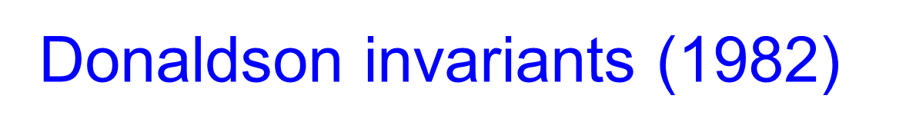
Glorious History Of
4d Field Theory & Four-Manifold Topology
Instantons (BPST) (1975)
Donaldson invariants (1982)
TQFT (1988)
Seiberg-Witten Invariants (1994)
Revolution of 1995
Notes:
Maybe not as glorious, but certainly not inglorious

Slide 4
A paradigmatic example of the modern interplay
between the physics and mathematics
Physical Mathematics And The Future
http://www.physics.rutgers.edu/~gmoore/
Today: Continue the line of development from 1988-1998

Slide 5
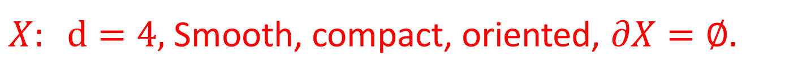
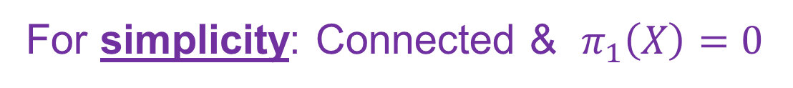
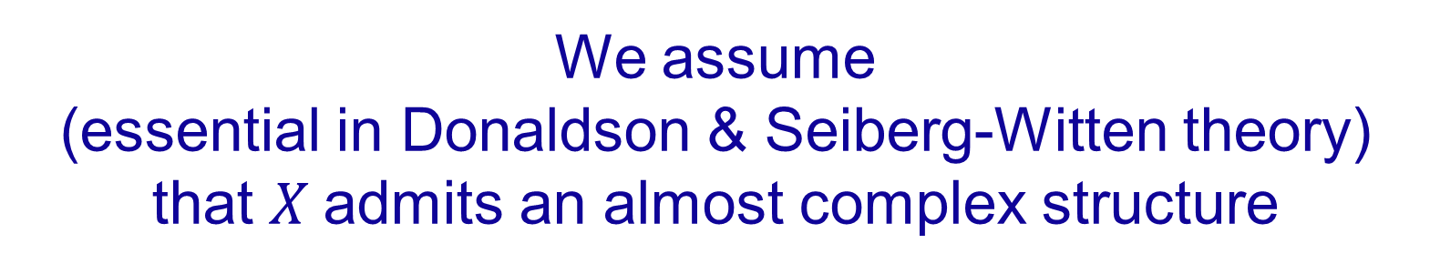
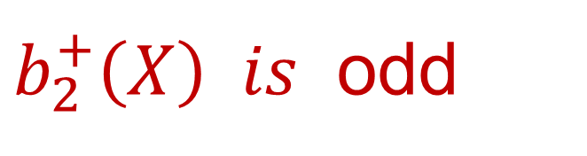
But not all questions are answered…
$X: d=4,$Smooth, compact, oriented, $∂X=∅.$
For simplicity: Connected & $π_{1}\left(X\right)=0$
We assume
(essential in Donaldson & Seiberg-Witten theory)
that $X$admits an almost complex structure
$b_{2}^{+}\left(X\right) is$ odd
Misses ``half’’ the world of four-manifolds!

Slide 6

We do not know anything even close to a complete topological invariant.

Slide 7
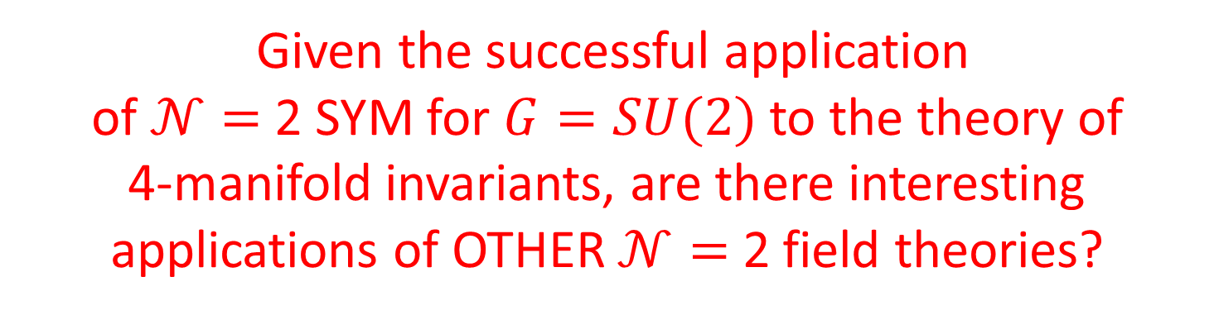

What About Other N=2 Theories?
There are infinitely many other four-dimensional N=2 supersymmetric quantum field theories.
Topological twisting should make sense
for any $𝒩=2$ theory $𝒯$.
(but $𝒯$-dependent details remain to be worked out)
Given the successful application
of $𝒩=$ 2 SYM for $G=SU(2)$ to the theory of
4-manifold invariants, are there interesting applications of OTHER $𝒩=$ 2 field theories?

Slide 8
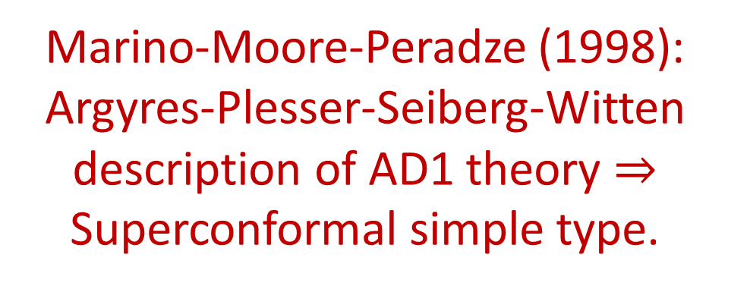
Yes
Learn more about existing invariants
Marino-Moore-Peradze (1998):
Argyres-Plesser-Seiberg-Witten description of AD1 theory $⇒$
Superconformal simple type.
Marino-Moore: SU(N) Donaldson invariants: Applications to 3d Floer homology
(MM 1998; Daemi & Xie 2020)

Slide 9

Generalizations
Other 4d theories
5d theories
6d theories
Coupling to background supergravity…
These might lead to truly new invariants that are independent of the
Donaldson/SW invariants …

Slide 10
…. or not …
Today’s talk: Some of these generalizations are already leading to some interesting issues in QFT…

Slide 11
1
Motivation
2
The Paradigm: SU(2) N=2 SYM & Donaldson invariants
3
Other d=4 N=2 Theories
5
4
d=5: ``K-theoretic Donaldson invariants’’
5
Family Donaldson invariants

Slide 12
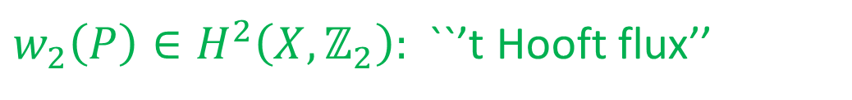
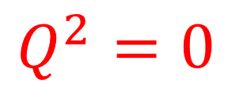
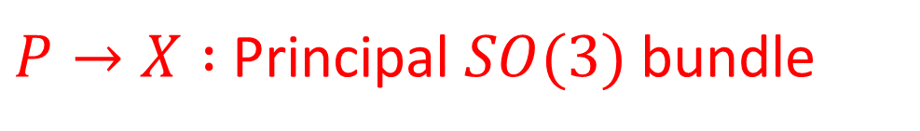



4d N=2 SU(2) SYM On X
$P→X :$Principal $SO(3)$ bundle
$w_{2}\left(P\right)∈H^{2}\left(X, ℤ_{2}\right):$ ``’t Hooft flux’’
``background 1-form symmetry gauge field’’
Witten (1988): ``Topological twisting’’
Spinors $→$ differential forms
$$Q_{α}^{A} , {\overline{Q}}_{\dot{α}}^{A} → Q, K, …$$
$$Q^{2}=0$$
$$\{ K, Q \} =d$$

Slide 13
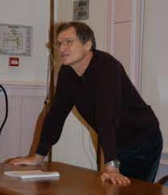
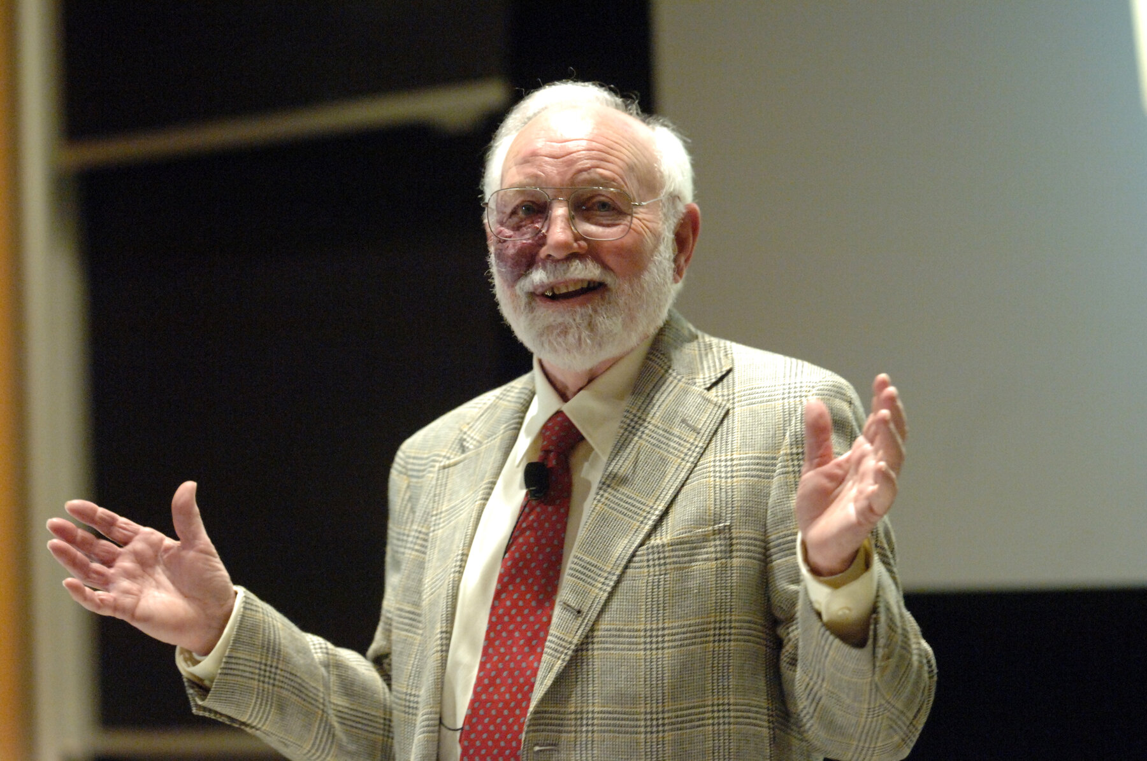



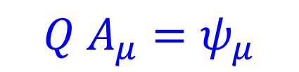
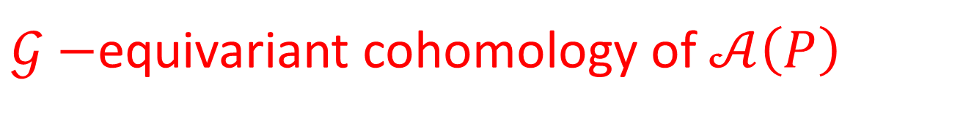

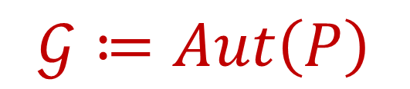

$$Q A_{μ}=ψ_{μ}$$
$$Q ψ_{μ}=−D_{μ}φ$$
$$Q φ=0$$
$$A∈𝒜\left(P\right)$$
$$φ∈Ω^{0}\left(X, ad P⊗ℂ\right)$$
$$An important viewpoint in$$
$$the section on families below$$
Baulieu & Singer, 1988
$$𝒢≔Aut\left(P\right)$$
Group of gauge transformations
$𝒢−$equivariant cohomology of $𝒜\left(P\right)$

Slide 14




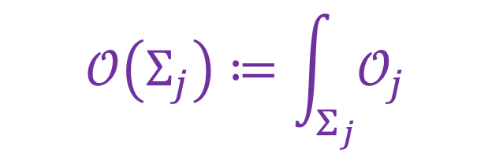
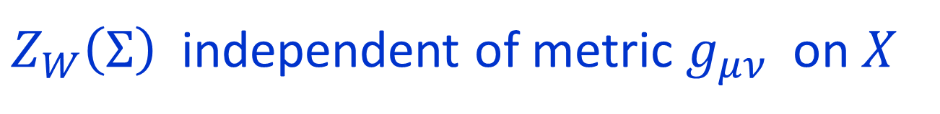


$Q−$closed observables: $𝒪\left(pt\right)=Tr\left(φ^{2}\left(pt\right)\right)$
$$\{ K, Q \} =d⇒$$
$$𝒪_{j}≔K^{j}𝒪$$
$$𝒪\left(Σ_{j}\right)≔\int_{Σ_{j}}{𝒪_{j} }$$
only depends on $\left[Σ_{j}\right]∈H_{j}\left(X\right)$
Function on $H_{∗}\left(X\right):$
$$Z_{W}\left(Σ\right)=⟨e^{𝒪\left(Σ\right)}⟩$$
Witten (1988): For a suitable
background $SU{\left(2\right)}_{R}$connection
$Z_{W}\left(Σ\right)$independent of metric $g_{μν}$on $X$

Slide 15
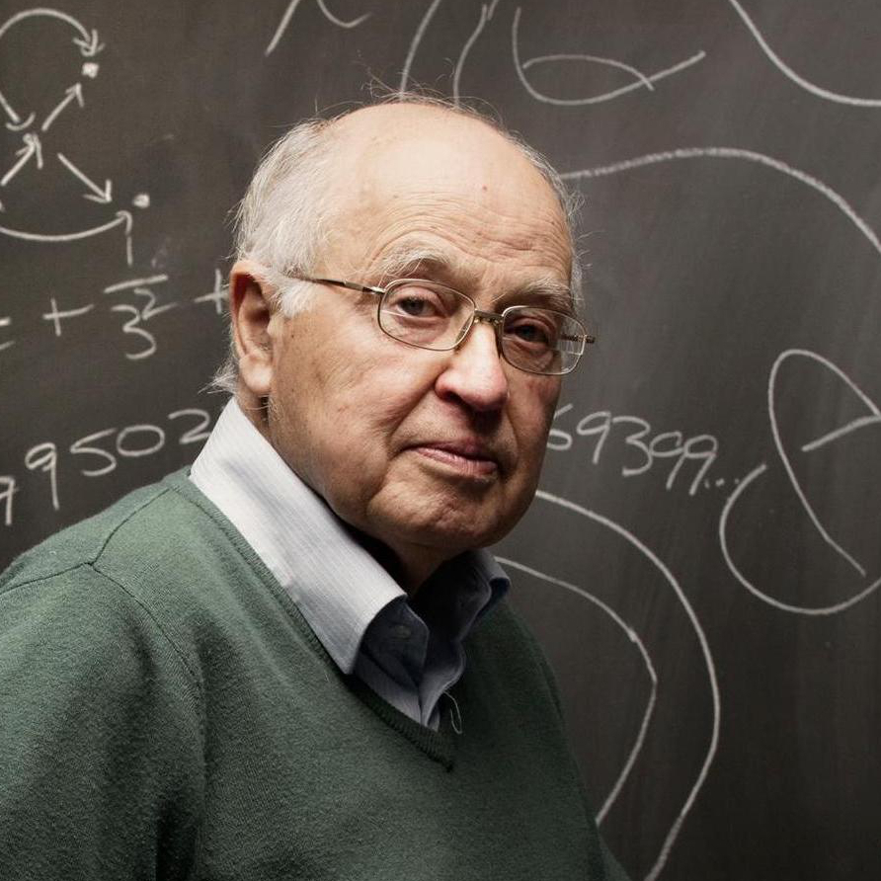

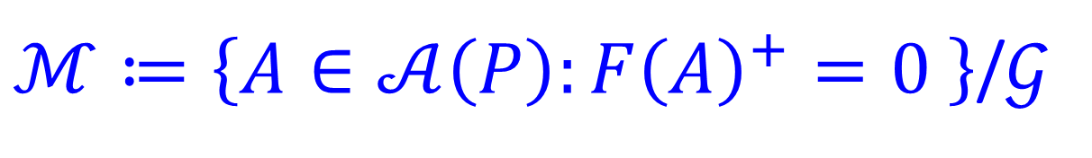

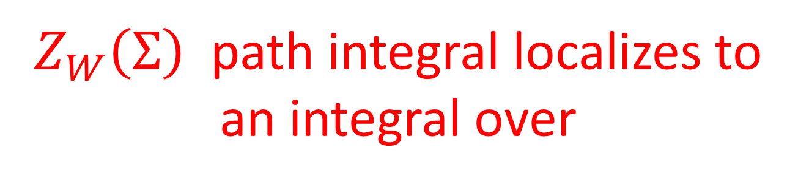

Witten (1988) & Atiyah& Jeffrey(1990)
$Z_{W}\left(Σ\right)$path integral localizes to
an integral over
$$ℳ ⊂𝒜(P)/𝒢$$
$ℳ≔\left\{A∈𝒜\left(P\right):F{\left(A\right)}^{+}=0 \right\}$/$𝒢$
$$F^{+}≔\frac{1}{2}\left(F+∗F \right)$$

Slide 16




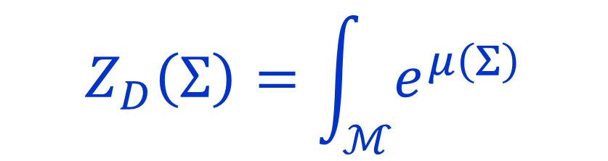
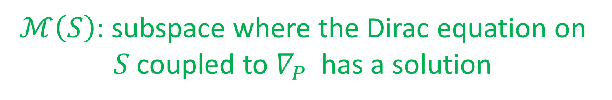
Donaldson Invariants
Donaldson: $μ:H_{∗}\left(X\right)→H^{∗}\left(ℳ\right)$
$S⊂X$: smooth surface.
$ℳ\left(S\right)$: subspace where the Dirac equation on $S$coupled to $∇_{P}$ has a solution
Poincare dual to $ℳ\left(S\right)$defines ${μ\left(S\right)∈H}^{2}\left(ℳ;ℚ\right)$
$$=\sum_{k,r}{\int_{ℳ_{k}}{\frac{μ{\left(Σ\right)}^{r}}{r!}}}$$
$$Z_{D}\left(Σ\right)=\int_{ℳ}{e^{μ\left(Σ\right)}}$$
$ℳ$depends on $g_{μν} ,$but $Z_{D}\left(Σ\right)$does not

Slide 17

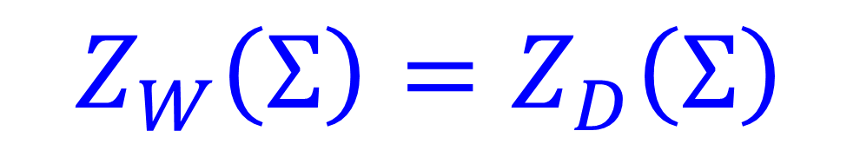
Main Statement
$$Z_{W}\left(Σ\right)=Z_{D}\left(Σ\right)$$
$${=: Z}_{DW}\left(Σ\right)$$

Slide 18
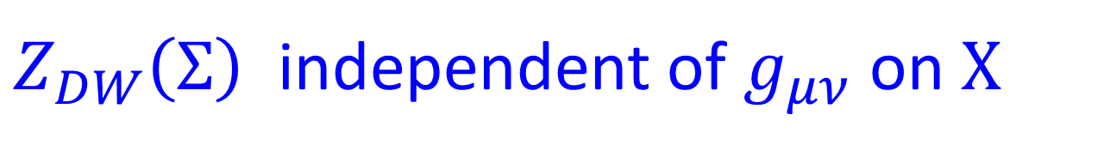


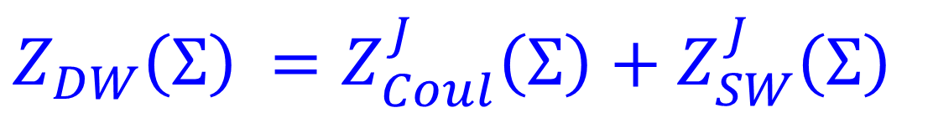


Evaluation Of $Z_{DW}\left(Σ\right)$
$Z_{DW}\left(Σ\right)$ independent of $g_{μν}$on $X$
Consider metric $L^{2}g_{μν}$ in the limit $L→∞$
$⇒$Use Seiberg-Witten LEET
$Z_{DW}\left(Σ\right)$ $=Z_{Coul}^{J}\left(Σ\right)+Z_{SW}^{J}\left(Σ\right)$
Witten 94
Moore-Witten 97
Period point
$$J∈H^{2}\left(X,ℝ\right): J=∗J$$

Slide 19
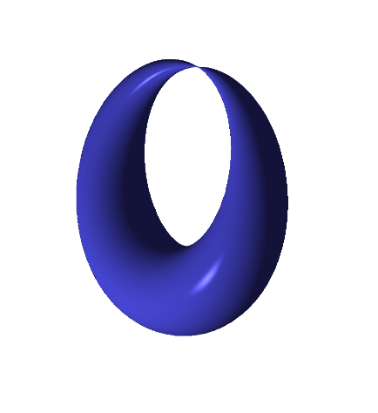
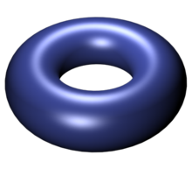
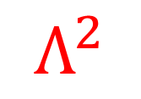
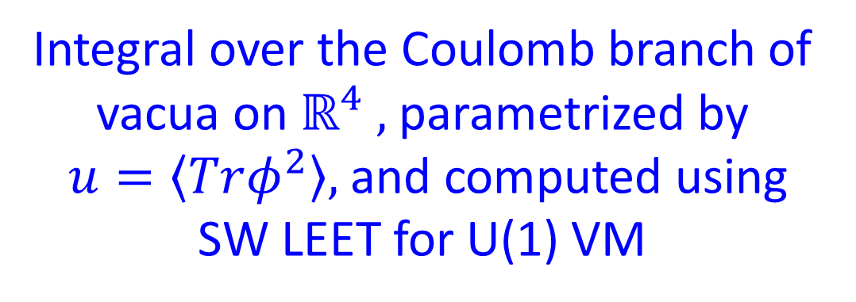

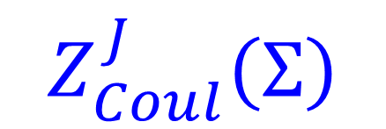



Integral over the Coulomb branch of vacua on $ℝ^{4} ,$parametrized by
$u=\left\langle Trφ^{2}\right\rangle ,$and computed using
SW LEET for U(1) VM
$$Z_{Coul}^{J}\left(Σ\right)$$
$$λ_{SW}$$
$$E_{u}$$
$${−Λ}^{2}$$
$$Λ^{2}$$
$$u$$

Slide 20
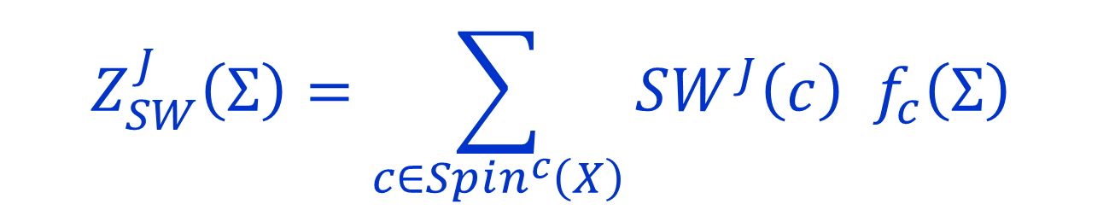


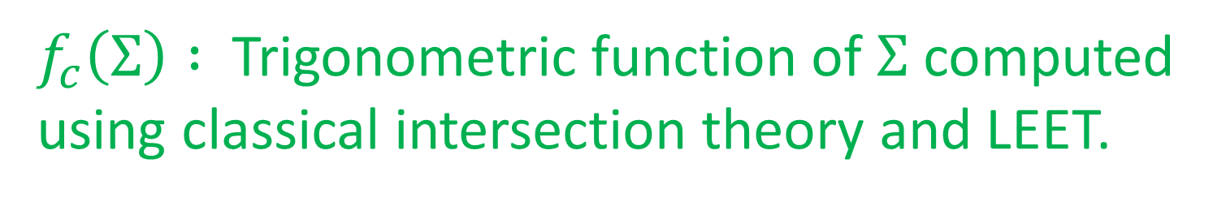
Singularities at $u= ±Λ^{2}$ spoil topological invariance.
Restore it with integral over ``Higgs branch vacua’’
$$Z_{SW}^{J}\left(Σ\right)=\sum_{c∈Spin^{c}\left(X\right)}{SW^{J}\left(c\right) f_{c}\left(Σ\right) }$$
$f_{c}\left(Σ\right) :$ Trigonometric function of $Σ$computed using classical intersection theory and LEET.
$$SW^{J}\left(c\right)∈ℤ$$
Seiberg-Witten invariants

Slide 21
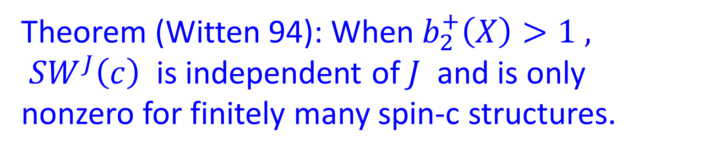





$$Spin^{c}\left(X\right)↔ w_{2}{\left(X\right)}^{lift}+2 H^2\left(X, ℤ\right)$$
Counts the number of solutions to SW equations:
$$SW^{J}\left(c\right)$$
$A_{ab} ``U\left(1\right)$connection’’
$$M∈Γ\left(W^{+}\right)$$
$$F{\left(A_{ab}\right)}^{+}=\overline{M}M$$
$$γ⋅D M=0$$
Theorem (Witten 94): When $b_{2}^{+}\left(X\right)>1 ,$
$SW^{J}\left(c\right)$ is independent of $J$ and is only nonzero for finitely many spin-c structures.

Slide 22
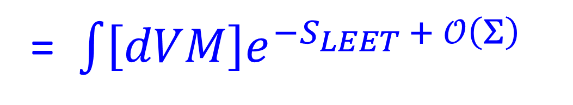
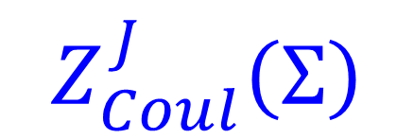
$$Z_{Coul}^{J}\left(Σ\right)$$
= $\int{\left[dVM\right]e^{−S_{LEET }+ 𝒪\left(Σ\right) }}$
$$U\left(1\right) VM=\left(A_{μ}, ψ_{μ},χ_{μν}, η, a\right)$$
$τ\left(a\right) :$Complicated function determined by SW LEET

Slide 23
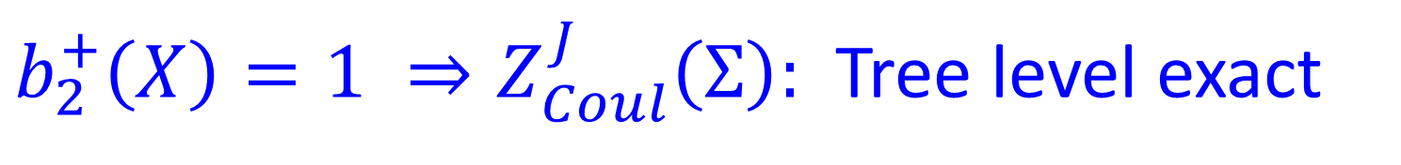
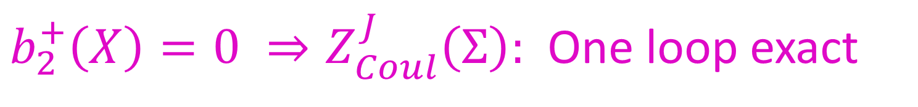
Claim (Moore-Witten 97):
$$b_{2}^{+}\left(X\right)>1 ⇒Z_{Coul}^{J}\left(Σ\right)=0$$
$b_{2}^{+}\left(X\right)=1 ⇒Z_{Coul}^{J}\left(Σ\right):$ Tree level exact
$b_{2}^{+}\left(X\right)=0 ⇒Z_{Coul}^{J}\left(Σ\right):$ One loop exact
N.B. Not a localization evaluation of $Z_{Coul}^{J}\left(Σ\right)$!!
1997 derivation overlooked some subtleties,
now being revisited with V. Saxena

Slide 24
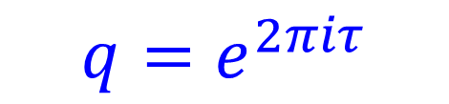
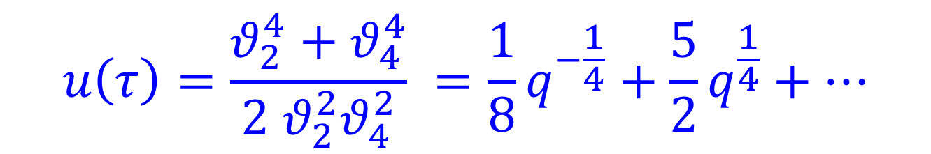
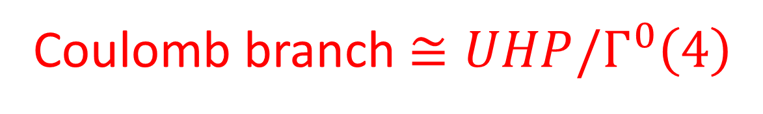
u-Plane Integral
SW94: Coulomb branch has a modular parametrization:
$$u\left(τ\right)=\frac{θ_{2}^{4}+θ_{4}^{4}}{2 θ_{2}^{2}θ_{4}^{2}} =\frac{1}{8}q^{−\frac{1}{4}}+\frac{5}{2}q^{\frac{1}{4}}+⋯$$
$$q=e^{2πiτ}$$
Coulomb branch $≅UHP/Γ^{0}\left(4\right)$

Slide 25
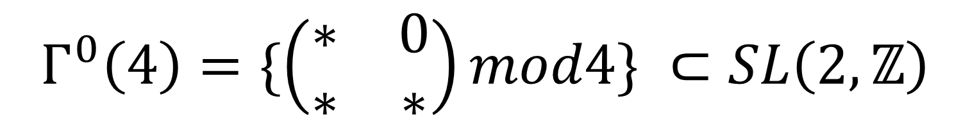
$$Γ^{0}\left(4\right)=\{\left(\begin{matrix}∗ & 0 \\ ∗ & ∗\end{matrix}\right)mod4\} ⊂SL\left(2,ℤ\right)$$

Slide 26
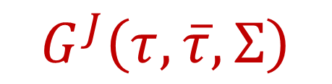
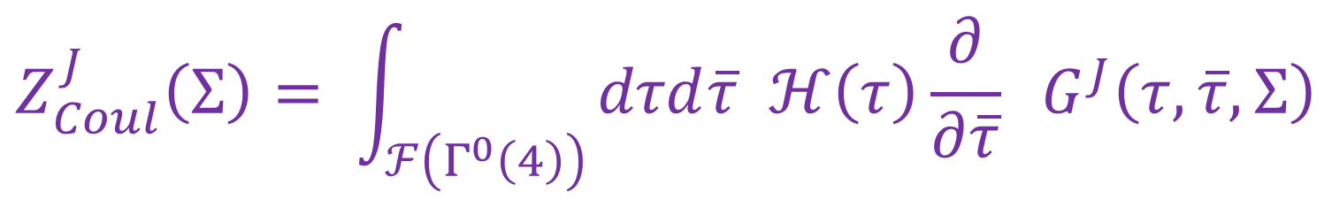
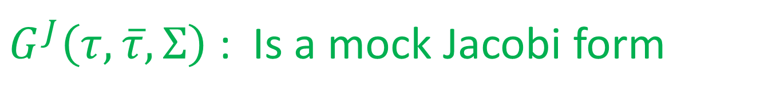

$$Z_{Coul}^{J}\left(Σ\right)= \int_{ℱ\left(Γ^{0}\left(4\right)\right)}{dτd\overline{τ} ℋ\left(τ\right)\frac{∂}{∂\overline{τ}} G^{J}\left(τ,\overline{τ}, Σ\right)}$$
Comes from the
photon path integral
$$G^{J}\left(τ,\overline{τ}, Σ\right)$$
Not holomorphic in $τ \left(or u\right)$
Continuously metric dependent.
$G^{J}\left(τ,\overline{τ}, Σ\right)$ : Is a mock Jacobi form
G. Korpas, J. Manschot, G. Moore, I. Nidaiev (2019)

Slide 27
1
Motivation
2
The Paradigm: SU(2) N=2 SYM & Donaldson invariants
3
Other d=4 N=2 Theories
5
4
d=5: ``K-theoretic Donaldson invariants’’
5
Family Donaldson invariants

Slide 28


Topological Twisting
For an astutely chosen background
$SU{\left(2\right)}_{R}$-symmetry connection:
$$A^{R−symmetry}∼ ω^{+, LC}$$
$$S_{N=2 SYM}= \left\{Q, V\right\}+∫τ_{uv} Tr F∧F$$
It is useful to rephrase topological twisting in terms of ``reduction of structure group’’

Slide 29

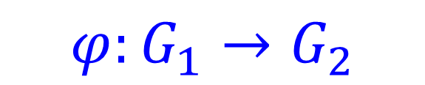


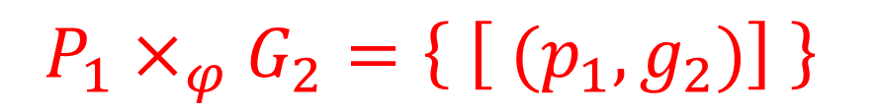
Reduction Of Structure Group
$$φ:G_{1}→G_{2}$$
Homomorphism of groups
Given a principal $G_{1}$bundle $P_{1}→M$ we can
form an associated principal $G_{2}$bundle
$$P_{1}×_{φ}G_{2}=\left\{ \left[ {(p}_{1},g_{2})\right] \right\}$$
$$\left(p_{1}g_{1}, g_{2}\right)∼\left(p_{1},φ\left(g_{1}\right)g_{2}\right)$$
Transition functions $g_{αβ}:U_{αβ}→G_{1}$map to new transition functions $φ\left(g_{αβ}\right):U_{αβ}→G_{2}$

Slide 30
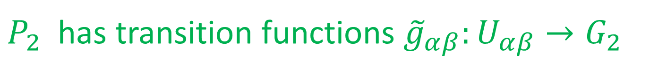
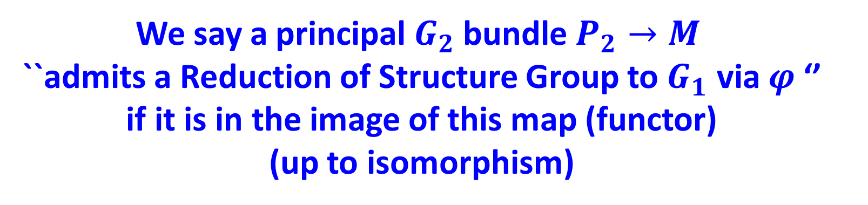


Reduction Of Structure Group (RSG)
We say a principal $G_{2}$bundle $P_{2}→M$
``admits a Reduction of Structure Group to $G_{1}$ via $φ$‘’ if it is in the image of this map (functor)
(up to isomorphism)
$P_{2}$ has transition functions ${\tilde{g}}_{αβ}:U_{αβ}→G_{2}$
We can find functions $g_{αβ}:U_{αβ}→G_{1}$such that
$${\tilde{g}}_{αβ}=φ\left(g_{αβ}\right)$$
AND
$$g_{αβ}g_{βγ}g_{γα}\left(x\right)=1_{G_{1}}$$

Slide 31



Examples Of RSG
A Riemannian metric on an $n$-manifold $M_{n}$ IS
an RSG of the frame bundle $Fr\left(M_{n}\right)$ via
$$φ:O\left(n\right)→GL\left(n,ℝ\right)$$
2. An orientation IS an RSG of the frame bundle $Fr\left(M_{n}\right)$ via
$$φ:GL^{+}\left(n,ℝ\right)→GL\left(n,ℝ\right)$$

Slide 32



Examples Of RSG
3. An almost complex structure
(compatible with a metric + orientation)
IS an RSG of the bundle of oriented ON frames via $φ:U\left(\frac{n}{2}\right)→SO\left(n\right)$
4. A $Spin^{c}$-structure IS an RSG of the bundle of
oriented ON frames via
$$φ:Spin^{c}\left(n\right)≔ \frac{Spin\left(n\right)×U\left(1\right)}{ℤ_{2}} → SO\left(n\right)$$

Slide 33


Reduction Of Structure Group (RSG)
RGS extends to category of
bundles with connection:
$∇_{1}$ on $P_{1}$
$$⇒ ∇_{2}=φ_{∗}\left(∇_{1}\right) on P_{1}×_{φ}G_{2}$$

Slide 34



Topological Twisting As RSG
[Manschot-Moore; Cushing,Moore,Rocek,Saxena; D. Freed, unpublished]
Background fields for $𝒩=2$ $SU\left(N\right)$ SYM:
A connection for $G^{phys}=\frac{Spin\left(4\right)×SU{\left(2\right)}_{R}}{⟨ \left(−1,−1, −1 \right)⟩}$
$$φ: SO\left(4\right)= \frac{\left(SU{\left(2\right)}_{+}×SU{\left(2\right)}_{−}\right)}{\left\langle \left(−1,−1\right)\right\rangle }→ G^{phys}$$
$$φ\left( \left[\left(u_{1},u_{2}\right)\right]\right)≔\left[ \left(u_{1},u_{2},u_{1}\right)\right]$$
$φ_{∗}\left(∇^{LC}\right)=$background fields (for ``0-form symmetry’’)
of the physical theory

Slide 35




Example: $SU\left(2\right), N=2^{∗}$ Symmetry group is
$G^{phys}= ( SU{\left(2\right)}_{+}×SU{\left(2\right)}_{−}×SU{\left(2\right)}_{R}×U\left(1\right) )/$ $𝒵$
$$𝒵=〈\left(−1,−1,−1,−1\right)〉≅ℤ_{2}$$
There is NO homomorphism from
$SO(4)$ to $G^{phys}$
(compatible with constraints on the morphism of Lie algebras)
There IS a homomorphism $Spin^{c}\left(4\right)→G^{phys }$
The twisted theory depends nontrivially on the $Spin^{c}$ structure on the 4-fold [Manschot & Moore 2021]

Slide 36



WIP with Vivek Saxena and Ranveer Singh aims to generalize the picture to arbitrary Lagrangian N=2 theories.
Conjecture: Topological theory depends on a $\frac{Spin\left(4\right)×U{\left(1\right)}^{N_{f}}}{ℤ_{2}}$structure +
restrictions on background gauge fields
for ``1-form symmetries’’
Goal: Further generalization to arbitrary class S theories.

Slide 37
What Do The Other (Lagrangian) Theories Compute?
The path integral for topologically twisted Lagrangian theories localizes to intersection theory on
moduli space of the
Nonabelian Seiberg-Witten equations
(instanton moduli space is a special case)

Slide 38






How Twisted Lagrangian Theories Generalize Donaldson Invariants
$$=\int_{ℳ}{e^{μ\left(\backslash Sigma\right)}ℰ}\left(𝒱\right)$$
$$Z\left(Σ\right)={〈e^{𝒪\left(Σ\right)}〉}_{𝒯}$$
But now $ℳ$: is the moduli space of:
$$F^{+}=𝒟(M,\overline{M})$$
$$γ⋅D M=0$$
$$M∈Γ\left( W^{+}⊗V\right)$$
$W^{+}:$ Rank 2 ``spin’’ bundle; $V$depends on matter rep
``Nonabelian Seiberg-Witten equations’’
[Labastida-Marino 1997; Losev-Shatashvili-Nekrasov1997 ]
Notes:
Say in words V is an associate bundle to the gauge bundle for a quaternionic representation of G

Slide 39


Defining the integral over $ℳ$
requires a choice of orientation
Orientability should be determined by the mod-two index of the deformation operator
$$d_{A}^{+}⊕d_{A}^{∗}⊕γ⋅D :Ω^{1}\left(X, adP\right)⊕Γ\left(W^{+}⊗V\right)→ Ω^{2,+}\left(X, ad P \right)⊕Ω^{0}\left(X, adP\right)⊕Γ\left(W^{−}⊗V \right)$$
View the determinant bundle of the deformation complex as the (real)
state space of a 5d invertible theory

Slide 40
We hope the theory is trivializable…
An orientation is a trivialization of this invertible theory.
Question (WIP with D. Freed):
Is there a useful description of the 5d invertible theory for the moduli space of the nonabelian
Seiberg-Witten equations for general compact group and quaternionic representation?

Slide 41
1
Motivation
2
The Paradigm: SU(2) N=2 SYM & Donaldson invariants
3
Other d=4 N=2 Theories
5
4
d=5: ``K-theoretic Donaldson invariants’’
5
Family Donaldson invariants

Slide 42

``K-Theoretic Donaldson Invariants’’

Slide 43




$𝒩=1$5D SYM
Vectormultiplet: $V=\left(A_{m}, σ,λ_{α}^{A}, D_{AB}\right)$
$S\left[V\right]= g_{5d,SYM}^{−2} \int_{X_{5}}{tr F∗F +tr Dσ∗D σ+⋯ }$
$$J_{TOP}=tr F^{2} ⇒ V^{\left(I\right)}=\left(A_{m}^{\left(I\right)}, σ^{\left(I\right)}, …\right)$$
Seiberg 1995
$S\left[V;V^{\left(I\right)}\right]=\int_{X_{5}}{A^{\left(I\right)}∧tr F^{2} + \int{ σ^{\left(I\right)} tr F∗F +⋯ }}$
$$σ^{\left(I\right)}∼g_{5d,SYM}^{−2}$$

Slide 44





Now take $X_{5}=X×S^{1}$
$θ∼ \oint_{S^{1}}{A^{\left(I\right)}}$const. on X
$F^{\left(I\right)}$pulled back from $X$
We have a partial topological twist based on reduction of structure group
$$φ: ℤ_{2} ×SO\left(4\right)→\left(Spin\left(5\right)×SU{\left(2\right)}_{R}\right)/ℤ_{2}$$
Background fields: $φ_{∗}\left(∇^{LC}\right)$
Topological on $X$but a nontopological, spin, theory on $S^{1}$
$$𝒬^{2}=∂_{t}$$

Slide 45



SQM With Target $ℳ$
Topological on X $⇒$ Can shrink $X⇒$
Describe the twisted theory in terms of
SQM on $S^{1}$with target space
the moduli space of instantons
[Nekrasov, 1996]
But $ℳ$ is not spin in general,
so the theory will be anomalous

Slide 46


Potential Global Anomalies
$w_{2}\left(ℳ\right)≠0$
1D:
$Pfaff\left(γ⋅D_{S^{1}}\right)$ not well-defined on $Lℳ$
5D:
$Pfaff\left(γ⋅D_{X×S^{1}}\right)$ not well-defined on $𝒜/𝒢$
All controlled by ``the same’’ 6d mod-two index.
Discussions are in progress with D.Freed and
E. Witten to give a useful formula for it.

Slide 47



Anomaly Cancellation
$S\left[V;V^{\left(I\right)}\right]=\int_{X×S^{1}}{F\left(A^{\left(I\right)}\right)∧CS\left(A_{dyn}\right)+⋯}$
$⇒$ SQM($ℳ) couples$ to a
``line bundle’’ $L_{CS}\left(n\right)→ℳ$
$$n≔\left[\frac{F^{\left(I\right)}}{2π}\right]∈H^{2}\left(X,ℤ\right)$$
Working hypothesis: For suitable $n$ $S_{ℳ}^{+} ⊗L\left(n\right)$ exists
Evidence: One can show
$X$admits an ACS $⇒$ $ℳ_{k }$ is spin-c

Slide 48





$$S_{twisted}=\left\{ Q, V \right\}+ \log{ℛ^{4} \int_{X}{tr\frac{F^{2}}{8π^{2}} }}$$
$$ℛ^{4}=\exp\left[ −8 π^{2}\frac{R}{g_{5d,YM}^{2}} +i θ \right]$$
$$m_{inst. part.}=\frac{1}{R} \log{ℛ^{2} }$$
$$ℛ=R Λ$$
$Λ$ dimensional scale in the physical theory

Slide 49


$g_{5d,sym}^{2}=∞ corresponds to the E_{1}$ 5d superconformal theory [Seiberg 1995]
And our formulae below indeed have special properties at $ℛ^{4}=1.$

Slide 50


At least formally the path integral
should compute
$Z\left(ℛ,n\right)=\sum_{k=0}^{∞}{ℛ^{\frac{d_{k}}{2}} T{r_{ℋ_{k}}\{\left(−1\right)}^{F}exp({− ℛ D_{L\left(n\right)}^{2} )}}$}
$d_{k}=\dim_{ℝ}{ℳ_{k}}$ $=4h^{∨}k −\dim{G\frac{χ+σ}{2} }$

Slide 51





$T{r_{ℋ_{k}}\{\left(−1\right)}^{F}exp({− ℛ D_{L\left(n\right)}^{2} )}$}
In good cases, this is the index of the Dirac operator $D_{L\left(n\right)}$
$⇒$``K-theoretic Donaldson invariants’’
All this should generalize to (anomaly-free) 6d SYM theories on $X×𝔼$
$$Index\left(D_{L\left(n\right)}\right)→Ell\left(σ(ℳ_{k})\right)$$

Slide 52


Five Dimensions
$$Z\left(ℛ,n\right)``=′′\sum_{k=0}^{∞}{ℛ^{d_{k}/2} \int_{ℳ_{k}}{ ch\left(L\left(n\right)\right) \hat{A}\left(ℳ_{k}\right) }}$$
[Nekrasov, 1996; Losev, Nekrasov, Shatashvili, 1997]
We study $Z\left(ℛ, n\right)$ using both
the Coulomb branch integral
and, independently, toric localization,
for $X$a toric Kahler manifold

Slide 53
2006:
2019:

Slide 54
Using the physical techniques we derived results
Differ from GNY!
Agree with GNY!
(Suitably interpreted.)
This raises a puzzle…

Slide 55



Total partition function is a sum of two terms
$$Z^{J}\left(ℛ,n\right)=Z_{Coul}^{J}\left(ℛ,n\right)+Z_{SW}^{J}\left(ℛ,n\right)$$
$Z_{Coul}^{J}\left(ℛ,n\right):$4d Coulomb branch integral
One can deduce $Z_{SW}^{J}$ from $Z_{Coul}^{J}$

Slide 56




SW special Kahler geometry is subtle
For 5d SYM gauge group of rank 1:
Coulomb branch = $ℂ$
$$U=〈 Pexp \oint_{S^{1}}{\left(σ+i A_{5d,ym}\right) 〉}$$
parametrized by :
$$=e^{Ra}+e^{−Ra}+instanton corr^{′}s$$
$a:$ cylinder valued
$ℱ\left(a\right)$ is known [Nekrasov 1996, 2000,…]

Slide 57





Modular Parametrization Of $U−$plane
The Coulomb branch is a branched double cover of the modular curve for $Γ^{0}\left(4\right)$
$${\left(\frac{U}{R}\right)}^{2}+u\left(τ\right)=8+4\left(ℛ^{2}+ℛ^{−2}\right)$$
$$u\left(τ\right)=\frac{θ_{2}{\left(τ\right)}^{2}}{θ_{3}{\left(τ\right)}^{2}}+\frac{θ_{3}{\left(τ\right)}^{2}}{θ_{2}{\left(τ\right)}^{2}}$$
Hauptmodul for $Γ^{0}\left(4\right)$

Slide 58




$$Z_{Coul}^{J}\left(ℛ,n\right)=\int_{ℱ}{dτd\overline{τ} ν C^{n^{2}}{ Ψ}^{J}\left(τ,\frac{n}{2} ζ\right)}$$
$$ν\left(τ,ℛ\right)=\frac{θ_{4}^{13−b_{2}}}{η^{9}} \frac{1}{\sqrt{1−2 ℛ^{2}u(τ)+ℛ^{4}}}$$
$$C\left(τ,ℛ\right)$$
Suitably modular invariant and holomorphic ``contact term’’
$$ζ\left(τ, ℛ\right)∼\frac{∂^{2}ℱ}{∂a ∂m_{inst}}$$

Slide 59



$$Ψ^{J}\left(τ,z\right)=\sum_{k∈H^{2}\left(X,ℤ\right)}{\left(\frac{∂}{∂\overline{τ}} E_{k}^{J} \right)q^{−\frac{k^{2}}{2}}e^{−2πi k⋅z} {\left(−1\right)}^{k⋅K}}$$
$$E_{k}^{J}=Erf\left( \sqrt{Imτ} \left(k+ \frac{Im z}{Im τ} \right)⋅J \right)$$
$$z→\frac{n}{2} ζ\left(τ,ℛ\right)$$
Not holomorphic.
Metric dependent .

Slide 60




Measure As A Total Derivative
$$Z_{Coul}^{J}\left(ℛ,n\right)=\int_{ℱ}{dτd\overline{τ} ℋ\left(τ\right){ Ψ}^{J}\left(τ,\frac{n}{2} ζ\right)}$$
$∃$suitably modular invariant
and nonsingular $\hat{G}\left(τ, \overline{τ}\right)$
$$\frac{∂}{∂\overline{τ}}\hat{G}=Ψ^{J}$$
(It can be hard to find explicit formulae
for $\hat{G} :$ one needs the theory of mock modular forms, and their generalizations.)

Slide 61


$$Imτ=Y$$
$$Z_{Coul}^{J}(n,ℛ)=\lim_{Y→∞} \int{dτ_{1} ℋ \hat{G}{\left.​\right|}_{τ=τ_{1}+i Y}}$$

Slide 62



Examples Of Explicit Results
$$X=ℂℙ^{2}$$
$$Z_{Coul}\left(n,ℛ\right)={\left[ ν\left(τ, ℛ\right) C{\left(τ, ℛ\right)}^{n^{2}} G\left(τ,ℛ\right)\right]}_{q^{0}}$$
$$G\left(τ,ℛ\right)=−\frac{e^{i πn\frac{ζ(τ,ℛ)}{2}}}{θ_{4}\left(τ\right)} \sum_{ℓ∈ℤ}{ {\left(−1\right)}^{ℓ} \frac{q^{\frac{ℓ^{2}}{2}−\frac{1}{8}}}{1−e^{i πn ζ\left(τ,ℛ\right)}q^{ℓ−\frac{1}{2}}}}$$

Slide 63



Examples Of Explicit Results
Wall Crossing Formula:
$$Z_{Coul}^{J} −Z_{Coul}^{J^{′}}={\left[ ν C^{n^{2}}Θ^{J,J^{′}}\left(τ,ℛ\right)\right]}_{q^{0}}$$
$$Θ^{J,J^{′}}= \sum_{k∈H^{2}\left(X,ℤ\right)}{\left(s_{k}^{J}−s_{k}^{J^{′}}\right)q^{−\frac{k^{2}}{2}}e^{−2πi k⋅n ζ(τ,ℛ)} {\left(−1\right)}^{k⋅K}}$$
$$s_{k}^{J}≔sign\left( \sqrt{Imτ} \left(k+ \frac{Im ζ\left(τ,ℛ\right)}{Im τ} \right)⋅J \right)$$

Slide 64


If we take these formulae literally, we get results that are very different from GNY
We get finite Laurent polynomials in $ℛ$
with terms involving negative powers of $ℛ$
It looks nothing like:
$$Z\left(ℛ,n\right)=\sum_{k=0}^{∞}{ℛ^{d_{k}/2} Index\left(D_{L\left(n\right)},ℳ_{k}\right)}$$

Slide 65




$ν, C, G,Θ^{J,J^{′}}$are functions of $τ$ and of $ℛ$
Subtle order of limits: $ℛ→0$ vs. $Im τ→∞$
Example: $u\left(τ\right)∼ \frac{1}{8}q^{−\frac{1}{4}}+\frac{5}{2}q^{\frac{1}{4}}−\frac{31}{4}q^{\frac{3}{4}}+𝒪\left(q^{\frac{5}{4}}\right)$
$$ν\left(τ,ℛ\right)=\frac{θ_{4}^{13−b_{2}}}{η^{9}} \frac{1}{\sqrt{1−2 ℛ^{2}u(τ)+ℛ^{4}}}$$

Slide 66

$$ζ\left(τ, ℛ\right)∼\frac{∂^{2}ℱ}{∂a ∂m_{inst}}$$
Similarly for

Slide 67



$$Z_{Coul}\left(n,ℛ\right)={\left[ ν\left(τ, ℛ\right) C{\left(τ, ℛ\right)}^{n^{2}} G\left(τ,ℛ\right)\right]}_{q^{0}}$$
$$Z_{Coul}^{J} −Z_{Coul}^{J^{′}}={\left[ ν C^{n^{2}}Θ^{J,J^{′}}\right]}_{q^{0}}$$
If we first expand the expressions in $\left[…. \right]$
in $ℛ$around $ℛ=0$ then take the constant $q^{0}$ term at each order in $ℛ$ we find remarkable and nontrivial agreement with similarly complicated results in GNY.

Slide 68

Using toric localization and the 5d instanton partition function we derived exactly the same formula for wall-crossing @ $∞$
This would be another entire seminar….

Slide 69




The Puzzle: The naïve physical interpretation suggests we should take the constant term in the $q$-expansion
$$Z_{Coul}\left(n,ℛ\right)={\left[ ν\left(τ, ℛ\right) C{\left(τ, ℛ\right)}^{n^{2}} G\left(τ,ℛ\right)\right]}_{q^{0}}$$
$$Z_{Coul}^{J} −Z_{Coul}^{J^{′}}={\left[ ν C^{n^{2}}Θ^{J,J^{′}}\right]}_{q^{0}}$$
But to get answers that agree with mathematical results we first expand in $ℛ$
and then take the constant term in $q$.

Slide 70



Using the wall-crossing behavior of $Z_{Coul}^{J}\left(ℛ,n\right)$
at the strong coupling cusps allows
one to derive $Z_{SW}^{J}$ $⇒$partition function for $b_{2}^{+}>1$
$G(ℛ,n)=$ $\frac{2^{2χ+3 σ−χ_{h}}}{{\left(1−ℛ^{2}\right)}^{\frac{1}{2}n^{2}+χ_{h}}} \sum_{c}{SW\left(c\right) {\left(\frac{1+ℛ}{1−ℛ}\right)}^{c⋅\frac{n}{2}}}$
$Z\left(ℛ,n\right)$ = Terms in the power
series with $ℛ^{d}$ with $d=\frac{χ+σ}{4} mod 4$
Agrees with, and generalizes, GKW Conjecture 1.1

Slide 71




$E_{1}$Theory
$$\lim_{ℛ→1}{ Z}_{Coul}^{J}≠ \int_{ℱ}{dτd\overline{τ} \lim_{ℛ→1}{ \left(ν_{R}C^{n^{2}}Ψ^{J}\right) }}$$
Strong coupling walls are SHIFTED from the walls defined by spin-c structures!
But this is nicely explained by the coupling to the background $V^{\left(I\right)}$
$⇒$perturbed SW equations !
$$F^{+}\left(A\right)+Im\left(ζ\right)F^{+}\left(A^{\left(I\right)}\right)=\overline{M}M$$

Slide 72

So far, we did not use any K-theory in describing
the ``K-theoretic Donaldson invariants’’
It would be very desirable to do so, because the 6d version, analogously formulated, could be quite interesting:
Conjecture:
Integrals in elliptic cohomology of distinguished classes defined by the susy sigma model with target space $ℳ_{k}$ define smooth invariants of four-manifolds

Slide 73
1
Motivation
2
The Paradigm: SU(2) N=2 SYM & Donaldson invariants
3
Other d=4 N=2 Theories
5
4
d=5: ``K-theoretic Donaldson invariants’’
5
Family Donaldson invariants

Slide 74


Family Donaldson Invariants
There is an interesting generalization to invariants for families of four-manifolds.
Mentioned by Donaldson long ago.
A modest amount of work has been done
in the math literature .

Slide 75




Families Of Metrics
Couple twisted theory to a
family of metrics: $g_{μν}\left(x;s\right)$
$s∈𝒫 :$Parameters of the family.
$Z_{DW}(g_{μν}\left(x;s\right)$) is independent of $s.$
A suitable coupling to background supergravity gives a partition function which is a closed differential form $Z_{i_{1}…i_{p}}{ds}^{i_{1}}∧⋯ds^{i_{p}} .$
Periods of these forms are the family Donaldson invariants.

Slide 76



Universal Family
$$𝒫=Met(X)/Diff^{+}\left(X\right)$$
$$π_{j}\left(\frac{Met\left(X\right)}{Diff^{+}\left(X\right)}\right)≅π_{j−1}\left(Diff^{+}\left(X\right)\right)$$
$$π_{1}\left(\frac{Met\left(X\right)}{Diff^{+}\left(X\right)}\right) ≅π_{0}\left(Diff^{+}\left(X\right)\right)$$
$π_{0}\left(Diff^{+}\left(X\right)\right)$: 4d mapping class group

Slide 77







Donaldson-Witten a la Baulieu-Singer
$$P→𝕏$$
$$𝒢≔Aut\left(P\right)$$
$𝒢−$equivariant cohomology of $𝒜\left(P\right)$
$${\left( Ω^{∗}\left(𝒜\left(P\right)\right)⊗S^{∗}\left(Lie𝒢\right)\right)}^{ 𝒢}$$
$$Q A_{μ}=ψ_{μ}$$
$$Q ψ_{μ}=−D_{μ}φ$$
$$Q φ=0$$
Atiyah & Jeffrey + Baulieu & Singer
$Z_{DW}$ : Pushforward in $𝒢−$equivariant cohomology.

Slide 78







$$𝒢_{d}≔Diff^{+}\left(𝕏\right)$$
$𝒢_{d}−$equivariant cohomology of $MET\left(𝕏\right)$
$$Q g_{μν}=Ψ_{μν}$$
$$Q Ψ_{μν}=∇_{μ}Φ_{ν}+∇_{ν}Φ_{μ}$$
$$QΦ^{μ}=0$$
Action $e^{−S}$ is a closed equivariant class in the $𝒢 ⋊𝒢_{d} −$equivariant cohomology of $MET\left(𝕏\right)×𝒜\left(P\right)$
Push-forward in $𝒢−$equivariant cohomology is a $𝒢_{d}−$equivariant class on $MET\left(𝕏\right)$

Slide 79

Thanks to heroic computations by JC and VS we have explicit actions $e^{−S}$obtained by coupling to truncated & twisted
$N=2$conformal supergravity

Slide 80
Coupling To Twisted Truncated Background Supergravity
$$S\left[g,Ψ,Φ\right]=S_{DW}+ ∫\sqrt{g} {( Ψ}^{μν}Λ_{μν}+Φ^{μ}Z_{μ}+Ψ^{μσ}Ψ_{ σ }^{ν} Υ_{μν} )$$
$$Λ_{μν}=Im τ_{IJ} \left( F_{ρμ}^{−,I} χ_{ν}^{ρ,J}\right)+⋯$$
$$Z_{μ} = ℱ_{IJK} ψ_{μ}^{I} F_{ρσ}^{+,J} χ^{ρσ K}+⋯$$
$$Υ_{μν}=Im τ_{IJ} χ_{μρ}^{I} χ_{ν}^{ρ,J}+⋯$$

Slide 81



$γ⊂\frac{Met\left(X\right)}{Diff^{+}\left(X\right)}$ nontrivial cycle from some nontrivial element of $π_{0}\left(Diff^{+}\left(X\right)\right)$
$$\oint_{γ}{ds \int_{X}{vol\left(g\right)\frac{{dg}_{μν}}{ds} \left\langle Λ^{μν}\right\rangle }}$$
$$Q\left(Λ_{μν}\right)= T_{μν}^{SYM}+⋯$$

Slide 82


This raises several questions:
$Λ^{μν}$is NOT $Q$-closed!!!
Does our period integral localize to integrals on bundles of moduli spaces of instantons?
Does tree-level exactness (of LEET) persist?
No restriction on $b_{2}^{+}.$No assumption of ACS.
Does it see the other half of the world of four-manifolds?

Slide 83
Questions & Future Directions
Topological data for twisting the general d=4 N=2 theory?
Invertible theory governing orientation of nonabelian SW moduli
Global anomalies of 5D SYM in topological twisting background
Puzzles regarding physical derivation of K-theoretic Donaldson invariants
Generalization to elliptic invariants from 6d theories on $X×E$
Puzzles concerning the family generalization of Donaldson invariants
Other puzzles and directions I did not have time to mention ….

Slide 84

NOT

