Slide 1
From
Rational Conformal Field Theories
To Modular Tensor Categories
To Nonabelions
Gregory Moore, Rutgers University
Perspectives In Theoretical Physics
Series on History Of Physics, September 26, 2024

Slide 2
Preliminaries
1. This talk is intended to provide primary source material for a hypothetical historian of science interested in RCFT, MTC, and nonabelions.
2. It will be focused (mostly) on my work and my role in these developments 1986-1989. The account will be biased.
3. Memory is notoriously unreliable.
4. We all have a tendency to inflate our importance, particularly in recollection of past achievements

Slide 3
Preliminaries
5. History is fragile: Written documents get lost or destroyed: Floods, fires, mold. Emails get lost or deleted. Magnetic tape decays….
6. But total loss of memory is a loss of identity, as in Alzheimer’s patients. The same is true for the scientific community. I commend the organizers for creating this series of talks.
7. I thought it might be valuable to take a look backward
and reflect on the road traveled.
Thank you for providing this opportunity.

Slide 4
1
Prehistory: A. 2dCFT and B. String Theory
2
Three Roads To RCFT: 1986-1987
3
Princeton: Fall 1987- January 1988
4
Braiding & Fusion & S & T: Moore & Seiberg Spring 1988
5
Chern-Simons Theory: July 1988- July 1989
6
MTC & Anyons: August 1989 – November 1989

Slide 5
Prehistory A: 2dCFT 1980-1986
1. Friedan’s thesis
2. Minimal Models: BPZ: 1983
3. WZW model
4. Modular invariance

Slide 6
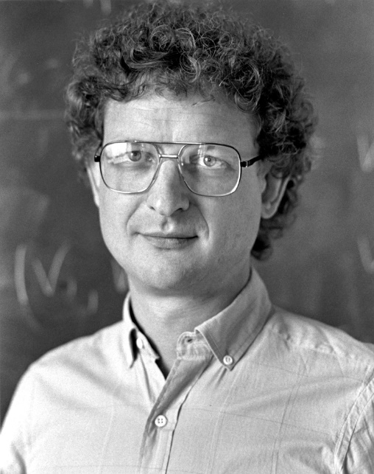
Conformal models related to solutions of Einstein’s equations
Leads to the idea that the space of 2d field theories is some amazing generalization of the space of manifolds

Slide 7
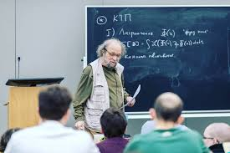
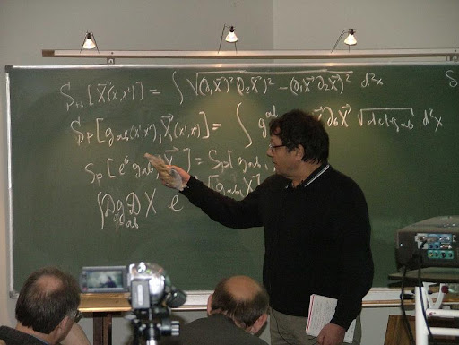
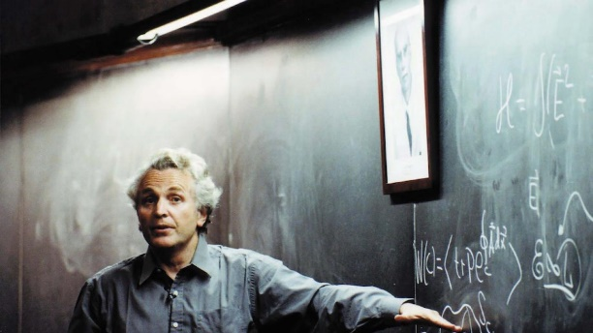

Virasoro symmetry: $vir{\left(c\right)}_{L} ⊕ vir{\left(c\right)}_{R}$

Slide 10
A propos the fragility of history -
When I moved from Chicago to Rutgers in 1989, I brought along a couple of backup tapes of my computer files. They wouldn't have contained notebooks; I was still writing on paper. But the tapes did contain the computer programs I wrote to explore my conjectures about the Virasoro unitarity constraints. Around that time there was a famous particle detector at SLAC called the Mark II detector. I gave a Fermi Institute seminar (in front of the hex people among others) on the unitarity results from the 2nd version of my program. I called the talk "Results from the Mark II Ghost Detector". Many years after the move to Rutgers, I got around getting the material on the tapes transferred to hard disks. It was too late. The magnetic tapes were unreadable. - Daniel Friedan, Sept. 2024

Slide 11
BPZ had a notion of fusion rules as selection rules,
but not as an algebra.

Slide 13
WZW Model
Argued for conformal invariance when WZ term is added.
Generalized BPZ to models with Lie group symmetry

Slide 15



WZW Model
$$ℋ≅⊕_{0≤λ⋅ρ≤k} V_{λ}⊗{\overline{V}}_{λ}$$
N.B. A finite sum
Compare Peter-Weyl theorem
$$L^{2}\left(G\right)≅ ⊕_{λ} V_{λ}⊗{\overline{V}}_{λ}$$
$$`` ℋ≅L^{2}\left(LG^{\left(k\right)}\right) ′′$$
It’s all about group theory, and becomes finite dimensional group theory in the semiclassical limit $k→∞$

Slide 16
Modular Invariance

Slide 17
Prehistory B: String Theory 1984-1986
Anomalies – cool thing to work on
@ Harvard 1982-1985
(Anomalies have a complex history)
2. Green-Schwarz anomaly cancellation
3. Heterotic String Theory & Calabi-Yau
4. Narain; Narain, Sarmadi, and Witten

Slide 19
Walking into the office of Alvarez-Gaume & Ginsparg and hearing about the news from Aspen.

Slide 20
Right-moving CFT does not have to be the same as the Left-moving CFT

Slide 22
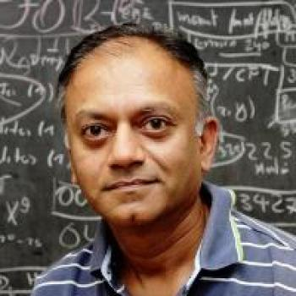

Slide 24
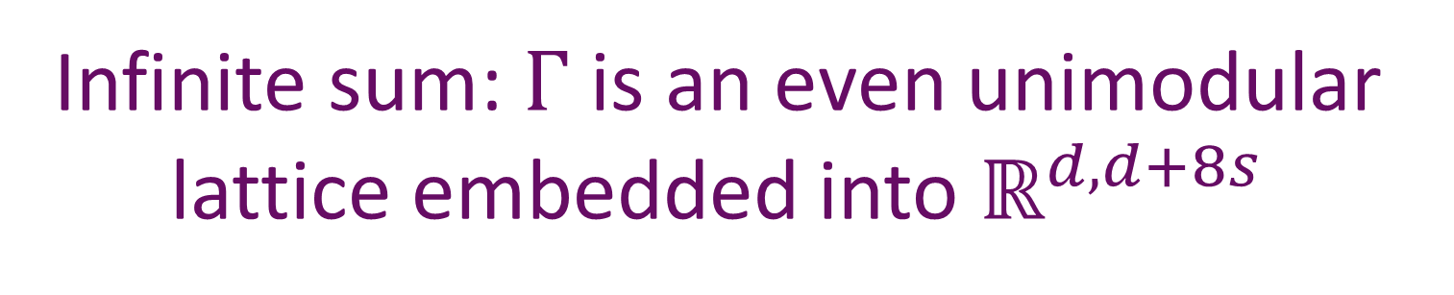
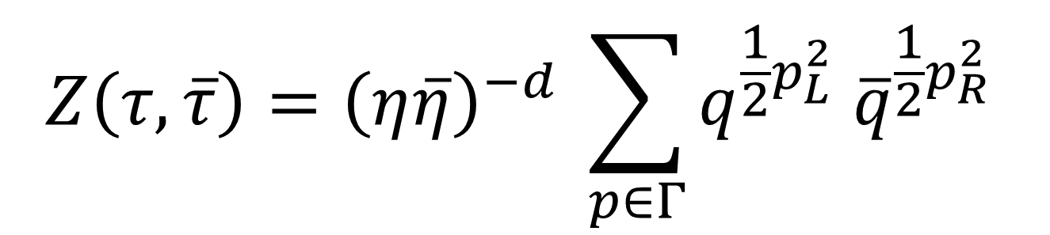
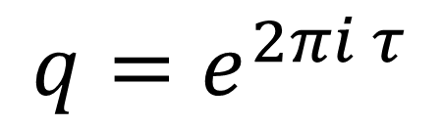
NSW: It’s just a toroidal compactification of heterotic string with flat metric, B-field, and gauge field
$$Z\left(τ,\overline{τ}\right)={\left(η\overline{η}\right)}^{−d} \sum_{p∈Γ}{q^{\frac{1}{2}p_{L}^{2}} {\overline{q}}^{\frac{1}{2}p_{R}^{2} }}$$
$$q=e^{2πi τ}$$
Infinite sum: $Γ$is an even unimodular lattice embedded into $ℝ^{d,d+8s}$
Siegel-Narain theta function

Slide 25

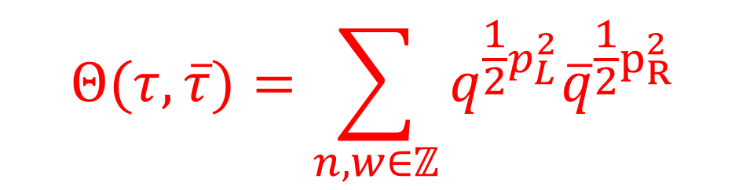
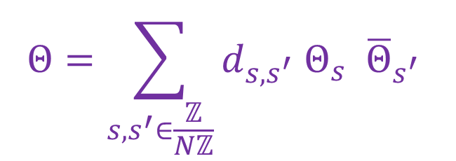
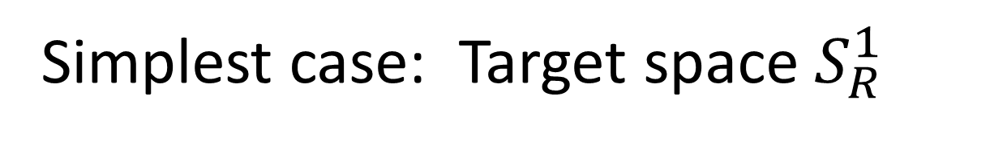


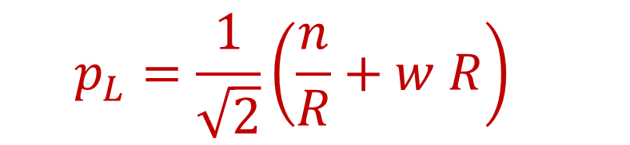
Simplest case: Target space $S_{R}^{1}$
$$Θ(τ,\overline{τ})=\sum_{n,w∈ℤ}{q^{\frac{1}{2}p_{L}^{2}}{\overline{q}}^{\frac{1}{2}p_{R}^{2}}}$$
$$p_{L}=\frac{1}{\sqrt{2}}\left(\frac{n}{R}+w R\right)$$
$$p_{R}=\frac{1}{\sqrt{2}}\left(\frac{n}{R}−w R\right)$$
$$Θ=\sum_{s,s^{′}∈\frac{ℤ}{Nℤ}}{d_{s,s^{′}} Θ_{s} {\overline{Θ}}_{s^{′}} }$$
When $R^{2}=\frac{a}{b}∈ℚ$
$$N=2ab$$
Noted c. 1987 by Friedan & Shenker; Moore;
Dijkgraaf, Verlinde, Verlinde (DVV) ; perhaps many others.

Slide 26
Harvard 1985-1986
Despite opposition from the senior faculty,
kids run the show.
L. Alvarez-Gaume, S. & V. Della Pietra,
J. . Distler, P. Ginsparg, G. Moore, P. Nelson,
J. Polchinski, C. Vafa
Trying to learn about the great developments from Princeton & Chicago. Lots of work on 2dCFT and string theory from the worldsheet perspective.

Slide 27
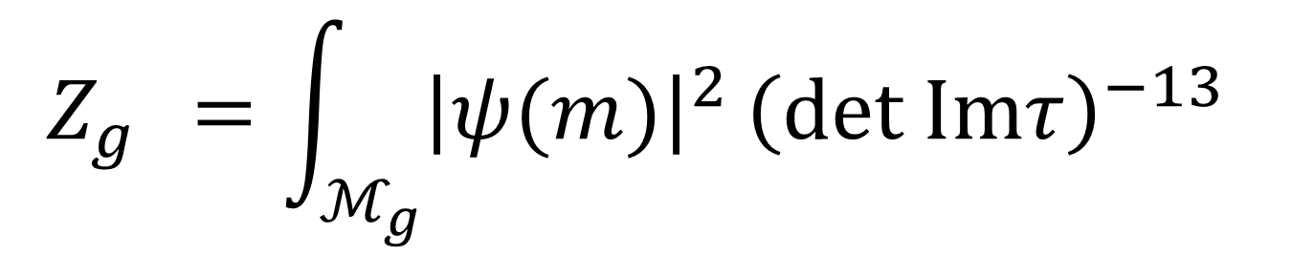

$$Z_{g }=\int_{ℳ_{g}}{{\left|ψ(m)\right|}^{2}}{\left(det Imτ\right)}^{−13}$$
$$=⟨ψ, ψ⟩$$

Slide 28

I went to David Mumford’s office to explain some of what was going on at the physics department: Theta functions, modular forms, integration on moduli space of curves.
His Tata Lectures On Theta were enormously helpful
to the work of several of us at Harvard at the time.
Mumford isomorphism $K\left(ℳ_{g}\right)⊗λ^{⊗−13}≅𝒪$
Full of excitement I called Phil Nelson, at the time he was visiting Joe Polchinski in UT Austin.
Too late.
There was competition between Harvard and Moscow – but it was not acrimonious.

Slide 29
1
Prehistory: A. 2dCFT and B. String Theory
2
Three Roads To RCFT: 1986-1987
3
Princeton: Fall 1987- January 1988
4
Braiding & Fusion & S & T: Moore & Seiberg Spring 1988
5
Chern-Simons Theory: July 1988- July 1989
6
MTC & Anyons: August 1989 – November 1989

Slide 30
Three Roads To RCFT
a.) Friedan & Shenker: Modular Geometry
b.) Moore: Atkin-Lehner Symmetry
c.) Dijkgraaf-Verlinde-Verlinde (DVV):
c=1 classification and beyond

Slide 31
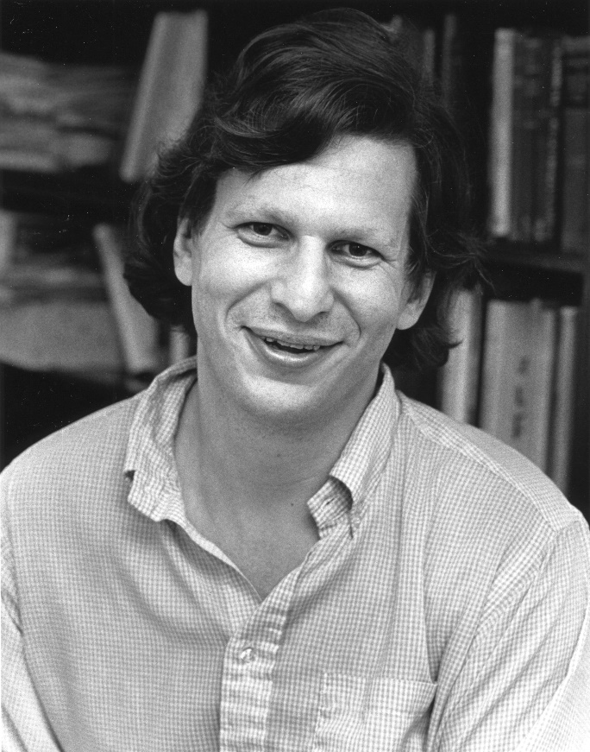
Friedan & Shenker 1986-1987

Slide 32
The analytic geometry construction was a synthesis of BPZ and Cardy. - Daniel Friedan, Sept. 2024

Slide 33
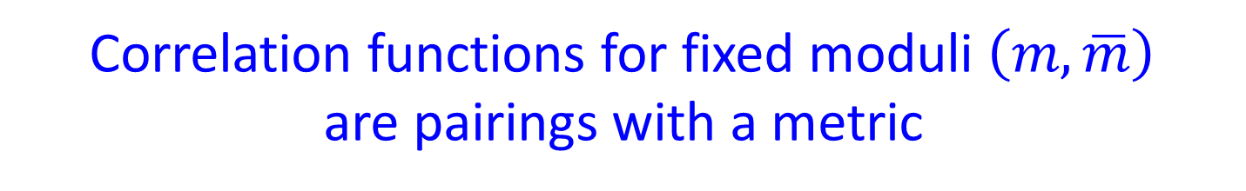
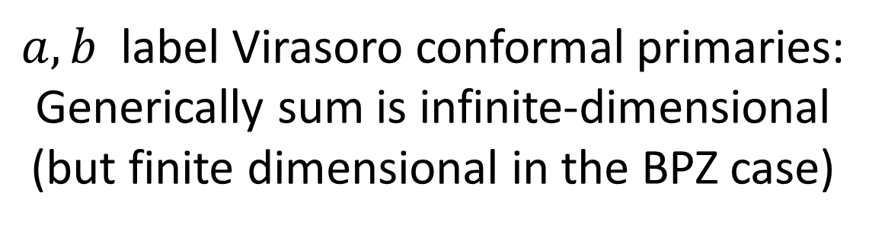
Conformal blocks are sections of projectively flat (infinite-dimensional) vector bundles over the moduli of curves.
Correlation functions for fixed moduli $\left(m,\overline{m}\right)$
are pairings with a metric
Moduli include positions of punctures.
$a,b$ label Virasoro conformal primaries:
Generically sum is infinite-dimensional (but finite dimensional in the BPZ case)

Slide 35
Friedan & Shenker, unpublished, 1986-1987 speculating:
Space of CFTS is an arithmetic variety. The degenerate points are like the ``rational points’’ of this variety.
I remembered that Peter Freund was thinking about p-adic string theory in 1986-87. His August 1987 paper cites private communication with Shenker and me on the subject. This was the
idea of reducing a rational conformal field theory at each of the prime numbers to build a p-adic version. - Daniel Friedan, Sept. 2024
Most likely Daniel coined the term ``rational conformal field theory’’
in the 1986-1987 school year.

Slide 37
Atkin-Lehner Symmetry 1986-1987

Slide 38
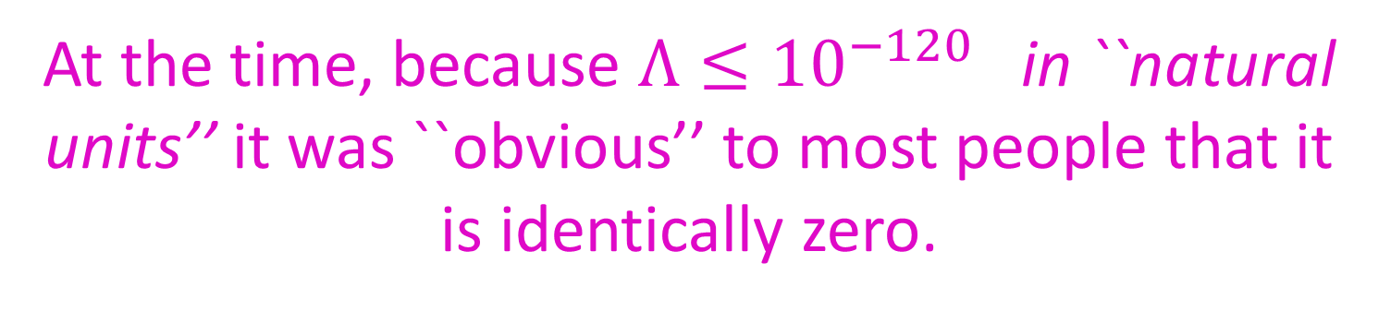
At Harvard/IAS in 1986-1987 I was interested in what string theory could say about the cosmological constant problem.
At the time, because $Λ≤{10}^{−120}$in ``natural units’’ it was ``obvious’’ to most people that it is identically zero.
Crossing the street at Harvard Square with Steve Weinberg
(Measured value ≅${10}^{−122}$ in Planck units $≅ {\left(0.008 eV\right)}^{4} )$
In string theory the (perturbative approx. to the )
cosmological constant is the partition function summed on genus g surfaces.

Slide 39



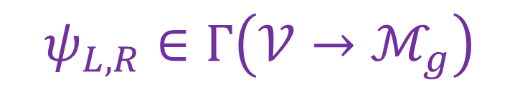
Heterotic string vacuum amplitude
(Belavin & Knizhnik; Friedan & Shenker):
$$Z =\left\langle ψ_{L} , ψ_{R}\right\rangle$$
$$ψ_{L,R}∈Γ\left(𝒱→ℳ_{g}\right)$$
Maybe $Z=⟨ψ_{L} , ψ_{R}⟩$ = 0 because of a
selection rule due to a symmetry?

Slide 40
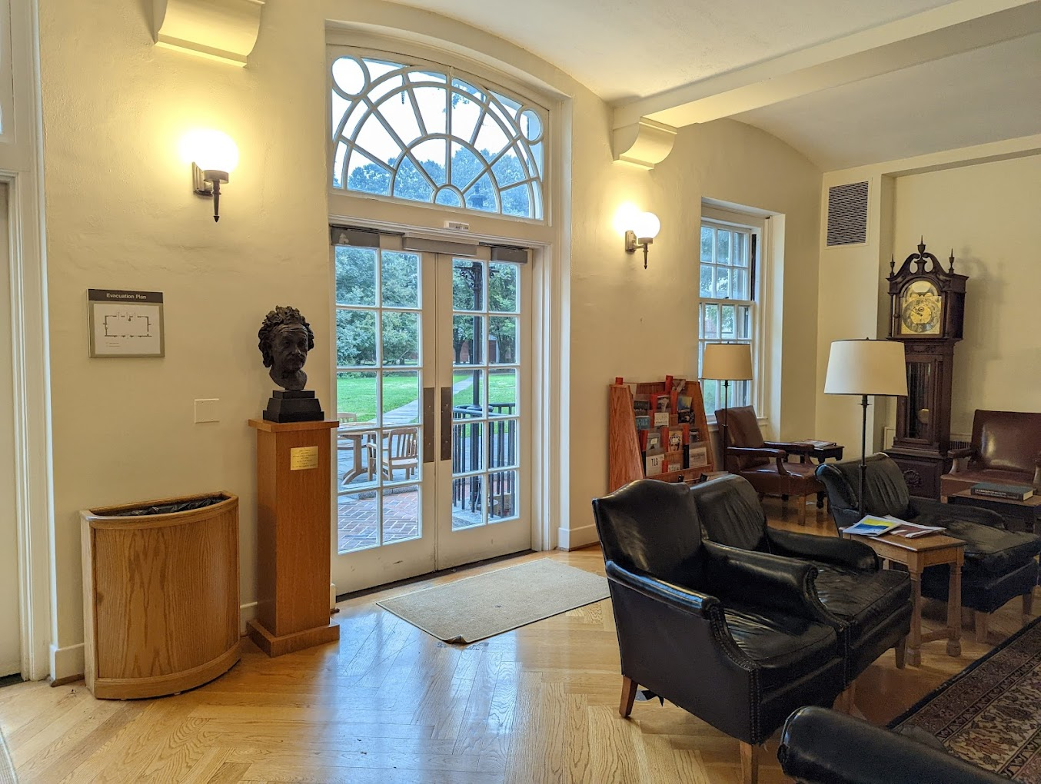
Discussion with Pierre Deligne at
IAS tea time about symmetries of moduli spaces: Atkin-Lehner symmetry.

Slide 41
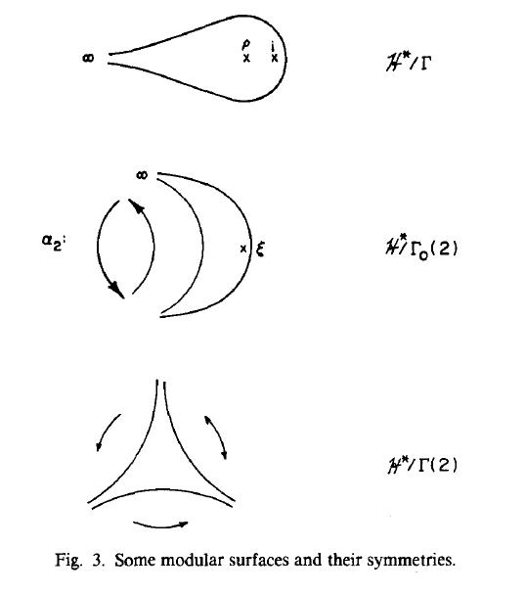

Slide 42
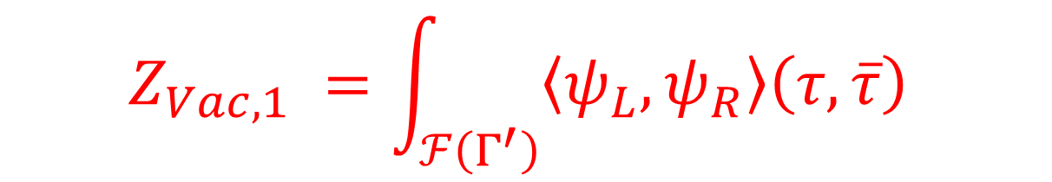
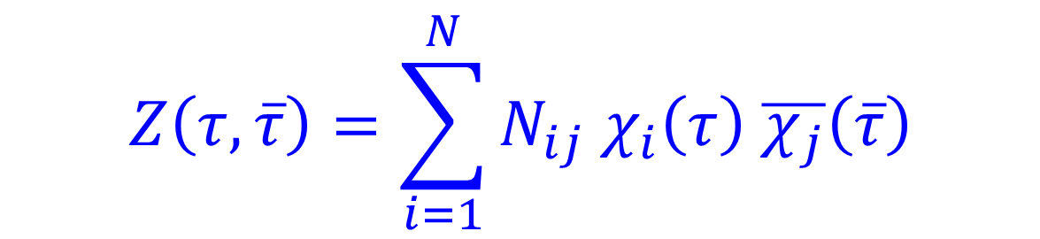

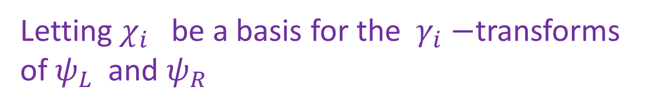

$$Z_{Vac,1} =\int_{ℱ\left(Γ^{′}\right)}{\left\langle ψ_{L},ψ_{R}\right\rangle \left(τ,\overline{τ}\right) }$$
$$PSL\left(2,ℤ\right)=\coprod_{i}{Γ^{′} ⋅γ_{i} }$$
Letting $χ_{i}$ be a basis for the $γ_{i}−$transforms of $ψ_{L}$and $ψ_{R}$
$$Z=\int_{ℳ_{1}}{Z\left(τ, \overline{τ}\right) }$$
$$Z\left(τ,\overline{τ}\right)=\sum_{i=1}^{N}{N_{ij} χ_{i}\left(τ\right) \overline{χ_{j}}\left(\overline{τ}\right)}$$

Slide 43
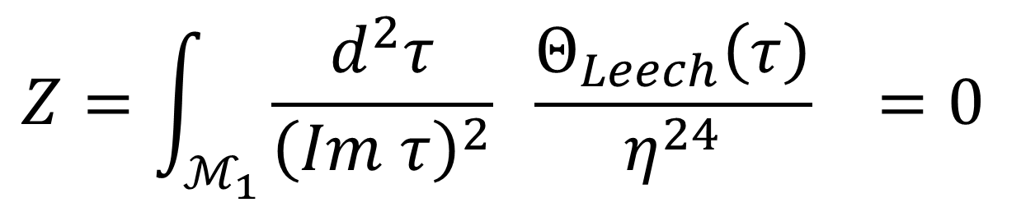
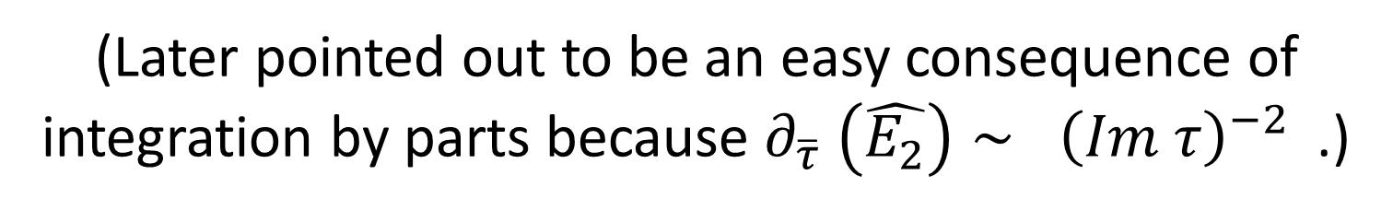
Use asymmetric orbifolds of Narain compactifications.
First example: $2d$compactification of heterotic string.
Amazing cancellation:
$$Z=\int_{ℳ_{1}}{\frac{d^{2}τ}{{\left(Im τ\right)}^{2}} \frac{Θ_{Leech}\left(τ\right)}{η^{24}} =0 }$$
(Later pointed out to be an easy consequence of integration by parts because $∂_{\overline{τ}} \left(\hat{E_{2}}\right)∼ {\left(Im τ\right)}^{−2}$.)

Slide 45
I spent a lot of time, with very limited success, trying to make models.
I decided to focus on what kind of CFT’s give partition functions which are finite sums of holomorphic times antiholomorphic functions of moduli

Slide 47
Probably the first mention of
``rational conformal field theories’’ in print.

Slide 48
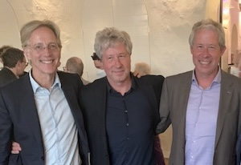
The Road from Utrecht

Slide 49
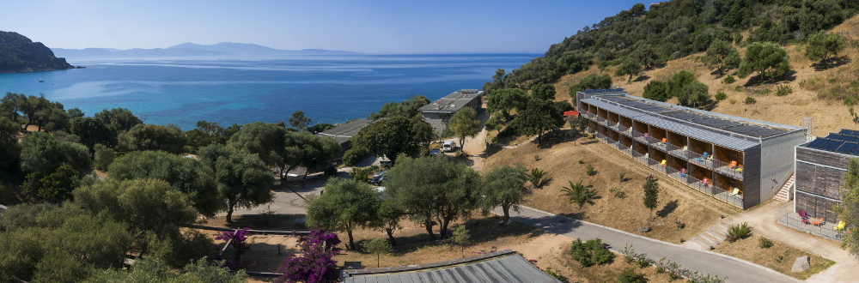
July 14-30, 1987

Slide 50
As you remember, when we first met at Cargese 1987, I was working with Herman and Robbert on c=1 CFT’s. This is also where I learned about the isolated c=1 models of Paul Ginsparg.
Other subjects that were covered at that school were orbifolds etc. I was very much influenced by the work of Dan Friedan and Steve Shenker (especially their paper on the analytic geometry of CFT), but also by all the developments related to the classification of modular invariants for minimal models and WZW models. People were also already thinking about extensions of the Virasoro algebra, such as W-algebras (e.g. by Kareljan Schoutens who was also at Utrecht). In the c=1 case we knew that rational radii were special and have an enlarged algebra .I think the relationship with theta functions and bosonization of fermions also made clear that there was something special about rational models.
In my recollection the concept of RCFT was natural consequence of the work of Dan and Steve, and I think Dan may have been the first to use this term. - Erik Verlinde, September 2024

Slide 53
Erik’s definition: Close to the modern one
Extended chiral algebra (holomorphic VOA) with finitely many (highest weight) representations.
The germ of the idea is already in the
DVV Cargese paper:

Slide 55
We’ll return to Erik’s paper (from March 1988)

Slide 56
1
Prehistory: A. 2dCFT and B. String Theory
2
Three Roads To RCFT: 1986-1987
3
Princeton: Fall 1987- January 1988
4
Braiding & Fusion & S & T: Moore & Seiberg Spring 1988
5
Chern-Simons Theory: July 1988- July 1989
6
MTC & Anyons: August 1989 – November 1989

Slide 60


Discussions with D. Friedan @ IAS
inspired me to try to prove that the central
charge and conformal weights in RCFT are $∈ℚ$
IAS tea time: I remarked to Greg Anderson
that we were interested in flat vector bundles:
He immediately said that we should be studying
ODE’s with regular singularities.

Slide 61
Representations of what???? We don’t say.

Slide 62
Used modular differential equations.

Slide 64
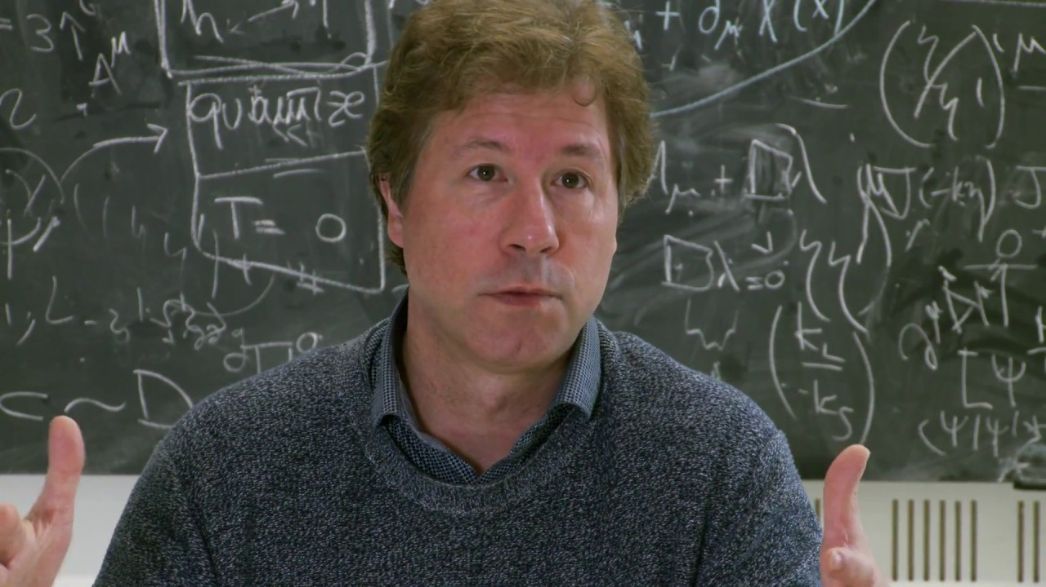
Jan. 5, 1988: Jadwin Hall, P.U.
E. Verlinde’s talk on modular transformations and the fusion rule algebra

Slide 66
First I thought about the operators in the c=1 model constructed out of the integrals of del phi, which later became a special case of the Verlinde operators. I discussed these ideas with Robbert and Herman at the time, and this ended up in the proceedings of the Cargese school. My goal was to see if similar operators could be defined for the other conformal field theories. Holomorphic factorisation was important for this, which was already emphasised in the work of Dan and Steve. In October 1987 I made my breakthrough.
- Erik Verlinde, Sept. 2024

Slide 67
Recalling what was done in the DVV Cargese paper

Slide 68
Generalizes to all RCFTs.
Identifies fusion rules with matrix coefficients of the Verlinde operator.
Fusion rules define an ALGEBRA.
From the construction, obviously diagonalized by the S-matrix.

Slide 69
Next day there was an important meeting
(first of three in this talk) in Witten’s office in D-building
with Kazhdan, Moore, Seiberg, and Witten. Trying to figure out what Erik had said.
Witten: ``It’s magic.’’
Erik released a preliminary version of his paper during his Princeton visit.
Crucial discussion with Erik about how to prove it.
He suggests looking at 2-point functions on the torus.

Slide 72
Elegant.
Readable.
Convincing.
David Kazhdan’s quip:
Physics is very interesting, there are many interesting theorems. Unfortunately, there are no definitions.

Slide 73
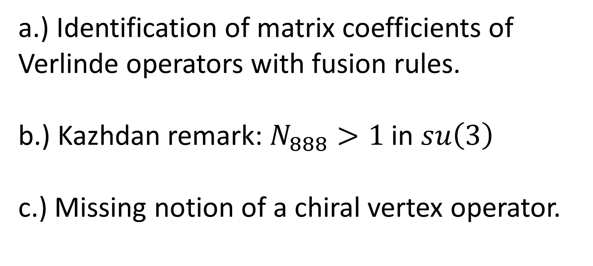
a.) Identification of matrix coefficients of Verlinde operators with fusion rules.
b.) Kazhdan remark: $N_{888}>1$in $su\left(3\right)$
c.) Missing notion of a chiral vertex operator.

Slide 74
1
Prehistory: A. 2dCFT and B. String Theory
2
Three Roads To RCFT: 1986-1987
3
Princeton: Fall 1987- January 1988
4
Braiding & Fusion & S & T: Moore & Seiberg Spring 1988
5
Chern-Simons Theory: July 1988- July 1989
6
MTC & Anyons: August 1989 – November 1989

Slide 75
January-February 1988: Discussions start with Seiberg
(and Tom Banks)
1. BPZ/FQS minimal models/unitarity classification
2. Constraints of modular invariance
3. c=1 classification of DVV & Ginsparg
4. Capelli,Itzykson,Zuber classification of SU(2) WZW models
5. Verlinde’s conjecture
The time for systematic
classification seemed right.

Slide 76
Someone (Goddard, Segal, or Witten) put Tsuchiya-Kanie’s paper in my hand

Slide 77
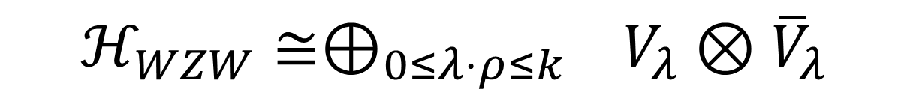
Notice: Completely chiral, even the Hilbert space $ℋ$!
$$ℋ_{WZW}≅⊕_{0≤λ⋅ρ≤k} V_{λ}⊗{\overline{V}}_{λ}$$

Slide 78
Chiral vertex operators

Slide 79
Braiding & Yang-Baxter

Slide 80
Tsuchiya-Kanie study fusion
But end their paper with complicated explicit formulae for connection coefficients for the KZ equation in the SU(2) WZW case. They did not introduce a fusion tensor.

Slide 81
Important follow-up to Tsuchiya-Kanie.
Studied monodromy representations provided by the Knizhnik-Zamolodchikov equations on the plane, and the relation to the braid group representations.
It did not influence me, but it did influence others in the field: Fröhlich, Segal, Witten
Did not combine the operations of braiding and fusing or generalize to higher genus.

Slide 82
Discussions
with Seiberg:
Polynomial constraints on braiding, fusion, and modular transformation matrices

Slide 86
The talk devoted a lot of space to a proof of the Verlinde conjecture using those relations.

Slide 87
2nd important meeting in Witten’s office in D-building
The day after my IAS seminar we met with Pierre Deligne (maybe also Kazhdan) in Witten’s office. Deligne explained to us about tensor categories.

Slide 88
Attitudes About Categories
I was aware of them, but had not studied anything in depth.
I did not take category theory seriously,
regarding it as overly formal abstract nonsense with no real content.
And I generally made fun
of category theory.

Slide 89
My joking response to Cumrun:
``Oh you’re just defining a functor.’’
We both laughed, and that was that.

Slide 90
From writeup of my Cargese talk:
Vanishing Vacuum Energies, 10/87:
Most other physicists I talked to didn’t know about category theory, and didn’t like it when it was explained.

Slide 91
I met MacLane years later. He sought me out to remind me of this and said he was very amused.

Slide 92
After the Deligne/Kazhdan/Witten response to my April 22, 1988 seminar we took categories seriously, and started studying

Slide 93


No categories. (Other than footnote with blooper.)
Change $C,N$ to $B,F .$
``Almost proved’’ $⇒$proved.

Slide 94
But we failed to appreciate the importance/
significance.
Other than the fact that it allowed us to give projective representations of mapping class groups at all genus and thereby define a
(finite-dimensional) modular geometry in the sense of Friedan & Shenker.

Slide 95
3-step classification program for RCFTs
Classify solutions to the polynomial equations.
(i.e. classify MTC’s.)
2. Use categorical viewpoint and try to imitate ``Tannakian’’ reconstruction to construct the chiral theory – up to holomorphic conformal field theories with trivial braiding/fusion/S-matrix.
3. Then classify the ways chiral parts can be glued together to make a full RCFT.

Slide 96
Combining Left and Right movers:
Automorphisms of the fusion rule algebra. (Parallel paper of Dijkgraaf-Verlinde.)
But again we failed to appreciate the importance/significance.

Slide 97
And we introduced more formally the idea of extensions of chiral algebras as a way to generate new RCFTs’
Add an integer spin holomorphic field to the chiral algebra (VOA) and only keep fields local with respect to that field.

Slide 98
Condensation
The key idea of “extensions of chiral algebras’’ led
to the topic of ``anyon condensation’’ in papers of
Bais and Slingerland in their study of spontaneous symmetry breaking of quantum group symmetry

Slide 99
Condensation
Nati and I have been very critical of the
use of the word “condensation’’
initiated by Bais and Slingerland
(and it has since become widespread and standard)
But… Preparing for this talk I found
an unpublished M&S paper …

Slide 100
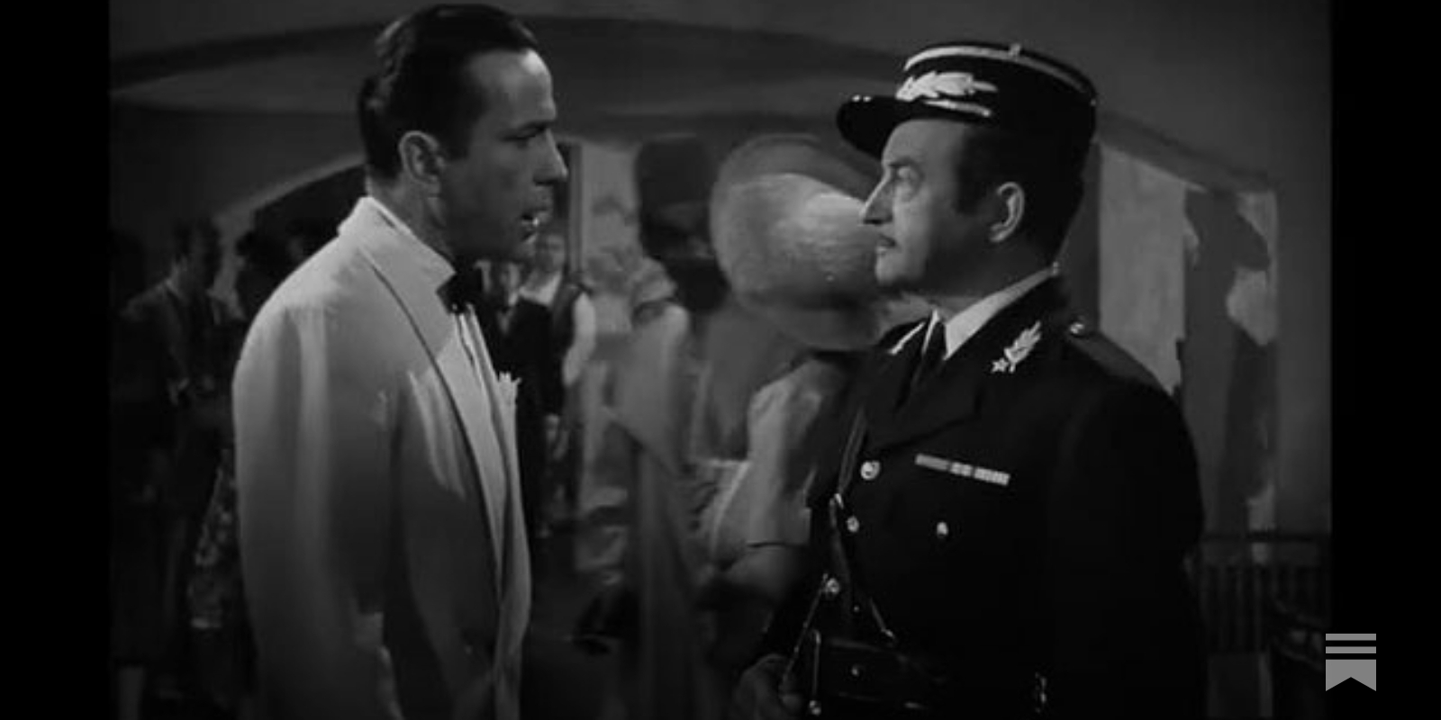
I’m Shocked! Shocked! To find that condensation has been going on at the Institute!

Slide 101
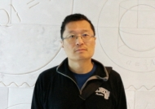
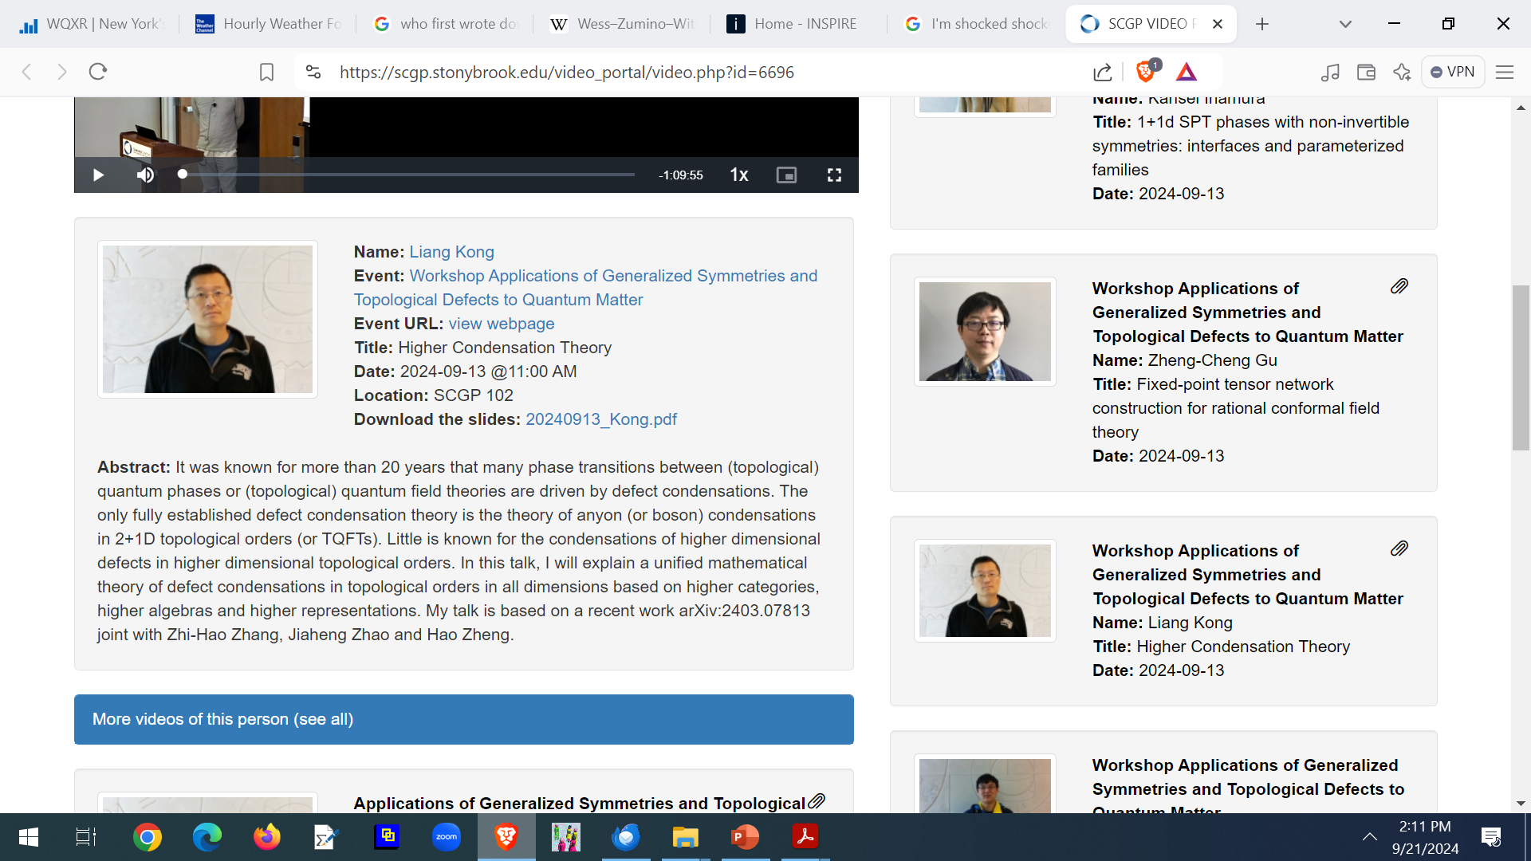
1307.8244
2204.02407
SCGP Workshop 20240913

Slide 102
Some Modern Developments:
Combining left-movers and right-movers is now understood in terms of topological defect operators:
Frohlich, Fuchs, Runkel, Schweigert, 0909.5013
Kapustin-Saulina, 1012.0911
A. Davydov, 1312.7466,1412.8505
But a systematic classification like that of
CIZ seems out of reach.

Slide 104
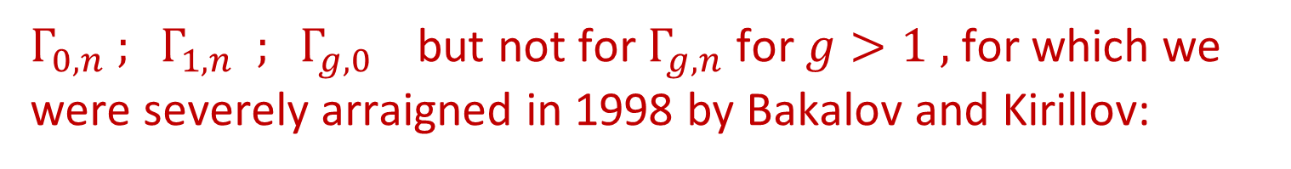
$Γ_{0,n} ; Γ_{1,n} ; Γ_{g,0}$ but not for $Γ_{g,n}$for $g>1 ,$for which we were severely arraigned in 1998 by Bakalov and Kirillov:

Slide 105
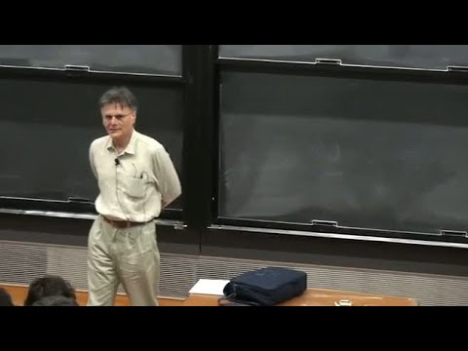
Parallel Developments At The Time
Graeme Segal: The definition of conformal field theory
Como, August 24–29, 1987.

Slide 106
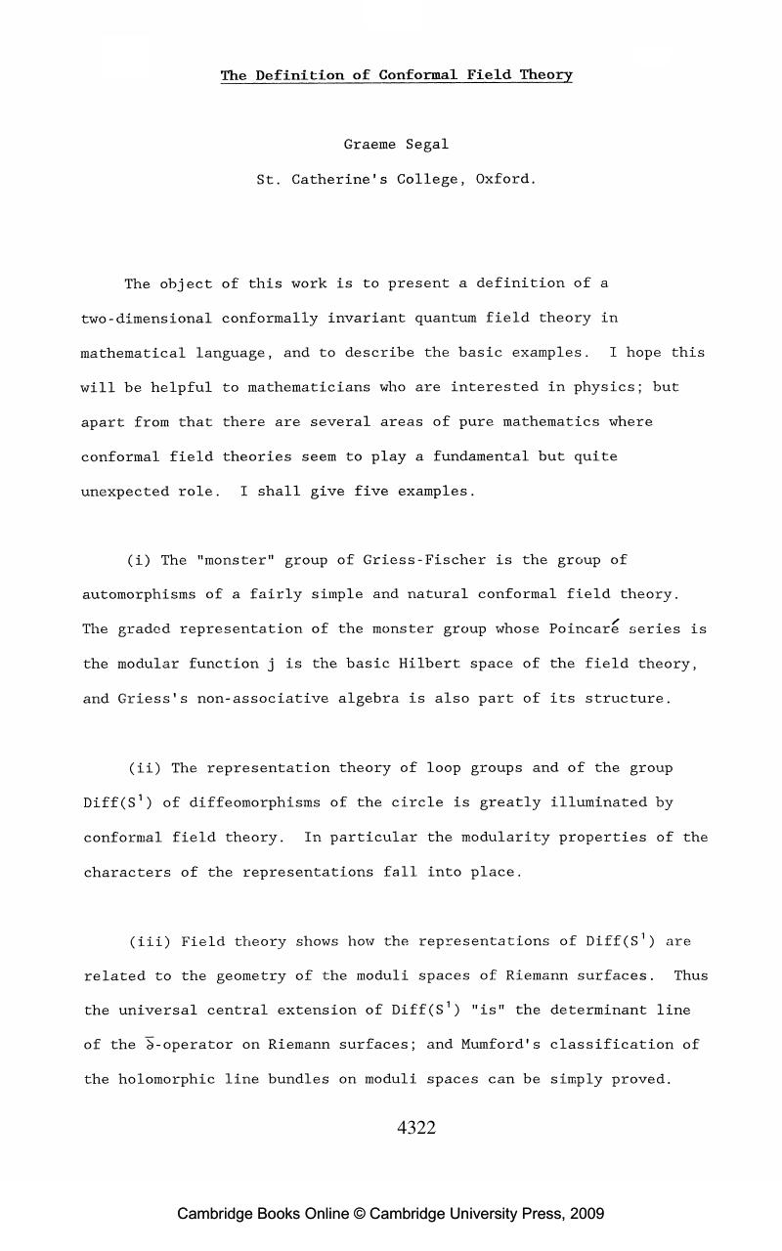

Slide 107
IXth International Congress on Mathematical Physics, Swansea,
July 1988. More on that later.

Slide 108
Parallel Developments At The Time
Constructive/Algebraic QFT Community:

Slide 109
MS Naturality paper cite credit for chiral vertex operators:
Using the approach to conformal blocks suggested by algebraic quantum field theory one is led to a concept of an ``exchange algebra’’ – very similar to the braiding algebra of chiral vertex operators.

Slide 110
Parallel Developments In Math
Braided ribbon tensor categories.
Motivations came from topology and higher category theory.

Slide 111
1
Prehistory: A. 2dCFT and B. String Theory
2
Three Roads To RCFT: 1986-1987
3
Princeton: Fall 1987- January 1988
4
Braiding & Fusion & S & T: Moore & Seiberg Spring 1988
5
Chern-Simons Theory: July 1988- July 1989
6
MTC & Anyons: August 1989 – November 1989

Slide 112
Chern-Simons Theory
Complicated and intricate history – deserving of an entirely separate talk.
1. Witten: Swansea and the Jones Polynomial
2. My trip to the Soviet Union, August 1988
3. Taming the conformal zoo
4. Explicit quantization:
Eliztur et. al. & Axelrod-Della Pietra-Witten

Slide 113
IXth International Congress on Mathematical Physics 17-27 July 1988, Swansea, UK
Atiyah, Segal, and Witten go to dinner at Annie’s restaurant.
All the pieces for the CS interpretation of the Jones polynomial fall into place for Witten.
He changes his talk for the next day.
3rd Important meeting in Witten’s office in D-building. Nati and I are stunned.

Slide 116
My trip to the Soviet Union:
2nd half of August 1988
Going to the Gelfand seminar in Moscow
(and risking my life).
2. Going to Faddeev’s institute in Leningrad (and almost getting arrested)
Discussions with Reshetikhin and Turaev: They were working on both quantum group representation theory and
3-manifold invariants.
4. Smuggling out manuscripts: The plane takes off

Slide 117
Following up on a paragraph in Witten’s paper ``Taming’’ explained how edge states naturally follow from the CSW theory on 3-fold with boundary.
(edge states will be relevant to the FQHE application )
Modern viewpoint is quite different: Boundary field theory & anomaly inflow

Slide 118
The paper also showed that all known RCFT’s, and all known methods of generating new RCFT’s fit into the framework of CSW theory with a compact Lie group.
Classification conjecture: Compact Lie groups.

Slide 119
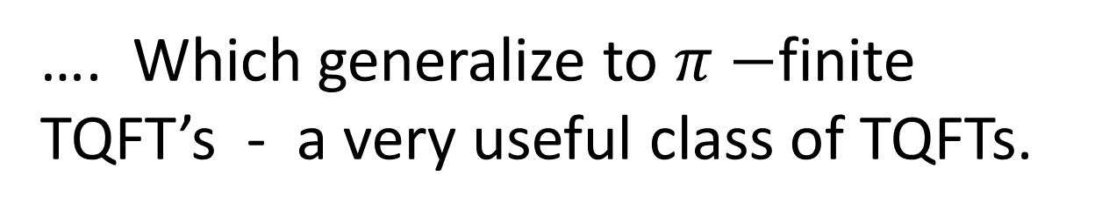
Finite groups are
compact Lie groups!
Beautiful work by Freed and Dijkgraaf-Witten led to the very fruitful subject of Dijkgraaf-Witten theories
…. Which generalize to $π−$finite TQFT’s - a very useful class of TQFTs.

Slide 120
Solving Chern-Simons theory with geometric quantization:
… and many other related papers in at the time …

Slide 121
Starting in the early 1980’s collaboration via email began. Here’s an example:

Slide 122

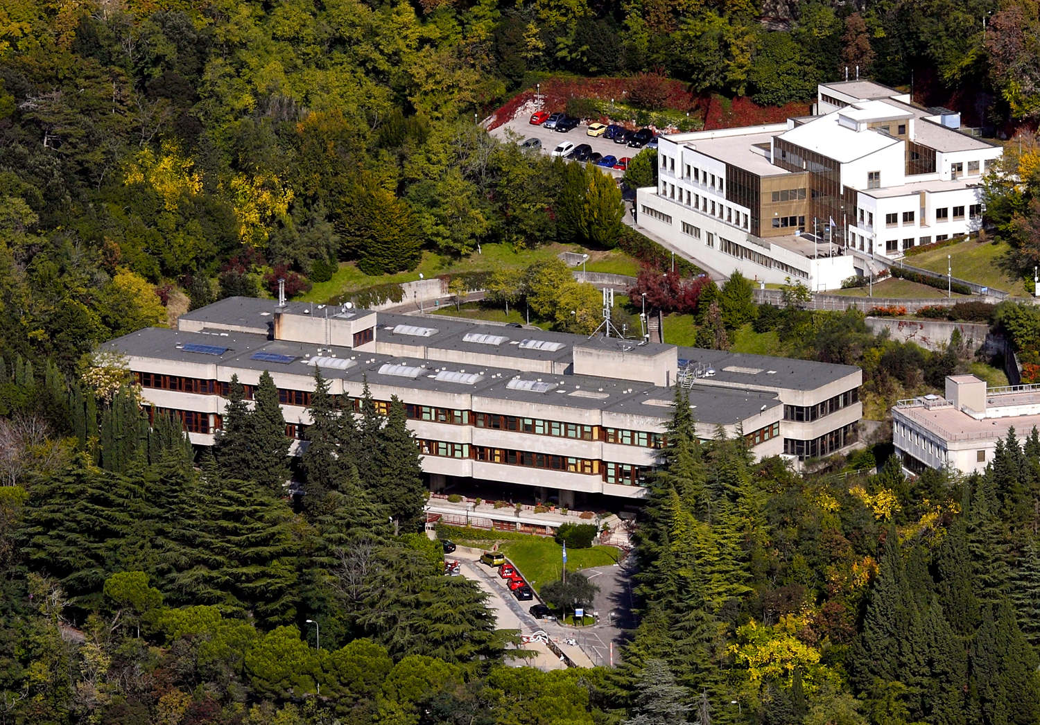

Moore Trieste 1989 Lectures
Seiberg 1989 Banff Lectures

Slide 125
These are the same as the modern axioms for an MTC expressed in terms of tensors derived using a set of simple objects.
Except:
Imposed modular identities on S.

Slide 126
The name modular tensor category
was invented by Igor Frenkel
The first time it appeared in print

Slide 127

Modern Definition (Turaev 92)
MTC: = Semisimple linear ribbon category
with finitely many simple objects and nondegenerate matrix:
$$S_{ij}:=Tr b_{i,j}∘b_{j,i}$$
Ribbon category = braided tensor category with twists and compatible duals.

Slide 128
Modern Definition
Emerged from works:
M&S, Lectures on RCFT
Reshetikhin-Turaev: 2 famous papers on quantum groups and invariants of links in 3-folds
Turaev, Modular categories and 3-manifold invariants, Int. J. Mod. Phys. 1992
Lyuboshenko, …

Slide 129
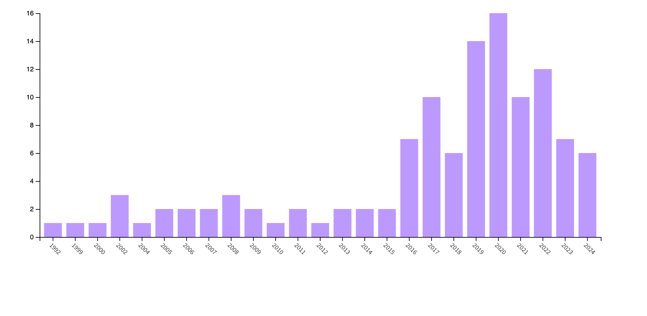
Web of Science search (20240922) for
``modular tensor category’’ in the abstract of published papers in its data base, as a function of time: 116 results.
Note: zero between 1992 and 1999.

Slide 130
The classification conjecture:

Slide 131
With most straightforward interpretation of ``equivalence’’ the conjecture is false: Teleman 2021
https://math.berkeley.edu/~teleman/paperlist.html
Nov. 11, 2021

Slide 132
The classification conjecture: Current Status
Correct version of ``equivalence’’ is Witt equivalence
Importance of Witt equivalence was not appreciated (by me) in 1989.
Witt equivalence $∼ Existence of topological interface$
Kitaev, arXiv:cond-matt/0506438
Kapustin-Saulina 1012.0911
Witt equivalence $∼ ⊗$ Drinfeld center of fusion category
Davydov, Müger, Nikschych, and Ostrik, 1009.2117
Davydov, Nikschych, and Ostrik, 1109.5558

Slide 133
Does every Witt equivalence class contain a WCS(G,k) for compact G ?
(Yes, but in a trivial and unsatisfying way with $G=1. )$
MTC = Drinfeld center of the Haagerup fusion category.
Is it the MTC of some RCFT?
All three steps of the proposed classification program from 1988-1989 are far from complete.

Slide 134
1
Prehistory: A. 2dCFT and B. String Theory
2
Three Roads To RCFT: 1986-1987
3
Princeton: Fall 1987- January 1988
4
Braiding & Fusion & S & T: Moore & Seiberg Spring 1988
5
Chern-Simons Theory: July 1988- July 1989
6
MTC & Anyons: August 1989 – November 1989

Slide 135
Nonabelions
Prehistory: See G. Goldin article.
Nick Read and the Pfaffian state
Talk at Soviet-American conference:
[October or November 1989
4. Kitaev 1997, 2006: It suddenly becomes relevant
5. Current experimental status.
Recent work on several platforms

Slide 138
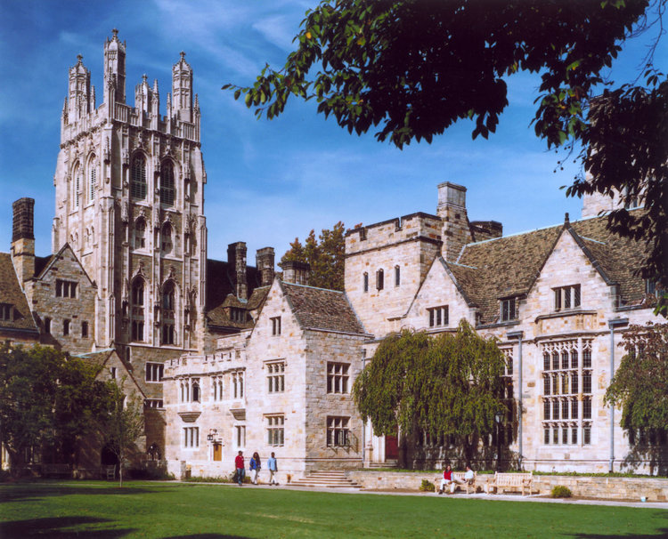
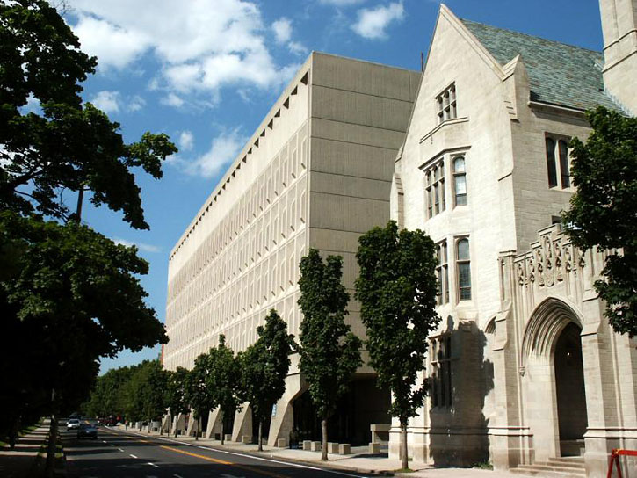
August 1989: Camping out at Yale

Slide 139
I wanted to apply MTC’s to anyon physics:
So, first thing upon arrival at Yale, August 1989
was to go see Nick Read.
In our very first conversation we had the Pfaffian state. One motivation for the Pfaffian state was the conformal blocks of the Ising model. This fit nicely with ideas Nick had about pairing and condensation.

Slide 141
Probably the first occurrence of the term``nonabelion’’.

Slide 143
Soviet-American Workshop On String Theory, Princeton University, Oct. 30 - Nov. 2, 1989

Slide 147

Reception:
One problem:
Overt hostility to the use of category theory.
For better or worse, I completely dropped this line of research and started working on matrix models of 2d gravity…

Slide 148
From Wikipedia article on “Anyon”
While at first non-abelian anyons were generally considered a mathematical curiosity, physicists began pushing toward their discovery when Alexei Kitaev showed that non-abelian anyons could be used to construct a topological quantum computer.

Slide 150
Experimental realization of nonabelions has not yet (20240926) been achieved.
But several encouraging experimental results exist – especially for the Majorana edge mode, in different platforms
(e.g. GsAs, graphene)
And several groups are getting
extremely close….

Slide 151
Thanks go to
Tom Banks, Dan Freed, Igor Frenkel,
Daniel Friedan, Chetan Nayak, Karin Rabe,
Nick Read, Graeme Segal, Nathan Seiberg, Steve Simon, Erik Verlinde, Edward Witten
for help providing relevant material and correcting errors

Slide 152

NOT

