Slide 1
K3 Surfaces,
Mathieu Moonshine, and Quantum Codes
Gregory Moore
Rutgers
Freed60, University of Austin,
January 15, 2019

Slide 2
a project with Jeff Harvey
….. still in progress ….

Slide 3
1
Brief Background On Moonshine
2
Quantum Mukai Theorem & GTVW Model
3
Supercurrents & Codes
4
RR States: MOG Construction Of The Golay Code
5
Conway Group Moonshine
6
Conclusion

Slide 4
Philosophy – 1/2
We can divide physicists into two classes:
Our world is a random choice drawn from a huge ensemble:

Slide 5
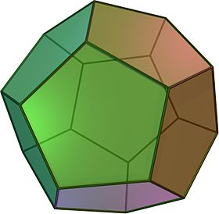
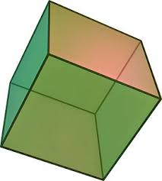
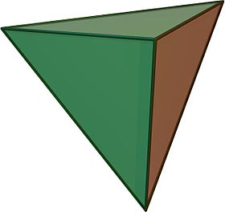
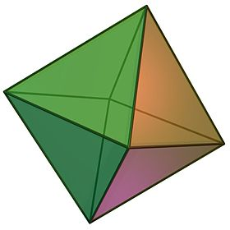
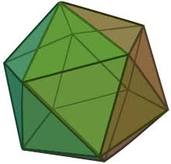
Philosophy – 2/2
The fundamental laws of nature are based on some beautiful exceptional mathematical structure:

Slide 6


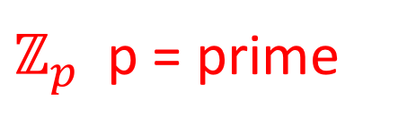
Background: Finite-Simple Groups
Jordan-Holder Theorem: Finite simple
groups are the atoms of finite group theory.
$ℤ_{p}$ p = prime
$$A_{n} n≥5$$
$SL_{n}(𝔽_{p})$ etc.
Notes:
M stands for ”Monster” but it could also stand for “Magic” because there are many truly amazing properties it satisfies.

Slide 7
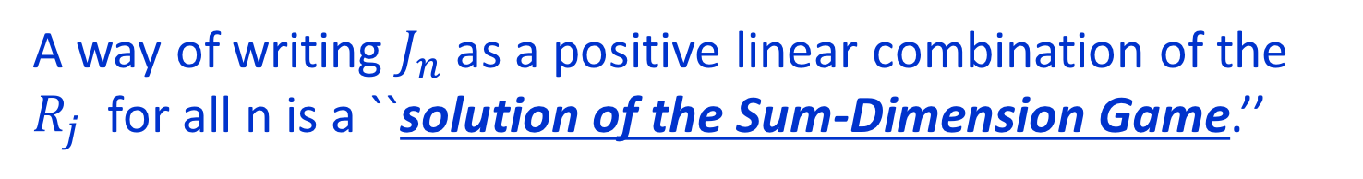
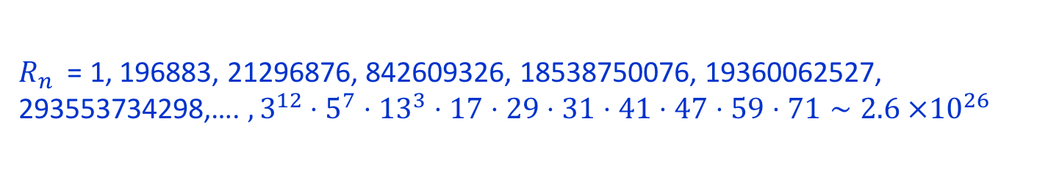





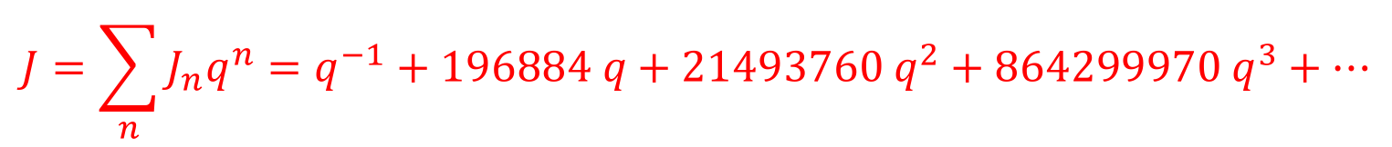
Background: McKay & Conway-Norton 1978-1979
$$J=\sum_{n}{J_{n}q^{n}=q^{−1}+196884 q+21493760 q^{2}+864299970 q^{3}+⋯}$$
Now list the dimensions of irreps of $𝕄$
$R_{n}$ = 1, 196883, 21296876, 842609326, 18538750076, 19360062527, 293553734298,…. $, 3^{12}⋅5^{7}⋅{13}^{3}⋅17⋅29⋅31⋅41⋅47⋅59⋅71∼2.6 ×{10}^{26}$
$$J_{−1 }=R_{1}$$
$$J_{1}=R_{1}+R_{2}$$
$$J_{2}=R_{1}+R_{2}+R_{3}$$
$$J_{3}={2R}_{1}+{2R}_{2}+R_{3}+R_{4}$$
A way of writing $J_{n}$as a positive linear combination of the $R_{j}$ for all n is a ``solution of the Sum-Dimension Game.’’
There are infinitely many such solutions!!

Slide 8
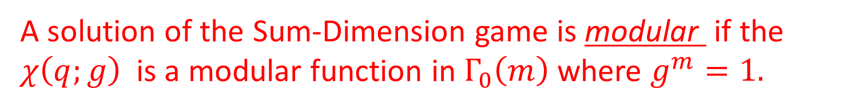

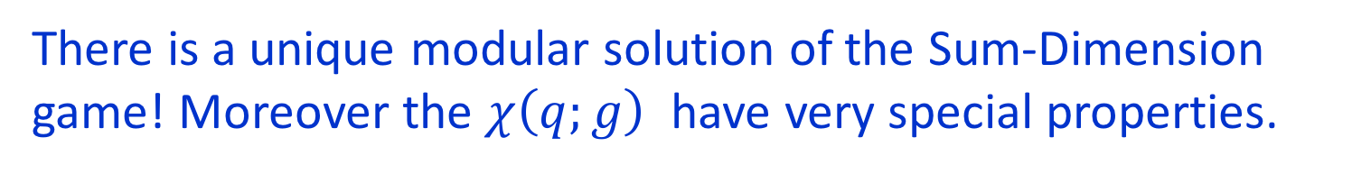

Background: Monstrous Moonshine
Which, if any, of these solutions is interesting?
Every solution defines an infinite-dimensional
$ℤ$-graded representation of $𝕄$
$$V=q^{−1} R_{1}⊕q\left(R_{1}⊕R_{2}\right)⊕q^{2}\left(R_{1}⊕R_{2}⊕R_{3}\right)⊕⋯$$
Now for every $g∈𝕄$we can compute the character:
$$χ\left(q;g\right)≔Tr_{V} {g q}^{N}$$
A solution of the Sum-Dimension game is modular if the $χ\left(q;g\right)$is a modular function in $Γ_{0}\left(m\right)$where $g^{m}=1.$
There is a unique modular solution of the Sum-Dimension game! Moreover the $χ\left(q;g\right)$ have very special properties.
Notes:
That is the Moonshine phenomenon.

Slide 9


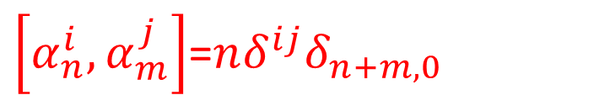
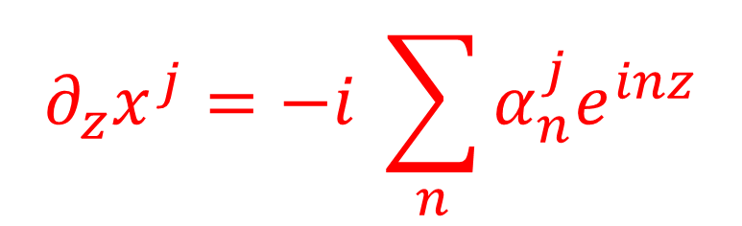
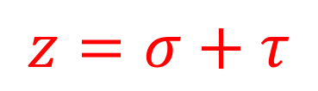
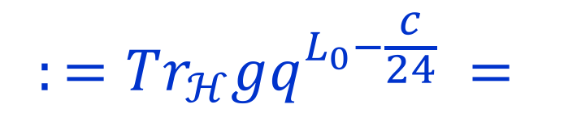
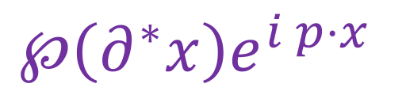
FLM Construction -1/3
String theory compactification of chiral bosonic string on a torus:
$$∂_{z}x^{j}=−i \sum_{n}{α_{n}^{j}e^{inz}}$$
$j=1,…, 24$
$$z=σ+τ$$
$\left[α_{n}^{i}, α_{m}^{j}\right]$=$nδ^{ij}δ_{n+m,0}$
$$α_{0}^{j}=p^{j}∈Λ$$
OPE of conformal fields form a VOA:
$$℘\left(∂^{∗}x\right)e^{i p⋅x}$$
g
$$:=Tr_{ℋ}gq^{L_{0}−\frac{c}{24}} =$$
g
1
1
Modularity

Slide 10

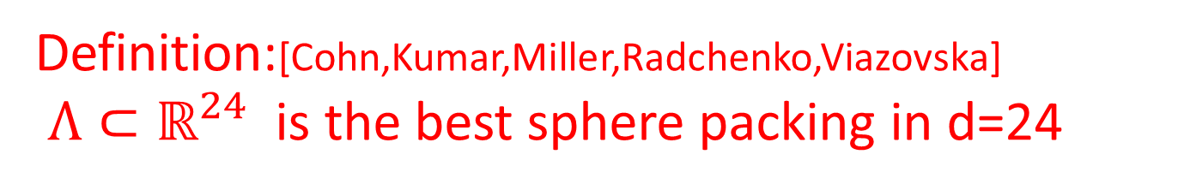

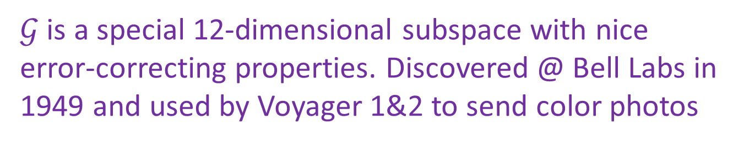
Leech & Golay
FLM use torus associated to Leech lattice $Λ:$
Definition:[Cohn,Kumar,Miller,Radchenko,Viazovska]
$Λ⊂ℝ^{24}$ is the best sphere packing in d=24
$Aut\left(Λ\right)=Co_{0}⊂SO(24)$
$Λ$ can be constructed using the Golay code $𝒢⊂𝔽_{2}^{24}$
$𝒢$ is a special 12-dimensional subspace with nice error-correcting properties. Discovered @ Bell Labs in 1949 and used by Voyager 1&2 to send color photos
Definition: $M24⊂S_{24}$ is the subgroup
of permutations preserving the set $𝒢$
Notes:
Later I will show you how you can construct the Golay code for yourself
At your own kitchen table – were you so inclined

Slide 11





FLM Construction – 2/3
Now ``orbifold’’ by $\vec{x}→−\vec{x}$for $\vec{x}∈ℝ^{24}/Λ$
‘’Orbifold by a symmetry G of a CFT’’:
Gauge the symmetry
Different G-bundles over the circle
$$ℋ_{untwisted}$$
$$Φ\left(σ+2π\right)=Φ\left(σ\right)$$
$$ℋ_{[g]−twisted}$$
$$Φ\left(σ+2π\right)=g⋅Φ\left(σ\right)$$

Slide 12


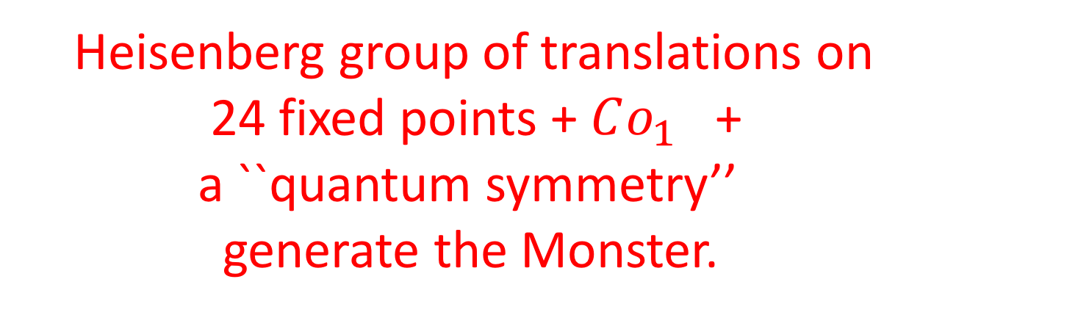
$𝕄$ As An Automorphism Group
Automorphisms of the OPE algebra of the quotient theory = $𝕄$
FLM & Borcherds:
Heisenberg group of translations on
24 fixed points + $Co_{1}$ +
a ``quantum symmetry’’
generate the Monster.
This is the gold standard for the conceptual explanation of Moonshine-modularity
(But a truly satisfying conceptual explanation
of genus zero properties remains elusive.)

Slide 13
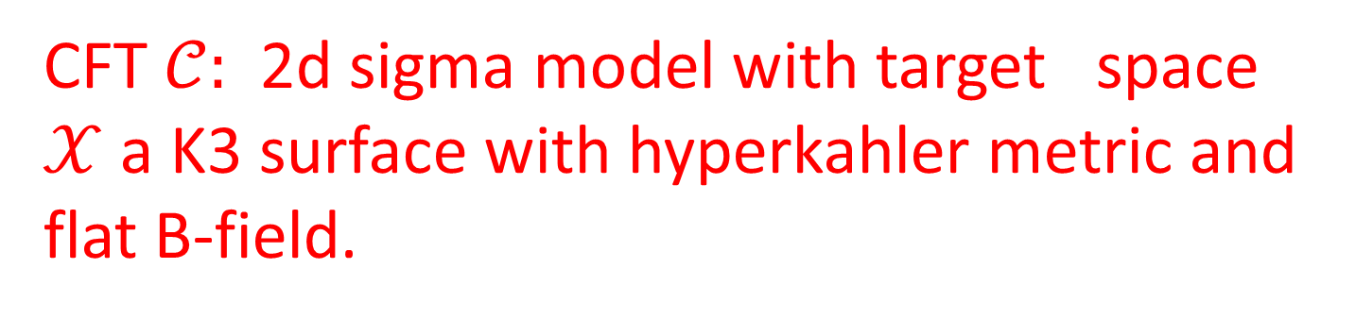
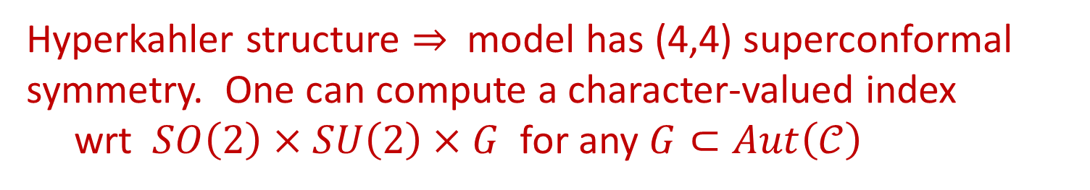

New Moonshine: Mathieu Moonshine
Eguchi, Ooguri, Tachikawa 2010
CFT $𝒞:$ 2d sigma model with target space $𝒳$a K3 surface with hyperkahler metric and flat B-field.
Elliptic genus: A character-valued
index on the loop space $L𝒳$
Hyperkahler structure $⇒$ model has (4,4) superconformal symmetry. One can compute a character-valued index
wrt $SO\left(2\right)×SU\left(2\right)×G$ for any $G⊂Aut\left(𝒞\right)$

Slide 14
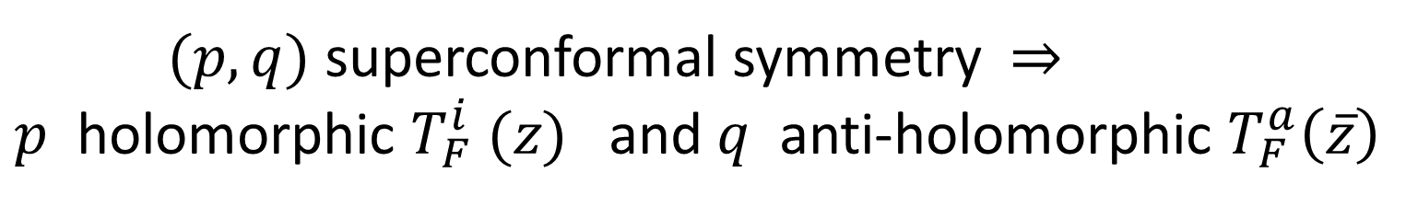
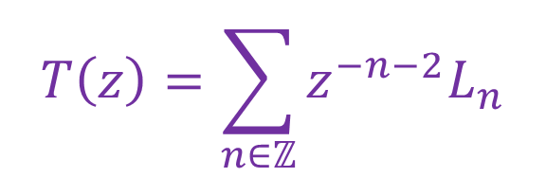

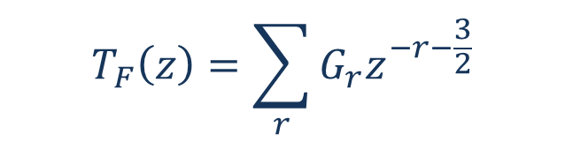
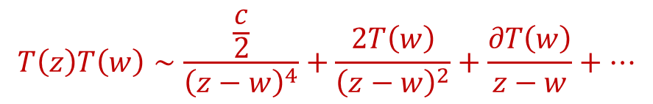
(Super-) Conformal Symmetry:
$$\left[L_{n},L_{m}\right]=\left(n−m\right)L_{n+m}+\frac{c}{12}\left(n^{3}−n\right)δ_{n+m,0} n,m∈ℤ$$
$$T\left(z\right)=\sum_{n∈ℤ}{z^{−n−2}L_{n}}$$
$$T\left(z\right)T\left(w\right)∼\frac{\frac{c}{2}}{{\left(z−w\right)}^{4}}+\frac{2T\left(w\right)}{{\left(z−w\right)}^{2}}+\frac{∂T\left(w\right)}{z−w}+⋯$$
Superconformal symmetry $⇒$ $ℤ_{2}−$graded extension
$$T_{F}\left(z\right)T_{F}\left(w\right)∼\frac{\frac{\hat{c}}{4}}{{\left(z−w\right)}^{3}}+\frac{\frac{1}{2}T\left(w\right)}{z−w}+⋯$$
$$T_{F}\left(z\right)=\sum_{r}{G_{r}z^{−r−\frac{3}{2}}}$$
$(p,q)$ superconformal symmetry $⇒$
$p$ holomorphic $T_{F}^{i} (z)$ and $q$ anti-holomorphic $T_{F}^{a}\left(\overline{z}\right)$

Slide 15
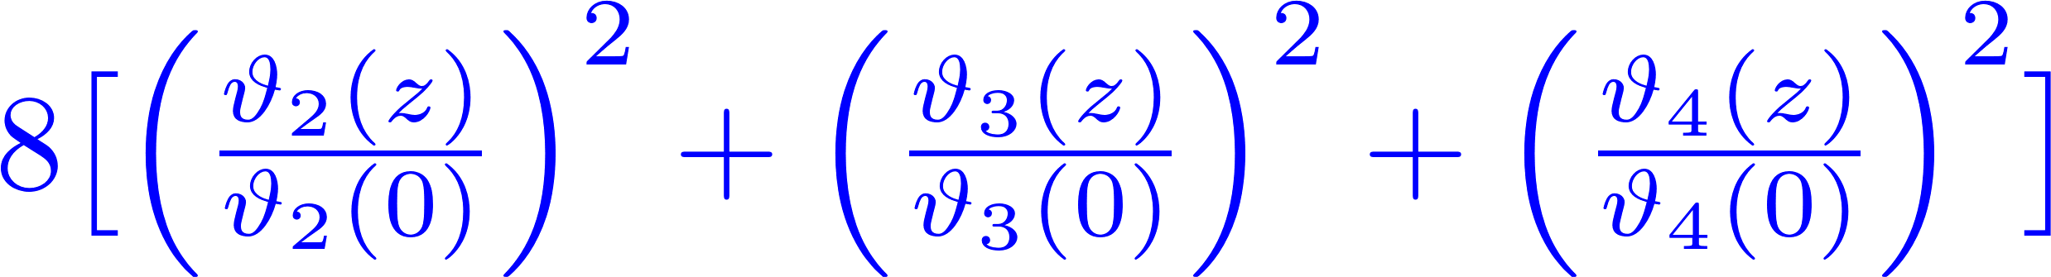

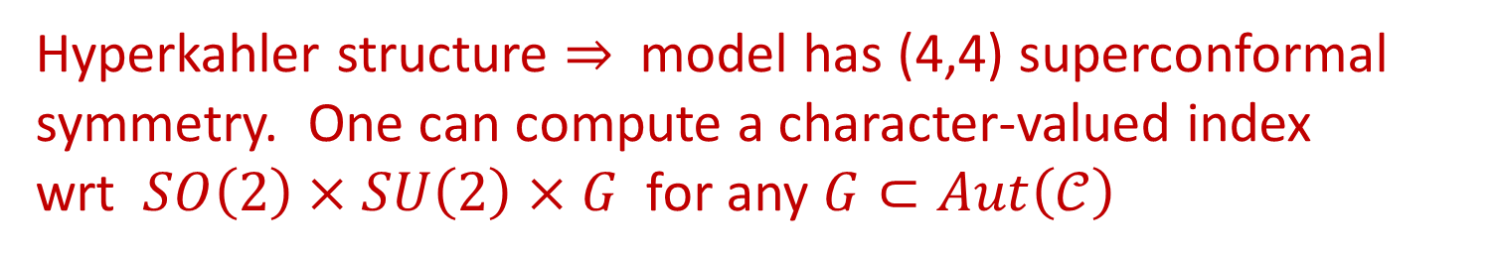
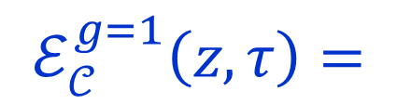
Elliptic Genus Of K3
Hyperkahler structure $⇒$ model has (4,4) superconformal symmetry. One can compute a character-valued index
wrt $SO\left(2\right)×SU\left(2\right)×G$ for any $G⊂Aut\left(𝒞\right)$
$$ℰ_{𝒞}^{g}\left(z,τ\right)=Tr_{ℋ_{RR}}{\left(−1\right)}^{F}⋅ g {⋅ e}^{2π i τ \left(L_{0}−\frac{c}{24}\right)+2πi z J_{0}^{3} −2πi \overline{τ}\left({\tilde{L}}_{0}−\frac{c}{24}\right)}$$
g
$$=$$
Modularity
1
Example:
$$ℰ_{𝒞}^{g=1}\left(z,τ\right)=$$

Slide 16
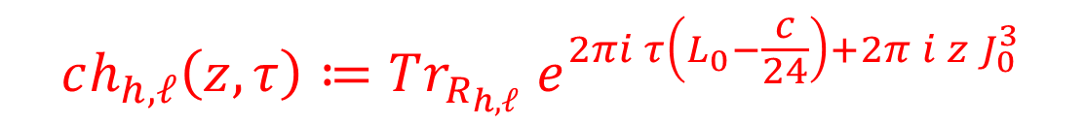

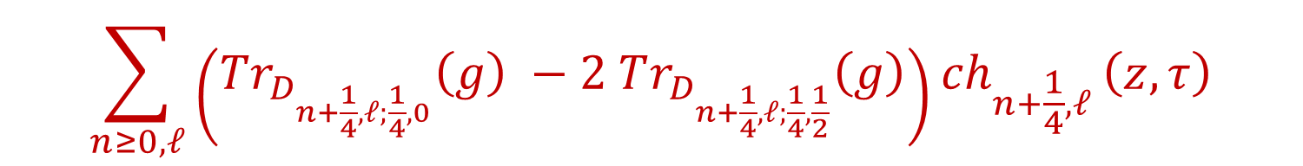
New Moonshine: Mathieu Moonshine
Model has (4,4) susy so consider isotypical decomposition:
$$ℋ_{RR}= ⊕_{h,ℓ;\tilde{h},\tilde{ℓ}}D_{h,ℓ;\tilde{h},\tilde{ℓ}} R_{h,ℓ}⊗{\tilde{R}}_{\tilde{h},\tilde{ℓ}}$$
$R_{h,ℓ}$ : Untry highest weight irrep of N=4 with $L_{0}v=h v$ and $J_{0}^{3}v=ℓ v$
$$ch_{h,ℓ}\left(z,τ\right)≔Tr_{R_{h,ℓ}} e^{2πi τ\left(L_{0}−\frac{c}{24}\right)+2π i z J_{0}^{3}}$$
$$ℰ_{𝒞}^{g}\left(z,τ\right)=$$
$$\sum_{n≥0, ℓ}{\left(Tr_{D_{n+\frac{1}{4},ℓ;\frac{1}{4},0}}\left(g\right) −2 Tr_{D_{n+\frac{1}{4},ℓ;\frac{1}{4},\frac{1}{2}}}\left(g\right)\right){ch}_{n+\frac{1}{4},ℓ}}\left(z,τ\right)$$

Slide 17
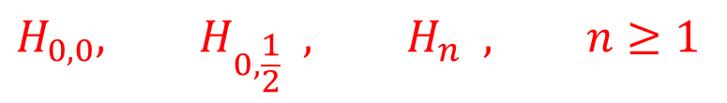
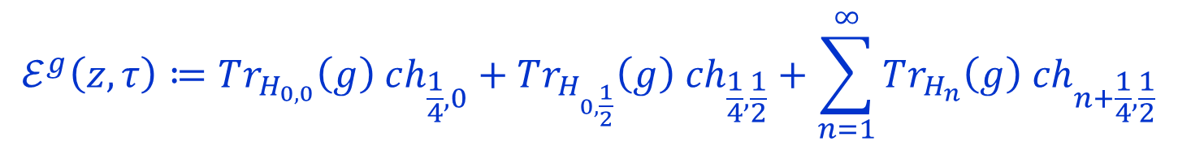

Statement Of Mathieu Moonshine
[EOT 2010, M. Cheng 2011, Gaberdiel, Hohenegger, Volpato 2011; Gannon 2012 ]
There exist an infinite set of representations of the group $M24$
$$H_{0,0}, H_{0,\frac{1}{2}} , H_{n} , n≥1$$
For ALL $g∈M24$
$$ℰ^{g}\left(z,τ\right)≔Tr_{H_{0,0}}\left(g\right) ch_{\frac{1}{4},0}+Tr_{H_{0,\frac{1}{2}}}\left(g\right) ch_{\frac{1}{4},\frac{1}{2}}+\sum_{n=1}^{∞}{Tr_{H_{n}}\left(g\right) ch_{n+\frac{1}{4},\frac{1}{2}}}$$
Has the expected modularity properties AS IF $g∈ Aut\left(𝒞\right)$
Umbral Moonshine: A nontrivial generalization of this statement:
There is one example for each of the 23 Niemeier lattices based on root systems.
[Cheng, Duncan, Harvey, 2012]
But there are no known physical/conceptual explanations of Mathieu or Umbral Moonshine.

Slide 18


Why Is It Moonshine?
There is no obvious action of M24 on $𝒞$ nor
on the highest weight states $D_{n+\frac{1}{4},ℓ;\frac{1}{4},\tilde{ℓ}}$
Why should these objects have good modular properties?
What do these representations have to do with (any) K3 sigma model?
… or with the space of loops on K3 ?
Can we define an action of M24 on $𝒞$ or on the
highest weight states $D_{n+\frac{1}{4},ℓ;\frac{1}{4},\tilde{ℓ}}$ ???
There is no known analog of the FLM construction.
Despite 9 years of intense effort by a small, but
devoted, community of physicists and mathematicians….

Slide 19
Strategies
1. Find a special point in the moduli space of K3 sigma models where the symmetry is manifest.
Ruled out by the Quantum Mukai Theorem (see below).
Find an algebraic structure of the highest weight “BPS states” - and ``algebra of BPS states’’
and study the automorphisms of this structure. (Some success with this approach for
the original monstrous moonshine example achieved by Natalie Paquette, Daniel Persson,
and Roberto Volpato. But the discussion still very incomplete.)
``Symmetry surfing’’ [Anne Taormina & Katrin Wendland]. Try to ``combine’’ symmetries of the CFT’s at different points in moduli space. Problem: Requires a notion of connection on the bundle of CFT’s over the moduli space. This raises many, many, very interesting, but unresolved issues.
Reduced symmetry (New proposal): Study the symmetries commuting
with just the (4,1) superconformal algebra, since only right-moving
N=1 is required to define the elliptic genus!

Slide 20
1
Brief Background On Moonshine
2
Quantum Mukai Theorem & GTVW Model
3
Supercurrents & Codes
4
RR States: MOG Construction Of The Golay Code
5
Conway Group Moonshine
6
Conclusion

Slide 21
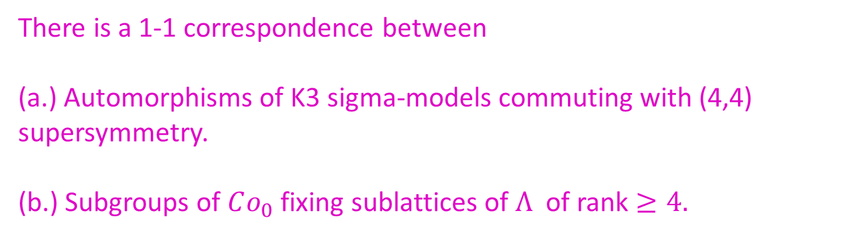
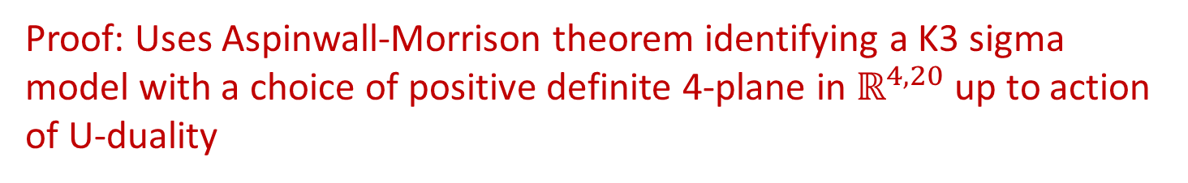
Quantum Mukai Theorem
M. Gaberdiel, S. Hohenegger, R. Volpato 2011
There is a 1-1 correspondence between
(a.) Automorphisms of K3 sigma-models commuting with (4,4) supersymmetry.
(b.) Subgroups of $Co_{0}$ fixing sublattices of $Λ$ of rank $≥4.$
Proof: Uses Aspinwall-Morrison theorem identifying a K3 sigma model with a choice of positive definite 4-plane in $ℝ^{4,20}$ up to action of U-duality
(A simple conceptual explanation follows from ``heterotic/typeII string duality’’ - Harvey-Moore 2016 .)

Slide 22
Fixed Sublattices Of The Leech Lattice
The culmination of a long line of work is the classification by Hohn and Mason of the 290 isomorphism classes of fixed-point sublattices of the Leech lattice:

Slide 23
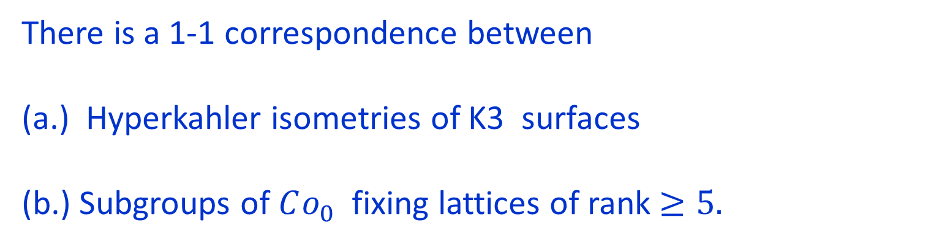
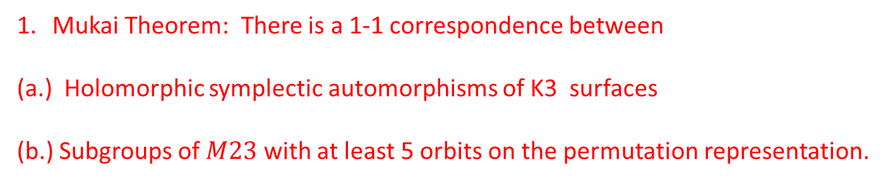
Remarks
Mukai Theorem: There is a 1-1 correspondence between
(a.) Holomorphic symplectic automorphisms of K3 surfaces
(b.) Subgroups of $M23$ with at least 5 orbits on the permutation representation.
String theory explanation of QMT suggests an interesting variant:
(arising from a discussion with Dave Morrison):
There is a 1-1 correspondence between
(a.) Hyperkahler isometries of K3 surfaces
(b.) Subgroups of $Co_{0}$ fixing lattices of rank $≥5.$

Slide 24
Remarks
From the viewpoint of explaining Mathieu Moonshine,
the QMT is a huge disappointment:
(a.) Some GHV groups are NOT subgroups of M24
(b.) M24 is not a subgroup of any quotient of any
GHV group.
4. However, only (4,1) susy is needed to define the elliptic genus. It turns out that Stab(4,1) is much bigger than Stab(4,4). Whether it is ``big enough’’ is unknown. We will discuss what is known about Stab(4,1) at the end.

Slide 25
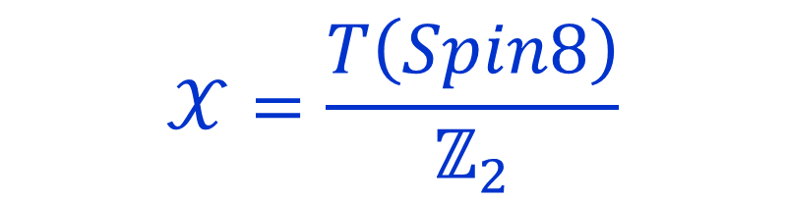
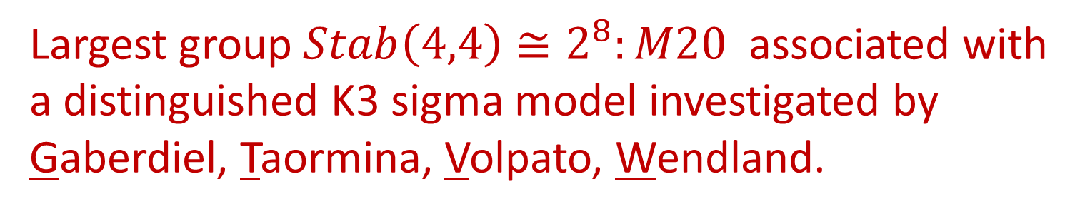
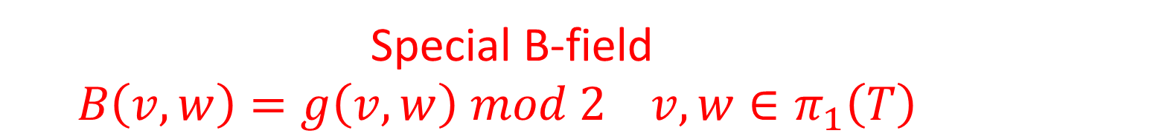
GTVW Model
Largest group $Stab\left(4,4\right)≅2^{8}:M20$ associated with a distinguished K3 sigma model investigated by Gaberdiel, Taormina, Volpato, Wendland.
2d susy sigma model with target:
$$𝒳=\frac{T\left(Spin8\right)}{ℤ_{2}}$$
Special B-field
$B\left(v,w\right)=g\left(v,w\right) mod 2$ $v,w∈π_{1}\left(T\right)$

Slide 26

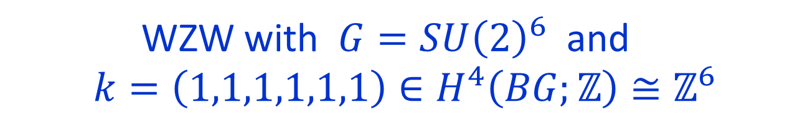
Equivalence To A WZW Model
Amazing result of GTVW:
This model is isomorphic to the product of 6 copies
of the bosonic k=1 SU(2) WZW model !
WZW with $G=SU{\left(2\right)}^{6}$ and
$$k=\left(1,1,1,1,1,1\right)∈H^{4}\left(BG;ℤ\right)≅ℤ^{6}$$
$LSU{\left(2\right)}^{k=1}$ has 2 unitary hw irreps: $V_{0}$ and $V_{1}$
$$ℋ≅{\left( V_{0}⊗{\tilde{V}}_{0}⊕V_{1}⊗{\tilde{V}}_{1} \right)}^{⊗6}≅ ⊕_{a∈𝔽_{2}^{6}} V_{a}⊗{\tilde{V}}_{a}$$

Slide 27
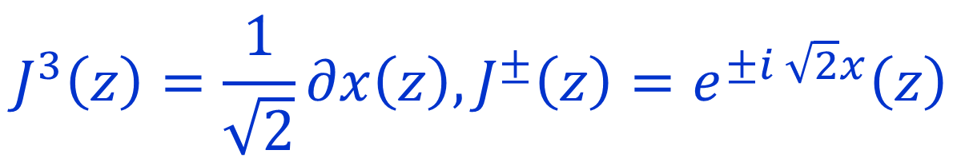
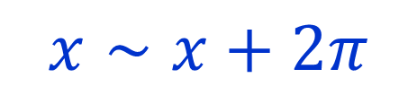
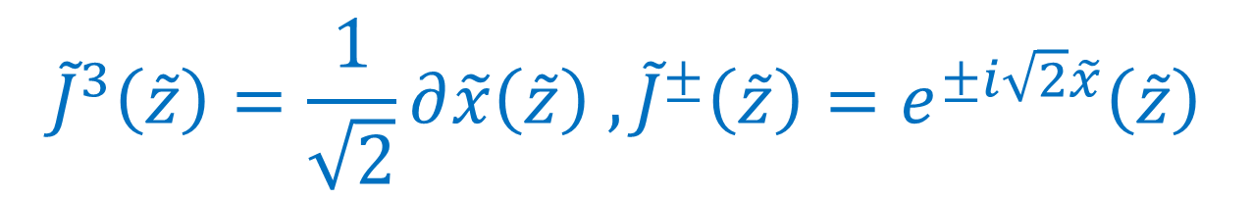
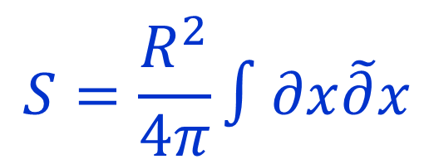

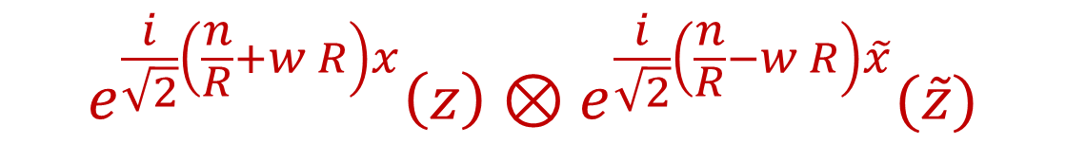
Frenkel-Kac-Segal
$$S=\frac{R^{2}}{4π}∫∂x\tilde{∂}x$$
$$x∼x+2π$$
Gaussian model:
$$e^{\frac{i}{\sqrt{2}}\left(\frac{n}{R}+w R\right)x}\left(z\right)⊗e^{\frac{i}{\sqrt{2}}\left(\frac{n}{R}−w R\right)\tilde{x}}(\tilde{z})$$
At R=1 we have a theory equivalent to the $SU{\left(2\right)}_{1}$WZW model
(”Witten’s nonabelian bosonization” or “FKS construction” )
$$J^{3}\left(z\right)=\frac{1}{\sqrt{2}}∂x\left(z\right), J^{±}\left(z\right)=e^{±i \sqrt{2}x}\left(z\right)$$
$${\tilde{J}}^{3}\left(\tilde{z}\right)=\frac{1}{\sqrt{2}}∂\tilde{x}\left(\tilde{z}\right) ,{\tilde{J}}^{±}\left(\tilde{z}\right)=e^{±i\sqrt{2}\tilde{x}}\left(\tilde{z}\right)$$
Gives an $su{\left(2\right)}_{L}⊕su{\left(2\right)}_{R}$current algebra.

Slide 28
1
Brief Background On Moonshine
2
Quantum Mukai Theorem & GTVW Model
3
Supercurrents & Codes
4
RR States: MOG Construction Of The Golay Code
5
Conway Group Moonshine
6
Conclusion

Slide 30

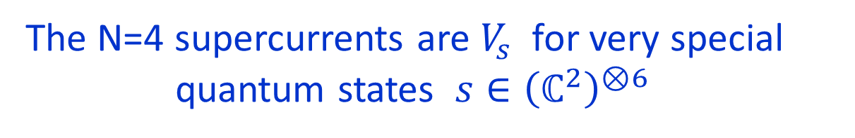
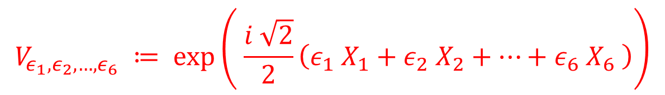
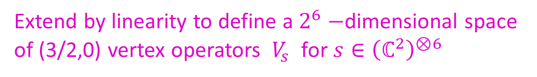
Chiral Fields Of Dimension 3/2
At the price of extending VOA’s to super-VOA’s we can introduce holomorphic fields of half-integral dimension:
$$V_{ε_{1}, ε_{2}, …, ε_{6}} ≔ \exp\left( \frac{i \sqrt{2}}{2}\left(ε_{1} X_{1}+ε_{2} X_{2}+⋯+ε_{6} X_{6} \right)\right)$$
$$ε_{i}∈\{ ±1 \}$$
${⇒ 2}^{6}$ vertex operators of conformal dimension = $\left(\frac{1}{4}\right)×6=\frac{3}{2}$
View $| ε_{1}, …, ε_{6} 〉∈{\left(ℂ^{2}\right)}^{⊗6}$ as a state in a system of 6 q-bits
Extend by linearity to define a $2^{6}−$dimensional space of (3/2,0) vertex operators $V_{s}$ for $s∈{\left(ℂ^{2}\right)}^{⊗6}$
The N=4 supercurrents are $V_{s}$ for very special
quantum states $s∈{\left(ℂ^{2}\right)}^{⊗6}$

Slide 31
N=4 Generators As States In A System Of 6 q-bits
$$\left[1\right]≔| − , + , + , + , + , + 〉$$
$$\left[135\right]≔| − , + , − , + , − , + 〉$$
$$Q^{+}=\frac{i−1}{2} \left( \left[∅\right]+\left[3456\right]+\left[245\right]+\left[236\right]−i\left[246\right]−i\left[235\right]+i\left[56\right]+i \left[34\right]\right)$$
$$Q^{−}=\frac{i−1}{2}(−\left[1\right]−\left[13456\right]+i\left[1246\right]+i\left[1235\right]−i\left(\left[156\right]+\left[134\right]\right)−\left[1245\right]−\left[1236\right])$$
$${\overline{Q}}^{+}=\frac{i−1}{2}(i \left[23456\right]+i\left[2\right]+\left[35\right]+\left[46\right]+\left[234\right]+\left[256\right]−i\left(\left[36\right]+\left[45\right]\right))$$
$${\overline{Q}}^{−}=\frac{i−1}{2}(i \left[123456\right]+i\left[12\right]+\left[135\right]+\left[146\right]+\left[1234\right]+\left[1256\right]−i\left(\left[136\right]+\left[145\right]\right))$$

Slide 32
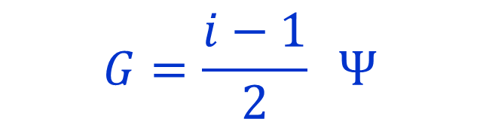

N=1 Generator
Up to $SU{\left(2\right)}_{R}$ symmetry there is a unique N=1 generator:
$$G=\frac{i−1}{2} Ψ$$
$$G=Q^{+}+{\overline{Q}}^{−}$$
$$Ψ= \left[∅\right]+i \left[123456\right]+(\left[1234\right]+\left[3456\right]+1256])+i(\left[12\right]+\left[34\right]+[56])$$
$$+ (\left[135\right]+\left[245\right]+\left[236\right]+[146])−i(\left[246\right]+235]+[136]+[145])$$
Is there a code governing this quantum state?
Yes!! It is the ``hexacode’’

Slide 33


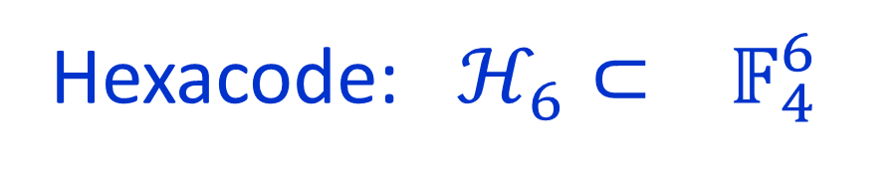

$𝔽_{4}$ And The Hexacode
Finite field of $4=2^{2}$ elements: $𝔽_{4}=\left\{ 0, 1, ω, \overline{ω} \right\}$
Addition: $1+ω=\overline{ω}$ $1+\overline{ω}=ω$ $ω+\overline{ω}=1$ $𝔽_{4}^{+}≅ℤ_{2}⊕ ℤ_{2}$
Multiplication: $ω⋅ω=\overline{ω} ω⋅\overline{ω}=1$
Hexacode: $ℋ_{6}⊂ 𝔽_{4}^{6}$
$$w=\left(a,b,c, Φ_{abc}\left(1\right) , Φ_{abc}\left(ω\right), Φ_{abc}\left(\overline{ω}\right)\right)$$
$$Φ_{abc}\left(x\right)≔a x^{2}+b x+c$$

Slide 34






Relation To Quaternion Group
$$Q≅ \left\{ ±1, ±i σ^{1} , ±i σ^{2} , ±i σ^{3} \right\}⊂SU(2)$$
Group of special unitary bit-flip and phase-flip errors in theory of QEC.
$$h$$
$$1→\left\{ ±1\right\}→ Q → 𝔽_{4}^{+}≅ℤ_{2}⊕ℤ_{2} →0$$
$$h\left(0\right)=\left(\begin{matrix}1 & 0 \\ 0 & 1 \end{matrix}\right)$$
$$h\left(1\right)=\left(\begin{matrix}0 & 1 \\ −1 & 0 \end{matrix}\right)$$
$$h\left(ω\right)=\left(\begin{matrix}0 & i \\ i & 0 \end{matrix}\right)$$
$$h\left(\overline{ω}\right)=\left(\begin{matrix}−i & 0 \\ 0 & i \end{matrix}\right)$$
$$h\left(x\right)h\left(y\right)=c_{x,y} h(x+y)$$
$c_{x,y}$ is a nontrivial cocycle with some nice properties.

Slide 35






N=1 Generator And The Hexacode
For $w=\left(x_{1},x_{2},…, x_{6}\right)∈𝔽_{4}^{6}$ define
$$h\left(w\right)≔h\left(x_{1}\right)⊗h\left(x_{2}\right)⊗⋯⊗h\left(x_{6}\right) ∈ SU{\left(2\right)}_{6} ⊂ End{\left(ℂ^{2}\right)}^{⊗6}$$
$$SU{\left(2\right)}_{6}≔SU{\left(2\right)}^{6}/ℤ_{2}^{5}$$
For general $w_{1},w_{2}∈𝔽_{4}^{6}$
this is a nontrivial cocycle.
$$h\left(w_{1})h(w_{2}\right)=χ\left(w_{1},w_{2}\right)h\left(w_{1}+w_{2}\right)$$
Nontrivial fact: The cocycle is trivial when restricted to $ℋ_{6}$ !
$$P=2^{−6}\sum_{w∈ℋ_{6}}{h(w)}$$
One dimensional projection operator
$$Ψ∈Im\left(P\right)$$

Slide 36




Consequences: 1/2
$V_{Ψ}$ generates an N=1 superconformal symmetry:
$$V_{s}\left(z_{1}\right)V_{s}\left(z_{2}\right)∼\frac{\overline{s}s}{z_{12}^{3}}+\frac{\overline{s}s}{z_{12}}T\left(z_{2}\right)+\frac{\overline{s}Σ^{A}s}{z_{12}^{2}}J^{A}\left(z_{2}\right)+\frac{\overline{s}Σ^{AB}s}{z_{12}}J^{A}J^{B}\left(z_{2}\right)+⋯$$
$J^{A}$ : generators of $SU{\left(2\right)}^{6}$ affine Lie algebra, $A=1, …, 3⋅6=18$
$Σ^{A}, Σ^{AB}$ generate 1- and 2- qubit errors
$$\overline{Ψ}Σ^{A}Ψ=0 \& \overline{Ψ}Σ^{AB}Ψ=0$$
Because $Ψ$ is in a QEC.
$$⇒ T_{F} = V_{Ψ}$$

Slide 37



Consequences: 2/2
$Stab_{SU{\left(2\right)}_{6}}\left(Ψ\right)$ is a finite group
Again follows from the error-correcting properties
of the hexacode because the generators
of $SU{\left(2\right)}_{6}$ are the $Σ^{A}$
Restricting to the error group $Q^{6}⊂SU{\left(2\right)}^{6}$
$$0→ ℤ_{2}^{5} → Stab_{Q^{6}}\left(Ψ\right)≅\left\{ \left(ε_{1}h\left(x_{1}\right), …, ε_{6} h\left(x_{6}\right)\right)\right| \left(x_{1},…, x_{6}\right)∈ℋ_{6} \prod_{i}{ε_{i}=1}\}$$
$$→ℋ_{6}→0$$

Slide 38
1
Brief Background On Moonshine
2
Quantum Mukai Theorem & GTVW Model
3
Supercurrents & Codes
4
RR States: MOG Construction Of The Golay Code
5
Conway Group Moonshine
6
Conclusion

Slide 39




RR Sector And The Golay Code
The crucial RR groundstates in the WZW description form a rep of ${\left(SU{\left(2\right)}_{L}× SU{\left(2\right)}_{R} \right)}^{6}$
$$V_{RR}^{gnd}≅ ⊕_{α=1}^{6} {\left(\frac{1}{2}\right)}_{L}^{\left(α\right)}⊗ {\left(\frac{1}{2} \right)}_{R}^{\left(α\right)}$$
There is a distinguished basis of RR groundstates:
$$ℍ ≅ {\left[ {\left(\frac{1}{2}\right)}_{L}⊗ {\left(\frac{1}{2}\right)}_{R} \right]}_{ℝ}$$
as $SU{\left(2\right)}_{L}×SU{\left(2\right)}_{R}$ representations

Slide 40






The usual basis $1, 𝔦, 𝔧,𝔨$ of quaternions corresponds to 4 distinguished spin states:
$$1 ↔\frac{1}{\sqrt{2}}( | +,−〉−| −, + 〉) ≔| 1 〉$$
$$𝔦 ↔\frac{1}{\sqrt{2}}( | +,+〉+| −, − 〉) ≔| 2 〉$$
$$𝔧 ↔\frac{i}{\sqrt{2}}( | +,+〉−| −, − 〉)≔| 3 〉$$
$$𝔨 ↔\frac{i}{\sqrt{2}}( | +,−〉+ | −, + 〉)≔| 4 〉$$
In this basis the action of $\left(ε_{L} h\left(x\right), ε_{R} h\left(x\right)\right)$
$ε_{L,R}∈\{ ±1 \}$ is diagonal, e.g. $\left(h\left(1\right), h\left(1\right)\right)$ takes:
$$| 1 〉→ | 1 〉 , |2〉→| 2 〉, |3〉→−| 3 〉 , |4〉→−| 4 〉$$

Slide 41













Column Interpretations Of Hexacode Digits
$$| 1 〉→ | 1 〉 , |2〉→| 2 〉, |3〉→−| 3 〉 , |4〉→−| 4 〉$$
$$\left[\begin{matrix}+ \\ + \\ − \\ −\end{matrix}\right]→ \left[\begin{matrix}0 \\ 0 \\ 1 \\ 1\end{matrix}\right]$$
$$h(0)$$
$$h(1)$$
$$h(ω)$$
$$h(\overline{ω})$$
$$| 1 〉$$
$$\left[\begin{matrix}0 \\ 0 \\ 0 \\ 0\end{matrix}\right]$$
$$\left[\begin{matrix}0 \\ 0 \\ 1 \\ 1\end{matrix}\right]$$
$$\left[\begin{matrix}0 \\ 1 \\ 0 \\ 1\end{matrix}\right]$$
$$\left[\begin{matrix}0 \\ 1 \\ 1 \\ 0\end{matrix}\right]$$
$$| 2 〉$$
$$| 3 〉$$
$$| 4 〉$$

Slide 42



So when we consider a general element of
$Stab_{Q^{6}}\left(Ψ\right)$ acting on the entire RR sector
we get a $4×6$ array of $0$’s and $1$’s
 | $$h(x_{1})$$ | $$h\left(x_{2}\right)$$ | $$h\left(x_{3}\right)$$ | $$h\left(x_{4}\right)$$ | $$h(x_{5})$$ | $$h(x_{6})$$
$$|1〉$$
$$|2〉$$
$$|3〉$$
$$|4〉$$
Example:
 | $$h(1)$$ | $$h\left(1\right)$$ | $$h(ω)$$ | $$h\left(ω\right)$$ | $$h(\overline{ω})$$ | $$h(\overline{ω})$$
$$|1〉$$ | 0 | 0 | 0 | 0 | 0 | 0
$$|2〉$$ | 0 | 0 | 1 | 1 | 1 | 1
$$|3〉$$ | 1 | 1 | 0 | 0 | 1 | 1
$$|4〉$$ | 1 | 1 | 1 | 1 | 0 | 0

Slide 43




Golay Code & The MOG
Nontrivial statement: The length 24 codewords generated from $Stab_{Q^{6}}\left(Ψ\right)$ are Golay code words. This gives half the Golay code $𝒢^{+}$
To get the full Golay code include worldsheet parity (exchanging left- and right-moving dof). This acts as the parity operator in $O(4)$
$$\left[\begin{matrix}− \\ + \\ + \\ +\end{matrix}\right]→ \left[\begin{matrix}1 \\ 0 \\ 0 \\ 0\end{matrix}\right]$$
$⇒$ ``odd interpretations of hexacode digits ‘’

Slide 44

Golay Code & The MOG
The action of the stabilizer of $Ψ_{L}−Ψ_{R}$ within $〈P, Q^{6}〉⊂{\left(Pin\left(4\right)\right)}^{6}$in the canonical basis of RR states defines the full Golay code.
This presentation of the Golay code is the
Miracle Octad Generator of Curtis and Conway.

Slide 45




So What?
The Golay code can be found in this action of symmetries commuting with (1,1) supersymmetry.
By definition, the automorphism group of the Golay code is $M24$
Conjecture 1: Suppose $Stab_{Q^{6}}\left(Ψ\right)⊂SU{\left(2\right)}^{6}$
is a normal subgroup of $Stab\left(4,1\right)∩SU{\left(2\right)}^{6}⊂SU{\left(2\right)}^{6}$
Then $Stab\left(4,1\right)$ has a quotient that contains a subgroup of the automorphisms of the (even) Golay code.
Conjecture 2: This quotient is a
maximal subgroup of $Aut\left(𝒢^{+}\right)$

Slide 46



What We (Don’t) Know About $Stab(4,1)$
1. $Stab\left(4,1\right)∩SU{\left(2\right)}^{6}$ is strictly larger than $Stab_{Q^{6}}\left(Ψ\right)$
2. $Stab\left(4,1\right)⊂{\left(Pin\left(4\right)\right)}^{6}: S_{6}$ is strictly larger than $Stab\left(4,4\right).$
$$|Stab\left(4,4\right)|= \left|2^{8}:M20\right|=2^{14}⋅3⋅5$$
$Stab\left(4,1\right)$ contains a subgroup of order $2^{17}⋅3^{2}⋅5$ and (thanks to JEFF and GAP) we understand the structure of this group.
The full group might be much larger.
3. For comparison $\left| M24 \right|=2^{10}⋅3^{3}⋅5⋅7⋅11⋅23$

Slide 47


We do not know if there are any
elements of order 7,11,23 in $Stab(4,1)$.

Slide 48
1
Brief Background On Moonshine
2
Quantum Mukai Theorem & GTVW Model
3
Supercurrents & Codes
4
RR States: MOG Construction Of The Golay Code
5
Conway Group Moonshine
6
Conclusion

Slide 49



Conway Group Moonshine
[Frenkel, Lepowsky, Meurman; Duncan; Duncan-Mack-Crane]
Susy sigma model with target
$𝔛=$ Cartan torus of E8, with special $B$-field.
Equivalent to 24 real fermions $λ_{i}$
(Holomorphic half of 24 Ising models.)
R groundstates = (a chiral) spinor S of Spin(24)
For $s∈S$ the vertex operator $V_{s}$ has
conformal dimension $h=\frac{24}{16}=\frac{3}{2}$

Slide 50


Spin operators for the 24 fermions have OPE:
$$V_{s}\left(z_{1}\right)V_{s}\left(z_{2}\right)∼\frac{\overline{s}s}{z_{12}^{3}}+\frac{\overline{s}s}{z_{12}}T\left(z_{2}\right)+\frac{\overline{s}γ^{ij}s}{z_{12}^{2}}λ_{i}λ_{j}+\frac{\overline{s}γ^{ijkl}s}{z_{12}}λ_{i}λ_{j}λ_{k}λ_{l}+⋯$$
So, in general $V_{s}$ does not generate an N=1 superconformal algebra …

Slide 51







Choose ON basis for $ℝ^{24}$ and Clifford generators $\left\{γ_{i}, γ_{j} \right\}=2 δ_{ij}$acting on irreducible module of $ℝ−$dimension $2^{12}.$
For $w∈𝔽_{2}^{24}$ define $γ_{w}≔γ_{1}^{w_{1}}⋯γ_{24}^{w_{24}}$
$γ_{w}$ generate a Heisenberg extension of $ℤ_{2}^{24}$
Theorem: The cocycle on $𝒢⊂𝔽_{2}^{24}$ is trivializable: There is $b\left(w\right)∈\{±1\} s$o that ${\tilde{γ}}_{w}≔b\left(w\right)γ_{w}$ satisfies:
$${\tilde{γ}}_{w_{1}}{\tilde{γ}}_{w_{2}}={\tilde{γ}}_{w_{1}+w_{2}}$$
$P≔\frac{1}{2^{12}}\sum_{w∈𝒢}{ {\tilde{γ}}_{w} }$
Rank one projector $Ψ=Ps_{0}$

Slide 52


$$V_{Ψ}\left(z_{1}\right)V_{Ψ}\left(z_{2}\right)∼\frac{\overline{Ψ}Ψ}{z_{12}^{3}}+\frac{\overline{Ψ}Ψ}{z_{12}}T\left(z_{2}\right)+\frac{\overline{Ψ}γ^{ij}Ψ}{z_{12}^{2}}λ_{i}λ_{j}+\frac{\overline{Ψ}γ^{ijkl}Ψ}{z_{12}}λ_{i}λ_{j}λ_{k}λ_{l}+⋯$$
Vanishing of last two terms follows from error-correcting properties of Golay
$$T_{F}=V_{Ψ}$$
Stabilizer of the rank one image of P turns out to be the Conway group! [Duncan 2003, Duncan-Mack-Crane 2014]

Slide 53
1
Brief Background On Moonshine
2
Quantum Mukai Theorem & GTVW Model
3
Supercurrents & Codes
4
RR States: MOG Construction Of The Golay Code
5
Conway Group Moonshine
6
Conclusion

Slide 54
Conclusions
Possible explanation of Mathieu Moonshine based on Stab(4,1)
(But there is no evidence for/against elements of order 7,11,23.)
2. Interesting connections between QEC and 2d N=1 superconformal symmetry – raises many questions.

Slide 55

HAPPY BIRTHDAY DAN!!!

