Slide 1
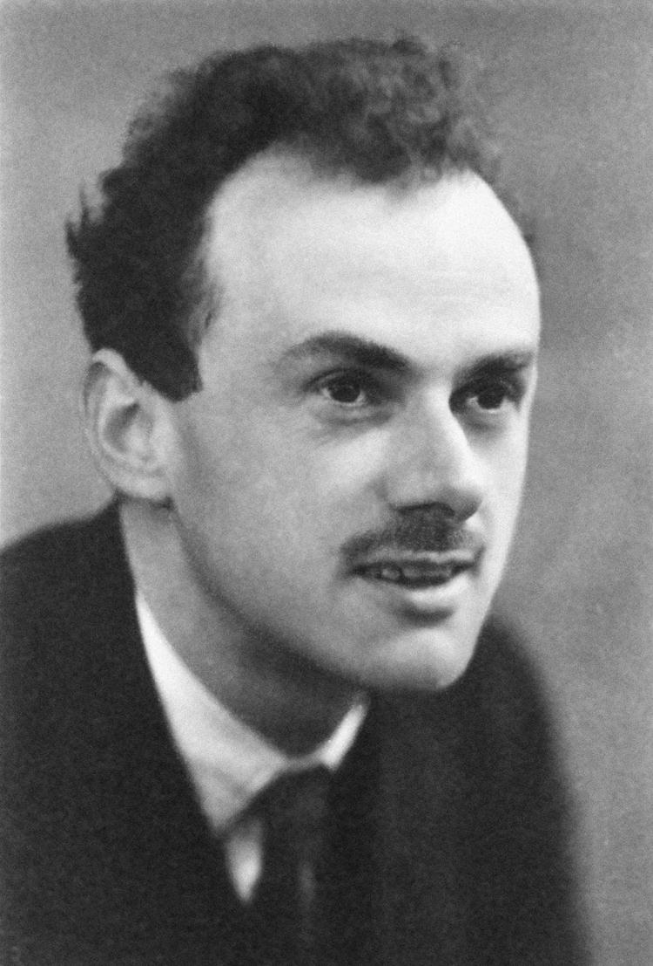
Comments On Continuous Families
Of Quantum Systems
Gregory Moore
Dirac Medal Ceremony
ICTP, Trieste, August 8, 2016

Slide 2
Soviet-American Workshop On String Theory, Princeton, October 1989

Slide 7
A Comment On Berry Connections
Part II

Slide 8
Philosophy
If a physical result is not mathematically natural, there might well be an underlying important physical issue.
We will illustrate this with continuous
families of quantum systems
i.e. quantum systems parametrized by a
space X of control parameters.
In this context one naturally encounters Berry connections – an enormously successful idea.

Slide 9
A Little Subtlety
Given a continuous family of Hamiltonians with a gap in the spectrum there is, in general, not one Berry connection, but rather a family of Berry connections.
Example: For band insulators there is a family of natural Berry connections, whose gauge equivalence classes are parametrized by a real-space torus.
This has consequences for topological contributions
to electric polarization and magneto-electric polarizability: a 3D Chern ``insulator’’ has a bulk QHE.

Slide 10
The origin of the problem is the problem of the origin.

Slide 11
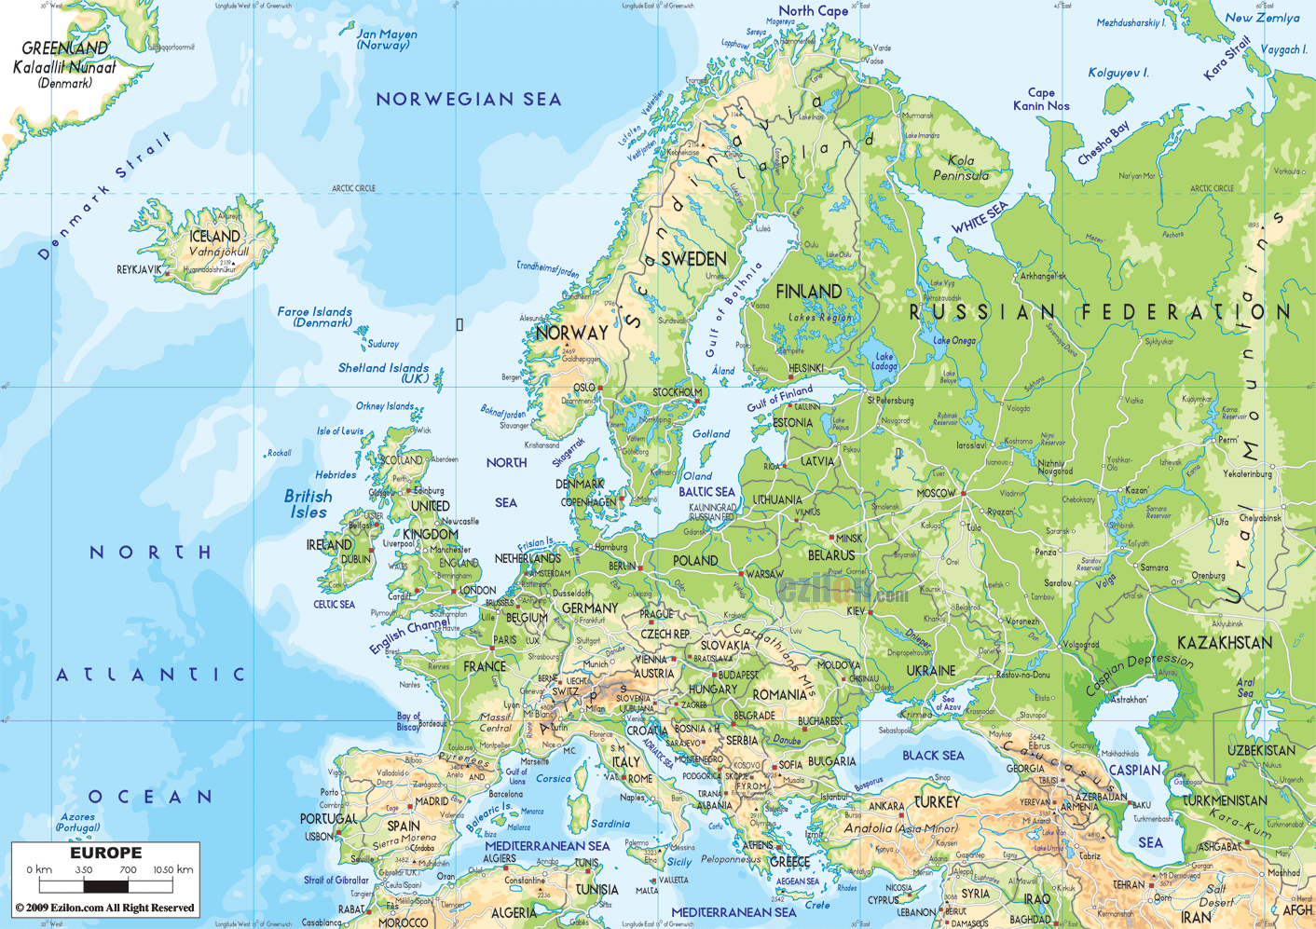
Affine Space
Like a vector space – but no natural choice of origin.
Definition: There is a transitive and free action of a vector space.

Slide 12
Non-symmorphic crystals
E(n): The Euclidean group of length-preserving transformations of affine n-dimensional space.
There is a natural subgroup $ℝn$ of translations
But there is no natural subgroup isomorphic to O(n):
One must CHOOSE an origin to define such a group.
That’s why there are non-symmorphic crystal structures.

Slide 13








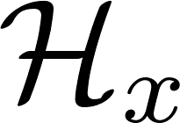


Hilbert Bundles
Hilbert bundle over a space
X of control parameters

Slide 14


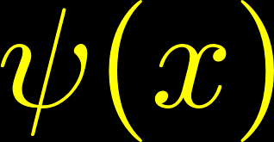
Sections Of A Hilbert Bundle
Space of sections:

Slide 15
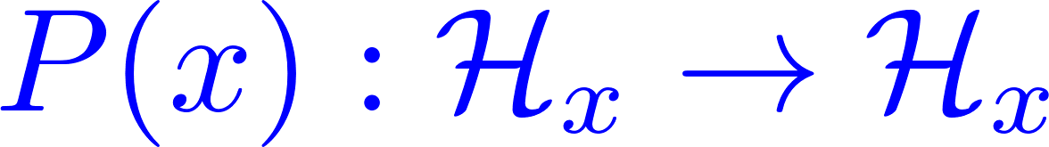

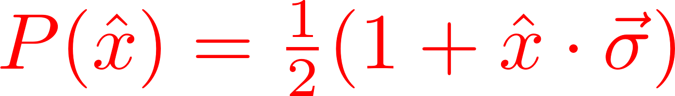
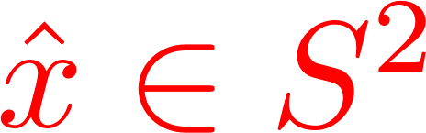

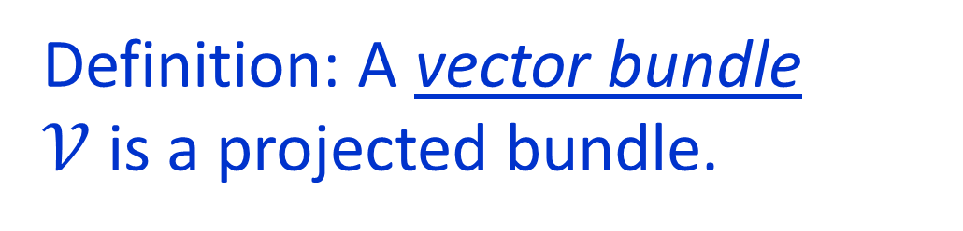
Projected Bundles
Given a continuous family of projection operators:
Projected bundle $𝒱$: Subbundle with sections:
Definition: A vector bundle
$𝒱$ is a projected bundle.

Slide 16
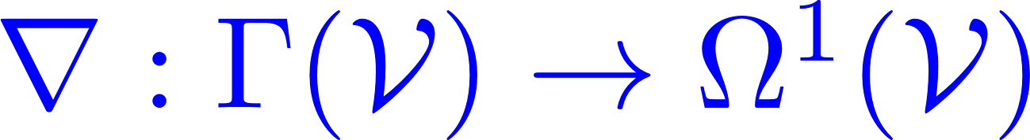

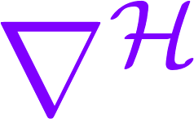
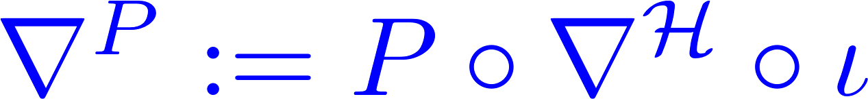
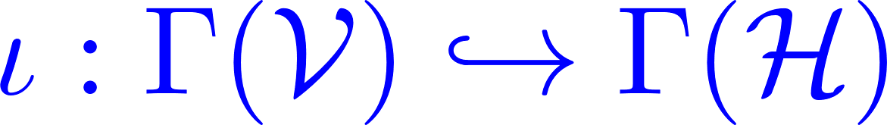
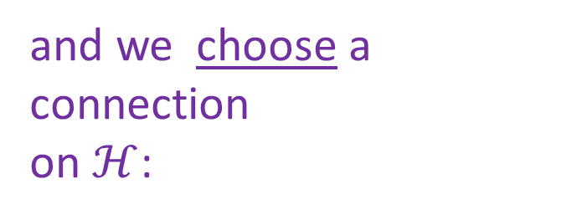

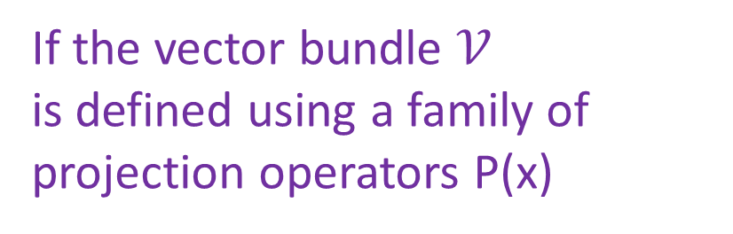
Projected Connection
Connection:
Remark: The space of connections on a vector bundle is an affine space modeled
on the vector space:
If the vector bundle $𝒱$
is defined using a family of
projection operators P(x)
and we choose a
connection
on $ℋ$:
we get a connection on the bundle$𝒱$ :
Notes:
Say after remark: So, there is no natural choice of origin. There is no natural choice of connection.

Slide 17
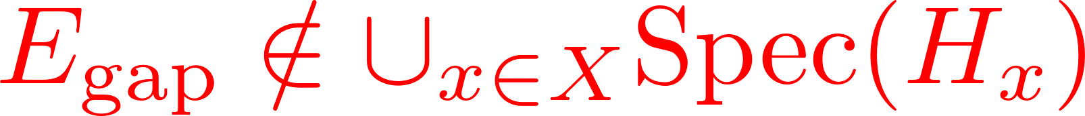
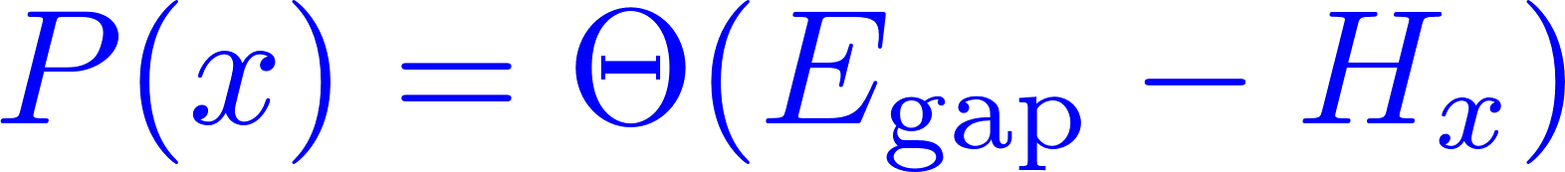
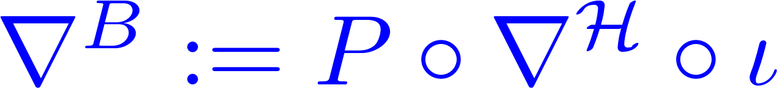
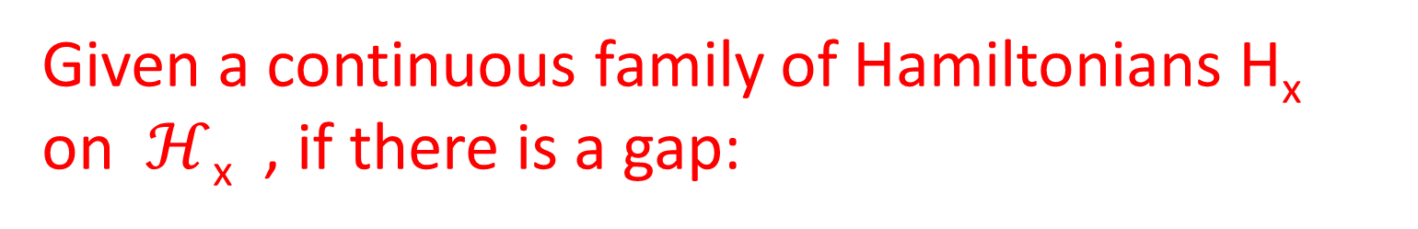
Berry Connection
Given a continuous family of Hamiltonians H_{x} on $ℋ$_{x} , if there is a gap:
we have a continuous family of projection operators:
[M. Berry (1983); B. Simon 1983) ]
Note that it requires a CHOICE of
Notes:
We could also call it the ``Barry connection’’ because essentially this geometrical picture was pointed out in a beautiful Phys Rev letter by Barry Simon.

Slide 18

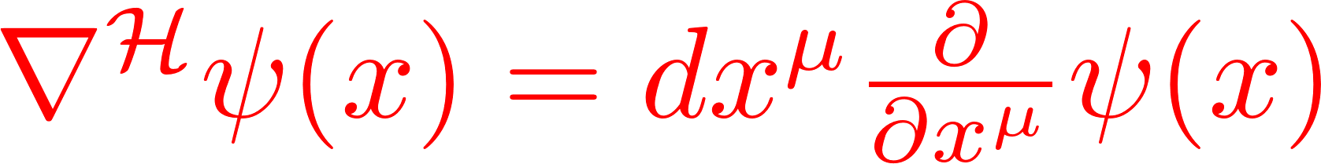
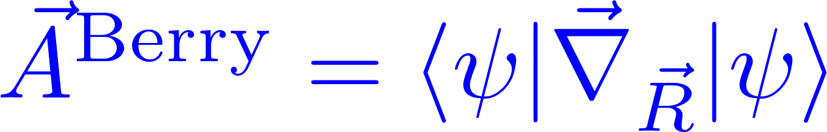


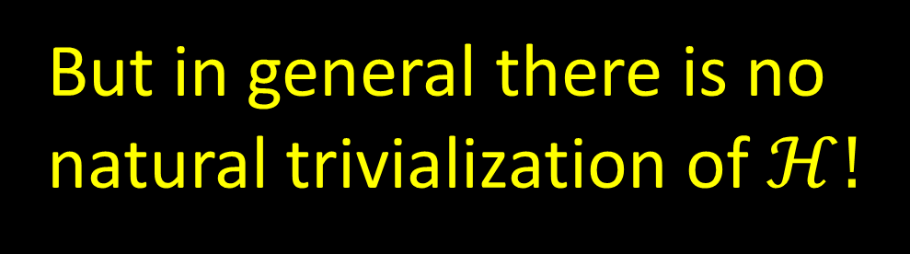
Commonly assumed: $ℋ$ has been trivialized:
Natural choice of $∇ℋ$:
The trivial connection.
But in general there is no
natural trivialization of $ℋ!$

Slide 19

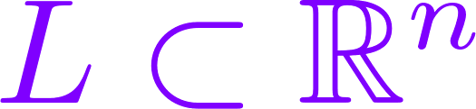
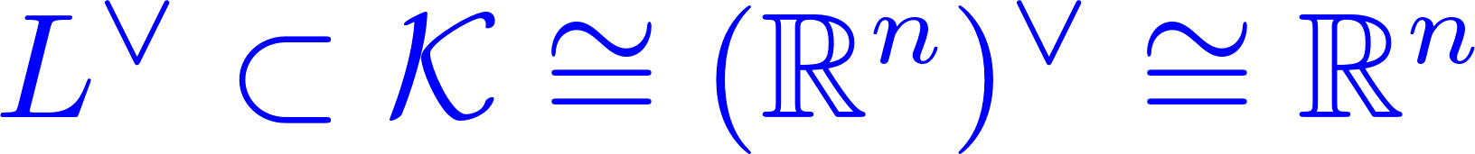
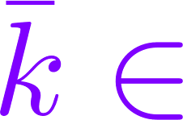

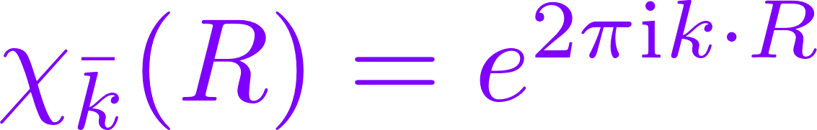

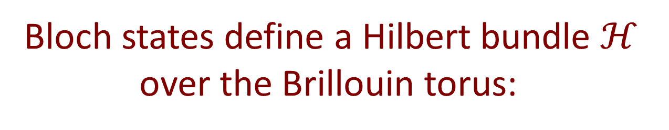
Hilbert Bundle Over Brillouin Torus
Crystal in n-dimensional affine space:
Invariant under a lattice of translations:
Brillouin torus:
= {unitary irreps of L}.
Reciprocal lattice:
Bloch states define a Hilbert bundle $ℋ$
over the Brillouin torus:

Slide 20

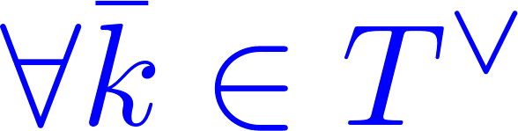
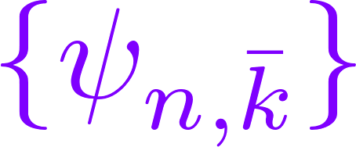


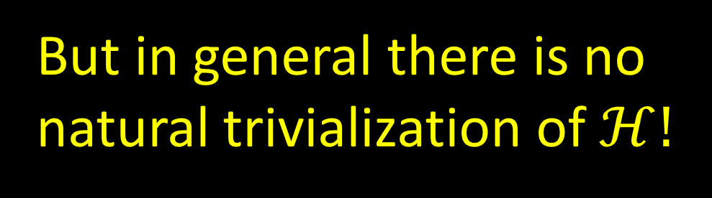
Trivializations Of $ℋ$
$ℋ$can be trivialized by choosing Bloch functions
smooth
A basis for Hilbert space
But in general there is no
natural trivialization of $ℋ!$
Notes:
Such trivializations DO exist: The problem is there are infinitely many of them, and there is no NATURAL
trivialization. You might try to take a basis defined by eigenfunctions of the Schrodinger operator, but
in general this will not give a trivialization: Certainly not if some bands have nonzero Chern number.
But one rarely needs a basis for physically meaningful results. For example for an insulator we can just define
But, as I stressed, the Hilbert bundle has no natural trivialization. So -

Slide 21
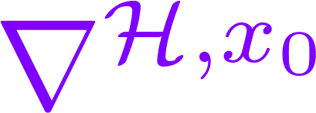
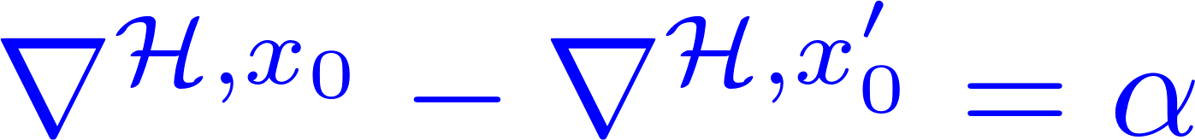
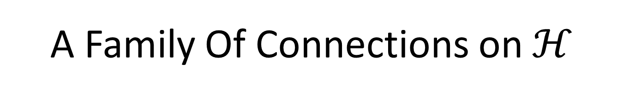
A Family Of Connections on $ℋ$
So: There is no such thing as ``THE’’ Berry connection in the context of band structure.
But, there is a natural family of connections on $ℋ$:
[Freed & Moore, 2012]
They depend on a choice of origin x₀ modulo L:

Slide 22
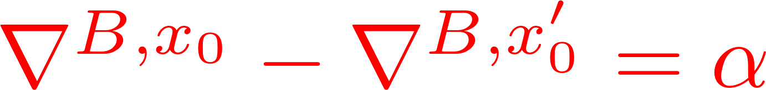
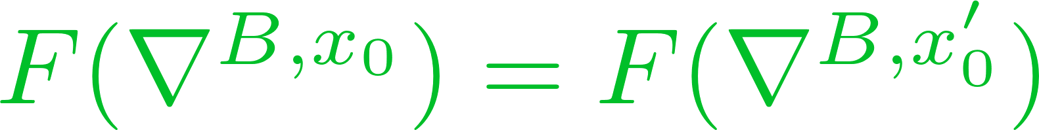
Berry Connections For Insulators
Insulator: Projected bundle $ℱ$of filled bands:
So what?
All Chern numbers unchanged….

Slide 23
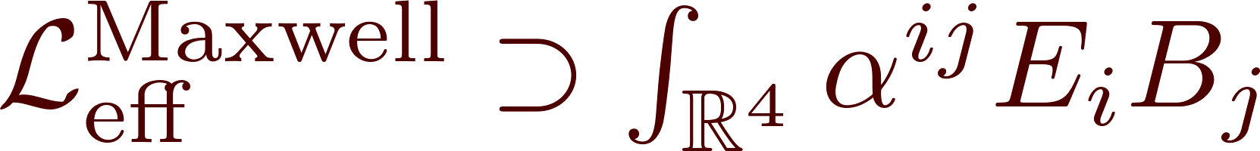
Electric polarization:
[ King-Smith & Vanderbilt (1993); Resta (1994) ]
Magnetoelectric Polarizability
``Axion angle’’
[ Qi, Hughes, Zhang; Essin, Joel Moore, Vanderbilt ]

Slide 24
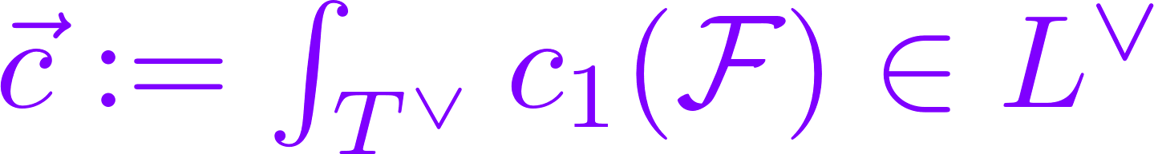

Dependence Of Axion Angle On x₀
QHE in the bulk of the ``insulator’’ in the plane orthogonal to

Slide 25
Part III
Born Rule For Families Of Quantum Systems Parametrized By A Noncommutative Manifold

Slide 26




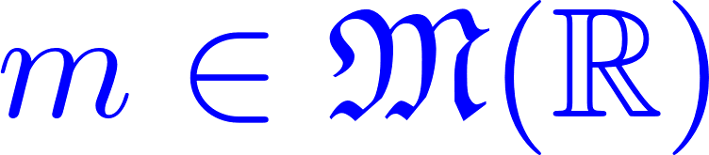
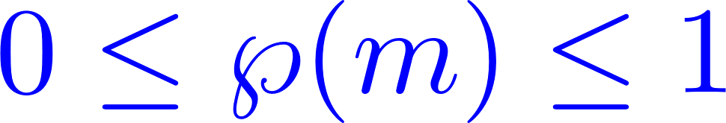
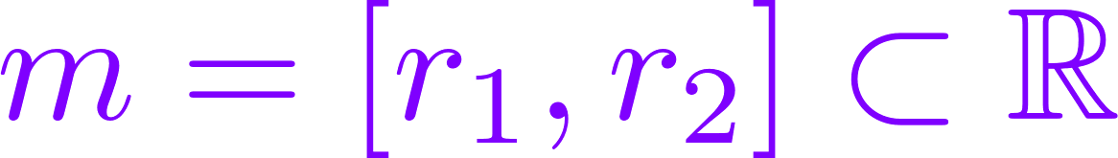

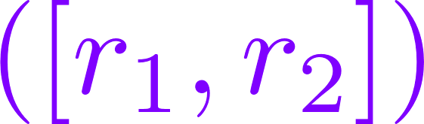

Quantum Systems
Set of physical ``states’’
Set of physical ``observables’’
Born Rule:
Probability measures on $ℝ$.
is the probability that a measurement of the observable O
in the state s has value between r₁ and r₂ .

Slide 27

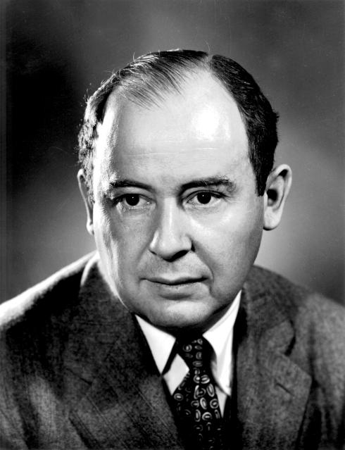

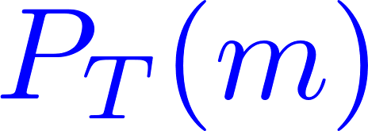



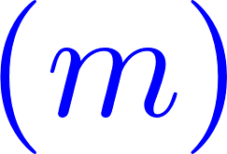
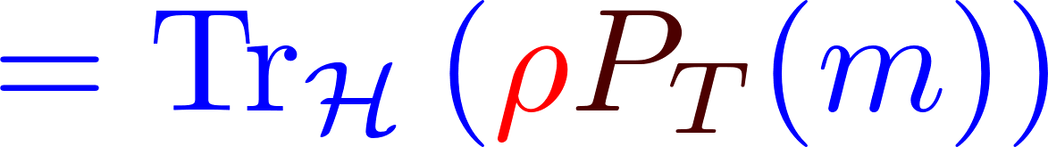
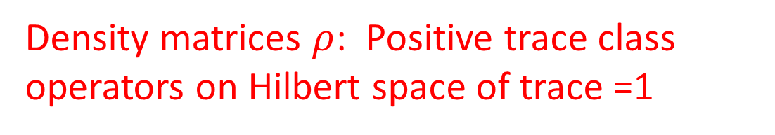
Standard Dirac-von Neumann Axioms
Density matrices $ρ$: Positive trace class operators on Hilbert space of trace =1
Self-adjoint operators T on Hilbert space
Spectral Theorem: There is a one-one correspondence of self-adjoint operators T and projection valued measures:
Example:

Slide 28
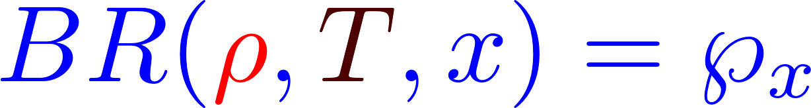
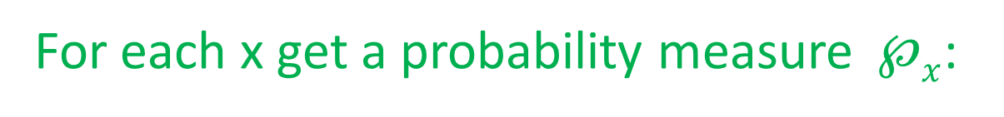
Continuous Families Of Quantum Systems
Hilbert bundle over space X of control parameters.
For each x get a probability measure $℘x$:

Slide 29

Noncommutative Families ?
What happens when the space X of control parameters is replaced by a noncommutative space ?
How does the Born rule change?
Why ask this question?

Slide 30

Curiosity.
(And the answer
is interesting.)
With irrational magnetic flux the Brillouin torus is replaced by a noncommutative manifold. (Bellisard, Connes, Gruber,…)
NC tt* geometry (S. Cecotti, D. Gaiotto, C. Vafa)
Boundaries of Narain moduli spaces of toroidal
heterotic string compactifications are NC
The ``early universe’’ might be NC

Slide 31

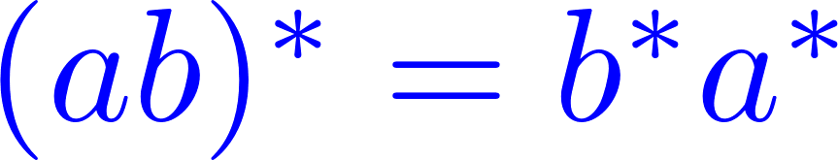


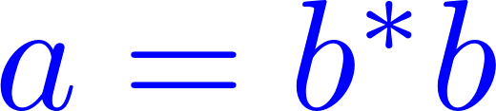
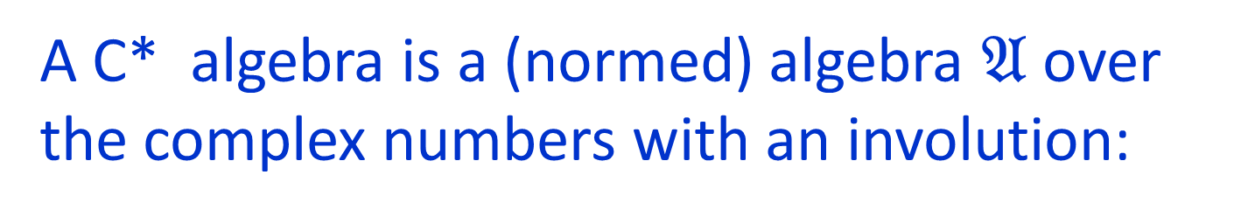
C* Algebras
A C* algebra is a (normed) algebra $𝔄$ over the complex numbers with an involution:
such that ….
Example 1:
Example 2:
Self-adjoint:
Positive:

Slide 32









Gelfand’s Theorem
The topology of a (Hausdorff) space X is completely
captured by the C*-algebra of continuous functions on X:
``Points’’ become
1D representations:
Commutative C* algebra:
A topological
space

Slide 33



Noncommutative Geometry
Statements about the topology/geometry of X are equivalent to algebraic statements about C(X)
Replace C(X) by a noncommutative C* algebra $𝔄$
Interpret $𝔄$ as the ``algebra of functions
on a noncommutative space’’ …
… even though there are no points.
``pointless geometry’’
Example: Noncommutative torus:

Slide 34

Noncommutative Control Parameters
We would like to define a family of quantum systems parametrized by a NC manifold whose ``algebra of functions’’ is a general C* algebra $𝔄$
What are observables?
What are states?
What is the Born rule?
What replaces the Hilbert bundle?
Notes:
Stress that amplitudes are elements of a noncommutative algebra so the usual formulae do not immediately generalize.

Slide 35





Noncommutative Hilbert Bundles
Definition: Hilbert C* module $ℰ$over C*-algebra $𝔄$.
Complex vector space $ℰ$ with a right-action of $𝔄$
and an ``inner product’’ valued in $𝔄$
(Positive element of the C* algebra.)
such that …..
Like a Hilbert space, but ``overlaps’’ are valued
in a (possibly) noncommutative algebra.

Slide 36





Quantum Mechanics With Noncommutative Amplitudes
Basic idea: Replace the Hilbert space by a Hilbert C* module
Overlaps are valued in a possibly noncommutative algebra.
QM:
QMNA:
Notes:
Stress that amplitudes are elements of a noncommutative algebra so the usual formulae do not immediately generalize.

Slide 37




Example 1: Hilbert Bundle Over A Commutative Manifold

Slide 38



Example 2: Hilbert Bundle Over A Fuzzy Point
Def: ``fuzzy point’’ has

Slide 39



Observables In QMNA
Consider ``adjointable operators’’
The adjointable operators
$𝔅$ are another C* algebra.
Definition: QMNA observables
are self-adjoint elements of $𝔅$
(Technical problem: There is no spectral theorem for self-adjoint elements of an abstract C* algebra. )

Slide 40











C* Algebra States
Definition: A C*-algebra state $ω$ $∈𝒮(𝔄)$
is a positive linear functional
d$μ$ = a positive measure on X:
$ρ$ = a density matrix
Notes:
OK, after many failed attempts to make sense of a Born rule in the context of QMNA I finally decided that a good definition of a QMNA state is the following:

Slide 41



QMNA States
Definition: A QMNA state is a completely positive unital map
``Completely positive’’ comes up naturally both in math and in quantum information theory.
Positive:
Unital:
Completely positive
Notes:
Say: So now we can move on to the QMNA Born rule.

Slide 42


QMNA Born Rule
Main insight is that we should regard the Born Rule as a map
For general $𝔄$the datum $ω$ $∈𝒮(𝔄)$together
with complete positivity of $φ$give just the right information to state a Born rule in general:
Notes:
Just say that this works very well with the case of a commutative base.

Slide 43




Family Of Quantum Systems
Over A Fuzzy Point
``A NC measure $ω$ $∈𝒮(𝔄)$’’ is equivalent to a density matrix $ρA$ on $ℋA$
QMNA state:

Slide 44


Quantum Information Theory
& Noncommutative Geometry
Last expression is the measurement by Bob of T in the state $ρA$ prepared by Alice and sent to Bob through quantum channel $ℰ$.

Slide 45

Three Conclusions
Don’t be discouraged by negative response.
(Within reason)
Please say, ``a Berry connection,’’ not ``the Berry connection.’’
(Unless you have specified $∇ℋ$)
QM can be generalized to QMNA.
(Is it really a generalization?)
(Is it useful?)

