Slide 1
Desperately Seeking Moonshine
Gregory Moore
a project with Jeff Harvey
DaveDay, Caltech, Feb. 25, 2016
Notes:
It is a great pleasure to be speaking here in honor of Dave. I’ve always admired Dave for many reasons. One of those reasons is that he is able to be in a momentum eigenstate and yet get lots of science done. This is something I am totally unable to do.
Of course, being in a momentum eigenstate his wavefunction is spread over the whole globe, and that must be why he has had such a global influence in Physical Mathematics.
Now, I have the dubious distinction of being the only speaker today that has NOT written a paper with Dave. But we HAVE worked on a few projects together, usually bearing some relation to the algebra of BPS states. So, today although I unfortunately won’t be directly talking about one of those projects, I will be discussing a project that is not totally unrelated.
And we will see that Dave’s work definitely had an important input into what I’ll describe.

Slide 2
Motivation
Search for a conceptual explanation of
Mathieu Moonshine phenomena.
Eguchi, Ooguri, Tachikawa 2010
Proposal: It is related to the
``algebra of BPS states.''
Something like: M24 is a distinguished
group of automorphisms of the algebra
of spacetime BPS states in some string compactification using K3.

Slide 3
String-Math, 2014
Today’s story begins in Edmonton, June 11, 2014. Sheldon Katz was giving a talk on his work with Albrecht Klemm and Rahul Pandharipande
He was describing how to count BPS states for type II strings on a K3 surface taking into account the
so(4) = su(2) + su(2) quantum numbers of a particle in six dimensions.
Slide # 86 said ….

Slide 4
Notes:
at which point I opened my big mouth and
pointed out that 231 is the dimension of an
irreducible representation of M24 --
at which point Dave interjected ``Looks like Moonshine to me.''

Slide 5
Heterotic/Type II Duality
Het/T4 = IIA/K3
DH states: Perturbative heterotic BPS states
D4-D2-D0 boundstates
Roughly: Cohomology groups of the moduli spaces of objects in D^{b}(K3) with fixed K-theory invariant and stable wrt a stability condition determined by the complexified Kahler class.
Aspinwall-Morrison Theorem:

Slide 6

Heterotic Toroidal Compactifications
Narain moduli space of CFT’s:

Slide 7
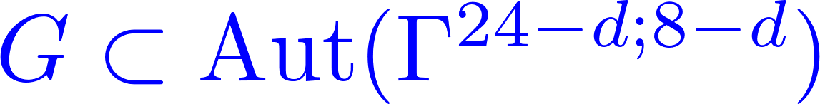



Crystal Symmetries Of Toroidal Compactifications
Construct some heterotic string compactifications with large interesting crystallographic group symmetries.
Then G is a crystal symmetry of the CFT:
Example: Weyl group symmetries of enhanced YM gauge theories.
These are NOT the kinds of crystal symmetries we want

Slide 8

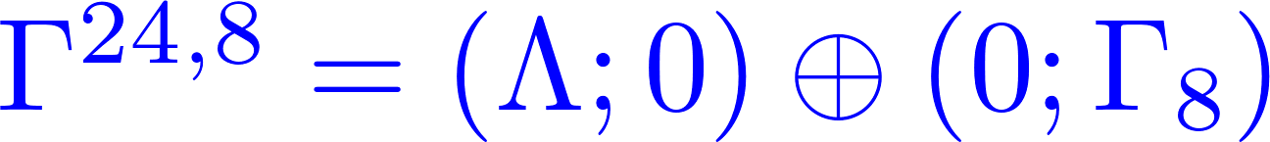

Conway Subgroup Symmetries
Start with a distinguished d=0 compactification:
Crystal symmetry:
Note that Co₀ is not a Weyl group symmetry of any enhanced Yang-Mills gauge symmetry.
Now ``decompactify’’

Slide 9


A Lattice Lemmino
&
isometric of rank d
Then there exists an even unimodular lattice with embedding
such that, if
then ^{24-d;8-d} has crystallographic symmetry

Slide 10
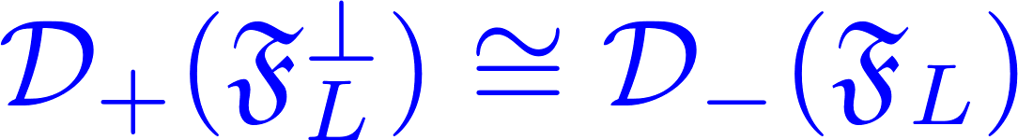


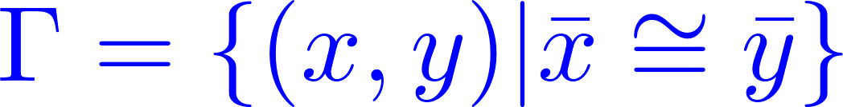
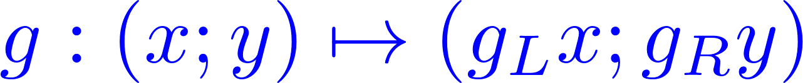


Easy Proof
Does not use the Nikulin embedding theorem.
Uses standard ideas of lattice theory.
See book of Miranda and Morrison for these ideas.

Slide 11
CSS Compactifications
This construction defines points of moduli space with
Conway Subgroup Symmetry:
call these CSS compactifications.
What crystal symmetries can you get?
In general, a sublattice preserves none of the
crystal symmetries of the ambient lattice.
Consider, e.g., the lattice generated by (p,q) in the square lattice in the plane.

Slide 12
Fixed Sublattices Of The Leech Lattice
The culmination of a long line of work is the classification by Hohn and Mason of the 290 isomorphism classes of fixed-point sublattices of ☹

Slide 13
Symmetries Of D4-D2-D0 Boundstates
Therefore the space of D4D2D0 BPS states on K3 will naturally be a representation of the subgroups of Co₀ that preserve sublattices of rank 4.
These discrete groups will be automorphisms of the algebra of BPS states at the CSS points.

Slide 14
Symmetries Of Derived Category
Theorem [Gaberdiel-Hohenegger-Volpato]: If G  O_{Z}(20;4) fixes a positive 4-plane in R^{20,4} then G is a subgroup of Co₀ fixing a sublattice with 4  rank.
Remark: GHV generalize the arguments in Kondo’s paper proving Mukai’s theorem that the symplectic automorphisms of K3 are subgroups of M23 with at least 5 orbits on 
Interpreted by Huybrechts in terms of the bounded derived category of K3 surfaces

Slide 15
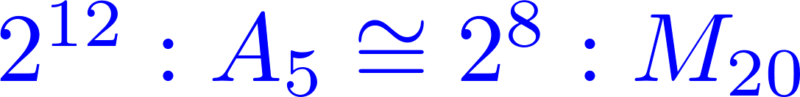
But Is There Moonshine In KKP Invariants?
So the invariants of KKP will show ``Moonshine’’ with respect to this symmetry……
But this is a little silly: All these groups are subgroups of O(20). If we do not look at more structure, that includes the momenta/characteristic classes we might as well consider the degeneracies as O(20) representations.

Slide 16
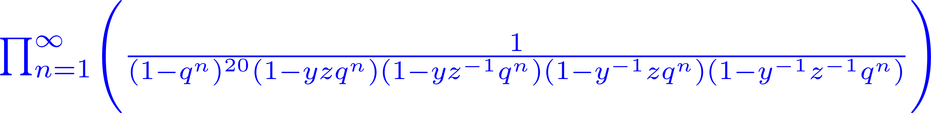

Silly Moonshine
is just the SO(4) character of a Fock space of 24 bosons.
All the above crystal groups are subgroups of O(20) so the ``Moonshine’’ wrt those groups is a triviality.
IS THERE MORE GOING ON ??

Slide 17




Baby Case: T7 & d=1
Decompose partition function of BPS states wrt reps of transverse rotation group O(1)
These numbers dutifully decompose nicely as representions of Co₂:
That’s trivial because Co₂  O(23)
But is there a Co₀ x O(1) symmetry? Co₀ is NOT a subgroup of O(23).
Co₀ x O(1) symmetry CANNOT come from a linear action on V₂₄.

Slide 18


The SumDimension Game
ETC.

Slide 19
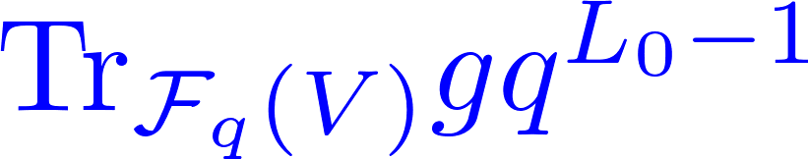
Defining Moonshine
Any such decomposition defines the massive states of F_{q}(V) as a representation of Co₀ x O(1).
Problem: There are infinitely many such decompositions!
What physical principle distinguishes which, if any, are meaningful?
Definition: You have committed Moonshine (for d=1) if you exhibit the massive sector of F_{q}(V) as a representation of
Co₀ x O(1)such that the graded character of any element g:
is a modular form for ₀(m) where m = order of g .

Slide 20
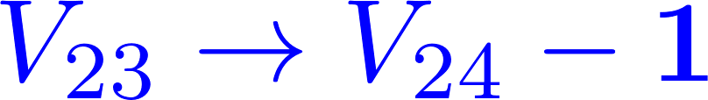
Virtual Representations
Most candidate Co₀ x O(1) representations will fail to be modular.
But if we allow virtual representations:
The characters are guaranteed to be modular!
But massive representations have no reason
to be true representations.
In fact, the negative representations cancel and ALL the massive levels are in fact true representations!!

Slide 21


But! The same argument
also shows they are
also true representations
of O(24) x O(1).

Slide 22
Lessons
Modularity of characters is crucial.
Virtual Fock spaces are modular.
There can be nontrivial cancellation
of the negative representations.
A ``mysterious’’ discrete symmetry can sometimes simply be a subgroup of a continuous symmetry.

Slide 23
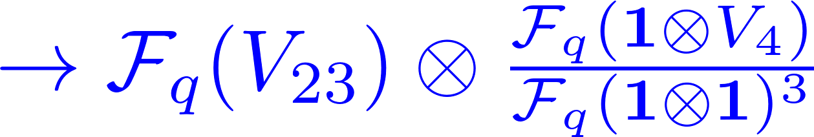
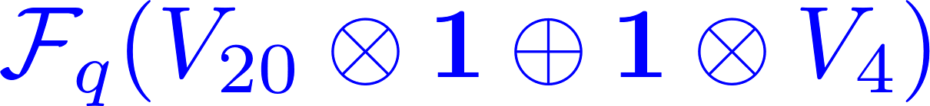

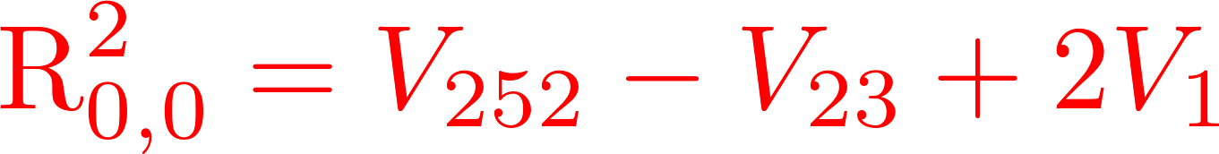
What About d=4 ?
Magical positivity fails:
But we are desperately seeking Moonshine...
So we ask: Could it still be that, magically, some positive combination of representations from the SumDimension game is nevertheless modular?

Slide 24
Characters Of An Involution
Should be modular form for ₀(2) .
Weight?
(assumed
half-integral)
Multiplier system?

Slide 25
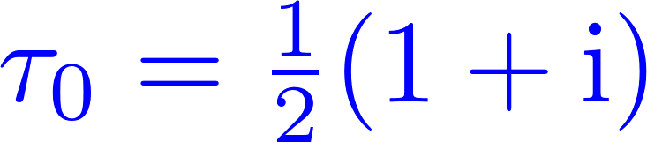
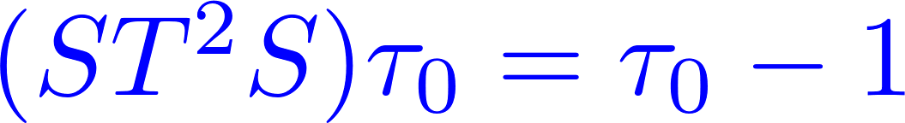
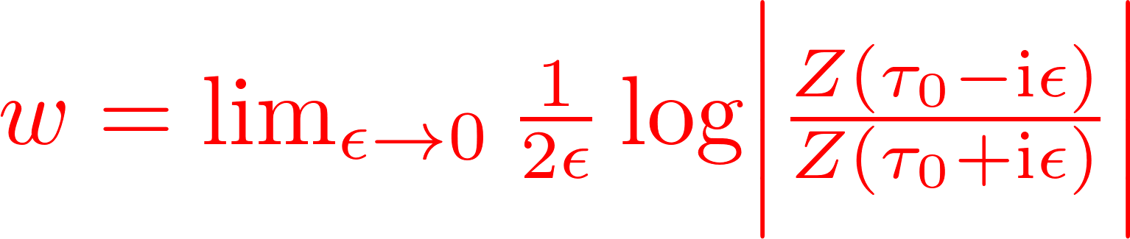
What Is Your Weight?
One can deduce the multiplier system from the weight,
and derive the weight numerically from:
Convergence is good so can compute the weight numerically.
For Z_{2A} it converges to -8.4…… Not pretty. Not half-integral !!
No positive combination of reps is modular. No M24 Moonshine.

Slide 26


Slide 27



Application To Heterotic-Type II Duality
Existence of CSS points have some interesting math predictions.
K3 and ellipticaly fibered CY3
Perturbative heterotic string states
Vertical
D4-D2-D0 boundstates

Slide 28

Orbifolds At CSS Points
Orbifold at the CSS points for d=2 (T⁶ compactification)
For simplicity: Z₂ orbifold
g_{R} an involution in W(E8) with
eigenvalues -1⁴, +1⁴

Slide 29
We can realize all but 6 of the 51 rank 2 HM classes:

Slide 30
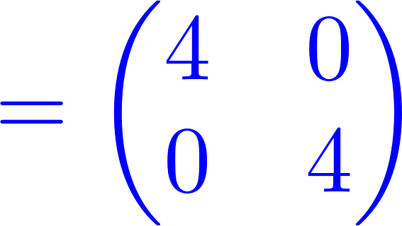




Explicit Example – 1/2
Gram matrix of
Can embed in Leech and E8 lattices
There exists g_{R} in W(E8) fixing with ev’s
+1⁴ , -1⁴. Mod out by this on the right.
Need to choose involution g_{L}.
Structure of Golay code implies the only possibilities:
Flipping 8,12,16 coordinates x^{i} according to octad/dodecad/
octad complement C-sets of the Golay code

Slide 31

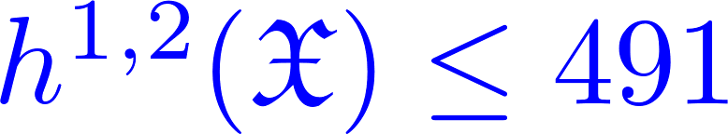
Explicit Example – 2/2
Massless sector:
Abelian gauge symmetry.
Personal Ad: Two Hodge numbers seek friendly compatible CY3…
(7,527)?
Huh?
TaxMan violates Wati’s bound:

Slide 32

Generalized Huybrechts Theorem
Should be the centralizer of an element of a subgroup of Co₀ fixing a rank two sublattice of ☹

Slide 33
Some General Questions
Clarify TaxMan example: Should every heterotic model on K3 x T2 have a type II dual?
Decreasing d  larger CSS groups: raises a general question about D-brane categories: What to do on
X x S¹ ?
There ARE A & B Models!
In the type II interpretation CSS only arise for special values of the flat RR fields. How do flat RR fields affect the BPS D-brane states?

Slide 34
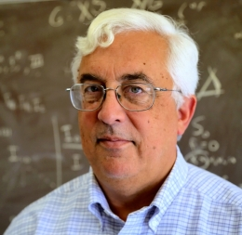
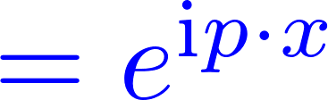

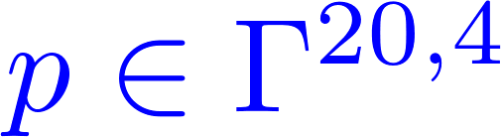
x
HAPPY BIRTHDAY DAVE!!

