Slide 1
Spectral Networks and Their Applications
Caltech, March, 2012
Gregory Moore, Rutgers University
Davide Gaiotto, G.M. , Andy Neitzke
pretty much finished
Spectral Networks and Snakes,
Spectral Networks,
Wall-crossing in Coupled 2d-4d Systems: 1103.2598
Framed BPS States: 1006.0146
Wall-crossing, Hitchin Systems, and the WKB Approximation: 0907.3987
almost finished
Four-dimensional wall-crossing via three-dimensional field theory: 0807.4723

Slide 2
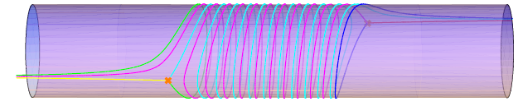
What are spectral networks?
Spectral networks are combinatorial
objects associated to a covering of Riemann surfaces   C
Spectral network
C
branch point

Slide 3
What are spectral networks good for?
They determine BPS degeneracies in D=4, N=2 field theories of class S. (this talk)
They give a “pushforward map” from flat U(1) gauge fields on  to flat nonabelian gauge fields on C.
They determine cluster coordinates on the moduli space of flat GL(K,C) connections over C.
“Fock-Goncharov coordinates’’
“Higher Teichmuller theory”
Higher rank WKB theory

Slide 4
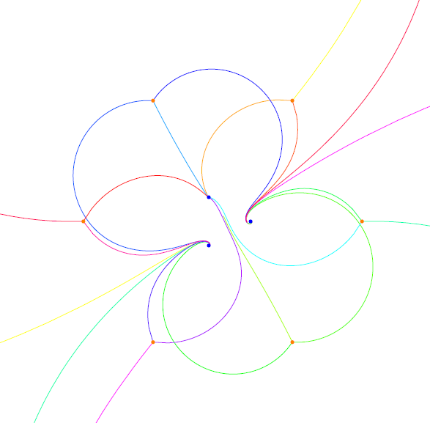
Minahan-Nemeschansky E₆ superconformal theory,
realized as an SU(3) trinion theory a la Gaiotto.
In general to d=4 =2 field theories we can asociate spectral networks, so
what better place to describe them than at the =2 birthday party?

Slide 5

OOPS….
Conference "N=4 Super Yang-Mills Theory, 35 Years After"
But =4 SYM is ``really’’ about the UV complete 6d theory S[g] with (2,0) susy….
To get =4 SYM we compactify S[g] on a torus….
A natural generalization is to ``theories of class S’’

Slide 6
Outline
Introduction
Theories of class S & their BPS states
Line defects and framed BPS states
Surface defects & susy interfaces
Spectral networks
Determining the BPS degeneracies
Conclusion

Slide 7
Theories of Class S
2
Consider 6d nonabelian (2,0) theory S[g] for ``gauge algebra’’ g
The theory has half-BPS codimension two defects D
Compactify on a Riemann surface C with D_{a} inserted at punctures z_{a}
Twist to preserve d=4,N=2
Witten, 1997
GMN, 2009
Gaiotto, 2009
Type II duals via ``geometric engineering’’
KLMVW 1996

Slide 8
Relation to Hitchin System
5D g SYM
σ-Model:

Slide 9
Defects
Physics depends on choice of
&

Slide 10
UV Curve
Seiberg-Witten Curve
SW differential
For g=su(K)
is a K-fold branched cover

Slide 11
Coulomb Branch & Charge Lattice
IR theory is a (self-dual) =2 abelian gauge theory
Coulomb branch
Local system of charges
(Actually,  is a subquotient. Ignore that for this talk. )

Slide 12
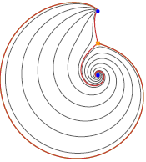
BPS States: Geometrical Picture
BPS states come from open M2 branes stretching between sheets i and j. Here i,j, =1,…, K. This leads to a nice geometrical picture with string webs:
Klemm, Lerche, Mayr, Vafa, Warner; Mikhailov; Mikhailov, Nekrasov, Sethi,
A WKB path of phase ☺ is an integral path on C
Generic WKB paths have both ends on singular points z_{a}
Separating WKB paths begin on
branch points, and for generic ☺,
end on singular points

Slide 13
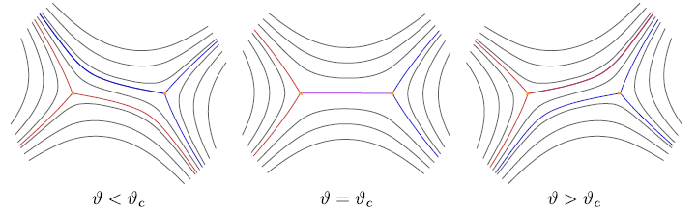
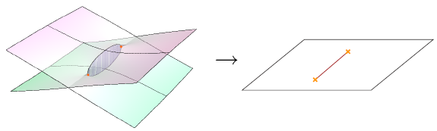
String Webs – 1/4
But at critical values of ϑ=ϑ_{c} ``string webs appear’’:
Hypermultiplet

Slide 14
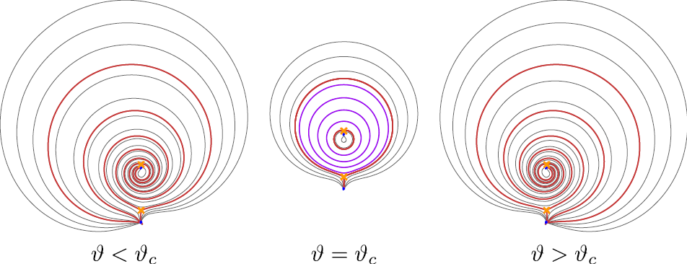
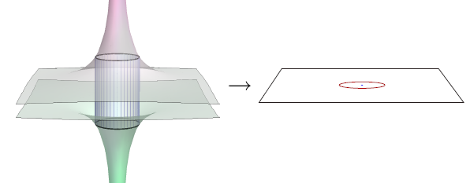
String Webs – 2/4
Closed WKB path
Vectormultiplet

Slide 15
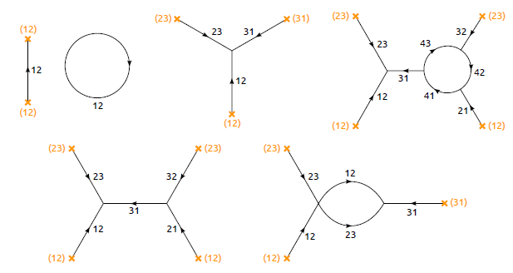
String Webs – 3/4
At higher rank, we get string junctions at critical values of ϑ:
A ``string web’’ is a union of WKB paths with endpoints on branchpoints or such junctions.

Slide 16
String Webs – 4/4
At higher rank, we get string junctions at critical values of ϑ:
A ``string web’’ is a union of WKB paths with endpoints on branchpoints or such junctions.
These webs lift to closed cycles γ in Σ and represent BPS states with

Slide 17
Outline
Introduction
Theories of class S & their BPS states
Line defects and framed BPS states
Surface defects & susy interfaces
Spectral networks
Determining the BPS degeneracies
Conclusion

Slide 18
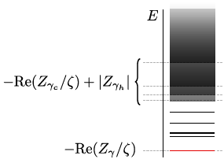
Line Defects & Framed BPS States (in general)
3
A line defect L (say along R_{t} x {0 } ) is of type ζ =e^{i☺}
if it preserves the susys:
Example:
Notes:
SAY AS AN ASIDE THAT A COROLLARY OF OUR WORK ARE EXACT RESULTS ON THESE SUSY LINE DEFECTS

Slide 19

Framed BPS States saturate this bound, and have framed protected spin character:
Piecewise constant in ζ and u, but has wall-crossing
across ``BPS walls’’ (for Ω(γ)≠ 0):
Particle of charge γ binds to the line defect:
Similar to Denef’s halo picture

Slide 20
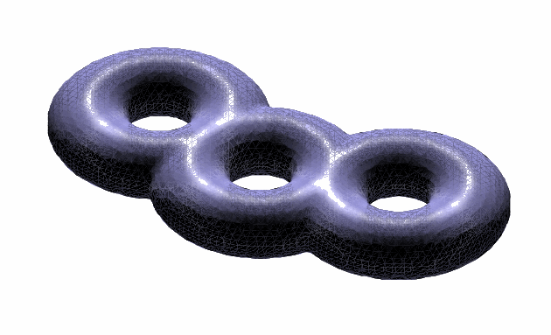
Line defects in S[g,C,D]
6D theory S[g] has supersymmetric
surface defects S(, σ )
For S[g,C,D] consider
Line defect in 4d labeled by isotopy class of a closed path ℘ and 
k=2:
Drukker, Morrison,
Okuda

Slide 21
Outline
Introduction
Theories of class S & their BPS states
Line defects and framed BPS states
Surface defects & susy interfaces
Spectral networks
Determining the BPS degeneracies
Conclusion

Slide 22
Surface defects
(in general)
4
UV Definition:
Preserves d=2 (2,2) supersymmetry subalgebra
Twisted chiral multiplet :
IR Description:
Coupled 2d/4d system

Slide 23

IR: Effective Solenoid
Introduce duality frame:

Slide 24
Canonical Surface Defect in S[g,C,D]
For z ∈ C we have a canonical surface defect S_{z}
It can be obtained from an M2-brane ending at x¹=x²=0 in R⁴ and z in C
In the IR the different vacua for this M2-brane are the different sheets in the fiber of the SW curve over z.
Therefore the chiral ring of the 2d theory should be the same as the equation for the SW curve!
Alday, Gaiotto, Gukov, Tachikawa, Verlinde; Gaiotto

Slide 25
Superpotential for S_{z} in S[g,C,D]
x_{i}
x_{j}
z
Homology of an open path on Σ joining x_{i} to x_{j} in the fiber over z.

Slide 26
Soliton Charges in Class S
_{ij} has endpoints covering z
x_{i}
x_{j}
z
branch point

Slide 27
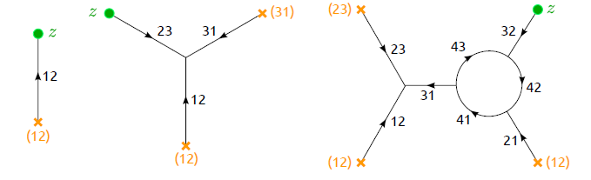
Solitons as open string webs
Solitons for S_{z} correspond to open string webs on C which begin and end at z
For solitons on S_{z} we define an index μ := signed sum over open string webs beginning and ending at z

Slide 28
Solitons in Coupled 2d4d Systems
Flux:
2D soliton degeneracies:

Slide 29
2d/4d Degeneracies: ω
Flux:
Degeneracy:

Slide 30

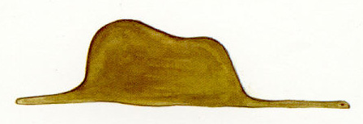
Supersymmetric Interfaces
UV:
IR:
Flux:

Slide 31
Susy Interfaces: Framed Degeneracies
Our interfaces preserve two susy’s of type ζ and hence we can define framed BPS states and form:

Slide 32
Susy interfaces for S[g,C,D]
Interfaces between S_{z} and S_{z’} are labeled by homotopy classes of open paths ℘ on C
L,☺ only depends on the homotopy class of 

Slide 33
IR Charges of framed BPS
Framed BPS states are graded by homology of open paths γ_{ij’} on Σ with endpoints over z and z’

C

Slide 34
SUMMARY SLIDE
FIELD THEORY
BPS DEGENERACY
CLASS S REALIZATION
string webs on C lifting to   H₁()
BPS PARTICLES
LINE DEFECT & Framed BPS
UV:closed  C
IR: closed   
UV: S_{z}
SURFACE DEFECT & Solitons
IR: Open paths on  joining sheets i and j above z.
SUSY INTERFACE
UV: Open path  on C z to z’
IR: Open path on  from
x_{i} to x_{j’}

Slide 35
Outline
Introduction
Theories of class S & their BPS states
Line defects and framed BPS states
Surface defects & susy interfaces
Spectral networks
Determining the BPS degeneracies
Conclusion

Slide 36
Spectral Networks
6
We will now show how the technique of spectral networks allows us to compute all these BPS degeneracies.
Fix ☺. The spectral network ☺ is the collection of points on C given by those z  C so that there is some 2d soliton on S_{z} of phase =e^{i☺}:

Slide 37
S-Walls
☺ contains the endpoints z of open string webs of phase ☺
These webs are made of WKB paths:
The path segments are ``S-walls of type ij’’

Slide 38
12
32
32
21
21
23
But how do we choose which WKB paths to fit together?

Slide 39
Formal Parallel Transport
Introduce the generating function of framed BPS degeneracies:

C

Slide 40
Homology Path Algebra
To any relative homology class
a  H₁(,{x_{i}, x_{j’} }; Z) assign X_{a}
X_{a} generate the “homology path algebra” of 

Slide 41
Four Defining Properties of F
1
2
Homotopy invariance
=
3
If  does NOT intersect ☺ :
4
If  DOES
intersect ☺ :
``Wall crossing formula’’

Slide 42
Wall Crossing for F(,☺)
ij

Slide 43
Theorem: These four conditions completely determine both F(,☺) and 
Proof:
The mass of a soliton with charge _{ij}
increases monotonically along the S-walls.
Natural mass filtration defines [☹]:

Slide 44
Evolving the network -1/3
For small ☹ the network simply consists of 3 trajectories emitted from each ij branch point,
ji
ij
ji
Homotopy invariance implies (_{ij})=1

Slide 45
Evolving the network -2/3
As we increase ☹ some trajectories will intersect. The further evolution is again determined by homotopy invariance
₁
and,
(_{ik}) is completely determined (CVWCF)
₂

Slide 46
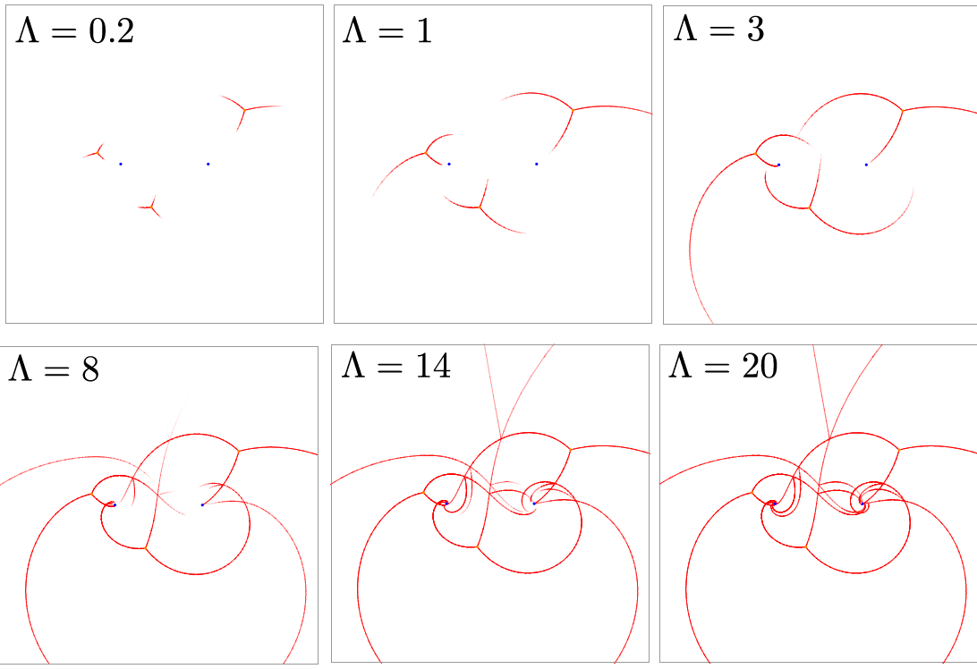

Slide 47
Outline
Introduction
Theories of class S & their BPS states
Line defects and framed BPS states
Surface defects & susy interfaces
Spectral networks
Determining the BPS degeneracies
Conclusion

Slide 48
Determine the 2d spectrum
Now vary the phase :
This determines the entire 2d spectrum:
for all
But also the spectral network changes discontinuously for phases ☺_{c} of  corresponding to 4d BPS states!

Slide 49
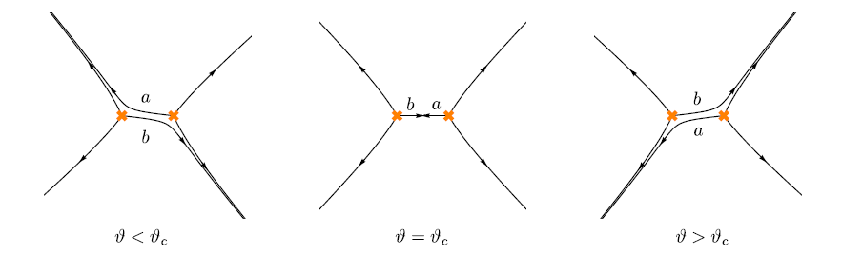
Movies: http://www.ma.utexas.edu/users/neitzke/movies/

Slide 50
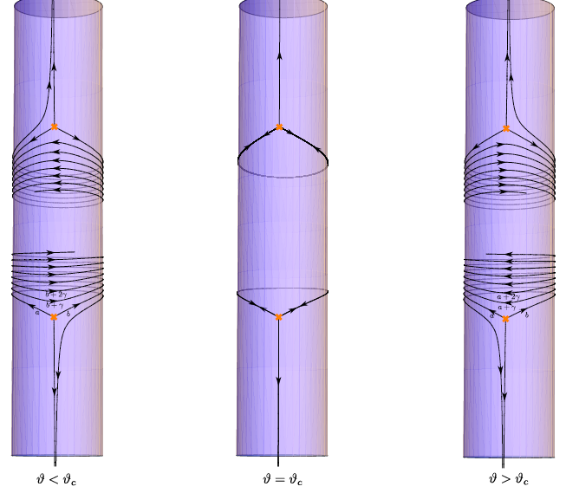

Slide 51
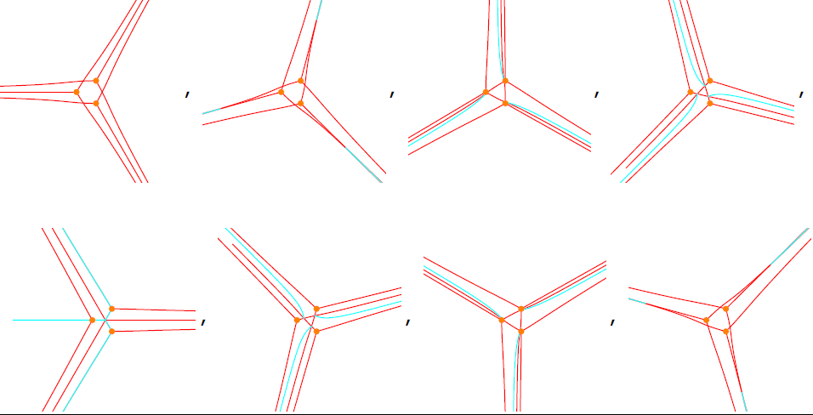

Slide 52
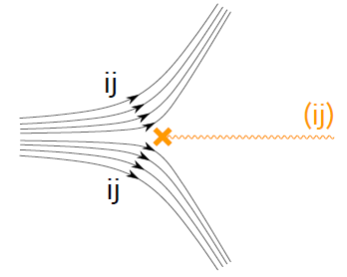
How does a spectral network jump discontinuously?
An ij S-wall crashes into an (ij) branch point
This happens precisely when there are string webs!
So ☺_{c} is the phase of a charge of a 4d BPS state

Slide 53
Explicit Formula for 
L(n) is explicitly constructible from the spectral network.

Slide 54
The 2D spectrum
determines
the 4D spectrum.

Slide 55
Spin Lifts
This technique is especially effective in a nice corner of the Coulomb branch of some su(k) theories
Consider an su(2) spectral curve:
T_{j} := Spin j rep. of sl(2)
k = 2j +1

Slide 56
Spin Lifts - B
is a degenerate su(k) spectral curve
Small perturbations deform it to a smooth SW curve of an su(k) theory
Our algorithm gives the BPS spectrum of this su(k) theory in this neighborhood of the Coulomb branch.

Slide 58
Outline
Introduction
Theories of class S & their BPS states
Line defects and framed BPS states
Surface defects & susy interfaces
Spectral networks
Determining the BPS degeneracies
Conclusion

Slide 59
Conclusion
We introduced “spectral networks,” a new combinatorial tool in supersymmetric field theory related to the physics of line and surface defects in N=2 theories of class S.
What are they good for?

Slide 60
as I already said….
They determine BPS degeneracies in 4D N=2 field theories of class S.
They give a “pushforward map” from flat U(1) gauge fields on  to flat nonabelian gauge fields on C.
They determine cluster coordinates on the moduli space of flat GL(K,C) connections over C.
“Fock-Goncharov coordinates’’
“Higher Teichmuller theory”
Higher rank WKB theory

Slide 61

Future Applications?
1. Geometric Langlands program??
2. Knot categorification?
3. Explicit hyperkahler
metrics?
Even the K3 metric?

