Slide 1
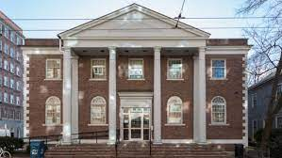
On The Physical Mathematics Dialogue
Gregory Moore
Rutgers University
October 27, 2023

Slide 2
Phys-i-cal Math-e-ma-tics, n.
Brit. /ˈfɪzᵻkl ˌmaθ(ə)ˈmatɪks / , U.S. /ˈfɪzək(ə)l ˌmæθ(ə)ˈmædɪks/
Pronunciation:
Physical mathematics is a fusion of mathematical and physical ideas, motivated
by the dual, but equally central, goals of
1. Elucidating the laws of nature at their most fundamental level,
together with
2. Discovering deep mathematical truths.
Notes:
Now, the history of the relation between math and fundamental physics
Has had its ups and downs over the past centuries. A high water mark came
After the upheavals in early 20th century physics with the introduction of
General relativity and quantum mechanics. In a famous paper Dirac said --

Slide 3
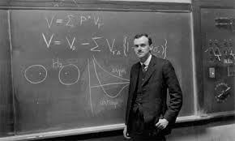
1931: Dirac’s Paper on Monopoles
Notes:
But then something happened during the 30’s – 60’s and there was relatively
Little interaction. This was perhaps most famously articulated by Freeman Dyson –

Slide 4
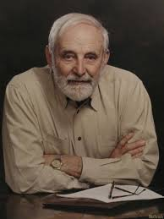
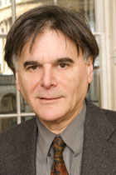
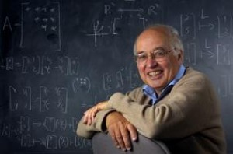
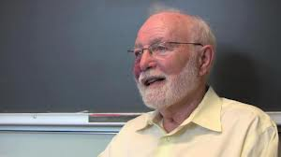
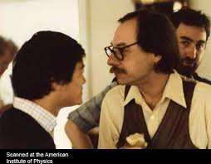
c. 1970: Some great mathematicians
got interested in aspects of fundamental physics …..
While some great physicists started producing results requiring ever increasing mathematical
sophistication, …..

Slide 5
Physical Mathematics Dialogue
In the past few decades a new field has emerged
with its own distinctive character, its own aims and values,
its own standards of proof.
One of the guiding principles is certainly the discovery
of the ultimate foundations of physics.
This quest has led to ever more sophisticated mathematics…
A second guiding principle is that physical insights can lead to surprising and new results in mathematics
Such insights are a great success - just as profound and notable as an experimental confirmation
of a theoretical prediction.
Notes:
This is what Graham’s book is about.

Slide 6
Today:
It’s best to discuss this by giving a paradigmatic example of the dialogue between physicists and mathematicians

Slide 7
Supersymmetric QFT &
Differential Topology of Four-Manifolds
Beautiful story.
I’m still working on it.
But I’ve given that talk quite a lot.
Dan is getting bored with it.

Slide 11



GENERALIZED SYMMETRY
Simons Collaboration on
Global Categorical
Symmetry
Coals to Newcastle

Slide 12
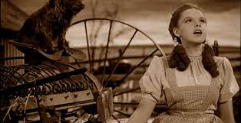
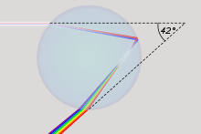
Somewhere Over The Rainbow
Descartes, Newton,Huygens,Young, Fresnel,

Slide 13
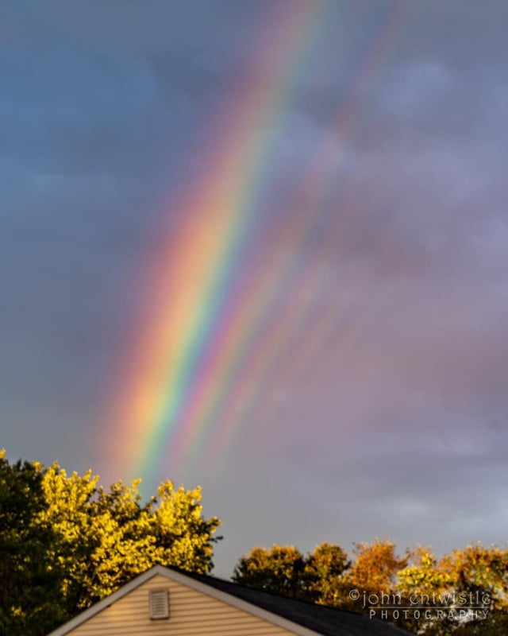
Supernumerary Arcs

Slide 14
1
Physical Mathematics
2
George Airy & George Stokes
3
Perturbative vs. Nonperturbative QFT
4
More About Airy & Stokes
Chern-Simons-Witten Gauge Theory
5
6
Stokes & Differential Equations
Summary & Future Directions
7

Slide 15
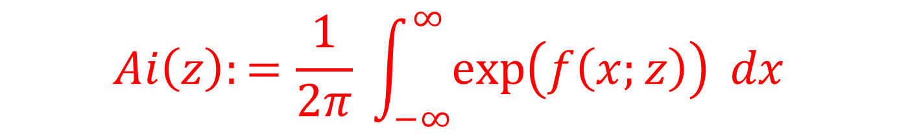
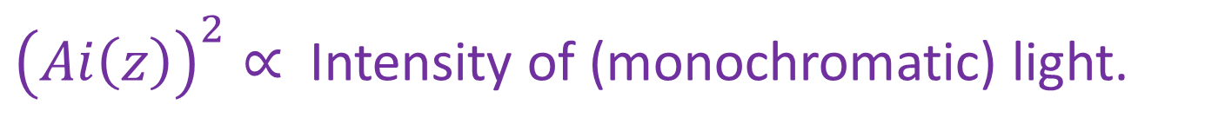
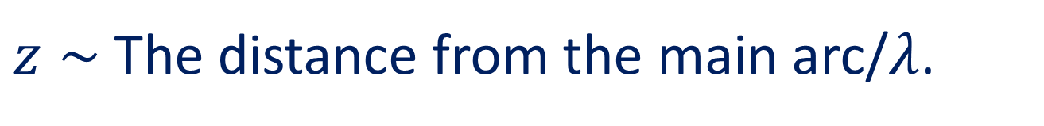

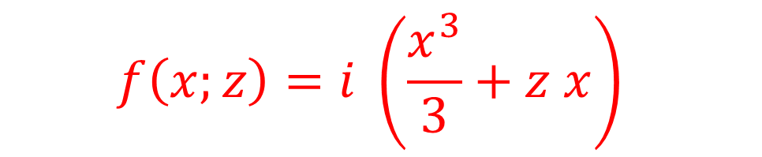
Airy’s Integral [1838]
$$Ai\left(z\right):=\frac{1}{2π} \int_{−∞}^{∞}{\exp\left(f\left(x;z\right)\right) dx }$$
$$f\left(x;z\right)=i \left(\frac{x^{3}}{3}+z x\right)$$
$z∼$The distance from the main arc/$λ$.
${\left(Ai\left(z\right)\right)}^{2}∝$Intensity of (monochromatic) light.
Wanted: Behavior for large $|z|$
But Airy couldn’t do the integral (very well) ….

Slide 16
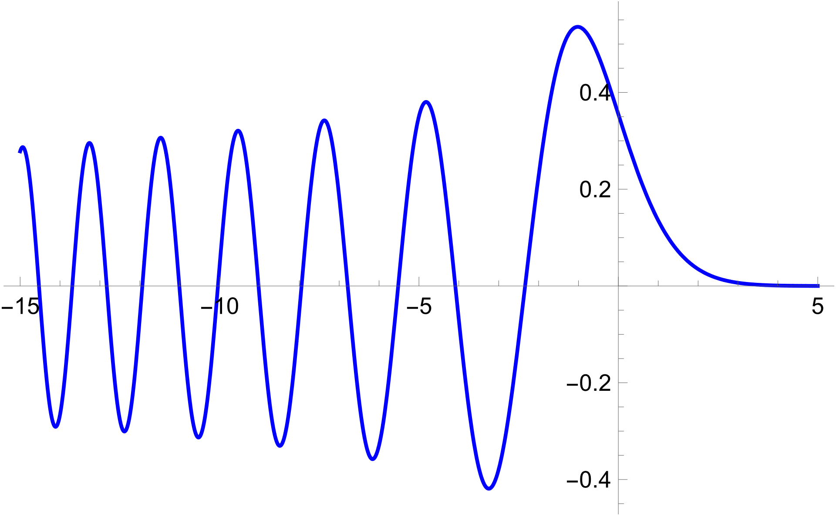
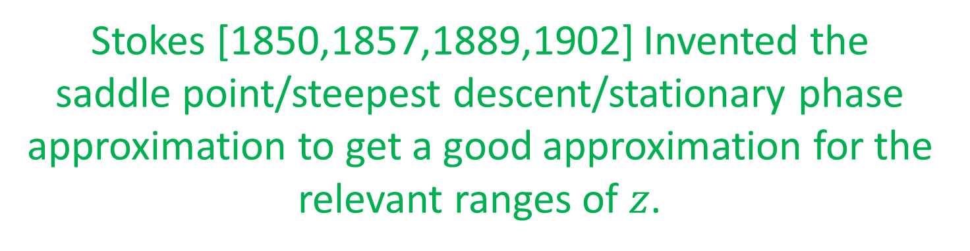
Stokes To The Rescue
Stokes [1850,1857,1889,1902] Invented the
saddle point/steepest descent/stationary phase approximation to get a good approximation for the relevant ranges of $z$.

Slide 17
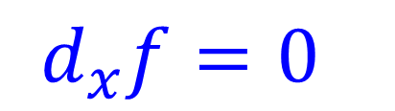

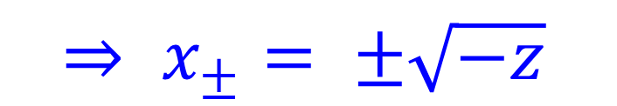

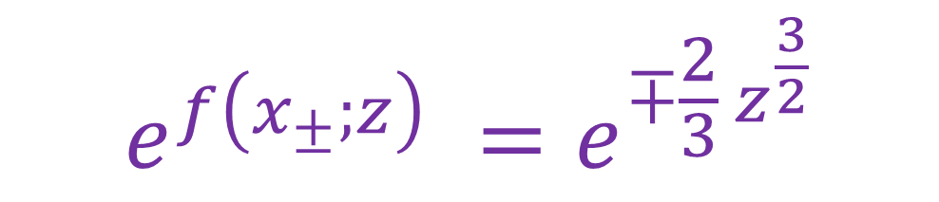

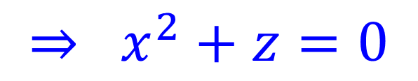
$$Ai\left(z\right)=\frac{1}{2π} \int_{−∞}^{∞}{\exp\left(f\left(x;z\right)\right) dx }$$
$$f\left(x;z\right)=i \left(\frac{x^{3}}{3}+z x\right)$$
Saddle points = critical points:
$$d_{x}f=0$$
$$⇒ x^{2}+z=0$$
$⇒ x_{±}= ±\sqrt{−z}$
$$z>0 ⇒ x_{±}= ±i \sqrt{|z|}$$
$$e^{f\left(x_{±};z\right)} =e^{∓\frac{2}{3} z^{\frac{3}{2}}}$$

Slide 18
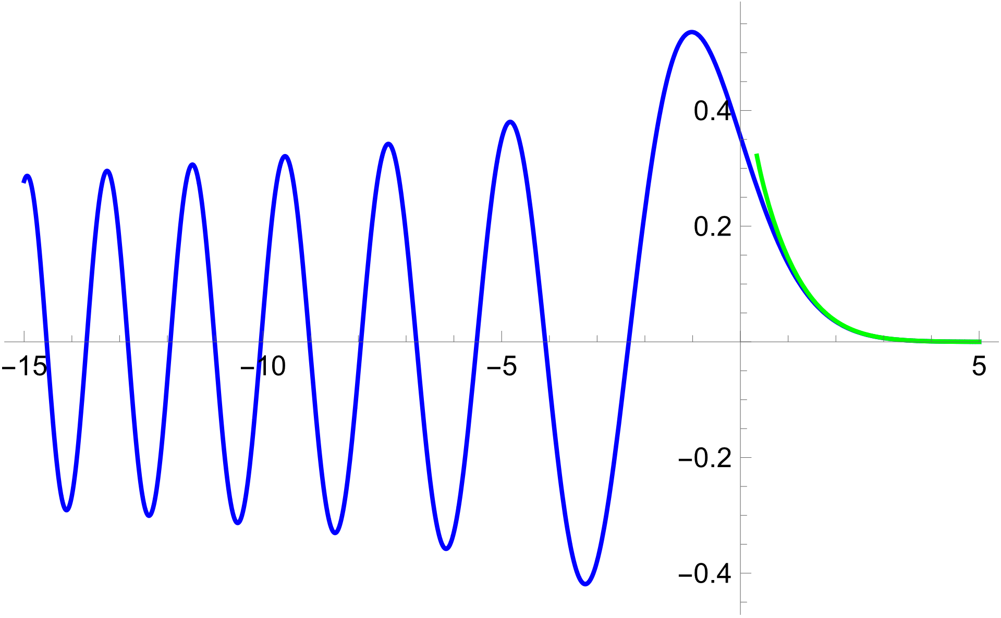
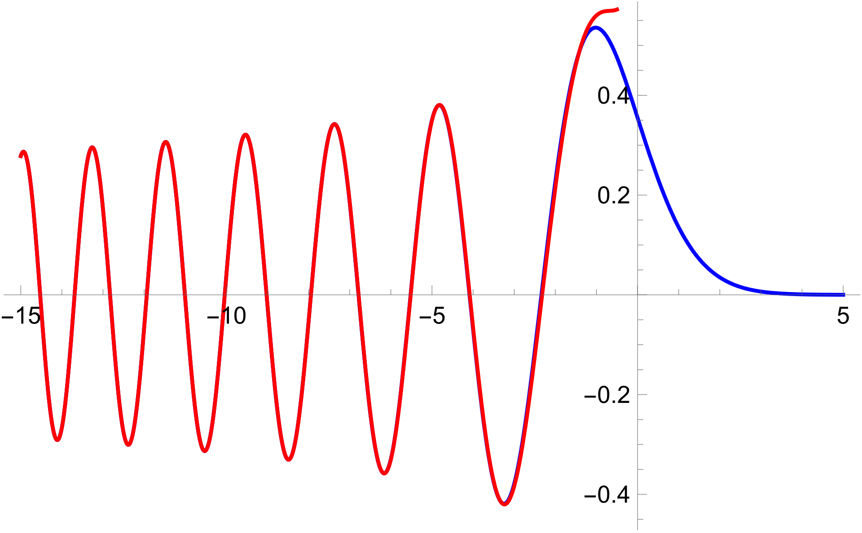


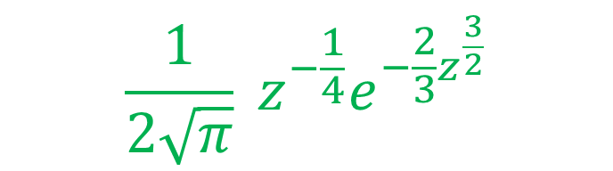
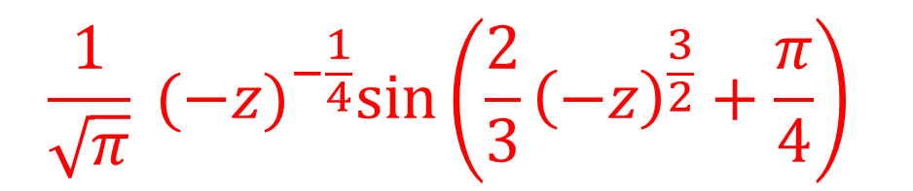
$$z→+∞$$
$$\frac{1}{2\sqrt{π}} z^{−\frac{1}{4}}e^{−\frac{2}{3}z^{\frac{3}{2}}}$$
$$z→−∞$$
$$\frac{1}{\sqrt{π}} {(−z)}^{−\frac{1}{4}}\sin\left(\frac{2}{3}{\left(−z\right)}^{\frac{3}{2}}+\frac{π}{4}\right)$$

Slide 19
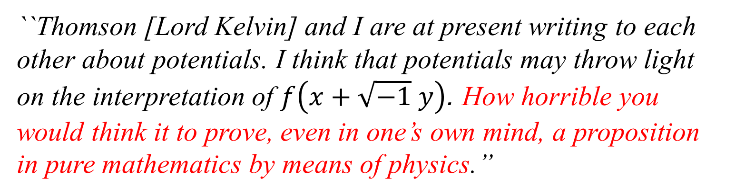
Stokes wrote to Arthur Cayley,
a pure mathematician, about his work 29th Oct. 1849
``Thomson [Lord Kelvin] and I are at present writing to each other about potentials. I think that potentials may throw light on the interpretation of $f\left(x+\sqrt{−1} y\right)$. How horrible you would think it to prove, even in one’s own mind, a proposition in pure mathematics by means of physics.’’
(Quoted from A. O’Donnell, ``The work of G.G. Stokes in
evaluating the Airy rainbow integral and its ramifications today,’’)
Notes:
Stokes, who was primarily interested in applications of mathematics to the physical sciences wrote to the pure mathematician Arthur Cayley while working on his 1850 paper………
History does not record whether Cayley thought this prospect was horrible or not, or whether Stokes was being sarcastic but…..

Slide 20
`` How horrible you would think it to prove, even in one’s own mind, a proposition in pure mathematics by means of physics.’’
Today, that ``horrible idea’’
is at the heart of physical mathematics.
In the context of (cohomological) TFT exact saddle point integrals have led to many important
mathematical developments:
Donaldson/Seiberg-Witten, Gromov-Witten invariants, Floer Theory,…

Slide 21
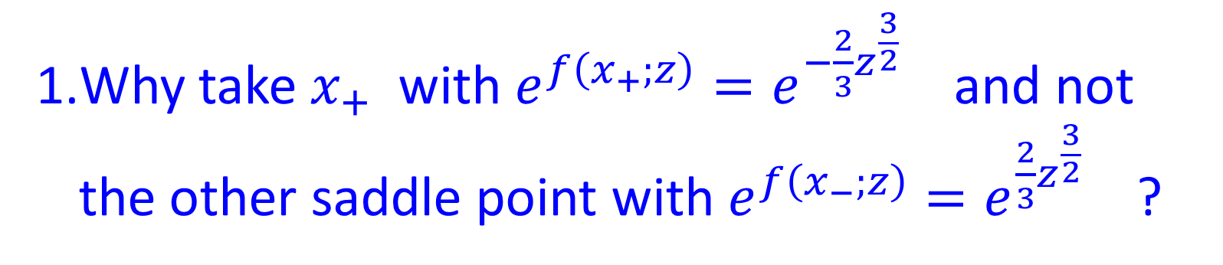

Three Odd Things About Stokes’ Computation
Why take $x_{+}$with $e^{f\left(x_{+};z\right)}=e^{−\frac{2}{3}z^{\frac{3}{2}}}$ and not the other saddle point with $e^{f\left(x_{−};z\right)}=e^{\frac{2}{3}z^{\frac{3}{2}}}$ ?
Is there a principle, other than that we don’t like the answer with $x_{−}$?

Slide 22
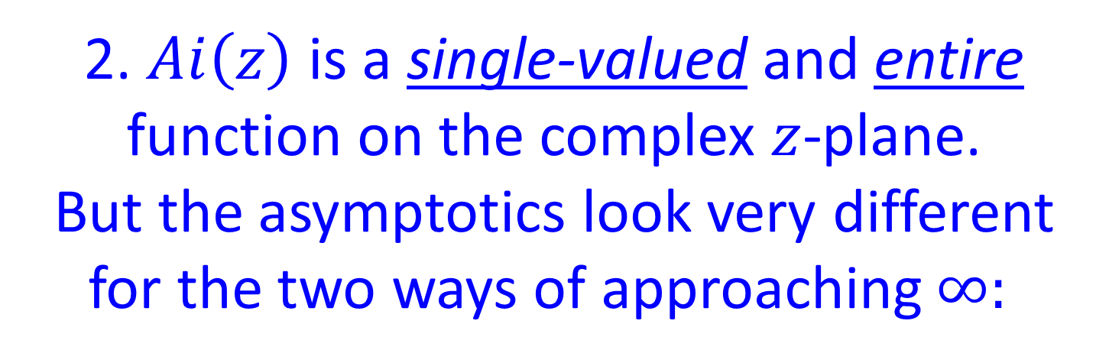
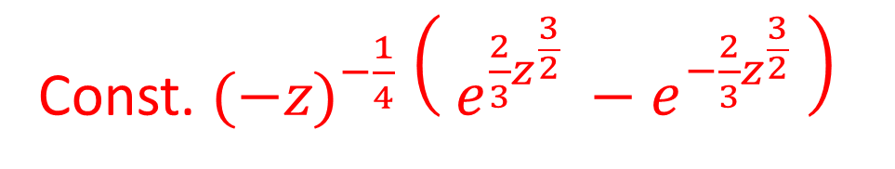


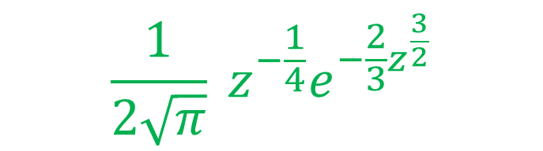
Three Odd Things About Stokes’ Computation
2. $Ai\left(z\right)$ is a single-valued and entire function on the complex $z$-plane.
But the asymptotics look very different for the two ways of approaching $∞:$
$$\frac{1}{2\sqrt{π}} z^{−\frac{1}{4}}e^{−\frac{2}{3}z^{\frac{3}{2}}}$$
$$z→+∞$$
Const. ${(−z)}^{−\frac{1}{4}} \left( e^{\frac{2}{3}z^{\frac{3}{2}}} −e^{−\frac{2}{3}z^{\frac{3}{2}}} \right)$
$$z→−∞$$

Slide 23
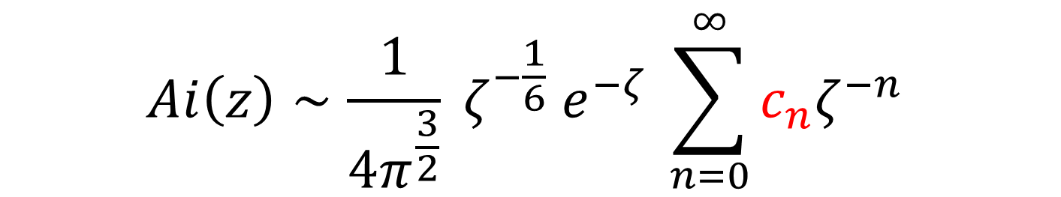

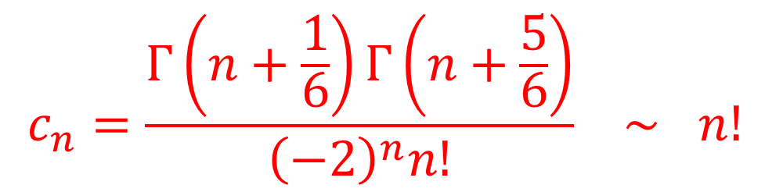
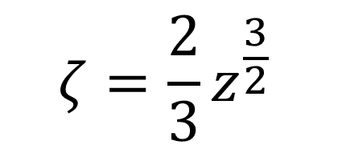
Three Odd Things About Stokes’ Computation
3. Stokes got an even better approximation. For $z→+∞$
$$Ai\left(z\right)∼\frac{1}{4π^{\frac{3}{2}}} ζ^{−\frac{1}{6}} e^{−ζ} \sum_{n=0}^{∞}{c_{n}ζ^{−n} }$$
$$c_{n}=\frac{Γ\left(n+\frac{1}{6}\right)Γ\left(n+\frac{5}{6}\right)}{{\left(−2\right)}^{n}n!} ∼ n!$$
$$ζ=\frac{2}{3}z^{\frac{3}{2}}$$
Series diverges: Has zero radius of convergence.

Slide 24
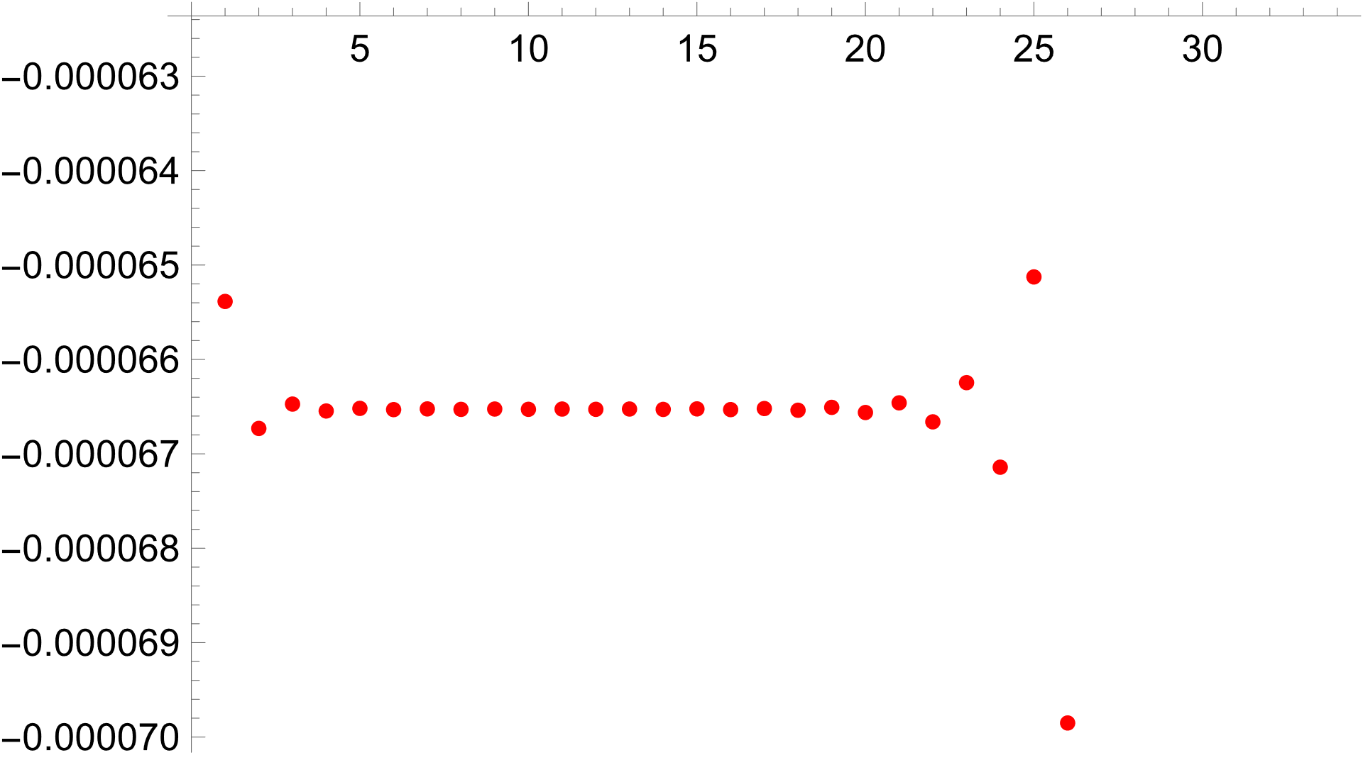
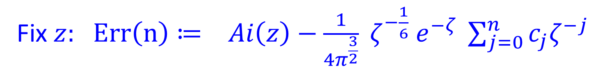



Stokes was confronting an example of an asymptotic series.
Fix $z:$ $Err\left(n\right)≔ Ai\left(z\right)−\frac{1}{4π^{\frac{3}{2}}} ζ^{−\frac{1}{6}} e^{−ζ} \sum_{j=0}^{n}{c_{j}ζ^{−j}}$
$$z=4$$
$$n=1,…, 30$$
For fixed $z$ the best approximation
has error $∼\sqrt{\left|ζ\right|}e^{−2 \left|ζ\right|}$

Slide 25

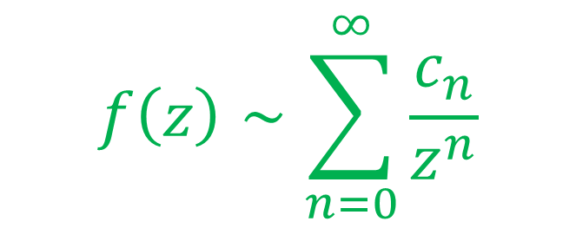

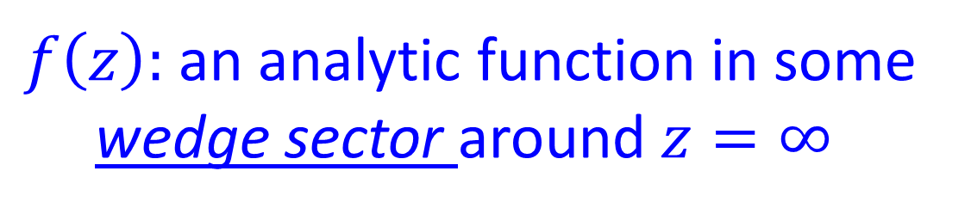

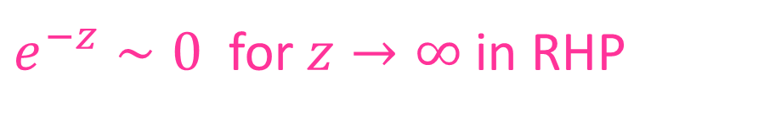

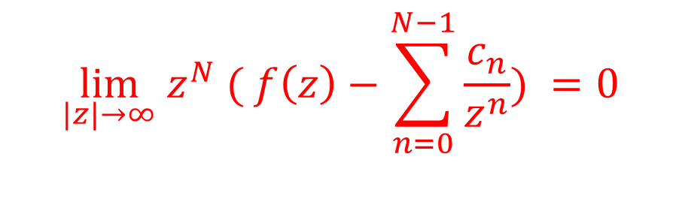

Modern definition of an asymptotic series [Poincare’ [1886]…. See Dingle’s book]
$$1/z$$
$f\left(z\right):$an analytic function in some wedge sector around $z=∞$
$$1/z$$
$$0$$
$$f\left(z\right)∼\sum_{n=0}^{∞}{\frac{c_{n}}{z^{n}}}$$
$$\lim_{|z|→∞} z^{N} ( f\left(z\right)−\sum_{n=0}^{N−1}{\frac{c_{n}}{z^{n}}) =0 }$$
Why the wedge?
$e^{−z}∼0$ for $z→∞$in RHP
$NOT for$ $z→∞$in LHP

Slide 26
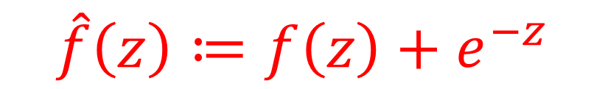


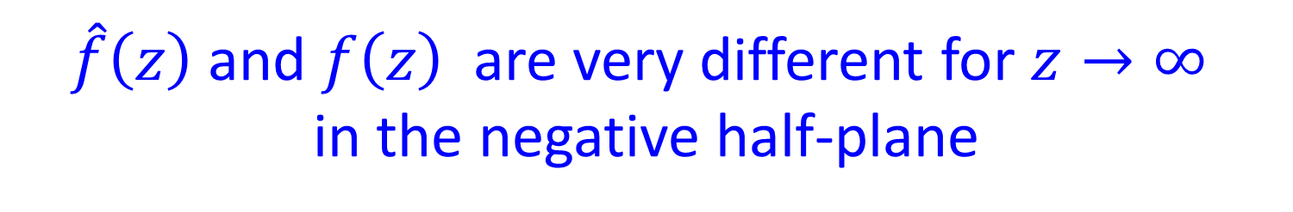
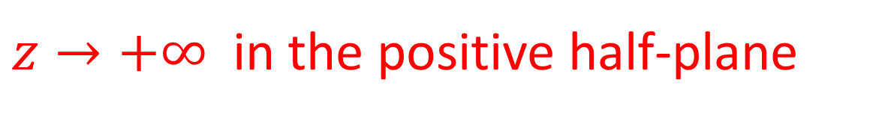
Suppose $f\left(z\right)$ is entire.
$$\hat{f}\left(z\right)≔f\left(z\right)+e^{−z}$$
$$∼ f\left(z\right)$$
$z→+∞$ in the positive half-plane
$\hat{f}\left(z\right)$and $f\left(z\right)$are very different for $z→∞$
in the negative half-plane
Asymptotic Expansion and
Analytic Continuation do not commute!
This is part of what’s going on in Stokes’ evaluation of Airy’s integral – but there is so much more…

Slide 27
1
Physical Mathematics
2
George Airy & George Stokes
3
Perturbative vs. Nonperturbative QFT
4
More About Airy & Stokes
Chern-Simons-Witten Gauge Theory
5
6
Stokes & Differential Equations
Summary & Future Directions
7

Slide 28
Stokes’ asymptotic expansion has a very common analog in Quantum Field Theory.
What is QFT?
Quantum Field Theory:
The most successful framework for describing Nature in the history of Science.
OK. But What is QFT?
A table of correlation functions
of local observables
Evaluation of Feynman path integrals
Notes:
When I was a graduate student here extremely good physicists would say… We’ll re-examine that viewpoint, but for now let’s see how this is connected to the asymptotic expansions of Stokes and Poincare.

Slide 29
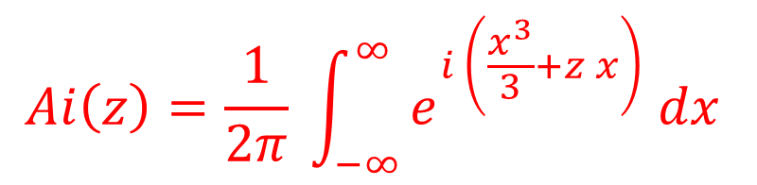
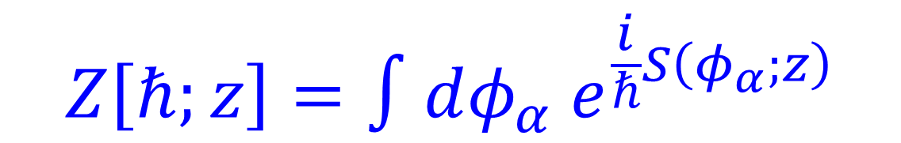
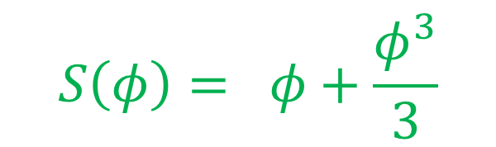
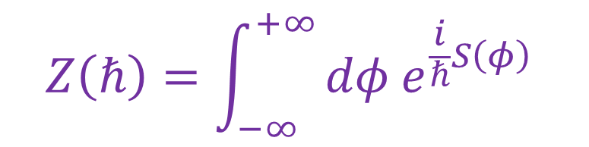
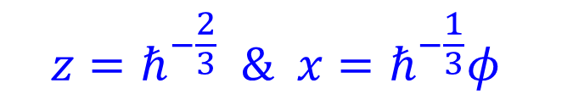
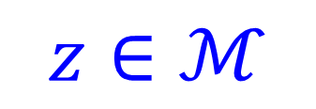
$$Ai\left(z\right)=\frac{1}{2π} \int_{−∞}^{∞}{e^{i \left(\frac{x^{3}}{3}+z x\right)} dx }$$
$$z=ℏ^{−\frac{2}{3}} \& x=ℏ^{−\frac{1}{3}}φ$$
$$Z\left(ℏ\right)=\int_{−∞}^{+∞}{dφ e^{\frac{i}{ℏ}S\left(φ\right)} }$$
$$S\left(φ\right)= φ+\frac{φ^{3}}{3}$$
Example of a 0-dimensional QFT
$$Z\left[ℏ;z\right]=∫dφ_{α} e^{\frac{i}{ℏ}S\left(φ_{α};z\right)}$$
$$z∈ℳ$$
Many (possibly infinitely many) degrees of freedom $φ_{α}$

Slide 30
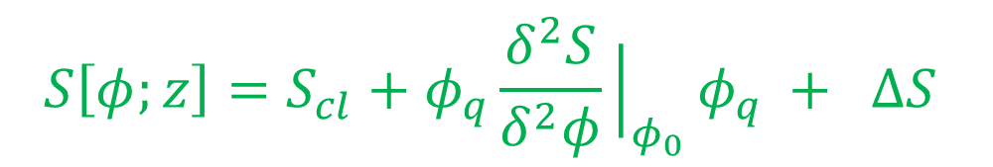



Semiclassical Analysis
Saddle point = solution $φ_{0}$
to equations of motion $\frac{δS}{δφ}{\left.​\right|}_{φ_{0}}=0$
(e.g. saddle points $x_{±}= ±\sqrt{−z}$ in the Airy integral)
Expand in quantum fluctuactions.
$$S\left[φ;z\right]=S_{cl}+φ_{q}\frac{δ^{2}S}{δ^{2}φ}{\left.​\right|}_{φ_{0}}φ_{q} + ΔS$$
$$φ=φ_{0}+φ_{q}$$
Expand $e^{−i ΔS/ℏ}$as a power series in $φ_{q}$ and do the Gaussian integrals…

Slide 31







$$Z\left[ℏ;z \right]∼ e^{\frac{i}{ℏ}S_{cl}} \sqrt{2πi\frac{ℏ}{S^{′′}\left(φ_{0}\right)}} × 𝒮$$
$$𝒮= 1+\sum_{g≥2}{ℏ^{g−1} \sum_{Γ∈𝒢_{g}}{\frac{1}{\left|Sym Γ\right|} \prod_{v∈Vert\left(Γ\right)}{c_{v} }}}$$
$𝒢_{g} :$Set of (Feynman) graphs of Euler character $χ=1−g$
$$𝒢_{2}=\{$$
$$,$$
$$,$$
$$\}$$
$$c_{v}= \frac{S^{\left(n\left(v\right)\right)}\left(φ_{0}\right)}{{\left(±\sqrt{{−S}^{′′}\left(φ_{0}\right)}\right)}^{n\left(v\right)}}$$
Notes:
And we weight the graphs by some rules which we should call the Feynman rules because in the context of QFT this IS the Feynman diagram expansion

Slide 32

In a general QFT we face the same puzzles we encounter in Stokes’ evaluation of the Airy integral
Which saddle points contribute?
The series in $ℏ$is typically an asymptotic series.

Slide 33








Triumph of the perturbative approach: QED:
Dyson, Feynman, Schwinger, Tomonaga (1946-1949)
$$\frac{g_{e}}{2}=1+\frac{α}{2π}+⋯$$
$${\left(\frac{g}{2}\right)}_{expt}=1.001 159 652 180 73 \left(28 ppt\right)$$
$${\left(\frac{g}{2}\right)}_{thry}=1.001 159 652 177 60 \left(520 ppt\right)$$

Slide 34
But doesn’t work so well for nonabelian gauge theories at large distance.
Perturbative analysis does not tell the whole story, in general.
Nonperturbative effects can be important
Central Issue In Much Of Modern Fundamental Physics

Slide 35
Physical mathematics dialogue of the past few decades has revealed special classes of theories or aspects of theories allowing nonperturbative analysis.
Typically involve ingenious and relentless pursuit of consequences of symmetry:
2d Rational Conformal Field Theory
Integrable models (Ising field theory, and relatives)
Solvable aspects of supersymmetric field theories
Anomalies

Slide 36


Precious & Few
Mathematically sound exact results in important cases like 4d Yang-Mills or QCD remains a major open problem
Value for humanity $≫{10}^{6} USD$
Precious and few are the exact results we two can share

Slide 37
Textbook Formulations
Of QFT Are Inadequate
1. Putting theories with nontrivial RG flow on a firm mathematical basis has proven to be extremely difficult.
2. There is much more to a QFT than the correlation functions of the local operators.
A QFT is NOT equivalent to a table of correlation functions of local operators.
A full description involves nonlocal ``defects’’ like
Wilson-’t Hooft lines, and their generalizations.

Slide 38
3. Some QFT’s are thought to have no description via an action principle involving fundamental field theoretic degrees of freedom.
4. Some QFT’s have many different action principles involving totally different field theoretic degrees of freedom
5. Physical observables like S-matrix amplitudes encode causality and locality in highly nonobvious and nontrivial ways. (See Arkani-Hamed’s talk. )
6. Many nontrivial field-theoretic phenomena have nontrivial geometrical reformulations.

Slide 39
So, what is QFT?

Slide 40


Functorial Approach
Atiyah, Segal [1988],…
Physics tells us how states evolve from the past to the future.
A physical state of a system in $n$spacetime dimensions is:
A description of the way things are, at a
fixed time, and is hence associated
with a spatial slice, i.e. an $\left(n−1\right)−$manifold: Space, at fixed time.

Slide 41


Functorial Approach
So spacetime evolution is described mathematically by a bordism from an initial spatial manifold to a
final spatial manifold
$$𝒮_{initial}$$
$$𝒮_{final }$$

Slide 42






In QM the description of physical states involves Hilbert spaces.
So, to spatial manifolds
we associate Hilbert spaces.
$$𝒮_{in}$$
$$𝒮_{fin }$$
$$Σ$$
$$ℋ\left(𝒮_{in}\right)$$
$$ℋ\left(𝒮_{fin}\right)$$
Amplitude - a linear map $F\left(Σ\right):ℋ\left(𝒮_{in}\right)→ℋ\left(𝒮_{fin}\right)$

Slide 43

DEFINITION:
An $n−$dimensional QFT is a monoidal functor from an $n−$dimensional bordism category to a monoidal $n−$category.
Many successes,
Leading experts Dan Freed, Mike Hopkins, …
Does QCD fit this framework?
Doesn’t address many of the points above.

Slide 44
So, what is QFT?
We know it when we see it.

Slide 45
1
Physical Mathematics
2
George Airy & George Stokes
3
Perturbative vs. Nonperturbative QFT
4
More About Airy & Stokes
Chern-Simons-Witten Gauge Theory
5
6
Stokes & Differential Equations
Summary & Future Directions
7

Slide 46


What about the choice of saddle point?
Recall Stokes’ evaluation of $Ai\left(z\right):$
One saddle contributes for $z→+∞$
Two saddles contribute for $z→−∞$

Slide 47





Generalize:
$$ℐ\left(k;γ;z\right)=\int_{γ}{dφ e^{ k S\left(φ;z\right) } }$$
$S\left(φ;z\right):$Holomorphic function on a noncompact Kähler manifold $X.$
Example: $X=ℂ^{ℓ}$and $S\left(φ;z\right)$ polynomial in $φ.$
$γ⊂X :$Noncompact real cycle:
Half the dimension of $X$
e.g. $X=ℂ,$ $γ$comes in from $∞$and goes out to $∞$
$k=\frac{1}{ℏ}$ in QM $k=\frac{1}{λ}$ in optics;

Slide 48


What cycles $γ$ should we use so the integral is well defined?
What are the $k→∞$asymptotics?

Slide 49







$$ℐ\left(k;γ;z\right)=\int_{γ}{dφ e^{ k S\left(φ;z\right) } }$$
$$\left|e^{k S\left(φ;z\right)}\right|=e^{h}$$
$$h=Re\left(k S\left(φ;z\right)\right)$$
When $φ→∞$along $γ$want $h→−∞$ and not $h→+∞$ for convergence.
Cauchy: Integral depends only on
HOW $γ$ behaves at $φ→∞$
$$\left[γ\right]∈H_{ℓ}\left(X, X_{−∞}\right)$$
$$ℓ=\dim_{ℂ}{X }$$
$X_{−∞}= \{ φ∈X \left| h\left(φ\right)<−T \right\}$ sufficiently large $T$

Slide 50












$$x$$
$$+$$
$$𝒞′$$
$$−$$
$$−$$
$$𝒞$$
$$+$$
$$+$$
$$−$$
$$𝒞′′$$
$$S=i \left(\frac{x^{3}}{3}+z x\right)$$
$$𝒞+𝒞^{′}+𝒞^{′′}=0$$

Slide 51





Morse Theory Indomitable!
Good basis of cycles from the downward Morse flows:
$$\frac{dφ^{i}}{dt}=−g^{ij}∂_{j}h$$
$$h=Re\left(k S\left(φ;z\right)\right)$$
$𝒞𝓇= \{ p \left| dh\left(p\right)=0 \right\} :$Isolated Morse critical points
$𝒟_{p}\left(k,z\right)= \{ φ_{0} | φ_{0}$ flows to $p$ for $t→−∞ \}$
Steepest descent paths from $p∈𝒞𝓇:$
Submanifold of $X$of half-dimension

Slide 52





Lefshetz Thimbles
$h=Re\left(k S\left(φ;z\right)\right)$ $⇒$ Morse Flow
= Hamiltonian Flow for $H=Im\left(k S\left(φ;z\right)\right)$
$𝒟_{p}\left(k,z\right)=$ Steepest descent manifold
= Stationary phase manifold $⇒$
$k→∞$asymptotics given by Feynman expansion:
$$ℐ\left(k;𝒟_{p}\left(k,z\right);z\right)$$
$$∼e^{k S\left(p;z\right)} {\left(\frac{2π}{−kS^{′′}}\right)}^{\frac{1}{2}}\left[ 1+𝒪\left(\frac{1}{k}\right) \right]$$

Slide 53


Lefshetz thimbles form a basis of the relative homology
$$\left[γ\right]=\sum_{p∈𝒞𝓇}{n_{p} \left[𝒟_{p}(k,z)\right] }$$
$$ℐ\left(k;γ;z\right)=\sum_{p∈𝒞𝓇}{n_{p} ℐ\left(k;𝒟_{p}\left(k,z\right);z\right)}$$

Slide 54






Lefshetz Thimbles Jump Across Stokes Walls
Vary $\left(k,z\right)∈ℂ×ℳ$
The thimbles $𝒟_{p}\left(k,z\right)$ vary smoothly
(parallel transport by Gauss-Manin connection)
EXCEPT …. Across Stokes’ walls!
$𝒮\left(p_{1},p_{2}\right)=$ Set of $\left(k,z\right)$ such that:
1. $Im\left(k S\left(p_{1};z\right) \right)= Im \left(k S\left(p_{2};z\right)\right)$
2. $Re(k S\left(p_{1};z\right))>Re\left(k S\left(p_{2};z\right)\right)$
3. There is a Morse flow $p_{1}→p_{2}$
Notes:
By definition, Stokes walls are real codimension one walls associated with pairs of critical points. By definition the set of (k,z) such that….
We’ll call D(p1) the “Big Thimble” and D(p2) the “Small Thimble”

Slide 55
















$$\left(k,z\right)$$
$$𝒮\left(p_{1},p_{2}\right)$$
See How They Jump
$${\left(k,z\right)}^{cr}$$
$$𝒟_{p_{2}}^{+}≅𝒟_{p_{2}}^{−}$$
$${\left(k,z\right)}^{−}$$
$${\left(k,z\right)}^{+}$$
$$𝒟_{p_{1}}^{+}≅𝒟_{p_{1}}^{−}+N_{p_{1},p_{2}} 𝒟_{p_{2}}^{−}$$
$$p_{1}$$
$$p_{1}$$
$$p_{1}$$
$$p_{2}$$
$$p_{2}$$
$$p_{2}$$
$${\left(k,z\right)}^{−}$$
$${\left(k,z\right)}^{cr}$$
$${\left(k,z\right)}^{+}$$

Slide 56











$$x$$
$$𝒟_{+}$$
$$𝒟_{+}$$
$$x_{+}$$
$$x_{+}$$
$$𝒟_{−}$$
$$𝒟_{−}$$
$$x_{−}$$
$$x_{−}$$
$$z=e^{i ε}$$
$$z=e^{−i ε}$$

Slide 57








z
$$𝒮\left(x_{+},x_{−}\right)$$
$$𝒟_{+}\left(z\right)$$
$$Re\left(kS_{+}\right)=Re\left(kS_{−}\right)$$
$$𝒟_{−}≪𝒟_{+}$$
$$𝒟_{+}\left(z\right)+𝒟_{−}\left(z\right)$$
$$𝒟_{+}≪𝒟_{−}$$
$$Re\left(kS_{+}\right)=Re\left(kS_{−}\right)$$
$$γ_{Ai}=𝒟_{+}\left(z\right)$$
Anti-Stokes walls:
Two thimbles exchange dominance.

Slide 58
March 19, 1857 letter to his fiancée
``When the cat’s away the mice may play. You are the cat and I am the mouse. I have been doing what I guess you won’t let me do when we are married, sitting up till 3 o’clock in the morning fighting hard against a mathematical difficulty. Some years ago I attacked an integral of Airy’s, and after a severe trial reduced it to a readily calculable form. But there was one difficulty about it which, though I tried till I almost made myself ill …. ‘’
Quoted from M.V. Berry, ``Smoothing A Victorian Singularity’’

Slide 59


$γ_{Ai}=\left[ℝ\right]= {n_{+}\left(z\right)[𝒟}_{+}\left(z\right)]+n_{−}\left(z\right){[𝒟}_{−}\left(z\right)$]
$n_{±}\left(z\right):$Discontinuous in $z$
That is Stokes’ great discovery: Stokes’phenomenon
One model for ``BPS state wall-crossing’’
Continues to be a hot topic of current research
in supersymmetric QFT

Slide 60
1
Physical Mathematics
2
George Airy & George Stokes
3
Perturbative vs. Nonperturbative QFT
4
More About Airy & Stokes
Chern-Simons-Witten Gauge Theory
5
6
Stokes & Differential Equations
Summary & Future Directions
7

Slide 61


Airy Integral of the 21st Century: Chern-Simons-Witten Gauge Theory
Gauge theory for gauge field $A$ with gauge group $G$on a 3-manifold $M_{3}$
$$Z_{CS}∼ \int_{\frac{𝒜}{𝒢}}{μ\left(A\right) e^{ i \frac{k}{4 π} \int_{M_{3}}{Tr\left(A dA+\frac{2}{3}A^{3}\right) } }}$$
Notes:
Now, the nature of the theory depends strongly on the nature of the gauge group G.

Slide 62

Chern-Simons-Witten Gauge Theory
$G$compact: A piece of 21st –century mathematics that fell into the 20th century.
Lots of exact results.
Deep Mathematics & Physics
Relation to RCFT: Early example of holography;
FQHE & anyons
MTCs; WRT invariants; Quantum Groups;….
In the wider universe of QFT:
Among the Precious & Few:

Slide 63

Chern-Simons-Witten Gauge Theory
$G$finite dimensional
noncompact Lie Group:
Much less understood
Growing literature:
Anderen-Kashaev; Beem; Collier; Dimofte; Eberhardt; Gaiotto; Garoufalidis; Gu; Gukov; Lenells, Marino; Mikhaylov; Teschner; Pasquetti; Pei; Putrov; Terashima; Vafa; Yamazaki; Witten; Zagier; …..
1. New 3-manifold invariants
3. 3d Quantum Gravity
2. Shed light on hyperbolic geometry
4. Closely related to 6d (2,0) theory

Slide 64




Chern-Simons-Witten Gauge Theory
& Knot Homology
Choose complex gauge group $G$
$𝒳=\{$complex G-gauge fields on $M_{3} \}$
Morse function: $W=k \int_{M_{3}}{Tr \left(A dA+\frac{2}{3} A^{3}\right) }$
2d (2,2) LG theory with target $𝒳$ Morse function $W$
Physical formulation of knot homologies.
Haydys-Witten/Kapustin-Witten PDE’s:
Analysis very nontrivial. Progress by Cliff Taubes

Slide 65

Potentially New Knot Invariants
Conjecture [Dimofte,Gaiotto,Khan,Moore,Neitzke,Yan]:
$a.)$The h.e. class of the ${ A}_{∞}−$category of $𝔅𝔯\left(CSLG\left(M_{3}\right)\right)$
is a 3-manifold invariant
b.) The h.e. class of $A_{∞}$ - algebras $End\left(𝔅\left(L\right)\right)$
are (new?) colored link invariants.

Slide 66
1
Physical Mathematics
2
George Airy & George Stokes
3
Perturbative vs. Nonperturbative QFT
4
More About Airy & Stokes
Chern-Simons-Witten Gauge Theory
5
6
Stokes & Differential Equations
Summary & Future Directions
7

Slide 67
We’ve only told half the story about Stokes’ phenomenon
Stokes’ phenomenon
plays and important role in the theory of
Differential Equations

Slide 68






One-dimensional Schrödinger equation
$$U\left(x\right)$$
$$E$$
$$x_{1}$$
$$x_{2}$$
$$x$$
$$\left(−ℏ^{2}\frac{d^{2}}{dx^{2}}+U\left(x\right)\right)ψ\left(x\right)=E ψ\left(x\right)$$
Find $L^{2}−$normalizable solutions. Only exist for special $E$

Slide 69




Zoom in on classical turning point $x_{2}$
$$U\left(x\right)=E+U^{′}\left(x_{2}\right)\left(x−x_{2}\right)+𝒪\left({\left(x−x_{2}\right)}^{2}\right)$$
$$z={\left(U^{′}\left(x_{0}\right)\right)}^{\frac{1}{3}} ℏ^{−\frac{2}{3}}\left(x−x_{2}\right)$$
$$\left(\frac{d^{2}}{dz^{2}}−z\right)ψ=0$$
Only one ``small’’ solution for $z→+∞:$
$$ψ\left(z\right)=const. Ai\left(z\right)$$

Slide 70
Startling prediction: There is a nonzero probability we’ll all find ourselves stuffed into a small bottle of water.
Stokes’ phenomenon has a manifestation in the theory of differential equations.

Slide 71




JWKB Approximation (1926)
(Invented by Liouville and Green in 1837.)
$$ψ\left(x\right)=e^{\frac{1}{ℏ}\int_{x_{0}}^{x}{λ_{x} dx }}$$
Ansatz:
$$λ_{x}^{2}=P\left(x\right)−ℏ∂_{x}λ_{x}$$
$$P\left(x\right)=U\left(x\right)−E$$
$$λ_{x}=\sqrt{P} −\frac{ℏ}{4} \frac{P^{′}}{P} +ℏ^{2}\sqrt{P} \frac{5{\left(P^{′}\right)}^{2}−4 P P^{′′}}{32P^{3}}+⋯$$
Two roots of $\sqrt{P} ⇒$basis of (formal) solutions

Slide 72



1. Series in $ℏ$ is typically asymptotic
2. Borel resummation technique produces true functions with this asymptotic expansion, provided we continue $ℏ$ into the complex plane.
But such solutions will typically only exist in angular sectors in the complex $ℏ−$plane. They are discontinuous across sectors:
A second version of Stokes’ phenomenon.
(Relation to first: Solve Schrödinger via Feynman path integral.)
``Exact WKB method’’: Balian, Delabaere, Ecalle, Parisi, Pham, Silverstone,Voros,….. [c. 1980]

Slide 73




Exact JWKB starts by considering the geometry of the leading approximation:
$$λ_{x}^{2}=P\left(x\right)−ℏ∂_{x}λ_{x}$$
$$y^{2}=P\left(x\right)$$
Equation for a Riemann surface $Σ$ double-covering the $x−$plane, $C$
Exact JWKB is all about the geometry of
flat connections over $Σ ,$ and $C,$
and their relation to each other.

Slide 74






Bohr-Sommerfeld quantization:
$$γ$$
$$Σ$$
$C$
$$\oint_{γ}{λ =\left(n+\frac{1}{2}\right)ℏ }$$
$$exp⁡(\frac{2πi}{ℏ}\oint_{γ}{λ ) =−1 }$$
Condition on the holonomy of a flat gauge field on $Σ$
Exact quantization is a condition on the holonomy of an $ℏ−$modified flat gauge field on $Σ$
Geometrization of the quantization problem for Schrödinger operators

Slide 75
Amazingly, all this turns out to be closely connected to
1. Exact results in four-dimensional supersymmetric gauge theories.
2. Hitchin integrable systems
3. Hyperkahler geometry

Slide 76


Davide Gaiotto
Andy Neitzke
Notes:
That’s Davide on the left, dealing with one of our paradoxes.

Slide 77
Geometrization Of Field Theoretic Phenomena
Class S & Spectral Networks:
Geometrization of BPS States & RG Flow
Strong/Weak Coupling Dualities
AdS/CFT and Holography
Origin Of Gauge Theory
and many more …
Notes:
Finally in the theory of D branes there is a very interesting geometrization of the Higgs mechanism that points to an important role for noncommutative geometry.

Slide 78
1
Physical Mathematics
2
George Airy & George Stokes
3
Perturbative vs. Nonperturbative QFT
4
More About Airy & Stokes
Chern-Simons-Witten Gauge Theory
5
6
Stokes & Differential Equations
Summary & Future Directions
7

Slide 79



Notes:
Well, 1994 was 25 years ago. Has anything happened since then? Well, quite a bit.
I have just told you one vignette within the larger subject of physical mathematics.
I could tell you other remarkable stories of the interplay between mathematicians
And physicists.
You might still be wondering: What about the four-manifold story? Well, there
Has been steady progress, and new results. I’ve produced a few myself. There
Hasn’t been anything like the Seiberg-Witten revolution – but it is clear the story is not over. The SW invariants are blind to certain very interesting questions about 4-dimensional spaces. As I said: We do not have anything close to a complete topological
Invariant. Will physics once again point the way? Some of us hope so, but we
Don’t know. That is always the nature of research, we don’t know what we’ll find because we are exploring the unknown –
Thanks for your attention.

Slide 80
Physical mathematics is alive & well
We want, but don’t have, the perfect definition of Quantum Field Theory
Why is geometrization of field theoretic phenomena
so widespread and so effective?

Slide 81

NOT

