Slide 1
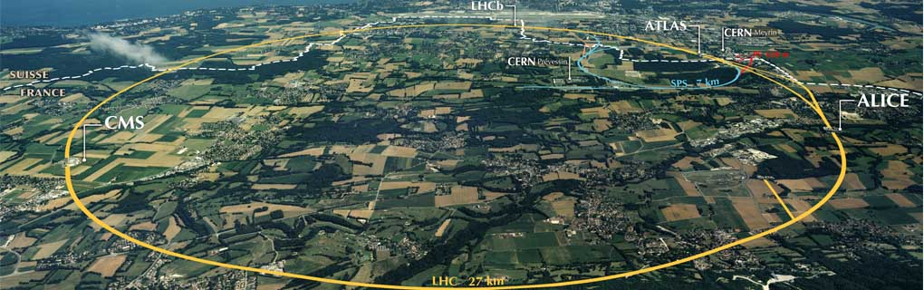
d=4 N=2 Field Theory and
Physical Mathematics
Gregory Moore
Rutgers University
CERN, July 12, 2017

Slide 2
Phys-i-cal Math-e-ma-tics, n.
Brit. /ˈfɪzᵻkl ˌmaθ(ə)ˈmatɪks / , U.S. /ˈfɪzək(ə)l ˌmæθ(ə)ˈmædɪks/
Pronunciation:
Frequency (in current use):
1. Physical mathematics is a fusion of mathematical and physical ideas, motivated by the dual, but
equally central, goals of elucidating the laws of nature at their most fundamental level, together with discovering deep mathematical truths.
2014 G. Moore Physical Mathematics and the Future, http://www.physics.rutgers.edu/~gmoore
…….
1573 Life Virgil in T. Phaer & T. Twyne tr. Virgil Whole .xii. Bks. Æneidos sig. Aiv^{v}, Amonge other studies ….. he cheefly applied himself to Physick and Mathematickes.

Slide 3

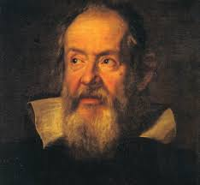
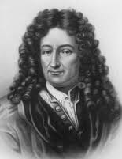
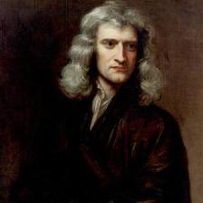
Snapshots from the
Great Debate
over
Kepler
Galileo
the relation between
Mathematics and Physics
Newton
Leibniz
Notes:
I am not a historian or philosopher of science, but my impression is that in the 16th and 17th century people such as
Kepler, Galileo, Newton, and Leibniz were called “natural philosophers’’

Slide 4
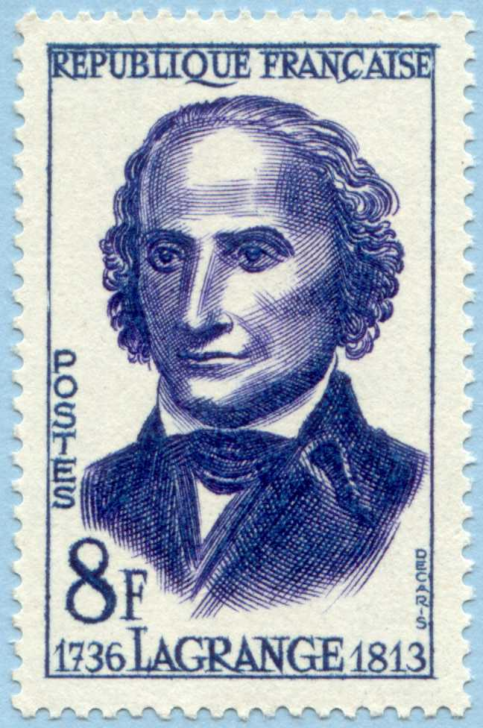
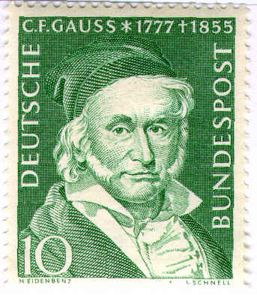
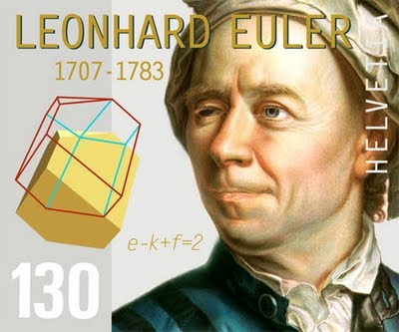
When did Natural Philosophers become either
Physicists or Mathematicians?
Even around the turn of the 19th century …
But 60 years later … we read in volume 2 of Nature ….

Slide 5
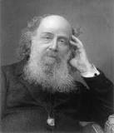
1869: Sylvester’s Challenge
A pure mathematician speaks:

Slide 6
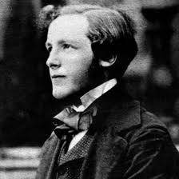
1870: Maxwell’s Answer
An undoubted physicist responds,
Maxwell recommends his somewhat-neglected dynamical theory of the electromagnetic field to the mathematical community:
Notes:
Not many mathematicians paid much attention., thus constituting, according to Freeman Dyson one of the greatest
Missed Opportunities of all time. Of course some first rate mathematicians did pay attention, such as Felix Klein, and
H. Poincare:

Slide 7
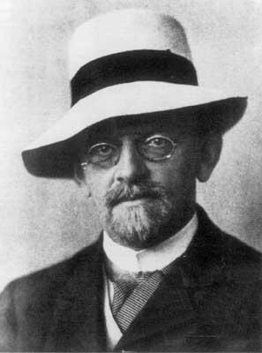
1900: The Second ICM
Hilbert announced his famous 23 problems for the 20th century, on August 8, 1900
Who of us would not be glad to lift the veil behind which the future lies hidden; to cast a glance at the next advances of our science and at the secrets of its development ….

Slide 8
1900: Hilbert’s 6th Problem
To treat […] by means of axioms, those physical sciences in which mathematics plays an important part […]
October 7, 1900: Planck’s formula, leading to h.
Notes:
Little could he realize on that cold and rainy Wednesday that within two short months, on a
Mild and clear Sunday, October 7, 1900 Max Planck would – in an act of desperation - guess his famous formula for the energy density of blackbody radiation, thus introducing a new constant of nature and
Initiating a a tumultuous three decades in physics, where many new important mathematical ideas played an important role in physics. And we, with our 20-20 historical hindsight can see that Professor Hilbert and his students were lacking some prerequisites – and when we teach we know that it is important for students to have proper prerequisites …

Slide 9
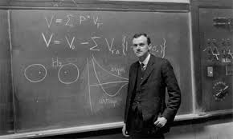
1931: Dirac’s Paper on Monopoles
Notes:
Those tumultuous 3 decades so some very important interactions of mathematics and physics – e.g. the mathematician Marcel Grossmann
And Einstein went a long way towards formulating general relativity,
And Max Born with help from von Neumann would recognize the crucial
Role of noncommutative algebra in quantum mechanics and at the end
Of this period there was great optimism and exuberance. For example in the magnificent paper of Dirac …

Slide 10
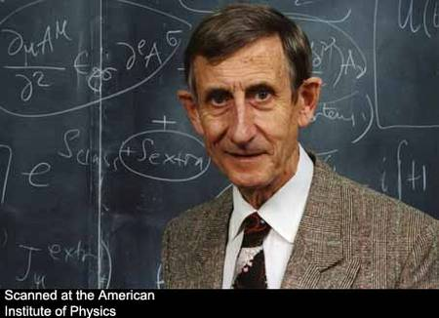
1972: Dyson’s Announcement

Slide 11

Well, I am happy to report that
Mathematics and Physics have remarried!
But, the relationship has altered somewhat…
A sea change began in the 1970’s …..
Atiyah, Bott, Singer, …

Slide 12
A number of great mathematicians got interested in the physics of gauge theory and string theory …..
and at the same time a number of great physicists started producing results requiring ever increasing mathematical sophistication, …..

Slide 13
Physical Mathematics
With a great boost from string theory, after 50 years of intellectual ferment a new field has emerged with its own distinctive character,
its own aims and values, its own standards of proof.
One of the guiding principles is certainly Hilbert’s 6th Problem (generously interpreted): Discover the ultimate foundations of physics.
As predicted by Dirac, this quest has led to ever more sophisticated mathematics…
But getting there is more than half the fun: If a physical insight leads to an important new result in mathematics – that is considered a great success.
It is a success just as profound and notable as an experimental confirmation of a theoretical prediction.

Slide 14
1
What can d=4,N=2 do for you?
Review: d=4, N=2 field theory
2
3
Wall Crossing 101
4
Theories Of Class S & Spectral Networks
5
Defects In QFT – Exact Results
6
Conclusion

Slide 15
Two Types Of Physical Problems
Type 1: Given a QFT find the spectrum of the Hamiltonian,
and compute forces, scattering amplitudes, expectation values of operators ….
Algebraic & Quantum
Type 2: Find solutions of Einstein’s equations,
and solve Yang-Mills equations on those Einstein manifolds.
Geometrical & Classical
Notes:
Before going on let me comment in passing on this word ``quantum field theory’’ –
Everybody here is familiar with fields in physics: The electric field, the magnetic field, and so on. I will be talking about various mathematical generalizations of those fields. And quantum field theory is just the quantum theory of those dynamical degrees of freedom. But the dirty secret is that – actually – nobody can give a really satisfactory definition of what a quantum field theory is. But as physicists – we know it when we see it.
I want to talk a bit about exact results on both these kinds of questions

Slide 16
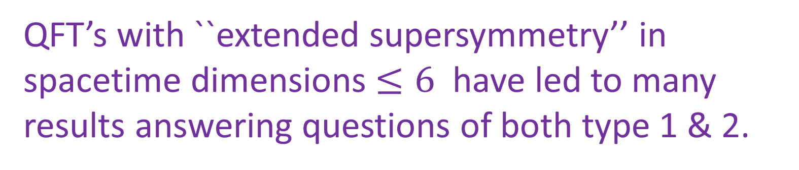
Exact Analytic Results
They are important
Where would we be without the harmonic oscillator?
Onsager’s solution of the 2d Ising model
in zero magnetic field
Modern theory of phase transitions and RG.
QFT’s with ``extended supersymmetry’’ in spacetime dimensions $≤6$ have led to many results answering questions of both type 1 & 2.
Notes:
Sometimes, some people are a bit disparaging about exact results. But – they are important.

Slide 17

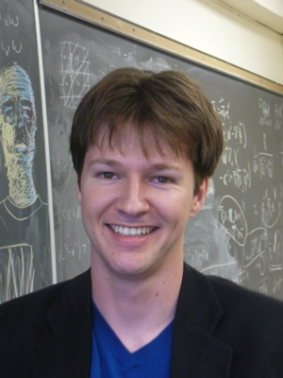
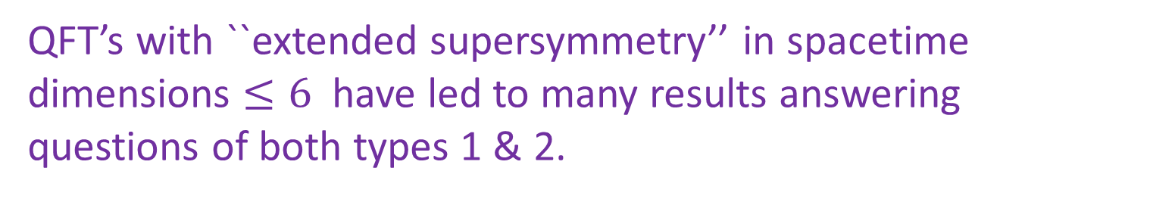
QFT’s with ``extended supersymmetry’’ in spacetime dimensions $≤6$ have led to many results answering questions of both types 1 & 2.
Surprise: There can be very close relations between questions of types 1 & 2
We found ways of computing the exact (BPS) spectrum of many quantum Hamiltonians via solving Einstein and Yang-Mills-type equations.
Another surprise: In deriving exact results about d=4 QFT it turns out that interacting QFT in SIX spacetime dimensions plays a crucial role!
Notes:
There are many many examples I could choose from to illustrate this, but I will focus on a project I spent about 6 years on with Davide Gaiotto and Andy Neitzke.
**************
So far I’ve been explaining why this subject is good for physics, but it is
Also great for mathematics…. It is a veritable cornucopia for mathematicians:

Slide 18

Cornucopia For Mathematicians
Provides a rich and deep
mathematical structure.
Gromov-Witten Theory, Homological Mirror Symmetry, Knot Homology, stability conditions on derived categories, geometric Langlands program, Hitchin systems, integrable systems, construction of hyperkähler metrics and hyperholomorphic bundles, moduli spaces of flat connections on surfaces, cluster algebras, Teichműller theory and holomorphic differentials, ``higher Teichműller theory,’’ symplectic duality, automorphic products and modular forms, quiver representation theory, Donaldson invariants & four-manifolds, motivic Donaldson-Thomas invariants, geometric construction of affine Lie algebras, McKay correspondence, ……….
Notes:
Of course I can’t explain all this in the remaining time, so we are going to focus on one key issue which led to many of these connections. We will focus on finding the so-called BPS spectrum

Slide 19
The Importance Of BPS States
Much progress has been driven by trying to understand a portion of the spectrum of the Hamiltonian – the ``BPS spectrum’’ –
BPS states are special quantum states in a supersymmetric theory for which we can compute the energy exactly.
So today we will just focus on the BPS
spectrum in d=4, N=2 field theory.
Notes:
This is the problem I solved with Gaiotto and Neitzke, for a large class of d=4 N=2 field theories, but in order for you to appreciate what we did in even the vaguest terms I need to spend most of the remainder of the talk explaining a lot of background.

Slide 20

Added Motivation For BPS-ology
Counting BPS states is also crucial to the string- theoretic explanation of Beckenstein-Hawking
black hole entropy in terms of microstates.
(Another story, for another time.)
+ $⋯$
Notes:
And there are further motivations, but I hope this is already enough
Motivation for you to pay attention to some technical details about d=4 N=2 theories….

Slide 21
1
What can d=4,N=2 do for you?
Review: d=4, N=2 field theory
2
2A
Definition, Representations, Hamiltonians
2B
The Vacuum And Spontaneous Symmetry Breaking
2C
BPS States: Monopoles & Dyons
2D
Seiberg-Witten Theory
2E
Unfinished Business
Notes:
I’ve subdivided this section to help you follow where I’m going.

Slide 22
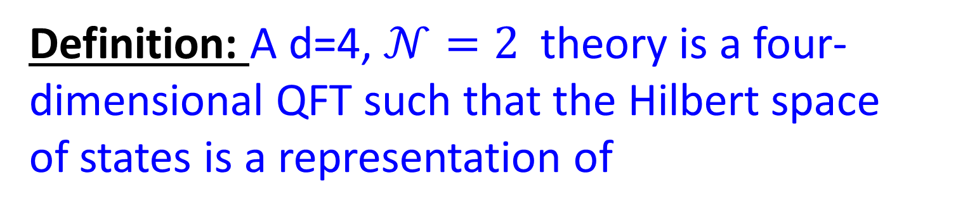
Definition Of d=4, N=2 Field Theory
This is a special kind of four-dimensional quantum field theory with supersymmetry
Definition: A d=4, $𝒩=2$theory is a four-dimensional QFT such that the Hilbert space
of states is a representation of
The d=4, N=2 super-Poincare algebra !
OK…..
….. So what is the
d=4, N=2 super-Poincare algebra??

Slide 23
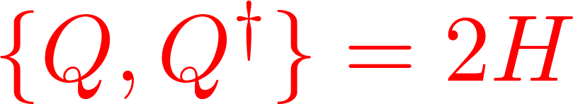
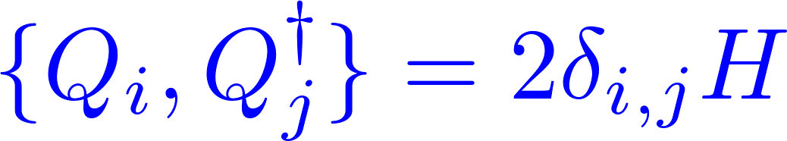
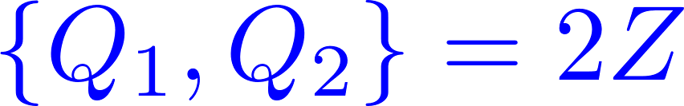
d=4,N=2 Poincaré Superalgebra
N=1 Supersymmetry:
There is an operator Q on the Hilbert space H
N=2 Supersymmetry:
There are two operators Q₁, Q₂ on the Hilbert space

Slide 24
d=4,N=2 Poincaré Superalgebra
(For mathematicians)
Super Lie algebra
$$𝔰^{0}=poin\left(1,3\right)⊕𝔲{\left(2\right)}_{R}⊕ℂ_{central}$$
Generator Z = ``N=2 central charge’’

Slide 25

The Power Of $𝒩=2$ Supersymmetry
Representation theory:
Field and particle multiplets
Hamiltonians:
Typically depend on very few parameters
for a given field content.
BPS Spectrum:
Special subspace in the Hilbert space of states
Notes:
“Symmetry is power”

Slide 26




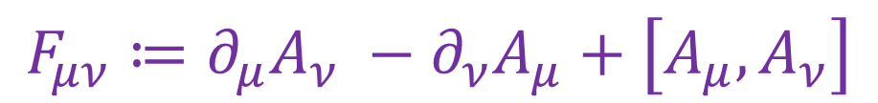
Important Example Of An $𝒩=2$ Theory
$𝒩=2$ supersymmetric version of Yang-Mills Theory
Recall plain vanilla Yang-Mills Theory:
Recall Maxwell’s theory of a vector-potential = gauge field: $A_{μ}$
In Maxwell’s theory electric & magnetic fields
are encoded in $F_{μν}≔∂_{μ}A_{ν}−∂_{ν}A_{μ}$
Yang-Mills theory also describes physics of
a vector-potential = gauge field: $A_{μ}$
But now $A_{μ}$ are MATRICES and the electric and magnetic fields are encoded in
$$F_{μν}≔∂_{μ}A_{ν} −∂_{ν}A_{μ}+\left[A_{μ}, A_{ν}\right]$$

Slide 27
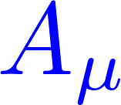


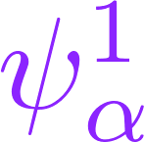
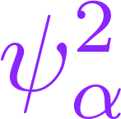

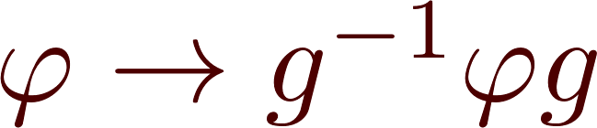
N=2 Super-Yang-Mills For U(K)
Gauge fields:
Doublet of gluinos:
Complex scalars
(Higgs fields):
All are K x K matrices
Gauge transformations:
Notes:
As an example: any Yang-Mills theory has an N=2 supersymmetric counterpart. For simplicity let’s focus on the examples of YM theory with gauge group U(K).

Slide 28
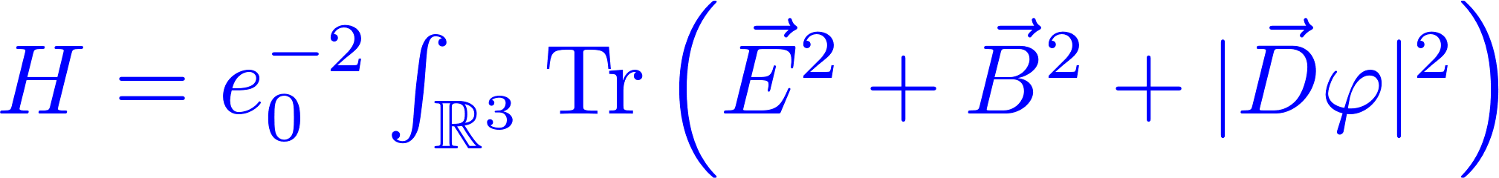
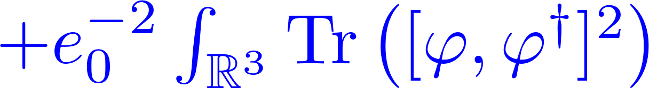
Hamiltonian Of N=2 U(K) SYM
The Hamiltonian is completely determined,
up to a choice of Yang-Mills coupling e₀²
Energy is a sum of squares.
Energy bounded below by zero.

Slide 29
1
What can d=4,N=2 do for you?
Review: d=4, N=2 field theory
2
2A
Definition, Representations, Hamiltonians √
2B
The Vacuum And Spontaneous Symmetry Breaking
2C
BPS States: Monopoles & Dyons
2D
Seiberg-Witten Theory
2E
Unfinished Business
Notes:
I’ve subdivided this section to help you follow where I’m going.

Slide 30

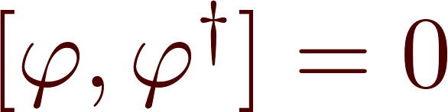
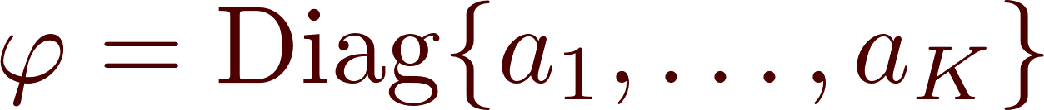
Classical Vacua
Classical Vacua: Zero energy field configurations.
Any choice of a₁,…a_{K} gives a vacuum!

Slide 31


Quantum Moduli Space of Vacua
The continuous vacuum degeneracy is an
exact property of the quantum theory:
The quantum vacuum is not unique!
Manifold of quantum vacua B
Parametrized by the complex numbers a₁, …., a_{K}

Slide 32
Gauge Invariant Vacuum Parameters
Physical properties depend on
the choice of vacuum u in B.
We will illustrate this by studying the properties
of ``dyonic particles’’ as a function of u.
Notes:
A better way to parametrize the vacua is by the expectation values of gauge invariant operators like traces of powers of varphi. So we can use these complex numbers u_s, or better, the vector of expectation values, which I’ll simply call u, as coordinates on the space B of vacua.
However you parametrize it, the important thing is that Physical properties depend on the choice of vacuum u in B.
But in order to make sense of what I mean by dyonic particles we first need to discuss spontaneous symmetry breaking.

Slide 33
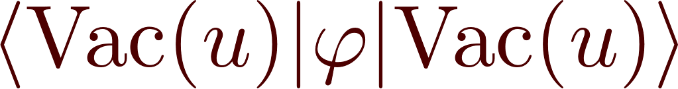

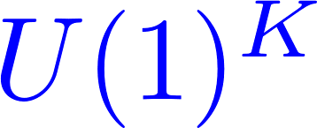
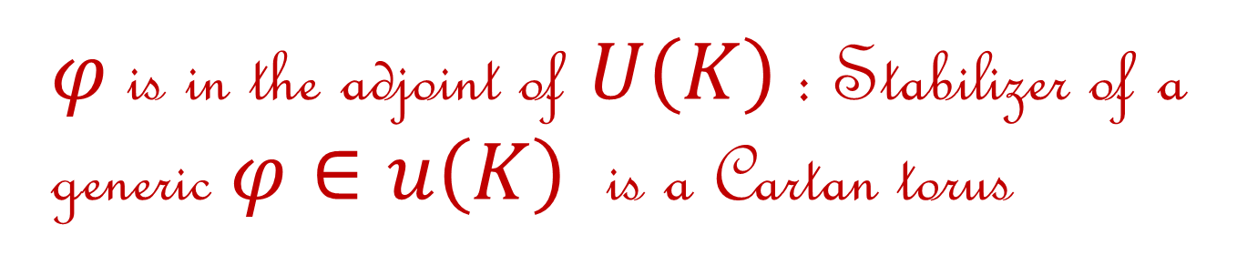
Spontaneous Symmetry Breaking
broken to:
(For mathematicians)
$φ$is in the adjoint of $U\left(K\right)$: Stabilizer of a generic $φ∈u\left(K\right)$ is a Cartan torus
Notes:
Physically there are consequences of the spontaneous symmetry breaking because the vev of the Higgs field provides a scale, and we are looking at low energies far below that scale.
To get an idea of what kind of low energy physics we expect lets put aside N=2 supersymmetry for a moment and think about what happens in the standard model, and the real world.

Slide 34
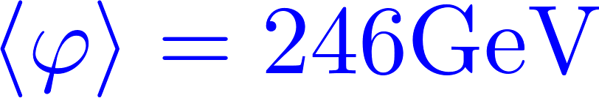
Physics At Low Energy Scales: LEET
Only one kind of light comes out of the flashlights from the hardware store….
Most physics experiments are described very accurately by using (quantum) Maxwell theory (QED). The gauge group is U(1).
The true gauge group of electroweak forces is SU(2) x U(1)
The Higgs vev sets a scale:
The subgroup preserving $〈φ〉$ is U(1) of E&M.
At energies << 246 GeV we can describe physics using Maxwell’s equations + small corrections:
Notes:
When you go to the hardware store you need to make lots of choices:
What kind of pliers or screwdrivers, nuts and bolts. But one thing you do NOT have to choose is what kind of light – what kind of gauge boson – is going to come out of the flashlights.
Indeed, all of everyday experience, and most physics experiments are described very
*************
But the true gauge group of electroweak forces is SU(2) x U(1). This is a four-dimensional group which means that there are four kinds of gauge bosons – four kinds of light. And indeed if you have a gigantic flashlight like the LHC then these light four kinds of light rays are flashing around and interacting in very complicated ways – because the group is nonabelian.
But at energies much smaller than 246 GeV – and the photons from a flashlight have an energy between 1 and 3 eV – a factor of almost 10^{12} smaller – we can describe physics just using Maxwell’s equations – the gauge theory of the unbroken subgroup, up to very tiny corrections.

Slide 35

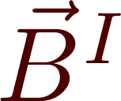
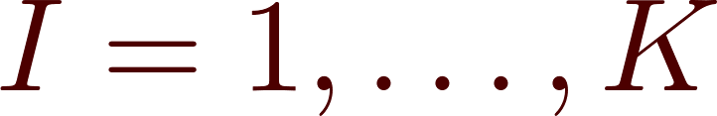
N=2 Low Energy U(1)^{K} Gauge Theory
Low energy effective theory (LEET) is described by an N=2 extension of Maxwell’s theory with gauge group U(1)^{K}
K different ``electric’’ and
K different ``magnetic’’ fields:
& their N=2 superpartners
Notes:
Returning now to N=2 U(K) SYM, the same story holds: At a point u on the vacuum manifold the Higgs field breaks the gauge symmetry to the subgroup U(1)^K
And the low energy theory is based on the ABELIAN gauge group U(1)^K.
Because it is abelian the K different kinds of light don’t interact with each other. So we have K completely separate electric and magnetic fields …

Slide 36
1
What can d=4,N=2 do for you?
Review: d=4, N=2 field theory
2
2A
Definition, Representations, Hamiltonians √
2B
The Vacuum And Spontaneous Symmetry Breaking √
2C
BPS States: Monopoles & Dyons
2D
Seiberg-Witten Theory
2E
Unfinished Business
Notes:
Now in the theory there will also be massive particles carrying charges
Under these unbroken electromagnetic gauge symmetries, and we’ll
Discuss those next.

Slide 37

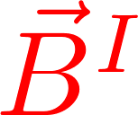


Electro-magnetic Charges
The theory will also contain ``dyonic particles’’ – particles with electric and magnetic charges for the fields
(Magnetic, Electric) Charges:
On general principles, the vectors
$γ$are in a symplectic lattice $Γ$.
Dirac quantization:

Slide 38
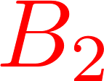


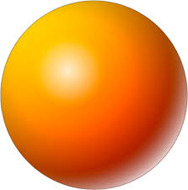
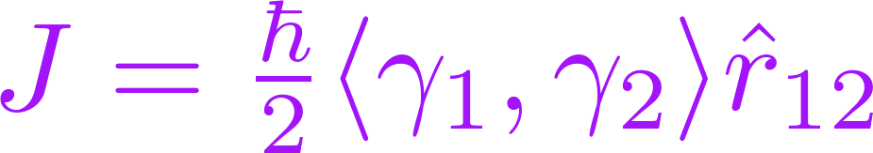


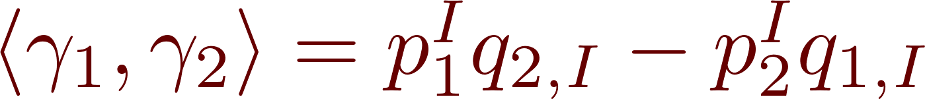

Notes:
The situation is axially symmetric so momentum circulates around the
Axis through the positions of particle 1 and particle 2. So there is angular momentum, and a beautiful little computation shows that the angular momentum is independent of the distance and proportional to the ``symplectic product of charges’’ .
Note that we could also consider the magnetic field sourced by
gamma1 and the electric field sourced by gamma2. That’s why
There are two terms in the symplectic product of charges.
Now in QUANTUM mechanics the angular momentum is quantized and hence this symplectic product must be an integer: That’s Dirac quantization.

Slide 39
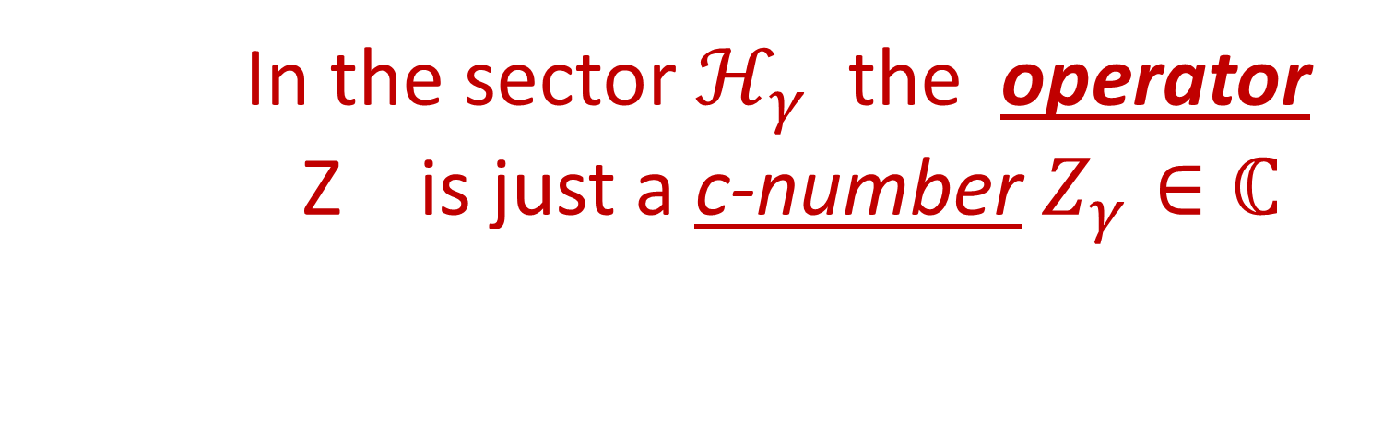

BPS States: The Definition
Charge sectors:
In the sector $ℋ_{γ}$ the operator
Z is just a c-number $Z_{γ}∈ℂ$
Bogomolny bound: In sector $ℋ_{γ}$
Notes:
By taking the square of a suitable linear combination of the supersymmetry operators Q and using the algebra one derives the famous Bogomolny bound:
In the sector \CH_{\gamma} ….

Slide 40

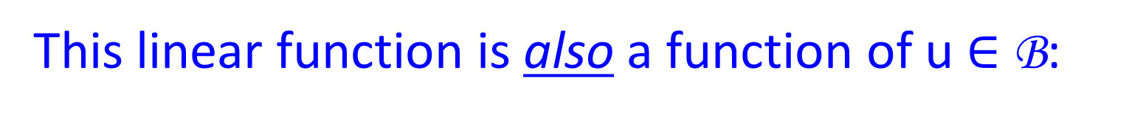

The Central Charge Function
The $𝒩=2$``central charge’’ $Z_{γ}$depends on $γ:$
This linear function is also a function of u $∈$ B:
On
So the mass of BPS particles depends on u $∈$ B.
Notes:
Not only the mass, but also electromagnetic forces depend on u….

Slide 41



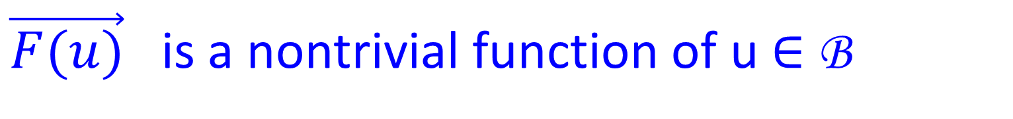
Coulomb Force Between Dyons
$\vec{F(u)}$ is a nontrivial function of u $∈$ B
It can be computed from $Z_{γ}$(u)
Computing $Z_{γ}\left(u\right) allows us to$
determine the entire LEET!

Slide 42
1
What can d=4,N=2 do for you?
Review: d=4, N=2 field theory
2
2A
Definition, Representations, Hamiltonians √
2B
The Vacuum And Spontaneous Symmetry Breaking √
2C
BPS States: Monopoles & Dyons √
2D
Seiberg-Witten Theory
2E
Unfinished Business
Notes:
I’ve subdivided this section to help you follow where I’m going.

Slide 43
So far, everything I’ve said
follows easily from
general principles

Slide 44
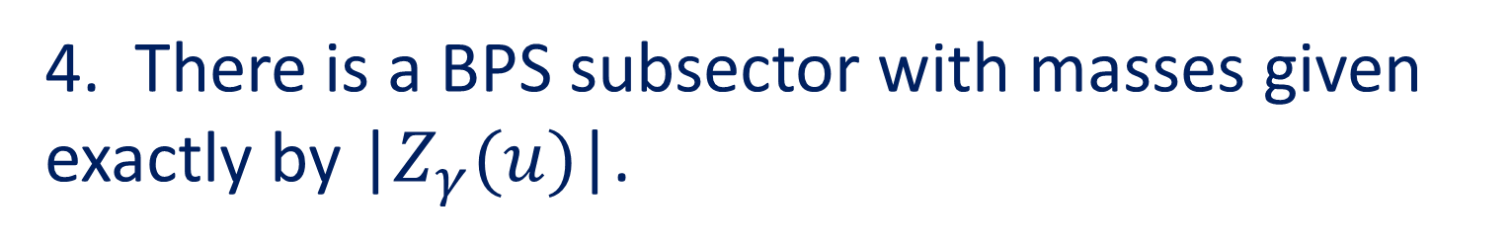
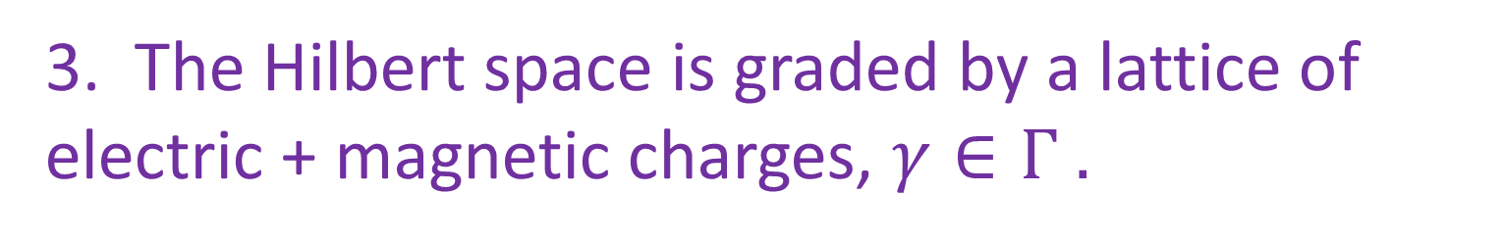
General d=4, N=2 Theories
1. A moduli space B of quantum vacua.
2. Low energy dynamics described by an effective N=2 abelian gauge theory.
3. The Hilbert space is graded by a lattice of electric + magnetic charges, $γ∈Γ .$
4. There is a BPS subsector with masses given exactly by |$Z_{γ}(u)$|.

Slide 45
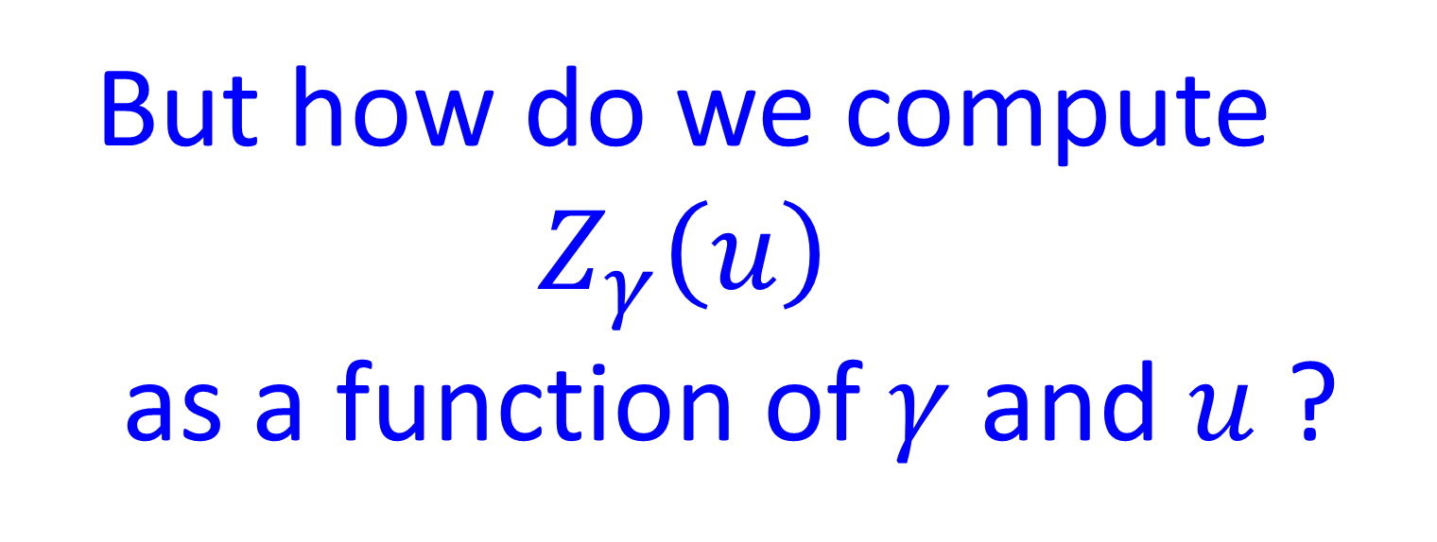
But how do we compute ${ Z}_{γ}\left(u\right)$
as a function of $γ$ and $u$ ?

Slide 46
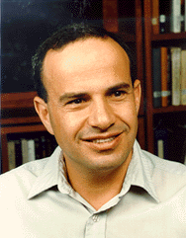
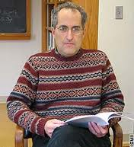
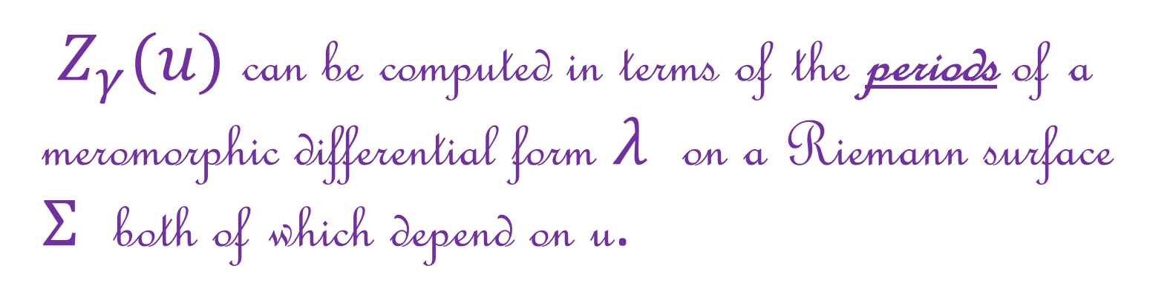
Seiberg-Witten Paper
Seiberg & Witten (1994) found a way for the case of SU(2) SYM.
$Z_{γ}(u)$ can be computed in terms of the periods of a meromorphic differential form $λ$ on a Riemann surface $Σ$ both of which depend on u.

Slide 47
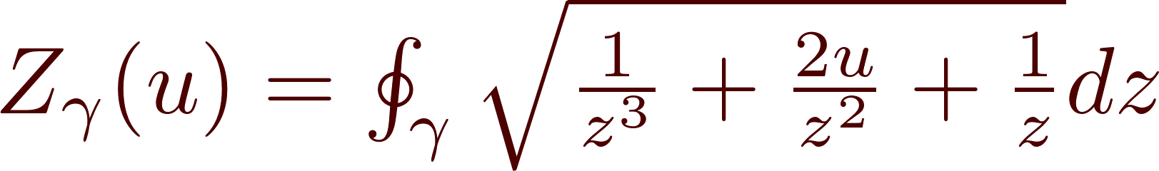
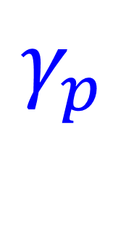


In more concrete terms: there is an integral formula like:
$γ$ is a closed curve…
Up to continuous deformation there are only two basic curves and their deformation classes generate a lattice!
$$γ_{p}$$
$$γ_{q}$$
Notes:
Where gamma is a closed curve…
At this point you might be confused by two things:
First of all, I said that \gamma was a electromagnetic charge vector. Now I’m saying it is a closed curve: Is this a misprint ?
And anyway, if it is a closed curve doesn’t Cauchy’s theorem say the integral is zero?
One at a time. Let’s begin with the second question:
Because of the singularities of the integrand and the branch cuts the integral can be nonzero. In fact, you can get different answers for different closed curves.
******************
In fact – because of Cauchy’s theorem – there are really only two distinct kinds of closed curves we need to worry about. If we deform them a little we’ll get the same answer.
So up to deformation the gamma-p and gamma-q curves span a lattice and we can identify the charge vector as a lattice vector with the closed curve up to deformation!

Slide 48
1
What can d=4,N=2 do for you?
Review: d=4, N=2 field theory
2
2A
Definition, Representations, Hamiltonians √
2B
The Vacuum And Spontaneous Symmetry Breaking √
2C
BPS States: Monopoles & Dyons √
2D
Seiberg-Witten Theory √
2E
Unfinished Business
Notes:
I’ve subdivided this section to help you follow where I’m going.

Slide 49
The Promise of Seiberg-Witten Theory: 1/2
Seiberg & Witten found the exact LEET for the particular case: G=SU(2) SYM.
They also gave cogent arguments for the exact BPS spectrum of this particular theory.
Their breakthrough raised the hope that for general d=4 N=2 theories we could find
many analogous exact results.

Slide 50

The Promise of Seiberg-Witten Theory: 2/2
U.B. 1: Compute $Z_{γ}\left(u\right)$ for other theories.
U.B. 2: Find the space of BPS states for other theories.
U.B. 3: Find exact results for path integrals – including insertions of ``defects’’ such as ``line operators,’’ ``surface operators’’, …..
Notes:
Although they did not literally say this, with 20-20 hindsight we now understand that they could have – indeed should have – suggested that it should be possible to compute exact results for correlation functions of operstors such as …

Slide 51

U.B. 1: The LEET: Compute $Z_{γ}\left(u\right)$.
Extensive subsequent work quickly showed that the SW picture indeed generalizes to all known d=4 , N=2 field theories:
Including much work done here at CERN - W. Lerche et. al.

Slide 52



$Z_{γ}(u)$ are periods of a meromorphic differential form on $Σ$_{u}
u
But, to this day, there is no general algorithm for computing $Σ$_{u} for a
given d=4, N=2 field theory.

Slide 53

But what about U.B. 2:
Find the BPS spectrum?
In the 1990’s the BPS spectrum was only determined in a handful of cases…
( SU(2) with (N=2 supersymmetric) quarks flavors: N_{f} = 1,2,3,4,
for special masses: Bilal & Ferrari)
Knowing the value of $Z_{γ}(u)$ in the sector $ℋ_{γ}$ does not tell us whether there are, or are not, BPS particles of charge $γ$. It does not tell us if
$ℋ_{γ}$^{BPS} is zero or not.

Slide 54
In the past 10 years there has been a great deal of progress in understanding the BPS spectra in a large class of other N=2 theories.
One key step in this progress has been a much-improved understanding of the
``wall-crossing phenomenon.’’

Slide 55
1
What can d=4,N=2 do for you?
Review: d=4, N=2 field theory
2
3
Wall Crossing 101
4
Theories Of Class S & Spectral Networks
5
Defects In QFT – Exact Results
6
Conclusion

Slide 56
Recall we want to compute the space of BPS states :
It is finite dimensional.
So let’s compute the dimension.
A tiny change of couplings can raise
the energy above the BPS bound:
The dimension can depend on u !
Notes:
This implies the dimension is not invariant under changes of u. That can make the dimension hard to compute. But this is a familiar situation in mathematics and a standard maneuver to deal with the
difficulty is to consider what is known as an ``index’’ -- it is something much easier to compute.

Slide 57




Atiyah & Singer
To The Rescue
Family of vector spaces dim $ℋ_{u}$ jumps with $u$
But there is an operator $ℱ^{2}=1$
$$I\left(u\right)=Tr_{ℋ_{u}}ℱ=\dim\left(ℋ_{u}^{+}\right)−\dim\left(ℋ_{u}^{−}\right)$$
Much better behaved!
Much more computable!
Example: Index of elliptic operators.

Slide 58



BPS Index
For $ℋ_{u}^{BPS}$take $ℱ={\left(−1\right)}^{F}$ (Witten index)
J₃ is any generator of so(3)
Formal arguments prove: $Ω\left(γ\right)$ is invariant under change of parameters such as the choice of u …
Notes:
And to give a sense of WHY Omega(gamma) should be independent of u I’ll review a tiny bit of index theory…

Slide 59


Index Of An Operator: 1/4
(For physicists)
Suppose $T_{u}$ is a family of linear operators
depending on parameters $u∈ℬ$
If V and W are finite-dimensional Hilbert spaces then:
independent of the parameter u!

Slide 60







Index Of An Operator: 2/4
Example: Suppose V=W is one-dimensional.
So if we take $\dim{V=3 and\dim{W=2 }}$ and consider the index of

Slide 61


Index Of An Operator: 3/4
Now suppose T_{u} is a family of
linear operators between two
infinite-dimensional Hilbert spaces
Still the LHS makes sense for suitable (Fredholm) operators and is invariant under continuous changes of (Fredholm) operators.

Slide 62

Index Of An Operator: 4/4
The BPS index $Ω\left(γ\right)$ is the index of
the supersymmetry operator Q
on Hilbert space.
(In the weak-coupling limit it is literally the index
of a Dirac operator on a moduli space of magnetic monopoles.)
Notes:
So now I’ve just spent four slides explaining to you that the index is
Invariant under deformations, so it should come as quite a shock
To learn that ….

Slide 63

The Wall-Crossing Phenomenon
But even the index can
depend on u !!
How can that be ?
BPS particles can form bound states which are themselves BPS!
Notes:
How can that be?
Mathematically – the supersymmetry operator can fail to be Fredholm at
Very special places in the moduli space of vacua.
Physically -
So, let us consider our two BPS dyons. There are several forces acting
On them: electromagnetic and scalar exchange. Suppose they form a boundstates. It turns out to be extremely useful to know a formula for the boundstate radius. And just such a formula was discovered by Frederik Denef about 15 years ago….

Slide 64




Denef’s Boundstate Radius Formula
The $Z_{γ}$’s are functions of the moduli $u∈ℬ$
So the moduli space of vacua B
is divided into two regions:
OR
Notes:
So the moduli space is divided in to by a wall:

Slide 65

R₁₂ > 0
R₁₂ < 0
Notes:
This wall is called the ``wall of marginal stability’’ for the following reason:
Imagine varying the moduli so that we cross from the side where R12>0, and the boundstate exists to the side where R12 < 0 and the boundstate can not exist.

Slide 66


Wall of Marginal Stability
u_{ms}
Consider a path of vacua crossing the wall:
u₊
u₋
Crossing the wall:

Slide 67


The Primitive Wall-Crossing Formula
(Denef & Moore, 2007)
Crossing the wall:
$$Δℋ^{BPS}=ℋ_{J_{12}}^{spin}⊗ℋ_{γ_{1}}^{BPS}⊗ℋ_{γ_{2}}^{BPS}$$

Slide 68


Non-Primitive Bound States
But this is not the full story, since the same marginal stability wall holds for charges
$N_{1}γ_{1}$ and $N_{2}γ_{2}$ for N₁, N₂ >0
The primitive wall-crossing formula assumes the charge vectors $γ_{1}$ and $γ_{2}$ are primitive vectors.
?????
Notes:
But there can be more complicated boundstates – say with many gamma1 and many gamma2 constituents, like this. What states do we gain or lose across the MS wall?

Slide 69


Kontsevich-Soibelman
WCF
In 2008 K & S wrote a wall-crossing formula for Donaldson-Thomas invariants of Calabi-Yau manifolds….
But their formula could in principle apply to ``BPS indices’’ of general boundstates in more general situations.
We needed a physics argument for why their formula should apply to d=4, N=2 field theories, in particular.

Slide 70
Notes:
That’s Davide on the left, dealing with one of our paradoxes.

Slide 71
We gave a physics derivation of the KSWCF
A key step used explicit constructions of hyperkahler metrics
on moduli spaces of solutions to Hitchin’s equations.
Hyperkahler metrics are solutions to Einstein’s equations.
Hitchin’s equations are special cases of Yang-Mills equations.
So Physics Questions of Type 1 and Type 2
become closely related here.
The explicit construction made use of techniques from the theory of
integrable systems, in particular, a form of
Zamolodchikov’s Thermodynamic Bethe Ansatz
The explicit construction of HK metrics also made direct contact with the
work of Fock & Goncharov on moduli spaces of flat conections on
Riemann surfaces. (``Higher Teichmuller theory’’)

Slide 72
1
What can d=4,N=2 do for you?
Review: d=4, N=2 field theory
2
3
Wall Crossing 101
4
Theories Of Class S & Spectral Networks
5
Defects In QFT – Exact Results
6
Conclusion

Slide 73
Wall-Crossing: Only half the battle…
The wall crossing formula only describes the CHANGE of the BPS spectrum across a wall of marginal stability.
It does NOT determine the BPS spectrum!
Further use of integrable systems techniques applied to Hitchin moduli spaces led to a solution of this problem for a infinite class of d=4 N=2 theories known as
``theories of class S’’

Slide 74

Theories Of Class S
Superconformal
6d theory
d=4 N=2 theory
Witten, 1997
GMN, 2009
Gaiotto, 2009
Type II duals via ``geometric engineering’’
KLMVW 1996
Captures most of the theories normally considered, and many many more.

Slide 75


Spectral Networks
Online software: LOOM
http://het-math2.physics.rutgers.edu/loom/
C.Y. Park, P. Longhi, A. Neitzke

Slide 76
1
What can d=4,N=2 do for you?
Review: d=4, N=2 field theory
2
3
Wall Crossing 101
4
Theories Of Class S & Spectral Networks
5
Defects In QFT – Exact Results
6
Conclusion

Slide 77
Interlude: Defects in Local QFT
The very notion of ``what is a quantum field theory’’ is evolving…
It no longer suffices just to know the correlators of all local operators.
Extended ``operators’’ or ``defects’’ have been playing an increasingly important role in recent years in quantum field theory.
Defects are local disturbances supported on submanifolds of spacetime.

Slide 78

Examples of Defects
Example 1: d=0: Local Operators
Example 2: d=1: ``Line operators’’
Gauge theory Wilson line:
Example 3: Surface defects: Couple a
2-dimensional field theory to an ambient
4-dimensional theory.

Slide 79






Notes:
Perhaps a helpful way to think about surface defects is to recall the beloved book ``Flatland’’ by a certain Mr. Square. It’s a delightful mathematical exploration of what life is like in different dimensions. It is also a biting satire on the injustices of Victorian society.
Whatever you may think of Victorian society, it was undeniably 3+1 dimensional, and
the author Edwinn Abbott lived in a 3+1 dimensional world. Nevertheless, if we
imagine him interacting with the inhabitants of LineLand we have an example of a surface defect: The inhabitants of LineLand describe their world with a 1+1 dimensional QFT, but there are also interactions with ambient 3+1 dimensional beings like Edwin Abbott
Of course, LineLand could be embedded in a 2+1 dimensional Flatland, (as in the book),
But FlatLand is embedded in Abbott’s 3+1 dimensions – so we have an example of
a defect within a defect.
And clearly you can generalize this…

Slide 80
Defects Within Defects
P
β
B
A
α
Q
Mathematically – related to N-categories….

Slide 81
Supersymmetric Line Defect VEVs
Large class of defects for which we can write exact results.
Example: SYM Wilson line
Algebraic & Quantum
Geometrical & Classical

Slide 82
1
What can d=4,N=2 do for you?
Review: d=4, N=2 field theory
2
3
Wall Crossing 101
4
Theories Of Class S & Spectral Networks
5
Defects In QFT – Exact Results
6
Conclusion

Slide 83
Take Away Messages – 1/2
Seiberg and Witten’s breakthrough in 1994, opened up many interesting problems. Some were quickly solved, but some remained stubbornly open.
But the past ten years has lead to a much deeper understanding of the BPS spectrum and the line and surface defects in these theories.

Slide 84
Take Away Messages – 2/2
This progress has involved nontrivial and
surprising connections to other aspects of
Physical Mathematics:
Hyperkähler geometry, cluster algebras, moduli spaces of flat connections, Hitchin systems,
integrable systems, Teichmüller theory, …
Notes:
Now, giving a talk on this topic is a bit frustrating because there is so much I have to leave out.
It is a little like going to a wonderful zoo with lots of fascinating exhibits There is so much to see
and so little time. There is a large community of people working on this general area of Physical
Mathematics and here are some of the many sites we’ve had to omit …

Slide 85

S-Duality and the modular groupoid
Nekrasov-Shatashvili: Quantum Integrable systems
Higgs branches
-backgrounds, Nekrasov partition functions, Pestun localization.
AGT: Liouville & Toda theory
Cluster algebras
Holographic duals
Three dimensions, Chern-Simons, and mirror symmetry
Z(S³ x S¹) Scfml indx
N=4 scattering

Slide 86

NOT

