Slide 1
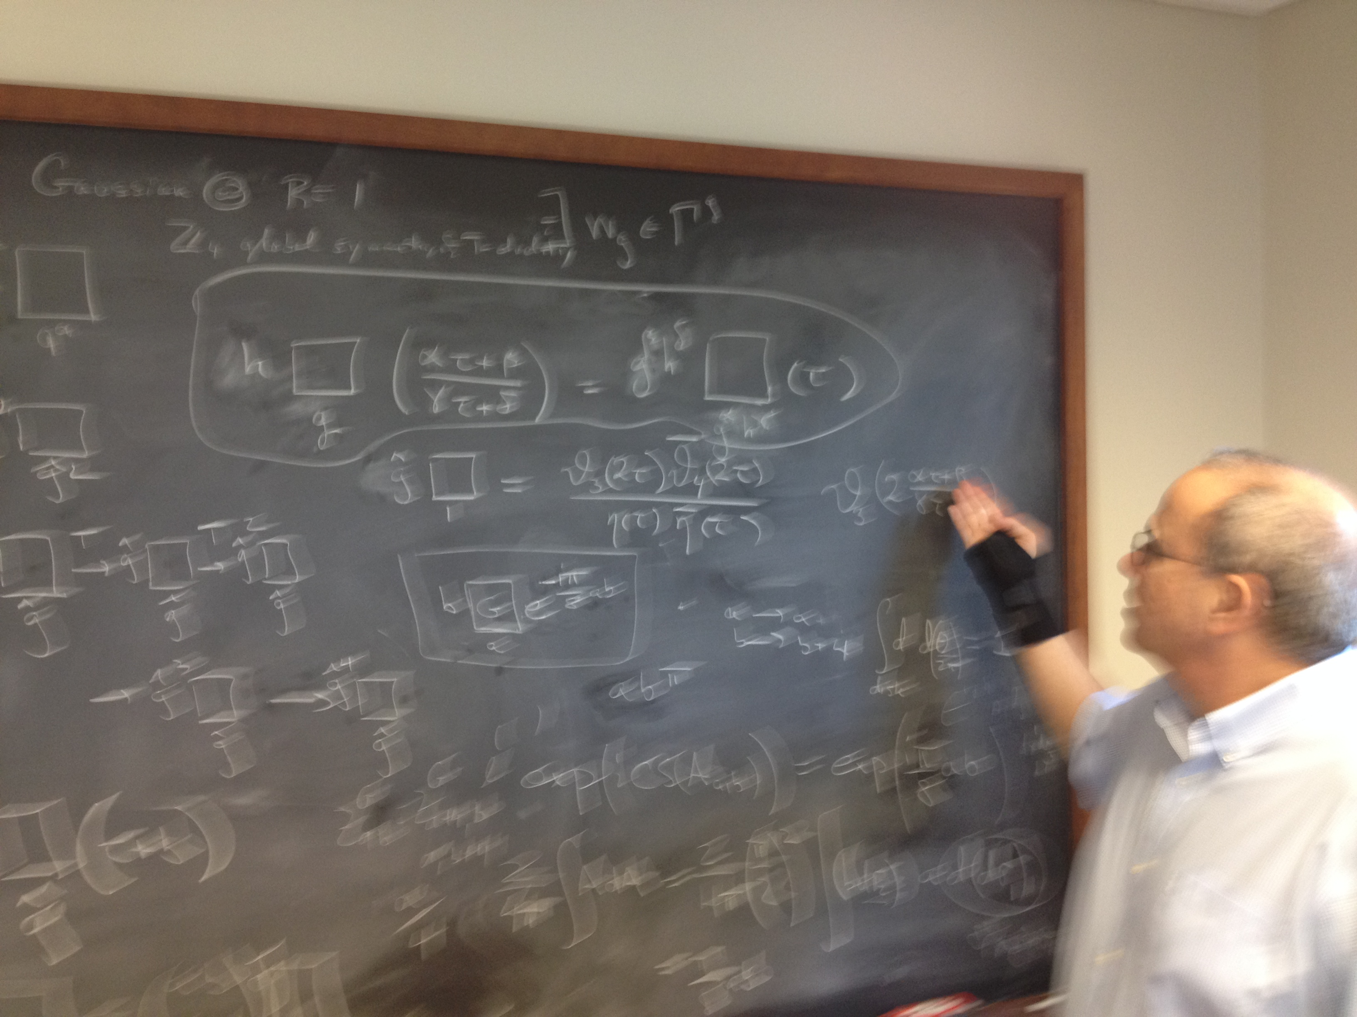
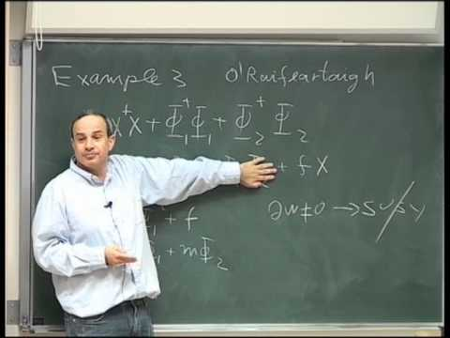
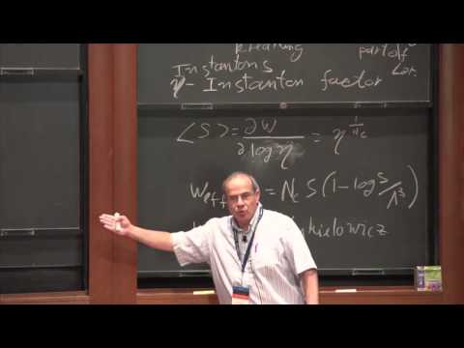

Congratulations
&
Happy Birthday !

Slide 2
Notes:
But I noticed that in the poster there is a serious mistake – one of the 10 hexagons
has the fusion matrix, not the braiding matrix. But you see it is the braiding matrix which satisfies the hexagon relation, not the fusion matrix. The fusion matrix satisfies a pentagon relation so really there should have been 12 pentagons, not 10 hexagons. And Nati has enough great results that you could have filled up 12 pentagons just as easily as 10 hexagons. Anyway, no matter how you factor sixty –
it has been a spectacular career Nati so – congratulations and Happy Birthday!

Slide 3
Notes:
Of course I was quite intrigued to see that the poster for this conference also used the
theme of hexagons.

Slide 4
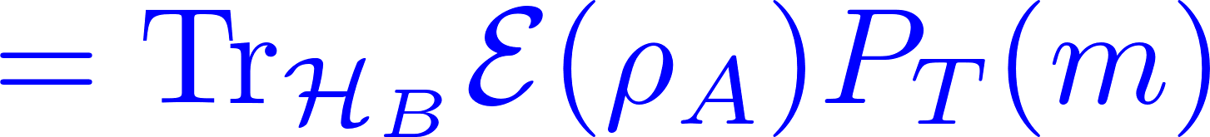
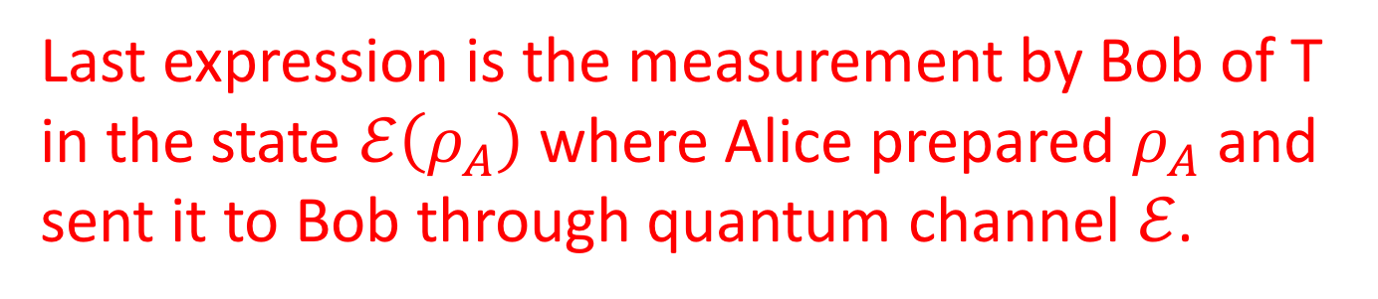
Quantum Information Theory
& Noncommutative Geometry
Last expression is the measurement by Bob of T in the state $ℰ\left(ρ_{A}\right)$ where Alice prepared $ρ_{A}$ and sent it to Bob through quantum channel $ℰ$.
Notes:
So, the point of this slide and indeed of chapter three is that some concepts in quantum information theory can be rephrased in terms of noncommutative geometry. Whether or not this statement is useful or interesting I’m not in a position to say. I simply offer it.
So, there you have it: Three points in a talk.
OK, it’s time to wrap up: You know, my best work with Nati involved a lot of pentagon and hexagon relations, And we spent a lot of time worrying about which relations were really
Independent from the others. Well, Nati, here is an independent hexagon relation for you

Slide 5



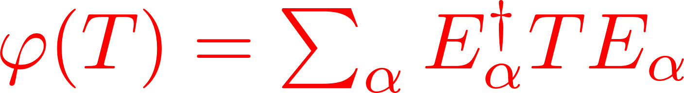
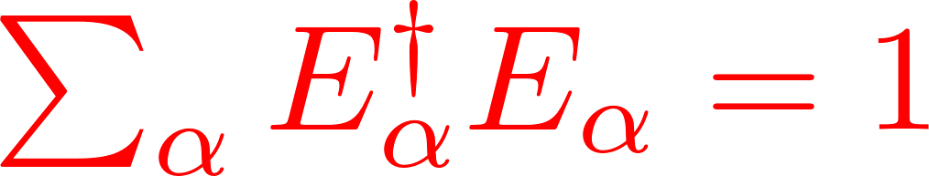
Family Of Quantum Systems
Over A Fuzzy Point
``A NC measure $ω$ $∈𝒮(𝔄)$’’ is equivalent to a density matrix $ρA$ on $ℋA$
QMNA state:

Slide 6

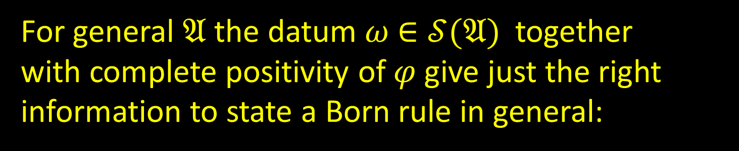
QMNA Born Rule
Main insight is that we should regard the Born Rule as a map
For general $𝔄$the datum $ω$ $∈𝒮(𝔄)$together
with complete positivity of $φ$give just the right information to state a Born rule in general:
Notes:
Roughly speaking the formula is just this – but actually, this doesn’t quite make sense technically,
For reasons I can explain to those who are really interested.
Let me just note first that it fits in very well with
The commutative case, and we’ll finish by discussing what it specializes to for the fuzzy point:

Slide 7

QMNA States
Definition: A QMNA state is a completely positive unital map
``Completely positive’’ comes up naturally both in math and in quantum information theory.
A natural generalization of
the Schrodinger (actually, Lindblad)
equation exists.
Notes:
And that gives us a way to define dynamics. But – as the shilling shocker says –
``We anticipate’’ – first, we need to finish talking about kinematics – namely, what is the Born rule?

Slide 8

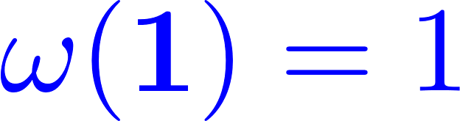






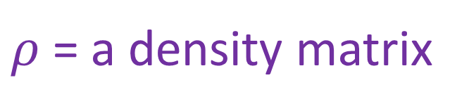
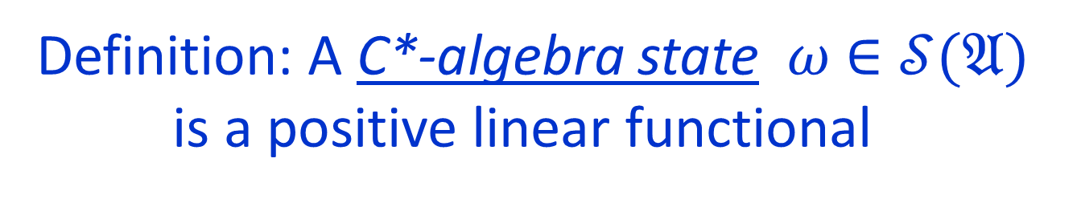
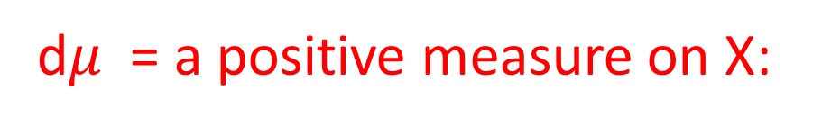
C* Algebra States
Definition: A C*-algebra state $ω$ $∈𝒮(𝔄)$
is a positive linear functional
d$μ$ = a positive measure on X:
$ρ$ = a density matrix
Notes:
OK, after wandering around in a dark wood for a long time I finally decided that a good definition of a QMNA state is the following:

Slide 9

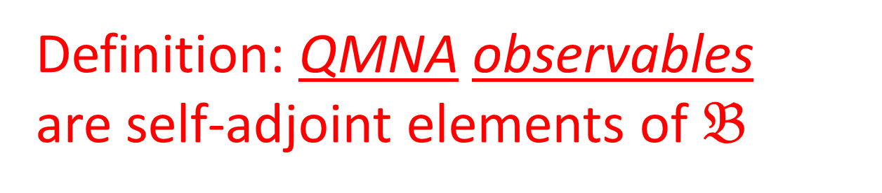
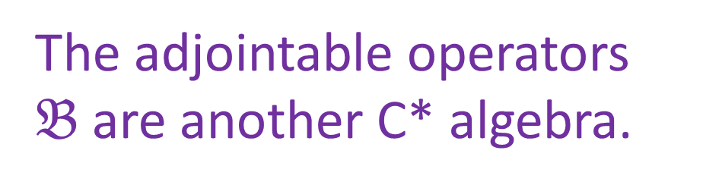
Observables In QMNA
Consider ``adjointable operators’’
The adjointable operators
$𝔅$ are another C* algebra.
Definition: QMNA observables
are self-adjoint elements of $𝔅$
(Technical problem: There is no spectral theorem for self-adjoint elements of an abstract C* algebra. )
Notes:
Now, finding a good definition of states in QMNA is considerably harder.
It’s a little bit like trying to open a tin of pineapple without a proper cantin-operner.
To begin let’s recall the notion of C*-algebra states.

Slide 10

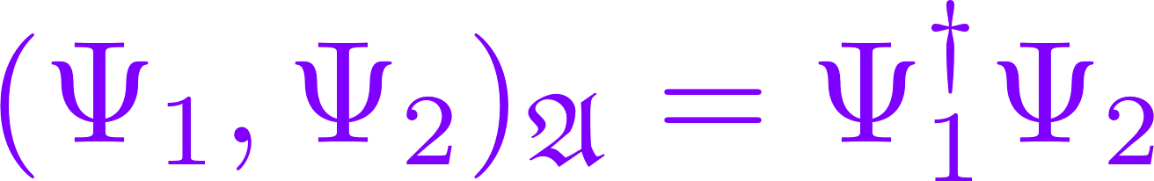
Example 2: Hilbert Bundle Over A Fuzzy Point
Def: ``fuzzy point’’ has

Slide 11
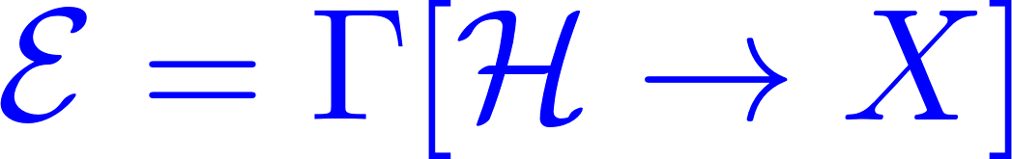



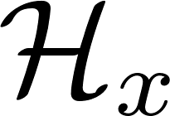
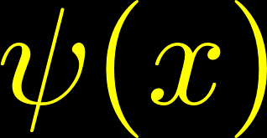



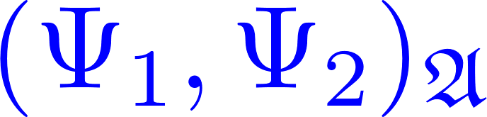
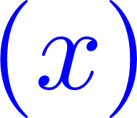
Example 1: Hilbert Bundle Over A Commutative Manifold

Slide 12

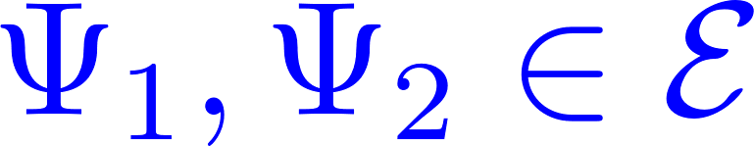





Quantum Mechanics With Noncommutative Amplitudes
Basic idea: Replace the Hilbert space by a Hilbert-module
So the Born rule is not obvious:
QM:
QMNA:
Notes:
In a Hilbert-module overlaps are valued in a possibly noncommutative algebra.
So this means the generalization of the Born rule is going to be a little nontrivial. You
See, in QM when we evaluate the probability of measuring some eigenvalue lambda
We evaluate this combination of wavefunctions and get a real number between 0 and 1.
But in QMNA if we mindlessly copy the formulae from the text books we get
Psi-lambda-Psi-Psi-lambda-Psi-star and this is valued in a possibly noncommutative algebra
Well, before we deal with this let’s look at our two examples of C* algebras

Slide 13



Noncommutative Hilbert Bundles
Definition: A Hilbert-module $ℰ$over C*-algebra $𝔄:$
Complex vector space $ℰ$ with a right-action of $𝔄$
and an ``inner product’’ valued in $𝔄$
(Positive element of the C* algebra.)
such that …..
Like a Hilbert space, but ``overlaps’’ are valued
in a (possibly) noncommutative algebra.

Slide 14
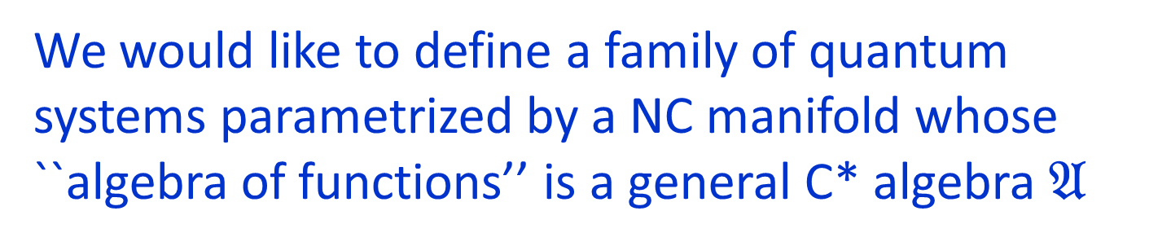
Noncommutative Control Parameters
We would like to define a family of quantum systems parametrized by a NC manifold whose ``algebra of functions’’ is a general C* algebra $𝔄$
What are observables?
What are states?
What is the Born rule?
What replaces the Hilbert bundle?
Notes:
…. In a general C* algebra \fA. SO: Now we have a number of questions to answer:

Slide 15



Noncommutative Geometry
Statements about the topology/geometry of X are equivalent to algebraic statements about C(X)
Replace C(X) by a noncommutative C* algebra $𝔄$
Interpret $𝔄$ as the ``algebra of functions
on a noncommutative space’’ …
… even though there are no points.
``pointless geometry’’
Example: Noncommutative torus:
Notes:
Even though there are no points – leading to the old joke that noncommutative geometry is
``pointless geometry’’

Slide 16





Gelfand’s Theorem
The topology of a (Hausdorff) space X is completely
captured by the C*-algebra of continuous functions on X:
Points ``are’’
1D representations:
Commutative C* algebra:
A topological
space

Slide 17

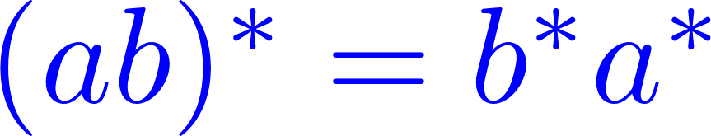



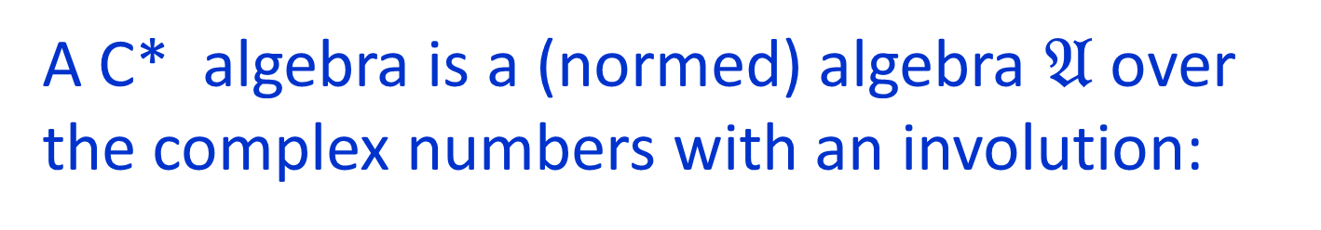
C* Algebras
A C* algebra is a (normed) algebra $𝔄$ over the complex numbers with an involution:
such that ….
Example 1:
Example 2:
Self-adjoint:
Positive:

Slide 18

Indeed, formulating the Born rule proves to be an interesting challenge.
Curiosity.
With irrational magnetic flux the Brillouin torus is replaced by a noncommutative manifold. (Bellisard, Connes, Gruber,…)
Noncommutative moduli of vacua of susy field theories. e.g. NC tt* geometry (S. Cecotti, D. Gaiotto, C. Vafa)
Boundaries of Narain moduli spaces of toroidal
heterotic string compactifications are NC
(closely related to the most-cited paper of Seiberg & Witten)
The ``early universe’’ might be NC
Notes:
You may well ask – “Why do this?” and the honest answer is just curiosity…
A more respectable answer is that with irrational magnetic flux ....
****
But the honest answer is really just curiosity.
Now to talk about noncommutative geometry we use the language of C* algebras

Slide 19
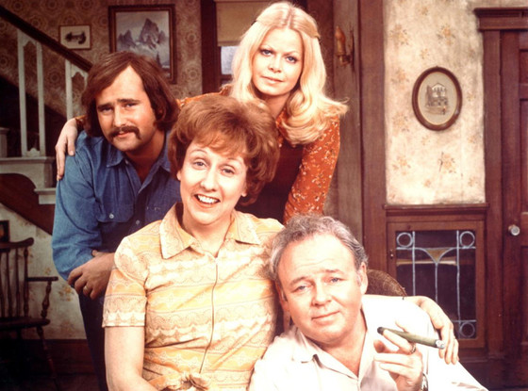
All In The Family
Let’s replace the family X of control parameters by a
noncommutative space
Notes:
Many of you will have no trouble recognizing the Bunkers. For those of you who don’t, you must know that the most popular TV show in the 1970’s was a sitcom – called ``All in the family’’ that helped many Americans come to terms with the great lurch towards social justice that took place in the 1960’s. The show broke all kinds of taboos and in particular broadened the notion of what kinds of families are deemed socially acceptable. So – in that spirit -

Slide 20
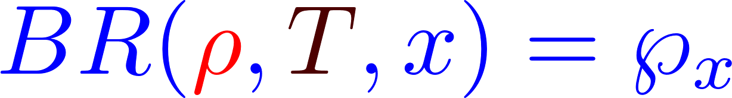

Continuous Families Of Quantum Systems
Hilbert bundle over space X of control parameters.
For each x get a probability measure $℘x$:
Notes:
So this is completely straightforward. But at this point we should pause and reflect on
what kind of families we would consider acceptable … My friends: There are all sorts of families!
For example, there’s the Bunker family...

Slide 21





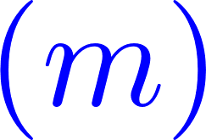
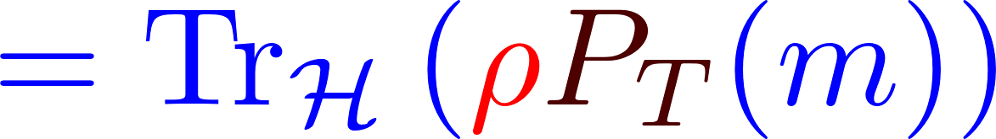
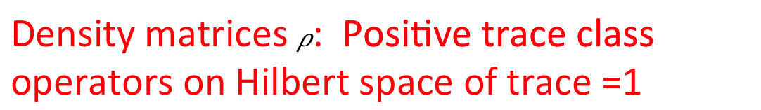
Standard Dirac-von Neumann Axioms
Density matrices $ρ$: Positive trace class operators on Hilbert space of trace =1
Self-adjoint operators T on Hilbert space
Spectral Theorem: There is a one-one correspondence of self-adjoint operators T and projection valued measures:
$$m⊂ ℝ→P_{T}\left(m\right)$$
Example:

Slide 22



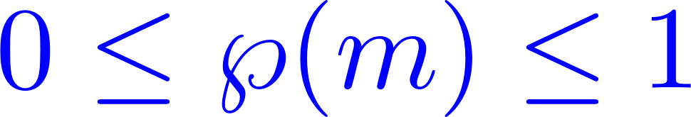
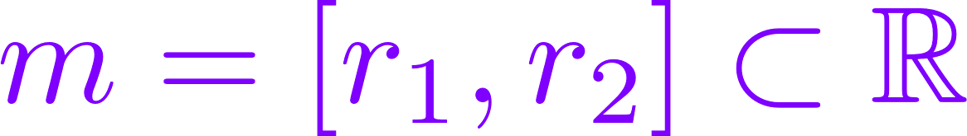

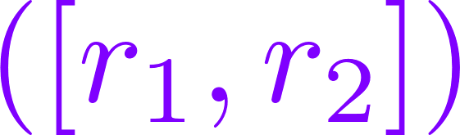

Quantum Systems
Set of physical ``states’’
Set of physical ``observables’’
Born Rule:
Probability measures on $ℝ$.
is the probability that a measurement of the observable O
in the state s has value between r₁ and r₂ .

Slide 23
Chapter Three
QUANTUM SYSTEMS– CONTINUOUS FAMILIES –
- ALL IN THE FAMILY – NONCOMMUTATIVE GEOMETRY –
- HILBERT MODULES - A BORN RULE AT LAST -
- QUANTUM INFORMATION THEORY –
- HEXAGONS & PENTAGONS

Slide 24
3D QHE
B. Halperin 1987; Kohmoto,Halperin, Wu 1992
Dislocations support chiral modes and give physical realizations of surface defects:
chiral bosons.
Closely related: Ran, Zhang, Vishwanath 2008 & Bulmash, Hosur, Zhang, Qi 2015
Notes:
Still, the topological effective action point of view can be powerful. For example,
Standard anomaly-inflow type arguments show that dislocations support chiral models –
Thus giving physical realizations of surface defects:
So there are c\cdot D chiral bosons on the surface defect. But I was scooped again by
The cond-matt literature since very similar statements appear in at least two papers –
In fact this nice figure is taken from Qi’s paper.
Nevertheless I believe there is more to be said about this example in particular, and I’m sure that
The general point I’m making has broader applications.
But we must push on!

Slide 25
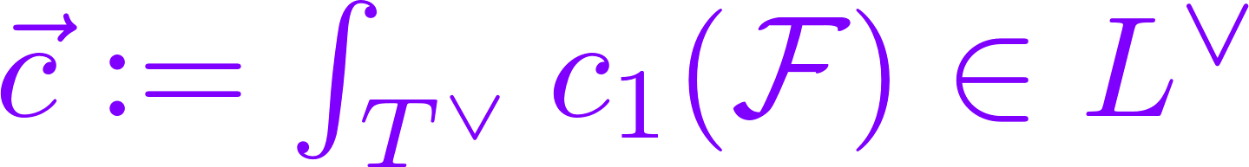

Dependence Of Axion Angle On x₀
QHE in the bulk of the ``insulator’’ in the planes orthogonal to
Notes:
So, for a while I was puzzled about how to interpret this linear dependence until I spoke to Edward.
He advised me to interpret this as just saying that theta is affine linear in x and to integrate by parts. His advice is always good so let’s take it.
******
So I was quite pleased by this. Here we started with this general mathematical philosophy
and ended up with an interesting physical effect! But after talking about this recently I learned that the basic physics had already been discovered by Bert Halperin over 30 years ago.

Slide 26
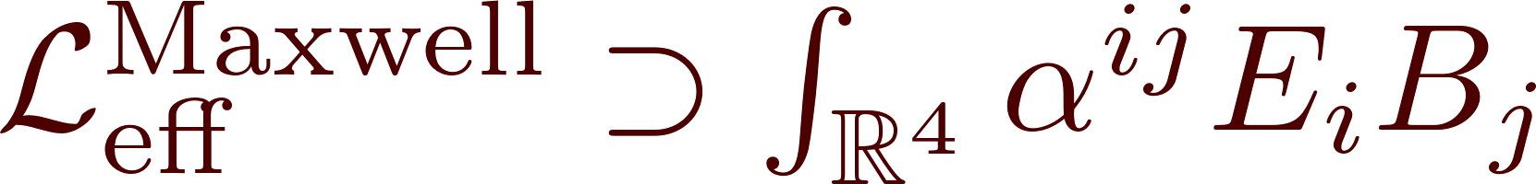
Electric polarization:
[ King-Smith & Vanderbilt (1993); Resta (1994) ]
Magnetoelectric Polarizability
``Axion angle’’
[ Qi, Hughes, Zhang; Essin, Joel Moore, Vanderbilt ]

Slide 27

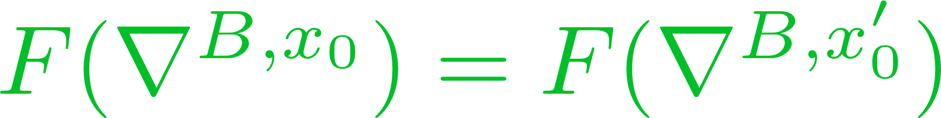
Berry Connections For Insulators
Insulator: Projected bundle $ℱ$of filled bands:
So what?
All Chern numbers unchanged….

Slide 28
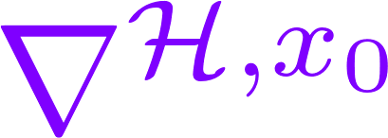
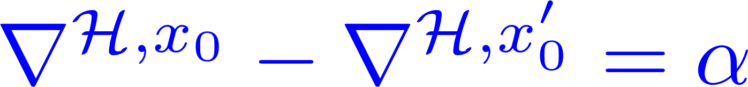
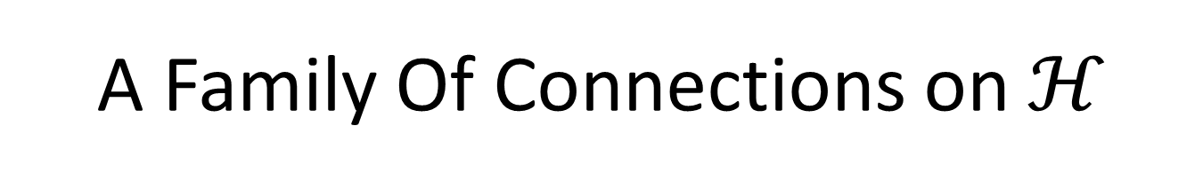
A Family Of Connections on $ℋ$
So: There is no such thing as ``THE’’ Berry connection in the context of band structure.
But, there is a natural family of connections on $ℋ$:
[Freed & Moore, 2012]
They depend on a choice of origin x₀ modulo L:

Slide 29


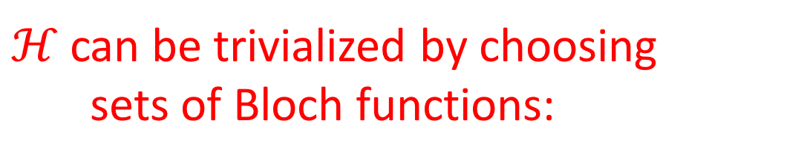
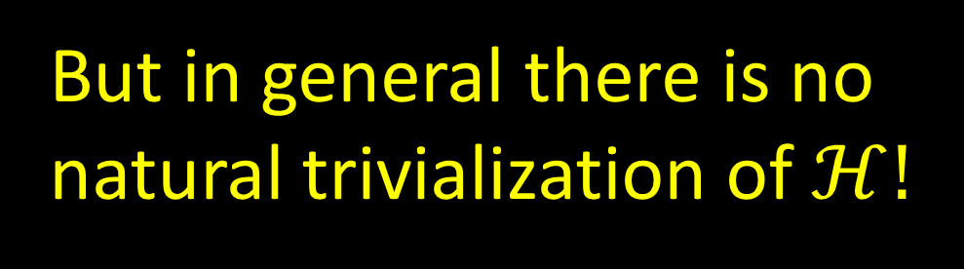
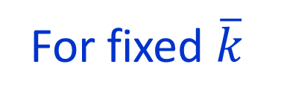


Trivializations Of $ℋ$
$ℋ$can be trivialized by choosing
sets of Bloch functions:
For fixed $n$ : smooth in $\overline{k}$
For fixed $\overline{k}$
A basis for Hilbert space
But in general there is no
natural trivialization of $ℋ!$

Slide 30

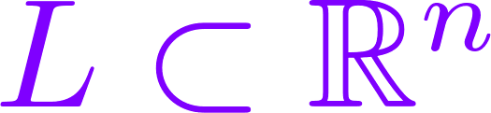
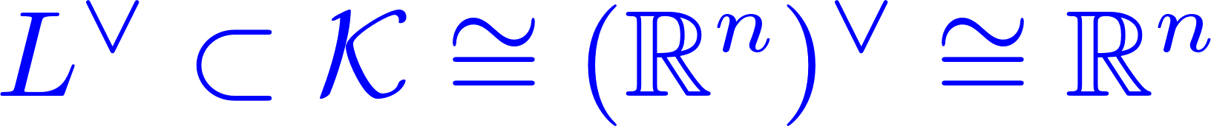
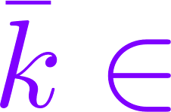

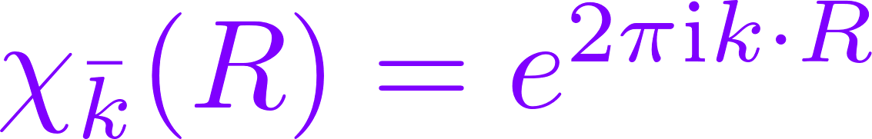


Hilbert Bundle Over Brillouin Torus
Crystal in n-dimensional affine space:
Invariant under a lattice of translations:
Brillouin torus:
= {unitary irreps of L}.
Reciprocal lattice:
Bloch states define a Hilbert bundle $ℋ$
over the Brillouin torus:

Slide 31
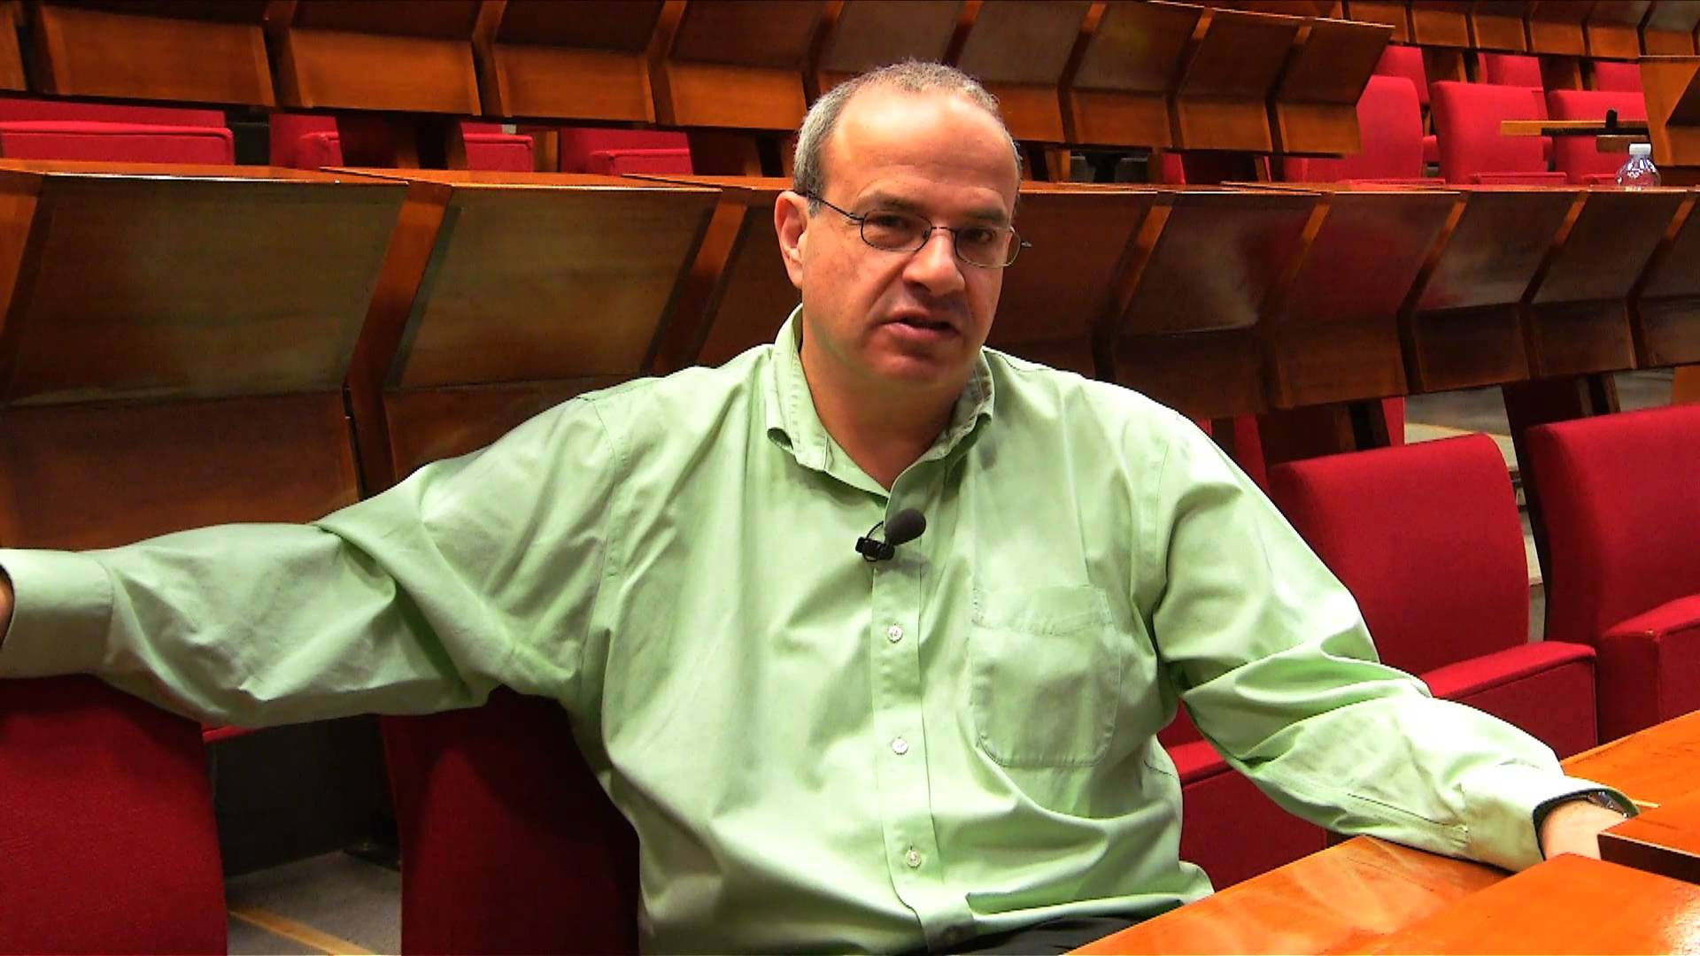
I’m a simple man….
Notes:
``I’m a simple man…’’ as many of us know this means one of two things. Either he is about to make an incredibly astute and penetrating observation or he’s fed up with meaningless formalism and wants to see a good example. OK, time to give an example.
My example is drawn from the theory of topological band structure – so let’s quickly review band structure, albeit from a highly mathematical point of view.

Slide 32

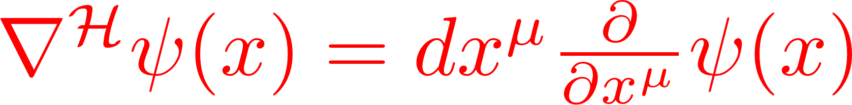
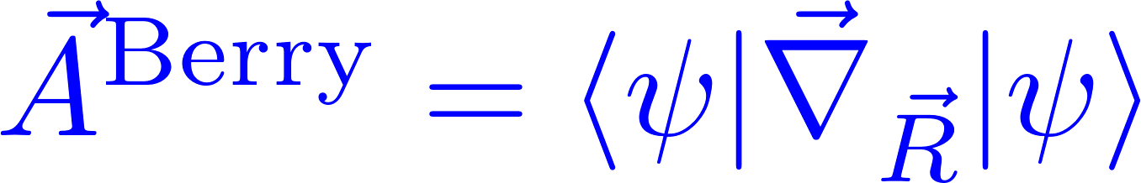
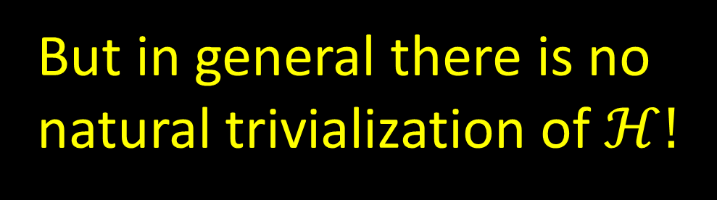


Commonly assumed: $ℋ$ has been trivialized:
Natural choice of $∇ℋ$:
The trivial connection.
But in general there is no
natural trivialization of $ℋ!$
Notes:
Now, a general theorem says that \CH is TRIVIALIZABLE, but in general there is no natural
Trivialization of \CH !!
OK. At this point I can well imagine Nati getting impatient….

Slide 33
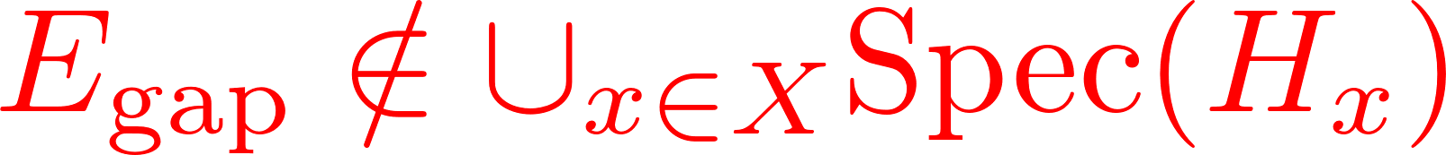





Berry Connection
Given a continuous family of Hamiltonians H_{x} on $ℋ$_{x} , if there is a gap:
we have a continuous family of projection operators:
[M. Berry (1983); B. Simon 1983) ]
Note that it requires a CHOICE of
Notes:
I’ll denote it nabla-B where the B is for ``Berry’’. It could also stand for ``Barry’’ because it was actually Barry Simon who first pointed out the proper geometric interpretation of Berry’s ``mysterious geometric phase’’.
But note that it requires a CHOICE of connection nabla-H on the Hilbert bundle. This is a point that was not mentioned in the physics papers and as far as I have seen is never mentioned in the physics literature.

Slide 34






Projected Bundles
Given a continuous family of projection operators:
Projected bundle V : Subbundle with sections:
$𝒱$ is the Hopf line bundle

Slide 35


Connection On A Vector Bundle V
Connection:
Remark: The space of connections on a
vector bundle is an affine space modeled
on the vector space:
Unless the bundle is trivial: V = X x V₀ for some fixed vector space V₀
there is no natural origin in the space of all connections.

Slide 36

Sections Of A Hilbert Bundle
Space of sections:

Slide 37





Hilbert Bundles
Hilbert bundle over a space
X of control parameters

Slide 38

Affine Space
Like a vector space – but no natural choice of origin.
Official Definition: An affine space is space with a transitive and free action of a vector space.
Notes:
Now this is a simple example, but bear in mind that the space of connections on a vector bundle is also an affine space and
Has no natural origin – we will return to this point.

Slide 39
The origin of the problem is
the problem of the origin.
Notes:
The slogan here is:

Slide 40
A Little Subtlety
Given a continuous family of Hamiltonians with a gap in the spectrum there is, in general, not one Berry connection, but rather a family of Berry connections.
This can have physical consequences:
I will illustrate that using examples
from topological band structure.
But the general remark should
have broad applications.

Slide 41
Philosophy
If a physical result is not mathematically natural, there might well be an underlying important physical issue.
I will illustrate this with continuous
families of quantum systems
i.e. quantum systems parametrized by a
space X of control parameters.
In this context one naturally encounters Berry connections – an enormously successful idea.
Notes:
I begin with a philosophical premise:

Slide 42
Chapter Two
PHILOSOPHY – ORIGINS & AFFINE SPACE –
- HILBERT BUNDLES –BERRY’S CONNECTION –
- A SIMPLE MAN - BAND STRUCTURE –
- A 3D QUANTUM HALL EFFECT

Slide 43

A Condition For Asymmetric Orbifolds
These are examples of asymmetric orbifolds.
Narain, Sarmadi, Vafa (1987) is an important paper giving general consistency conditions for asymmetric orbifolds. But one condition was a little mysterious:
for all Narain vectors p.
Violated by T-duality orbifold of four copies of the Gaussian model
Conjecture: Not a true consistency condition: It means the group acting on the CFT is really $ℤ_{4}$
Notes:
NSV wrote an important paper stating general consistency conditions for asymmetric orbifolds
That generalized conditions set forth in Dixon-Harvey-Vafa & Witten.
*****
So Jeff, and Nati and I

Slide 44


“Why don’t you think what you are doing? You go about things in such a slap-dash style. You’d get a scaffolding pole entangled you would!”
Gaussian model at self-dual point has $SU{\left(2\right)}_{L}×SU{\left(2\right)}_{R}$ symmetry.
T-duality is a 180 degree rotation in SO(3)_{R} :
Therefore lifts to an order four element in SU(2)_{R}
-- even in the untwisted sector!
Now the method of orbits gives a sensible Z

Slide 45

Still, even with level matching satisfied, something peculiar is going on:
S
g
1
T
g
1
g
g²
g³
T
T
T
g
g
g
So, in the twisted sector, g is actually order four!
But computation of the partition function in the
$g^{2}$-twisted sector gives negative half-integral degeneracies….
Notes:
So g is order four - even though we thought we started with a transformation that is order two – an involution.
After all: T-duality takes R to 1/R. Isn’t that order two? Well somehow it is order four in the twisted sector.
Still, we thought, it is surely order two in the untwisted sector, and assuming this we computed the full partition function, but the computation of the partition function in the g2 –twisted sector gives negative half-integral degeneracies.
So we were quite confused until we talked to Nati, who said –

Slide 46


Can You Orbifold By T-Duality?
Comes up in some recent work on Mathieu Moonshine with Jeff …
Would be a nice way to construct ``monodrofolds’’ and ``T-folds’’
[Hellerman & Walcher 2005 ]
Example: Consider a periodic scalar at the self-dual radius:
One loop modular anomaly in g-twisted sector:
$$E_{L}=\frac{1}{2}p_{L}^{2}+ ℤ∈\frac{1}{4}ℤ$$
$$E_{R}=\frac{1}{16}+\frac{1}{2}ℤ$$
But four copies of the Gaussian model has no one-loop anomaly.
Notes:
We begin with the question: Can you orbifold by T-duality?
It is a question that came up in some work I’ve been doing with Jeff on Moonshine – which I’ll tell you all about, some other time. Of course, we were not the first people to ask this question. For example it was noticed some time ago that it would be a nice way to make ..

Slide 47
Chapter One
AN ORBIFOLD BY T-DUALITY? –
- A ONE LOOP ANOMALY AND A PUZZLE -
- NATI IS SARCASTIC – AN OLD CONDITION REVISITED -

Slide 48
Prologue
There were four of us -
- Nati, Jeffrey Samuel Harvey,
and myself, and Maldacena.
We were sitting in my office,
skyping, and talking about how confused we were –
confused from a conceptual point of view I mean, of course.
With me, it was my talk that was out of order.
I knew it
was my talk that was out of order, because I had just been reading a blog in which were detailed various mistakes by which a man could tell when his talk was out of order.
I made them all.
Nati said: You know, you’re on the wrong track altogether.
You must not think of the results you can do with, but only of the results that you can’t do without.
Nati comes out
really quite sensible at times. You’d be surprised.
I call that downright wisdom.

Slide 49

Three Points In A Talk
(To say nothing of the prologue!)
G.K.G.
Notes:
The title of my talk refers to Jerome Klapka Jerome’s classic novel, Three Men In A Boat, To Say Nothing Of The Dog. It is much beloved by many people throughout the world, including Nati and myself. Of course, Nati read it in Hebrew, which differs in some ways from the English version, so here Nati
is the original English addition – Three Men In A Boat [handing the book] –
To Say Nothing Of The Dog [handing the other book]. And for those of you who don’t know it, if you can get nothing better out this talk, get a good book out of it, at least.

