Slide 1
Some Comments on
Physical Mathematics
Gregory Moore
Rutgers University
APS Meeting, Savannah, GA, April 5, 2014
Written version available at http://www.physics.rutgers.edu/~gmoore/

Slide 2
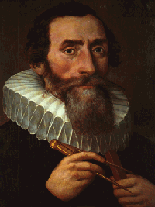
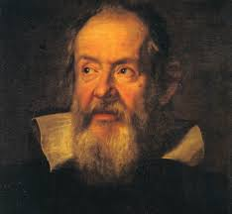
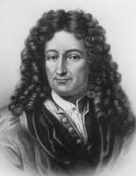
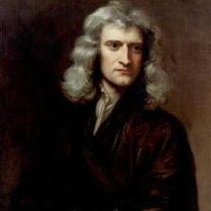
Part I:
Snapshots from the
Great Debate
over
Kepler
Galileo
the relation between
Mathematics and Physics
Newton
Leibniz
Notes:
I am not a historian or philosopher of science, but my impression is that in the 16th and 17th century people such as
Kepler, Galileo, Newton, and Leibniz were called “natural philosophers’’

Slide 3
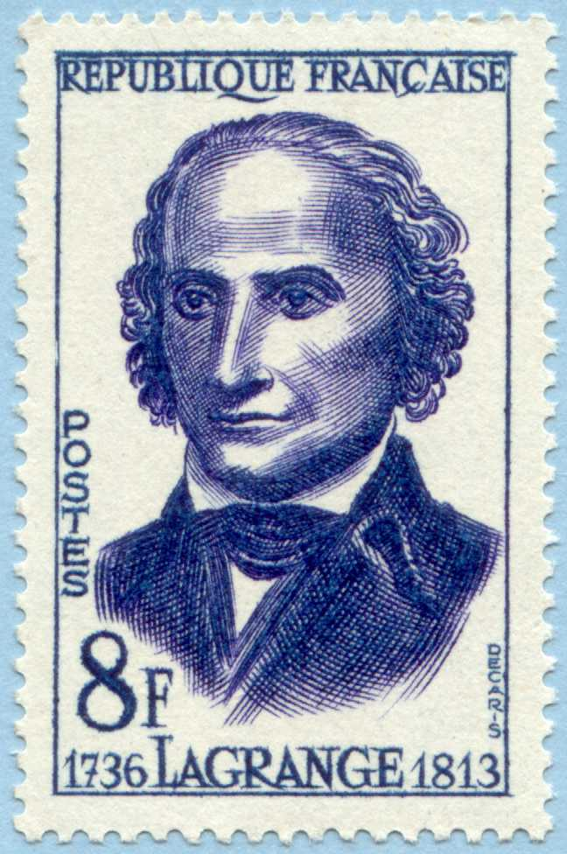
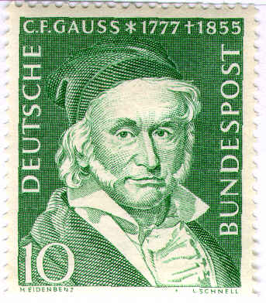
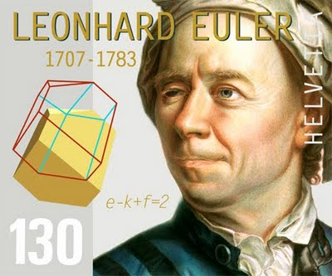
When did Natural Philosophers become either physicists or mathematicians?
Even around the turn of the 19th century …
But, we can read in volume 2 of the journal Nature ….

Slide 4
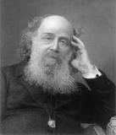
1869: Sylvester’s Challenge
A pure mathematician speaks:

Slide 5
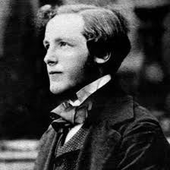
1870: Maxwell’s Answer
An undoubted physicist responds,
Maxwell recommends his somewhat-neglected dynamical theory of the electromagnetic field to the mathematical community:

Slide 6
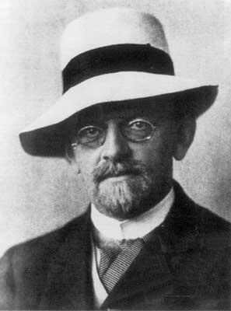
1900: Hilbert’s 6th Problem

Slide 7
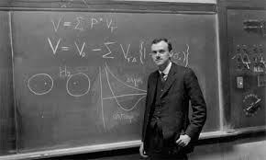
1931: Dirac’s Paper on Monopoles

Slide 8
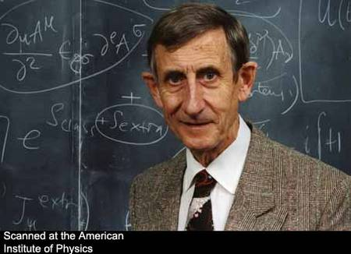
1972: Dyson’s Announcement

Slide 9

Well, I am happy to report that
Mathematics and Physics have remarried!
But, the relationship has altered somewhat…
A sea change began in the 1970’s …..
Atiyah, Bott, Singer, …

Slide 10
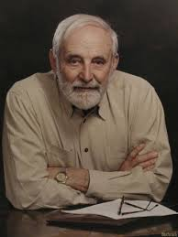
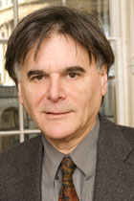
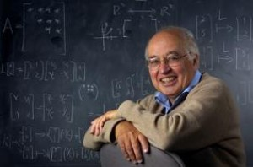
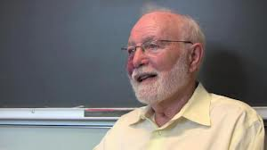

A number of great mathematicians got interested in the physics of gauge theory and string theory, among them,
M. Atiyah
I. Singer
R. Bott
G. Segal

Slide 11
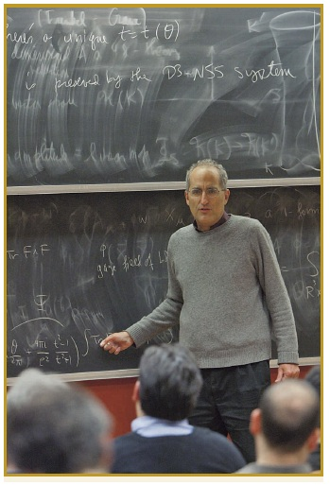
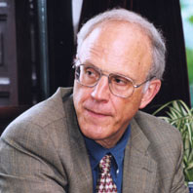

And at the same time a number of great physicists started producing results requiring increasing mathematical sophistication, among them
S. Coleman
D. Gross
E. Witten

Slide 12
Physical Mathematics
With a great boost from string theory, after 40 years of intellectual ferment a new
field has emerged with its own distinctive character, its own aims and values, its own standards of proof.
One of the guiding principles is certainly Hilbert’s 6th Problem (generously
interpreted): Discover the ultimate foundations of physics.
As predicted by Dirac, this quest has led to ever more sophisticated mathematics…
But getting there is more than half the fun: If a physical insight leads to a new result in mathematics – that is considered a great success.
It is a success just as profound and notable as an experimental confirmation of
a theoretical prediction.
The discovery of a new and powerful invariant of four-dimensional manifolds is a vindication just as satisfying as the prediction of a new particle.

Slide 13
Part II: Theories with Extended Supersymmetry
A Fruitful Collaboration
Part III:
Part IV:
Future Directions
Notes:
Say in words: Now we change pace and zoom in from these grand vistas to the minutia of individual research. I have time to illustrate
My theme of Physical Mathematics by talking about just one project related to what is called theories with four-dimensional N=2 supersymmetry.

Slide 14
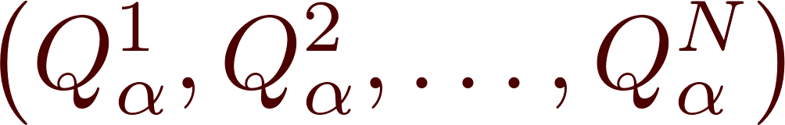

Why Extended Supersymmetry ?
1970’s: Kinematics – construction of field multiplets and Lagrangians: Brilliant application of symmetry principles.
Around 1994 another great change began to take place:
Nontrivial
dynamics
Yet susceptible
to exact results
Many physicists began to gather nontrivial evidence that these theories have strong-weak dualities
Work of Seiberg & Witten in 1994 made it clear that these theories are in the ``Goldilocks’’ class
Notes:
Pause after u in M: ``What kind of exact results? “

Slide 15
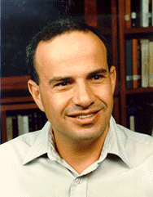
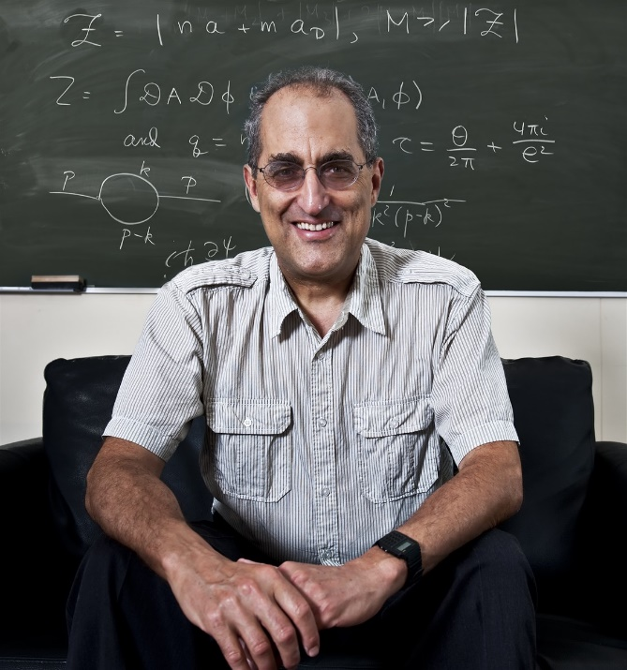
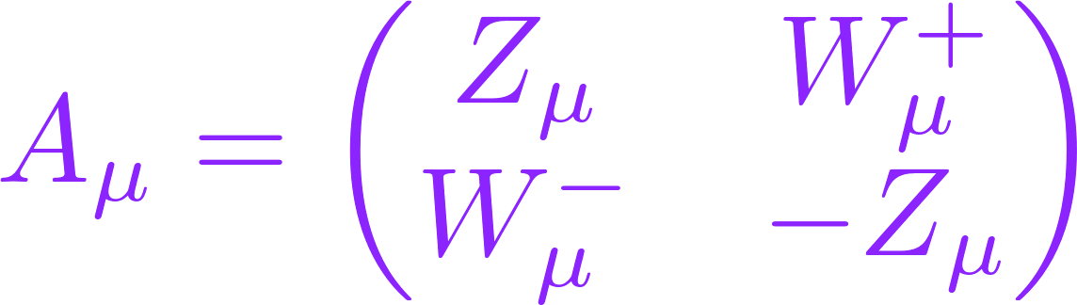
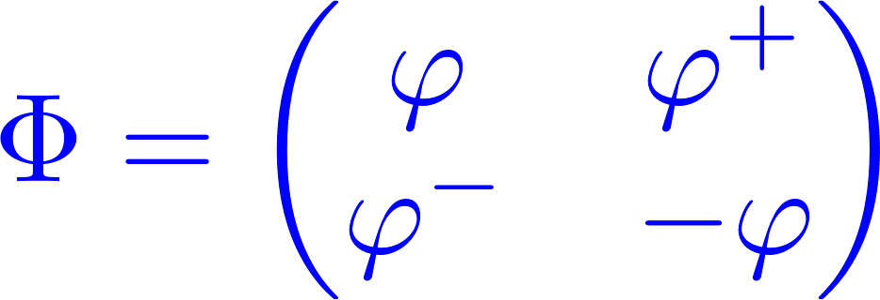
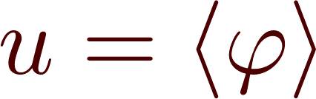

Seiberg-Witten Breakthrough
SU(2) gauge theory
N=2 Susy
Higgs
At low energies physics is described by an N=2 version of Maxwell’s theory.

Slide 16


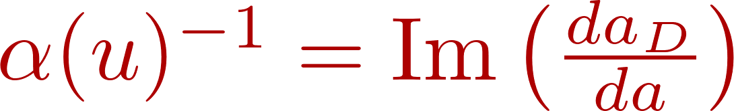
A Manifold of Quantum Vacua
u is undetermined even at the quantum level so there is a manifold of quantum vacua:
For SU(2) N=2 YM, u is just a complex number:
Low energy physics depends on u: The strength of Coulomb’s law depends on u: The fine structure constant  depends on u.
Seiberg & Witten showed how to compute (u) exactly in terms of two functions a(u) and a_{D}(u)

Slide 17
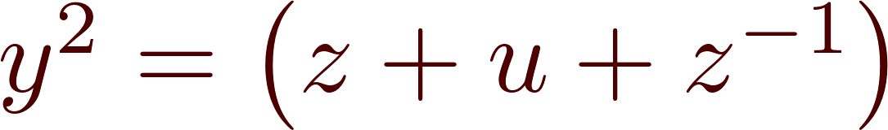
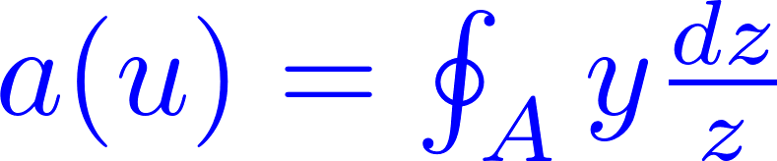
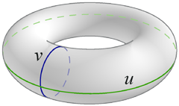

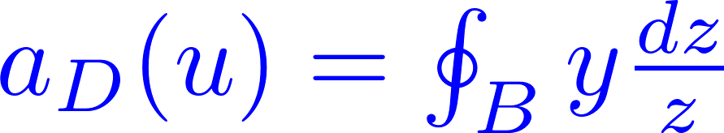

Elliptic Curves
The theory of elliptic curves is a deep and wonderful subject in mathematics, and continues to be the focus of important research today.
For example, the proof of Fermat’s Last Theorem in 1995 relied heavily on new results on elliptic curves.
Notes:
Say: The important point is:

Slide 18
Unreasonable Effectiveness
It is another example of Wigner’s ``Unreasonable Effectiveness of Mathematics in the Natural Sciences’’
But then, in the hands of Witten, the SW insight led to startling new results in mathematics – new four-manifold invariants.
Later, Moore & Witten explained in greater detail how these new invariants are related to the invariants of Donaldson.
And Marino, Moore, and Peradze used the existence of N=2 superconformal fixed points to predict new results in the topology of four-manifolds.
This is one good example (out of very many) of the Unreasonable Effectiveness of Physics in Mathematics .

Slide 19
The Threefold Promise of Seiberg-Witten Theory
Exact statements about the massless particles and how they interact at low energies.
Exact statements about the spectrum of the Hamiltonian for a subspace of the Hilbert space of the theory –
the so-called ``BPS subspace.’’
Exact statements about path integrals with extended observables inserted.
(``Line operators’’ , ``surface operators’’ , domain walls.)

Slide 20
What Are BPS States?
They are quantum states
(annihilated by some supersymmetry operators)
whose quantum properties are rigidly constrained by the supersymmetry algebra.
So we can make exact statements.

Slide 21
Mass Formula & Central Charge
Given a BPS state  there is an associated ``central charge’’ Z  C
Mass() = | Z |
Z(u) turns out to be an interesting, computable function of u  
Particle of (electric, magnetic) charge =(q,p) has

Slide 22
Finding the BPS Spectrum ?
Tells us the mass a particle of charge (q,p) would have, if it exists.
It does not tell us whether particles of charge (q,p) do or do not exist!
The BPS spectrum of N=2 theories was only known for some isolated examples in the 1990’s.
Around 2007 this began to change. Since then we have developed a much more systematic understanding of the BPS spectrum for many N=2 theories.
The key was a phenomenon known as ``wall-crossing’’

Slide 23
Walls of Marginal Stability
BPS states can form boundstates, which are themselves BPS.
If ₁ and ₂ are BPS states the 2-particle boundstate has
BE:
One real equation
WALL in M

Slide 24


Notes:
Say in words: Now imagine varying the moduli so that we cross from the side where R12>0, and the boundstate exists to the side where R12 < 0 and the boundstate cannot exist.

Slide 25

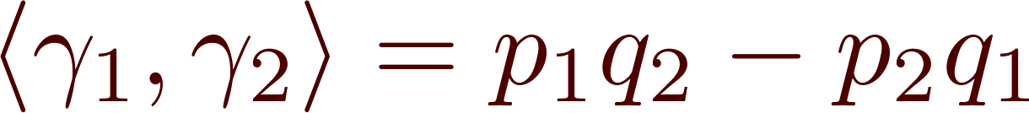
Boundstate Radius Formula
In a semiclassical picture the constituent BPS states are solitonic dyons of charges ₁ and ₂.
The electromagnetic forces cancel the scalar forces exactly at a magic boundstate radius.
The formula was found by Frederik Denef.

Slide 26
R₁₂ > 0
R₁₂ < 0
Notes:
Say in words: Now imagine varying the moduli so that we cross from the side where R12>0, and the boundstate exists to the side where R12 < 0 and the boundstate cannot exist.

Slide 27
A Picture of Wall-Crossing
Lee & Yi; Kol; Mikhailov, Nekrasov & Sethi; Denef & Moore:
For u  MS(₁,₂)
R₁₂(u)  
₁
₂
R₁₂(u)

Slide 28
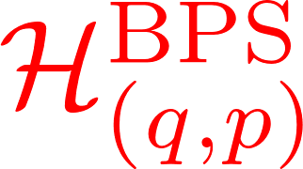
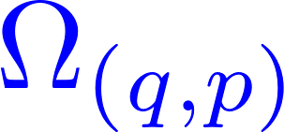
BPS Index
In general, understanding how the vector space of BPS states changes is too hard to start with.
An important simplification of the problem is to consider instead an ``index’’ - a signed sum over the BPS states:
vector space
integer
The BPS index  is typically independent of parameters and thus much more computable. However – because of wall-crossing it is only piecewise-continuous.
Denef-Moore derived formulae for  across wall for some boundstates, then, soon thereafter….
Notes:
Say: But there can also be multiparticle boundstates…

Slide 29
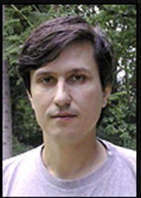
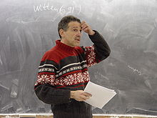
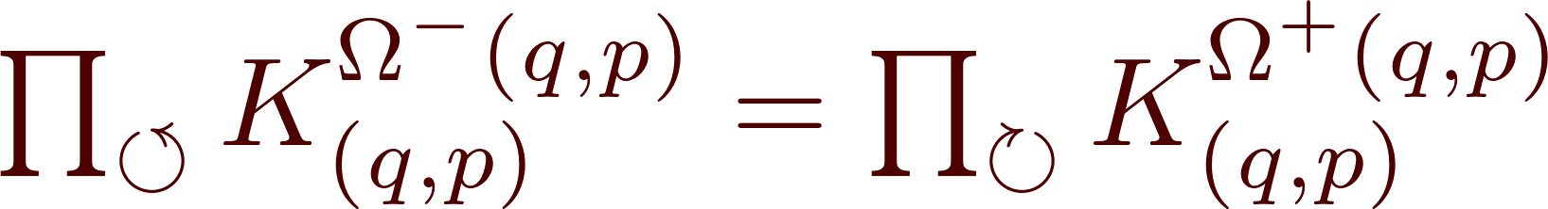
Kontsevich-Soibelman WCF
For (seemingly) different reasons K&S came up with a mathematical formula for the change of the index involving completely new ideas:
K_{(q,p)}: group elements in a certain nonabelian group
The phases of the central charges Z= a ₁ + b ₂ , with a,b nonnegative, change from cw to ccw when u passes through MS(₁ ,₂)

Slide 30
Who ordered that !?

Slide 31
Part III
A Fruitful Collaboration

Slide 32

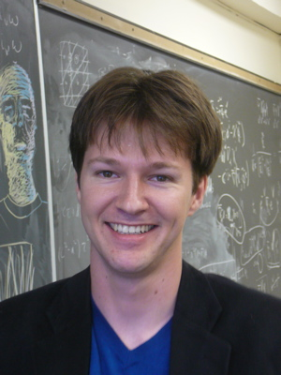
Davide Gaiotto (Perimeter)
Andy Neitzke (UT Austin)
and I set out to understand where this comes from
(Two) physical derivations of the KSWCF
+ a nontrivial generalization of the KSWCF
2nd derivation: Above mechanism captures
the essential physics of the KSWCF

Slide 33
Physics Results from GMN project
``New’’ class of d=4 N=2 field theories (``class S’’)
New relations of d=4, N=2 with integrable systems and CFT
Exact results for Wilson-’t Hooft (and other) line operators and surface operators

Slide 34
Math results from GMN project
1. New constructions of hyperkahler metrics
and hyperholomorphic vector bundles
New perspectives & results on cluster algebras, cluster varieties and the higher Teichmuller theory of Fock and Goncharov
3. New construction of a combinatoric object associated to branched covers of Riemann surfaces, called a ``spectral network.’’

Slide 35
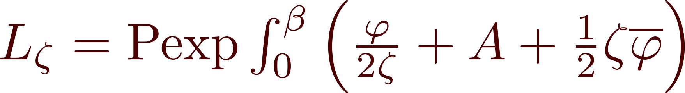
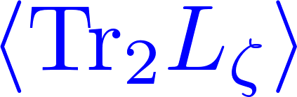
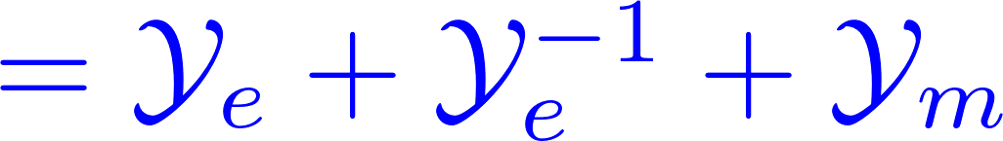
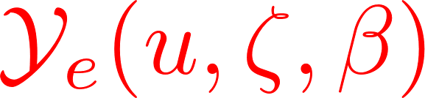
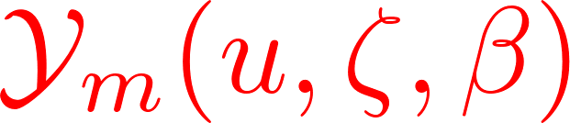
Sample Result
Pure SU(2) N=2 gauge theory
at finite temperature :
Susy Wilson line wrapped on Euclidean time circle of radius 
Exactly computable

Slide 36
&
satisfy a system of integral equations formally identical to Zamolodchikov’s Thermodynamic Bethe Ansatz
One of many relations to integrable systems…
+ Many connections to mathematics ….
They are special ``cluster coordinates’’ on a manifold M closely related to M
Moreover, we can construct explicit solutions to
Einstein’s equations on M using these functions.
Notes:
Before moving on to the next slide talk about the wonderful playground, or zoo, of fascinating results

Slide 37

S-Duality
Higgs branches
Coulomb branch & Hitchin moduli
AGT & Toda CFT
HK geometry
-backgrounds, Nekrasov partition functions, Pestun localization.
Cluster algebras
Quantum Integrable
BPS states & wall-crossing
Holographic duals
Domain walls &
3D Chern-Simons
Line & Surface defects
N=4 scattering
Z(S³ x S¹) Scfml indx

Slide 38

Part IV: Future Directions

Slide 39

Future Directions - A
Many good directions exist within the subject of theories with extended susy:
Go back to the original problem: Really understand the actual space of BPS states, not just the index. This requires new techniques and methods.
``CATEGORIFICATION’’

Slide 40
S-Duality
Higgs branches
Coulomb branch & Hitchin moduli
AGT & Toda CFT
HK geometry
-backgrounds, Nekrasov partition functions, Pestun localization.
Cluster algebras
Quantum Integrable
BPS states & wall-crossing
Holographic duals
Domain walls &
3D Chern-Simons
Line & Surface defects
N=4 scattering
Z(S³ x S¹) Scfml indx

Slide 41

Future Directions - B
Study of the six-dimensional (2,0) theories
Claim, based on string theory constructions:
There is a family of stable field theories, S[g] with six-dimensional (2,0) superconformal symmetry. (Witten; Strominger; Seiberg).
Characterizing properties of these hypothetical theories can be deduced from their relation to string theory and M-theory.
But, these theories have not been constructed
-- even by physical standards --

Slide 42

M5

Slide 43

Future Directions - C
The modern version of Hilbert’s 6th problem:
Find the defining axioms for M-theory.
The community seems to have put the problem aside –
at least temporarily.
But Physical Mathematics will surely play an important role in its resolution.
Physical Mathematics will be an important fixture of the intellectual landscape for some time to come.
Notes:
I’ll end the talk by making a prediction, in which I have great confidence: Physical Mathematics will be…

