Slide 2
Drude model prediction
273K
77K

Slide 3
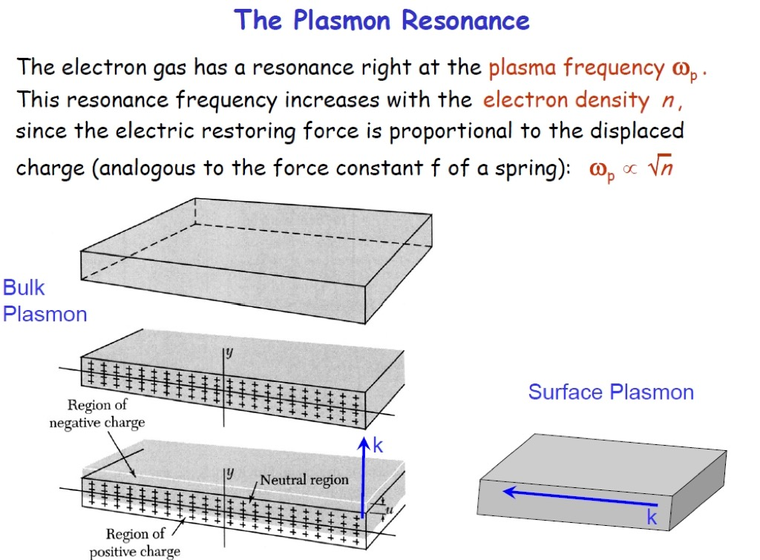
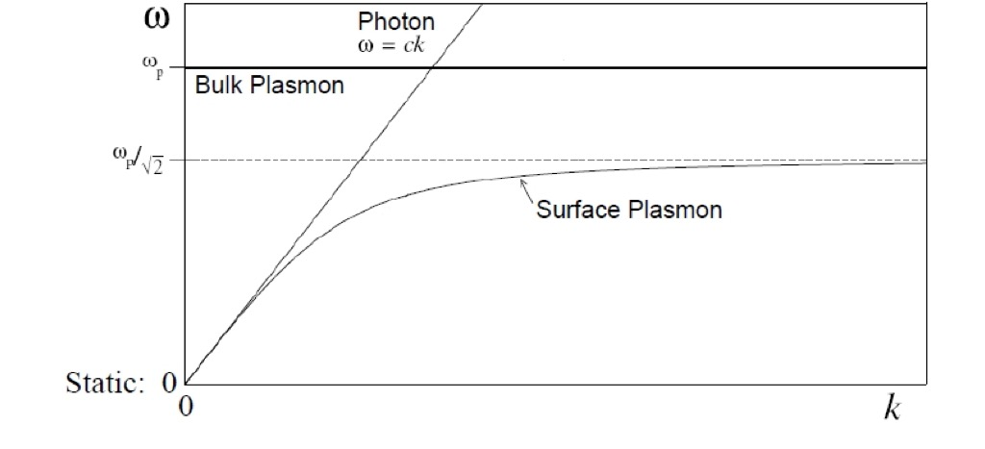

Slide 4
