Slide 1
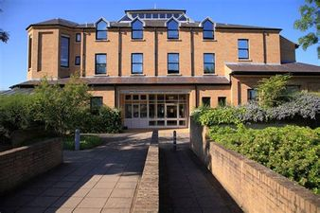
Three Pedestrian Overpasses
Between Number Theory And Physics
Gregory Moore
Rutgers
August 25, 2022

Slide 2


Slide 3


Slide 4

Moonshine Phenomena,
Supersymmetry, and Quantum Codes

Slide 5
1.A: Some Background

Slide 6

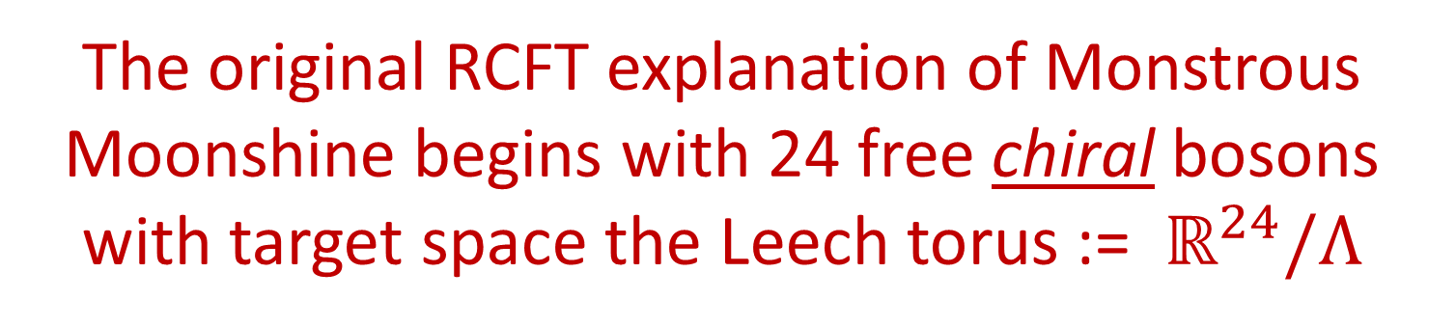
RCFT Approach To FLM
The original RCFT explanation of Monstrous Moonshine begins with 24 free chiral bosons with target space the Leech torus := $ℝ^{24}/Λ$
$Λ⊂ℝ^{24}$ is the Leech lattice,
D25-brane
Moreover, target space torus has a very special ``B-field’’
$$S=∫d^{2}σ ( G_{μν} ∂_{i}x^{μ} ∂^{i}x^{ν}+B_{μν}ε^{ij}∂_{i}x^{μ}∂_{j}x^{ν})$$
Notes:
Later I will show you how you can construct the Golay code for yourself
At your own kitchen table – were you so inclined

Slide 7


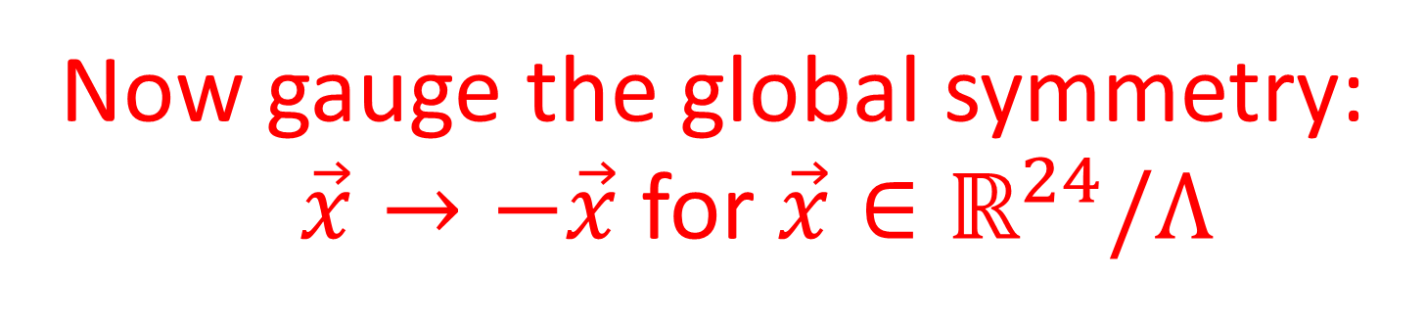
$ℤ_{2}−$Orbifold
Now gauge the global symmetry:
$\vec{x}→−\vec{x}$for $\vec{x}∈ℝ^{24}/Λ$
$$ℋ_{Λ}=ℋ_{Λ}^{+}⊕ℋ_{Λ}^{−}$$

Slide 8
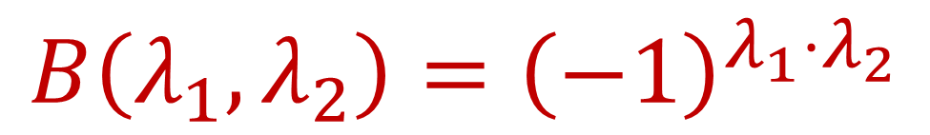
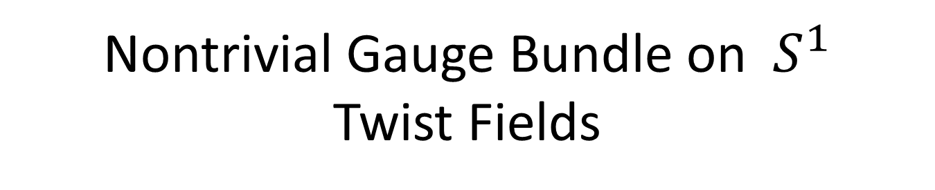
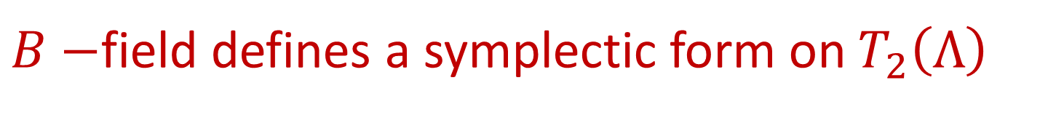
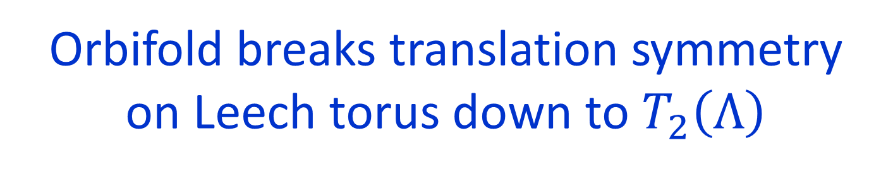


Nontrivial Gauge Bundle on $S^{1}$
Twist Fields
Identify order two points in the torus $ℝ^{24}/Λ$
$$T_{2}\left(Λ\right)≔Λ/2Λ$$
Orbifold breaks translation symmetry
on Leech torus down to $T_{2}\left(Λ\right)$
$B−$field defines a symplectic form on $T_{2}\left(Λ\right)$
$$B\left(λ_{1}, λ_{2}\right)={\left(−1\right)}^{λ_{1}⋅λ_{2}}$$

Slide 9

Noncommutative Translations - 2/2
Unbroken translation symmetry realized on Hilbert space via a nontrivial central extension
$$0→ ℤ_{2} → ℋ\left(T_{2}\left(Λ\right)\right)→ T_{2}\left(Λ\right)→0$$
$$T(λ_{1})T(λ_{2})=ε\left(λ_{1},λ_{2}\right)T\left(λ_{1}+λ_{2}\right)$$
$$\frac{ε\left(λ_{1},λ_{2}\right)}{ε\left(λ_{2},λ_{1}\right)}= {\left(−1\right)}^{λ_{1}⋅λ_{2}}$$
Early example of noncommutative geometry on D-branes induced by a B-field

Slide 10
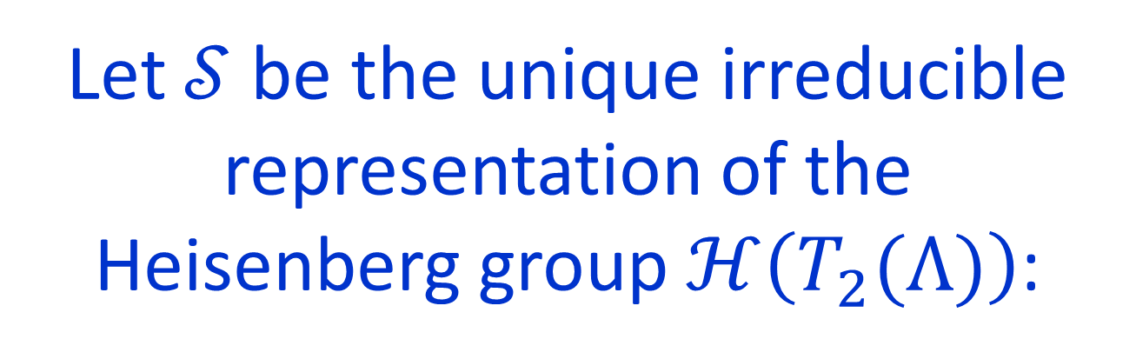
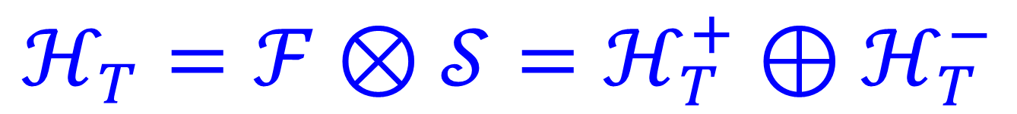

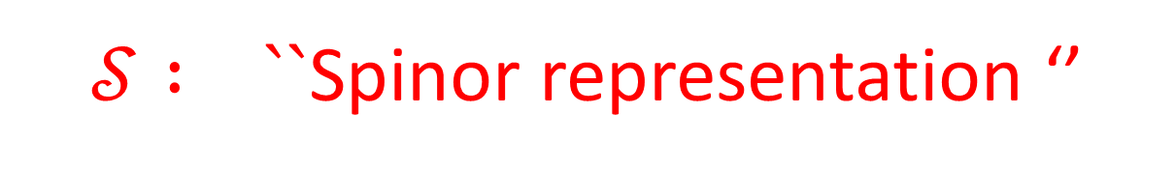
Let $𝒮$ be the unique irreducible representation of the
Heisenberg group $ℋ\left(T_{2}(Λ)\right)$:
Construct it using $γ−$matrices.
$𝒮 : ``$Spinor representation ‘’
$$ℋ_{T}=ℱ⊗𝒮=ℋ_{T}^{+}⊕ℋ_{T}^{−}$$

Slide 11


FLM Module
$$ℋ_{FLM}=ℋ_{Λ}^{+}⊕ ℋ_{T}^{+}$$
FLM & Borcherds:
The automorphism group of the VOA $ℋ_{FLM}$is the Monster Group

Slide 12
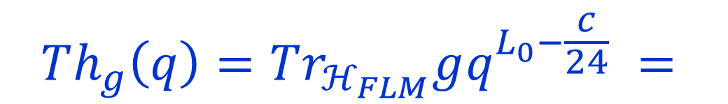
Payoff: Conceptual Explanation of Modularity
g
$$Th_{g}\left(q\right)=Tr_{ℋ_{FLM}}gq^{L_{0}−\frac{c}{24}} =$$
1
Modularity
This is the gold standard for the conceptual explanation of Moonshine-modularity
A truly satisfying conceptual explanation
of genus zero properties remains elusive.
Important progress: Duncan & Frenkel 2009;
Paquette, Persson, Volpato 2017

Slide 13
1.B: Statement
Of The Problem

Slide 14
1988:

Slide 15
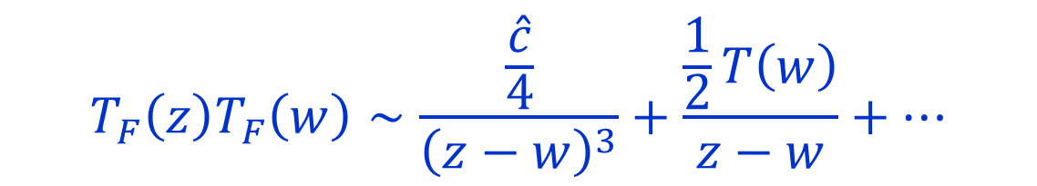
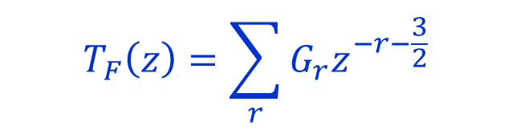
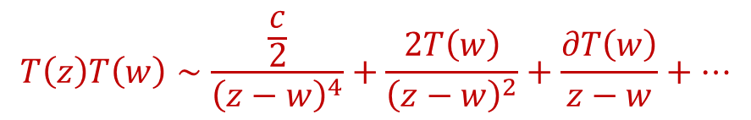
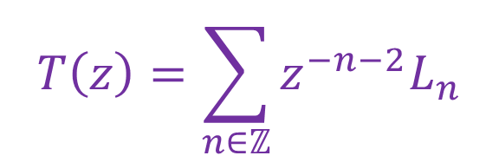
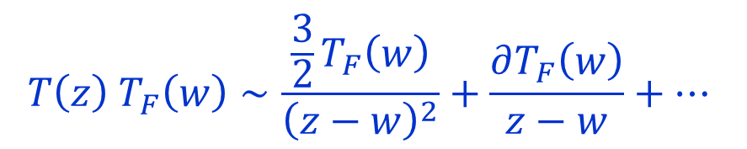
(Super-) Conformal Symmetry:
$$\left[L_{n},L_{m}\right]=\left(n−m\right)L_{n+m}+\frac{c}{12}\left(n^{3}−n\right)δ_{n+m,0} n,m∈ℤ$$
$$T\left(z\right)=\sum_{n∈ℤ}{z^{−n−2}L_{n}}$$
$$T\left(z\right)T\left(w\right)∼\frac{\frac{c}{2}}{{\left(z−w\right)}^{4}}+\frac{2T\left(w\right)}{{\left(z−w\right)}^{2}}+\frac{∂T\left(w\right)}{z−w}+⋯$$
Superconformal symmetry $⇒$ supercurrent:
$$T\left(z\right) T_{F}\left(w\right)∼\frac{\frac{3}{2}T_{F}\left(w\right)}{{\left(z−w\right)}^{2}}+\frac{∂T_{F}\left(w\right)}{z−w}+⋯$$
$$T_{F}\left(z\right)=\sum_{r}{G_{r}z^{−r−\frac{3}{2}}}$$
$$T_{F}\left(z\right)T_{F}\left(w\right)∼\frac{\frac{\hat{c}}{4}}{{\left(z−w\right)}^{3}}+\frac{\frac{1}{2}T\left(w\right)}{z−w}+⋯$$
Notes:
Nick has explored applications of these superconformal algebras
To condensed matter in interesting ways – for example generating
interesting states like Read-Rezayi and others.

Slide 16


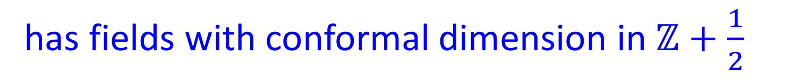
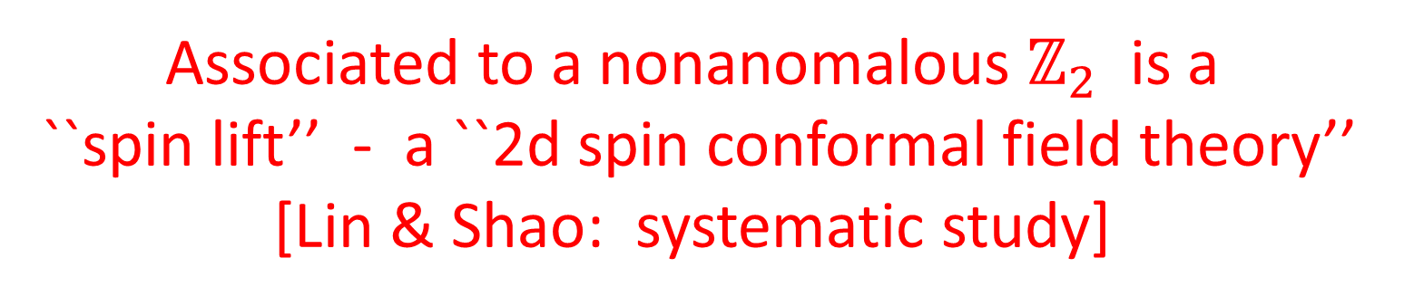
There are no dimension 3/2 fields in $ℋ_{FLM}$
Associated to a nonanomalous $ℤ_{2}$ is a
``spin lift’’ - a ``2d spin conformal field theory’’
[Lin & Shao: systematic study]
$$ℋ_{B\&B}=ℋ_{Λ}⊕ℋ_{T}$$
has fields with conformal dimension in $ℤ+\frac{1}{2}$

Slide 17

What is the actual supercurrent?
Not known. Not easy.
Today I will fill in this gap.
It is very recent work with R. Singh

Slide 18
1.C: Solution
Of The Problem

Slide 19
In one of our (several) attempts to explain Umbral Moonshine, Jeff Harvey and I discovered a curious relation between supercurrents in certain superconformal 2d field theories and quantum error correcting codes.

Slide 20
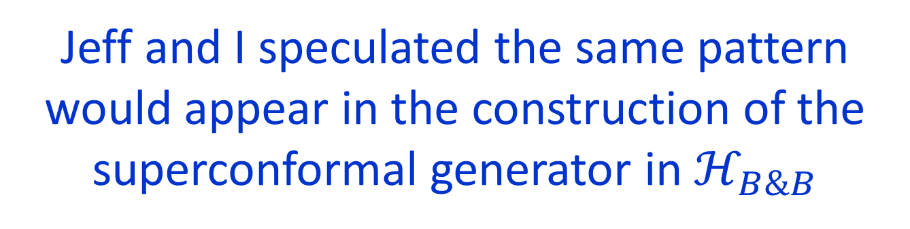
Work with Jeff focused on a K3 sigma model and Conway Moonshine
We showed that the superconformal current could be constructed using a special spinor determined by a code.
Jeff and I speculated the same pattern would appear in the construction of the superconformal generator in $ℋ_{B\&B}$
This turns out to be correct

Slide 21

With a student,
Ranveer Singh,
we have indeed realized
the supercurrent in this way

Slide 22
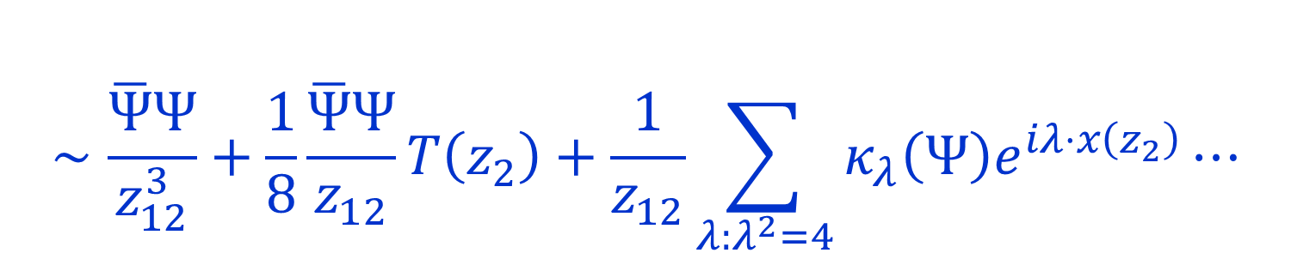

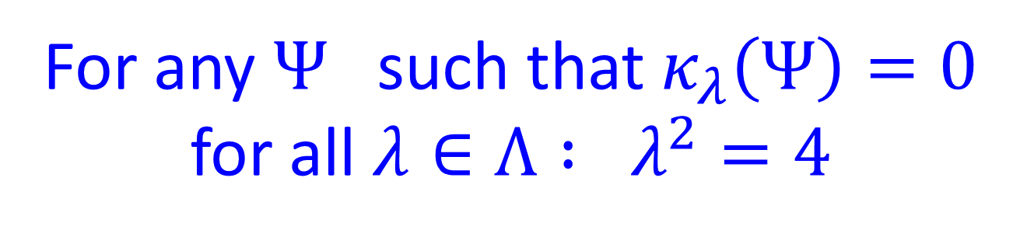
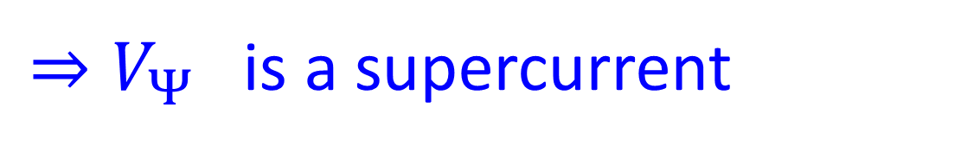

For every spinor $Ψ∈𝒮$we have a dimension 3/2 primary field $V_{Ψ}∈ℋ_{T}$
$$V_{Ψ}\left(z_{1}\right)V_{Ψ}\left(z_{2}\right)∼$$
$$∼\frac{\overline{Ψ}Ψ}{z_{12}^{3}}+\frac{1}{8}\frac{\overline{Ψ}Ψ}{z_{12}}T\left(z_{2}\right)+\frac{1}{z_{12}}\sum_{λ:λ^{2}=4}{κ_{λ}\left(Ψ\right)e^{iλ⋅x\left(z_{2}\right)}}⋯$$
For any $Ψ$ such that $κ_{λ}\left(Ψ\right)=0$ for all $λ∈Λ : λ^{2}=4$
$⇒V_{Ψ}$ is a supercurrent

Slide 23

We need to compute $κ_{λ}\left(Ψ\right)$
We need to know about
the OPE of bosonic twist fields …..
…. challenging …..

Slide 25

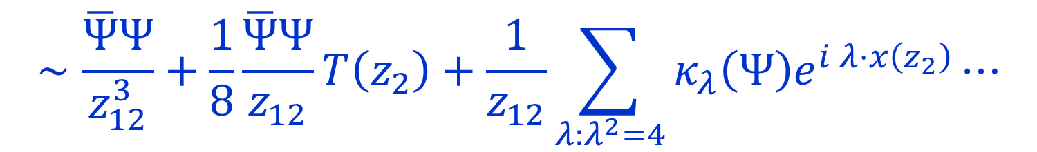

$$∼\frac{\overline{Ψ}Ψ}{z_{12}^{3}}+\frac{1}{8}\frac{\overline{Ψ}Ψ}{z_{12}}T\left(z_{2}\right)+\frac{1}{z_{12}}\sum_{λ:λ^{2}=4}{κ_{λ}\left(Ψ\right)e^{i λ⋅x\left(z_{2}\right)}}⋯$$
$$κ_{λ}\left(Ψ\right)∼〈Ψ, T\left(λ\right)Ψ〉$$
$$T\left(λ\right)∈ℋ\left(T_{2}\left(Λ\right)\right)$$

Slide 26

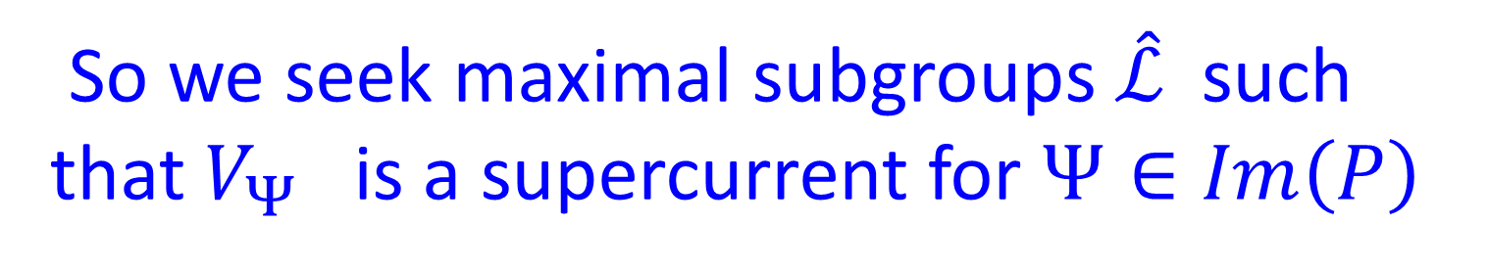



A Strategy To Find A Suitable $Ψ$
For any Abelian subgroup $\hat{ℒ}⊂ℋ\left(T_{2}\left(Λ\right)\right)$
$$P=\sum_{\left[λ\right]∈\hat{ℒ}}{T\left(λ\right)}$$
is proportional to a projection operator
$\hat{ℒ}$ maximal $⇒$ $P$ is rank one
So we seek maximal subgroups $\hat{ℒ}$ such that $V_{Ψ}$ is a supercurrent for $Ψ∈Im\left(P\right)$

Slide 27
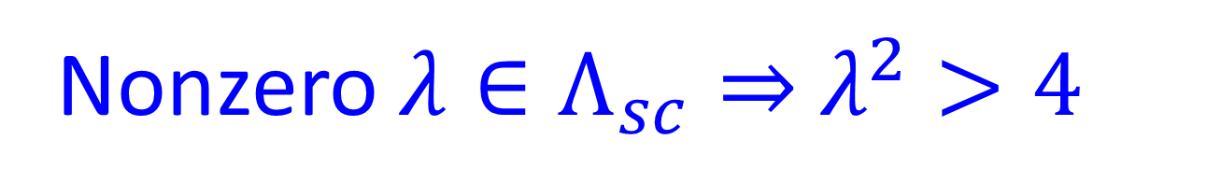



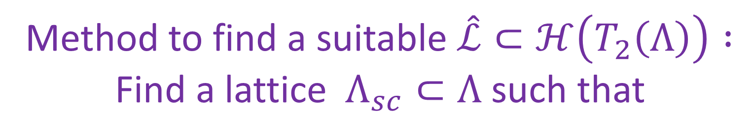
Method to find a suitable $\hat{ℒ}⊂ℋ\left(T_{2}\left(Λ\right)\right) :$ Find a lattice $Λ_{sc}⊂Λ$such that
$$λ_{1},λ_{2}∈Λ_{sc} ⇒ λ_{1}⋅λ_{2}=0 mod 2$$
$$2Λ ⊂Λ_{sc}⊂Λ$$
$$2^{12}$$
$$2^{12}$$
$λ∈Λ_{sc}⇒ λ^{2}=0 mod 4$
Nonzero ${λ∈Λ}_{sc}⇒$ $λ^{2}>4$

Slide 28


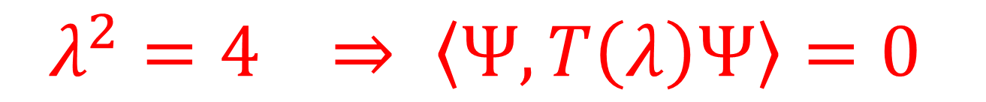


Choose an isomorphism $T_{2}\left(Λ\right)≅𝔽_{2}^{24}$
$$\hat{ℒ}→ℒ→ 𝒞 ⊂ 𝔽_{2}^{24}$$
$$λ^{2}=4 ⇒ 〈Ψ, T\left(λ\right)Ψ〉=0$$
because of the error correcting properties of $𝒞$
Existence of $Λ_{sc} {⇒ V}_{Ψ}$is a superconformal
current in $ℋ_{B\&B}$ for $Ψ∈Im P$

Slide 29


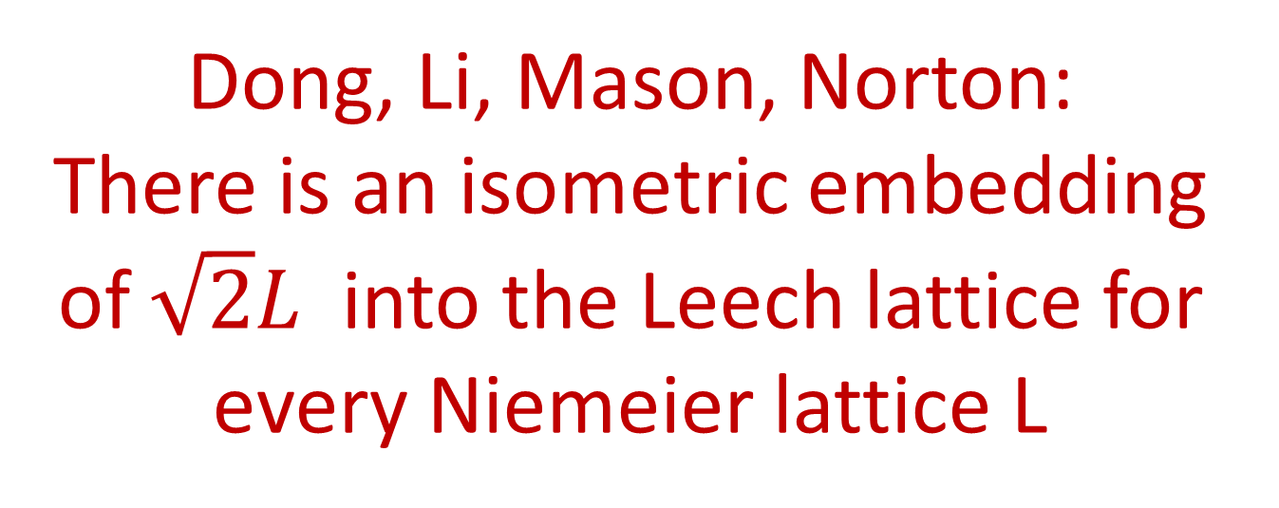

Example of a sublattice $Λ_{sc}$
Dong, Li, Mason, Norton:
There is an isometric embedding of $\sqrt{2}L$into the Leech lattice for every Niemeier lattice L
$$Λ_{sc}≅ \sqrt{2}Λ$$
Are there others?
Does $ℋ_{B\&B}$have $𝒩>1$ supersymmetry ?

Slide 30

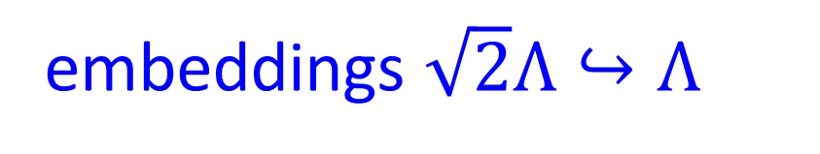
Embarrassment Of Riches
Dong, Li, Mason, Norton: There are
5163643468800000
embeddings $\sqrt{2}Λ↪Λ$
For each embedding $ι$we get a self-dual doubly even code $𝒞_{12}^{ι}⊂𝔽_{2}^{24}$
Inequivalent codes give
different supercurrents

Slide 31

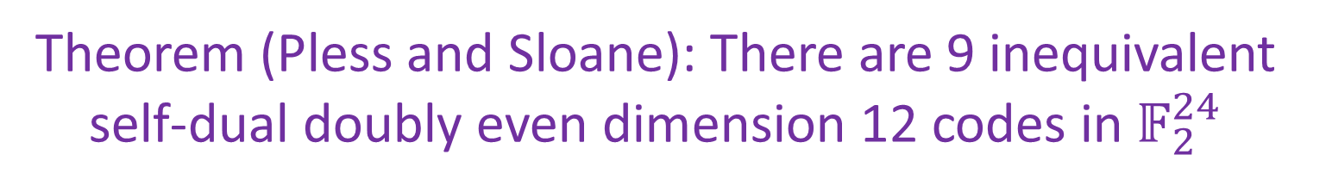

Theorem (Pless and Sloane): There are 9 inequivalent self-dual doubly even dimension 12 codes in $𝔽_{2}^{24}$
So, our construction can yield up to
9 distinct supercurrents
We are trying to find $𝒩$
Using the quaternary Golay code we can show that $𝒩≥2$

Slide 32
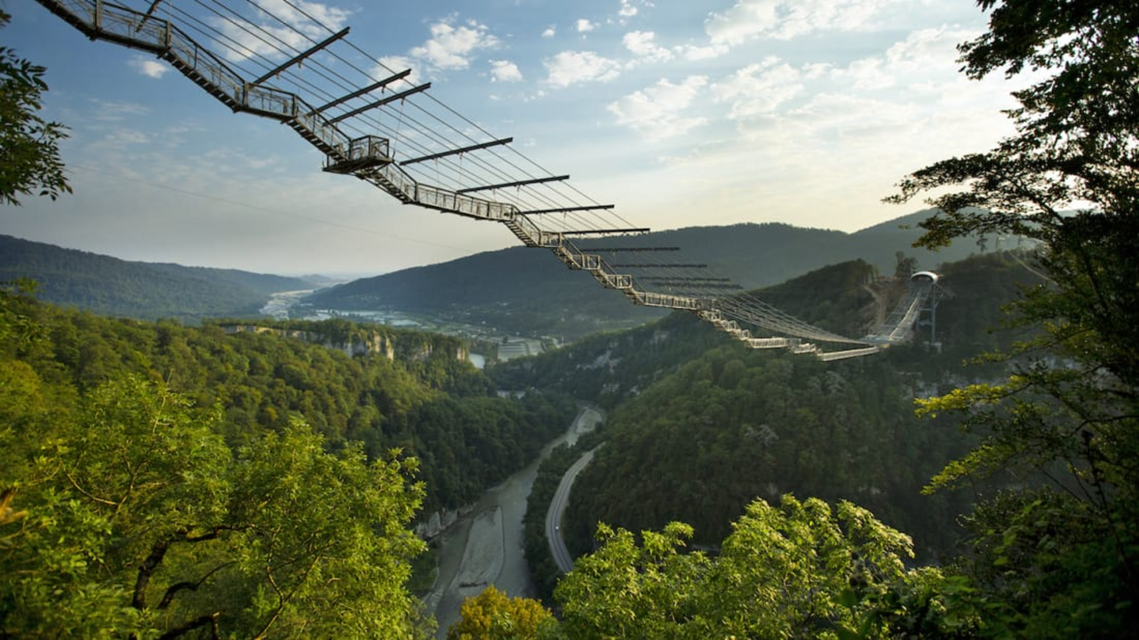
Time Reversal In
Chern-Simons-Witten Theory

Slide 33
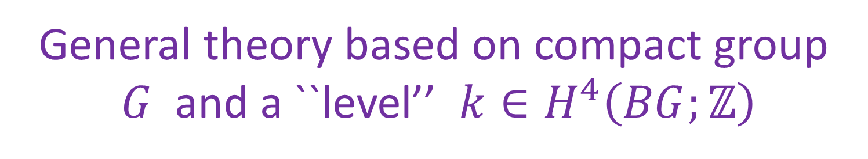

When does 3d Chern-Simons-Witten theory have a time reversal symmetry?
General theory based on compact group
$G$ and a ``level’’ $k∈H^{4}\left(BG;ℤ\right)$
Which $\left(G,k\right)$ give
T-reversal invariant theories?
Related: When does Reshetikhin-Turaev-Witten topological field theory factor through
the unoriented bordism category?

Slide 34

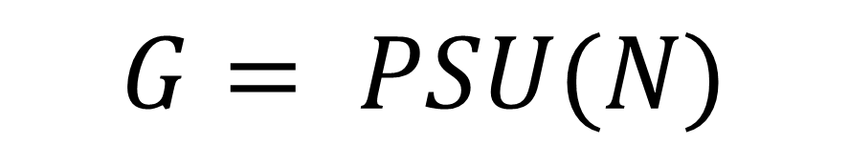
Some nontrivial examples of
T-invariant CSW theories
appeared in several recent papers
[Seiberg & Witten 2016; Hsin & Seiberg 2016; Cordova, Hsin & Seiberg ]
$$G= PSU(N)$$
$$k=N$$
But there is no systematic understanding.

Slide 35


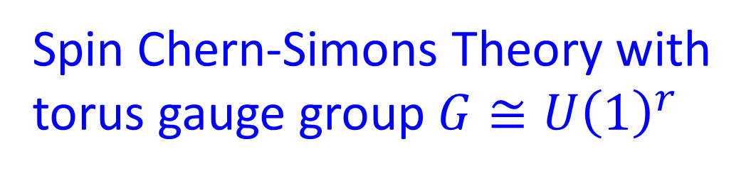

With my student Roman Geiko we have recently carried out a systematic study for
Spin Chern-Simons Theory with
torus gauge group $G≅U{\left(1\right)}^{r}$
$$S=\frac{1}{4π}∫K_{IJ} A_{I} d A_{J}$$
$K_{IJ} : r×r$nondegenerate, integral symmetric matrix: determines integral lattice $L$

Slide 36



Classical T-reversal:
$∃ U∈GL\left(r, ℤ\right)$ such that
$$UKU^{tr}=−K$$
(Note: $σ\left(L\right)=0 )$
But there can be quantum T-reversal symmetries not visible classically.
Rank 2 examples studied by
Seiberg & Witten; Delmastro & Gomis

Slide 37

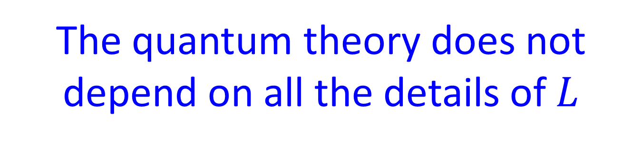
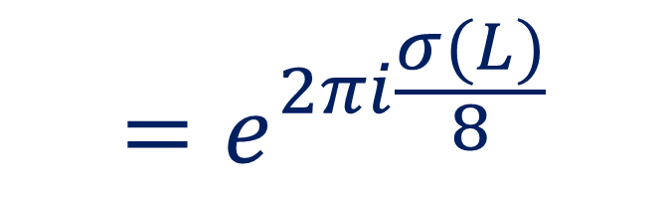
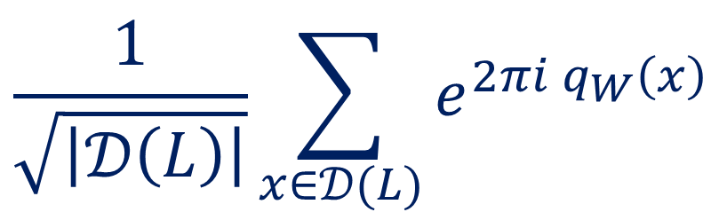

The quantum theory does not depend on all the details of $L$
What does it depend on?
Finite Abelian group $𝒟\left(L\right)≔L^{∨}/L$
a.k.a ``group of anyons’’ a.k.a. ``group of 1-form symmetries’’
Quadratic Refinement (spin of anyons) :
$q_{W}\left(x\right)=\frac{1}{2}\left(\tilde{x},\tilde{x}−W\right)+\frac{1}{8}\left(W,W\right) mod ℤ$
$$\frac{1}{\sqrt{\left|𝒟\left(L\right)\right|}}\sum_{x∈𝒟(L)}{e^{2πi q_{W}\left(x\right)} }$$
$$=e^{2πi\frac{σ(L)}{8}}$$

Slide 38
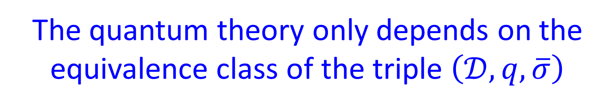
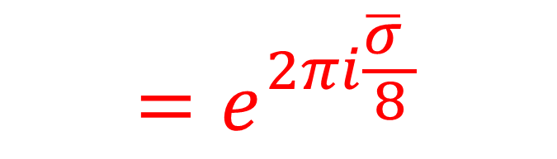
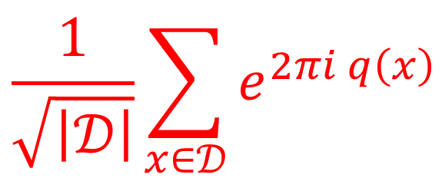
Theorem
[ Belov & Moore; Freed,Lurie,HopkinsTeleman]
The quantum theory only depends on the equivalence class of the triple $\left(𝒟, q, \overline{σ}\right)$
$$q:𝒟→ℝ/ℤ$$
$$\overline{σ}∈ℤ/24ℤ$$
$$\frac{1}{\sqrt{\left|𝒟\right|}}\sum_{x∈𝒟}{e^{2πi q\left(x\right)} }$$
$$=e^{2πi\frac{\overline{σ} }{8}}$$
Conversely, every such triple arises from some torus CSW theory

Slide 39


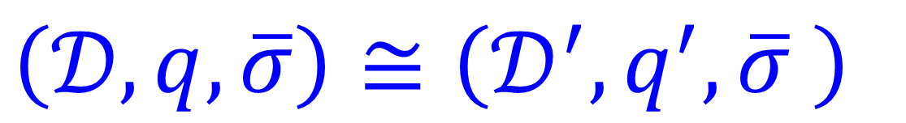

Equivalence of triples
$\left(𝒟,q,\overline{σ}\right)≅\left(𝒟^{′},q^{′},\overline{σ} \right)$
$∃$isomorphism
$$f:𝒟→𝒟^{′}$$
$$∃ Δ^{′}∈𝒟^{′}$$
$$q\left(x\right)=q^{′}\left(f\left(x\right)+Δ^{′}\right)$$

Slide 40
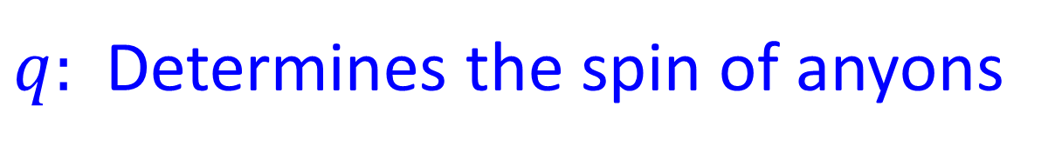
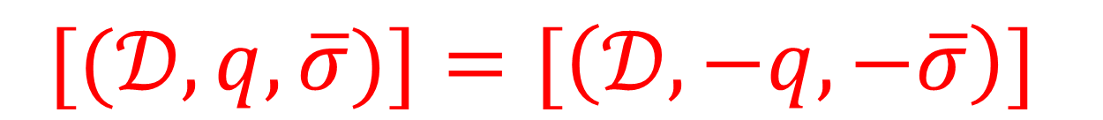

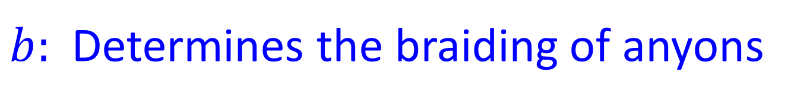
T-Reversal Criterion
$$[(𝒟,q,\overline{σ})]=[\left(𝒟,−q, −\overline{σ}\right)]$$
$q:$Determines the spin of anyons
$b:$Determines the braiding of anyons
$$T$$

Slide 41



Simpler Problem: The Witt Group (1936)
$$b\left(x,y\right)=q\left(x+y\right)−q\left(x\right)−q\left(y\right)+q\left(0\right)$$
Throw away $q,\overline{σ}$ and just keep $b.$
Classify $\left[\left(𝒟, b\right)\right]$
$$\left[\left(𝒟_{1},b_{1}\right)\right]+\left[\left(𝒟_{2},b_{2}\right)\right]≔\left[\left(𝒟_{1}⊕𝒟_{2}, b_{1}⊕b_{2}\right)\right]$$
Abelian monoid $𝒟ℬ$

Slide 42


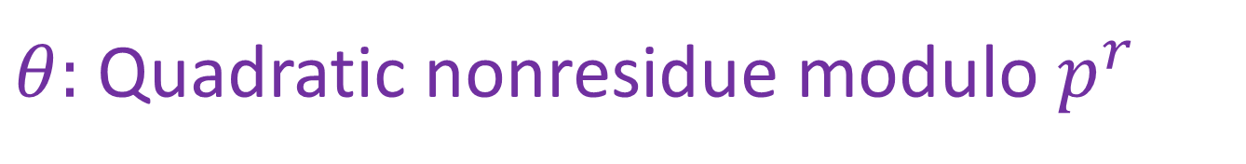
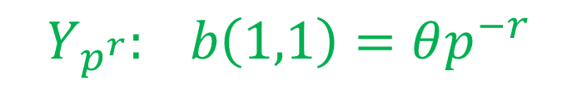

$$𝒟ℬ= ⊕_{p} 𝒟ℬ_{p}$$
Odd $p:$ $𝒟ℬ_{p}$is generated by forms on $ℤ/p^{r}ℤ$
$$X_{p^{r}}: b\left(1,1\right)=p^{−r}$$
$$Y_{p^{r}}: b\left(1,1\right)=θp^{−r}$$
$θ:$Quadratic nonresidue modulo $p^{r}$
$p=2$ Many generating forms:
$$A_{2^{r}}, B_{2^{r}},C_{2^{r}}, … , F_{2^{r}}$$

Slide 43



Submonoid $𝒮𝓅ℓ$ Split forms:
$$𝒟=𝒟_{1}⊕𝒟_{2}$$
$$𝒟_{1}=𝒟_{1}^{⊥}$$
$$𝒲𝒾𝓉𝓉 ≔ 𝒟ℬ/𝒮𝓅ℓ$$
Abelian group whose structure is known.

Slide 44

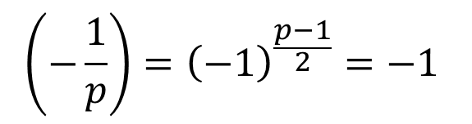
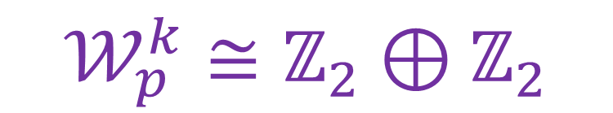

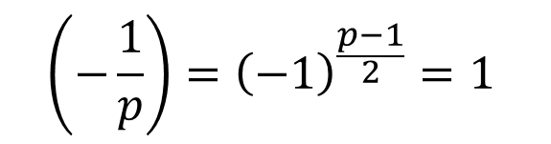
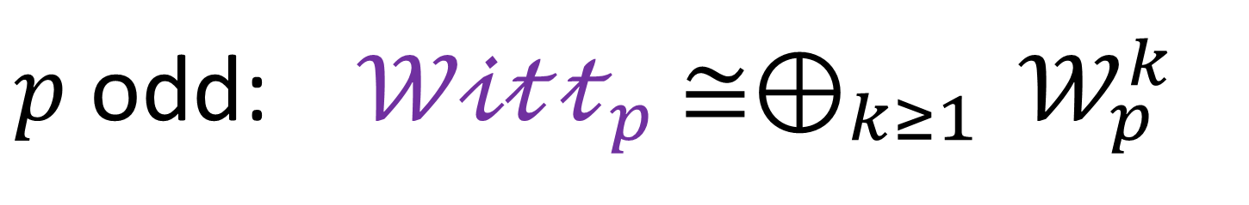
Wall, Miranda, Kawauchi & Kojima
determine relations on the generators
$$𝒲𝒾𝓉𝓉 ≅⊕_{p} 𝒲𝒾𝓉𝓉_{p}$$
$p$odd: $𝒲𝒾𝓉𝓉_{p}$ $≅{⊕_{k≥1 }𝒲}_{p}^{k}$
$$𝒲_{p}^{k}≅ℤ_{2}⊕ℤ_{2}$$
$$\left(−\frac{1}{p}\right)={\left(−1\right)}^{\frac{p−1}{2}}=1$$
$$𝒲_{p}^{k}≅ℤ_{4}$$
$$\left(−\frac{1}{p}\right)={\left(−1\right)}^{\frac{p−1}{2}}=−1$$

Slide 45



$$𝒮𝓅ℓ⊂$$
$$𝒟ℬ^{T}≔ \{ \left[𝒟,b\right]=\left[𝒟,−b\right] \} ⊂𝒟ℬ$$
Roman computed generators for the (infinite) Abelian subgroup
$$𝒟ℬ^{T}/𝒮𝓅ℓ$$
and then refined it to
$T−$invariant triples

Slide 46

Theorem: A T-invariant triple $\left[\left(𝒟,q,\overline{σ}\right)\right]$must be a direct sum of

Slide 47

Example: $L≅A_{4}$ and $L≅D_{4}$ can be primitively embedded into $E_{8}$ (Nikulin)
These are positive definite, and cannot be T-invariant classically
Nevertheless, they are quantum T-invariant

Slide 48

Conjecture for the general
(non-spin) case:
$$\left(G,k\right)→CSW\left(G,k\right)→ MTC\left(G,k\right)$$
Moore & Seiberg
Witten
$$WZW(G,k)$$

Slide 49



Definition [Lee & Tachikawa; Kong & Zhang]: The time reversal of an MTC $𝒞$ with braiding
$B_{x,y}:x⊗y→y⊗x$and ribbon structure $θ_{x}:x→x$is the MTC $𝒞^{rev}$with
$$B_{x,y}^{rev}≔B_{y,x}^{−1}$$
$$θ_{x}^{rev}≔θ_{x}^{−1}$$
A CSW theory is time reversal invariant if there is an equivalence of MTC’s
$$MTC{\left(G,k\right)}^{rev}≅ MTC\left(G,k\right)$$

Slide 50


There is a mathematical notion of a
Witt group of (nondegenerate) braided fusion categories.
[Davydov, Müger, Nikshych, Ostrik 2010]
$𝒞_{1}∼𝒞_{2}$ if there exist fusion categories $𝒟_{1}$ and $𝒟_{2}$such that
$$𝒞_{1}⊗Z\left(𝒟_{1}\right)≅𝒞_{2}⊗Z\left(𝒟_{2}\right)$$

Slide 51

CONJECTURE
A (bosonic) $CSW\left(G,k\right)$is T-invariant
iff
$\left[MTC\left(G,k\right)\right]$ is order 2 in $𝒲𝒾𝓉𝓉$

Slide 52

Condition On Higher Gauss Sums
Higher Gauss sums $\sum_{x}{d_{x}^{2}θ_{x}^{n}}$ studied in
[Ng, Schopieray, Wang 2018;
Kaidi, Komargodski,Ohmori,Seifnashri, Shao 2021]
are all real.
The examples of Seiberg et. al. satisfy
this condition.

Slide 53


Topological Interfaces
It is always true that $𝒞⊗𝒞^{rev} ≅Z\left(𝒟\right)$ and therefore there is a topological gapped boundary condition for $𝒞⊗𝒞^{rev}$
[Freed & Teleman]
Conjecture is equivalent to existence
of a topological interface between $CS\left(G,k\right)$ and its time-reversal
(Related to work of Kapustin & Saulina.)

Slide 54

U-Plane For 5d SYM And
Four-Manifold Invariants

Slide 55

``K-Theoretic Donaldson Invariants’’

Slide 56



Five Dimensions
Partial Topological Twist of 5d SYM on $X×S^{1}$
Reduces to SQM on the moduli space of instantons:
(Requires that $ℳ$ be Spin-c )
$$ℛ≔R Λ$$
$$Z\left[ℛ\right]=\sum_{k=0}^{∞}{ℛ^{d_{k}/2} \int_{ℳ_{k}}{\hat{A}\left(T ℳ_{k}\right) }}$$
[Nekrasov (1996); Losev, Nekrasov, Shatashvili (1997); …. ]
+ important generalization …

Slide 57







Chern-Simons Observables
$U{\left(1\right)}_{inst}$symmetry with current
$$J=Tr\left(f∧f \right)$$
Couple to background
gauge field $A:$
$$n≔\left[\frac{F\left(A\right)}{2π}\right]∈H^{2}\left(X,ℤ\right)$$
$$𝒪\left(n\right)=\int_{Σ\left(n\right)×S^{1}}{ Tr\left(a da+\frac{2}{3}a^{3}\right)+⋯}$$
$=\int_{X×S^{1}}{F\left(A\right)∧Tr\left( a da+\frac{2}{3}a^{3}\right)}$ + susy completion
$$Z\left(ℛ,n\right)≔〈 e^{𝒪\left(n\right)}〉$$

Slide 58

Five Dimensions
$$Z\left(ℛ,n\right)=\sum_{k=0}^{∞}{ℛ^{d_{k}/2} \int_{ℳ_{k}}{ ch\left(L\left(n\right)\right) \hat{A}\left(ℳ_{k}\right) }}$$
Using both the Coulomb branch integral
(a.k.a. the U-plane integral) and, independently, localization techniques,
we make contact with the work of mathematicians

Slide 59
2006:
2019:

Slide 60

$$b_{2}^{+}\left(X\right)=1$$
Derived a wall-crossing formula
Differs from GNY.
Agrees with GNY.
(Suitably interpreted.)
This raises some puzzles…

Slide 61






$$Z^{J}\left(ℛ,n\right)=Φ^{J}\left(ℛ,n\right)+Z_{SW}^{J}\left(ℛ,n\right)$$
$$J∈H^{2}\left(X,ℝ\right): J=∗J \& J^{2}=1 \& J∈Positive LC$$
$Z_{SW}^{J}$ : Contribution of SW invariants
$Φ^{J}\left(ℛ,n\right):$4d Coulomb branch integral
One can deduce $Z_{SW}^{J}$ from $Φ^{J}$
For 5d SYM gauge group of rank 1:
Coulomb branch = $ℂ$
Measure is singular at 4 special points and $∞$

Slide 62

SW special Kahler geometry is subtle
$a:$ cylinder valued
$$ℱ ∼ R^{−2}Li_{3}\left(e^{−2Ra}\right)+⋯$$
$+Instanton corrections$
[Nekrasov, 1996]

Slide 63




Modular Parametrization Of $U−$plane
$${\left(\frac{U}{R}\right)}^{2}+\tilde{u}{\left(τ\right)}^{2}=8+4\left(ℛ^{2}+ℛ^{−2}\right)$$
$$\tilde{u}\left(τ\right)=2 \left( \frac{θ_{2}\left(τ\right)}{θ_{3}\left(τ\right)}+\frac{θ_{3}\left(τ\right)}{θ_{2}\left(τ\right)}\right)$$
Hauptmodul for $Γ^{0}\left(8\right)$

Slide 64





$$Φ^{J}\left(ℛ,n\right)=\int_{ℱ}{dτd\overline{τ} ν\left(τ\right){ C\left(τ\right)}^{n^{2}}{ Ψ}^{J}\left(τ, \frac{v\left(τ\right)}{2}n\right)}$$
$$ν\left(τ\right)=\frac{θ_{4}^{13−b_{2}}}{η^{9}} \frac{1}{\sqrt{1−2 ℛ^{2}u(τ)+ℛ^{4}}}$$
$$4u\left(τ\right)= {\tilde{u}\left(τ\right)}^{2}−8$$
$$\frac{θ_{1}\left(τ,\frac{v\left(τ\right)}{2}\right)}{θ_{4}\left(τ,\frac{v\left(τ\right)}{2}\right)}=−ℛ$$
$$C\left(τ\right)=\frac{θ_{4}\left(τ,\frac{v\left(τ\right)}{2}\right)}{θ_{4}\left(τ\right)}$$

Slide 65





$$Ψ^{J}\left(τ,z\right)=\sum_{k∈H^{2}\left(X,ℤ\right)}{\left(\frac{∂}{∂\overline{τ}} E_{k}^{J} \right)q^{−\frac{k^{2}}{2}}e^{−2πi k⋅z} {\left(−1\right)}^{k⋅K}}$$
$$E_{k}^{J}=Erf\left( \sqrt{Imτ} \left(k+ \frac{Im z}{Im τ} \right)⋅J \right)$$
$$C\left(τ\right)=\frac{θ_{4}\left(τ,\frac{v\left(τ\right)}{2}\right)}{θ_{4}\left(τ\right)}$$
$$ν\left(τ\right)=\frac{θ_{4}^{13−b_{2}}}{η^{9}} \frac{1}{\sqrt{1−2 ℛ^{2}u(τ)+ℛ^{4}}}$$
$$Φ^{J}\left(ℛ,n\right)=\int_{ℱ}{dτd\overline{τ} ν\left(τ\right){ C\left(τ\right)}^{n^{2}}{ Ψ}^{J}\left(τ, \frac{v\left(τ\right)}{2}n\right)}$$

Slide 66




Wall-Crossing Formula @ $∞$
$$Φ^{J} −Φ^{J^{′}}={\left[ ν C^{n^{2}}Θ^{J,J^{′}}\right]}_{q^{0}}$$
$$\sum_{k}{\left[ sgn\left\{ \left(k+\frac{n}{2}\frac{Im v\left(τ\right)}{Im τ}\right)⋅J\right\} −\left\{ J→J^{′}\right\} \right] q^{−\frac{k^{2}}{2}}e^{−2πi k⋅n\frac{v\left(τ\right)}{2}}{\left(−1\right)}^{k⋅K}}$$
$ν, C, Θ^{J,J^{′}}$ are functions of $τ$ and of $ℛ$
Subtle order of limits: $ℛ→0$ vs. $ℑτ→∞$

Slide 67



A. First expand in $ℛ$around $ℛ=0$ then take the constant $q^{0}$ term at each order in $ℛ$
This agrees with GNY
B. First expand in $q$ and extract the constant $q^{0}$term
1. Results differ from GNY
2. Terms involving negative powers of $ℛ$
$$Z\left(ℛ,n\right)=\sum_{k=0}^{∞}{ℛ^{d_{k}/2} \int_{ℳ_{k}}{ e^{c_{1}\left(L\left(n\right)\right)} \hat{A}\left(ℳ_{k}\right) }}$$

Slide 68

Did we make a technical mistake?
Probably not:
Using toric localization and the 5d instanton partition function we derived exactly the same formula for wall-crossing @ $∞$

Slide 69



Moreover, using the wall-crossing behavior of $Φ^{J}\left(ℛ,n\right)$ at the strong coupling cusps allows
one to derive $Z_{SW}^{J}$ $⇒$partition function for $b_{2}^{+}>1$
$G(ℛ,n)=$ $\frac{2^{2χ+3 σ−χ_{h}}}{{\left(1−ℛ^{2}\right)}^{\frac{1}{2}n^{2}+χ_{h}}} \sum_{c}{SW\left(c\right) {\left(\frac{1+ℛ}{1−ℛ}\right)}^{c⋅\frac{n}{2}}}$
$$Z\left(ℛ,n\right)=\sum_{ξ∈μ_{4}}{ξ^{−χ_{h}}G\left(ξℛ,n\right)}$$
Agrees with, and generalizes, GKW Conjecture 1.1

Slide 70

Explicit evaluation of our
$U$-plane integral $Φ^{J}$
for special values of $J$involves some interesting technical considerations in the theory
of Jacobi-Maass forms

Slide 71



The Special Period Point
For any manifold with $b_{2}^{+}=1$
$∃$special $J_{0}$ such that $Ψ_{ν}^{J_{0}}$factorizes:
$$Ψ^{J_{0}}(τ, z)=f(τ,z) Θ_{L_{−}}\left(τ,z\right)$$
$$f(τ,z)=\sum_{k∈ℤ}{∂_{\overline{τ}}E_{k}^{J} q^{−\frac{1}{4}k^{2}} e^{−2πi k⋅z}}$$

Slide 72



Measure As A Total Derivative
$$Ω=d Λ$$
$$Λ=dτ ℋ \hat{G}$$
Where we can write $\hat{G}$ explicitly so that $Λ$is:
Well-defined
Nonsingular away from $τ∈ \{ cusps\}$
3. Good $q_{i}$expansion near cusps

Slide 73




Harmonic Jacobi-Maass Forms
These conditions determine $\hat{G}$uniquely.
Modular completion of an Appel-Lerche sum
$$F\left(τ, z\right)∼ \frac{e^{−2πi z}}{θ_{4}\left(2τ\right)} \sum_{n∈ℤ}{\frac{{\left(−1\right)}^{n}q^{n^{2}−\frac{1}{4} }}{1+e^{4πi z}q^{2n−1}}}$$
$$z=n_{0} \frac{v\left(τ\right)}{2}$$
$$n_{0}≔n⋅J$$

Slide 74


The modular completion is not unique because we can add a meromorphic modular function to $F\left(τ,\frac{n_{0}v\left(τ\right)}{2}\right)$
We need to choose the one
with no unwanted poles
in the fundamental domain.
This is technically challenging for general values of $n_{0}$

Slide 75


All this should generalize to (anomaly-free) 6d SYM theories on $X×𝔼$
$$\hat{A}\left(ℳ_{k}\right)→Ell\left(ℳ_{k},q\right)$$

Slide 76

So far, we did not use any K-theory in describing
the ``K-theoretic Donaldson invariants’’
It would be very desirable to do so, because the 6d version, analogously formulated could be quite interesting:
Conjecture:
Integrals in elliptic cohomology of distinguished classes defined by the susy sigma model with target space $ℳ_{k}$ define smooth invariants of four-manifolds

Slide 77




Summary
The FLM/Beauty & Beast formulation of the Monster group has underlying extended superconformal symmetry with $𝒩≥2$
Complete classification of T-invariant quantum spin CSW theories for torus gauge group.
The general case is stated, conjecturally,
in terms of a Witt group
Twisted 5d SYM computes $\hat{A}$-genera of instanton moduli spaces, but the physical path integral leads to puzzling discrepancies with the mathematical results of GNY/GKW and the general predictions
of UV localization.

Slide 78

NOT

